Slide 1
Hyperon Spectroscopy with PANDA
_
Sep 13, 2016 | Albrecht Gillitzer, IKP Forschungszentrum Jülich
Young Scientist Convent, LVIII PANDA Meeting, Mainz, September 2016

Slide 2
Outline
How to understand baryonic excitation spectra?
What is the present status in baryon spectroscopy?
What can we do with PANDA?
What are the challenges and requirements?

Slide 3
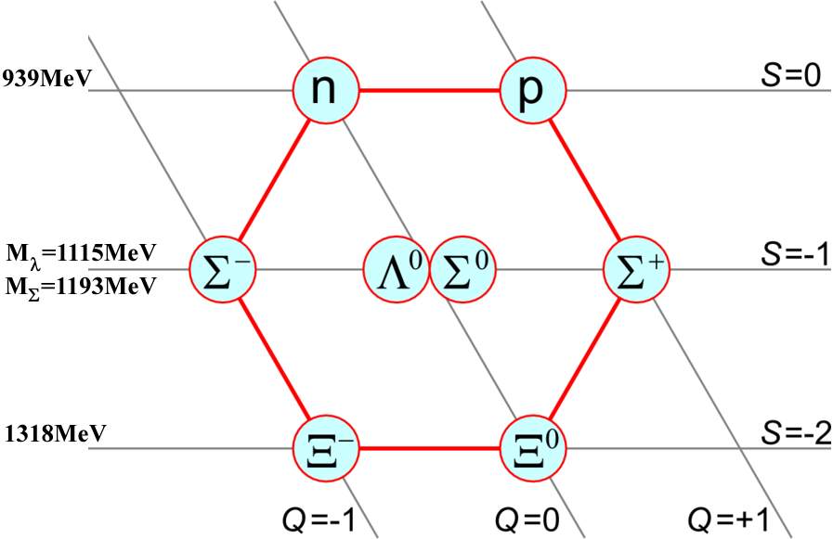
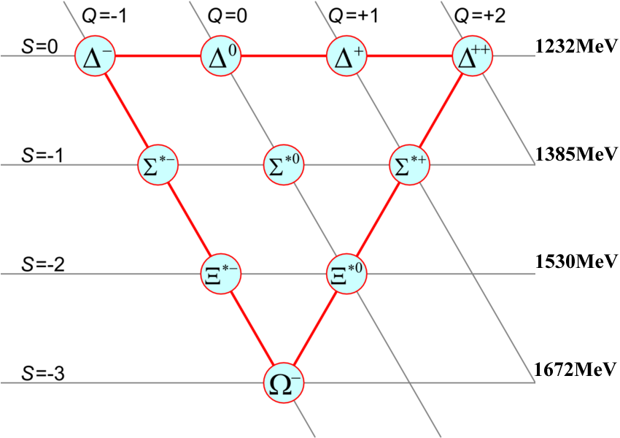
Ground States of Light Baryons: SU(3)_{F} Symmetry
J^{P} = 1/2⁺ ↑↓↑
J^{P} = 3/2⁺ ↑↑↑
baryon octet
baryon decuplet
Gell-Mann 1961: „The Eightfold Way“, SU(3) symmetry
Gell-Mann, Zweig 1964: 3 „quarks“ as constituents

Slide 4
Need for Color
Baryon decuplet
three identical fermions in Δ⁺⁺, Δ⁻, Ω⁻ :
→ problem with Pauli principle
H. Fritzsch, M. Gell-Mann, H. Leutwyler, Phys. Lett. B47 (1973) 365:
„Advantages of the Color Octet Gluon Picture“
Ψ = φ_{color} ξ_{space} ζ_{flavor} χ_{spin}
color charge of hadrons is zero: φ_{color} always antisymmetric

Slide 5
Combining Spin, Flavor & Orbital Angular Momentum
flavor only: SU(3)_{F}
with S, M, A symmetric, mixed symmetry and antisymmetric in flavor (and spin)
part under exchange of any 2 quarks
combine flavor & spin: SU(6)_{f,s} : 6 basic states: d↑, d↓, u↑, u↓, s↑, s↓
decomposed as:
superscript: (2S+1) spin multiplicity

Slide 6
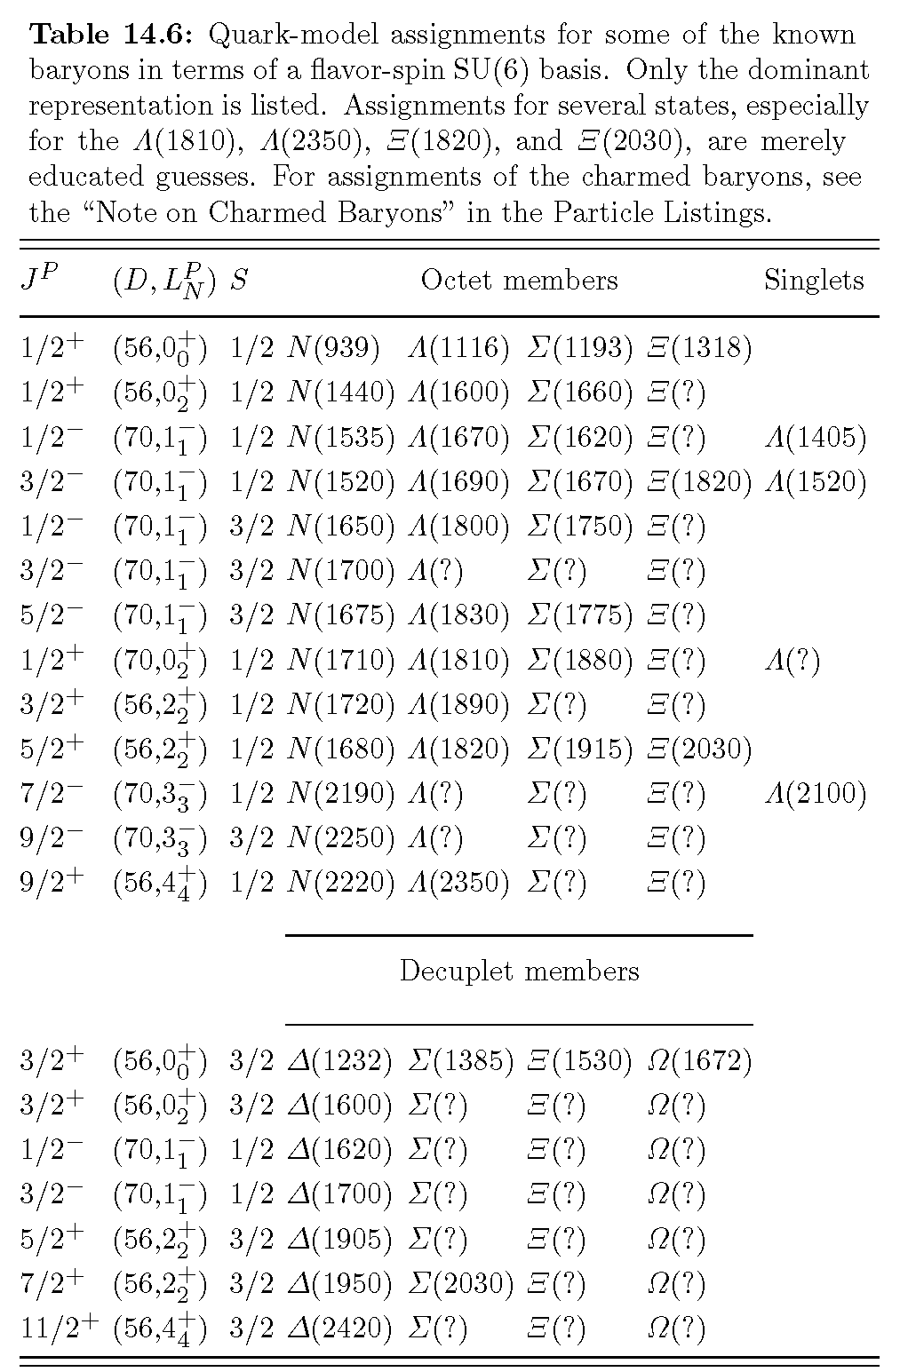
SU(6) × O(3)
classification of baryons by
J^{P}: total baryon spin, parity
D: SU(6) multiplet
L: total quark orbital
angular momentum
N: # quanta of excitation
S: total quark spin
note: baryons with same J^{P}
can mix!
assignment partially uncertain
source: PDG 2008

Slide 7
Non-Relativistic Constituent Quark Model
(N.Isgur, G. Karl, PLB 72 (1977) 109)
Ansatz:
spin-independent + spin-dependent part:
split into harmonic part + anharmonic perturbation
with

Slide 8
Non-Relativistic Constituent Quark Model
⇒ exactly solvable for H₀ , for simplicity S = 0 & S = −3: m₁= m₂ = m₃ ≡ m
change of variables: ⇒
correspondingly:
with
⇒
⇒ 2 degenerate oscillators
σ denotes the symmetry w.r.t.
exchange of two quarks
equidistant energy levels:
remember: N = 2(n - 1) + l

Slide 9
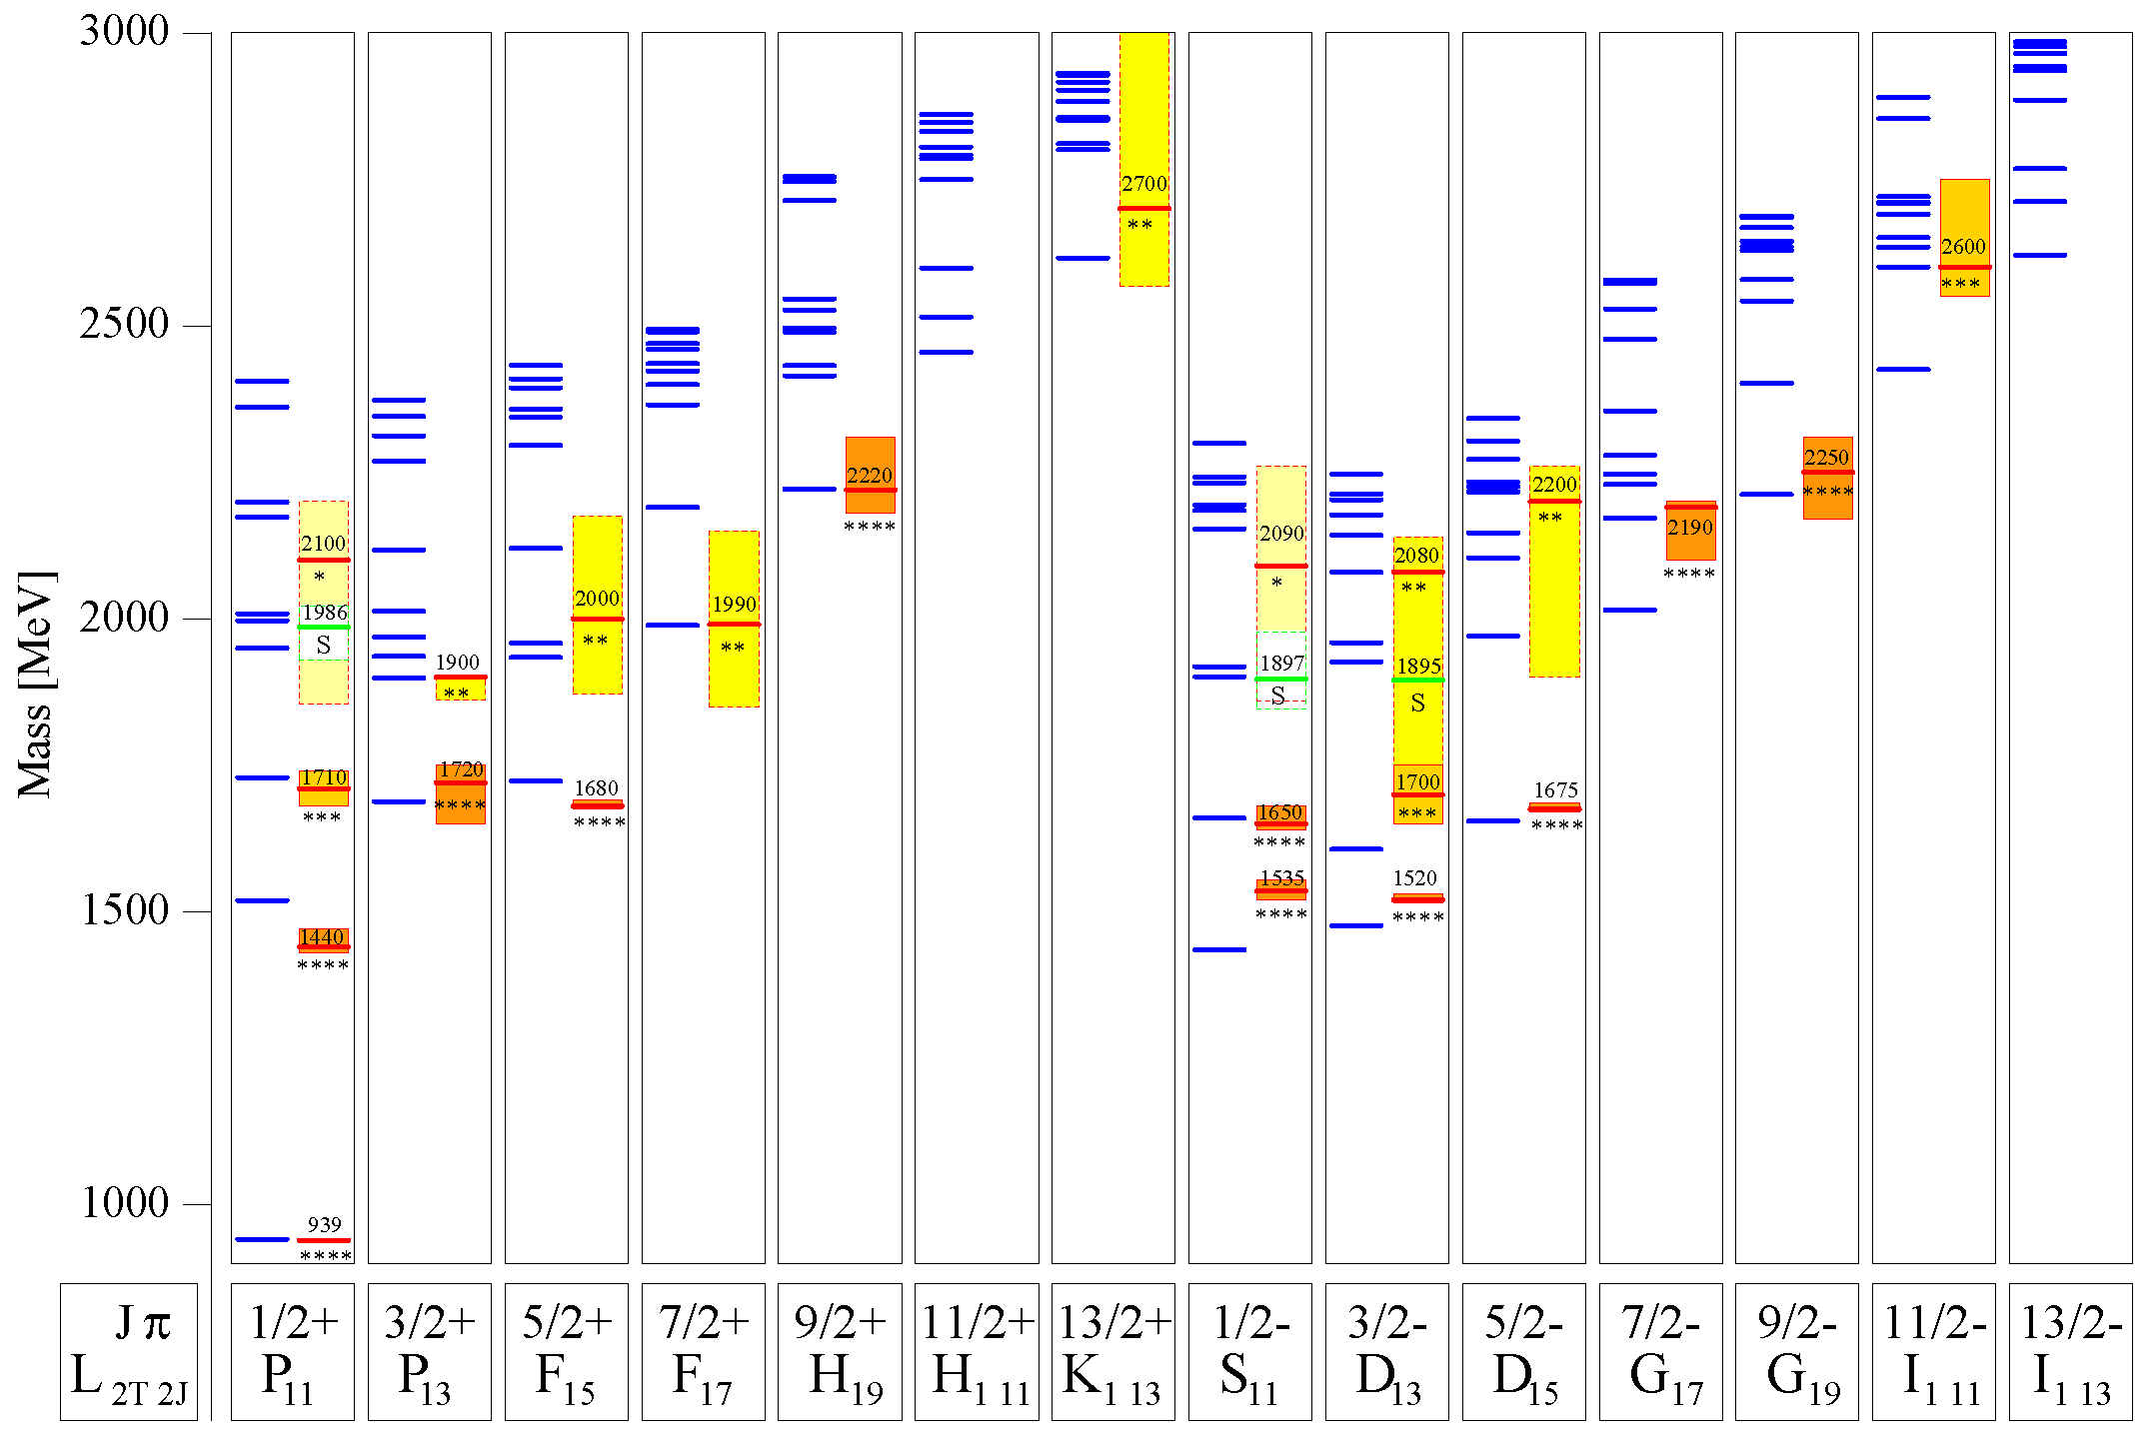
Modern Quark Models
N*
U. Löring et al., Eur. Phys. J. A10 (2001) 395

Slide 10
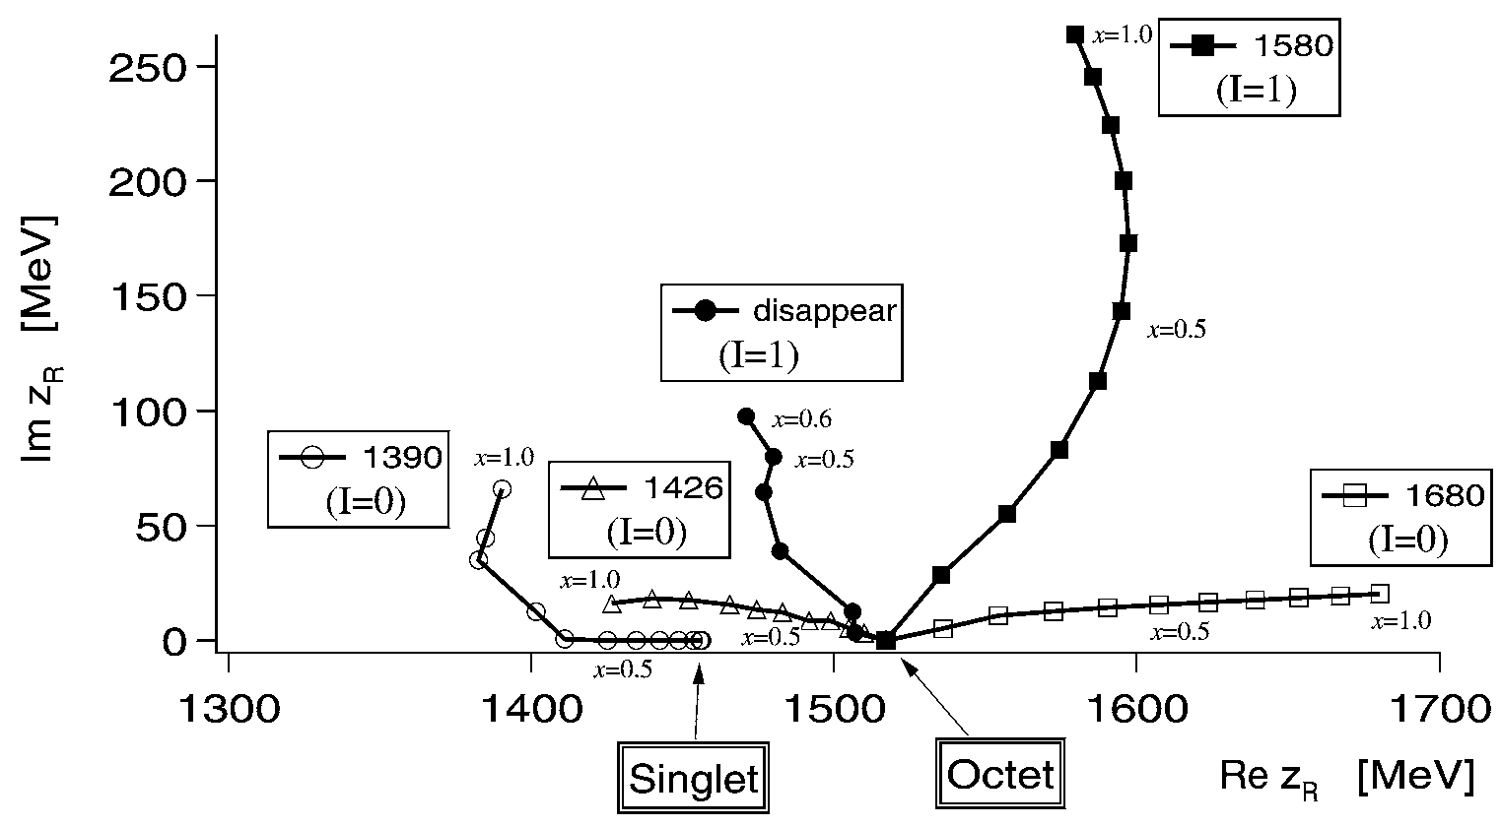
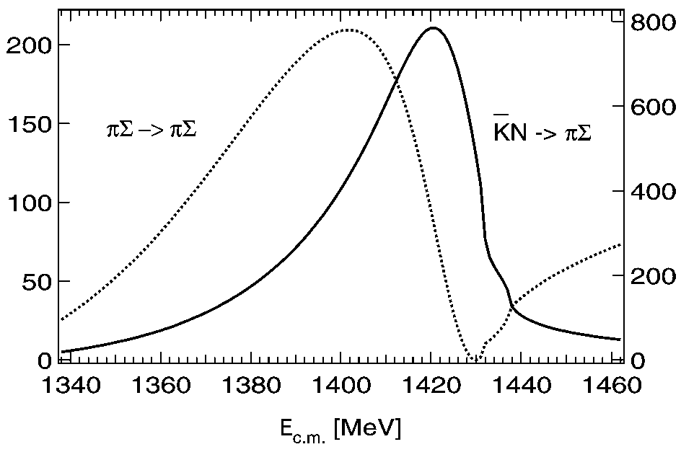
Dynamical Generation of Resonances
example: Λ(1405)
meson octet ⊗ baryon octet in S = -1, Q = 0
coupled channel analysis:
$K^{−}p, {\overline{K}}^{0}n, π^{0}Λ, π^{0}Σ^{0},π^{+}Σ^{−},π^{−}Σ^{+}, ηΛ, ηΣ^{0}, K^{0}Ξ^{0}, K^{+}Ξ^{−}$
D. Jido et al., Nucl. Phys. A725 (2003) 181

Slide 11
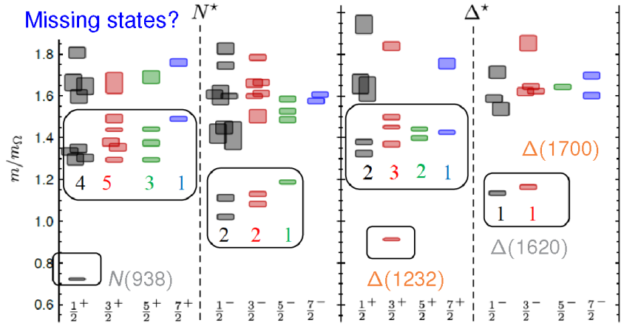
Lattice QCD
$$m_{π}=396 MeV$$
exhibits features of SU(6)×O(3) symmetry
level count consistent with quark model
R.G. Edwards et al., Phys. Rev. D 84 (2011) 074508

Slide 12
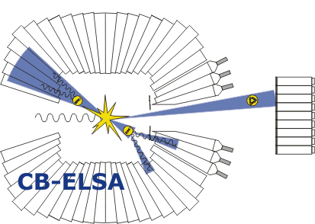
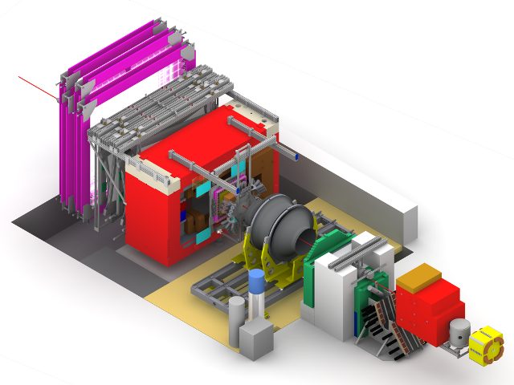
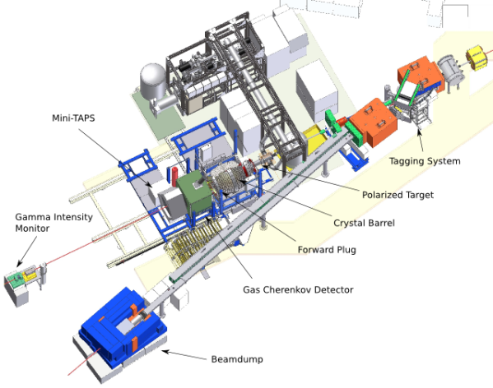
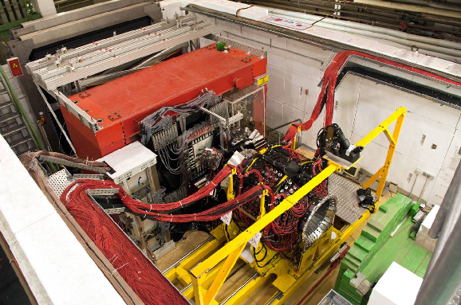
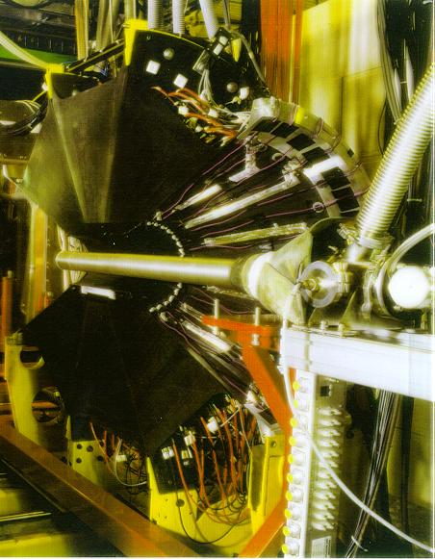
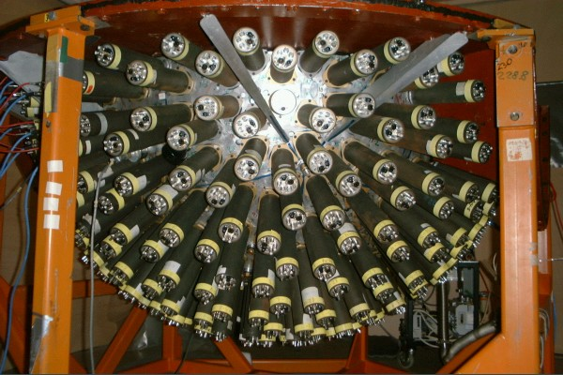
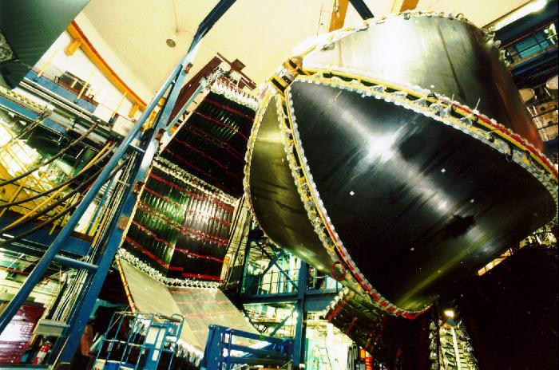
Experimental Activities
Early studies: π induced reactions: πN → πN, ππN, KΛ, KΣ, …
Modern studies: Baryon Spectroscopy with in photo-induced reactions

Slide 13
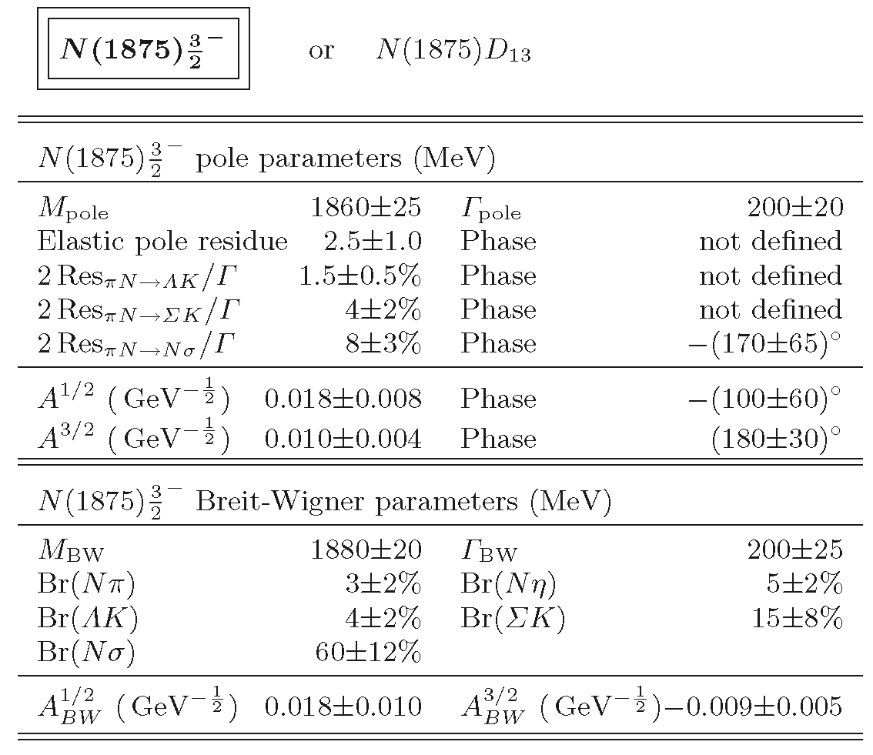
Achievements in N* Spectroscopy
BnGa PWA:
A.V. Anisovich et al., EPJA 48 (2012) 15

Slide 14
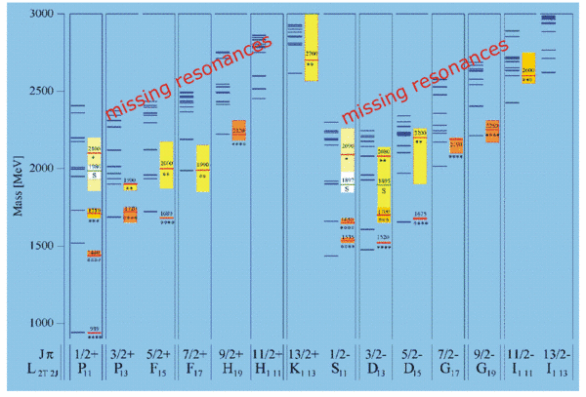
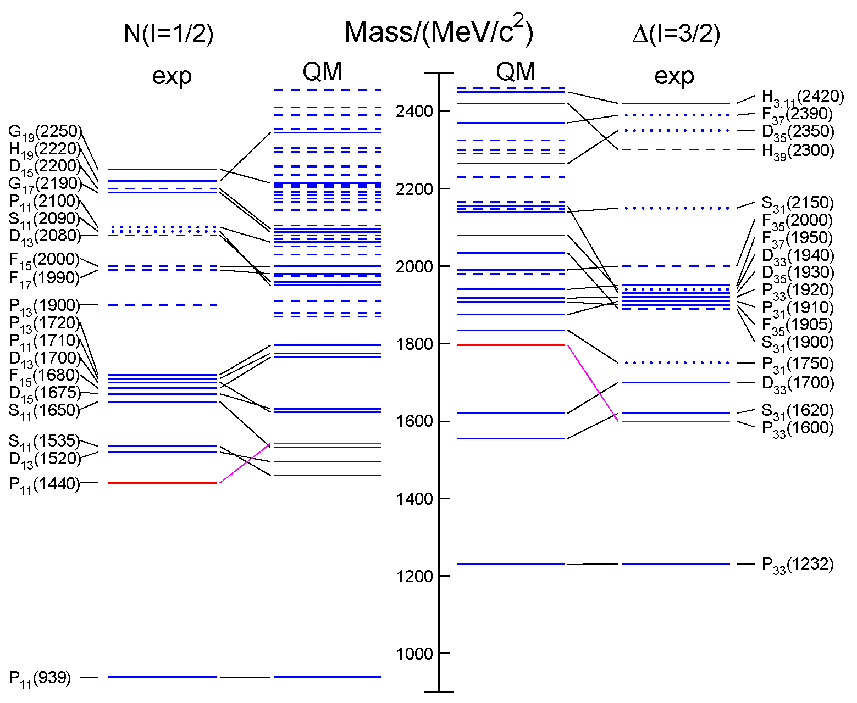
Open Questions
Missing resonances
Wrong masses, wrong sequence
Relevant degrees of freedom?
3-quark?
quark-diquark?
meson-baryon dynamics
from RPP 2014 / QM: S. Capstick, W. Roberts

Slide 15
Strange Partners
Approximate SU(3) flavor symmetry
N* & Δ states have partners in the strange sector
focus on Ξ and Ω
Ξ: as many states as N* & Δ together ⁽¹⁾
Ω: as many states as Δ
scrutinize our understanding of the baryon excitation pattern
⁽¹⁾ in case of SU(3) symmetry !

Slide 16
Status of Ξ* Resonances: RPP 2014
Chin. Phys. C 38 (2014) 090001
?
Ξ(1820):
Teodoro78 favors J = 3/2, but cannot make a parity discrimination. Biagi 87c is consistent with J = 3/2 and favors negative parity for this J value.
?

Slide 17
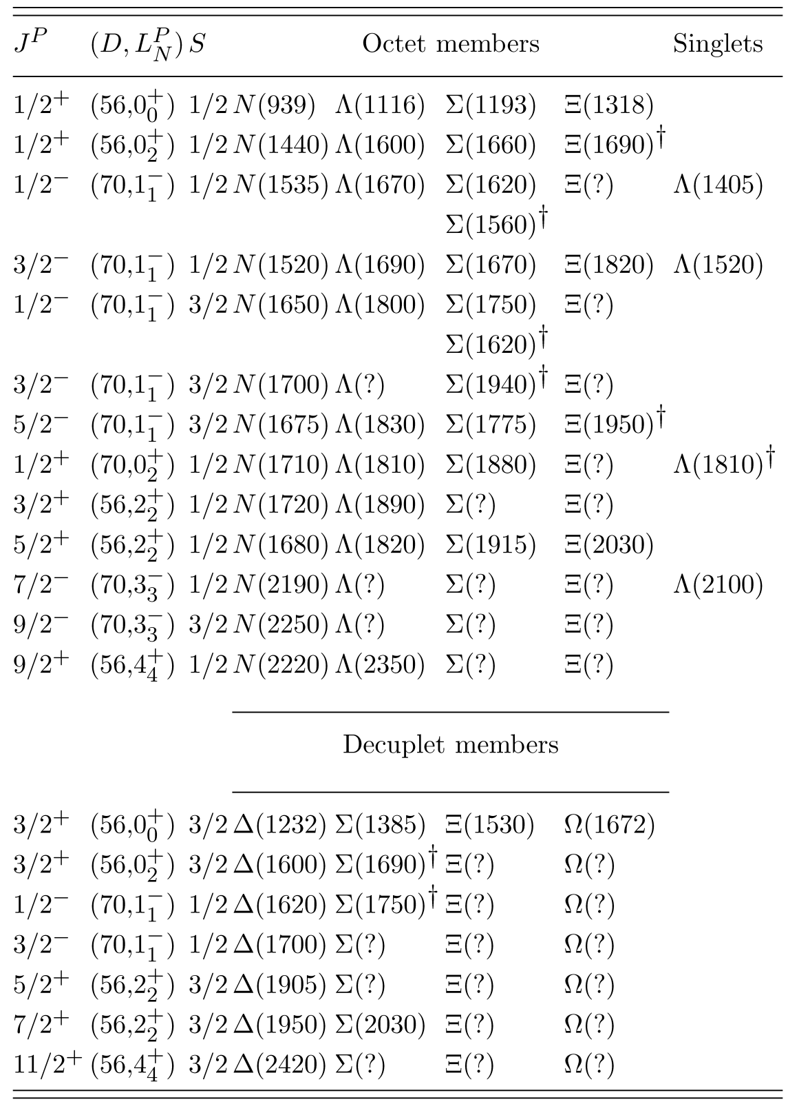
SU(6) x O(3) Classification
RPP 2014: Chin. Phys. C 38 (2014) 090001
„Assignments for …
Ξ(1820) and Ξ(2030), are merely
educated guesses.“
Ξ(1690), Ξ(1950):
T. Melde et al., PRD 77 (2008) 114002
decuplet: no Ξ*, no Ω*
“… nothing of significance on Ξ resonances has been added since our 1988 edition.”
?

Slide 18
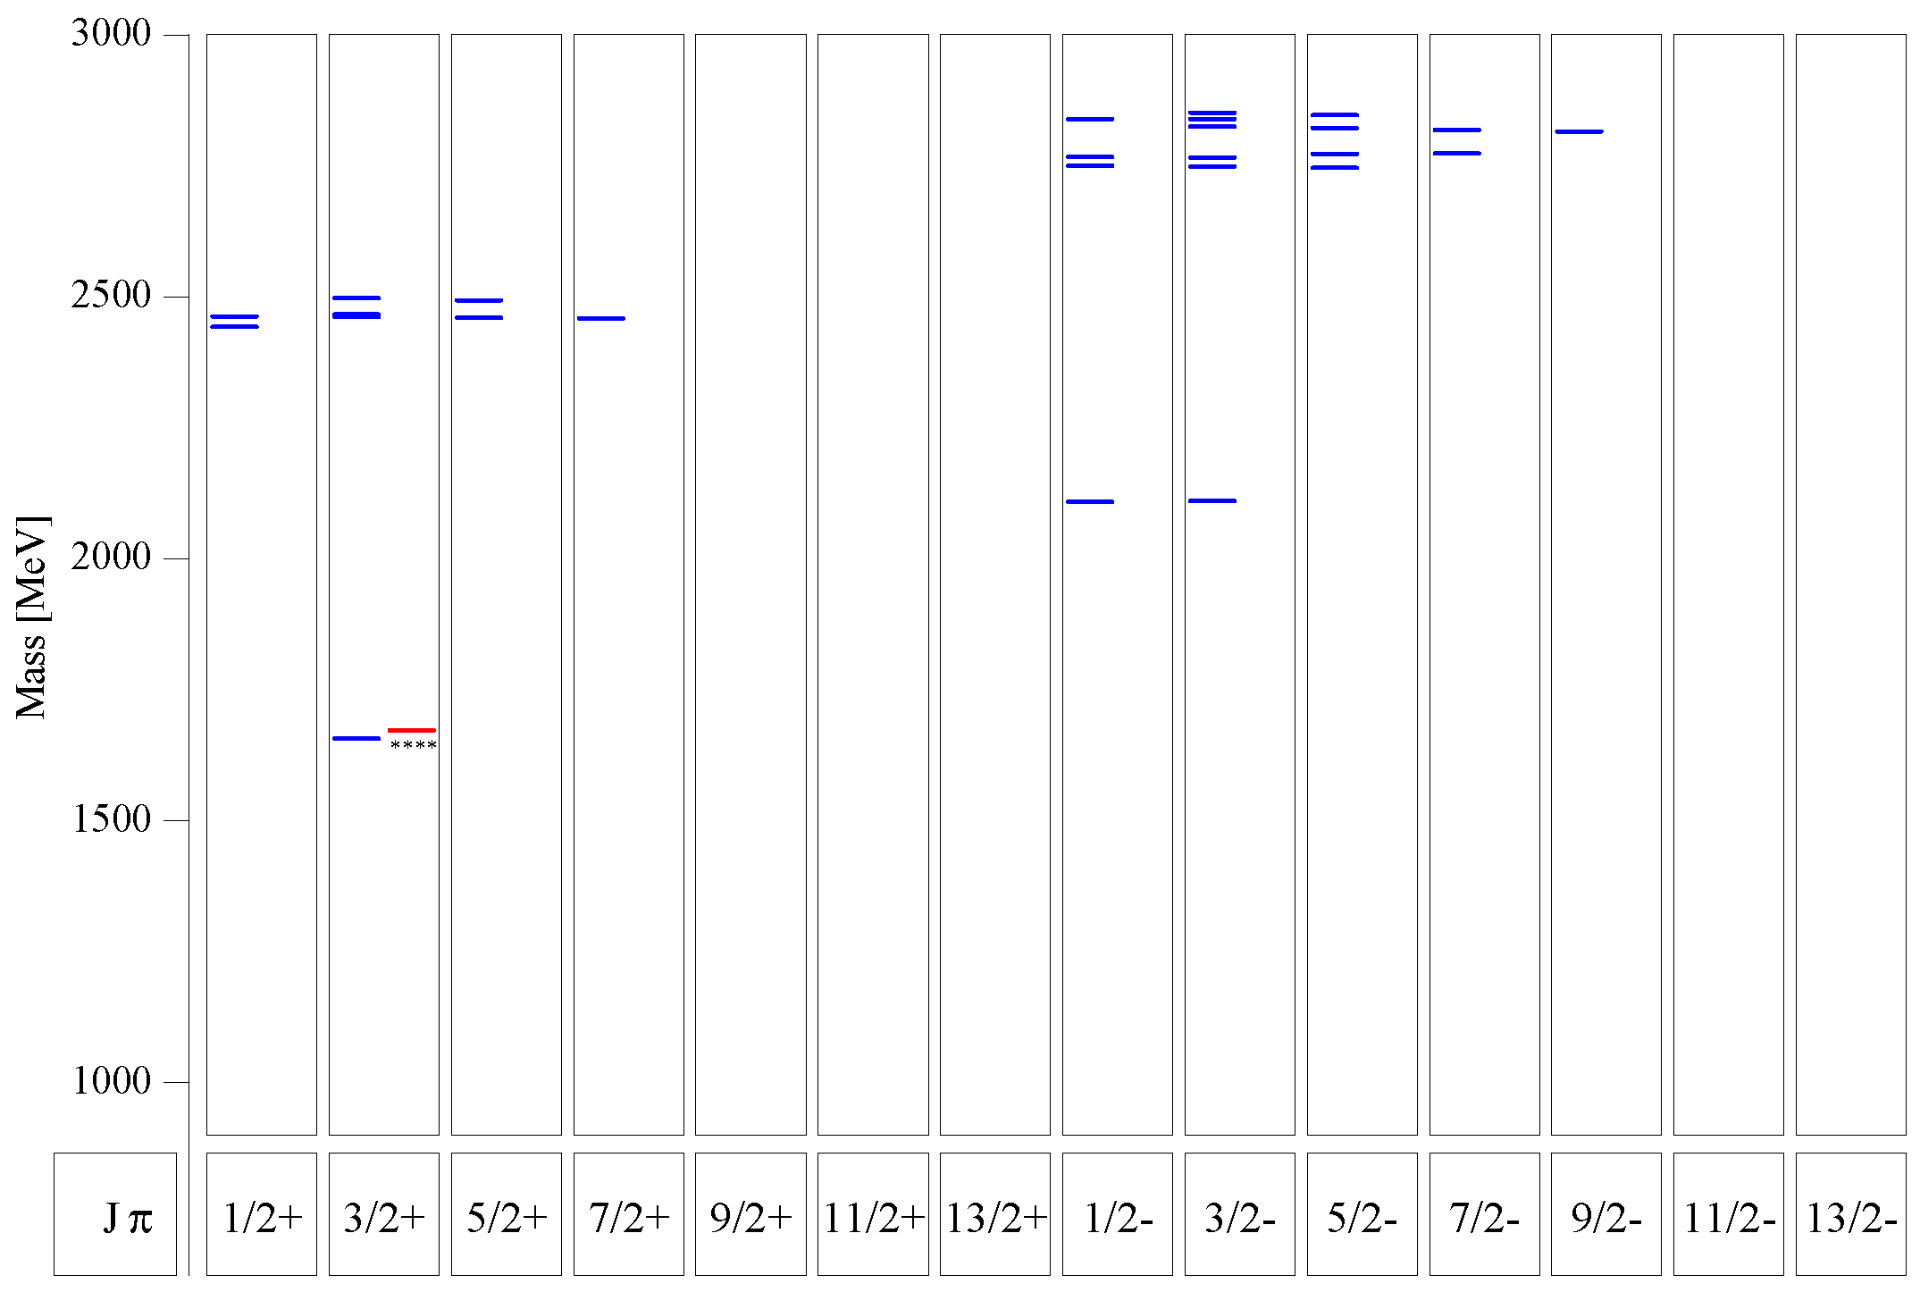
Quark Model for Ξ & Ω
Ξ:
many states predicted below 3 GeV
compare 1/2⁺ and 1/2⁻ excitation
Ω:
several states predicted between 2 GeV and 3 GeV
compare 3/2⁺ and 3/2⁻ excitation
Ξ
U. Löring et al., EPJA 10 (2001) 447
Ω
s.a.: M. Pervin, W. Roberts, PRC 77 (2008) 025202

Slide 19
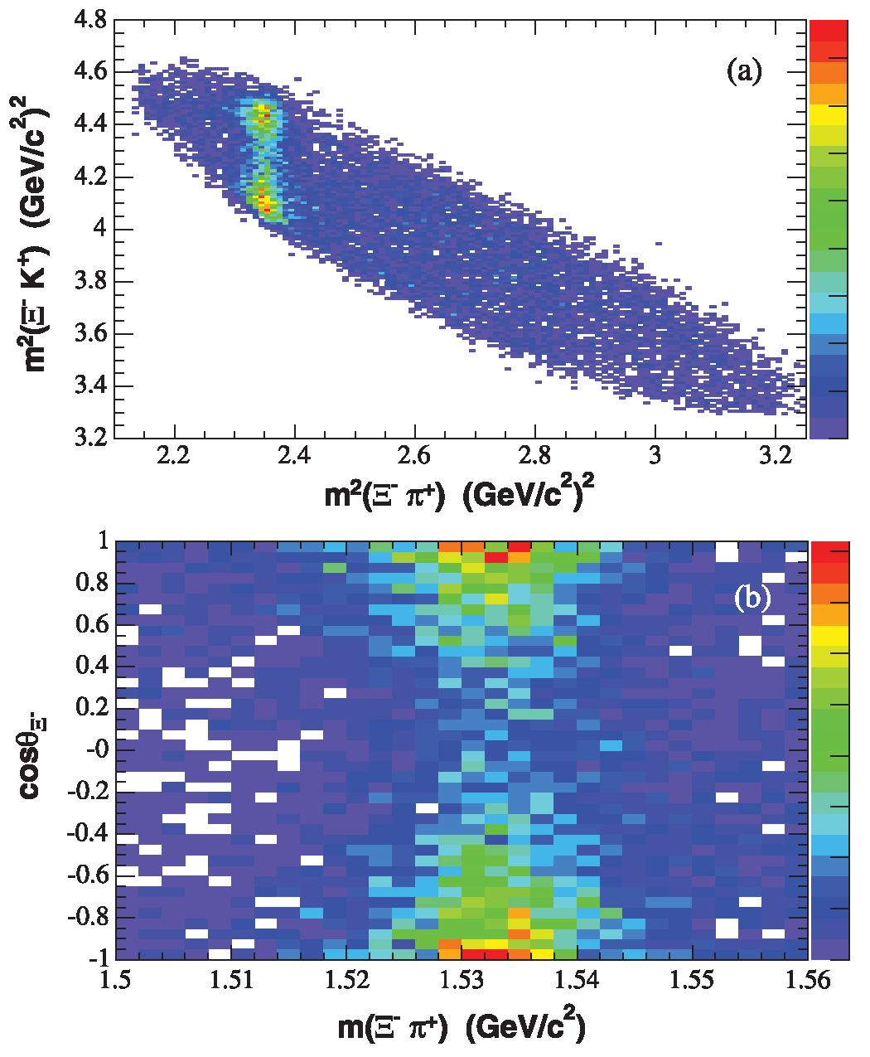
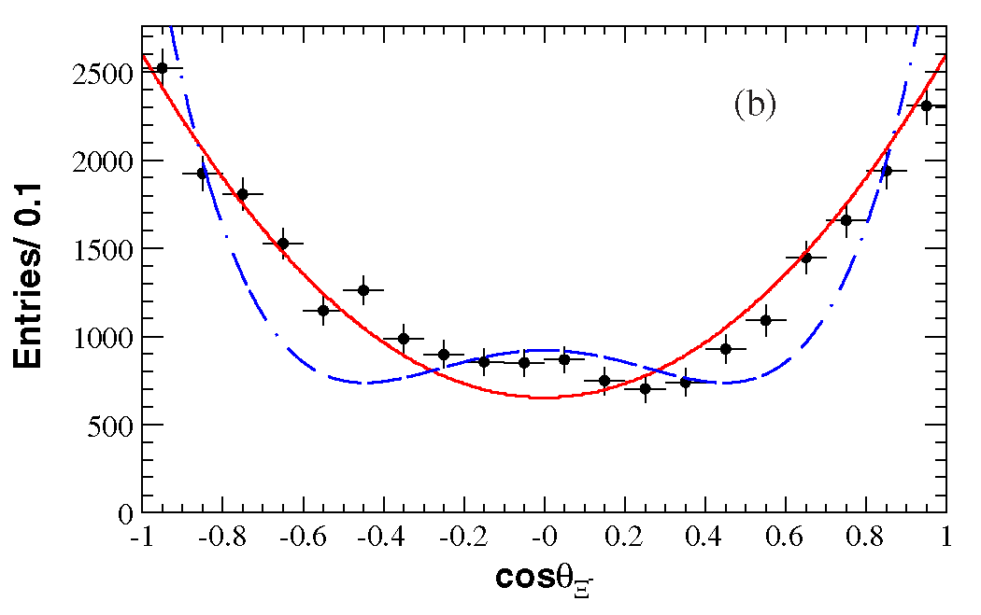
Data on Ξ* States: Ξ(1530)
The only reasonably well studied Ξ resonance:
Ξ(1530) - decuplet g.s. J^{P} = 3/2⁺
Г = 9…10 MeV
decay: ~100% Ξπ
BaBar measured the Ξ(1530)⁰ spin J = 3/2 in Λ_{c}⁺ → Ξ⁻ π⁺ K⁺
favor J^{P} = 1/2⁻ for Ξ(1690)
Compare to Δ!!
J = 3/2
J = 5/2
BaBar: B. Aubert et al., PRD 78 (2008) 034008

Slide 20
A Little Bit of PANDA History
_
Original Focus: Charmonium States, Hybrids and Glueballs
see „FAIR“ CDR, Nov 2001, PANDA TPR, Feb 2005
Charmonium
Gluonic Excitations
Charm in Nuclei
Hypernuclei and -atoms
Further options (open charm, nucleon structure and form factors, CP violation)

Slide 21
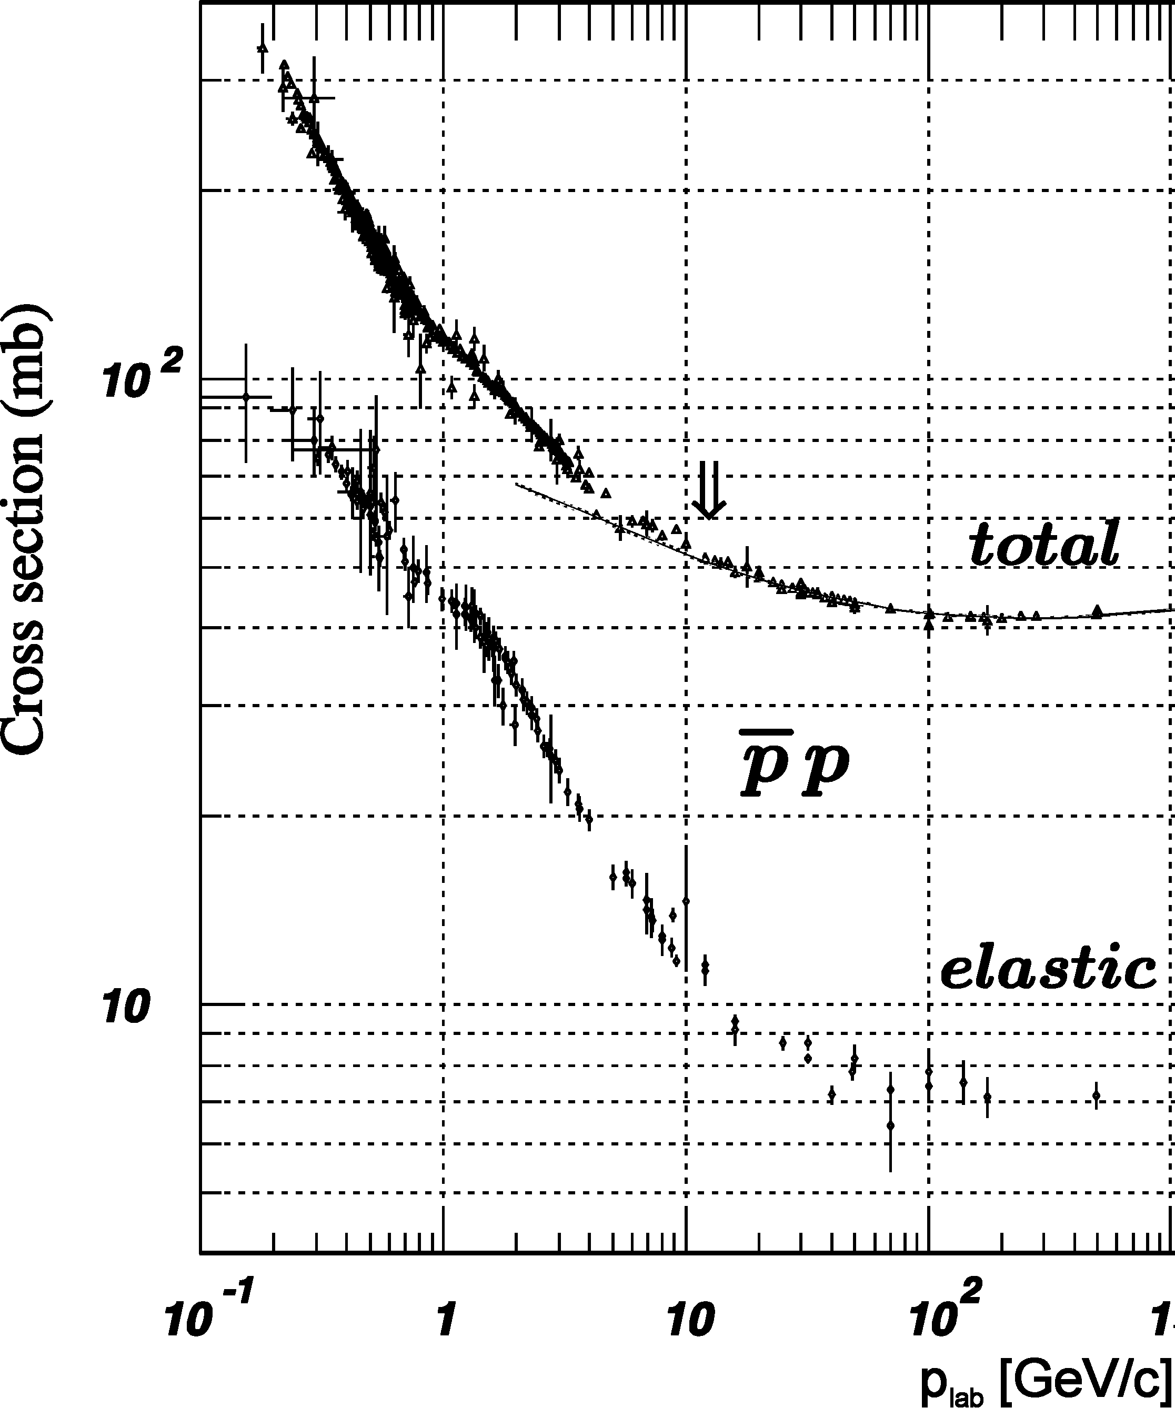
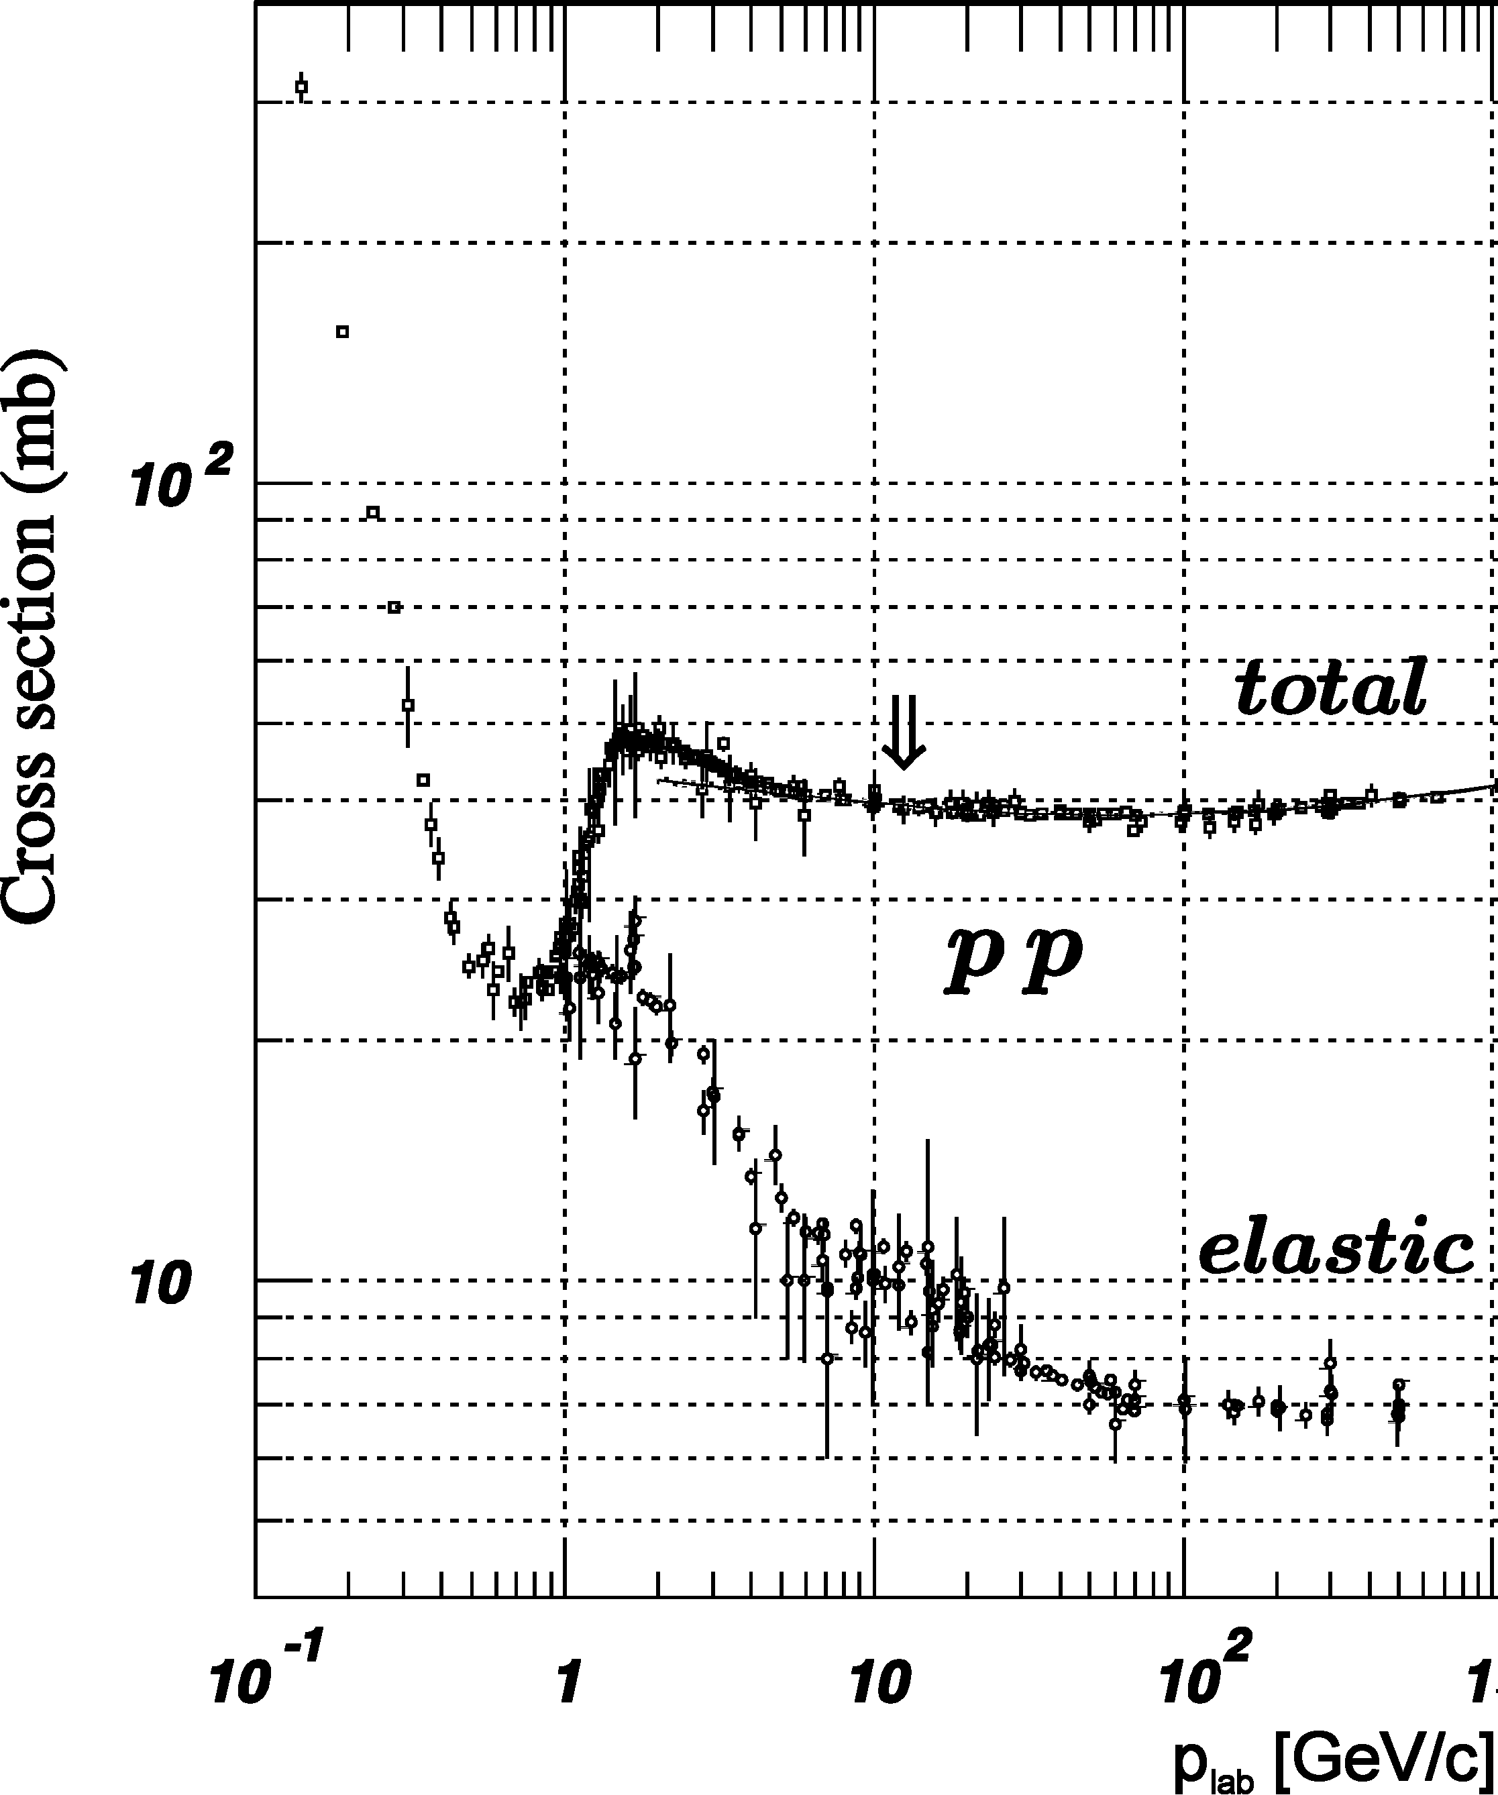
Composition of the pp cross section
_
annihilation
inelastic
inelastic part:
σ_{non-ann} /σ_{ann} : ~ 0.1 (p = 1.5 GeV/c), ~ 1 (p = 5 GeV/c), ~3 (p = 15 GeV/c)

Slide 22
PANDA is a Factory for (Excited) Hyperons !
_
hyperon-antihyperon cross sections:
$σ\left(\overline{p}p→\overline{Λ}Λ, \overline{Λ}Σ, \overline{Σ}Σ\right)≅10…100 μb$ measured
$σ\left(\overline{p}p→\overline{Ξ}Ξ\right)≅2 μb$ measured
$σ\left(\overline{p}p→\overline{Ω}Ω\right)≅2…100 nb$ predicted
production rates at full luminosity 2⋅10³² s⁻¹cm⁻² :
up to 1.7⋅10⁹ Λ per day, ~(1 - 5)⋅10⁸ Σ per day (charge state dep.)
up to 3.5⋅10⁷ Ξ per day
maybe 5⋅10⁵ Ω per day (using σ = 30 nb)
at comparative energy above threshold, we expect the same order of magnitude for excited states

Slide 24
Most Promising: Study Ξ Resonances
very little known ←→ rather high cross section
find missing resonances
determine branching to various decay modes:
$Ξπ, Ξπ^{+}π^{−}, Ξπ^{0}π^{0}, ΛK^{−}, Σ\overline{K}, Ξη, Ξηπ, Ξη^{′}, Ξω, Ξφ, …$
determine J^{P} quantum numbers if possible
recent progress:
PAWIAN now includes baryons
see talk by Bertram Kopf
strategy:
select $\overline{p}$ momentum to produce a specific resonance close to threshold

Slide 25
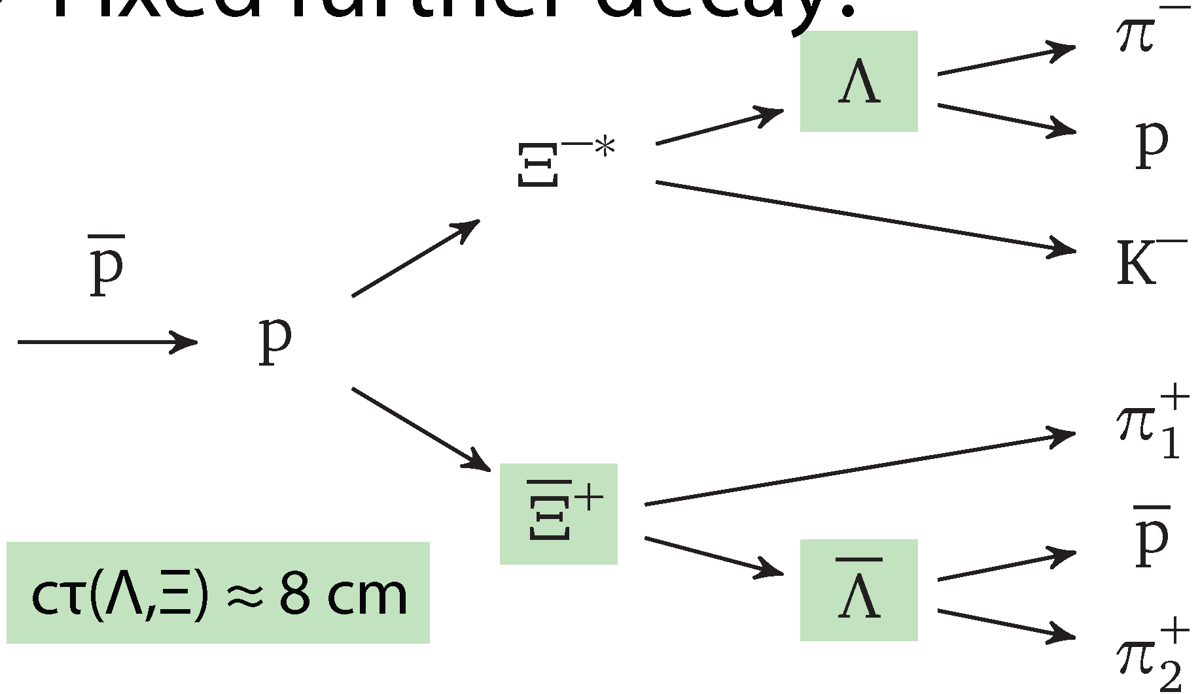
Recent Simulation & Analysis
new MC simulations & analyses:
André Zambanini, completed, PhD thesis U Bochum 2015
4.1 GeV/c pp → Ξ(1690)⁻Ξ⁺ → K⁻ΛΞ⁺
~0.5⋅10⁶ signal events, ~50⋅10⁶ DPM background events
Jennifer Pütz, PhD thesis fully devoted to Ξ spectroscopy
4.6 GeV/c pp → Ξ(1820)⁻Ξ⁺ → K⁻ΛΞ⁺ & c.c.
1.5⋅10⁶ signal events, 15⋅10⁶ DPM background events so far
_
_
_
_
_
_

Slide 26
dM
${\overline{Ξ}}^{+}ΛK^{−}$ final state: $M^{2}\left(ΛK^{−}\right)$vs. $M^{2}\left({\overline{Ξ}}^{+}Λ\right)$
(bef. 4C kin. fit)
_
σ_{M}(Ξ⁺) = 3.2 MeV
f_{rec} ~ 2.5%, f_{bckg} ~ 0.2⋅10⁻⁷
André Zambanini, Dissertation Univ. Bochum (2015)

Slide 27
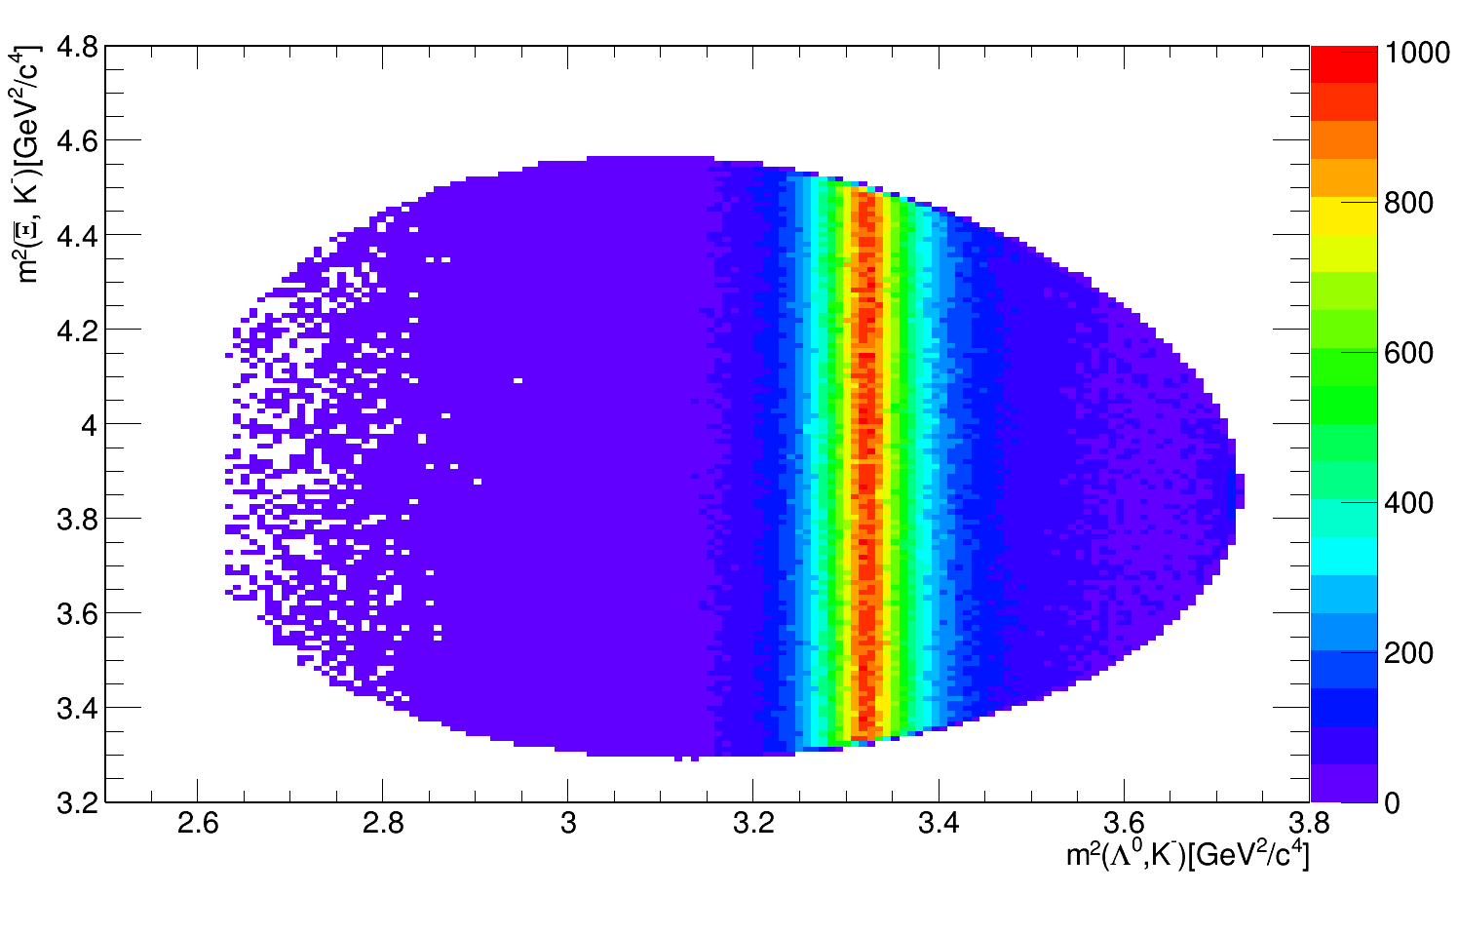
pp → Ξ⁺Ξ(1820)⁻ → Ξ⁺ΛK⁻
_
_
_
${\overline{Ξ}}^{+}ΛK^{−}$ final state: $M^{2}\left({\overline{Ξ}}^{+}K^{−}\right)$ vs $M^{2}\left(ΛK^{−}\right)$
Generated
Reconstructed
_
σ_{M}(Ξ⁺) = 4.0 MeV
f_{rec} = 2.1% (updated)
background suppression under study
Jenny Pütz, Talk at FAIRNESS 2016

Slide 28
Early Physics: Expected Rates for Strange Baryons
initial phase: $L≅{10}^{31}{cm}^{−2}s^{−1}$ instead of $L≅{2∙10}^{32}{cm}^{−2}s^{−1}$
nevertheless the $Ξ\overline{Ξ}$ production rate will be $R_{Ξ\overline{Ξ}}≅10/s≅{10}^{6}/d$
for $Ω\overline{Ω}$ production we expect $R_{Ω\overline{Ω}}≅0.3/s≅{3∙10}^{4}/d$
for excited states the cross section should be of the same order of magnitude as for the ground state for given $\sqrt{s}−\sqrt{s_{thr}}$
the detected rate depends on the specific decay mode (branching & reconstruction efficiency)
e.g. $\overline{p}p→{\overline{Ξ}}^{+}Ξ^{∗−}→$ ${\overline{Ξ}}^{+}Ξ^{−}π^{0}→\overline{Λ}π^{+}Λπ^{−}π^{0}→\overline{p}π^{+}π^{+}pπ^{−}π^{−}π^{0}$ assume $b=0.5∙{0.64}^{2}=0.2$ and $ε=5\%$ → $R_{det}≅$ ${10}^{4}/d$

Slide 29
Ξ* / Ω* Studies within the PANDA Physics Program
_
good case for initial phase with lower L
Λ & Σ spectroscopy can be done in parallel
long runs to measure the X(3872) width in energy scan planned:
parallel trigger for Ξ* and Ω*
p ≈ 7.0 GeV/c
M_{max}(Ξ*) ≈ 2.55 GeV (M_{max}(Ω*) ≈ 2.20 GeV)
later: long runs for threshold scan of D_{s}D_{s}(2317)
p ≈ 8.8 GeV/c
M_{max}(Ω*) ≈ 2.61 GeV
$$±$$
$$∓$$

Slide 30
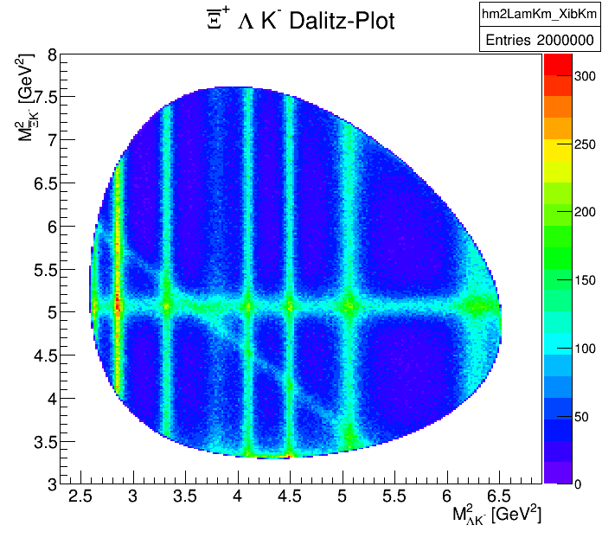
Ξ* Production at p = 7.0 GeV/c (it will not look like this)
EvtGen
${\overline{p}p→{\overline{Ξ}}^{+}Ξ^{∗−}→\overline{Ξ}}^{+}ΛK^{−}$
included all Ξ* states in PDG above $Λ\overline{K}$ threshold
typical width ~20 MeV
decay: PHSP
added ${\overline{Ξ}}^{+}ΛK^{−}$ cont., $Λ^{∗}$& $Σ^{∗}$states ⁽¹⁾, $K\left(3100\right)$ ⁽²⁾
⁽¹⁾ $Σ\left(2250\right)$ enhanced
⁽²⁾ seen in $\overline{p}Λ$, $\overline{p}Λ nπ$ & c.c.

Slide 31
Challenges & Requirements
Complex decay topology
Number of charged particles in final state
Displaced vertices
Charged → charged + neutral
need
Realistic pattern recognition for displaced tracks
Vertex fitter for charged + neutral
Decay tree fitter
Realistic tracking for FTS
Forward Boost ←→ PANDA Start Setup !

Slide 32
still valid !

Slide 33
still valid !

