Slide 1










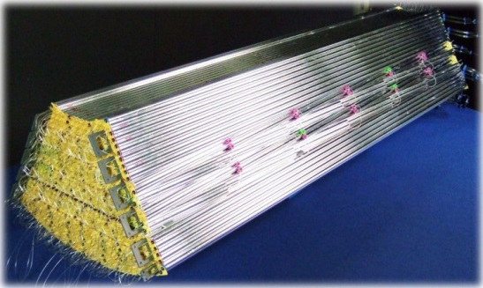
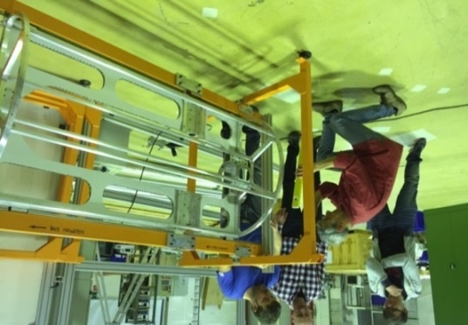
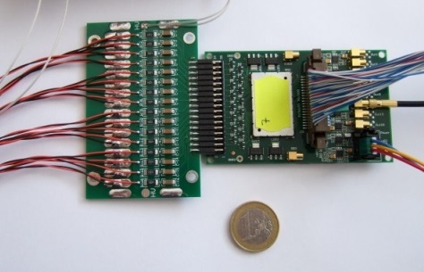
STT Status Update
Peter Wintz (FZ Jülich) for the STT group
LVIII. PANDA CM, HI-Mainz, Sep-14th, 2016

Slide 2
STT Status Update (WPs)
Beam tests and setups
Pre-series test set up
Electronic readout systems
dE/dx Readout results
Phase - 0 experiment setup

Slide 3
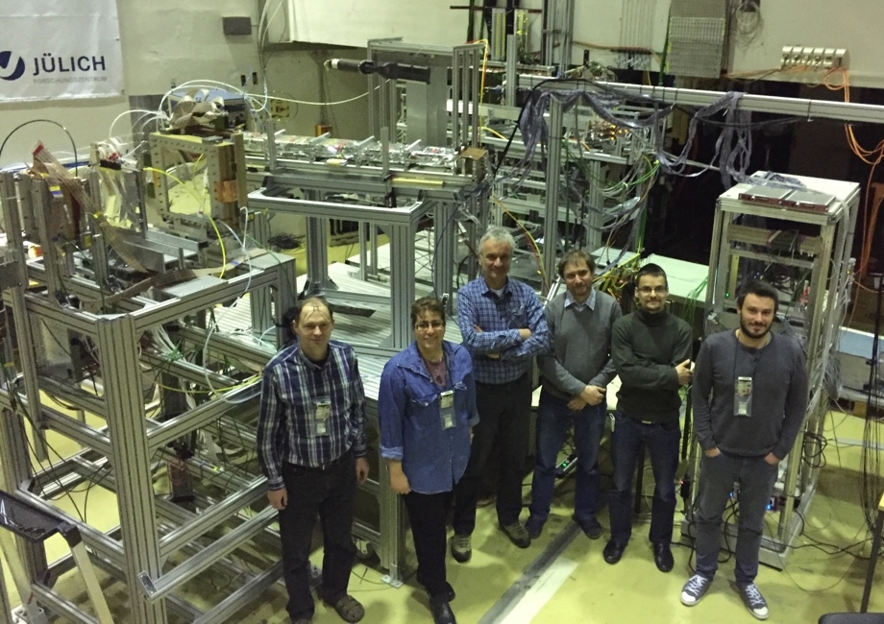
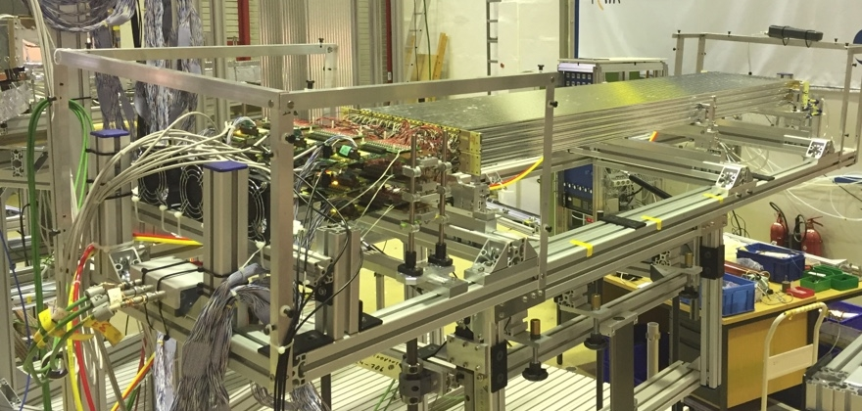
WP- Beam Tests & Setups
New experimental area set up (COSY-TOF), ~2m beam line height
Beam time in Apr/May-2016, 1 week proton beam, 4× different momenta
3× straw setups: 2× STTs (ADC / ASIC-TRB readout) + FT (ASIC-TRB)
Scintillators, GEM chamber and MWPCs for beam profile and trigger
Data analysis ongoing, next beam time in Dec-2016, 1 week deuteron beam
Test setups in experimental area (left) and
STT setup with ASIC/TRB readout (top).

Slide 4

WP - Pre-Series Test (Milestone M8)
STT pre-series test
  Mechanical setup: one STT hexagon sector, ~ 700 channels
  Electronic readout system: in-beam test, high-rate and dE/dx separation
  Beam test results as basis for decision of final electronic readout system
WP - Mech. System status still “pending“, MP & funding
  Aim to clarify situation and resume WP in 2017
  Hexagon sector set up with existing prototype frame
M8: slightly delayed from Q2/2017 → Q4/2017 by
  ADC-based readout development stalled in 2015
  Beam time request (COSY) in Dec-2016 for period Q3/Q4-2017
Manpower for pre-series test execution and data analysis critical

Slide 5
WP – Electronic Readout
STT with readout of drift time and dE/dx for PID, two readout solutions
ASIC/TRB (drift time and time-over-threshold for dE/dx information)
    Pre-series system set up ongoing (700 ch), all components specified and available, currently bonding of >100 ASICs by company
    dE/dx separation power by time-over-threshold demonstrated by in-beam tests, time-over-thresh resolution studies ongoing
ADC/FPGA (pulse shape sampling for drift time and dE/dx)
Activities suspended in 2015, resumed in 2016 (WP by ZEA2-FZJ)
    System design & work plan in progress, next in-beam prototype tests in Nov/Dec-2016, pre-series system scheduled for Q3/2017
Readout decision in Q4/2017, workshop (in Krakow) by end 2016 to define decision criteria and process, TC involvement

Slide 6
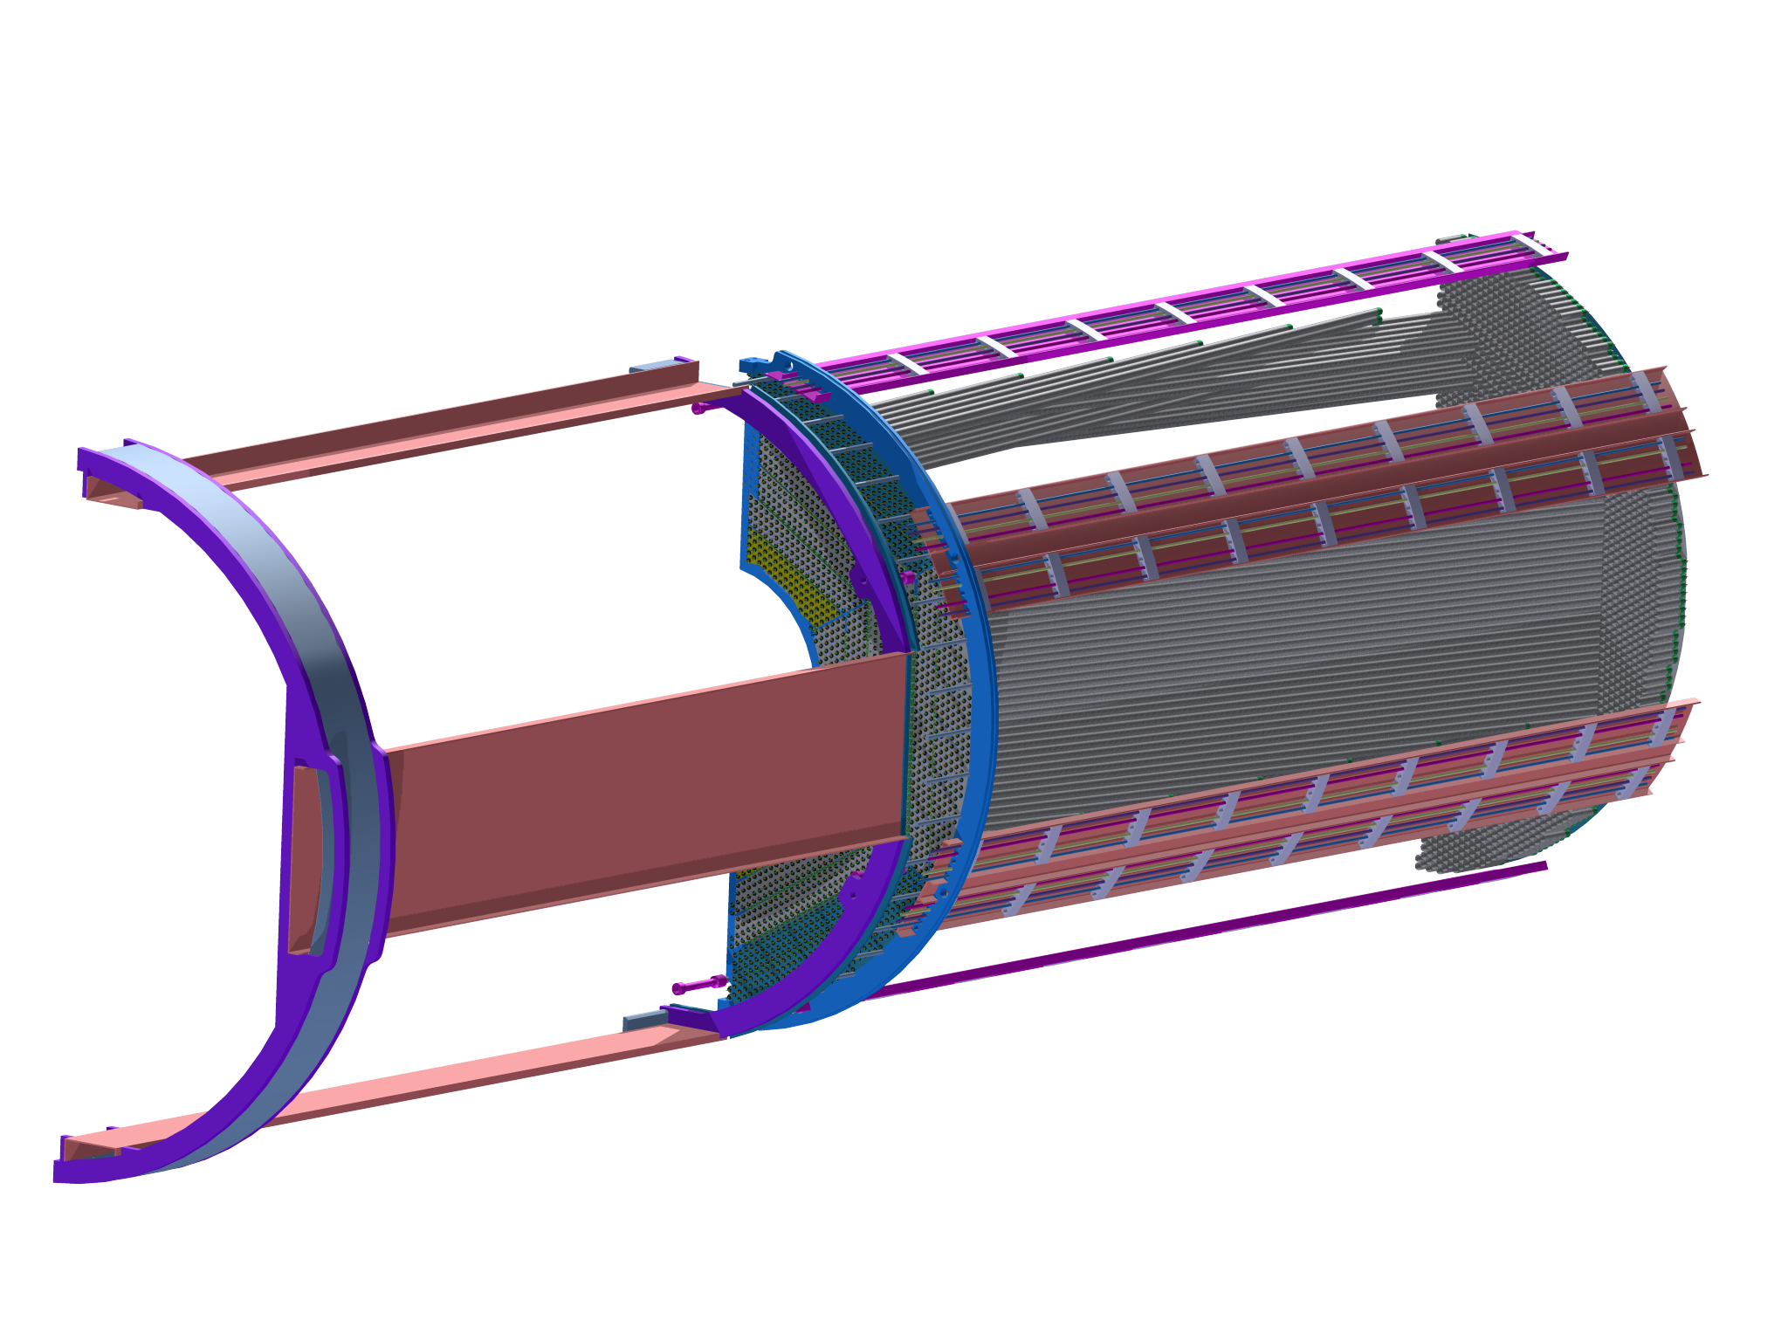
WP – Electronic Readout/Mech. System
Detector front-end layout for ASIC/TRB readout system
Pre-series components defined:, FE-boards, cables, supplies, ..
STT semi-barrel: straw module and cable-routing mechanical frame system.

Slide 7
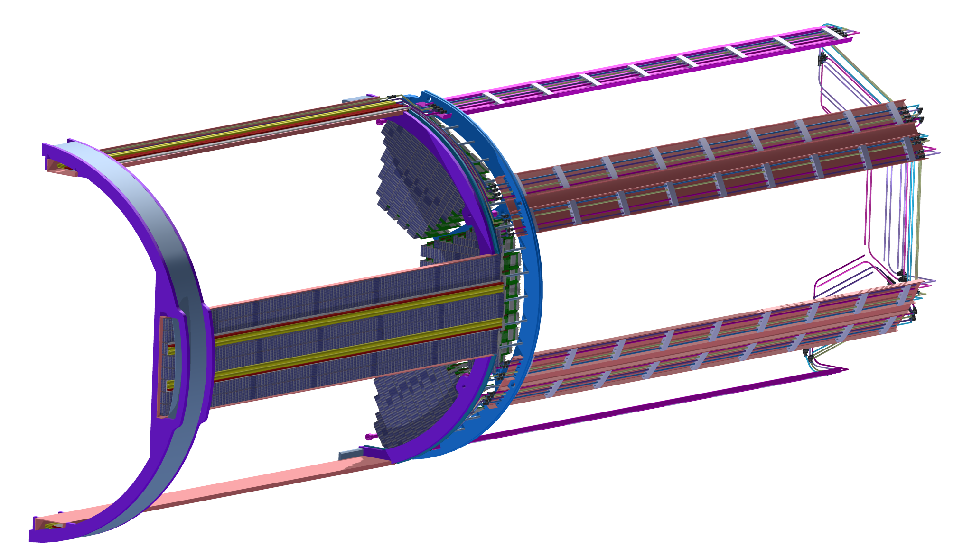
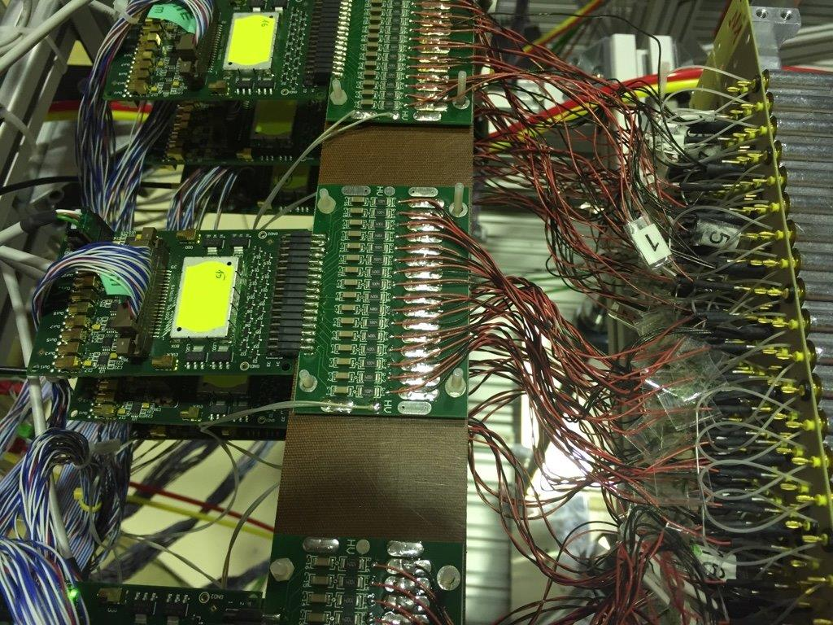
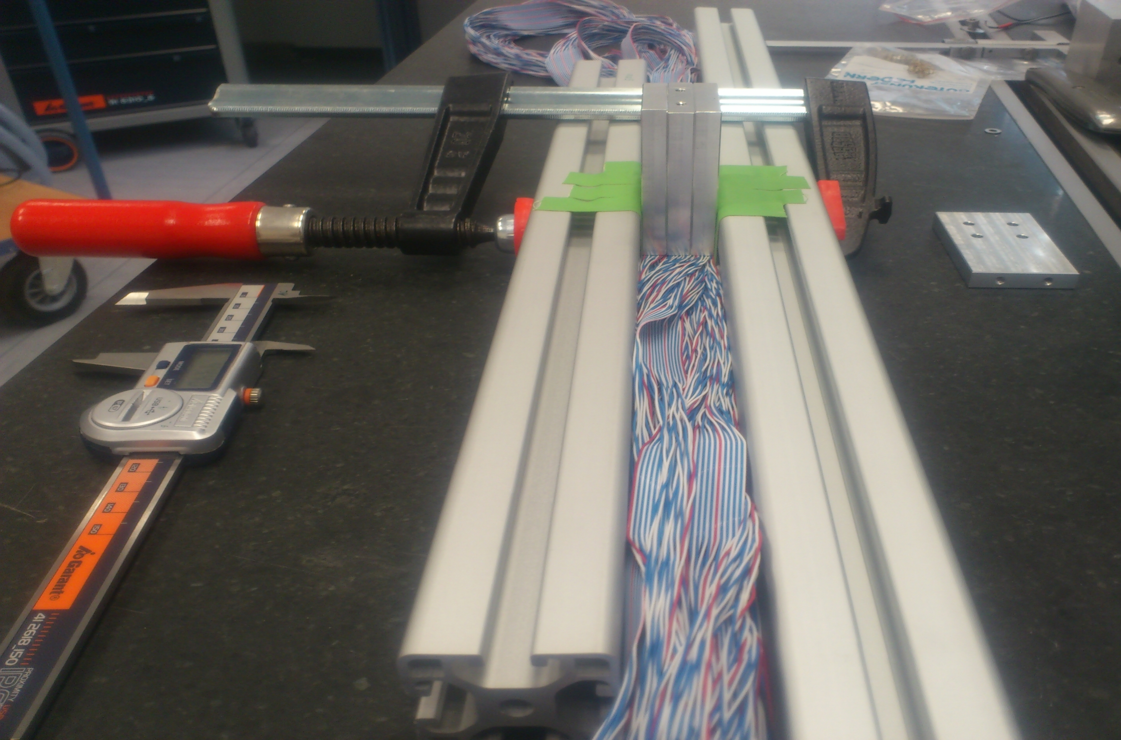
WP – Electronic Readout/Mech. System
Detector front-end layout for ASIC/TRB readout system
Pre-series components defined:, FE-boards, cables, supplies, ..
Gas lines and manifolds, FE-boards and cabling for ASIC/TRB readout system (top figure). FE-boards at test system (top right). Cable packaging cross-section (lower right)..

Slide 8
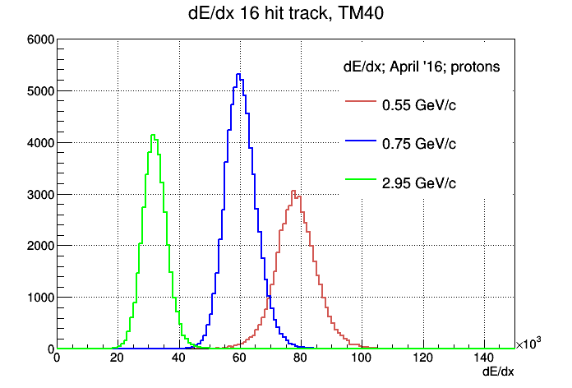
dE/dx-Readout Results
(Apr-2016 Beam Time)
Study of dE/dx - separation power for proton beam at 4 different momenta
By time-over-threshold (top figure, very preliminary!)
  24-30 straw hits per track, ToT truncation
  dE/dx-separation by ToT demonstrated!
  resolution study ongoing (trunc low ToT tails)
  high/low threshold no effect (1-thr ASIC)
  (1 GeV/c data sample strange)
By pulse shape sampling (figure below)
  16 straw hits per track, 40% truncation
  high dE/dx-resolution by pulse integration
  results for prototype ADC (240 MHz)
  repeat for pre-series readout system
Pawel Strzempek
(Jagiell. U Krakow)
Krzysztof Pysz
(IFJ PAN Krakow)

Slide 9
New WP – Phase 0 Experiment Setup
Goal: combine physic runs with detector tests before PANDA starts (phase 0)
Global test system under experiment conditions (HADES)
STT contribution: 640 straws in 4 double-layers (STS1), PANDA-STT straw materials & assembly techniques, straw length ~ 75cm
PANDA-FT4 dimensions & synergies (mech. frame by FT/HADES group)
Use ASIC/TRB3 readout system after STT pre-series tests in 2017
Upgrade by 2 tracking stations:
STS1, STS2
HADES

Slide 10
Thank you
for
your attention

