Slide 1
Ξ Spectroscopy and the PANDA ‚Start Setup‘
Sep 13, 2016 | Albrecht Gillitzer, IKP Forschungszentrum Jülich
LVIII PANDA Meeting, Mainz, September 2016

Slide 2
Current Version of the PANDA ‚Start Setup‘
Day-1 master macros distributed by Stefano July 25 as basis for the physics simulation and analysis studies:
Cluster Jet Target
No GEM planes → need MVD or STT_{stereo} for p_{z}
No Disc DIRC → no K/π separation
FTS planes 1 2 3 4 (no 5 6 ) → poor p resolution
No RICH
How does this affect Hyperon Spectroscopy & Hyperon Spin Physics?

Slide 3
Need Studies at Different Levels
MC event generation, e.g. EvtGen: p_{T} vs. p_{L}, θ vs. p
PandaRoot simulation, count # hits in each sub-detector
PandaRoot simulation and full event reconstruction
Complication: displaced decay vertices of hyperons ! (affects 1. & 3.)

Slide 4
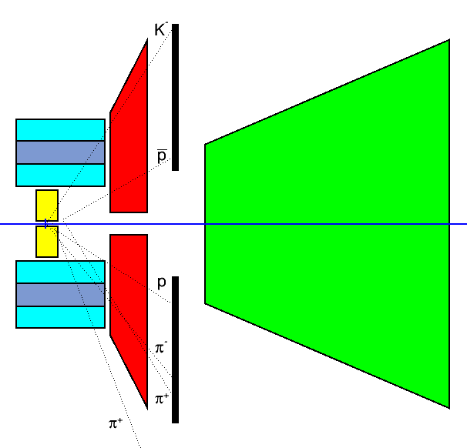
Fast Geometric Analysis with Straight Tracks
EvtGen events
4.1 GeV $\overline{p}p→{\overline{Ξ}}^{+}ΛK^{−}$
$\overline{p}π^{+}π^{+}p{π^{−}K}^{−}$final state
simplified geometry of MVD, STT, GEM, FTS
neglect magnetic field (conservative)
evaluate path length in each sub-detector volume & R(z_{STT})

Slide 5
Detector Geometry
Detector ⁽¹⁾ | Z_{us} | Z_{ds} | R_{i} | R_{o}
MVD | -170 | 230 | 10 | 135
STT | -550 | 1100 | 150 | 420
STT_{stereo} | -550 | 1100 | 239 | 331
GEM #1 | 1194 | - | 45 | 450
GEM #3 | - | 1885 | 45 | 740
FwdEndCap(x) ⁽²⁾ | 2450 | 2450 | - | [432] ⁽²⁾
FwdEndCap(y) ⁽²⁾ | 2450 | 2450 | - | [214] ⁽²⁾
FTS | 2954 | 7475 | - | -
⁽¹⁾ all values in mm
⁽²⁾ elliptical opening, θ_{x} = ±10º, θ_{y} = ±5º

Slide 6
Scan of 100 Events in Event Display
display primary particles only
display MVD, STT, GEM, FTS points only
minimum requirement: all 6 tracks visible on ‚global‘ scale
how „straight“ are the tracks?
what is the event topology?
1 : both p & p in FTS
2 : one of p, p in FTS
3 : both p & p in GEM
4 : one of π, K in FTS
5 : both p & p vertex ‚beyond‘ MVD
6 : one of p, p vertex ‚beyond‘ MVD
_
_
_
any of these disfavors recostruction with MVD & STT only
_
_

Slide 7
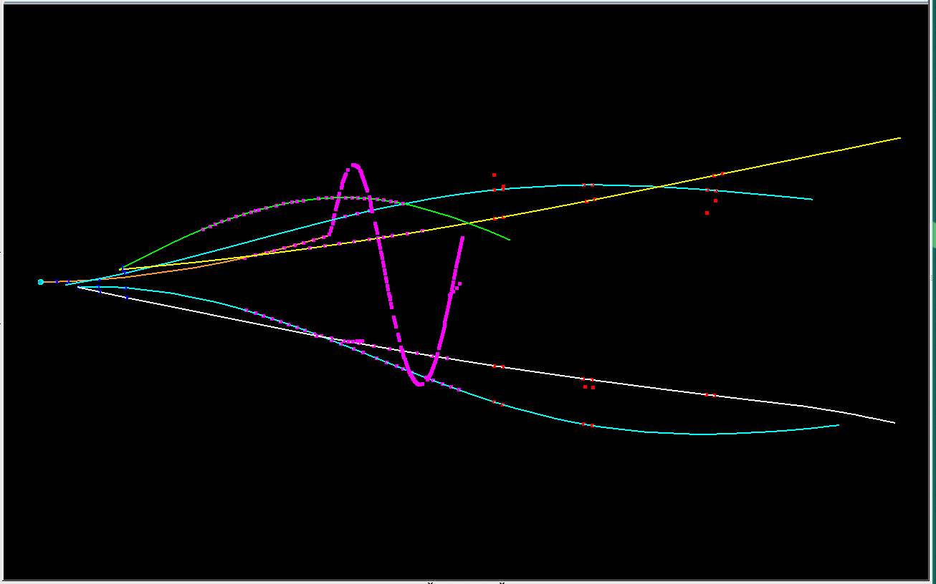
event #04
GEM
STT
p
MVD
π⁺
π⁻
K⁻
FTS →
_
π⁺
p
3 6

Slide 8
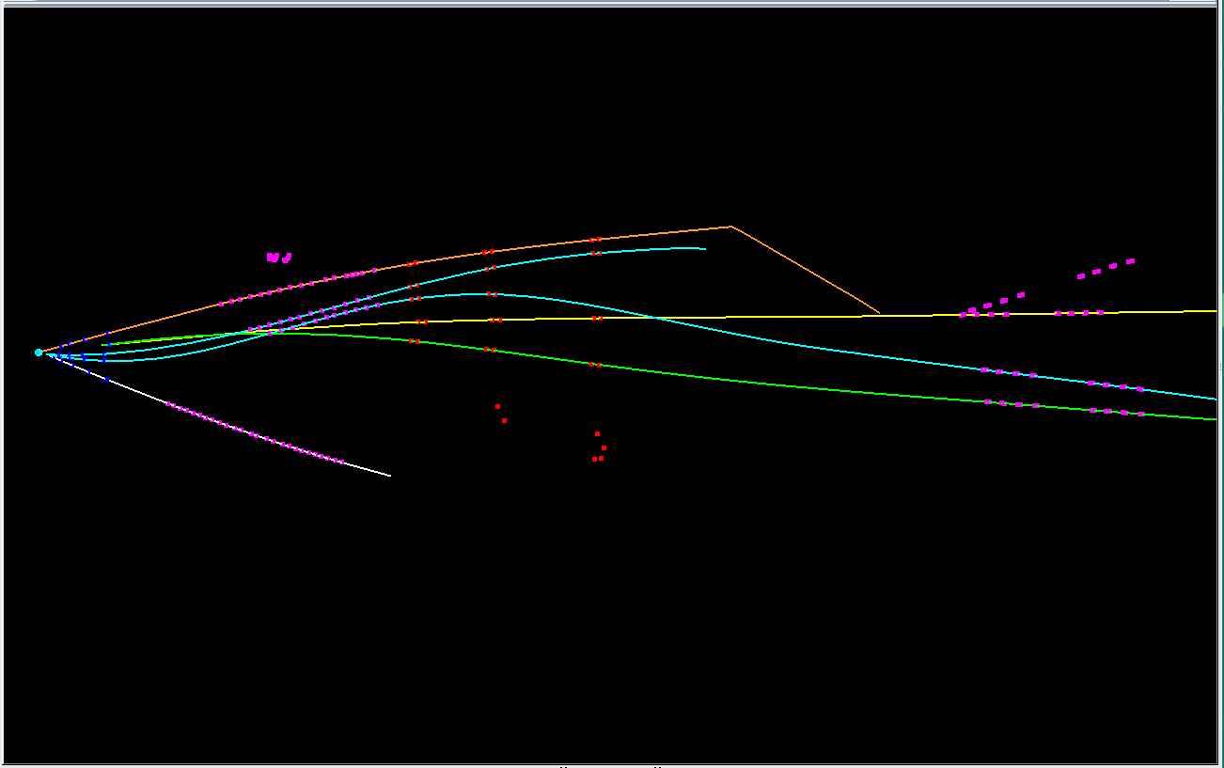
event #15
GEM
STT
K⁻
FTS
π⁺
MVD
p
π⁺
π⁻
_
p
2 4 6

Slide 9
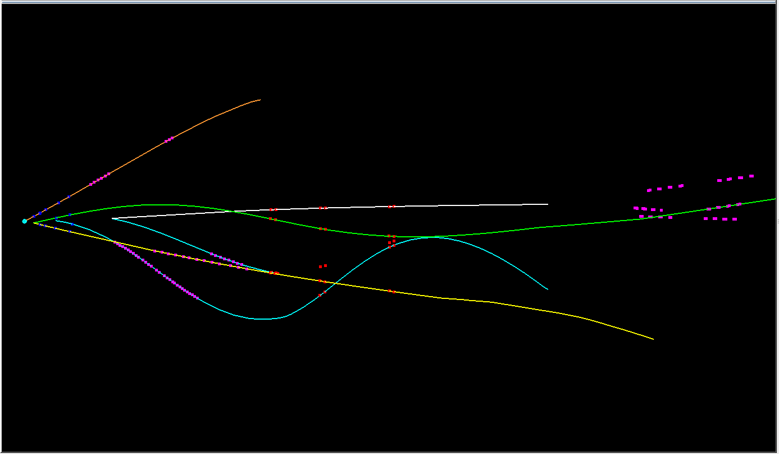
event #17
3 4 6

Slide 10
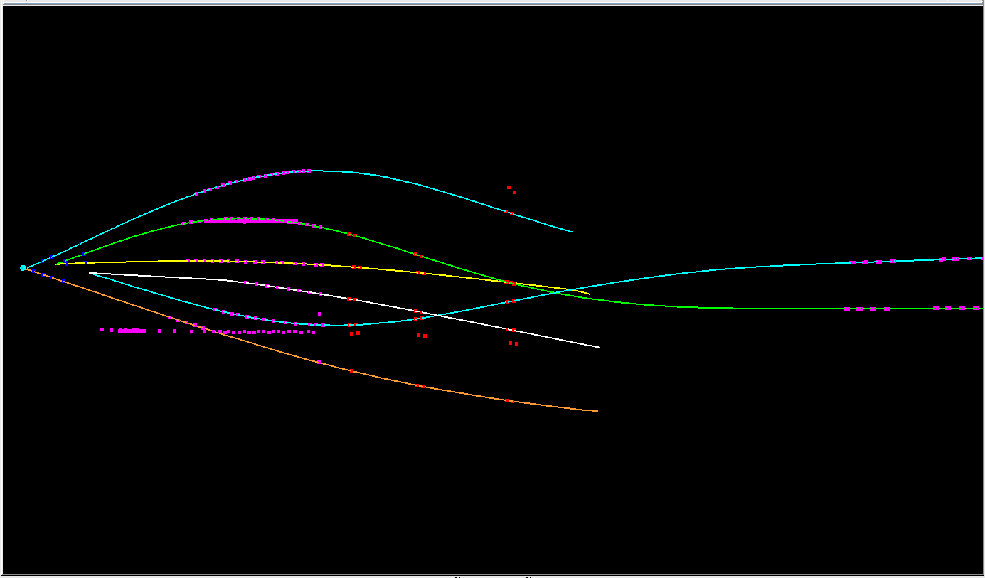
event #33
3 4 6

Slide 11
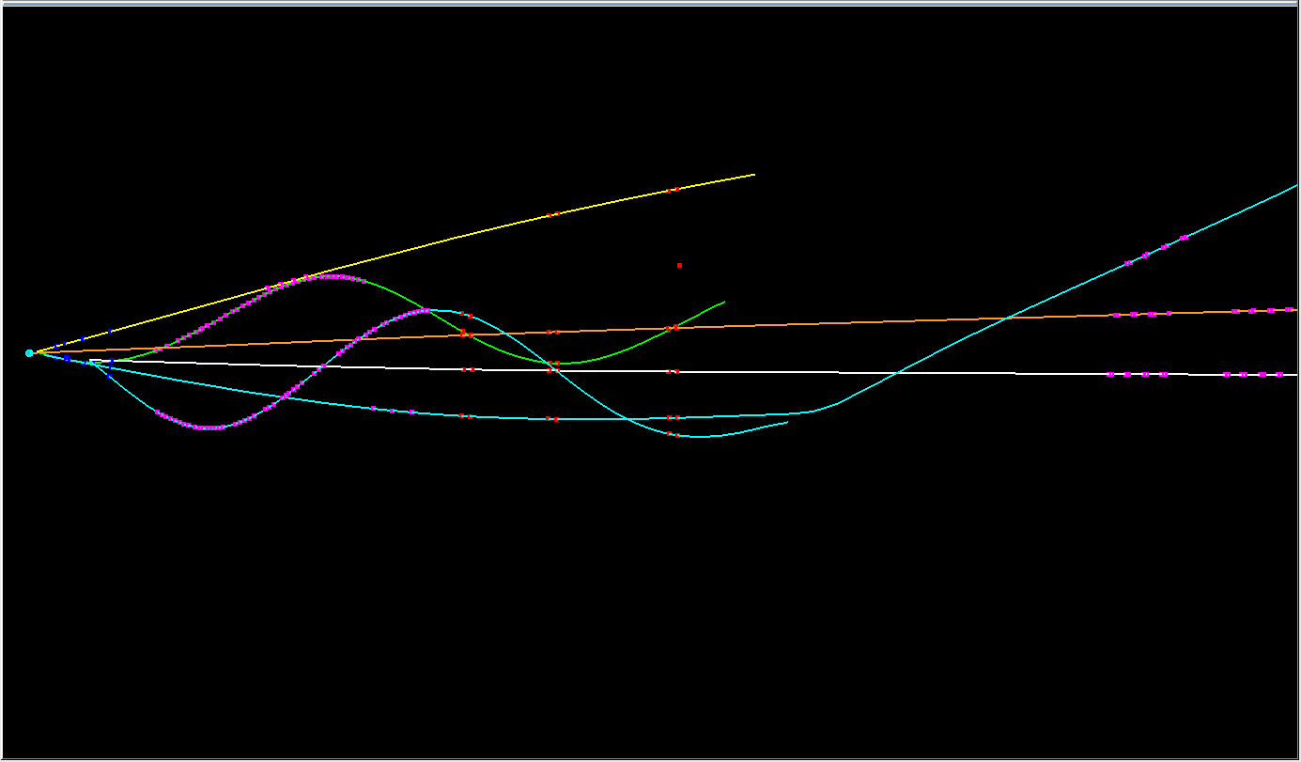
event #34
2 3 4 6

Slide 12
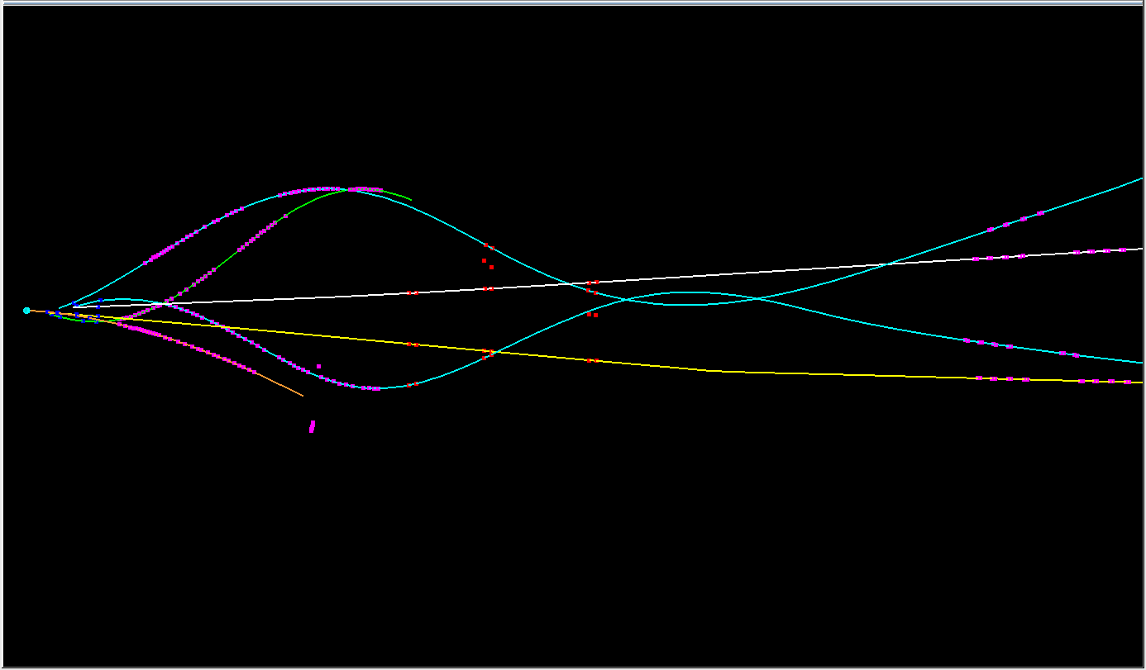
event #35
1 3 4

Slide 13
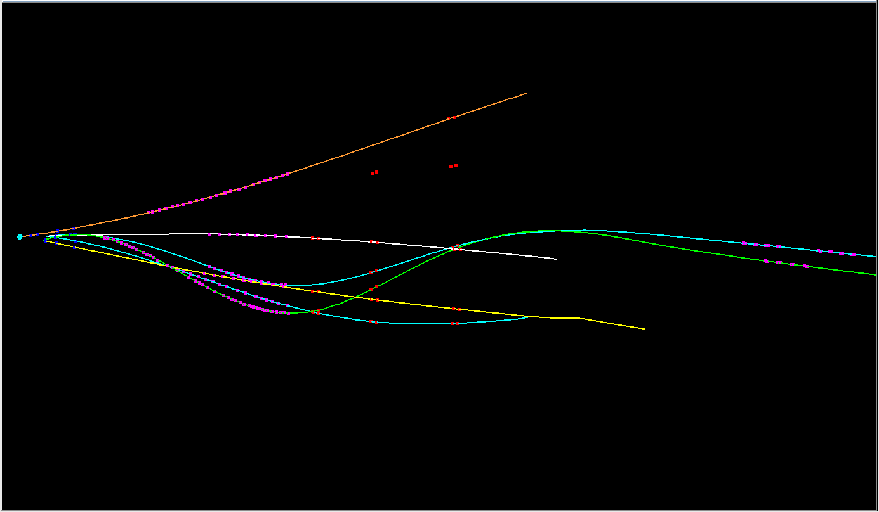
event #36
3 4 6

Slide 14
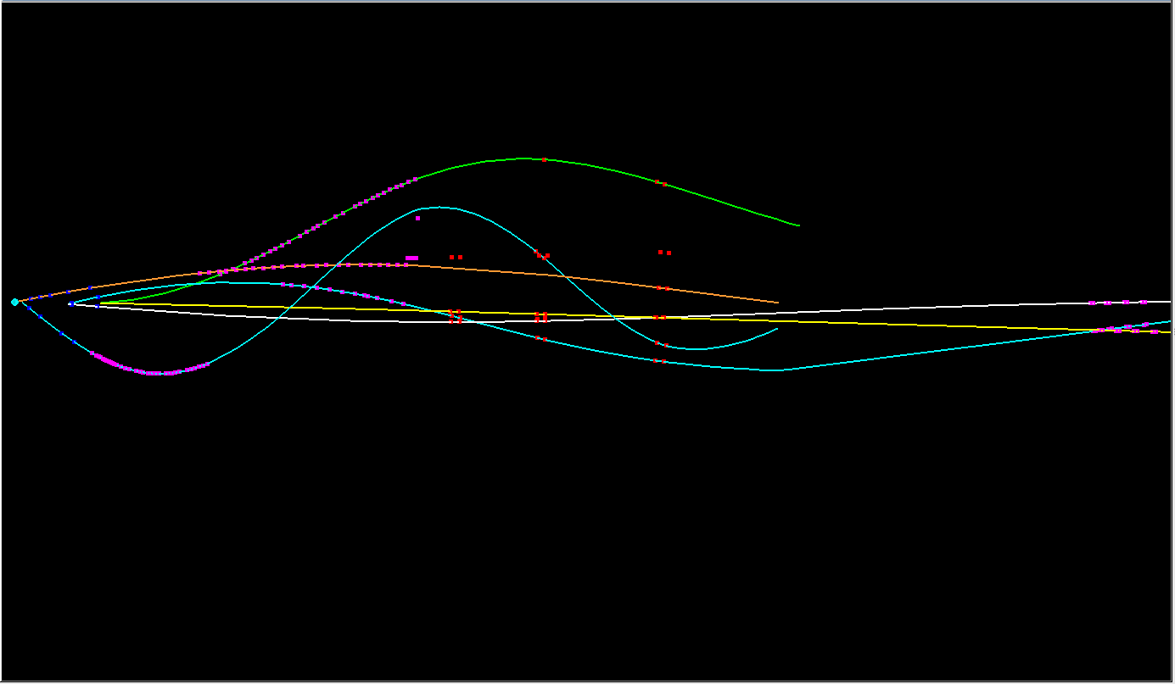
event #37
1 3 4 6

Slide 15
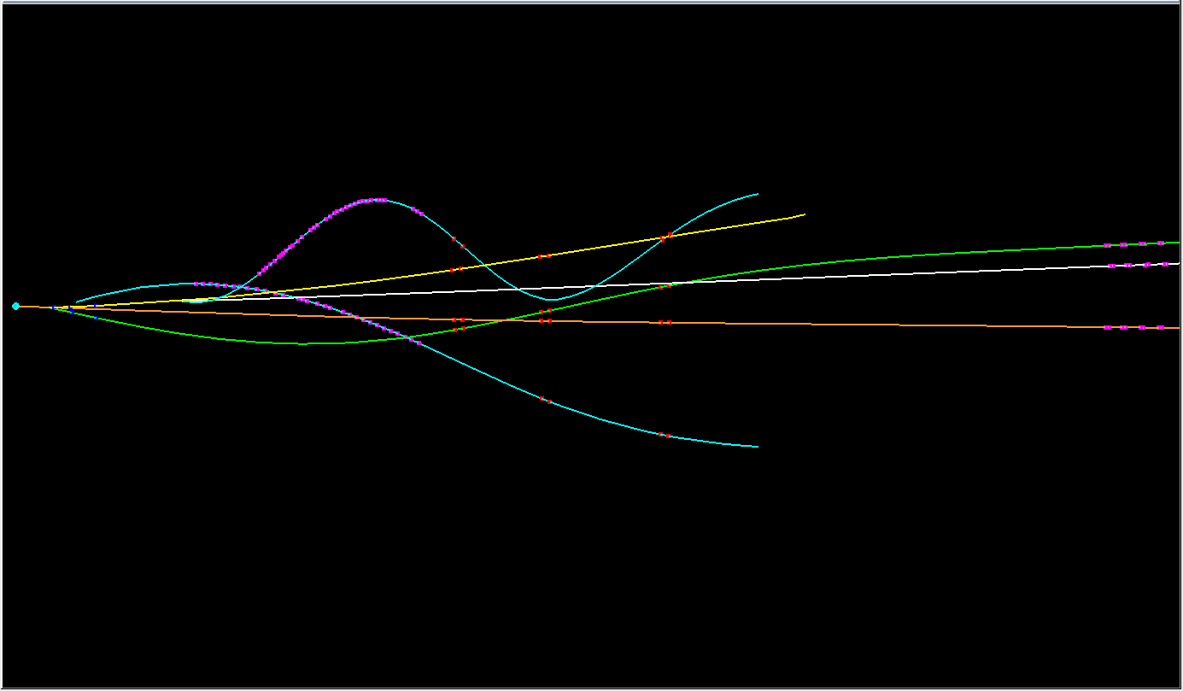
event #38
2 4 6

Slide 16
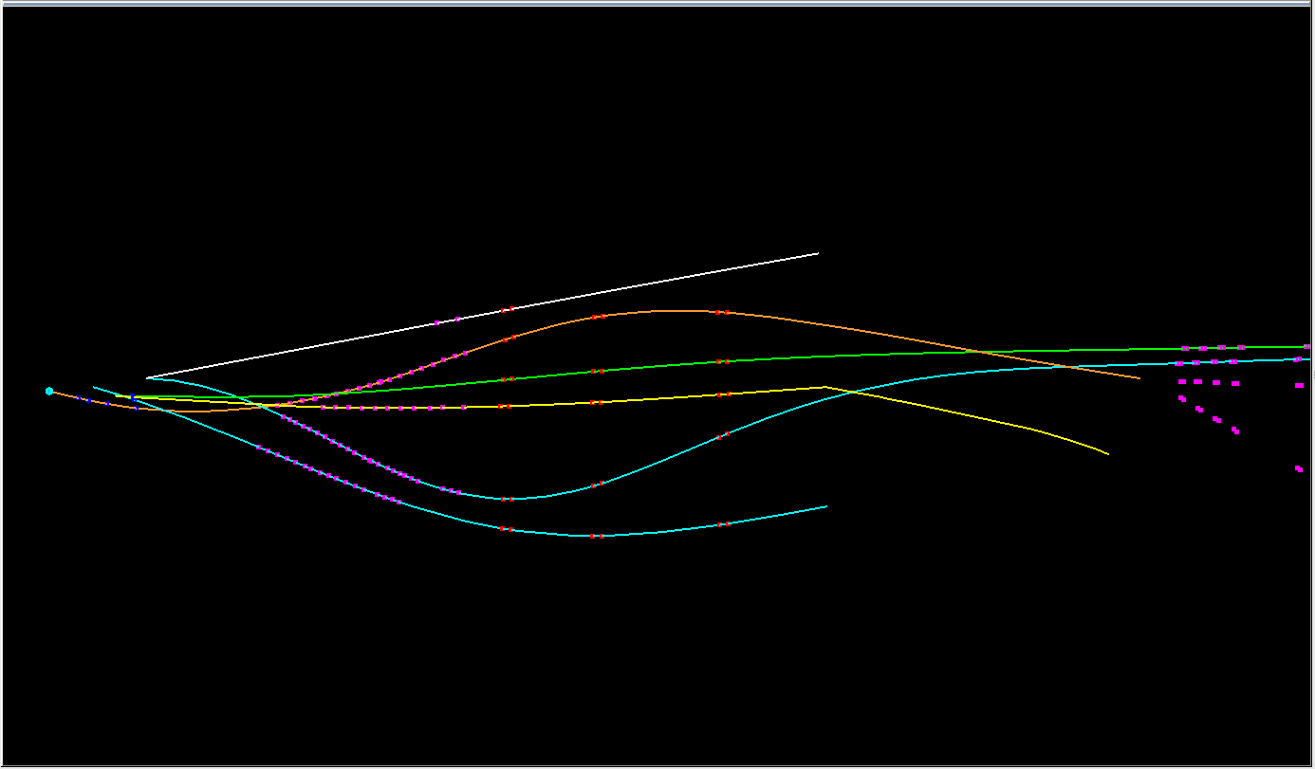
event #48
3 4 5

Slide 17
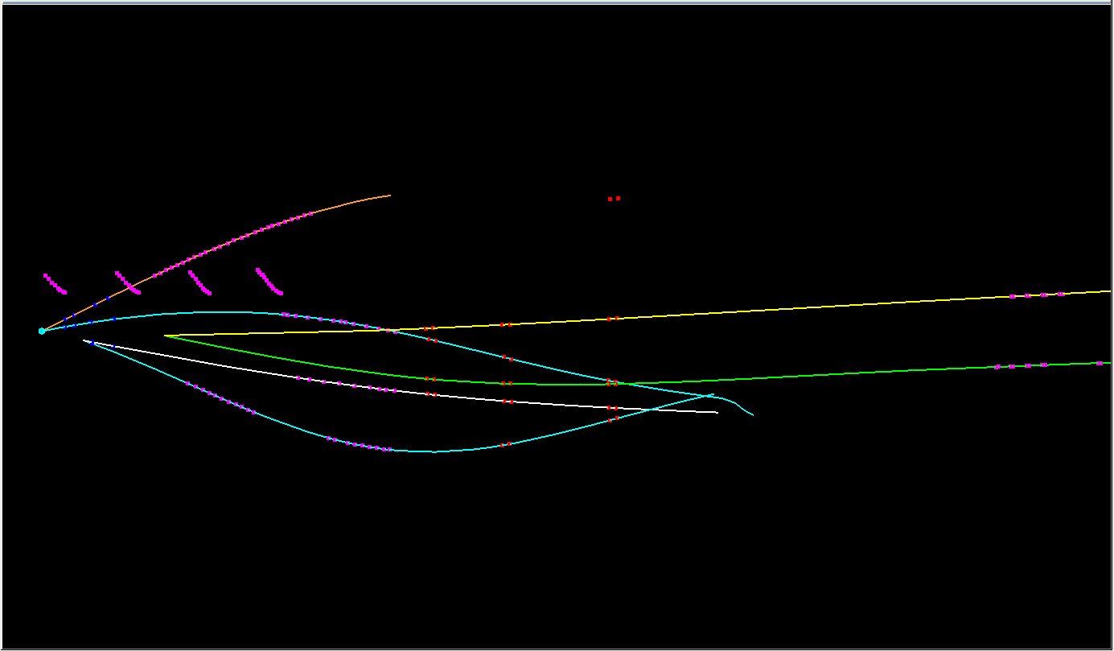
event #58
2 3 4 6

Slide 18
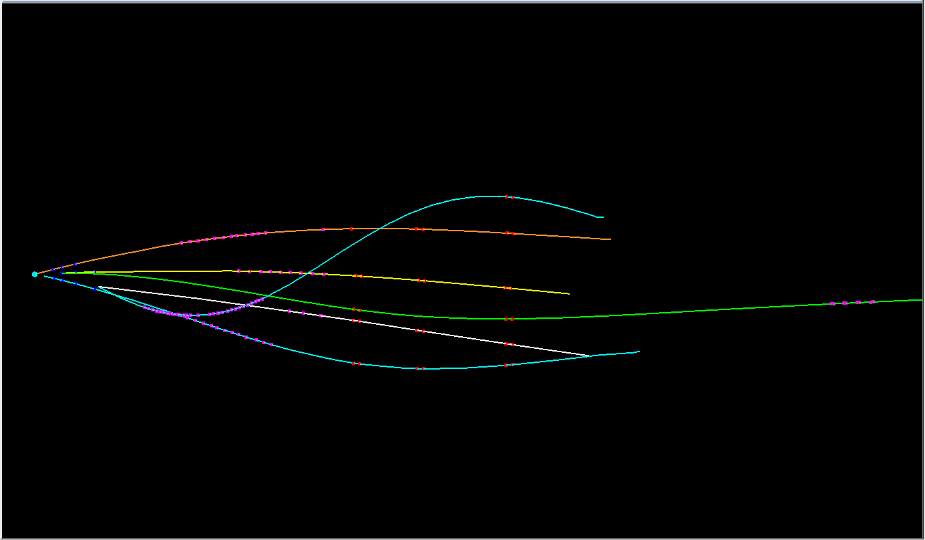
event #64
3 4 6

Slide 19
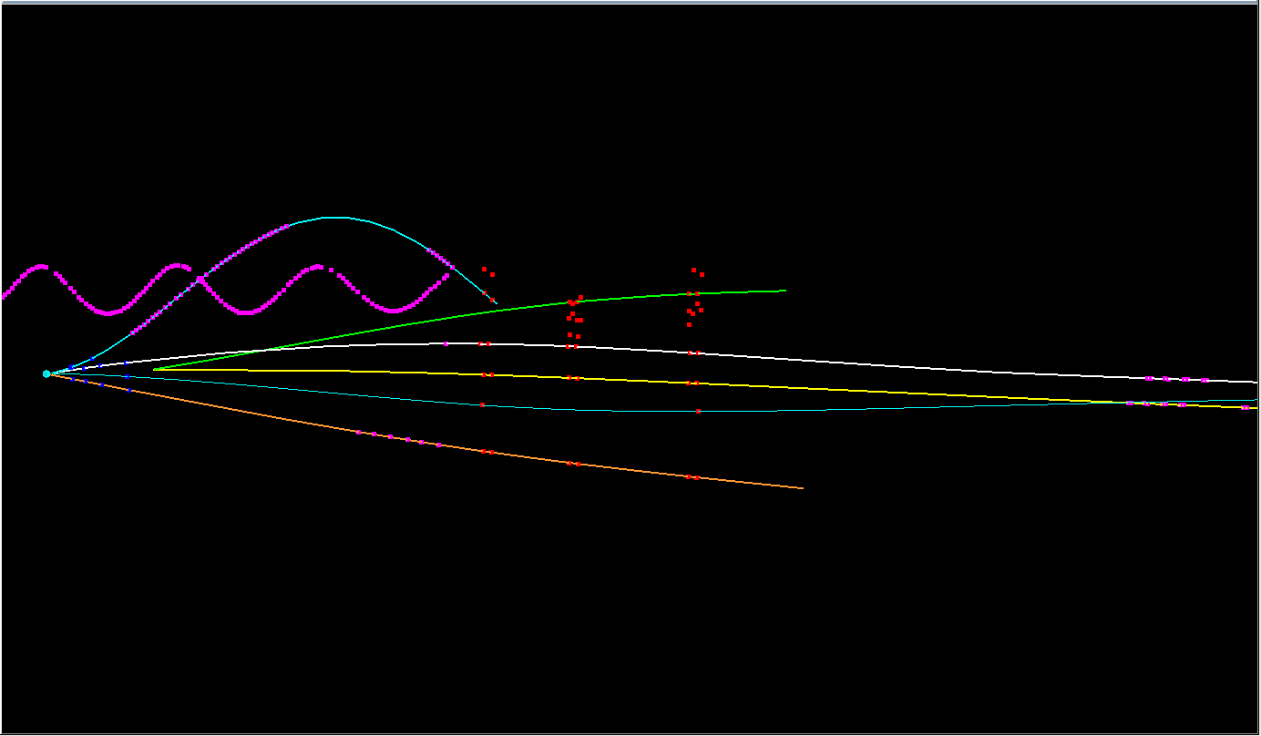
event #66
1 3 6

Slide 20
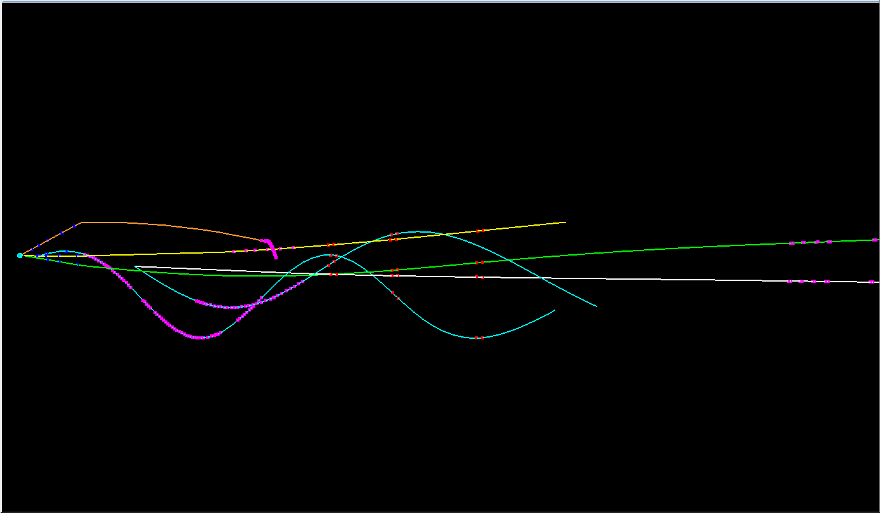
event #67
2 3 4 6

Slide 21
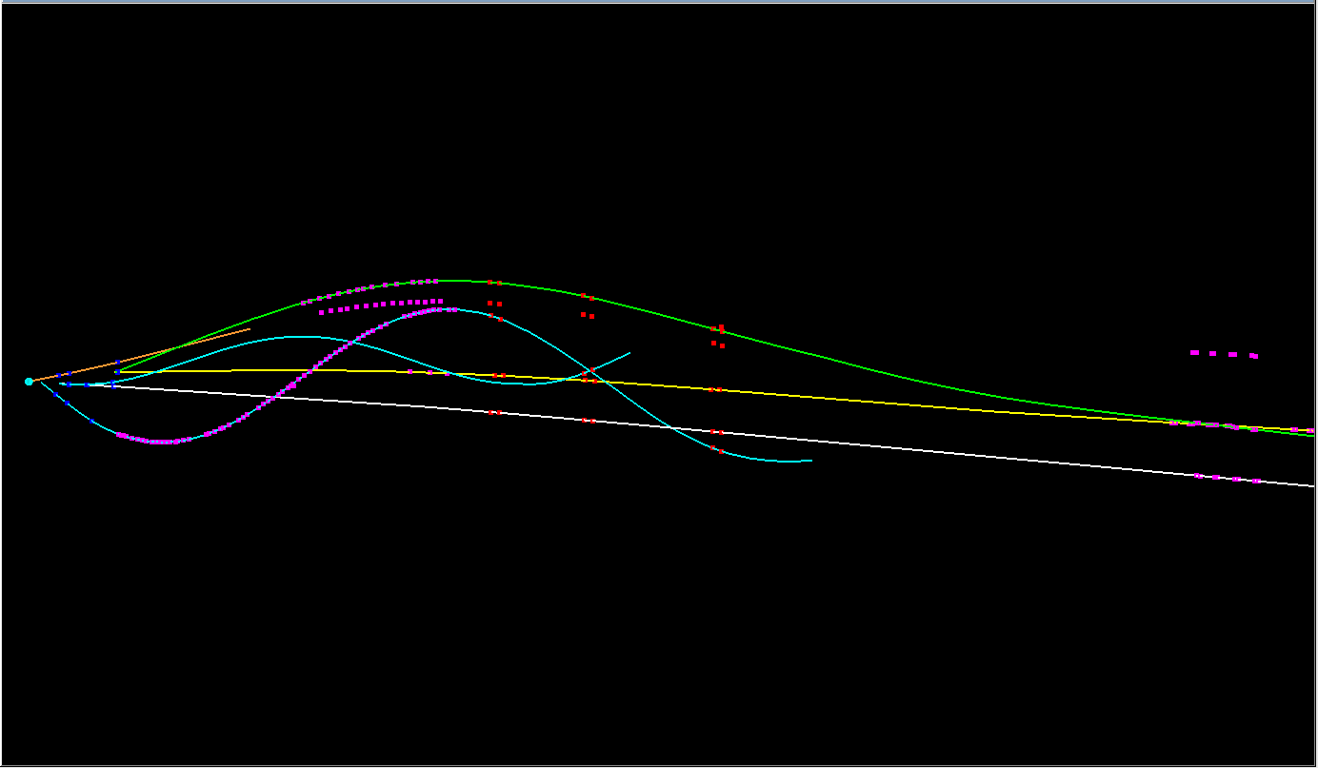
event #69
1 3 4 6

Slide 22
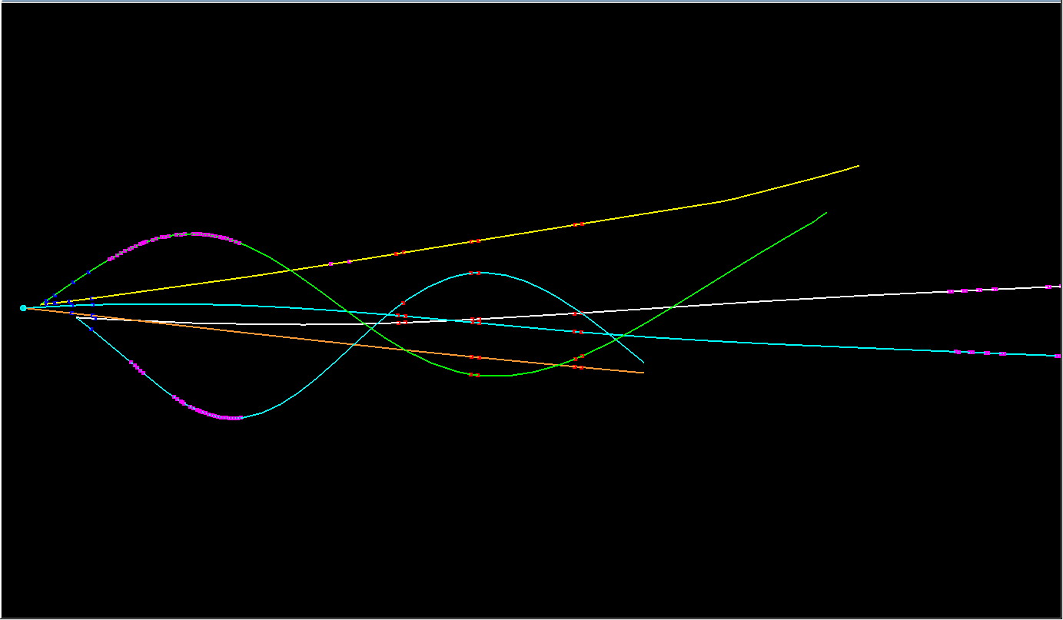
event #70
2 3 4 6

Slide 23
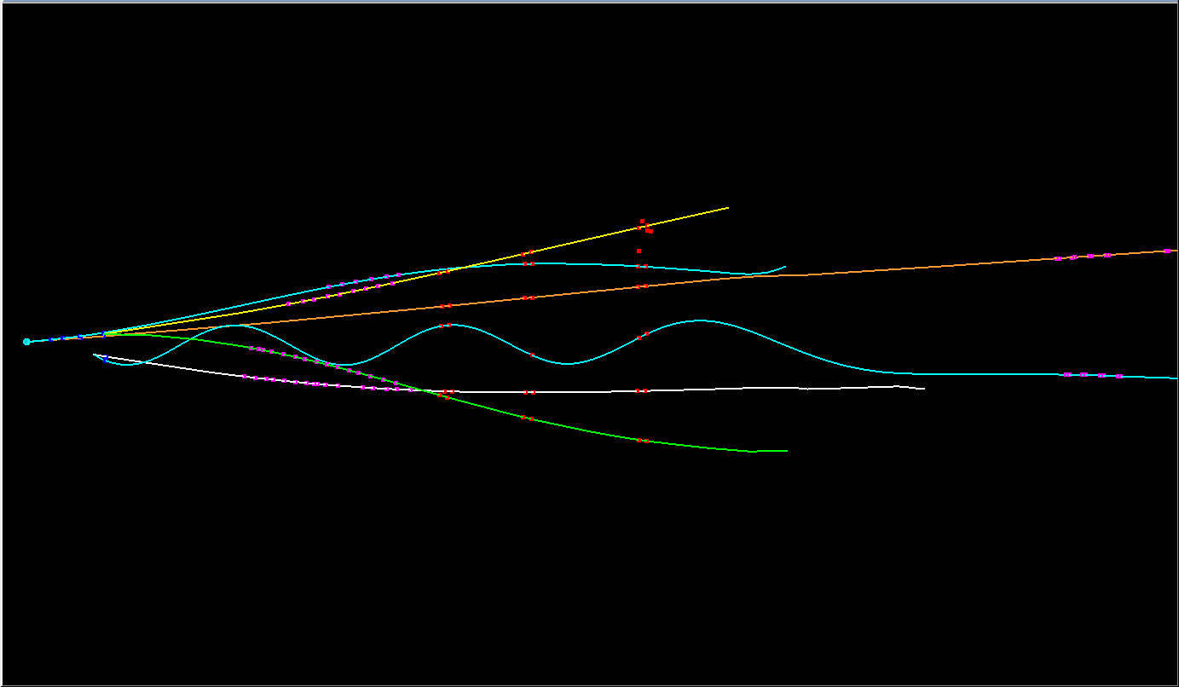
event #71
3 4 6

Slide 24
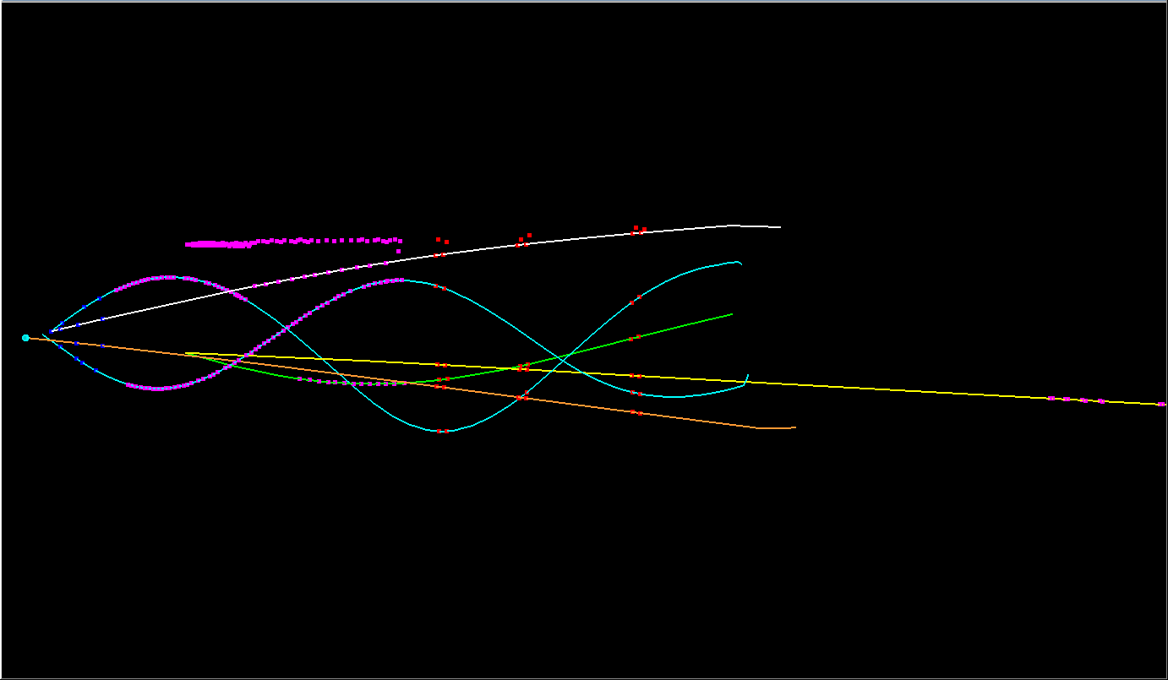
event #73
2 3 6

Slide 25
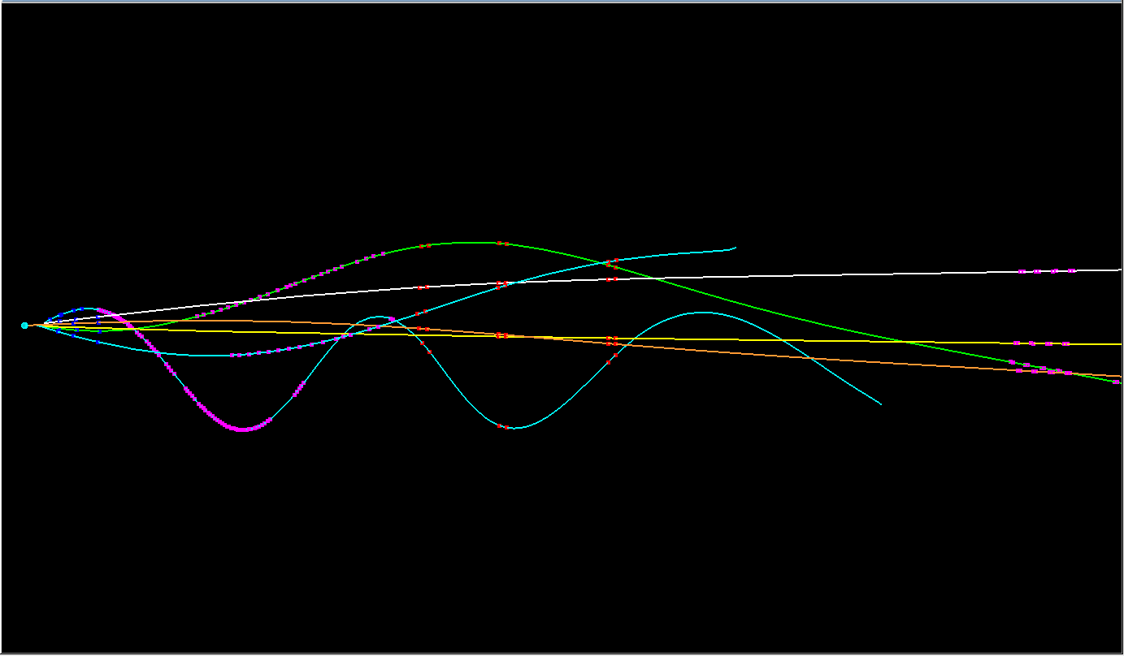
event #74
1 3 4

Slide 26
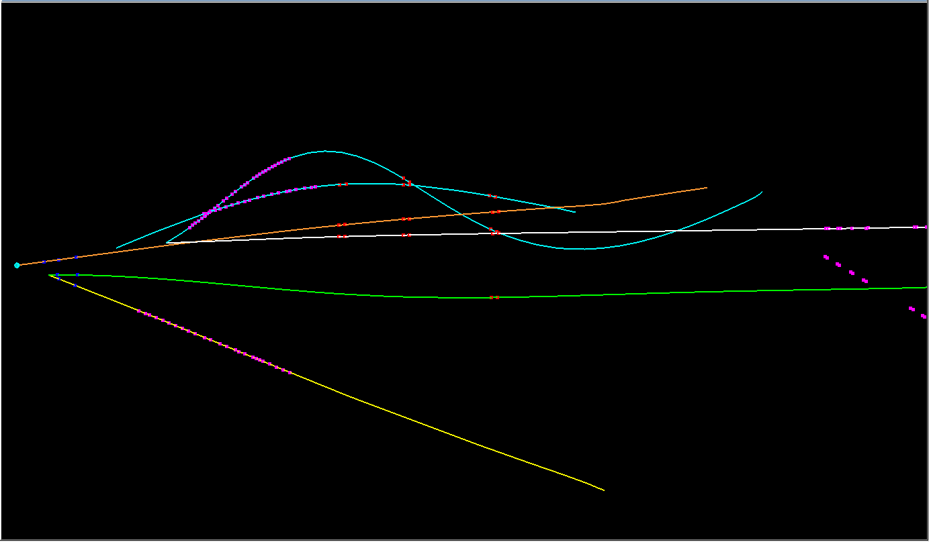
event #75
2 6

Slide 27
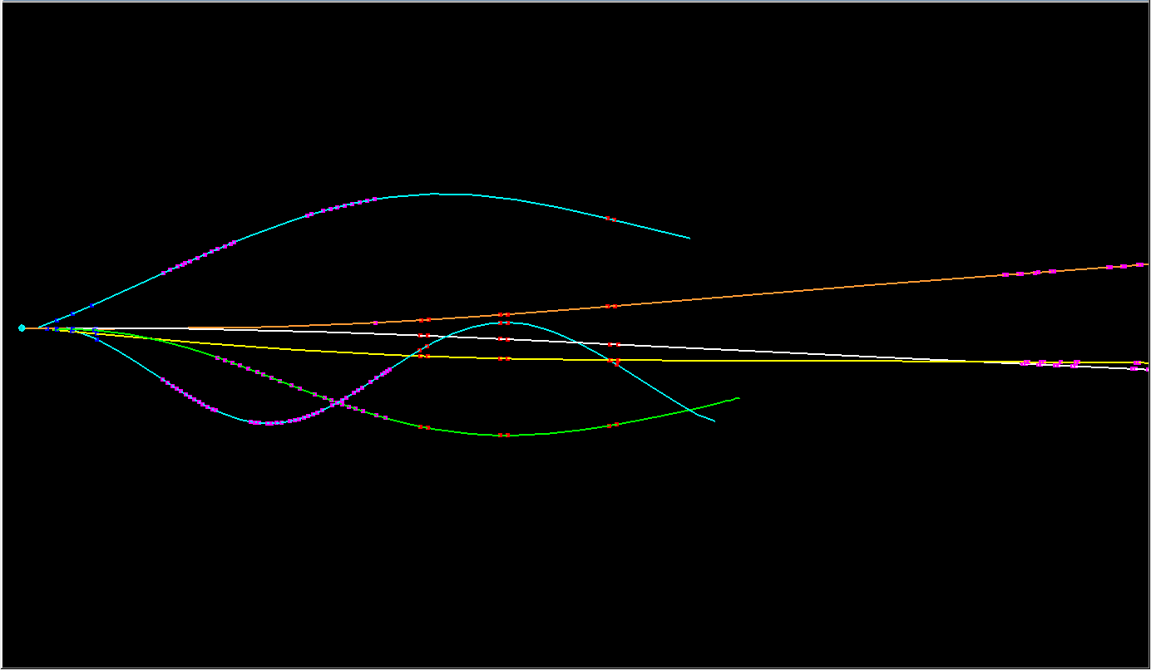
event #77
1 3 4

Slide 28
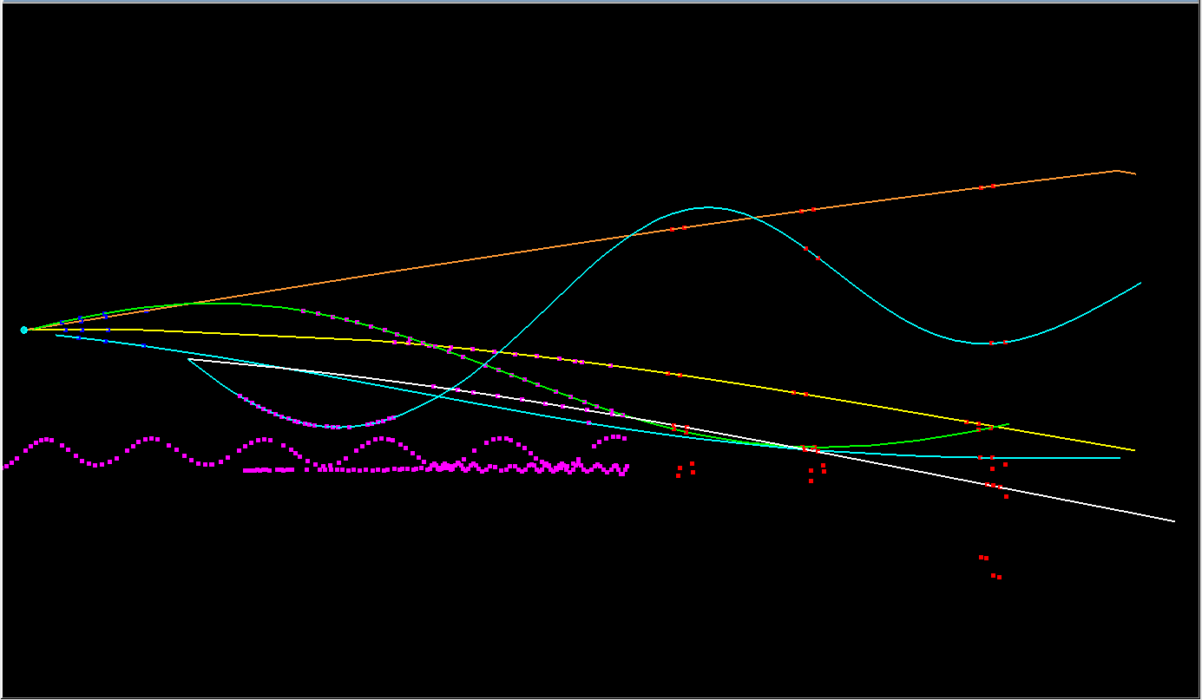
event #79
3 6

Slide 29
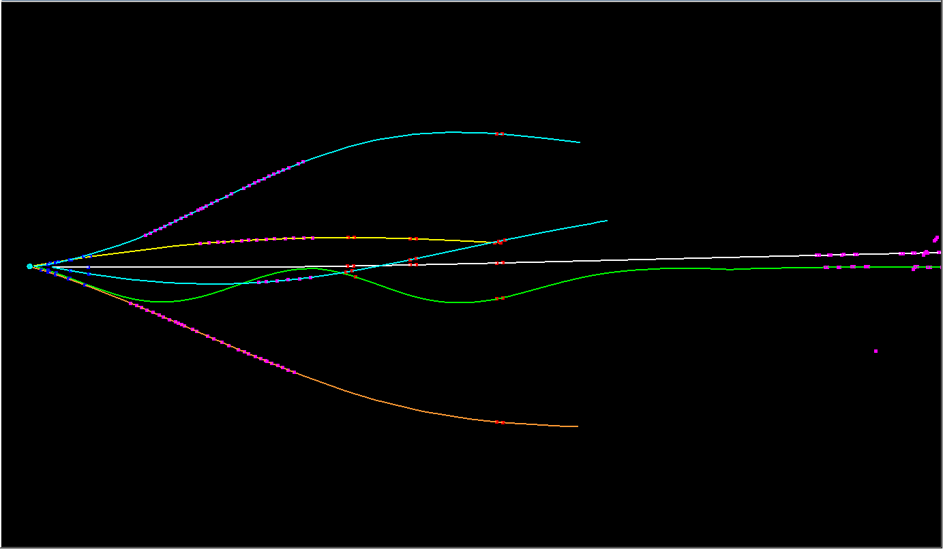
event #84
2 3 4

Slide 30
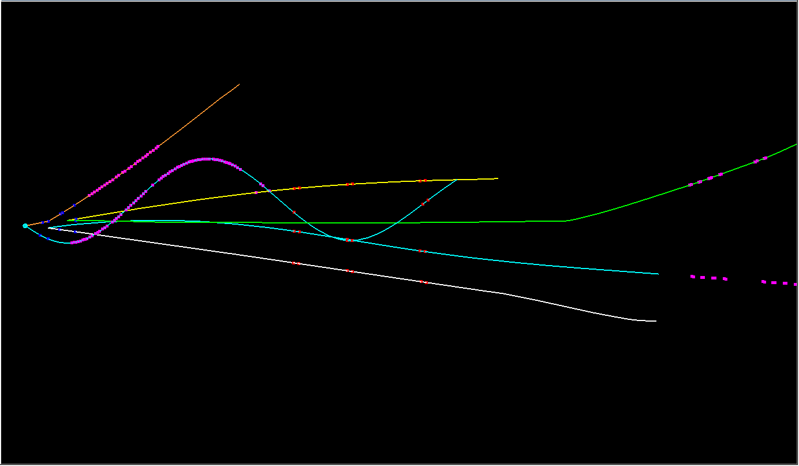
event #85
3 4 6

Slide 31
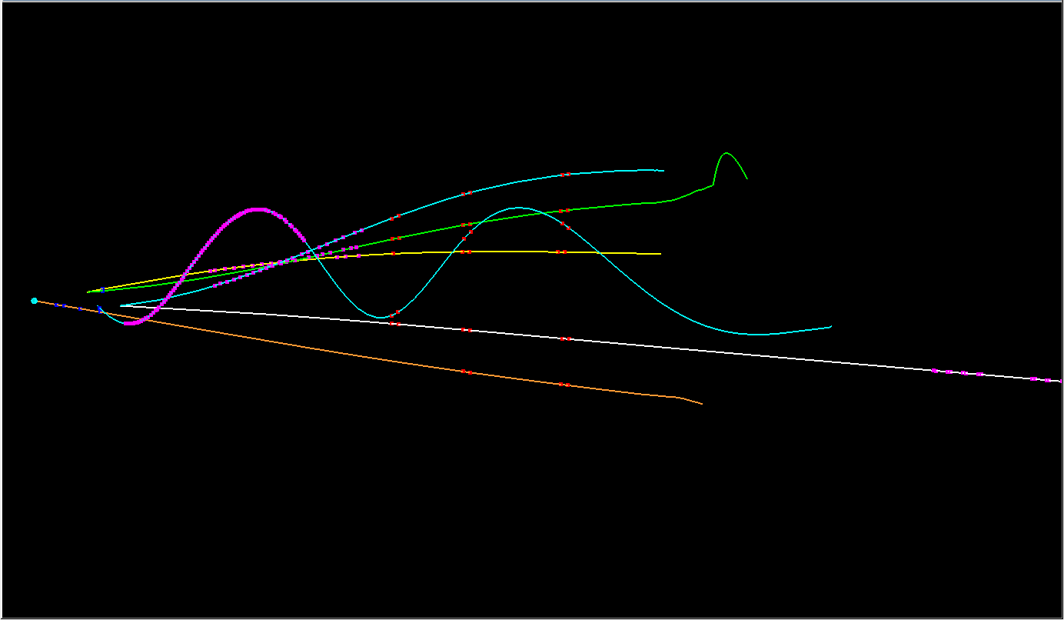
event #86
2 3 5

Slide 32
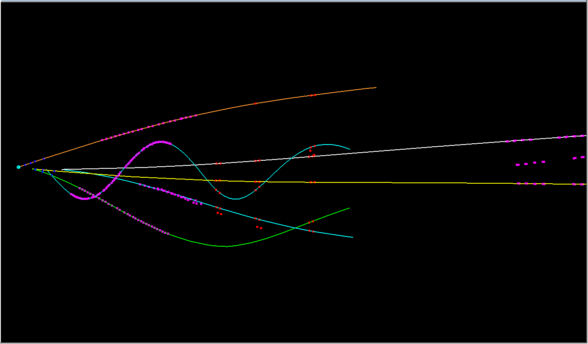
event #87
1 3 6

Slide 33
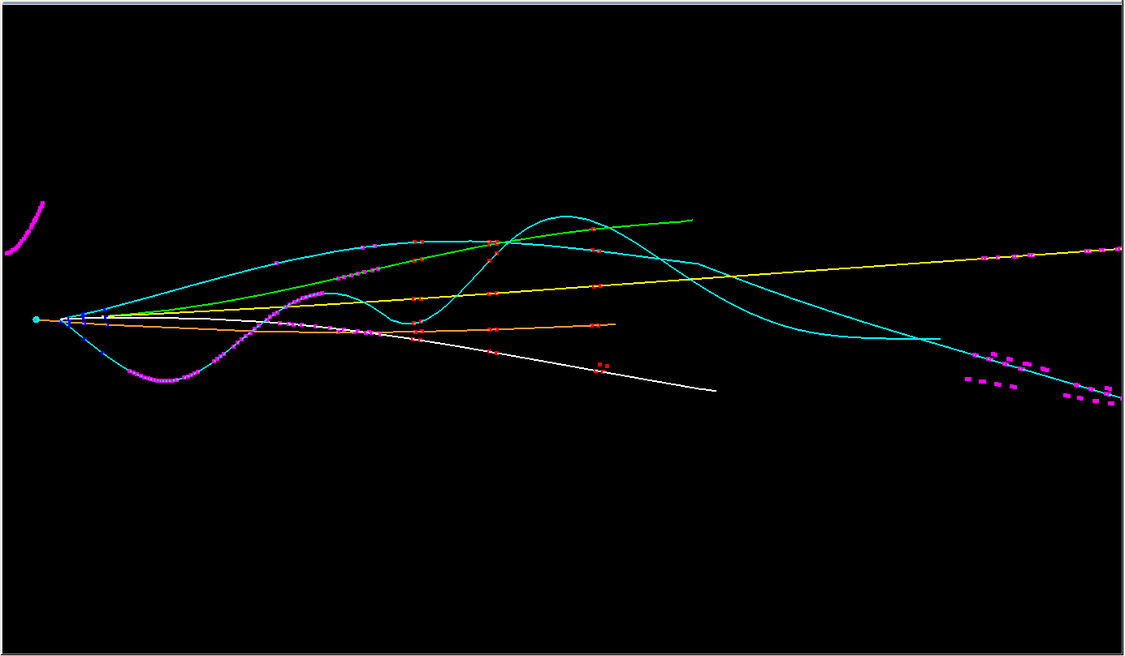
event #88
2 3 4 6

Slide 34
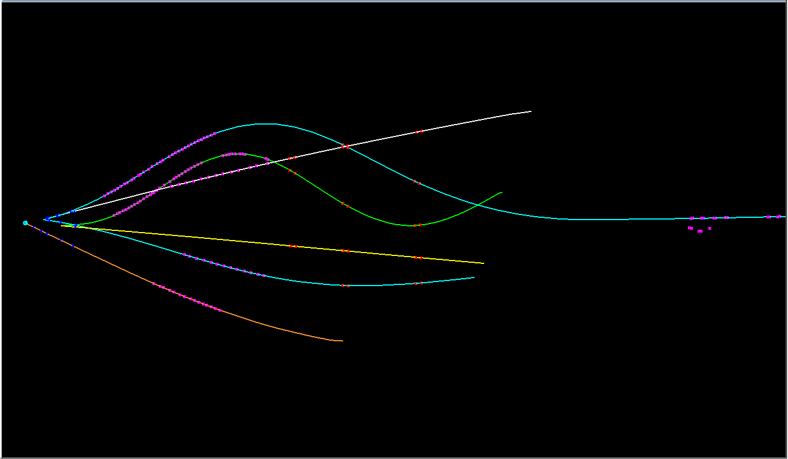
event #92
3 4 6

Slide 35
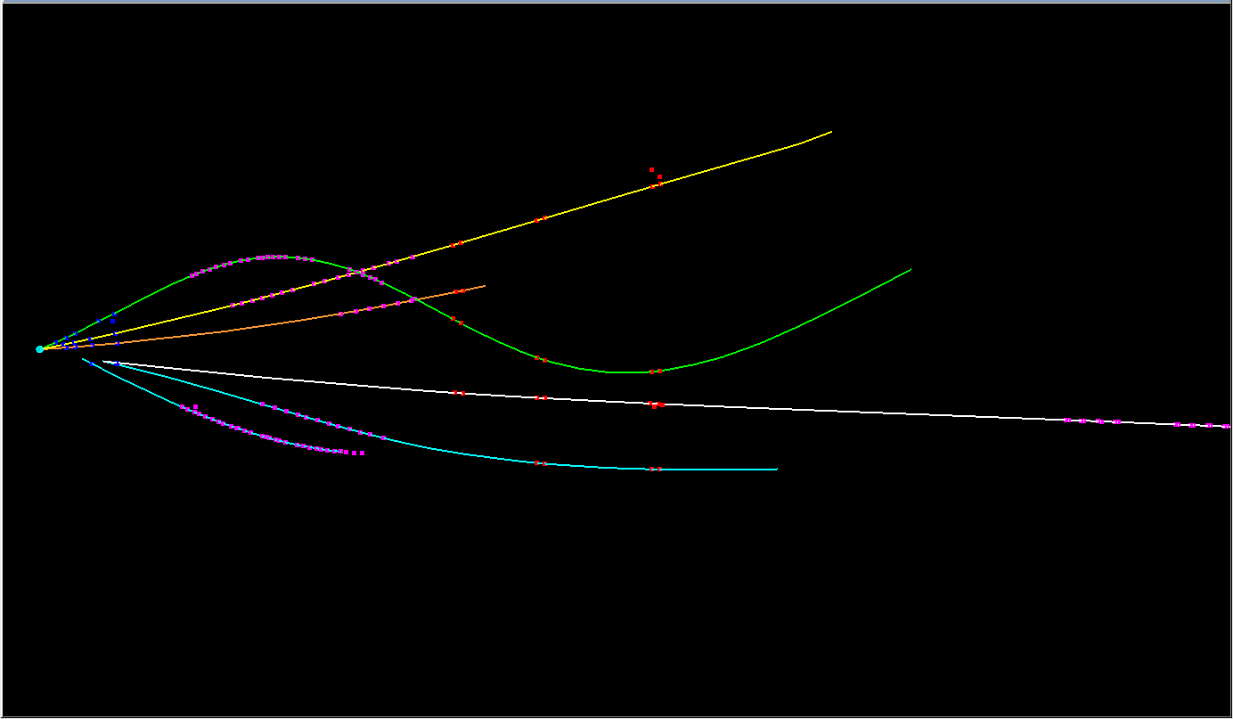
event #94
2 3 6

Slide 36
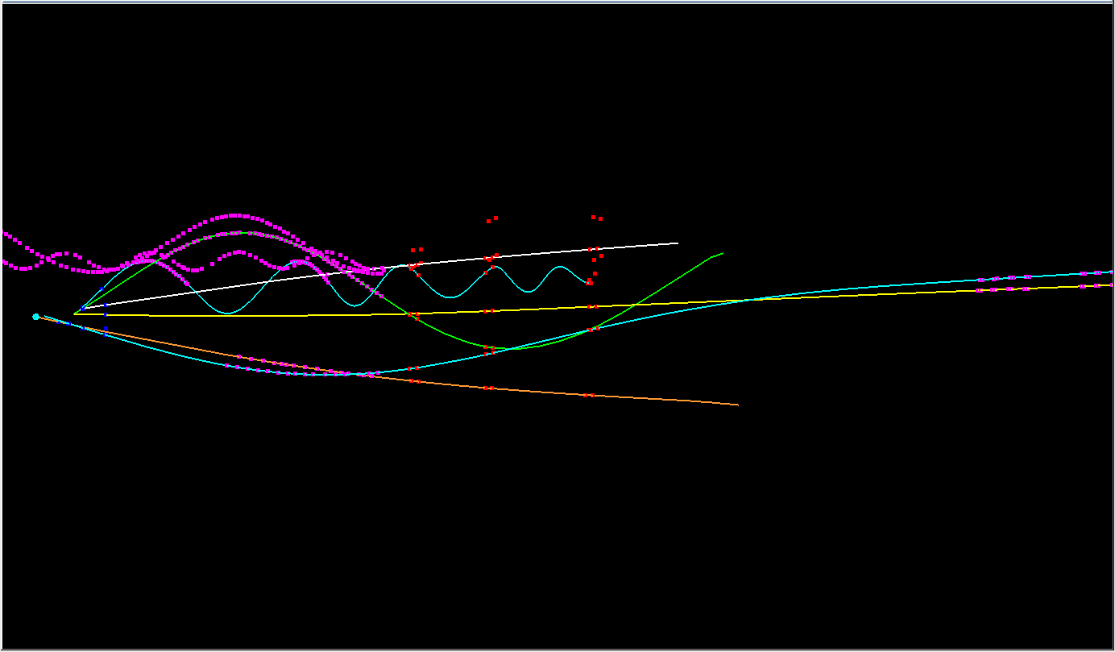
event #97
1 3 4 6

Slide 37
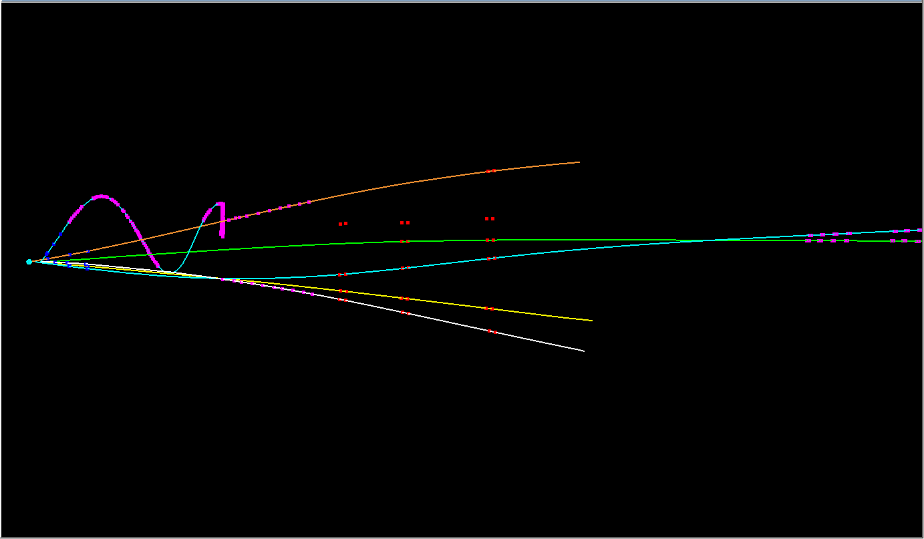
event #98
3 4

Slide 38
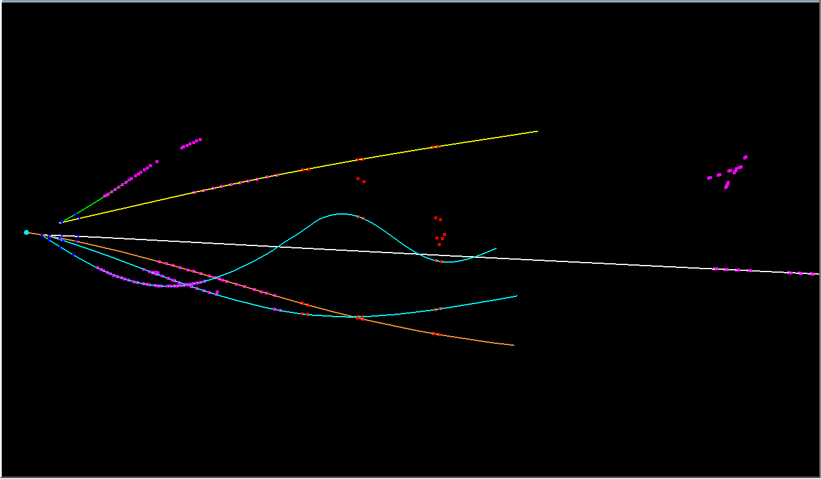
event #99
2

Slide 39
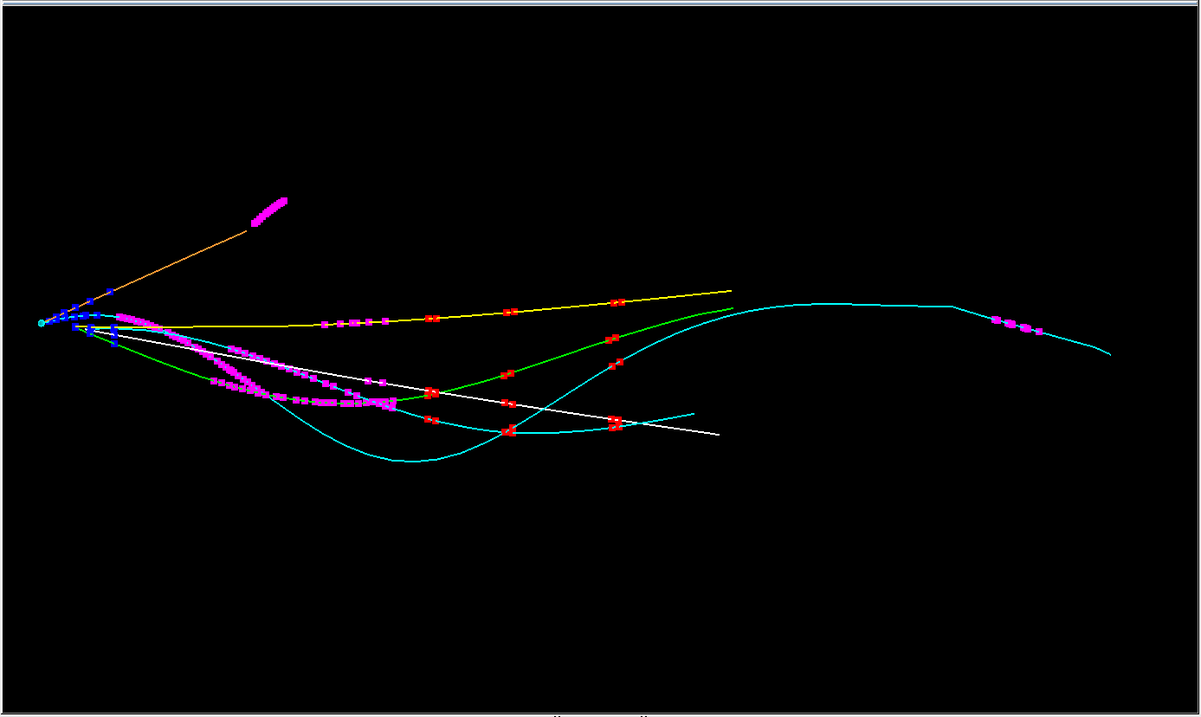
event #06
3 4

Slide 40
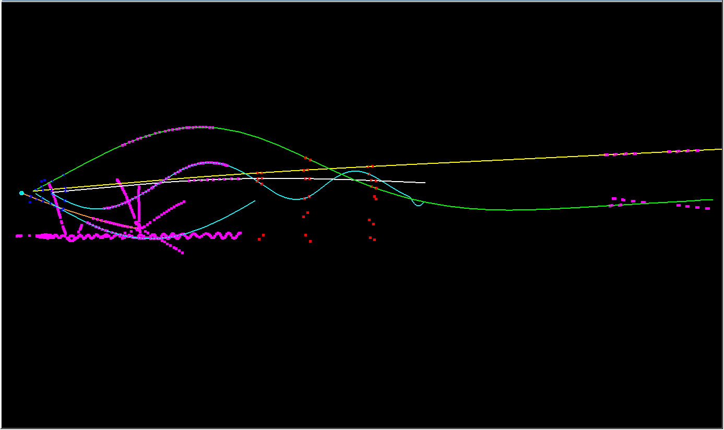
event #11
2 3 4

Slide 41
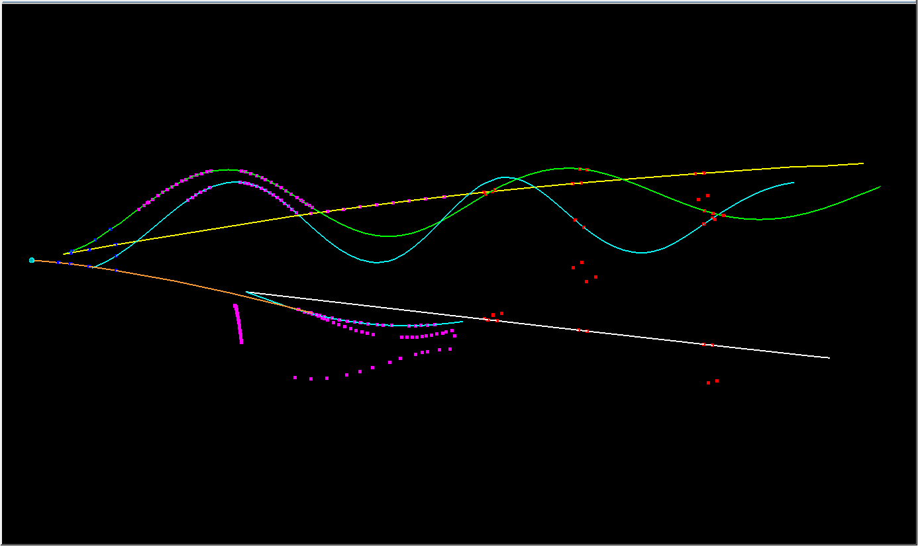
event #13
3 6

Slide 42
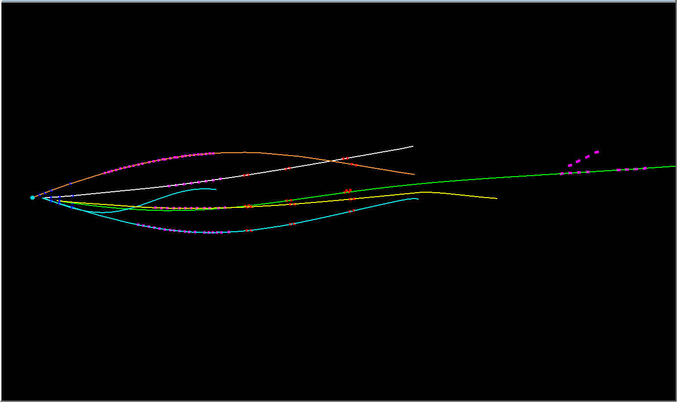
event #20
2 3

Slide 43
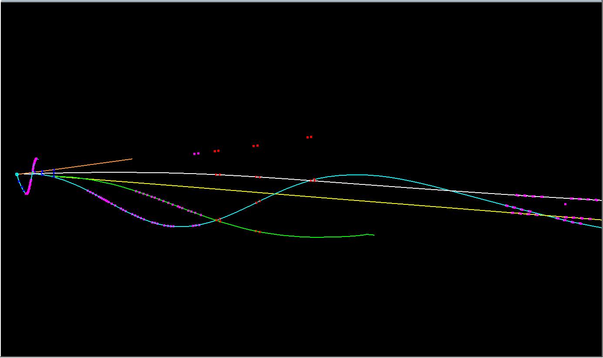
event #21
1 4 6

Slide 44
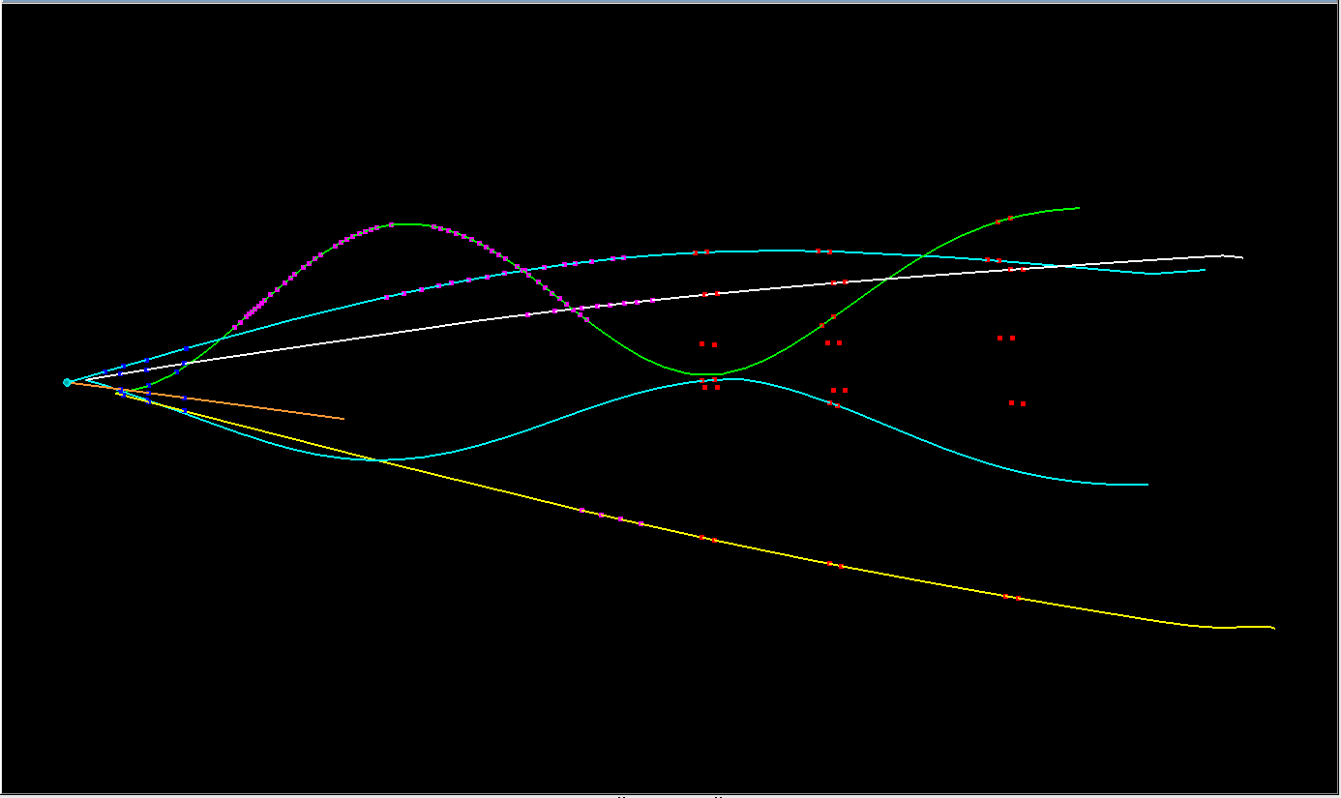
event #22
3

Slide 45
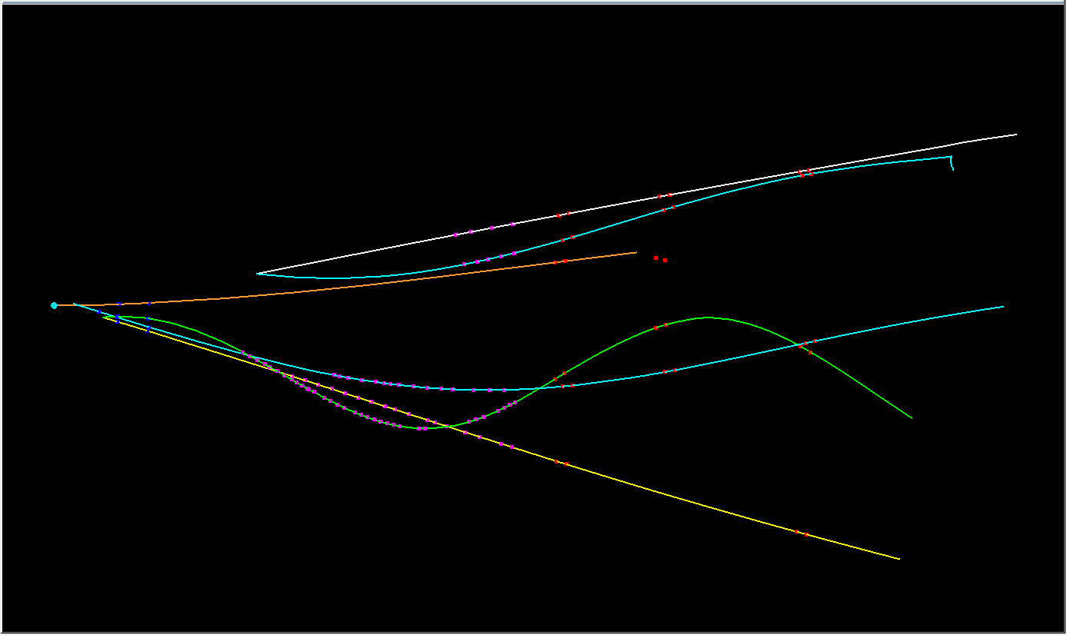
event #23
3 6

Slide 46
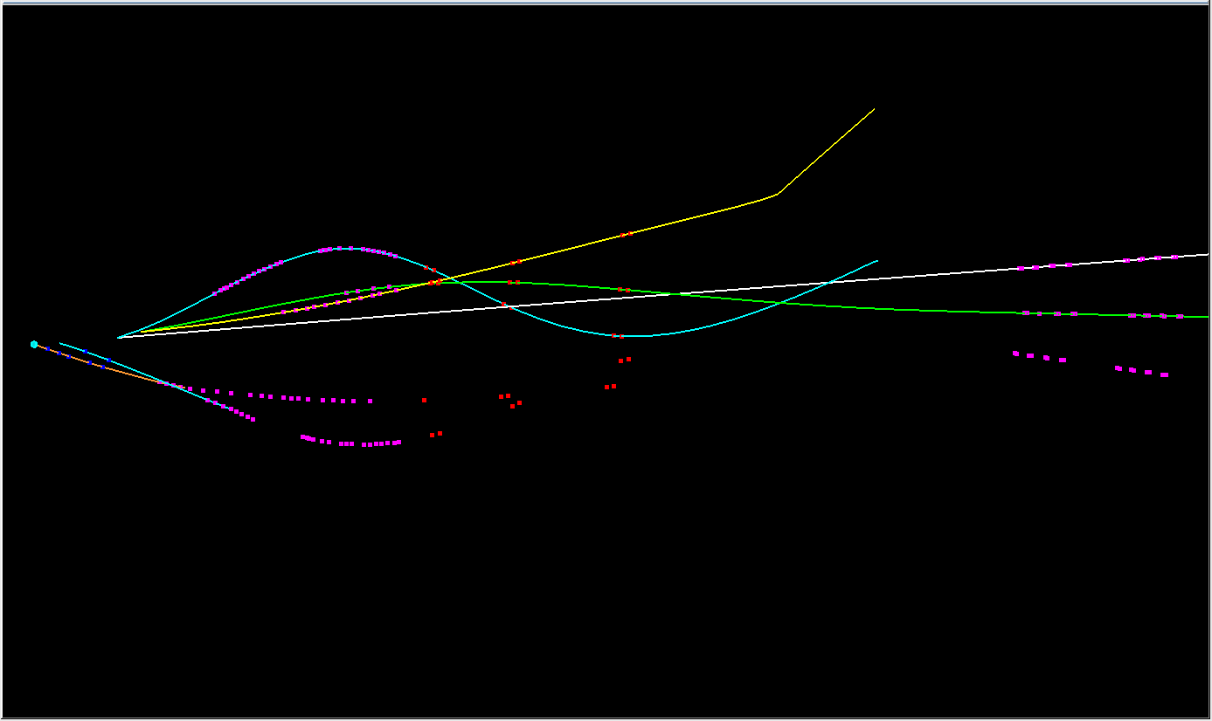
event #26
2 4 5

Slide 47
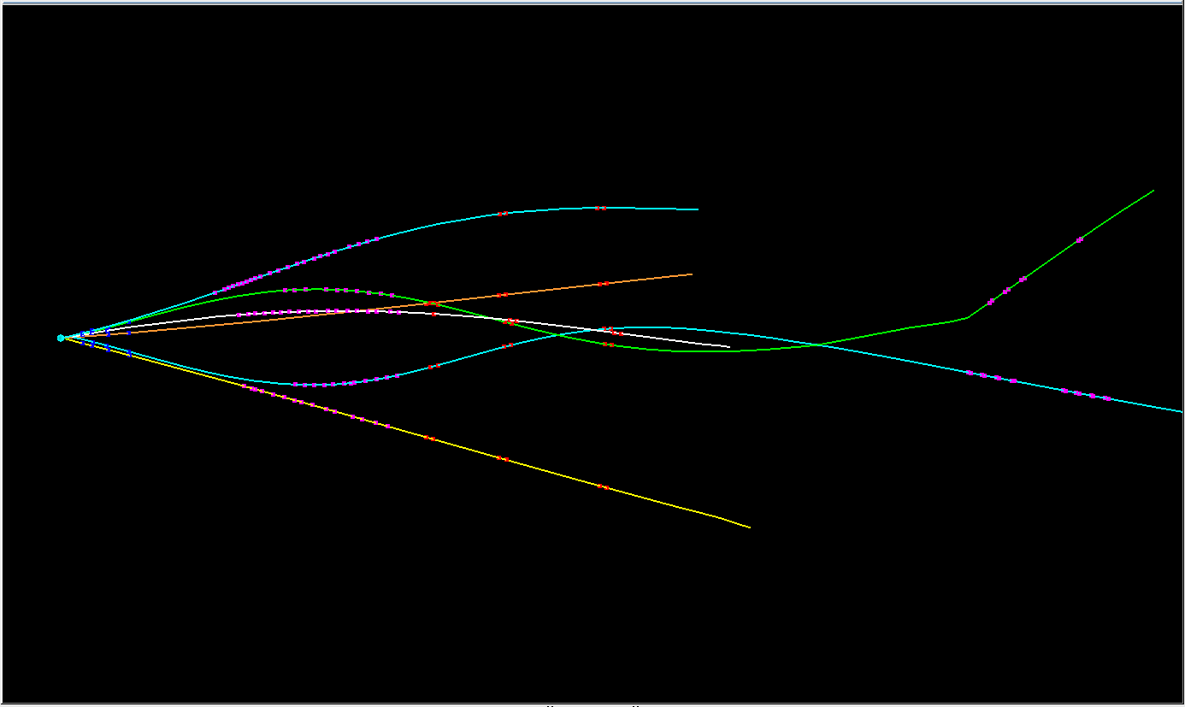
event #27
3 4

Slide 48
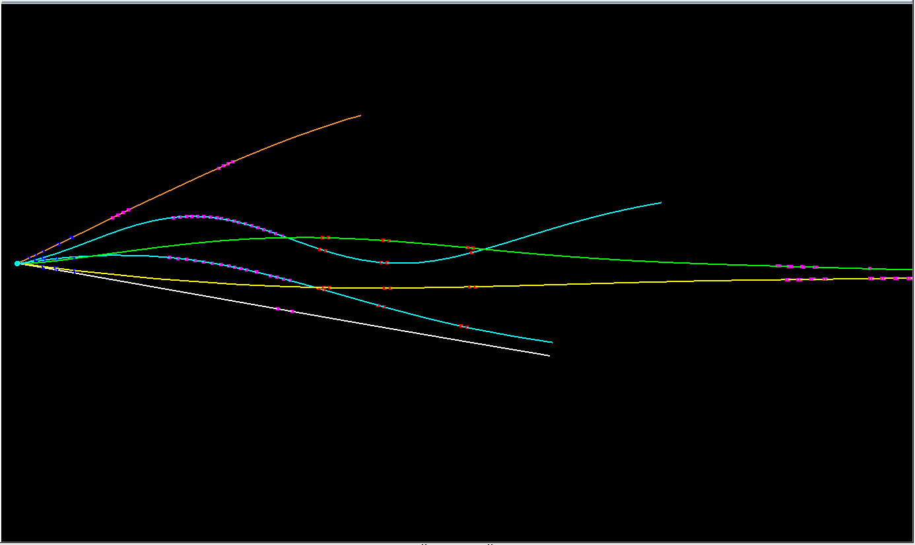
event #30
2 4

Slide 49
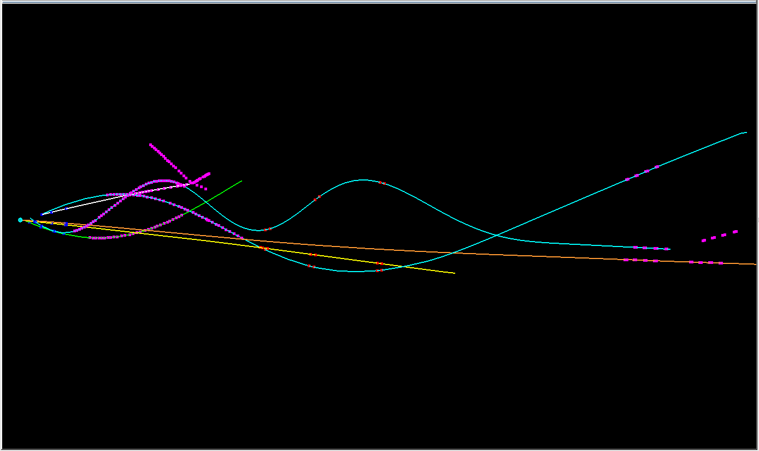
event #39
4

Slide 50
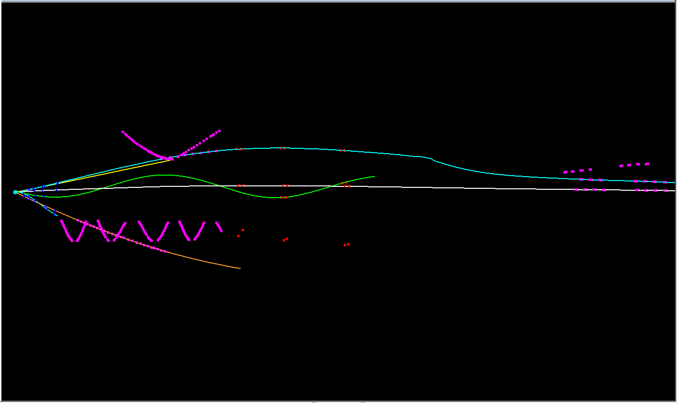
event #41
2 4

Slide 51
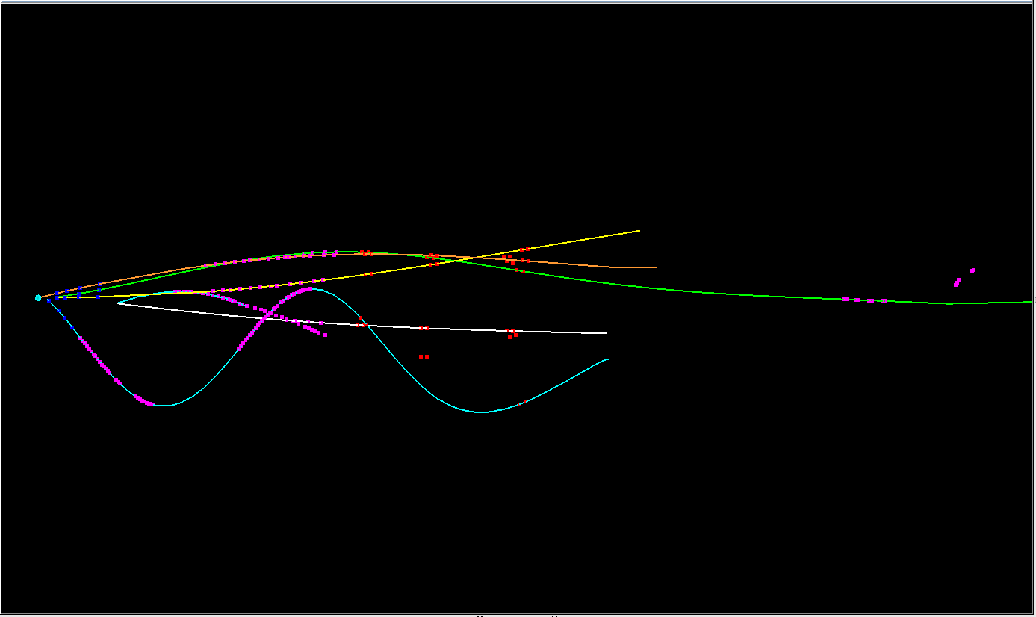
event 47
3 4 6

Slide 52
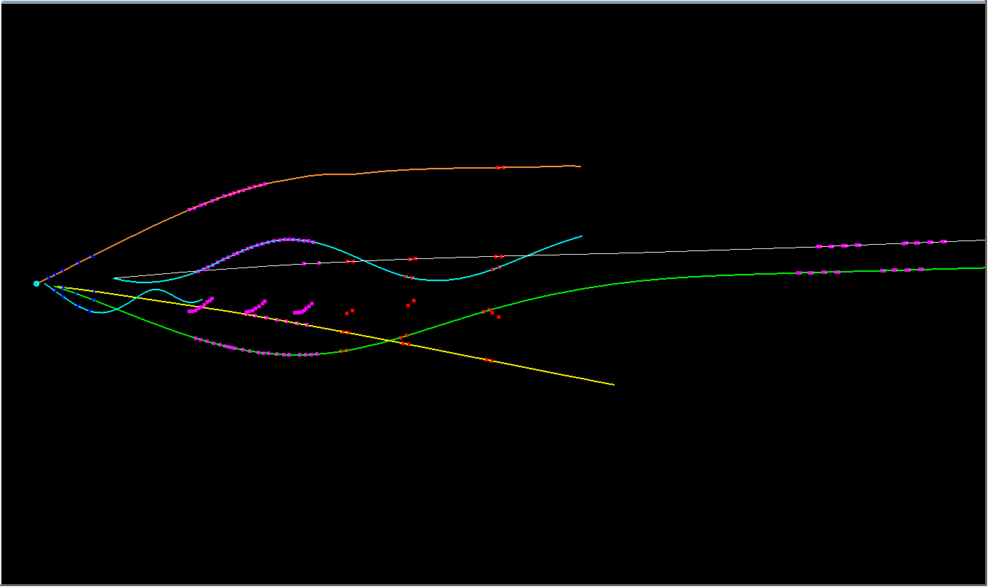
event #49
2 3 4 6

Slide 53
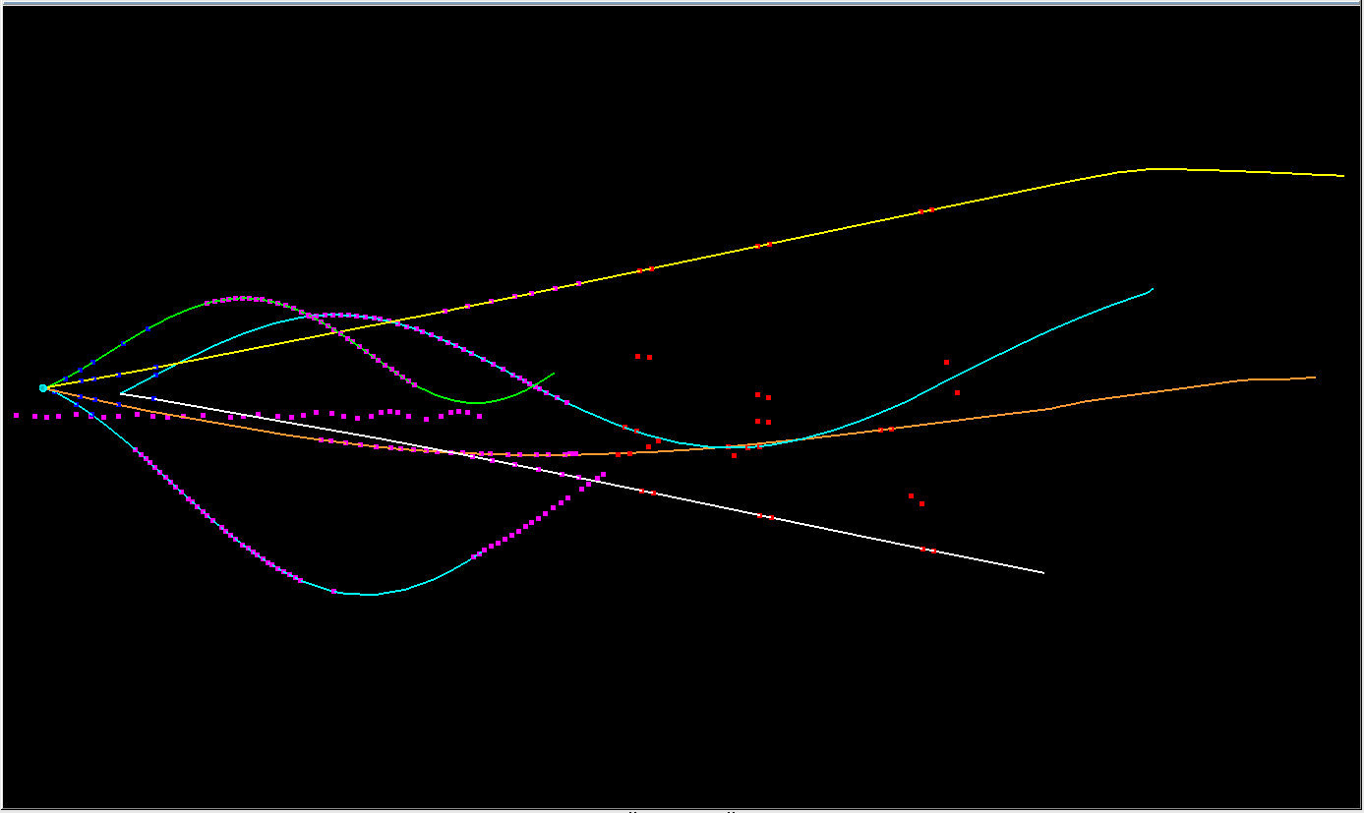
event #55
3 6

Slide 54
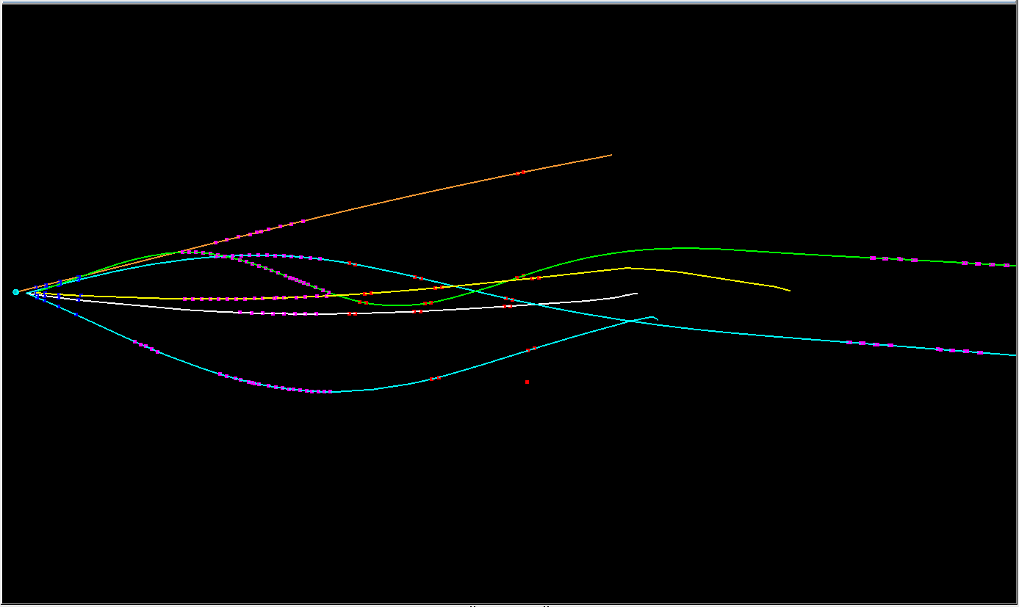
event #57
3 4

Slide 55
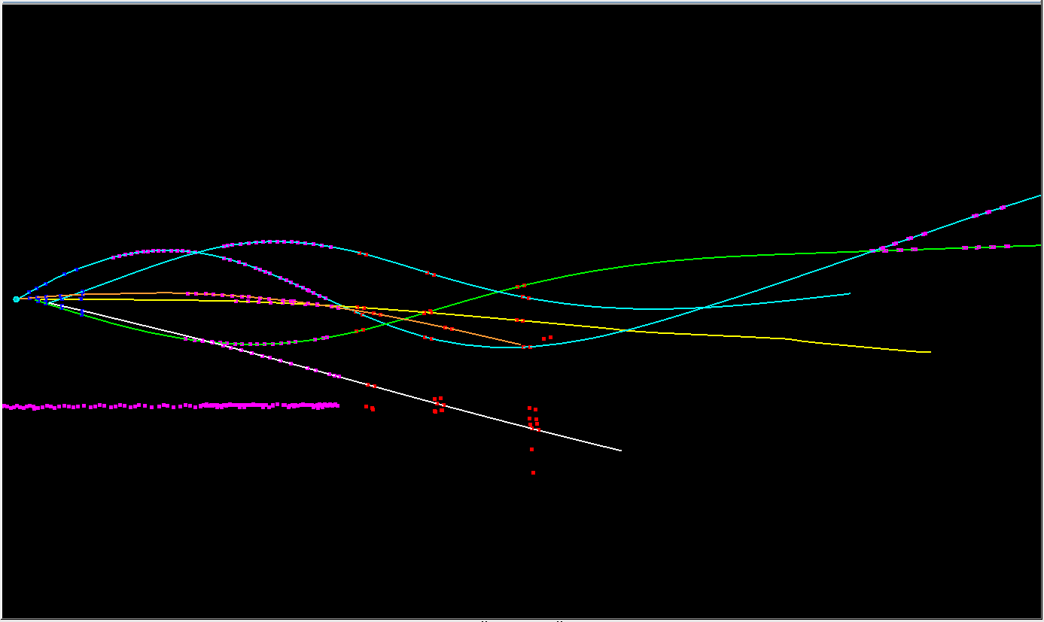
event #59
3 4

Slide 56
event #81
3 6

Slide 57
event #82
2 3 4

Slide 58
event #83
3 4 6

Slide 59
Interim Conclusion based on Event Display
large number of secondary particles
about 1/2 of events is lost due to scattering, absorption or decay
straight track approximation is good for p, p and fair for K⁻
most pion tracks (but not all) strongly deviate from straight lines
reconstruction with MVD and STT alone seems to be difficult for all scanned events
_

Slide 60
Fast Geometric Analysis with Straight Tracks
4.1 GeV $\overline{p}p→{\overline{Ξ}}^{+}ΛK^{−}$
$\overline{p}π^{+}π^{+}p{π^{−}K}^{−}$final state
evaluate fractional path length in each sub-detector volume: f_{L} = L/L_{max} Δf_{L} = f_{L}(MVD) + f_{L}(STT) – f_{L}(GEM) – f_{L}(FTS)
compare radial distance of hit on xy plane at end of STT with outer radius of stereo layers

Slide 61
Fractional Path Length in Sub-Detectors
test model with prompt particles
K⁻ is the only prompt particle
plot fractional path length vs. θ
MVD
+ STT
GEM + MVD + STT
GEM + MVD
FTS
+ GEM
+ STT
+ MVD

Slide 62
Fractional Path Length Difference (MVD+STT) – (GEM+FTS)
_
p
p
K⁻
π⁻
π⁺
π⁺
₁
₂
Δf_{L} = f_{L}(MVD) + f_{L}(STT) – f_{L}(GEM) – f_{L}(FTS); f_{L} = L/L_{max}

Slide 63
Acceptance ( ΔF_{L} > 0 )
particle | f_{acc}
$$p$$ | 0.425
$$\overline{p}$$ | 0.265
$$K^{−}$$ | 0.808
$$π^{−}$$ | 0.743
$${π^{+}}_{1}$$ | 0.856
$${π^{+}}_{2}$$ | 0.635
all | 0.034
_
all
p
p
K⁻
π⁻
π⁺
π⁺
₁
₂

Slide 64
Radial Distribution at STT End Plane

Slide 65
Acceptance ( R > R_{crit} )
R_{crit} = 331 mm
particle | f_{acc}
$$p$$ | 0.109
$$\overline{p}$$ | 0.088
$$K^{−}$$ | 0.498
$$π^{−}$$ | 0.630
$${π^{+}}_{1}$$ | 0.745
$${π^{+}}_{2}$$ | 0.594
all | 4⋅10⁻⁶
_
all
p
p
K⁻
π⁻
π⁺
π⁺
₁
₂
→ almost zero efficiency if p_{z} information from STT is required !

Slide 66
More Realistic: Combine MVD & STT for p_{z}
need both p_{z} and p_{T} information from central detector
a track starting downstream of MVD must pass the STT stereo layer
a track starting inside MVD must at least pass the last two MVD discs and two axial STT double-layers
L_{MVD} ⋅ cosθ > 70 mm L_{STT} ⋅ sinθ > 40 mm

Slide 67
Acceptance (R > R_{crit}) || ((L_{MVD} > L_{c1}) && (L_{STT} > L_{c2}))
particle | F_{acc}
$$p$$ | 0.447
$$\overline{p}$$ | 0.314
$$K^{−}$$ | 0.793
$$π^{−}$$ | 0.785
$${π^{+}}_{1}$$ | 0.876
$${π^{+}}_{2}$$ | 0.700
all | 0.045
_
p
p
K⁻
π⁻
π⁺
π⁺
all
₁
₂
L_{c1} > 70 mm / cosθ : hits in last 2 discs
L_{c2} > 40 mm / sinθ : hits in inner two double layers

Slide 68
Effect on 2-Body Masses ( ΔF_{L} > 0 )

Slide 69
Effect on 2-Body Masses (R > R_{crit}) || ((L_{MVD} > L_{c1}) && (L_{STT} > L_{c2}))

Slide 70
Effect on Ξ⁺ΛK⁻ Dalitz Plot
_

Slide 71
Angular Distribution in Gottfried-Jackson Frame
_
angular momentum visible in 2 + 3 → R → b + c
a
b
c
Ξ⁺
Λ
K⁻
b
R
Ξ*
3
2
θ
3
K⁻K⁻
c
1
2
_
p
p
generated events,
no condition
$$\left[K^{−}K^{−}\right]+p→ΛK^{−}$$
$$K^{+}+\overline{p}→{\overline{Ξ}}^{+}K^{−}$$
$$\overline{n}+p→Λ{\overline{Ξ}}^{+}$$

Slide 72
Effect on Angular Distribution (GJ Frame)

Slide 73
Conclusion
This analysis is applicable for all reactions at all momenta.
One obtains a qualitative but quasi-immediate answer on the effect of missing GEM and incomplete FTS.
For the reaction 4.1 GeV/c $\overline{p}p→{\overline{Ξ}}^{+}ΛK^{− },$relevant for the study of $Ξ\left(1690\right)$ it demonstrates the importance of GEM & FTS; using the “Start Setup” for this reaction will result in a dramatic loss of efficiency.
My personal conclusion: not a proof but strong evidence that GEM & FTS are mandatory for strange baryon spectroscopy; at least one of the two must be complete.

Slide 74
SPARE

Slide 75
p p Correlations
_
R > R_{crit} : 4.7⋅10⁻³
ΔL > 0 : 0.101

