Slide 1
First Test of FairMQ for PandaRoot
| Tobias Stockmanns

Slide 2
FairMQ
slides taken from Alexey Rybalchenko

Slide 3
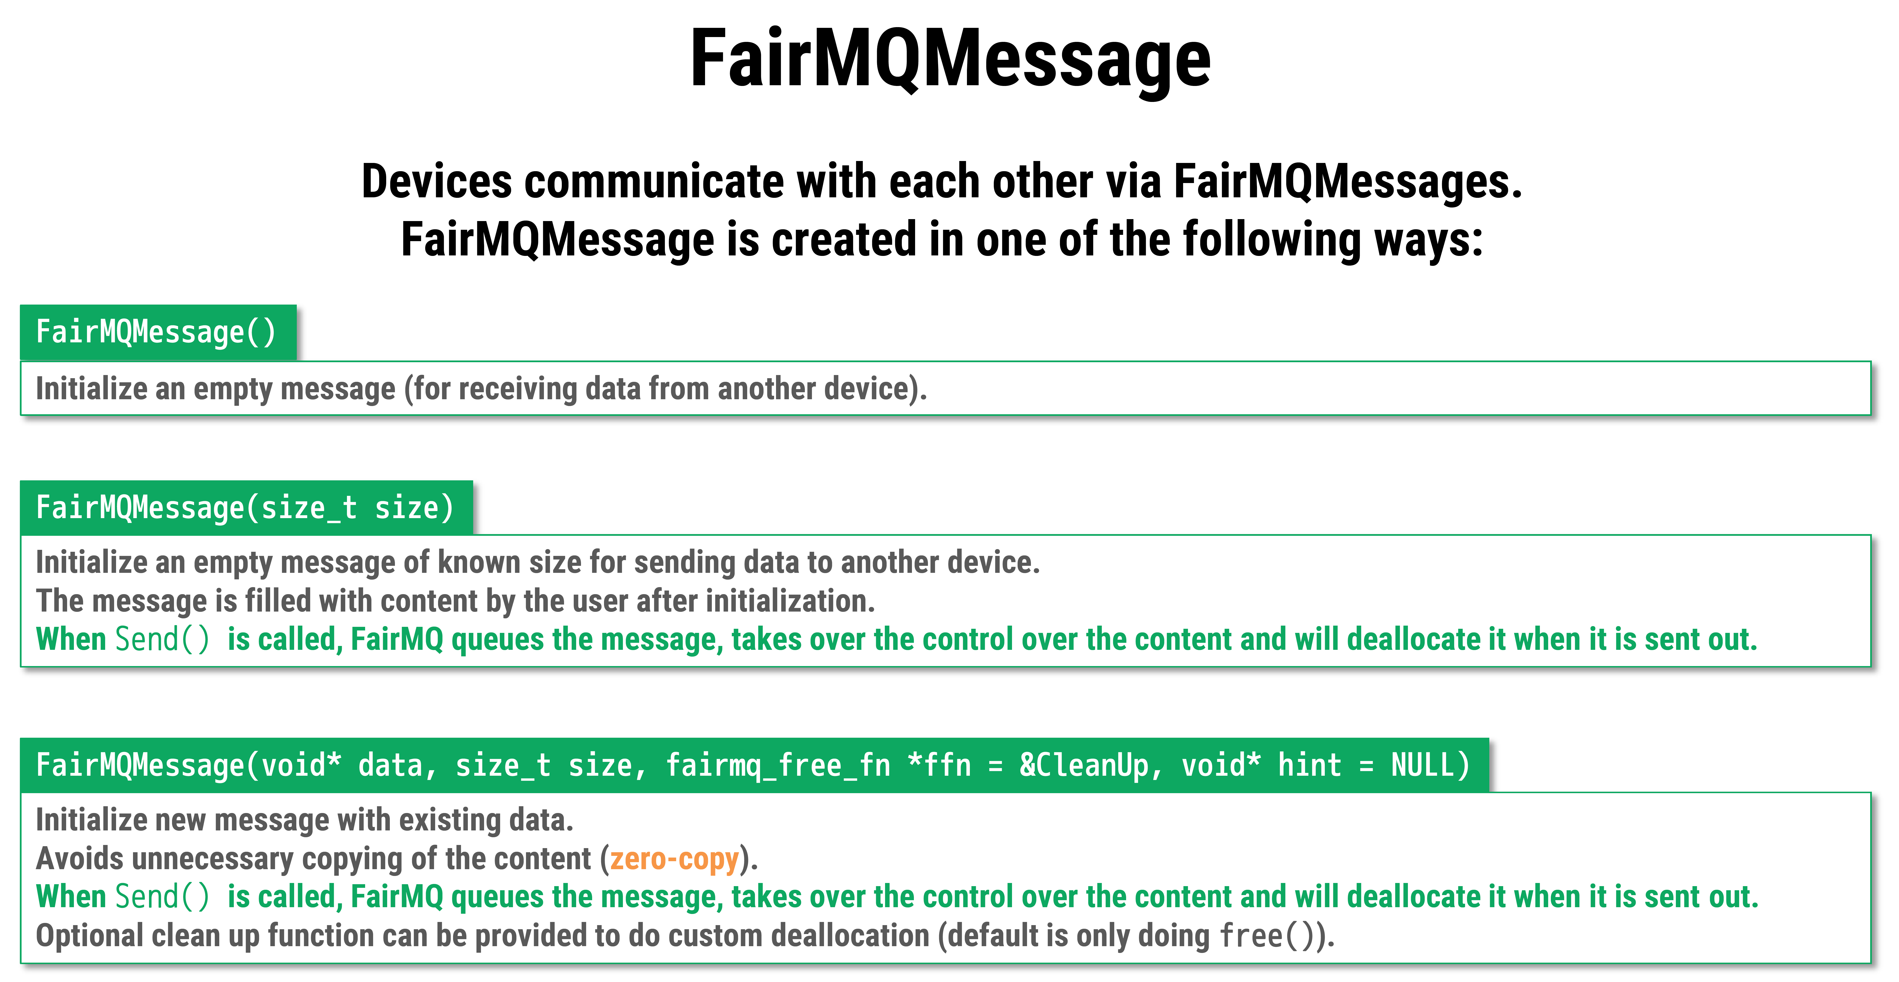
slides taken from Alexey Rybalchenko

Slide 4
slides taken from Alexey Rybalchenko

Slide 5
slides taken from Alexey Rybalchenko

Slide 6
How to use it in PandaRoot?
The easy way → ROOT TMessage
The generalized performant way → BOOST serialization
The tough way → binary

Slide 7
The easy way
PndMQFileSampler
Generic file sampler for TObjects in PandaRoot files
Needs:
FileName
BranchName + target output
Does:
Takes data from File
Serialize it in a TMessage
Sends it to port
data-out 1
FairEventHeader / MVDPixelDigi / MVDStripDigi
data-out 2
TTree
File Sampler
FairEventHeader / STTHit
data-out 3
FairEventHeader / GEMDigi
data-out n

Slide 8
The easy way
PndMQTaskProcessor Template
Takes every PndRoot task
Provides access to parameter database
Handles incoming and outgoing data
Takes incoming data from TMessages
De-serializes it in TObject*
Puts data in TList IN
Reverse process for outgoing data
Calls two methods:
InitMQ
Takes parameters from parameter database
Creates new TClonesArrays for incoming data
ExecMQ
Assigns outgoing TClonesArrays to TList Out
Calls standard Exec
Task Proces.

Slide 9
The easy way
PndMQFileSink
Saves TObject* from FairMQ connection into predefined branch of PndRoot file
Up to now only one output branch per FileSink
File Sink
TTree

Slide 10
Putting everything together
Param DB
Pixel Digi->Hit
MvdPixelDigi
Pixel Digi->Hit
File Sink
MvdPixelHit
Pixel Digi->Hit
TTree
TTree
File Sampler
TTree
Strip
Digi->Hit
Strip Digi->Hit
MvdStripHit
File Sink
MVDStripDigi
Strip Digi->Hit

Slide 11
BOOST Serialization
Next approach to use BOOST serialization and build it more for time based simulations
Put everything into bursts of data (corresponding to 2 µs of beam time)
Burst:
Header:
RunID
BurstID
BranchName
Data:
vector< vector < FairTimeStamp* > >

Slide 12
PndMQFileSamplerBursts
PndMQFileSamplerBursts
Generic file sampler for TObjects in PandaRoot files
Needs:
FileName
BranchName + target output
Burst time
Does:
Takes data from File
Collects data of one burst
Serialize it in BurstData
Sends it to ports
data-out 1
FairEventHeader / MVDPixelDigi / MVDStripDigi
data-out 2
TTree
File Sampler Bursts
FairEventHeader / STTHit
data-out 3
FairEventHeader / GEMDigi
data-out n

Slide 13
PndMQBurstProcessors
MQBurstProcessors:
Base class for BurstData to process
Gives access to ParamDB
Handles receiving and sending of BurstData
SetParams() and ProcessData() as pure virtual methods
Burst Process.
PndPixelDigiBurstProcessor:
Sort Data
Find events by gaps
Find clusters
Calculate PndMvdPixelHits
PixelDigi Process.

Slide 14
PndMQMerger
PndMQMerger:
Receives data from different PndMQBurstProcessors
Holds data until all data for one burst is available
Processes complete burst data or sends it to next device
data-in 1
data-in 2
Data of all data-in for one burst
Burst Merger
data-in 3
data-in n

Slide 15
Putting everything together
Param DB
Pixel Digi->Hit
MvdPixelDigi
Pixel Digi->Hit
MvdPixelHit
Pixel Digi->Hit
TTree
File Sampler
Bursts
Burst Merger
MVDStripHit

Slide 16
Pros & Cons
Pros:
Faster serialization (according to Alexey)
Get rid of ROOT dependencies
More online style
Easier to adopt to other hardware
Cons:
Separation of data handling and processing in PndRoot needed
Move from TClonesArray to vector< vector < FairTimeStamp* > >

