Slide 1
Miscellaneous MEC Topics
Mainz, CM September 2016, MEC Session
J. Lühning, GSI
Interfaces
Mounting of Heavy Components in Target Spectrometer
Support of Central Detectors

Slide 2
Interfaces
Interfaces need to be defined between neighboring components. In 2014, Evgeny Koshurnikov had posted a first draft, which Lars Schmitt had adopted and modified in the EDMS document
“Detailed Specification for the PANDA Superconducting Solenoid Magnet”,
s. https://edms.cern.ch/document/1713314/2
From chapter 3.3 of that document:
Floor space and geometrical constraints
Overall dimensions
Rail tracks
Detector support
Services and cables (recesses in barrel yoke)
Muon filter
Muon detectors (barrel layers)
Backward Endcap EMC
Barrel DIRC readout
Target system
Auxiliary Platform
Electronic racks

Slide 3
Interfaces
In his latest CM presentation Evgeny Koshurnikov had named additional interfaces, mainly for the cold mass and the cryostat (s. https://indico.gsi.de/conferenceDisplay.py?confId=4839):
Control Dewar with helium supply lines
Bus bars of the power supply and control Dewar current leads
Control Dewar and target equipment on the top platform
Bus bars and helium tubing of the cold mass inside the interface box
Ties of the cold mass suspension system and the brackets on the outer surface of the SC coil support cylinder
Positions of scaffold stairs to get to the top platform

Slide 4
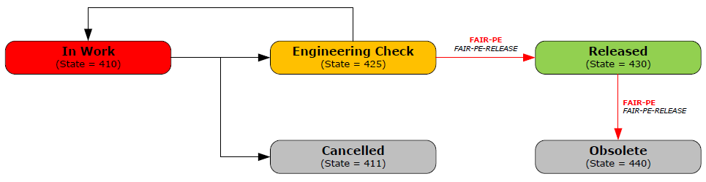
Interfaces
How should we proceed?
Proposal:
Generation of one EDMS document for each interface, which has to be checked by the involved system managers and released by the TC.
(EDMS type: Engineering - Functional Specifications (EF), release procedure: FAIR-PE)
After finishing all interface documents, they should be merged into one big document (proposal by Evgeny Koshurnikov).

Slide 5
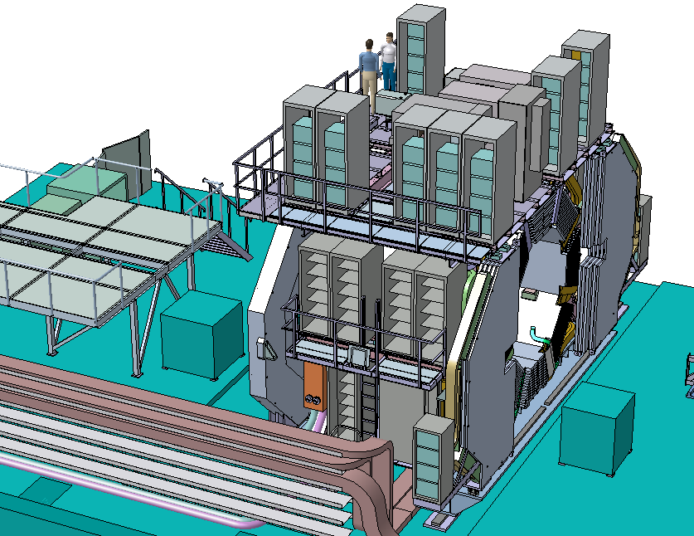
Mounting of Heavy Components in Target Spectrometer
concrete block upstream, upper surface 2.1 meter below beam height
concrete block downstream
Target Spectrometer in maintenance position, concrete blocks may be used for installation of cryostat, barrel-EMC, and FE-EMC. Horizontal dimensions of concrete blocks: only as big as necessary, with horizontal acceleration of heavy parts 1.5 m/s² (0.075·g × safety factor 2).

Slide 6
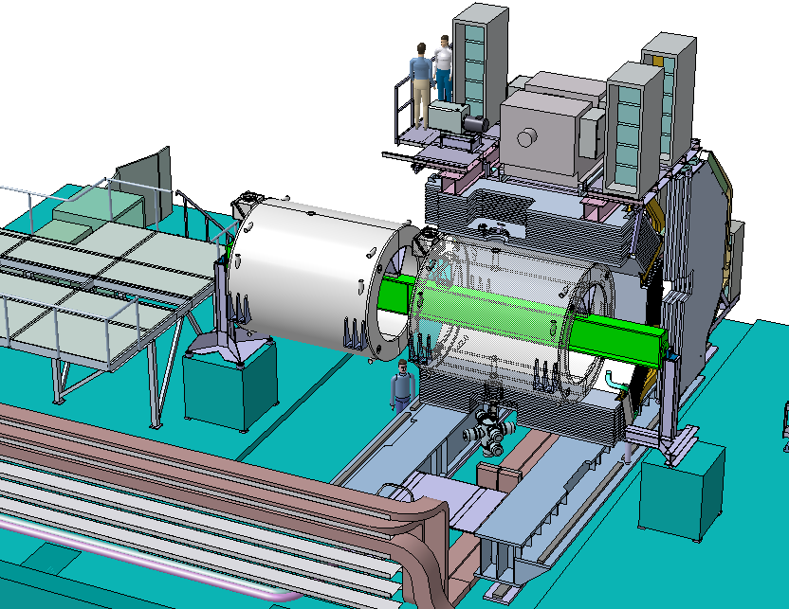
Mounting of Heavy Components in Target Spectrometer
cryostat position before move-in
beam HEB-700 (length 9.4m, I_{x}=256dm⁴),
usable for both cryostat and b-EMC
support usable for both cryostat and barrel-EMC
Target Spectrometer (eastern half hidden), support set-up for cryostat

Slide 7
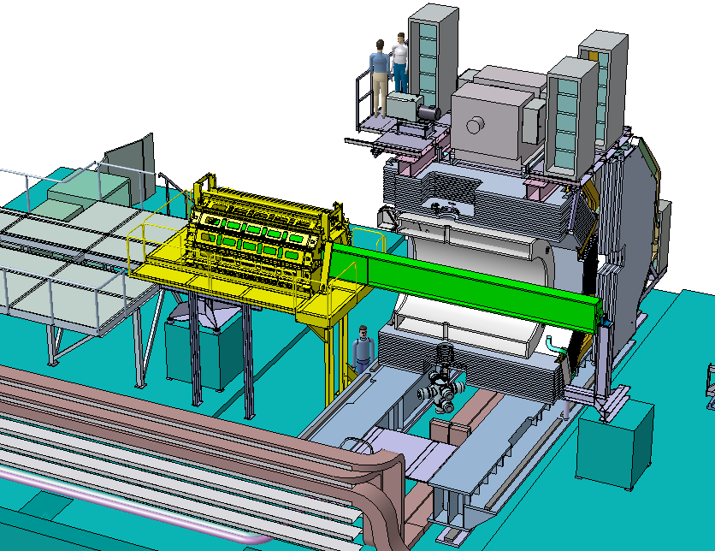
Mounting of Heavy Components in Target Spectrometer
barrel-EMC in assembly position
Max. beam deflection during movement 6 mm
gangway around barrel-EMC ranging from
-6.8m < z < -1.9m
Max. load on downstream support reached when b-EMC in target position: 130 kN
Barrel-EMC set-up in assembly position,
yellow parts taken from a design that Valeriy Ferapontov had proposed

Slide 8
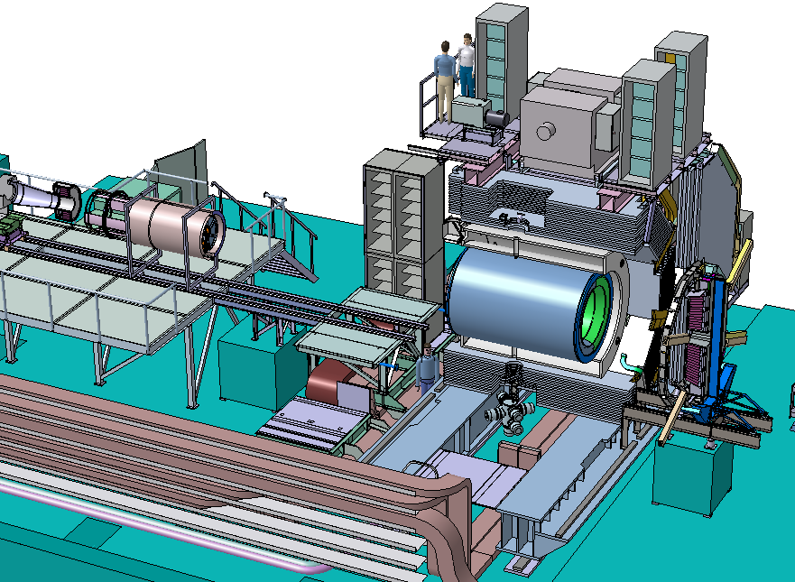
Mounting of Heavy Components in Target Spectrometer
maintenance position for Central Trackers and BE-EMC
auxiliary platform
FE-EMC position before move-in
rail support for FE-EMC
FE-EMC mounting set-up

Slide 9
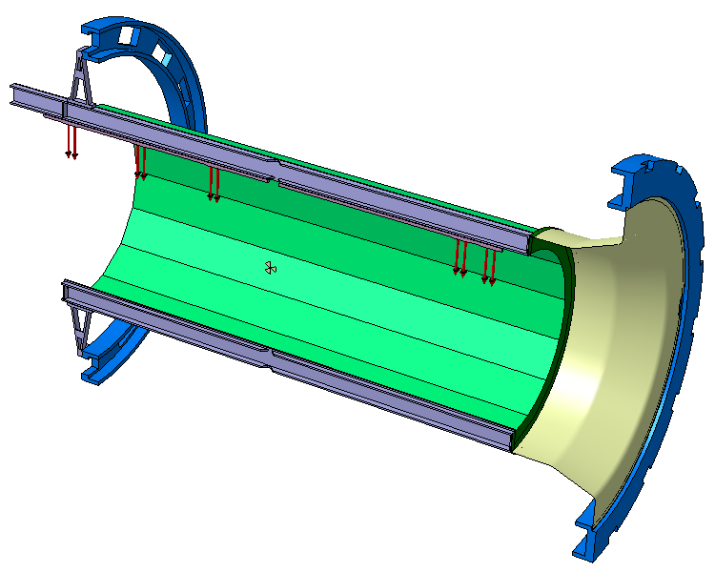
Support of Central Detectors
barrel-EMC flanges
load by STT, MVD, supplies applied only to upper CT-beam
(½ mass ~100 kg)
upper CT-beam
DIRC barrel
(mass of one half ~200 kg)
downstream support cone (CFRP 1 mm)
lower CT-beam
Model for FEM analysis (western half).
CT-beams are supposed to be made of aluminium, main moment of inertia ~280 cm⁴

Slide 10
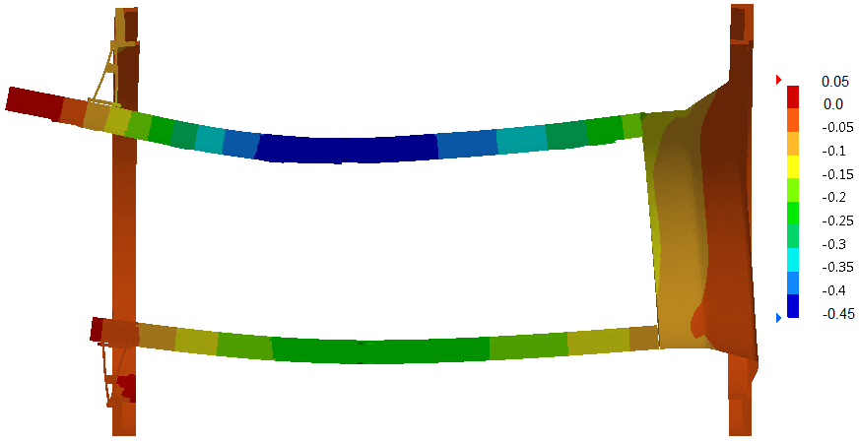
Support of Central Detectors
max. deflection of upper CT-beam 0.45 mm (-Δy)
Deflection of CT-beams under all weights (magnification factor 400).
Colours indicate the vertical displacement.
Downstream support cone is able to carry considerable radial loads but hardly any axial load.

