Slide 1
STT update
Artur Cebulla (FZ Jülich) for the STT group
LVIII. PANDA CM Mainz, MEC session, Sep-12th, 2016

Slide 2
STT update
DIRC STT issue
STT services
Solution approach

Slide 3
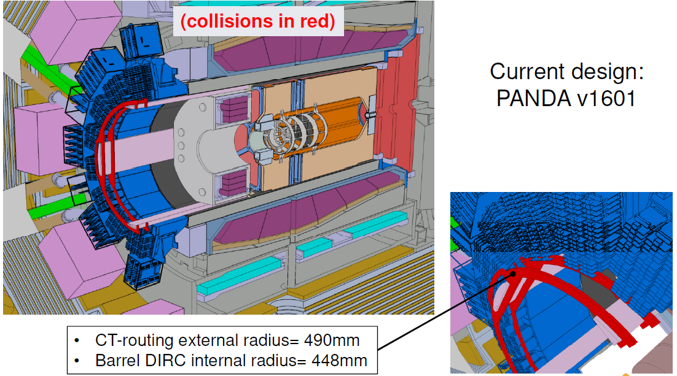
DIRC/STT issue

Slide 4
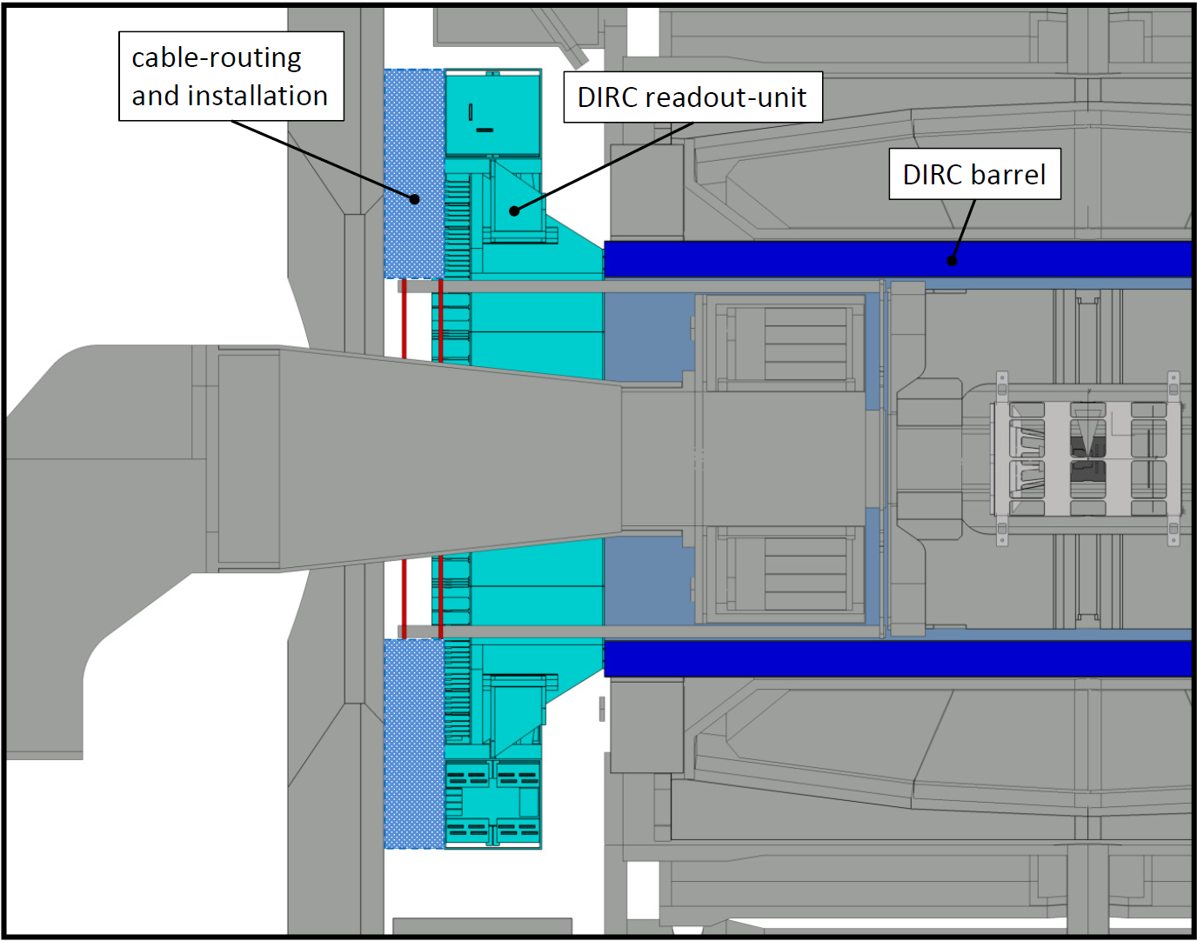
DIRC/STT issue
STT Frame/Support

Slide 5
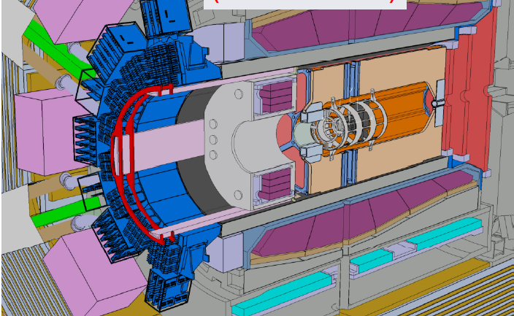
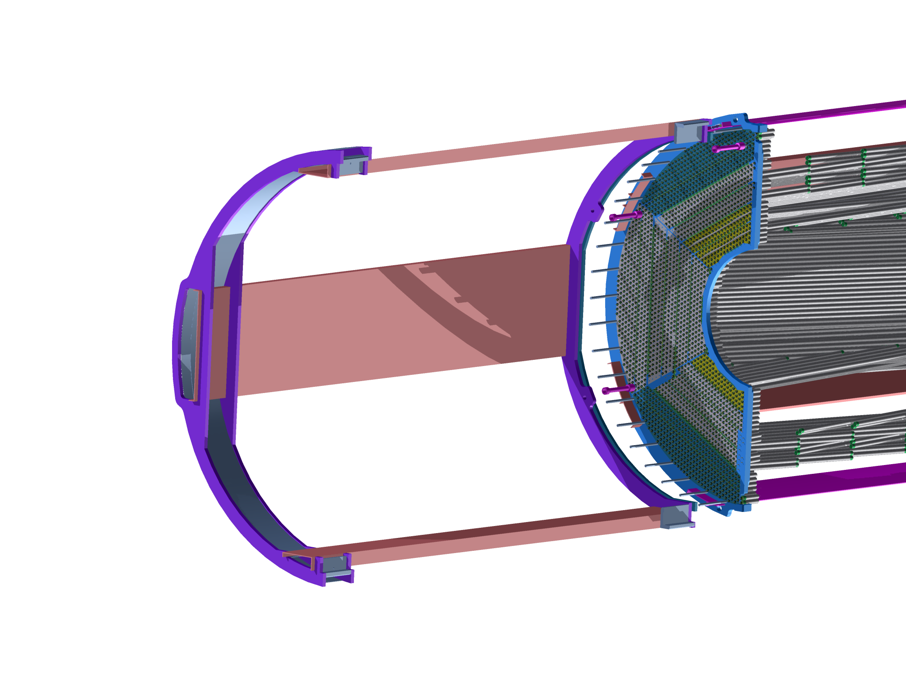
DIRC/STT issue

Slide 6
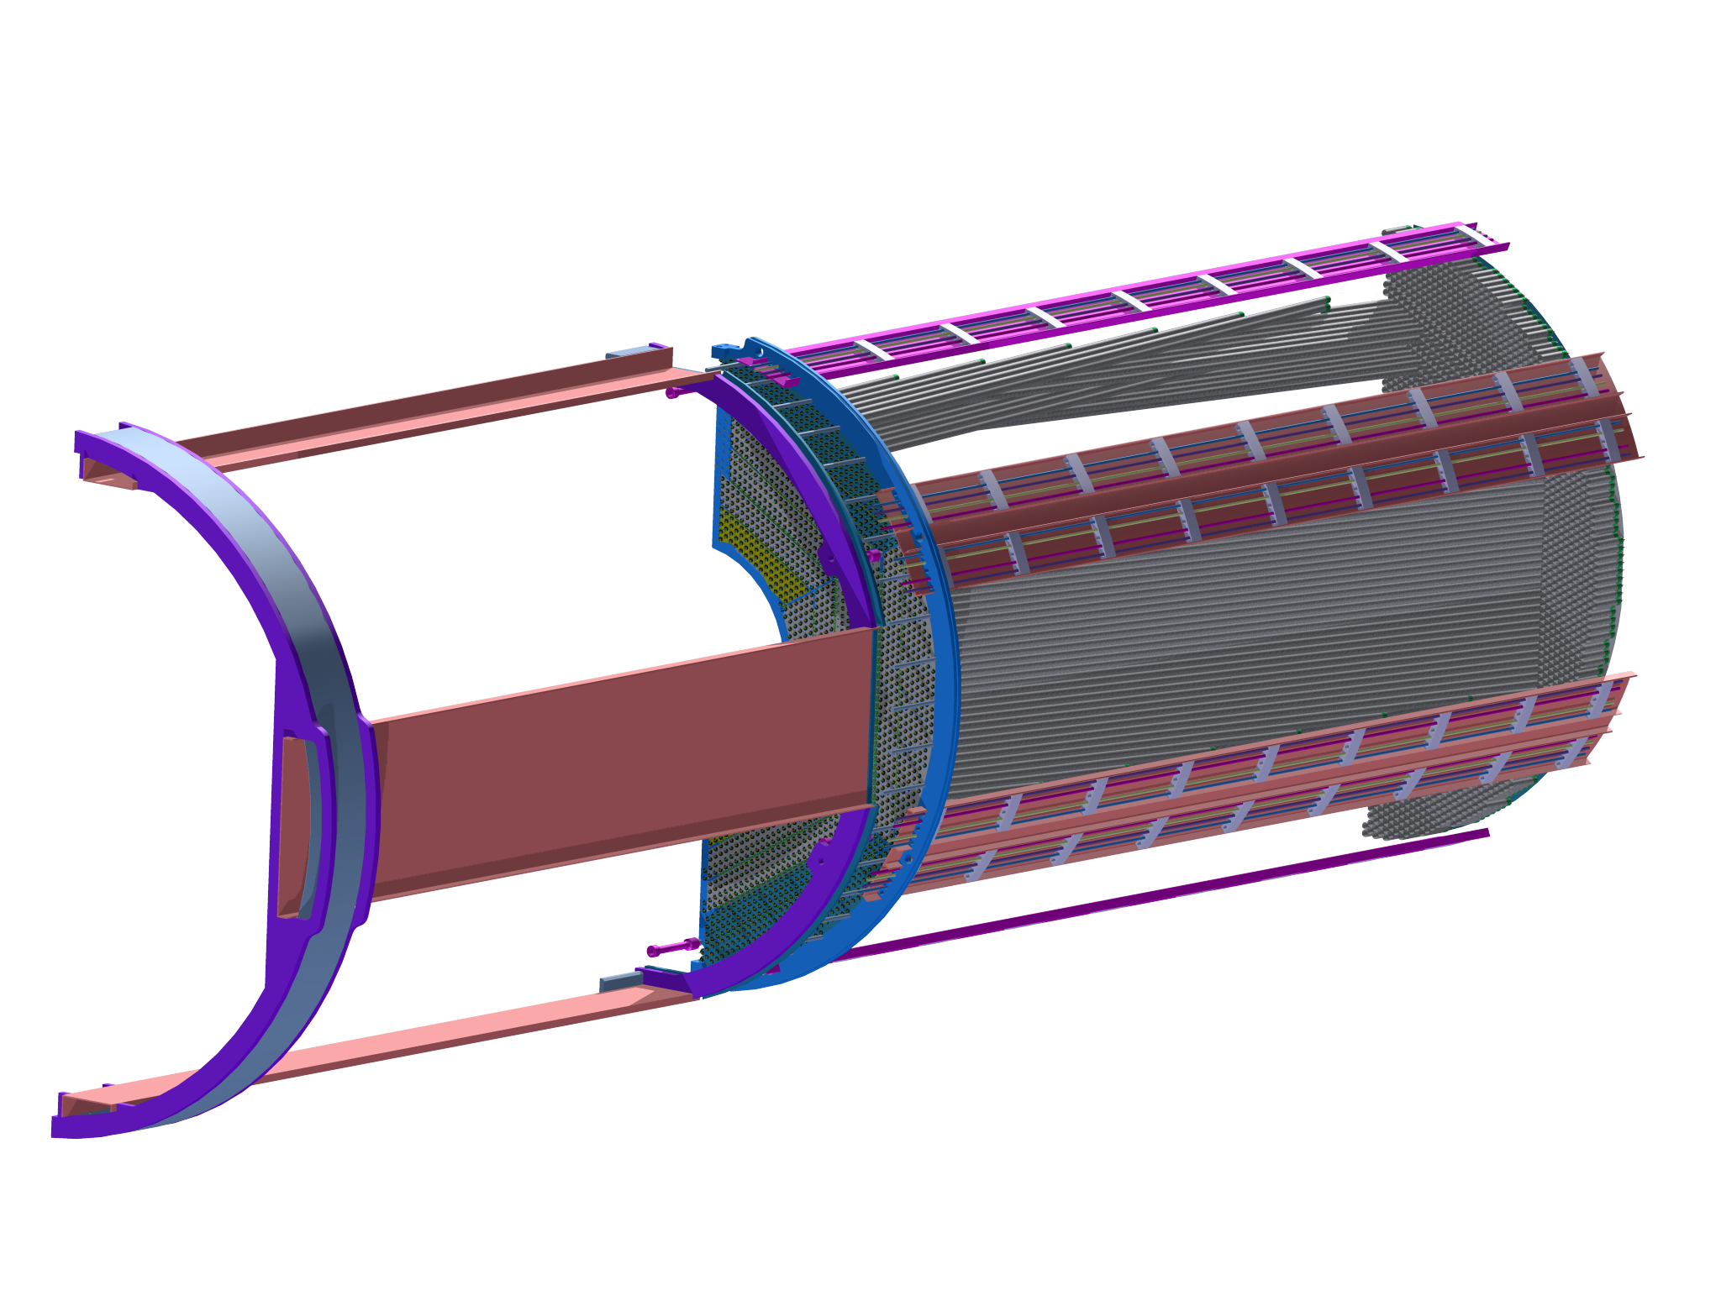
STT services
Insertion services

Slide 7
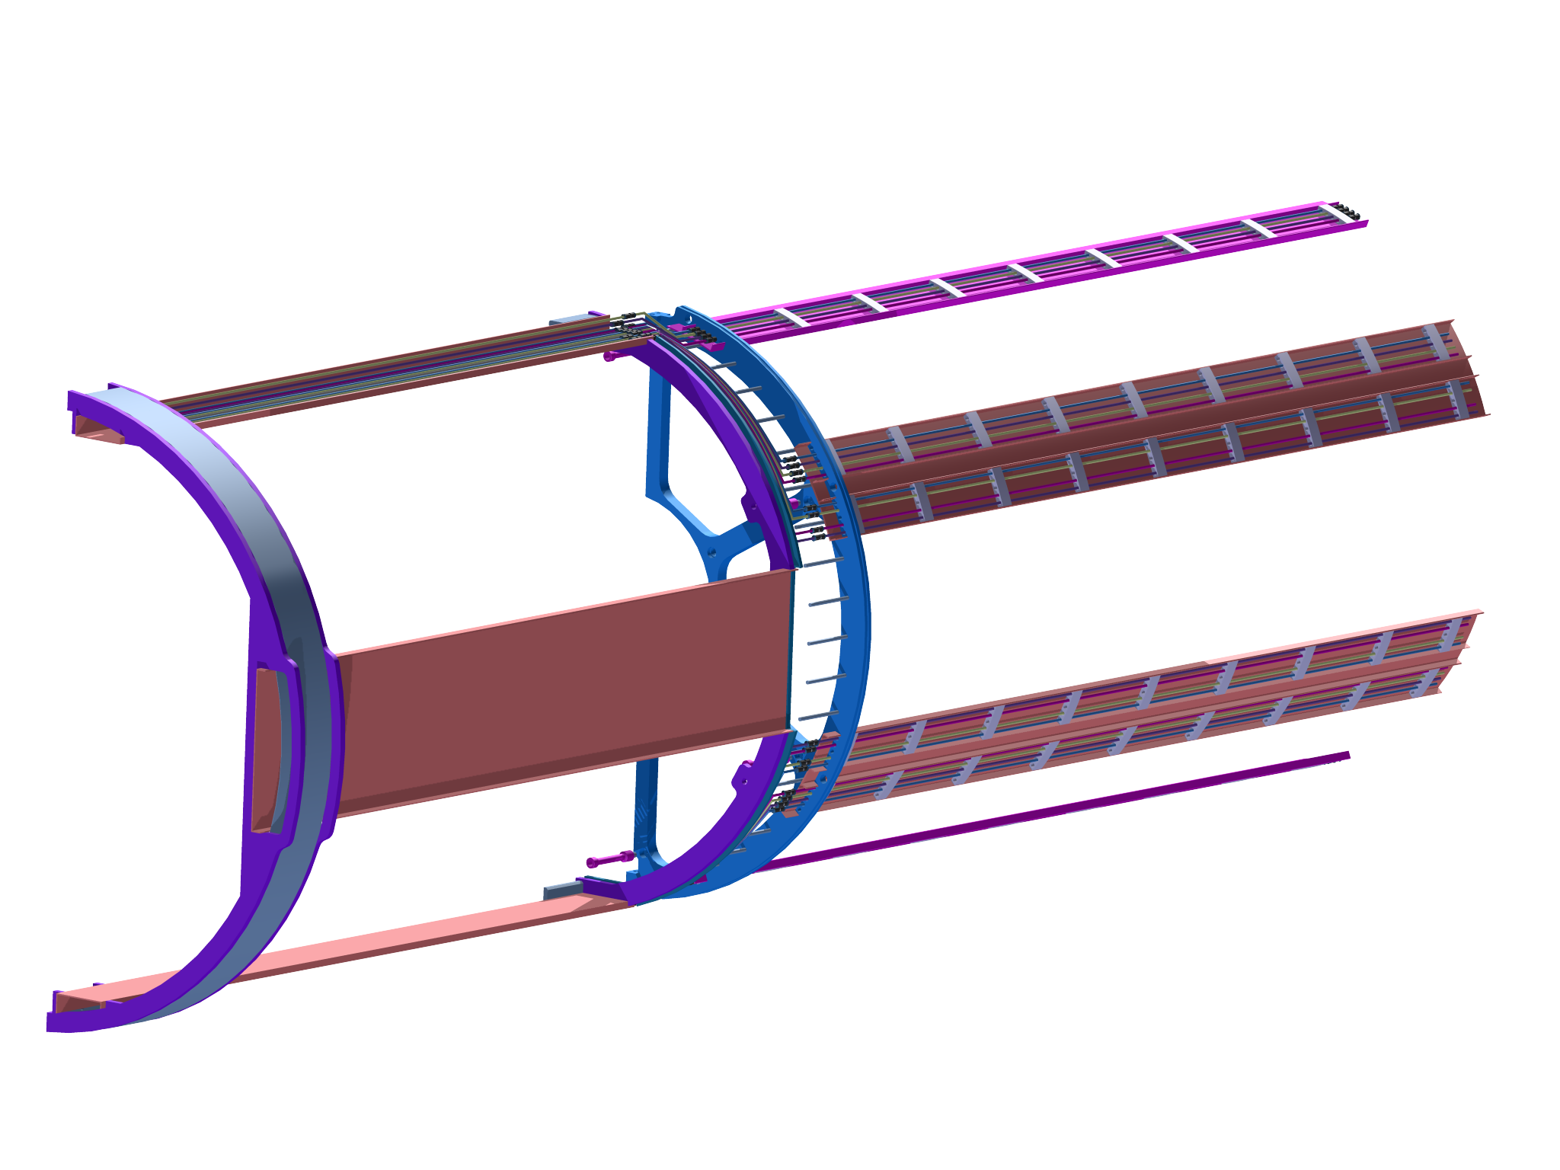
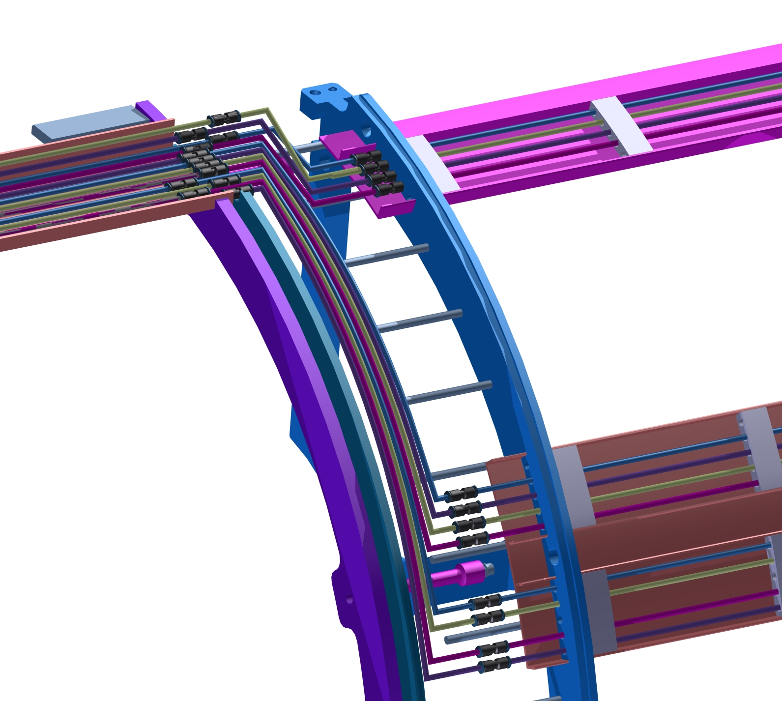
STT services
Insertion of Gas Pipes

Slide 8
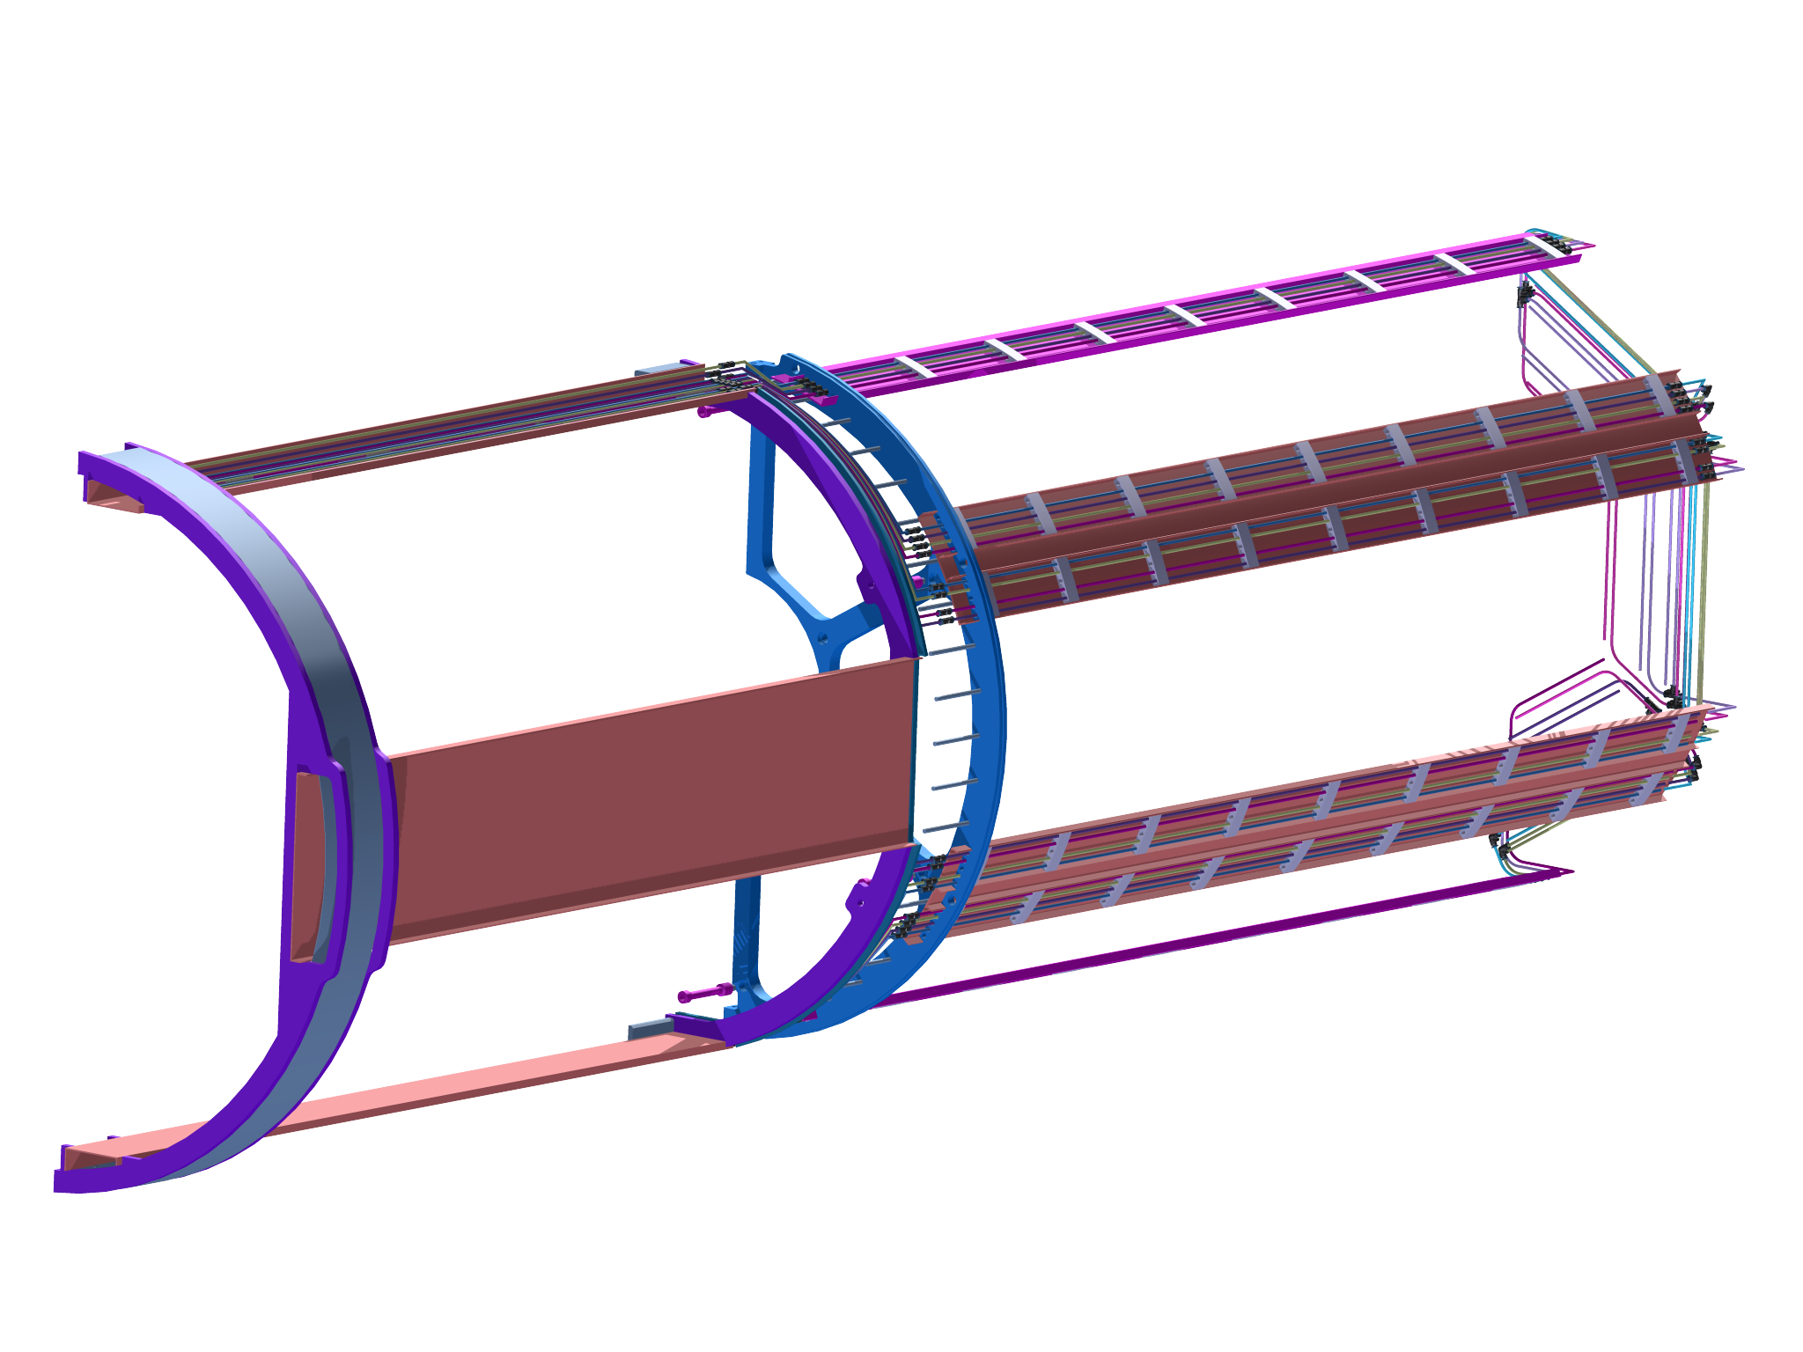
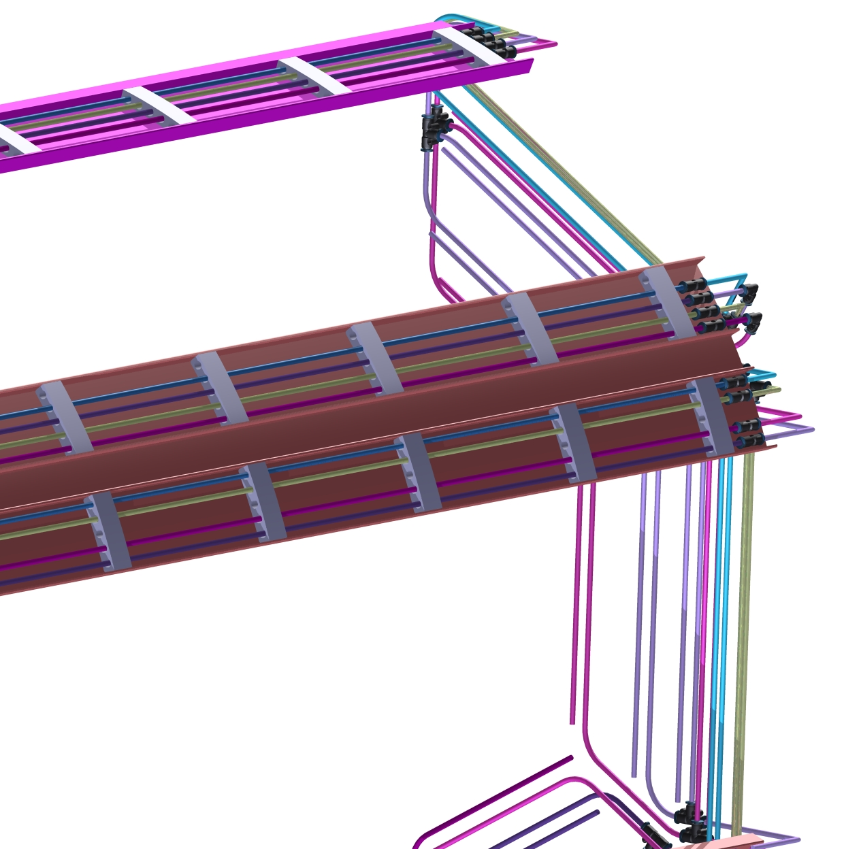
STT services
Insertion of gas manifolds

Slide 9
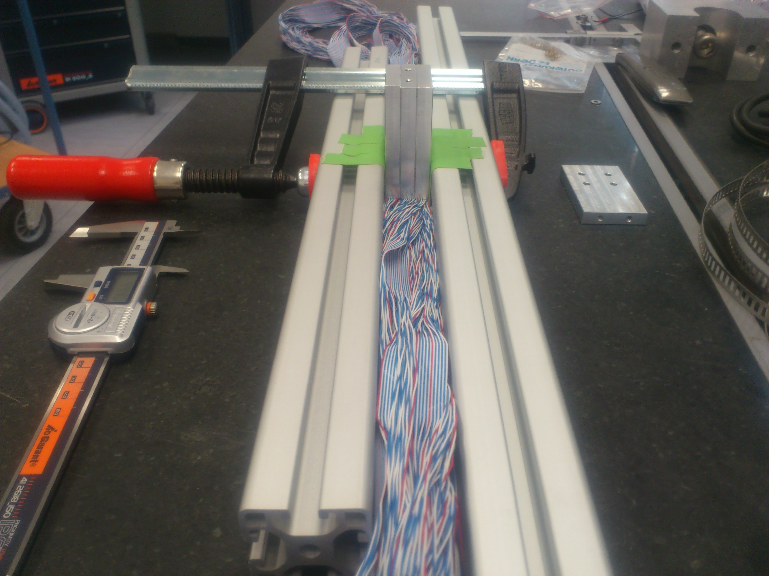
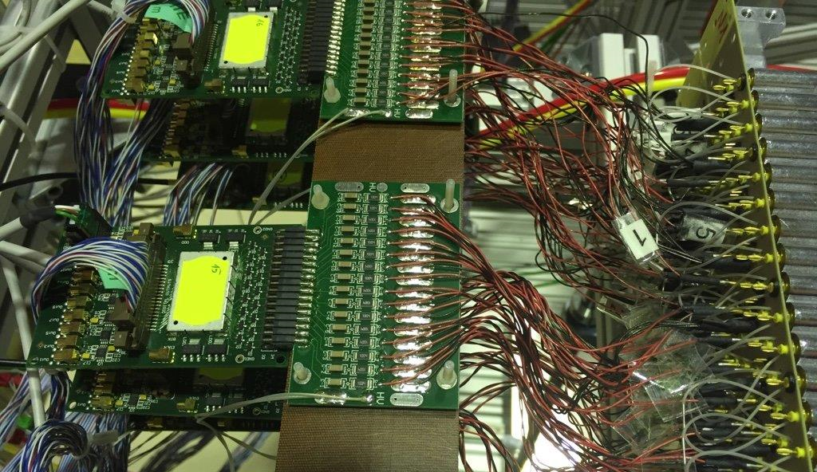

STT services
Insertion of electrical services

Slide 10
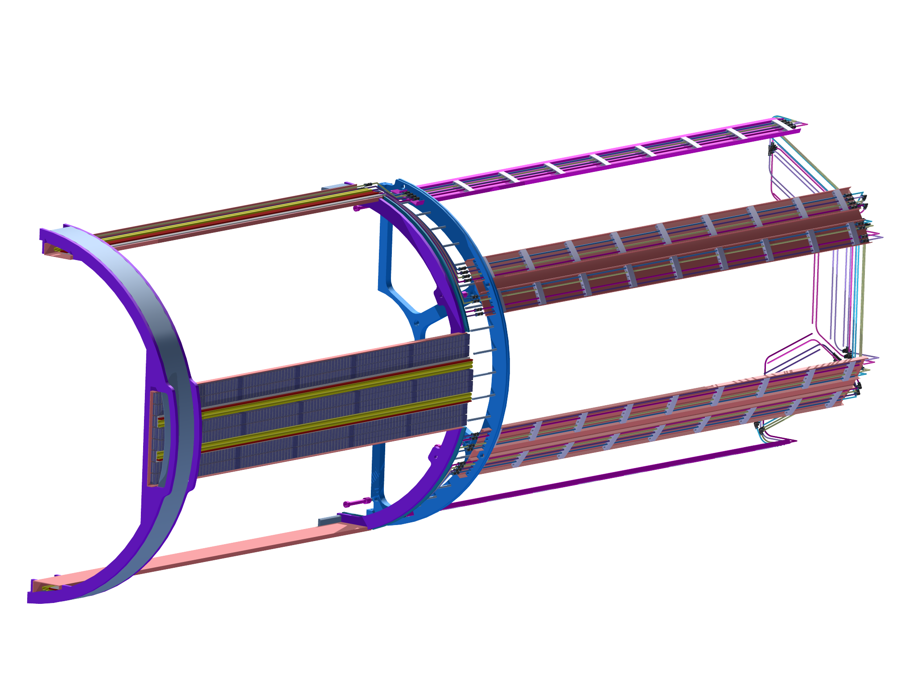
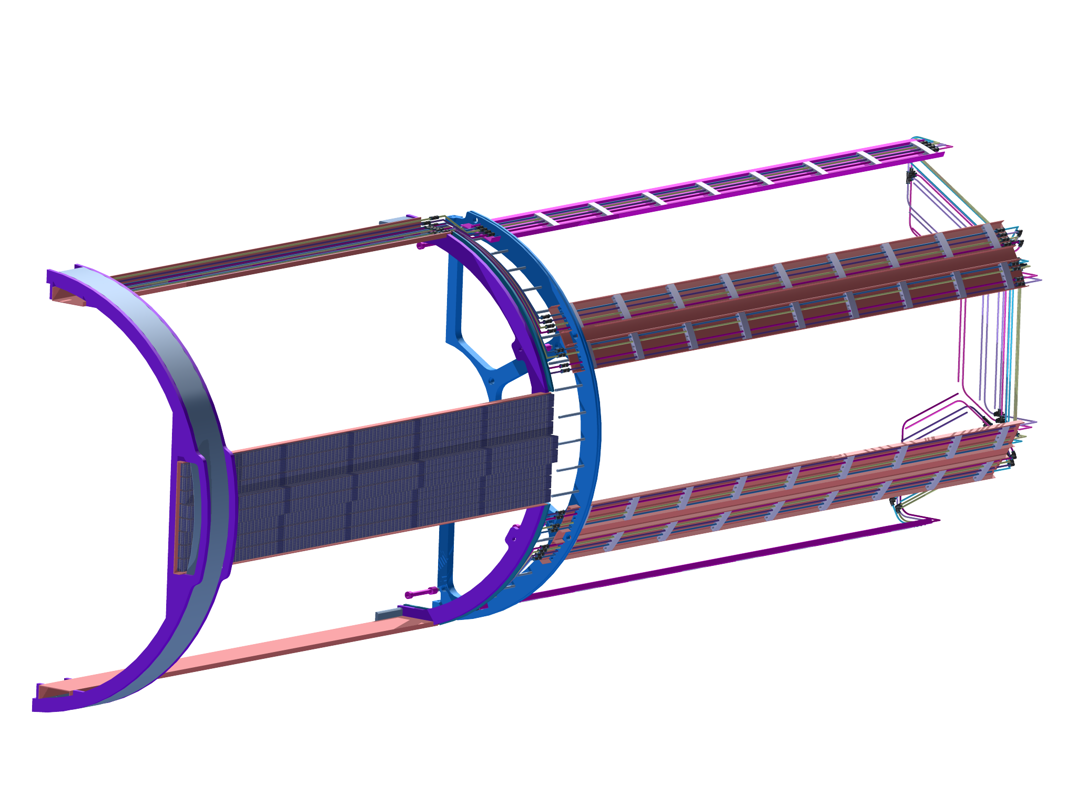
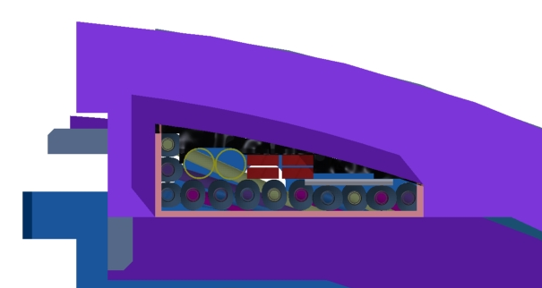
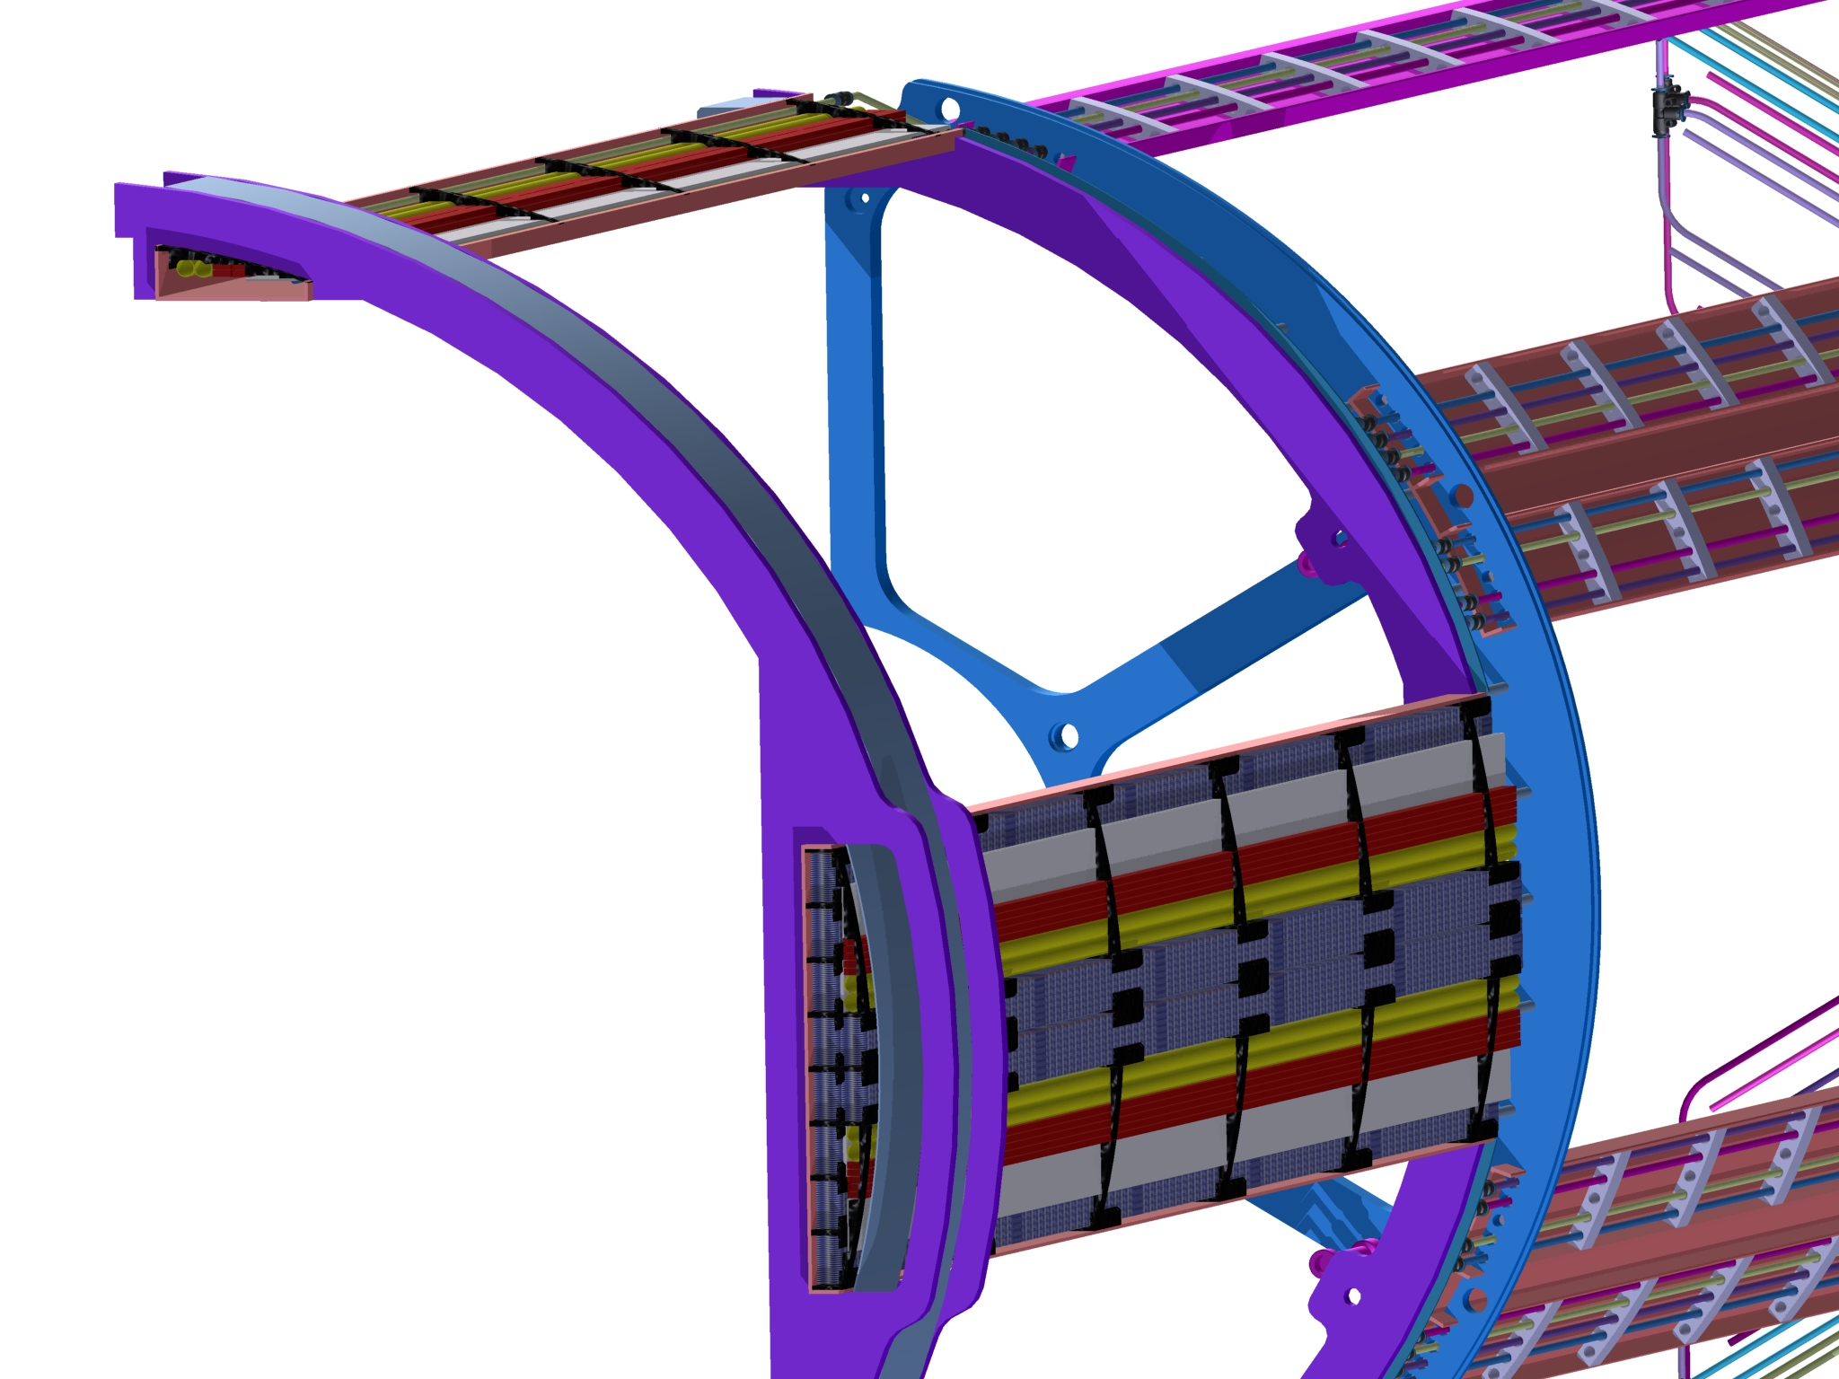
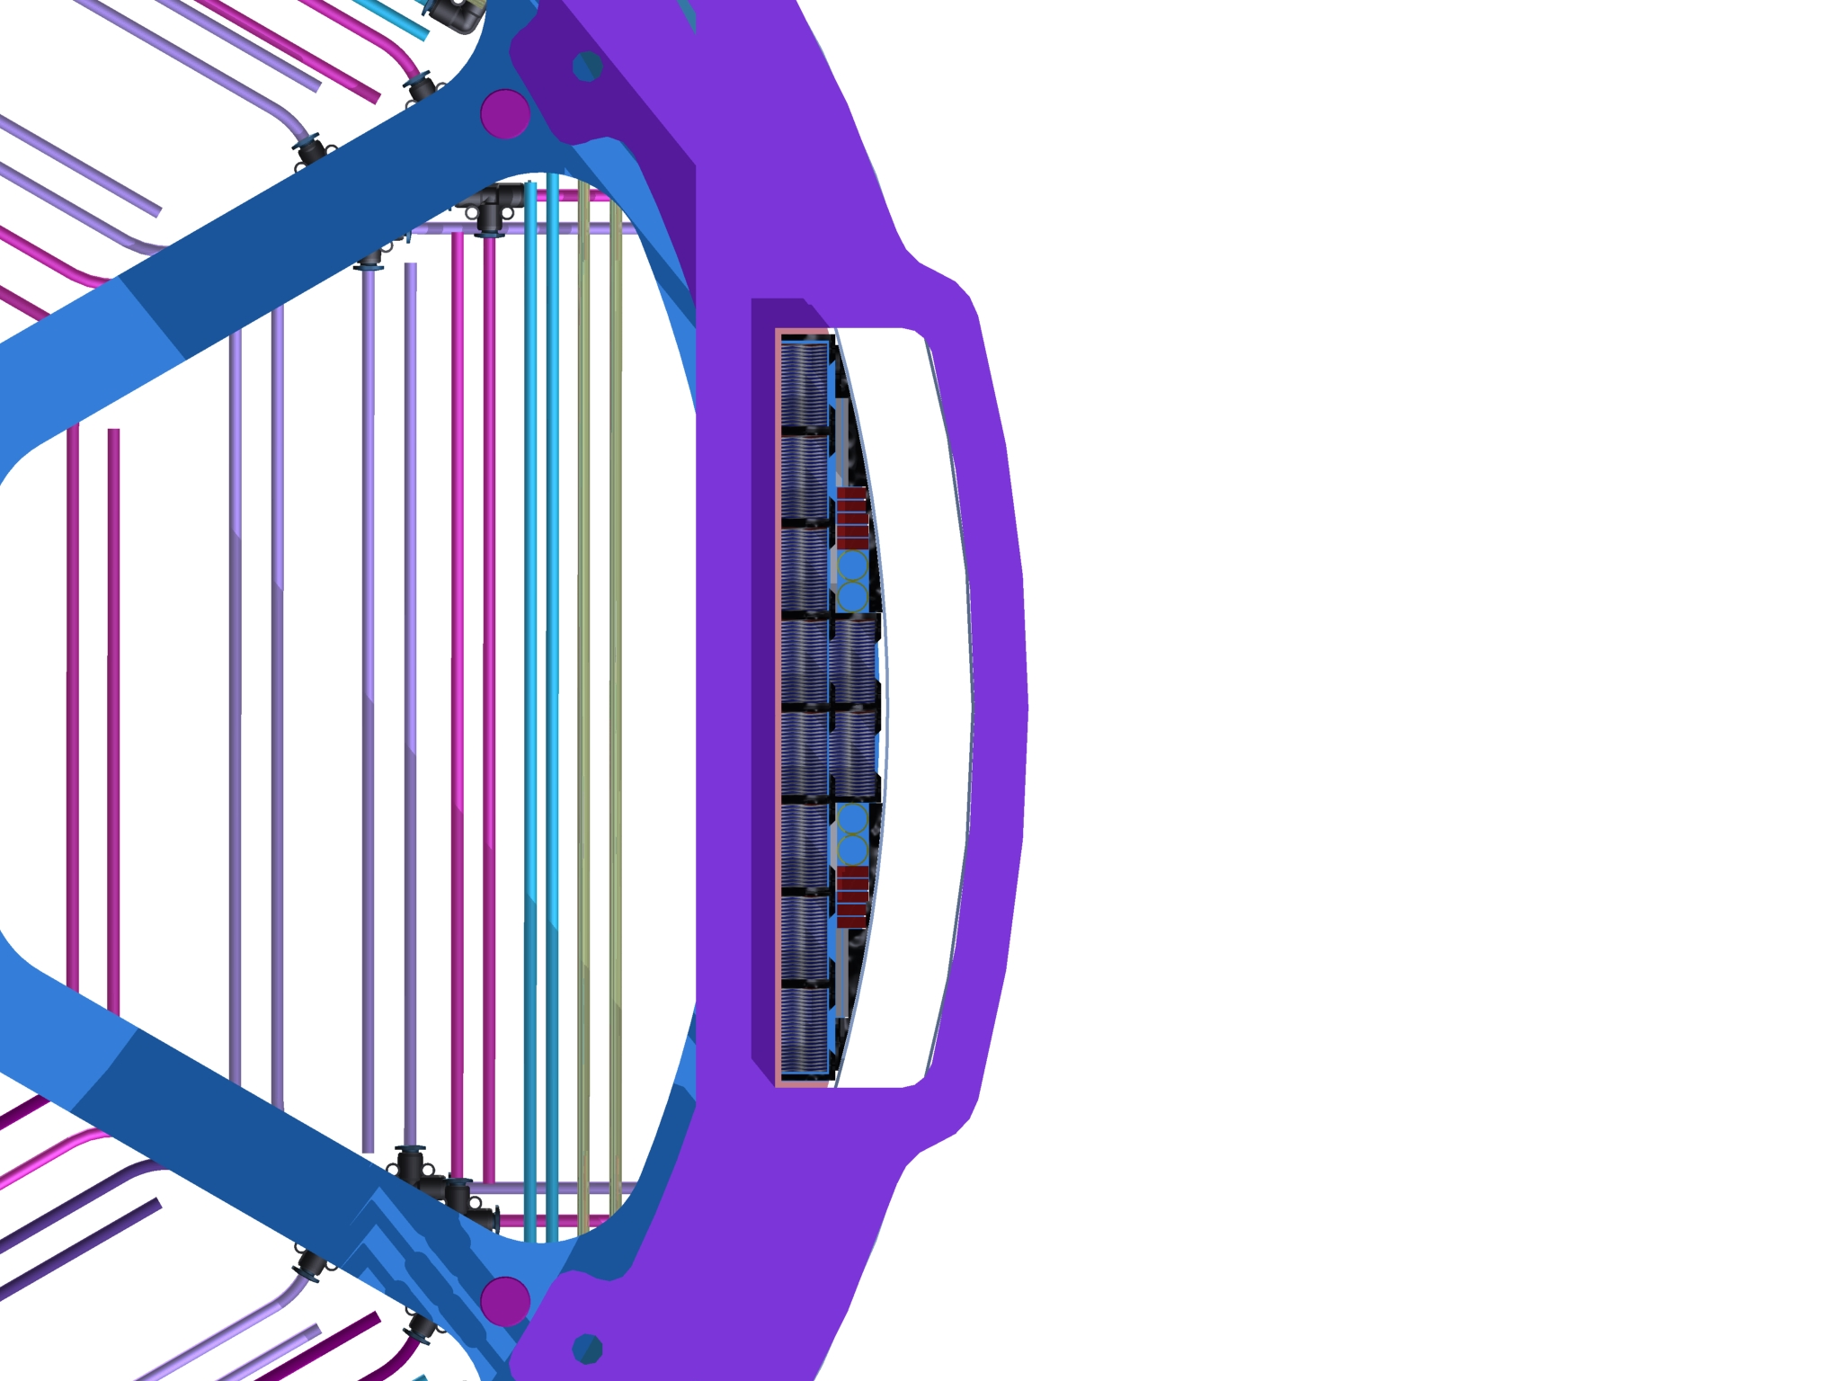
STT services

Slide 11
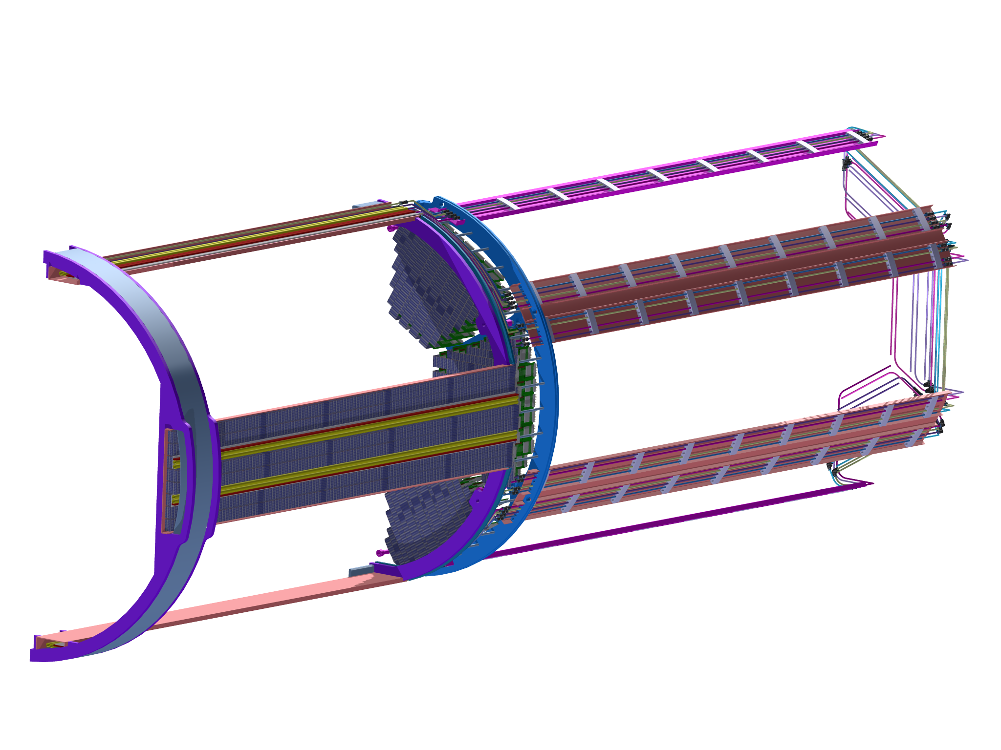
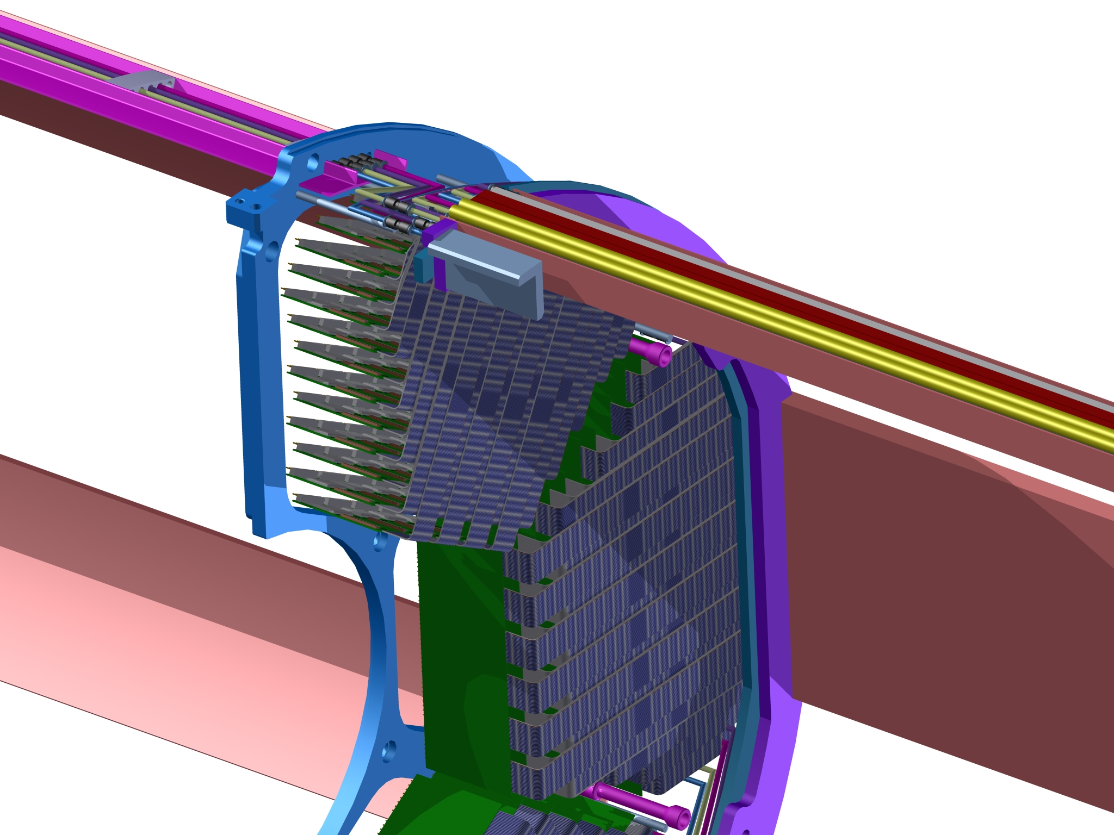
STT Cable routing
Insertion of readout boards

Slide 12
Solution approach
Support structure
Shift in z – door direction
Readout cablemanagment
Shift supportring in z direction

Slide 13
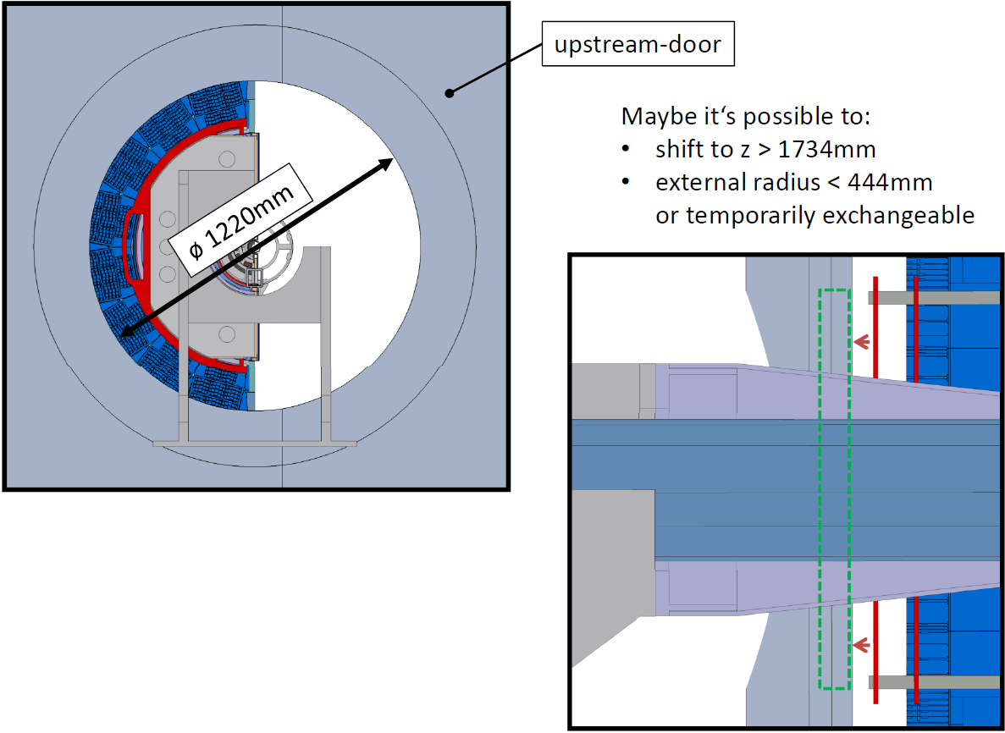
Solution approach
I. Support structure

Slide 14
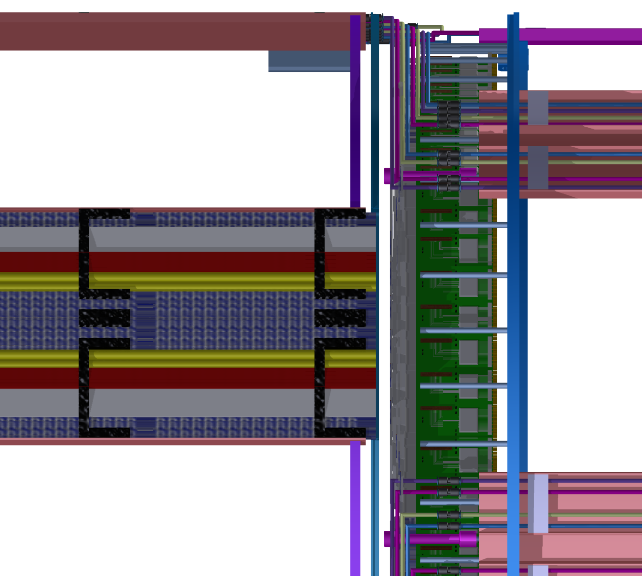
Solution approach
II. Readout cablemanagment

Slide 15
Thank you for your
attention

