Slide 1
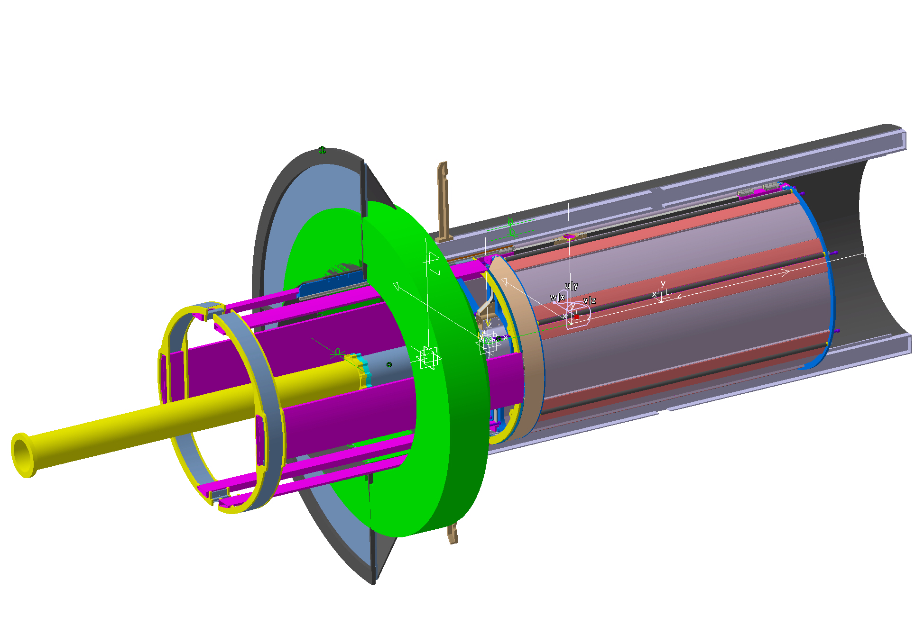
Backward CABLES DUCT FRAME> Outer Radius 473mm
OIL THANK (Old Version) > Inner Radius 448mm
CABLES DUCT > Outer Radius 443mm
QUARTZ BARS & PMTs(New Version) > Inner Radius 448mm
NOTHING SEEMS CHANGED: 448-443= 5mm Safety Distance

Slide 2
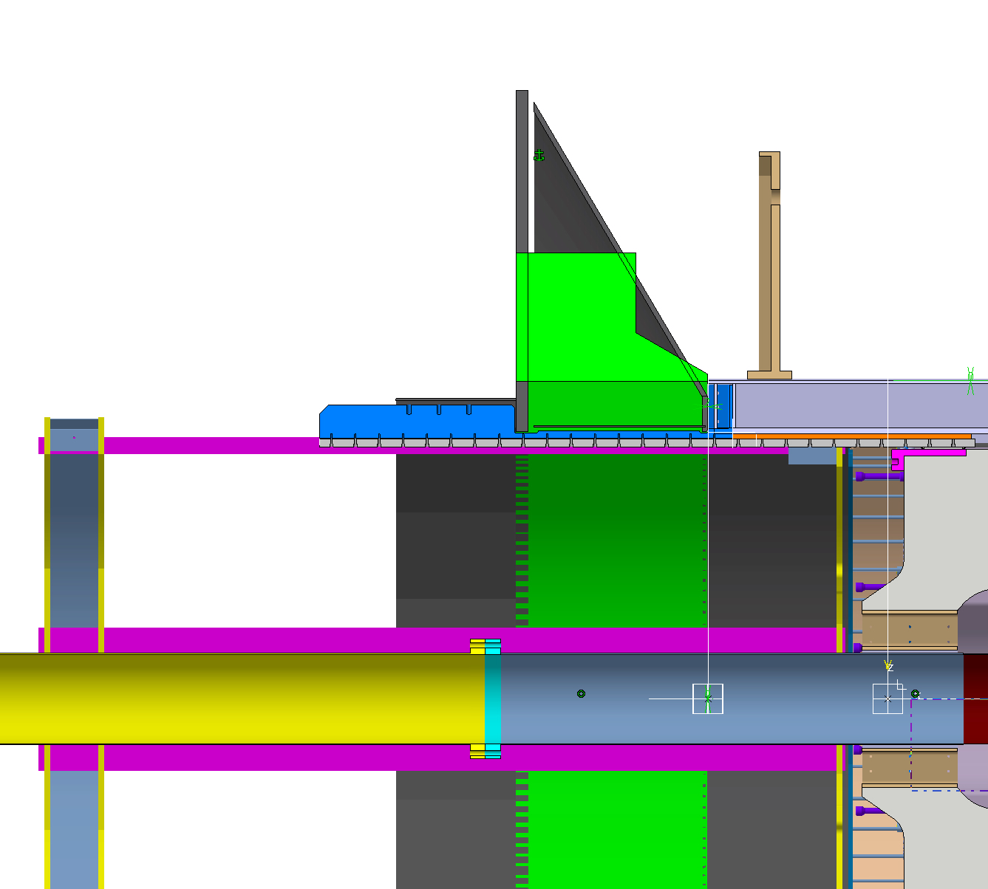
IT’S NOT CLEAR HOW MUCH IS THE INNER RADIUS OF THE DIRC CABLES ZONE
AND OF THE RELATIVE SAFETY ZONE (IN ANY CASE I ASSUME FROM YOUR
MAIL THAT YOU HAVE UNDER CONTROL THIS ISSUE)
CABLES ROUTING ZONE > Inner Radius ? mm
SAFETY DISTANCE > ? mm

Slide 3
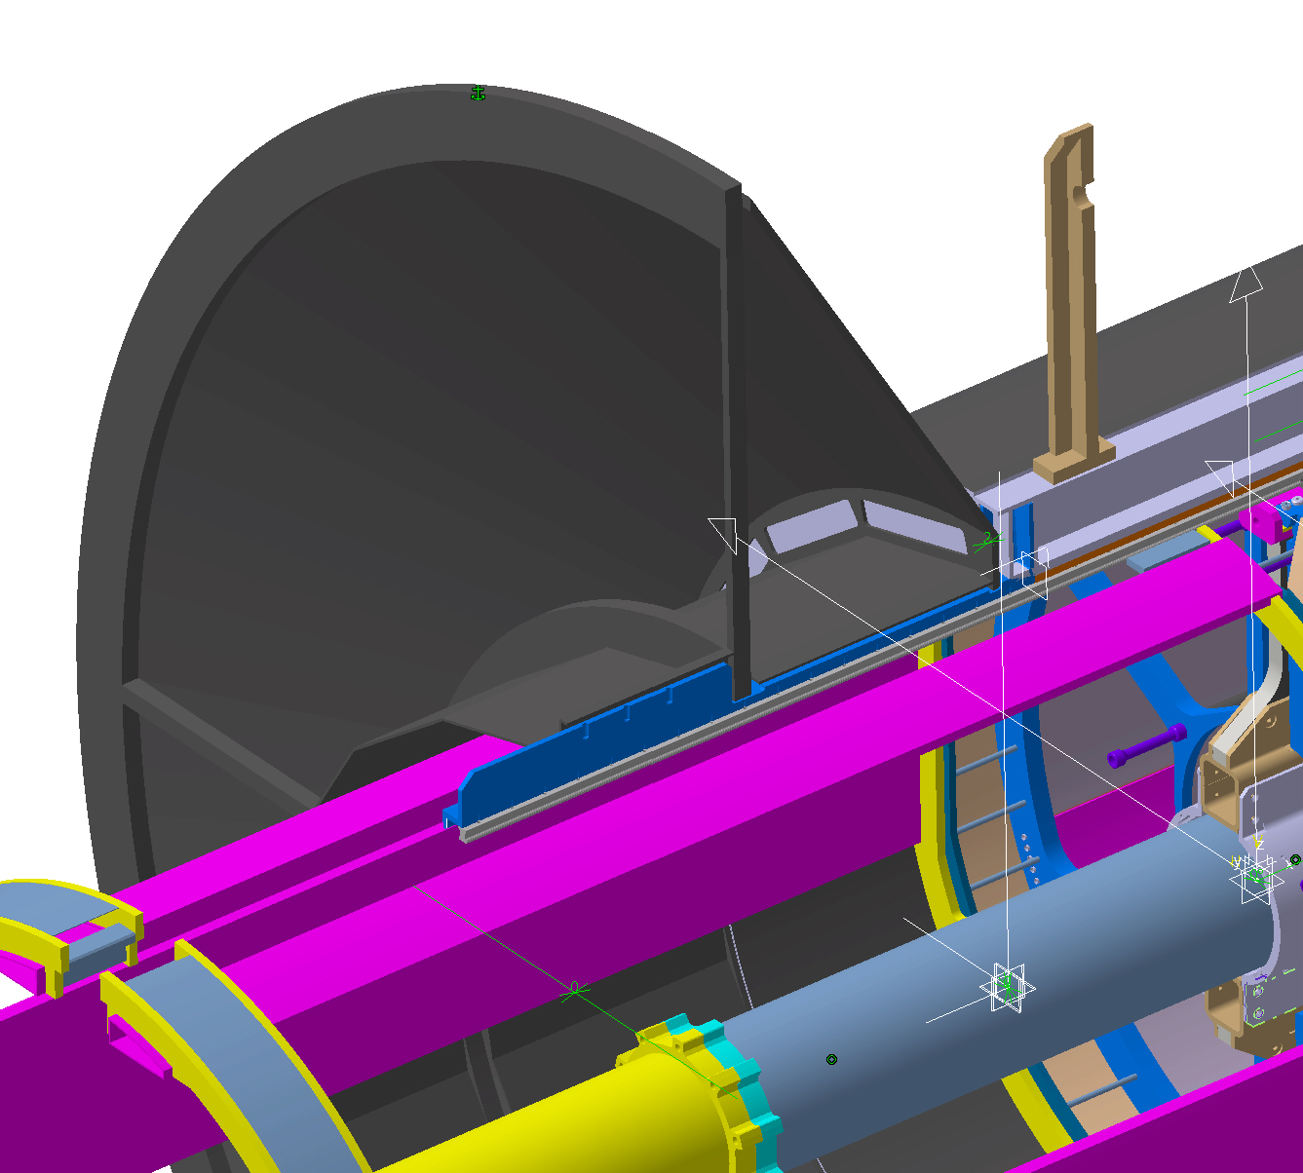
STT RAIL SUPPORT BEAM
OIL THANK (Old Version)
OIL TANK SUPPORT SYSTEM
FOR STT RAIL SUPPORT BEAM
AN ATHER REMARK MUST BE DONE RELATIVELY TO THE
SUPPORT SOLUTION NEEDED TO SUPPORT THE STT RAIL IN THE
DIRC READ-OUT ZONE.
IN HE PIC THE OLD AGREEDED SOLUTION.

