Slide 1
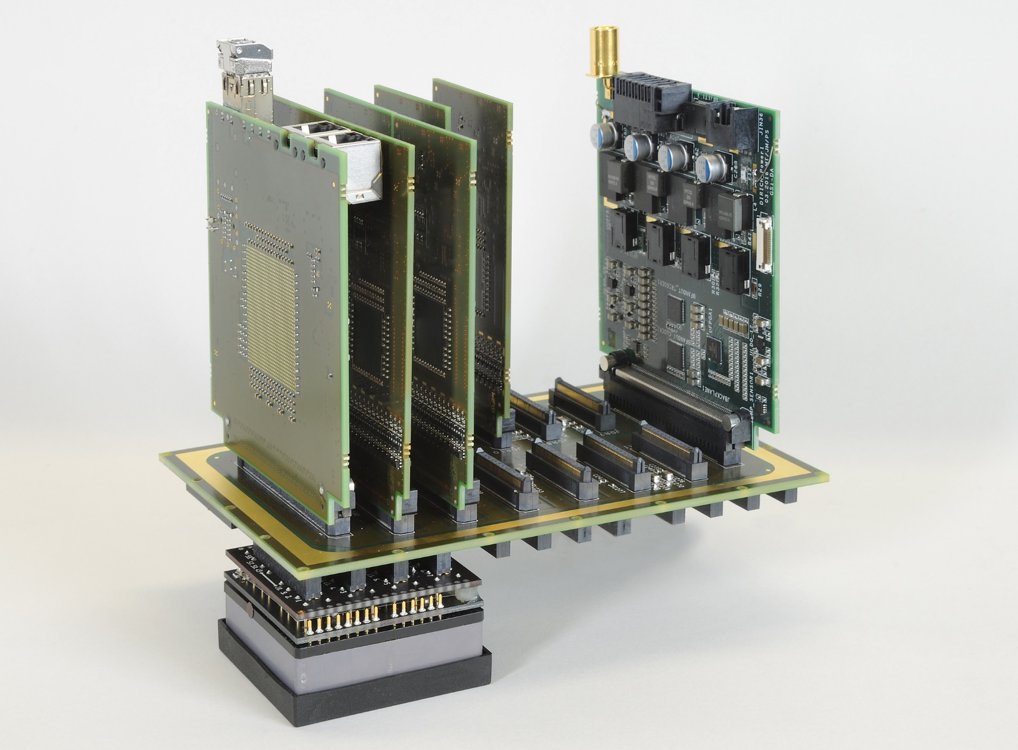
Readout 28.07.16
Side view
DiRICH
HV & LV
supply
Concentrator
Backplane
MAPMT

Slide 2
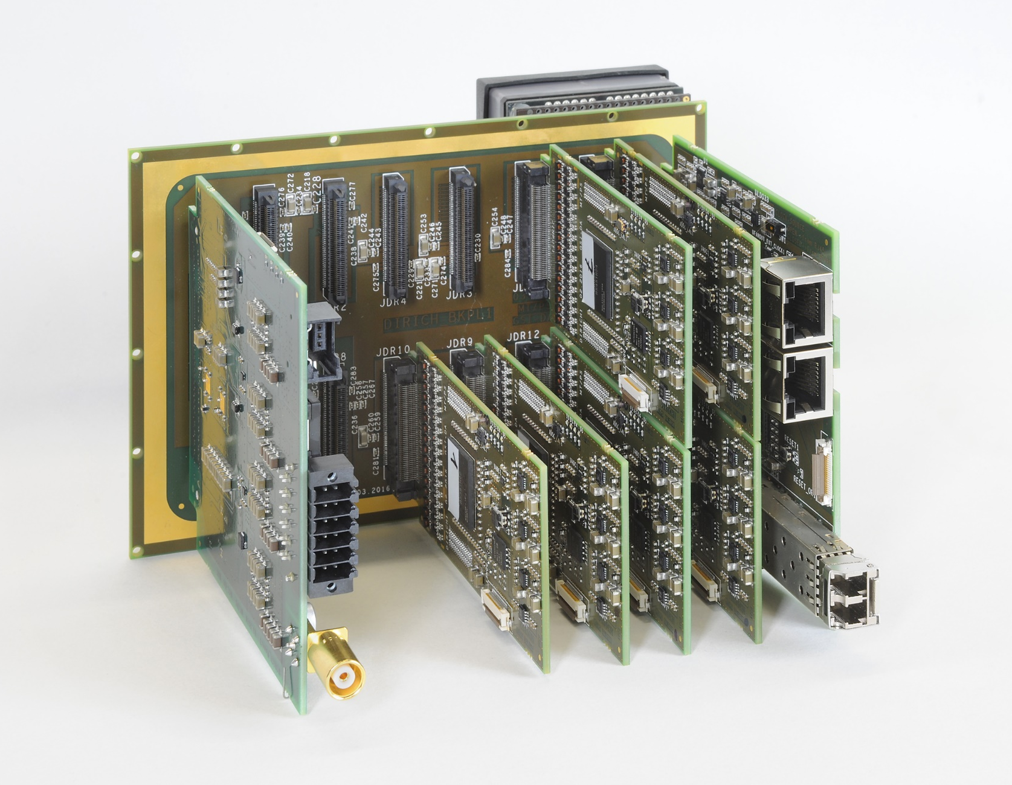
Readout 28.07.16
Rear side view
MAPMT
Backplane
Concentrator
HV & LV
supply
DiRICH

Slide 3
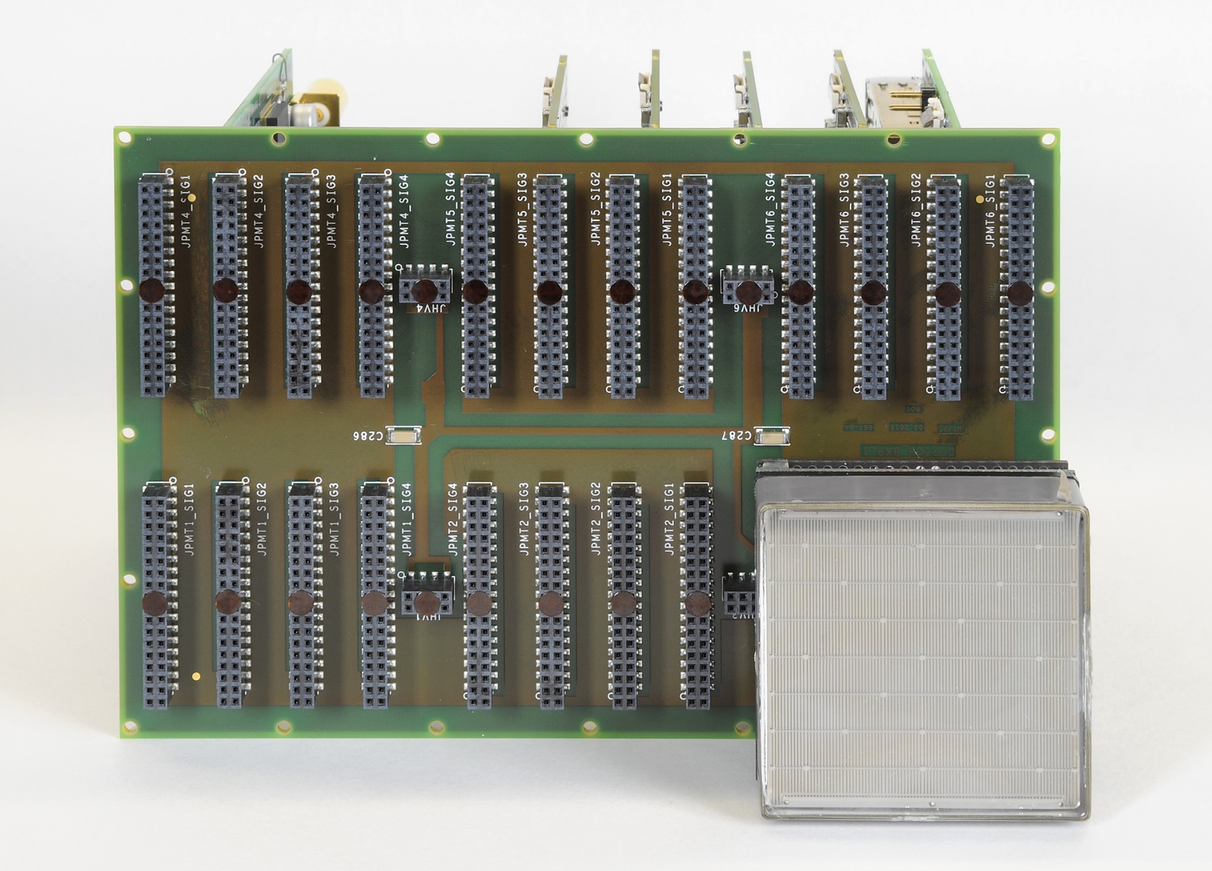
Readout 28.07.16
Front (MAPMT) side view
HV & LV
supply
DiRICH
Concentrator
MAPMT
Backplane

Slide 4
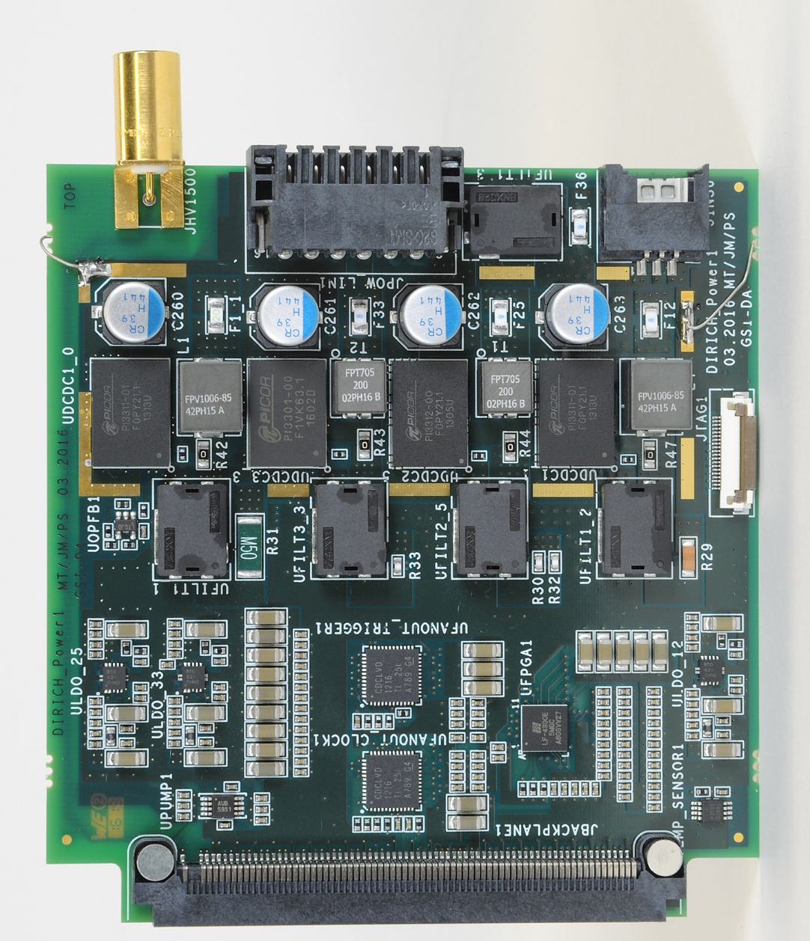
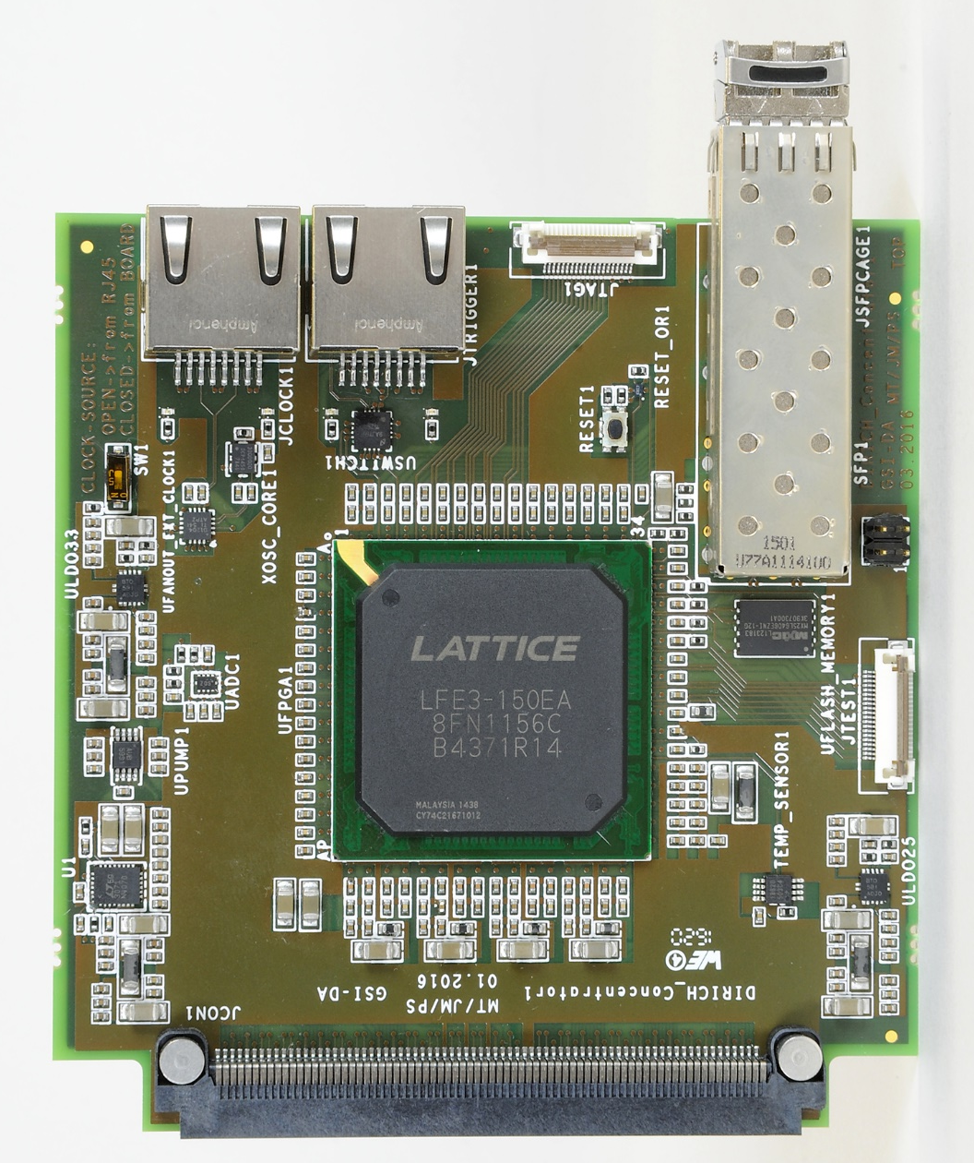
Readout 28.07.16
Power supply & TRB connectivity
HV & LV supply
Concentrator

Slide 5
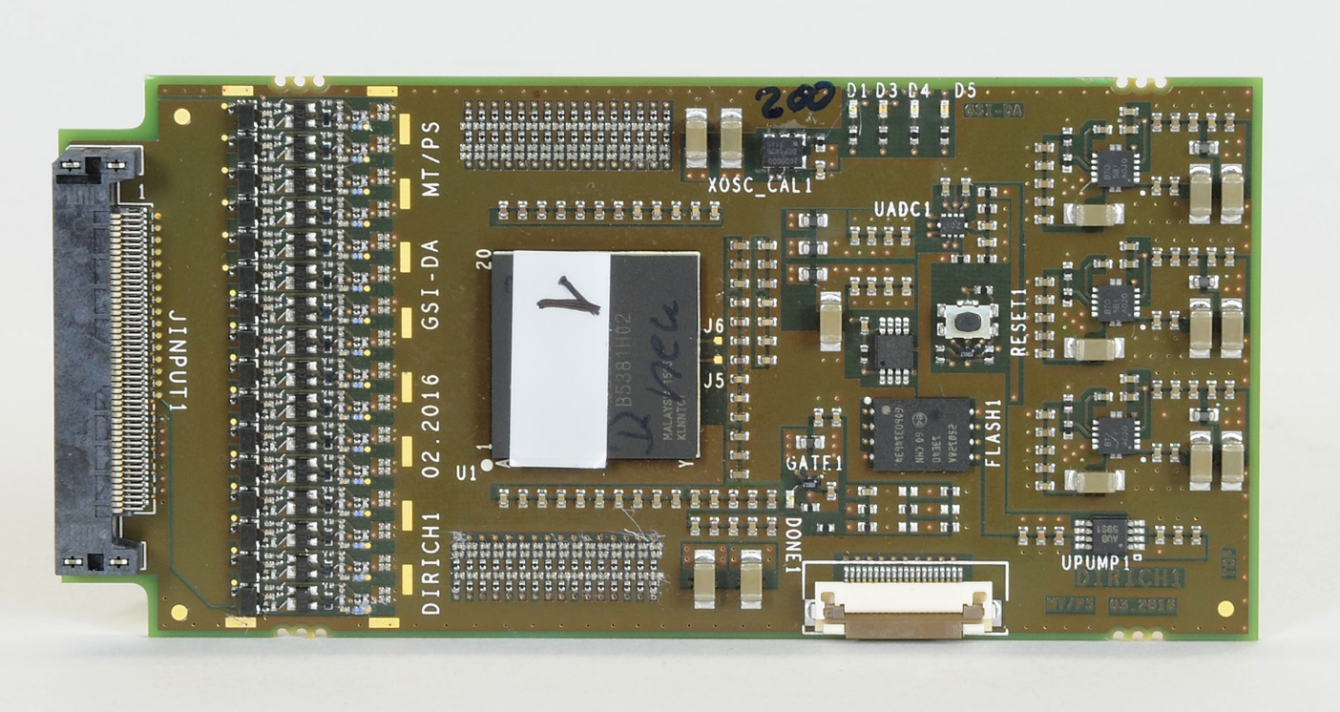
Readout 28.07.16
DiRICH front end (32 channels)

Slide 6
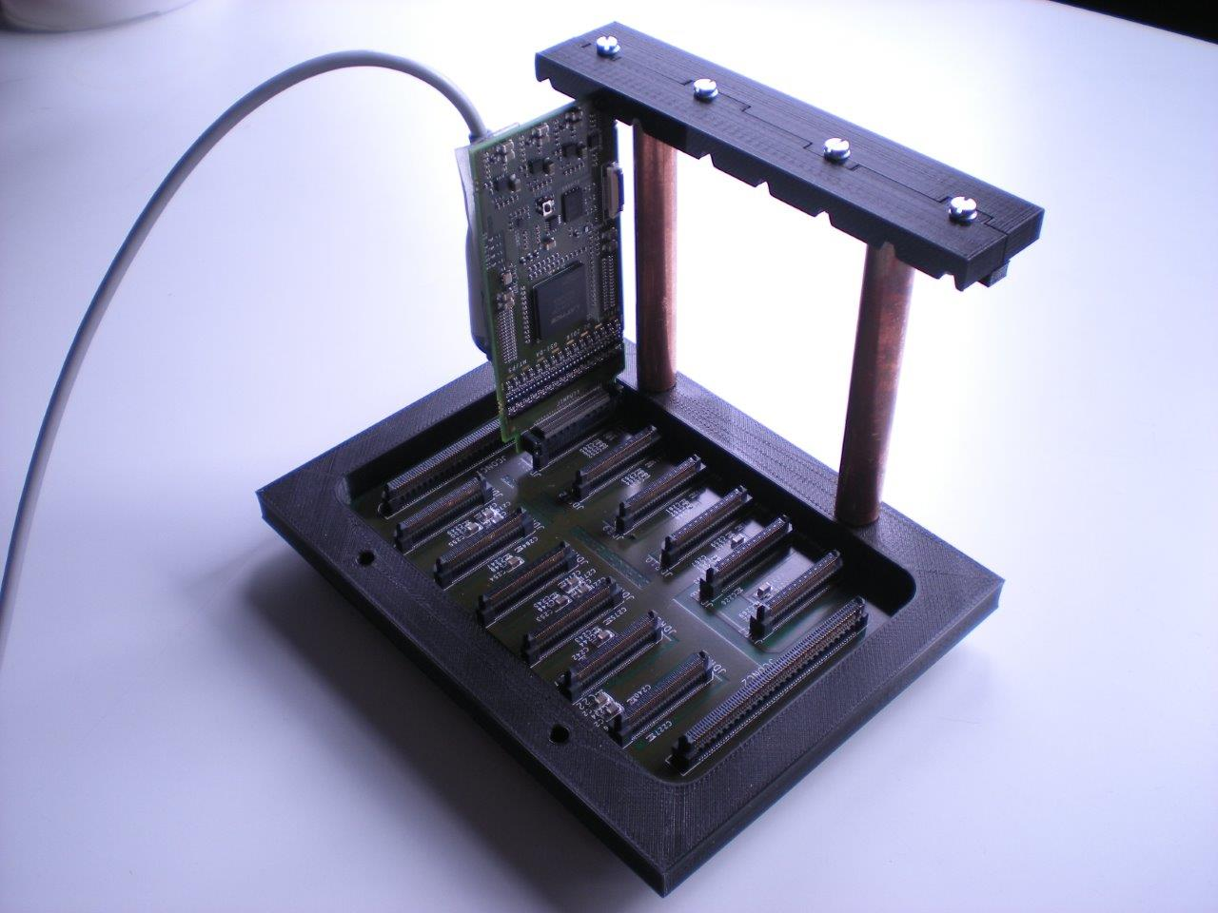
Readout 28.07.16
Mounting support structure

Slide 7
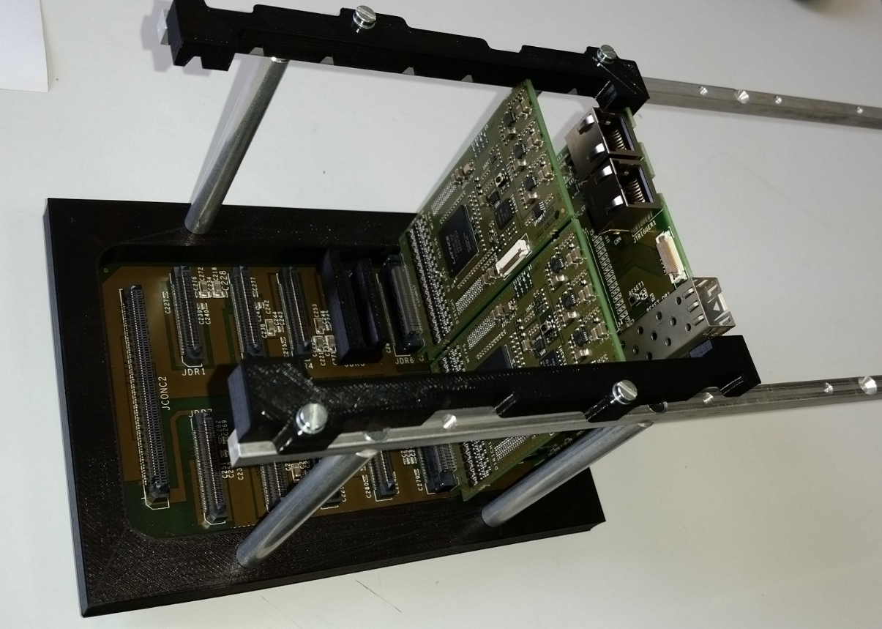
Readout 28.07.16
Mounting support structure

