Slide 1
„Status cw-linac“
Motivation
Timeline and status
Testing of components
Further strategy
GSI/HIM : W. Barth ● V. Gettmann ● M. Heilmann ● S. Mickat ●
M. Miski-Oglu ● S. Yaramyshev ● F. Dziuba
IAP GUF: M. Amberg ● M. Basten ● M. Busch ● H. Podlech ●
U. Ratzinger

Slide 2
Motivation and Main Design Parameter
Reactions at coulomb barrier → production of SHE
Operation cw
Mass / Charge 6
Beam current ≤1 mA
Injection energy 1.4 MeV/u
Output energy 3.5 - 7.3 MeV/u
Production of element ${}_{113}^{278}{\text{uut}}$ $σ=55$fb (S. Hoffman, GSI)
 | GSI- Unilac | cw-Linac
Beam intensity(particle/s) | $$3∙{10}^{12}$$ | $$6∙{10}^{13}$$
Beam on target | 10 weeks | 4 days
W. Barth
Status cw-linac, 22.8.16

Slide 3
Superconducting CW-LINAC Layout (S. Minaev, 2009)
HLI
injector@GSI
Multigap CH-cavities
Small number of rf cavities and short cavity lengths (up to 1 m)
acc. gradient of 5 MV/m → compact linac design
Several cavities, solenoids per cryostat
Modular construction
W. Barth
Status cw-linac, 22.8.16

Slide 4
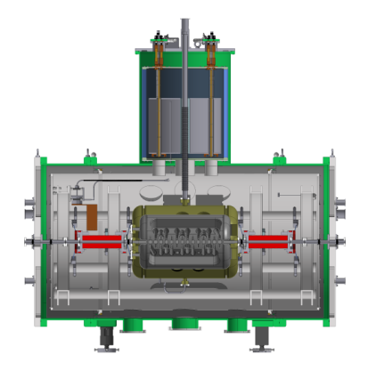
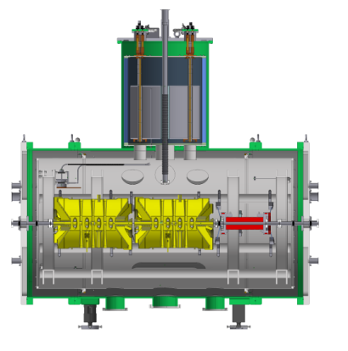
Layout and Time Line for Advanced Demonstrator
Evaluated within POF3
HLI
injector@GSI
A/q=6
11 m
1.39
1.88
2.4
3
3.6
E (MeV/u)
2016
2017
2019
Step 0
demonstrator (1 cavity)
Step 1
demonstrator (3 cavities)
Step 2
advanced demonstrator (7 cavities)
W. Barth
Status cw-linac, 22.8.16

Slide 5
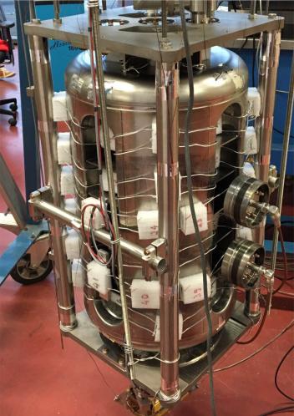
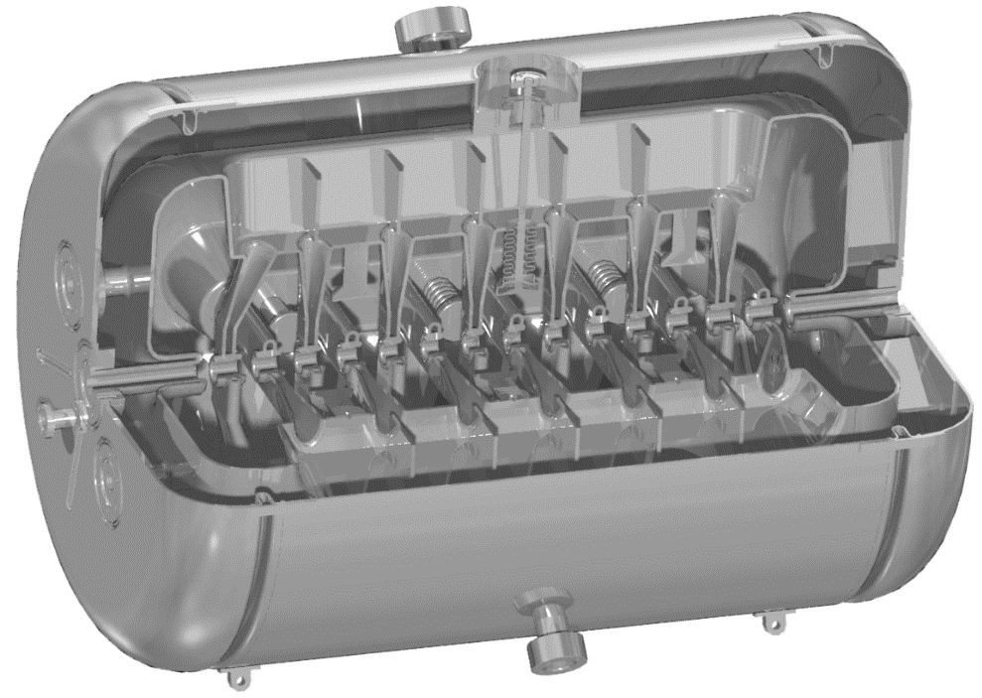
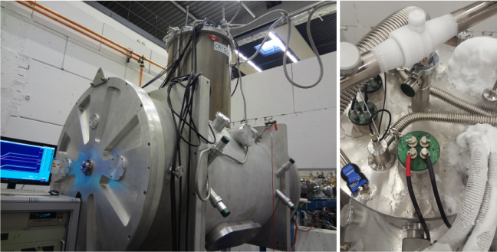
Step 0: CW-LINAC Demonstrator @ GSI
Matching line (ready)
High Charge State Injector (existing)
LHe infrastructure (ready)
Tested
delivery @Mai 2016
delivered & tested
Technical challenges:
Design and production of the sc CH-cavity
Constant alignment of the components during cool-down
W. Barth
Status cw-linac, 22.8.16

Slide 6
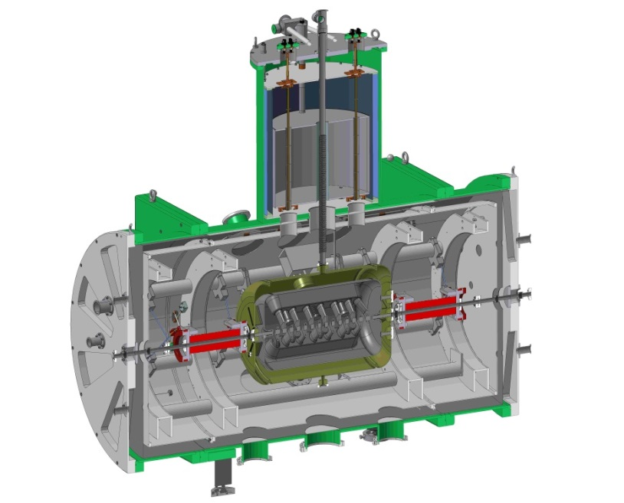
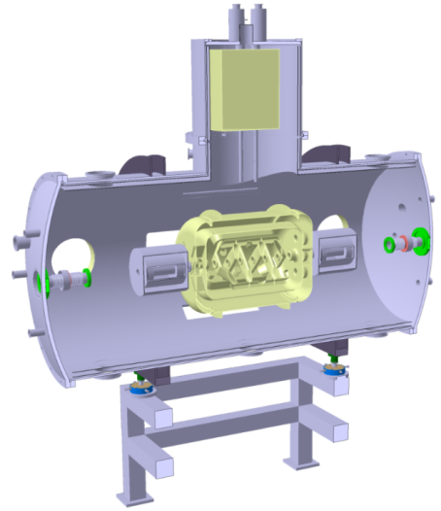
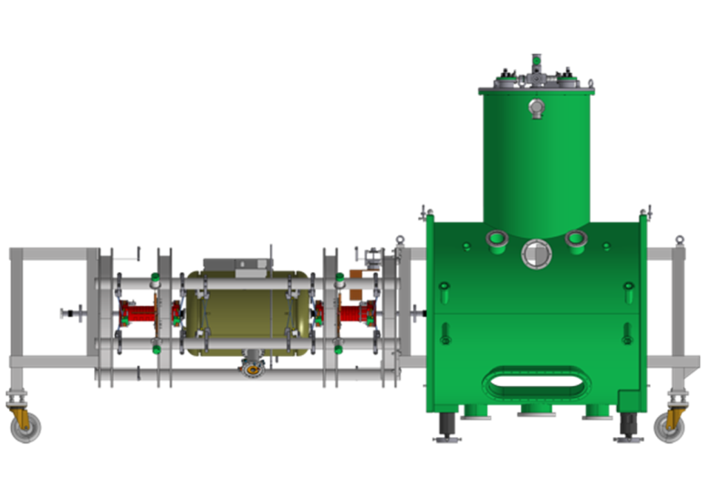
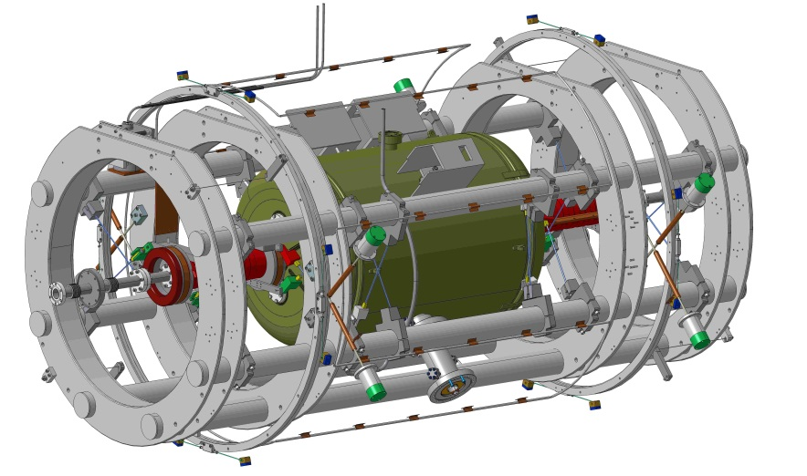
Design of Cryomodule by Cryogenic
Trial Design Aug. 2010
Final Design
Frame with Cavity and Solenoids
Assembly
W. Barth
Status cw-linac, 22.8.16

Slide 7
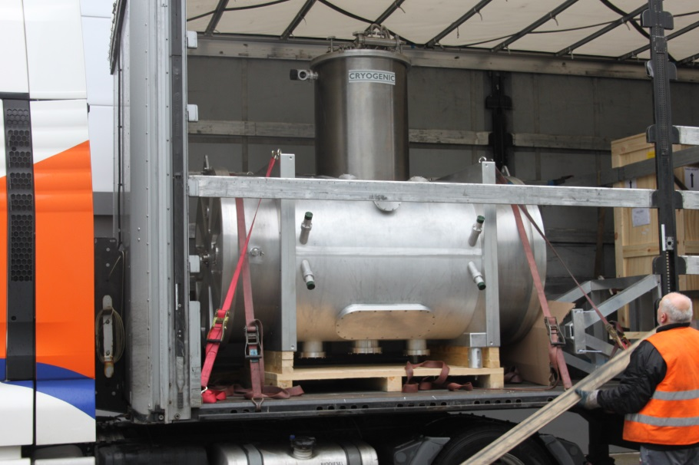
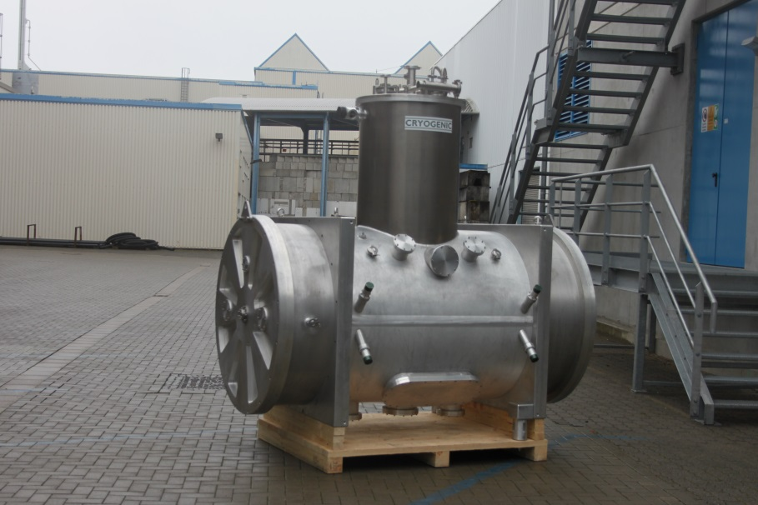
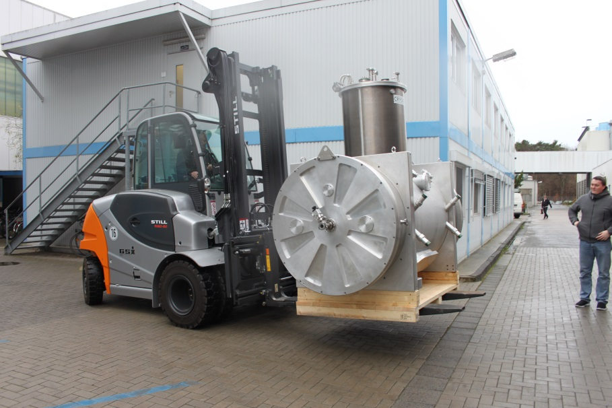
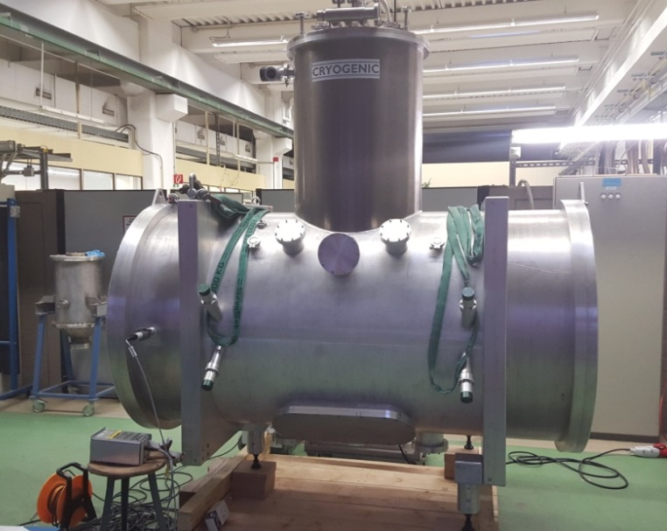
Delivery to GSI (19.11.15)
W. Barth
Status cw-linac, 22.8.16

Slide 8
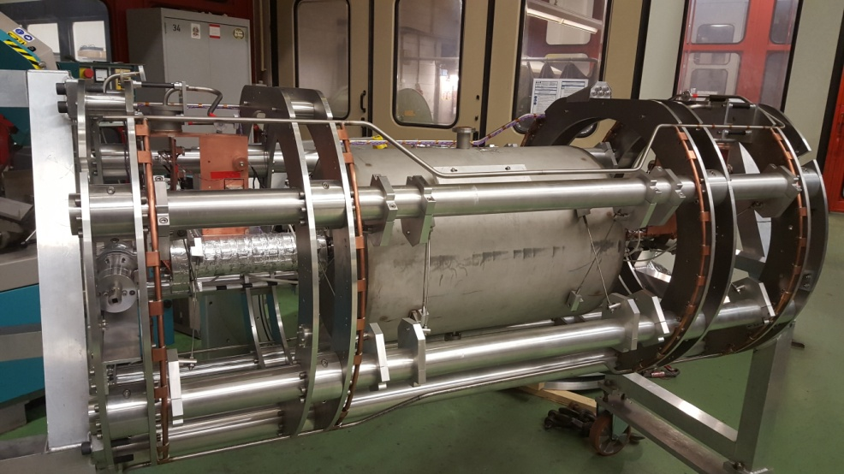
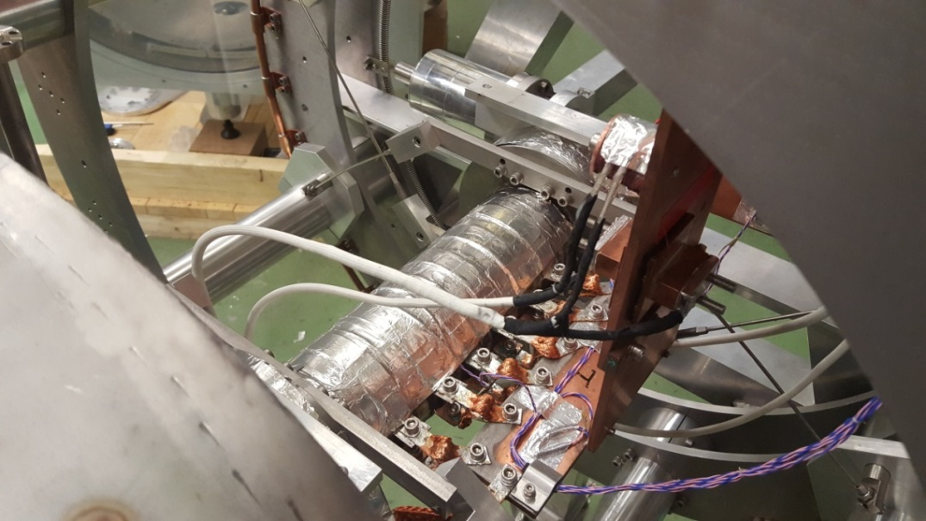
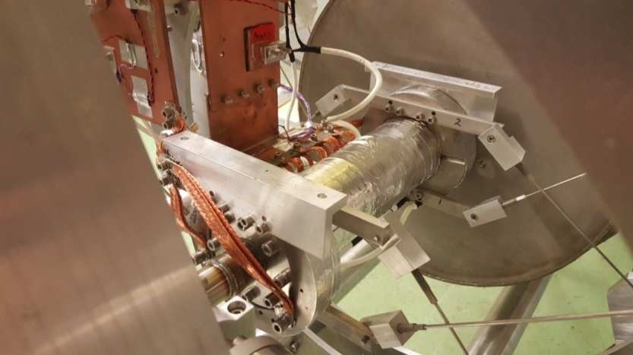
Cryomodule-assembly @ GSI
Frame with the dummy cavity
„Dry“ cooling of sc-solenoids
Special suspension of components preserves alignment during cooldown
W. Barth
Status cw-linac, 22.8.16

Slide 9
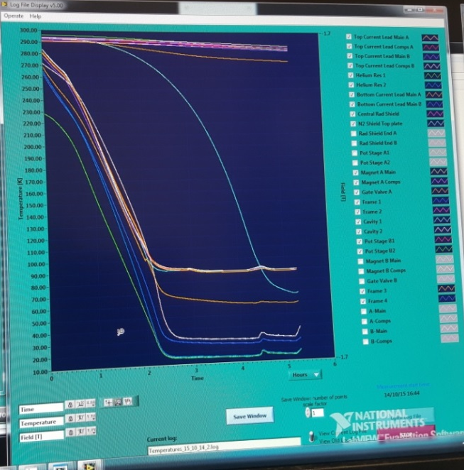
First cool down test @ GSI (17.12.15)
Cryostat installed in cw-bunker
Temperature is monitored during cooldown
sc-Solenoids were ramped at 9.3 T
Standby losses of cryostat 3W
Drift of components during cooldown +-0.15mm
W. Barth
Status cw-linac, 22.8.16

Slide 10
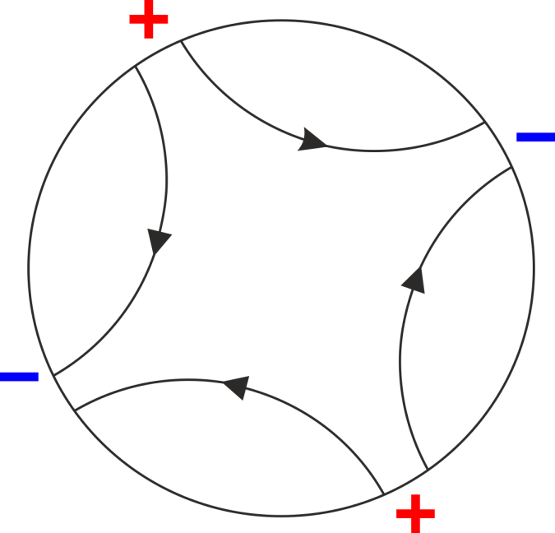
Cross Bar H-Mode Accelerating Cavity
$\vec{E}$field of H₂₁₁ Mode
of ”pillbox“ cavity
Drift tubes are alternating connected to “+” and “-” potential
Cross bar H-mode cavity → CH-cavity
W. Barth
Status cw-linac, 22.8.16

Slide 11
CH-Cavity for Demonstrator @ 216.8 MHz (F. Dziuba, Ph. D thesis)
Production @ RI
delivery September 2016
β | 0.059
Frequency | 216.816 MHz
Cells | 15
Length βλ-def (mm) | 691
Diameter (mm) | 409
Cell length | 40.82
E_{a} (MV/m) | 5.1
B_{p}/ E_{a} | 5.2
Helium out
Tuner flange
Helium vessel
Dynamic bellow
tuner
Helium in
Transverse size & efficiency → 2 x 108.408 MHz =216.816 MHz
W. Barth
Status cw-linac, 22.8.16

Slide 12
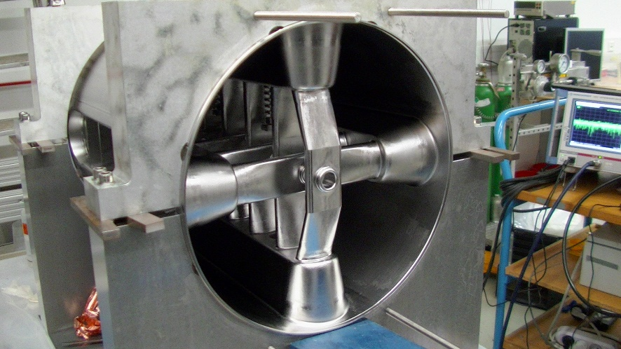
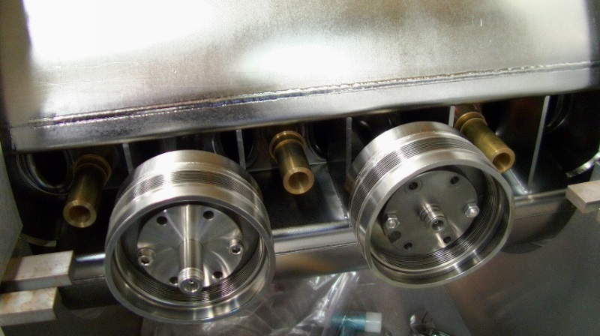
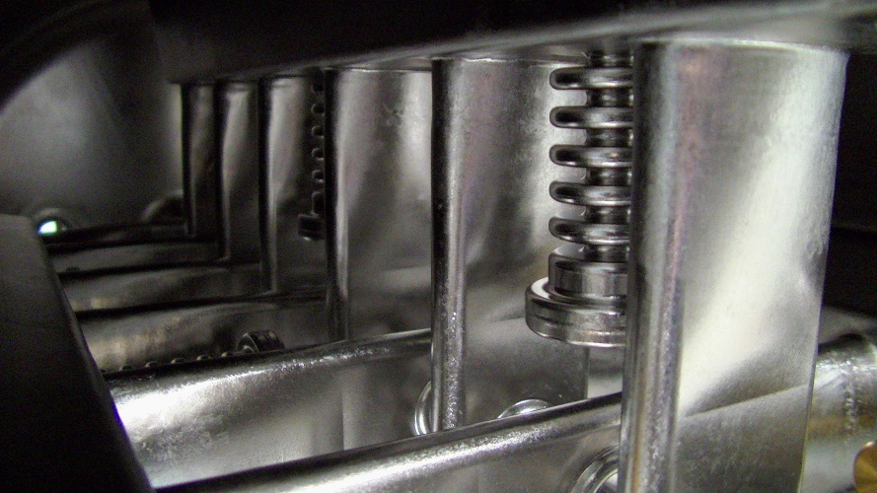
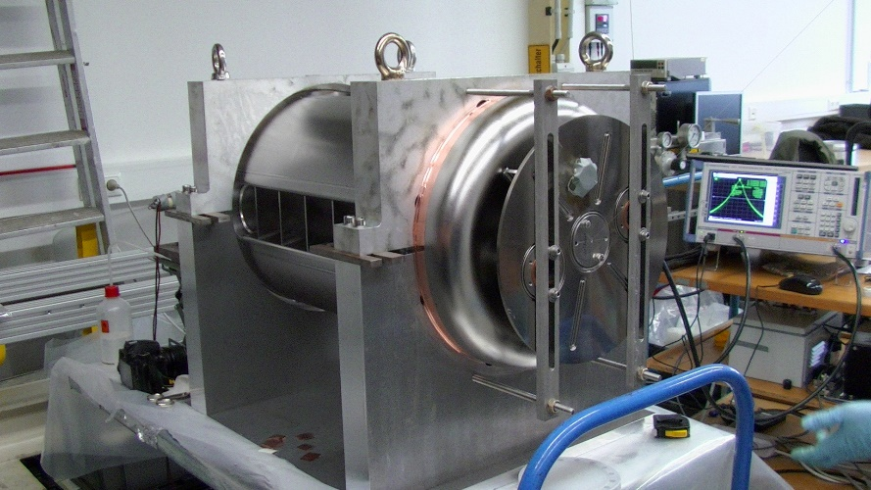
Cavity Production @ RI (Bergisch Gladbach, Germany)
cavity inside
rf-coupler flanges
bellow tuner
cavity with end caps
W. Barth
Status cw-linac, 22.8.16

Slide 13
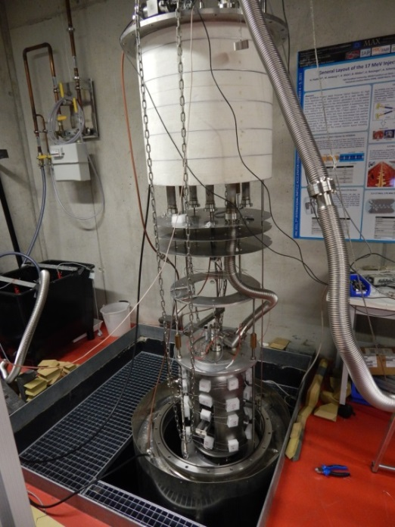
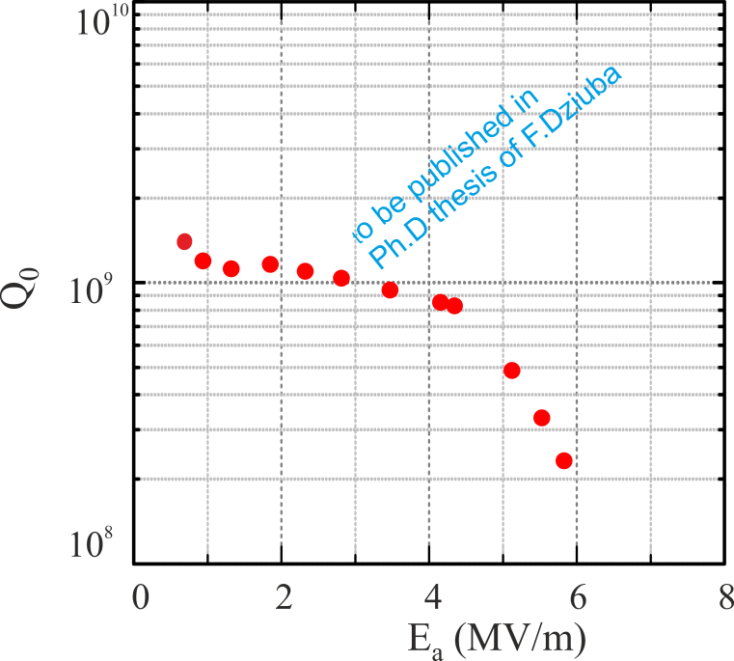
Quality Factor Q vs E_{a} for CH-Demonstrator (F. Dziuba, Ph. D thesis)
IAP @ Uni Frankfurt
RF-testing is completed
Q₀=5 x 10⁸ @5 MV/m (design acc. gradient)
Demonstrator cavity is in final production step (welding of He-reservoir)
Accelerating gradient can be increased by high pressure rinsing and Ar-discharge
W. Barth
Status cw-linac, 22.8.16

Slide 14
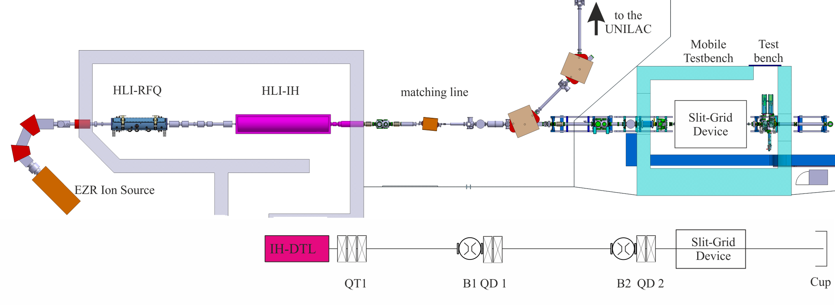
Transverse Emittance Measurement at Side of cw Demonstrator @ July 2015
Beam test of the matching line
Measurement of transverse emittance at side of cw-demonstrator
Reliable information about transverse emittance at exit of HLI for design of Advanced Demonstrator
W. Barth
Status cw-linac, 22.8.16

Slide 15
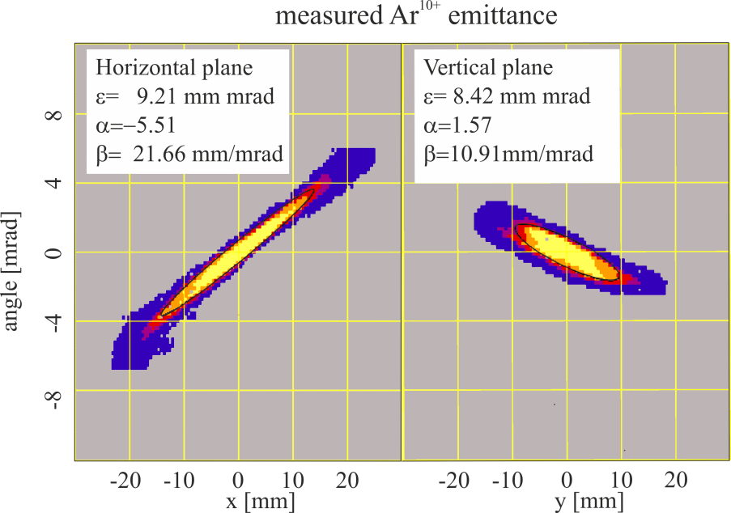
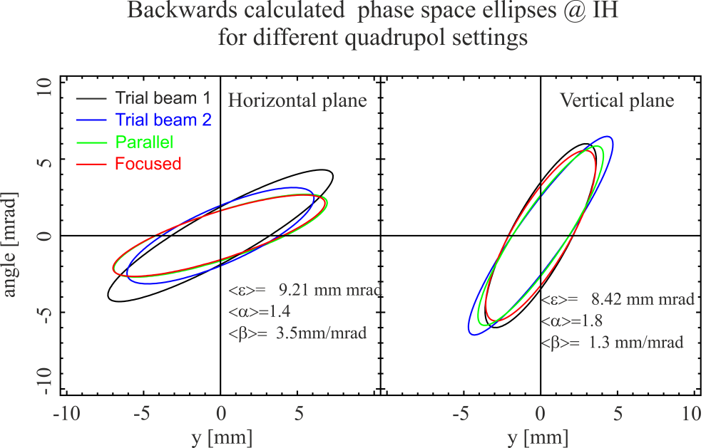
Measurement Results and Backwards Calculation
Slit grid device measure the transverse emittance in horizontal vertical planes
Excitation currents of quadrupoles was gauged prior measurement with dedicated DC current transformer
Backwards calculations has been done by the matrix code ”TRACE 3-D”
Measurement for different quadrupole settings increase the significance
Discrepancy is due to different settings of steering magnets
W. Barth
Status cw-linac, 22.8.16

Slide 16
Step 1&2: Advanced Demonstrator @ GSI
2.5 m
The standard cryomodule contains 2 cavities and 1 solenoid
Cavity 2&3 are already in production. Delivery @ Q1 of 2017
Tendering for cryostat @ Q4 of 2016
Advanced demonstrator allows first experiment at coulomb barrier for light and medium heavy ions
W. Barth
Status cw-linac, 22.8.16

Slide 17
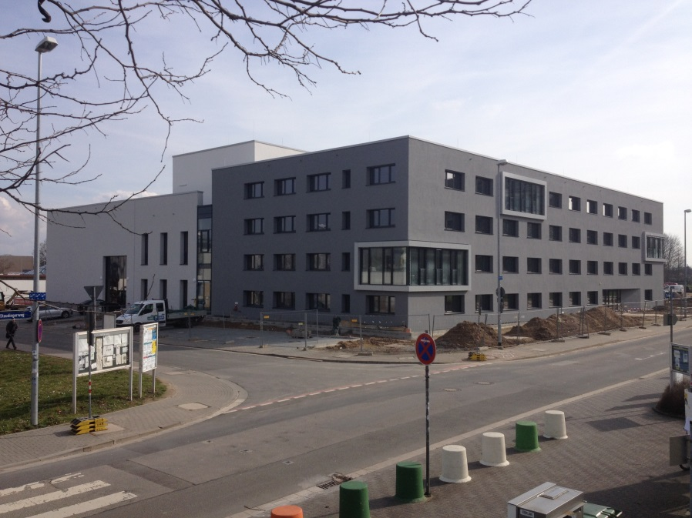
Infrastructure @ HIM
Ready to move in
High Pressure Rinsing (HPR)
RF testing (warm & cold cavities)
Cleanroom environment
Optional: setup for BCP
W. Barth
Status cw-linac, 22.8.16

Slide 18
Summary
Matching line is tested
Liquid He infrastructure is tested
Cold test of entire Demonstrator cryostat (incl. dummy cavity)
sc-solenoids (B = 9.3 T) successfully tested
RF-testing of Demonstrator cavity is completed @GUF
Demonstrator cavity is in final production step
2nd Rebuncher cavity ready for commissioning
New clean room@GSI available
2 Power coupler delivered
Power coupler test bench in preparation
Production of two further (short) CH-cavities already started
Standard cryostat is defined
W. Barth
Status cw-linac, 22.8.16

Slide 19
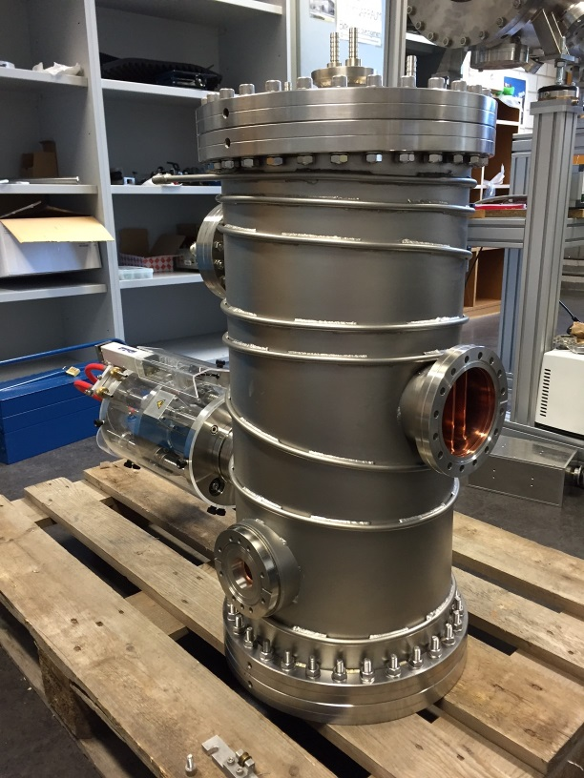
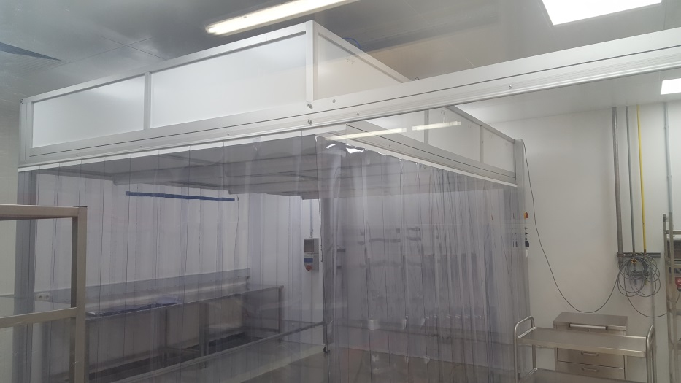
Recent delivery of components
High Power rf coupler
108 MHz-rebuncher
Clean room upgrade @GSI
(class ISO 5 (required: ISO 6), at FFU unit: class ISO 2 (required: ISO4))

Slide 20
Schedule of activities 2016
April&July: First beam tests with cryostat
3D matching
sc-solenoids
bunch structure monitor
July: commissioning of local clean room
>August: delivery of power coupler and rf-conditioning
September: Commisiioning/Rebuncher
October: rf-test of demonstrator cavity at site
November: beam test of fully equipped cryostat (CH-cavity+solenoids)
Next steps:
Further Improvement of the demonstrator cavity
Ordering of standard cryostats
Commissioning of infrastructure @ HIM
Delivery of “short” cavity
W. Barth
Status cw-linac, 22.8.16

Slide 21
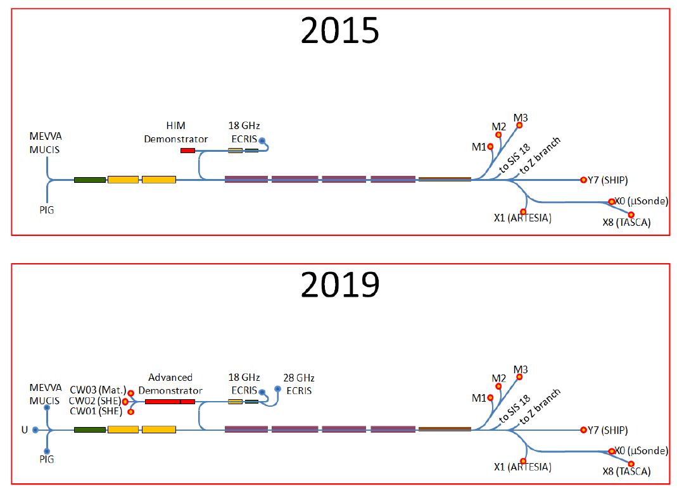
Further strategy I
W. Barth
Status cw-linac, 22.8.16

Slide 22
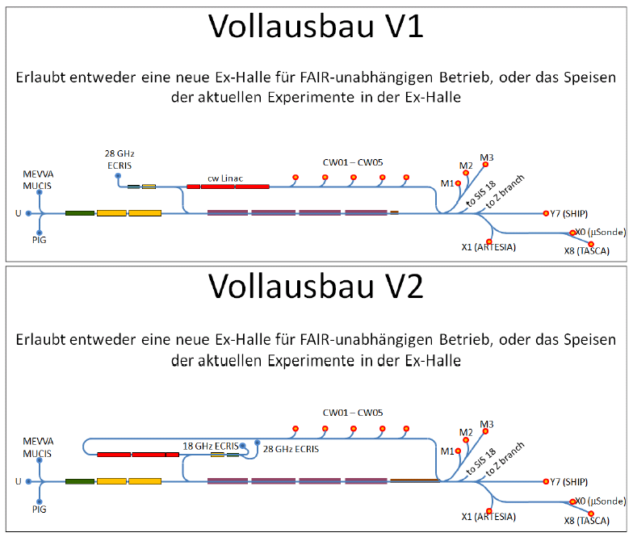
Further strategy II
W. Barth
Status cw-linac, 22.8.16

Slide 23
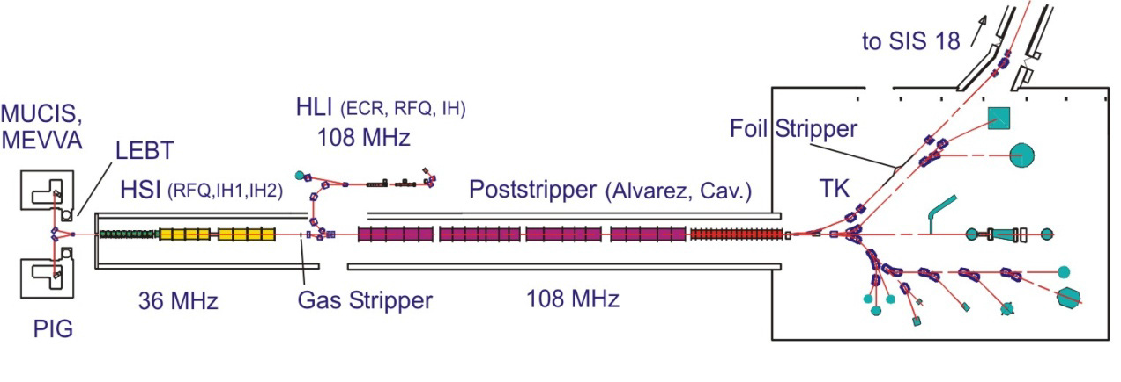
Further strategy III
HLI
cw-LINAC
HSI
ALVAREZ
W. Barth
Status cw-linac, 22.8.16

Slide 24
Offene Fragen...
UNILAC Upgrade
Wie sind die Betriebslimits nach dem Upgrade (10Hz, 0,6ms)?
10 Hz, ca. 0.5 ms
Möglichkeiten gibt es diese Limits zu erweitern (20Hz, 2ms, für A3 Energie)?
Derzeit keine Änderungen beim HF-Upgrade, GF-Beschluss: A1-A3 Senderupgrade>2021
Übergangsphase
Mischbetrieb 50Hz und 1Hz Hochstrom
Mischbetrieb HLI/HSI stellt kein Problem dar
Mischbetrieb HSI PIG/MEVVA oder MUCIS mit entsprechender Vorbereitung
Wie kritisch ist der Parallelbetrieb?
Welcher? – ansonsten: siehe oben
Gibt es weitere Einschränkungen außer dem MAZ für die Alvarez DC Magnete?
Es gibt jede Menge Einschränkungen – es hängt davon ab, welche Anforderungen erfüllt sein müssen?
Cw-Linac
Ist eine Pulslängenvariation möglich?
Ja, durch Makropulschopper
Max. m/q? Welche Ionen können mit der heutigen EZR Quelle im cw-Linac beschleunigt werden?
max. A/q =6, z.B. 48Ca10+, etc. – schwere Ionen stehen nicht mit einer ausreichend hohen Ladung zur Verfügung!
Wie sind die Schritte eines modularer Aufbaus? Mögliche Ausbaustufen?
siehe Vortrag, 2016: 1.9 MeV/u, 2019: 3.9 MeV/u (ca. 4.7 MeV/ für A/q=5)
Ist ein Betrieb mit zweiter Quelle (Penning im nicht cw-Betrieb) möglich?
Transferlinie HSI => cw-LINAC
Mögliche Strahlführung für einen zweiten LINAC (zB. cw-linac)
Einkopplung EH, Chopper, Paralellbetrieb X, Y, Z, M
siehe Übersichtsbild

