Slide 1
UNILAC
Workshop, GSI, 22.Aug2016, S. Mickat

Slide 2
How the roadmap for a new Poststripper looks like?
Motivation – overaged post-stripper is a risk for FAIR commissioning
Three LINAC Concepts (Alvarez, IH, Hybrid) - LINAC department favours Alvarez solution due to flexibility, beam quality, systematic matching
External Review is called in October 2016
One of the basic boundary condition: RF gallery upgrade
User requirements (EH, M-Branch) How to deal with the decided short pulse operation @10 Hz? What energy range is requested? ->Longterm strategy is needed.

Slide 3
What has changed since February?
new post-stripper project has reached the UNILAC-Upgrade projects in priority
stronger focus on reliability than performance (worst case: post stripper fails when FAIR is ready for commissioning)
MEBT redesign
Compact LEBT
& Terminal West
RFQ-redesign of electrodes
pulsed gas stripper,
EMTEX

Slide 4
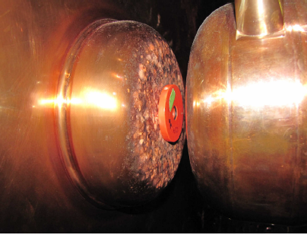
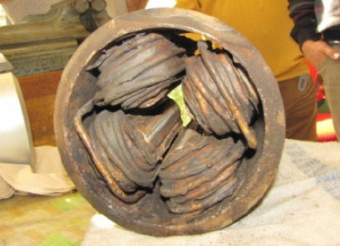
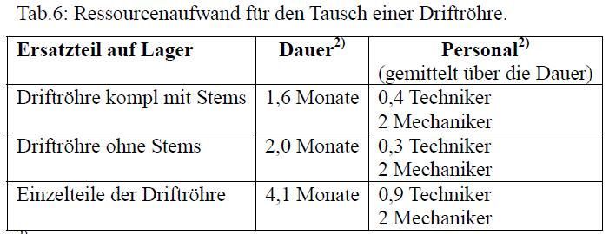
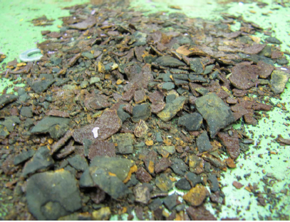
Kann der existierenden „Alvarez“ saniert werden?
effort for refurbishment (costs, time, man power)
beats the effort for a new post stripper Linac highly

Slide 5
What are the new post-stripper concepts?
new Alvarez (synchronous particle bd)
6x IH cavities IH-LINAC (former HE-LINAC) (KONUS)
13x IH cavities Hybrid-LINAC (synchronous particle bd)
cw LINAC (EQUUS, no post-stripper option, in addition)

Slide 6
Entwicklung Verstärker Prototyp & Stufenweise Modernisierung
Neuer 1,8 MW Verstärkerkreis von THALES (Prototyp)
Entwicklung 150 kW Tansistor-Treiberverstärker (Prototyp)
Umbau bestehende Alvarez-Endstufen & Aufbau separate Steuerracks:
Neuentwicklung SPS-Verstärkersteuerung & ME
Kommerzielle Netzgeräte für UG1
Moderne SPS-Steuerung für UA-Netzgeräte
Neuentwicklung digitale LLRF & ω₀ Regelung (Prototypen)
Längerfristig: Austausch der bestehenden Endstufen & Treiberverstärker durch die Neuentwicklungen (noch nicht finanziert)
Stufe 1
(bis 2018)
Stufe 2
(später)

Slide 7
Overview: Parameters
 |  | New Alvarez | IH LINAC (6x IH) | Hybrid Linac (13x IH) | Cw Linac
Output Energy | [MeV/u] | 3.3-11.4 | (3.9-)11.4 | 5.3@June2016 (3.3-11.4) | 3.5-7.3
Operation frequency | [MHz] | 108 | 108 | 108 | 217
A/Q |  | 8.5 | 8.5 | 8.5 | 6
Design Ion |  | 238U28+ | 238U28+ | 238U28+ | (ECR)
Duty Cycle (rf) | [%] | 0.2 (2) | 0.2 (2) | 0.2 (2) | 100
Repetition rate | [Hz] | 10 | 10 | 10 | -
Pulse length (rf) |  | 200µs (2 ms) | 200µs (2 ms) | 200µs (2 ms) | -
Currents | [emA] | 15 | 15 | 15 | -
Emittance growth | [%] | 5 | 15 | 10 @5.3 MeV/u | -
Beam dynamics |  | Synchr Particle | KONUS | Synchr Particle | EQUUS

Slide 8
Overview: Features
 |  | New Alvarez | IH LINAC (6x IH) | Hybrid LINAC (13x IH) | Cw Linac
suitable for new post stripper |  | yes | yes | yes | in addition
suitable for FAIR injector |  | yes | yes | yes | no, Limited in energy and intensity
rf-gallery compatible |  | yes | yes | no (solid state rf) | no
Suitable for X,Y,Z,M-Branch |  | Shortpulse, Longpulse up to A3 possible (2018) | Shortpulse, Longpulse up to A3 possible (2018) | Shortpulse | Dedicated
Costs | [Mio] | 34 Mio | 27 Mio (HE-LINAC) | 20 Mio (not confirmed yet) | 27 Mio (EXON 2013)
Commissioning |  | 2022 | 2022 | 2022 | -
perspective |  | To be reviewed | To be reviewed | To be reviewed | No funding, directorate (June2016)

Slide 9
mein persönliches „Brainstorming“
Nutzeranforderungen – langfristige Perspektive
IH Linac – dedizierter FAIR Injector,
enges Parameterfenster am Eingang
Hybrid Linac – Kurzpulsbetrieb (Festkörperverstärker)
Alvarez – Bedingungen wie gehabt, solange HF-Gallerie nicht komplett modernisiert ist
FAIR ist Hauptexperiment
cw LINAC parallel zum UNILAC (Finanzierung, Zeitplan)
dedizierter FAIR Injektor
parallel zum existierenden Alvarez
Einzelresonatoren
(Energievariation)
cw LINAC auf „grüner Wiese“
(Radioaktiv Labore, ISL-> M-Zweig)
Experimenttransfer an andere Beschleunigeranlagen
SIS18 – UNILAC als Injektor
(EH-Experimente damals?)
Priorität – Kosten – Manpower - Zeitskala

Slide 10
Danke

Slide 11
Post-stripper Collaboration
X. Du¹, P. Gerhard¹, L. Groening¹, H.Hähnel², M. Heilmann¹, S. Mickat¹, M. Kaiser¹, H. Podlech², U. Ratzinger², A. Rubin¹, B. Schlitt¹, G. Schreiber¹, A. Seibel², R. Tiede²
¹ GSI Helmholtzzentrum
² Goethe University Frankfurt

Slide 12
What are the main Upgrade activities @HSI?
..introduced in February aiming at best possible HSI-IH performance
MEBT redesign
Compact LEBT
& Terminal West
RFQ-redesign of electrodes
pulsed gas stripper,
EMTEX

Slide 13
U-Measurements (July 2016)
A. Adonin on Wed

Slide 14
p-Measurements (July 2016)

Slide 15
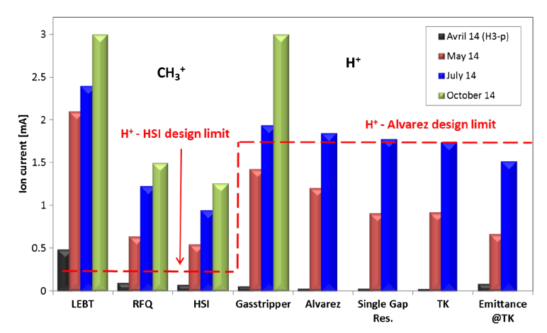
p-Measurements (2014)

Slide 16
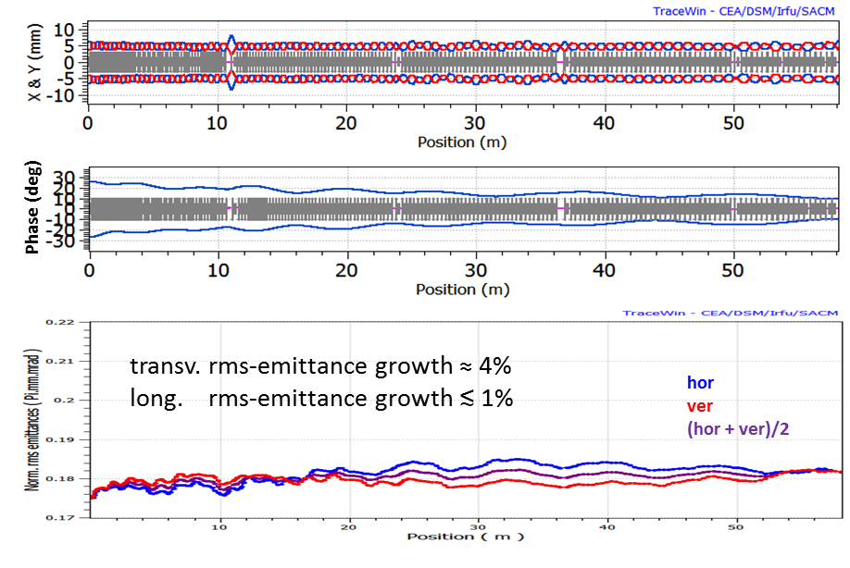
Alvarez-DTL
Input:
15 mA ²³⁸U²⁸⁺
βγε_{⊥,rms} = 0.175 µm
ε_{||,rms} = 70 keV/u deg
Gaussian
very low emittance growth thanks to high periodicity and systematic matching

Slide 17
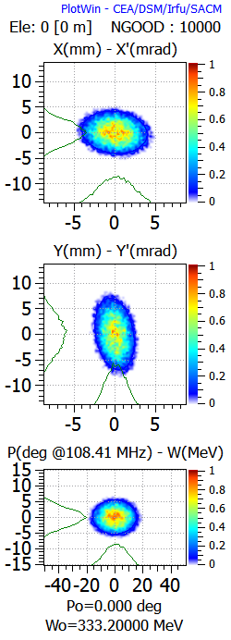
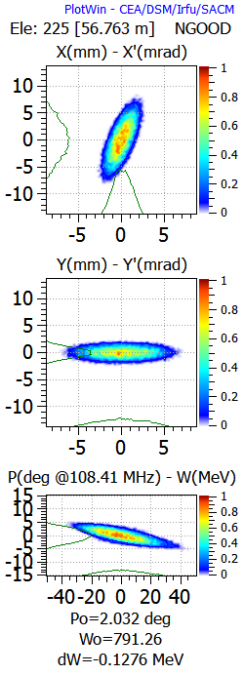
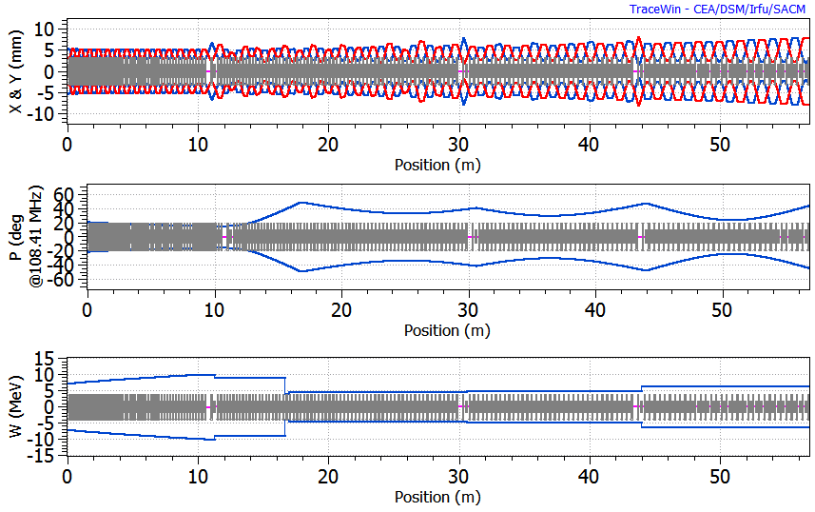
Design adapted - short 2nd tank (A. Rubin)
X-X'
Emit [rms] = 0.1750 Pi.mm.mrad [ Norm. ]
Emit [95.00%] = 0.8808 Pi.mm.mrad [ Norm. ]
Beta = 0.9700 mm/Pi.mrad
Alpha = 0.1100
Y-Y'
Emit [rms] = 0.1750 Pi.mm.mrad [ Norm. ]
Emit [95.00%] = 0.8835 Pi.mm.mrad [ Norm. ]
Beta = 0.3500 mm/Pi.mrad
Alpha = 0.2300
Phase-Energy
Emit [rms] = 16.5700 Pi.deg.MeV [ Norm. ]
Emit [95.00%] = 83.9397 Pi.deg.MeV [ Norm. ]
Beta = 2.8933 deg/Pi.MeV
Alpha = 0.0070
X-X'
Emit [rms] = 0.1749 Pi.mm.mrad [ Norm. ]
Emit [95.00%] = 0.8814 Pi.mm.mrad [ Norm. ]
Beta = 0.4490 mm/Pi.mrad
Alpha = -0.9769
Y-Y'
Emit [rms] = 0.1750 Pi.mm.mrad [ Norm. ]
Emit [95.00%] = 0.8857 Pi.mm.mrad [ Norm. ]
Beta = 3.3134 mm/Pi.mrad
Alpha = -0.0102
Phase-Energy
Emit [rms] = 16.8927 Pi.deg.MeV [ Norm. ]
Emit [95.00%] = 86.1853 Pi.deg.MeV [ Norm. ]
Beta = 11.6049 deg/Pi.MeV
Alpha = 1.2701
I=0, negligible trans. emittance growth
long. emittance growth 3%

Slide 18
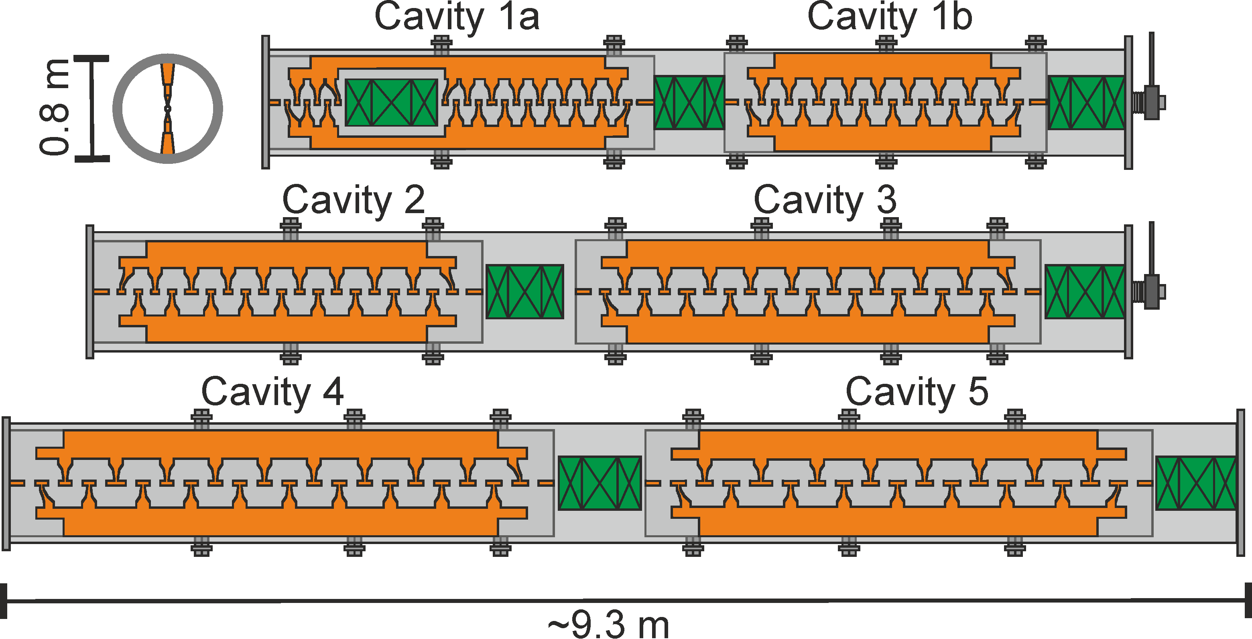
IH-LINAC
~ 25 m
~ 50 m
36 MHz HSI
108 MHz - IH-DTL
1.4 – 11.4 MeV/u
transport /
future upgrades
details soon by U. Ratzinger

Slide 19
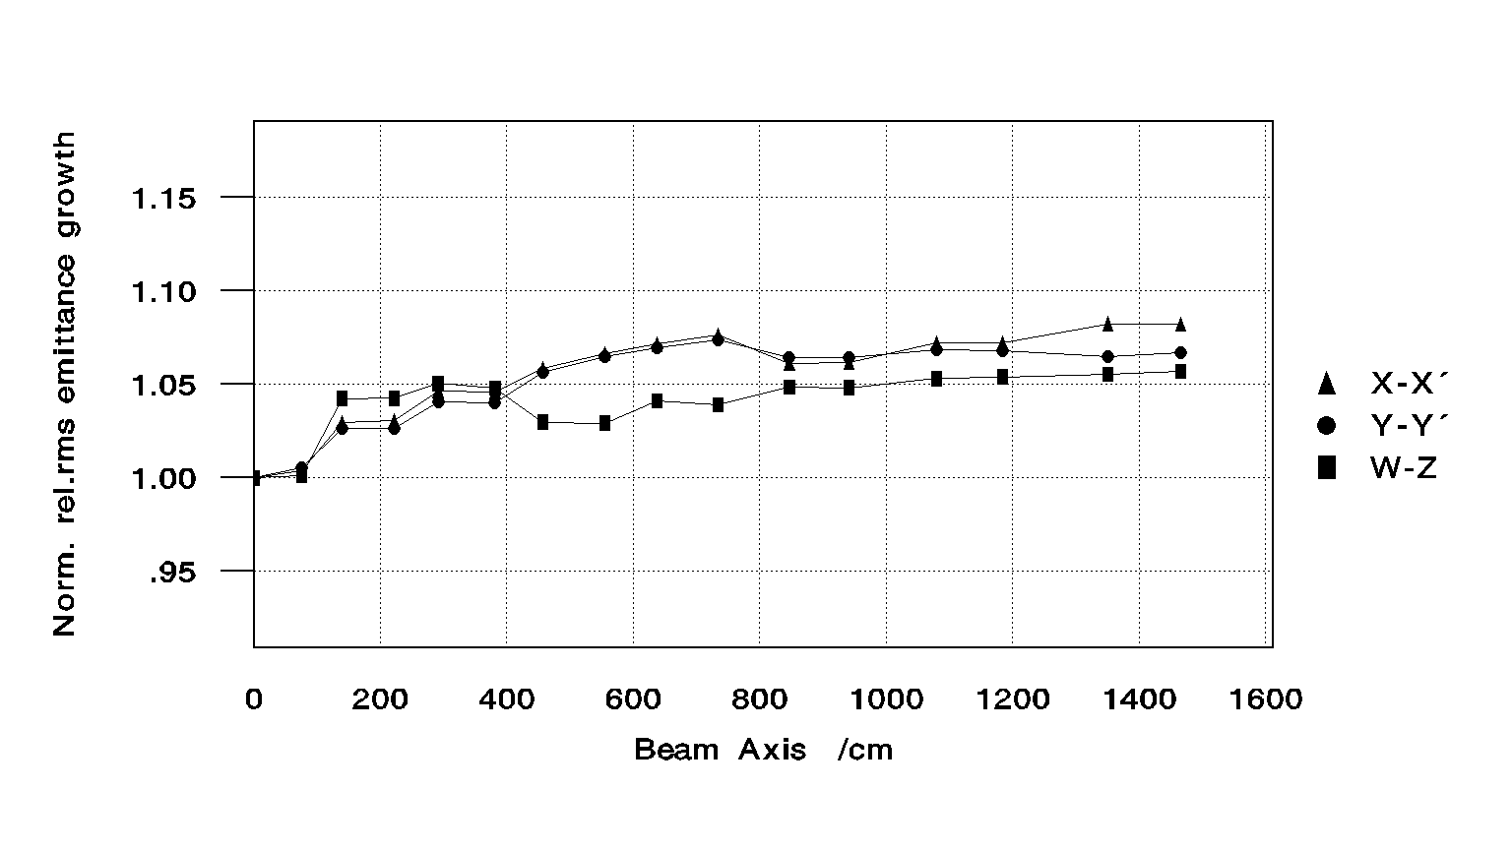
Hybrid LINAC
13x short IH
Features
by H. Podlech et al
synchronous particle beam dynamics
Quasi-periodic lattice
Small emittance growth
Shorter cavities (fabrication, tuning)
Easy maintenance and access
Many intermediate energies
Larger longitudinal acceptance compared to longer structures
Less power per cavity → solid state technology (state of the art, modularized)
Compact (L≈30 m)
Cost effective (<20 M€)
June2016, 5.3 MeV/u with seven cavities

Slide 20
Alvarez-Type DTL – rf-design (X. Du)
Design V5 | tank I 20160713 | tank II 20160713 | BBQ 5&6 20160713 | tank III 20160713 | tank IV 20160713 | tank V 20160713
energy [MeV/u] | 1.392 – 3.316 | 3.316 – 4.351 | 4.351 – 4.351 | 4.351 - 6.621 | 6.621 – 8.966 | 8.966 – 11.341
apperture radius [mm] | 15 | 17.5 | 17.5 | 17.5 | 17.5 | 17.5
rf-phase [deg] | -30 | -30 | -90 | -30 | -25 | -25
# cells | 55 | 20 | 2 | 43 | 35 | 31
L_{gap} / L_{cell} | 0.27 | 0.27 – 0.28 | 0.28 | 0.23 – 0.25 | 0.22 – 0.23 | 0.22 - 0.23
rf-length [m] | 10.54 | 4.99 | 0.53 | 12.78 | 12.41 | 12.53
E_{surf,max} [E_{K}] | 1.00 | 1.00 | 1< | 0.96 | 0.98 | 0.96
P_{loss,MWS} [MW] | 0.885 | 0.555 | 0.121< | 0.870 | 0.842 | 0.853
P_{beam} [MW] | 0.245 | 0.132 | / | 0.289 | 0.299 | 0.303
<Z_{eff}> [MΩ/m] | 28.67 | 27.95 | 12.8 | 33.48 | 38.02 | 38.13
E_{eff},_{mean} (MV/m) | 1.55 | 1.76 | / | 1.51 | 1.61 | 1.61
E_{eff},_{mean} (MV/m) | 1.59

Slide 21
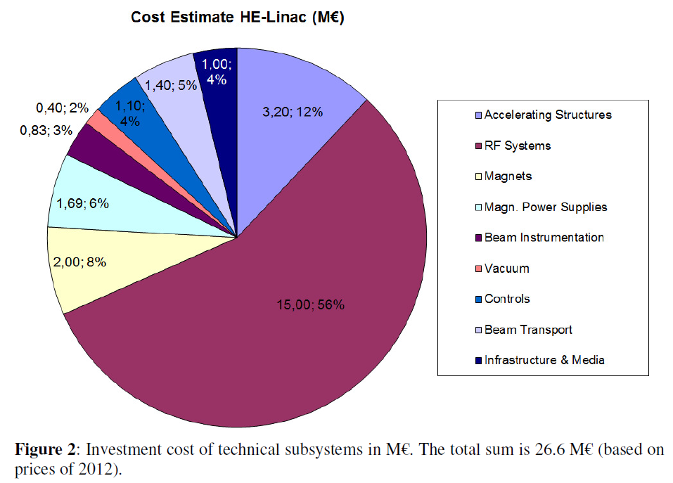
What is the basis of our cost estimation?
26.6 Mio €

Slide 22
Cost estimate
 | IH-LINAC (2012->2016) | Alvarez | Hybrid LINAC
Total | 27.312.120,00 € | 33.564.944,90 € | <20.000.000 €
Accelerating Structures | 3.283.200,00 € | 12.379.250,62 €
RF Systems | 15.390.000,00 € | 15.390.000,00 €
Magnets | 2.052.000,00 € | - €
Magn Power Supplies | 1.733.940,00 € | 2.000.000,00 €
Beam Instrumentation | 851.580,00 € | 873.721,08 €
Vacuum | 410.400,00 € | 800.000,00 €
Controls | 1.128.600,00 € | 1.128.600,00 €
Beam Transport | 1.436.400,00 € | 736.873,20 €
Infrastructure&Media | 1.026.000,00 € | 256.500,00 €
component lists are needed/made for detailed estimation

Slide 23
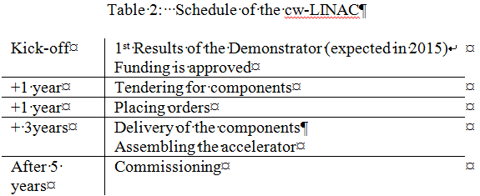
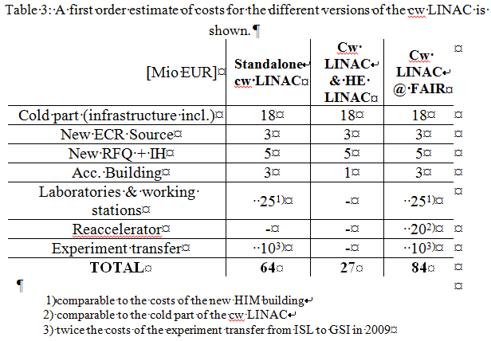
EXON2013, Vladiwostok, RU

Slide 24
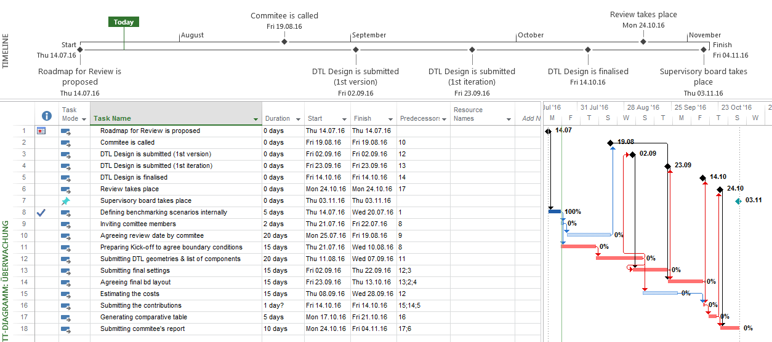
Proposed (tight) schedule for a Oct-review
Review is organised by directorate & AO

Slide 25
Proposal: Benchmarking Scenarios
MAC@June2016, L. Groening
at DTL entrance: ²³⁸U²⁸⁺ @ 1.394 MeV/u, Gaussian distribution, TraceWin, field maps
Input |  |  |  | Output
I [mA] | βγε_{x,rms} [mm mrad] | βγε_{y,rms} [mm mrad] | ε|| [MeV/u deg] | E_{fin} [MeV/u]
16.5 | 0.175 | 0.175 | 0.07 | 11.4
16.5 | 0.175 | 0.175 | 0.14 | 11.4
16.5 | 0.175 | 0.175 | 0.035 | 11.4
0 | 0.175 | 0.175 | 0.07 | 11.4
0 | 0.175 | 0.175 | 0.07 | 3.3(Alv) / 3.9(IH)
16.5 | 0.0875 | 0.350 | 0.07 | 11.4
FAIR
long. accept.
X,Y,Z,M -Branch
EMTEX
Meeting for agreeing benchmarking scenarios is called by AO in August

Slide 26
User requirements
LINAC dept/Collaboration works out, evaluate, favors, recommends post-stripper solutions
-> decision by directorate -> driven by user community
Focus on FAIR -> short-pulse rf-gallery upgrade RF gallery upgrade is one of the most important boundary condition
UNILAC RF reliability is increased when the solid state pre amplifiers are commissioned
Energy limited long-pulse operation possible until power-amplifiers (A1-A2B ) are exchanged, -> no longterm perspective: no spare parts (tubes) fabricated -> remainder are buyed expensively every year.
a compromise for all applications until dedicated long pulse/cw LINAC is thinkable
-> Poster of J. Zappai et al

Slide 27
How the roadmap for a new Poststripper looks like?
Motivation – overaged post-stripper is a risk for FAIR commissioning
Three LINAC Concepts (Alvarez, IH, Hybrid) - LINAC department favours Alvarez solution due to flexibility, beam quality, systematic matching
External Review is called in October 2016
One of the basic boundary condition: RF gallery upgrade
User requirements (EH, M-Branch) How to deal with the decided short pulse operation @10 Hz? What energy range is requested? ->Longterm strategy is needed.

