Slide 1
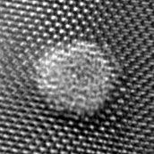
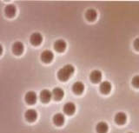
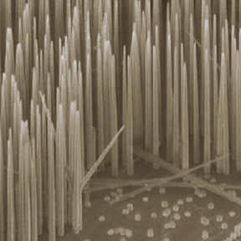
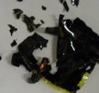
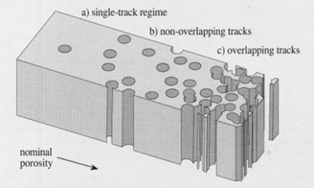
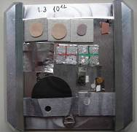
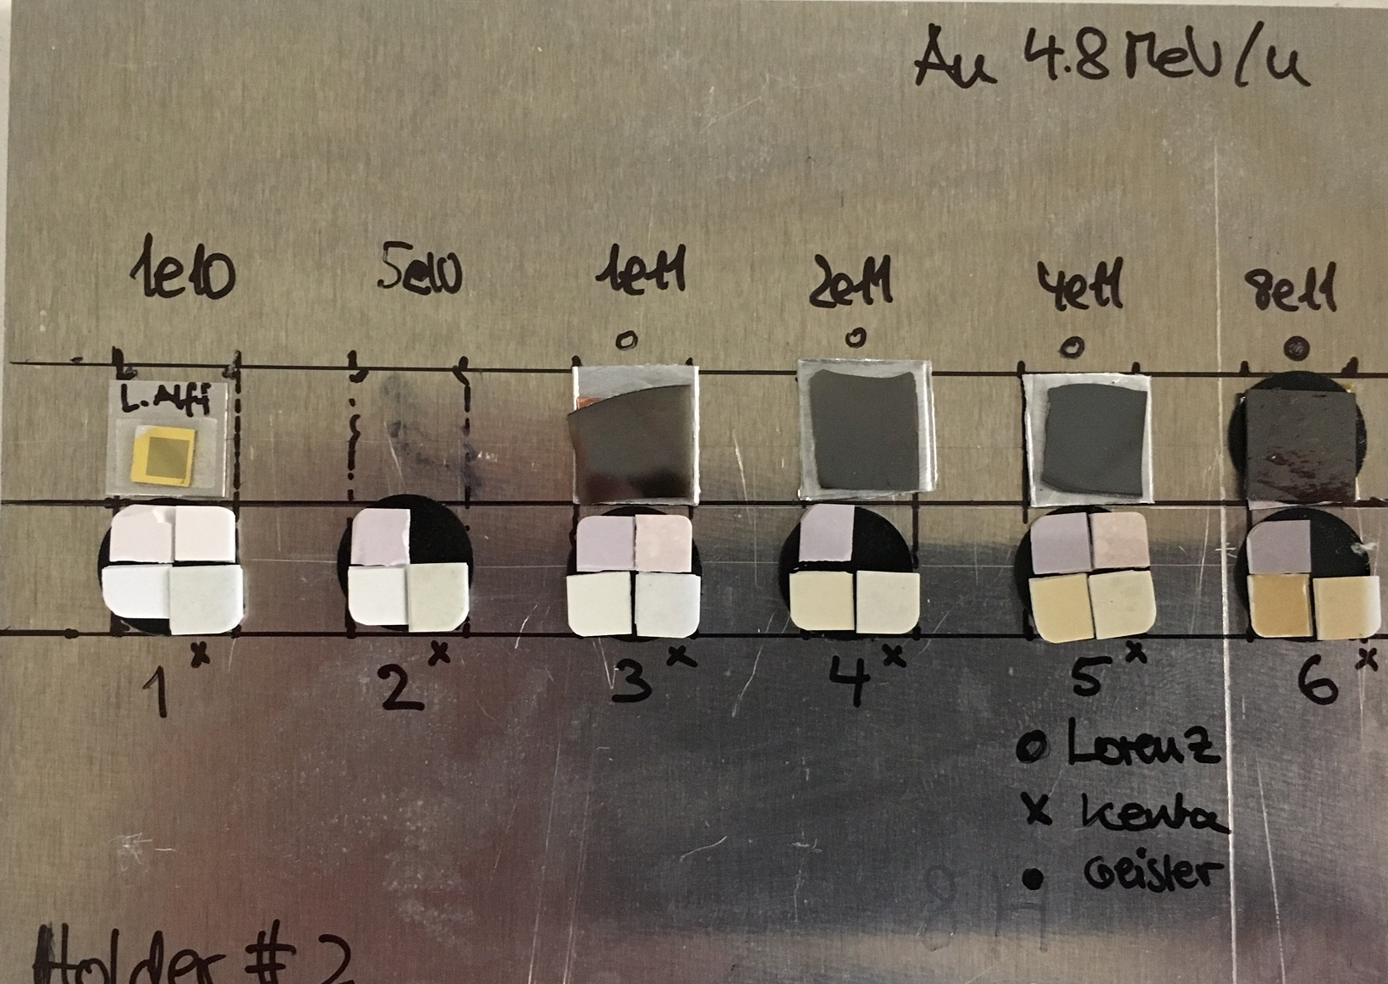
MATerials Research: Topics and Activities
Radiation effects
track formation
damage analysis
beam-induced changes
radiation hardness
Ion-track nanotechnology
Synthesis and characterization
nanopores
nanowires
2 nm
User facility
irradiation service
support external users
broad spectrum of beam parameters
~90 user groups, 22 countries
FAIR-relevant Materials
desorption (vacuum problems)
insulating components
high-dose materials
- target wheel (Super-FRS)
- beam dumps
- collimators, etc.

Slide 2
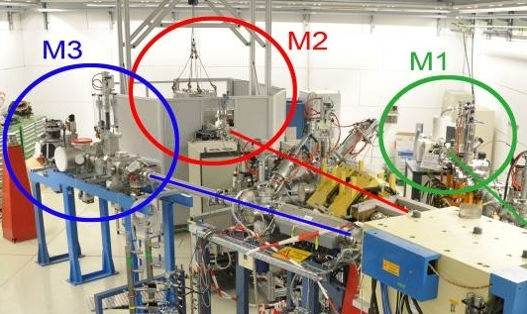
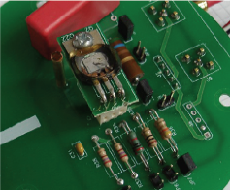
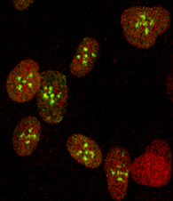
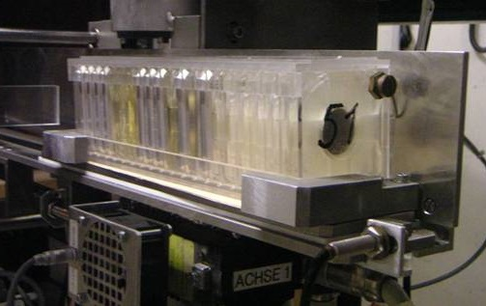
MATerials Research: Beamlines
M-Branch (M1, M2, M3)
material analysis in-situ and on-line
(microscopy, spectroscopy, etc.)
UNILAC
X0-Beamline
automatic sample
exchange system
X0-Beamline
microprobe
(Bio & Mat)

Slide 3
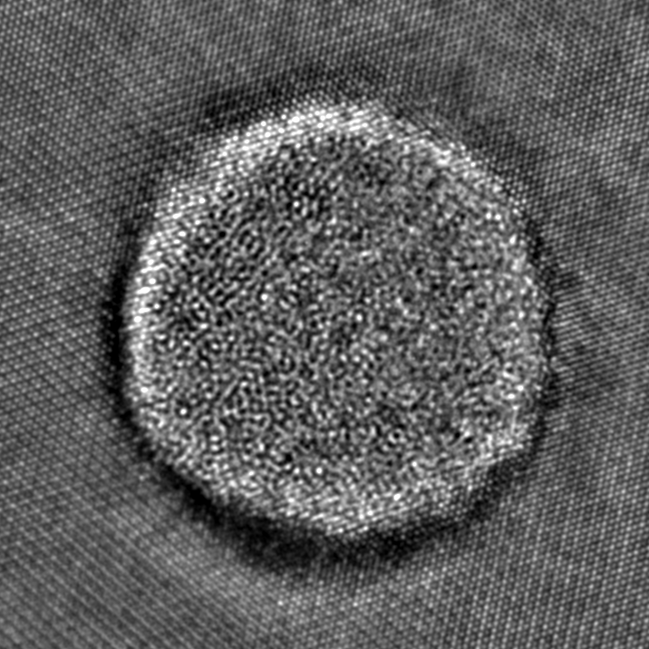
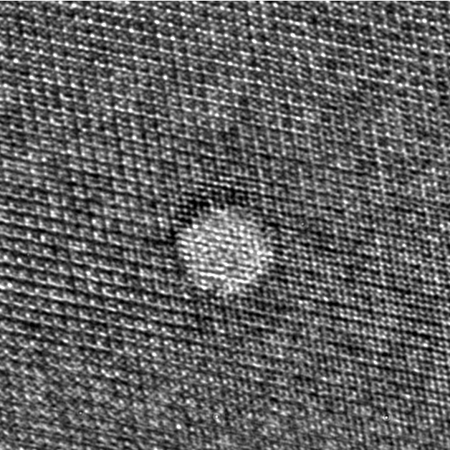
Physics behind MATerials Research
most important parameter = energy loss of ions
UNILAC energies
ion track in
pyrochlor Gd₂Ti₂O₇
U
Au
¹⁹⁷Au
Xe
Kr
¹⁰¹Ru
Ar
SRIM code

Slide 4
Physics behind MATerials Research
most important parameter = energy loss of ions
UNILAC energies
U
SIS energies →
lower energy loss
Au
Xe
Kr
Ar

Slide 5
Physics behind MATerials Research
high energy → large ion range
at 10 MeV/u → ion range 50 – 100 µm
important for bulk samples
little variation of energy loss
unique compared to most other ion beam facilities
U
Au
Xe
Kr
Ar
SRIM code

Slide 6
Beam parameter: duty cycle
Radiation effects scale with accumulated fluence (ions/cm²)
→ important: high duty cycle
I
50 Hz / 5 msec
☺
t
I
10 Hz / 2 msec
😐
loss of x12.5
t
I
☹
loss of x50
5 Hz / 1 msec
t
6

Slide 7
Beam parameter: flux
too high flux (ions/cm²s) leads to detrimental effects (heat load)
limit depends on ion species and radiation hardness of material
I
50 Hz / 5 msec
☺
t
☹
I
5 Hz / 1 msec
t
7

Slide 8
Beam parameter: summary
Important parameters
energy loss of ions → U ...Au ions preferred
ion range for volume irradiations → high energy (11 MeV/u)
accumulation of ions (fluence) →long pulse length
detrimental flux effects (heat load) → limited pulse currents
optimum → high duty cycle

Slide 9
Beam requirements: X0-beamline
Broad Beam Facility
Ion species: Au ..... U
Energy: > 5-6 MeV/u, optimal: 11.4 MeV/u
Rate: 5 - 50 Hz
Pulse length: 1 - 5 ms
Intensity: 10⁴ - 10¹⁰ ions/s
General schedule:
10-20 days/year
Parasitic mode possible
3-6 month of operation
work horse of user facility
samples for ion track nanotechnology
single-ion irradiations
300 samples per shift

Slide 10
Beam requirements: X0-microprobe
Microprobe
Ion species: C ..... U
Energy: 4.8 – 11.4 MeV/u
Rate: 5 - 50 Hz
Pulse length: 1 - 5 ms
Intensity: 10⁶ - 10⁸ ions/s
General schedule:
10-20 days/year
Parasitic mode difficult but possible ( ≥10 Hz)
3-6 month of operation
user facility for targeted irradiations
living cells (biophysics)
electronics (ESA, etc)

Slide 11
Beam requirements: M-branch
M-branch
Ion species: C - U (typ. Au)
Energy: 3.6 - 11.4 MeV/u
Rate: 5-50 Hz
Pulse length: 1 - 5 ms
Intensity: 10⁶-10¹⁰ ions/s
General schedule:
20-40 days/year (main)
20-40 days/year (parasitic)
3-6 month of operation
user facility
on-line damage analysis
(FAIR materials, Verbundforschung, intern. collaborations)

Slide 12
Beam requirements: summary MAT
Ion species: C .... U (frequently Au)
Energy: 3.6 - 11.4 MeV/u
Rate: 5 - 50 Hz
Pulse length: 1 - 5 ms
Intensity: 10⁴-10¹⁰ ions/s
General schedule:
20 - 40 days/year (main)
40 - 80 days/year (parasitic)
3 - 6 month of operation
frequent beamtimes instead of long runs
flexible beam sharing (main/parasitic)

Slide 13
Open Questions
Future operation of UNILAC:
  operation with Penning source (normal current mode)
  duty cycle for high current source
  realistic operating scenarios (beam sharing, multi user operation)
  parallel operation of second source (operation parameters)
CW-Linac:
beam parameters:
  available ion species (Au, U ?)
  type of source
  maximal energy (10 MeV/u ?)
  maximum m/q
  pulse structure / frequency
  Parallel operation to FAIR-Injector
  Funding situation
  Time schedule

