Slide 1
Z6 experiments and necessary beam parameters

Slide 2
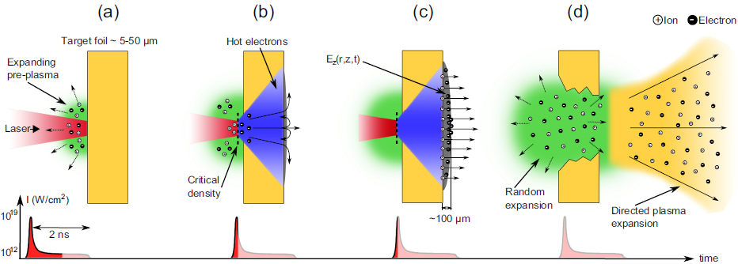
Experiments
LIGHT

Slide 3
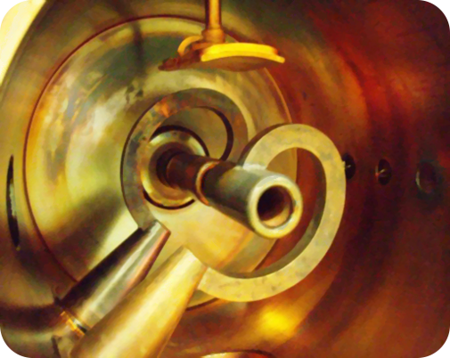
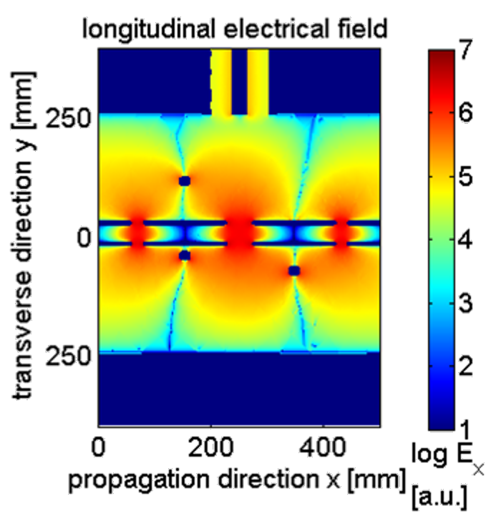
Experiments
LIGHT
double spiral resonator
> 100 kW rf power
3 gaps
±1 MV acc. voltage
108.4 MHz

Slide 4
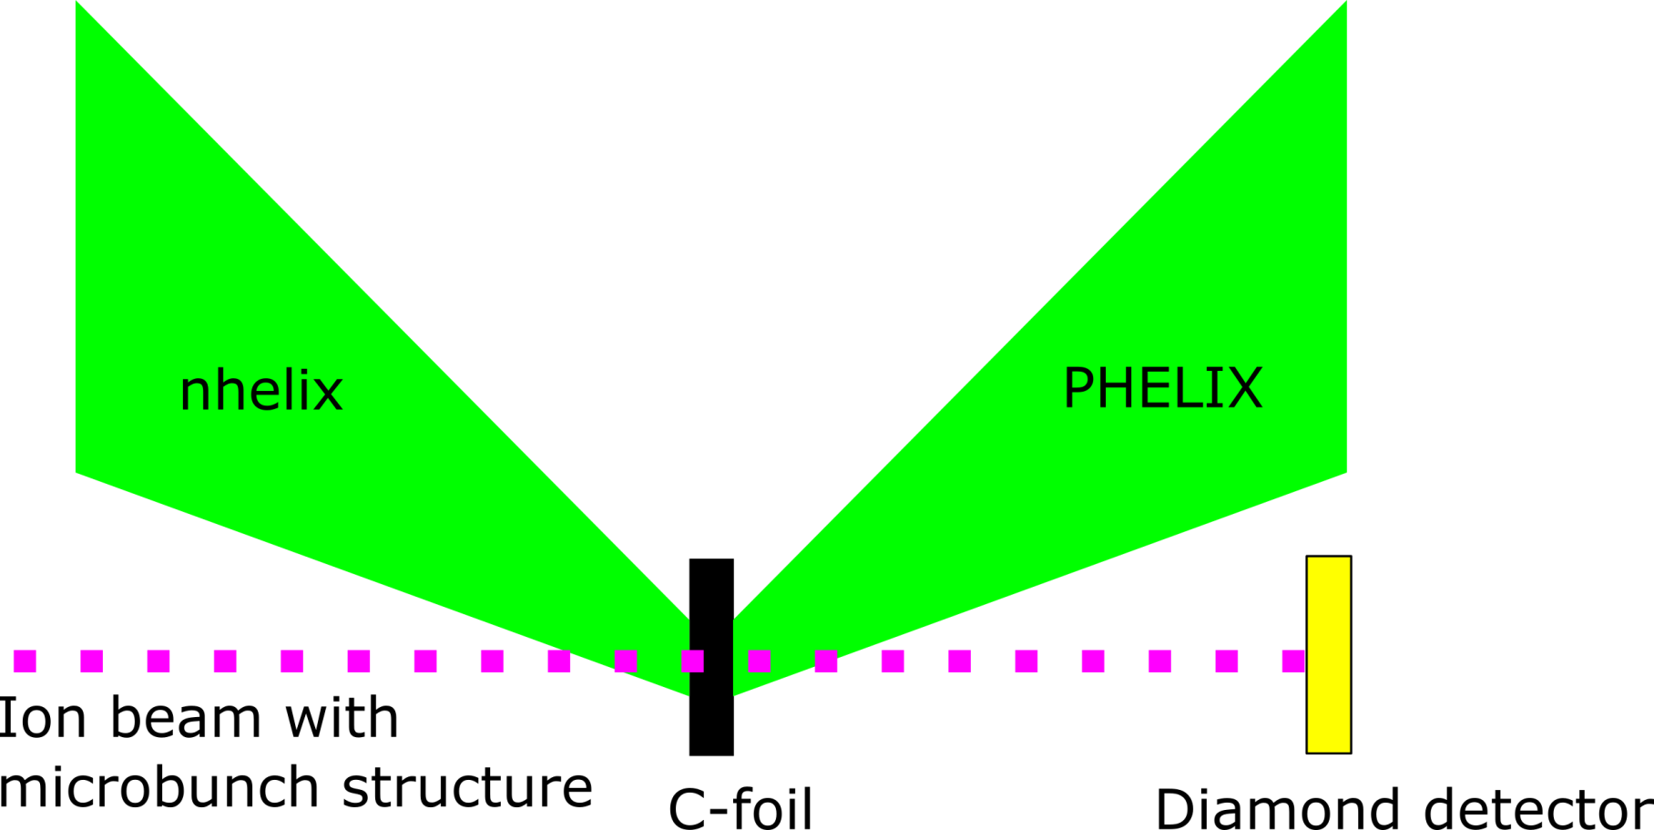
Experiments
Energy loss in plasma

Slide 5
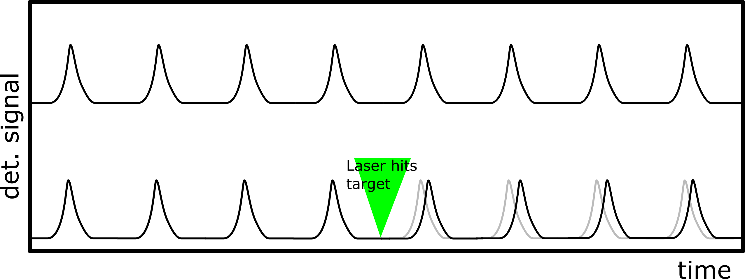
Experiments
Energy loss in plasma

Slide 6
Important beam parameters
as much particles per micro bunch as possible (at least the same intensities as before)
at least 100 µs of stable macro bunch
repetition rate f_{r} = 5 Hz / n where n is an integer
micro bunch as short as possible (< 3 ns)
ion species: C Ca Ar
ion energies: 3.6 MeV/u (as low as possible)
108 MHz rf transmitter for LIGHT

