Slide 1
UNILAC requirements for BIOPHYSICS research
M. Scholz, T. Friedrich, K.-O. Voss

Slide 2
Experimental questions → Variation in radiation quality
Broadbeam experiments (X6)
Microbeam experiments (X0)
Summary: Requirements

Slide 3
Energies of interest
Stopping Power
(Radiation Action)
Depth in water
UNILAC
FAIR
SIS
The coexisting availability of beams covering the entire energy range
and ion species under otherwise equal conditions is a prerequiste for systematic biophysics experiments – and unique @GSI.
Jakob et al., Int. J. Radiat. Biol. 2002

Slide 4
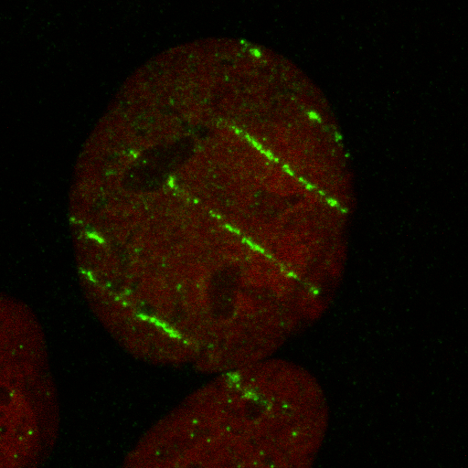
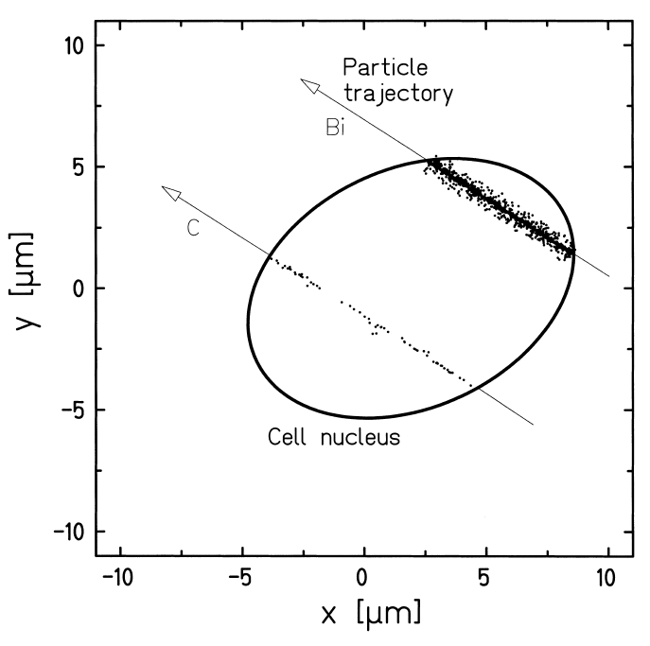
UNILAC experiments
sample holder
Repair of DNA damage depends
on damage density / complexity
Bi
C
Jakob et al., Int. J. Radiat. Biol. 2002
Typically: 2-3 d beamtimes, moderate intensities, parasitic mode, irradiation in air

Slide 5
UNIversal Linear ACcelerator
Goal: Variation of damage density by variation of dE/dx
Tool: Choice of ion species for given energy
He – U: Mechanisms of radiation action
He – C: Radiation protection, Radon project
He – Ne: Radiation therapy
Energies: Broadbeam (X6): min. ~6 MeV/u for light ions (He – C)
Broadbeam (X6): min. ~8 MeV/u for heavier ions (Ar – U)
Microbeam (X0): optimal ~ 5 MeV/u (C – U)

Slide 6
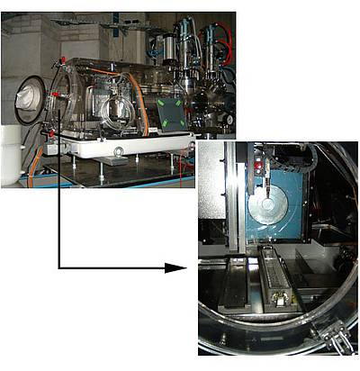
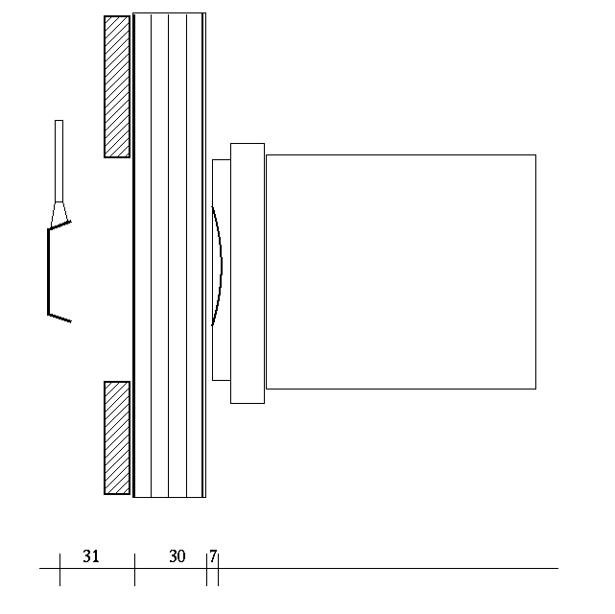
UNILAC Facilities: Broadbeam (X6)
IC
Mylar foils
Exit Window
Air Gaps
~Air gaps + foils: 100μm H₂O-equivalent thickness

Slide 7
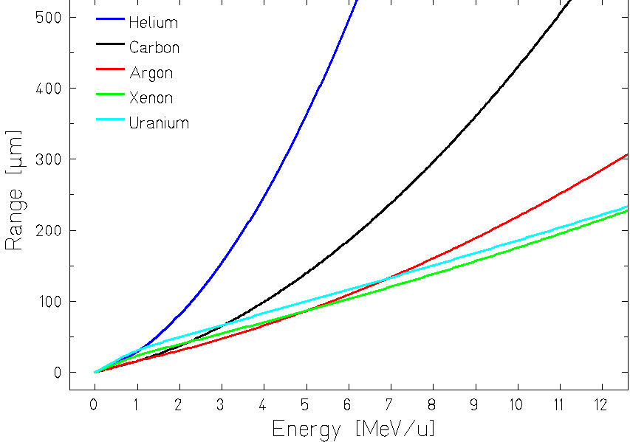
Requirements for E_{min}
Material in front of sample
Required remaining range
Potential improvements:Reduce material in beam

Slide 8
Typical broadbeam experiments
Irradiate sample by sample...
Fluences: min. 10³/cm² (~10⁴ particles)
max. 10⁸/cm² (~10⁹ particles)
Variation: x 20 within sample series (sec)
Variation: x 10⁵ from series to series (~15 min)
Macropulses: To compensate statistical fluctuations, irradiation with more than one macropulse required. Not too high intensity tolerated.
High variation in time averaged particle flux needed
Goal: Cover high flux range without complicated operator intervention
Parameter: Irradiation time (< ~ 5 - 60 s)
Particles per macropuls (change requires new dosimetry)
Macropulse length
Duty cycle
Flexibility in these parameters needed

Slide 9
Example: Change of time averaged flux
I
50Hz / 5msec
t
I
5Hz / 1msec
t
Required flexibility: Duty cycle: 1-10 Hz
Pulse lengths: 0.5-5 ms

Slide 10
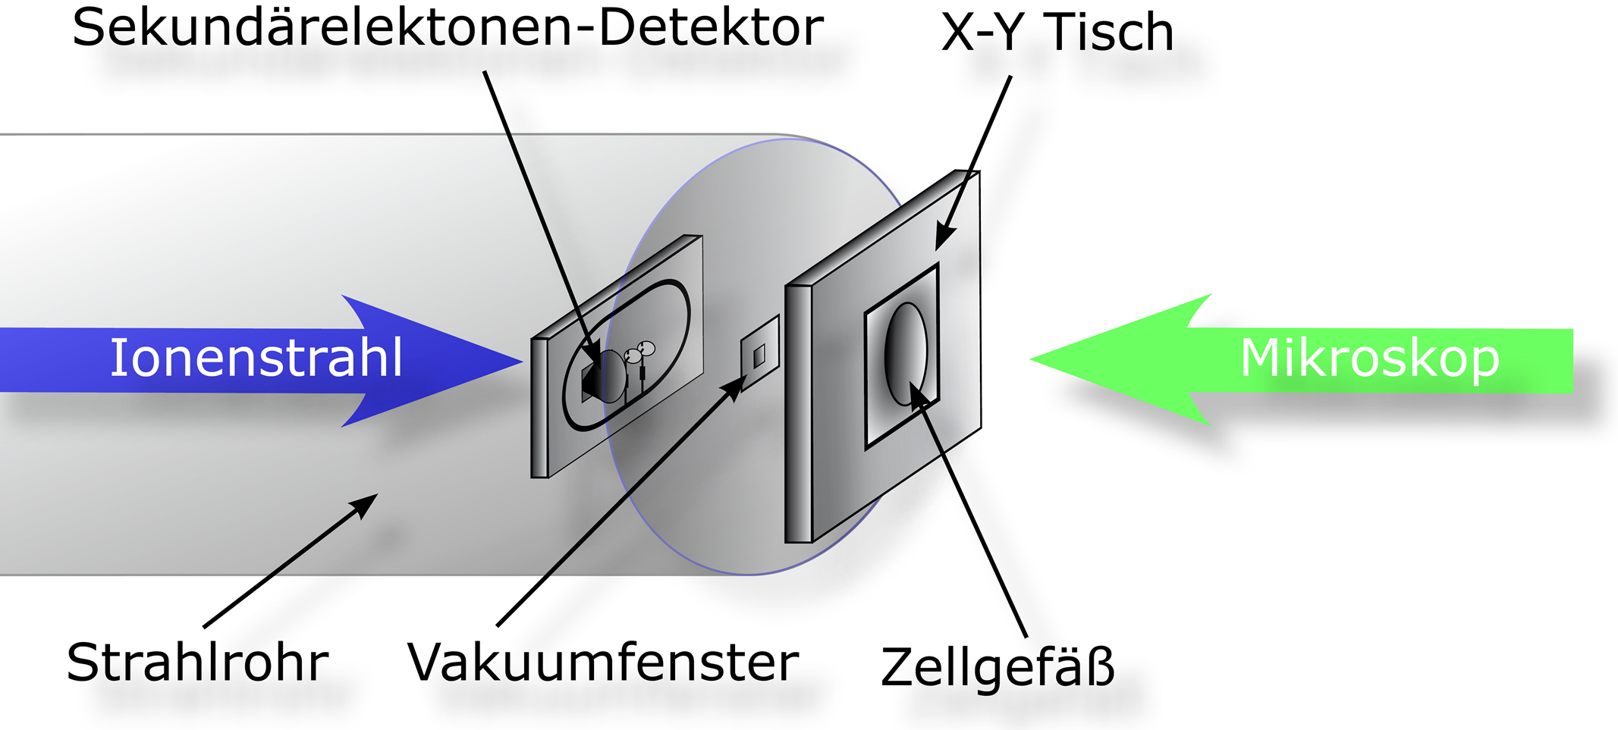
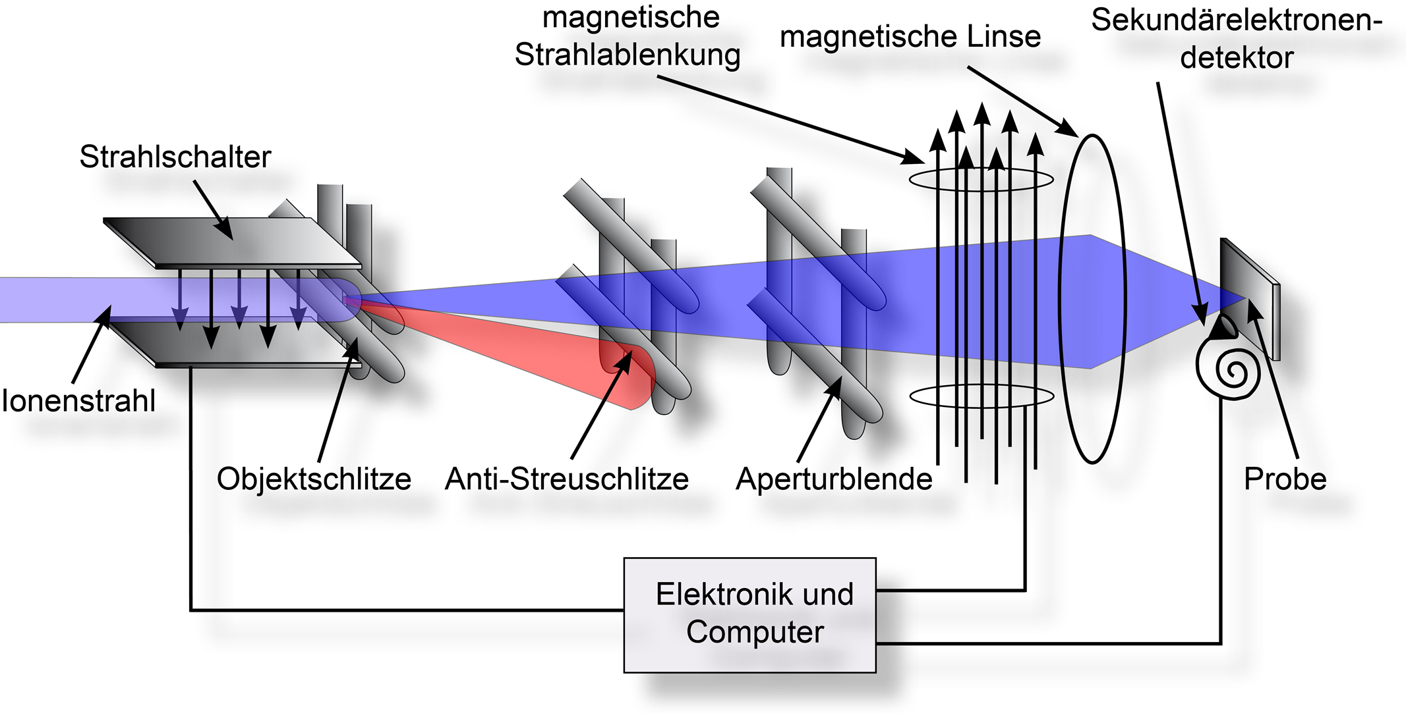
UNILAC Facilities : Microbeam (X0)
Exit Window: 200nm Si₃N₄, 1mm²
Distance in air: <300µm
4µm Polypropylen foil in front of cells

Slide 11
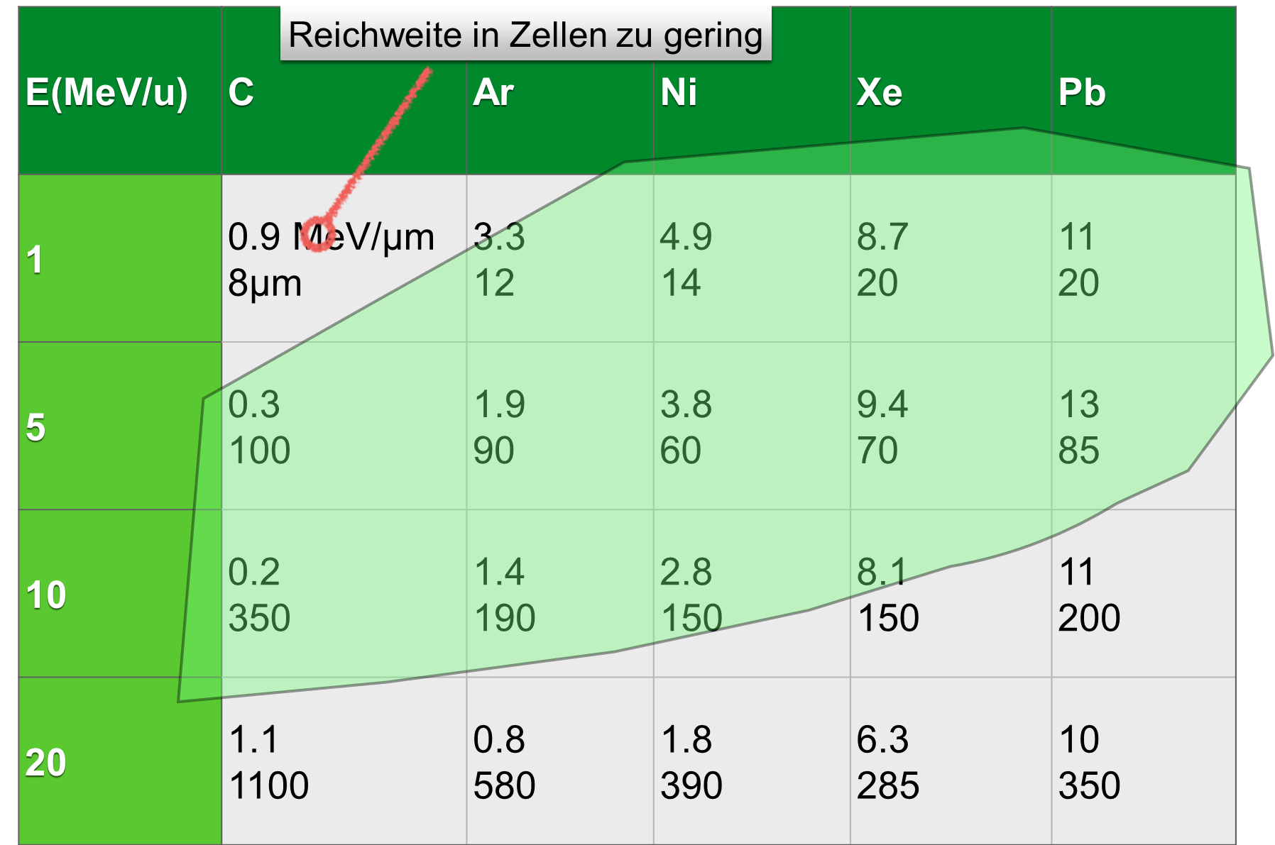
Optimal energy for microbeam irradiation
Limited range in cells
Rigidity limit of magnetic lense: ~ 5 A
m/q = 8 (z.B. Au 25+) → E_max = 8.5 MeV/u
m/q = 6 (z.B. C 2+) → E_max = 11.4 MeV/u
Potential improvements:
higher charge state / stripping
thicker lense
Limited magnetic rigidity

Slide 12
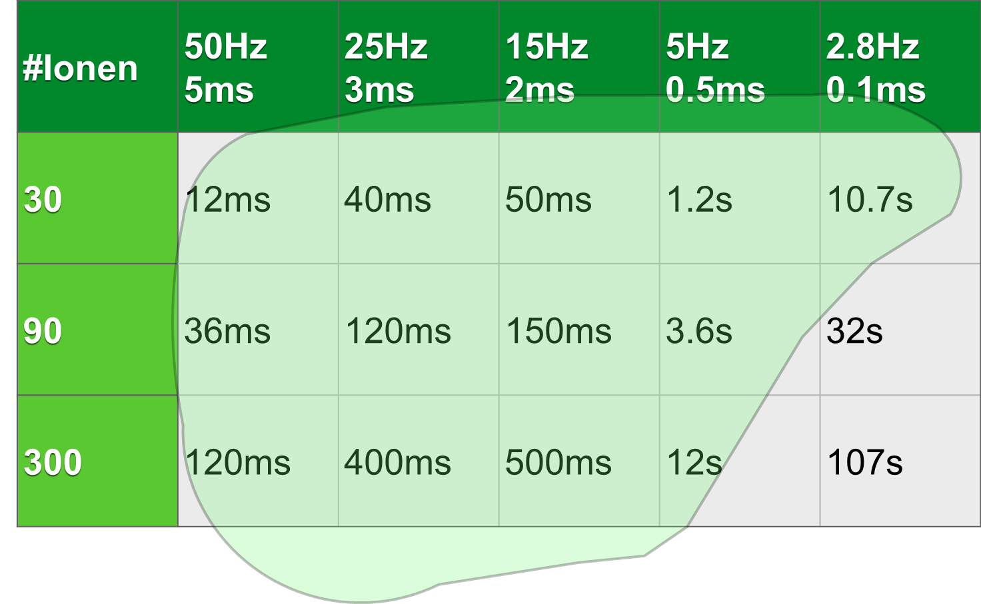
Impact of pulse structure at the microbeam
Irradiation time for 0.1 ms dead time / ion (calculated for carbon)

Slide 13
Summary: Requirements
 | Broadbeam | Microbeam
Ion species | p – U (All) | C and heavier
Energies | 3 – 8 MeV/u (3 – 6.5 MeV/u) | ~ 5 MeV/u (ab 1.4 MeV/u)
particles / macropulse | 10⁴-10⁹ | 10⁸ – 10⁹
Pulse length | 0.5 – 5 ms (0.5 – 2 ms) | 0.1 – 5 ms (0.1 – 2 ms)
Repetition rate | 1 – 10 Hz (1 – 5 Hz) | 3 – 50 Hz
...and: - Immediate flexibility in pulse length / repetition rate - Delivery in parasitic mode highly efficient (parallel sources & experiments / parallel to SIS injection) → Optimized experimental throughput
Flexibility, variability and redundancy in beam parameters and beam availability should be kept as much as possible!

Slide 14
Open questions
For existing / optimized UNILAC:
Maximum tolerable duty cycle for high current source
Energy/Ion dependence of duty cycle
Realistic operating scenarios
Parallel operation of ion sources
For additional CW-Linac:
Range of ion species / source availability
Maximal energy
Pulse structure / frequency
Dynamic intensity range
Pulse structure / frequency
Parallel operation to FAIR-injector
General:
Overall time schedule?

