Slide 1
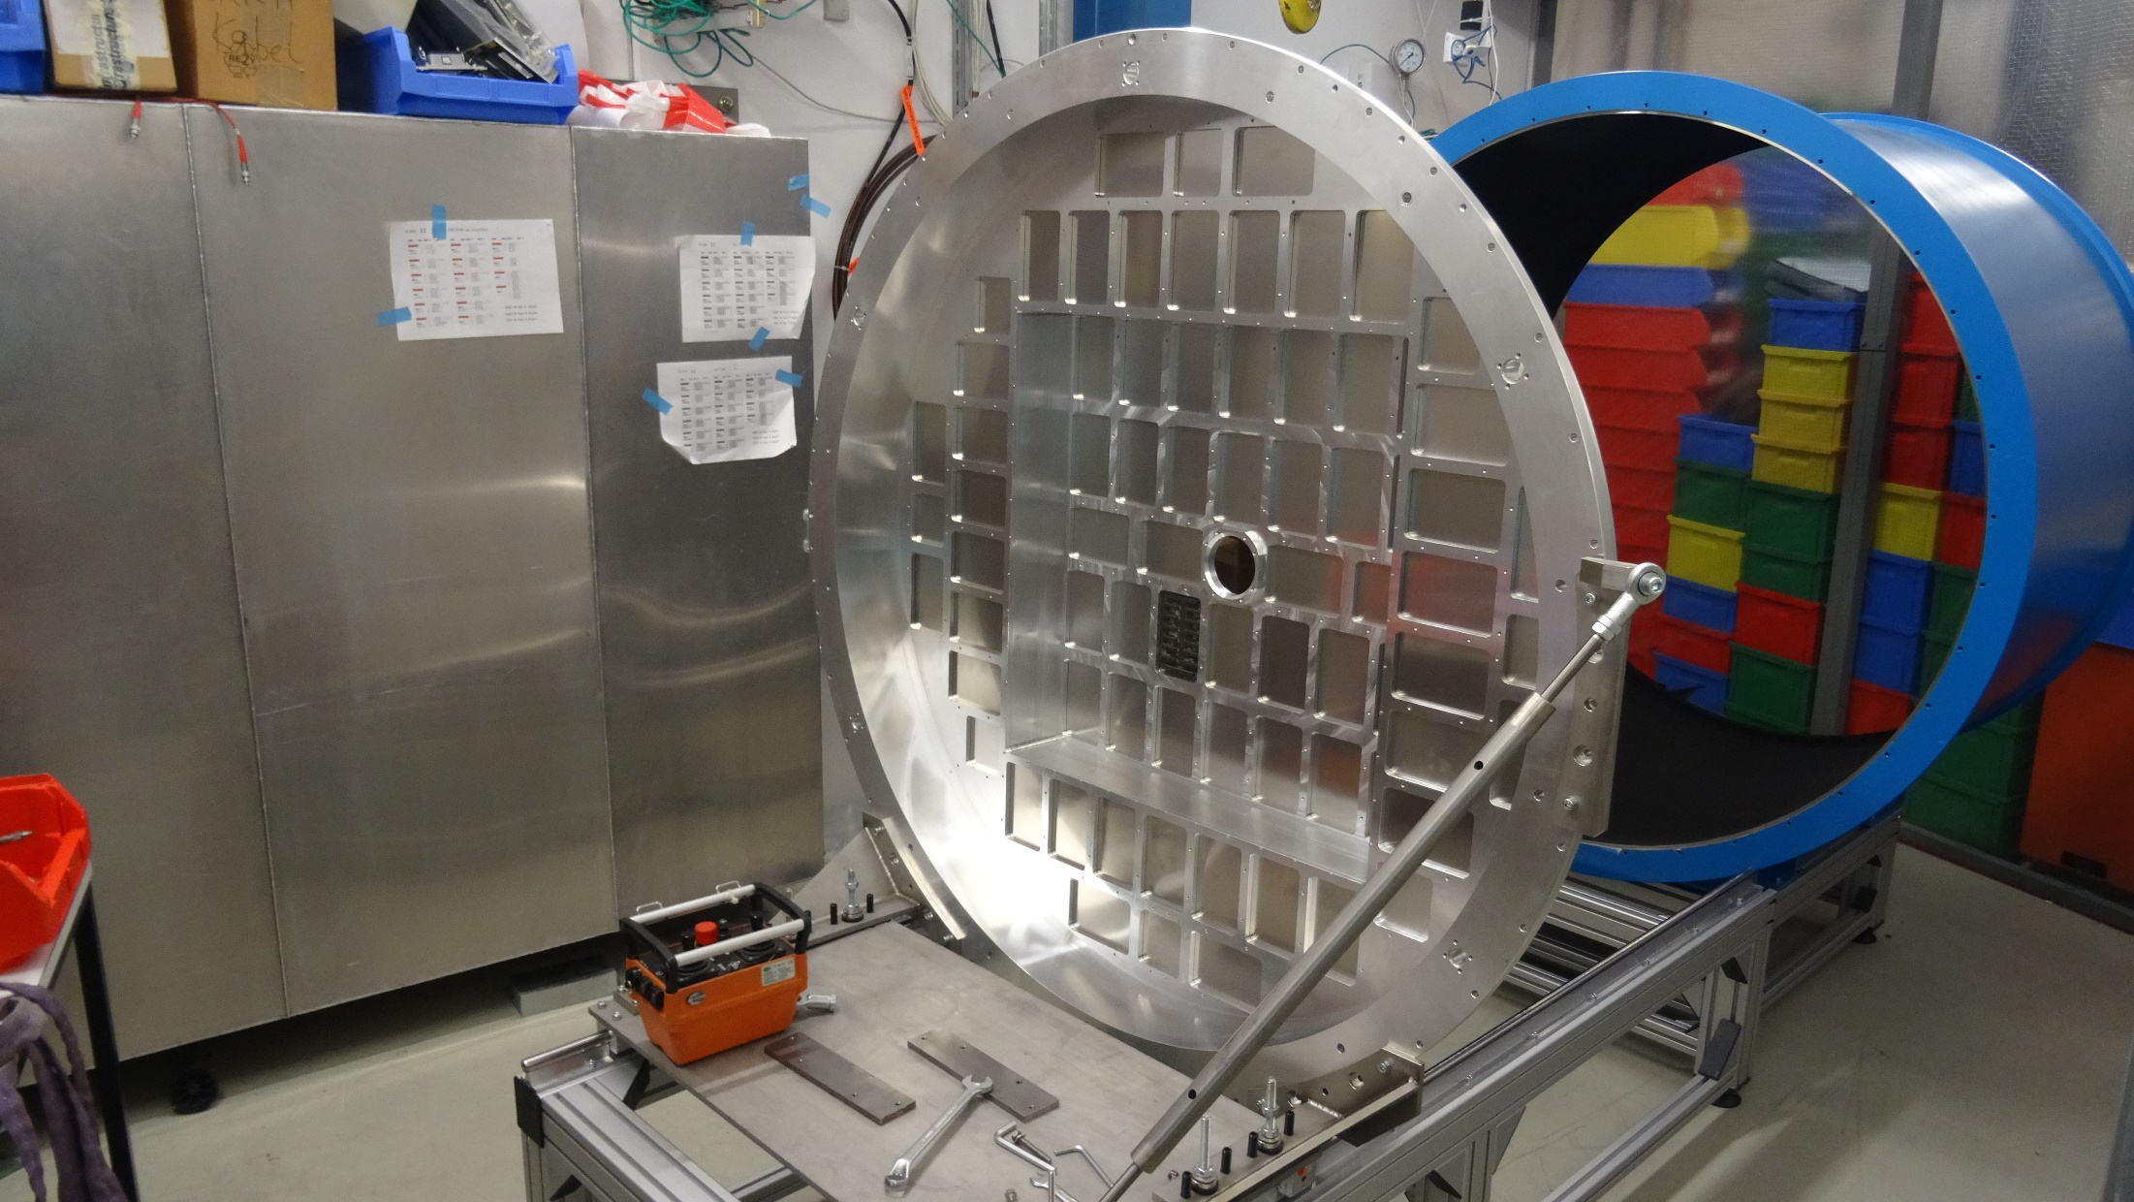
RICH700 Assembly 28.07.16
Assembly in the tent

Slide 2
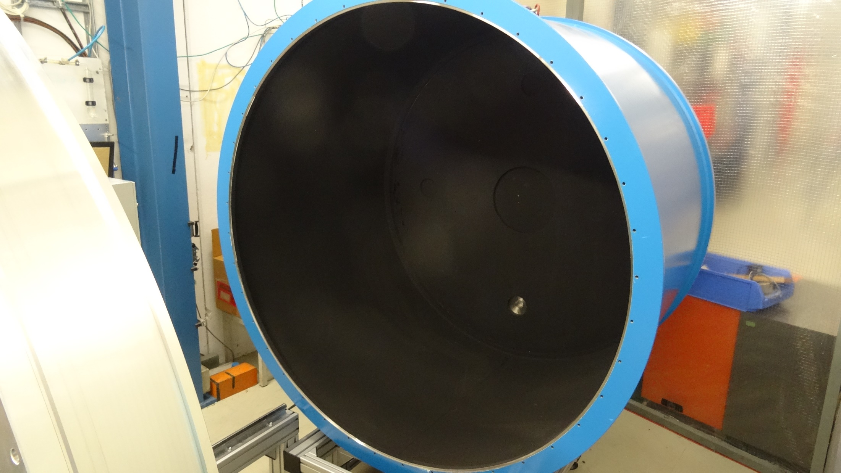
RICH700 Assembly 28.07.16
Assembly in the tent. The black hole

Slide 3
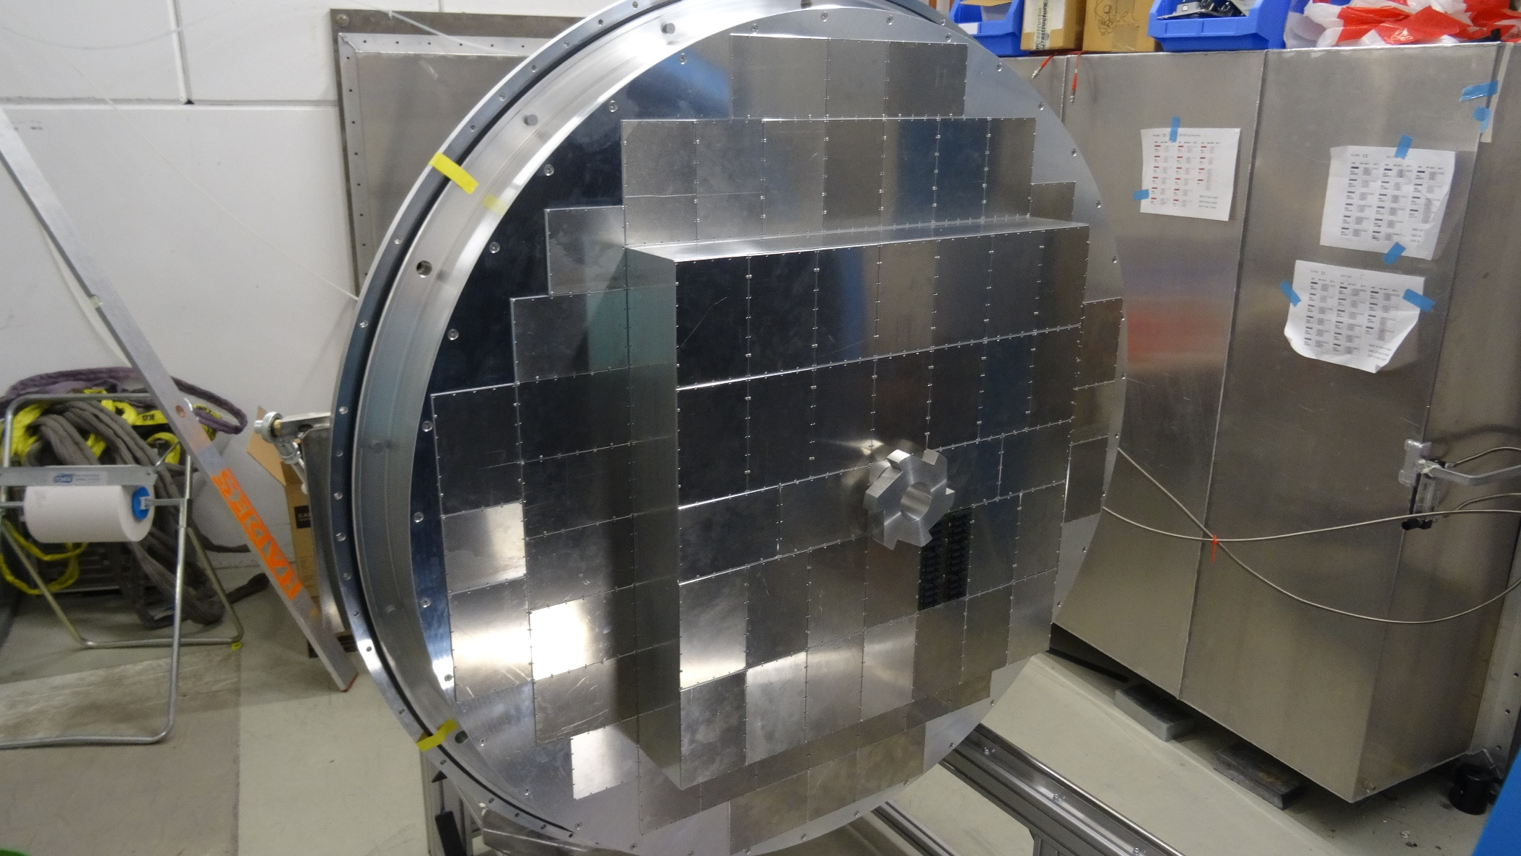
RICH700 Assembly 28.07.16
Assembly in the tent
Front side with beam tube & window hub

Slide 4
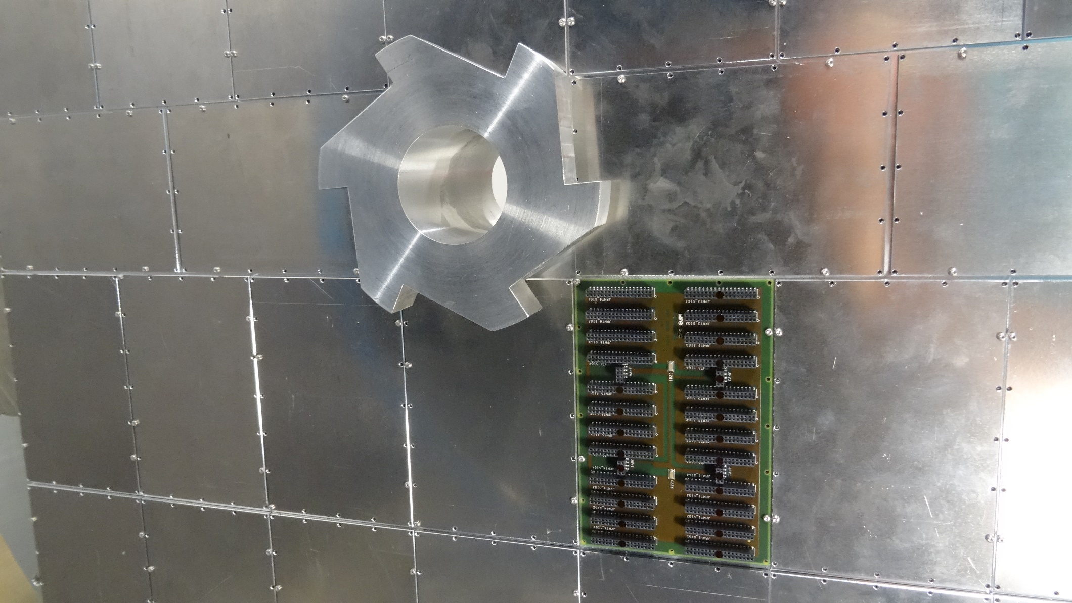
RICH700 Assembly 28.07.16
Assembly in the tent
Front side with beam tube & window hub

Slide 5
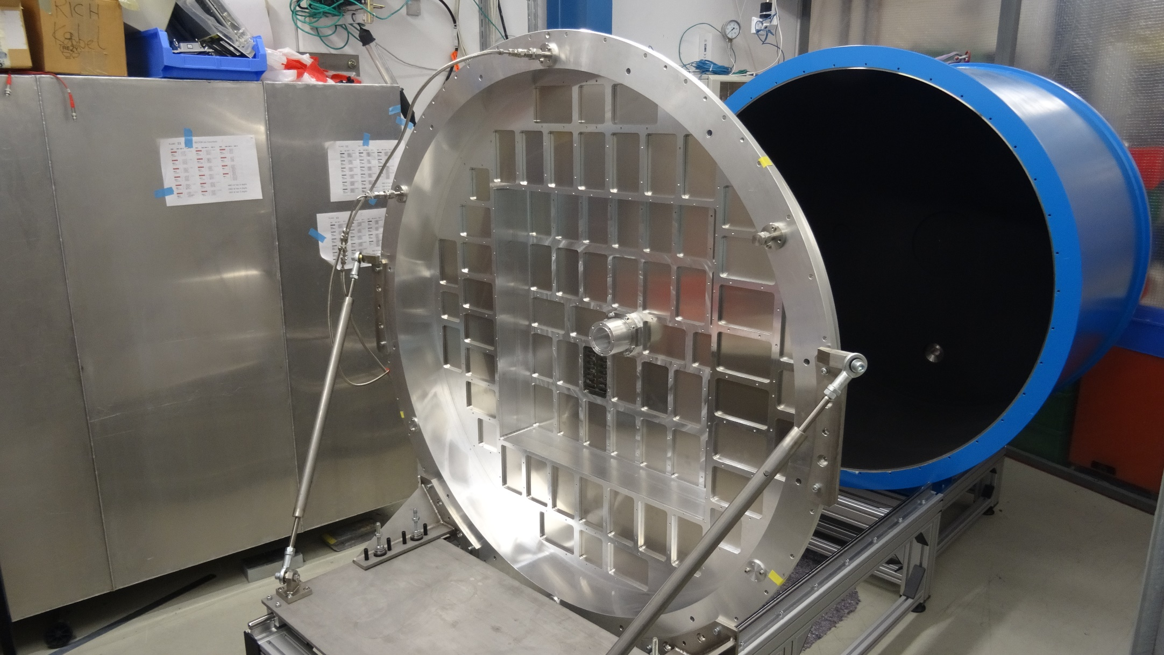
RICH700 Assembly 28.07.16
Assembly in the tent
Detector in service position

Slide 6
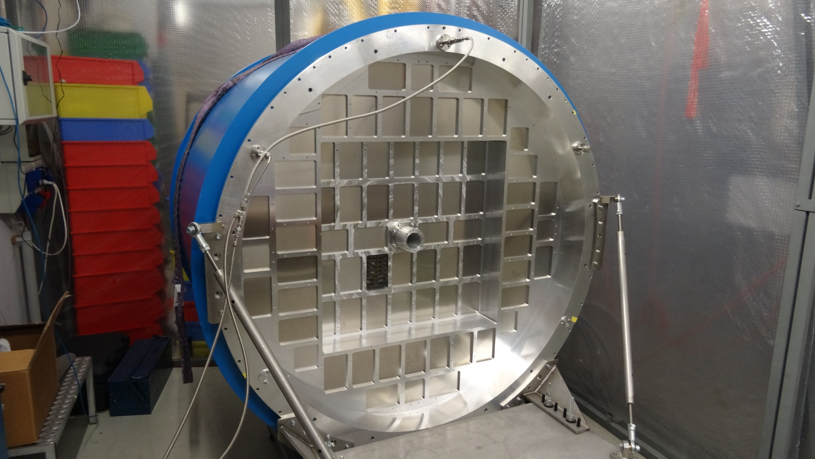
RICH700 Assembly 28.07.16
Assembly in the tent
Detector in measurement position

Slide 7
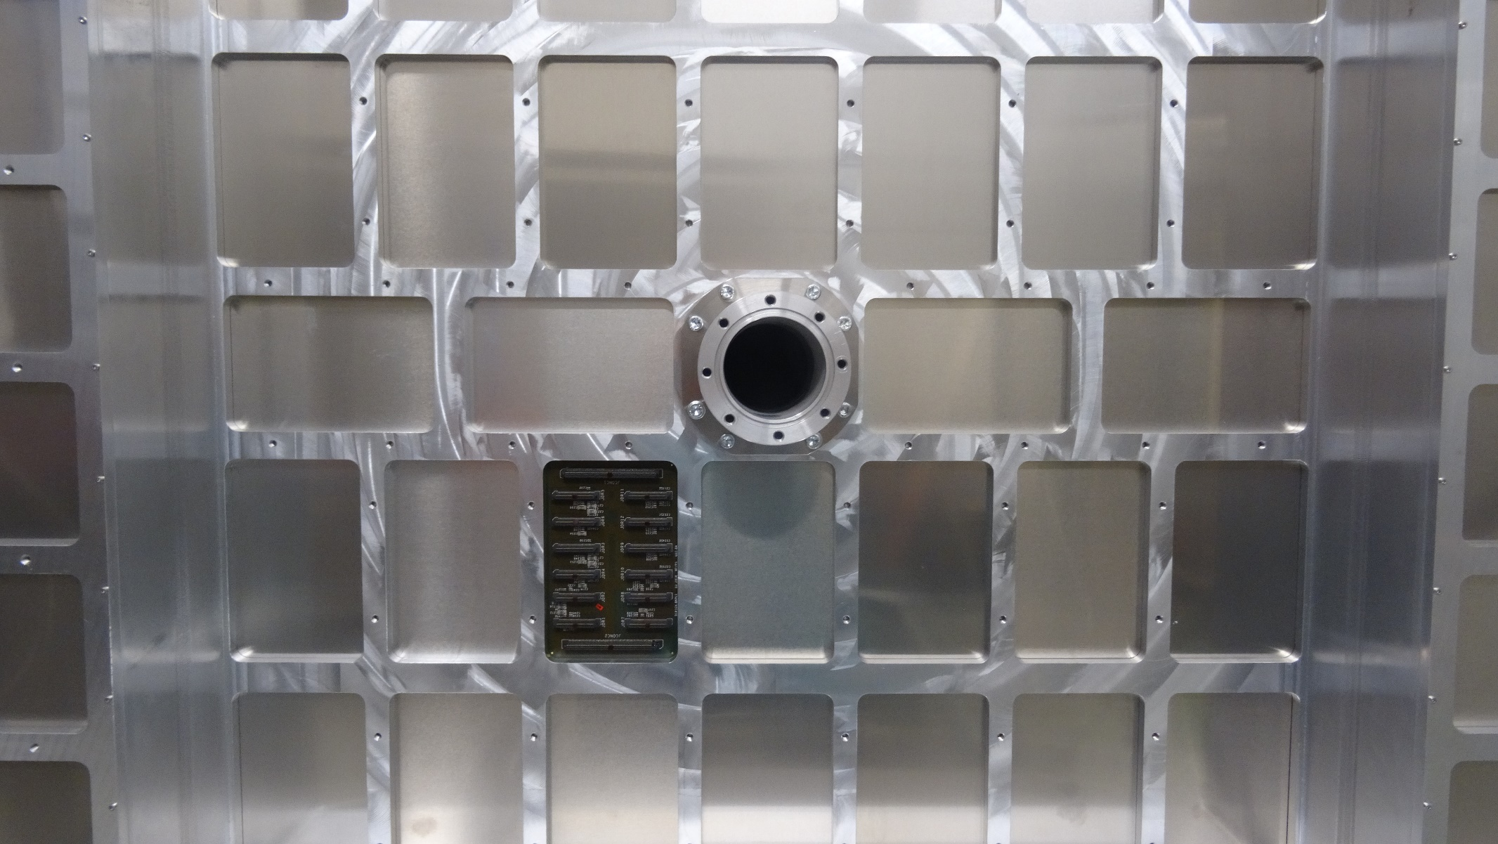
RICH700 Assembly 28.07.16
Assembly in the tent
Detector in measurement position

Slide 8
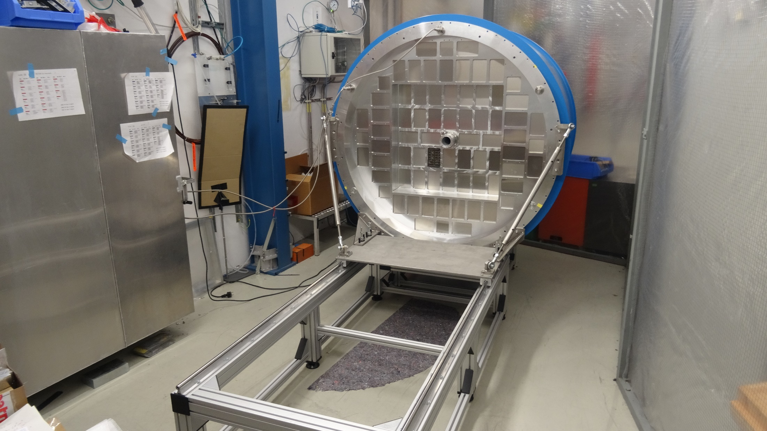
RICH700 Assembly 28.07.16
System nearly ready

