Slide 1
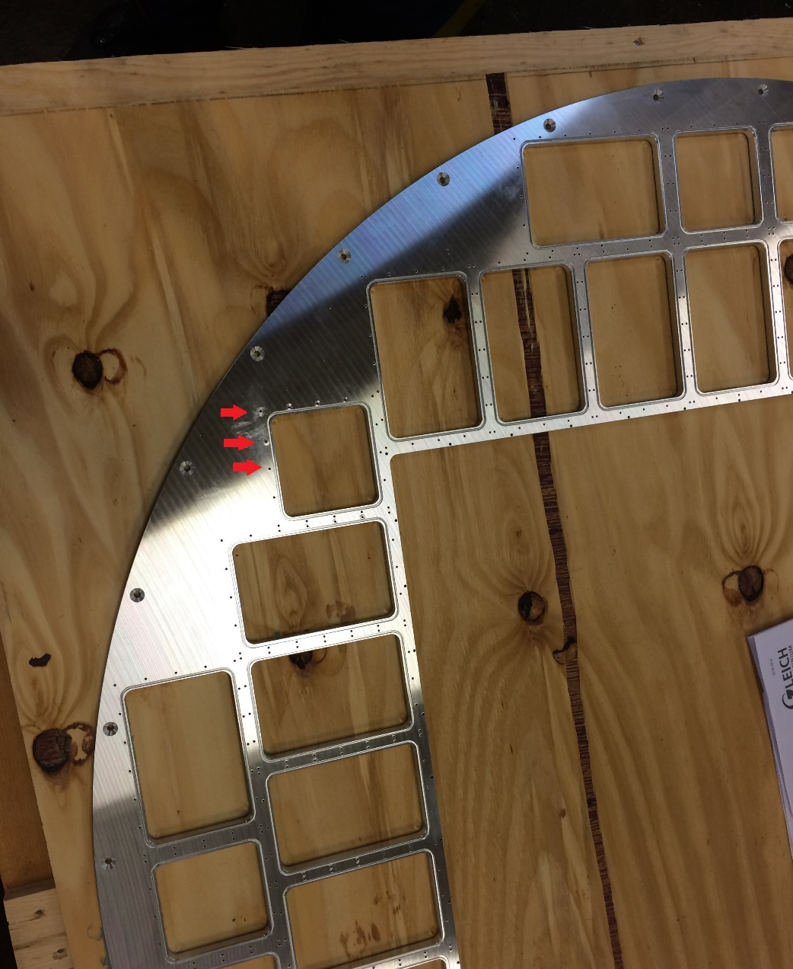
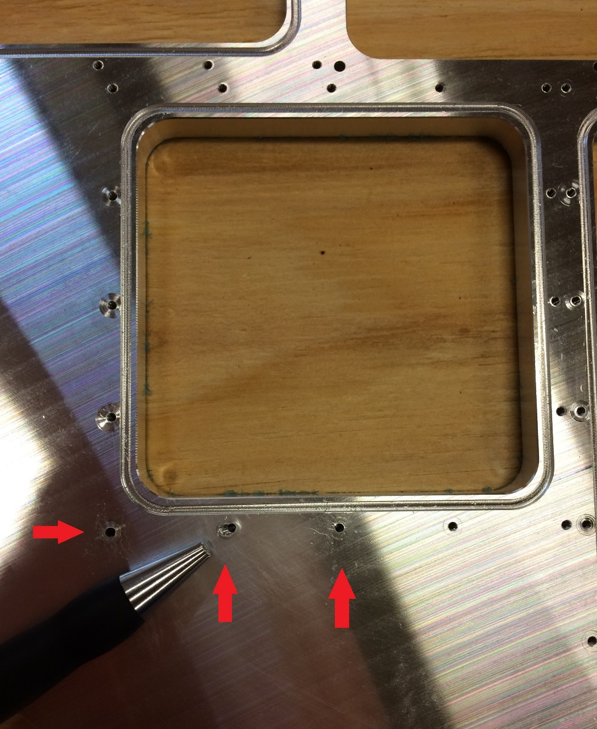
RICH700 Assembly 21.07.16
Pre-assembly at Kinkele GmbH

Slide 2
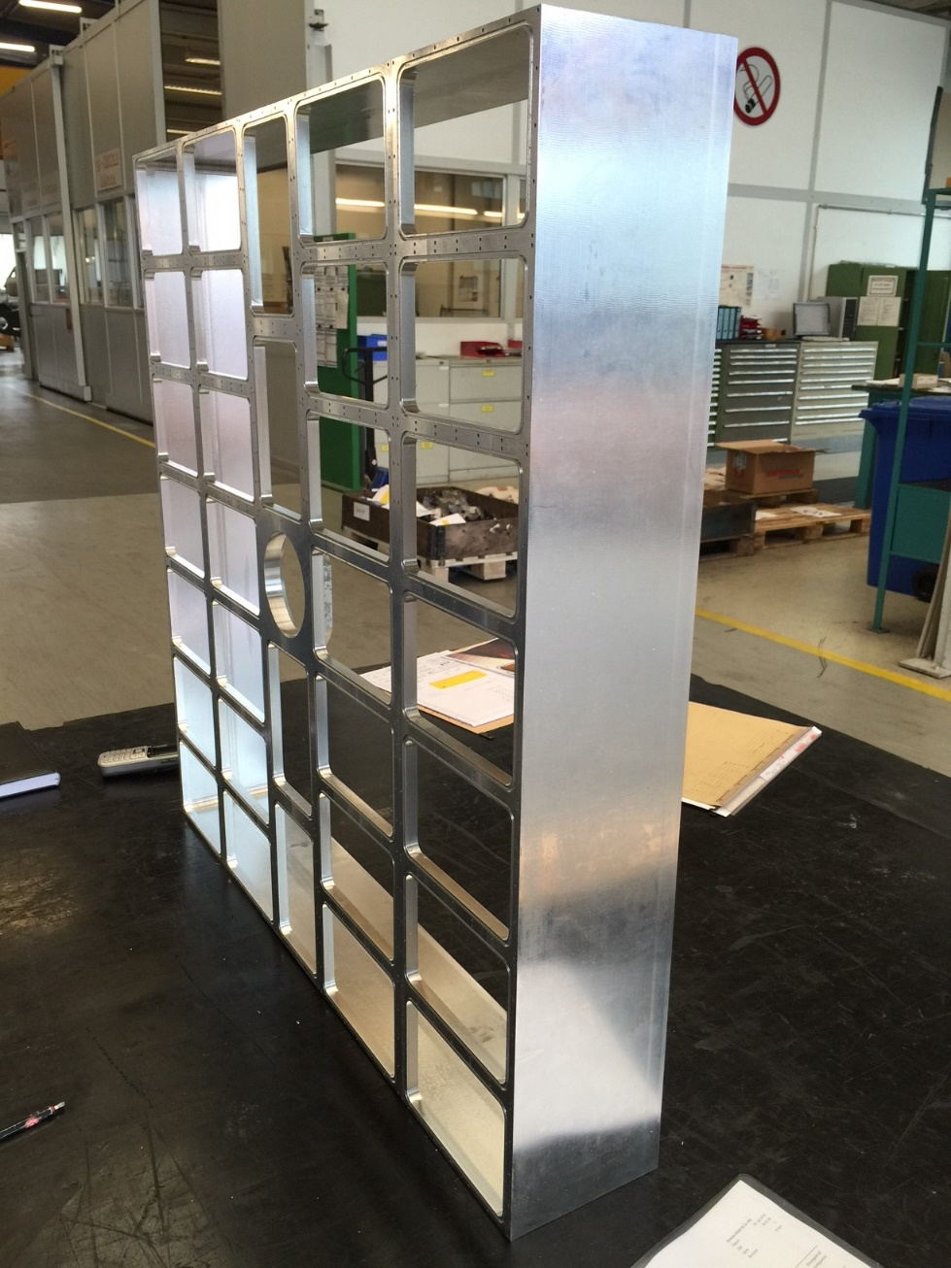
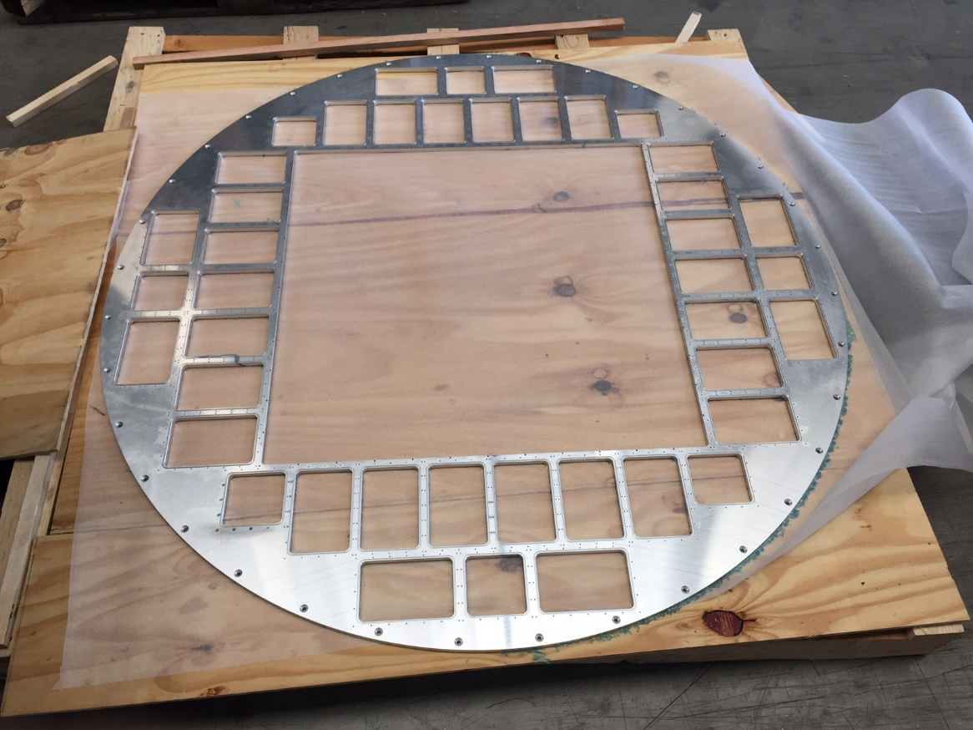
RICH700 Assembly 26.07.16
Pre-assembly at Kinkele GmbH
The box
The plate

Slide 3
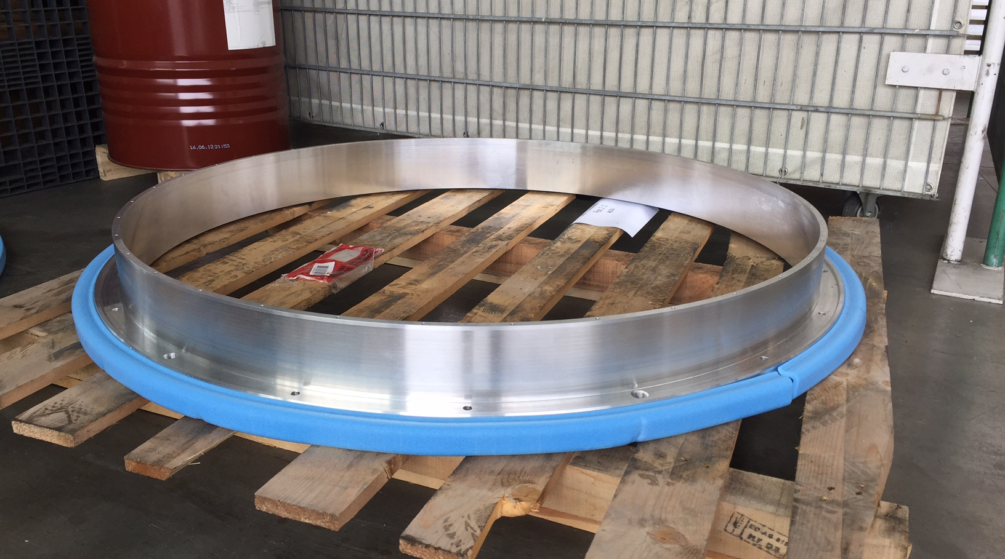
RICH700 Assembly 26.07.16
Pre-assembly at Kinkele GmbH
The flange

Slide 4
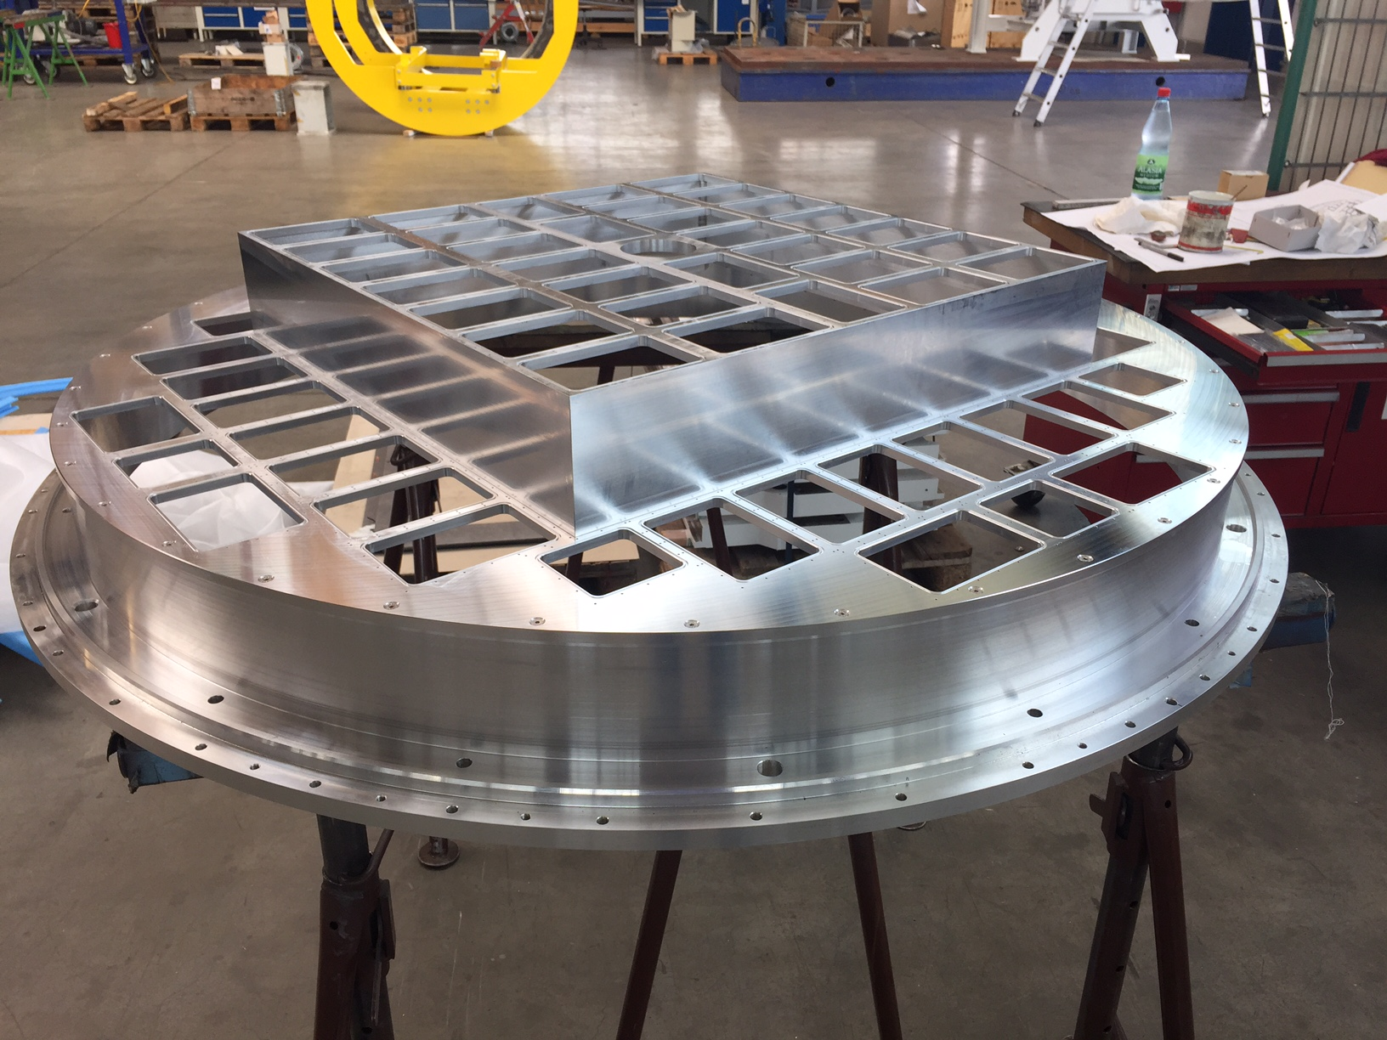
RICH700 Assembly 26.07.16
Pre-assembly at Kinkele GmbH

