Slide 1
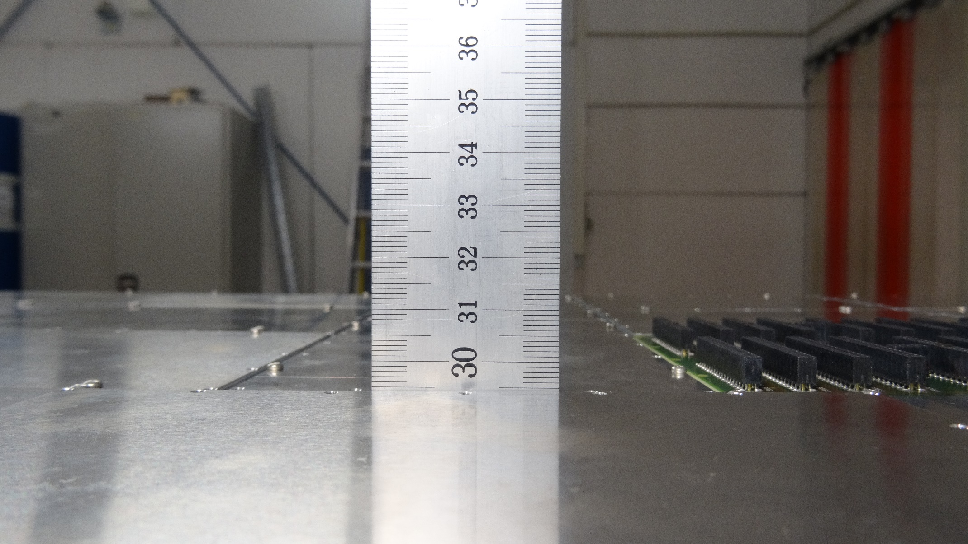
RICH700 Assembly 28.07.16
Detector frame with closed holes
No load

Slide 2
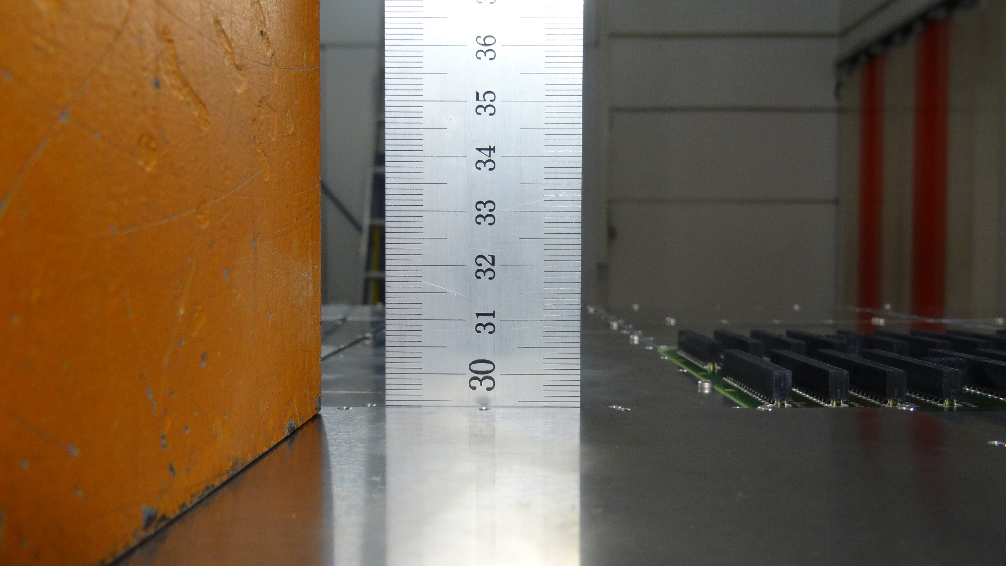
RICH700 Assembly 28.07.16
Detector frame with closed holes
Load: 7.8 kg

Slide 3
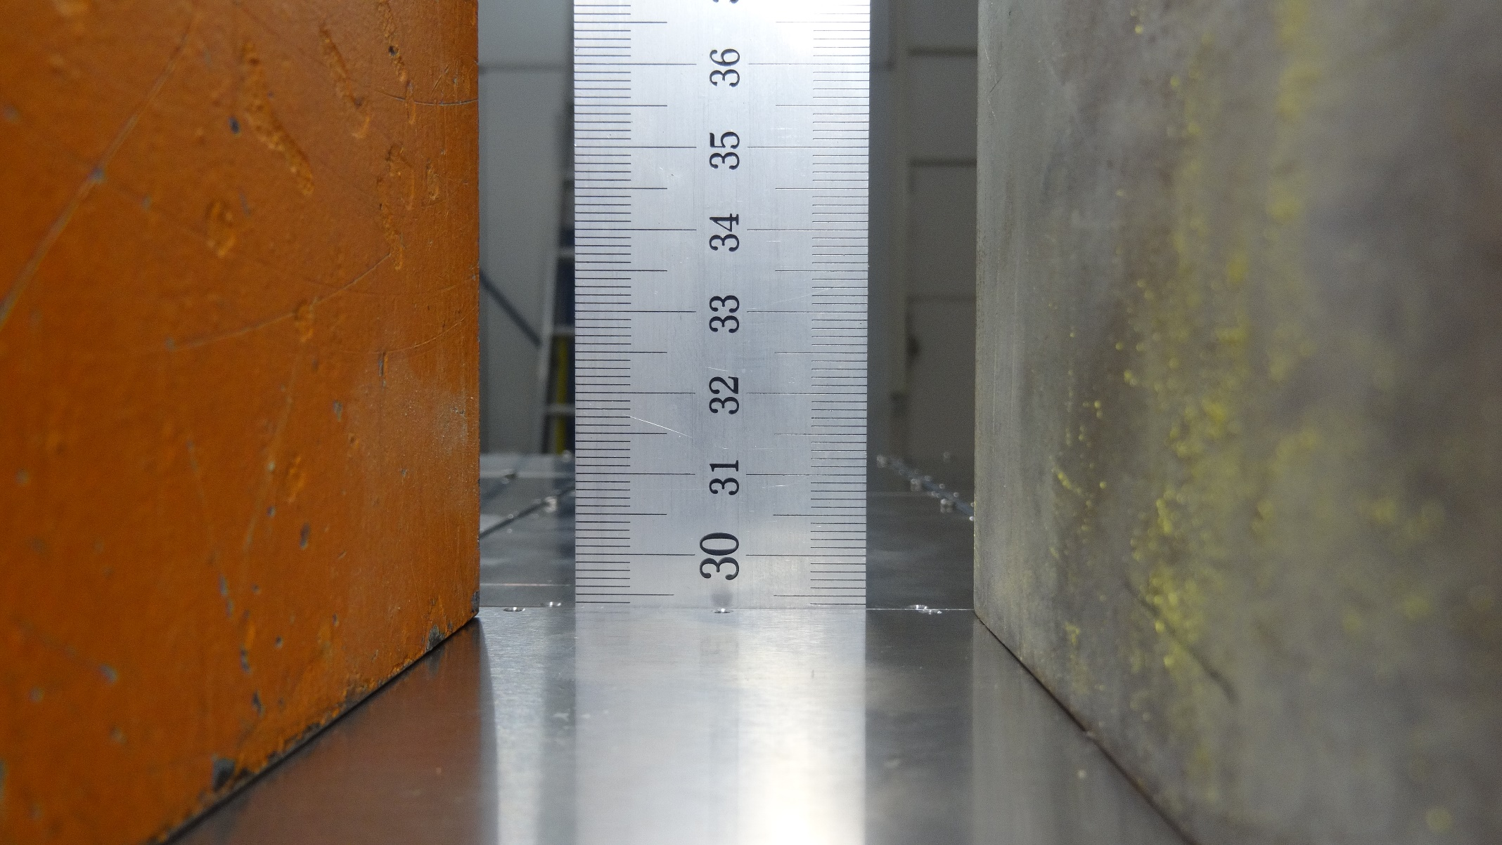
RICH700 Assembly 28.07.16
Detector frame with closed holes
Load: 15.6 kg

Slide 4
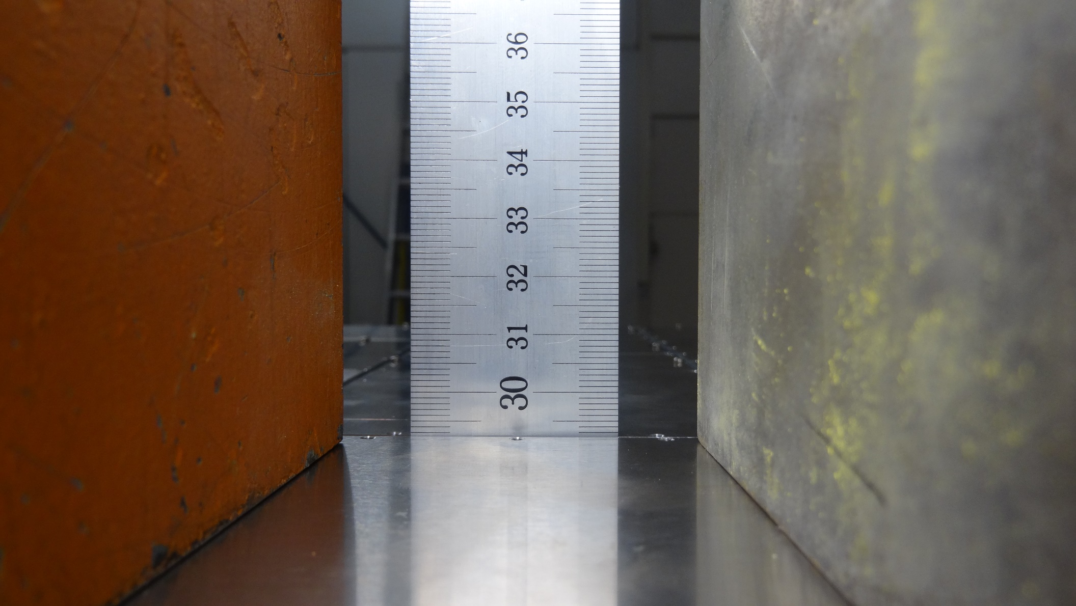
RICH700 Assembly 28.07.16
Detector frame with closed holes
Load: 35.2 kg

Slide 5
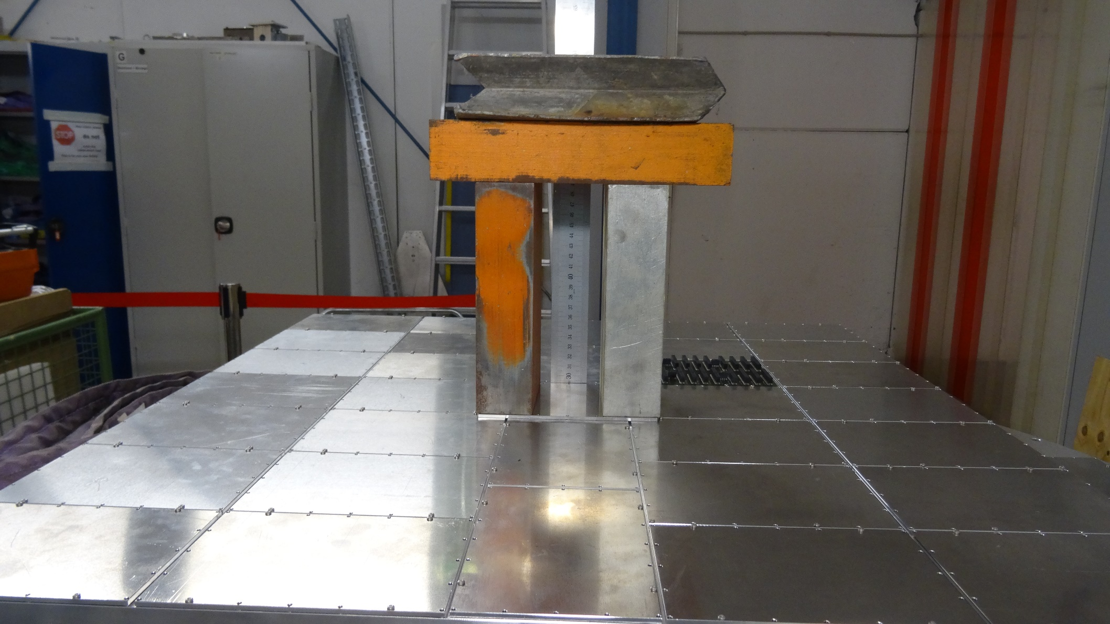
RICH700 Assembly 28.07.16
Detector frame with closed holes
Load: 35.2 kg

Slide 6
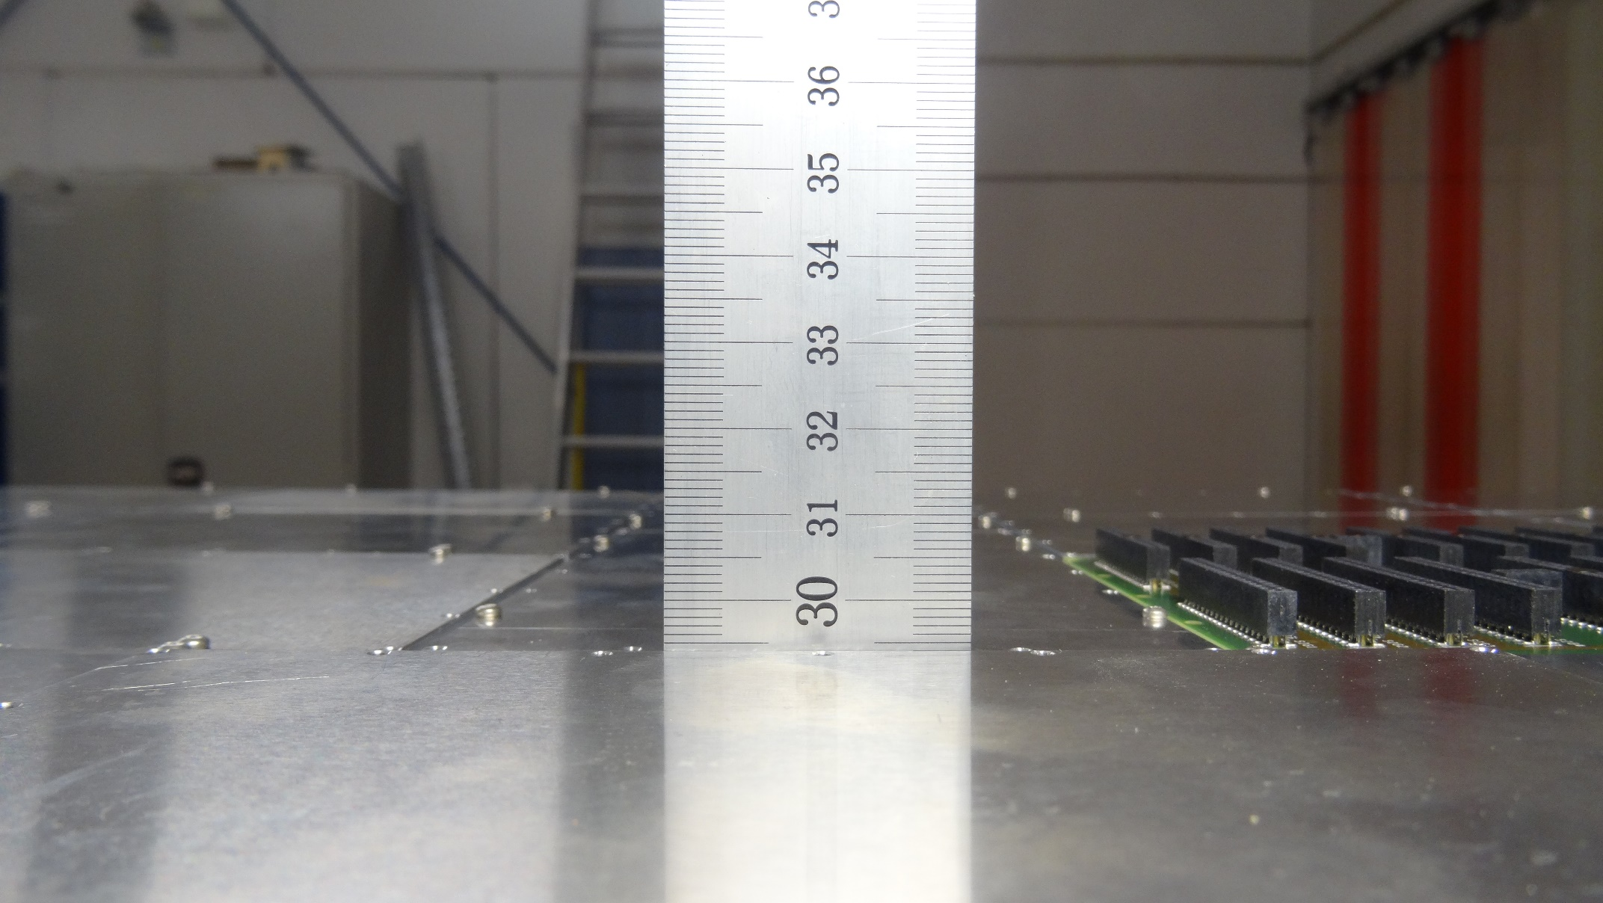
RICH700 Assembly 28.07.16
Detector frame with closed holes
Post load, no deformation

