Slide 1
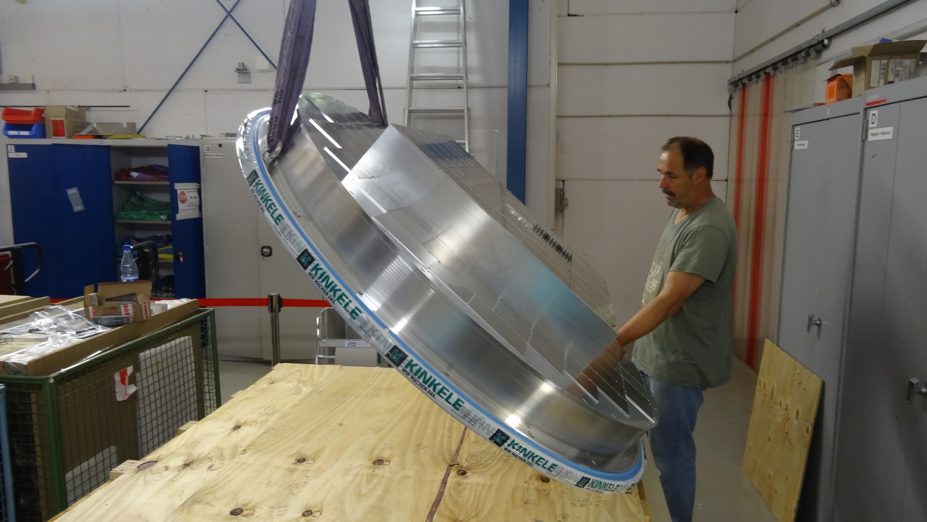
RICH700 Assembly 28.07.16
Flying to the tent

Slide 2
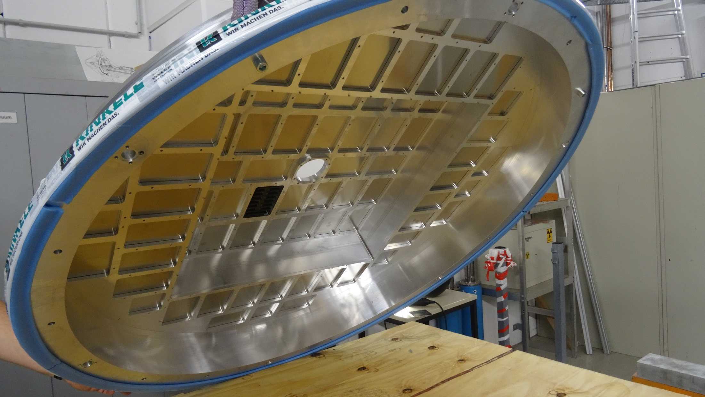
RICH700 Assembly 28.07.16
Flying to the tent

Slide 3
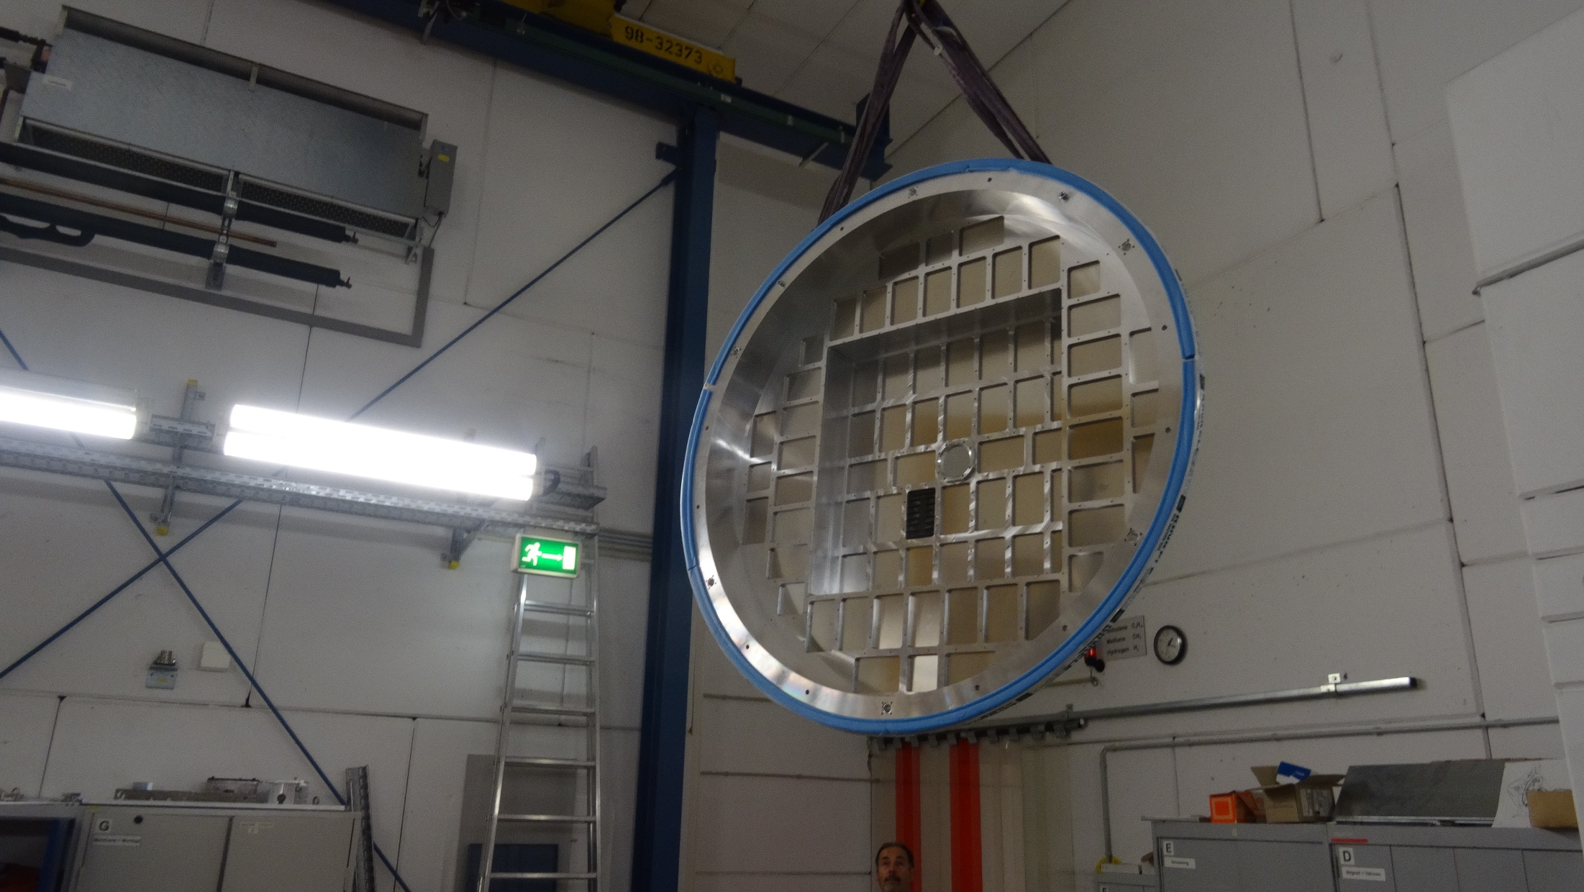
RICH700 Assembly 28.07.16
Flying to the tent

Slide 4
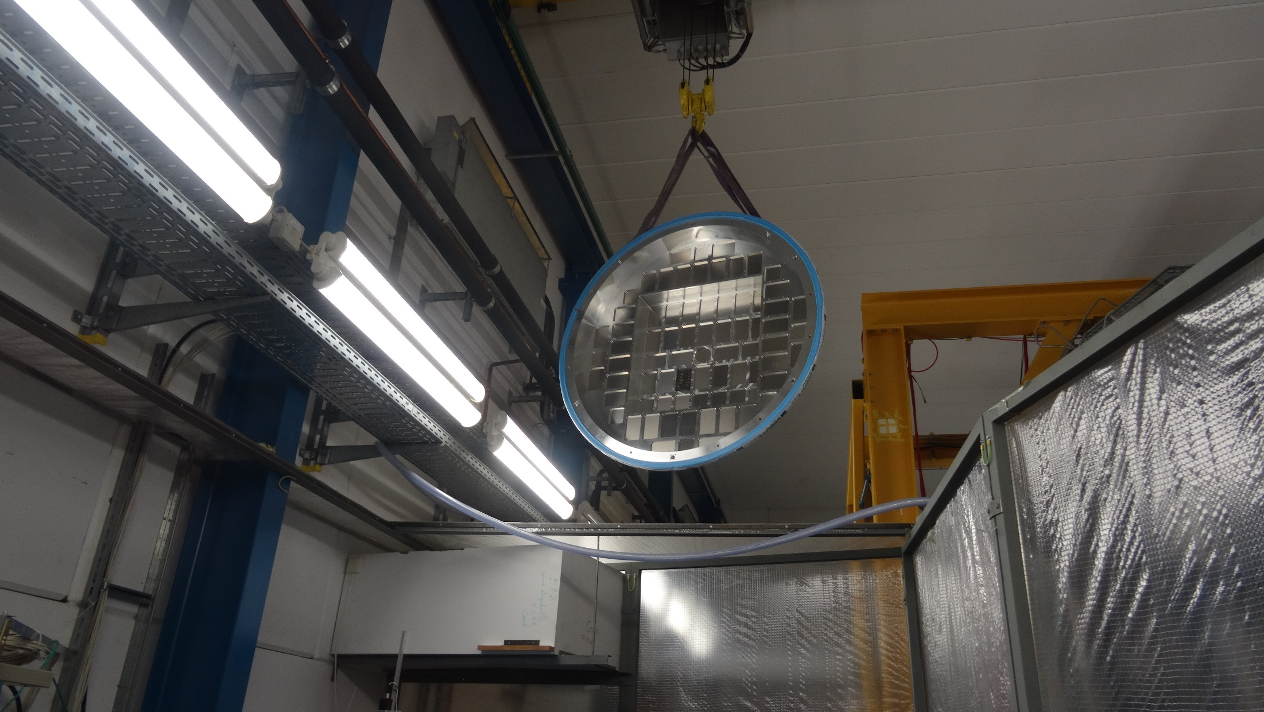
RICH700 Assembly 28.07.16
Flying to the tent

Slide 5
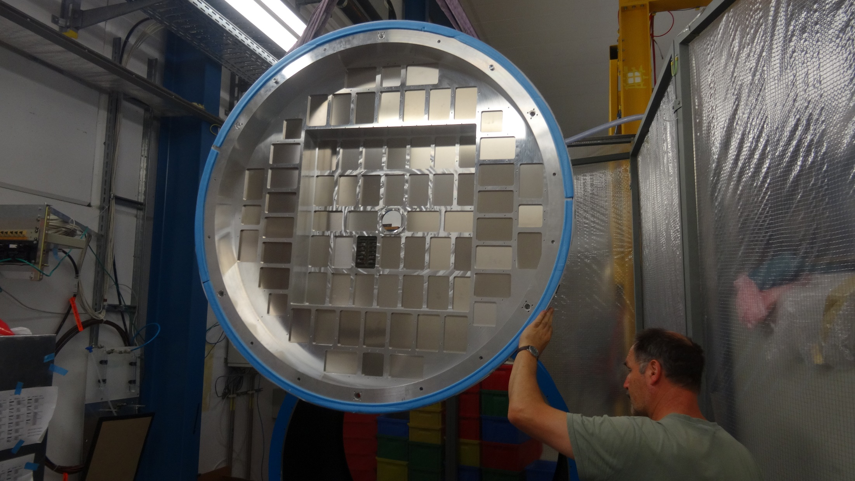
RICH700 Assembly 28.07.16
Flying to the tent

Slide 6
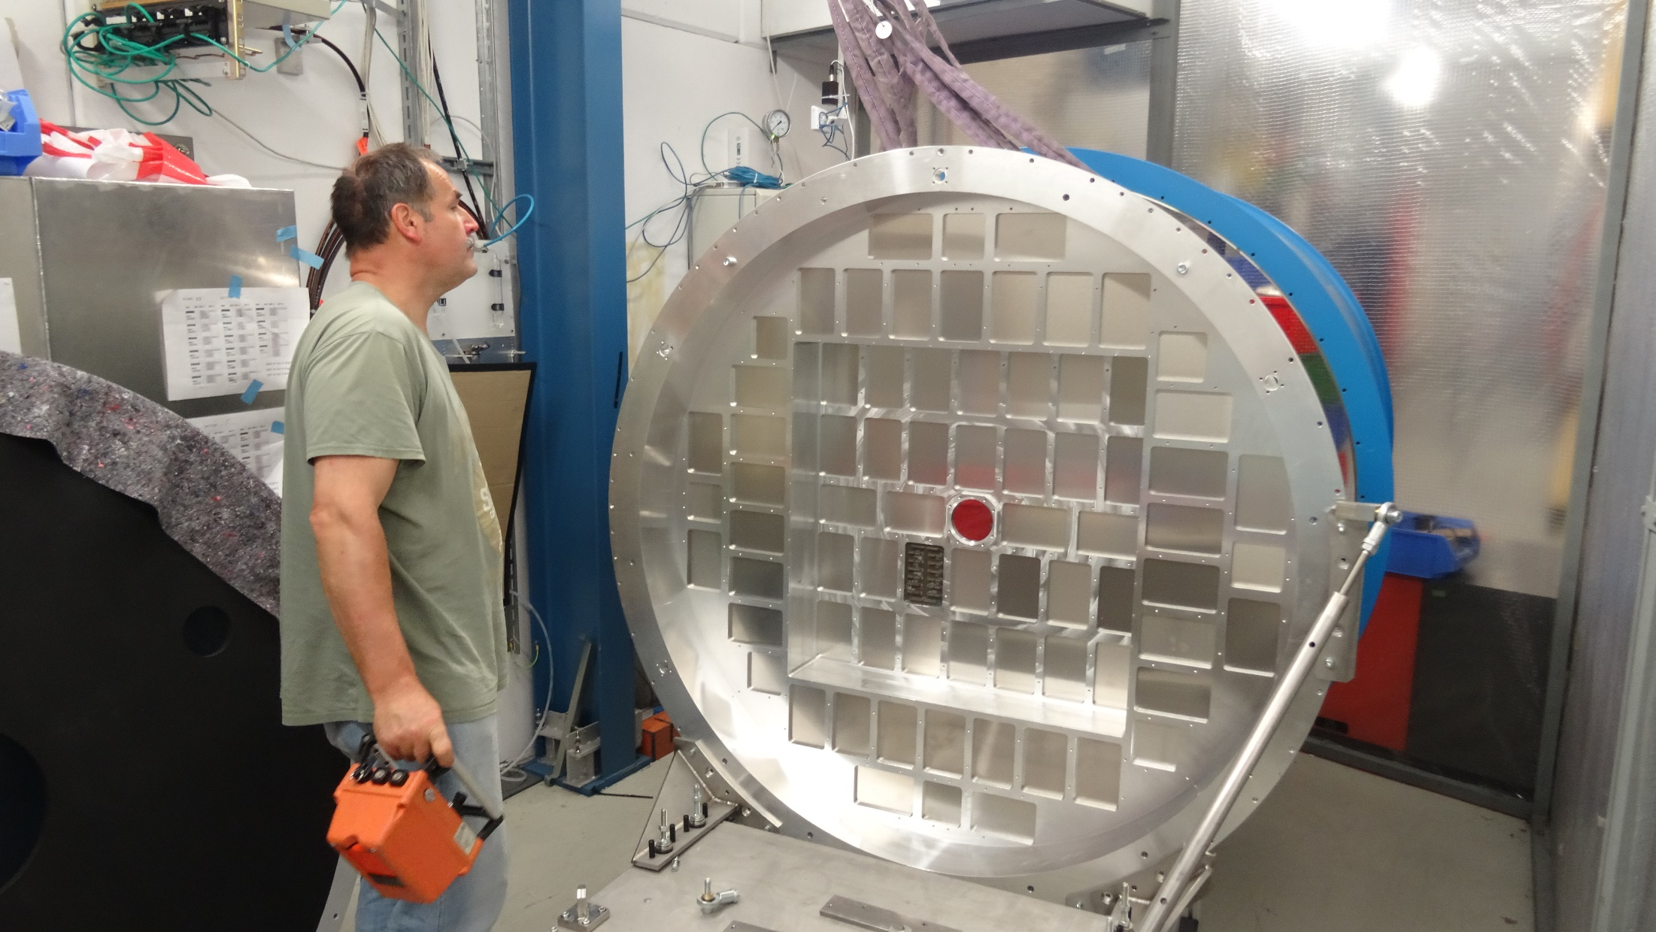
RICH700 Assembly 28.07.16
Flying to the tent

