Slide 1
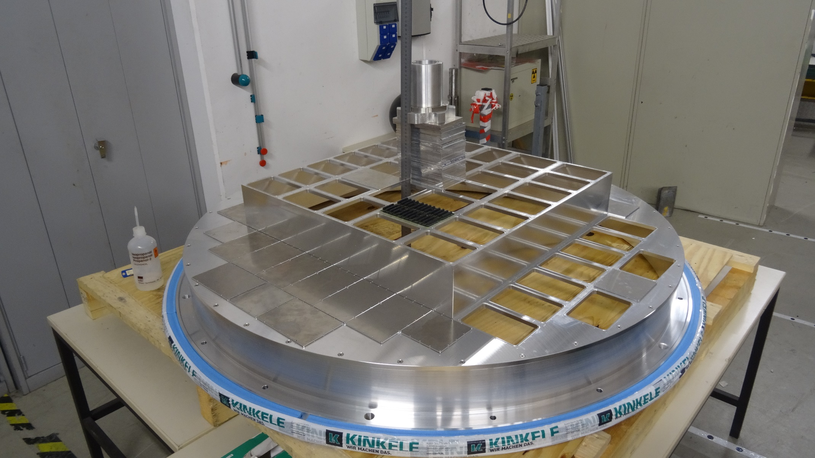
RICH700 Assembly 28.07.16
Detector frame with open holes
No load

Slide 2
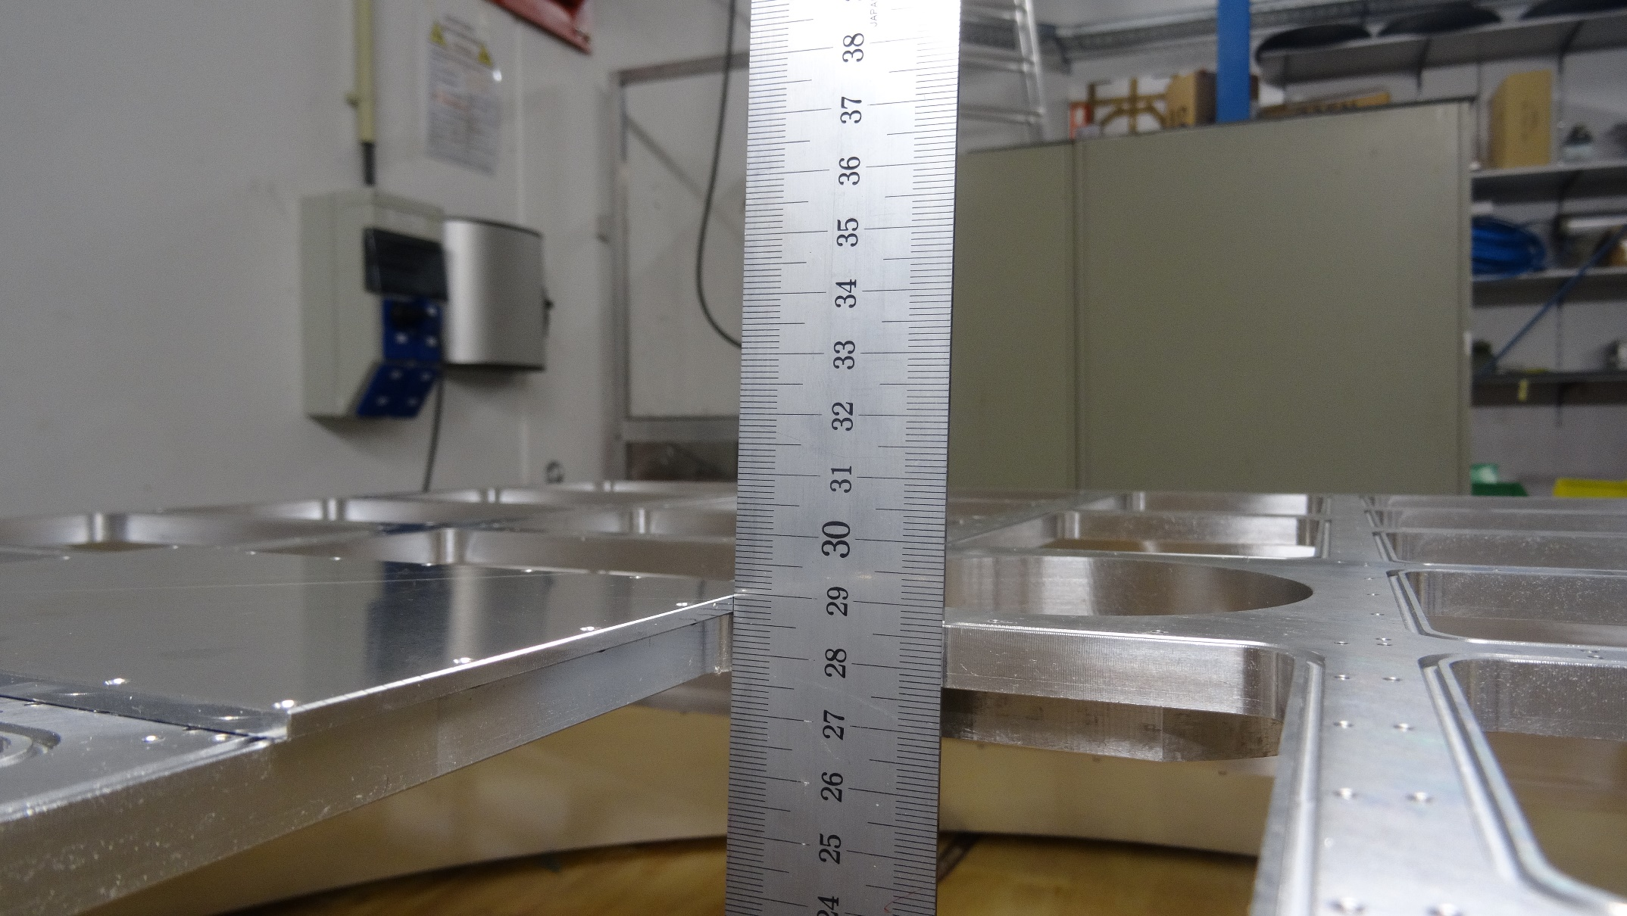
RICH700 Assembly 28.07.16
Detector frame with open holes
No load

Slide 3
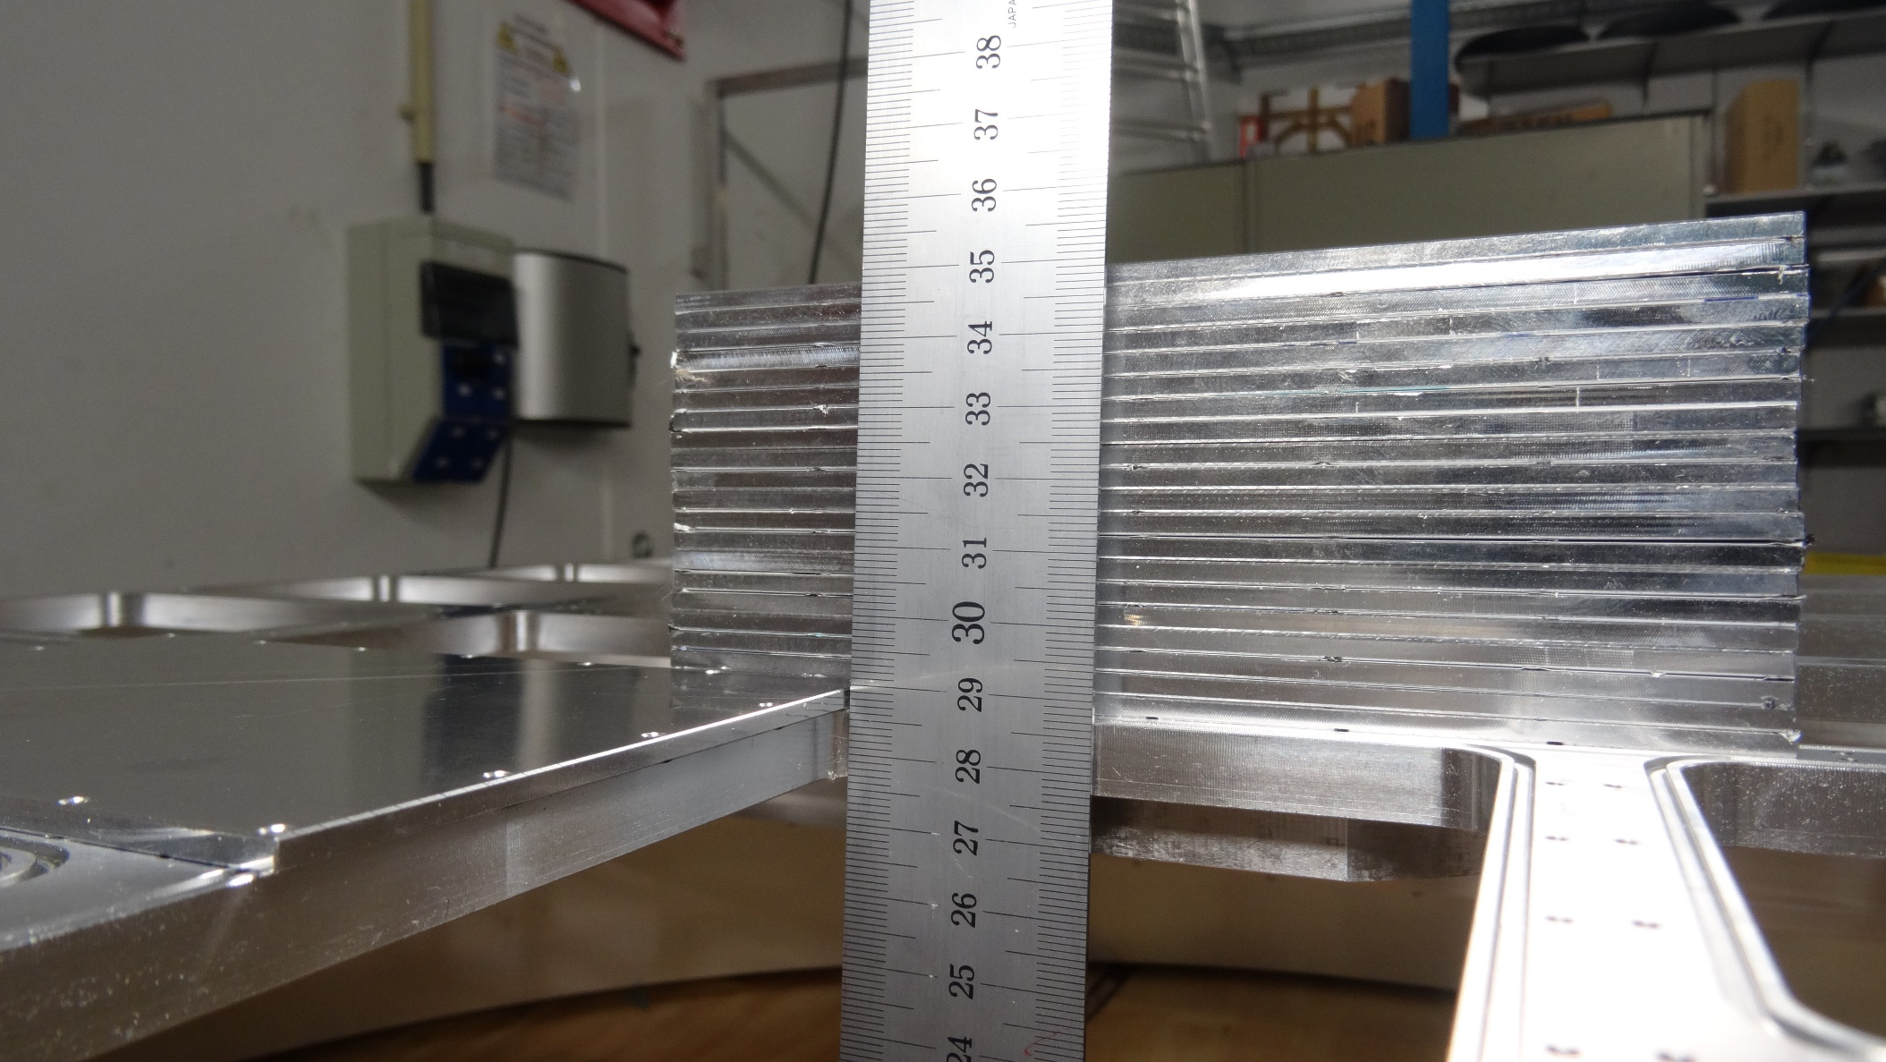
RICH700 Assembly 28.07.16
Detector frame with open holes
Load: 2.5 kg (20 Al – plates)

Slide 4
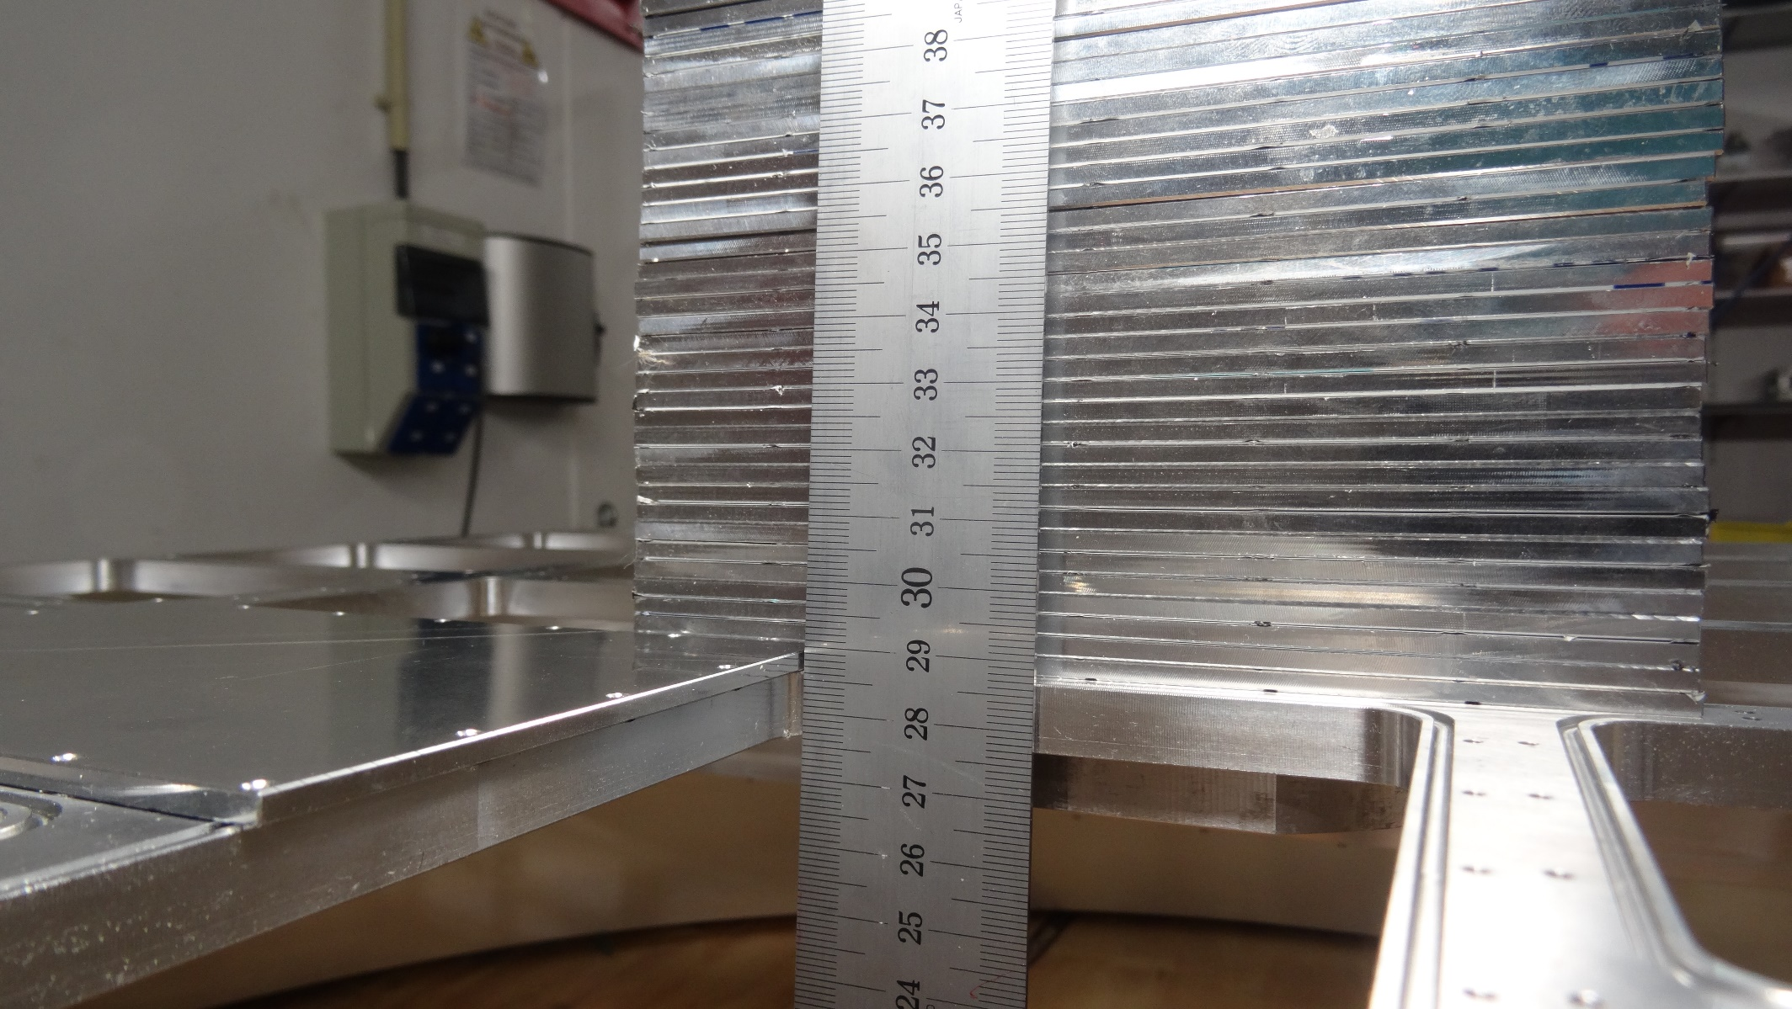
RICH700 Assembly 28.07.16
Detector frame with open holes
Load: 5.0 kg (40 Al – plates)

Slide 5
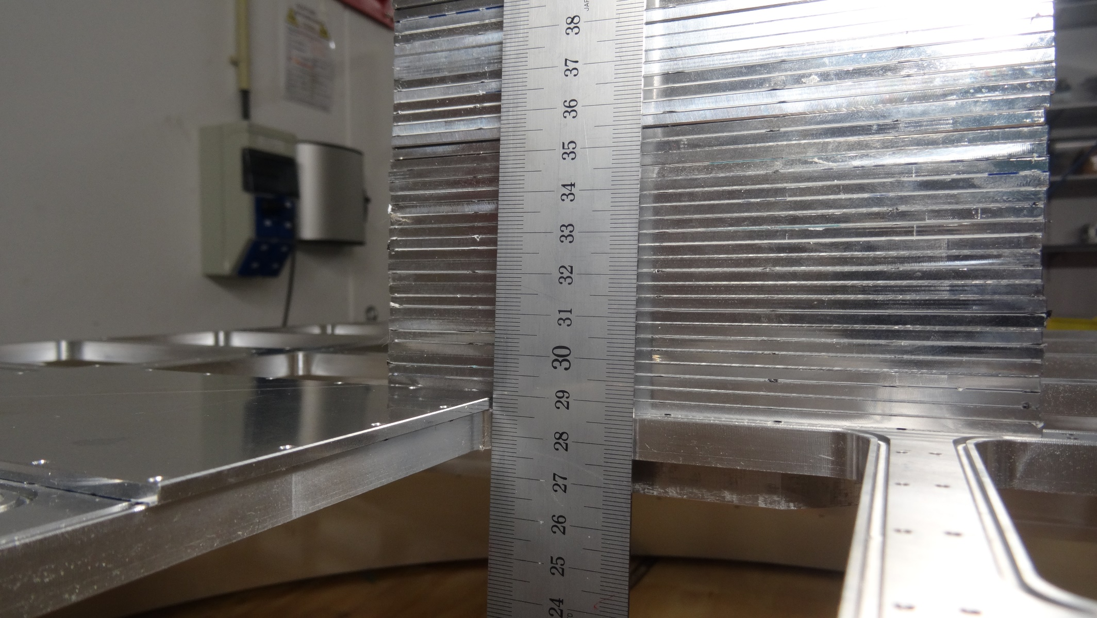
RICH700 Assembly 28.07.16
Detector frame with open holes
Load: 10.0 kg (56 Al – plates + x)

Slide 6
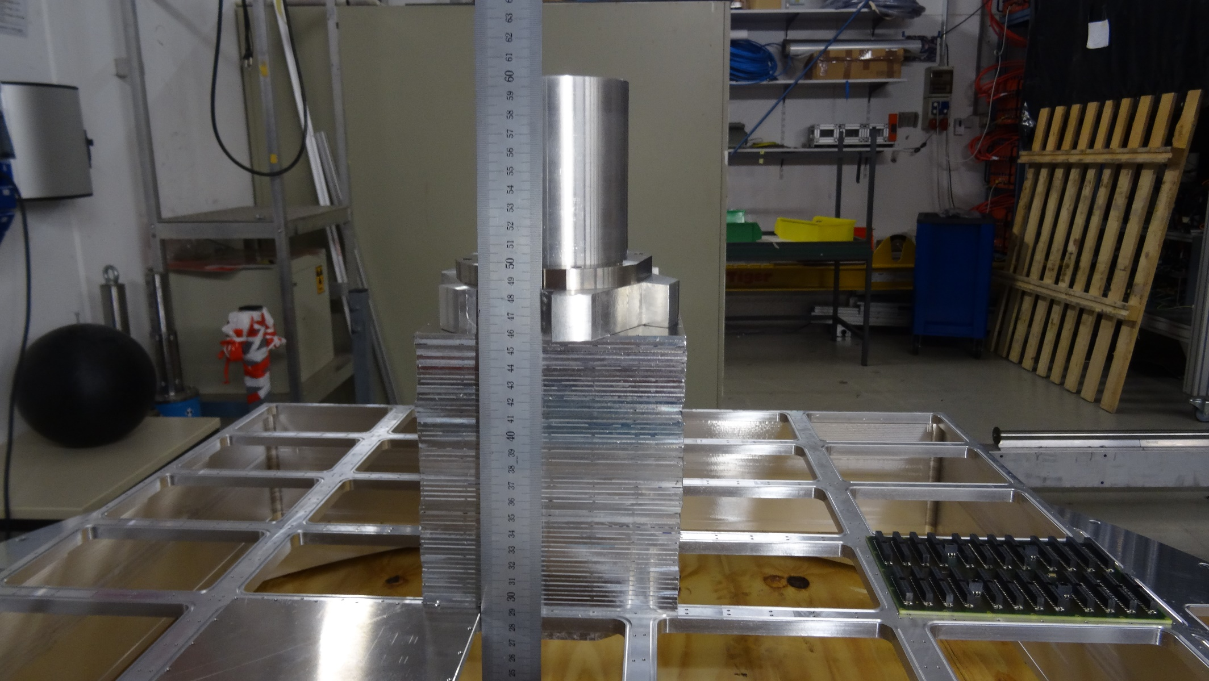
RICH700 Assembly 28.07.16
Detector frame with open holes
Load: 10.0 kg (56 Al – plates + x)

