Slide 1
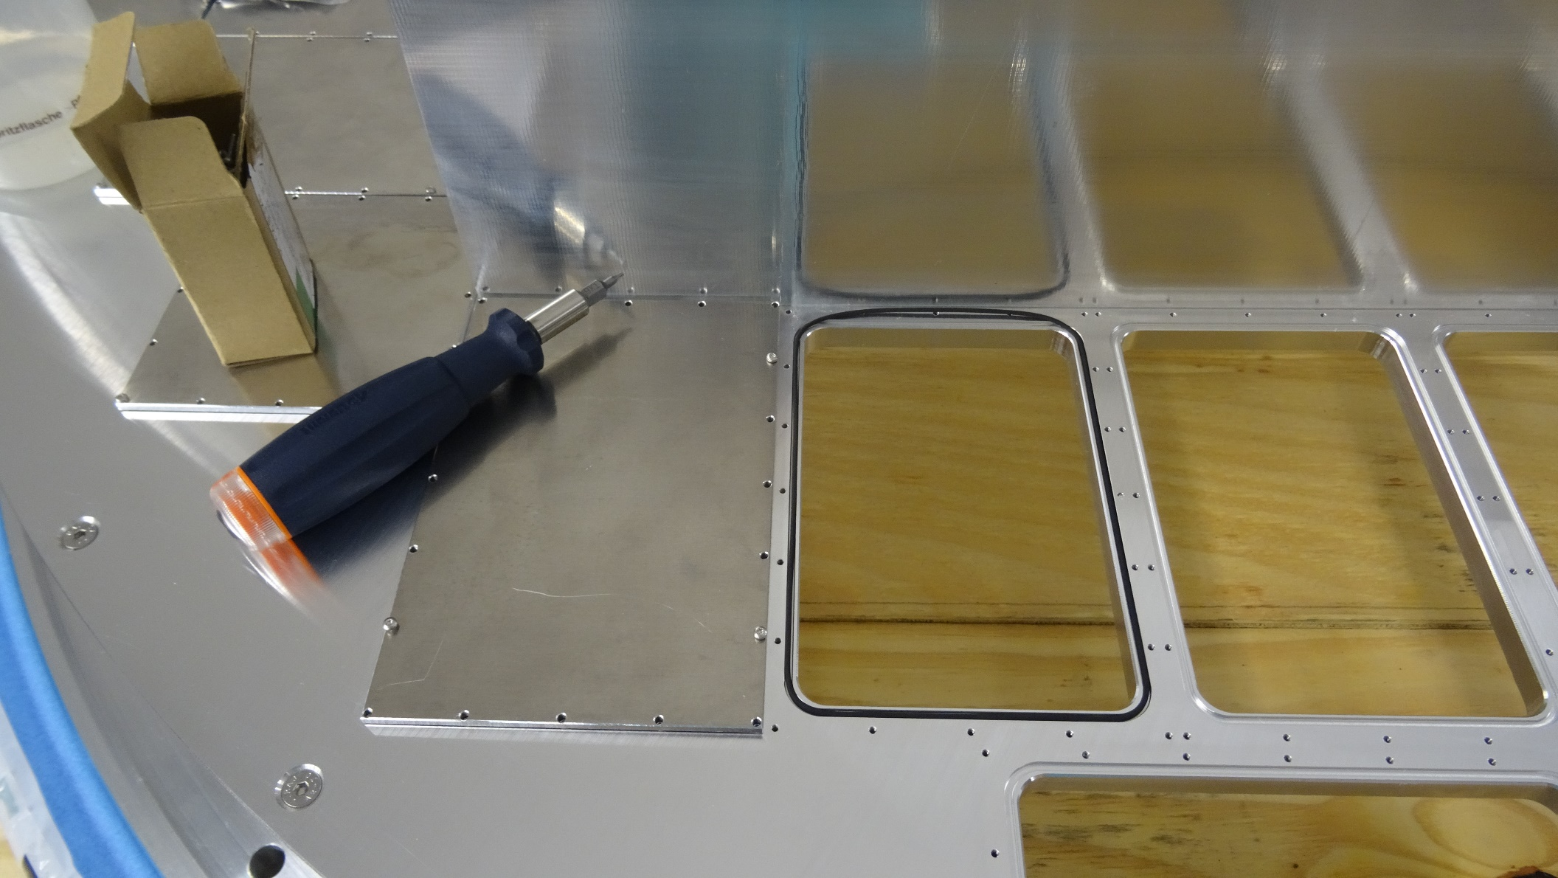
RICH700 Assembly 28.07.16
Mounting Al - plates (d = 3 mm) with M2x8 TX screws
O-rings & max torque screwdriver

Slide 2
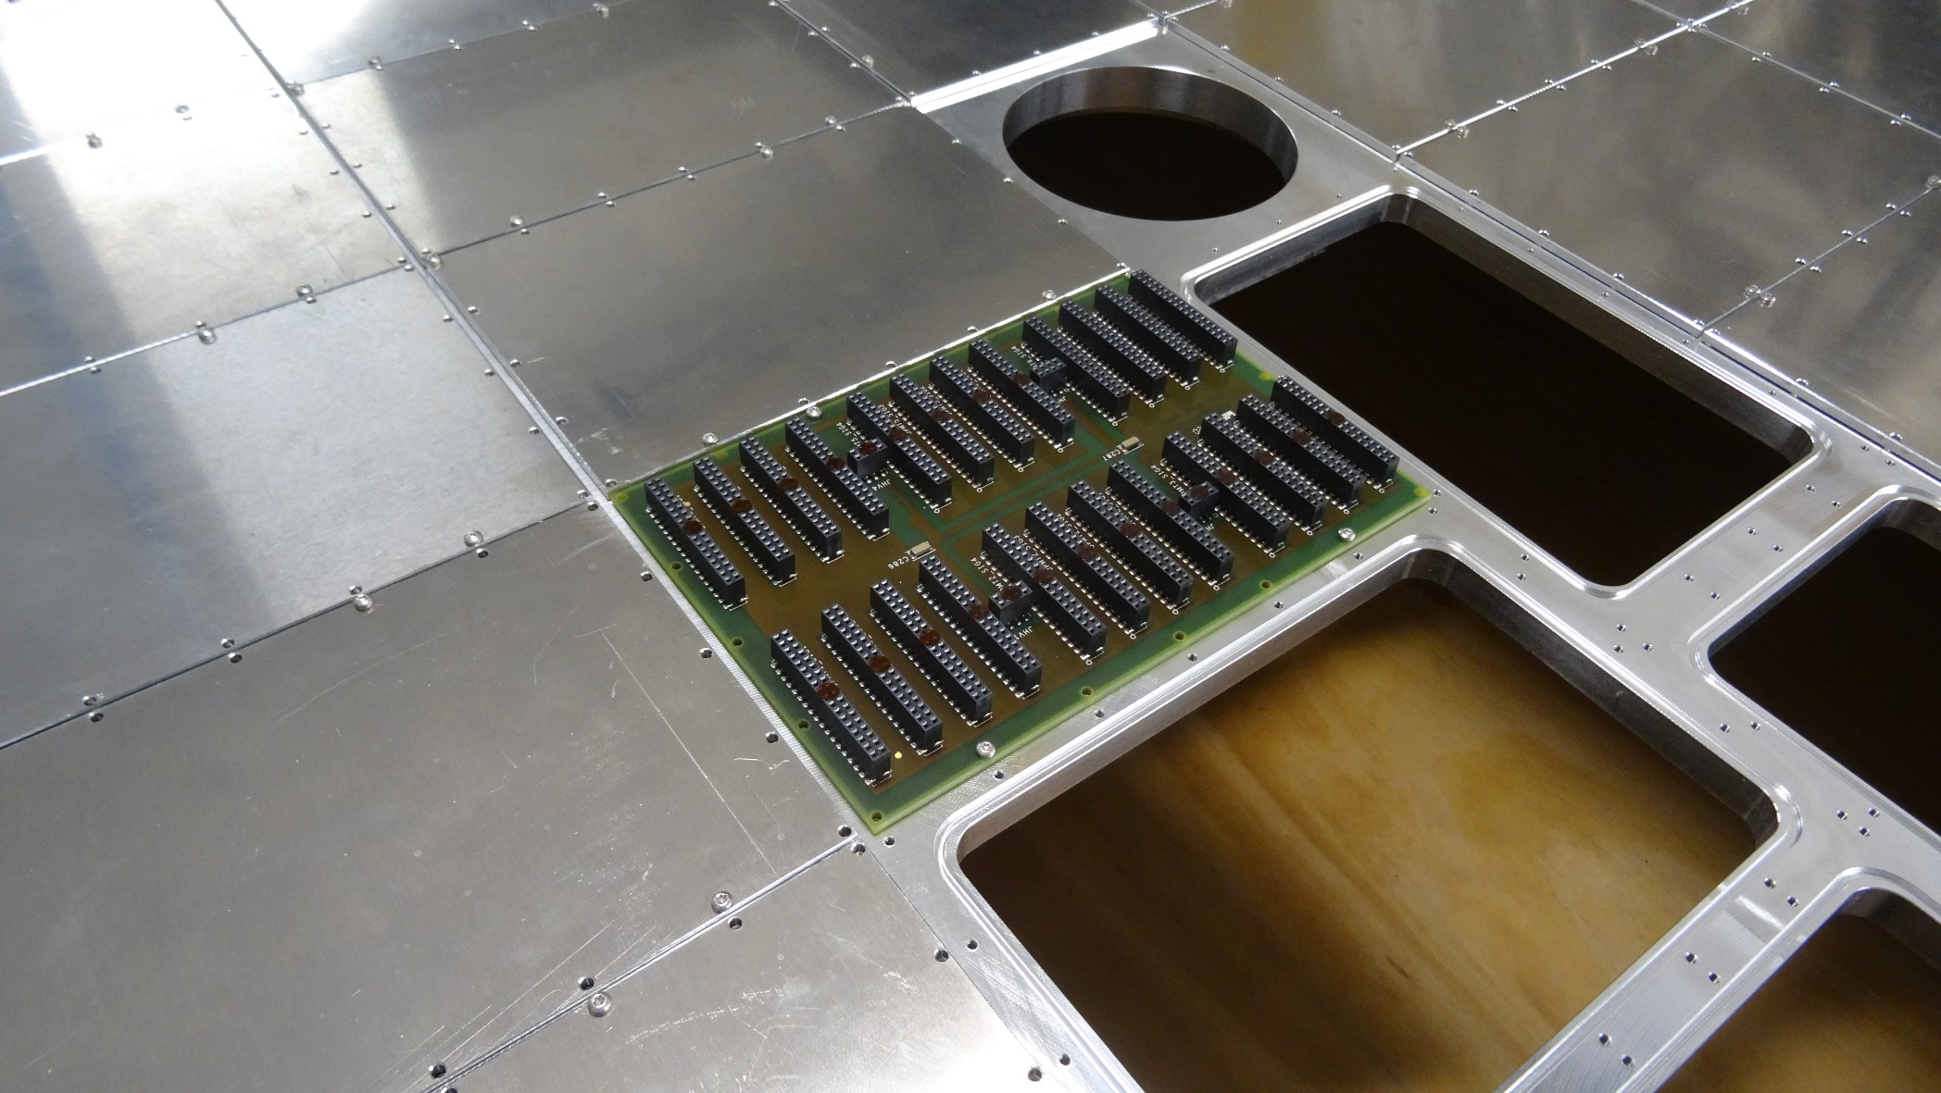
RICH700 Assembly 28.07.16
Mounting Al - plates (d = 3 mm) with M2x8 TX screws
1 MAPMT carrier PCB (backplane)

Slide 3
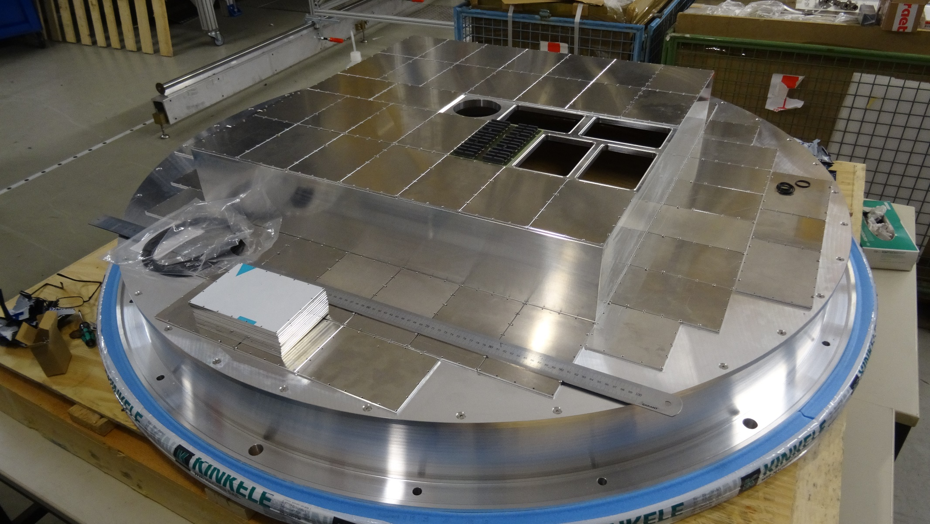
RICH700 Assembly 28.07.16
Mounting Al - plates (d = 3 mm) with M2x8 TX screws
Detector nearly closed

