Slide 1

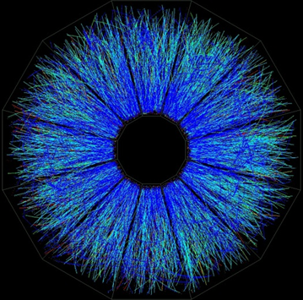
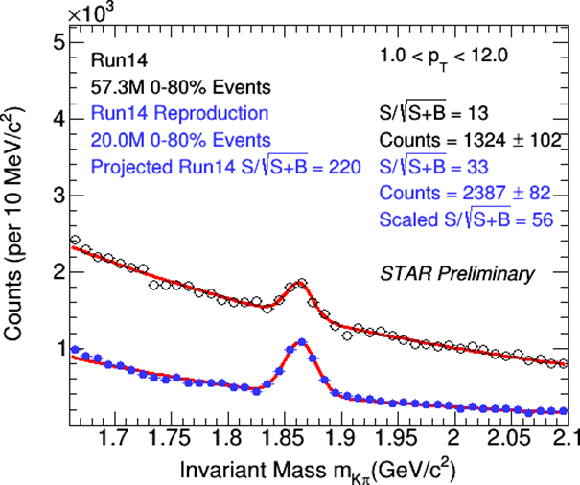
Open heavy flavor at RHIC
Jaroslav Bielčík
Czech Technical University
in Prague
EMMI Rapid Reaction Task Force
Extraction of heavy-flavor transport coefficients in QCD matter
18 - 22 July 2016, GSI Darmstadt

Slide 2
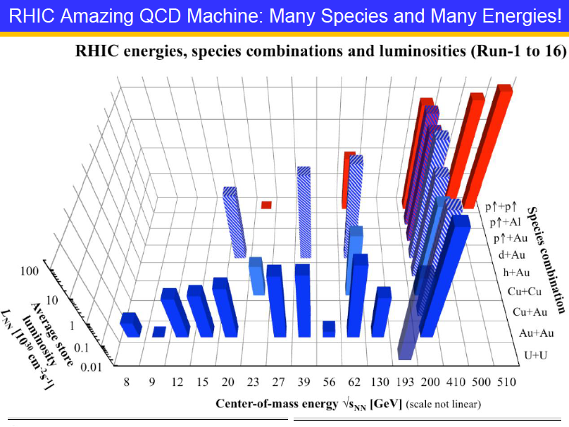
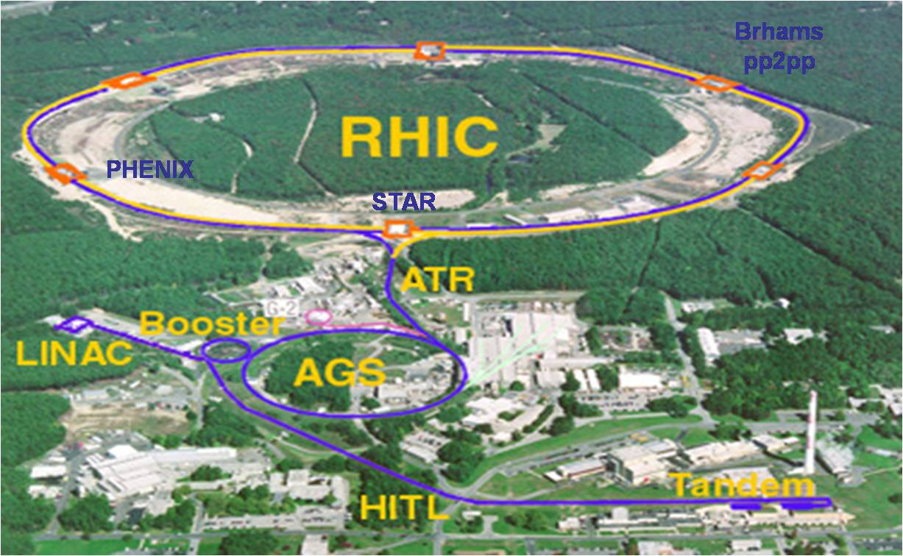
Relativistic Heavy-Ion Collider
Extremely versatile: has collected data colliding a large array of different heavy ions
Only polarized proton collider in the world

Slide 3
Outline
D mesons in p+p collisions
d+Au NPE measurements
D mesons with STAR HFT
NPE in heavy ion at RHIC

Slide 4
Heavy quarks – open questions
Colour charge and quark mass dependence of energy loss
Expectation Ec < Eu,d,s< Eg vs. observation RAA(D) ≈ RAA(π)
Low p_{T} (<10 GeV/c): mass effect on energy loss + radial flow?
At which p_{T} does R_{AA}(b) become compatible with R_{AA}(light)?
Energy loss mechanism: collisional vs. radiative
Path length dependence of energy loss (via v₂ at high p_{T})
Correlation measurements
Cold nuclear matter effects in the initial and final state
d+Au, system and energy scan
Collectivity and thermalization
charm v₂ and R_{AA} measurements at low p_{T}
Hadronization mechanism: coalescence vs. fragmentation
D_{s}, Λ_{s} measurements; v₂ and R_{AA} measurements at low pT
SaporeGravis network review Eur. Phys. J. C (2016) 76:107

Slide 5
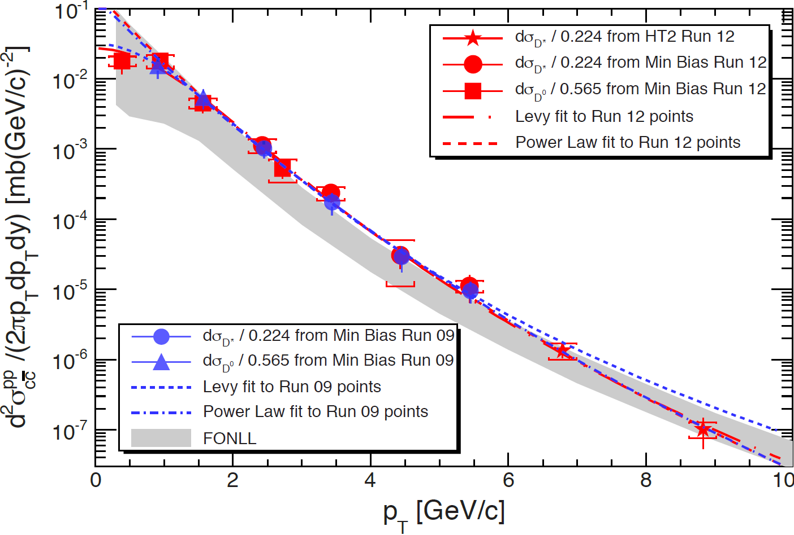
D⁰ and D* p_{T} spectra in p+p 200 GeV collisions
STAR Preliminary
New measurement from Run 12 extents the range towards low-p_{T.}
FONLL upper band is consistent with charm spectra.
FONLL: 200 GeV M. Cacciari, PRL 95 (2005) 122001
.
Run 09: Phys. Rev. D 86 (2012) 72013

Slide 6
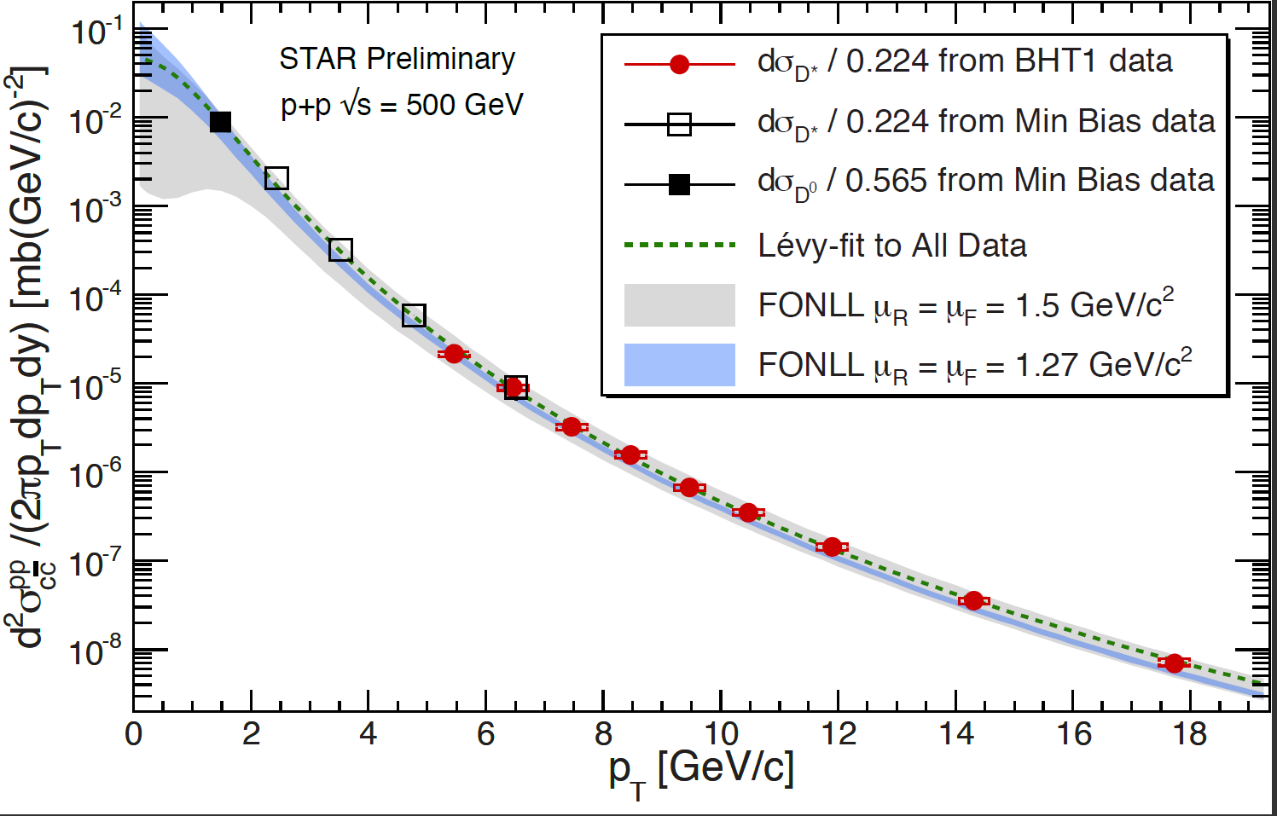
D⁰ and D* p_{T} spectra in p+p 500 GeV collisions
D* measurement in p+p 500 GeV up to p_{T} ~ 18 GeV/c.
FONLL is consistent with data.
FONLL: 500 GeV R.Vogt priv. comm., |y| < 1
.

Slide 7
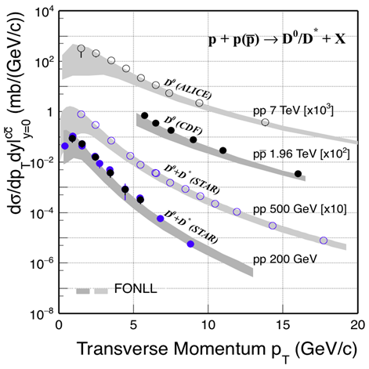
STAR: PRD 86 (2012) 072013, NPA 931 (2014) 520
CDF: PRL 91 (2003) 241804; ALICE: JHEP01 (2012) 128
FONLL: PRL 95 (2005) 122001

Slide 8
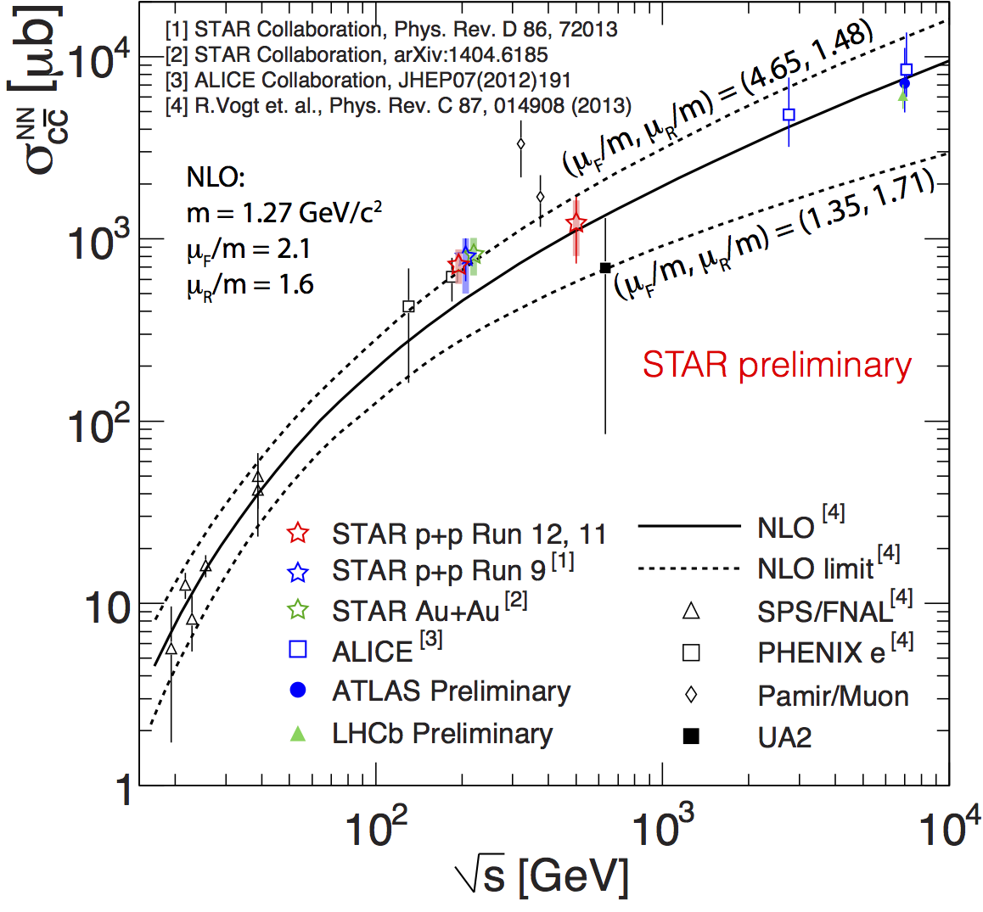
Total inclusive charm cross-section
STAR 200GeV and 500 GeV
data points are in world data trend.
NLO pQCD calculations
reproduce the data well.

Slide 9
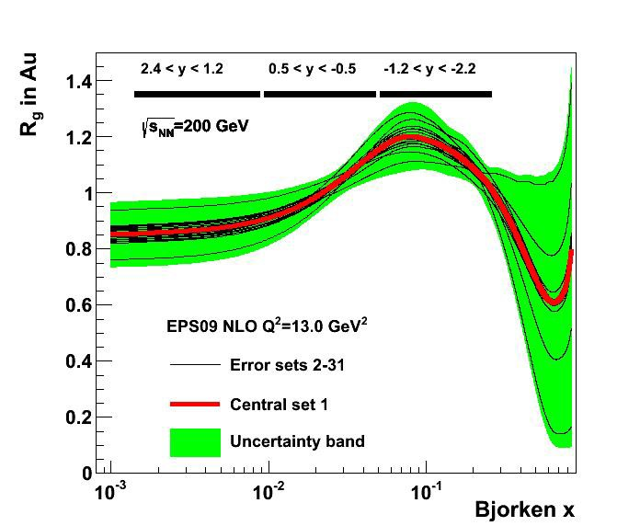
Cold nuclear matter@dAu 200GeV
Non-photonic electrons at midrapidity (PHENIX)
Central - Enhancement at intermediate p_{T}
Peripheral - Consistent with
scaled p+p results
mid
Shadowing/Anti-Shadowing Transition
PHENIX Phys. Rev. Lett. 109, 242301 (2012)
R_{g} from EPS09

Slide 10
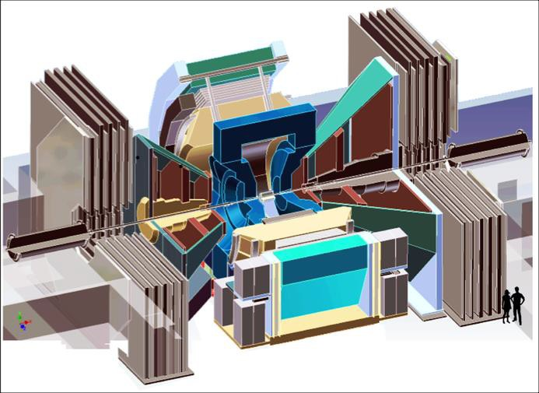


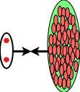


Muons at Forward/Backward Rapidity@PHENIX
PHENIX Phys. Rev. Lett. 112, 252301 (2014)
Central:
Peripheral:
Suppression
at forward rapidity
Enhancement
at backward rapidity
Consistent with
scaled p+p results
fwd
bwd
μ
Shadowing Region
μ
Anti-Shadowing Region
R_{g} from EPS09
d
Au

Slide 11
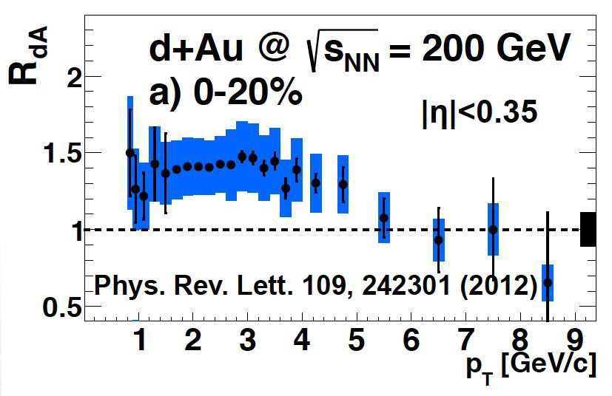
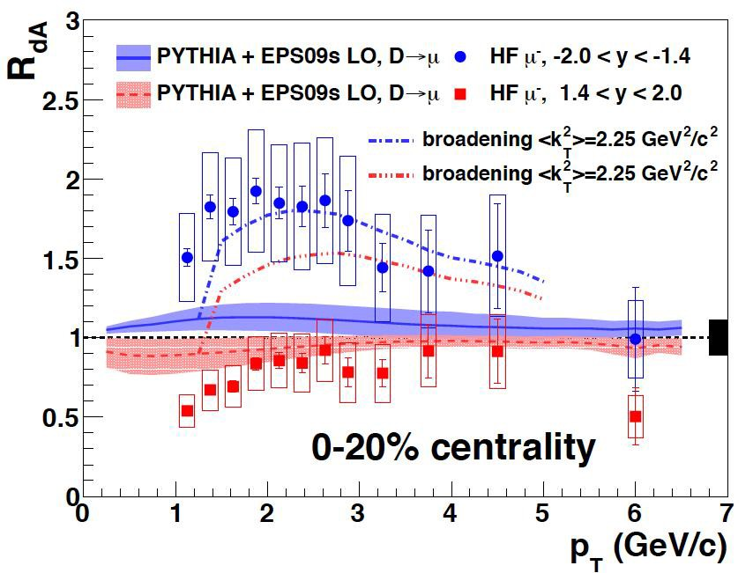
R_{dAu}@PHENIX
Initial-state effects fail to reproduce the data at both rapidity simultaneously
  Modification of nPDF
  Initial k_{T} broadening
Cronin enhancement?
  Initial k_{T} component due to multiple scattering of incoming partons
Phys. Rev. C. 88, 024906 (2013)

Slide 12
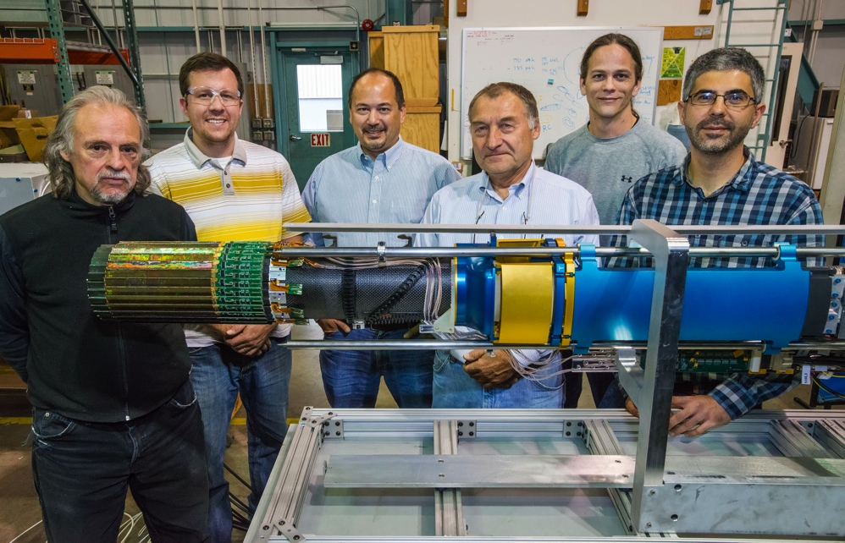
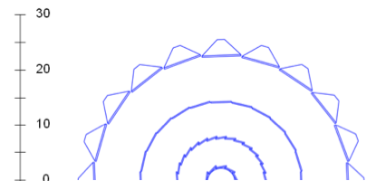
STAR Heavy Flavor Tracker (HFT)
TPC – Time Projection Chamber (main tracking detector in STAR)
HFT – Heavy Flavor Tracker
SSD – Silicon Strip Detector
IST – Intermediate Silicon Tracker
PXL – Pixel Detector (356M pixels on ~0.16 m² of silicon)
Acceptance coverage:
-1< η < 1
0 < φ < 2π
STAR+HFT collected MB events
Run14 Au+Au 1.2B
Run15 p+p 1B
p+Au 0.6B
Run 16 Au+Au 2B
R (cm)
σ = ~1 mm
SSD r = 22
IST r = 14
PXL r₂ = 8
  r₁ = 2.8
σ = ~300 μm
σ = ~250 μm
σ = <30 μm

Slide 13
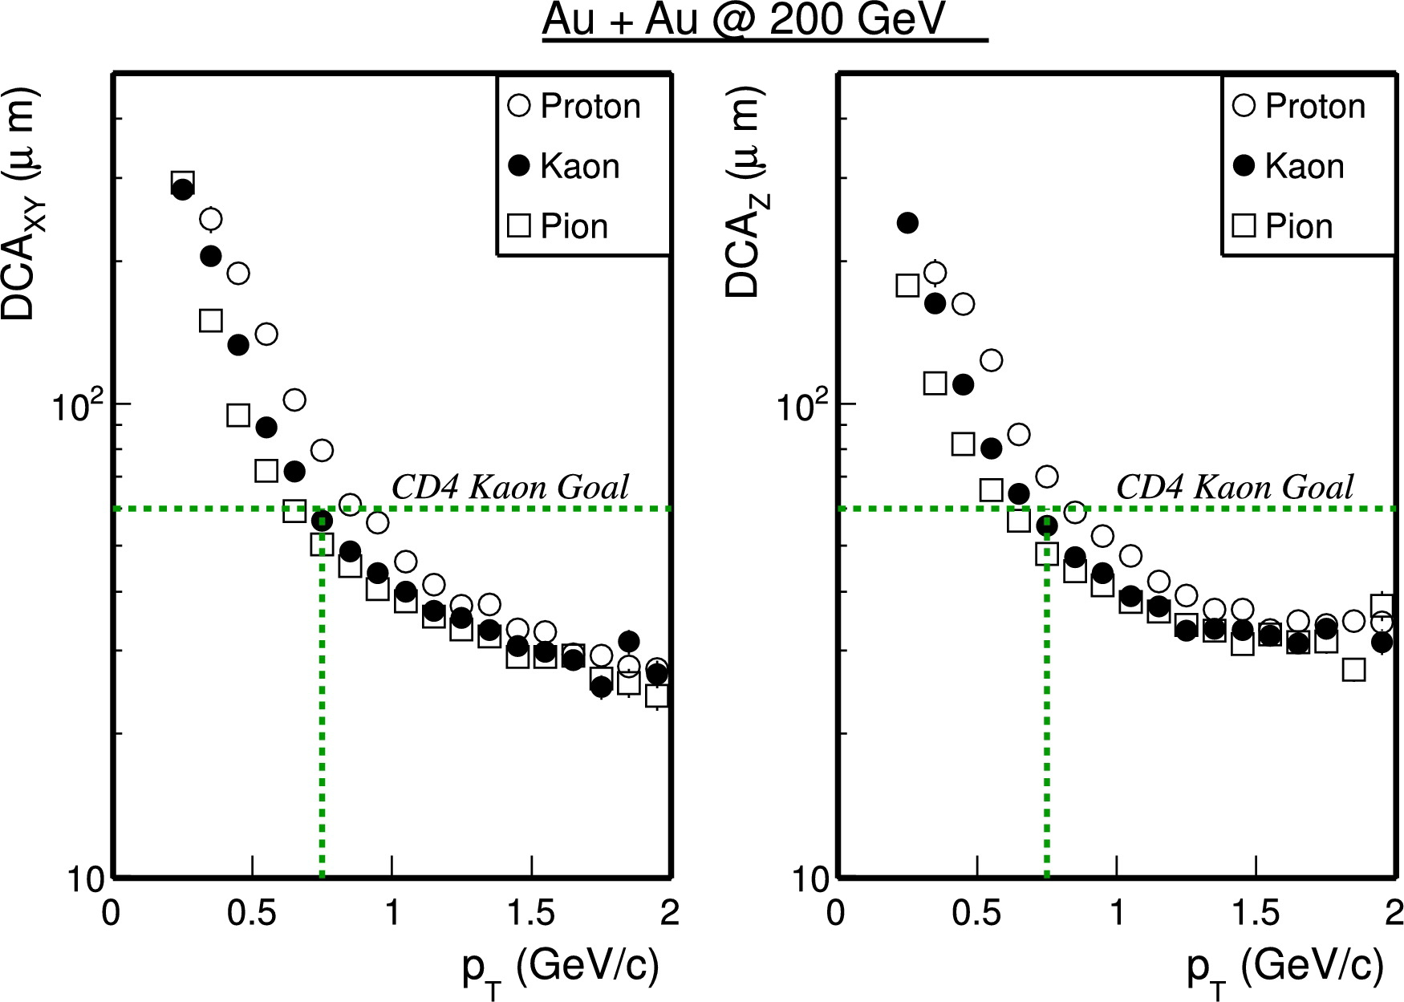
HFT Performance vs. design goals
STAR Preliminary
Kaon track pointing resolution exceeds the requirement < 55 μm at p_{T}=750 MeV/c
Pointing resolution in the region with Al-cables ~ 45 μm

Slide 14
D mesons with HFT
STAR Preliminary
RHIC Run 14
Excellent long-lived hadron and electron identification
Secondary vertex reconstruction with HFT → full kinematic reconstruction of charmed hadron

Slide 15
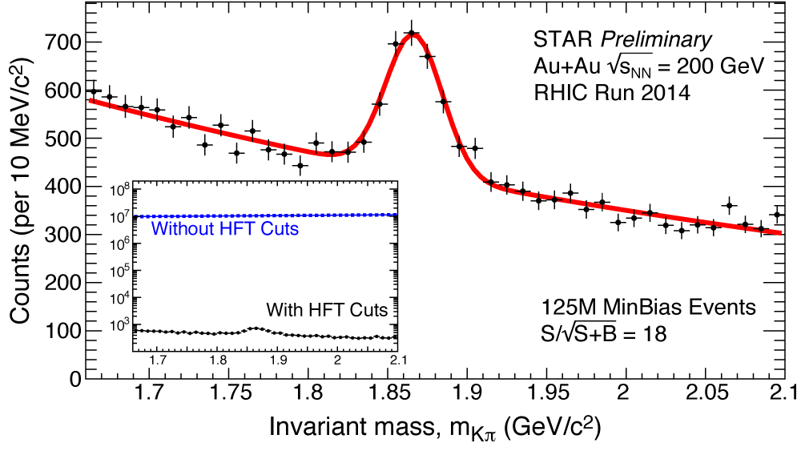
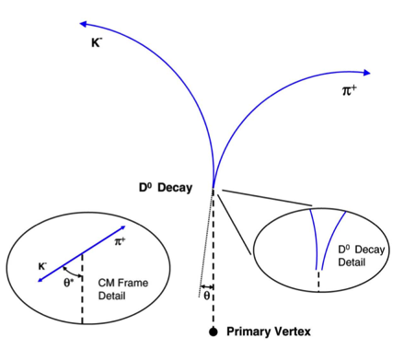
Topological reconstruction with HFT
Greatly reduced combinatorial background (4 orders of magnitude)
Highly improved S/B
 | w/o HFT | w HFT
 | 2010 + 2011 | 2014
# events(MB) analyzed | 1.1 B | 780 M
significance per billion events | 13 | 51
Notes:
Update BR ratio to 3.89

Slide 16
Nuclear modification factor
(780M)
High p_{T}: significant suppression in central Au+Au collisions.
  New results have improved precision
  Strong charm-medium interaction
R_{AA}(D) > 1 p_{T} ~ 1.5 GeV/c
  Indication of charm coalescence with bulk
(1.1B)
STAR Preliminary
Transverse Momentum p_{T} (GeV.c)
STAR: PRL 113 (2014) 142301
PLB 655 (2007) 104
Notes:
Draw theory lines one by one and have some conclusion

Slide 17
Nuclear modification factor
High p_{T}: significant suppression in central Au+Au collisions.
  New results have improved precision
  Strong charm-medium interaction
R_{AA}(D) > 1 p_{T} ~ 1.5 GeV/c
  Indication of charm coalescence with bulk
STAR Preliminary
Similar suppression for light partons and charm quarks at high p_{T} (>4 GeV/c)
STAR: PRL 113 (2014) 142301
PLB 655 (2007) 104
Notes:
Draw theory lines one by one and have some conclusion

Slide 18
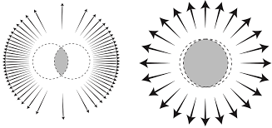
D⁰ azimuthal anisotropy
D⁰ azimuthal anisotropy significantly above zero for p_{T} > 2 GeV/c
Data favor the model including charm quark diffusion in the medium
STAR Preliminary
  Theory: arXiv:1506.03981 (2015) & private comm.
Notes:
Draw theory lines one by one and have some conclusion

Slide 19
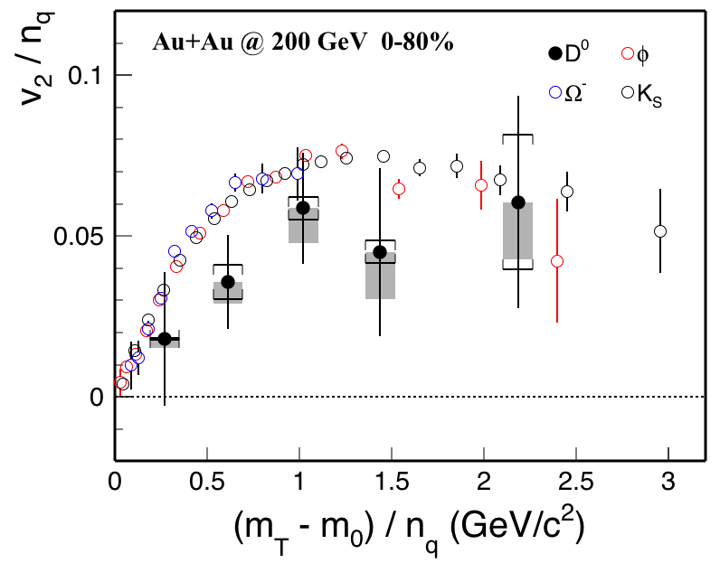
Mass effect
STAR:PRC 77 (2008) 54901
PRL 116 (2016) 62301
STAR Preliminary
STAR Preliminary
Systematically below results obtained for light hadrons. Need better statistics for a firm conclusion
  Suggests charm quarks may not be fully thermalized with the medium
Notes:
This slide should include only data results, left slide remove theory and do chi test against hadrons

Slide 20
Charm mesons vs models
Models can successfully describe both R_{AA} and v₂
TAMU: non-perturbative T-Matrix approach:
(2πT)D = 2 - ~11
SUBATECH: pQCD + Hard Thermal Loops for resummation:
(2πT)D = 2 - 4
DUKE: Langevin simulation with transport properties tuned to LHC data:
(2πT)D = 7
STAR Preliminary
  Theory: PRC 92(2015) 024907
  arXiv:1506.03981 (2015)
  & private comm.
  STAR 2010/11: PRL 113 (2014) 142301
STAR Preliminary
Notes:
This slide should include only data results, left slide remove theory and do chi test against hadrons

Slide 21
Extracting the diffusion coefficient (2πT)D
Values for the diffusion coefficient extracted from models as a function of T/T_{c} and inferred range (2 to ~ 11) from STAR data.
Lattice calculations, although with large uncertainties, are consistent with values inferred from data
STAR Preliminary
STAR Preliminary
STAR Preliminary
Notes:
This slide should include only data results, left slide remove theory and do chi test against hadrons

Slide 22
Run 14 data reprocessing
Improved HFT tracking efficiency after PXL decoding issue has been discovered and resolved -> Factor 2-4 improvement in D⁰ significance
Preliminary results are consistent with the results obtained with the available re-processed sample
Run 16:
  Full aluminum cables for inner layer of PXL: Factor 2 -3 further improvement for D⁰ significance @ 1 GeV/c
  Precision heavy flavor measurements
Notes:
Run14 will have full statics
Run 15 pp and pA
Run16 full aluminum cables, SSD and 2 billion -> significance improvement 2-3 for 1 GeV D0 -> centrality dependence

Slide 23
D⁰ spectra in U+U 193 GeV
Phys. Rev. Lett. 113, 142301 (2014)
U+U collisions can reach 20% more energy density.
Similar suppression pattern in U+U collisions.

Slide 24
D⁰ spectra in Au+Au vs. U+U collisions
Number of participants
Similar suppression of charm mesons and pions.
Increasing suppression with N_{part.}

Slide 25
NPE UU193GeV
Improved reference from Run12 data
- For 0-5% Au+Au 200 GeV and U+U 193 GeV no difference observed

Slide 26
Non-photonic electrons in 200 GeV Au+Au
PHENIX: PRL 109 242301
Au+Au 200 GeV (min.bias)
d+Au 200 GeV
1.0 < p_{T} < 5 GeV/c : R_{AA} (e_{HF}) > R_{AA}(π⁰)
p_{T} > 5 GeV/c : R_{AA}(e_{HF}) ~ R_{AA}(π⁰)
At high-p_{T}:suppression similar to pions
1.0 < p_{T} < 5 GeV/c : R_{AA} (e_{HF}) > R_{AA}(π⁰)
p_{T} > 5 GeV/c : R_{AA}(e_{HF}) ~ R_{AA}(π⁰)
At high-p_{T}: suppression similar to pions
Heavy flavor are suppressed due to final state effects in hot and dense nuclear medium in Au+Au 200 GeV.
No difference vs, pions observed.

Slide 27
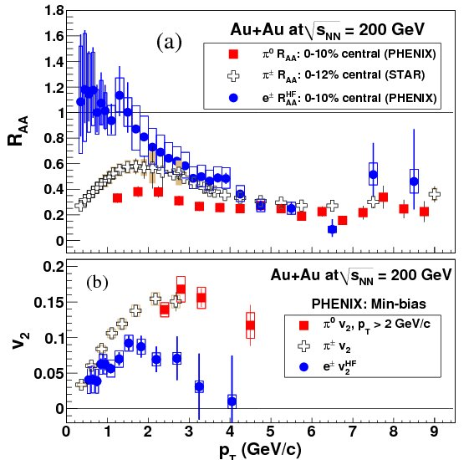
Heavy Flavor Electrons
R_{AA} and v₂
High-p_{T}
Significant suppression
Similar suppression of light
hadrons and EHF (c+b):
what about c-e and b-e?
Low-p_{T}
Little suppression
EHF less suppressed
than light hadrons.
Significant v₂, but less than
light hadrons.

Slide 28
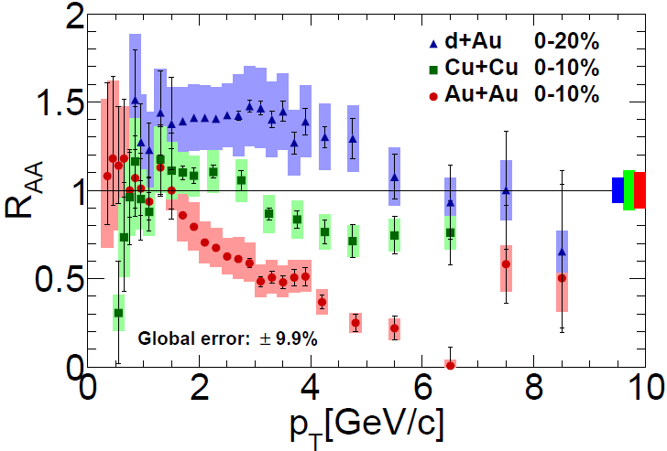
Non-photonic electrons in Cu+Cu 200GeV
PHENIX: Phys.Rev. C90 (2014) 034903
Clear enhancement in d + Au
Cold nuclear matter effects
Large suppression in Au + Au
Hot Medium effects
Cu + Cu system intermediate
R_{AA} between that in d + Au and
Au + Au
Interplay between CNM and
Hot Medium effects.

Slide 29
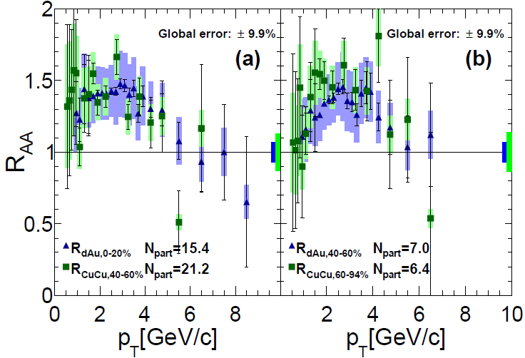
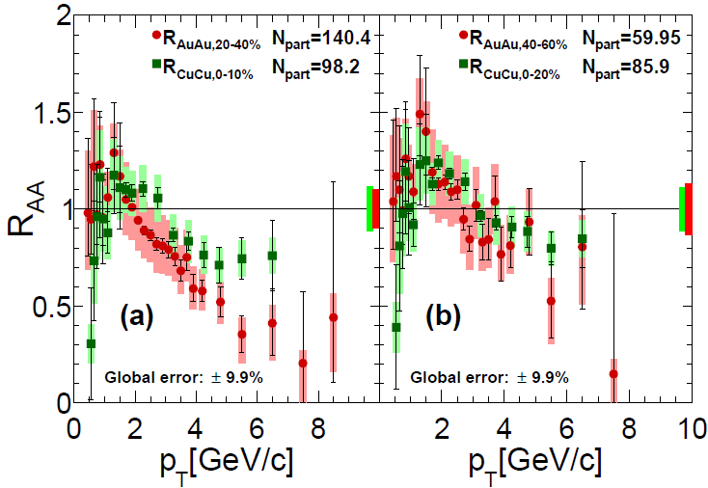
Nuclear modification for similar <N_{part}>
PHENIX: Phys.Rev. C90 (2014) 034903
<N_{part}> = 15 in d+Au
<N_{part}> = 20 in Cu+Cu
<N_{part}> = 7 in d+Au
<N_{part}> = 6 in Cu+Cu
<N_{part}> = 100 in Cu+Cu
<N_{part}> = 140 in Au+Au
<N_{part}> = 86 in Cu+Cu
<N_{part}> = 60 in Au+Au
Similar enhancement and suppression are seen for the different system at similar <N_{part}>

Slide 30
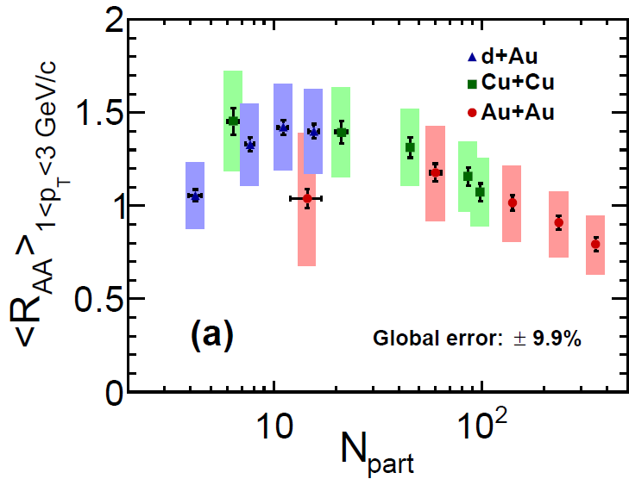
N_{part} dependence of R_{AA}
PHENIX: Phys.Rev. C90 (2014) 034903
Increase of enhancement
CNM effects
Onset of suppression
Hot matter effects take over
Enhancement and suppression effects depend on system size

Slide 31
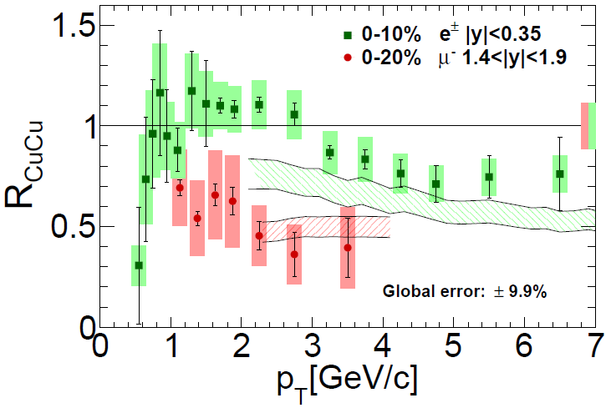
Cu+Cu 200 GeV e^{+/-} midrapidity vs. μ⁻ for forward rapidity
PHENIX: Phys.Rev. C90 (2014) 034903
More suppression in μ⁻ yield
Additional CNM effects like shadowing and initial state energy loss
Theoretical calculation
R.Sharma et al. Phys.Rev. C 80 (2009)
054902
partonic energy loss
suppression due to fragmentation and dissociation of heavy-flavor hadrons
shadowing effect
Cronin effect
No theoretical calculation to explain both data

Slide 32
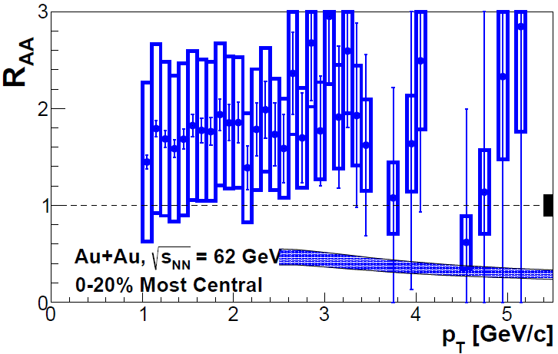
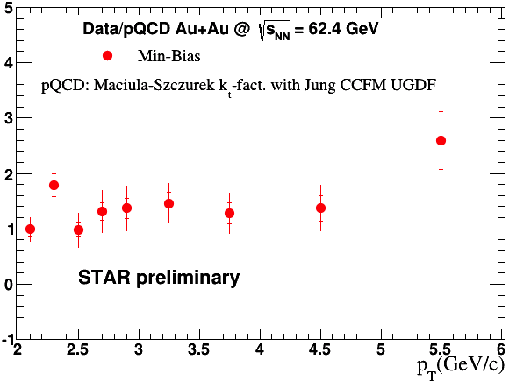
Non-photonic electrons Au+Au 62.4 GeV
R_{AA}
PRD 87 (2013) 9, 094022
STAR preliminary
Vitev model can describes 200 GeV suppression but it underpredicts 62.4 GeV data.
No suppression of NPE observed
in 62.4 GeV Au+Au collisions.
Cold nuclear matter effects are not known.
Note: pQCD-scaled p+p reference

Slide 33
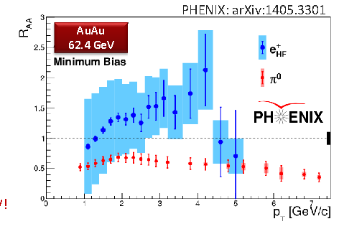
R_{AA} heavy flavor vs. pions
PHENIX: PRL 109 242301
PHENIX: PRC 91 044907
Au+Au 62 GeV
1.0 < p_{T} < 4-5 GeV/c : R_{AA} (e_{HF}) > R_{AA}(π⁰)
There is enhancement at Au+Au 62 GeV
What is the source of this difference?
Due to less energy loss? larger
Cronin effects?
Initial state effects might be different.

Slide 34
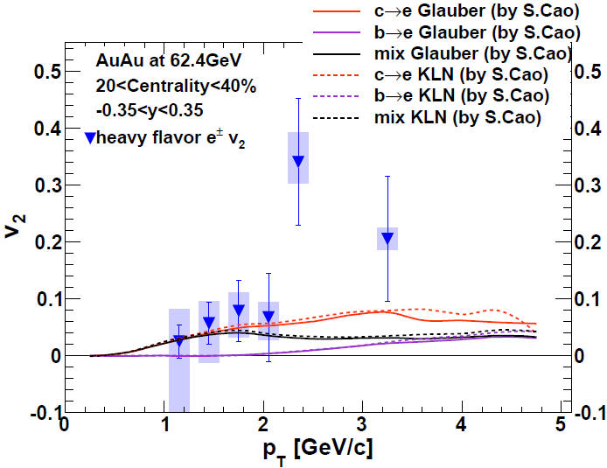
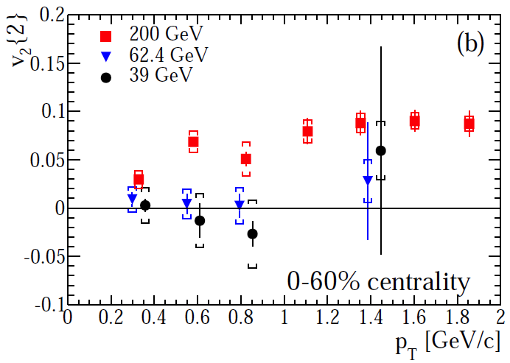
Non-photonic electrons Au+Au 39, 62.4 GeV
Anisotropy (v₂)
Charm has a positive v₂ in
62 GeV Au + Au p_{T}> 1GeV.
Collective motion of charm itself?
Collective motion of charmed hadrons through recombination with flowing light partons?
arXiv:1405.6348
(Submitted to PLB)
NPE in 39 and 62.4 GeV Au+Au collisions consistent with no flow.
Statistically different from 200 GeV for p_{T} < 1 GeV/c.

Slide 35

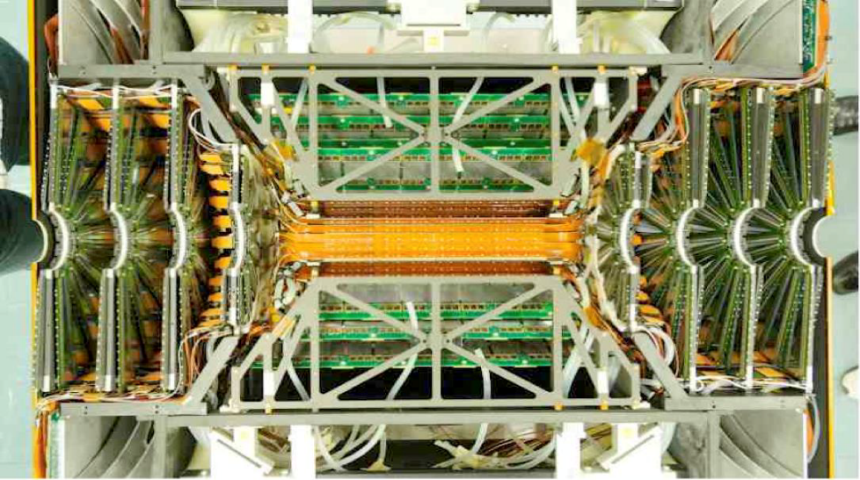
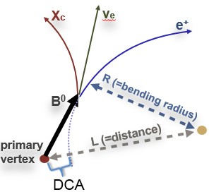
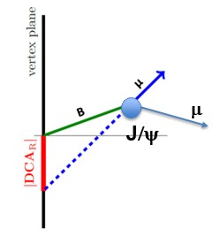

What NEW on Open Heavy Flavor?
c/b separation by secondary vertex
• VTX (2011):
- Midrapidity: |η | <1.2
- AuAu 200 GeV:
~ 60 μm DCA_{T}
resolution
Life time (cτ)
D⁰ : 123 μm
B⁰ : 464 μm
VTX detector
• FVTX (2012):
- Forward rapidity - 1.2 < |η| < 2.2
- Improved muon momentum
resolution & precise
tracking
FVTX detector
TAKEN FROM RACHID NOUICER SQM 2016 TALK

Slide 36
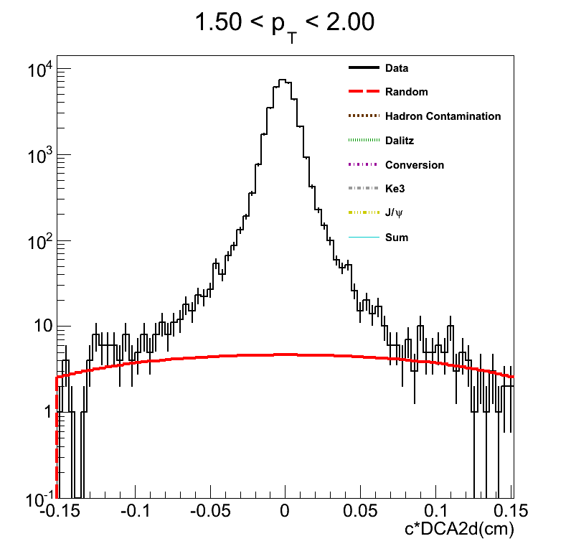
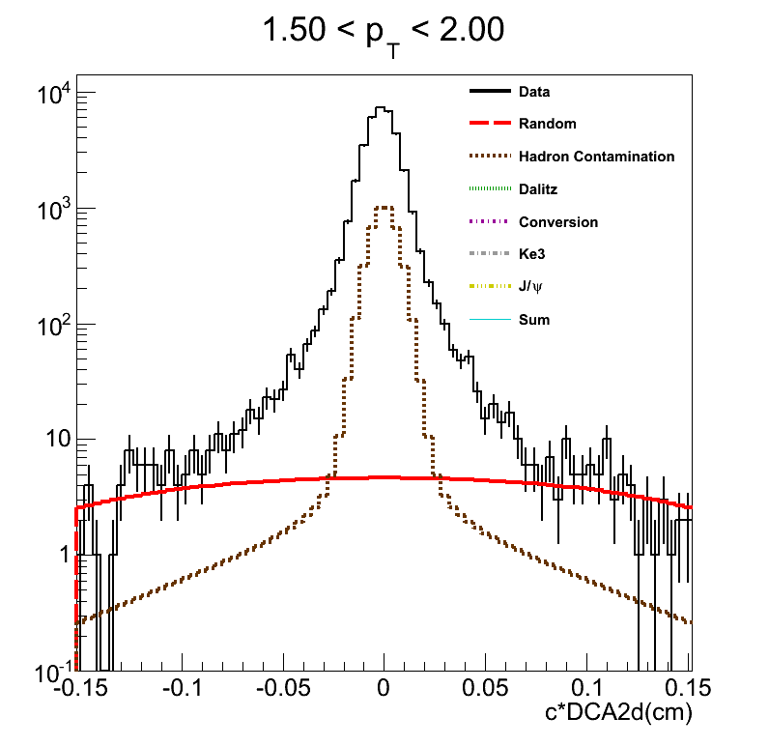
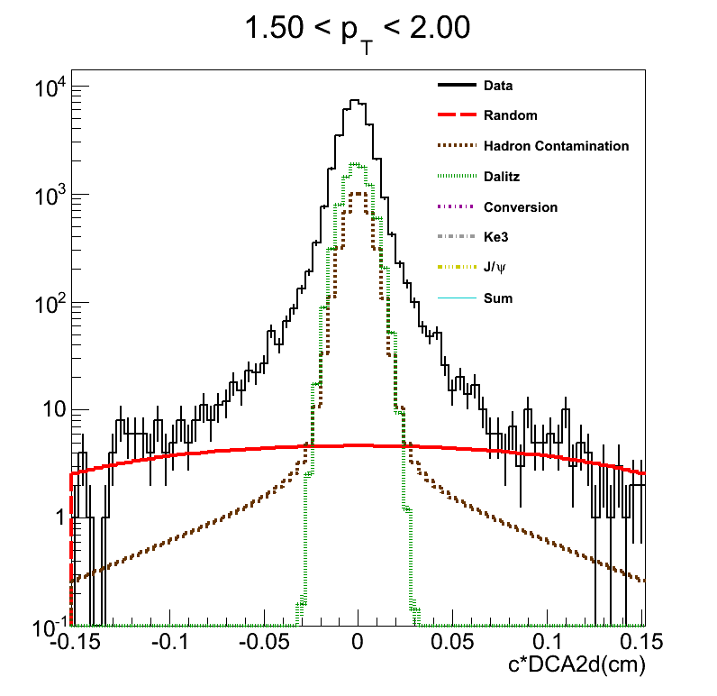
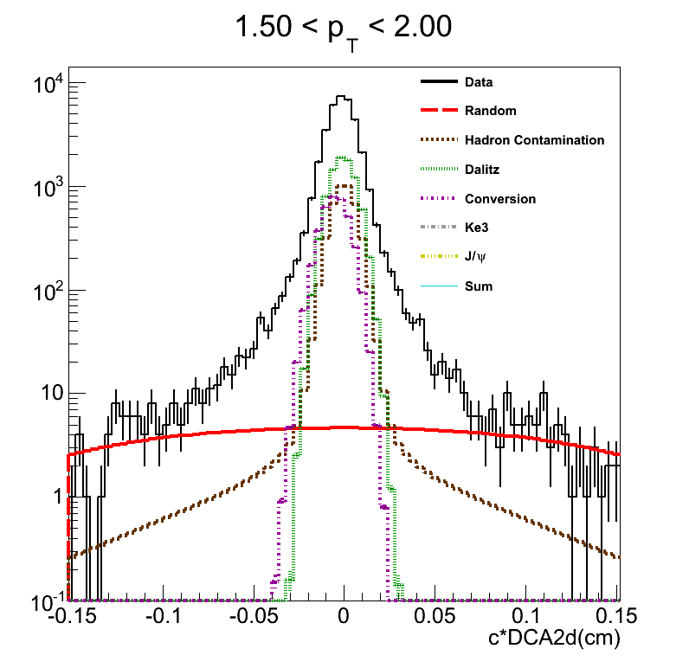
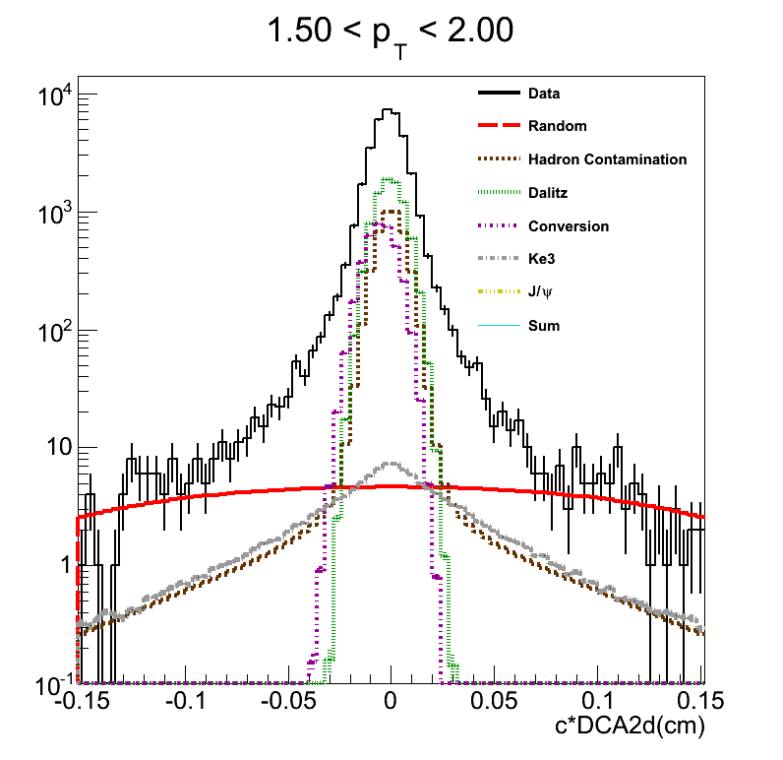
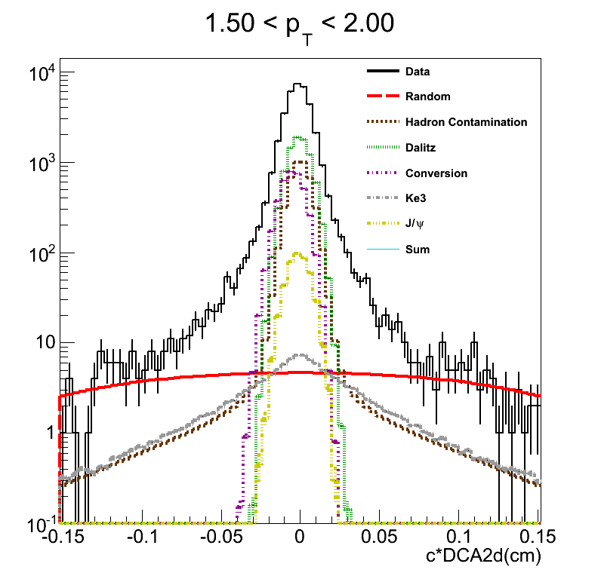
What NEW on Open Heavy Flavor?
First Results from PHENIX VTX: b/c separation
DCA_{T} Distributions: Backgrounds
High-Multiplicity Bkg.
Data driven shape
Tracks with large DCA_{L}
Conversions:
Monte Carlo shape
With Measured Pi0 yield
~75% rejected
Mis-identified hadrons:
Data driven shape
RICH Swap Method
Ke3:
Monte Carlo shape
With measured yield
Dalitz:
Monte Carlo shape
With measured yield
J/ѱ->e⁺e⁻:
Monte Carlo shape
With measured yield
PHENIC: PRC 93, 034904 (2016)
TAKEN FROM RACHID NOUICER SQM 2016 TALK

Slide 37
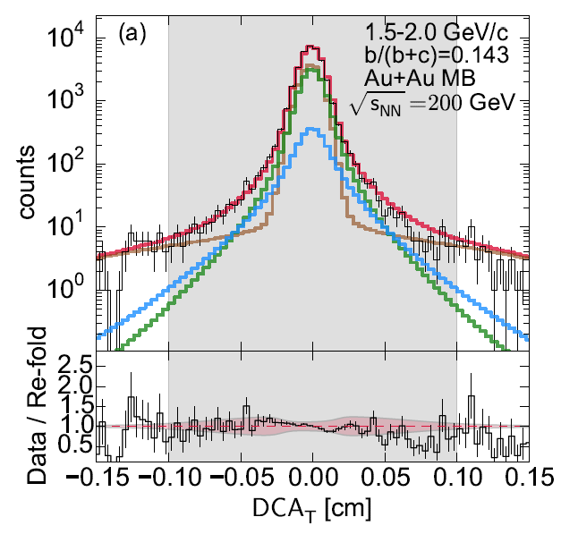
What NEW on Open Heavy Flavor?
First Results from PHENIX VTX: b/c separation
DCA_{T} Distributions: b/c separation
PHENIX: PRC 93, 034904 (2016)
c->e:
Monte Carlo shape
Normalization from unfolding
b → e
b->e:
Monte Carlo shape
Normalization from unfolding
c → e
Total
The charm and bottom yield predicted by the unfolding is consistent with electron measured DCA_{T} distributions.
Data
Backgrounds
TAKEN FROM RACHID NOUICER SQM 2016 TALK

Slide 38
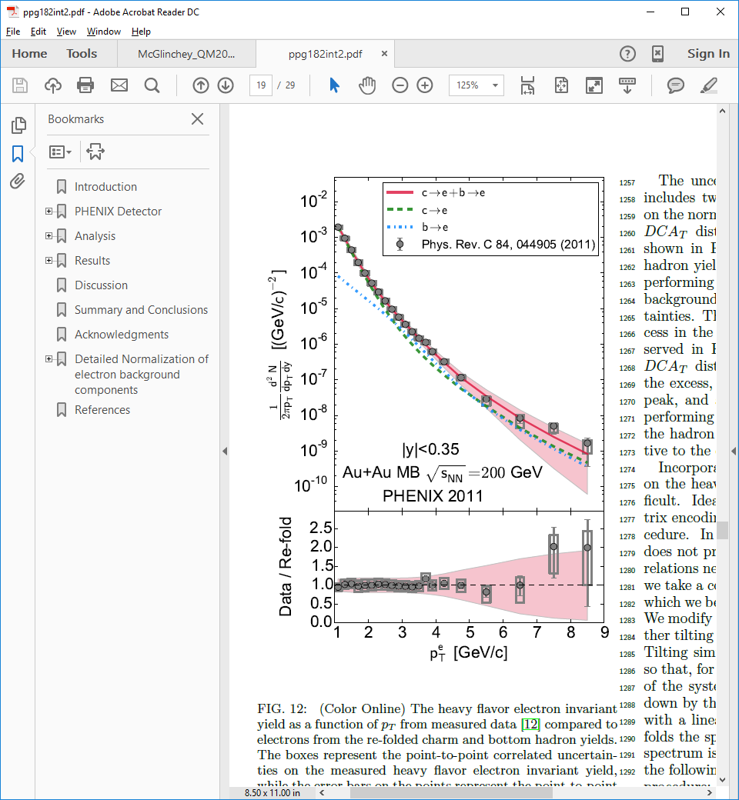
What NEW on Open Heavy Flavor?
First Results from PHENIX VTX: b/c separation
Invariant yield compared to previous published results
PHENIX: PRC 93, 034904 (2016)
The unfolding results are consistent with the previous published inclusive heavy flavor electron invariant yields.
TAKEN FROM RACHID NOUICER SQM 2016 TALK

Slide 39
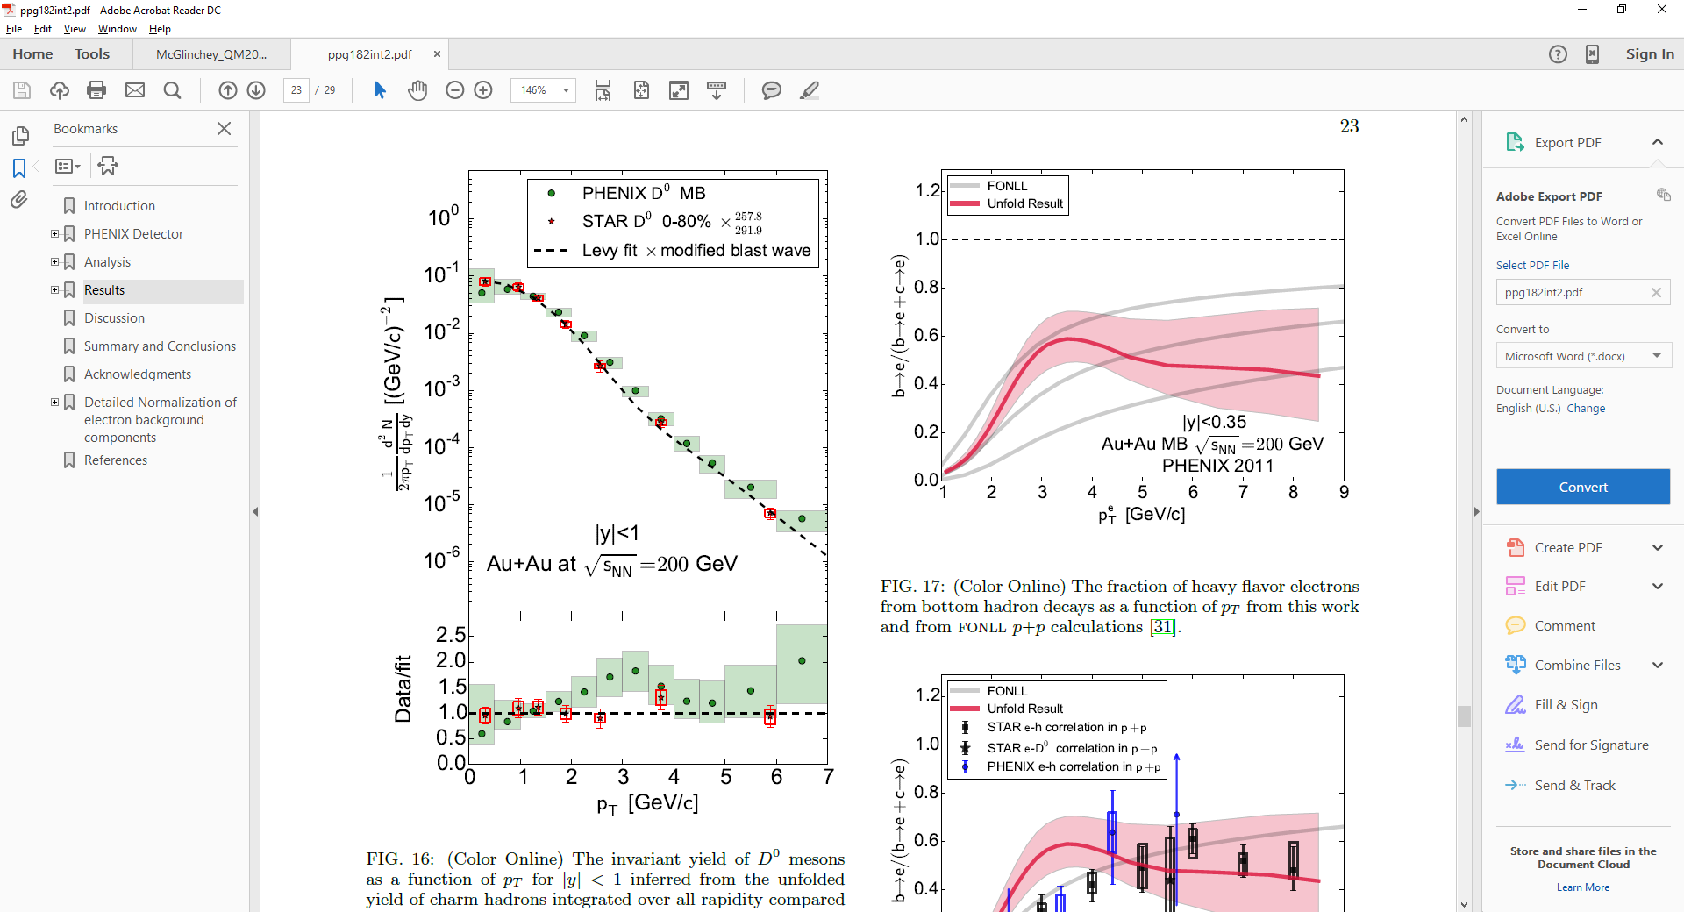
What NEW on Open Heavy Flavor?
First Results from PHENIX VTX: b/c separation
Invariant yield:
PHENIX unfolded D⁰ p_{T} spectra agrees
within uncertainties with measurements
from STAR.
PHENIX: PRC 93, 034904 (2016)
TAKEN FROM RACHID NOUICER SQM 2016 TALK

Slide 40
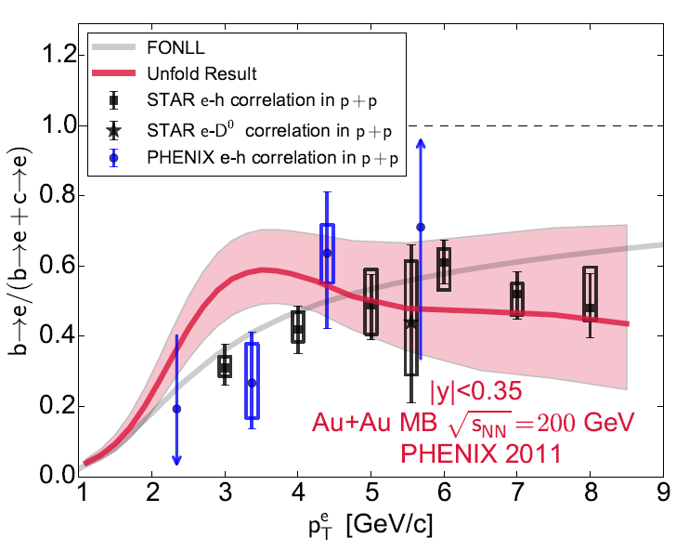
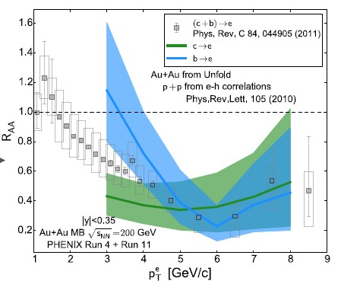
What NEW on Open Heavy Flavor?
First Results from PHENIX VTX: b/c separation
Bottom and Charm R_{AA}
PHENIX: PRC 93, 034904 (2016)
PHENIX: PRC 93, 034904 (2016)
Stay Tuned:
• 2014 data set x10 better statistics than 2011
- Decrease uncertainties
- Increase p_{T} reach
- Centrality separation
• Good 2015 p+p and p+Au data sets
We see that around p_{T} < 4 GeV the electrons from bottom experience much less suppression than electrons from charm.
TAKEN FROM RACHID NOUICER SQM 2016 TALK

Slide 41

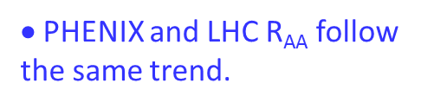

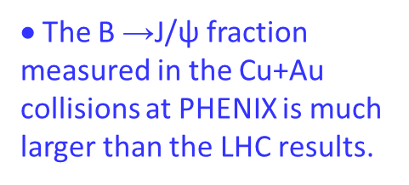
What NEW on Open Heavy Flavor?
Nuclear Modification factor Cu+Au at 200 GeV: R_{AA} (B->J/ѱ )
$\text{•}$The B →J/ψ fraction measured in the Cu+Au collisions at PHENIX is much larger than the LHC results.
$\text{•}$Assuming the fraction
is 0.1 in 200 GeV p+p collisions, the R_{CuAu} defined as is less suppressed
$\text{•}$PHENIX and LHC R_{AA} follow the same trend.
TAKEN FROM RACHID NOUICER SQM 2016 TALK

Slide 42
Summary
Recent charm production measurement in p+p at 200 and 500 GeV in extented
p_{T} range. The pQCD calculations are consistent with data.
Large suppression of heavy quark production at high-p_{T} in D⁰ and
non-photonic electrons measurements in 200 GeV central Au+Au and U+U collisions.
Similar to light quarks. Dead cone effect?
Comparison to models (2πT)D = 2 - ~11
d+Au, Cu+Cu, Au+Au 200 GeV
Similar enhancement and suppression for the different system at similar <Npart>
Au+Au 62 GeV , need for better reference
Importance of CNM effects at low energies.
Finite v₂ of non-photonic electrons at 200 GeV
Consistent with zero at lower energies p_{T}<1GeV/c, nonzero for p_{T}>1GeV/c.
Charm flow?
Significant improvement of heavy flavor measurements with STAR HFT
and PHENIX VTX.

Slide 43
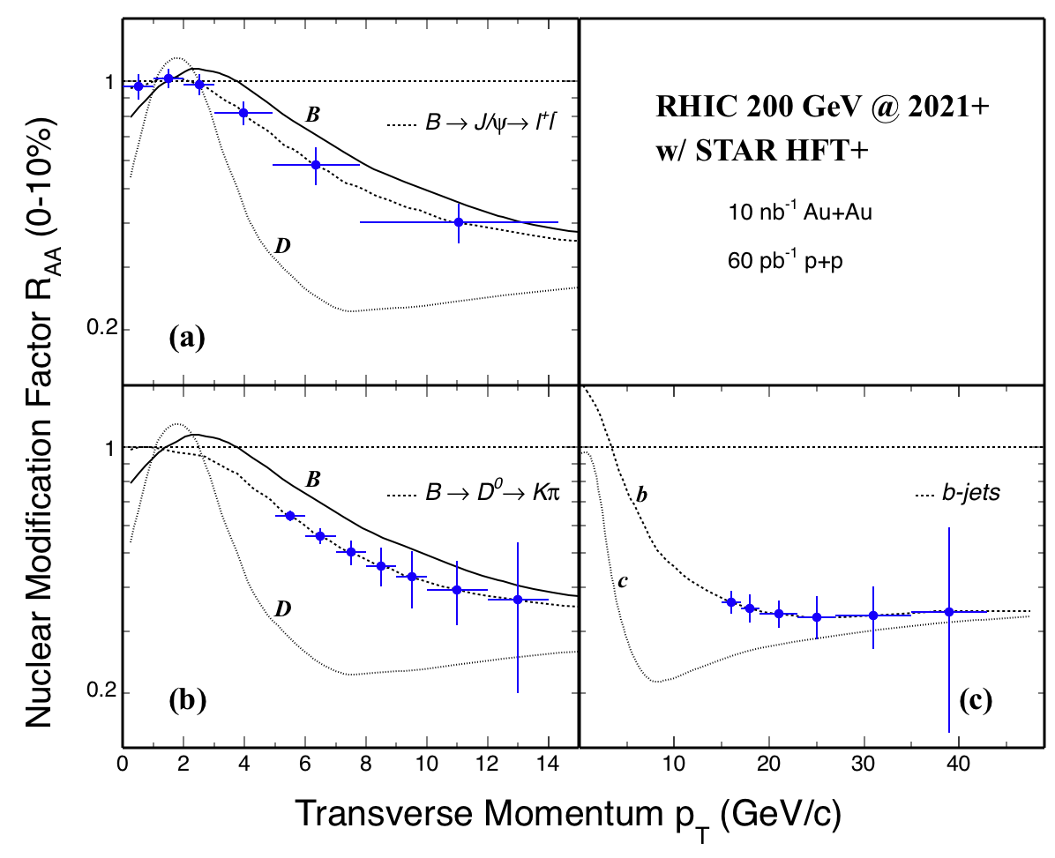
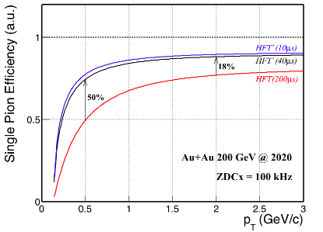
HFT+ simulation
Efficiency: fast vs. slow HFT
HFT+ flagship measurements
HFT (~200 μs) → HFT+ (≤40 μs)
R_{AA} for J/ψ and D⁰ from B, and b-jets
The planned HFT+ program (2021-2022) is complementary to sPHENIX at RHIC and ALICE HF program at LHC

Slide 44
Future HFT+ Upgrade plan (2021-2022)
HFT+ upgrade motivation:
Measure bottom quark hadrons at the RHIC energy
Take data in higher luminosity with high efficiency
HFT+ detector requirements:
Faster frame readout of 40 μs or less
Similar or better: pointing resolution S/N ratio
Total power consumption
Radiation length
Compatible with the existing insertion mechanism, support structure, air cooling system
HFT+ read-out electronics requirements:
Compatible with STAR DAQ system and trigger
ALICE ITS Upgrade
MAPS sensor
STAR HFT
mechanics and
services
STAR + ALICE
new development

Slide 45


Slide 46



Electron-Muon Correlation@dAu200GeV
p+p
d+Au
pQCD-based models agree with the data in p+p collisions
Clear suppression of e-mu correlation in d+Au collisions
  CNM effects from heavy nuclei
fwd
mid
e
μ
R_{g} from EPS09
d
Au
Phys. Rev. C. 89, 034915 (2014)

Slide 47


Models backward@dAu
A. Sickles
I. Vitev et al
Phys. Lett. B740 (2015) 25
Phys. Lett. B731 (2014) 51
Radial flow also qualitatively reproduce the enhancement
pQCD calculation considering incoherent multiple scattering reproduce the enhancement at backward rapidity

Slide 48




Heavy flavor with HFT 2014-2016

Slide 49



Ralf Rapp @ SaporeGravis workshop 2014
importance of flow + Cronin effect
at lower energies

Slide 50

Non-photonic electrons azimuthal anisotropy
STAR arXiv:1405.6348
STAR
preliminary
Anisotropy (v₂)
Substantial elliptic flow of NPE is seen in 200 GeV Au+Au collisions.
Models with strong charm medium coupling are consistent with the data
within the current uncertainties.
it’s challenging for models to describe suppression and flow at the same time.

Slide 51


Heavy Flavor Tracker
HFT
SSD
IST
PXL
Inner Field Cage
Outer Field Cage
FGT
TPC Volume
Detector | Radius (cm) | Hit Resolution R/ϕ - Z (μm - μm) | Radiation length
SSD | 22 | 20 / 740 | 1% X₀
IST | 14 | 170 / 1800 | <1.5% X₀
PIXEL | 8 | 12 / 12 | ~0.4% X₀
 | 2.5 | 12 / 12 | ~0.4% X₀
Solenoid
EAST
WEST

Slide 52

NPE flow in Au+Au 200 GeV
arXiv:1405.6348
Finite v2 at low and intermediate pT
Increase of v2 at high pT likely due to jet-like correlation

Slide 53





Heavy Flavor Comparison with J/ψ
d-Going
Mid-Rapidity
Au-Going
Similar suppression at forward rapidity
  Low co-mover density
  Same suppression mechanism
Different behavior at mid and backward rapidity
  Different suppression mechanism
Larger nuclear break-up effects at higher-density region
J/ψ: Phys. Rev. C. 87, 034904 (2013)

Slide 54

R_{dAu} v.s. N_{coll}
Peripheral R_{dA} ≈ 1
Central Mid/Backward- R_{dA} >1
Forward-y R_{dA} < 1
Difference Back/Forward beyond EPS09s nPDF

Slide 55



What NEW on Open Heavy Flavor?
First Results from the PHENIX FVTX: B-meson → J/ѱ in Cu+Au 200 GeV
Using muon pairs in the J/ѱ mass region an analysis was performed to determine the fraction from B → J/ѱ decays
TAKEN FROM RACHID NOUICER SQM 2016 TALK

Slide 56


What NEW on Open Heavy Flavor?
First Results from the PHENIX FVTX: B-meson → J/ѱ in Cu+Au 200 GeV
Au-going
DCA_{R} Distributions for clarity are shown BG subtracted
Cu-going
• Prompt J/ѱ and B-> J/ѱ DCA_{R} template shapes, determined using MC simulations, were used in the fit.
• The sum of the DCA_{R} contributions agrees well with the data as shown in the bottom panel.
TAKEN FROM RACHID NOUICER SQM 2016 TALK

Slide 57



What NEW on Open Heavy Flavor?
First Results from the PHENIX FVTX: B-meson → J/ѱ in Cu+Au 200 GeV
B->J/ѱ fraction
PHENIX: Au+Cu at 200 GeV
${\text{•} F}_{B→J/\text{ѱ}}$ was determined
for both the gold and
copper going directions.
$$\text{•} \text{The} \text{B}\text{−}\text{meson} \text{fraction} \text{is} \text{larger} \text{in} \text{Cu}\text{+}\text{Au} \text{collisions} \text{because} \text{integrated} \text{pT} \text{and} \text{centrality} \text{B}\text{−}\text{mesons} \text{are} \text{less} \text{suppressed} \text{than} \text{prompt} \text{J}\text{/}\text{ѱ}$$
TAKEN FROM RACHID NOUICER SQM 2016 TALK

Slide 58

What NEW on Open Heavy Flavor?
First Results from the PHENIX FVTX: B-meson → J/ѱ in p+p 510 GeV
B->J/ѱ fraction
PHENIX: p+p at 510 GeV compared to word data
The fraction of B-mesons in J/psi yields is of around 10%, in accordance with world data.
The B →J/ψ fraction does not have the energy
dependence for J/ψ p_{T} < 5 GeV/c region.
TAKEN FROM RACHID NOUICER SQM 2016 TALK

