Slide 1

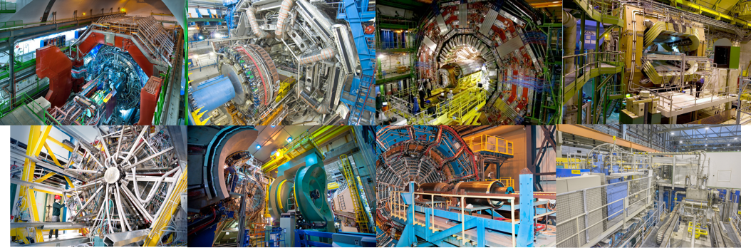
(Ultra-)relativistic heavy-ion physics from SIS18 to LHC energies
Alexander Kalweit, CERN

Slide 2
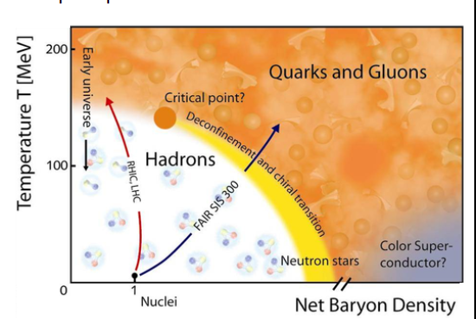
Outline
Thermodynamics
of QCD
(Ultra-)relativistic
heavy-ion physics:
E_{Beam} >> m_{Ion}
Experiments and
accelerators
Some further selected
results
(anti-)(hyper-)nuclei across
different collision energies
Ultra-relativistic heavy-ion physics is a huge field with many experiments and observables → impossible to cover all topics! Today: a very biased selection towards LHC (ALICE).

Slide 3
Thermodynamics of QCD

Slide 4
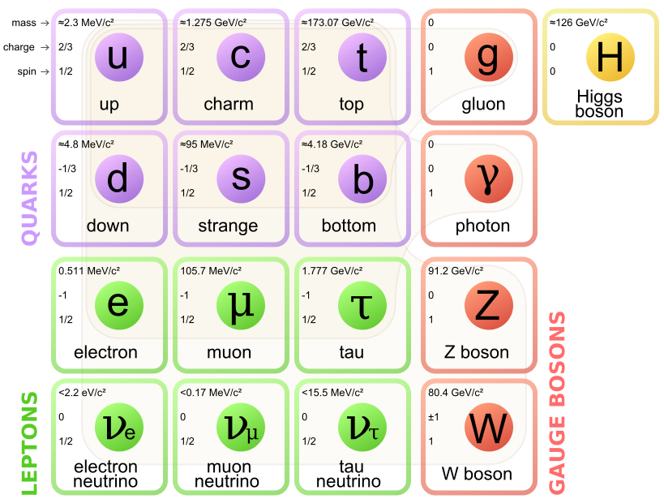
The standard model
The standard model describes the fundamental building blocks of matter (Quarks and Leptons) and their Interactions:
Elektromagnetic: γ
Weak interaction: W&Z
Strong interaction: Gluons
Gravitation: Graviton?
Dramatic confirmation of the standard model in the last years at the LHC: discovery and further investigation of the Higgs-Boson.
However, no signs of physics beyond the standard model were found (SUSY, dark matter..).
→ Discovery potential in many body phenomena!
[https://commons.wikimedia.org/wiki/File:Standard_Model_of_Elementary_Particles.svg]

Slide 5
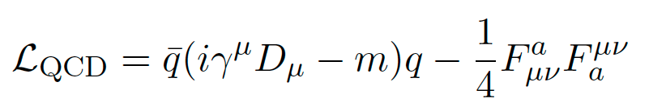
Quantumchromodynamics (QCD)
QCD is considered as the correct theory of the strong interaction:
Quark-field
Quark-mass
Gluon field strength tensor
Properties of QCD:
(a.) Confinement: Quarks and gluons are bound in color neutral mesons (q&anti-q) or baryonen (qqq).
(b.) Asymptotic freedom: Interaction strength decreases with increasing momentum transfer (α_{S}➞0 for Q² ➞∞).
(c.) Chiral symmetry: Interaction between left- and right handed quarks disappears for massless Quarks.
[Prog.Part.Nucl.Phys. 58 (2007) 351-386]

Slide 6
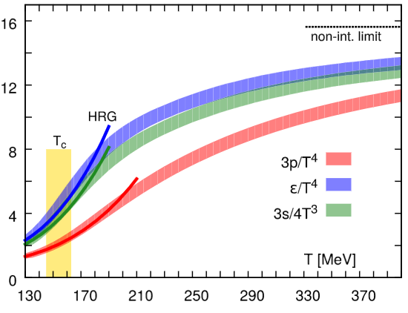
QGP as the asymptotic state of QCD
Quark-Gluon-Plasma (QGP): at extreme temperatures and densities quarks and gluons behave quasi-free and are not anymore localised to individual hadrons.
Asymptotic freedom: free quarks & gluons
bound quarks & gluons
Where is the phase transition?
→ Lattice QCD
Temperature T
T₀ ≈ 1/40 eV
Critical temperature
T_{c} ≈ 156 MeV
T → ∞
[PRD 90 094503 (2014)]

Slide 7
Chiral and de-confinement transition
The chiral symmetry is spontaneously broken in the ground state (hadronic phase) → dynamical generation of the constituent quark mass.
Both phase transitions take place at the same temperature in Lattice QCD (de-confined ⬌ confined and chiral symmetry restored ⬌ chiral symmetry broken).
[PLB 723 (2013) 360]
Lattice QCD

Slide 8

Short introduction to statistical thermodynamics (A)
The maximum entropy principle leads to the thermal most likely distribution for different particle species.
Entropy: the number of possible micro-states Ω being compatible with a macro-state for a given set of macroscopic variables (E, V, N):
Compatibility to a given macroscopic state can be realised exactly or only in the statistical mean.
L. Boltzmann

Slide 9

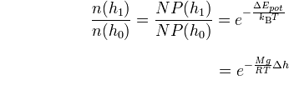
Short introduction to statistical thermodynamics (B)
A small example: barometric formula (density of the atmosphere at a fixed temperature).
Probability to find a particle on a given energy level j:
Energy on a given level is simply the potential energy: Epot = mgh
Boltzmann factor
Partition function Z
(Zustandssumme = “sum over states”)

Slide 10




Thermal model for heavy-ion collisions
Starting point: grand-canonical partition function for an relativistic ideal quantum gas of hadrons of particle type i (i = pion, proton,… → full PDG!):
Once the partition function is known, we can calculate all other thermodynamic quantities:
dispersion relation
(relativistic)
(-) for bosons, (+) for fermions (quantum gas)
spin
degeneracy
chemical potential representing each conserved quantity
Only two free parameters are needed: (T,µB). Volume cancels if particle ratios
ni /nj are calculated. If yields are fitted, it acts as the third free parameter.
Partition function shown here is only valid in the resonance gas limit (HRG), i.e. relevant interactions are mediated via resonances, and thus the non-interacting hadron resonance gas can be used as a good approximation for an interacting hadron gas.

Slide 11
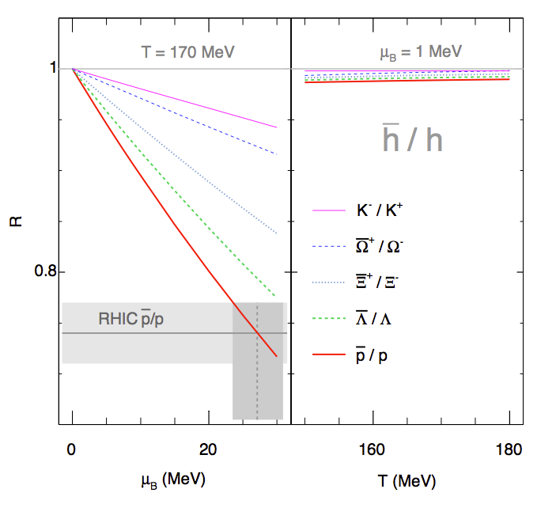

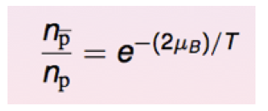
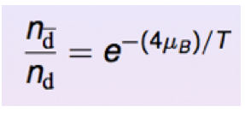
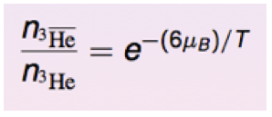
The baryochemical potential µB
In contrast to the (chemical freeze-out) temperature T, the baryochemical potential is a less intuitive quantity…
It quantifies the net-baryon content of the system (baryon number transport to midrapidity):
fundamental
thermodynamic relation
However, (anti-)nuclei are more sensitive:
(I. Kraus)

Slide 12
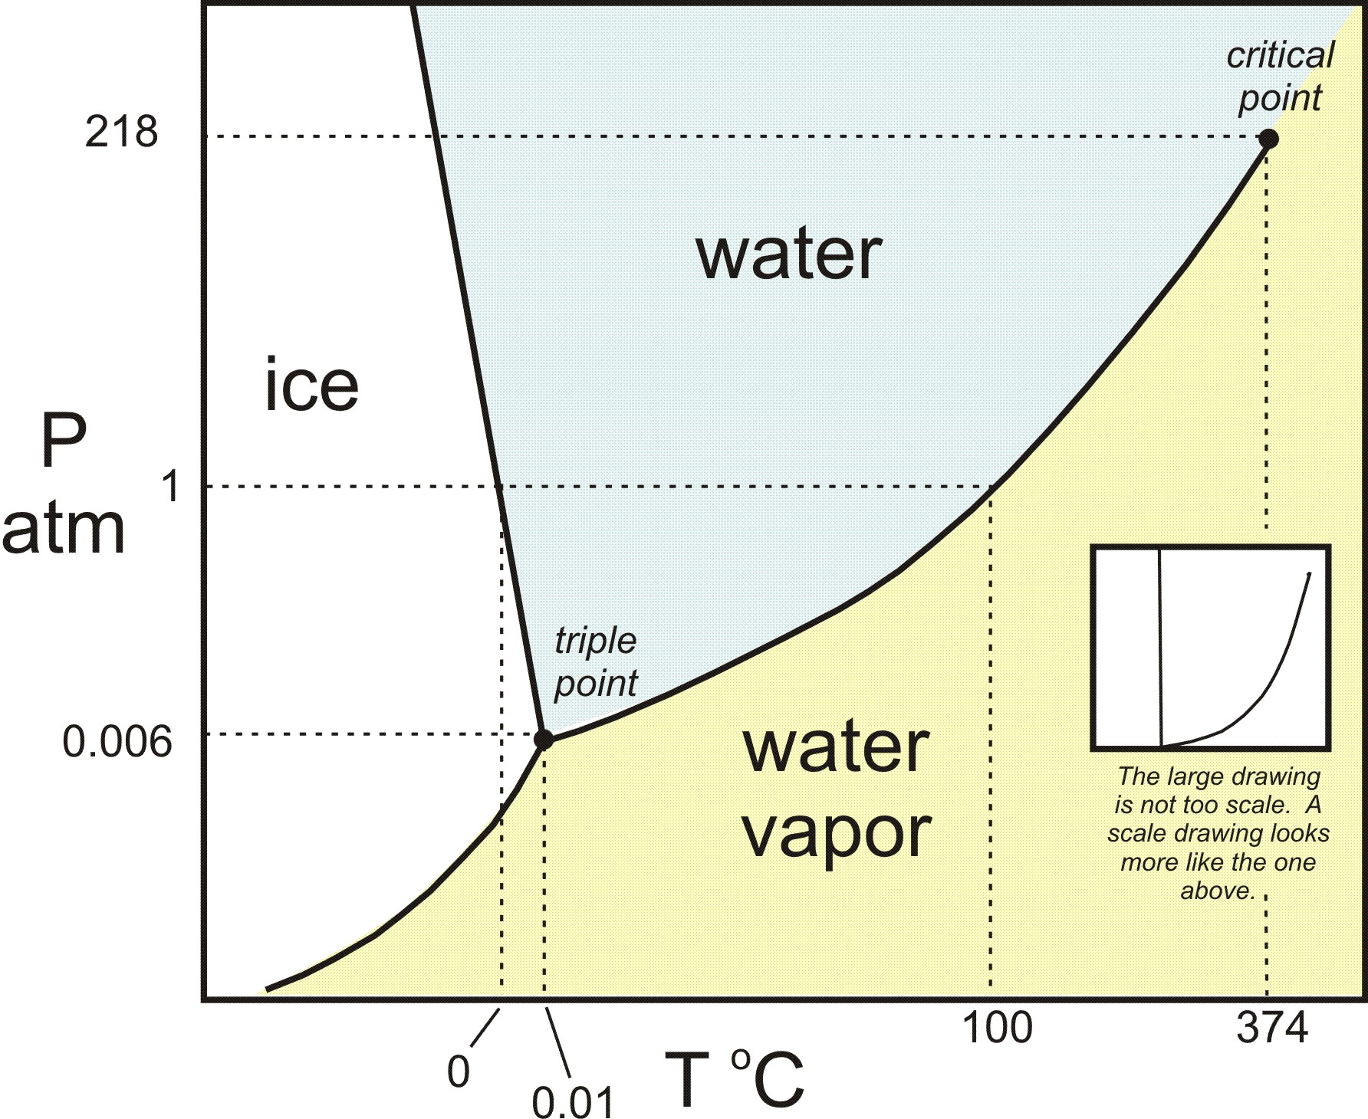
The phase diagram of QCD
The thermodynamics of QCD can be summarized in the following (schematic) phase diagram.
Control parameters: temperature T and baryo-chemical potential µ_{B}.
At LHC-energies (√s = 5.02 TeV): µ_{B} ≈ 0 MeV << T_{ch}
At SIS18: (√s = 2.4 GeV): µ_{B} ≈ 883 MeV >> T_{ch}
Early universe
LHC
critical
point
[http://serc.carleton.edu/research_education/equilibria/phaserule.html]
[Ann. Rev. Nucl. Part. Sci. 62 (2012) 265]

Slide 13
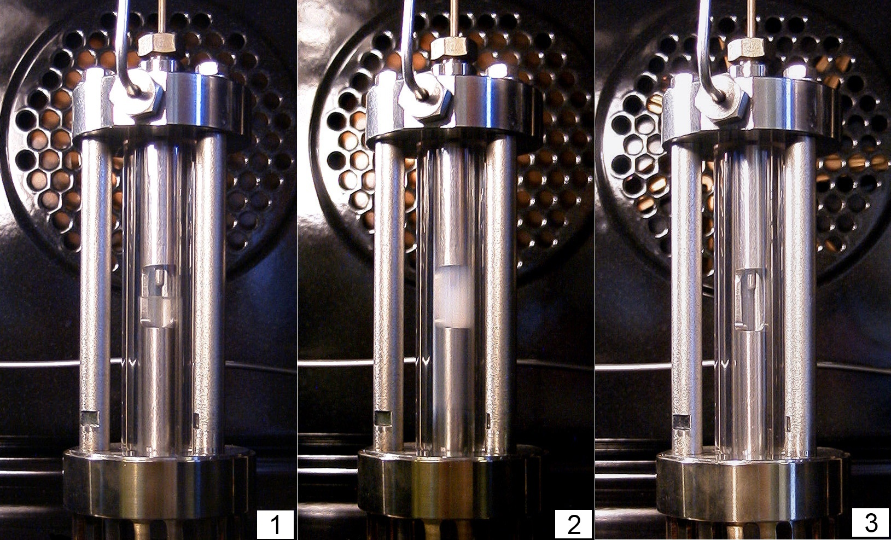
Critical fluctuations
Phase transitions are often connected to critical phenomena.
Example: Opalescence of Ethene at the critical point.
[S. Horstmann, Ph.D. Thesis University Oldenburg]

Slide 14
Heavy-Ion Physics and
Bulk Particle Production

Slide 15
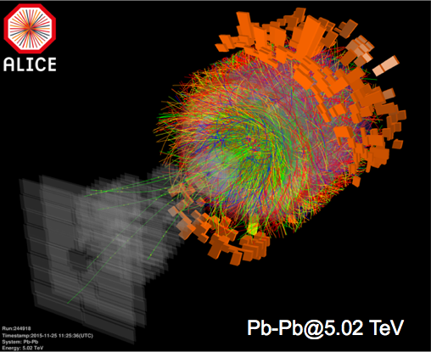
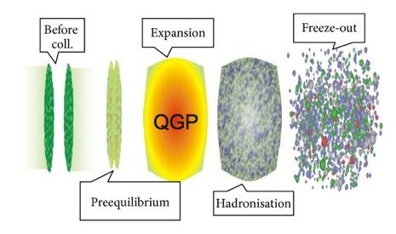
Quark matter in the laboratory
Collisions of ultra-relativistic heavy-ions at large accelerators allow the creation of several ten thousand hadrons (≈ 22000 in central collisions) in local thermodynamic equilibrium in the laboratory.
[arXiv:1207.702]

Slide 16
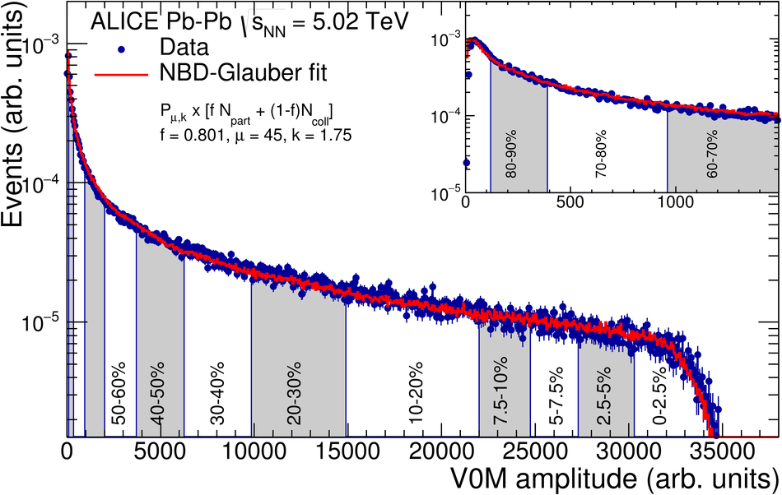
Geometry of heavy ion collisions
We can control (a posteriori) the geometry of heavy ion collisions
Centrality Variables:
Number of nucleon-nucleon collisions N_{coll}
Number of nucleon participants N_{part}
Percentile of hadronic cross section
Participants
NN Collisions
Peripheral
Central
~ # charged particles

Slide 17
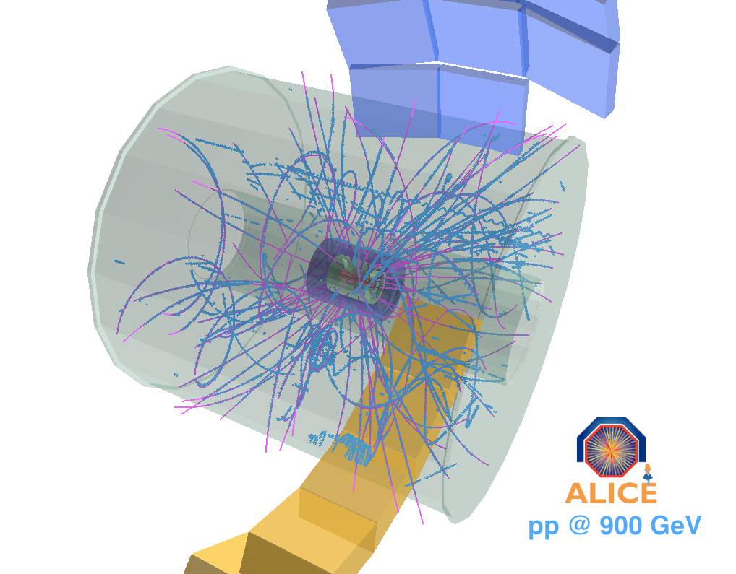
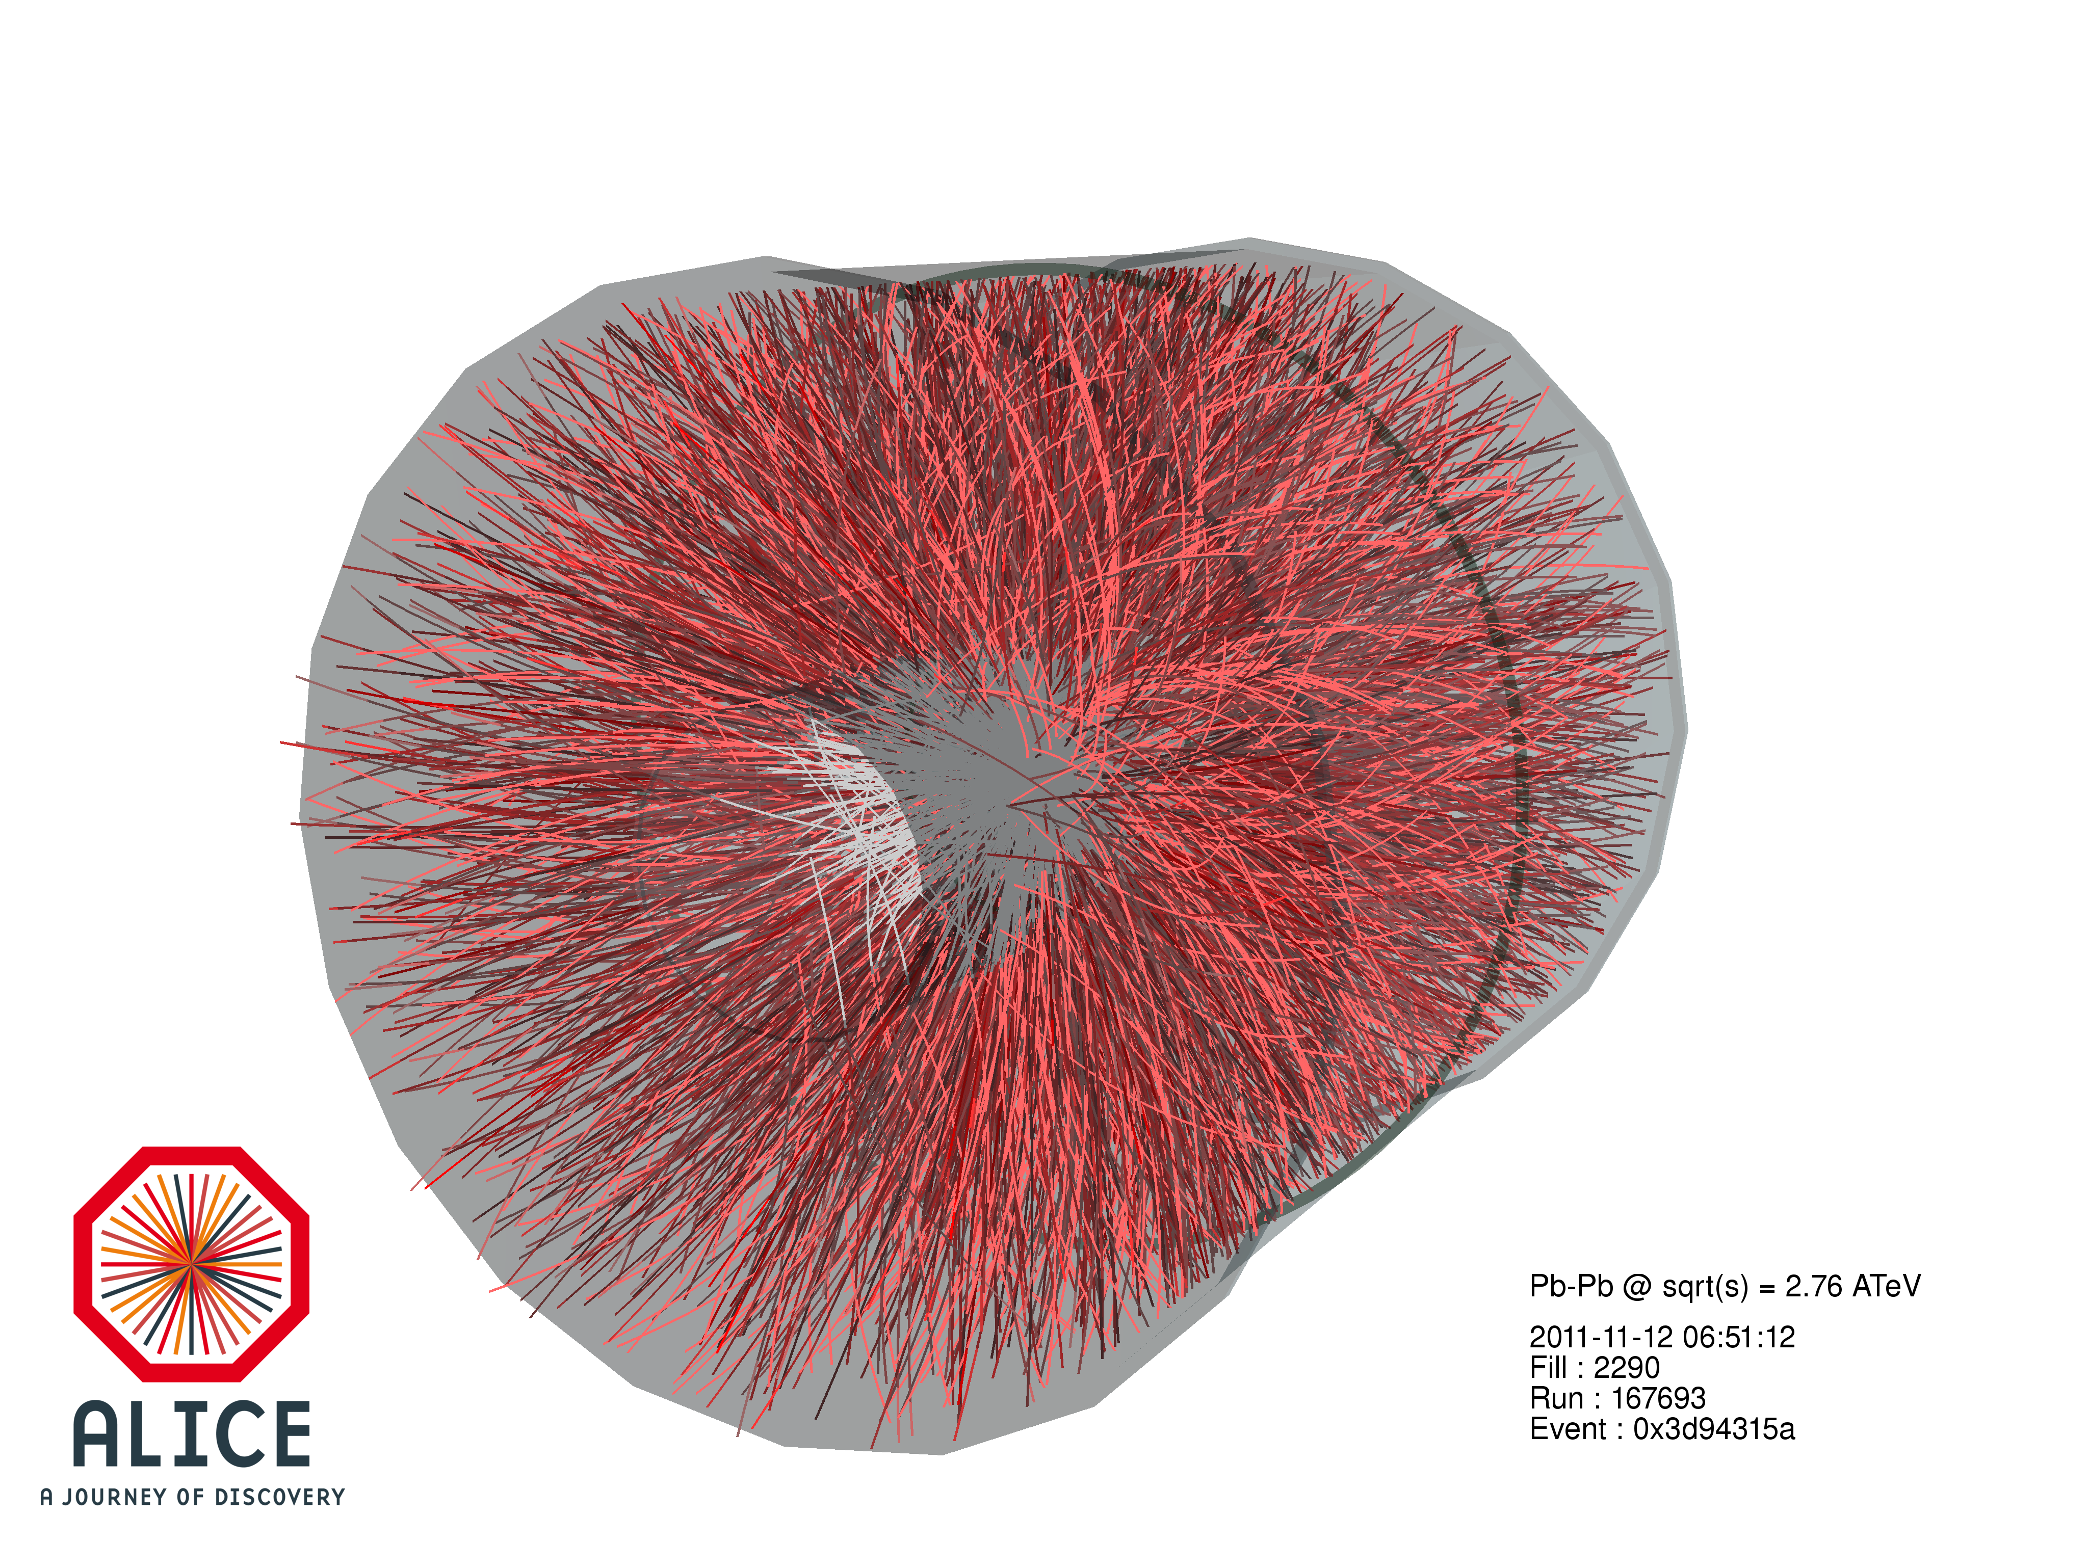
A fireball in thermal equilibrium
pp
It is important to distinguish between
  a system of individual particles and
  a medium in which individual degrees of freedom do not matter anymore and we can apply thermodynamic concepts.
Thermodynamic concepts are typically used for systems with 10⁵-10²³ particles in local thermal equilibrium.
  central Pb-Pb collision 2.76 TeV (LHC): dNch/dη ≈ 1600
  high mult. p-Pb collision (LHC): dNch/dη ≈ 60
  pp collision 7 TeV (LHC): dNch/dη ≈ 6
Lifetime of the system must be long enough so that equilibrium can be established by several (simulations indicate 5-6) interactions between its constituents.
Success of hydro models describing flow effects in Pb-Pb supports idea of matter in local thermal equilibrium.
Success of thermal models describing hadron yields in
Pb-Pb supports idea of matter in local thermal equilibrium.
Pb-Pb
Equilibrium in smaller systems?
p-Pb or high multiplicity pp.
➔ interesting research topic!

Slide 18
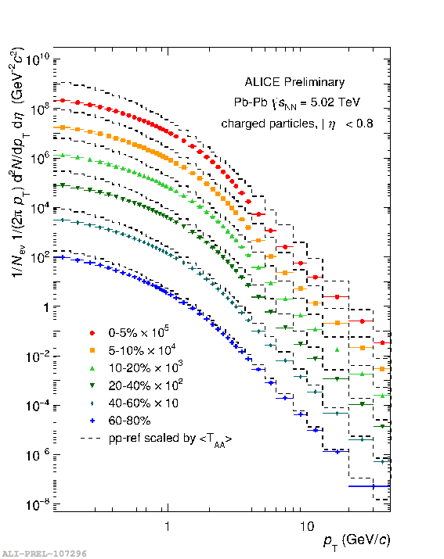

Bulk particle production and collectivity
Low pT hadrons composed of (u,d,s) valence quarks define the collective behaviour of the fireball.
≈ 98% of all particles are produced with pT < 2 GeV/c (at LHC).
≈ 80% of all particles are pions,
≈ 13% are kaons, and
≈ 4% are protons (at LHC)..
“Standard model of ultra-relativistic
heavy-ion physics”/
“Classical model of ultra-relativistic
heavy-ion physics”:
A fireball in local thermodynamic
equilibrium:
  particle chemistry in agreement with
  thermal model predictions
  pT-spectra and v2 measurements show
  patterns of radial and elliptic
  hydrodynamic flow.

Slide 19
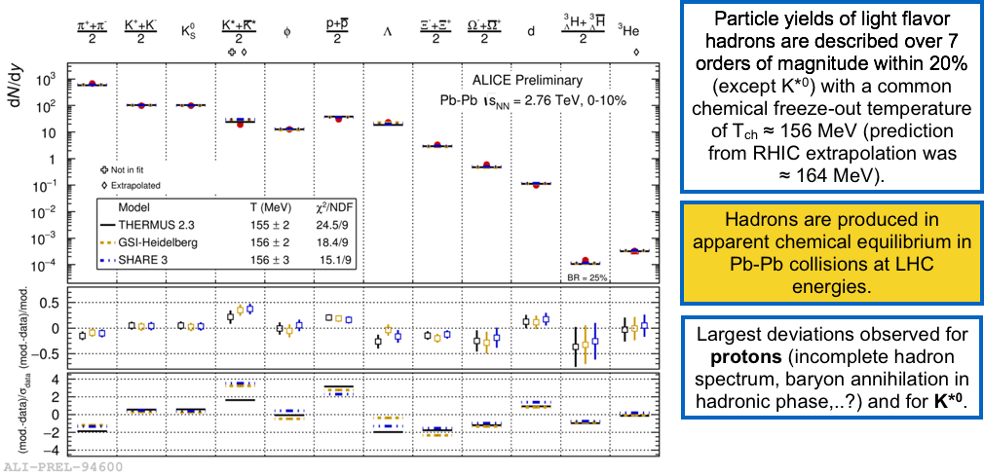
Chemical equilibrium (LHC)

Slide 20
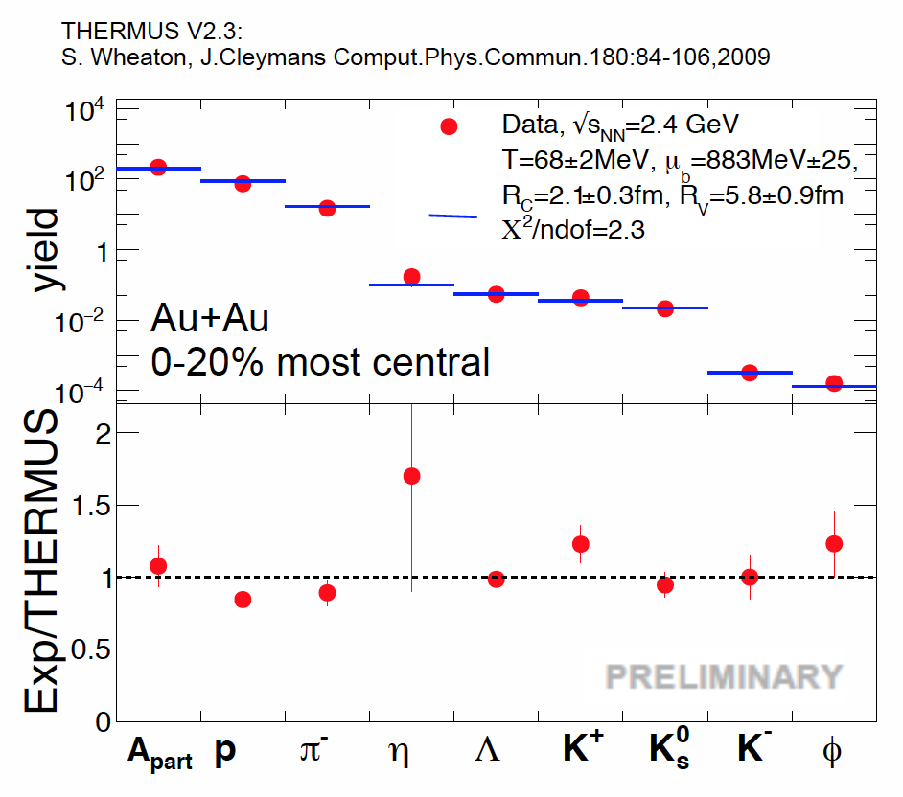
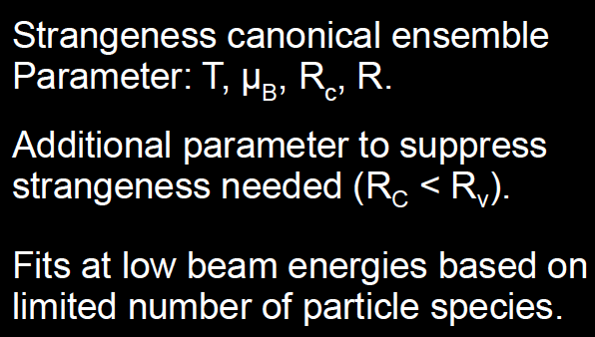
Chemical equilibrium (SIS18)
[HADES overview talk, QM2017]

Slide 21
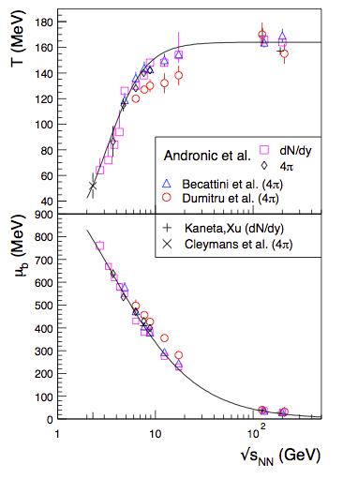
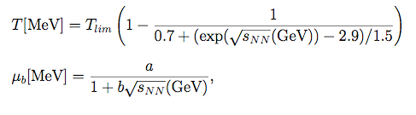
Chemical equilibrium vs collision energy (1)
[A. Andronic et al., NPA 834 (2010) 237]
Hadron yields from AGS up to RHIC and LHC can be described in a hadro-chemical model applying thermal fits.
Effective parameterization of (T, µB) as a function of collision energy:
Particle ratios can be calculated (or predicted) at any collision energy….
One observes a limiting temperature of hadron production around T≈160MeV.

Slide 22
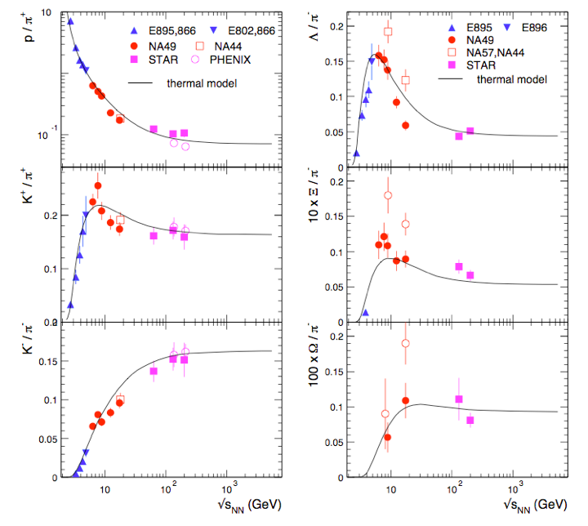
Chemical equilibrium vs collision energy (2)

Slide 23
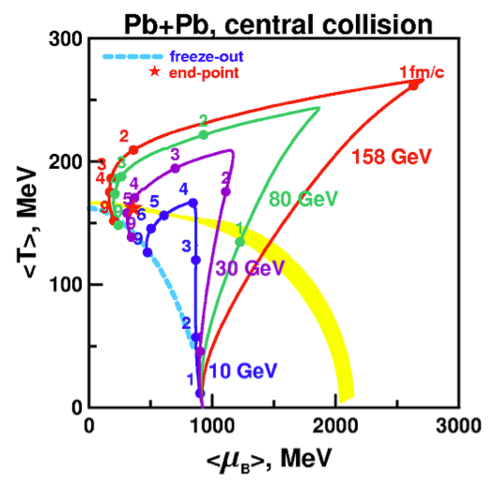
Chemical freeze-out line
By colliding nuclei with different center of mass energies, different regions of the phase diagram are explored.
Thermal model fits to the experimental data define the chemical freeze-out line in the QCD phase diagram.
P. Braun-Munzinger and J. Stachel, arXiv:1101.3167
Y.B. Ivanov et al., Phys. Rev. C 73 (2006) 30.

Slide 24
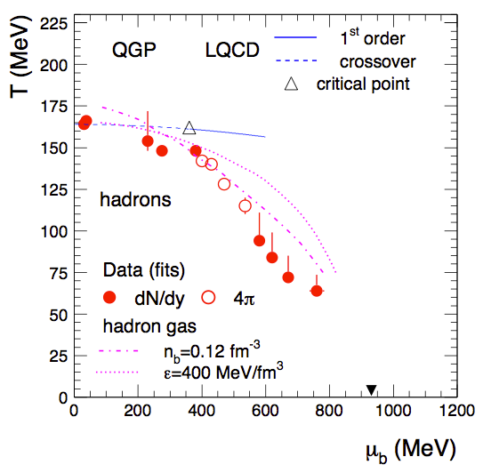
Chemical freeze-out and the QGP
A priori, a thermal model description is not related to the QGP itself. It describes a hadron gas.
However, the chemical freeze-out line determined by thermal fits coincides with the phase boundary calculated by lattice QCD above top SPS energies!
However, collision rates and timescales of fireball expansion imply that equilibrium cannot be reached in the hadronic phase…
Do multi-particle collisions near TC equilibrate the system? A rapid change in density near the phase transition can explain this [1].
Alternatively, the system is ‘born into equilibrium’ by the filling of phase space during hadronization [2].
P. Braun-Munzinger and J. Stachel, arXiv:1101.3167
[1] Braun-Munzinger, P., Stachel, J. & Wetterich, C.,
Phys. Lett. B. 596, 61–69 (2004).
[2] Stock, R. Phys. Lett. B 456, 277–282 (1999).

Slide 25
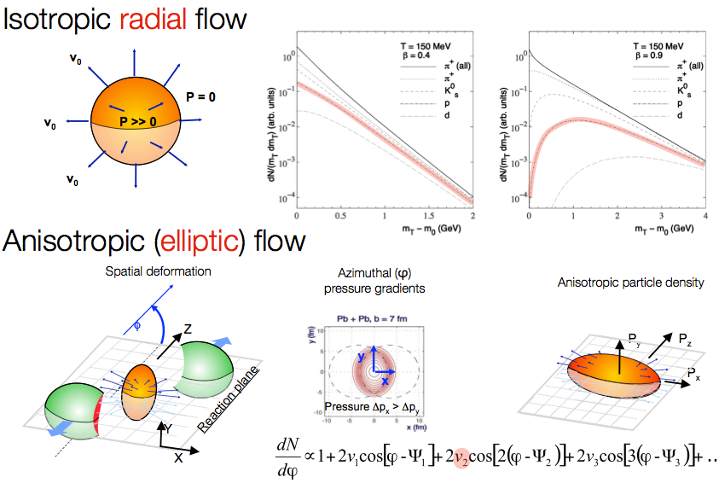
Radial and elliptic flow

Slide 26
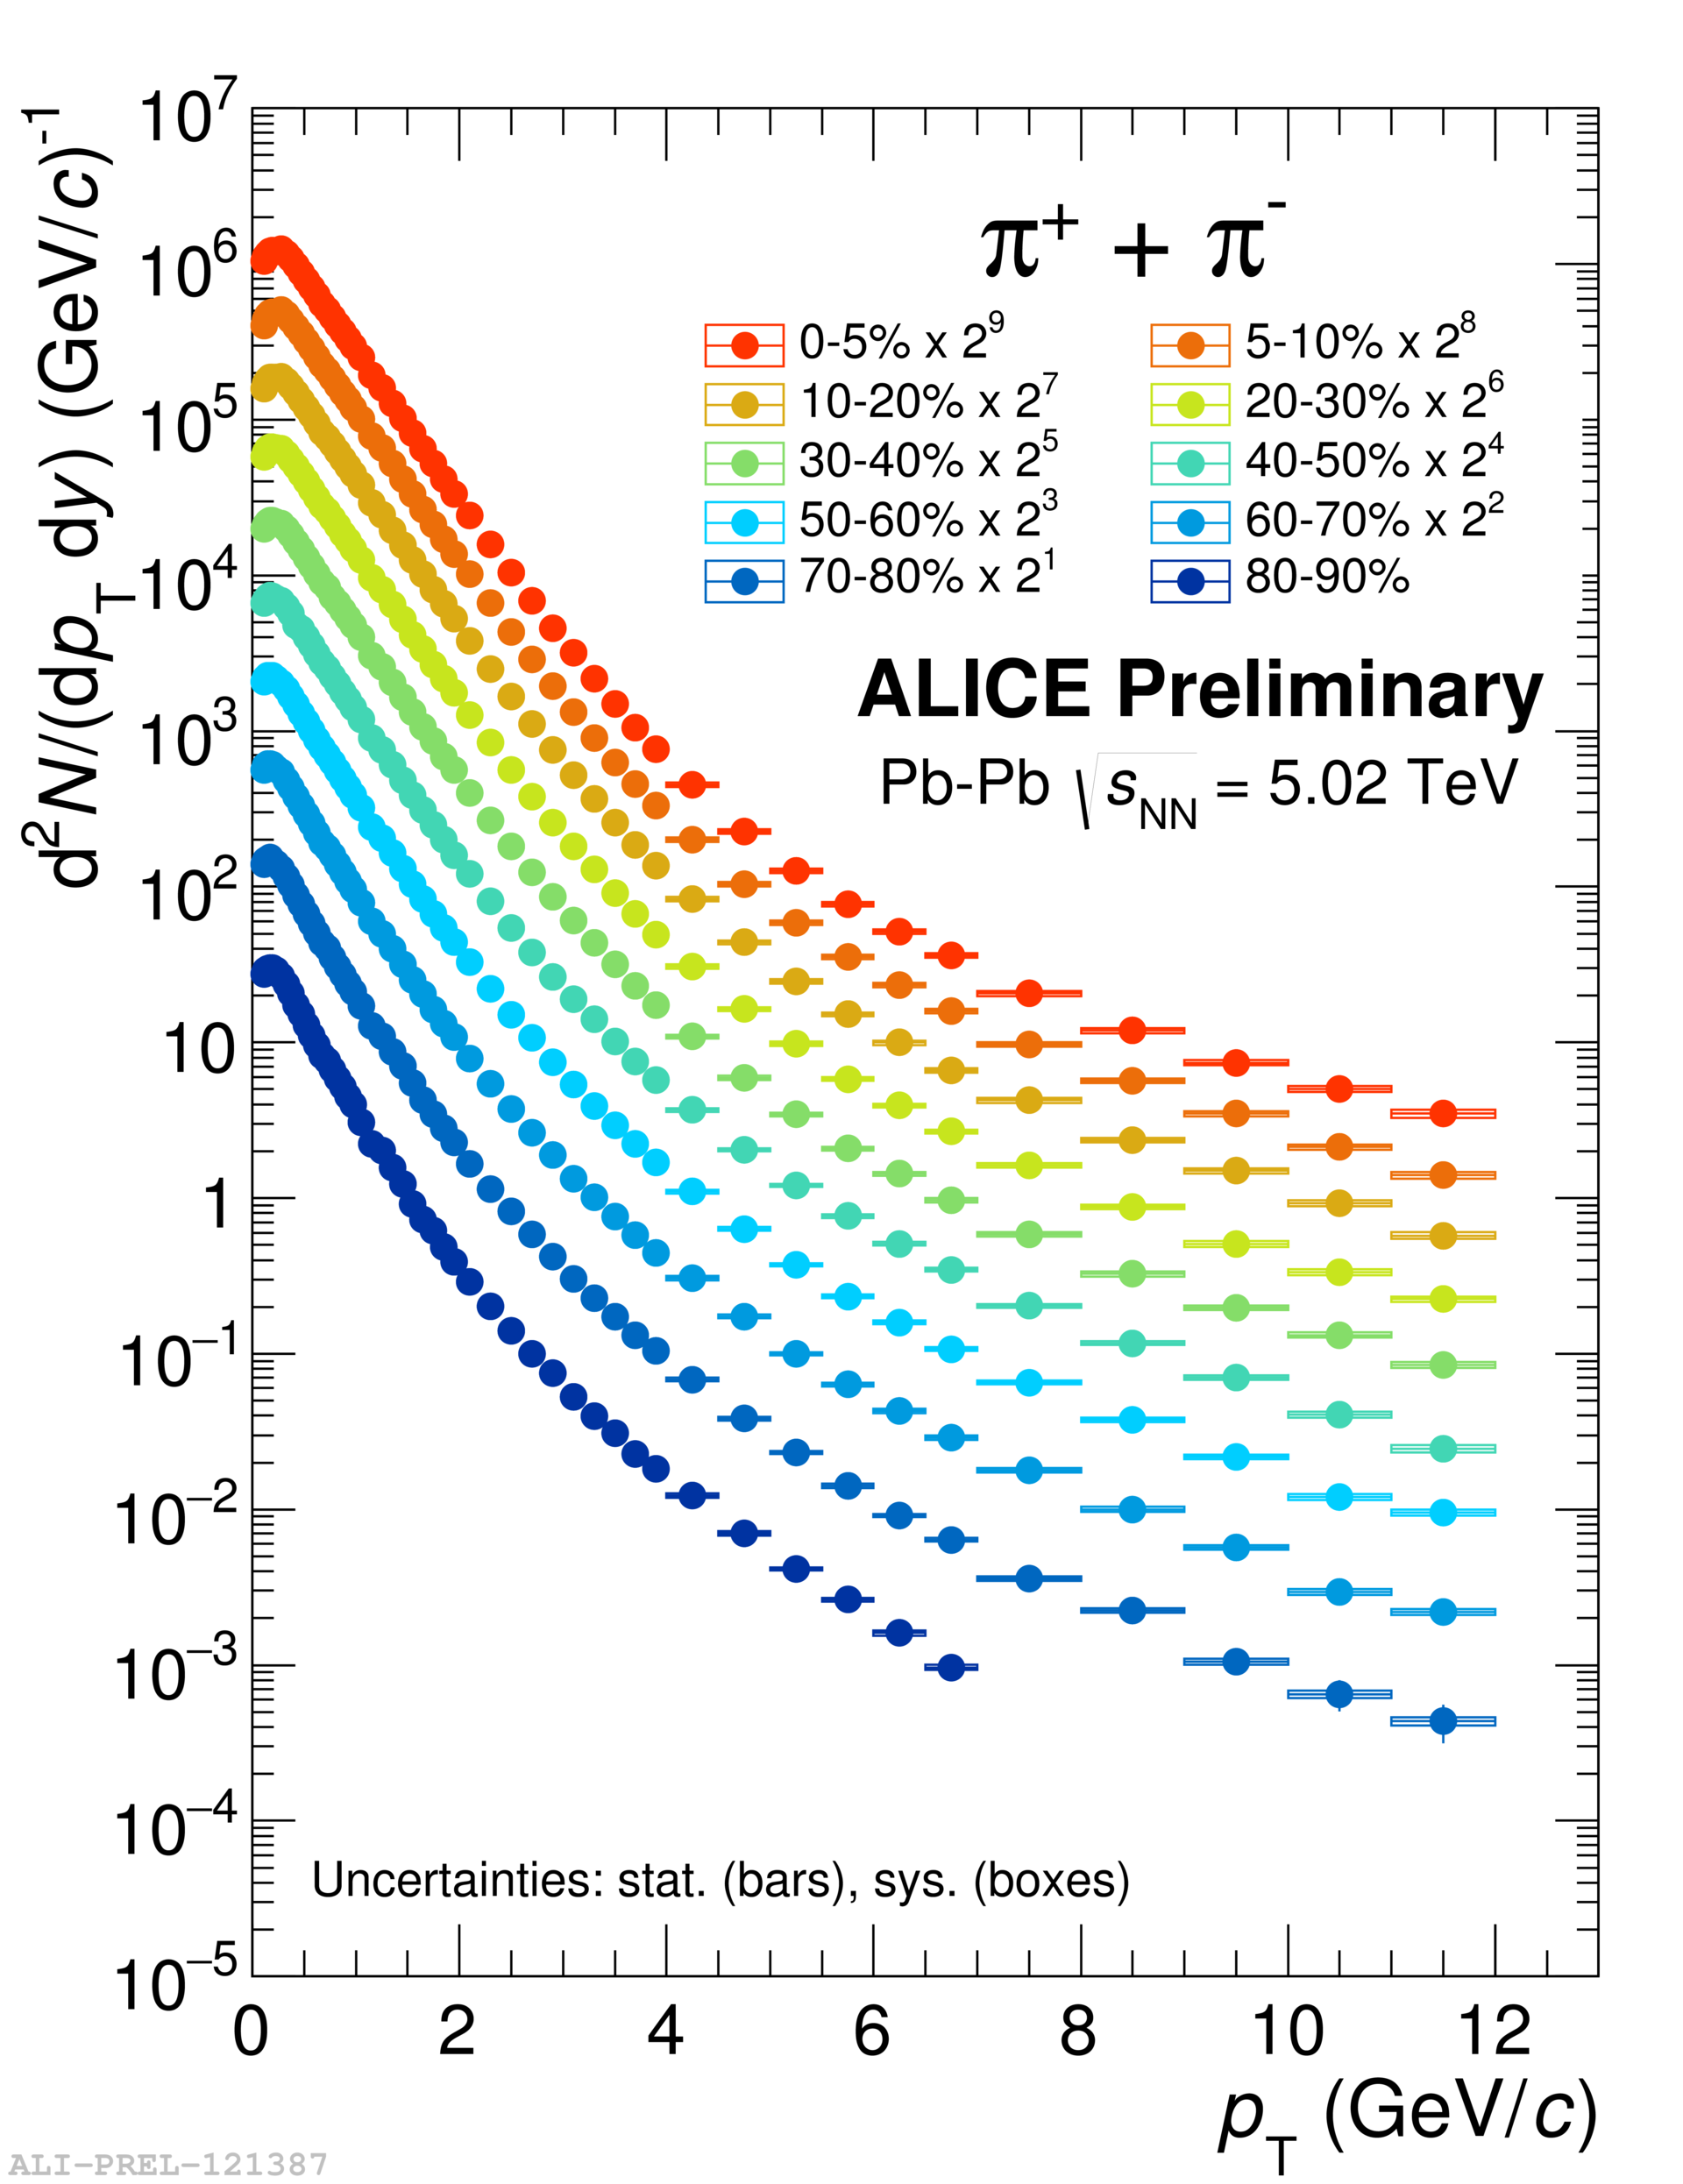
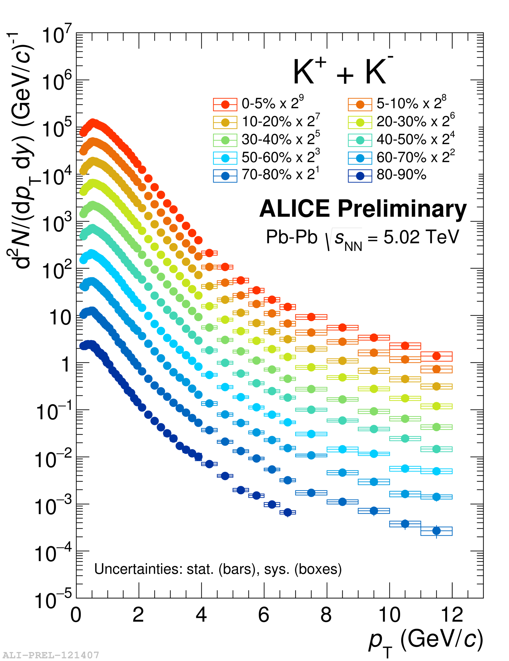
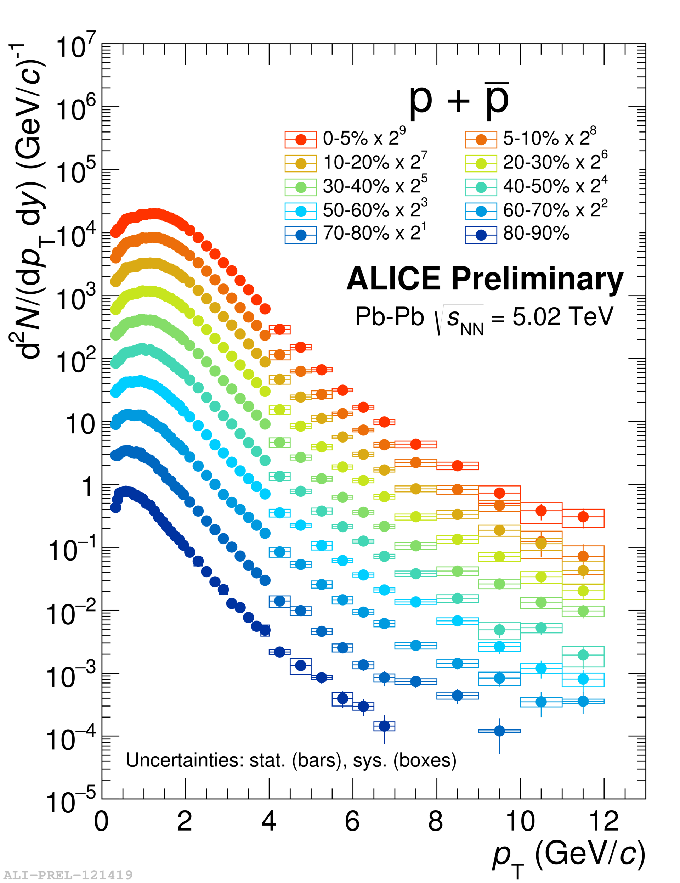
Radial flow (ALICE)
Expected mass ordering
(p = βγ⋅m) observed.

Slide 27
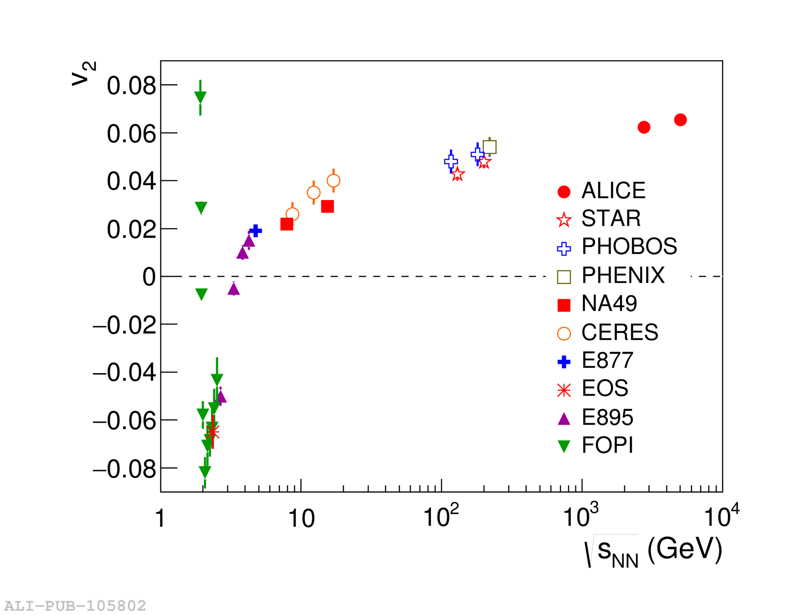
Elliptic flow (heavy-ion physics)
[PRL 116, 132302 (2016)]

Slide 28
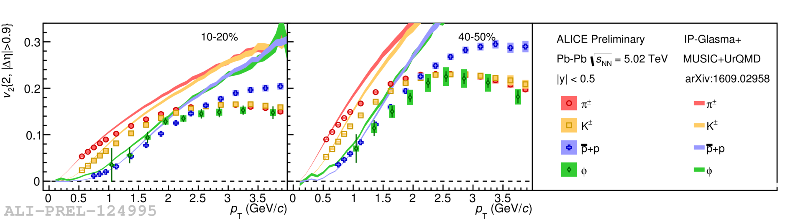
Elliptic flow (ALICE)
Validity of hydrodynamic description confirmed at the highest centre-of-mass energies available.
Expected mass ordering
(p = βγ⋅m) observed.

Slide 29
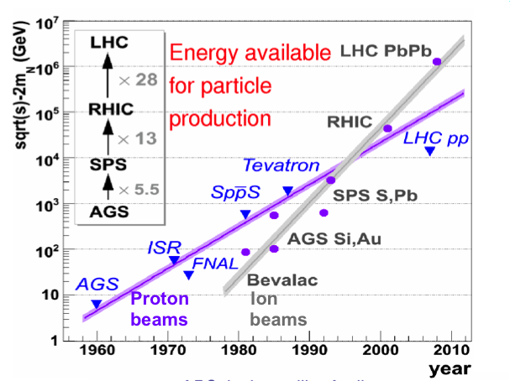
Experimental methods and experiments

Slide 30
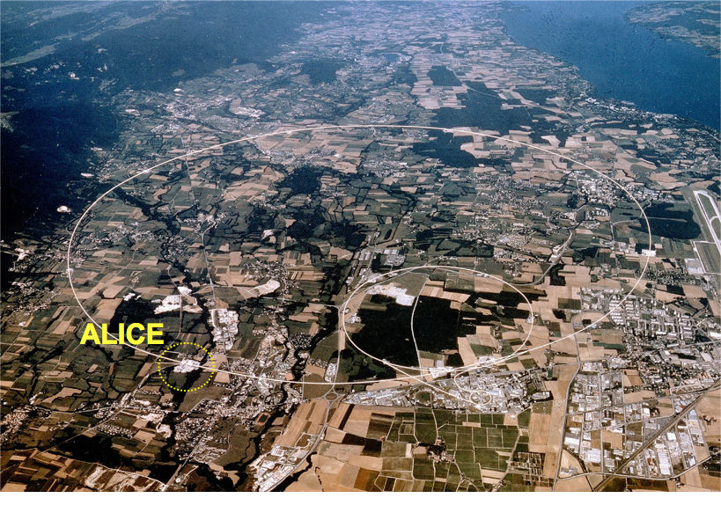
LHC
LHC: Large Hadron Collider → six months of pp collisions and one month of
Pb-Pb collisions (√s_{NN} = 5.02 TeV) per year
All four major LHC experiments have a heavy-ion program!
CMS
LHC Run 3 (2020-2023): Increase of the available statistic by two orders of magnitude with the help of the ALICE Upgrade.
LHCb
ATLAS

Slide 31
ALICE
ALICE: A Large Ion Collider Experiment

Slide 32

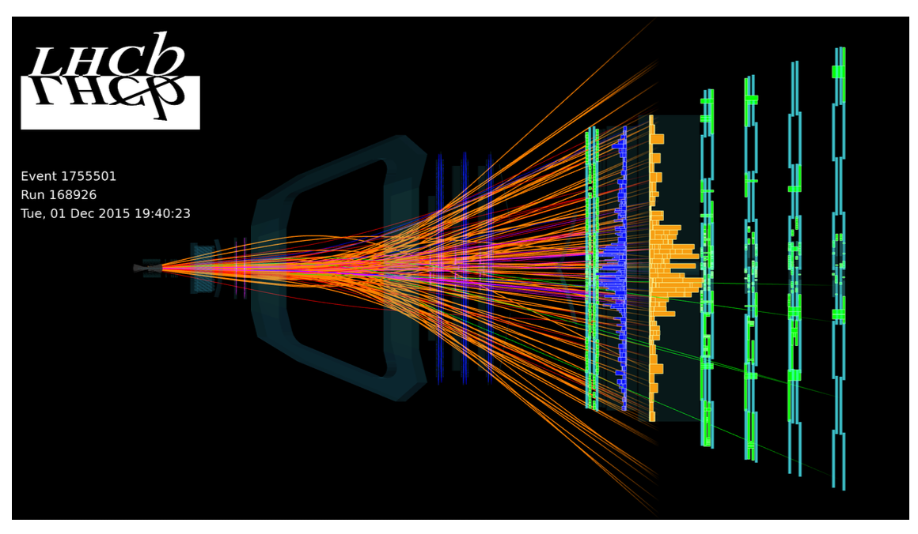
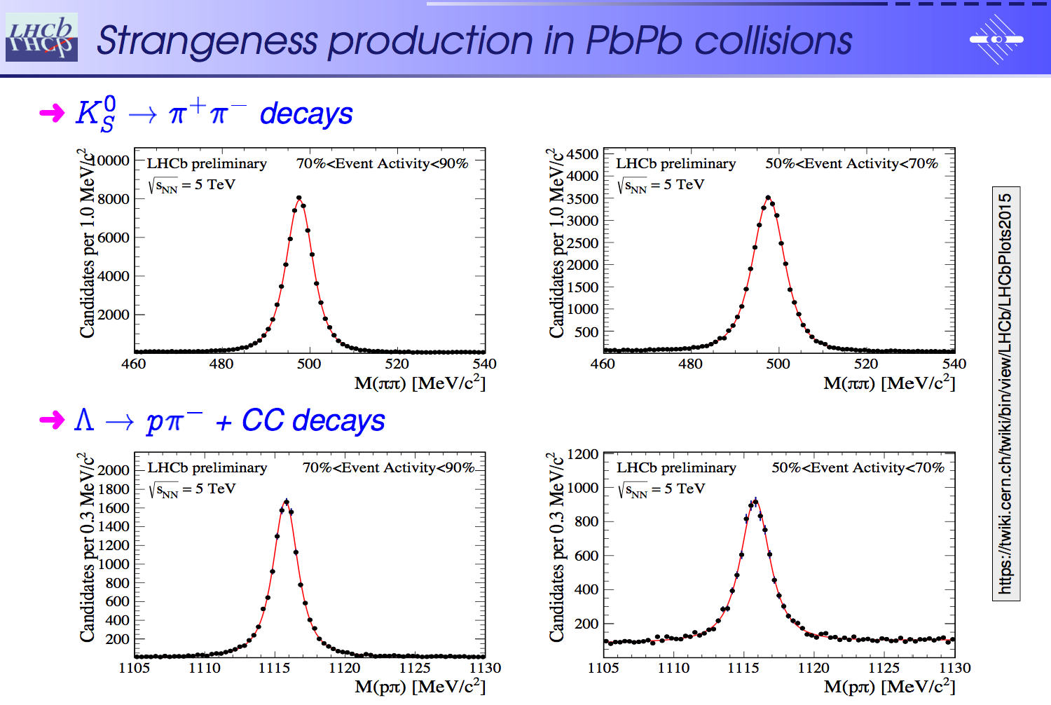
LHCb
The experimental heavy-ion community is growing..
Looking forward to many interesting results on strangeness in a variety of collision systems and kinematic ranges with an impressive detector.
Experimental challenge: make tracking working for as central collisions as possible!
➔ tracking may be possible up to 15k VELO hits
➔ corresponds to 50-100% centrality.

Slide 33
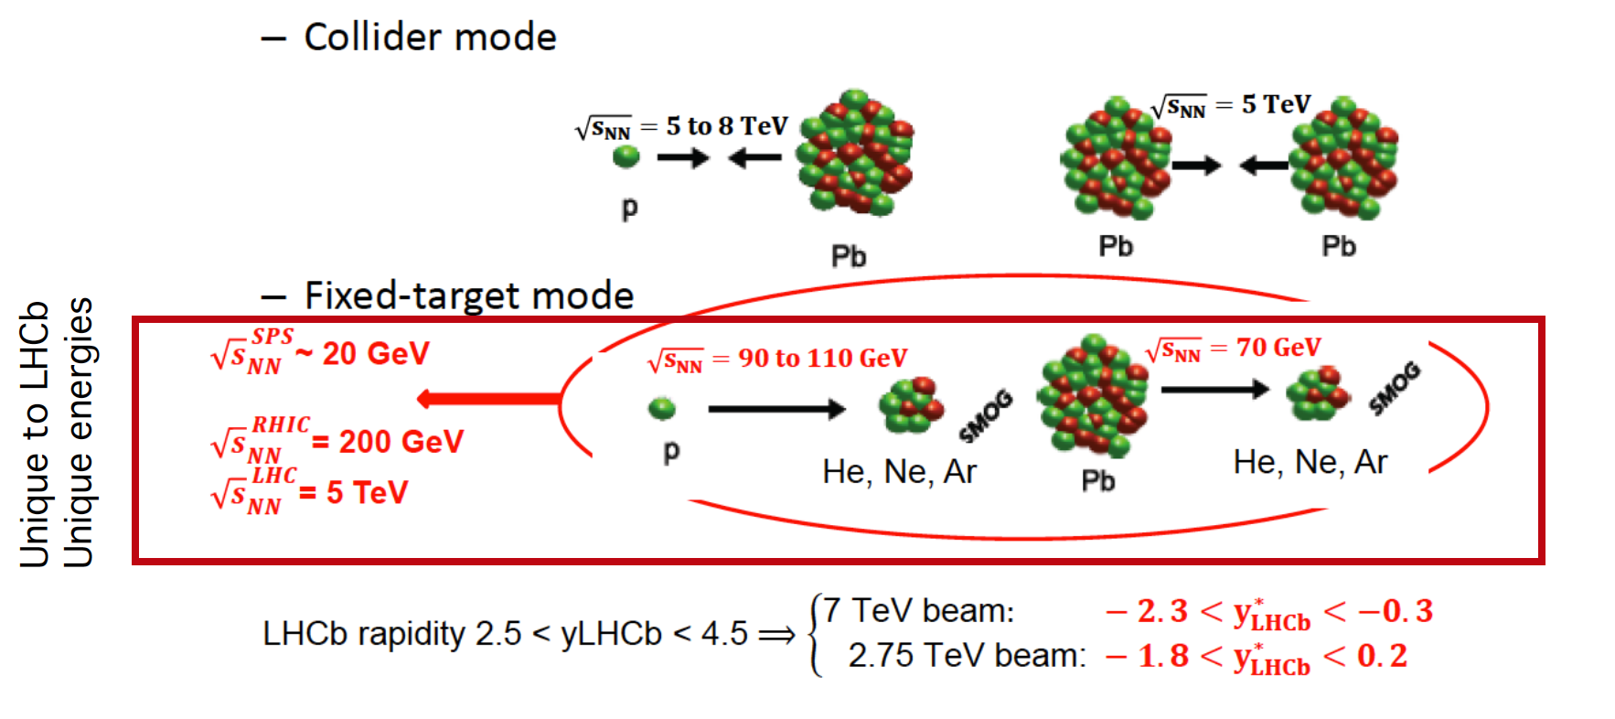
LHCb → fixed target program
[LHCb overview talk, QM2017]

Slide 34
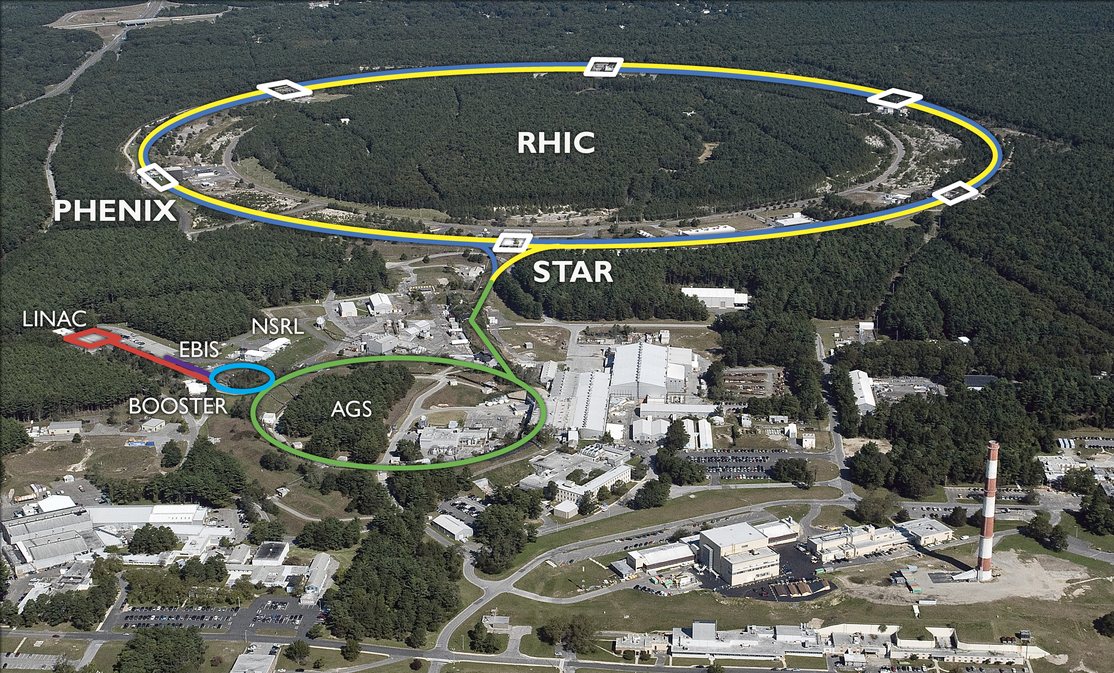
RHIC
Dedicated heavy-ion machine allowing a detailed beam energy scan from √s = 7 to 200 GeV.

Slide 35
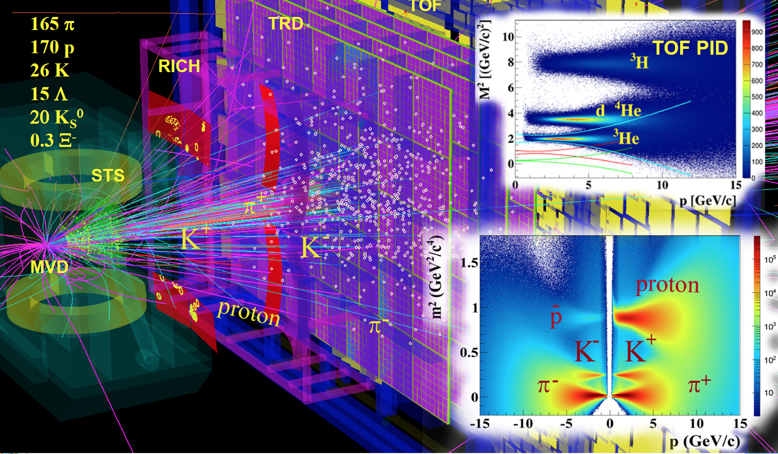
GSI & FAIR
Currently: HADES @ SIS18
Future: CBM @ FAIR → dedicated talk by I. Selyuzhenkov

Slide 36
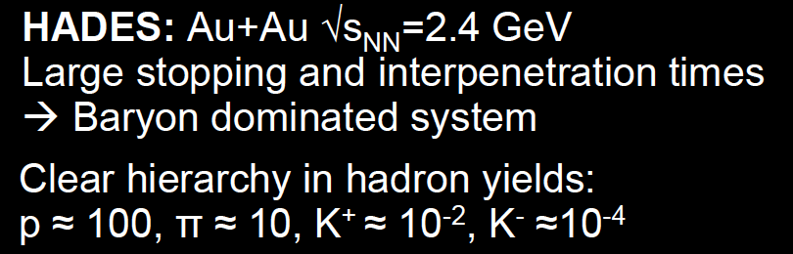
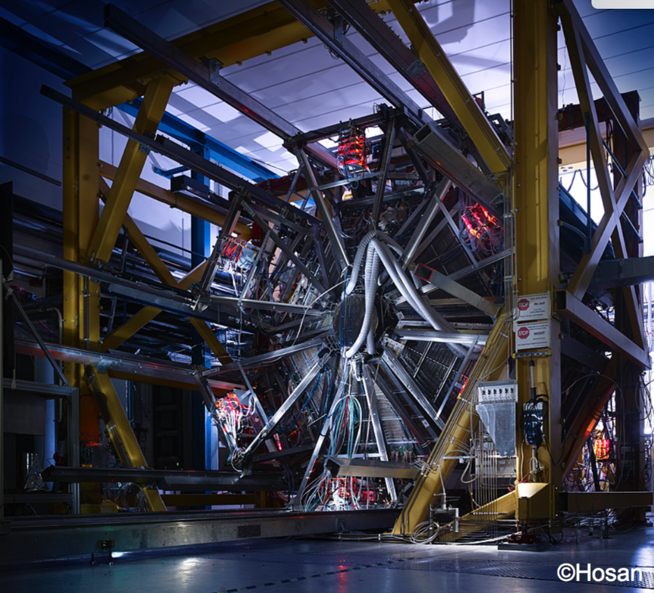
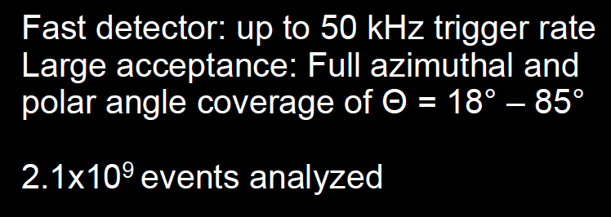
HADES
Reminder (LHC)
≈ 80% of all particles are pions,
≈ 13% are kaons, and
≈ 4% are protons
(at LHC → meson dominated).

Slide 37
Some Selected Results

Slide 38
Some Selected Results:
Direct Photons

Slide 39
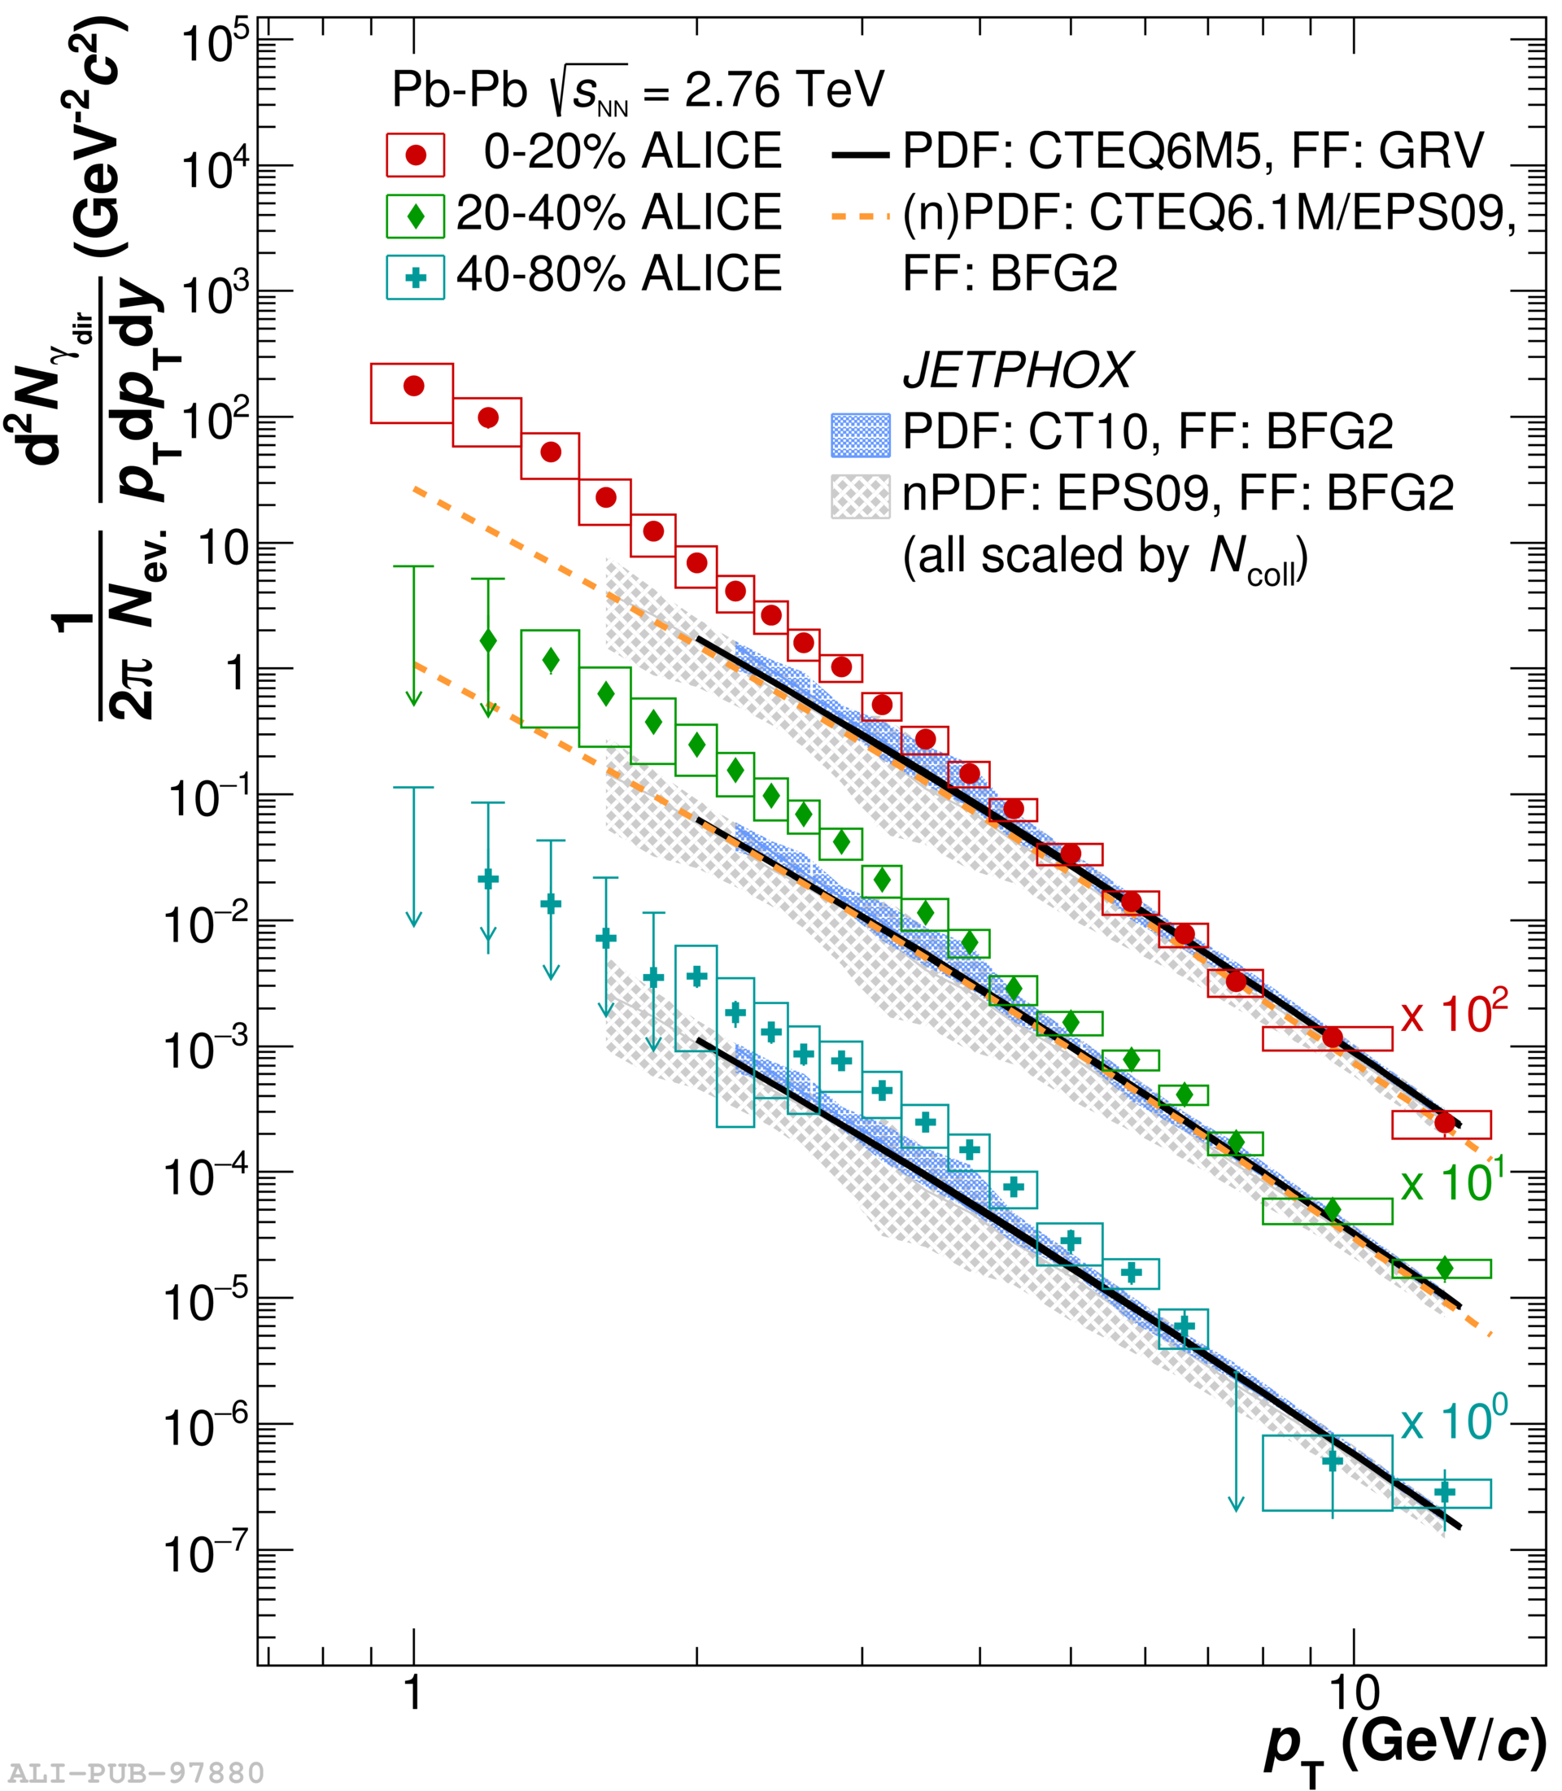
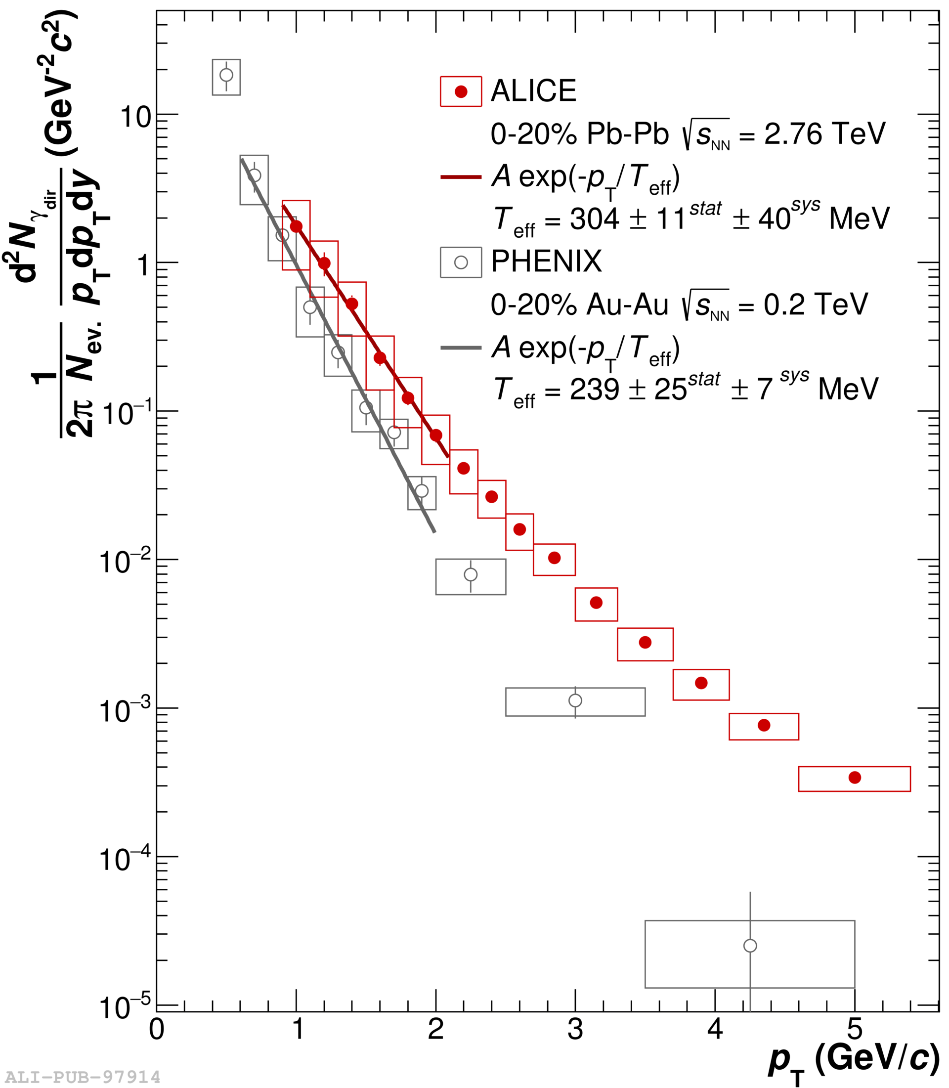
Direct photons in Pb-Pb
[arXiv:1509.07324]
Teff = 304 ± 11 ± 40 MeV
Higher initial temperature and larger blue shift by stronger radial flow.

Slide 40
Some Selected Results:
Net-Charge Fluctuations and Sequential Freeze-Out

Slide 41
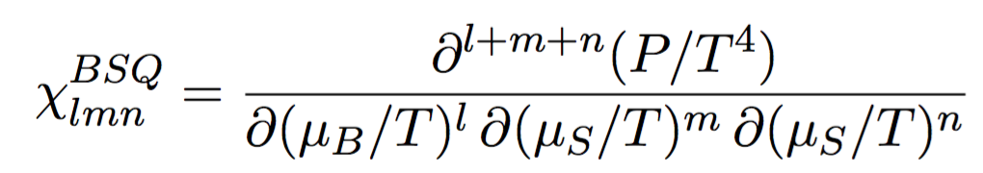
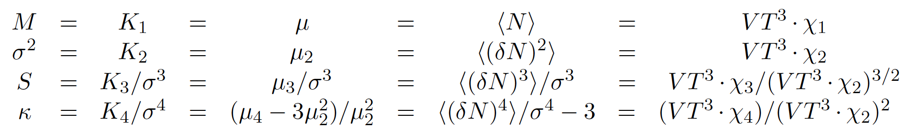


Fluctuations in QCD
QCD phase transitions: the thermodynamic susceptibilities χ of the conserved quantities of QCD (electric charge Q, baryon number B, Strangeness S) correspond to (event-by-event) fluctuations in the particle production.
Fluctuations are quantified as moments (mean, variance, skewness, kurtosis) or cumulants K of the event-by-event distributions:

Slide 42
Fluctuations in Lattice QCD
Thermodynamic susceptibilities are directly accessible in ab-inito Lattice QCD calculations and can be directly compared to experimental results.
[PRD 86 (2012) 034509]
[PRL 111 (2013) 062005]

Slide 43
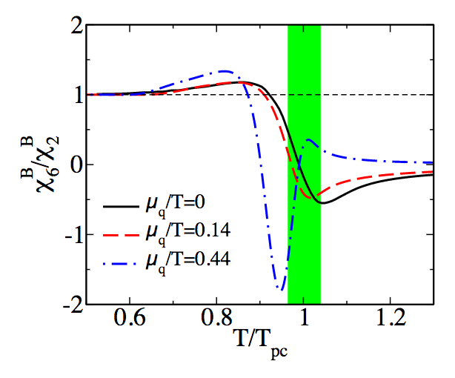
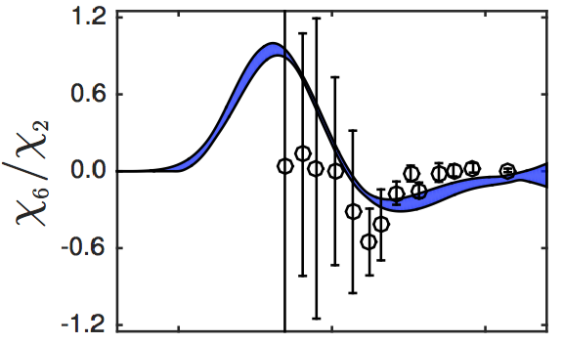
Critical fluctuations
Susceptibilities of lower order (2. and 3.) are sensitive to the chemical freeze-out (phase transition temperature and baryo-chemical potential).
Susceptibilities/fluctuations of higher order (4. and 6.) are sensitive to remnants of the chiral phase transition (critical chiral fluctuations)!
Hadron-Resonance-Gas (HRG) model serves as a clearly defined baseline.
[--> Talk by I. Portillo yesterday]
[Eur. Phys. J. C 71 (2011) 1694]

Slide 44
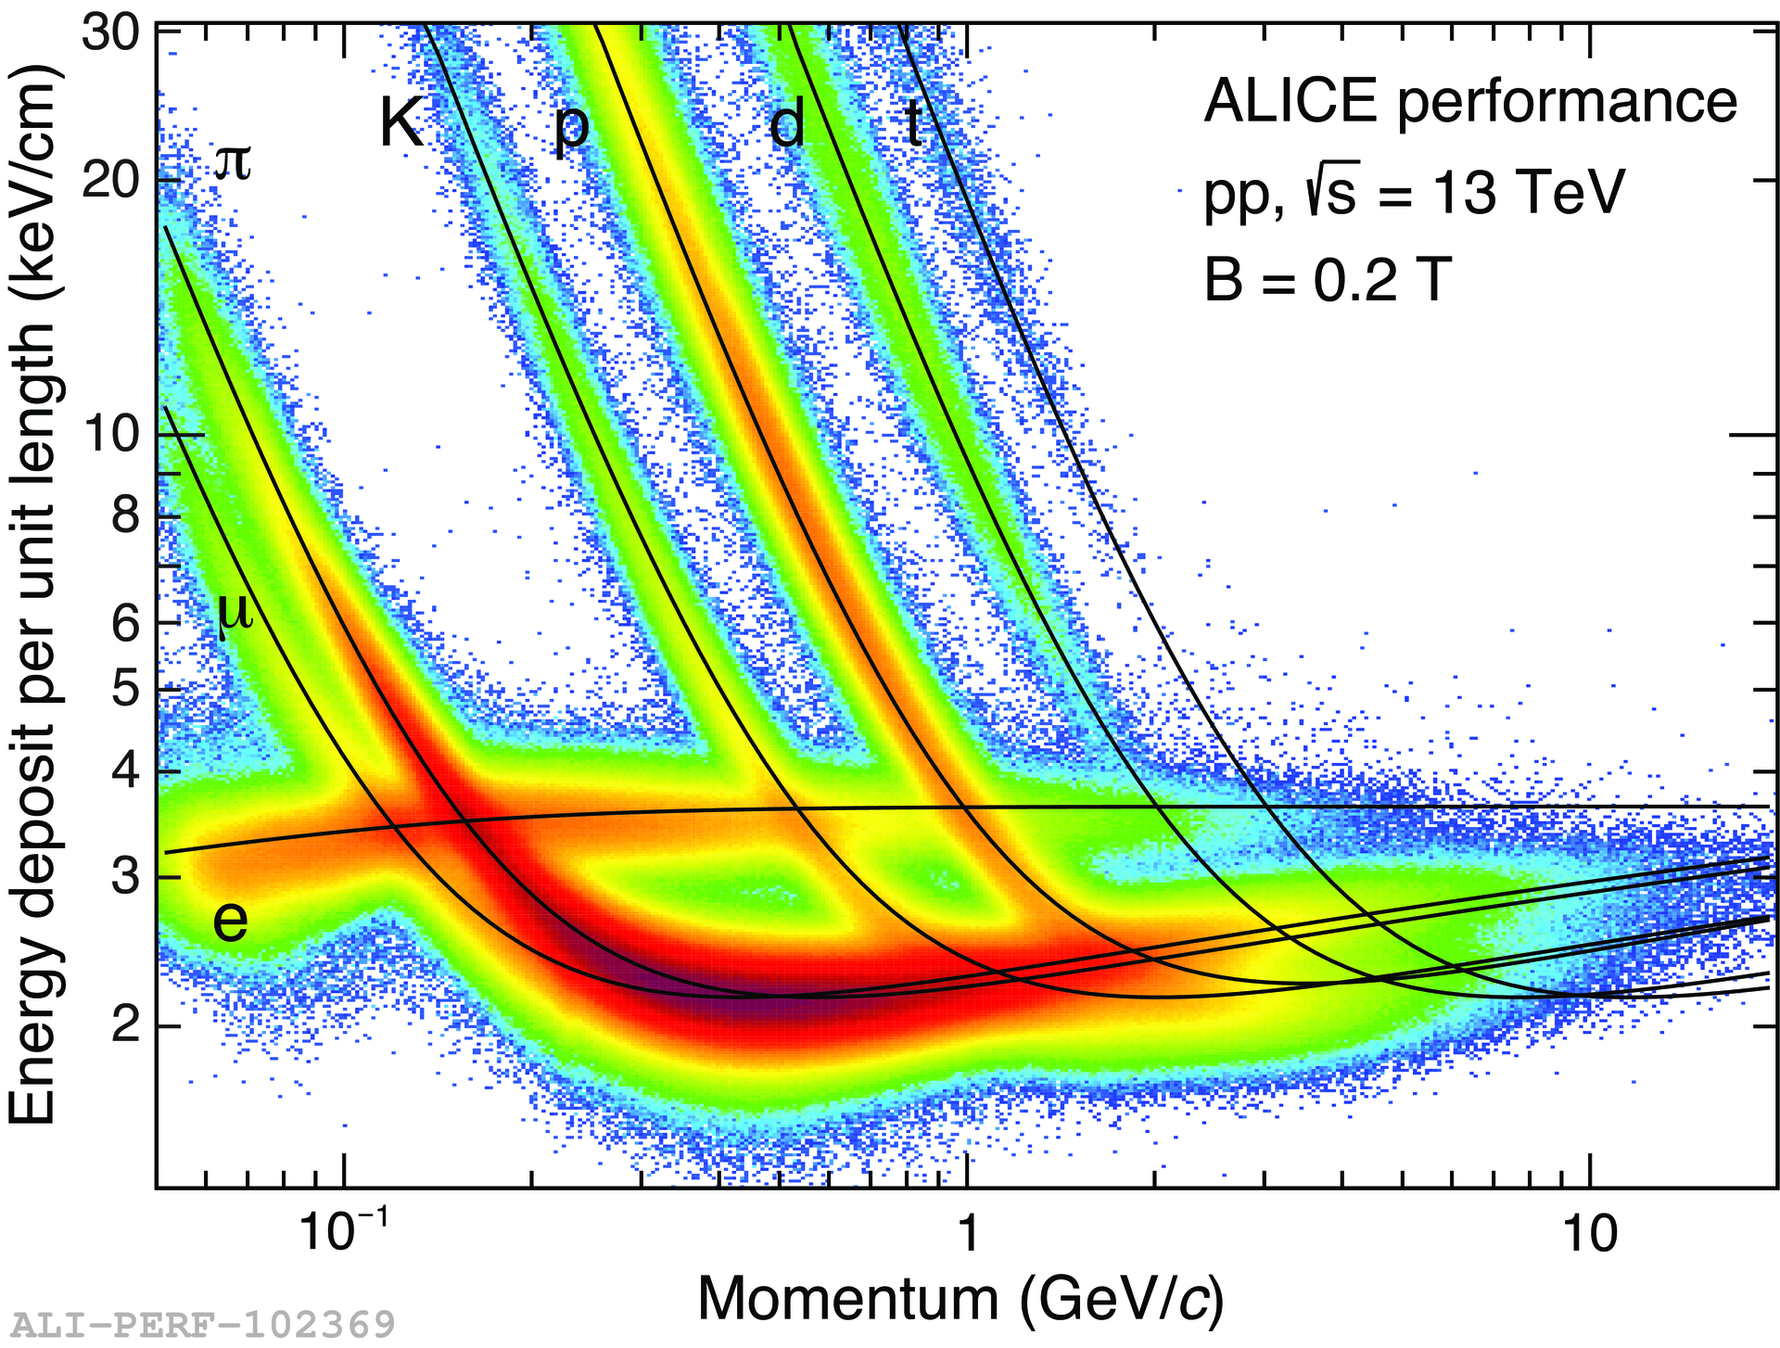
Experimental challenges
Basic measurement: fluctuations in baryon number.
Measure in each event the number of baryons and the number of anti-baryons. In practice: number of protons and anti-protons.
Determine the moments of the distribution.
[STAR@RHIC, PRL 112 (2014) 032302]

Slide 45
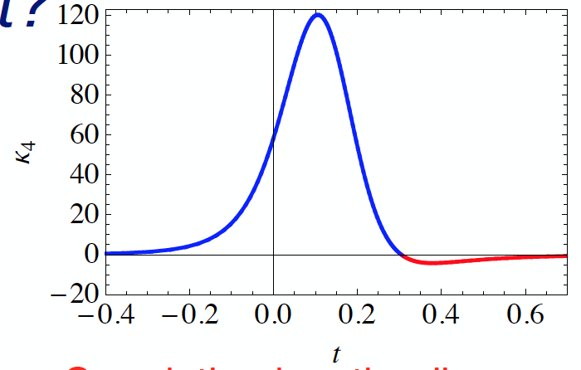

Experimental results -- criticality
Correlation length is expected to diverge in the critical point. → net-proton kurtosis is expected to diverge from Poisson baseline (HRG expectation).
[M. Stephanov. PRL 107:052301(2011)]
[STAR, QM2017 overview talk]

Slide 46

Sequential freeze-out (1)
Are the deviations observed in the thermal model fit for p and Ξ due to physics?
Two main ideas on the market:
(1.) Different chemical freeze-out temperatures for s w.r.t. to u,d quarks.
(2.) Inelastic collisions in the hadronic phase.
Similar to heating a mixture of alcohol (boiling point 78,32 °C) and water (boiling point 100 °C).

Slide 47
Sequential freeze-out (2)
Different chemical freeze-out temperatures for (s) w.r.t. to (u,d) quarks:
  Motivated by LQCD results from
  Wuppertal-Budapest collaboration.
  Supported by chemical freeze-out
  conditions from net-charge
  fluctuations.
  However, no clear ordering
  Ω > Ξ or ϕ > Λ or K in the yields!
  => Needs to be re-addressed
  precisely from the experimental
  side (LHC Run 2, STAR with HFT):
  yields and fluctuations!
  What is the dynamical picture?

Slide 48

Sequential freeze-out (3)
Inelastic collisions in the hadronic phase:
  Studied by UrQMD afterburner added to SHM fits (significant improvement of χ²/ndof and increase in freeze-out temperature → Tch beyond region supported by Lattice?).
  Leads to centrality dependent effects which can be studied experimentally, but more precise data is needed to investigate significance of trends.
  => Needs to be re-addressed precisely from the experimental side
  (LHC Run 2, STAR with HFT).
UrQMD 158 AGeV Pb+Pb central
SHM
SHM+UrQMD

Slide 49


Sequential freeze-out (4)
First look at LHC Run2 data (5.02 TeV) consistent with previous measurements:
Strange and multi-strange results will be released soon.

Slide 50


HADES net-proton
HADES Au+Au data at sqrt(sNN) = 2.41 GeV continues the trend of the STAR-BES data to even lower energies.
Different rapidity window (Δy=0.2) with respect to STAR (Δy=0.5) in order to ensure large enough distance to beam rapidity.
A strong dependence of the observable on the rapidity window is observed.
sqrt(sNN)
Sketch of rapidity distribution at high energies
(LHC, top RHIC) from V. Koch.

Slide 51

Some Selected Results:
(anti-)(hyper-)Nuclei

Slide 52


Light (anti-)nuclei
Even in Pb-Pb collisions at LHC energies, light anti-nuclei are rarely produced.
(Anti-)nuclei up to the
(anti-)alpha are in reach (1st observation of the anti-alpha by the STAR experiment at RHIC in 2011).
P
A very good and very stable particle identification is needed to separate these rare particles from the background.
N

Slide 53

Mass ordering
For each additional nucleon the production yield decreases by a factor of about 300!
p
d
Such a behaviour can be directly derived from the thermal model which predicts in first order
dN/dy ~ exp(-m/T)
³He
⁴He

Slide 54

(anti-)nuclei and the thermal model
The statistical-thermal model describes correctly the d/p ratio over a large range of collision energies despite the low binding energy w.r.t. to the temperature of the medium (E_{B} ≈ 2.2 MeV << 156 MeV).

Slide 55

Hyper-nuclei (1)
By ‘replacing’ one nucleon by one hyperon, the table of nuclides can be extended in a third dimension.
Hyper-nuclei have a long tradition in nuclear physics: discovery in the 1950s by M. Danysz and J. Pniewski in a nuclear emulsion exposed to
cosmic rays.
deuteron
p
triton
n
p
n
hyper-triton
n
p
n
Λ

Slide 56



Hyper-nuclei (2)
Reconstruction of hyper-nuclei can be based on well established techniques for Λ and other weakly decaying light flavor hadrons as lifetimes and decay topologies are similar.
Experimentally one searches
for (anti-)nuclei from displaced vertices:
Branching ratios are only partially
constrained by measurements.

Slide 57

Hyper-nuclei (3)
[Phys.Lett.B697:203-207,2011]
Production rates for rare hyper-nuclei show a maximum at FAIR energies in statistical-thermal model calculations.
Needs high rates, good vertexing and good PID
=> Interesting physics opportunities for CBM, PANDA,..

Slide 58


Hyper-triton lifetime
From an exponential fit to the differential yield in cτ bins, the lifetime of the hyper-triton can be extracted.
[arXiv:1506.08453]

Slide 59
Summary and Conclusion

Slide 60
Summary and conclusion
Forefront research in (ultra-)relativistic heavy-ion physics covers a wide range of topics over a wide range of collision energies.
From a theory side: towards ab initio QCD calculations (as little modeling as possible). We study many-body QCD from first principles.
=> Experimentalists need to measure observables which are calculable.
From an experimental side: increasing precision and investigation of the rarest particles.

Slide 61
Thank you!

Slide 62
Backup Slides

Slide 63
Short introduction to statistical thermodynamics (B)
We therefore distinguish three different statistical ensembles:
(i) micro-canonical: E, V, N fix
(ii) canonical: T, V, N fix
➔ given volume element is coupled to a heat bath
(iii) grand-canonical: T, V, µ fix
➔ given volume element can also exchange particles with its surrounding (heat bath
and particle reservoir)
Statistical
model for e⁺e⁻
collisions.
E,V,N
TB
Strangeness
conservation in
peripheral HI
collisions.
TB, V, N
TB
Central
relativistic
heavy-ion
collisions.
TB, V, µ
µ

Slide 64

Net-kaon fluctuations
New measurement of of net-Kaon cumulants for Au +Au collisions at
√s_{NN} = 7.7, 11.5, 14.5, 19.6, 27, 39, 62.4 GeV.
The values for κσ² and Sσ/Skellam are consistent with Poisson and negative binomial distribution baseline within errors.
First attempts made for the extraction of freeze-out conditions, but need increased experimental precision:
C. Ratti et al.

Slide 65


Particle production at LHC energies
Particle production in pp, p-Pb, and Pb-Pb collisions at LHC shows an equal abundance of matter and anti-matter in the central rapidity region.
5% of all charged particles are protons (the ‘lightest nucleus’)
Phys. Rev. Lett. 109, 252301 (2012)
[arXiv:1506.08951]

Slide 66

QCD Phasendiagramm 2
Alternative Darstellung:

Slide 67

Global and local charge conservation
Experimentally it is clear what needs to be done: we need to scan as much as we can the available phase space.

Slide 68


Centrality dependence of efficiency

Slide 69

Proper time and (pseudo-)rapidity

Slide 70



Heavy ion collision
Colliding nuclei

Slide 71


Heavy ion collision
Production of colour medium and equilibration
PreEquilibrium

Slide 72


Heavy ion collision
QGP and expansion
QGP expansion
PreEquilibrium

Slide 73


Heavy ion collision
Hadronisation and Chemical freeze-out
Chemical freeze-out
Hadronisation
QGP expansion
PreEquilibrium

Slide 74

Heavy ion collision
Kinetic freeze-out
Kinetic freeze-out
Chemical freeze-out
Hadronisation
QGP expansion
PreEquilibrium

