Slide 1
muCool: Development of a high-brightness low-energy muon beamline
Ivana Belosevic
on behalf of the muCool collaboration

Slide 2
Why do we care about muons?
Muonium spectroscopy
Gravity of antimatter
electron
-
antimuon
+
Muonium
complementary to antihydrogen gravity experiments: AEGIS, ALPHA, GBAR
also:
Solid state physics (muon spin rotation)
New physics?
Notes:
Why are we interested in muons?
Many interesting experiments
Form exotic atom called muonium, which consists of antimuon and electron
-hydrogen-like system, but instead of proton we have point-like particle
-spectroscopy
Since antimuon is much heavier, muonium is mostly made of antimatter – could also do an experiment to measure gravitational constant of antimatter
Also applications in solid state physics – muons have spin, so we can study magnetic properties of materials
Search for BSM physics (anomalous muon g-2, lepton flavor violation)

Slide 3
Aim: high quality muon beam
IN
OUT
standard
muon
beam
our
muon
beam
energy: <1 eV
diameter: <1 mm
energy: 4 MeV
diameter: $1$0 mm
phase space compression: 10¹⁰
efficiency: 10⁻³
Notes:
The experiments mentioned before require high quality muon beam
But standard muon beams don’t fulfill this requirement, they are very wide and have large divergence
What we do is we take such ugly beam and transform it into very small and very parallel beam
Using our device we can achieve a phase space compression/improvement by 10 orders of magnitude with 10^-3 efficiency (muon lifetime)

Slide 4
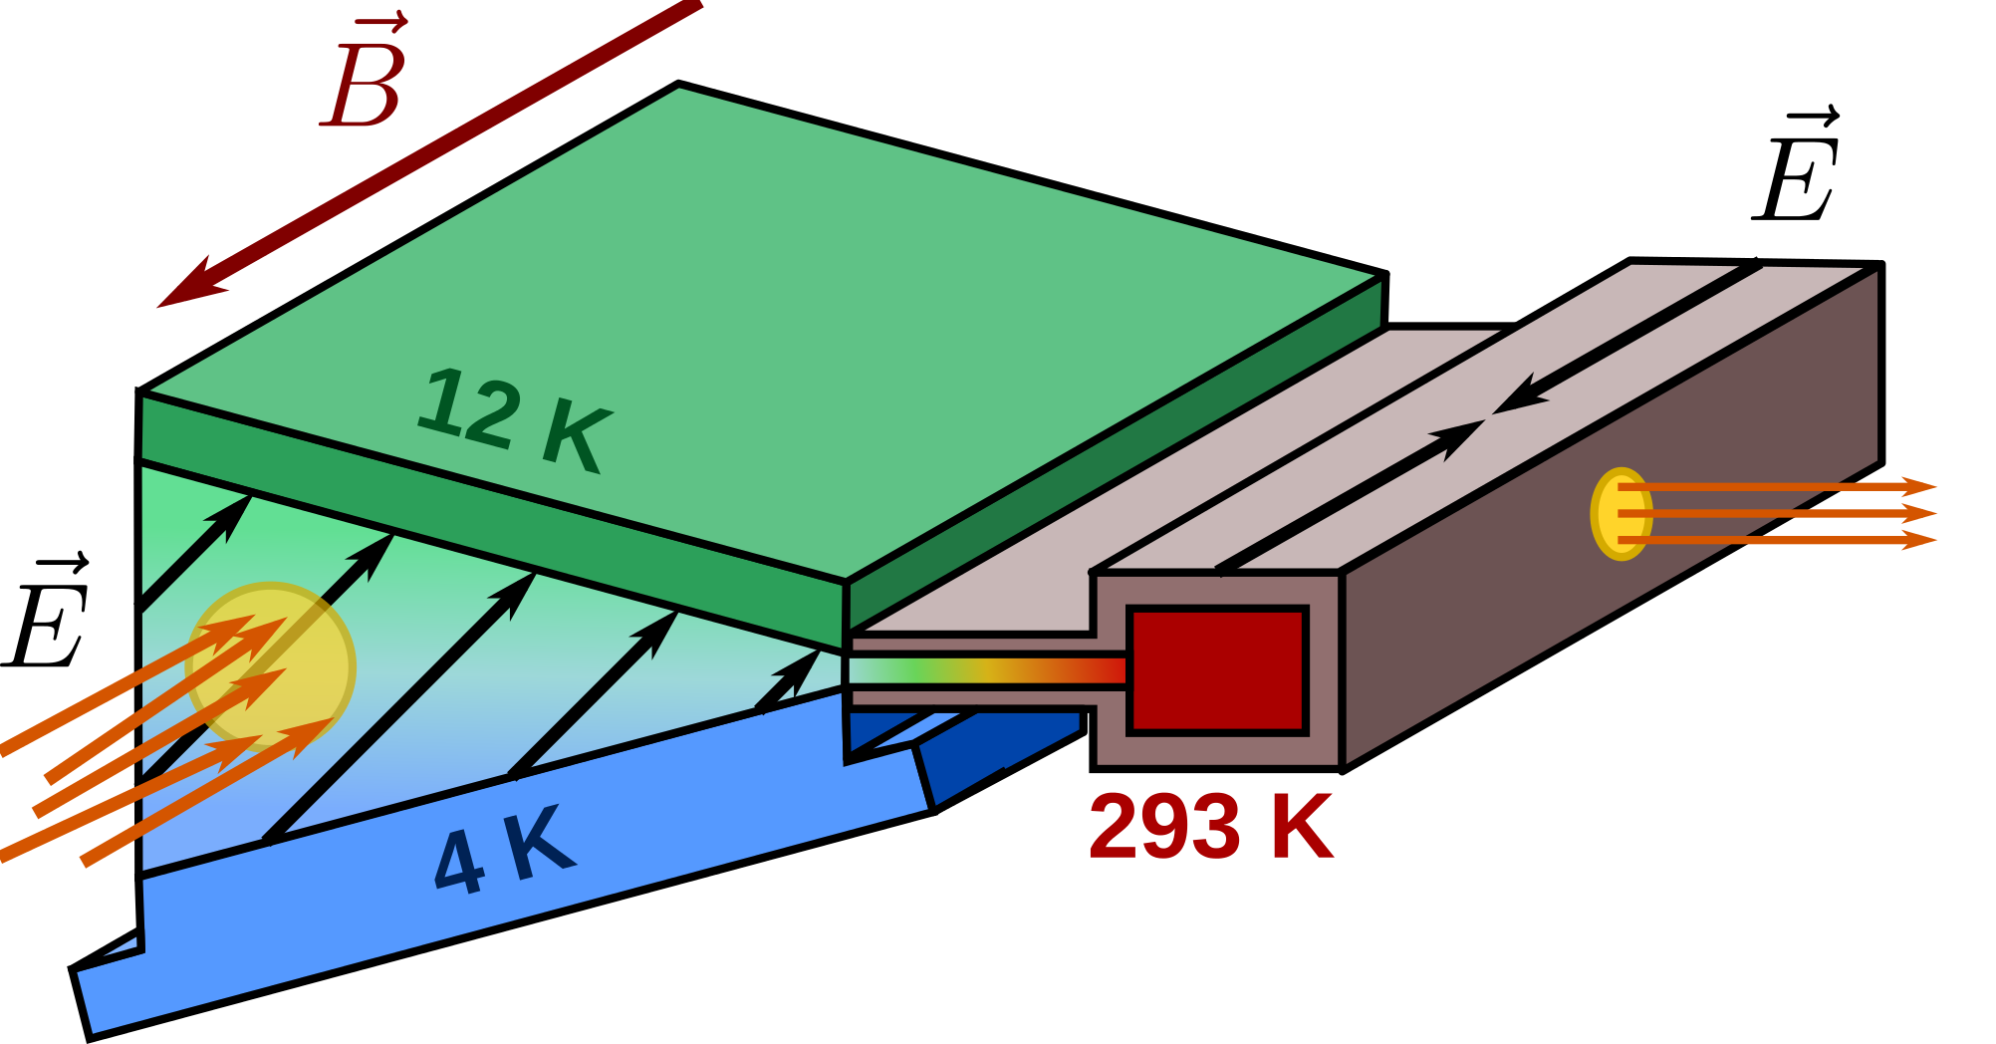
Working principle
1st stage
2nd stage
OUT
IN
D. Taqqu, PRL97, 194801 (2006)
Y. Bao et al., PRL 112, 224801 (2014)
→ Transforms a standard ${μ }^{+}$beam into
a high-brightness low-energy ${μ }^{+}$ beam
Notes:
Here is a scheme of our device that we use to transform standard muon beam into a high quality beam
Our device is filled with helium gas
We start with standard muon beam (e.g. PSI), stop it in few mbar of helium gas and compress the beam with magnetic and electric fields.
Several stages, 1st at cold temperatures (beam compressed vertically), 2nd at room temperature (beam compressed in z-direction)

Slide 5
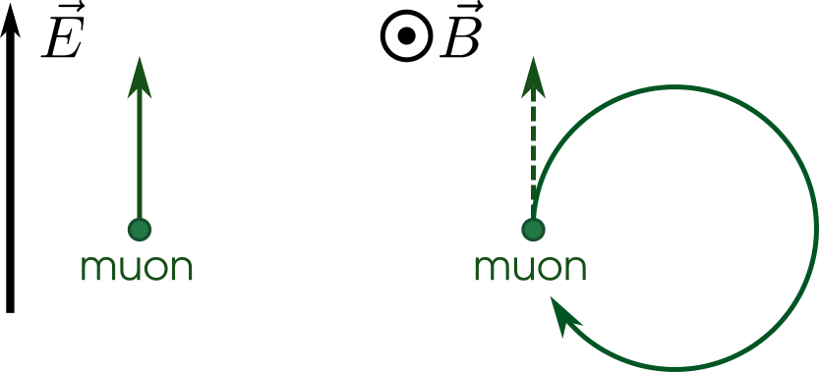
Trajectories in $\vec{E}$ and $\vec{B}$ fields
+
= ?
Notes:
We use electric and magnetic fields to reduce the size of a muon beam.
To understand that we need to understand the motion of charged particles in crossed E and B fields.
First look separately what happenes with muon when we have electric or magnetic field
Electric field – muon accelerated in the direction of el. field
Magnetic field – if muon at rest – nothing happens
- if muon has velocity - loop

Slide 6
Trajectories in $\vec{E}$ and $\vec{B}$ fields
+
=
drift perpendicular to both $\vec{E}$ and $\vec{B}$ field
(in $\hat{E}×\hat{B}$ direction)
Notes:
When we superpose electric and magnetic field something strange happens
Muon move perpendicular to both E- and B- field
Start with particle at rest – acc. by Efield, trajectory bent by Bfield until it start going against the Efield and decelerates again.
Drift perpendicular to both E- and B- field direction

Slide 7
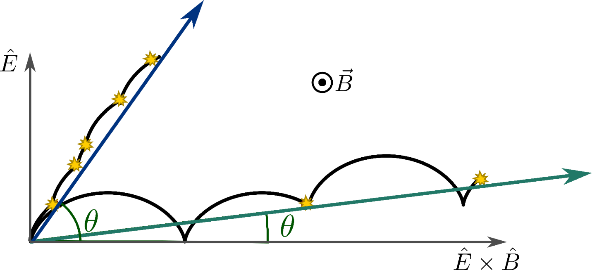
Trajectories in $\vec{E}$ and $\vec{B}$ fields + gas
In gas: collisions with gas atoms with frequency $f_{col}$
$$\tan{θ∝f_{col}}$$
high $f_{col}$
low $f_{col}$
Notes:
We add gas, as in our setup -> collisions with gas alter the direction of motion
Two cases:
High collision frequency – collision before the end of the period -> moving more in E field direction
Low collision frequency – similar to vacuum –> moving more in ExB direction
Summarised by formula: angle theta proportional to collision frequency
We can control the direction of particle by changing the collision frequency

Slide 8
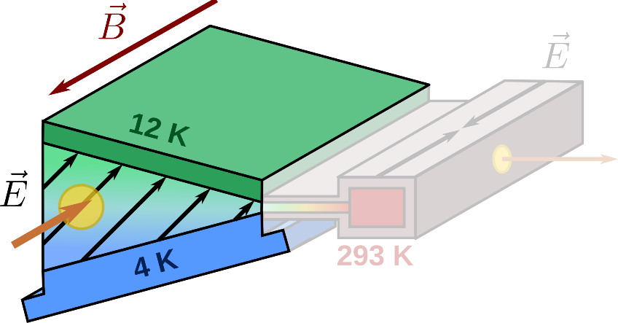
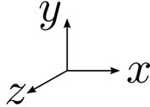
Working principle – 1st stage
Notes:
Now we apply this to our beamline- 1st stage
Different temp on top and bottom – different densities – different collision freq. – different muon direction
Electric field at 45° angle to x-axis

Slide 9
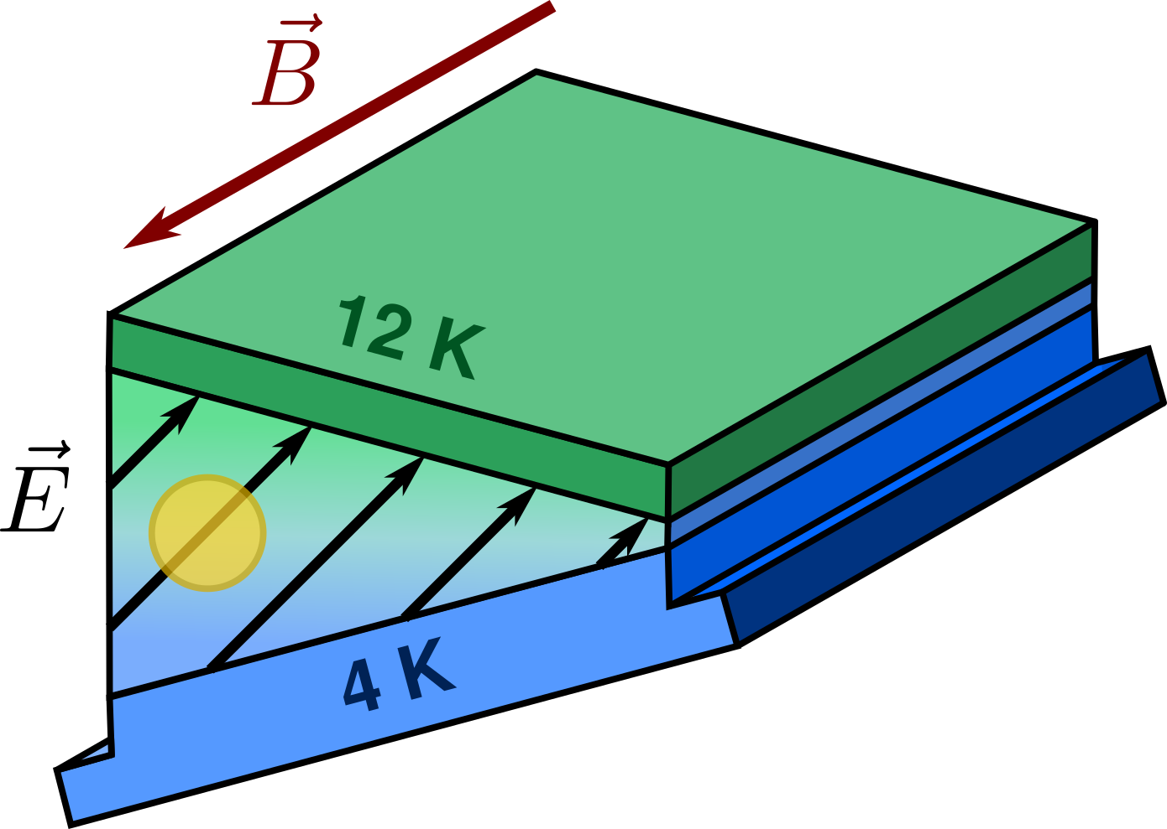
Working principle – 1st stage
Notes:
Electric field at 45° angle to x-axis
upper part: higher temperature -> lower density -> lower collision frequency -> muons moving more in ExB field direction (DOWN)
bottom part: lower temperature -> higher density -> higher collision frequency -> muons moving more in E field direction (UP)

Slide 10
Working principle – 1st stage
Notes:
GEANT4 simulation of muon trajectories with temp. gradient, 45° Efield and Bfield out of plane
we start with large beam and end up with small beam – therefore TRANSVERSE COMPRESSION
DRIFT and COMPRESSION

Slide 11
Setup at the Paul Scherrer Institute
Target
Notes:
1st stage in real life
gas volume enclosed by thin foil lined with electrodes (defining electric field)

Slide 12
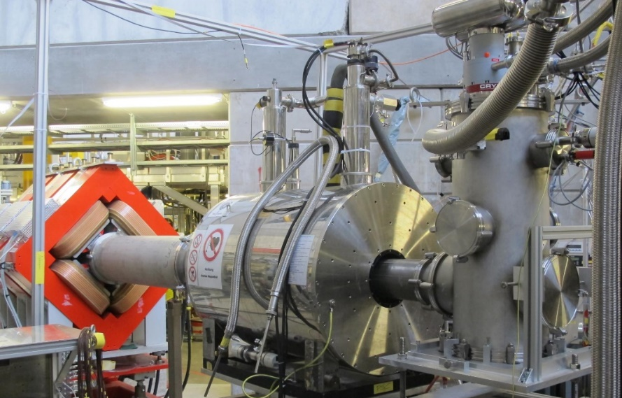
Setup at the Paul Scherrer Institute
Beamline – solenoid - cryostat
Notes:
Whole setup, muon beamline – target on a cold finger – cryo – magnet

Slide 13
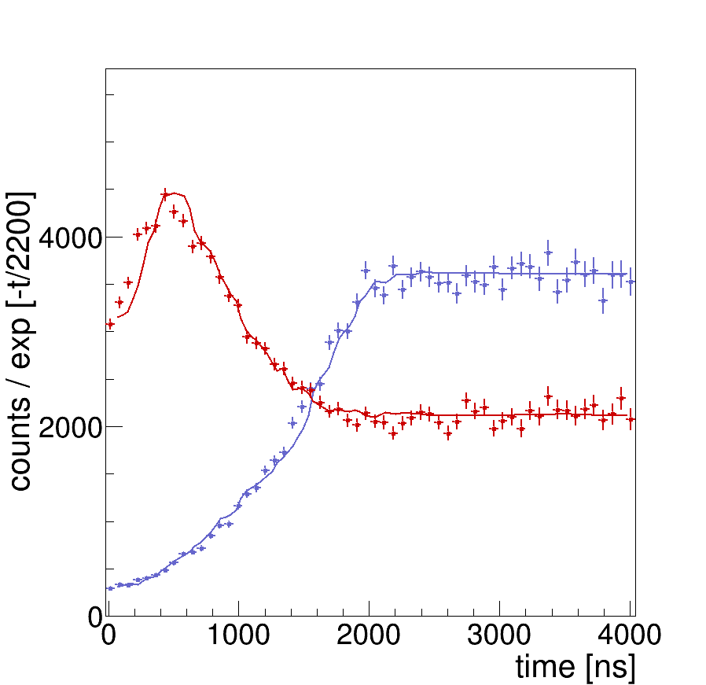
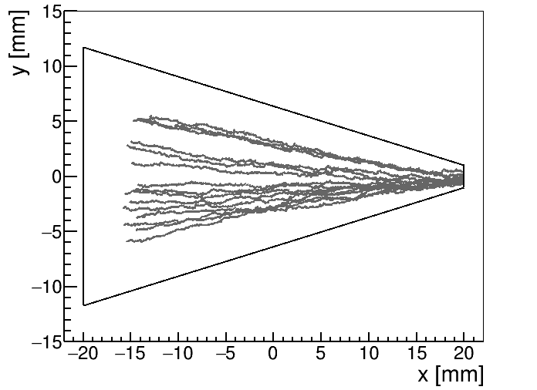
And it’s also working…
Detector 1
Detector 2
Detector 2
Detector 1
Notes:
To detect compression/drift we place detector in the tip of the target.
Detector counts positrons from muon decay.
We expect to see more counts in the detector when muons are close to it, less when they are far away.
Here shown time spectra of detector – number of counts versus time in the detector
Crosses are data!!!
Detector #1: number of counts increases with time – muon coming closer and closer to the detector – consistent with sim. trajectories
Detector #2: number of counts first increases, then again decreases -> muons fly by the detector
Consistent with the simulation. Represented by line.
After some time flat – because muons crash into the wall and don’t move anymore.
Compression takes 2us – very fast

Slide 14
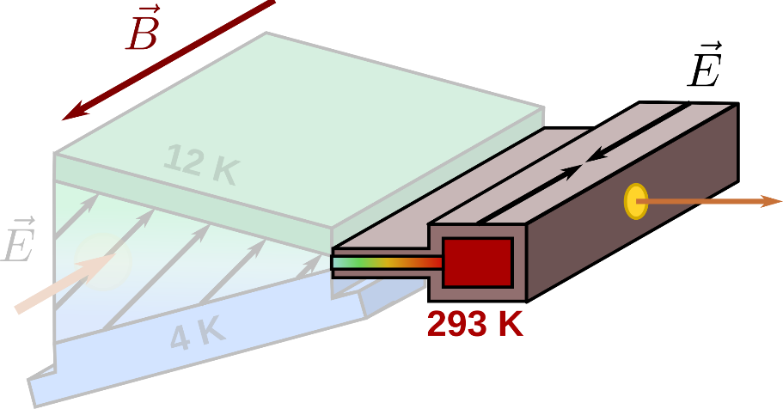
2nd stage
muon trajectories (simulation)
Y. Bao et al., PRL 112, 224801 (2014)
Notes:
Now we have muon beam compressed in vertical direction (transverse), but beam still large along the z-direction
Second stage – at room temperature – longitudinal compression
Electric field pointing towards the center, parallel to B-field – no funny ExB drift
Muons will simply follow the electric field (E-field parallel to B-field)
Simulation: looking from the top: muons everywhere in z-direction

Slide 15
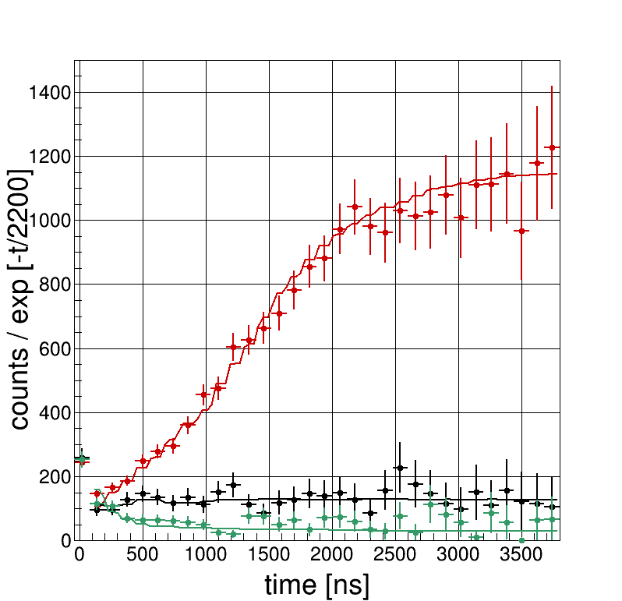
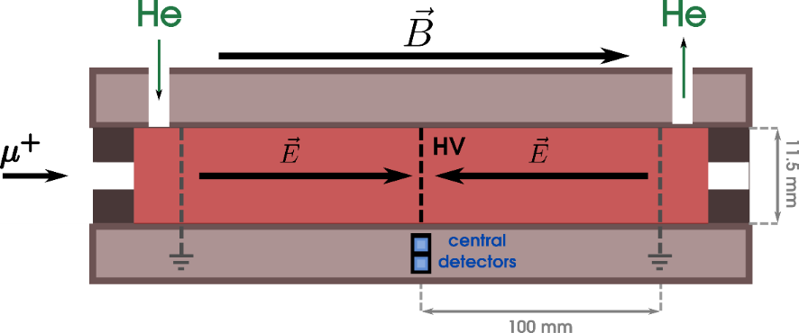
2nd stage
Measured time spectra ($e^{+}$ from $μ^{+}$ decay)
-500 V
0 V
+500 V
Notes:
Now we have muon beam compressed in vertical direction (transverse), but beam still large along the B-field direction
Second stage – at room temperature – longitudinal compression
Electric field pointing towards the center, parallel to B-field – we achieve this by putting outside to ground and the center to high voltage
Depending on the sign of HV we can change the direction of the field
In the center two detectors – in coincidence
In case of 0 HV – flat spectrum – muons just stop in the target and don’t move afterwards
In case of -HV number of counts increases at late times – muons come to the center of the target (because of el. fields pointing towards the center)
In case of +HV – opposite - number of counts decreases at late times – muons are pushed away from the center of the target (because of el. fields pointing away from the center)
Measuring for different HV allows us to extract the compression efficiency – analysis shows that it’s 90+-13%
Simulation fits the data.

Slide 16
1st stage + 2nd stage?
Notes:
Initally, we wanted to first have 1st stage and then 2nd
But now we want to be even more efficient: do both stages at the same time (in parallel)

Slide 17
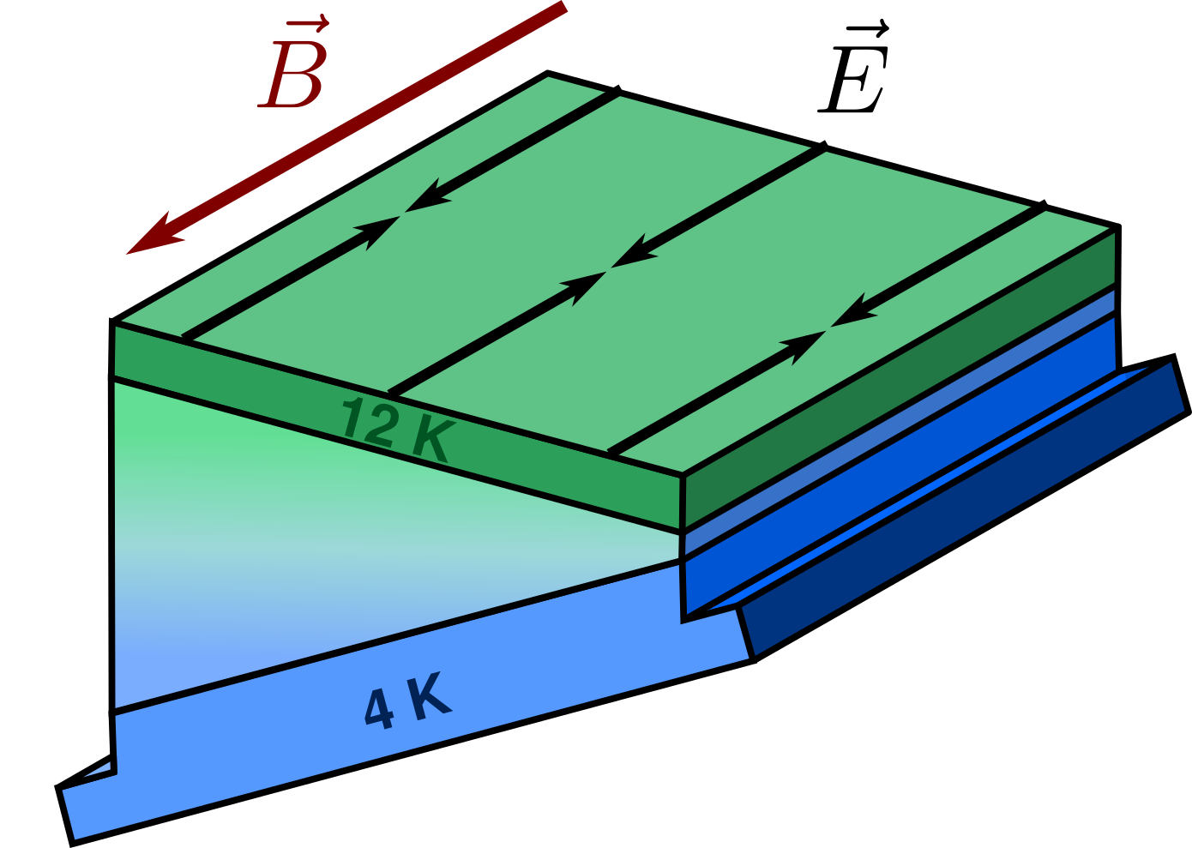
1st stage + 2nd stage?
Notes:
How to combine these 2 stages?
One idea: keep 1st stage almost as it is, with temp. gradient and 45° el. field
Then on top of that we add electric field as it was in 2nd stage, pointing towards the center in z-direction
Total el. field: sum of the 45° field from 1st stage and el. field from 2nd stage
BUT: how to produce such electric field?
We need to apply correct potentials at the boundaries of our combined stage

Slide 18
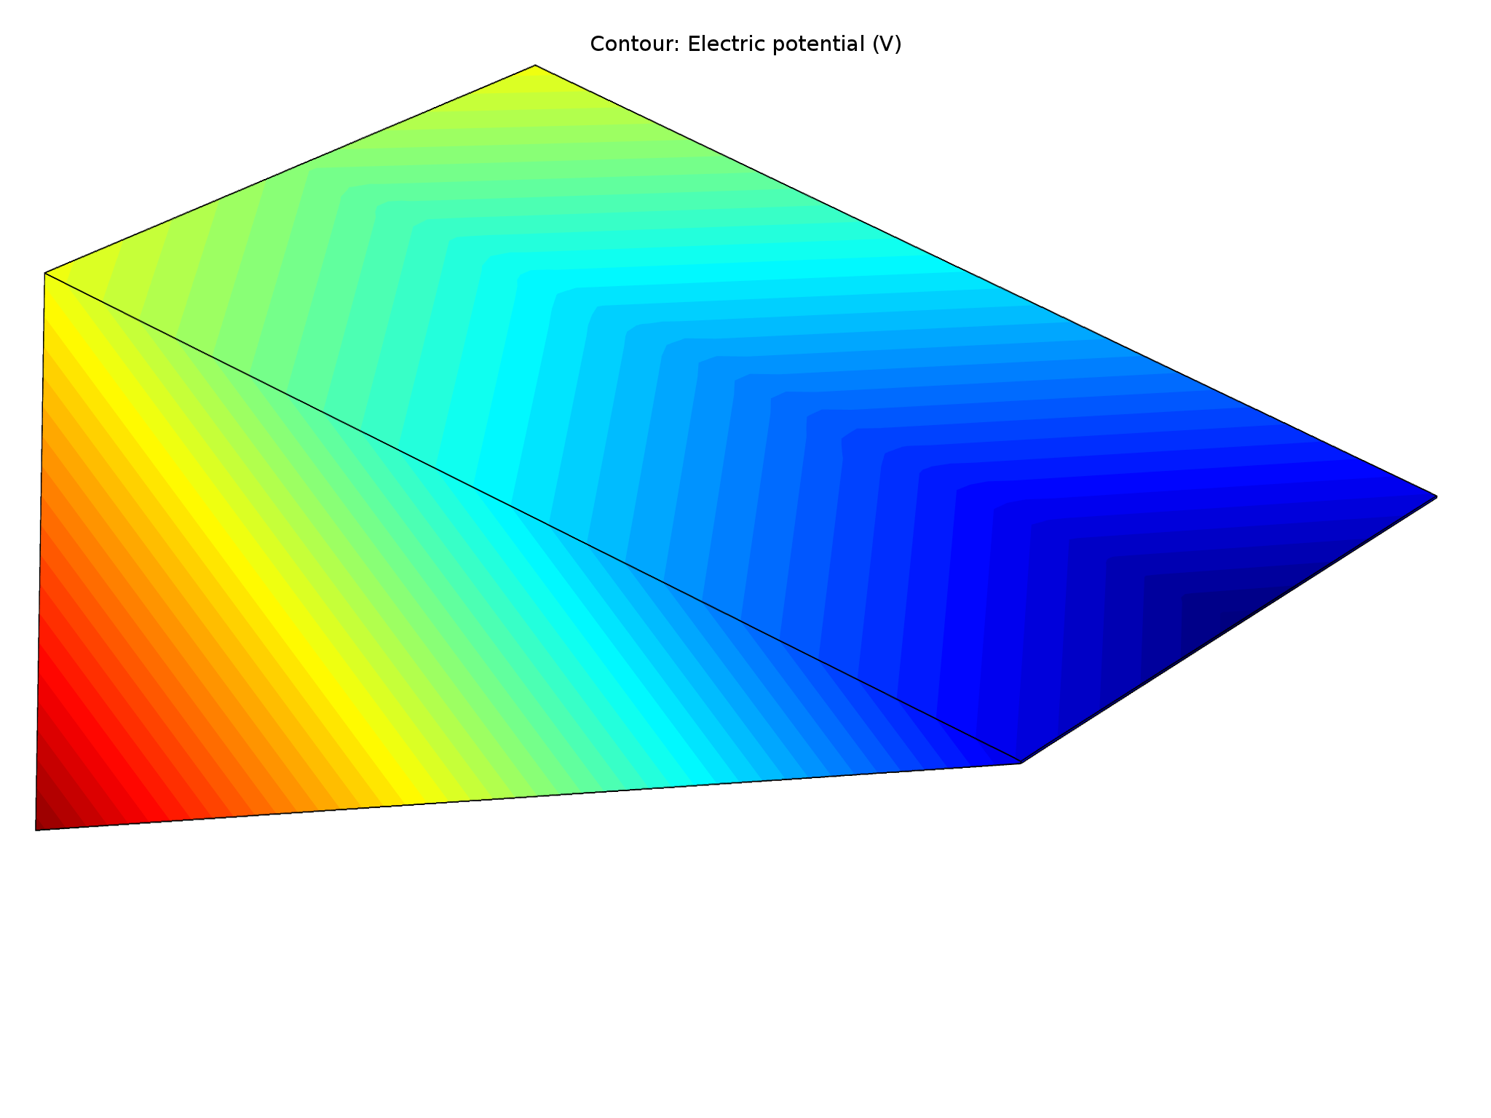
1st stage + 2nd stage?
Notes:
Potential can be simply calculated by integrating the electric field
Result shown here
Red color – higher potential, blue – ground
Electric field will simply be perpendicular to these equipotential lines
In front -> 45 ° field
On top: V-shaped potential in z-direction – field pointing toward the center in z-direction (2nd stage field)

Slide 19
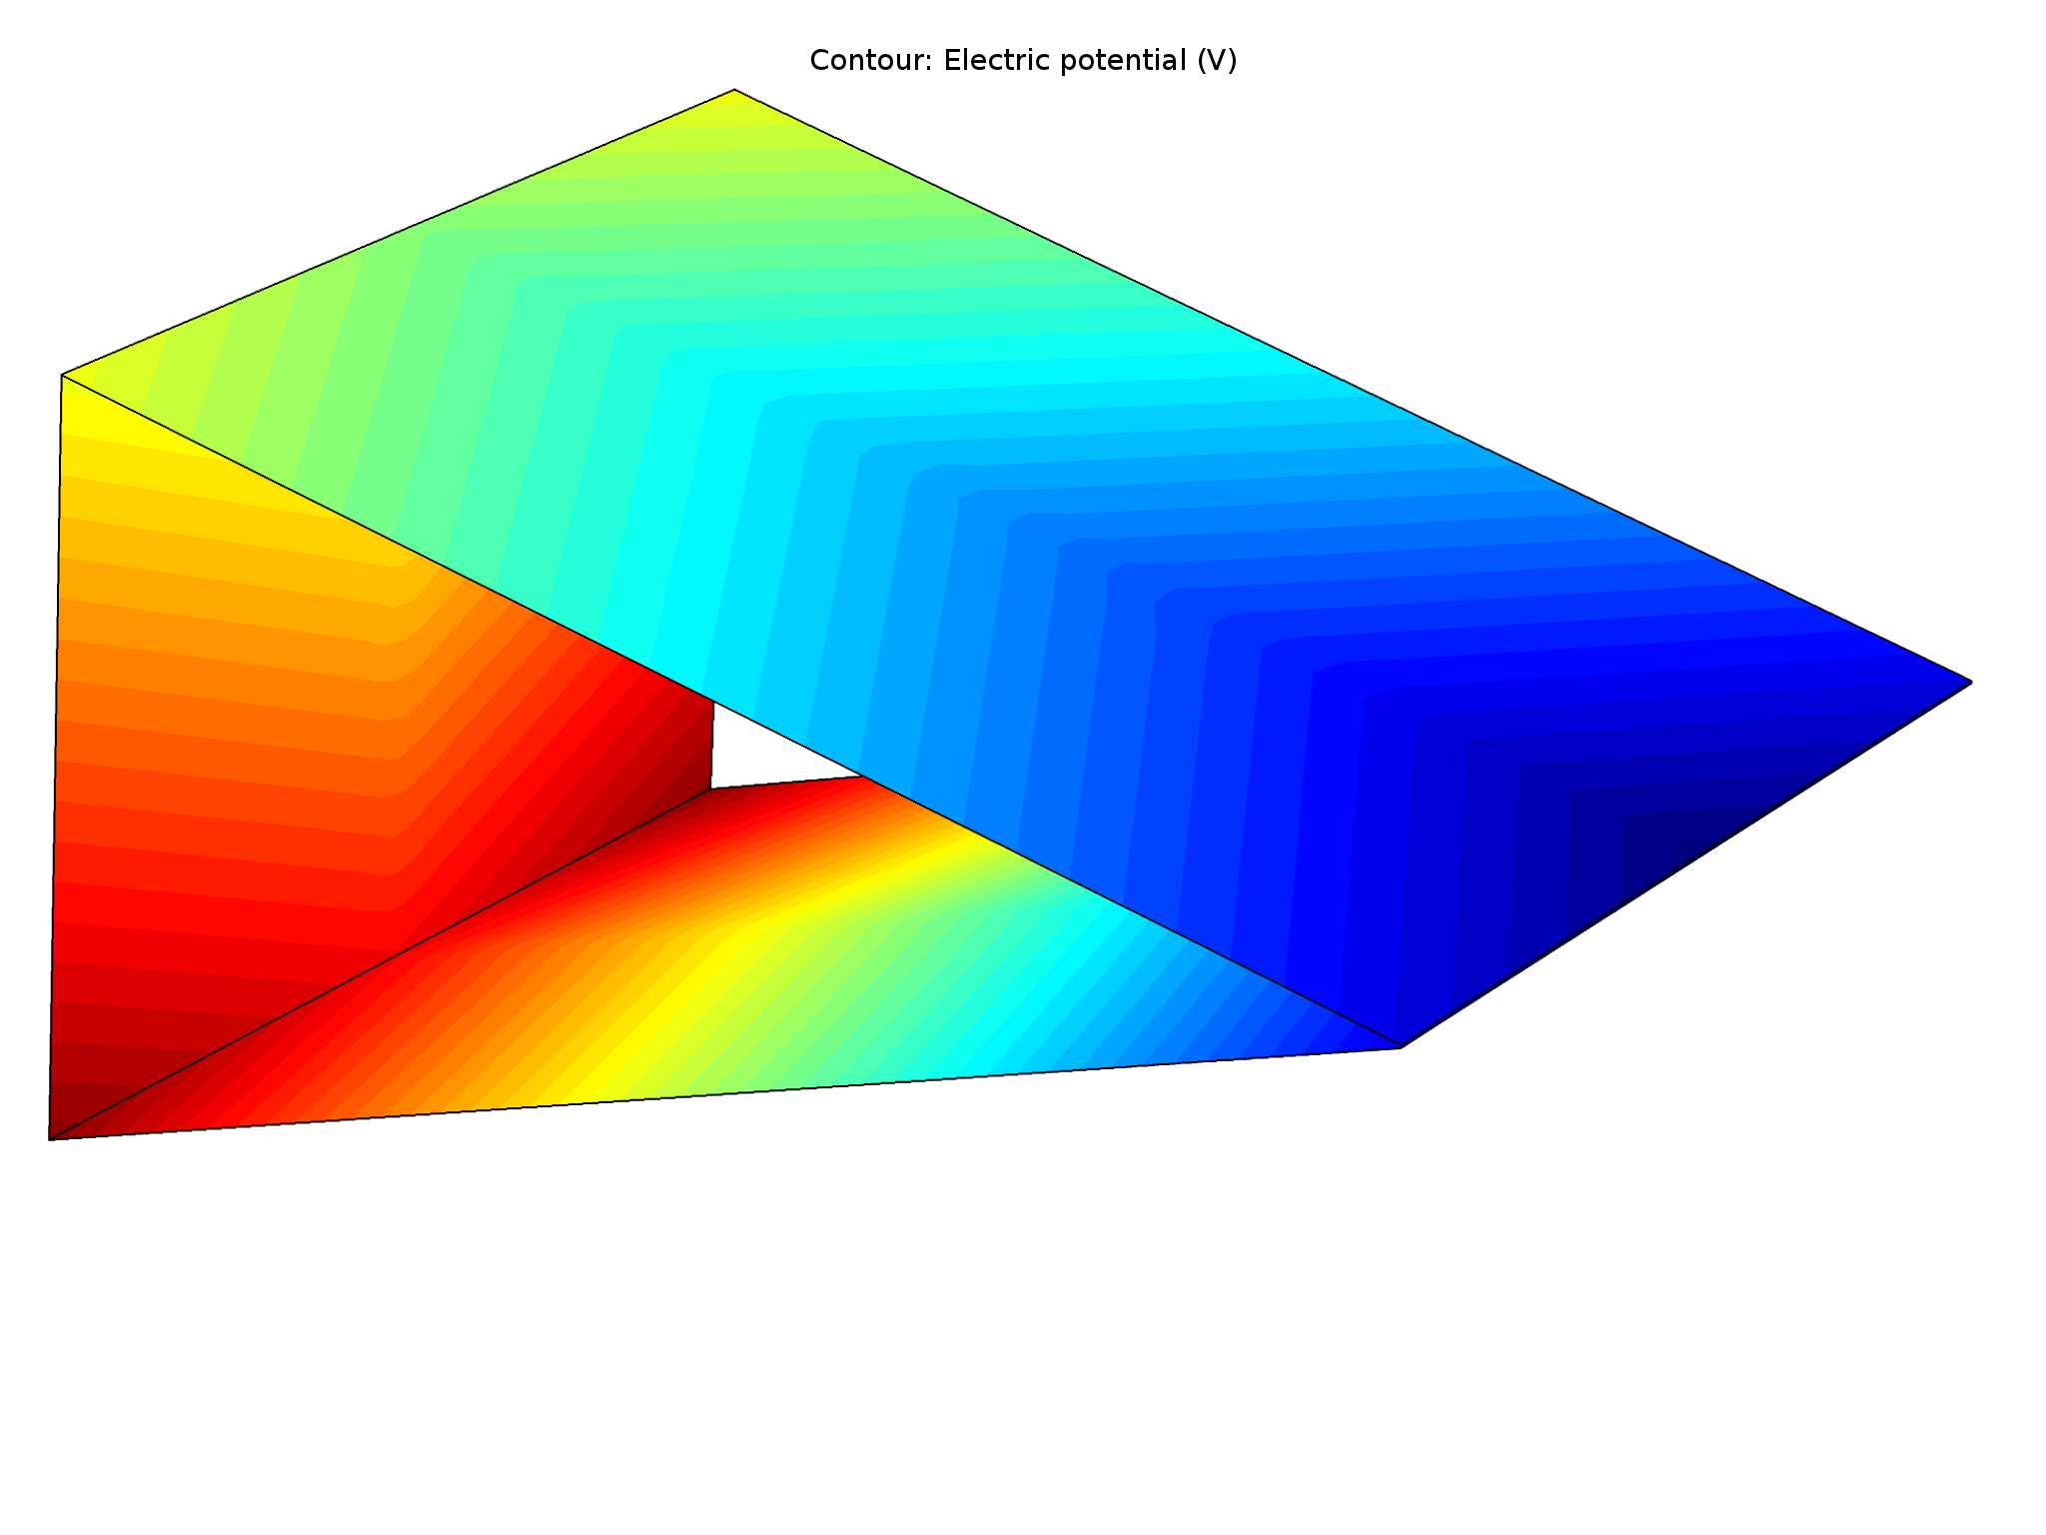
1st stage + 2nd stage?
Notes:
Here shown how the potential looks on the other walls

Slide 20
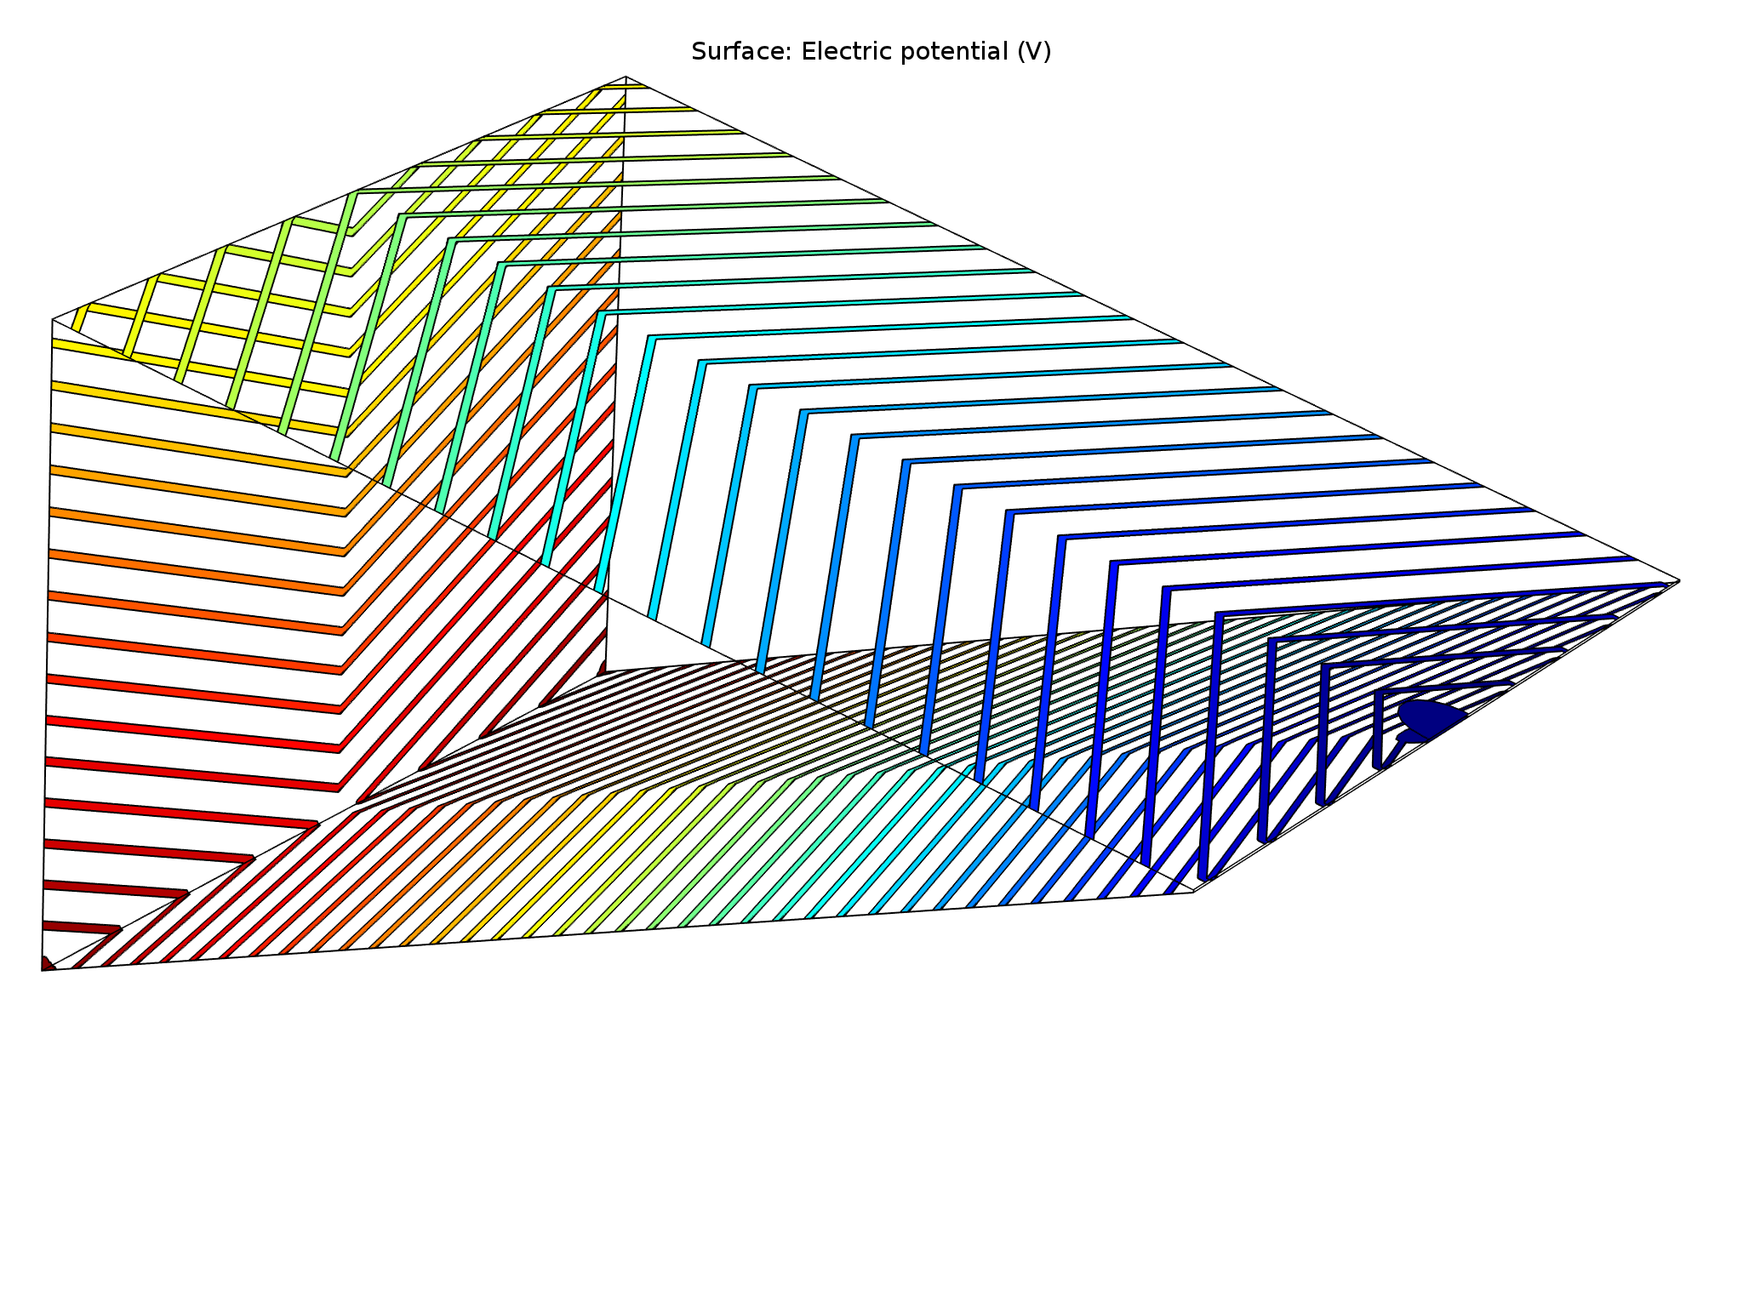
1st stage + 2nd stage?
Notes:
The way we define the potential is by thin metallic electrodes
Each electrode is defining the equipotential line, so the shape of the electrodes will be given by the calculated el. potential
Each electrode at different potential

Slide 21
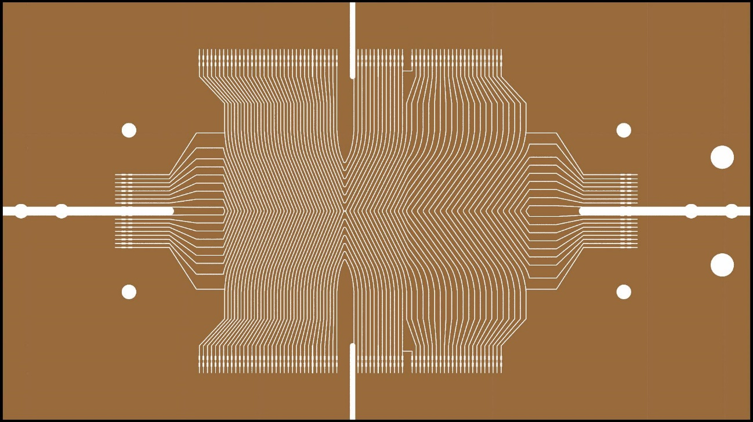
Current development
Notes:
The way we produce this:
We take Kapton foil, print all the electrodes on it and then fold the foil in this triangular shape
You see different strip for top, side and bottom walls

Slide 22
Making the target
Notes:
Cryostat with cold finger, target in front
Whole setup, muon beamline – target on a cold finger – cryo – magnet
Two beamtimes: 2014 and 2015

Slide 23
Notes:
Simulation of the muon trajectories in the combined stage
Start we the stopped muons, wide swarm in the vertical and z-direction
Simulataneous compression in both directions

Slide 24
Conclusions
First two stages demonstrated independently
Measurements and simulations agree
Current development: combining two stages

Slide 25
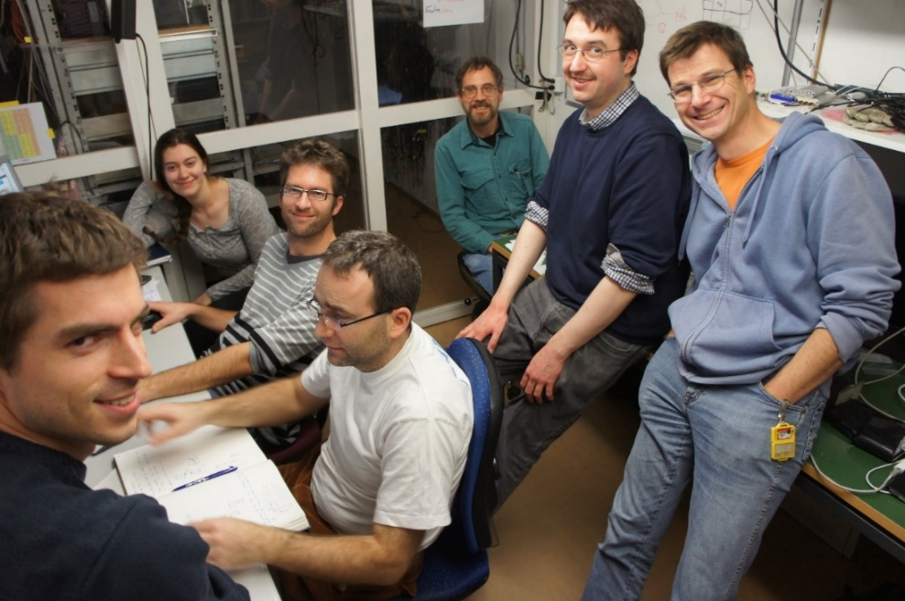
muCool collaboration:
A. Antognini
I. Belosevic
A. Eggenberger
K. Kirch
F. Piegsa
D. Taqqu
G. Wichmann
Y. Bao
M. Hildebrandt
A. Knecht
A. Papa
C. Petitjean
N. Ritjoho
S. Ritt
A. Stoykov
D. M. Kaplan
T. J. Phillips

Slide 26
Backup slides
Notes:
Cryostat with cold finger, target in front
Whole setup, muon beamline – target on a cold finger – cryo – magnet
Two beamtimes: 2014 and 2015

Slide 27
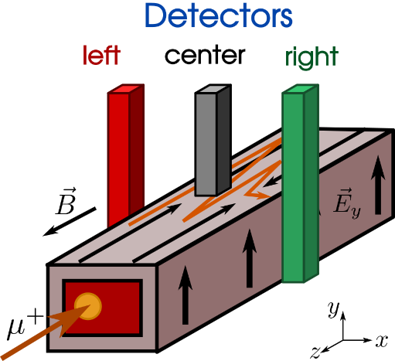
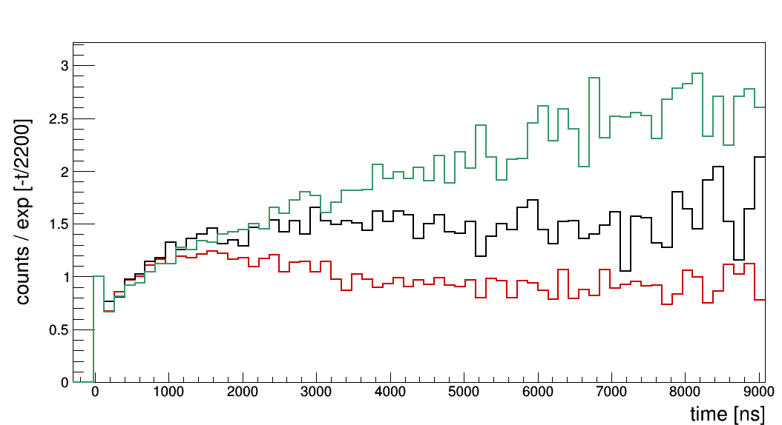
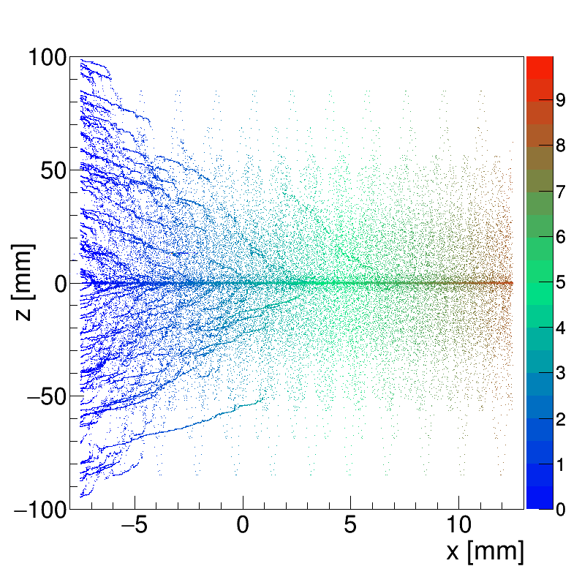
Longitudinal compression with $\hat{E}×\hat{B}$ drift
Measured time spectra ($e^{+}$ from $μ^{+}$ decay)
comp.
drift
right
center
left
muon trajectories
time ($μ$s)
Increase of counts in the right detector and decrease of counts in the left detector at late times show that muons moved from left to right (in +x direction).
Notes:
We have 3 detectors
Increase of counts in the right detector and decrease of counts in the left detectors at late time – muons moved from left to right
Increase of counts at early times is because of longitudinal compression (same in all 3 detectors)

Slide 28
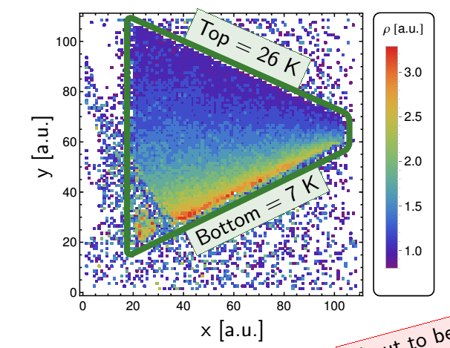
Temperature gradient
demonstrated via neutron radiography
Wichmann, G. et al., Nucl. Instr. Meth. Phys. Res. A 814 (2016)
achieved:
top = 18.6 K
bottom = 6 K
@ 8.6 mbar, 5 T, 1 m long cold finger
Notes:
Temperature gradient - demonstrated with neutron radiography at PSI (figure: measured density gradient)
Last year achieved 6K on the bottom and 18.6K at top in 5T Bfield
Cryogenic temperatures not trivial since we have to put our target inside magnet bore hole -> we need 1m long cold finger (shown in the photo)

