Slide 1
Measurement of (anti-)hypernuclei production with ALICE at the LHC
Stefano Piano on behalf of ALICE Collaboration
INFN sez. Trieste

Slide 2
Motivation to measure (ANTI-)HYPERNUCLEI IN Pb-pb collisions WITH ALICE at the lhc
ALICE aims to study the formation of Quark-Gluon Plasma, its properties and evolution:
(anti-)(hyper)nuclei yields are sensitive to the freeze-out temperature due to their large mass (e.g. in the Thermal Model yield scales roughly ∝ e^{(-M/Tchem)})
light (anti-)(hyper)nuclei, small binding energy and small Λ separation energy, e.g. B_{Λ}(³_{Λ}H = 0.13 ± 0.05 MeV) [H. Bando et al., Int. J. Mod. Phys. A 5 4021 (1990)] :
  light (anti-)(hyper)nuclei should dissociate in a medium with high T_{chem} (~156 MeV) and be suppressed
  light (anti-)(hyper)nuclei production determined by the entropy per baryon (fixed at chemical freeze-out)
  if light (anti-)(hyper)nuclei yields equal to thermal model prediction ⇒ sign for adiabatic (isentropic) expansion in the hadronic phase
  A=3 (anti-)(³He, t, ³_{Λ}H), a simple system of 9 valence quarks:
    ³_{Λ}H / ³He and ³_{Λ}H / t (and anti) ⇒ Lambda-nucleon correlation (local baryon-strangeness correlation)
    t / ³He (and anti) ⇒ local charge-baryon correlation
    YN & YY interaction (strangeness sector of hadronic EOS, cosmology, physics of neutron stars)
  Anti-nuclei in nature:
  matter–antimatter asymmetry [J.~Adam et al. (ALICE Collaboration), Nature Phys. (2015)] (see Colocci talk)

Slide 3
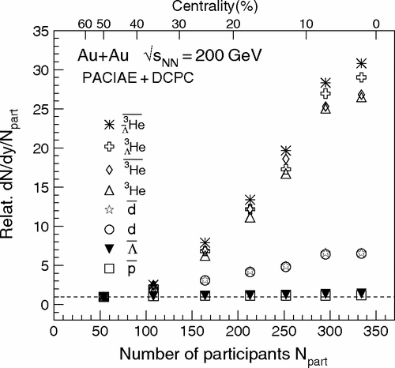
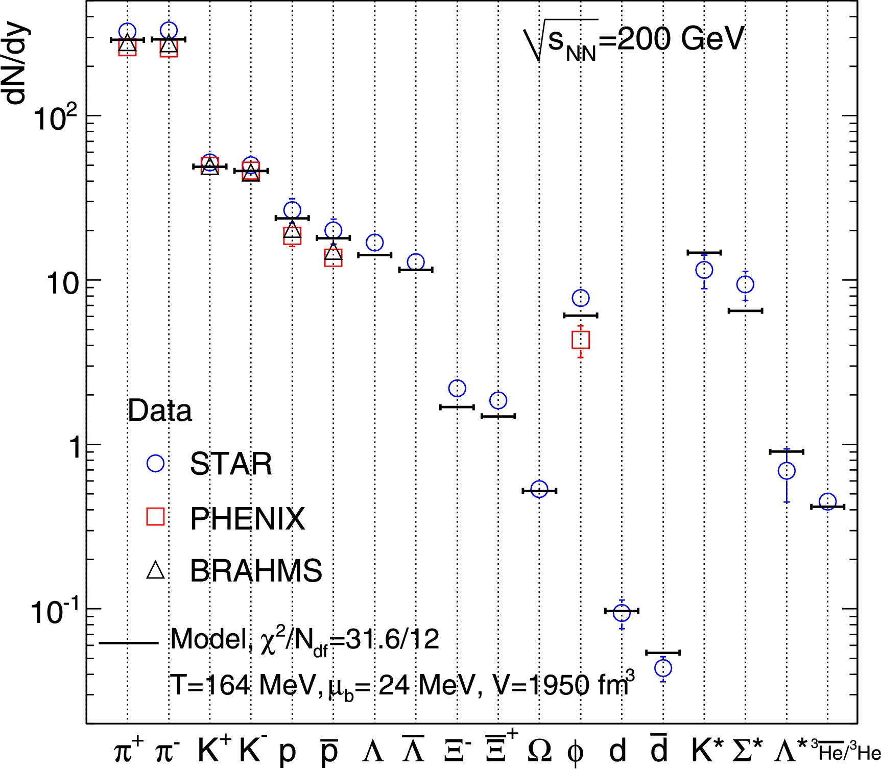
(Anti-)(Hyper)nuclei production in UrHIC
Statistical Thermal model
Coalescence
Thermodynamic approach to particle production in heavy-ion collisions
Abundances fixed at chemical freeze-out (T_{chem}) (hyper)nuclei are very sensitive to T_{chem} because of their large mass (M)
Exponential dependence of the yield ∝ e^{(-M/Tchem)}
If baryons at freeze-out are close enough in Phase Space an (anti-)(hyper)nucleus can be formed
(Hyper)nuclei are formed by protons (Λ) and neutrons which have similar velocities after the freeze-out
G. Chen et al., Phys. Rev. C 88, 034908 (2013)
A. Andronic et al., Phys. Lett. B 697, 203 (2011)

Slide 4
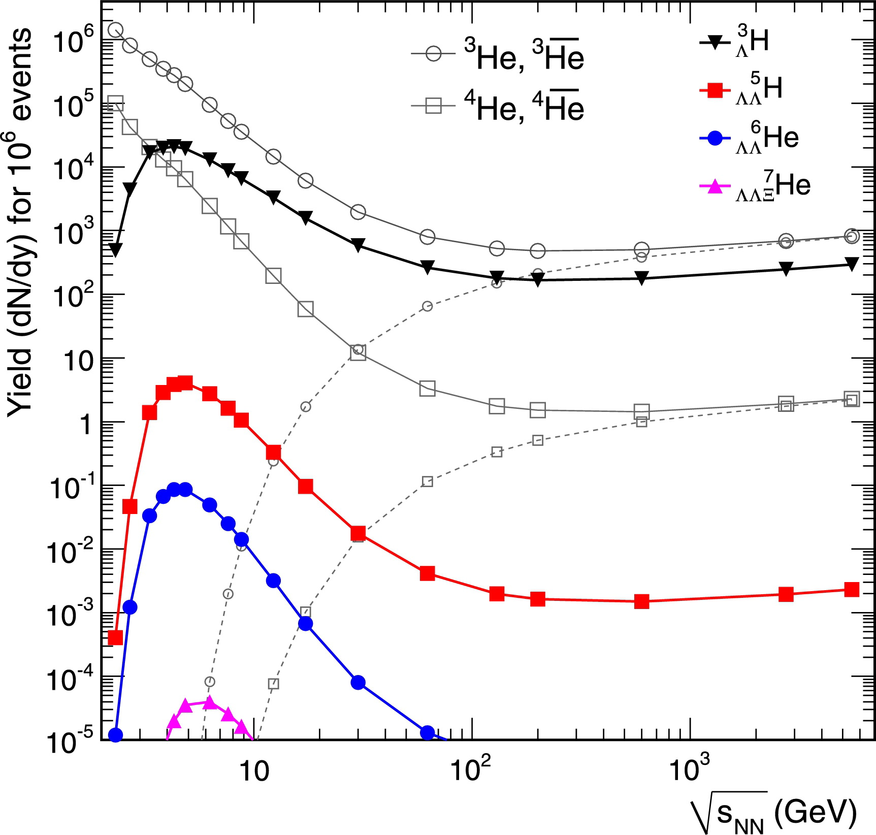
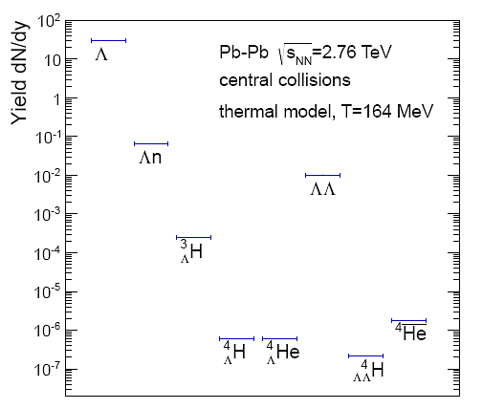
(Anti-)(Hyper)nuclei production at LHC
Production yield estimate (thermal model) of (anti-)(hyper)nuclei in central heavy ion collisions at LHC energy:
 | Yield/event at mid-rapidity and central collisions
π | ~800
p | ~40
Λ | ~30
d | ~0.17
³He | ~0.01
³_{Λ}H | ~0.003
Light nuclei (see Dönigus talk)
Hypertriton
Search for: Λn, ΛΛ dibaryons (see Mastroserio talk)
A. Andronic et al., Phys. Lett. B 697, 203 (2011)
LHC
A. Andronic et al., Phys. Lett. B 697, 203 (2011)
A. Andronic, private communication

Slide 5
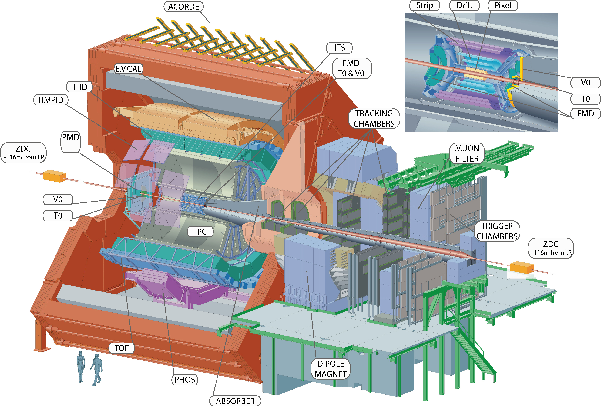
A Large Ion Collider Experiment
ALICE particle identification capabilities are unique. Almost all known techniques are exploited: dE/dx, time-of-flight, transition radiation, Cherenkov radiation, calorimetry and decay topology (V0, cascade)
ITS: precise separation of primary particles and those from weak decays (hyper-nuclei) or knock-out from material
K. Aamodt et al. (ALICE Collaboration), JINST 3 (2008) S08002
B. B. Abelev et al. (ALICE Collaboration), Int. J. Mod. Phys. A 29 (2014) 1430044

Slide 6
A Large Ion Collider Experiment
ALICE particle identification capabilities are unique. Almost all known techniques are exploited: dE/dx, time-of-flight, transition radiation, Cherenkov radiation, calorimetry and decay topology (V0, cascade)
ITS: precise separation of primary particles and those from weak decays (hyper-nuclei) or knock-out from material
TPC: particle identification via dE/dx (allows also separation of charges).
K. Aamodt et al. (ALICE Collaboration), JINST 3 (2008) S08002
B. B. Abelev et al. (ALICE Collaboration), Int. J. Mod. Phys. A 29 (2014) 1430044

Slide 7
A Large Ion Collider Experiment
ALICE particle identification capabilities are unique. Almost all known techniques are exploited: dE/dx, time-of-flight, transition radiation, Cherenkov radiation, calorimetry and decay topology (V0, cascade)
ITS: precise separation of primary particles and those from weak decays (hyper-nuclei) or knock-out from material
TPC: particle identification via dE/dx (allows also separation of charges).
TOF: particle identification via time-of-flight
K. Aamodt et al. (ALICE Collaboration), JINST 3 (2008) S08002
B. B. Abelev et al. (ALICE Collaboration), Int. J. Mod. Phys. A 29 (2014) 1430044

Slide 8
A Large Ion Collider Experiment
ALICE particle identification capabilities are unique. Almost all known techniques are exploited: dE/dx, time-of-flight, transition radiation, Cherenkov radiation, calorimetry and decay topology (V0, cascade)
ITS: precise separation of primary particles and those from weak decays (hyper-nuclei) or knock-out from material
TPC: particle identification via dE/dx (allows also separation of charges).
TOF: particle identification via time-of-flight
TRD: electron identification via transition radiation
ITS+TPC+TRD: excellent track reconstruction capabilities in a high track density environment
K. Aamodt et al. (ALICE Collaboration), JINST 3 (2008) S08002
B. B. Abelev et al. (ALICE Collaboration), Int. J. Mod. Phys. A 29 (2014) 1430044

Slide 9
A Large Ion Collider Experiment
ALICE particle identification capabilities are unique. Almost all known techniques are exploited: dE/dx, time-of-flight, transition radiation, Cherenkov radiation, calorimetry and decay topology (V0, cascade)
ITS: precise separation of primary particles and those from weak decays (hyper-nuclei) or knock-out from material
TPC: particle identification via dE/dx (allows also separation of charges).
TOF: particle identification via time-of-flight
TRD: electron identification via transition radiation
ITS+TPC+TRD: excellent track reconstruction capabilities in a high track density environment
HMPID: particle identification via Cherenkov radiation
K. Aamodt et al. (ALICE Collaboration), JINST 3 (2008) S08002
B. B. Abelev et al. (ALICE Collaboration), Int. J. Mod. Phys. A 29 (2014) 1430044

Slide 10
A Large Ion Collider Experiment
ALICE particle identification capabilities are unique. Almost all known techniques are exploited: dE/dx, time-of-flight, transition radiation, Cherenkov radiation, calorimetry and decay topology (V0, cascade)
ITS: precise separation of primary particles and those from weak decays (hyper-nuclei) or knock-out from material
TPC: particle identification via dE/dx (allows also separation of charges).
TOF: particle identification via time-of-flight
TRD: electron identification via transition radiation
ITS+TPC+TRD: excellent track reconstruction capabilities in a high track density environment
HMPID: particle identification via Cherenkov radiation
ALICE is ideally suited for the identification of light (anti-)(hyper)nuclei

Slide 11
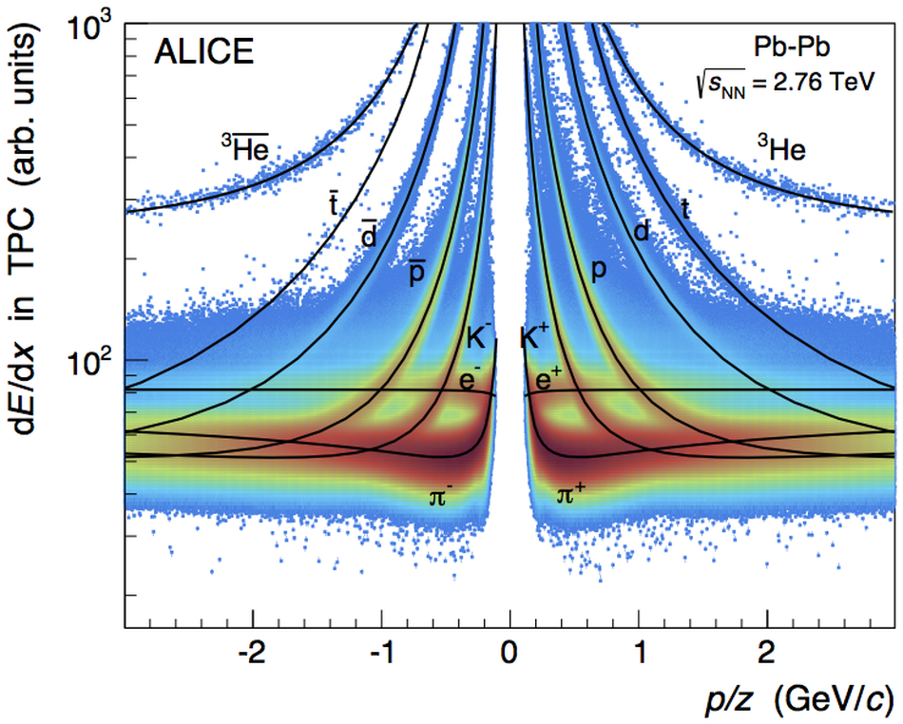
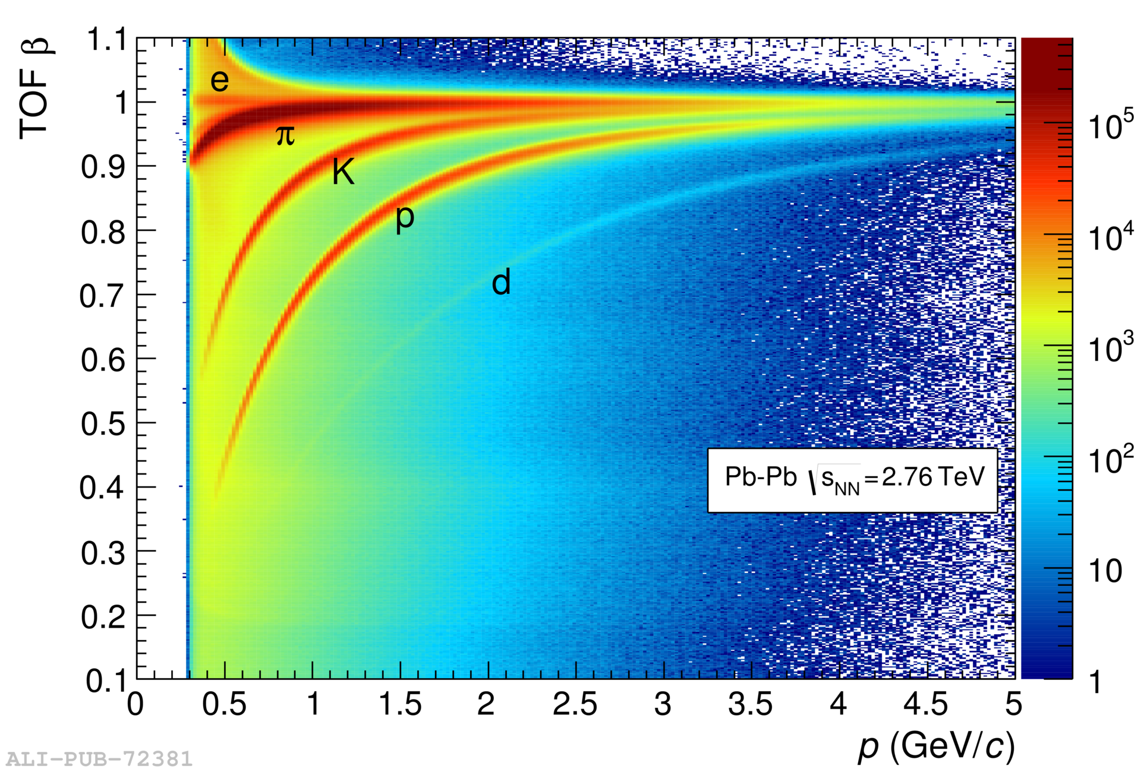
Nuclei identification
Low momenta
Nuclei identification via dE/dx measurement in the TPC:
dE/dx resolution in central Pb-Pb collisions: ~7%
Excellent separation of (anti-)nuclei from other particles over a wide momentum range
About 10 anti-alpha candidates identified out of 23x10⁶ events by combining TPC and TOF particle identification
Phys. Rev. C 93 (2015) 024917
Higher momenta
Excellent TOF performance:
σ_{TOF} ≈ 85 ps in Pb-Pb collisions allows identification of light nuclei over a wide momentum range
Velocity measurement with the TOF detector is used to evaluate the m² distribution and to subtract background from the signal in each p_{T}-bin by fitting the m² distribution

Slide 12
(ANTI)hyperTRITON identification
Decay Channels
BR = 0.25 (*)
³_{Λ}H search via two-body decays into charged particles:
Two body decay: lower combinatorial background
Charged particles: ALICE acceptance for charged particles (|η|<0.9) higher than for neutrals (|η|<0.7)
Signal Extraction:
Identify ³He and π
Evaluate (³He,π) invariant mass
Apply topological cuts in order to:
  identify secondary decay vertex and
  reduce combinatorial background
APPLIED CUTS:
● Cos(Pointing Angle) > 0.99
● DCA π to PV > 0.4 cm
● DCA between tracks < 0.7 cm
● (³He,π) p_{T}> 2 GeV/c
● |y| ≤ 1
● cτ > 1 cm
(*) Kamada et al., PRC57(1998)4

Slide 13
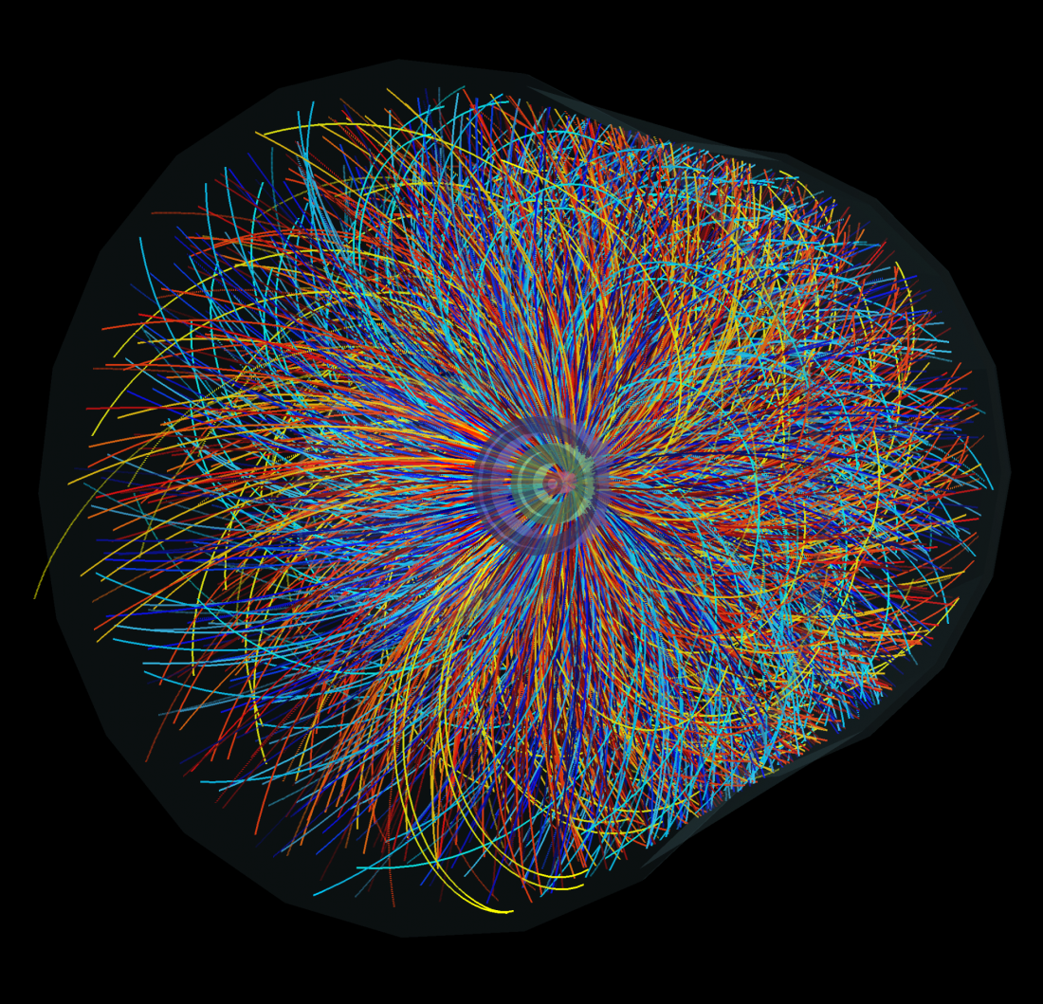
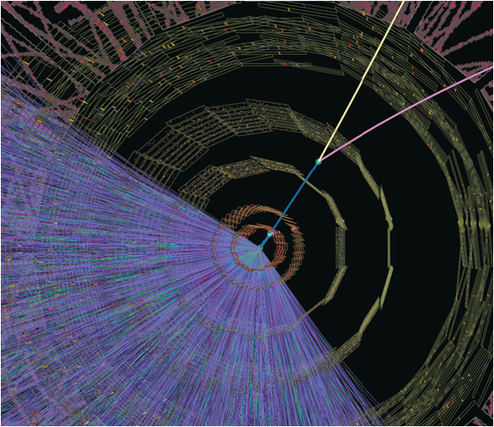
The experimental challenge
The challenge: extract the ³_{Λ}H signal from an overwhelming background
At √s_{NN} = | 2.76 TeV | 5.02 TeV
Centrality | dN_{ch}/dη (|η| < 0.5)
0-5 % | 1601 ± 60 | 1943 ± 54
K. Aamodt et al. (ALICE Collaboration) Phys. Rev. Lett. 106, 032301 (2011) ; J. Adam et al (ALICE Collaboration) Phys. Rev. Lett. 116, 222302 (2016)

Slide 14
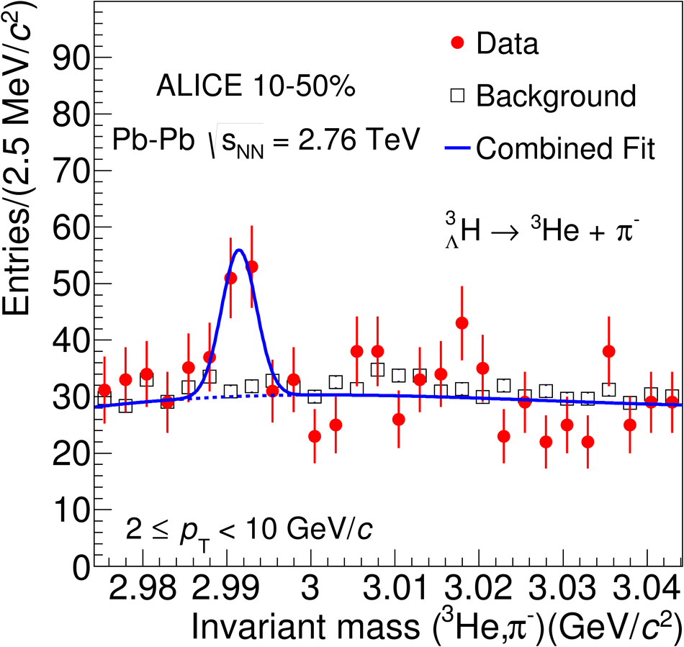
(ANTI-)hyperTRITON identification
Phys. Lett. B 754 (2016) 360-372
Decay Channels
³_{Λ}H search via two-body decays into charged particles:
Two body decay: lower combinatorial background
Charged particles: ALICE acceptance for charged particles (|η|<0.9) higher than for neutrals (|η|<0.7)
Signal Extraction:
Identify ³He and π
Evaluate (³He,π) invariant mass
Apply topological cuts in order to:
  identify secondary decay vertex and
  reduce combinatorial background
Background estimation: π track rotated 20 times
μ = 2.991 ± 0.001 ± 0.003 GeV/c²
= (3.01 ± 0.24)x10⁻³ GeV/c²
To be compared to literature value:
= 2.99131 ± 0.00005 GeV/c²
[Juric, Nucl. Phys. B 52, 1 (1973)]

Slide 15
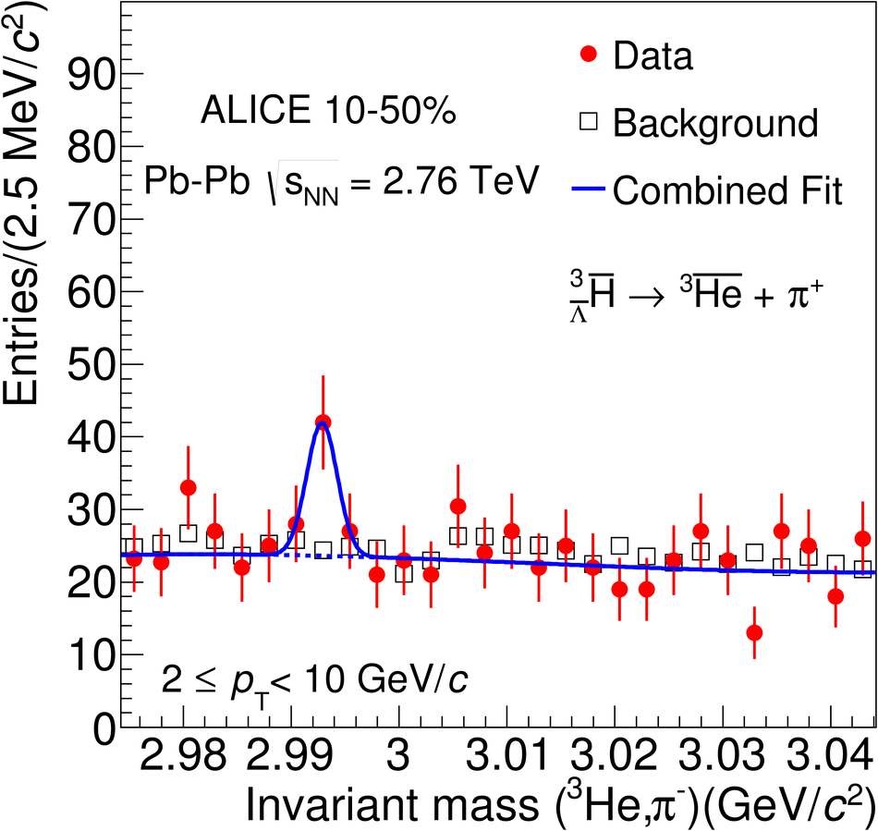
(ANTI-)hyperTRITON identification
Phys. Lett. B 754 (2016) 360-372
Decay Channels
³_{Λ}H search via two-body decays into charged particles:
Two body decay: lower combinatorial background
Charged particles: ALICE acceptance for charged particles (|η|<0.9) higher than for neutrals (|η|<0.7)
Signal Extraction:
Identify ³He and π
Evaluate (³He,π) invariant mass
Apply topological cuts in order to:
  identify secondary decay vertex and
  reduce combinatorial background
Background estimation: π track rotated 20 times
μ = 2.991 ± 0.001 ± 0.003 GeV/c²
= (3.01 ± 0.24)x10⁻³ GeV/c²
To be compared to literature value:
= 2.99131 ± 0.00005 GeV/c²
[Juric, Nucl. Phys. B 52, 1 (1973)]

Slide 16
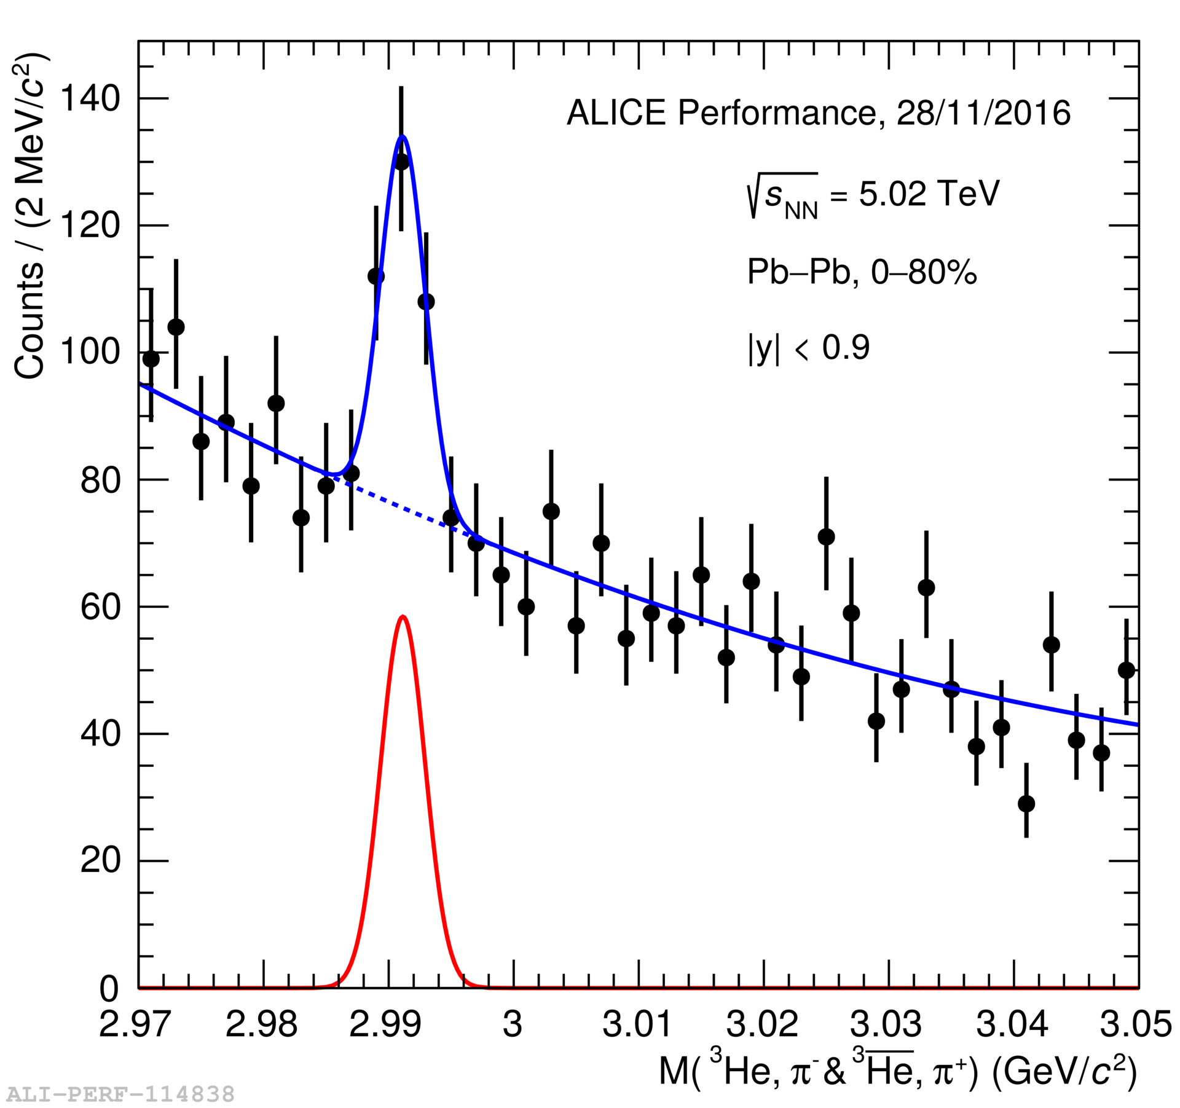
(ANTI-)hyperTRITON identification
Decay Channels
New preliminary results
at √s_{NN} = 5.02 TeV
³_{Λ}H search via two-body decays into charged particles:
Two body decay: lower combinatorial background
Charged particles: ALICE acceptance for charged particles (|η|<0.9) higher than for neutrals (|η|<0.7)
Signal Extraction:
Identify ³He and π
Evaluate (³He,π) invariant mass
Apply topological cuts in order to:
  identify secondary decay vertex and
  reduce combinatorial background
Background estimation: π track rotated 20 times

Slide 17
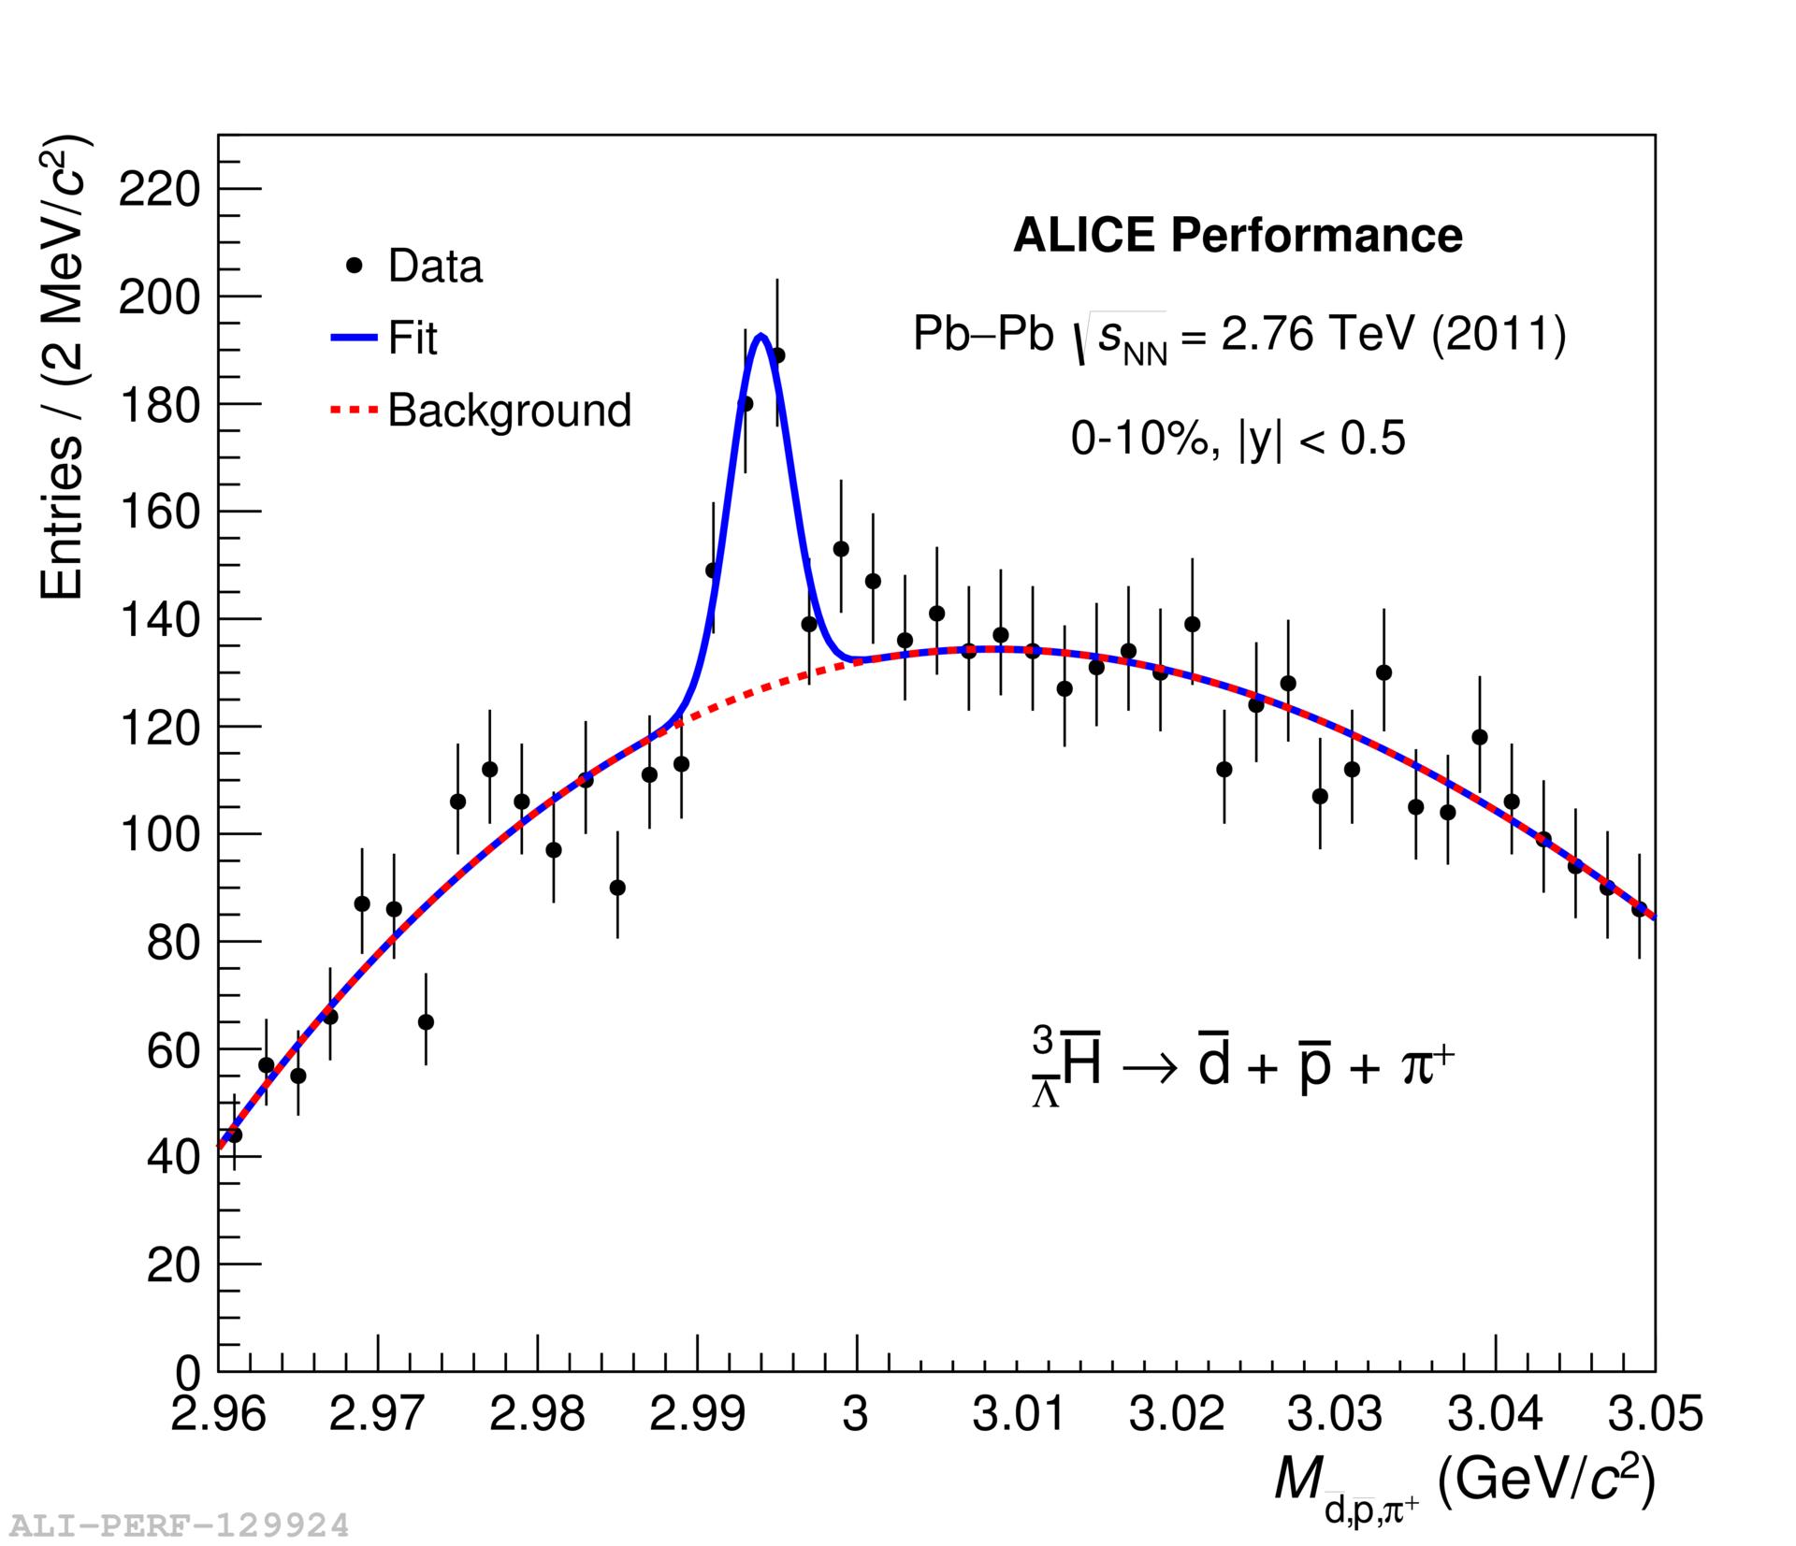
(ANTI-)hyperTRITON identification
Decay Channels
New preliminary results: three body decay
at √s_{NN} = 2.76 TeV
³_{Λ}H search via three-body decays into charged particles:
Three body decay: higher combinatorial background but
Higher B.R. ~ 41% (Kamada et al., PRC57(1998)4)
Charged particles: ALICE acceptance for charged particles (|η|<0.9) higher than for neutrals (|η|<0.7)
Signal Extraction:
Identify d, p and π and anti
Evaluate (d,p,π) invariant mass
Apply topological cuts and background estimation

Slide 18
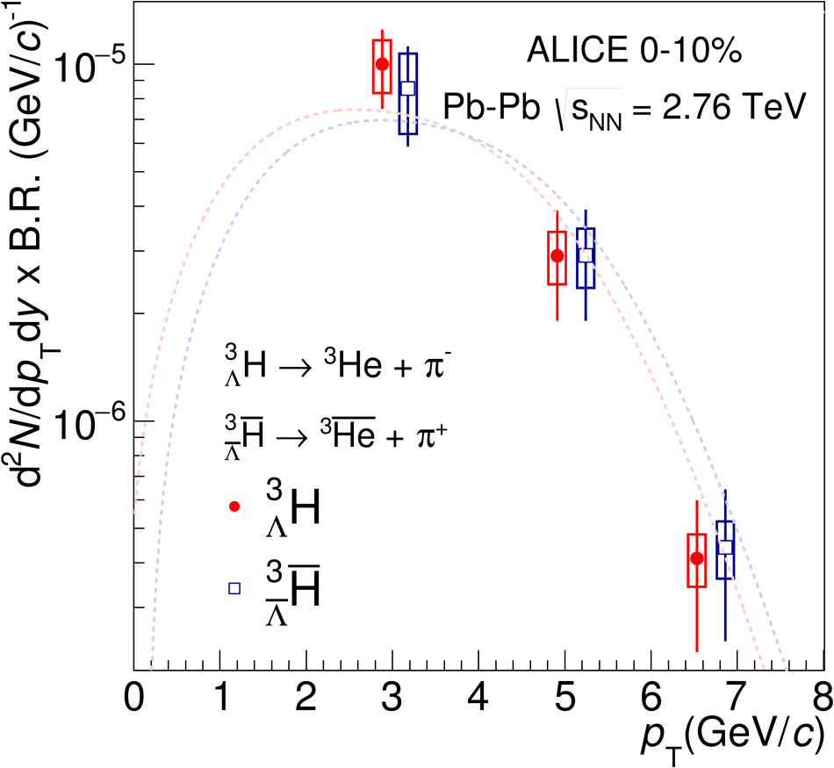
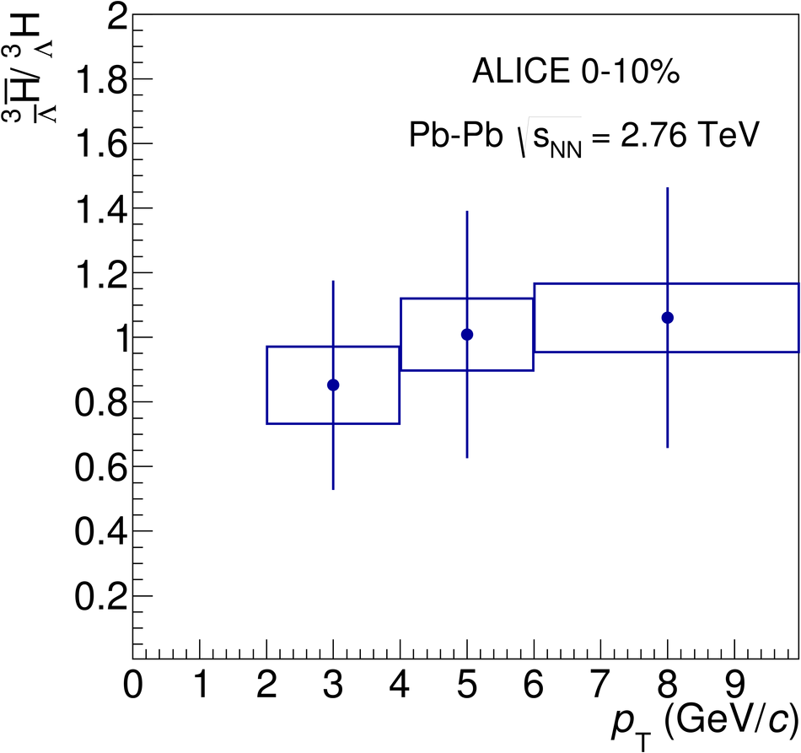
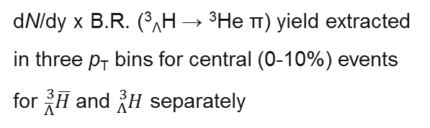
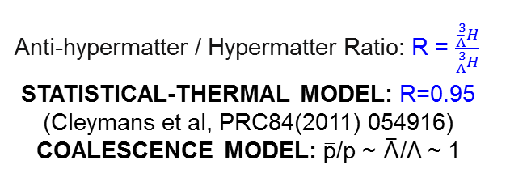
(ANTI-)hyperTRITON yields
Phys. Lett. B 754 (2016) 360-372
Phys. Lett. B 754 (2016) 360-372
Anti-hypermatter / Hypermatter Ratio: R = $\frac{{}_{\overline{Λ}}^{3}{\overline{H}}}{{}_{Λ}^{3}H}$
STATISTICAL-THERMAL MODEL: R=0.95
(Cleymans et al, PRC84(2011) 054916)
COALESCENCE MODEL: p/p ~ «/Λ ~ 1
dN/dy x B.R. (³_{Λ}H → ³He π) yield extracted in three p_{T} bins for central (0-10%) events for ${}_{\overline{Λ}}^{3}{\overline{H}}$and ${}_{Λ}^{3}H$ separately

Slide 19
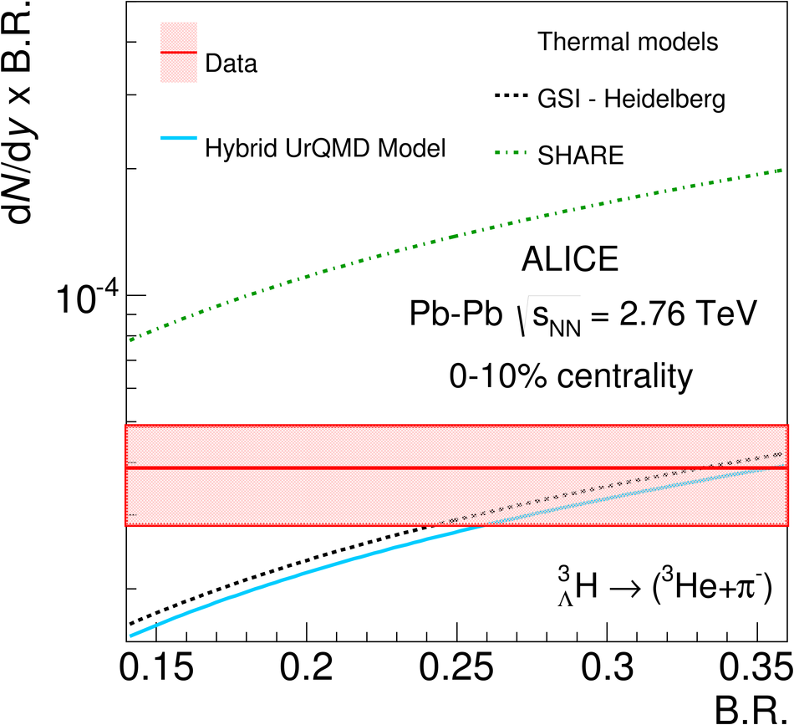
Comparison with theoretical predictions
Phys. Lett. B 754 (2016) 360-372
Three different theoretical predictions drawn as a function of BR(³_{Λ}H → ³He+π⁻) after being multiplied by BR:
Hybrid UrQMD: combines the hadronic transport approach with an initial hydrodynamical stage for the hot and dense medium (J. Steinheimer et al., Phys. Lett. B 714, 85 (2012))
GSI-Heidelberg: equilibrium statistical model with T_{chem}=156 MeV (A. Andronic et al., Phys. Lett. B 697, 203 (2011))
SHARE: non-equilibrium thermal model with T_{chem}=138.3 MeV (M. Petráň et al., Phys. Rev. C 88, 034907 (2013))
Great sensitivity to theoretical models parameters
Non–equilibrium statistical thermal model (Petran-Rafelsky SHARE) provides better global fitting (χ²∼1) to lower mass hadrons but misses ³_{Λ}H and light nuclei
Experimental data closest to equilibrium thermal model with T_{chem} = 156 MeV and to Hybrid UrQMD

Slide 20
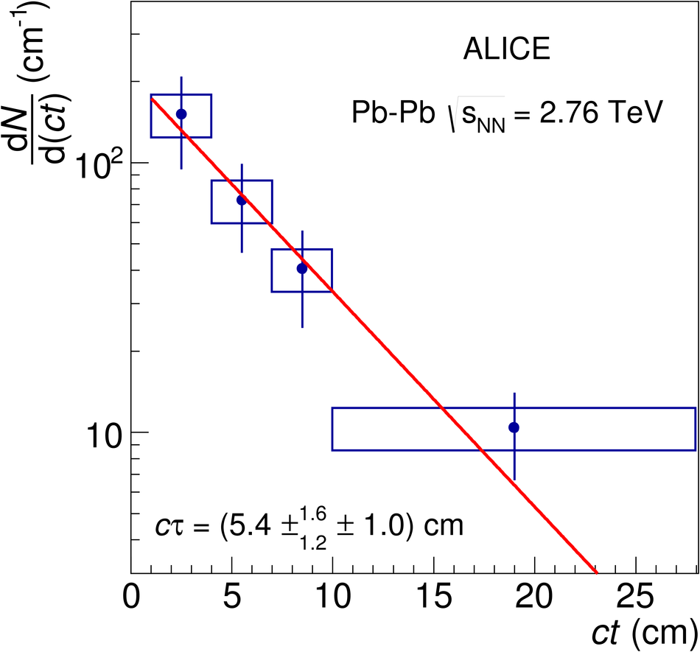
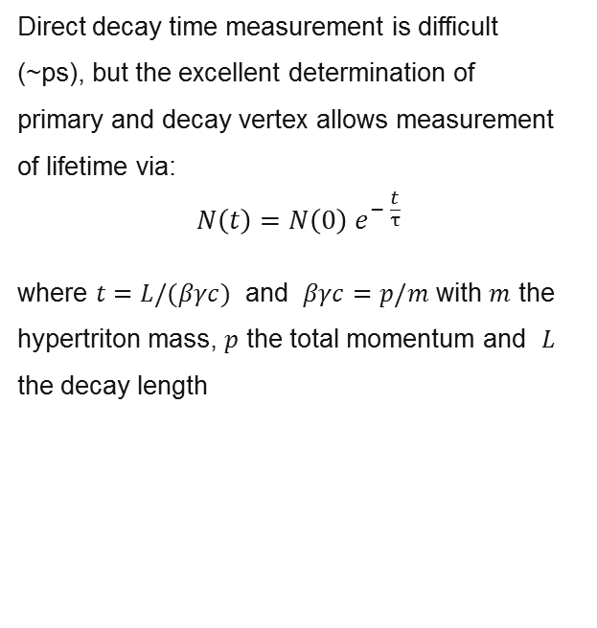
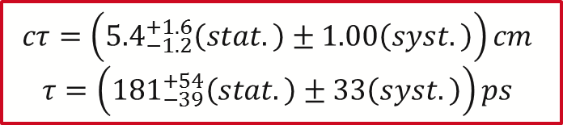
hyperTRITON LIFETIME DETERMINATION
Direct decay time measurement is difficult
(~ps), but the excellent determination of
primary and decay vertex allows measurement
of lifetime via:
$$N\left(t\right)=N\left(0\right) e^{− \frac{t}{τ}}$$
where $t=L/(βγc)$ and $βγc=p/m$ with $m$ the hypertriton mass, $p$ the total momentum and $L$ the decay length
$$cτ=\left({5.4}_{−1.2}^{+1.6}\left(stat.\right)±1.00\left(syst.\right)\right)cm$$
$$τ=\left({181}_{−39}^{+54}\left(stat.\right)±33\left(syst.\right)\right)ps$$
Phys. Lett. B 754 (2016) 360-372

Slide 21
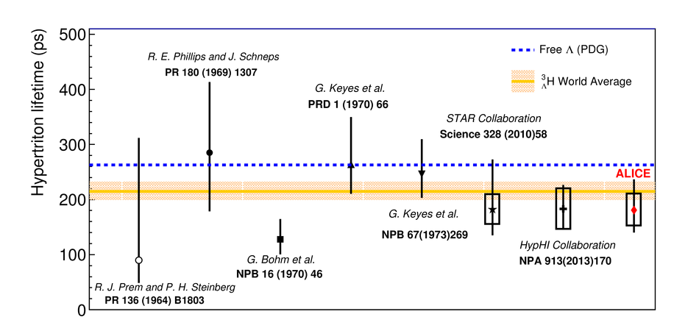
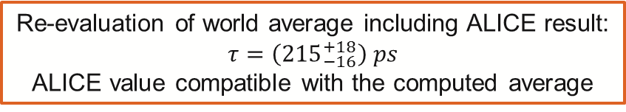
hyperTRITON LIFETIME WORLD AVERAGE
Phys. Lett. B 754 (2016) 360-372
Re-evaluation of world average including ALICE result:
$$τ=\left({215}_{−16}^{+18}\right) ps$$
ALICE value compatible with the computed average

Slide 22
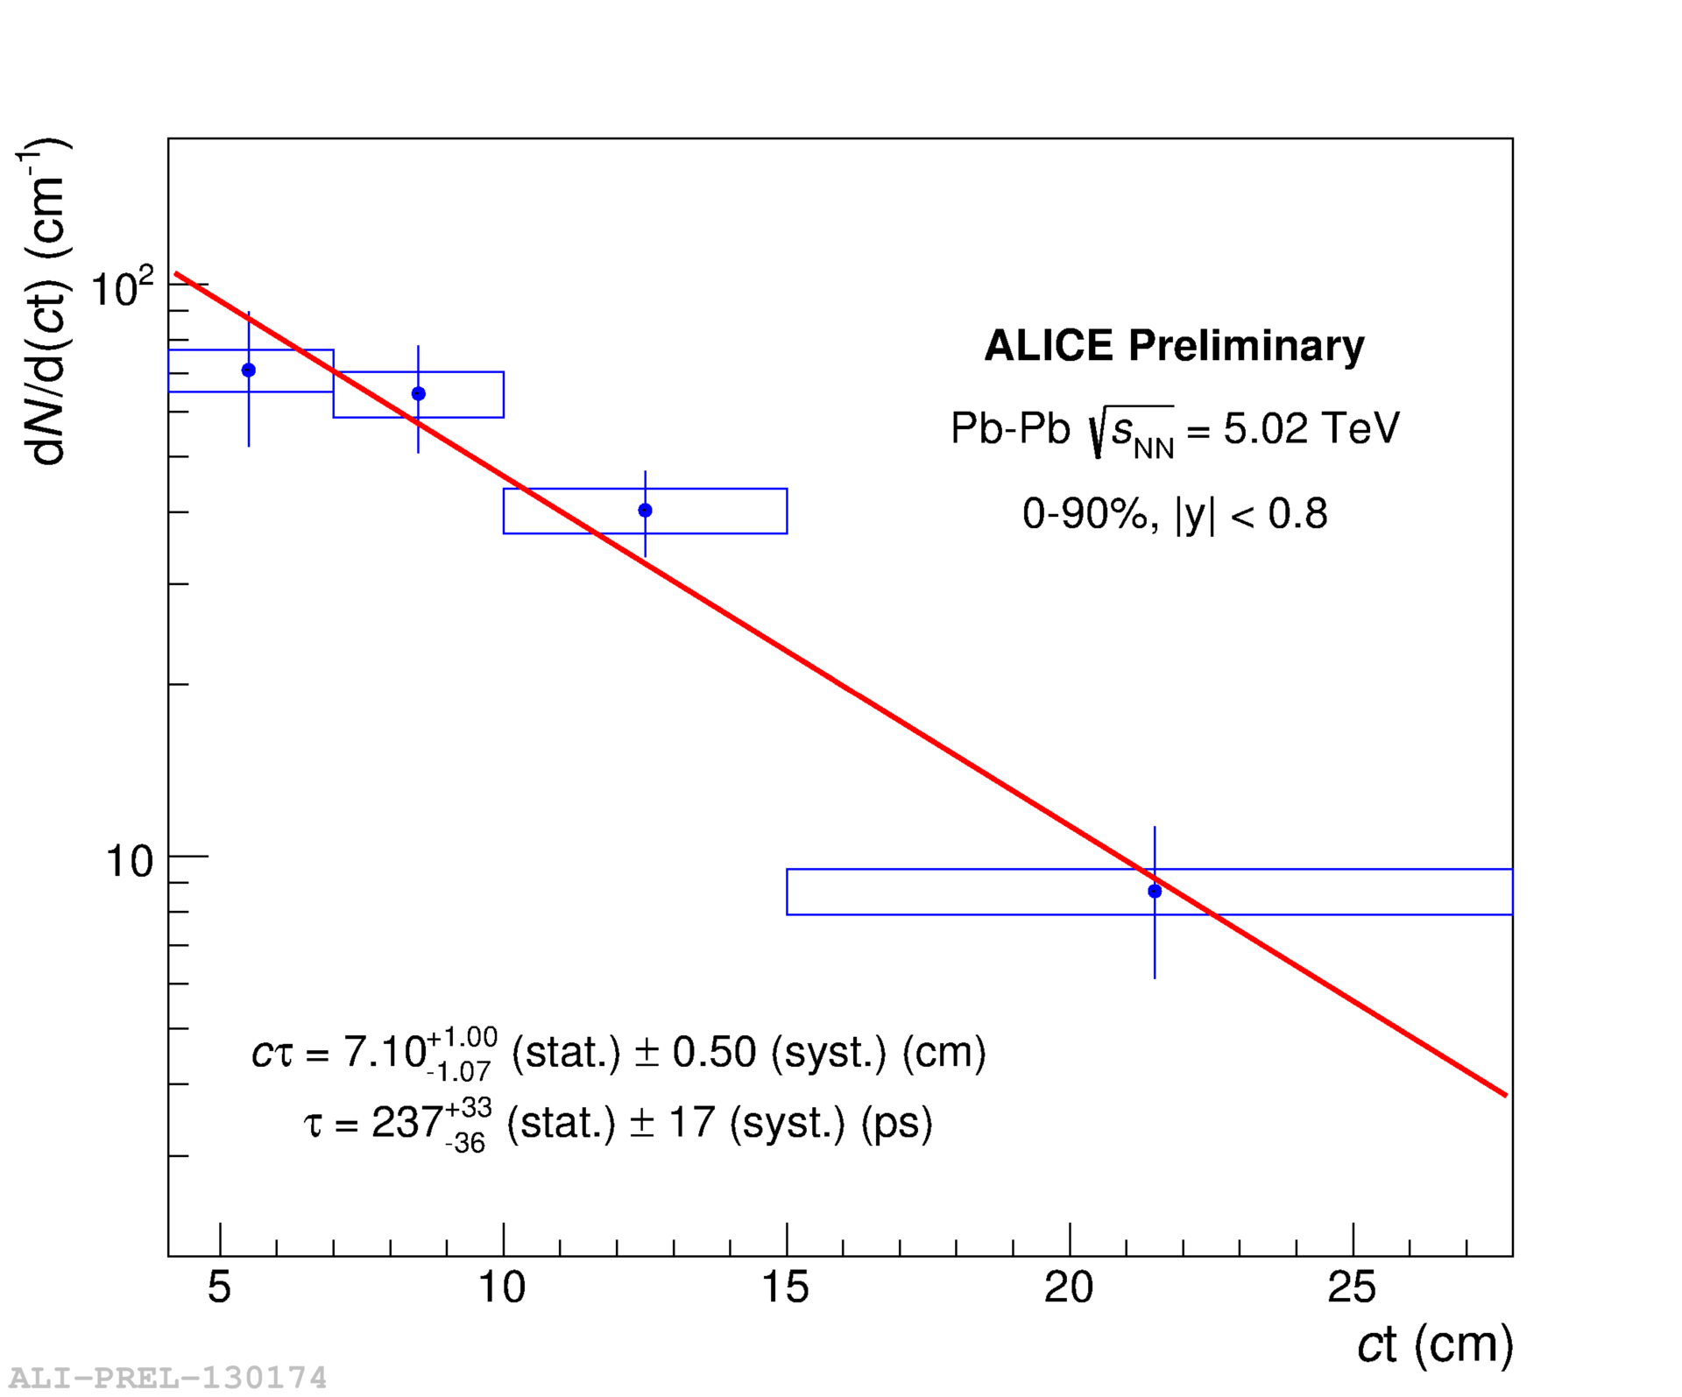
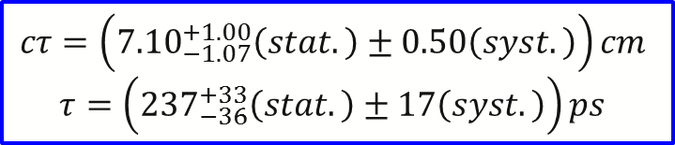
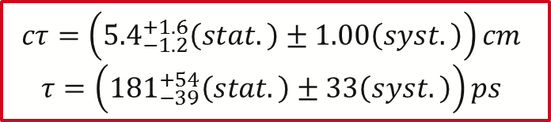
hyperTRITON LIFETIME DETERMINATION
Phys. Lett. B 754 (2016) 360-372
New preliminary results at √s_{NN} = 5.02 TeV
$$cτ=\left({5.4}_{−1.2}^{+1.6}\left(stat.\right)±1.00\left(syst.\right)\right)cm$$
$$τ=\left({181}_{−39}^{+54}\left(stat.\right)±33\left(syst.\right)\right)ps$$
$$cτ=\left({7.10}_{−1.07}^{+1.00}\left(stat.\right)±0.50\left(syst.\right)\right)cm$$
$$τ=\left({237}_{−36}^{+33}\left(stat.\right)±17\left(syst.\right)\right)ps$$

Slide 23
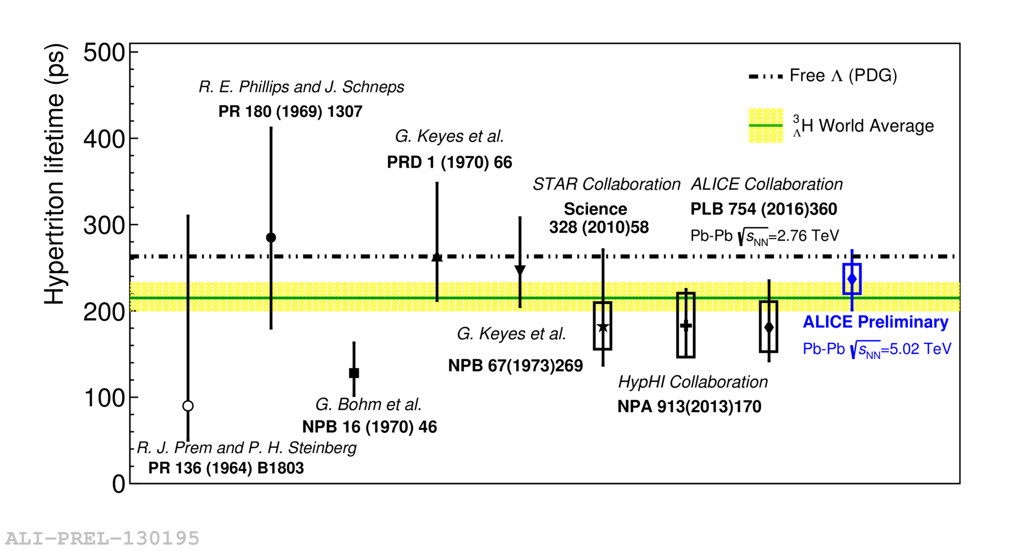
hyperTRITON LIFETIME WORLD AVERAGE
Previous heavy-ion experiment results show a trend well below the free Λ lifetime
ALICE result from Pb-Pb at 5.02 TeV is closer to the free Λ
More precision, reducing the statistical uncertainties can be reached:
  Another Pb-Pb data sample will be collected in 2018 at the LHC:
    the expected statistics for ³_{Λ}H is >~2x
    lifetime in the 3-body decay channel

Slide 24
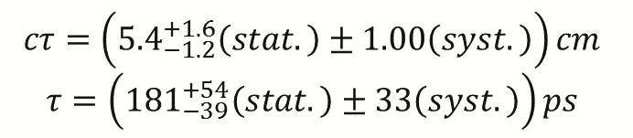
hyperTRITON LIFETIME UNCERTAINITIES
$$cτ=\left({5.4}_{−1.2}^{+1.6}\left(stat.\right)±1.00\left(syst.\right)\right)cm$$
$$τ=\left({181}_{−39}^{+54}\left(stat.\right)±33\left(syst.\right)\right)ps$$
At the end of Pb-Pb during RUN2 (Nov. 2018)
the expected statistics for ³_{Λ}H is >2x
During the Long Shutdown 2 (2019-2020):
New Inner Tracking System (ITS)
  improved pointing precision
  less material -> thinnest tracker at the LHC
Upgrade of Time Projection Chamber (TPC):
  new GEM technology for readout chambers
  continuous readout
  faster readout electronics
High Level Trigger (HLT):
  new architecture
  on line tracking & data compression
  50kHz PbPb event rate
At the end of RUN3 (2023) (*)
the expected Integrated Luminosity: ~10 nb⁻¹
the expected statistics for ³_{Λ}H is ~200x
Stat: |  | +30% - 22%
Syst: |  | 18%
 | Signal Extraction | 9%
 | Tracking Efficiency | 10%
 | Absorption | 12%
Phys. Lett. B 754 (2016) 360-372
At the end of RUN3:
Statistical uncertainty will be negligible
With the LS2 ALICE upgrades:
Signal extraction and tracking efficiency uncertainties will be strongly reduced
(*) Technical Design Report for the Upgrade of the ALICE Inner Tracking System B. Abelev et al. (The ALICE Collaboration) 2014 J. Phys. G: Nucl. Part. Phys. 41 087002

Slide 25
conclusions
Excellent ALICE performance allows for detection of light (anti-)nuclei and (anti-)hypernuclei
Blast-Wave fits can be used to extrapolate the yields to the unmeasured p_{T} region of light hypernuclei in Pb-Pb.
Hypertriton yield is in agreement with the current best thermal fit from equilibrium thermal model (T_{chem} = 156 ± 2 MeV)
The excellent determination of primary and decay vertices allows for the measurement of lifetime via exponential fit of the proper decay time distribution
Re-evaluation of the hypertrion lifetime world average
ALICE preliminary result from Pb-Pb at 5.02 TeV is closer to the free Λ
Future LHC runs, RUN2 and RUN3, and ALICE upgrades will allow for precise study of (anti)hypertriton production yield and lifetime

Slide 26
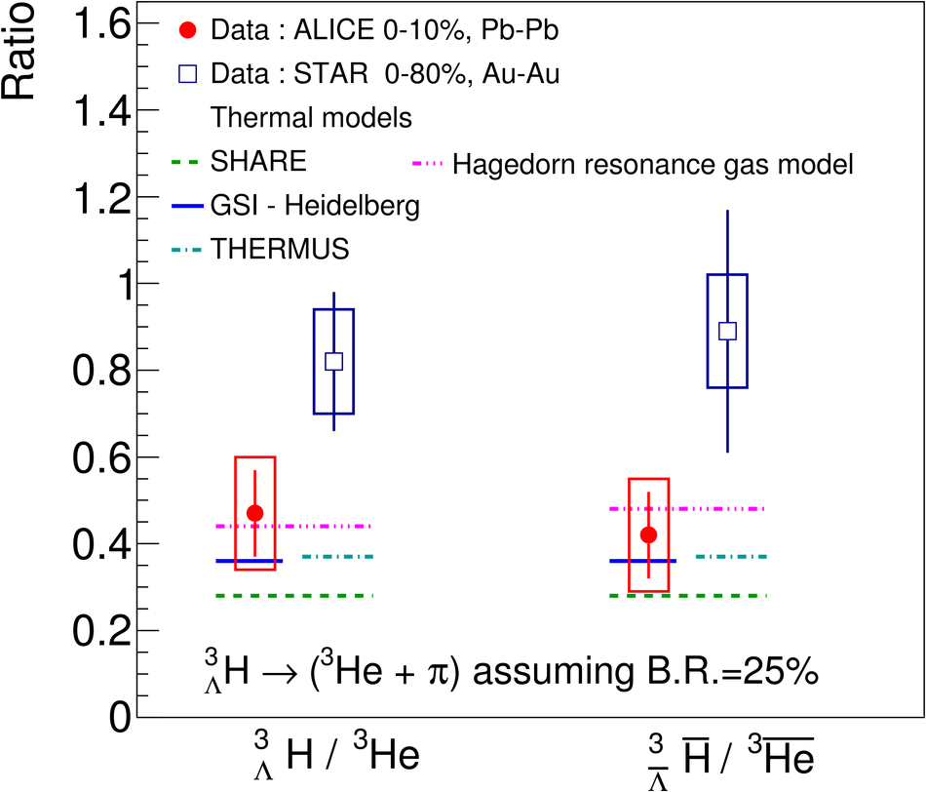
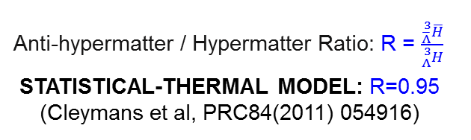
(ANTI-)hyperTRITON yields RATIOS
Phys. Lett. B 754 (2016) 360-372
Phys. Lett. B 754 (2016) 360-372
Anti-hypermatter / Hypermatter Ratio: R = $\frac{{}_{\overline{Λ}}^{3}{\overline{H}}}{{}_{Λ}^{3}H}$
STATISTICAL-THERMAL MODEL: R=0.95
(Cleymans et al, PRC84(2011) 054916)
Hypermatter / Matter Ratio
and
Anti-hypermatter/ Anti-matter Ratio

Slide 27
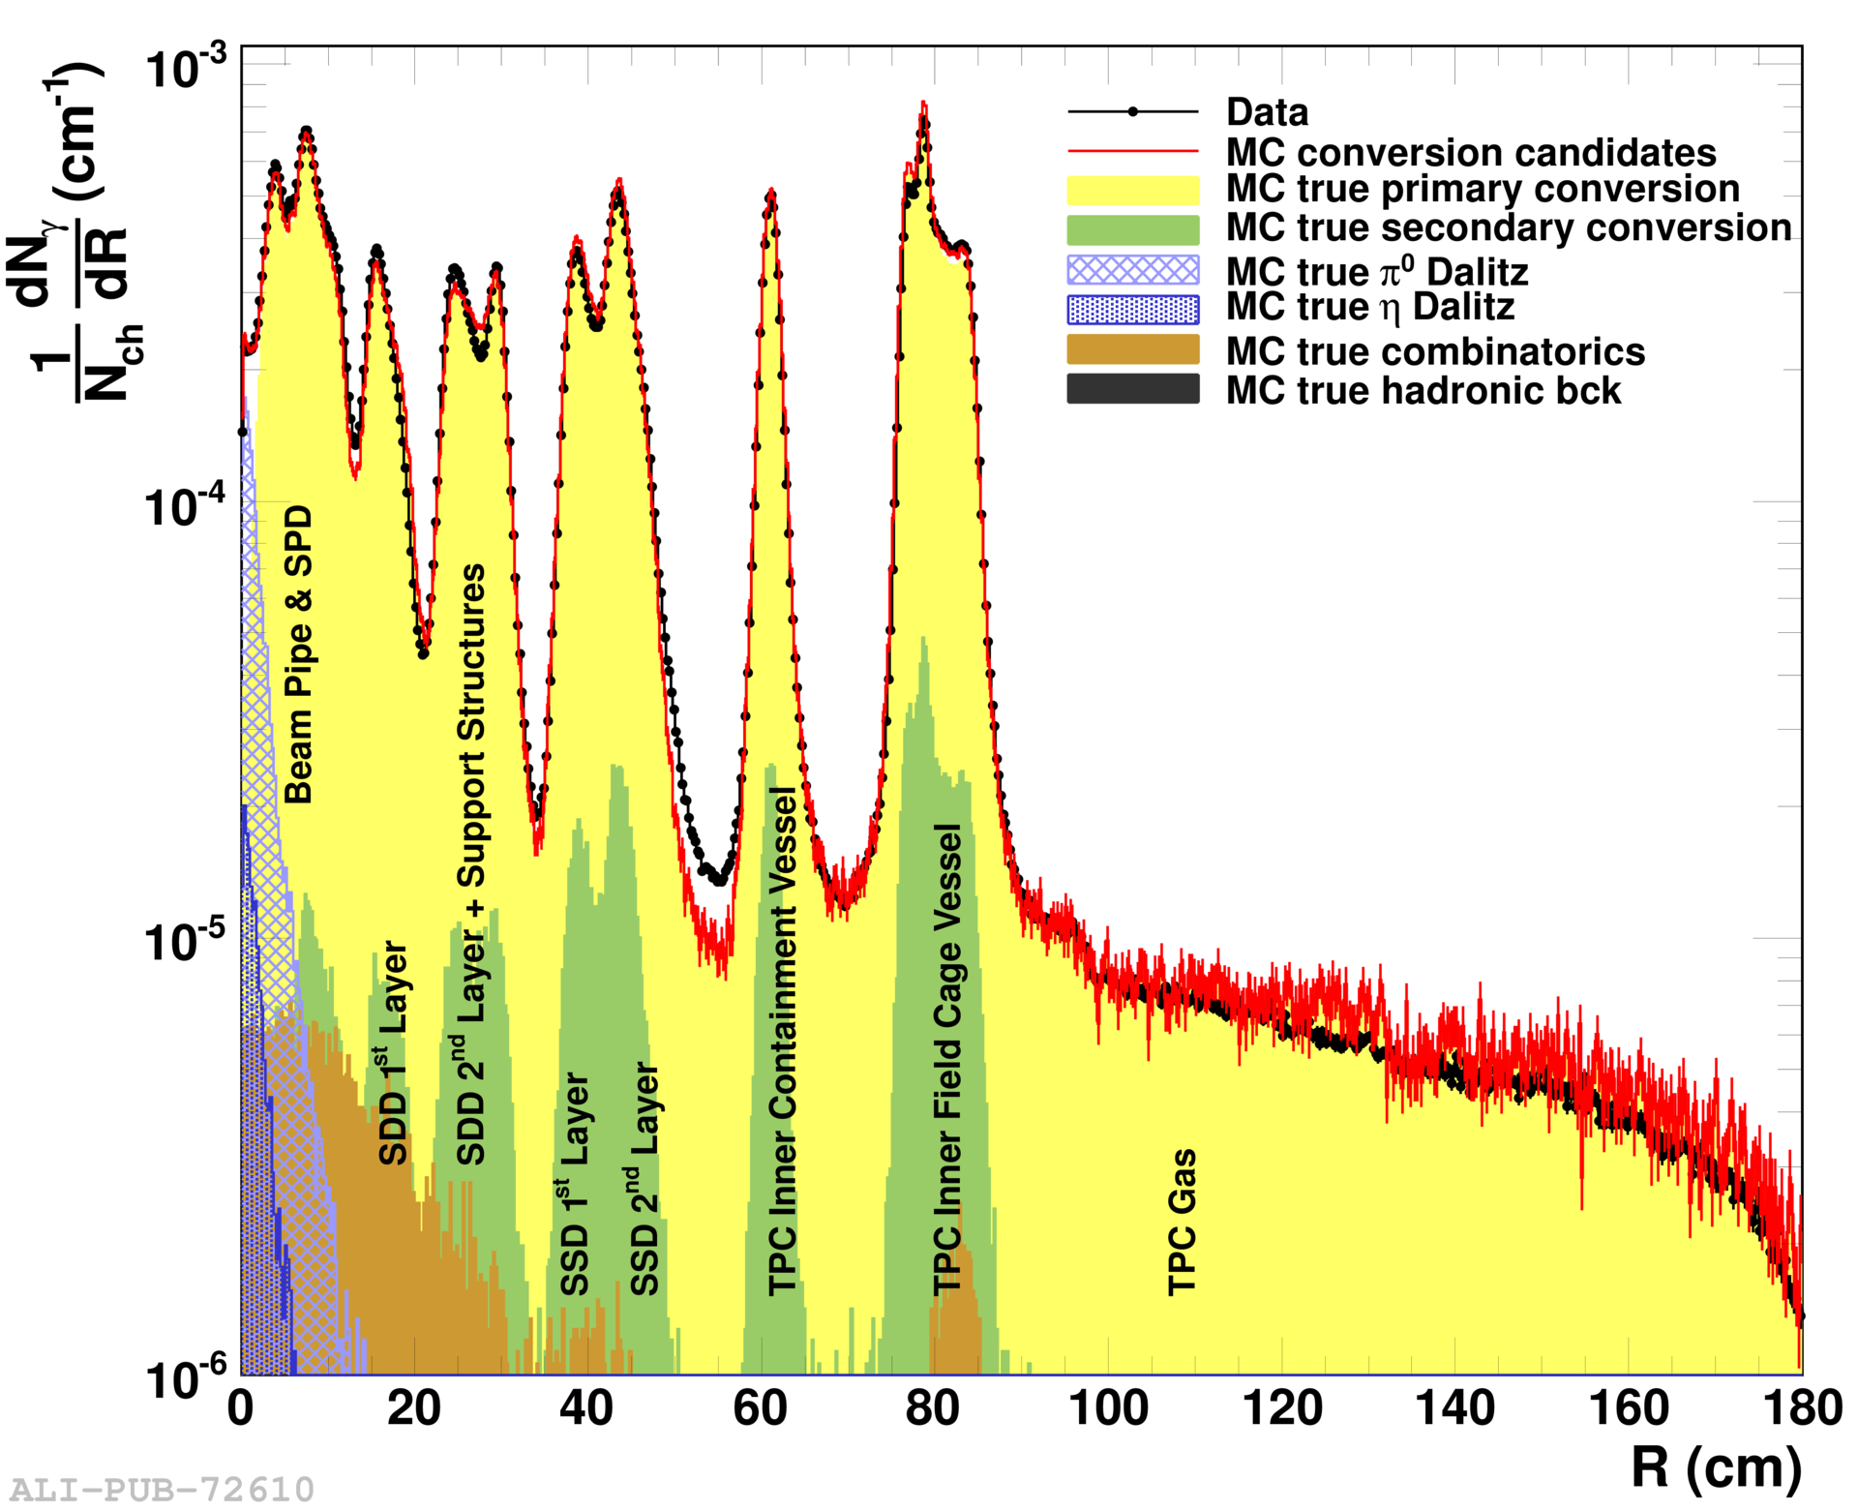
hyperTRITON LIFETIME UNCERTAINITIES
$$cτ=\left({5.4}_{−1.2}^{+1.6}\left(stat.\right)±1.00\left(syst.\right)\right)cm$$
$$τ=\left({181}_{−39}^{+54}\left(stat.\right)±33\left(syst.\right)\right)ps$$
Stat: |  | +30% - 22%
Syst: |  | 18%
 | Signal Extraction | 9%
 | Tracking Efficiency | 10%
 | Absorption | 12%
Phys. Lett. B 754 (2016) 360-372
(anti)hypertriton absorption is not negligible:
(anti)hypertriton is barely bound: stronger absorption in matter than t or ³He
distribution of the material well known from the distribution of reconstructed photon conversions
more precise evaluation of absorption cross section of ³_{Λ}H and ³He is needed

Slide 28
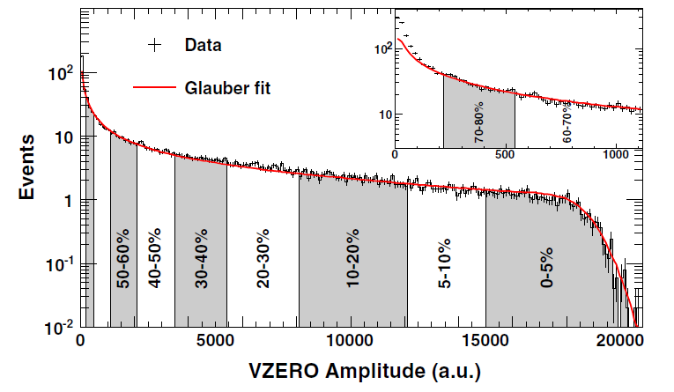
Collision geometry
Central collisions
Peripheral collisions
Nuclei are extended objects
Geometry not directly measurable
Centrality (percentage of the total cross section of the nuclear collision) connected to observables via Glauber model
Data classified into centrality percentiles for which the average impact parameter, number of participants, and number of binary collisions can be determined
Participants
b
b
Spectators
K. Aamodt et al. (ALICE Collaboration), Phys. Rev. Lett. 106, 032301 (2011)

