Slide 1
Particle Physics at the
European Spallation Source
ESS
ANNI – cold beam line
nnbar
UCN source
Torsten Soldner
Institut Laue Langevin
Thanks for material to C. Crawford (hadronic weak interaction), D. Milstead (nnbar), F. Piegsa (beam EDM), V. Santori (ESS), O. Zimmer (UCN)

Slide 2
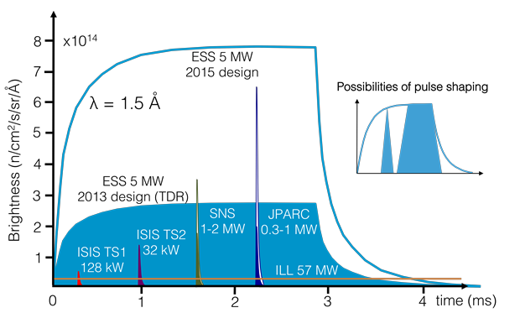
ESS – A long-pulse spallation source
 | SNS | ESS
Average power | 1.4 MW | 5 MW
Proton pulse length | 695 ns | 2.86 ms
Peak power | 34 GW | 125 MW
Energy per pulse | 24 kJ | 357 kJ
Pulse repetition rate | 60 Hz | 14 Hz
Moderation time constant ∼ 100 μs
Time-averaged brightness:
ESS ∼ ILL
Peak brightness:
ESS ∼ 30 × ILL

Slide 3
ESS & Neutrinos, Muons?
Very powerful proton accelerator but long-pulse time structure not adapted
ESSνSB proposal:
  CP violation in neutrino oscillation
  Mass hierarchy
Major investments:
  Accelerator upgrade: 10 MW, H–
  Compressor ring
  High-power targets
  500 kt Detector at ∼ 500 km
… and ESS mission change
arXiv:1212.5048
arXiv:1309.7022

Slide 4
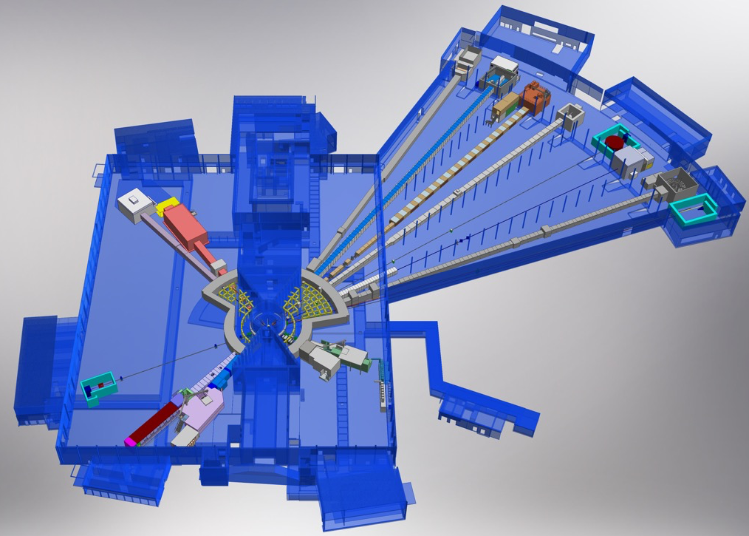
ESS Instrument Suite
NMX
BEER
C-SPEC
BIFROST
MIRACLES
MAGIC
T-REX
ODIN
HEIMDAL
DREAM
22 public instruments, ∼ 16 selected for
Life sciences
Soft condensed matter
Chemistry of materials
Energy research
Magnetism, superconductivity
Engineering, geosciences
Archaeology, heritage conservation
∼ 6 more to come
1 particle physics in reference suite
> 22 with external funding
LoKI
VESPA
FREIA
SKADI
50 m
ESTIA
100 m
150 m

Slide 5
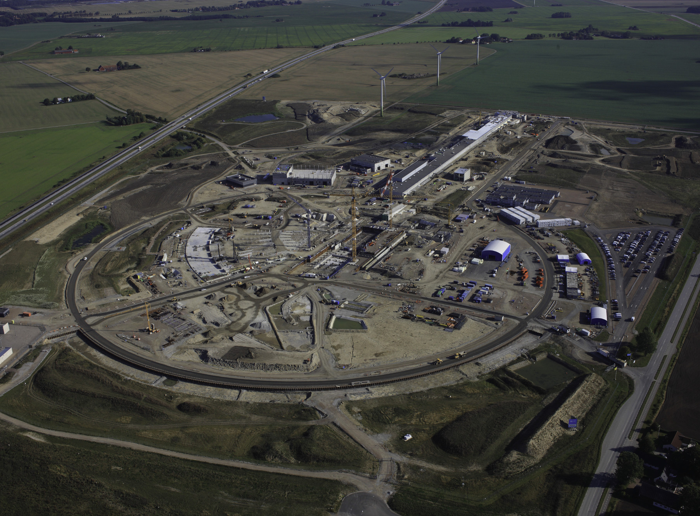

Schedule
2025
ESS Construction Phase Complete
2014
Construction Starts on Green Field Site
2023
ESS Starts
User Program
2009
Decision to Site ESS in Lund
2019/2020
Machine Ready for
1st Beam on Target
2012
ESS Design Update Phase Complete
2003
European Design of ESS Completed
Aerial view August 2017

Slide 6
Proposals for Particle Physics with Neutrons
Time-averaged brightness:
ESS ∼ ILL
Peak brightness:
ESS ∼ 30 × ILL
Exploit pulse structure → Gain from peak brightness
  ANNI : Cold beam line (full proposal)
Exploit green-field → Gain from design optimization
  Search for neutron-antineutron oscillations (LoI)
  Source for ultra-cold neutrons (LoI)

Slide 7
ANNI – Science case
Neutron beta decay with 10⁻⁴ accuracy
  Broad-band probe for physics beyond the standard model, at scales of 1-100 TeV
New approaches to electromagnetic properties of the neutron
  Beam methods for EDM and charge as probe for matter creation and unification of forces
Absolute measurements in hadronic weak interaction
  Systematic experimental study of QCD in non-perturbative regime

Slide 8
Neutron beta decay
V-A
V+A
S
T

Slide 9
Theory of Everything
10¹⁹
Energy [GeV]
Accuracy
Grand Unification
10¹⁶
Exotic Fermions
10⁵
Neutron beta decay :
Broad band probe for new physics
Contact
Interaction
ANNI precision physics
10⁻⁴
10⁴
L-R Models
SUSY
LHC direct production
Charged Higgs
Lepto-quarks
10³
Standard Model
10⁻³
10²
V_{ud}, g_{A}
τ_{n}
V-A
V+A
S
T
A
C
N
R
b_{ν}
a
D
B
b
…

Slide 10
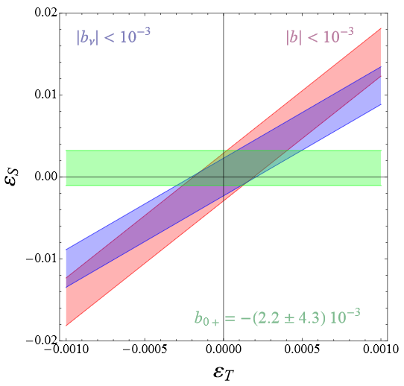
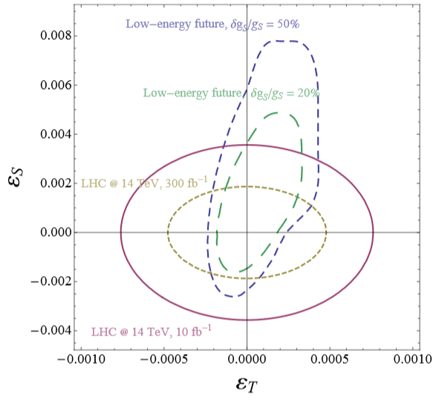
Example: Fierz term b
|b_{GT}| < 10⁻³
T. Bhattacharya et al., Phys. Rev. D 85 (2012) 054512,
V. Cirgliano et al., Prog. Part. Nucl. Phys. 71 (2013) 93.

Slide 11
Advantage of pulsed beam – PERKEO III
ξ
Count rate (ILL): 40 000/s
Ill-defined spectrometer response
Beam-related background
Scattering ~10⁻³
γ, fast n ~10⁻⁴
Decay probability ~ 10⁻⁶/m
(Lifetime 880 s)

Slide 12
Spatial localization of neutrons
ξ
Count rate (ILL): 400/s
Monochro & chopping
Well-defined spectrometer response
No
beam-related background
Regain factor 10 at pulsed source ESS!

Slide 13
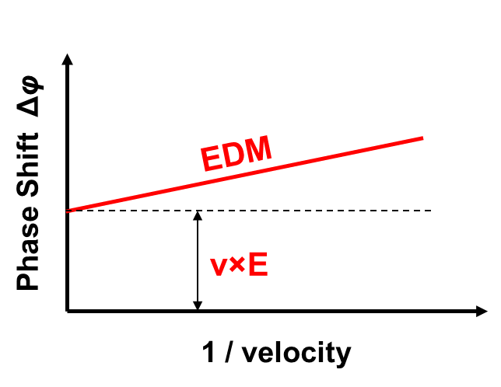
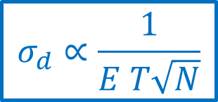
Electric dipole moment
UCN
B
n Spin up
π/2 flip
Free precession
π/2 flip
$$σ_{d}∝\frac{1}{E T\sqrt{N}}$$
t
x
Piegsa, PRC 88, 045502 (2013)
v-dependent
Systematics
λ
B
Pulsed
cold beam
Time-dependent optics
↖

Slide 14

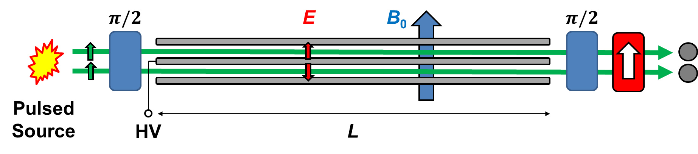



Neutron Beam EDM
2 Neutron beams
E > 50 kV/cm
B₀ = 200 μT
L = 5 m (proof-of-prin.)
L = 50 m (full-scale)
  Unique, complementary and novel approach – ideal for ESS
  Directly measures main systematic false effect (v×E)
  Proof-of-principle planned for PSI and ILL
Piegsa, PRC 88, 045502 (2013)
Courtesy F. Piegsa

Slide 15
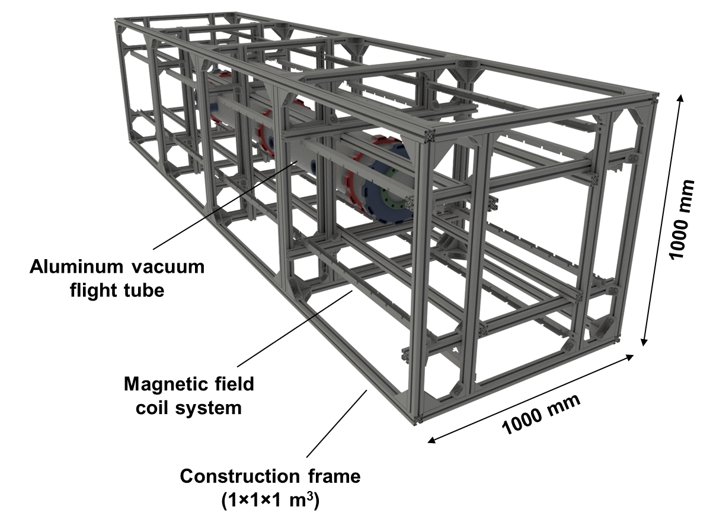
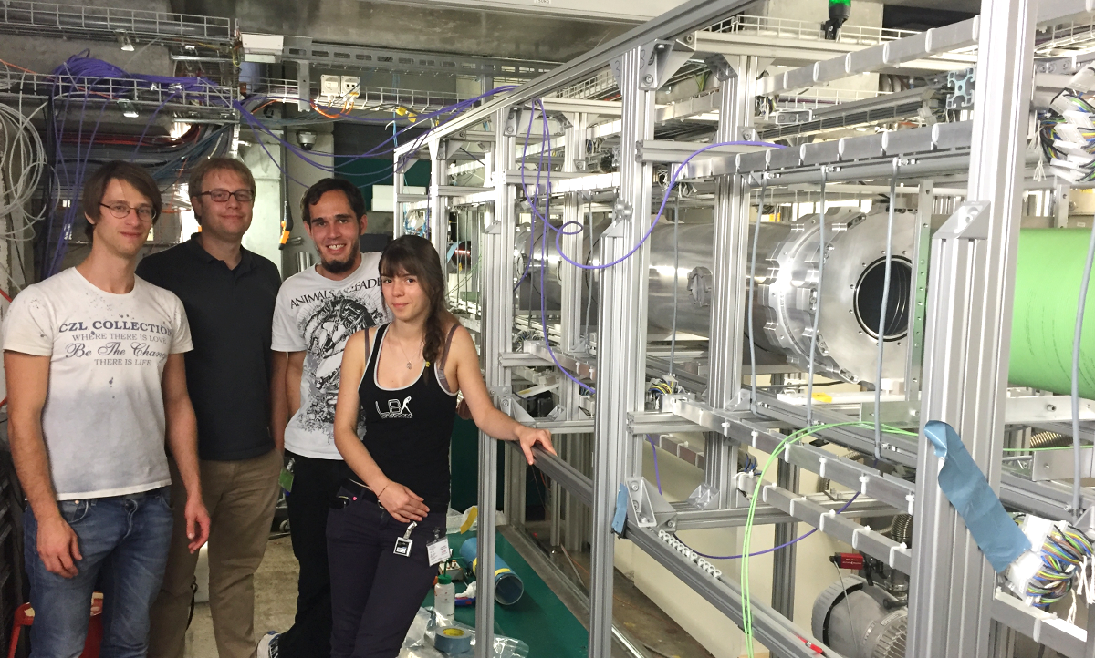
Neutron Beam EDM
  Currently first Experiments with Prototype Setup at PSI
PhD and Postdoc Opportunities
Piegsa, PRC 88, 045502 (2013)
Courtesy F. Piegsa

Slide 16
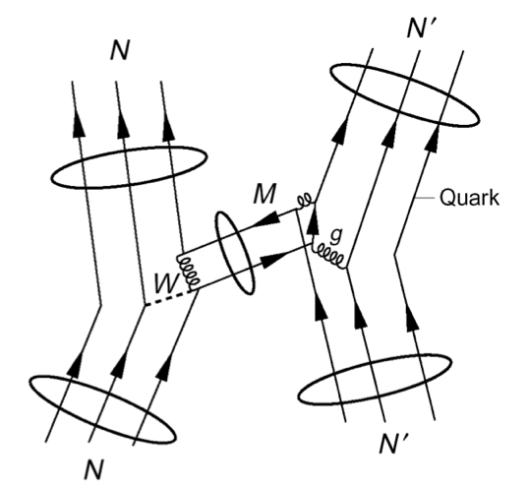
Hadronic weak interaction
Least understood weak interaction
  Complicated by nuclear structure
  Strongly suppressed by M_{π}²/M_{W}² ~ 10⁻⁷
  Unique PV signature
Motivation
  W,Z range 0.002 fm → probe of short-range quark correlations in QCD nonperturbative regime
  Nuclear PV – test of nuclear structure models
  Test of EFT in ΔS = 0 sector (ΔI=1/2 rule not understood)
  Physics input to PV electron scattering experiments
  0νββ decay – matrix elements of 4-quark operators
Courtesy C. Crawford

Slide 17
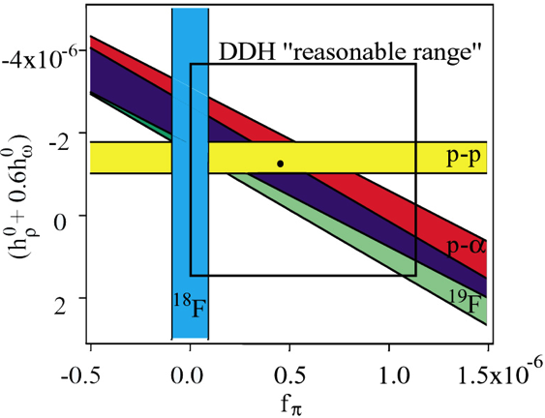
Hadronic weak interaction
λ
[Schindler & Springer, Prog. Part. Nucl. Phys. 72 (2013) 1]
Theory:
~5 coupling constants
Large uncertainties due to non-perturbative QCD
First results from lattice QCD!
#N | System |  | Prediction | Exp Sensitivity
2 | np | φ_{n} | 10⁻⁷…10⁻⁶ rad/m | –
2 | np→dγ | A_{γ} | 1∙10⁻⁸ | SNS 10⁻⁸
3 | nd | φ_{n} | 10⁻⁷…10⁻⁶ rad/m | –
3 | nd→tγ | A_{γ} | 10⁻⁶ | –
4 | n³He→p³H | A_{p} | 10⁻⁶ | –
5 | n⁴He | φ_{n} | <10⁶ rad/m | NIST 10⁻⁶rad/m
LOI Crawford
Neutron and computing at the extreme scale
1 Petaflop Year:
  first calculations of hadronic PV
100 Petaflop Year:
  Precision calculation of g_{A}
  Disconnected diagrams for T-odd observabl
1 Exaflop Year:
  PV nuclear force
  Neutron EDM from Θ_{QCD}
p-p and nuclei
[DOE Workshop on Forefront Questions in Nuclear Science and the Role of High Performance Computing]
1st Lattice QCD result (with simplifications):
J. Wasem, Phys. Rev. C 85 (2012) 022501
NPDGamma sensitivity at SNS

Slide 18

ESS: Statistics AND Systematics!
Spatial localization of neutron pulse
  Separation of beam-related background
  Separation of undefined spectrometer response
Time localization of neutron pulse
  Signal/background
  Suppression of background and drifts with different time constant
Separation by neutron wavelength
  Velocity dependence of signal and systematics
  Loss-free monochromatization
Time-dependent neutron optics
  Wavelength-specific optics adapts to all neutrons
π/2
π/2

Slide 19
Localization in time
τ
BG with different time constant
Traps of charged particles
Background from beta activation
BG time constant >> Pulse period
Gain:
Changing environment
Variable background conditions (neighbors, high voltage)
Drifting detector
Typical drift times >> pulse period
Gain:
Measure parameters close to signal and correct

Slide 20
ANNI Instrument proposal
H. Abele TU Wien
G. Konrad SMI Wien
B. Märkisch TU München
U. Schmidt Universität Heidelberg
T. Soldner ILL
C. Theroine ESS
LOIs for experiments by
K. Bodek (Krakow, n decay)
F. Piegsa (Bern, beam EDM)
C. Crawford (Kentucky, weak N-N interaction)
New partners very welcome !

Slide 21
Concept
Maximum statistics at minimum systematics for versatile user instrumentation
Fully exploit pulse structure
Assure low background
Optimize for beam quality
Include polarization
Include ep/n separator
Provide flexibility
Short instrument
14 Hz ESS, no frame overlap, optimization for pulse localization → experiments start at 26 m

Slide 22

ANNI design
Guide – high flux, low background
  Suppression of secondary showers: 2× out of sight
  Polarization options for highest flux and for highest value (P > 99.9%)
  Keep low beam divergence
  Optimized for series of reference experiments
Chopper system – fully exploit pulse structure
  Enables frame overlap suppression, pulse localization, pulse multiplication, monochromatization

Slide 23

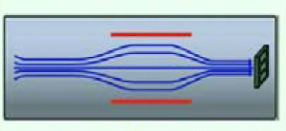
ep/n separator – successor of PERC
User
monitor
User
instrument
B
R×B spectrometer
Wien filter for protons
Fully optimized for ESS
Two detectors for improved systematics (backscattering, stability)
Will profit from experience and max PERC concept
Electrostatic chopper & p detector
Magnetic spectrometer
MAC-E filter (“aSPECT”)
Electron detector

Slide 24
ANNI – Benchmarks
Experiment | Facility | Gain Event rate | Gain Signal / Background | Comment
NPDGamma | FnPB (SNS) | 15 | 1 | Wavelength information
PERC | MEPHISTO (FRM II) | 17 34 | 1 1 | Pulse localization in space With PMC
PERKEO III | PF1B (ILL) | 6 16 | 1 1 | Pulse localization in space With PMC
aSPECT | PF1B (ILL) | 1 0.4 | 3 10 | Pulse localization in time at ANNI only
BeamEDM | PF1B (ILL) | 25 | 1 | Wavelength information, time dependent optical elements
World leading from 1 MW ESS power

Slide 25
LoI : nnbar @ ESS
Goal
Search for nnbar, gain factor 1000 in discovery potential
Search for nn’ by regeneration experiment
Collaboration
Speakers: G. Brooijmans, D. Milstead
Lead scientist: Y. Kamyshkov
New collaborators welcome
Concept
Beam extraction from large solid angle using modern neutron optics, longer flight path
HIBEAM (High Intensity Baryon Extraction and Measurement) as prototype and for intermediate physics results
Exploits “green-field” nature of ESS

Slide 26
Science case nnbar
Review:
arxiv:1410.1100
In SM: B and L accidental symmetries at perturbative level, violated non-perturbatively
Beyond SM: B violation generic feature
B violation needed for baryogenesis, nnbar could enable or constrain models of electroweak or post-spahleron baryogenesis
ΔB = 2 complementary to ΔB = 1:
  Observable nnbar probes ~1000 TeV (e.g. breaking scenarios of GUT)
  p decay probes GUT scale
Several models propose observable nnbar
Bound nnbar limited by neutrino background (at existing technology)
Complementary: free nnbar would limit Lorentz invariance violating operators to < 10⁻²³ GeV, bound nnbar not

Slide 27
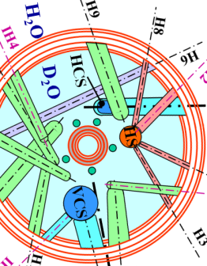
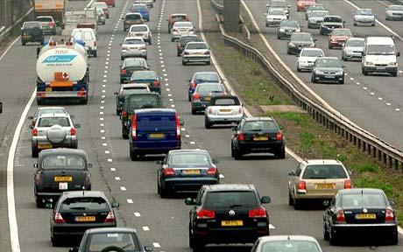
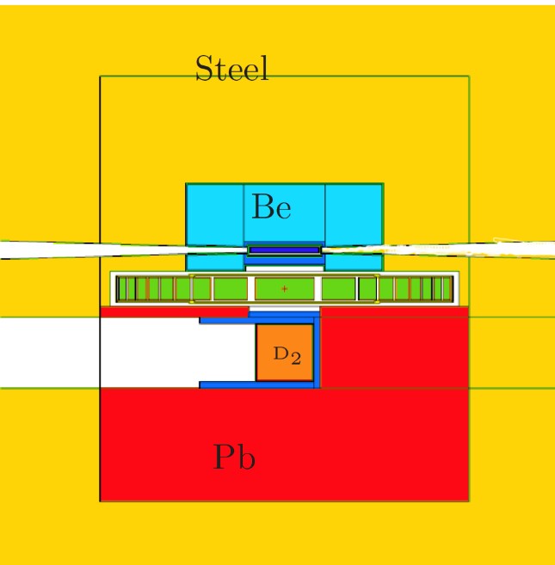
nnbar at ESS
Cold moderator
Magnetic screen
Parallelizing
optics
⁵⁸Ni guide
∼ 80 m free flight
1 year running
Replacement of reactor vessel
Option for optimized cold moderator
m∼6 super mirrors, focusing
200 m free flight
Statistics gain : ∼ 2-3 orders
ESS included special large beam port (essential!)
5 years running

Slide 28
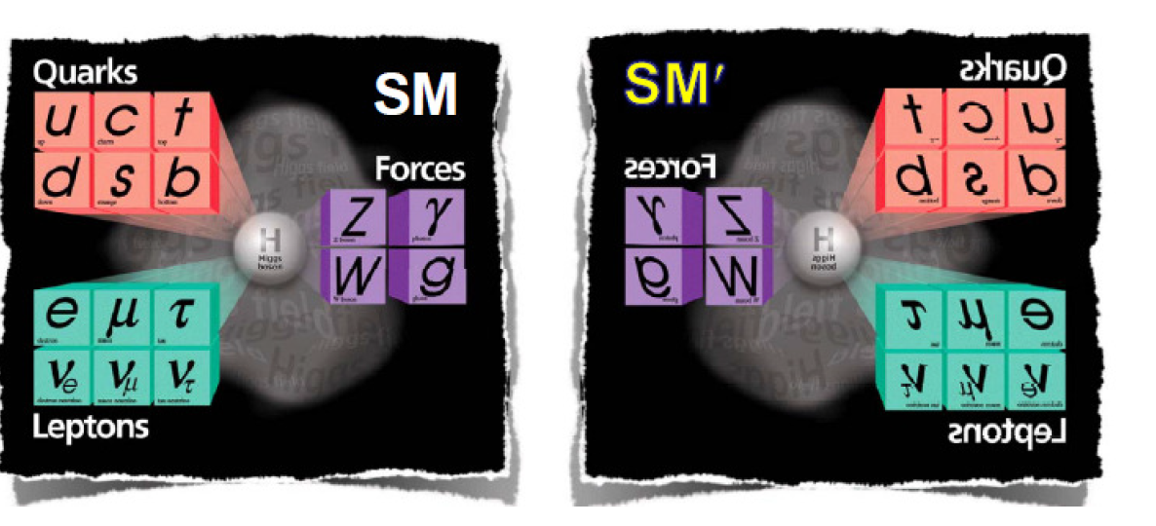
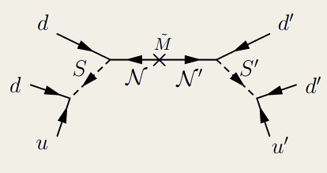
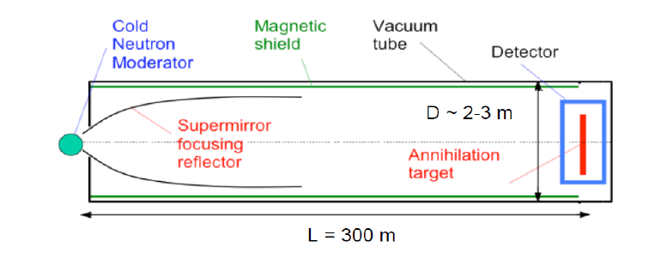


nn’ at ESS
Courtesy D. Milstead
Hidden sector
Restores parity symmetry
Accessible by oscillation of Q=0 particles
Dark matter candidate
Regeneration experiment
Neutron absorber
Neutron counter
$$n→n′$$
$$n′→n$$
arXiv:1703.06735
Magnetically controlled regions

Slide 29
HIBEAM & nnbar Strategy
Courtesy D. Milstead
Stage 1: HIBEAM
  2025-2030
  nnbar prototype, factor 10 in discovery potential
  Search for nn’
  Measurements of weak nucleon-nucleon interactions
Stage 2: nnbar
  Late 2020, duration 5 years
  Full scale experiment, factor 1000 in discovery potential
  Further measurements of nn’, weak nucleon-nucleon interactions

Slide 30
LoI : UCN Source
Scientific program
Cryogenic EDM experiment
Short-range gravity
Neutron beta decay
Neutron optics and quantum mechanics
Proposers
O. Zimmer, H. Abele, P. Fierlinger,
T. Jenke, T. Lauer, S. Paul – ILL, TUM, TUW
Concept
Extraction of 8.9 Å neutrons with large solid angle, focussing on superfluid ⁴He UCN production volume
Large (nnbar) beam port, exploits “green-field” nature of ESS: extraction optimized from moderator
ω
free neutron dispersion
1 meV
(12 K)
„phonon-roton“
dispersion
of superfluid ⁴He
7 nm⁻¹
(8.9 Å → UCN)
q

Slide 31
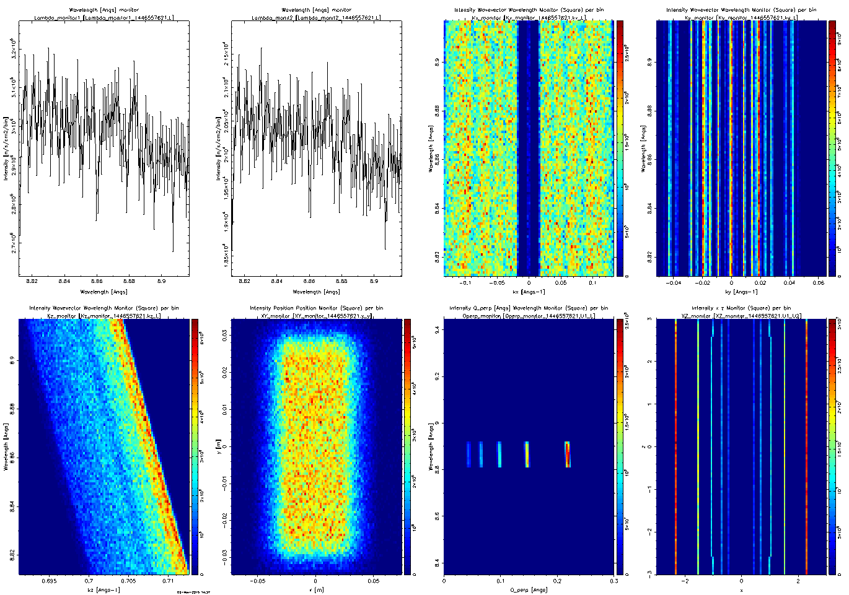
UCN Source – Cold neutron extraction
Courtesy O. Zimmer
ESS moderator
He-II converter
arXiv:1611.07353
Hino et al.:
D. Kepka et al.:

Slide 32
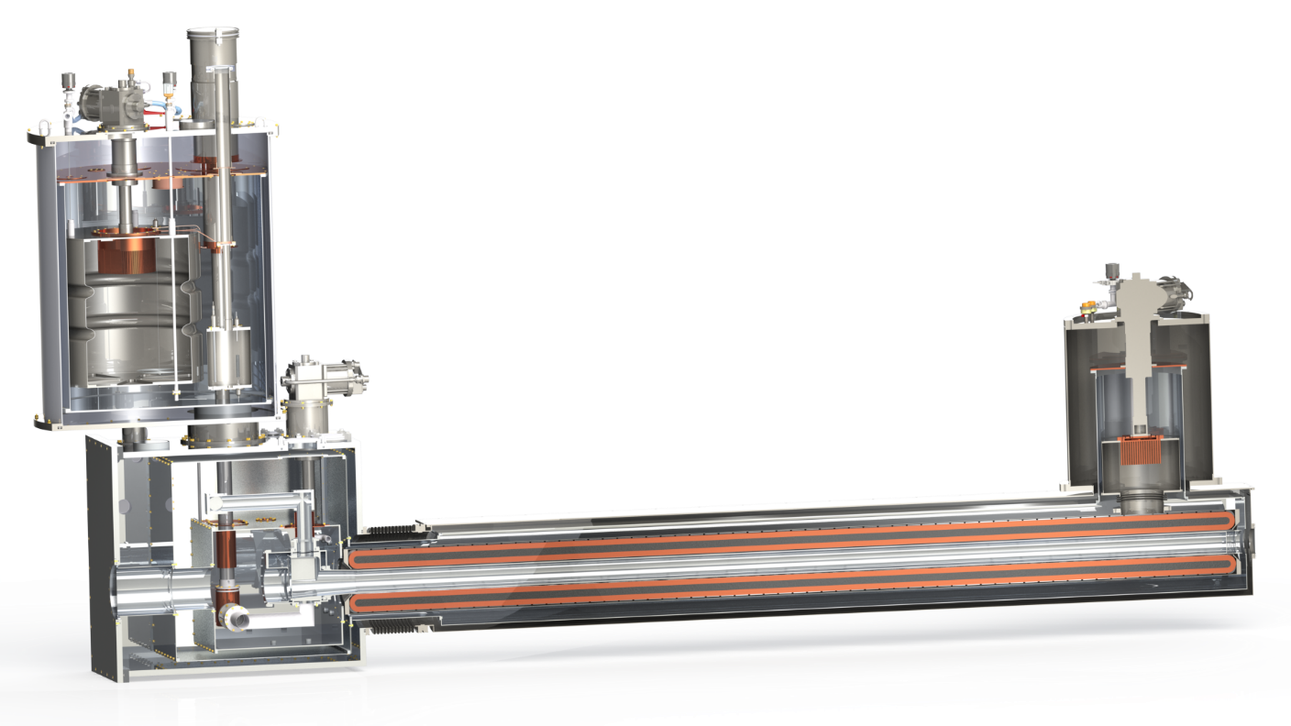

SuperSUN UCN Source – precursor for ESS
Courtesy O. Zimmer
Converter volume: 12 litres
UCN production rate: 10⁵ s⁻¹ (E < 230 neV)
Saturated UCN number: 4×10⁶ (stage I, fomblin spectrum, 2018)
2×10⁷ (stage II, polarized, E < 230 neV, >2019)

Slide 33
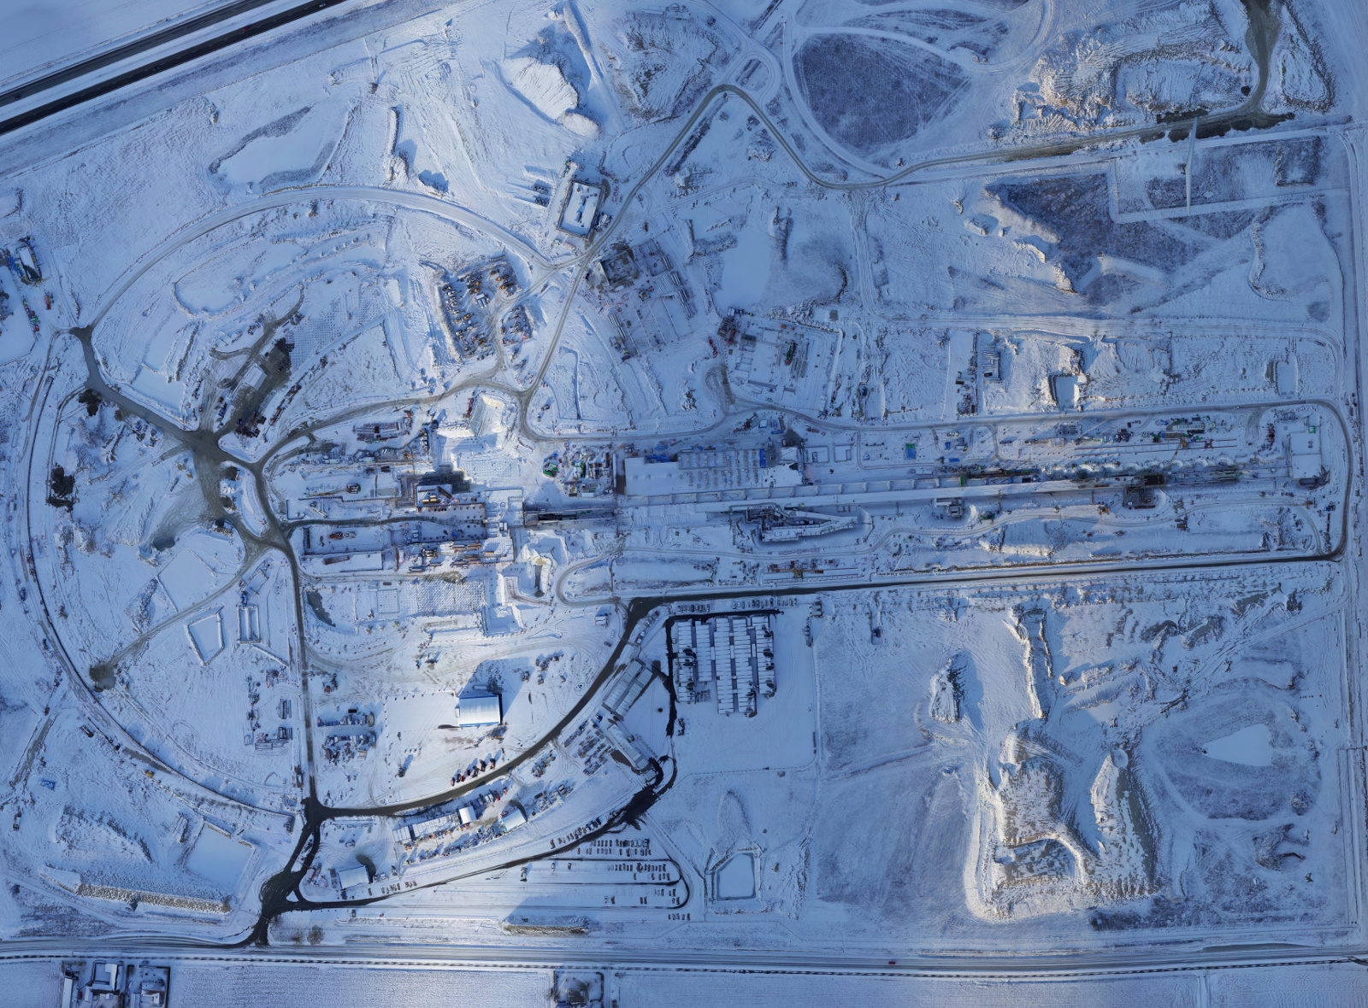
Summary
ESS: New facility with excellent opportunities for particle physics
Cold beam line ANNI:
  Fully exploits pulse structure
    Pulse localization in space and time
    Wavelength-dependent systematics
    Time-dependent neutron optics
  Cleaner systematics at full statistics
  Will outperform all existing cold beam lines for particle physics by 1-2 orders of magnitude
nnbar: Factor 1000 in discovery potential due to optimized extraction & length
UCN source: Substantial gain due to optimized extraction
Joint strategy or competing proposals?
ξ
τ
λ
↖

