Slide 1
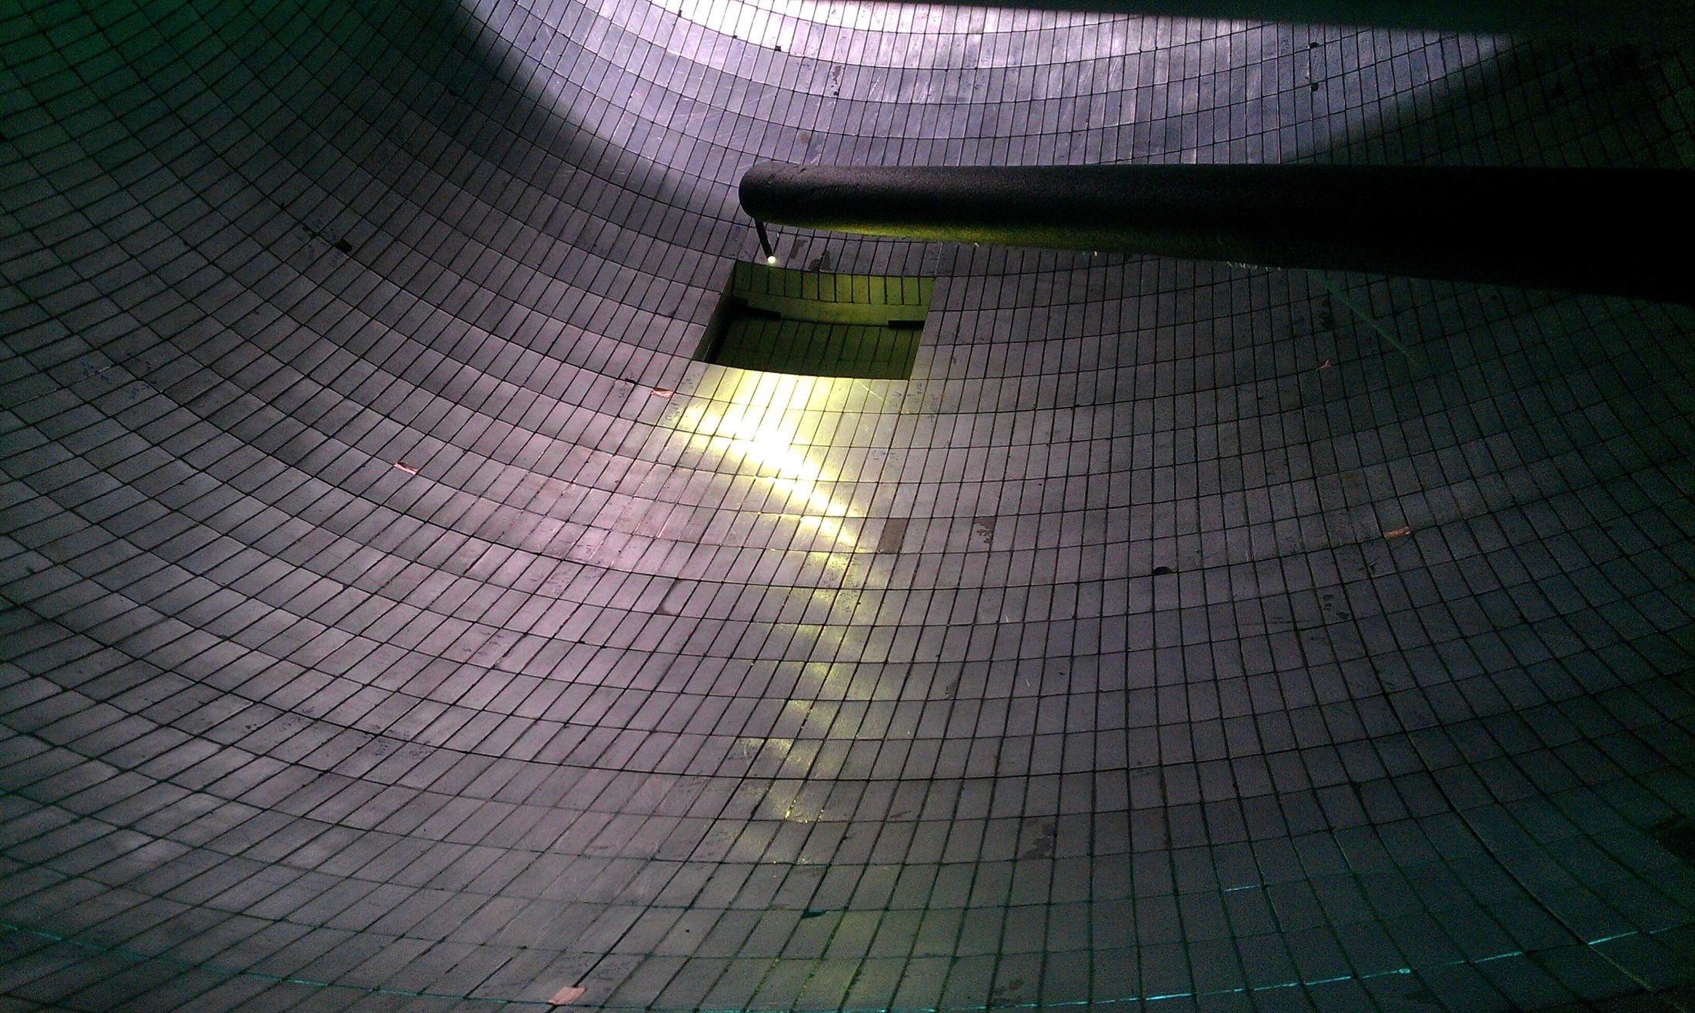

Precision Neutron Lifetime Measurement using a Magneto-Gravitational Trap
Chen-Yu Liu
Indiana University
September 14, 2017
EXA2017
ӦAW, Vienna
Notes:
[Breath]
I am honored to tell you about an experiment, that is currently taking place just 40 miles north of here at the Los Alamos National Laboratory.
We are trying to improve the measurement of the neutron lifetime.

Slide 2
UCNtau Collaboration
R. W. Pattie Jr.¹, N. B. Callahan², C. Cude-Woods^{1,3}, E. R. Adamek², M. A. Blatnik⁴, L. Broussard⁵, S. M. Clayton¹, S. A. Currie¹, E. B. Dees³, X. Ding⁶, E. M. Engel⁷, D. E. Fellers¹, W. Fox², P. Geltenbort^{12.}, K. P. Hickerson⁴, M. A. Hoffbauer¹, A. T. Holley⁸, A. Komives⁹, C.-Y. Liu², S. W. T. MacDonald¹, M. Makela¹, C. L. Morris¹, J. D. Ortiz¹, J. Ramsey¹, D. J. Salvat¹⁰, A. Saunders¹, S. J. Seestrom^{1†}, E. I. Sharapov¹¹, S. K. Sjue¹, Z. Tang¹, J. Vanderwerp², B. Vogelaar⁶, P. L. Walstrom¹, Z. Wang¹, W. Wei¹, H. L. Weaver¹, J. W. Wexler³, T. L. Womack¹, A. R. Young³, and B. A. Zeck^{1,3}
Affiliations:
¹ Los Alamos National Laboratory, Los Alamos, NM 87545, USA
² Center for Exploration of Energy and Matter and Department of Physics, Indiana University, Bloomington, IN 47408, USA
³ Triangle Universities Nuclear Laboratory and North Carolina State University, Raleigh, NC 27695, USA
⁴ Kellogg Radiation Laboratory, California Institute of Technology, Pasadena, CA 91125, USA
⁵ Oak Ridge National Laboratory, Oak Ridge, TN 37831, USA
⁶ Department of Physics, Virginia Polytechnic Institute and State University, Blacksburg, VA 24061, USA
⁷ West Point Military Academy, West Point, NY 10996, USA
⁸ Department of Physics, Tennessee Technological University, Cookeville, TN‎ 38505, USA
⁹ Department of Physics and Astronomy, DePauw University, Greencastle, IN 46135-0037, USA
¹⁰ Department of Physics, University of Washington, Seattle, WA 98195-1560, USA
¹¹ Joint Institute for Nuclear Research, Dubna, Moscow region, Russia, 141980
¹² Institut Laue-Langevin Grenoble, France, CS 20156
Student
Postdoc
Spokesperson
Spokesperson emeritus
R. W. Pattie, et al, “Measurement of the neutron lifetime using an asymmetric magneto-gravatational trap and in situ detection”, submitted to Science; https://arxiv.org/abs/1707.01817

Slide 3
Abstract:
The precise value of the mean neutron lifetime, τ_{n}, plays an important role in nuclear and particle physics and cosmology. It is a key input for predicting the ratio of protons to helium atoms in the primordial universe and is used to search for new physics beyond the Standard Model of particle physics.
There is a 3.9 standard deviation discrepancy between τ_{n} measured by counting the decay rate of free neutrons in a beam (887.7 ± 2.2 s) and by counting surviving ultracold neutrons stored for different storage times in a material trap (878.5 ± 0.8 s).
The experiment described here eliminates loss mechanisms present in previous trap experiments by levitating polarized ultracold neutrons above the surface of an asymmetric storage trap using a repulsive magnetic field gradient so that the stored neutrons do not interact with material trap walls and neutrons in quasi-stable orbits rapidly exit the trap.
As a result of this approach and the use of a new in situ neutron detector, the lifetime reported here 877.7 ± 0.7 (stat) +0.3/-0.1 (sys) s is the first modern measurement of τ_{n} that does not require corrections larger than the quoted uncertainties.

Slide 4
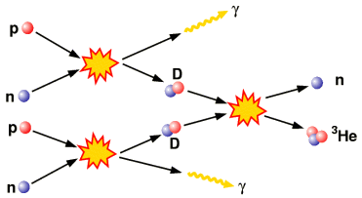
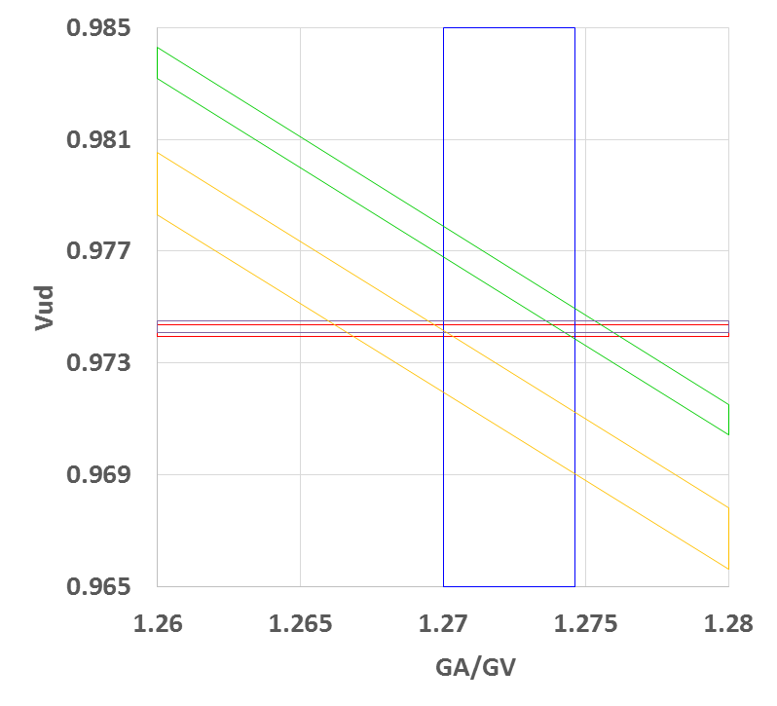
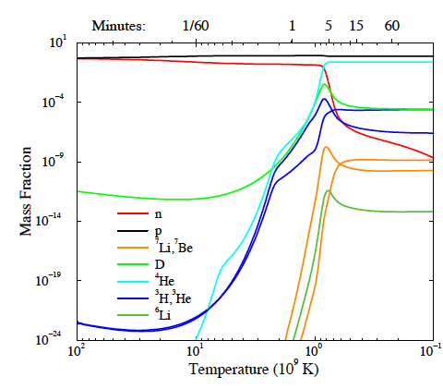
Importance of precise measurements of τ_{n}
Primodial “big bang” nucleosynthesis
Standard model tests
pdg τ_{n}
beam τ_{n}
pdg λ
CV
0⁺→ 0⁺decays
v_{ud}
Notes:
Vus – kaon, hyperon, tau decays (.2253 (14), ,2250 (27) and .2202 (15)
Vud (nuclear) -.97425 (8)exp, (10)nucl dep, and (18)RC => Vus =.2255 (10)
Vud (neutron) - .9774 (5)tau and (16)A and (2)RC => Vus=.2114

Slide 5

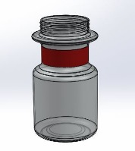

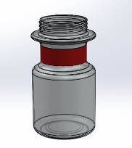
The two techniques used to measure τ_{n}
Cold Neutron Beam
Number Observed
Ultracold Neutron (UCN)
Bottle
Fill
Store
Count
Time
Notes:
Systematics from Nico, slide 40
Geoff Greene has said – beam measurements look difficult and they are, whereas UCN measurements look simple, but they are not. I hope to convince you that our approach is relatively almost as simple as the cartoon above illustrates, at least as compared to beam measurements which are indeed an experimental tour de force…which over decades have squeezed out incredible precision.
So, if you want to make a measurement of the neutron lifetime at the 1s level or better, what technique is currently state of the art?
Uncertainties in beam measurments….

Slide 6
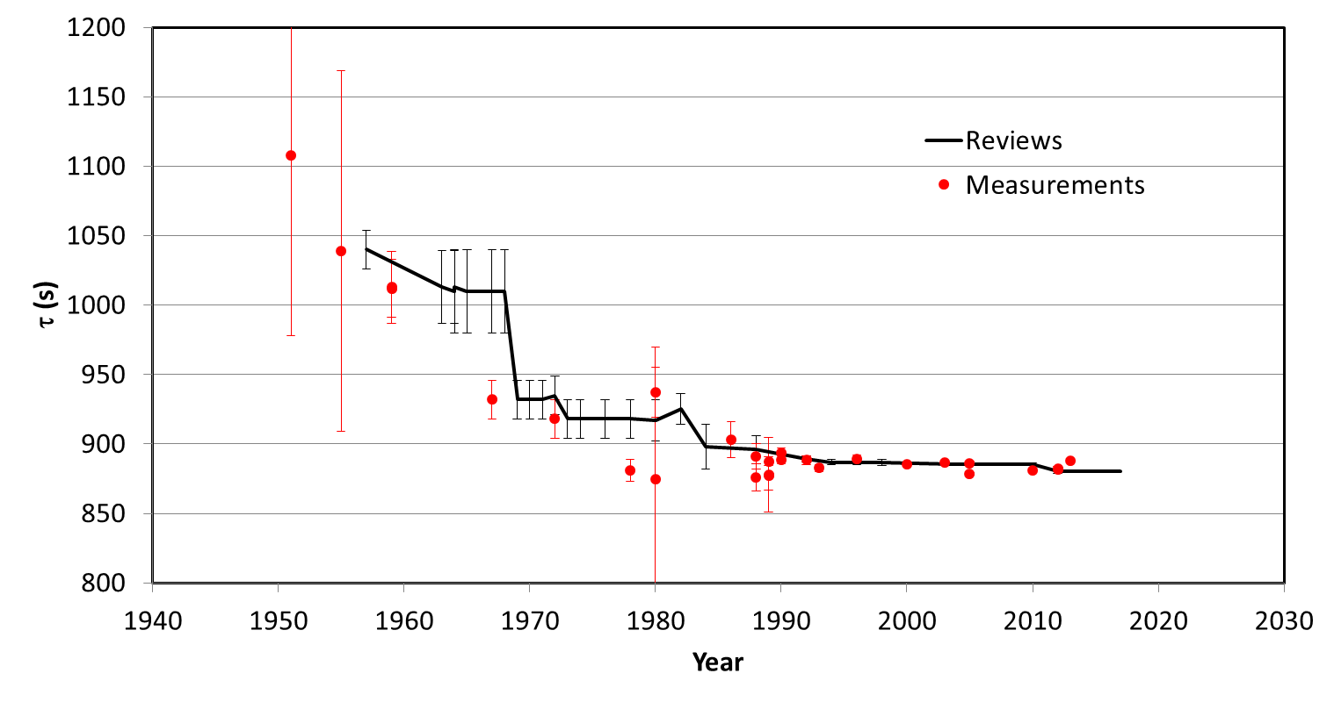
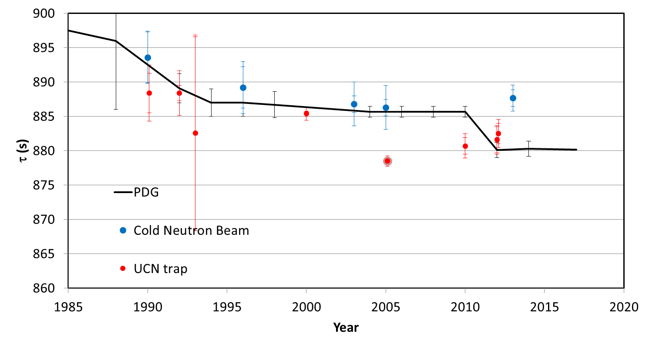
History and status of τ _{n}
Most precise Beam: τ _{n} = 887.1 ± 2.2 s
Most precise Bottle: τ _{n} = 878.5 ± 0.8 s
Notes:
Wonderful review by Wiedfeldt and greene rev mod physics volume 83, 2011
Rutherford suggested existence neutron ~ 1920 (atomic number differs from atomic mass and positively charged protons alone would not be bound by EM force only)
Chadwick discovered neutron in 1932 (1.005 -1.008 amu – close to present value of 1.0087 amu
First accurate mass Chadwick, goldhaber in 1934 – after more accurate measurement in 1935 these authors suggest neutron could decay into a proton, electron, and neutrino
Oak ridge graphite reactor operated ~ 1 year after first reaction at CP-1 Stagg field Chicgo – in 1940’s first observation of decay of free decay of neutron observed by Snell and company - and so the entreprise of neutron lifetime measurement was launced.
There is significant disagreement between measurements made with cold neutron beams and bottled ultra cold neutrons
The UCNτ Collaboration is using a magneto-gravitational trap to make a measurement of the lifetime that eliminates major systematic uncertainties in previous bottle measurements

Slide 7
History and status of τ _{n}
Most precise Beam: τ _{n} = 887.1 ± 2.2 s
Most precise Bottle: τ _{n} = 878.5 ± 0.8 s
Notes:
Wonderful review by Wiedfeldt and greene rev mod physics volume 83, 2011
Rutherford suggested existence neutron ~ 1920 (atomic number differs from atomic mass and positively charged protons alone would not be bound by EM force only)
Chadwick discovered neutron in 1932 (1.005 -1.008 amu – close to present value of 1.0087 amu
First accurate mass Chadwick, goldhaber in 1934 – after more accurate measurement in 1935 these authors suggest neutron could decay into a proton, electron, and neutrino
Oak ridge graphite reactor operated ~ 1 year after first reaction at CP-1 Stagg field Chicgo – in 1940’s first observation of decay of free decay of neutron observed by Snell and company - and so the entreprise of neutron lifetime measurement was launced.
There is significant disagreement between measurements made with cold neutron beams and bottled ultra cold neutrons
The UCNτ Collaboration is using a magneto-gravitational trap to make a measurement of the lifetime that eliminates major systematic uncertainties in previous bottle measurements

Slide 8

UCN for beta decay measurements
UCN can be stored using materials, gravity, and magnetic fields
Decays/beam large
Backgrounds low

Slide 9
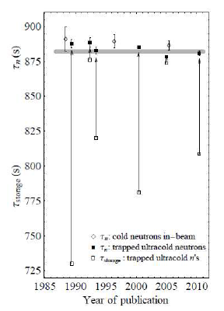
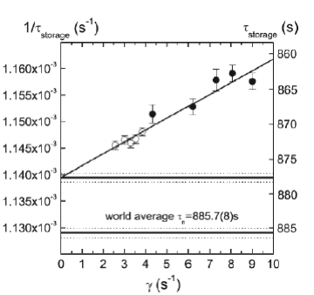
Measuring the lifetime with UCN is challenging!
Beam measurements require absolute determination of the neutron beam fluence, decay volume, and absolute proton detector efficiency.
  Have involved multiple systematic corrections of order 5 sec
Bottle measurements must correct for UCN losses other than the neutron beta decay.
  These corrections are often of the same order as the quoted uncertainty
We have designed a bottle that has negligible intrinsic losses using the magnetic interaction
Dubbers & Schmidt, Rev. Mod. Phy. 83 (1111) 2011
A. Serebrov, et al. (2008)
Notes:
Dubbers & Schmidt summarized the challenge using this graph.
150s correction from the “measured storage time” to the “beta-decay time” .
Serebrov: 5 s correction (0.5%) -> need to measure the loss lifetime to 10% to get < 1s precision.
Use solid coating -> no qausi-elastic scattering as in fomblin liquid.
Compare neutrons stored in traps of different surface to volume ratio, and measure the lifetime of groups of neutrons with different energy, in order to extract the energy dependence of the loss mechanism.
The trouble is despite many efforts, there is no reliable model of UCN loss on surface. The surface quality can vary everytime you open the vacuum chamber.
Most of the rest of the talk will focus on UCN measurements, so short discussion of UCN

Slide 10
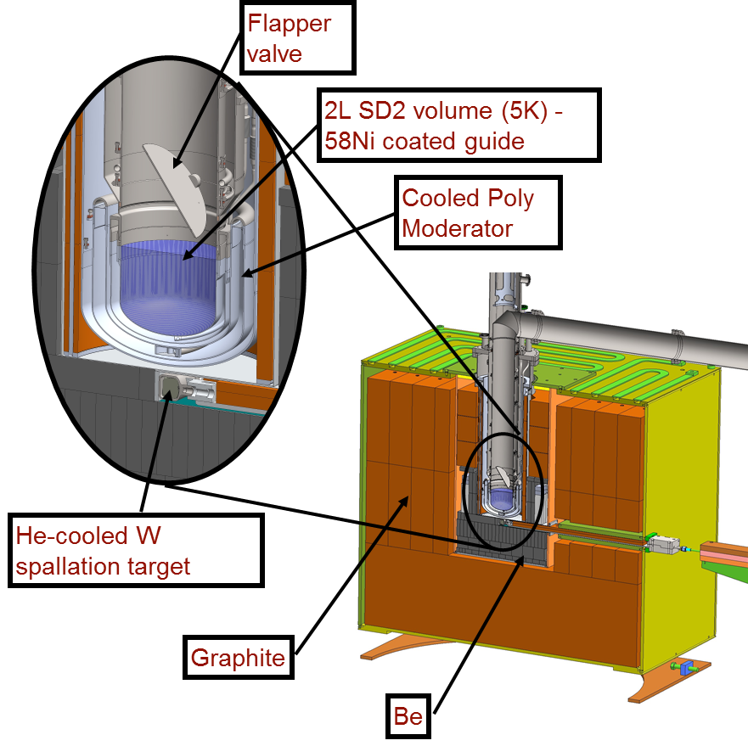
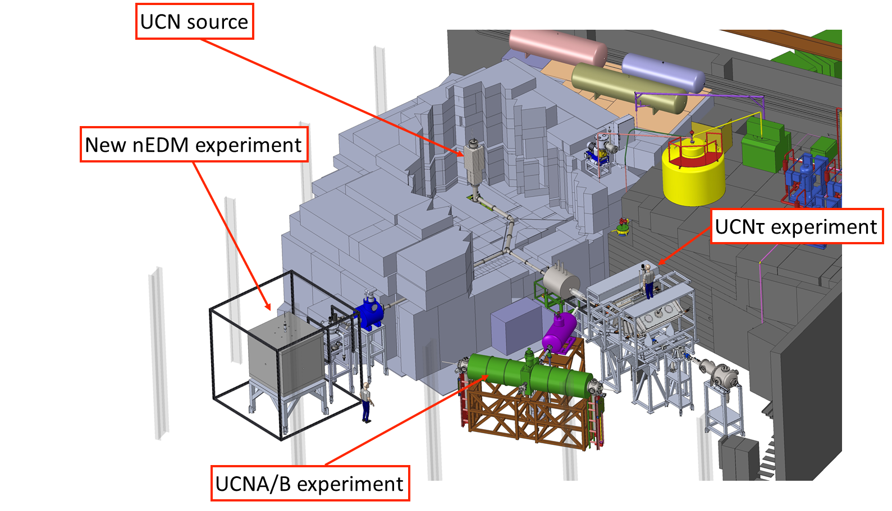
UCN “Pokotilovsky”source operating at the Los Alamos Neutron Science Center (LANSCE)
Source upgrade:
Better moderator cooling
NiP guides
Optimized geometry
UCN density measured by Vanadium activation: 184 UCN/cc.
See talk by Takeyasu Ito
A. Saunders, et al. RSI 84, 013304 (2013)
Notes:
The 52 V production rate, R , was measured to be
R = 1.82(18) °ø 103 s−1 with a gate valve detector rate of 318
UCN/s. If this is taken as the UCN flux into the area of the
foil, the UCN density can be calculated using kinetic theory
as: ρUCN = 4R
a ¯ v , where ¯ v = 390 cm/ s is the average neutron
velocity and a is the area of the foil. This gives a density of
44 (5) UCN/cm3 when normalized to the gate valve monitor
rate 586 s−1 , obtained when the source and beam are optimally
tuned.
There are

Slide 11
UCN “Pokotilovsky”source operating at the Los Alamos Neutron Science Center (LANSCE)
Source upgrade:
Better moderator cooling
NiP guides
Optimized geometry
UCN density measured by Vanadium activation: 184 UCN/cc.
A. Saunders, et al. RSI 84, 013304 (2013)
Notes:
The 52 V production rate, R , was measured to be
R = 1.82(18) °ø 103 s−1 with a gate valve detector rate of 318
UCN/s. If this is taken as the UCN flux into the area of the
foil, the UCN density can be calculated using kinetic theory
as: ρUCN = 4R
a ¯ v , where ¯ v = 390 cm/ s is the average neutron
velocity and a is the area of the foil. This gives a density of
44 (5) UCN/cm3 when normalized to the gate valve monitor
rate 586 s−1 , obtained when the source and beam are optimally
tuned.
There are

Slide 12
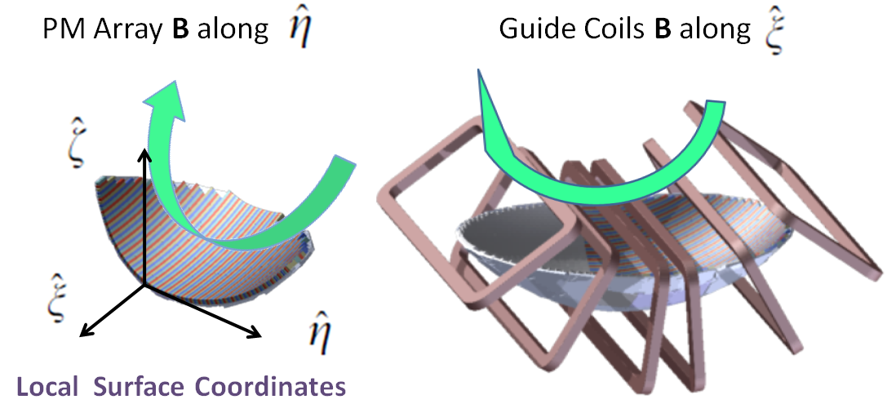
UCNτ: Magneto-Gravitational Trap
Magnetic trapping: Halbach array of permanent magnets along trap floor repels spin polarized neutrons.
Minimize UCN spin-depolarization loss: EM Coils arranged on the toroidal axis generates holding B field throughout the trap (perpendicular to the Halbach array field).
Walstrom et al, NIMA, 599, 82 (2009)
Notes:
So we decide to trap neutrons in a magneto-gravitational trap.
The use of magnetic and gravitational fields eliminates material surface to avoid any loss related to material interaction. Neutrons of one spinstate are reflected by the magnetic field generated by a halbach array of permanent magnets, and confined by gravity up to certain height.
To avoid the spin-depolarization loss due to crossing regions of zero field, we add a set of EM coils to superimpose a holding field perpendicular to the array field.

Slide 13
Main Features of the UCNτ Experiment
An intrinsically low loss rate and long trap lifetime
  confinement w/ magnetic fields & gravity; no material interaction.
Rapid evolution and mixing of the phase space
  fast removal of quasi-bound neutrons; The neutron population quickly reach a stochastic distribution.
Phase-space insensitive detection scheme.
  → Negligible bias on neutron detection efficiency even if the neutron distribution could evolve between the short and long storage times.
A large neutron statistics for sub-1 sec precision (1 s statistical uncertainty every few days)
  → enable data-driven study of systematic effects: needs a large volume, high UCN density, and high neutron detection efficiency.

Slide 14
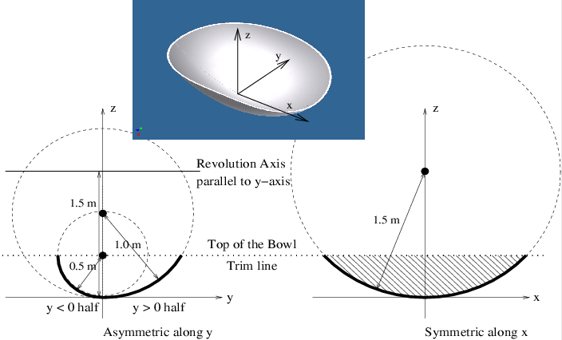
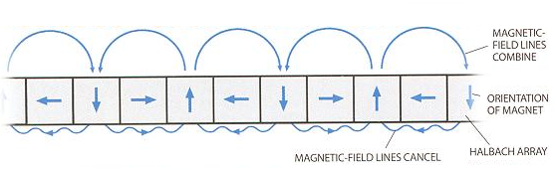
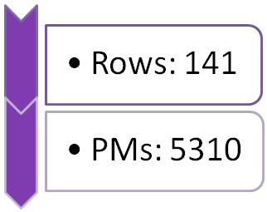
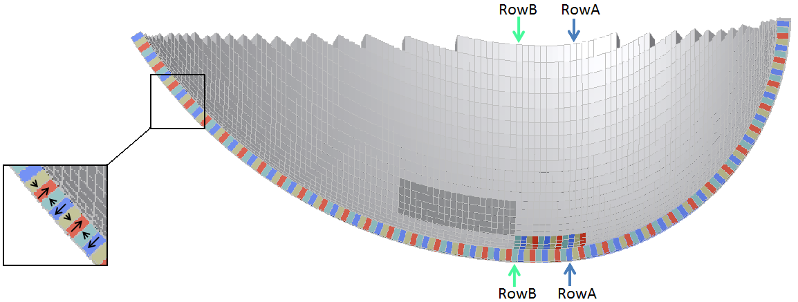
Details of the Halbach Array
Notes:
…the magnets were applied in strips along the symmetry direction to create a discrete approximation to a Halbach configuration in the asymmetry direction. This leads to a field ripple which, along with the asymmetry, serves to mix phase space trajectories.

Slide 15
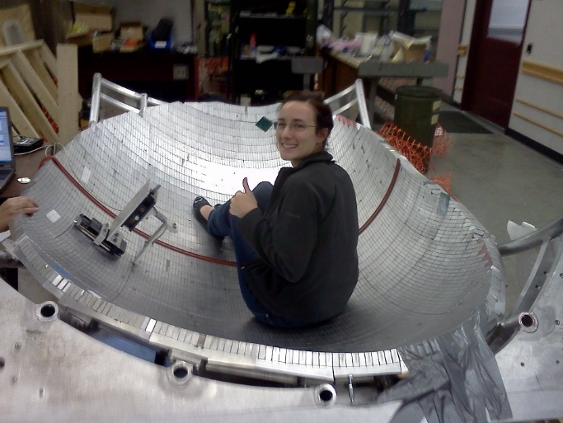
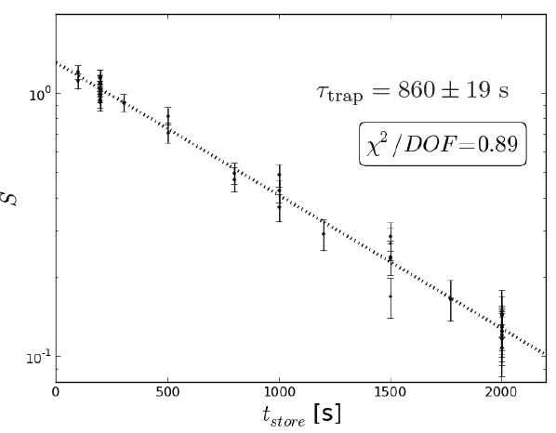
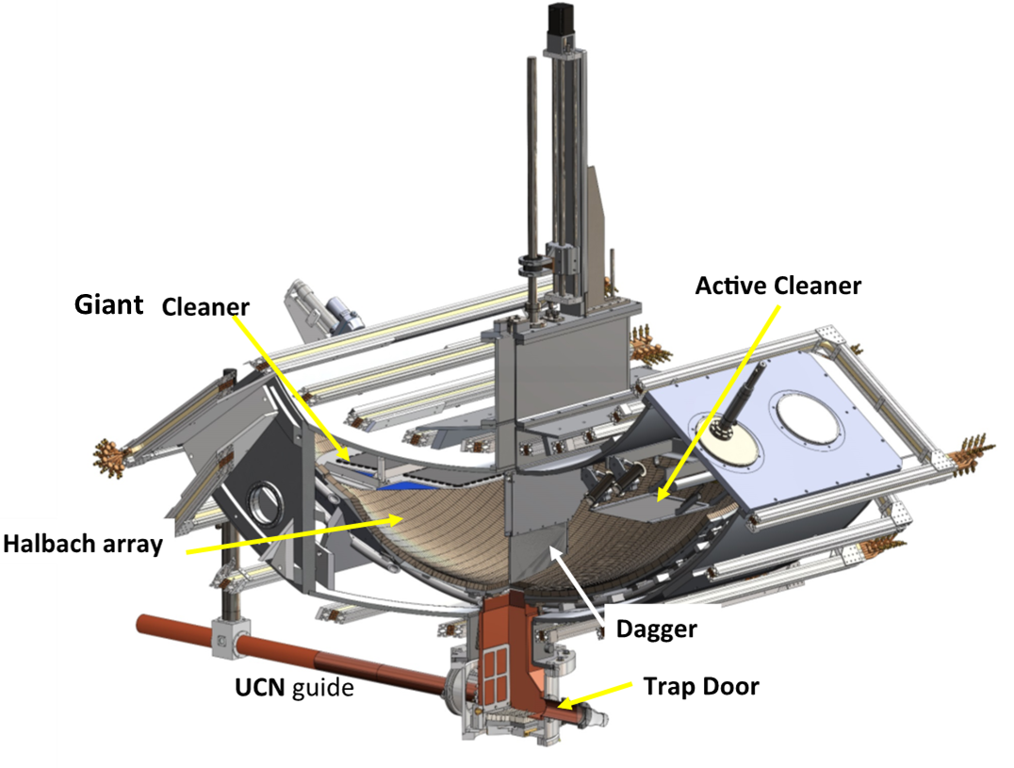
UCNτ Magneto-gravitational trap
D. Salvat, PRC 89, 052501 (2014)
Notes:
Magnetic trapping on bottom and sides:
5310 Permanent Magnets, 141 Rows
Al-coated NdFeB, 2” x 1” x 0.5”
~ 1T Field at surface
Gravitational trapping on top
50cm trap depth
Volume: 670 L

Slide 16
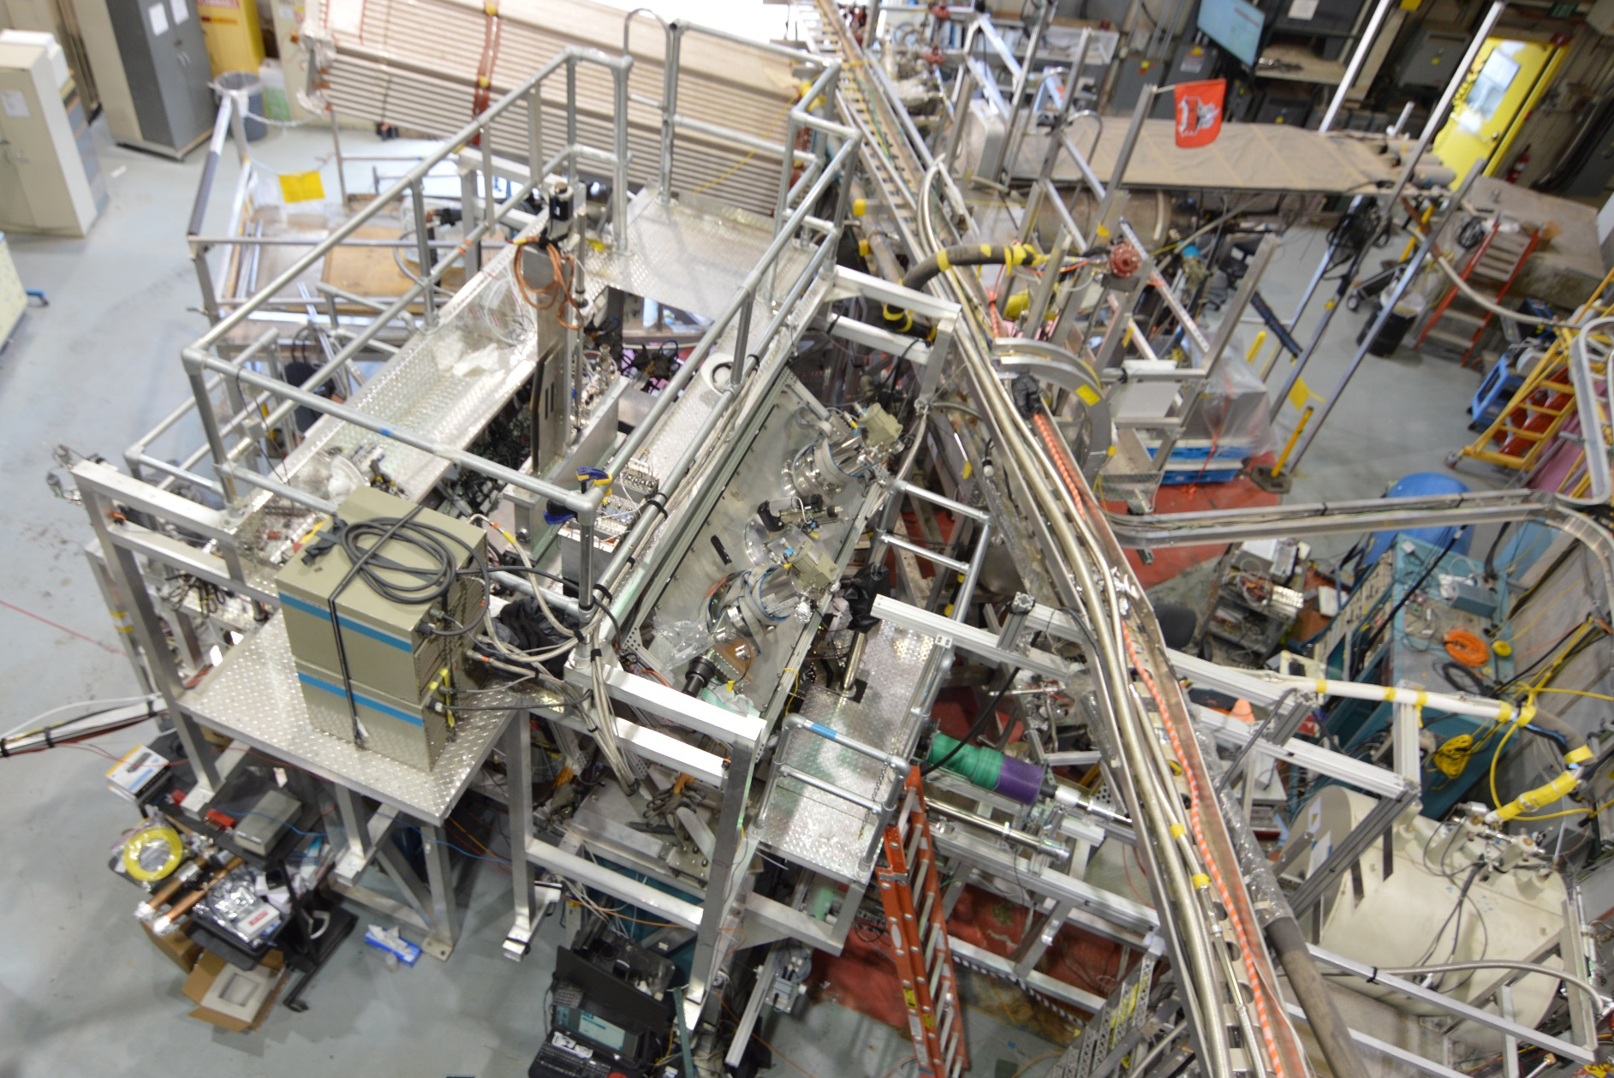
UCNτ Magneto-gravitational trap at Los Alamos Natl. Lab
Large Halbach array of permanent magnets – large neutron statistics
Intrinsically long lifetime - no material interactions during storage period
Asymmetric trap for rapid evolution and mixing of the phase space – fast removal of quasi-bound neutrons
In situ active detector – neutron unloading observed in real time
Notes:
Magnetic trapping on bottom and sides:
5310 Permanent Magnets, 141 Rows
Al-coated NdFeB, 2” x 1” x 0.5”
~ 1T Field at surface
Gravitational trapping on top
50cm trap depth
Volume: 670 L

Slide 17
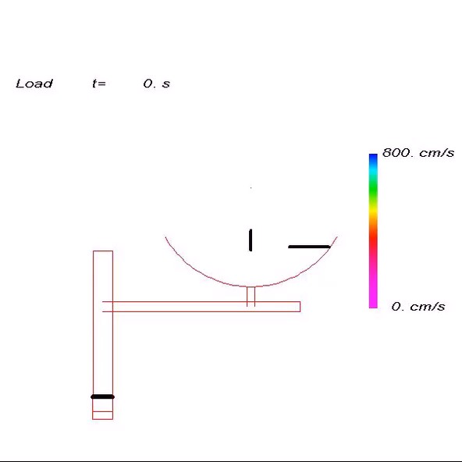
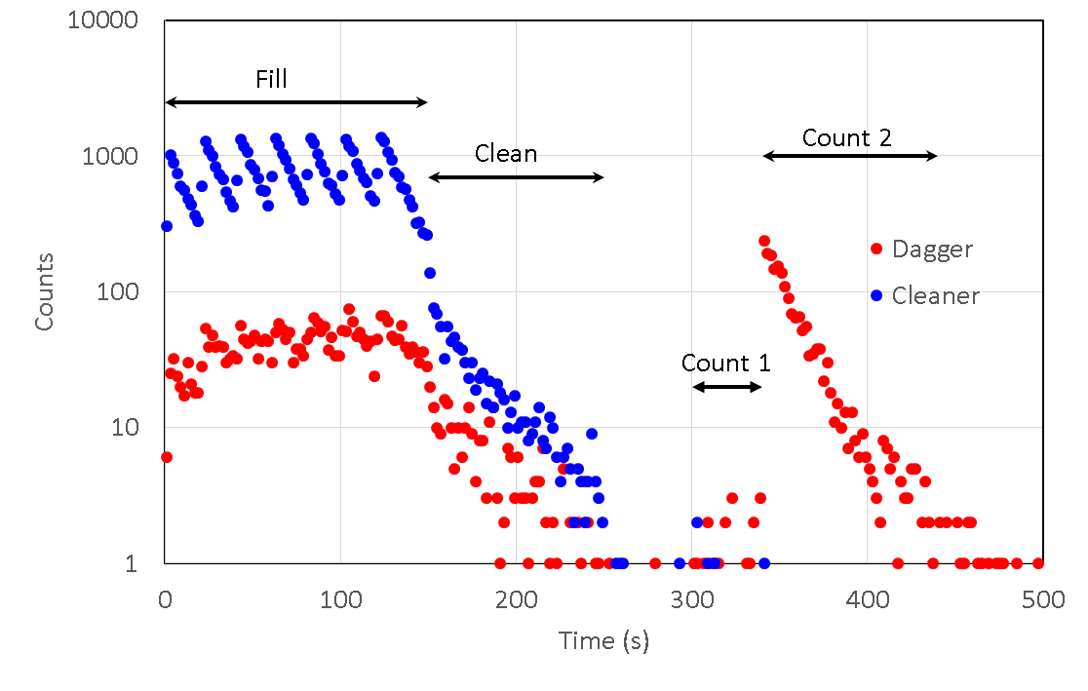
Illustration of cleaning and unloading
Load trap for 150 sec
Clean for a variable time (100-400 sec)
Cleaners in trap for loading and cleaning
Dagger can also be lowered during loading and cleaning – “dagger cleaning”
Cleaners and dagger raised during storage time (10 – 1510 sec)
Dagger lowered to count remaining UCN – either in 1 single step, or multiple steps

Slide 18
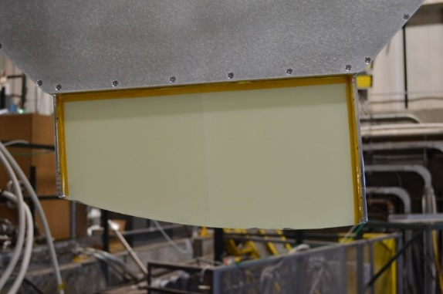
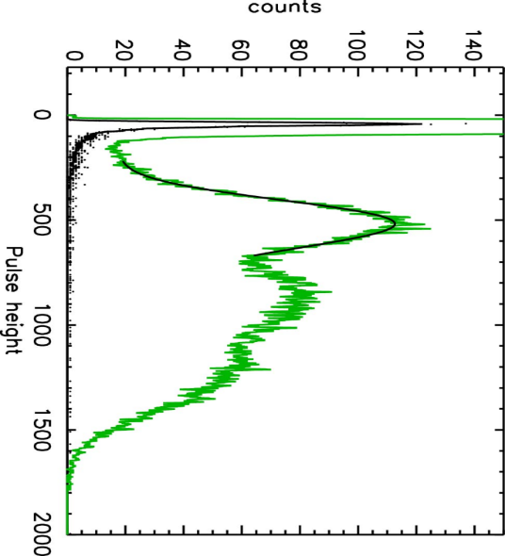
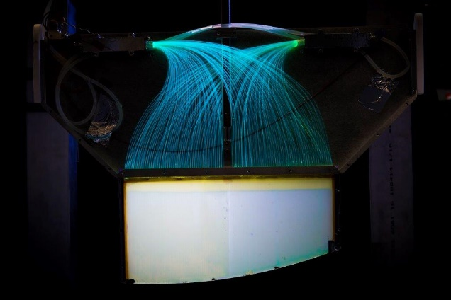
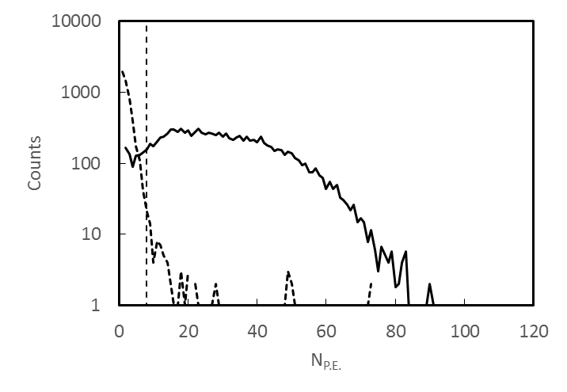
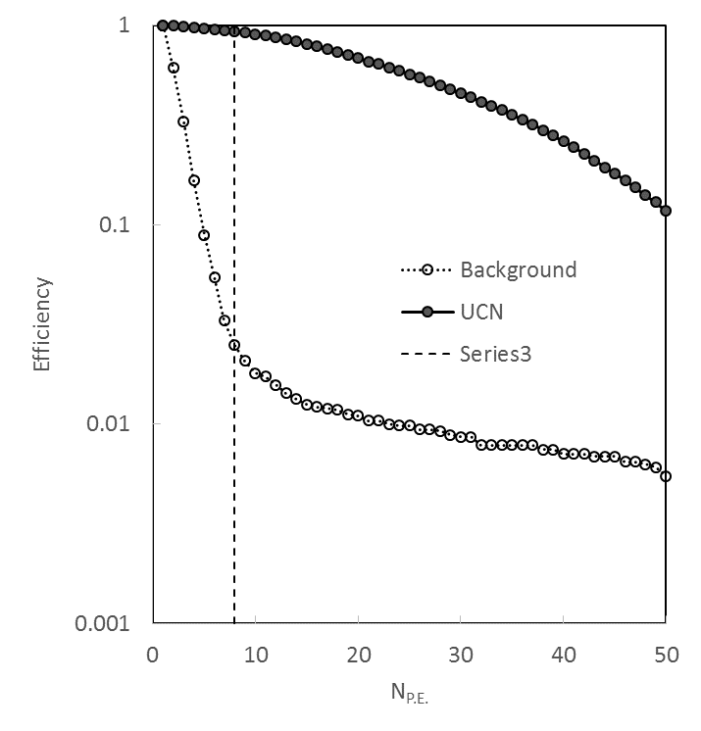
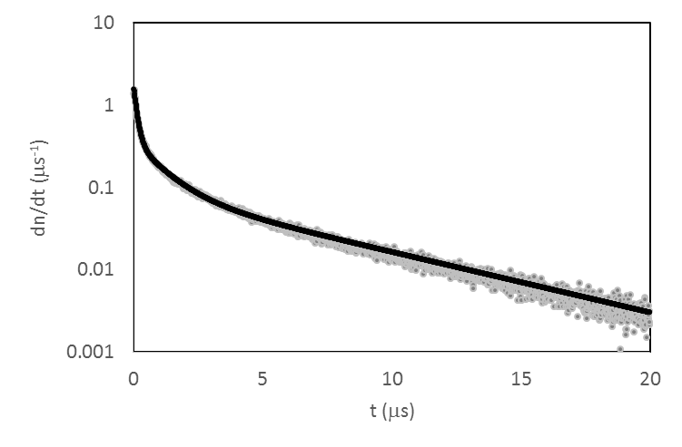
UCN Detector
WSF/PM tube cover
Z. Wang et al., NIMA 798, 30 (2015).
¹⁰B coated ZnS foils
The signals were discriminated with a 0.5 photo-electron threshold.
Logic pluses with a width of 10 ns were recorded using a multi scalar with a clock period of 0.8 ns.
Coincidences in software
n + ¹⁰B → ⁷Li + α
⁷Li
⁴He
⁷Li+⁴He
20 nm of ¹⁰B on ZnS screen
Light Output
Efficiency
Pulse shape

Slide 19
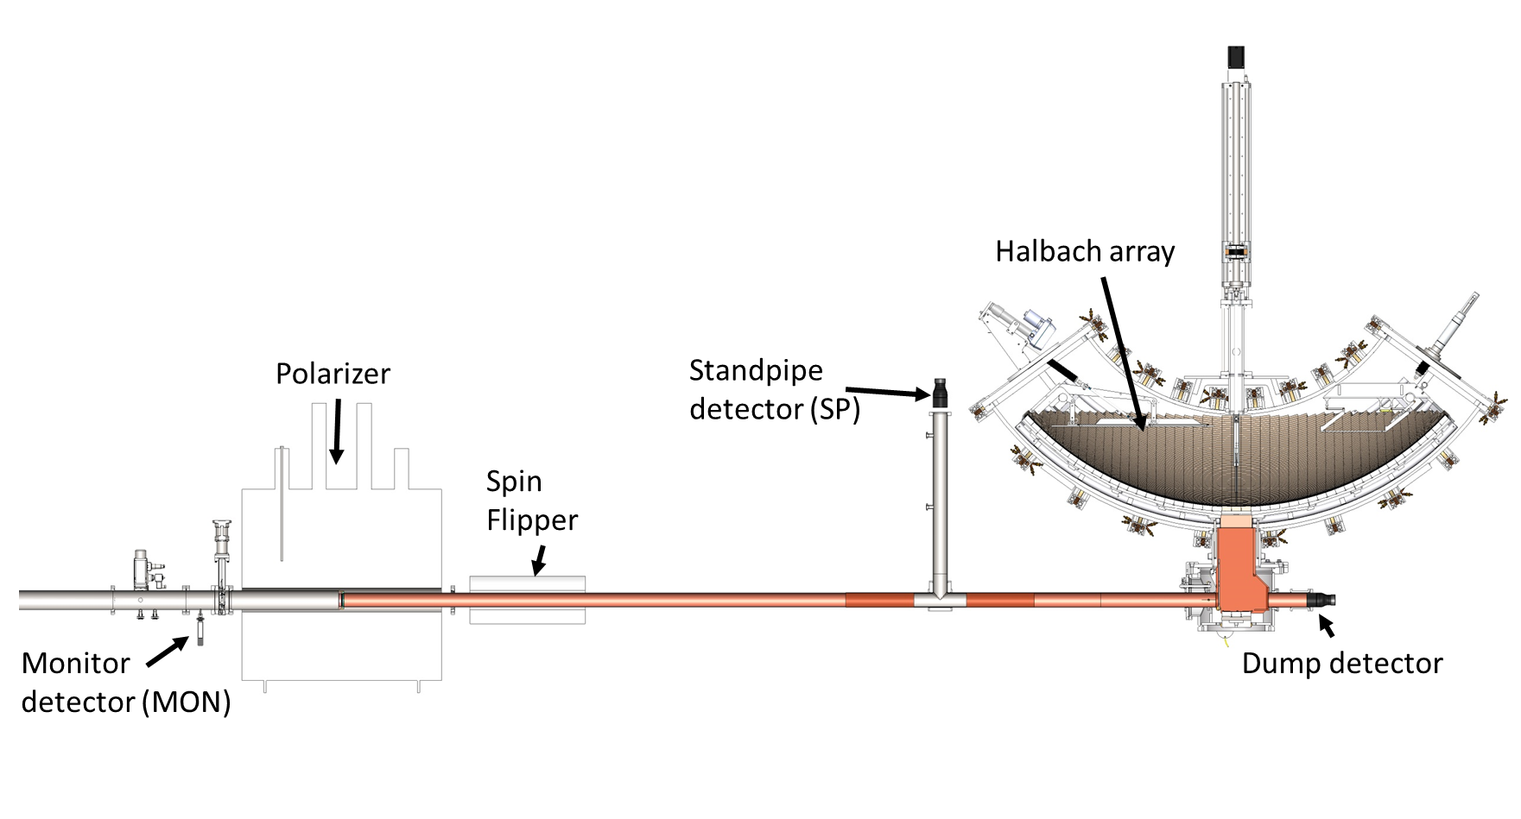
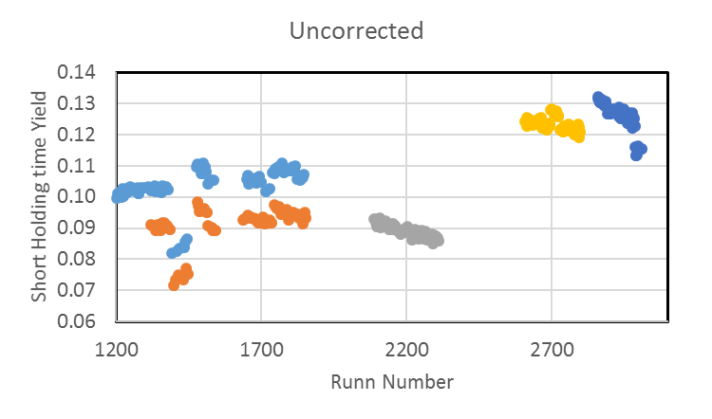
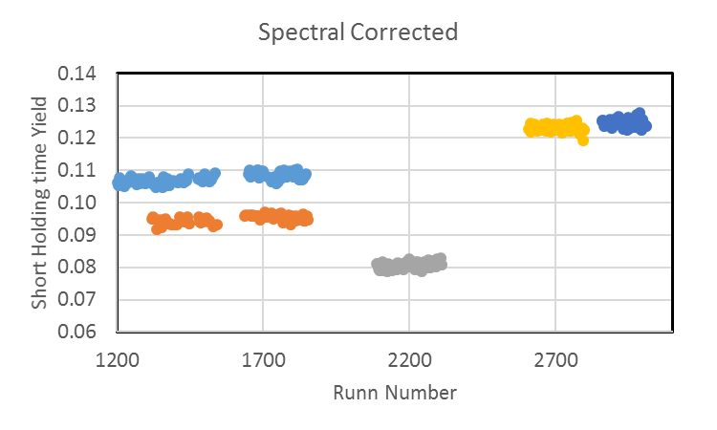
Flux Monitoring
All monitors is ¹⁰B/Zns scintillators *
No 3He
Use ratio of the Mon to SP to correct for spectral effects

Slide 20
Multi-step UCN detection
(Hz)
P1 counts neutrons above 25 cm.
It has a large draining time ~ 100 s.
The high-energy neutrons are removed from the subsequent counting at lower height using the fit extrapolated from data in P1.

Slide 21
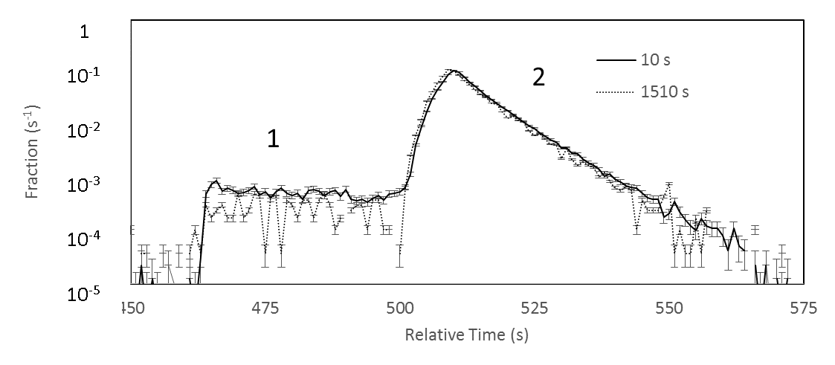
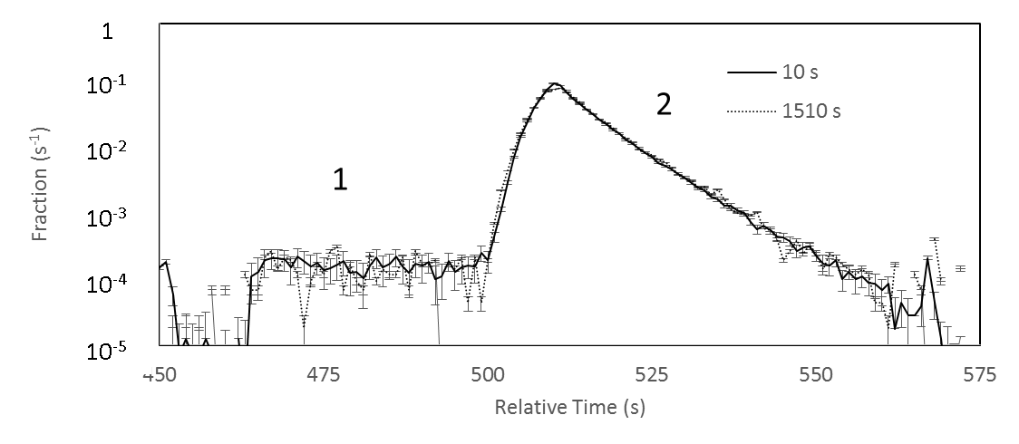
Analysis of non-blinded tune up data
Morris, et al., RSI 88, 053508 (2017)
No Dagger Cleaning
Shallow Dagger Cleaning
A - One step counting
B - Two step counting
C - Two step counting with dagger cleaning
Notes:
Figure 8) Overlay of the short and long, background subtracted, two step unloading spectra for two step counting. The long holding time spectrum has been offset in time to line up with the short holding time spectrum, and both have been normalized by their integrals. Counting groups are labeled 1 and 2
Figure 9) Same as Figure 8 but with dagger cleaning.

Slide 22
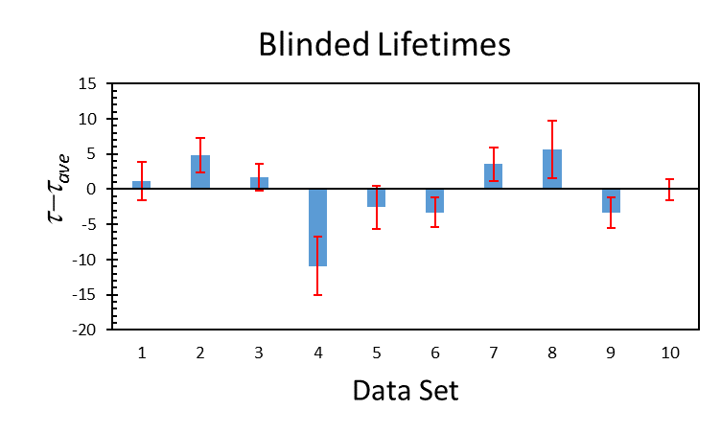
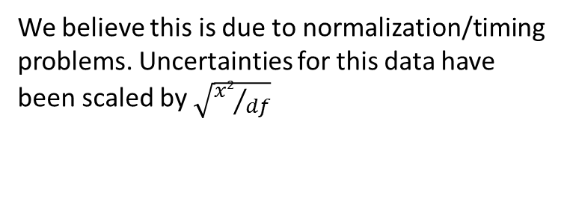
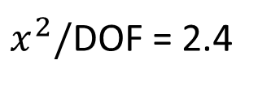
A number of blinded data sets were taken in 2015/2016 to study UCN cleaning
-AC: active cleaner (small area, fitted with UCN detectors), at 37 cm.
-Giant: giant cleaner (large area, no detetors), at 37 cm.
-DC: deep cleaning by lowering dagger at 25 cm.
Overall Statistical Uncertainty 0.7 sec
Blinded lifetimes for different conditions vary somewhat more than statistics (analysis of green shaded run-sets)
$x^{2}/$DOF = 2.4
We believe this is due to normalization/timing problems. Uncertainties for this data have been scaled by $\sqrt{{x2}/{df}}$

Slide 23
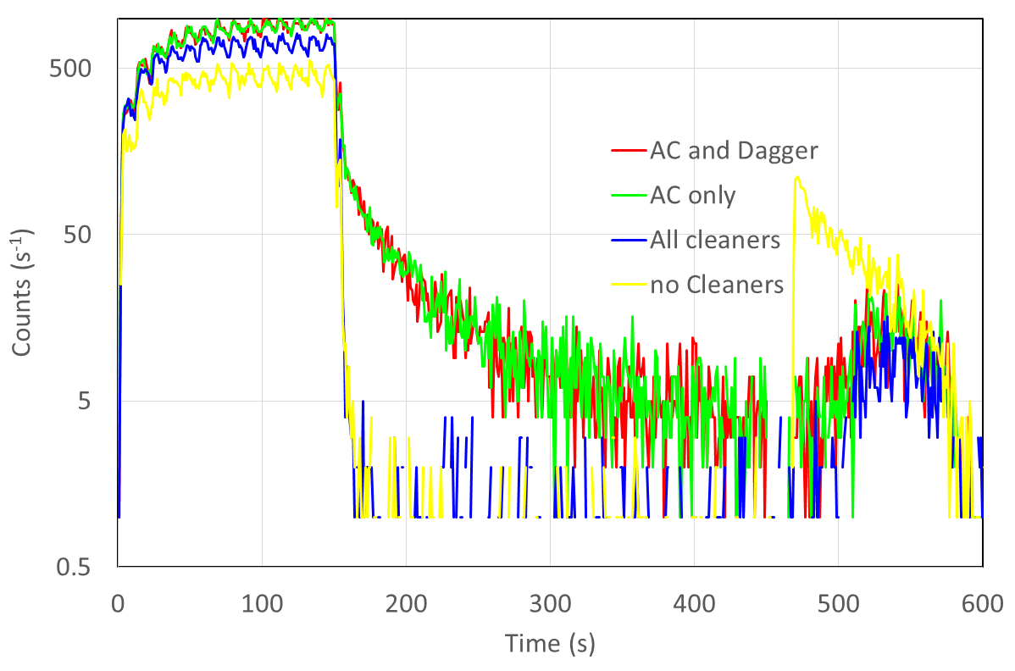
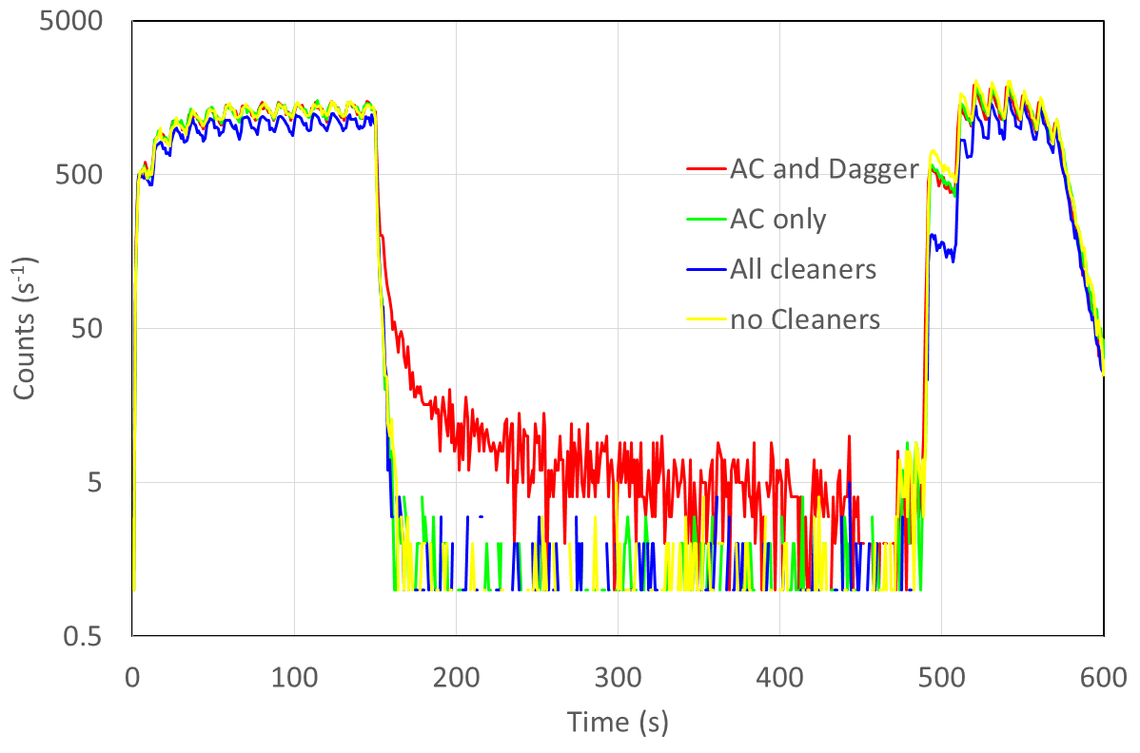
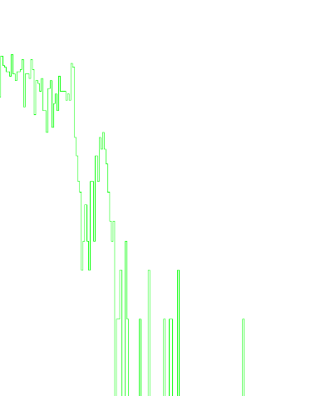
Cleaning – 2016/2017
Both measures UCN above 32 cm
 | AC | Dagger (P1)
AC + Dagger | 66 | 107
AC only | 54 | 68
All cleaners | 1 | -1
No cleaners | 1278 | 91
The giant cleaner (at 32 cm) eliminates the need for a cleaning correction
Active cleaner signal
Dagger detector signal
Neutron pulse due to heating from the trap door closing

Slide 24
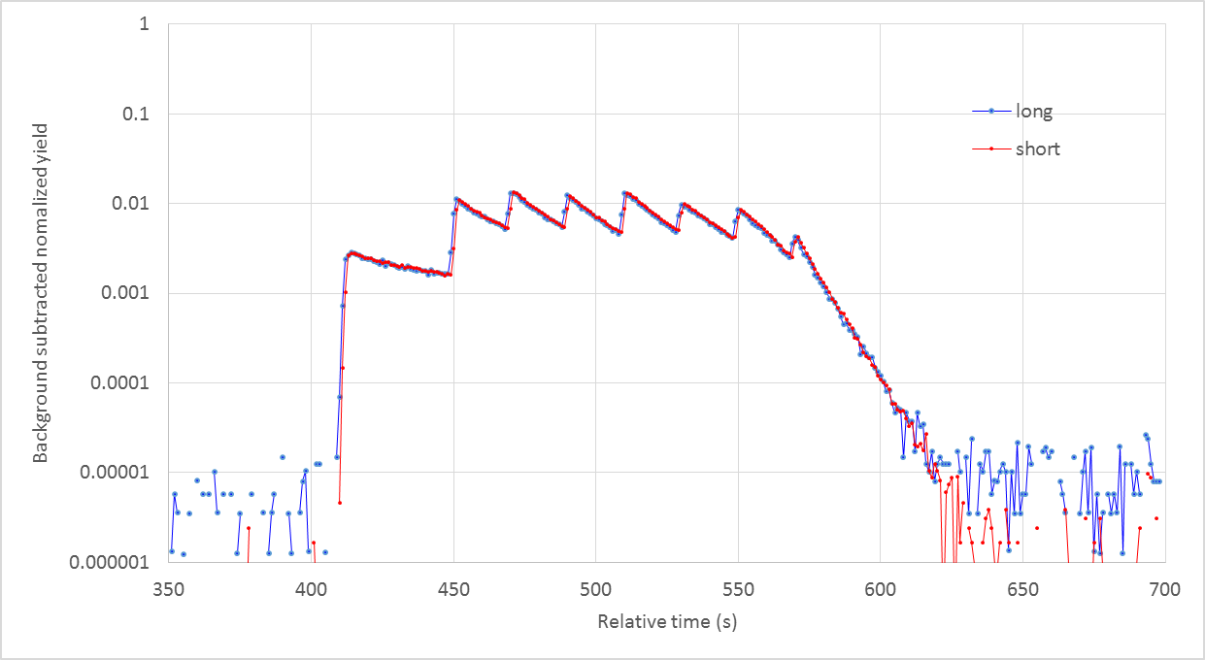
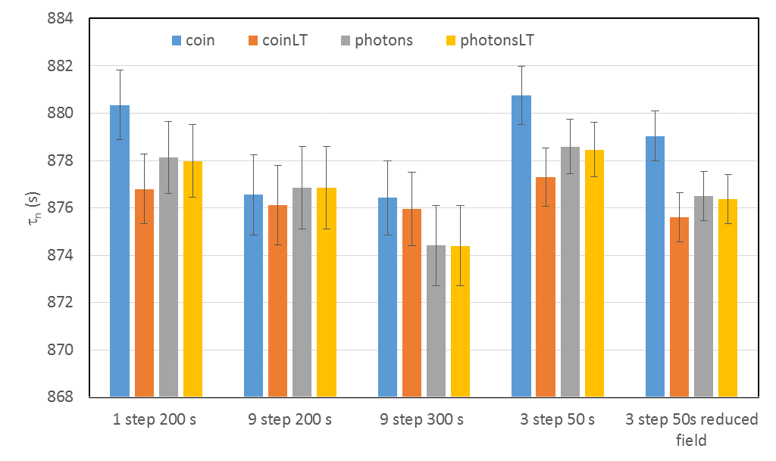
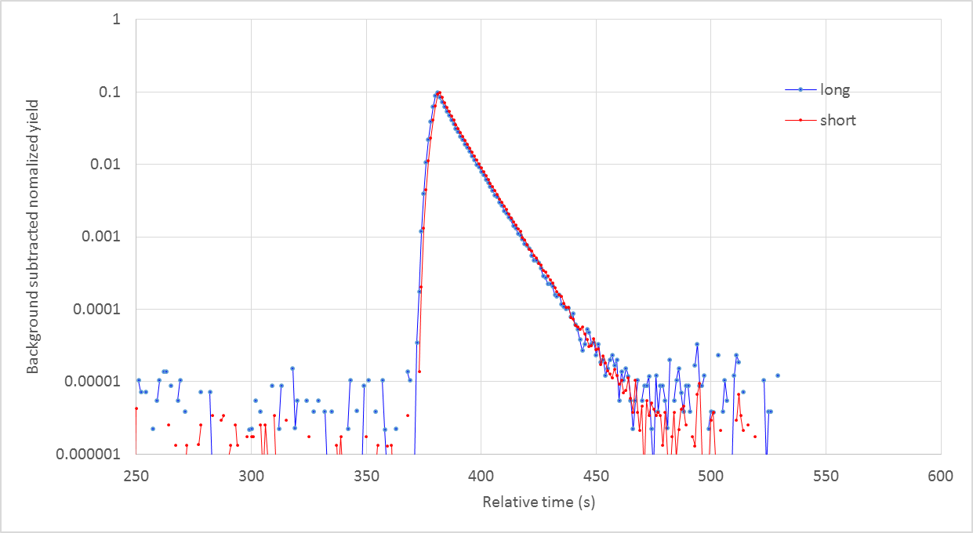
FY2017 results with giant cleaner and new source.
Trap cleaned to 10⁻⁴
No cleaning correction needed
New “current mode” counting method
Used a different blinding factor from 2015/2016 data

Slide 25
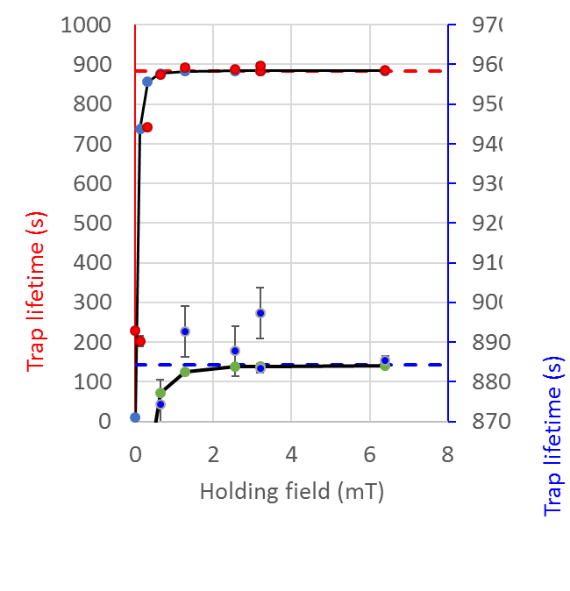
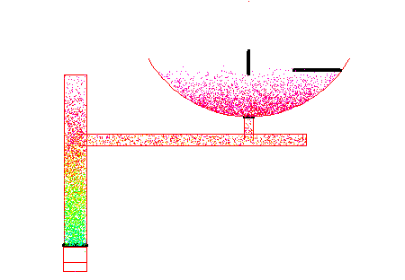
Systematic uncertainties for the “current mode” counting
Effect | Upper bound (s) | Direction | Method of evaluation
Depolarization | 0.07 | + | Varied external holding field
Microphonic heating | 0.24 | + | Detector for heated neutrons
Insufficient cleaning | 0.07 | + | Detector for uncleaned neutrons
Dead time/pileup | 0.04 | ± | Known hardware dead time
Phase space evolution | 0.10 | ± | Measured neutron arrival time
Residual gas interactions | 0.03 | ± | Measured gas cross sections and pressure
Background variations | <0.01 | ± | Measured background as function of detector position
Total | 0.28 |  | (uncorrelated sum)
Heating
Insufficient Cleaning
Limit established by long holding time excess
Limit established by short holding time excess
Using analysis by Steyerl et al. 2016

Slide 26
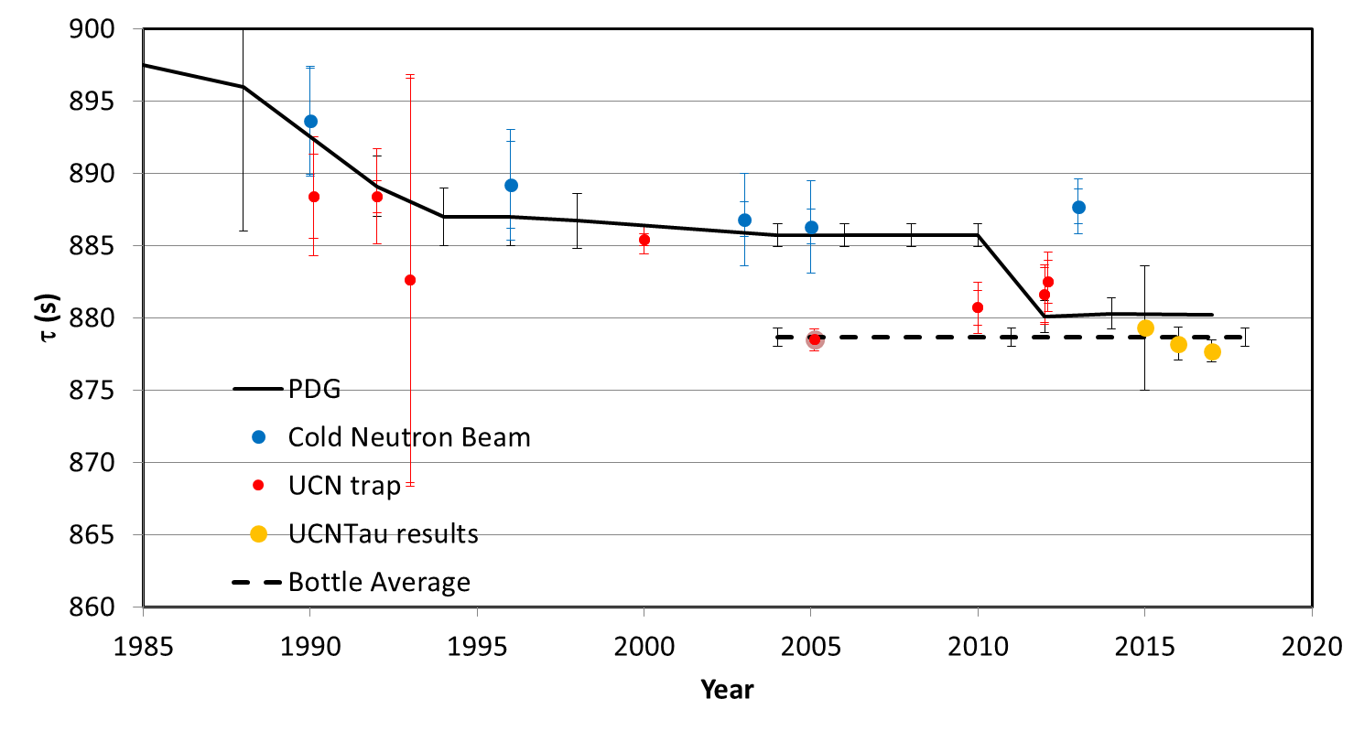
New results

Slide 27
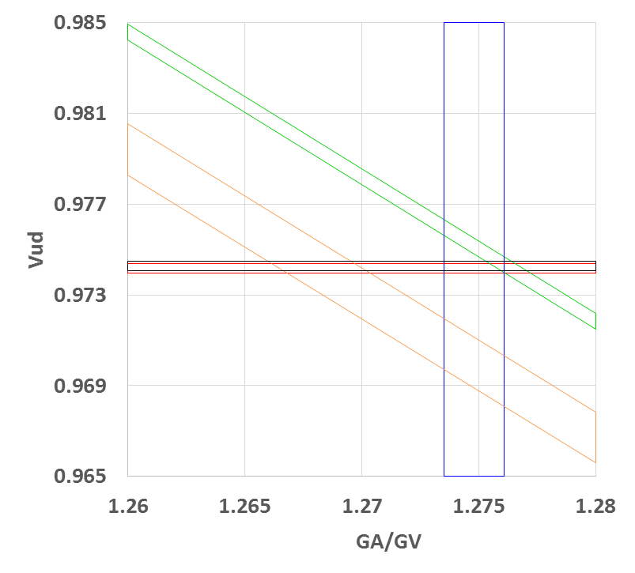
pdg τ_{n}
bottle τ_{n}
beam τ_{n}
beam τ_{n}
pdg λ
UCN+beam λ
0⁺→ 0⁺decays
0⁺→ 0⁺decays
v_{ud}
v_{ud}
CV
CV

Slide 28
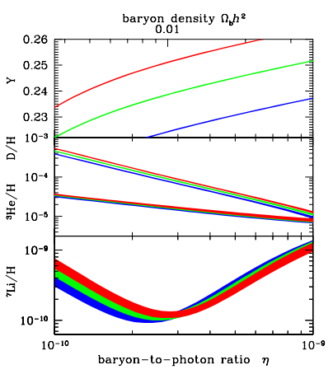
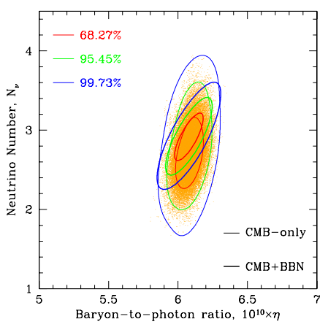
BBN: τ_{n} and Y_{p} (primordial ⁴He abundance)
N=4
N=3
N=2
R. H. Cyburt, B.D. Fields, K.A. Olive, T-H Yeh,
Rev. Mod. Phys. 88, 015004 (2016)
Notes:
The more number of light neutrinos, the higher the radiation pressure, the faster the universe expand, and the weak interaction freezes out at a higher temperature, the larger the n/p ratio, and thus higher Yp.
After one, during nuclear synthesis, there are more He4 nuclide formed.
-CMB: not only measures the curvature of the universe, but also measures the baryon to photon ratio, because the photon was tightly coupled to the baryon plasma, and its distribution tells us about the density of the baryons.
-Acoustic oscillation.
-The CMB photon, diffuse due to Thompson scattering, also probes the concentration of the free electrons, the number of which is affect by the presence of He4, which removes the electrons from plasma to form neutral atoms.

Slide 29
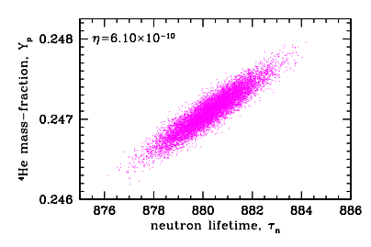

BBN: τ_{n} & Y_{p}
BBN
CMB
Astrophysical Observations
-R. H. Cyburt, B.D. Fields, K.A. Olive, T-H Yeh,
Rev. Mod. Phys. 88, 015004 (2016)
-L. Salvati et al. JCAP 1603 (2016) no.03, 055
Notes:
-Finally, the neutron lifetime is also intimately related to the physics of big-bang nucleosynthesis, which is one of the a direct probes to early universe.
-The longer the neutron lifetime, the less tightly coupled are the nucleons to the thermal cosmic soup, the earlier the freeze-out time; the more n/p ratio, the larger the Yp number.
-The primordial neutrons are then protected from beta-decay, by fusing with proton to form deuteron, He3, He4, and Li7.
-The arxiv paper suggests that the Plank data supports a long neutron lifetime, but don’t forget that we also have direct astrophysicsal observations that prefers a shorter neutron lifetime.
-the power spectrum density of the cosmic microwave background (CMB): measures the curvature of the universe, but also measures the baryon to photon ratio, because the photon was tightly coupled to the baryon plasma, and its distribution tells us about the density of the baryons.
-Acoustic oscillation.
-The CMB photon, diffuse due to Thompson scattering, also probes the concentration of the free electrons, the number of which is affect by the presence of He4, which removes the electrons from plasma to form neutral atoms.

Slide 30
We have developed a new method for measuring the neutron lifetime
We have demonstrated an in situ active neutron detector that allows for many systematic tests and enables the measurement of corrections for cleaning effectiveness and phase space evolution.
We have made a measurement of τ _{n} for the first time with no extrapolation: 877.7 ± 0.7 (stat) +0.3/-0.1 (sys) s.
All systematic uncertainties have been quantified by measurements.
During 2017/2018 running, with x5 lower background and optimized data-taking, we hope to achieve a statistical uncertainty of ± 0.35 s (stat) ± 0.15 s (20 weekends of data)
Notes:
1.2 sec is from Adams original table. My revised estimate is .7 . See back up slide 17.
Depends on what you correct for and add an uncertainty for versus estimates for systematics you have not corrected for

Slide 31
Statistical reach for one-weekend run

Slide 32
Bias from statistical models
The standard “weighted average” assumes a Gaussian distributed event population and can result in a significant statistical bias.
Number of trapped neutrons are Poisson distributed.
Neutron decays follow binomial distribution, which gives a uncertainty much smaller than sqrt(N).
*The most probable is smaller than the mean for Poisson and binomial distributions.

Slide 33
Background variations

