Slide 1
Tracking

Slide 2
Motivation
Why tracking?
Distinguish charged from neutral particles
Determine the charge of a particle
Determine the absolute momentum
Determine the direction of momentum
Determine the production/decay point
See the full story

Slide 3
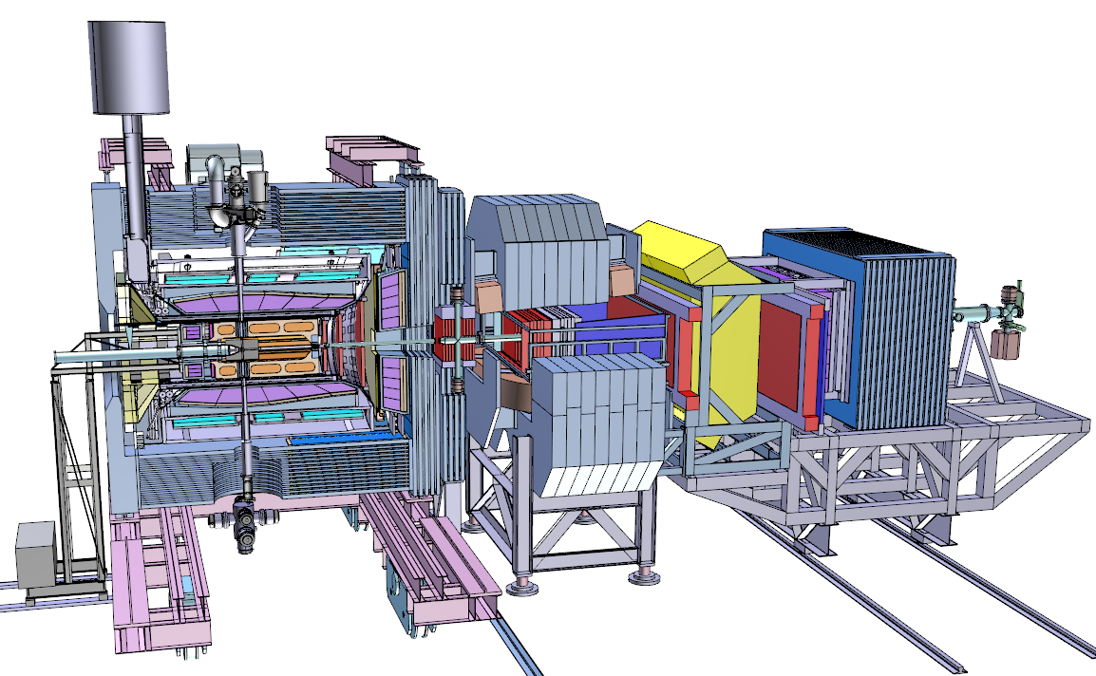
AntiProton Annihilation at Darmstadt
13 m

Slide 4
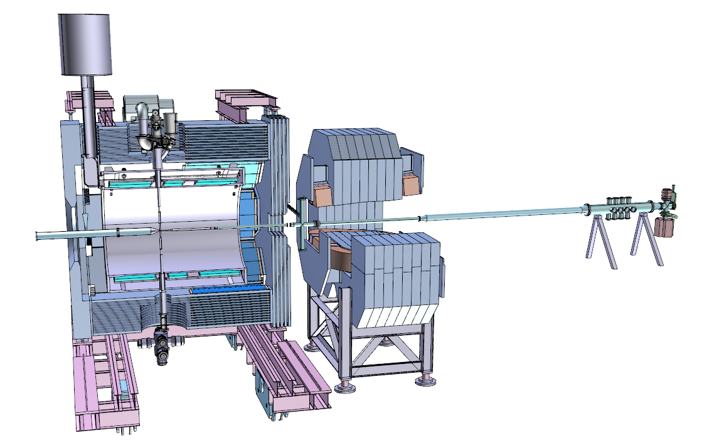
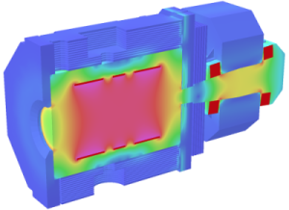
Magnet System
Dipol magnet to measure p_{l} for forward tracks Parabola approximation
Solenoid magnet to measure p_{t} Helix approximation

Slide 5
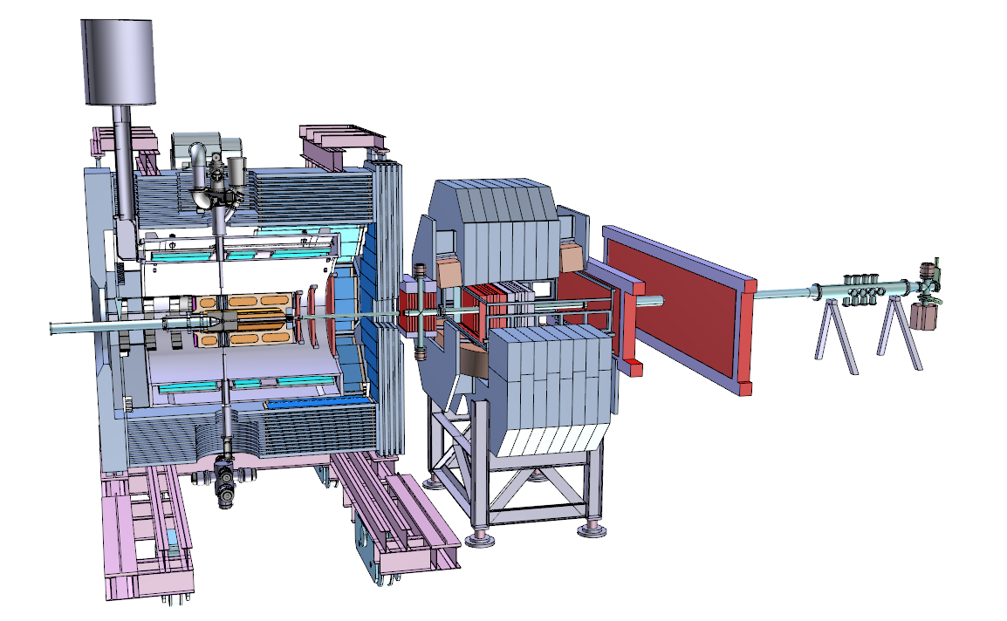
Spurdetektoren

Slide 6
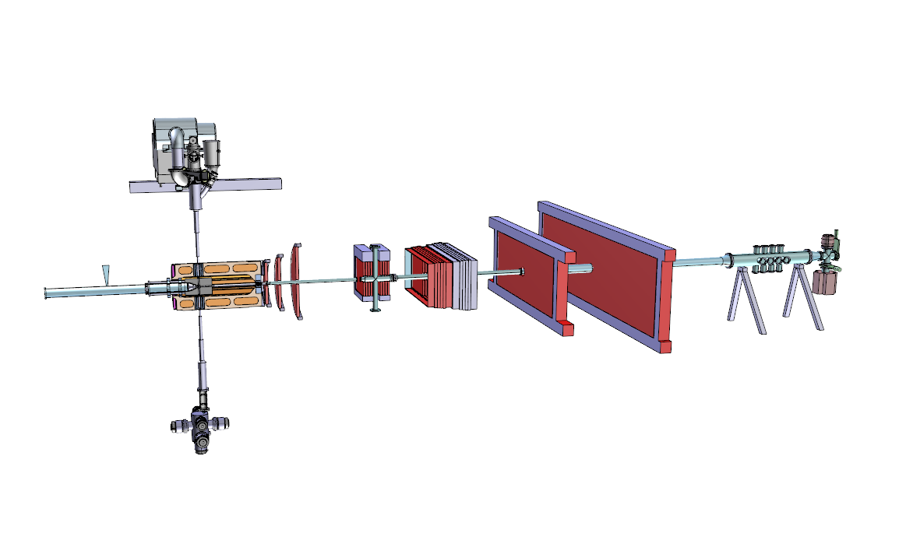
Tracking Detectors
Straw Tube Tracker
Luminosity Detector
Micro Vertex Detector
GEM Detector
Forward Tracking Stations

Slide 7
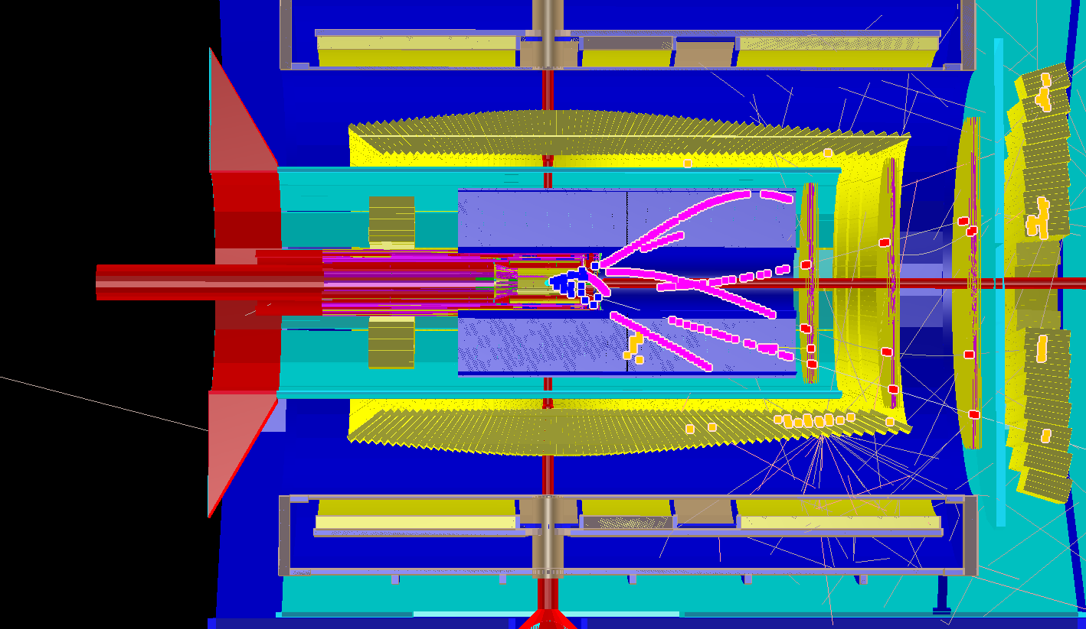
PANDA Event Simulation

Slide 8
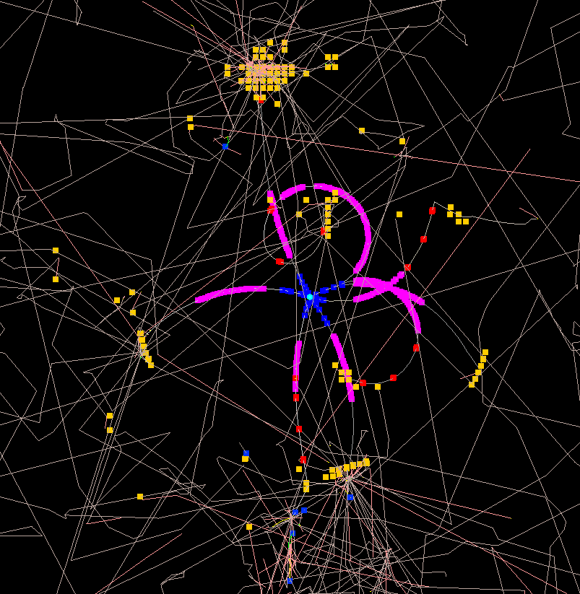
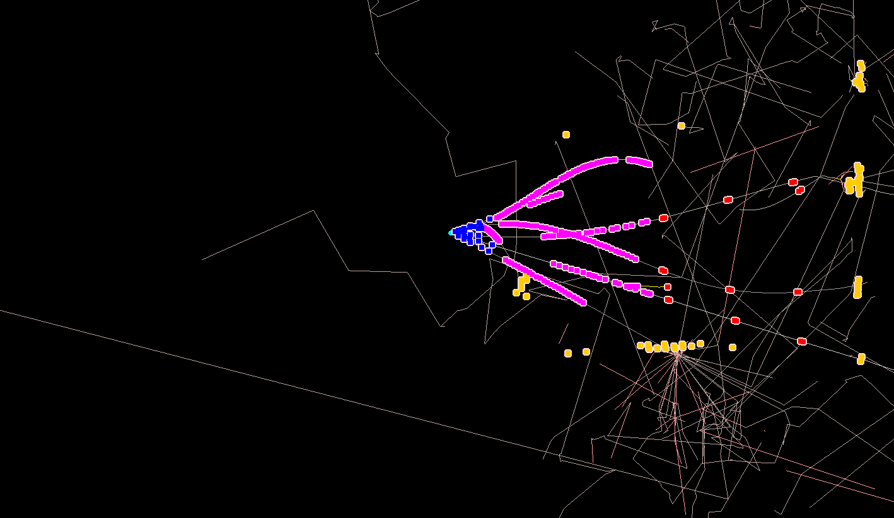
PANDA Event Simulation

Slide 9
Procedure
Full track reconstruction happens in various steps:
Group the hits which belong to the same track
Fast evaluation of the track parameters
Precise fitting of the track parameters
Propagate track parameters to the point where they are needed
pattern recognition / track finding
pre-fit
Kalman fit
propagation / extrapolation

Slide 10
The Data
The following objects contain the tracking information
They “live” in pnddata/TrackData
PndTrackCand
Collection of hits inside a track
Output of track finder
PndTrack
Parameters of track
Output of prefit and Kalman fit

Slide 11
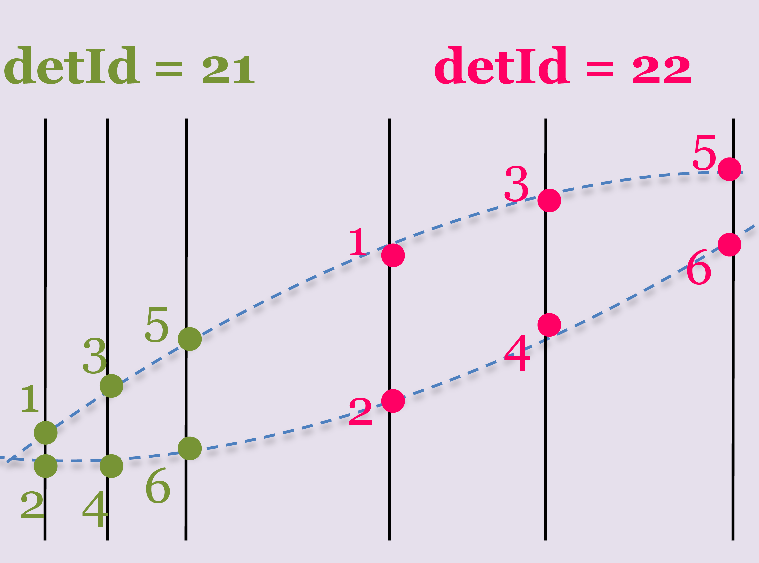
PndTrackCand
Is a collection of hits
Each hit is represented by a PndTrackCandHit which is a FairLink(detId, hitId) plus a sorting parameter rho.
detId is the branch ID of the detector who generated the hits
hitId is the position in the TClonesArray
Rho is an sorting parameter of a hit along the track
No fixed rule how to calculate rho

Slide 12
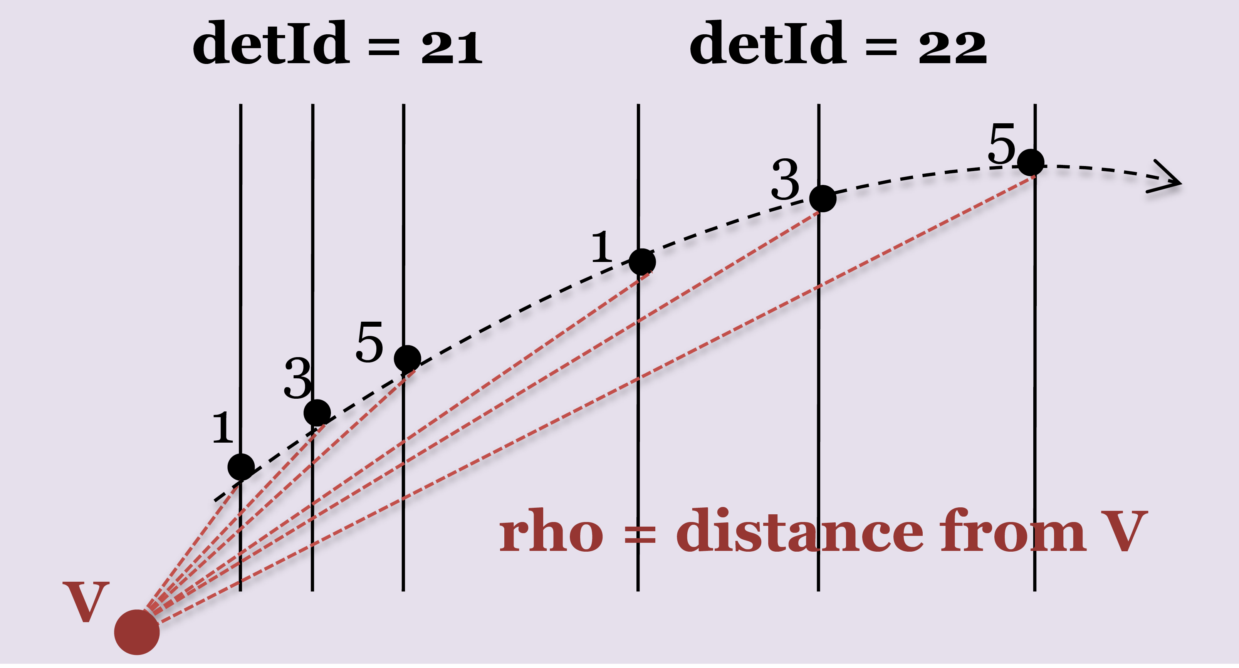
PndTrackCand - Rho
Possible candidates for Rho
Distance from vertex (not a good one)
Time (but time resolution usually not sufficient)
Length along track (arc length for helix)
Secondaries: Where is the start of the track?

Slide 13
PndTrack
This is the hypothesis of a track
Identified by the momentum, charge and position at the first and last hit
PndTrackCand accessible via PndTrack
Why two times the track information?

Slide 14
Data Summary
We have two objects to describe a track:
PndTrackCand which contains the list of hits in the track
PndTrack which contains the parameters of the track
Why two objects instead of one?

Slide 15
Data Summary
We have two objects to describe a track:
PndTrackCand which contains the list of hits in the track
PndTrack which contains the parameters of the track
Why two objects instead of one?
PndTrackCand can be used by different algorithms or different particle hypotheses

Slide 16
Track finding

Slide 17
Track Finding Strategies
local
operates on the data of one sub-detector
finds all possible tracks in this sub-detector
tracks in different sub-detectors are combined via their track parameters
refit of complete track at the end
global
operates on the data of more then one sub-detector at once
finds a complete track

Slide 18
Track Finding Strategies
local vs. global
local
optimized algorithms for each sub-detector
no need to wait until data from all sub-detectors is available
several different algorithms needed (for each sub-detector and to combine the data)
how to handle tracks with insufficient hits in one sub-detector?
global
all information at hand from the beginning
just one (but big) algorithm
treatment of different kind of data difficult (straws vs. pixel)

Slide 19
Track Finding Strategies
Additional considerations:
All at once ←→ Iterative
Online ←→ Offline
Performance vs. speed
Primary ←→ Secondary
Primary: coming from the interaction point
Secondary: all the rest
Primary tracks more easy to find
Secondaries important e.g. for hyperon physics

Slide 20
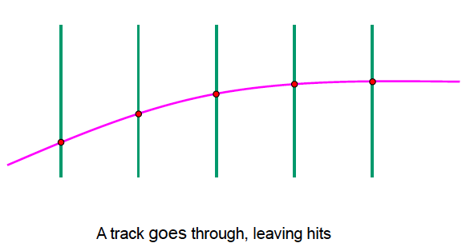
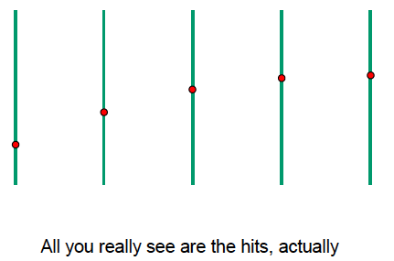
Track Finding
Considerations
Finite number of planes
Often only one coordinate per plane
Interactions with material (multiple scattering, energy loss, Bremsstrahlung for e-)
Detector imperfections (inefficiency, limited spatial resolution, alignment)
Extra hits from noise, pileup, low momentum particles…

Slide 21
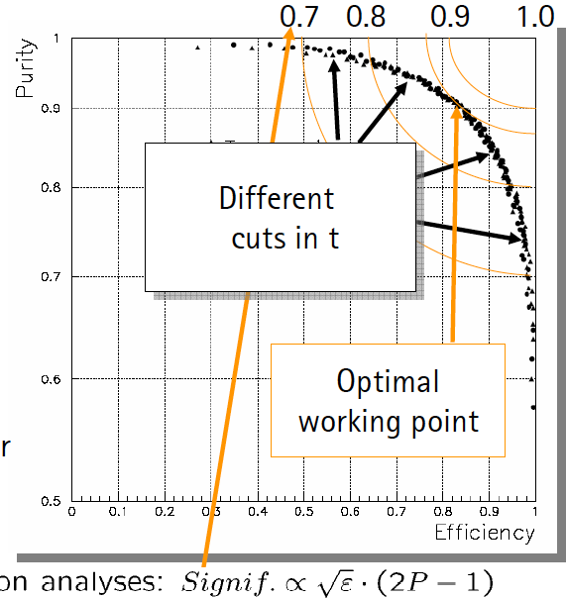
Track Finding
Conflicting Demands
High efficiency find all true tracks relevant for the physics
High purity minimize incorrect assign- ment of hits to a track, that reduces the resolution
Low ghost rate do not find fake tracks
Speed often online tracking is needed as part of a trigger decision (limited time (latency) and resources).

Slide 22
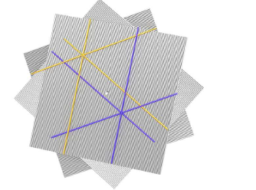
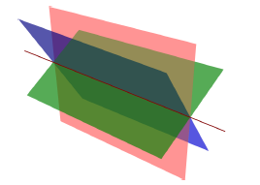
Track Finding with 1D Detectors
Tracking in space (generally needs many layers)
Combine layers to get a 3D space point,
do 3D tracking with these points
Tracking in projections (generally needs more CPU)
find 2D track candidates, then
combine projections (here each line in 2D is a plane in 3D)

Slide 23
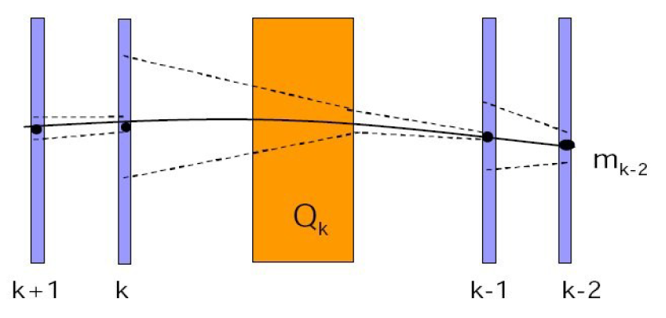
Local Method: Track Following
Follow track through layers
Define initial track segment (track seed)
Use track model to extrapolate to next detector layer
Define search window around expected position, depends on resolution and amount of material
If hit found, add it to the track candidate and iterate to next layer
Detector inefficiency: if no hit found go to next layer, allow several missing layers
Allow for combinations, if more than one hit in window follow all paths concurrently, decide later what is correct
Kalman-filter, will be discussed later

Slide 24
Global Method: Histogramming
For circular tracks (homogeneous B-field (usually solenoid))
Conformal mapping (transformation: circles to lines)
Compute angle Φ
Make a histogram of Φ
Find peaks in Φ histogram
Transforms a 2D problem to 1D
If tracks don’t come from (x,y)=(0,0)
Line is offset, and washed out peak in 1D histogram
Solution: x’=x-x₀ and y’=y-y₀ where (x₀,y₀) is e.g. the innermost point on the track

Slide 25
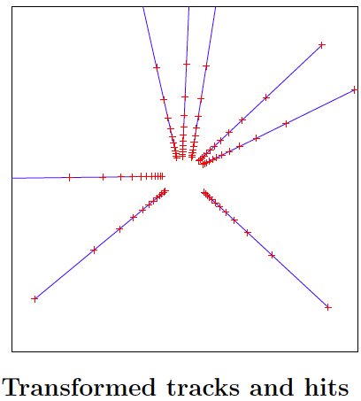
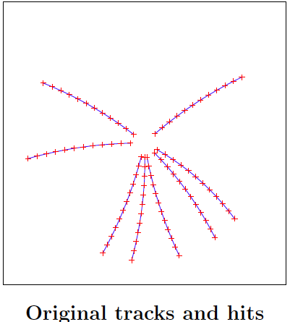
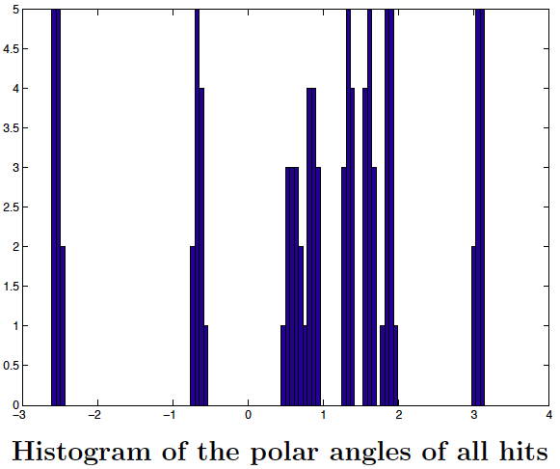
Histogram Method
Coordinate space Transformed space
As you see, the histogram binning is not arbitrary, it is related to the resolution. Too fine: then the hits don’t make a peak Too coarse: then the peaks overlap, and _{the resolution gets worse.}

Slide 26
Hough Transformation
Histogramming technique based on coordinate transformation
Transform point (image space) to parameter space
Hit in image space becomes a trajectory in parameter space
Hits from the same track → trajectories cross in param. space
Binning of parameter space (histogram) (bin size: tradeoff between resolution, efficiency and speed)
Find peaks in histogram → track candidate
Very fast for simple track models (straight line, circle)
Well suited for parallel processing → fast online trigger

Slide 27
Offline PANDA Examples

Slide 28
Global pattern recognition
PndSttMvdTrackFinder / PndSttMvdGemTrackFinder
default global PR
Contains: MVD + STT + GEM
Starts from MVD and STT stand alone track finders
Extrapolates STT to MVD and vice versa
New track candidate of MVD and STT is refitted
Refitted track extrapolated to GEM stations
Only primary tracks
No refit with GEM stations because magnetic field in GEMs not homogeneous enough for helix assumption

Slide 29
Global pattern recognition 2
PndBarrelTrackFinder
Alternative global PR
Does not start at any specific detector
Treats MVD, STT and GEM hits equal
Looks for correlation in xy plane
Tries to gather z information when possible
Hit mixing to avoid unphysical correlations
Only primary tracks

Slide 30
Online PANDA Examples

Slide 31
Riemann Track Finder
The Riemann Track Finder is based on a fast circle fit using a Riemann surface:
The 2D points in xy-plane are projected on a paraboloid (w = x² + y²)
A fast fit of a plane through the new 3D points give you the plane parameters which can be bijectively mapped to the radius and the origin of the circle
In a second fit one plots the arc length of the hits on the circle versus their z-position which should be a straight line
The method is very fast if you neglect energy loss and multiple scattering
Both can be implemented which leads to very good accuracy but then it is slower than a standard Kalman fit
Riemann fit was implemented by Sebastian in pandaRoot but without error treatment

Slide 32
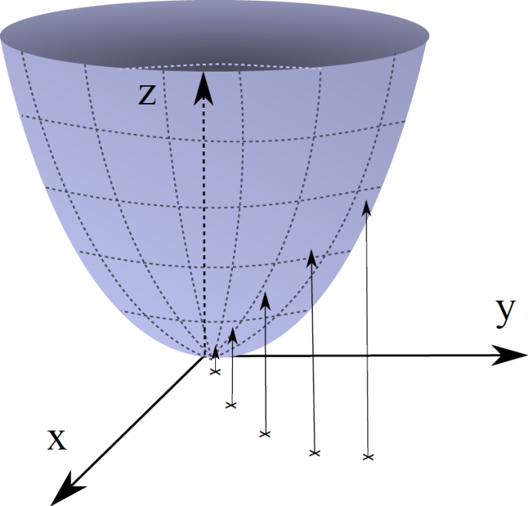
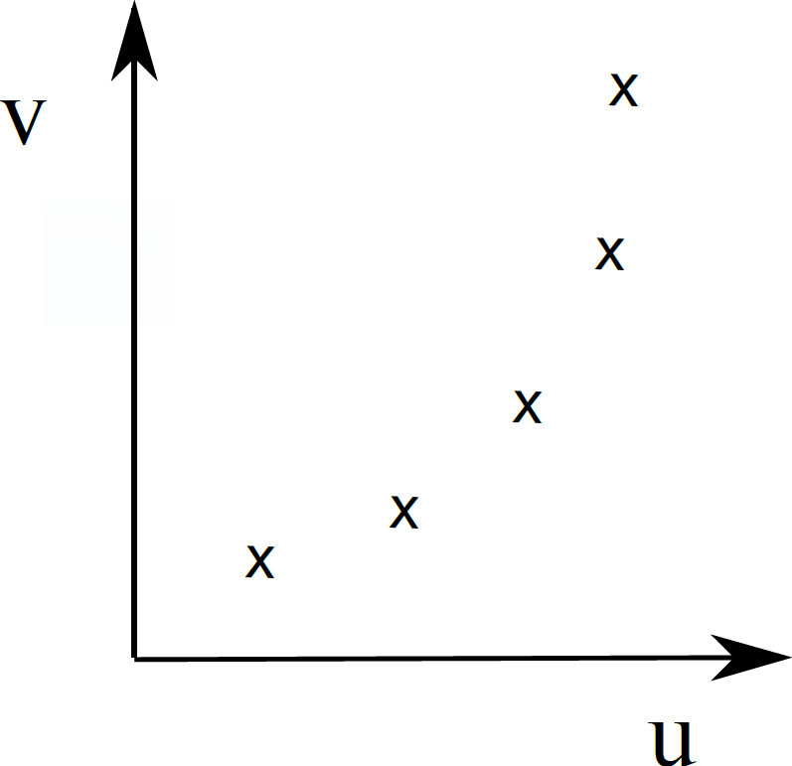
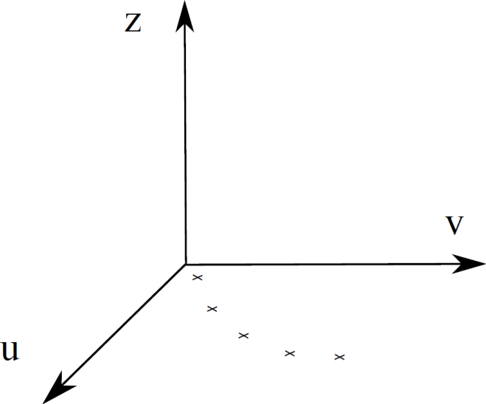
Riemann Track Finder
Points to be fitted
Add z-dimension
Map onto paraboloid

Slide 33
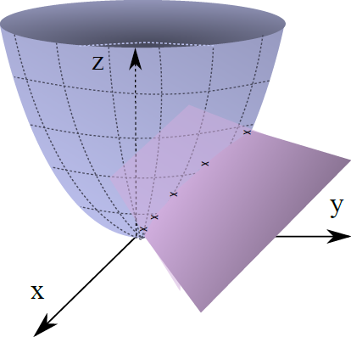
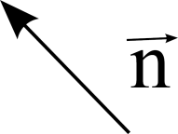
Calculation of plane through 3D points simple eigenvalue determination

Slide 34
Riemann Track Finder
Find all (reasonable) combinations of three points
Calculate Riemann plane
Calculate distance of all hits to plane
If below threshold add them to plane
Recalculate plane at the end (or in between?)
Take only those planes (circles) with more than 3 hits
Linear fit or arc length vs. z-coordinates of hits for z-Dimension

Slide 35
CA Track Finder

Slide 36
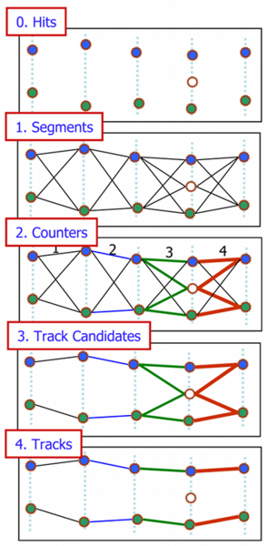
Cellular Automaton as Track Finder
Build short track segments
Connect according to track model, estimate a possible position on a track
Tree structures appear, collect segments into track candidates
Select best track candidate

Slide 37
Cell Track Finder

Slide 38
CellTrackFinder
1. Generation of tracklets in STT
Primary tracklets: use of cellular automaton
Combination of tracklets: use of Riemann Fit
Faulty: Fit to center of the tubes
Add remaining hits to best fitting Track
→ TrackletGenerator
2. Correction of STT-Hits based on event time
Correct points for Riemann Fit by calculating tangents to the isochrones
→ HitCorrector

Slide 39
1. TrackletGenerator Cellular Automaton
Abstract discrete model for dynamic systems
Definition by:
Cell
Neighborhood relations
Discrete number of states
Transition rules for states
Simultaneous changes

Slide 40
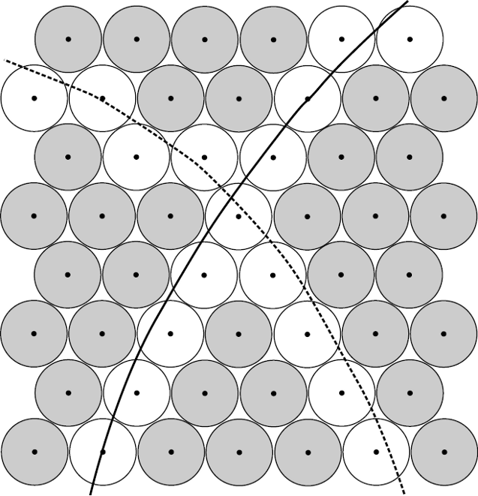
1. TrackletGenerator Cellular Automaton - Apply to STT

Slide 41
1. TrackletGenerator Cellular Automaton – Apply to STT
Number of Neighbours:
1
unambiguous
2
> 2
ambiguous

Slide 42
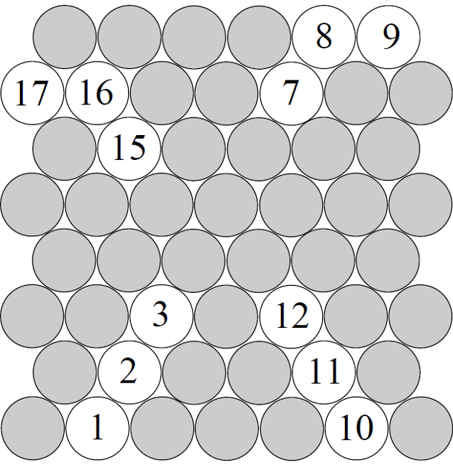
1. TrackletGenerator Cellular Automaton - Apply to STT
Cell: Straw with hit and one or two neighbours
Rule: Compare your status with the status of your neighbours and take the smallest one

Slide 43
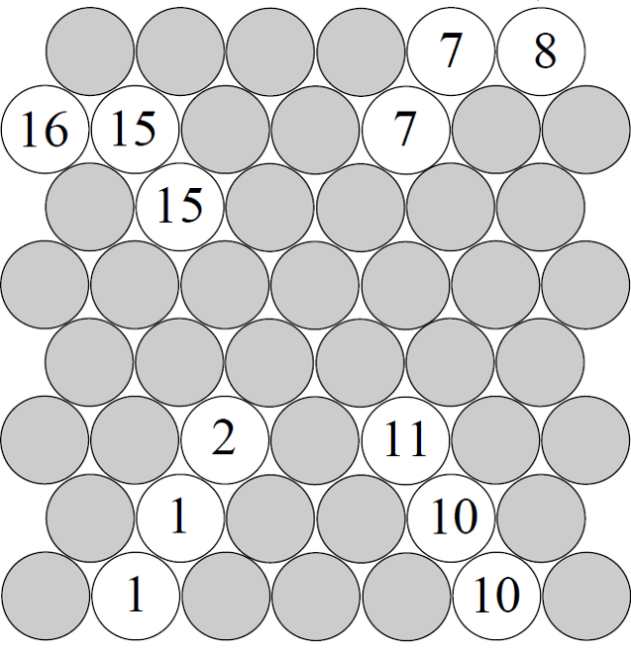
1. TrackletGenerator Cellular Automaton - Apply to STT
Cell: Straw with hit and one or two neighbours
Rule: Compare your status with the status of your neighbours and take the smallest one

Slide 44
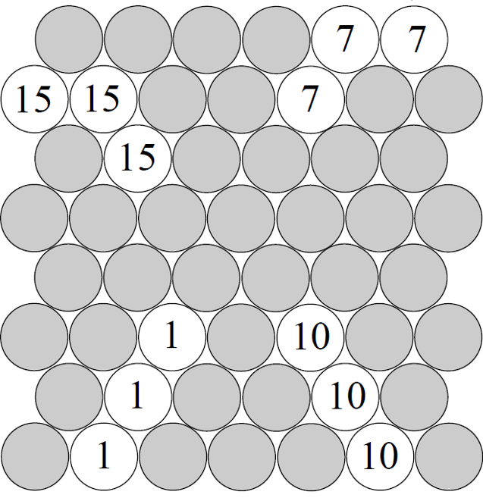
1. TrackletGenerator Cellular Automaton - Apply to STT
Cell: Straw with hit and one or two neighbours
Rule: Compare your status with the status of your neighbours and take the smallest one

Slide 45
1. TrackletGenerator Cellular Automaton - Apply to STT
Cell: Straw with hit and one or two neighbours
Rule: Compare your status with the status of your neighbours and take the smallest one

Slide 46
1. TrackletGenerator Cellular Automaton - Apply to STT
Cell: Straw with hit and more than two neighbours
Rule: Copy the status of all your neighbours into your status

Slide 47
1. TrackletGenerator Cellular Automaton - Apply to STT
Cell: Straw with hit and more than two neighbours
Rule: Copy the status of all your neighbours into your status
15
7
1
10

Slide 48
1. TrackletGenerator Cellular Automaton - Apply to STT
Cell: Straw with hit and more than two neighbours
Rule: Copy the status of all your neighbours into your status
7/15
7/15
1/10 7/15
1/10
1/10

Slide 49
1. TrackletGenerator Cellular Automaton - Apply to STT
Cell: Straw with hit and more than two neighbours
Rule: Copy the status of all your neighbours into your status
1/10 7/15
1/10 7/15
1/10 7/15
1/10 7/15
1/10 7/15

Slide 50
1. TrackletGenerator Riemann fit
Advantages
quadratic → linear
explicit solution
already implemented in PandaRoot
Fit Plane
Normal vector → Circle parameters

Slide 51
1. TrackletGenerator Result of the combination
1/10 7/15
1/10 7/15
1/10 7/15
1/10 7/15
1/10 7/15

Slide 52
Circle Hough

Slide 53
Idea
STT Isochrone
(0,0)

Slide 54
Idea
Track (circle) tangent to isochrone

Slide 55
Idea
Track (circle) tangent to isochrone
Goes through (0,0)

Slide 56
Idea
Track (circle) tangent to isochrone
Goes through (0,0)

Slide 57
Idea

Slide 58
Idea

Slide 59
Idea

Slide 60
Idea

Slide 61
Idea

Slide 62
Idea
Calculate possible circles for all hits
Fill circle centers into xy-histo
Find peaks
Hits in peaks are part of a track
Calculate track parameters from circle centers

Slide 63
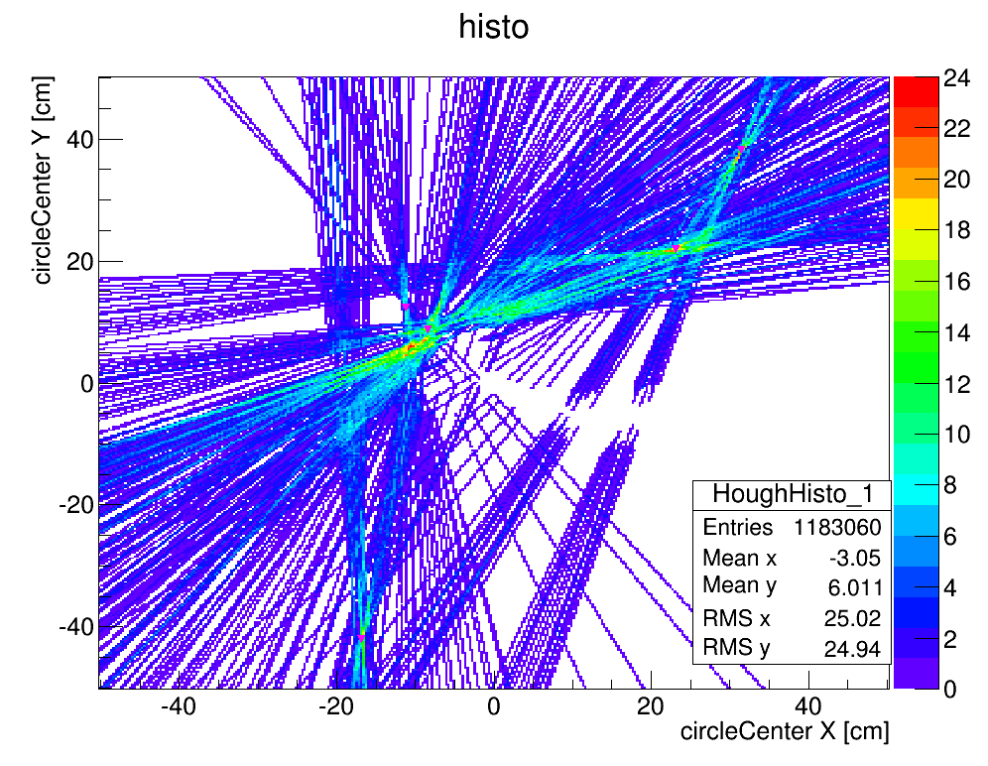
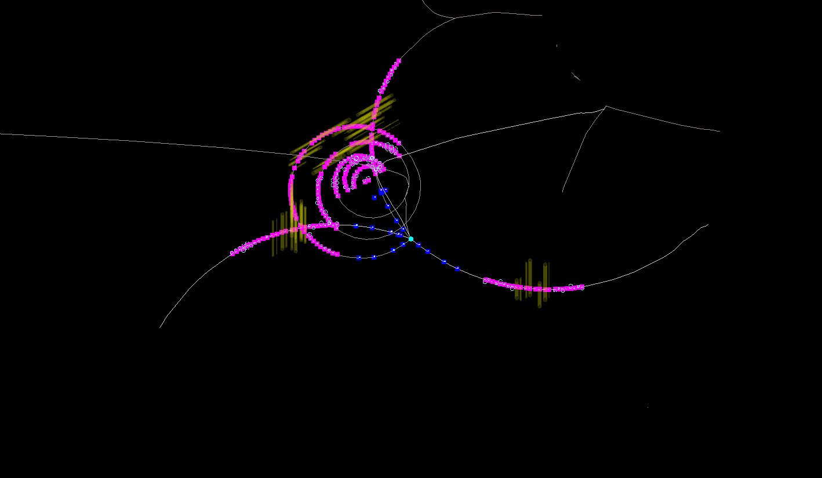
DPM Example 2

Slide 64
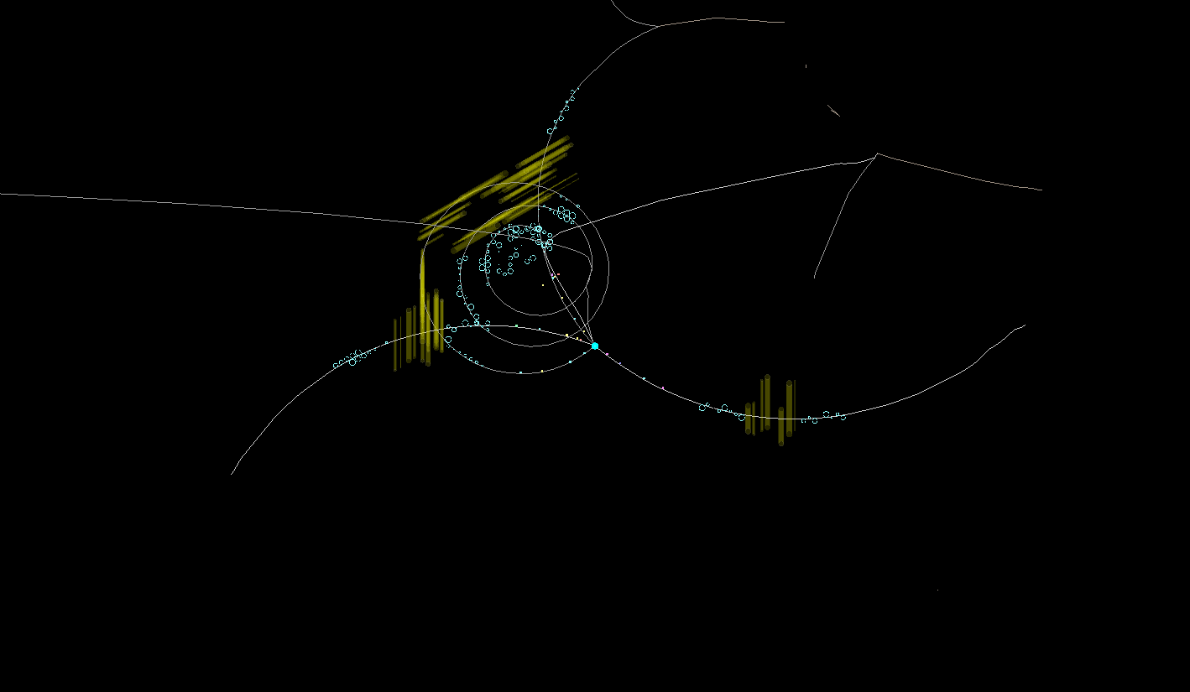
DPM Example 2

Slide 65
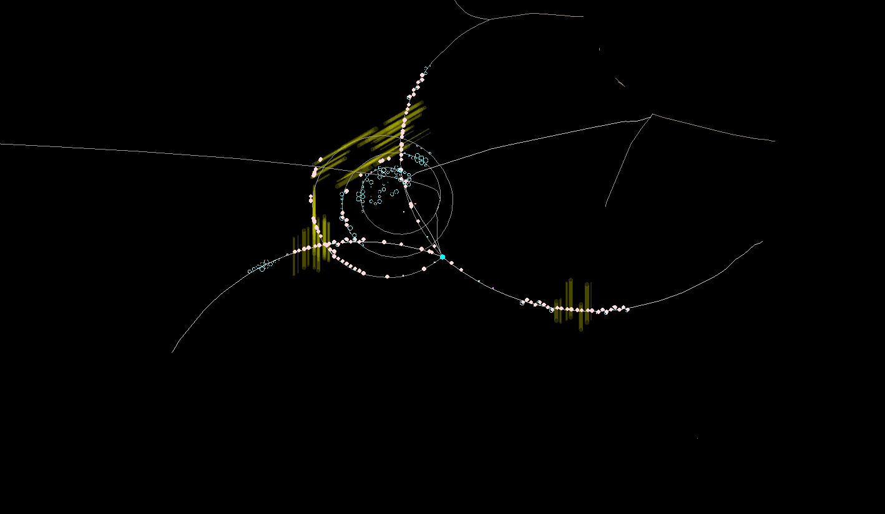
DPM Example 2

Slide 66
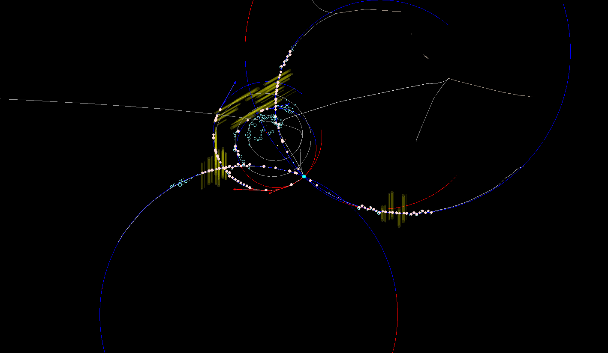
DPM Example 2

Slide 67
Kalman Filter

Slide 68
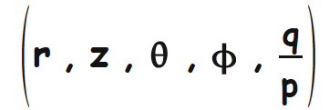
Track Parametrization
In vacuum the trajectory is defined by the initial parameters or state vector.
5 parameters are necessary and sufficient
Each point along the trajectory, describe with a 5-component state-vector (and its 5x5 covariance vector)
Should be continuous to small changes, approx. Gaussian errors, linear approximation to track propagation
Best parameterization depends upon B-field and detector geometry: e.g. detector surface normal to z-axis surface=beam pipe (collider)
✧ DELPHI barrel: x = (Φ, z, θ, β = φ − Φ, 1/R)
✧ DELPHI forward: x = (x, y, θ, φ, 1/R)
✧ CMS global: position, momentum, charge
✧ CMS local: x = (q/p, dx/dz, dy/dz, x, y)

Slide 69
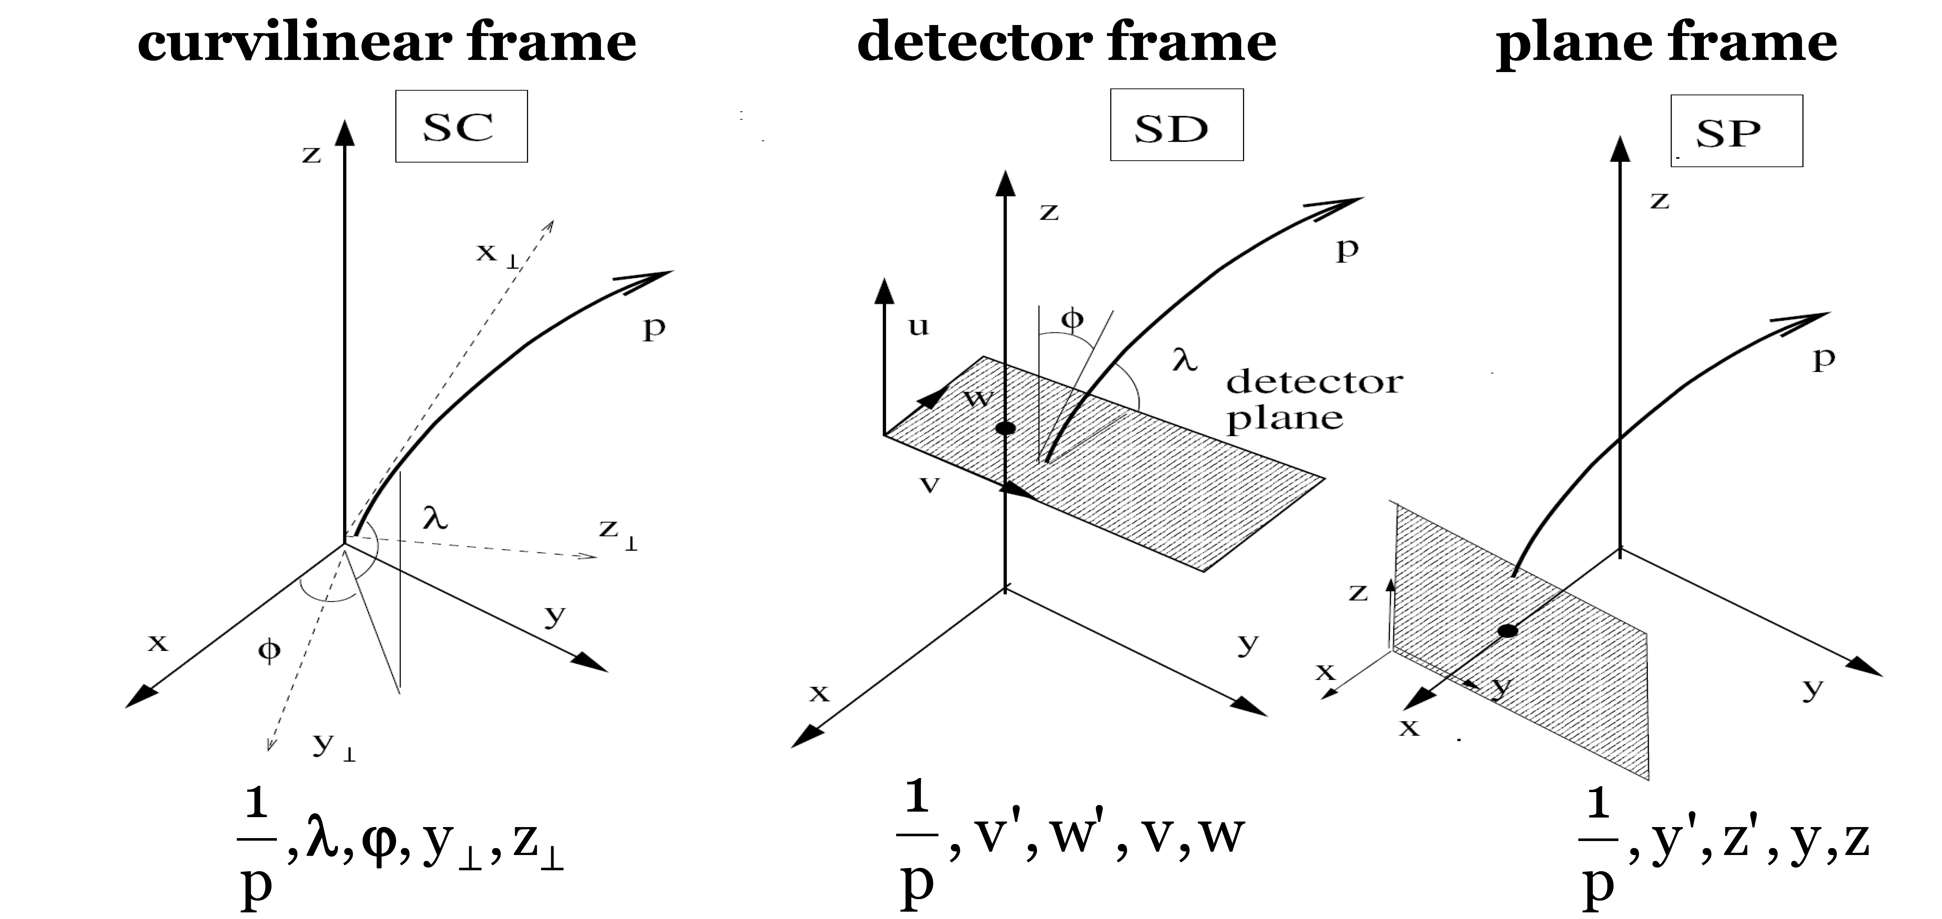
Panda Track Parametrization
FairTrackPar/FairTrackParP/FairTrackParH
The physical path of a particle of assigned mass m and momentum p is a six-fold entity of parameters: x, y, z, p_{x}, p_{y}, p_{z} (+ q)
Track is defined as set of points in detectors, corresponding to the intersection of the physical path of a particle with the detector planes → among six parameters one is fixed by the measurement plane

Slide 70
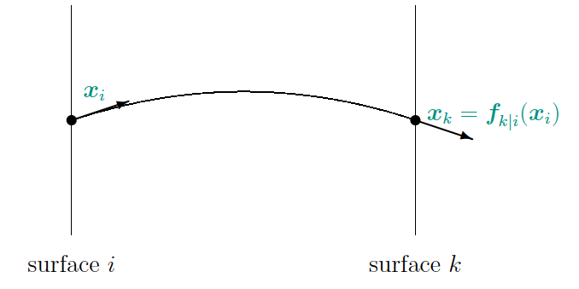
Track Model
Track Model describes how the state vector at one surface depends on the state vector at a different surface. (describes particle trajectory)
x_{k} = f_{k|i}(x_{i})
f_{k|i} is the track propagator from surface i to surface k.

Slide 71
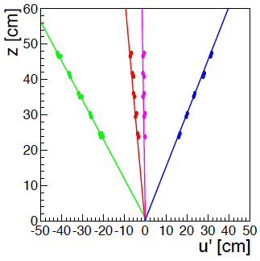
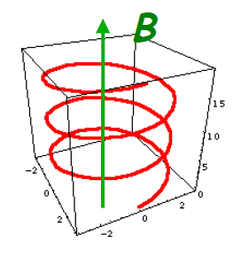
Track Model
No magnetic field, no material: straight line
Homogeneous magnetic field: helix (2D circle)
Analytic calculation only for simple cases (like above)
Inhomogeneous B-field, material (energy straggling, small angle scattering): iterative numerical extrapolation of track segments over short distances
Many tracks, many extrapolation steps, need high computing speed
Simplest: Newton iteration, or describe each segment as a parabola
Better: numerical integration like “Runge-Kutta”

Slide 72
Measurement Model
The measurement model describes the functional dependence of the measured quantities on the state vector at the detector surface:
The vector of measurements m_{k} usually collects the measured coordinates, but may contain also other quantities, e.g. measurements of direction or even momentum.
Error on measurement assumed to be Gaussian which is not always true!

Slide 73
Kalman Filter
Iterative LS estimation of the state vectors in all measurement layers (or even material layers).
Two steps are repeated:
Prediction: extrapolate the state to the next layer, add up multiple scattering, subtract energy loss
Update: combine the predicted state with the current measurement
A good initial state (seed) is important. Its weight should be small.

Slide 74
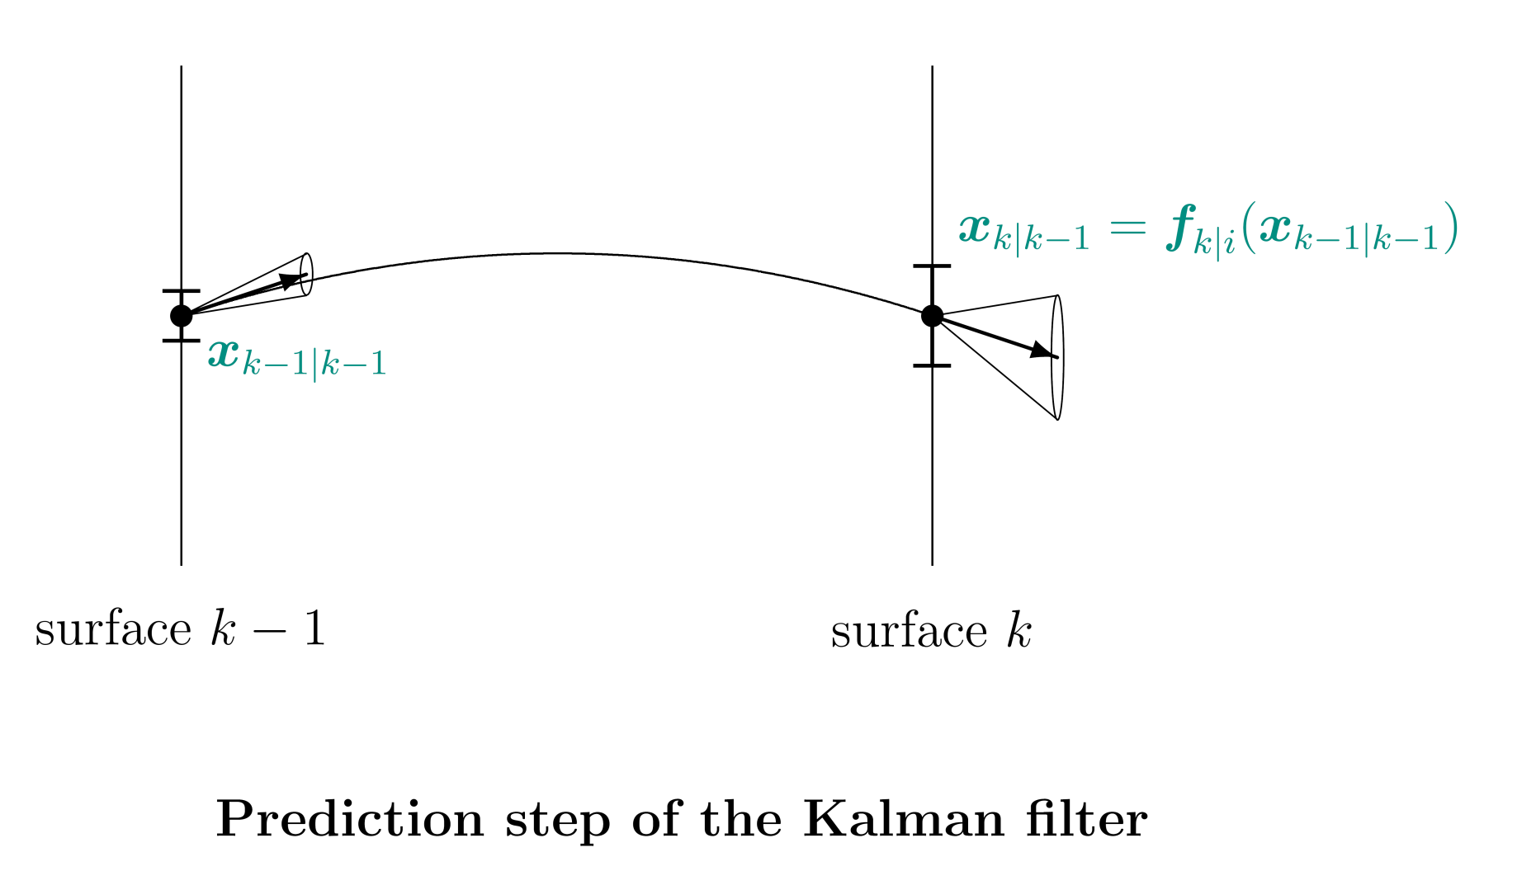
Prediction stage of Kalman Filter

Slide 75
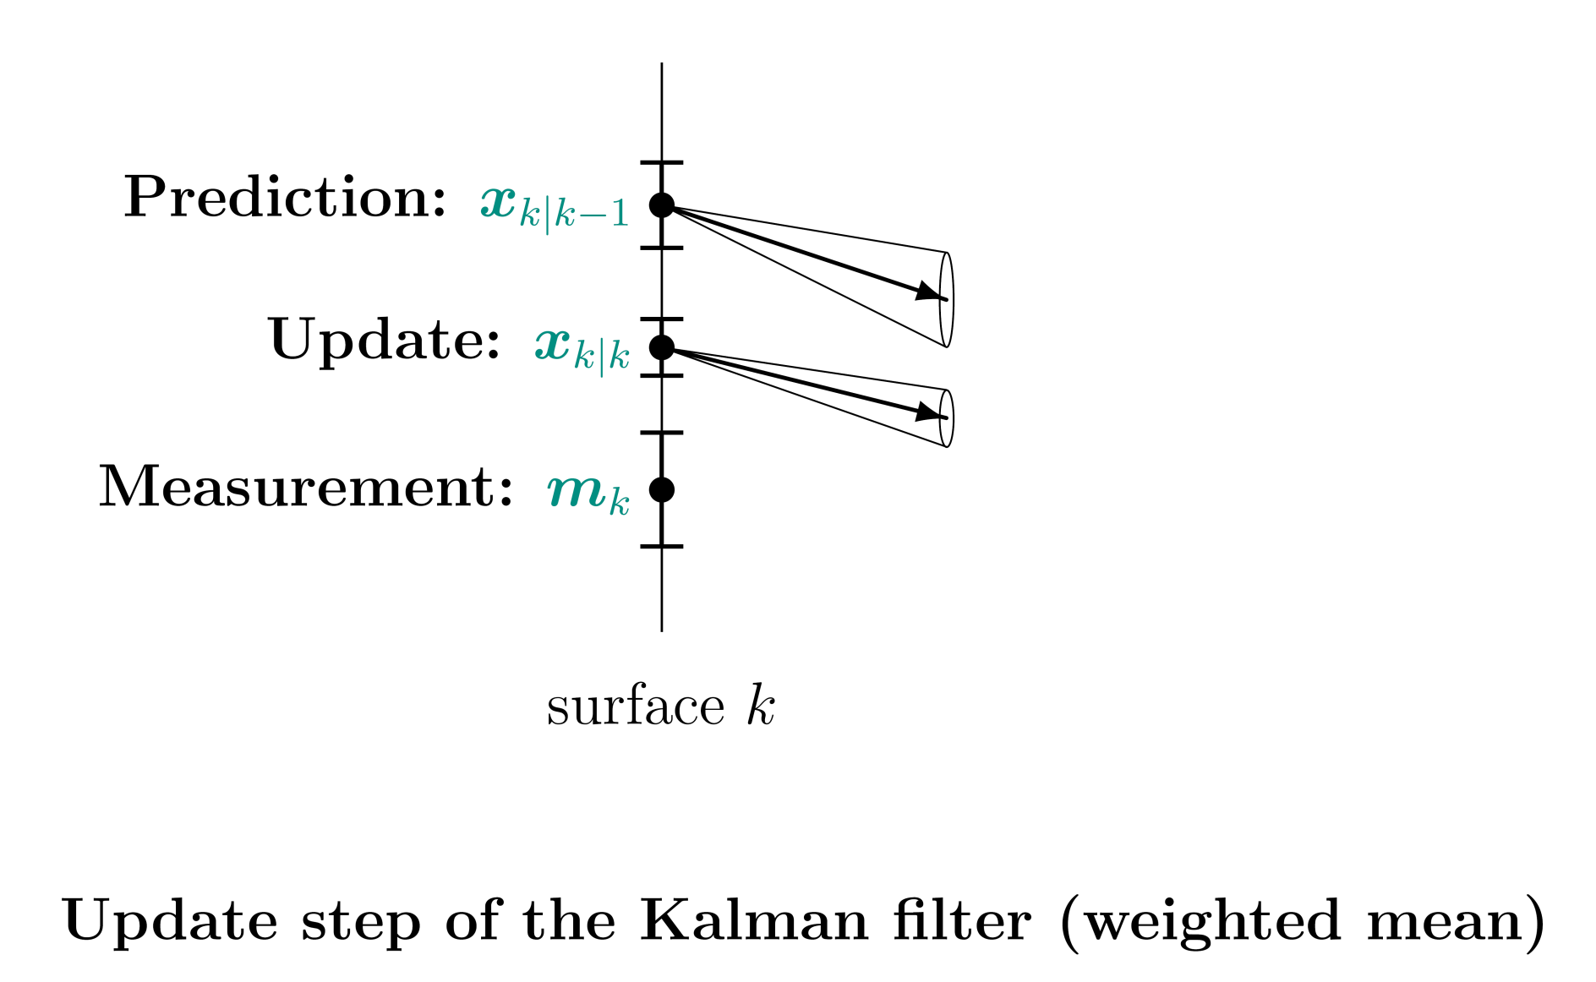
Update stage of Kalman Filter

Slide 76
Smoother
The last estimate x_{n} of the filter contains the full information.
The full information can be propagated back to all previous estimates.
This can be done by another iterative procedure, the smoother.
The smoother runs in the opposite direction to the filter.

Slide 77
Smoother
The smoother can also be realized by combining two filters.
One filter runs from m₁ to m_{n}: forward filter .
One filter runs from m_{n} to m₁: backward filter .
The smoothed states are the weighted mean of the predicted states one filter and the updated states of the other filter.
This is numerically more stable.
The smoothed state x_{0|n} is the best linear estimate and therefore the same as the usual Least-Squares estimate x

Slide 78
Kalman Filter
The Kalman filter can therefore be used for track finding.
Generate a track seed.
Iterate the following sequence:
Extrapolate and look for compatible measurements.
If there is none, go on.
If there is one, take the most compatible one and make an update.
If no compatible measurements can be found in several layers, drop the track candidate.

Slide 79
Kalman Filter in PandaRoot
Genfit
Originally started as part of PandaRoot as a generic fitting package written by TU Munich
Now independent external package
Exists (at the moment) as two implementations: Genfit 1 and Genfit 2
Genfit 1 is a very old version of Genfit using GEANE as track propagator
Genfit 2 is a more up-to-date version using a Runge Kutta track propagator → change to recent Genfit 2 planned for next release
Tests of performance are ongoing in PandaRoot

Slide 80
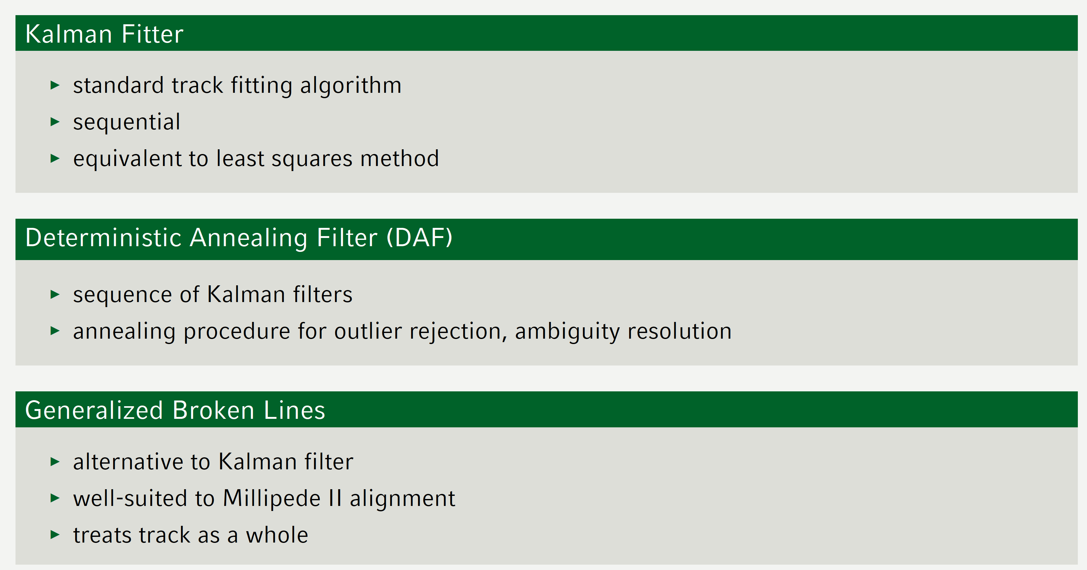
Genfit
Offers different track fitters:

Slide 81
Usage of Genfit in PandaRoot
PndRecoKalmanTask* recoKalman = new PndRecoKalmanTask();
recoKalman->SetTrackInBranchName("SttMvdGemTrack");
recoKalman->SetTrackOutBranchName("SttMvdGemGenTrack");
recoKalman->SetBusyCut(50); // CHECK to be tuned
//recoKalman->SetIdealHyp(kTRUE);
//recoKalman->SetNumIterations(3);
recoKalman->SetTrackRep(0); // 0 Geane (default), 1 RK
//recoKalman->SetPropagateToIP(kFALSE);
fRun->AddTask(recoKalman);

Slide 82
Usage of Genfit2 in PandaRoot
PndRecoKalmanTask2* recoKalman = new PndRecoKalmanTask2();
recoKalman->SetTrackInBranchName("SttMvdGemTrack");
recoKalman->SetTrackOutBranchName("SttMvdGemGenTrack");
recoKalman->SetBusyCut(50); // CHECK to be tuned
//recoKalman->SetIdealHyp(kTRUE);
//recoKalman->SetNumIterations(3);
//recoKalman->SetTrackRep(0); // 0 Geane (default), 1 RK
//recoKalman->SetPropagateToIP(kFALSE);
fRun->AddTask(recoKalman);

Slide 83
Track Propagation - GEANE

Slide 84
GEANE
Track follower / propagator
Simplified geant3 tracking algorithm + error propagation
Original Code is in Fortran
Distributed with geant3 by CERN
Part of FairRoot
It extrapolates both the mean values of the parameters and their covariance matrices
It uses the MC geometry
It takes into account:
material effects
magnetic field
physical effects
Different reference frames
Different kinds of propagation

Slide 85
Geane Interface
In geane you will find:
FairGeane: this is the task reading in the physics cuts and the physics effects to take into account
This task has to be added to your macro otherwise GEANE will not work!
FairGeanePro: contains the propagation stuff
In trackbase you will find
FairTrackPar/ParP/ParH: track representations of GEANE
FairGeneUtil: frame transformations from to MARS, SC, SD, SP (C++ translation of FORTRAN methods)

Slide 86
How to use it
First define the start plane:
Define the end position:
Do the propagation:
Back propagation:
Bool_t PropagateFromPlane(TVector3& v1, TVector3& v2);
Bool_t PropagateToPlane(TVector3& v0, TVector3& v1, TVector3& v2);
Bool_t PropagateToVolume(Tstring VolName, Int_t CopyNo,Int_t option);
Bool_t PropagateToLength(Float_t length);
Bool_t PropagateToPCA(Int_t pca, Int_t dir);
Bool_t Propagate(FairTrackParH* TStart, FairTrackParH* Tend, Int_t PDG)
Bool_t Propagate(FairTrackParP* TStart, FairTrackParP* TEnd, Int_t PDG)
Bool_t setBackProp()

Slide 87
How to use it
First define the start plane:
Define the end position:
Do the propagation:
Back propagation:
Bool_t PropagateFromPlane(TVector3& v1, TVector3& v2);
Bool_t PropagateToPlane(TVector3& v0, TVector3& v1, TVector3& v2);
Bool_t PropagateToVolume(Tstring VolName, Int_t CopyNo,Int_t option);
Bool_t PropagateToLength(Float_t length);
Bool_t PropagateToPCA(Int_t pca, Int_t dir);
Bool_t Propagate(FairTrackParH* TStart, FairTrackParH* Tend, Int_t PDG)
Bool_t Propagate(FairTrackParP* TStart, FairTrackParP* TEnd, Int_t PDG)
Bool_t setBackProp()

Slide 88
Track Propagator
Additional track propagators:
FairRKPropagator
4th order Runge-Kutta propagator
not used
PndHelixPropagator
much faster than GEANE
but no energy loss
no varying magnetic field

Slide 89
Tracking QA

Slide 90
Introduction
Various different tracking algorithms
Common basis needed to compare and improve tracking algorithms
Common development of Lia Lavezzi and me
Idea:
Have a set of macros which work on any tracking algorithms which produces PndTrack and PndTrackCand
Set of identical simulation and digitization files for all tracking algorithms

Slide 91
Criteria
Track efficiency
How many MC tracks have been found by track finder
Hit efficiency
How many hits of a MC track have been found by the track finder
Purity
Belong all hits of one found track belong to one MC track
Clones
How often was a track found by the track finder
Ghosts
How many hits not belonging to an MC track have been found

Slide 92
Criteria
Partially found
Not all hits belonging to one track have been found but all hits belong to one MC track
Spurious found
> 70% found hits belong to one MC track
Fully found
100 % of MC hits have been found and no other hits are part of the track
Clone
A MC track was found more than once
Ghost
A reconstructed track not matching to an MC track

Slide 93
Efficiency
To determine the efficiency of a track finder a basis is needed:
All tracks? What about neutral particles or tracks without hits?
Only tracks with hits? How many hits?
A barrel track finder cannot find tracks in the forward region
Different criteria defined:
At least three hits (minimum for circle determination)
Possible Track:
Definable by user via functor (who knows what a functor is?)
Some predefined in PndTrackers/PndIdealTrackFinder/PndTrackFunctor.h

Slide 94
Efficiency
Predefined functors:
StandardTrackFunctor:
MVD > 3 or MVD+Stt+GEM > 5
FtsTrackFunctor
FTS > 5
NoFtsTrackFunctor
FTS == 0 and StandardTrackFunctor
Some more specific for certain track finders
OnlySTTFunctor, RiemannMvdSttGemFunctor, …

Slide 95
Implementation
Macros in /macro/trackingQA
sim, digi and par files provided in folder
reco_complete.C(TString prefix)
Does the tracking. Your tracking code has to go here!
In addition runs an ideal track finder to compare with
Usage:
Add prefix to identify which data you want to run on
root reco_complete.C"(\"dpm_G4_7G0_1000\")"

Slide 96
Implementation
trackingQA_complete.C(TString prefix, TString branch, Int_t nEvents=0):
Compares tracking algorithms with ideal tracking
Usage
Add the same prefix as in reco_complete.C
Add the branch name with the final results of your tacking code (has to be of type PndTrack)
Optional add the number of events you want to run on
root trackingQA_complete.C"(\"dpm_G4_7G0_1000\", \"SttMvdGemTrack\")"

Slide 97
Implementation
plot_trackingQA(TString fileName)
Plots the generated histograms of trackingQA in a nice way
Usage:
Give the complete file name of the trackingQA.root file
QA_histos(TString prefix, TString trackBranch)
Generates a large set of extracted histograms
Usage:
Give prefix and branchName
comp_recoqa(TString ,fn TString fn2, int picpercan, …)
Combines the histograms of two different tracking algorithms
New feature pictures per canvas

Slide 98
Hit Efficiency

Slide 99
Momentum Resolution

Slide 100
Performance

Slide 101
Overview Performance

Slide 102
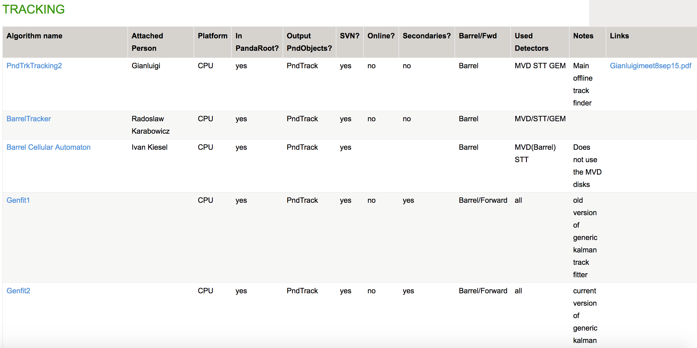
Overview of Track Finder

