Slide 1
Time-based simulation
PANDA Computing Workshop - SUT

Slide 2
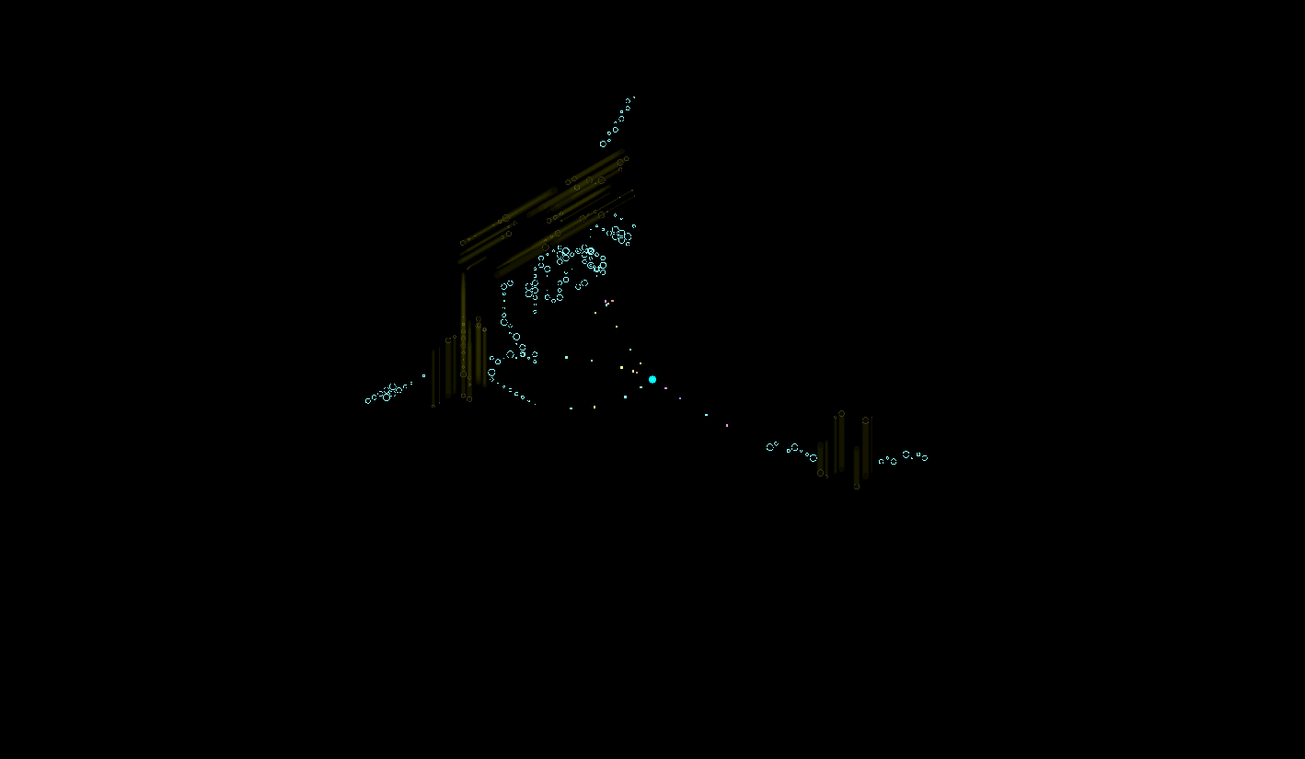
Time-Based Simulation
Single Event

Slide 3
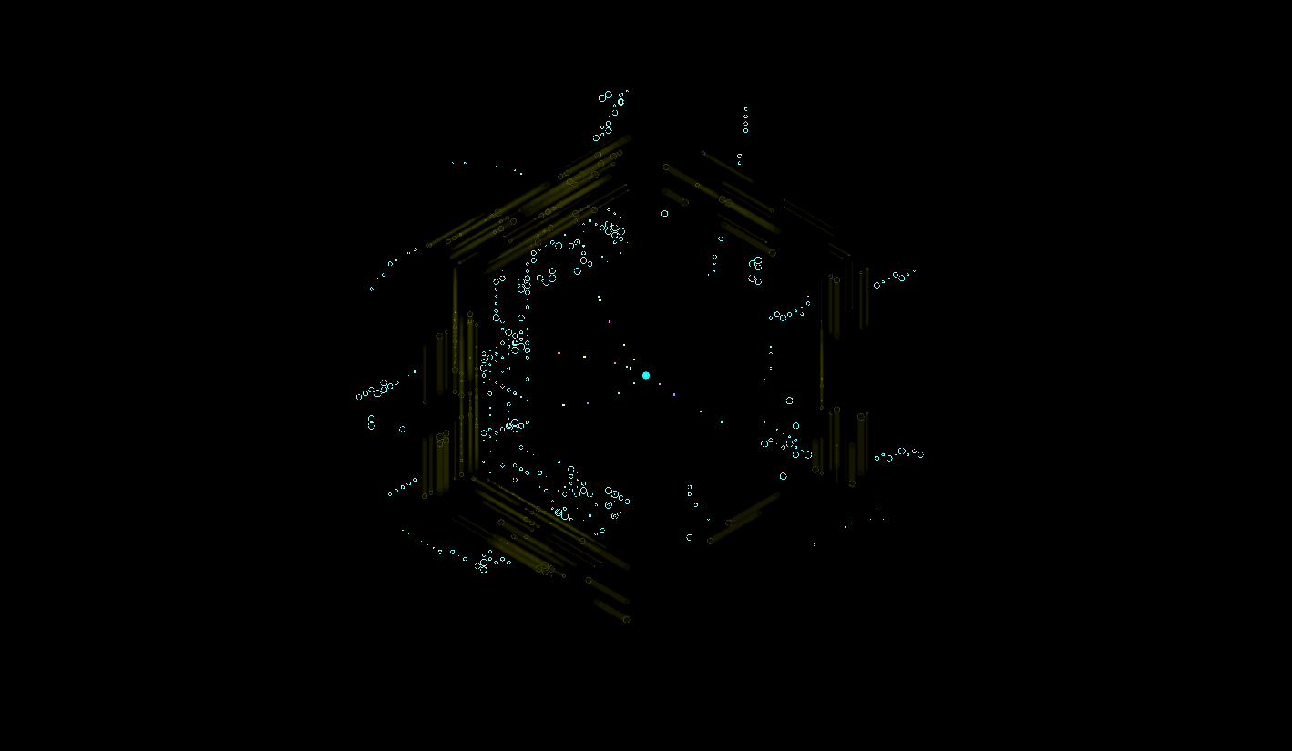
Time-Based Simulation
20 MHz overlap

Slide 4
Event Mixing (Mohammad’s work)
MC Files:
MC file does not know anything about time structure
Time structure is calculated in Digitization stage
Many different signal files can be added to one background file
Where the data is coming from is stored in EventHeader
No overlap (pileup) of events
FairMixedFileSource does the job
Back-ground
Digiti zation
Signal 1
Event 0: from BG with time 50.3
Event 1: from BG with time 72.4
………………………………….
Event 102: from Signal 1
with time 10230.1
Signal 2
…
FairRoot/examples/simulation/Tutorial2/macros/create_digis_mixed.C

Slide 5
How do events overlap?
Problem: In the (usual) event-based simulation each event can be treated completely independent of each other and time between events does not play a role. This is not the reality in experiments:
Sensor elements are still blocked from previous hits
Electronic is still busy
Hits too close in time cannot be distinguished
…
Special problem for PANDA:
Continuous beam with Poisson statistics ➔ many events with short time between them
No hardware trigger

Slide 6
Event Structure and Detector Response
ev 1
ev 2
ev 3
time
SciTil
EMC
MVD
STT
.
.
.
= detector hits from different events

Slide 7
Event Structure and Detector Response
ev 1
ev 2
ev 3
time
STT
.
.
.
= detector hits from different events

Slide 8
Event Structure and Detector Response
ev 1
ev 2
ev 3
time
Wanted data structure
STT
Data structure in Tree
Event 1
Event 2
Event 3
.
.
.
= detector hits from different events

Slide 9
Times to take into account
EventTime
EventTime [ns]

Slide 10
Times to take into account
EventTime

Slide 11
Times to take into account
EventTime
Sen s o r

Slide 12
Times to take into account
EventTime
TimeOfFlight
Time Of Flight
Sen s o r

Slide 13
Times to take into account
EventTime
TimeOfFlight
TimeStamp
U
U_{thr}
TimeStamp
t
Sen s o r
Electronics

Slide 14
Times to take into account
EventTime
TimeOfFlight
TimeStamp
Signal with different charge
U
U_{thr}
TimeStamp is charge dependent
t
Sen s o r
Electronics

Slide 15
Times to take into account
EventTime
TimeOfFlight
TimeStamp
U
U_{thr}
t
Sen s o r
Electronics

Slide 16
Times to take into account
2nd hit in same detector elemet
EventTime
TimeOfFlight
TimeStamp
U
U_{thr}
t
Sen s o r
Electronics

Slide 17
Times to take into account
EventTime
TimeOfFlight
TimeStamp
Start/ActiveTime
U
Start Time
Active Time
U_{thr}
t
Sen s o r
Electronics

Slide 18
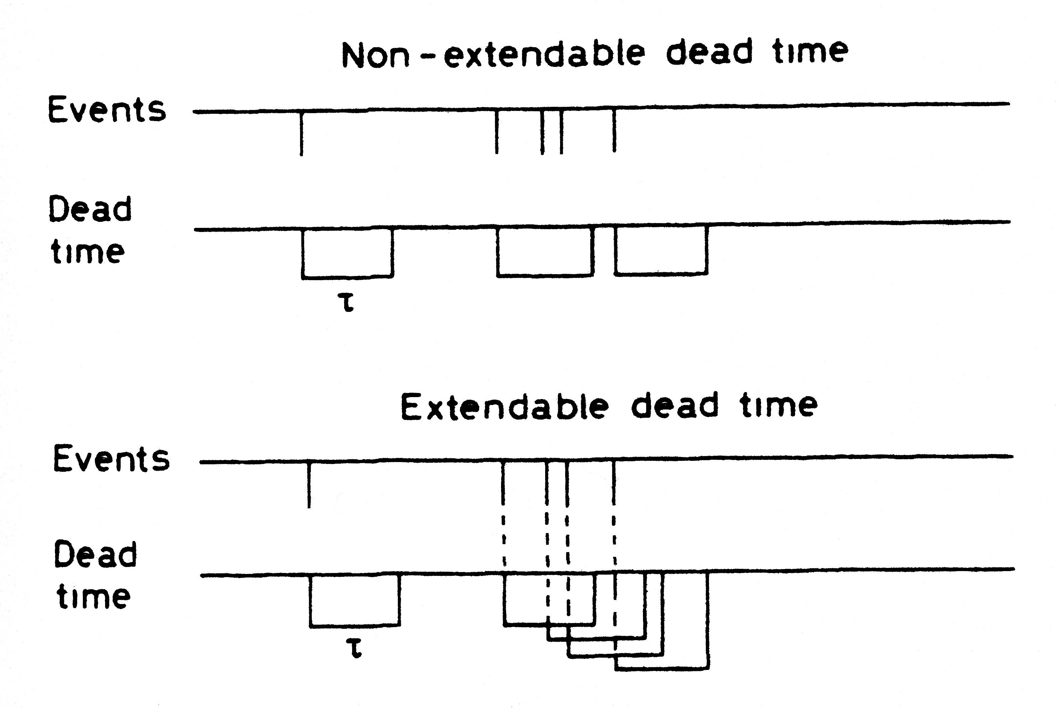
Dead Time
Finite time required by a detector to process an event, during which no additional signal can be registered
Two cases:
detector is insensitive → non-extendable/paralyzable dead time
detector stays sensitive → extendable or paralyzable dead time (e.g. rate of a Geiger-Müller counter drops at at very high dosis)

Slide 19
Necessary Times
4 times necessary:
Event Time
Assigned to Events in digitization if fRun->SetEventMeanTime(Double_t) is set in the digi macro
Value can be accessed in tasks via: FairRootManager::Instance()-> GetEventTime()

Slide 20
Necessary Times
4 times necessary:
Event Time
Time-of-Flight:
Automatically stored in the MC points of each detector

Slide 21
Necessary Times
4 times necessary:
Event Time
Time-of-Flight
Time Stamp:
Time assigned to each detector hit (MANDATORY for PANDA!)
Absolute time! (includes Event Time, ToF , Electornics)
Resolution and offset depends on individuall detector

Slide 22
Necessary Times
4 times necessary:
Event Time
Time-of-Flight
Time Stamp
Start/Active Time:
Time window an event can influence any other event happening in the same detector element
Strongly detector dependent
What happens if a second hit occurs during the active time of a previous hit is strongly detector dependent (hit lost, new hit modified, old hit modified, new hits created, …)
Absolute time!

Slide 23
FairWriteoutBuffer
Special buffer to store detector data between events
You give the data you want to store an absolute time window this data is active in your detector and can influence later events.
If the same detector element is hit a second time the data is modified.
This is an abstract base class where you have to inherit from

Slide 24
Sorting the data

Slide 25
Sorting the data
It is essential for the later extraction of the data that it is sorted by its time stamp
A base class for the sorter (FairRingSorter) and a base class for a sorter task (FairRingSorterTask) are already implemented in the software
To use them you have to derive your own sorter classes from them and overwrite some methods

Slide 26
Technical implementation – Ring Sorter
Number of storage cells given by the spread of the time stamps within the data stream
Width of one storage cell given by time resolution of detector
Storage Pointer
position calculated numerically from time stamp
0-Element Pointer
If a storage position is calculated which would override old data, the old data is saved to disk and the storage cell is freed

Slide 27
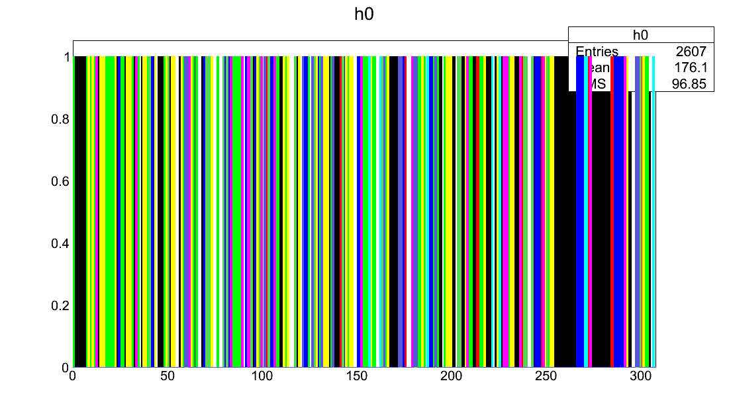
Digi Data randomized
Digi Data Stream
Same color = same event
Digi Index

Slide 28
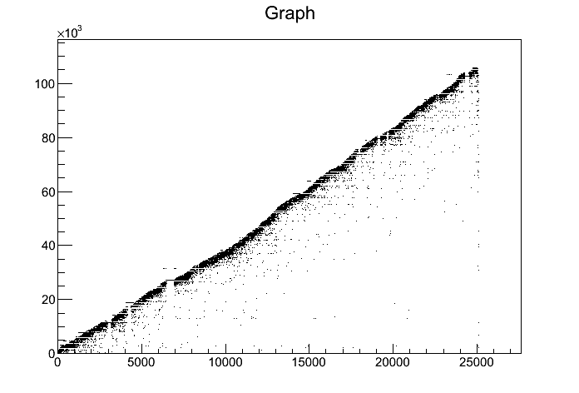
Digi Data randomized
TimeStamp of Digi vs Index
Time Stamp [ns]
Digi Index

Slide 29
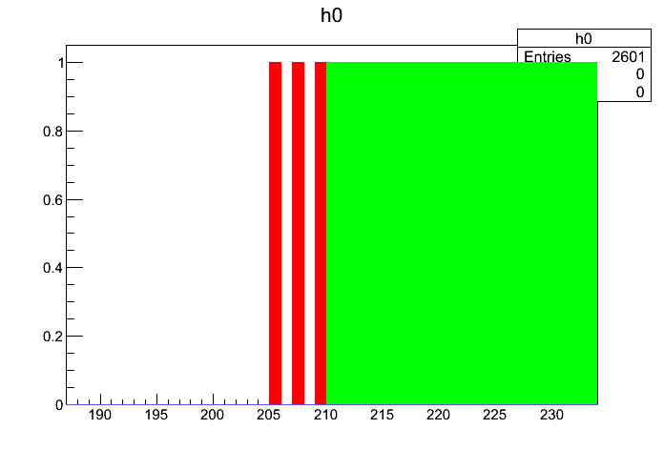
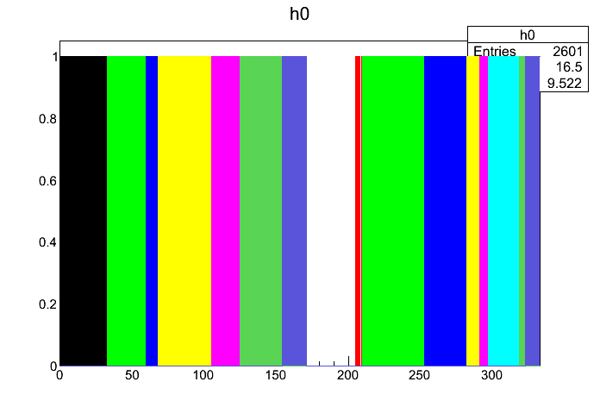
Digi Data Sorted
Digi Data Stream
Same color = same event
Digi Index

Slide 30
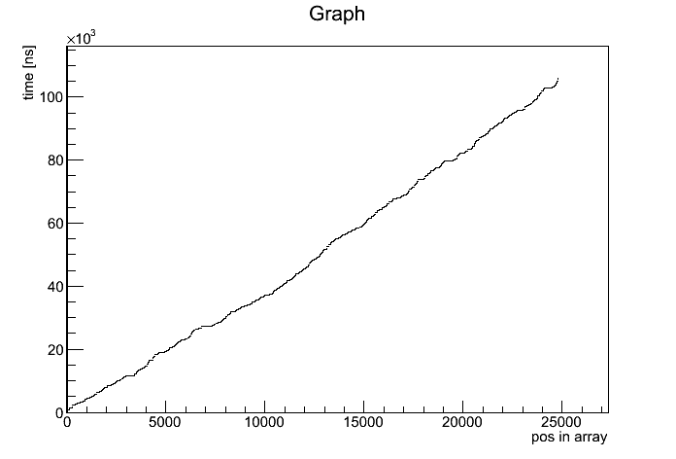
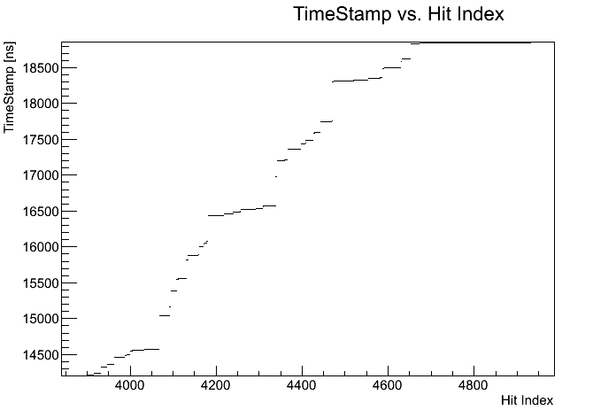
Digi Data Sorted
TimeStamp of Digi vs Index after sorting
Time Stamp [ns]
Digi Index

Slide 31
Reading back the data

Slide 32
Reading back data
Reading back data is done via the FairRootManager
Two different methods exists
FairRootManager::GetData(BranchName, Functor, Parameter);
FairRootManager::GetData(BranchName, StartFunctor, StartParam., StopFunctor, StopParam.);
GetData with one functor/parameter runs always forward in time
Data is only read once
GetData with two sets of functor/parameter is able to get data within a time interval
Data can be extracted many times
Works only with special functors ➔ next page

Slide 33
What is a Functor?
A (binary)functor is a class with an operator() which takes two parameters as an input and has one output.
In our case the parameters are FairTimeStamp*, double as input and bool as output.
The functor is true if it gets data which does not fit into the selection criterion
In this way you can define your own data selectors
Existing examples:
StopTime: Returns all data with a TimeStamp less than the given parameter
TimeGap: Returns all data before a time gap larger than the given parameter
For the GetData-Method with two functors the first has to be the StopTime - functor

Slide 34
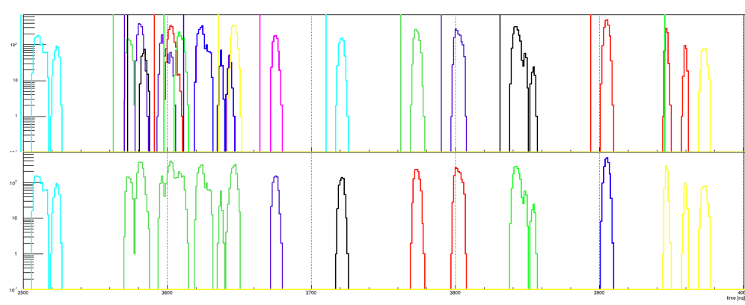
Data packaging
Select data packages according to time gaps between digi clusters
Works very well for detectors with precise time measurement
Example: GEM Digis
MC Truth
Packages
R. Karabowicz

Slide 35
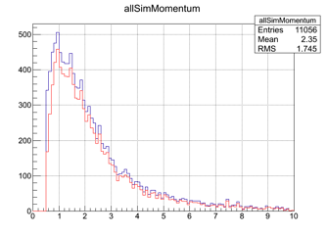
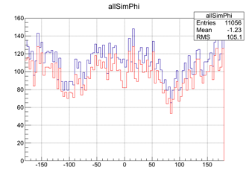
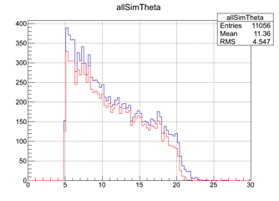
GEM Tracking Efficiency
87% for primaries with |p|>1GeV/c,
compared to ~95% in event-based reconstruction
R. Karabowitcz

Slide 36
GEM Event Building
Use the tracks’ start-time
• Tracks with start-time closer than 3 ns end up in one event (3ns come from the tracks start-times correlation), with event time set to a mean of constituent tracks’ start times
• Even one track can form an event
• Compare reconstructed event times with MC event times, if the difference is smaller than 5 ns the MC event is considered to be reconstructed
R. Karabowicz

Slide 37
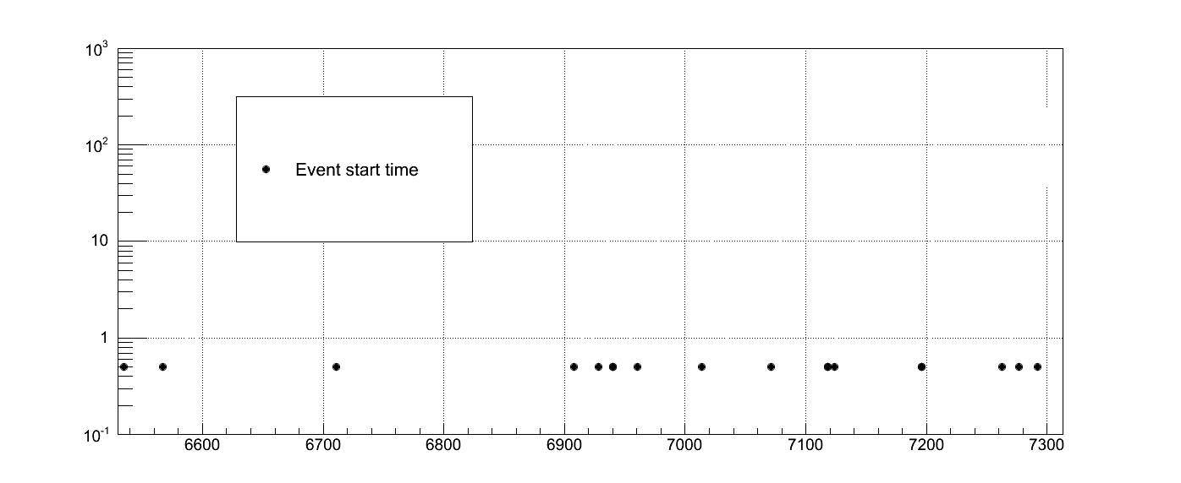
Event Builder
R. Karabowicz

Slide 38
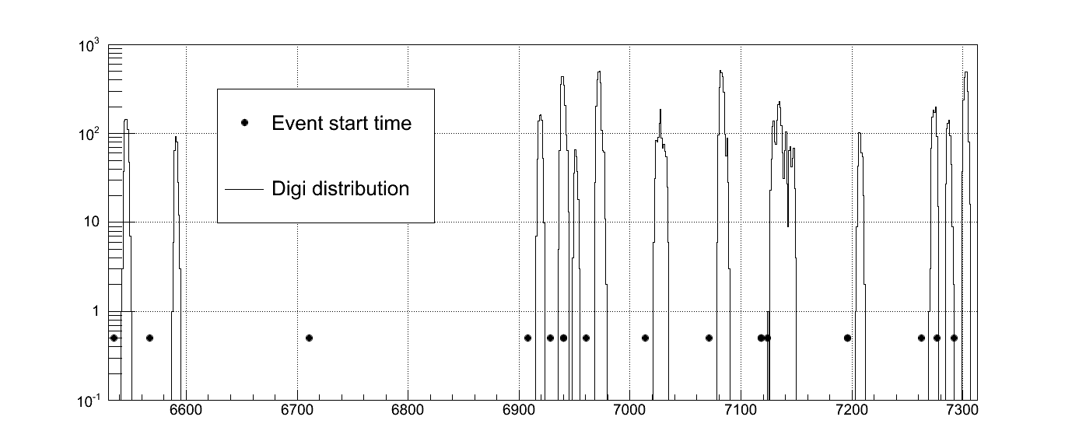
Event Builder
R. Karabowicz

Slide 39
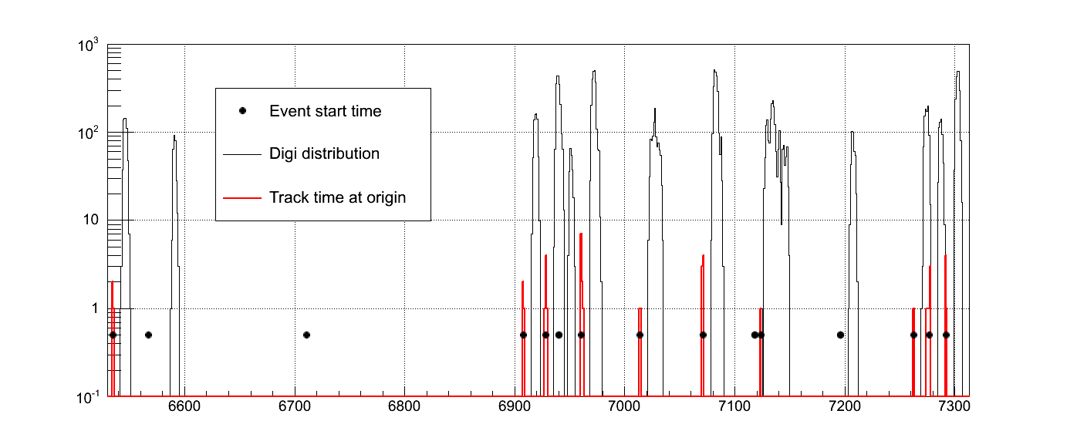
Event Builder
R. Karabowicz

Slide 40
Event Builder
R. Karabowicz

Slide 41
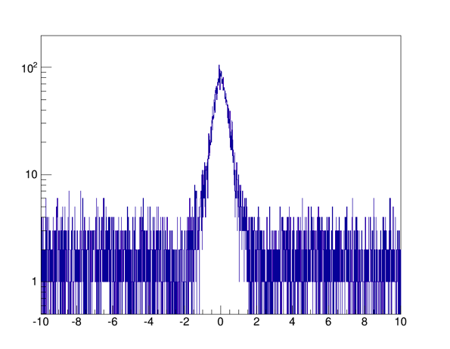
GEM Event Reconstruction
10000 DPM events
simulated
• 8165 events with reconstructable track in GEM tracker
• 7536 events Reconstructed (92.3%)
• 139 ghost events (1.8%)
R. Karabowicz

Slide 42
Event Display
Event selected by MVD via time gap
STT hits matching to MVD time

Slide 43
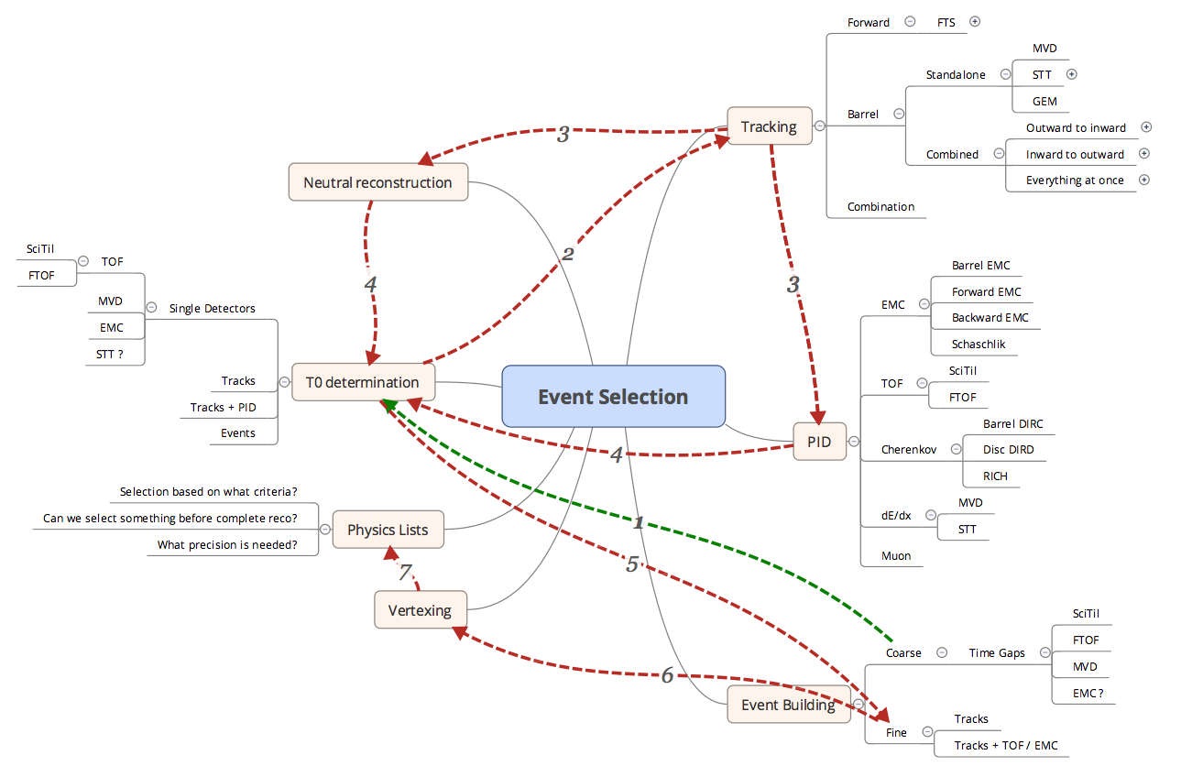
Event Building

Slide 44
How to implement it

Slide 45
Storing the data

Slide 46
STEP 1
Check the data object you want to store:
Does it derive form FairTimeStamp ?
Does it have an operator<< ?
Does it have an bool operator< (const yourClass& name) const ?
Does it have an equal(FairTimeStamp*) method?
The equal method should return true if two identical detector elements are compared (e.g. the same pixel, pad, strip, straw, …)
It should not check if the data in the element is identical as well
An example can be found in PndSdsDigiPixel

Slide 47
STEP 2
Derive your own buffer class from FairWriteoutBuffer
In the class header you have to add:
std::map<yourDataClass, double> fData_map;
yourWriteoutBuffer::yourWriteoutBuffer(TString branchName, TString folderName, Bool_t persistance): FairWriteoutBuffer(branchName, “yourDataClass", folderName, persistance)
Implement the pure virtual methods:
void AddNewDataToTClonesArray(FairTimeStamp* data) { FairRootManager* ioman = FairRootManager::Instance(); TClonesArray* myArray = ioman-> GetTClonesArray(fBranchName); new ((*myArray)[myArray->GetEntries()]) yourclass(*(yourclass*)(data)); }
Double FindTimeForData(FairTimeStamp* data) { std::map<yourclass, double>::itertor it; yourclass myData = *(yourclass)data; it = fData_map.find(myData); if (it == fData_map.end()) return -1; else return it->second; }

Slide 48
STEP 2b
Implement the pure virtual methods:
void FillDataMap(FairTimeStamp* data, double activeTime) { yourclass myData = *(yourclass*)data; fData_Map[myData] = activeTime; }
void EraseDataFromDataMap(FairTimeStamp* data) { yourclass myData = *(yourclass*)data; if (fData_map.find(myData) != fData_map.end()) fData_map.erase(fData_map.find(myData)); }

Slide 49
Modify
Overwrite Modify(…) if you want to have a different PileUp behavior (optional)
Modify(…)is called if data should be written into the buffer of an element which already exists in the buffer (e.g. same pixel hit a second time)
The standard behavior is that the new data is just ignored
Input is the old data already in the buffer and the new data which goes into the buffer
Output is a vector of data which will be stored in the buffer plus the new active time of the data

Slide 50
STEP 3
Open your digi task:
Add to the header file:
YourWriteoutBuffer* yourBufferName;
void RunTimeBased(){fTimeOrderedDigi = kTRUE;}
Bool_t fTimeOrderedDigi;
Replace in Init() the creation of the TClonesArray for your data class by::
yourBufferName = new YourWriteoutBuffer(OutputBranchName, FolderName, Persistance);
yourBufferName = (YourWriteoutBuffer*)ioman-> RegisterWriteoutBuffer(OutputBranchName, youBufferName);
yourBufferName->ActivateBuffering(fTimeOrderedDigi);

Slide 51
STEP 3
Replace in Exec() the filling of the TClonesArray of your data object by:
The writeout buffer replaces the usual TClonesArray used to store the data
If the variable fTimeOrderedDigi is set to kFALSE the behaviour of the buffer is identical to the standard TClonesArray storage of data
yourBufferName->FillNewData(yourData, theAbsoluteStartTimeOfTheData, theAbsoluteActiveTimeOfTheData);

Slide 52
STEP 4
Add to your CMakeLists.txt and …LinkDef.h file the new classes
Make sure that you store a TimeStamp including error with your data!
Now add in your digi macro the line fRun->SetEventMeanTime(yourValue); to assign a time to the events.
To use now the buffer you just need to set in your digi macro yourTask->RunTimeBased();
This data has to go to a root file before you can continue analysing the digitized data!
That’s it.

Slide 53
STEP 5
Compile it, run it, test it
If you look at the output data you should see that the digis are not any longer stored in the same entry of the branch as the MC data but at later entries.
You should have one entry more in the digi file as in the MC file

Slide 54
STEP 6
For the FairRingSorter only the method CreateElement() has to be overwritten
This method creates a new element of the object which was passed by a FairTimeStamp pointer to the method
Here is an example:
FairTimeStamp* PndSdsDigiPixelRingSorter::CreateElement(FairTimeStamp* data) {
return new PndSdsDigiPixel(*(PndSdsDigiPixel*)data);
}

Slide 55
STEP 7
For the FairRingSorterTask two methods have to be overwritten: InitSorter and AddNewDataToTClonesArray
Here is an example of InitSorter:
And for AddNewDataToTClonesArray:
FairRingSorter* PndSdsDigiPixelSorterTask::InitSorter
(Int_t numberOfCells, Double_t widthOfCells)
{
return new PndSdsDigiPixelRingSorter(numberOfCells, widthOfCells);
}
void PndSdsDigiPixelSorterTask::AddNewDataToTClonesArray
(FairTimeStamp* data)
{
FairRootManager* ioman = FairRootManager::Instance();
TClonesArray* myArray = ioman->GetTClonesArray (fOutputBranch);
new ((*myArray)[myArray->GetEntries()])PndSdsDigiPixel (*(PndSdsDigiPixel*)(data));
}

Slide 56
Test it
Compile it.
Add to your digi task the new sorter task after your digitization task.
Run your digi macro.
Compare the sorted digis with the unsorted digis. In which entry of the Tree are they stored?
What happens if you change the size of the RingSorter?

Slide 57
STEP 8
Add in your reco task header: #include “FairTSBufferFunctional.h“ and BinaryFunctor* fFunctor; //!
In Init() of your task cxx file add: fFunctor = new StopTime();
In Exec() of Task:
if (FairRunAna::Instance()->IsTimeStamp()){
fDigiArray = FairRootManager::Instance()-> GetData(yourDigiBranchName, fFunctor, FairRunManager::Instance()->GetEventTime() + 10);
}

Slide 58
STEP 8
At the end of Exec() add:
fHitarray->Sort();
fDigiArray->Delete();

Slide 59
STEP 9
To activate the reading back of the data via the functors you have to add fRun->RunWithTimeStamps() in your reco macro.
If you leave RunWithTimeStamps() away GetData(…) returns the data as it is stored in the entries of your digi branch
Run your macro.
What happens if you set RunWithTimeStamps or leave it away?
What happens if you modify the functor parameters?
Test the other functor.

Slide 60
MVD Examples
Examples of the time ordered simulation can be found in /macro/mvd/TimeOrderedSim
To check that everything is working you should start a TreeViewer and scan the TimeStamp variable of your data. If it is randomized before your RingSorter and it is sorted afterwards it works.

