Slide 1
Particle Identification
originally from S. Spataro (2012)

Slide 2
Outlook
Physical Background
Current Design
Reconstruction and Correlation
Bayes Method
PID with MVA
Things to do

Slide 3
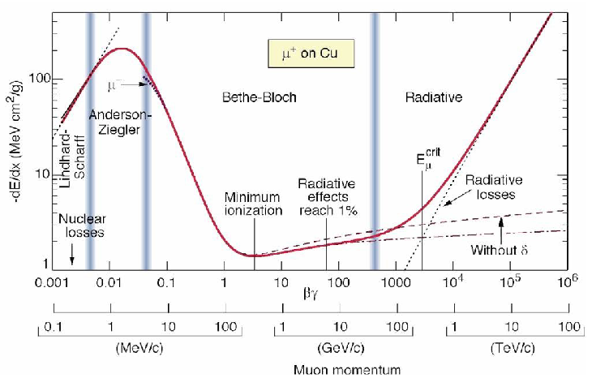
dE/dx discussion
electronic stopping power ~ β
non-ionizing interactions
bremsstrahlung
~ 1/β²
(Fermi-)Plateau
Rise: T_{max} ~ β²γ²
const
~ ln βγ
Minimum at βγ ≈ 3.0 – 3.5 ➔ minimum ionizing particle (MIP)

Slide 4
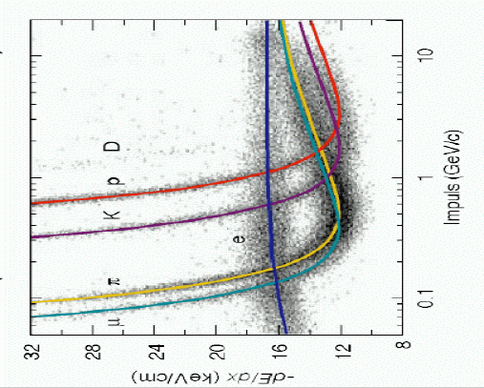
Particle Identification
dE/dX only dependent of velocity and not from mass ➔ particle identification
Heavy particles:
dE/dx well described by Bethe-Bloch-Formula
Ionization and excitation of target electrons
Electrons do not obey the Bethe-Bloch-Formula

Slide 5
Cherenkov Radiation
Cherenkov radiation is emitted when a charged particle passes a dielectric medium with velocity
➔ the particle is faster than the group velocity of light in the medium
threshold
saturated angle

Slide 6
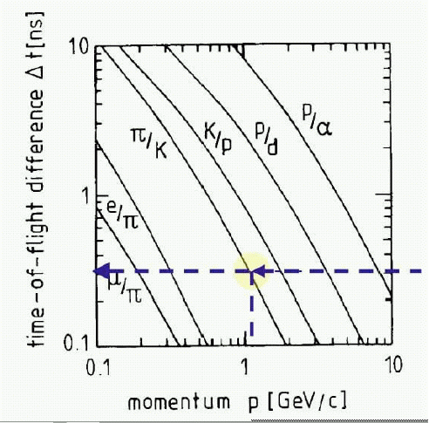
Time Difference
time difference after 1 m
time resolution 300 ps
➔ Kaon-pion separation up to 1 GeV/c for L = 3 m
TOF limited for particles with p < GeV/c

Slide 7
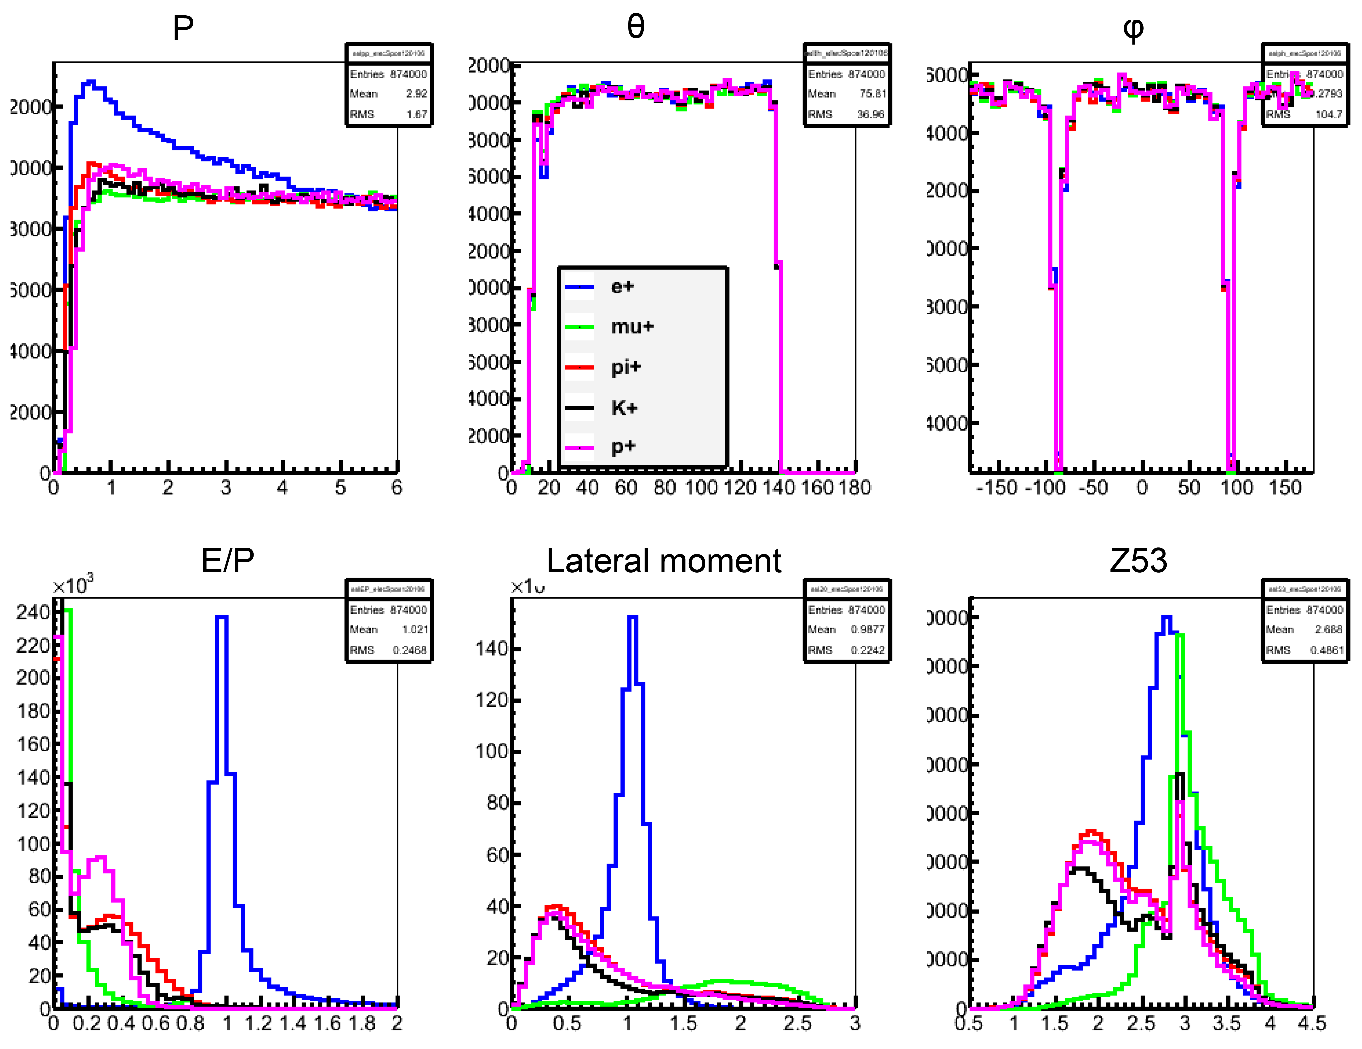
PID in EMC

Slide 8
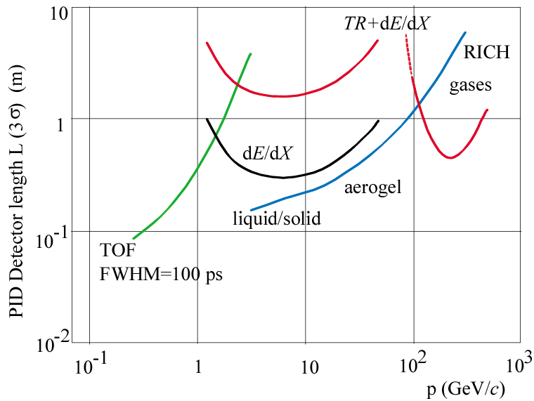
Summary of PID techniques
A number of powerful methods are available to identify particles over a large momentum range.
Depending on the available space and the environment, the identification power can vary significantly.
A very coarse plot ….
e± identification
Pion-Kaon separation for different PID methods.
The length of the detectors needed for 3σ separation.
π/K separation

Slide 9
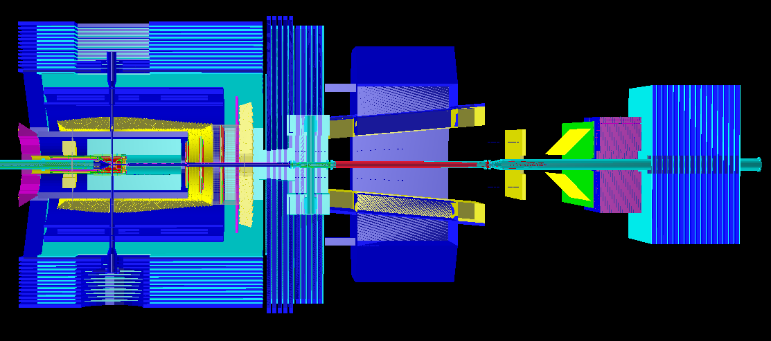
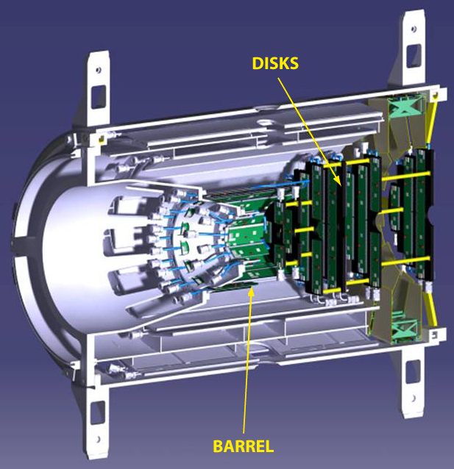
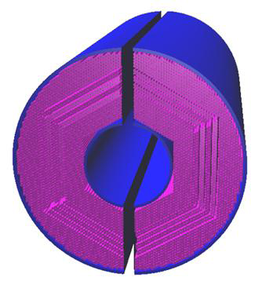
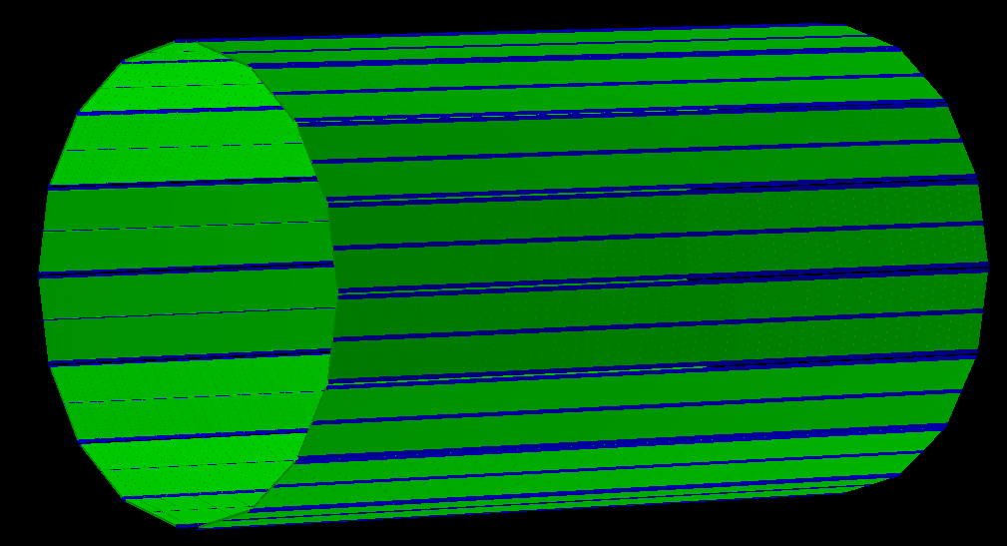
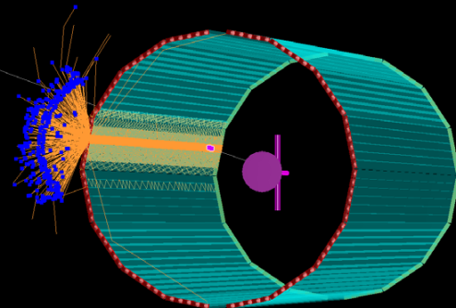
Particle Identification
Forward
EMC
MVD
STT
EMC
p
TOF
DIRC
MDT
FTOF
FWDMDT

Slide 10
PANDA Data Flow
* Dual parton Model
** Ultra Relativistic Quantum
Molecular Dynamics
Event Generator
EvtGen
DPM*
Pythia6/8
UrQMD **
FTF
Transport
GEANT3/GEANT4
Digitizer
MVD
STT
FTS
GEM
TOF
DIRC
MUON
EMC
Tracking
Charged Track
Charged Candidate
Neutral Candidate
Particle
Identification
PID Probability
Important for PID
Analysis
Analysis

Slide 11
PID Data Flow
PndTrack
(CT)
PndTrack
(CT+GENFIT)
PndTrack (FT)
PndTrack
(FT+GENFIT)
PndPidCandidate
(PidChargedCand)
PndPidCorrelator
extrapolation to PID detectors
retrieval PID information
PndPidCandidate
(PidNeutralCand)
PndPidAssociatorTask
probability/pdf
Track parameters
PID raw values
Detector indexes
PndPidProbability
Bayes, MVA, HardCuts,…
Probability/pdf for all the PID hypothesis

Slide 12
PndPidCandidate
PidChargedCand
PidNeutralCand
PndPidProbability
MVD dE/dx
P(e), P(π), P(K), …
Candidate Index
PndPidProbability
DIRC θ_{ch}
P(e), P(π), P(K), …
Candidate Index
Momentum
Time-of-flight
EMC energy
EMC shower shape
Cherenkov angle
MVD dE/dx
# Muon Layers
…
PndPidProbability
STT dE/dx
P(e), P(π), P(K), …
Candidate Index
PndPidProbability
Muon HardCuts
P(e), P(π), P(K), …
Candidate Index
PndPidProbability
MVA
P(e), P(π), P(K), …
Candidate Index
PndAnaPidCombiner
Analysis

Slide 13
Flexible way to switch between different algorithms
PndPidCandidate
PndPidProbability
PidChargedCand
Momentum
STT dE/dx
EMC energy
EMC shower shape
Cherenkov angle
MVD dE/dx
# Muon Layers
…
PidNeutralCand
Momentum
STT dE/dx
EMC energy
EMC shower shape
Cherenkov angle
MVD dE/dx
# Muon Layers
…
EMC SS
P(e)
P(π)
P(μ)
P(K)
P(p)
…
DIRC
P(e)
P(π)
P(μ)
P(K)
P(p)
…
MVD
P(e)
P(π)
P(μ)
P(K)
P(p)
…
…
P(e)
P(π)
P(μ)
P(K)
P(p)
…
PndAnaPidCombiner
analysis->FillList(pip, “PionLoose”,”BEMC;BMVD;BDIRC”)
candidate
list
selection
criterium
algorithms to merge

Slide 14
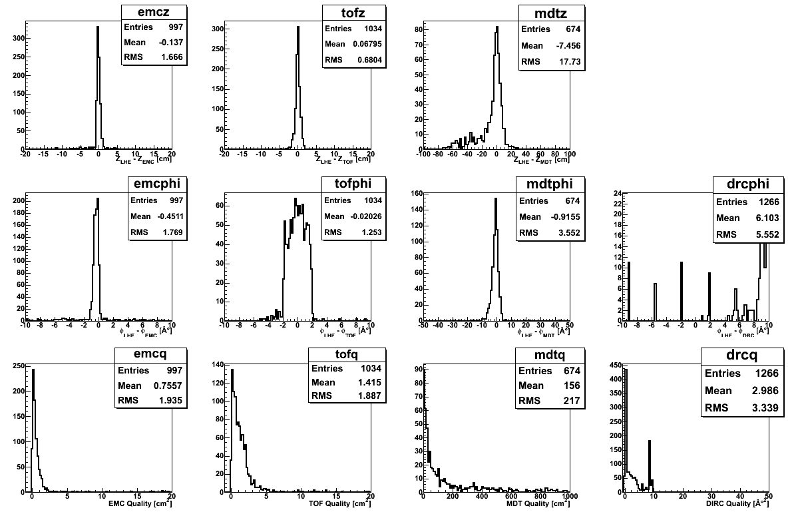
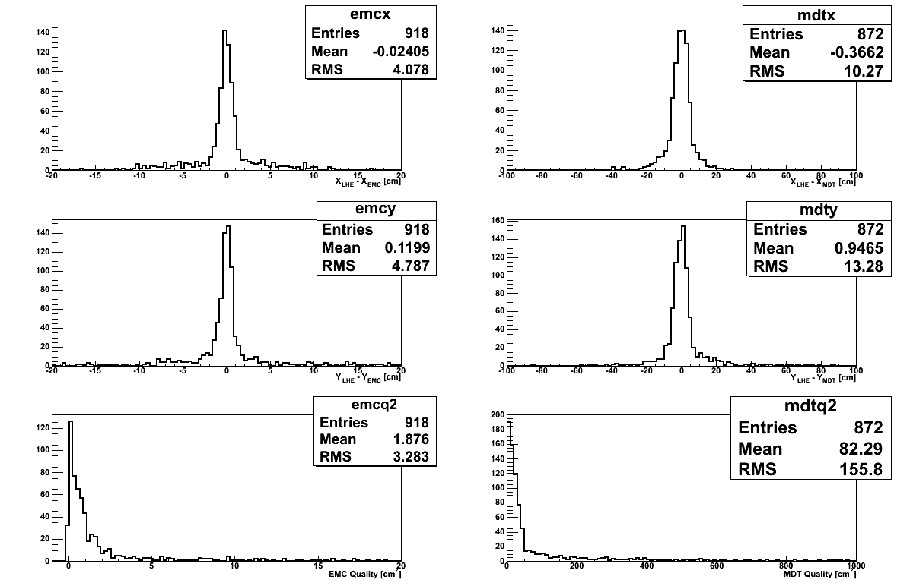
Correlation: PndPidCorrelator
correlates tracks to PID detectors
PidChargedCand
finds not correlated EMC clusters
PidNeutralCand
constructs PID informations
GEANE
Propagate to PCA
Track propagation

Slide 15
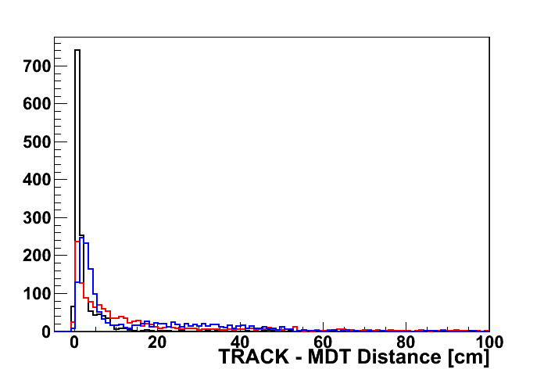
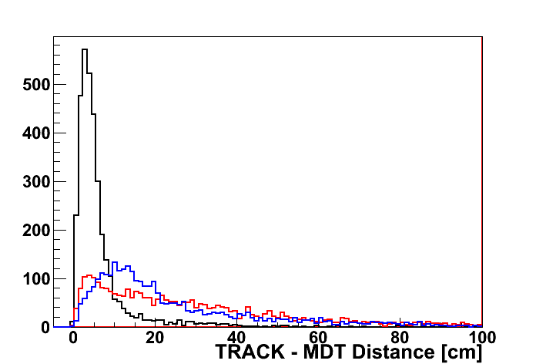
Extrapolation Residuals
ENDCAP + MF
BARREL
μ @ 3 GeV/c
@ 3 GeV/c
μ @ 1 GeV/c
μ @ 3 GeV/c
@ 3 GeV/c
μ @ 1 GeV/c
Momentum dependence!!

Slide 16
PndPidCorrelator* corr = new PndPidCorrelator();
//corr->SetVerbose();
corr->SetInputBranch("SttMvdGemGenTrack");
corr->SetInputBranch2("FtsIdealGenTrack");
//corr->SetDebugMode(kTRUE);
//corr->SetFast(kTRUE);
fRun->AddTask(corr);
Barrel tracking
Forward Tracking
No propagation, only tracks
macro/pid/run_pid_stt.C

Slide 17
//_________________________________________________________________
Bool_t PndPidCorrelator::GetDrcInfo(FairTrackParH* helix, PndPidCandidate* pidCand) {
if ((helix->GetMomentum().Theta()*TMath::RadToDeg())<20.) return kFALSE;
FairGeanePro *fProDrc = new FairGeanePro();
if (!fCorrErrorProp) fProDrc->PropagateOnlyParameters();
//---
…
for (Int_t dd = 0; dd<drcEntries; dd++)
{
drcHit = (PndDrcHit*)fDrcHit->At(dd);
if ( fIdeal && ( ((PndDrcBarPoint*)fDrcPoint->At(drcHit->GetRefIndex()))->GetTrackID() !=pidCand->GetMcIndex()) ) continue;
drcHit->Position(drcPos);
if (fGeanePro) // Overwrites vertex if Geane is used
{
fProDrc->PropagateToVolume("DrcBase",0,1);
vertex.SetXYZ(-10000, -10000, -10000); // reset vertex
FairTrackParH *fRes= new FairTrackParH();
Bool_t rc = fProDrc->Propagate(helix, fRes, fPidHyp*pidCand->GetCharge());
if (!rc) continue;
vertex.SetXYZ(fRes->GetX(), fRes->GetY(), 0.);
drcGLength = fProDrc->GetLengthAtPCA();
}
Float_t dphi = vertex.DeltaPhi(drcPos);
Float_t dist = dphi * dphi;
if ( drcQuality > dist)
{
drcIndex = dd;
drcQuality = dist;
drcThetaC = drcHit->GetThetaC();
drcThetaCErr = drcHit->GetErrThetaC();
drcPhot = 0; // ** to be filled **
}
}
if ((drcQuality<fCorrPar->GetDrcCut()) || (fIdeal && drcIndex!=-1))
{
pidCand->SetDrcQuality(drcQuality);
pidCand->SetDrcThetaC(drcThetaC);
pidCand->SetDrcThetaCErr(drcThetaCErr);
pidCand->SetDrcNumberOfPhotons(drcPhot);
pidCand->SetDrcIndex(drcIndex);
}
return kTRUE;
}
PndPidCorrelator.cxx::GetDrcInfo(…)

Slide 18
Implementation: Probability and Classifiers
pid/PidClassifier
PndPidXxxAssociatorTask
pid/PidData
pid/PidData
PndPidCandidate
PndPidProbability
GetElectronPidProb()
GetMuonPidProb()
GetPionPidProb()
GetKaonPidProb()
GetProtonPidProb()
PndPidIdealAssociatorTask
associates candidates
with MonteCarlo PID

Slide 19
PndPidIdealAssociatorTask *assMC= new PndPidIdealAssociatorTask();
fRun->AddTask(assMC);
PndPidMvdAssociatorTask *assMvd= new PndPidMvdAssociatorTask();
fRun->AddTask(assMvd);
PndPidMdtHCAssociatorTask *assMdt= new PndPidMdtHCAssociatorTask();
fRun->AddTask(assMdt);
PndPidDrcAssociatorTask *assDrc= new PndPidDrcAssociatorTask();
fRun->AddTask(assDrc);
PndPidDiscAssociatorTask *assDisc= new PndPidDiscAssociatorTask();
fRun->AddTask(assDisc);
PndPidSttAssociatorTask *assStt= new PndPidSttAssociatorTask();
fRun->AddTask(assStt);
PndPidEmcBayesAssociatorTask *assEMC= new PndPidEmcBayesAssociatorTask();
fRun->AddTask(assEMC);
macro/pid/run_pid_stt.C

Slide 20
Particle Identification
Forward
EMC
MVD
STT
EMC
p
TOF
DIRC
MDT
FTOF
FWDMDT

Slide 21
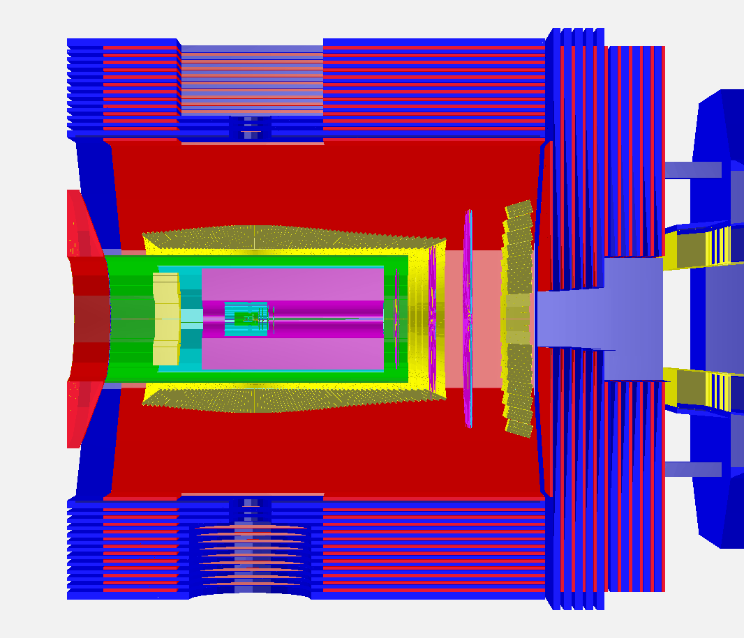
Requirements for Particle Identification
different detectors for PID
covering
different momentum/angle ranges
MVD, TPC/STT, Cherenkov, EMC, MDT…
handling of different PID signals (dE/dx, θ_{C}, EMC shower, …)
combining several PID detectors to improve identification
if one detector does not contribute to PID, it should not decrease the identification perfomances

Slide 22
Requirements for Particle Identification (II)
handling of different PID signals (dE/dx, θ_{C}, EMC shower, …)
combining several PID detectors to improve identification
if one detector does not contribute to PID, it should not decrease the identification perfomances
PID procedure should be as much as possible automatic
PID depends also on analysis
we need to separate
Detector response (i.e. resolution)
Event/track selection (analysis)

Slide 23
Probability Density Function
a function that describes the relative likelihood for a random variable to occur at a given point in the observation space (Wikipedia)
i.e. Gaussian distribution
probability to find a variable
in a given range [a,b]
Probability Density Function

Slide 24
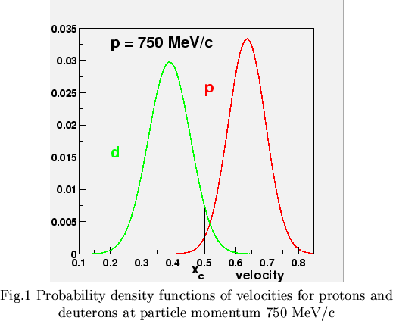
Probability Density Function - II
HADES
gaussian
distributions
For each particle hypothesis
calculation of (normalized) pdf
from simulation
from experimental data
x – signal (p, dE/dx, θ_{C}…)
h – particle hyp (e, μ, π, K, p)
depends on
detector response

Slide 25
The Bayes Theorem
If many detectors/algorithms contributing to PID
Global Likelihood
k = MVD dE/dx, DRC θ_{C}…
Probability that a given track with given params x
corresponds to particle type h

Slide 26
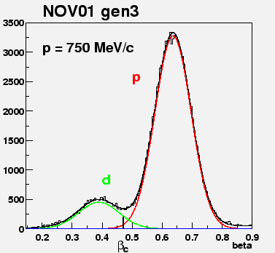
The Bayes Theorem - II
apriori probability to find the particle kind h in the detector
pdf
P(h) depends only on
track/event selection
counts

Slide 27
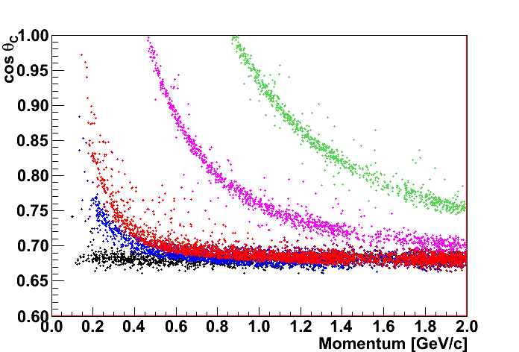
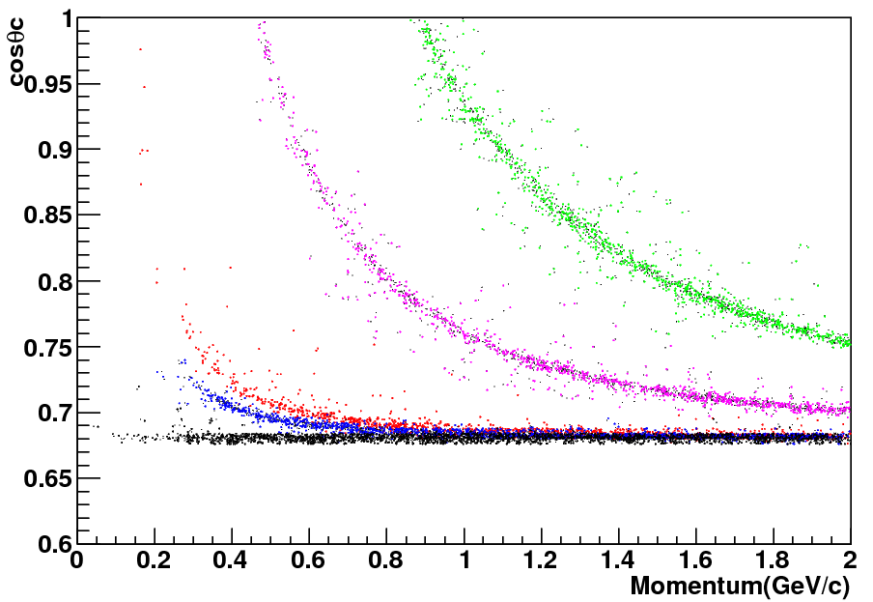
Algorithms: Bayesian Method
particle flux
Global Likelihood
probability
algorithms
BARREL DIRC
P>20%
DISC DIRC
P>20%
k
p
k
p
π
π
μ
μ
e
e

Slide 28
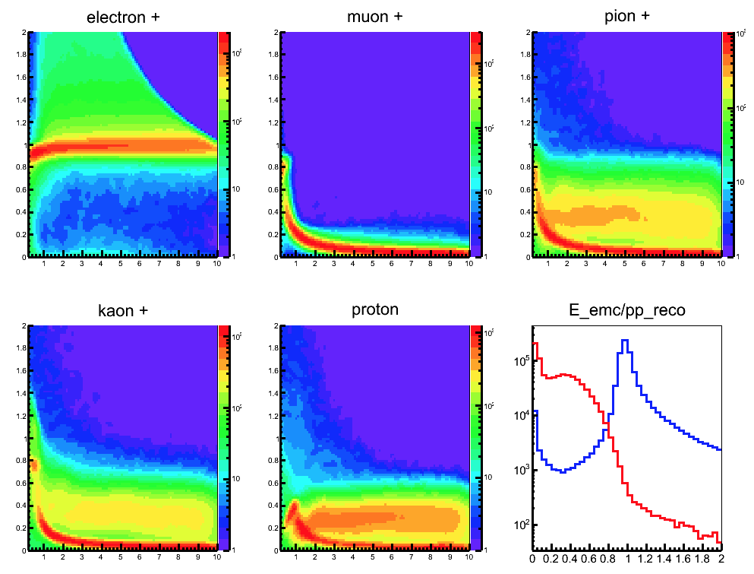
Particle Identification with EMC
μ⁺
π⁺
e⁺
E/P vs P
k⁺
p⁺
e
π

Slide 29
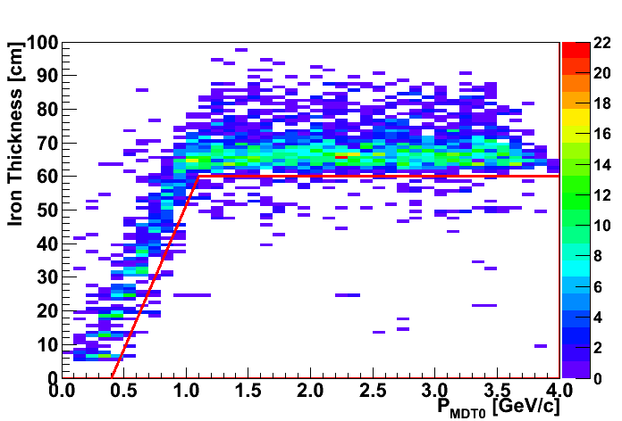
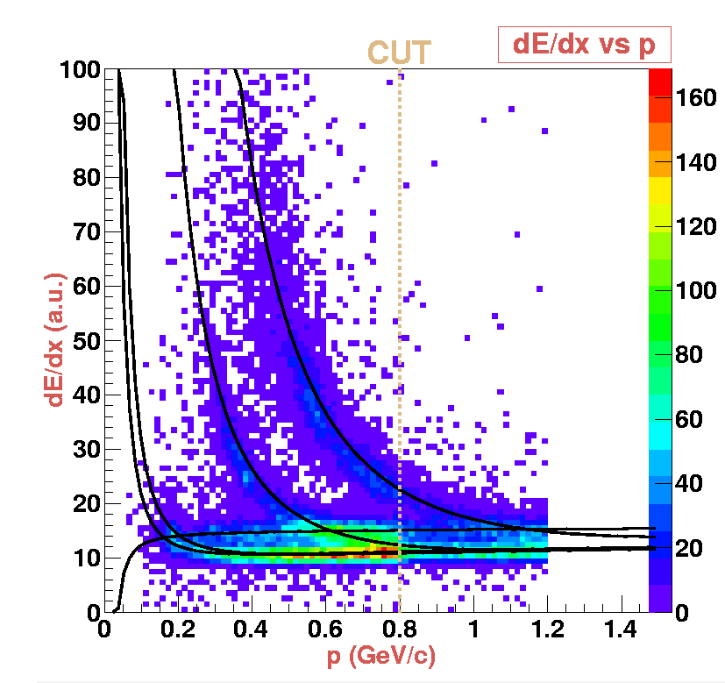
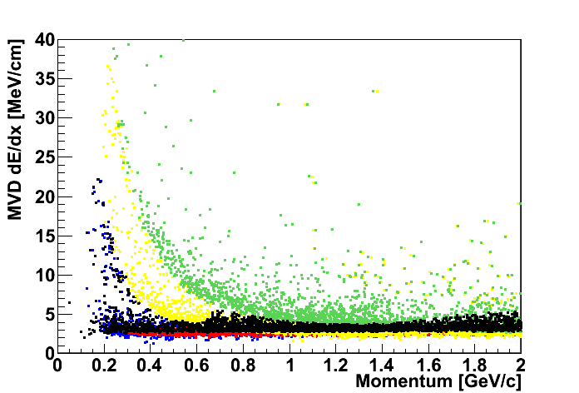
MDT: Hard Cuts
P(μ)=1
Algorithms
Bayesian Method/Hard Cuts
P(μ)=0
STT: dE/dx
MVD: dE/dx
P>20%
K
p
old plot
π
μ
e

Slide 30
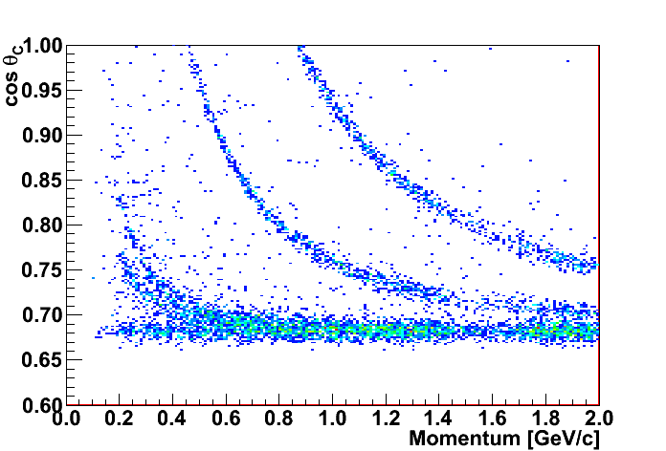
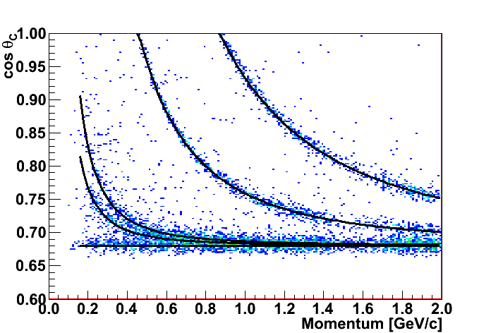
DIRC: PndPidDrcAssociatorTask (Stefano)
2000 e, μ, π, K, p
p [0.2, 2.0] GeV/c
θ [20°, 120°]
φ [0°, 360°]
p
K
π
μ
e
pdf: Gaus
center
cos θ_{C} = 1/nβ
sigma
parametrization
σ(e) = σ(μ) = σ(π) = 0.006
σ(K) = σ(p) = 0.005

Slide 31
Particle Identification with DIRC
PndPidProbability::GetXxxProb()
PndPidProbability::GetXxxPdf()
Xxx
Electron, Muon, Pion, Kaon, Proton
p
P(p)>0.2
P(K)>0.2
P(π)>0.2
P(μ)>0.2
P(e)>0.2
K
π
μ
e

Slide 32
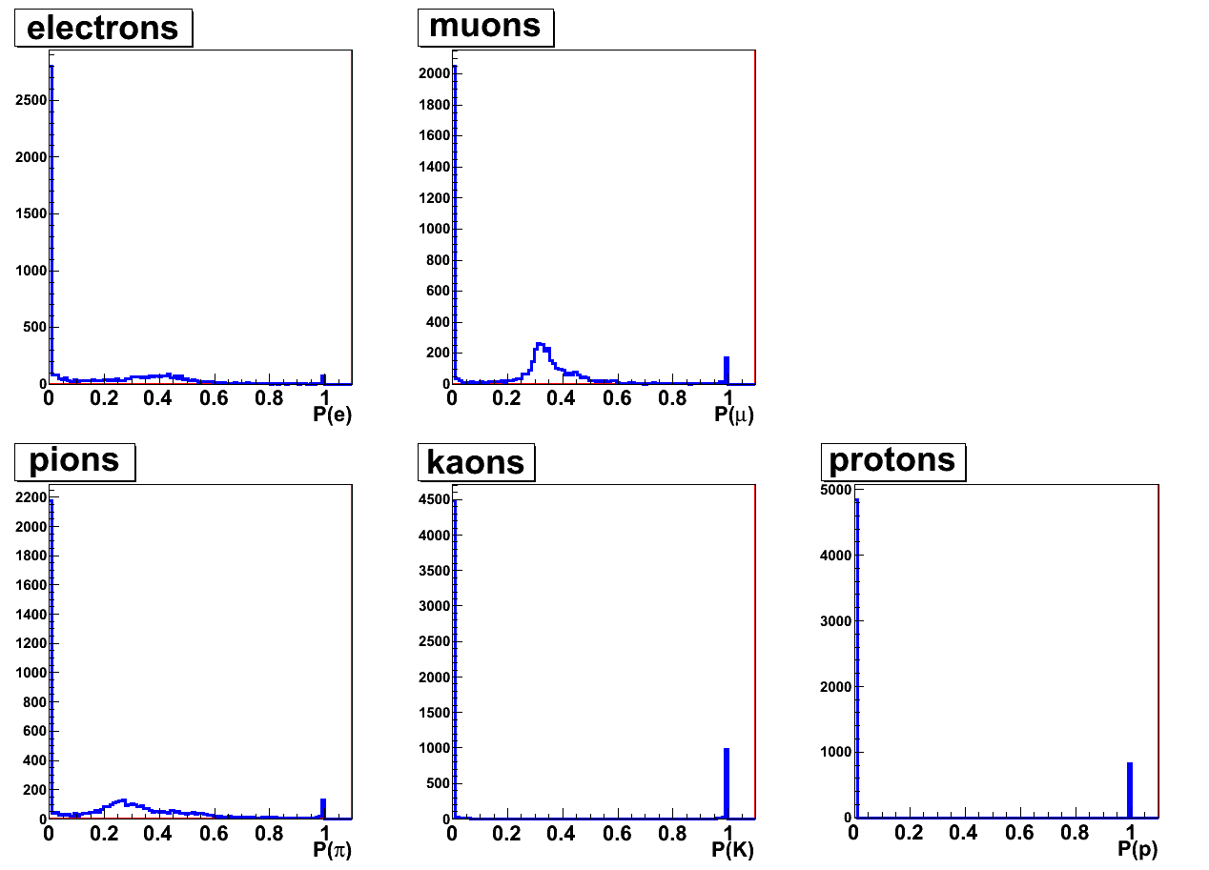
Combined Particle Identification
macro/pid/pid_check.C
PndPidProbability *drc = (PndPidProbability *)drc_array->At(ii);
PndPidProbability *mvd = (PndPidProbability *)mvd_array->At(ii);
PndPidProbability *combo = (*drc) * (*mvd);
combining
different algorithms
simple multiplication

Slide 33
Particle Flux
P(h) depends only on
track/event selection
PndPidProbability::GetXxxProb(PndPidProbability* flux)
PndPidProbability::GetXxxProb() → default
PndPidProbability* flux = new PndPidProbability(1,1,1,1,1))

Slide 34
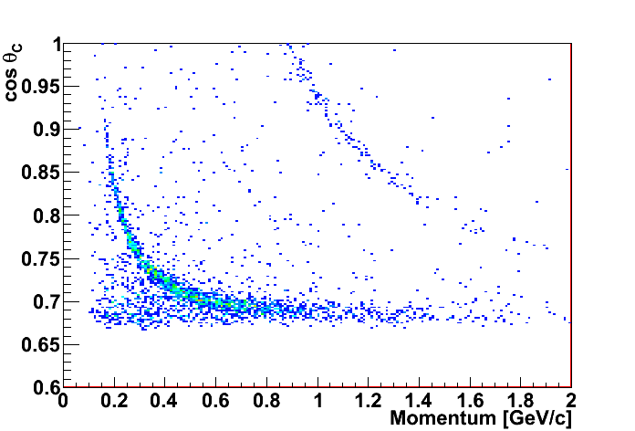
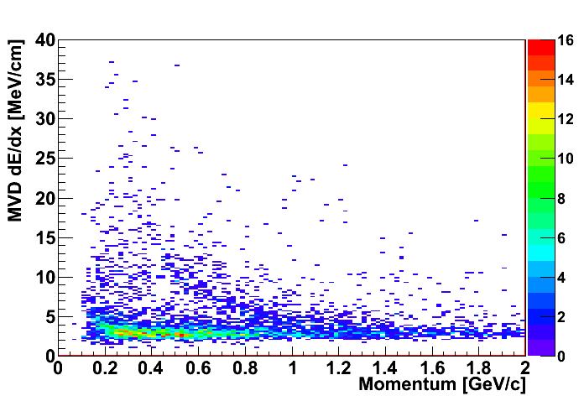
Particle Flux - DPM
2000 events @ 6 GeV/c
no elastic
particle yields
primary + secondary
 | - | +
e | 239 | 237
μ | 114 | 101
π | 2282 | 2375
K | 42 | 35
p | 517 | 1052
PndPidProbability *flux = new PndPidProbability(239+237,114+101,2282+2375,35+42,517+1052)

Slide 35
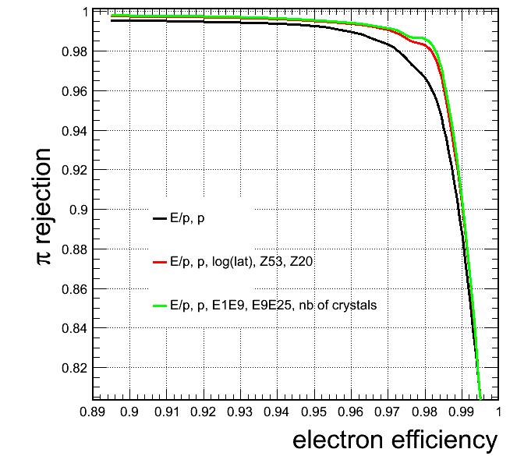
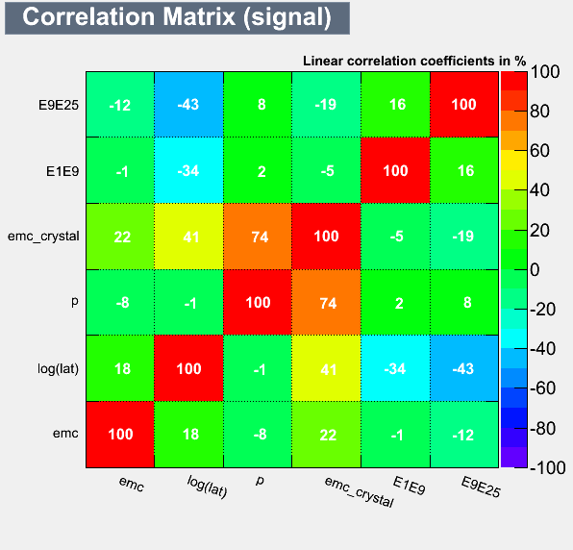
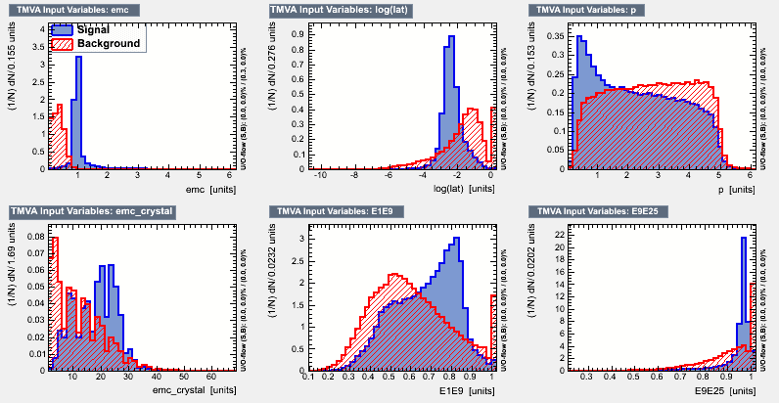
MultiVariate Particle Identification
implementation of TMVA methods
EMC shower shape analysis
e/π
separation in EMC
preliminary tests for muons (MDT)
M.Babai. G.Gumberidze, D.Melnichuk
← Correlation
Variables →

Slide 36
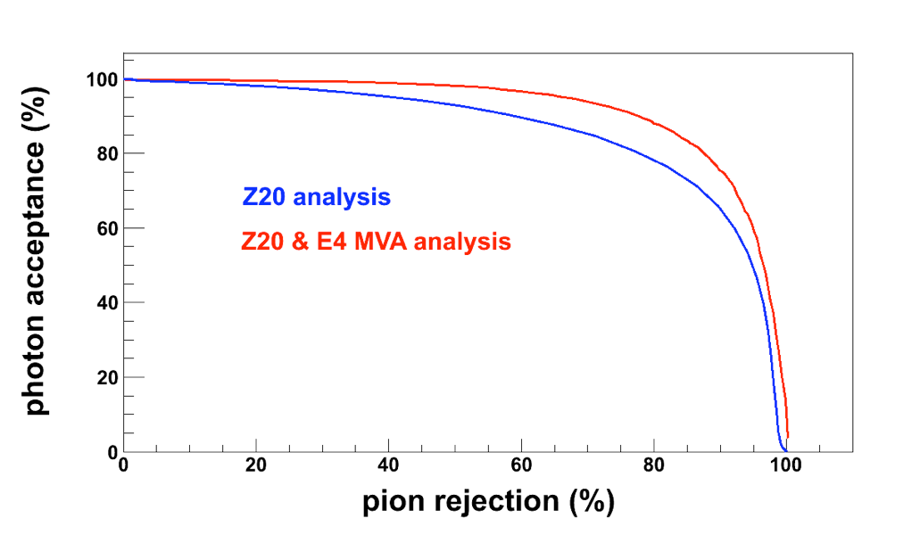
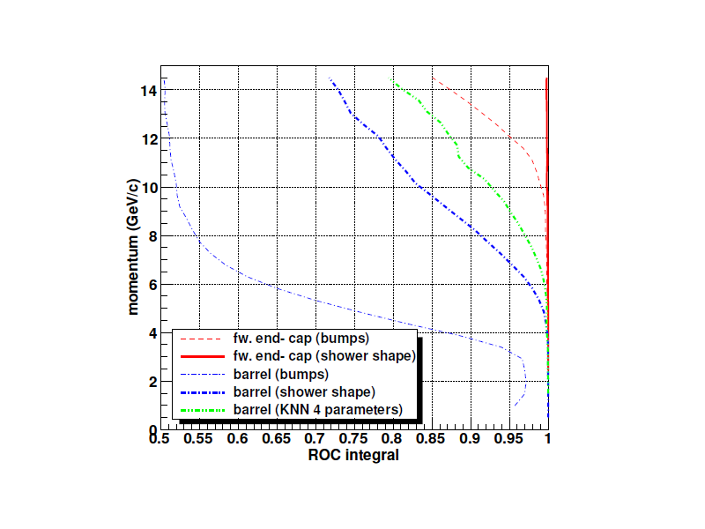
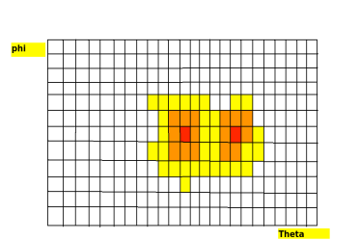
Multivariate Particle Identification
implementation of TMVA methods
well promising
BUT
never put inside PandaRoot
γ/π°
separation in EMC
KNN

Slide 37
Things to do: Reconstruction
Validate momentum reconstruction for different particle kinds
Validate momentum reconstruction for different particle hypothesis (kalman)
Study and improve track correlation (momentum-wise?)

Slide 38
Things to do: Reconstruction
Improve and make faster the correlation
Proper set of correlation windows, as a function of momentum?
Study and improve the anti-correlation for neutrals
Correlation with forward PID detector is almost missing
…

Slide 39
Things to do: Algorithms
Evaluate efficiency and purity for each algorithm (standard macro)
Evaluate perfomances by combining different algorithms (global PID)
Global MVA analysis
Influence of Geant3/Geant4
…

Slide 40
Things to do: Algorithms
Forward PID under development
EMC MVA method for π° identification?
MDT Muon identification with MVA
MDT neutral particle identification?
Use PID for analysis!!!!
…

Slide 41
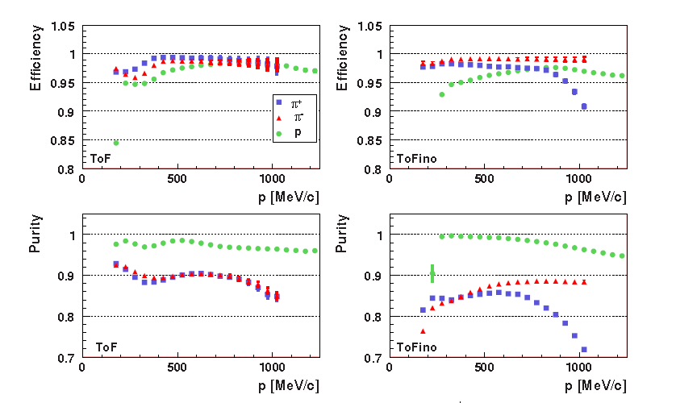
How to validate: Efficiency and Purity
TOF
TOFINO+preShower
HADES: EPJA40(2009)45

Slide 42
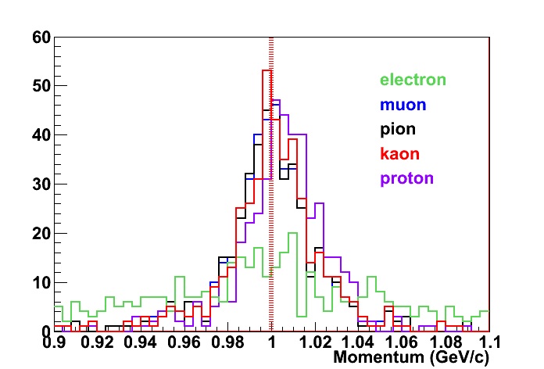
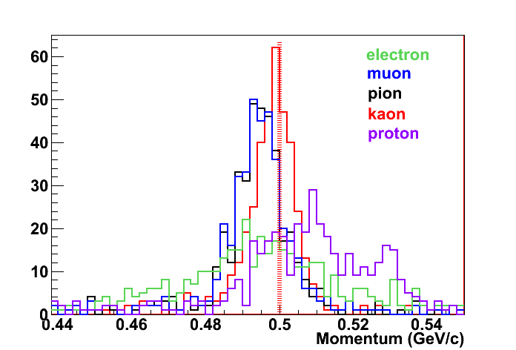
Multi-Hypothesis Particle Fit
kaons @ 1 GeV/c
kaons @ 500 MeV/c

Slide 43
Things to do: Design and interface to analysis
Current Design
PidChargedCand
μ hypothesis
PndTrack
Kalman
μ hypothesis
PndTrack
prefit
Analysis
PidProbability
μ hypothesis for e
μ hypothesis for μ
μ hypothesis for π
μ hypothesis for K
μ hypothesis for p
also MC hypothesis

Slide 44
Things to do: Design and interface to analysis
New Design ?
PndTrack
e hypothesis
PidChargedCand
e hypothesis
PidProbability
e
A
N
A
L
Y
S
I
S
PndTrack
μ hypothesis
PidChargedCand
μ hypothesis
PidProbability
μ
PndTrack
prefit
PndTrack
π hypothesis
PidChargedCand
π hypothesis
PidProbability
π
PndTrack
K hypothesis
PidChargedCand
K hypothesis
PidProbability
K
PndTrack
p hypothesis
PidChargedCand
p hypothesis
PidProbability
p

Slide 45
END !

