Slide 1
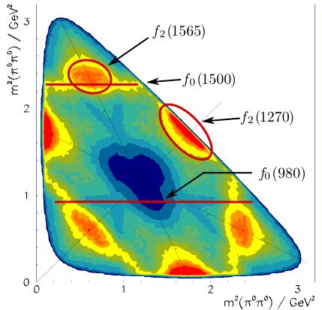
Physics Analysis Concepts with PandaRoot (3)
PANDA Computing Week 2017
Nakhon Ratchasima, Thailand, July 3 - 7, 2017
Klaus Götzen GSI Darmstadt

Slide 2
Topics
Effective Analysis - Working with ROOT TTrees
Event Generators:
EvtGen, DPM, FTF, Box Generator
Generation and Simulation
Stand-alone generation (simpleEvtGen, DPMGen, FTFGen)
Fast Simulation (PndFastSim, PndFsm...)
Full Simulation

Slide 3
EFFECTIVE ANALYSIS ROOT TREES

Slide 4
Analysis with ROOT TTree
User analyses commonly use histograms to store results like invariant mass distributions/angles
This has several disadvantages
Can't change to finer binning (detect small scale features)
Can't change scope (extend range to larger ROI)
Can't check impact of related cuts
Can't study correlations between observables
Can't study additional variables not put to histograms
My personal recommendation
Store TTree instead of (or in addition to) histograms
This overcomes all issues above

Slide 5
Analysis with ROOT TTree
ROOT's TTree
Imagine as a large table with a row per event/combination
Columns are so-called branches containing the values
Offers simple interactive analysis
Most powerful command-line feature TTree::Draw
> root ntp0_dd.root
root [0]
Attaching file ntp0_dd.root as _file0...
root [1] .ls
TFile** ntp0_dd.root chain files
TFile* ntp0_dd.root chain files
KEY: TTree ntp0;1 D0->K- pi+
root [2] ntp0->GetEntries() // get number of events/entries in TTree
(Long64_t) 1710036
root [3] ntp0->Print() // get information about branches
******************************************************************************
*Tree :ntp0 : D0->K- pi+ *
*Entries : 1710036 : Total = 1006429833 bytes File Size = 573205551 *
* : : Tree compression factor = 1.76 *
******************************************************************************
*Br 0 :ev : ev/I *
*Entries : 1710036 : Total Size= 6846211 bytes File Size = 1994787 *
*Baskets : 65 : Basket Size= 391168 bytes Compression= 3.43 *
*............................................................................*
*Br 1 :cand : cand/I *
...

Slide 6
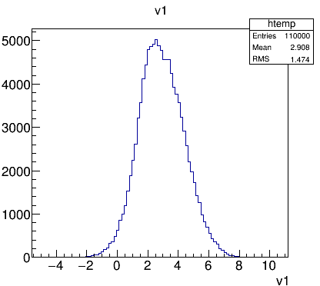
TTree::Draw Basics
TTree::Draw syntax t->Draw(expression(s) [,cut,option,nentries,firstentry])
Some examples:
root [0] tree->Draw("v1") // distribution of variable 'v1' (auto-range histo)
root [1] tree->Draw("v2:v3") // 'v1' vs. 'v2' -> correlation
root [2] tree->Draw("v1","v1>1") // 'v1' only for cases when 'v1>1'
root [3] tree->Draw("v1>>h(20,2,5)") // 'v1' in histogram with 20 bins, range [2..5]
root [4] tree->Draw("sqrt(v1+v2^2)") // result of formula for each event (auto-range)
root [5] tree->Draw("v2:v3","","col") // 2D histogram with color map instead scatter plot
root [6] tree->Draw("v3","","",100) // first 100 entries of v3

Slide 7
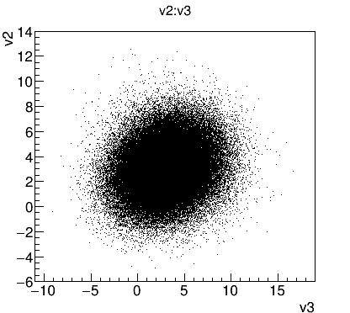
TTree::Draw Basics
TTree::Draw syntax t->Draw(expression(s) [,cut,option,nentries,firstentry])
Some examples:
root [0] tree->Draw("v1") // distribution of variable 'v1' (auto-range histo)
root [1] tree->Draw("v2:v3") // 'v1' vs. 'v2' -> correlation
root [2] tree->Draw("v1","v1>1") // 'v1' only for cases when 'v1>1'
root [3] tree->Draw("v1>>h(20,2,5)") // 'v1' in histogram with 20 bins, range [2..5]
root [4] tree->Draw("sqrt(v1+v2^2)") // result of formula for each event (auto-range)
root [5] tree->Draw("v2:v3","","col") // 2D histogram with color map instead scatter plot
root [6] tree->Draw("v3","","",100) // first 100 entries of v3

Slide 8
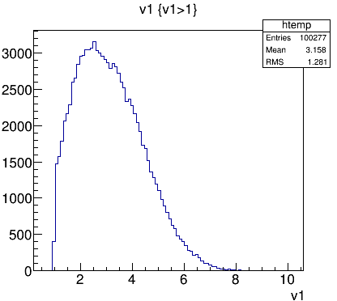
TTree::Draw Basics
TTree::Draw syntax t->Draw(expression(s) [,cut,option,nentries,firstentry])
Some examples:
root [0] tree->Draw("v1") // distribution of variable 'v1' (auto-range histo)
root [1] tree->Draw("v2:v3") // 'v1' vs. 'v2' -> correlation
root [2] tree->Draw("v1","v1>1") // 'v1' only for cases when 'v1>1'
root [3] tree->Draw("v1>>h(20,2,5)") // 'v1' in histogram with 20 bins, range [2..5]
root [4] tree->Draw("sqrt(v1+v2^2)") // result of formula for each event (auto-range)
root [5] tree->Draw("v2:v3","","col") // 2D histogram with color map instead scatter plot
root [6] tree->Draw("v3","","",100) // first 100 entries of v3

Slide 9
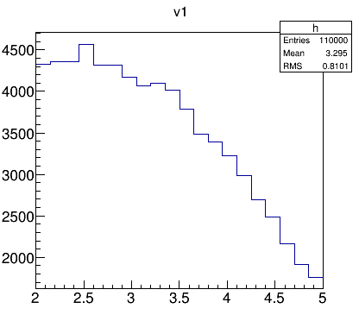
TTree::Draw Basics
TTree::Draw syntax t->Draw(expression(s) [,cut,option,nentries,firstentry])
Some examples:
root [0] tree->Draw("v1") // distribution of variable 'v1' (auto-range histo)
root [1] tree->Draw("v2:v3") // 'v1' vs. 'v2' -> correlation
root [2] tree->Draw("v1","v1>1") // 'v1' only for cases when 'v1>1'
root [3] tree->Draw("v1>>h(20,2,5)") // 'v1' in histogram with 20 bins, range [2..5]
root [4] tree->Draw("sqrt(v1+v2^2)") // result of formula for each event (auto-range)
root [5] tree->Draw("v2:v3","","col") // 2D histogram with color map instead scatter plot
root [6] tree->Draw("v3","","",100) // first 100 entries of v3

Slide 10
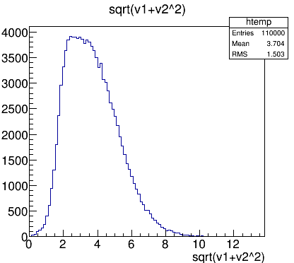
TTree::Draw Basics
TTree::Draw syntax t->Draw(expression(s) [,cut,option,nentries,firstentry])
Some examples:
root [0] tree->Draw("v1") // distribution of variable 'v1' (auto-range histo)
root [1] tree->Draw("v2:v3") // 'v1' vs. 'v2' -> correlation
root [2] tree->Draw("v1","v1>1") // 'v1' only for cases when 'v1>1'
root [3] tree->Draw("v1>>h(20,2,5)") // 'v1' in histogram with 20 bins, range [2..5]
root [4] tree->Draw("sqrt(v1+v2^2)") // result of formula for each event (auto-range)
root [5] tree->Draw("v2:v3","","col") // 2D histogram with color map instead scatter plot
root [6] tree->Draw("v3","","",100) // first 100 entries of v3

Slide 11
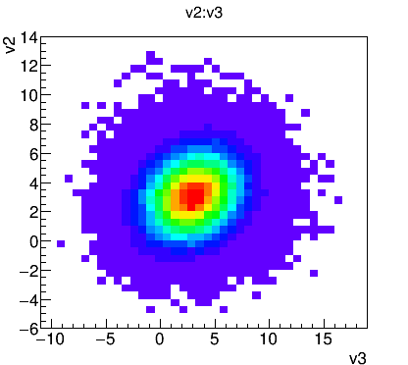
TTree::Draw Basics
TTree::Draw syntax t->Draw(expression(s) [,cut,option,nentries,firstentry])
Some examples:
root [0] tree->Draw("v1") // distribution of variable 'v1' (auto-range histo)
root [1] tree->Draw("v2:v3") // 'v1' vs. 'v2' -> correlation
root [2] tree->Draw("v1","v1>1") // 'v1' only for cases when 'v1>1'
root [3] tree->Draw("v1>>h(20,2,5)") // 'v1' in histogram with 20 bins, range [2..5]
root [4] tree->Draw("sqrt(v1+v2^2)") // result of formula for each event (auto-range)
root [5] tree->Draw("v2:v3","","col") // 2D histogram with color map instead scatter plot
root [6] tree->Draw("v3","","",100) // first 100 entries of v3

Slide 12
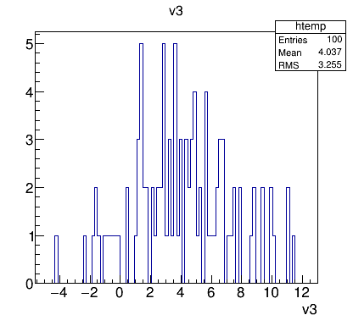
TTree::Draw Basics
TTree::Draw syntax t->Draw(expression(s) [,cut,option,nentries,firstentry])
Some examples:
root [0] tree->Draw("v1") // distribution of variable 'v1' (auto-range histo)
root [1] tree->Draw("v2:v3") // 'v1' vs. 'v2' -> correlation
root [2] tree->Draw("v1","v1>1") // 'v1' only for cases when 'v1>1'
root [3] tree->Draw("v1>>h(20,2,5)") // 'v1' in histogram with 20 bins, range [2..5]
root [4] tree->Draw("sqrt(v1+v2^2)") // result of formula for each event (auto-range)
root [5] tree->Draw("v2:v3","","col") // 2D histogram with color map instead scatter plot
root [6] tree->Draw("v3","","",100) // first 100 entries of v3

Slide 13
TTree::Draw Basics
TTree::Draw syntax t->Draw(expression(s) [,cut,option,nentries,firstentry])
Some examples:
root [0] tree->Draw("v1") // distribution of variable 'v1' (auto-range histo)
root [1] tree->Draw("v2:v3") // 'v1' vs. 'v2' -> correlation
root [2] tree->Draw("v1","v1>1") // 'v1' only for cases when 'v1>1'
root [3] tree->Draw("v1>>h(20,2,5)") // 'v1' in histogram with 20 bins, range [2..5]
root [4] tree->Draw("sqrt(v1+v2^2)") // result of formula for each event (auto-range)
root [5] tree->Draw("v2:v3","","col") // 2D histogram with color map instead scatter plot
root [6] tree->Draw("v3","","",100) // first 100 entries of v3
Take a look to
https://root.cern.ch/root/htmldoc/guides/users-guide/Trees.html#ttreedraw-examples
for annotated examples of TTree::Draw()

Slide 14
EVENT/PARTICLE GENERATORS

Slide 15
Important Particle Generators in PANDA
EvtGen (PndEvtGenDirect / simpleEvtGen)
Generate signal reactions or specific backgrounds
DPM - Dual Parton Model (PndDpmDirect / DPMGen)
Study p background reactions
FTF (PndFtfDirect / FTFGen)
Study p and A background reactions
Particle Gun (PndBoxGenerator)
Single tracks for acceptance, efficiency, resolution studies
Many others not discussed here
GiBuu, UrQmd, Fluka, Pythia,...

Slide 16
EvtGen - Properties
EvtGen - Generating specific signal/background reactions
Decayer rather than generator
Knows many actual particle properties (evt.pdl) and decays (DECAY.DEC)
Extendable with new decay models
Configuration of a well defined decay chain
noPhotos
Decay pbarpSystem
1.0 J/psi pi+ pi- PHSP;
Enddecay
Decay J/psi
0.0597 e+ e- VLL;
0.0596 mu+ mu- VLL;
Enddecay
End

Slide 17
EvtGen - Properties
EvtGen - Generating specific signal/background reactions
Decayer rather than generator
Knows many actual particle properties (evt.pdl) and decays (DECAY.DEC)
Extendable with new decay models
Configuration of a well defined decay chain
noPhotos
Decay pbarpSystem
1.0 J/psi pi+ pi- PHSP;
Enddecay
Decay J/psi
0.0597 e+ e- VLL;
0.0596 mu+ mu- VLL;
Enddecay
End
EvtGen switches;
Alias definitions
Decay definition
Decay Models
Decay fractions
(autom. normalized)
End of decay file with <CR>

Slide 18
EvtGen - Particles and Decays
Knowledge base: particle list, decay table, decay models
evt.pdl
DECAY.DEC

Slide 19
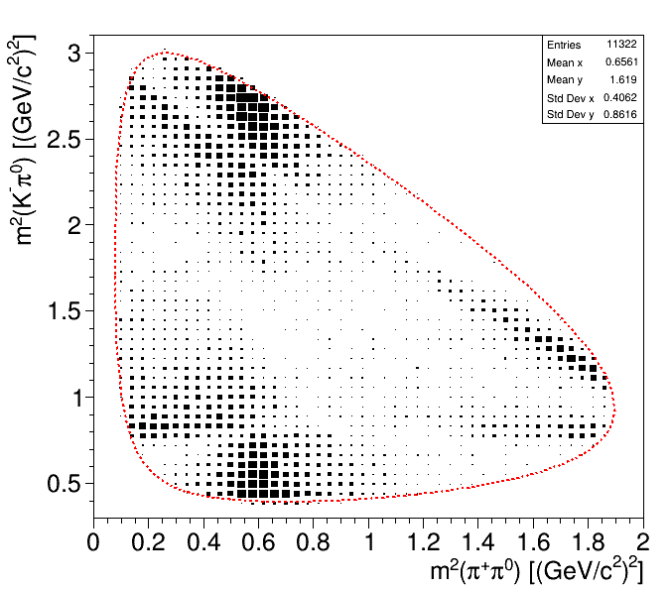
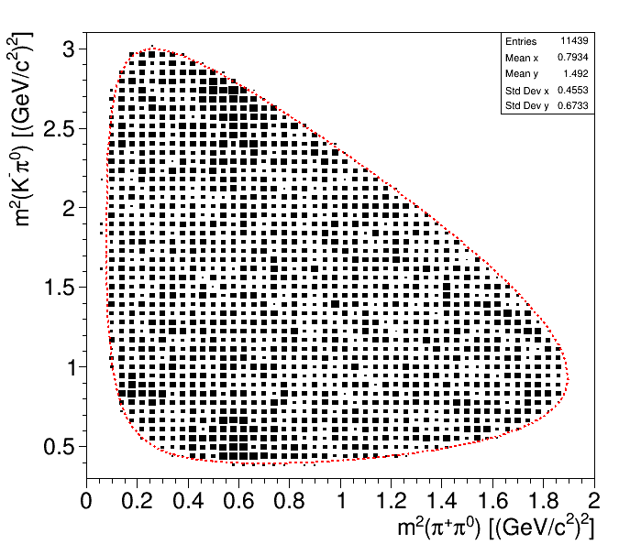
EvtGen - Aliases and Decay-Models
Alias MyD0 D0
Alias MyD0b anti-D0
Decay pbarpSystem
0.5 MyD0 anti-D0 PHSP;
0.5 MyD0b D0 PHSP;
Enddecay
Decay MyD0
1.0 K- pi+ pi0 PHSP;
Enddecay
Decay MyD0b
1.0 K+ pi- pi0 D_DALITZ;
Enddecay
End
Alias is copy of known particle
Decay not specified
→ decay according to DECAY.DEC!
D_DALITZ
PHSP

Slide 20
EvtGen - CAVEAT: Long Living Particles
A word of warning ...
Definition of long-living (charged) particle decays of e.g. Ξ⁺ or Σ⁺ prevents proper simulation of interaction and curvature
Partial workaround: https://panda-wiki.gsi.de/foswiki/pub/Computing/Minutes02May2017/2.5.2017_teammeeting.pdf
EvtGen
Geant
p
π⁻
p
Λ⁰
π⁻
π⁻
Λ⁰
Ξ⁻
Ξ⁻
π⁻
interaction
& curvature

Slide 21
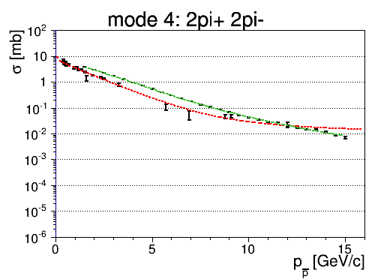
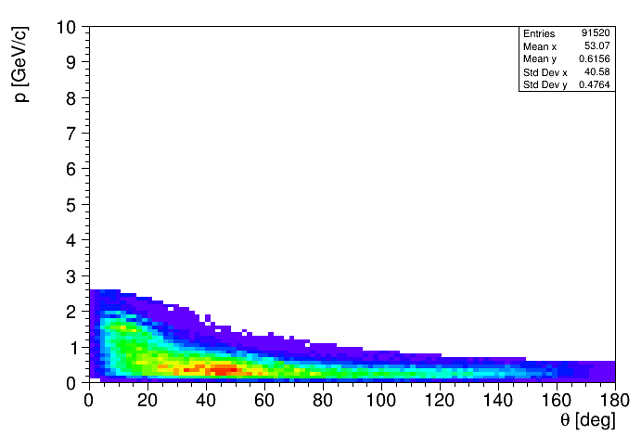
DPM (Dual Parton Model) - Studying Background
DPM - Generating generic background
Produces generic p reactions (simulates hadronization)
Study multiplicities, phsp coverage, background level
Roughly reproduces generic cross sections
Intermediate resonances (decay switchable)
No displacement for decaying long living resonances!
exp.
DPM
p = 2 GeV/c

Slide 22
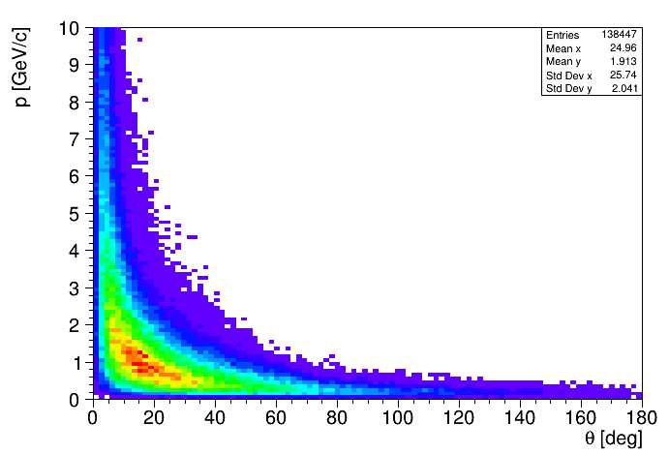
DPM (Dual Parton Model) - Studying Background
DPM - Generating generic background
Produces generic p reactions (simulates hadronization)
Study multiplicities, phsp coverage, background level
Roughly reproduces generic cross sections
Intermediate resonances (decay switchable)
No displacement for decaying long living resonances!
exp.
DPM
p = 15 GeV/c

Slide 23
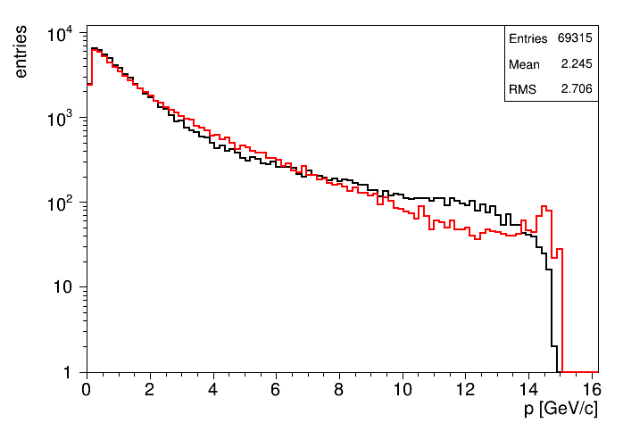
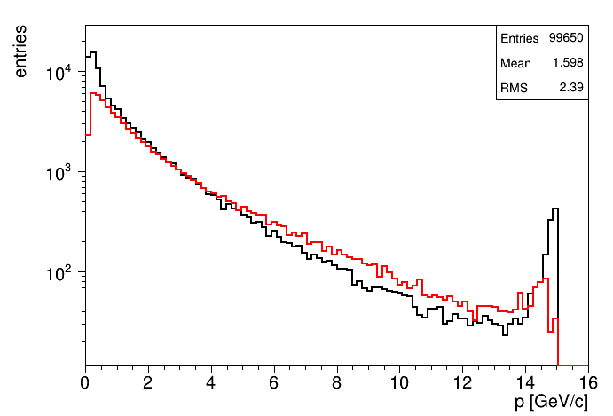
FTF - Background with proton and nuclear targets
FTF - Generating generic background with p and A targets
Produces generic p/A reactions
As DPM: multiplicities, phsp coverage, background level
Intermediate resonances
Compares reasonably to DPM
p
p / A
DPM (15GeV)
FTF (15GeV)
FTF C (15GeV)
FTF p (15GeV)

Slide 24
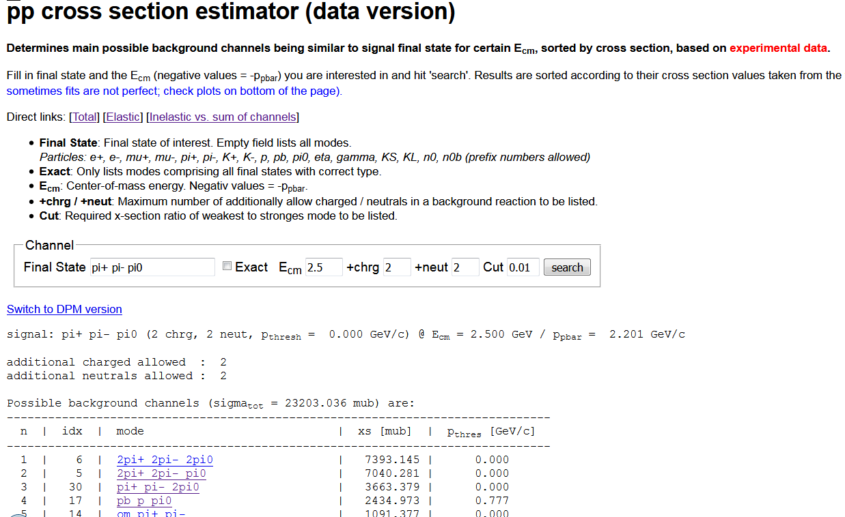
Insertion: Online p Cross Section DB
Estimating cross sections for particular final states → https://panda.gsi.de/pbarx/

Slide 25
Insertion: Online p Cross Section DB
Estimating cross sections for particular final states → https://panda.gsi.de/pbarx/
final state
E_{cm}
additional particles allowed
x-sections at that
cm energy

Slide 26
Insertion: Online p Cross Section DB
Estimating cross sections for particular final states → https://panda.gsi.de/pbarx/

Slide 27
Insertion: Online p Cross Section DB
Estimating cross sections for particular final states → https://panda.gsi.de/pbarx/

Slide 28
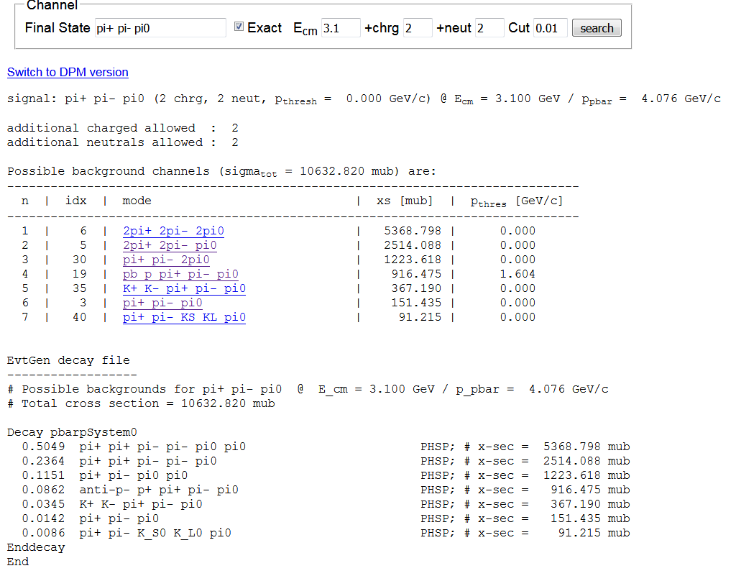
Insertion: Online p Cross Section DB
Example: Search for glue ball G → K⁺ K⁻ γ @ 3.1 GeV (J/ψ energy)
Possible backgrounds: π⁺π⁻π⁰, π⁺π⁻2π⁰, 2π⁺2π⁻π⁰, 2π⁺2π⁻2π⁰,...

Slide 29
Insertion 2: Number of Events to Simulate
Signal channel with decays involving BR_{i} (product = f_{BR})
Simulate S₀ signal and B₀ background events
Question: What is good choice for S₀ and B₀?
S₀ depends on desired relative efficiency uncertainty Δε_{S,rel}
B₀ → input: σ_{S}, σ_{B}, ε_{S}, BR_{i}, desired ΔB/B<Δ_{rel} and S_{d}/B_{d}>r in data
Example: σ_{S}=100nb, σ_{B}=10mb, ε_{S}=20%, f_{BR}=2%, Δ_{rel}=10%, r=3 → B₀ > 7.5 · 10⁹ events, bkg suppression ε_{B} < 1.33 · 10⁻⁸

Slide 30
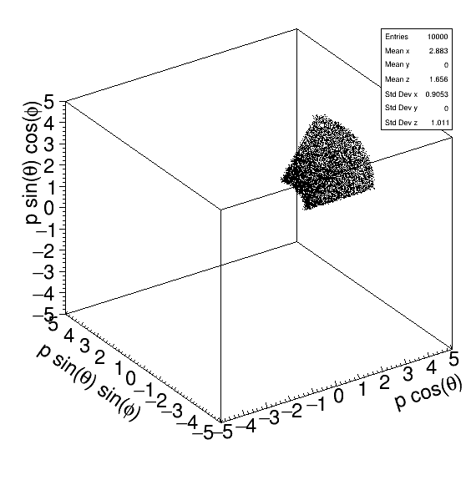
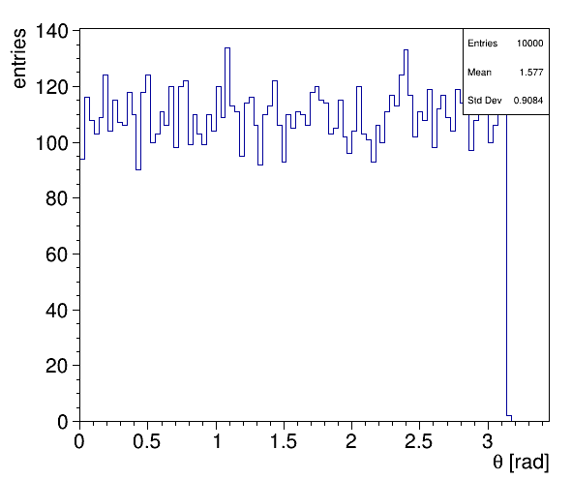
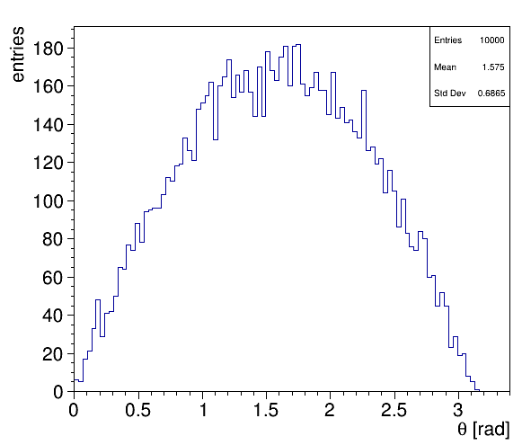
Box Generator - The Particle Gun
Box Generator - Acceptance and resolution studies
Single particles of defined species and multiplicity
Setting ranges in p, pt, θ, cos(θ), φ, y, η
Setting fixed arbitrary origin or from box volume
uniform θ
uniform cos(θ)
p, θ - range, fixed φ

Slide 31
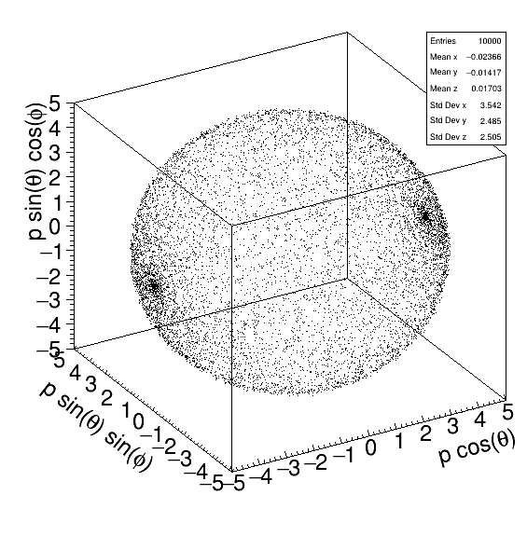
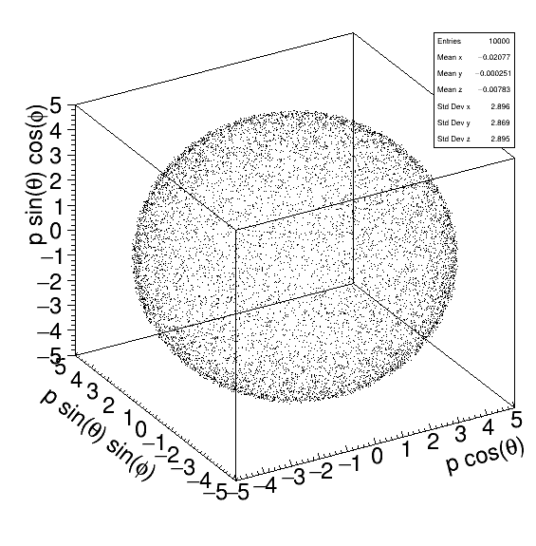
Box Generator - The Particle Gun
Box Generator - Acceptance and resolution studies
Single particles of defined species and multiplicity
Setting ranges in p, pt, θ, cos(θ), φ, y, η
Setting fixed arbitrary origin or from box volume
uniform θ
uniform cos(θ)
p, θ - range, fixed φ

Slide 32
GENERATION AND SIMULATION

Slide 33
Generation and Simulation
Three levels of studying particle distrib. with different purpose
Stand-alone usage of generators (EvtGen, DPM, FTF)
Study undistorted true distributions
Principle phase space/multiplicity considerations
Fast Simulation
Simplified effective simulation of acceptance & resolution
High speed, easy configurable for physics/detector performance
Full Simulation
Full Geant featured microscopic particle transport
Realistic digis and reconstruction simulation

Slide 34
EvtGen - Stand-alone Usage
Stand-alone executable: build/bin/simpleEvtGen(RO)
ASCII (simpleEvtGen) or ROOT (simpleEvtGenRO) output
Needs links/copies of evt.pdl and DECAY.DEC to directory
Call w/o parameter prints help text
build/bin > ./simpleEvtGenRO
USAGE:
simpleEvtGen <particle> <dec-file> <# events> <pbar-mom/cms-energy> <rand seed> <A_Target>
<particle> = particle type to decay, e.g. 'eta_c', 'pbarpSystem' etc.
<dec-file> = EvtGen decay file (.DEC) to use; see directory 'test' for examples
<# events> = number of events to produce; default value = 10
<pbar-mom> = (>0) momentum of the pbar beam; (<0) negativ cms energy; default value = mass of <particle>, mandatory, when <particle> = pbarpSystem
<rand seed> = random seed for TRandom3. Value < 0 = use default random gen.; default = -1
<A_Target> = target nucleus mass number; mandatory when <particle> = 'pbarASystem'
build/bin > ./simpleEvtGenRO pbarpSystem Jpsi2pi.dec 1000 7.0
...
build/bin > root -l evtOutput.root
root [0] .ls
TFile** evtOutput.root
TFile* evtOutput.root
KEY: TTree ntp;1 ntp

Slide 35
EvtGen - ROOT Output
Contents of the output TTree are event based arrays with
Array indices according order in decay file configuration
For first example
0 = pbarpSystem, 1 = J/psi, 2 = pi+, 3 = pi-, 4 = mu+,...
Branches | Content
ev, nTrk | Event, #particles in event
N, Id | particle ID, pdg code
M1, M2, nDau, DF, DL | Mother - daughter information
E, px, py, pz, pt, p, tht, m | 4-vector information
t, x, y, z | space-time vertex
arrays
DF[0]
DL[0]
DF[1]
build/bin > root -l evtOutput.root
root [0] ntp->Draw("m[1]") // plots generated mass distribution of J/psi

Slide 36
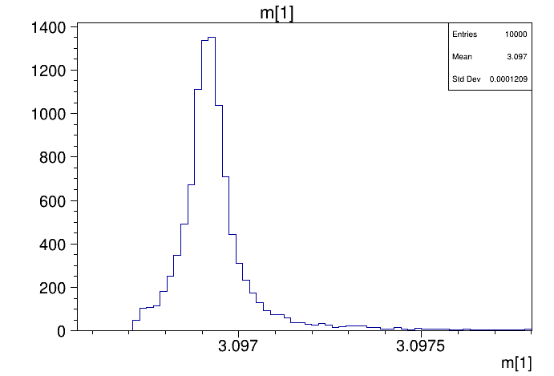
EvtGen - ROOT Output
Contents of the output TTree are event based arrays with
Array indices according order in decay file configuration
For first example
0 = pbarpSystem, 1 = J/psi, 2 = pi+, 3 = pi-, 4 = mu+,...
Branches | Content
ev, nTrk | Event, #particles in event
N, Id | particle ID, pdg code
M1, M2, nDau, DF, DL | Mother - daughter information
E, px, py, pz, pt, p, tht, m | 4-vector information
t, x, y, z | space-time vertex
arrays
DF[0]
DL[0]
DF[1]
build/bin > root -l evtOutput.root
root [0] ntp->Draw("m[1]") // plots generated mass distribution of J/psi

Slide 37
DPM - Stand-alone Usage
Stand-alone executable: build/bin/DPMGen
Input parameters:
Random seed
Beam momentum (for PANDA: 1.5 ... 15 GeV/c)
Mode (0 = inelastic, 1 = inel. + elastic, 2 = elastic)
Un/stable settings (e.g. '111 0' lets π⁰ be decayed by DPM)
Number of events
Output:
ROOT file containing TTree 'data' with TParticles

Slide 38
DPM - ROOT Output
Relevant (and filled) information in ROOT output
No mother-daughter relations stored
Branches/Methods | Content
Npart | #particles in event
fPdgCode | PDG code of particle
fE, fPx, fPy, fPz, fCalcMass | 4-vector information
Theta(), Phi(), Pt(), P() Eta(), Y() | Additional kinematic information
arrays
build/bin > ./DPMGen
Give as seed a large float number (eg. 123456.): 23
Enter P_lab(GeV/c), 15
Enter Elastic : 0., 1. or 2.
0
Enter: particle PDGcode and status
(for example -- Pi0 unstable: 111 0), To go to event generation, Enter: 0 0
0 0
Enter N_Events 30000
build/bin > root -l Background-micro.root
root [0] data->Draw("fCalcMass","fabs(fPdgCode)==3122")

Slide 39
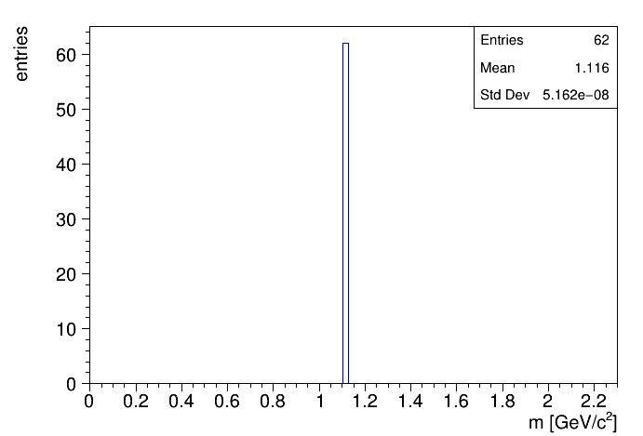
DPM - ROOT Output
Relevant (and filled) information in ROOT output
No mother-daughter relations stored
Branches/Methods | Content
Npart | #particles in event
fPdgCode | PDG code of particle
fE, fPx, fPy, fPz, fCalcMass | 4-vector information
Theta(), Phi(), Pt(), P() Eta(), Y() | Additional kinematic information
arrays
build/bin > ./DPMGen
Give as seed a large float number (eg. 123456.): 23
Enter P_lab(GeV/c), 15
Enter Elastic : 0., 1. or 2.
0
Enter: particle PDGcode and status
(for example -- Pi0 unstable: 111 0), To go to event generation, Enter: 0 0
0 0
Enter N_Events 30000
build/bin > root -l Background-micro.root
root [0] data->Draw("fCalcMass","fabs(fPdgCode)==3122")

Slide 40
Fast Simulations - Motivation
Instead of microscopic simulation with Geant propagation
Effective smearing and rejetion of generator particles
Purpose: Study of
Reaction kinematics
Detector configurations
Simulate large number of events in short time
Well controlable to anticipate future detector performance
Same analysis code as for full simulation and reconstruction
Goal is not necessarily to imitate current full simulation performance, in particular where this is not yet final

Slide 41
FastSim - Concept
Generator Particle P
Detector 1
Detector 2
Detector n
...
Response 1 for P
Response 2 for P
...
Response n for P
Modify/Reject/Add info to P according to total response
reject
add
Reco Particle P'
Secondaries for P'

Slide 42
FastSim - Acceptance Modelling
Spatial acceptance typically defined by polar θ range from IP
Different trackers or EMCs should not overlap!
Barrel DRC
EMC Barrel
Central Tracking
(STT + MVD)
Disc DRC
EMC BwdCap
Fwd
Tracker
IP
STT + GEM
EMC FwdCap
Just for illustration
Not complete!

Slide 43
FastSim - Detector Modules
Target Spectrometer
Forward Spectrometer
STT
STT + MVD + GEM
Fwd TS
TRK
STT + MVD
MVD + GEM
MVD Vtx
EMC Barrel
EMC Fwd
EMC FS
EMC
EMC Bwd
EMC Barrel
STT PID
DIRC PID
EMC FS PID
PID
EMC Fwd
MVD PID
DISC PID
RICH PID
EMC Bwd
MUO PID
MUO FS PID

Slide 44
FastSim - Detector Parameters/Response
Detector parameters
Global detection efficiency ε
Spatial acceptance in θ (sometimes φ)
Kinematic acceptance (p_{min}, p_{t,min}, E_{min}, ...)
Resolutions: dp/p, dE/E, dt/t, dθ, dφ, vertex
Detector specific parameters (geometry, # layers, granularity,...)
Detector responses
Accept/reject particle (no or pure PID response → rejection)
Current resolution dp/p, dE/E, dt/t, dθ, dφ, vertex
PID probabilities (P_{e}, P_{μ}, P_{π}, P_{K}, P_{p})
Raw PID information (E_{EMC}, θ_{C}, dE/dx, L_{iron}, ...)
Total response
created from individual responses + applied to particle

Slide 45
FastSim - Free Detector Configuration
→ Simple change of detector parameters on macro level
fSim->AddDetector("ScSttAlone",
"thtMin=145.0 thtMax=159.5 ptmin=0.1 pRes=0.04 thtRes=0.006 phiRes=0.007 efficiency=0.25" );
fSim->AddDetector("ScSttMvd",
"thtMin=20.9 thtMax=145.0 ptmin=0.1 pRes=0.02 thtRes=0.001 phiRes=0.001 efficiency=0.85" );
fSim->AddDetector("ScSttMvdGem",
"thtMin=7.8 thtMax=20.9 ptmin=0.1 pRes=0.02 thtRes=0.001 phiRes=0.001 efficiency=0.85" );
fSim->AddDetector("ScMvdGem",
"thtMin=5.0 thtMax=7.8 ptmin=0.1 pRes=0.03 thtRes=0.001 phiRes=0.001 efficiency=0.60" );
...
fSim->AddDetector("EmcFwCap", "thtMin=10.0 thtMax=22.0 Emin=0.01 dist=2.5" );
fSim->AddDetector("EmcBarrel", "thtMin=22.0 thtMax=142.0 Emin=0.01 barrelRadius=0.5" );
fSim->AddDetector("EmcBwCap", "thtMin=142.0 thtMax=160.0 Emin=0.01 dist=0.7" );
...
fSim->AddDetector("DrcBarrel", "thtMin=22.0 thtMax=140.0 dthtc=0.01 nPhotMin=5 effNPhotons=0.075" );
fSim->AddDetector("DrcDisc", "thtMin=5.0 thtMax=22.0 dthtc=0.01 nPhotMin=5 effNPhotons=0.075" );
...

Slide 46
Running Fast Simulation
Macro tutorials/thailand2017/tut_fastsim.C
Creates same output format as Full Simulation
> root -l -b -q 'tut_fastsim.C(1000,"signal","pp_jpsi.dec", 7.0, "pbarpSystem")'
> root -l signal_fast.root
root [0]
Attaching file signal_fast.root as _file0...
(TFile *) 0x385f240
root [1] .ls
TFile** signal_fast.root
TFile* signal_fast.root
KEY: TFolder cbmroot;1 Main Folder
KEY: TList BranchList;1 Doubly linked list
KEY: TList TimeBasedBranchList;1 Doubly linked list
KEY: FairFileHeader FileHeader;1
KEY: TTree cbmsim;1 /cbmroot
root [1] TBrowser b

Slide 47
Running Fast Simulation
Macro tutorials/thailand2017/tut_fastsim.C
Creates same output format as Full Simulation
> root -l -b -q 'tut_fastsim.C(1000,"signal","pp_jpsi.dec", 7.0, "pbarpSystem")'
> root -l signal_fast.root
root [0]
Attaching file signal_fast.root as _file0...
(TFile *) 0x385f240
root [1] .ls
TFile** signal_fast.root
TFile* signal_fast.root
KEY: TFolder cbmroot;1 Main Folder
KEY: TList BranchList;1 Doubly linked list
KEY: TList TimeBasedBranchList;1 Doubly linked list
KEY: FairFileHeader FileHeader;1
KEY: TTree cbmsim;1 /cbmroot
root [1] TBrowser b
MC info
Reco cands
Event
& PID
info

Slide 48
EXERCISES

Slide 49
Exercises Preparations
Preparation/hints in tutorials/thailand2017/README
To use the event generators stand-alone, do: cd $VMCWORKDIR/tutorials/thailand2017 . ./prep_generators
This creates some links and copies files to ./generators
Change to ./generators to run them
mkdir generators
ln -s $FAIRLIBDIR/../bin/simpleEvtGenRO generators/
ln -s $FAIRLIBDIR/../bin/DPMGen generators/
ln -s $FAIRLIBDIR/../bin/FTFGen generators/
cp $VMCWORKDIR/pgenerators/EvtGen/EvtGen/Private/evt.pdl generators/
cp $VMCWORKDIR/pgenerators/EvtGen/EvtGen/Private/DECAY.DEC generators/
cp $VMCWORKDIR/pgenerators/FtfEvtGen/Pbar*.mac generators/

Slide 50
Exercises Suggestions
Rho Tutorial website: http://panda-wiki.gsi.de/cgi-bin/view/Computing/PandaRootRhoTutorial
Take a look to tutorials/thailand2017/README Exercises: #7 - #9
Write decay file for an arbitrary channel (or use existing)
Generate some stand-alone EvtGen events
Generate some background events with DPM at same energy
Compare momentum distributions of final states
Run FastSimulation with same inputs
Compare stand-alone and fast simulation output

Slide 51
Exercises Preparation
Preparation/hints in tutorials/thailand2017/README
To have some data for tutorial macros, do one of the following a) . ./tut_runall.sh 1000 # sim/reco 1000 events pbarp -> J/psi pi+ pi- b) cp data/signal_p*root . # preproduced default data
Macros named 'tut_ana...C' are stubs and should be completed by you.
At places marked with ' #### EXERCISE: ...' some code needs to be added; Run macros (default or different input data) with > root -l tut_ana...C # signal_pid.root, signal_par.root > root -l 'tut_ana...C(0,"mydata")' # mydata_pid.root, mydata_par.root
If getting stuck, sample solutions are in the subfolder 'solution' Run solution macros directly (default or different input data) with > root -l solution/tut_ana...C > root -l 'solution/tut_ana...C(0,"mydata")'

