Slide 1
Good Programming Practice
| Tobias Stockmanns

Slide 2
Why is this necessary?
When ever
many people work
over a long time
on a complex software project
with a high demand on reproducibility
it is mandatory to have at least a basic knowledge to write proper code, because
You want to read and understand what others did (or what you did after a year not looking into the code)
You want to find bugs easily and fix them just on one place
You want to add additional features without rewriting the hole code again
You want to profit from the work of others
You want that the full project works

Slide 3
Level 1

Slide 4
Do not copy and paste code
Most important rule!
But one of the most broken one
If you copy code from someone else (or even more often from yourself) you increase the places where you have to fix something if there was a bug in the first place
If you want to add additional features you have to do it many times
Better use common methods/functions and common base classes to reuse existing code without copying.

Slide 5
KISS – keep it simple, stupid
“Keep things as simple as possible bot not simpler” - A. Einstein
Most important for code is that it is understandable
So prefer simple, short and easily understandable solutions
“Any fool can write code that computers can understand, good programmers write code that humans can understand.”

Slide 6
Coding Conventions
Every project with more than one developer should have a set of coding conventions to improve the readability of the code
For PANDA they were defined 2007 and can be found at: http://panda-wiki.gsi.de/cgi-bin/view/Computing/PandaRootCodingRules

Slide 7
Coding Conventions
PandaRoot follows the ROOT coding conventions
All PandaRoot classes should start with the suffix Pnd !
Include files in the C++ code will have the extension ".h".
The implementation files in C++ will have the extension ".cxx“.
Every include file should contain a mechanism to prevent multiple inclusions. For the file XxxMyFile.h, the Panda convention is: #ifndef XXXMYFILE_HH #define XXXMYFILE_HH [....] #endif

Slide 8
Coding Conventions
Use a separate .cxx file, and corresponding .h file, for each C++ class. The filename should be identical to the class name.
Do not create class names (and therefore filenames) that differ only by case.
The identifier of every globally visible class, function or variable should begin with the package "TLA" (Three Letter Acronym) prefix from the package to which it belongs (e.g. mvd, emc, tpc, etc.) This implies that the implementation (.cxx) and interface (.h) files for C++ classes should also begin with the same prefix.

Slide 9
Coding Conventions
Avoid overloading functions and operators unless there is a clear improvement in the clarity of the resulting code. For read and write access to data members, use: int GetMyData( ) const; void SetMyData( const int value ); rather than int MyData( ) const; void MyData( const int value ); In fact, using SetMyData is a strict rule. Please use it. GetMyData is not a strict rule, but strongly encouraged.

Slide 10
Coding Conventions
Members of a class should start with an f at the beginning:
Examples: fX, fData, …
Use the root types insteadt of C++ types:
Int_t, Double_t, Bool_t
Compare the same data types with each other:
Unsigned with unsigned
Int_t with Int_t and not with Double_t

Slide 11
Coding Conventions
Don't implicitly compare pointers to nonzero (i.e. do not treat them as having a boolean value). Use if ( 0 != ptr ) ... instead of if ( ptr ) ... If you are doing an assignment in a comparison expression, make the comparison explicit: while ( 0 != (ptr=iterator() ) ) ... instead of while ( ptr=iterator() ) ...

Slide 12
Coding Conventions
format of Comments
When using C++, the preferred form for short comments is: // This is a one-line comment. i.e. use the "//" comment format. If the comment extends over multiple lines, each line must have // at the beginning: // This is a long and boring comment. // I need to put // at the start of each line. // Note that the comment starts at the // and // extends to the end of line. These comments // can therefore appear on the same line as code, // following on from the code.
Do not use "/* */" comments because they are very error prone

Slide 13
Documentation – self-documenting
The best code is a self-documenting code
Keep it short
No method longer than a page
No class more complex than necessary
Keep it structured
Not more than one statement ended by a “ ; ” in each line
Indent your blocks int Foo(bool isBar) { if (isFoo) { bar(); return 1; } else { return 0; } }

Slide 14
Documentation – self-documenting
Use speaking variable/method/function/class names
Use English!
As longer the scope of a variable is as more detailed should be its name
If the scope is short the name should be short
Do not use abbreviations
Use CamelCasing
Methods with boolean return type should start with an Is…, e.g. IsFound(), IsEmpty(), … or in appropriate cases with Has…, Can…
Search methods should start with a Find…, e.g. FindTimeStamp()
Use enums for type-identification

Slide 15
Documentation
Documentation should be in the .h as well as in the .cxx file
In the .h file the interface is described:
What is the method doing?
What is the meaning of the parameters (units!)?
What is the meaning of the return value?
In the .cxx file it should be explained how something is done
Use doxygen for documentation! http://www.stack.nl/~dimitri/doxygen/

Slide 16
Use the SVN/GIT
SVN/GIT allows you to do changes on your code without harming the code of others and your own code
Therefore the development branch / your fork exists
A stable version of pandaRoot is moved into your own development branch / fork
Here you can do your code changes without interfering with the work of others
Once your work is finished and tested you can merge it back into the trunk / make a pull request
Documentation can be found at the PandaComputing wiki pages: http://panda-wiki.gsi.de/cgi-bin/view/Computing/PandaRootSvnDev2Trunk

Slide 17
Use an appropriate development suite
Modern development suits help you in your day-by-day coding work a lot
They offer code completion, automatic formatting, checking for syntax failures and many more
There are many free on the market:
KDevelop
QDevelop
eclipse
…
It does not matter which you use but use one
I am using eclipse including SVN and doxygen. How to use svn and cmake within eclipse can be found here

Slide 18
Level 2
How to write decent classes

Slide 19
SOLID - Principle
Single Responsibility Principle
Open Closed Principle
Liskov Substitution Principle
Interface Segregation Principle
Dependency Inversion Principle
For more information see http://www.clean-code-developer.de/
http://www.codeproject.com/Articles/93369/How-I-explained-OOD-to-my-wife

Slide 20
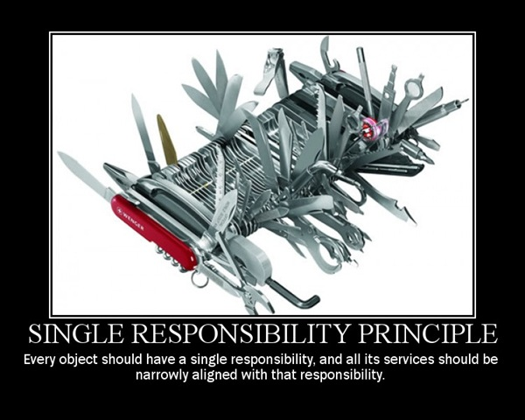
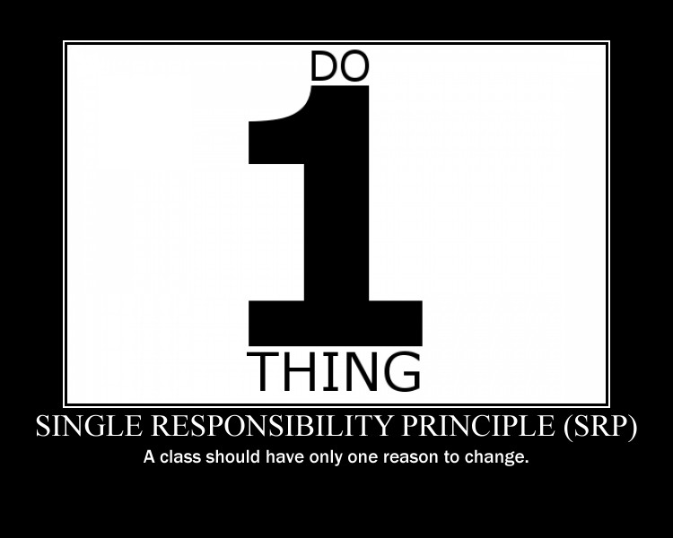

Slide 21
Single Responsibility Principle
A class should only have one single responsibility
The responsibility should be entirely encapsulated by the class
There should be no more than one reason to change a class
Reduces the number of dependencies
Keeps classes slim
Better to understand

Slide 23
Open Closed Principle
A class should be open for extension, but closed for modification
Make it easy to add new functionality and different algorithms to your classes
Protect the existing ones against any external modifications

Slide 24
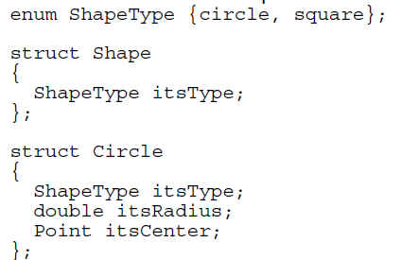
Example for bad code

Slide 25
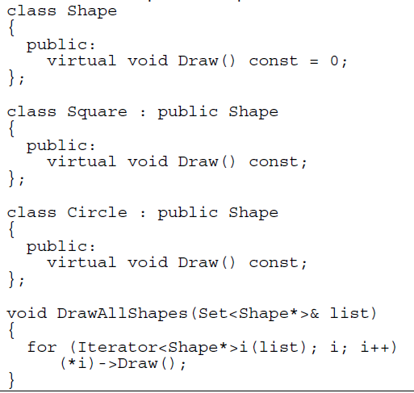
How to do it better

Slide 26
Open / close principle continued
Make all data variables private
Access them via Set/Get methods
Only implement Set if it is really necessary
Do not use global variables
Hide as much as you can from the user

Slide 28
Liskov Substitution Principle
Objects in a program should be replaceable with instances of their subtypes without altering the correctness of that program
Protect your code from unwanted behavior
Rule to decide if a class can be a subclass of another one

Slide 29
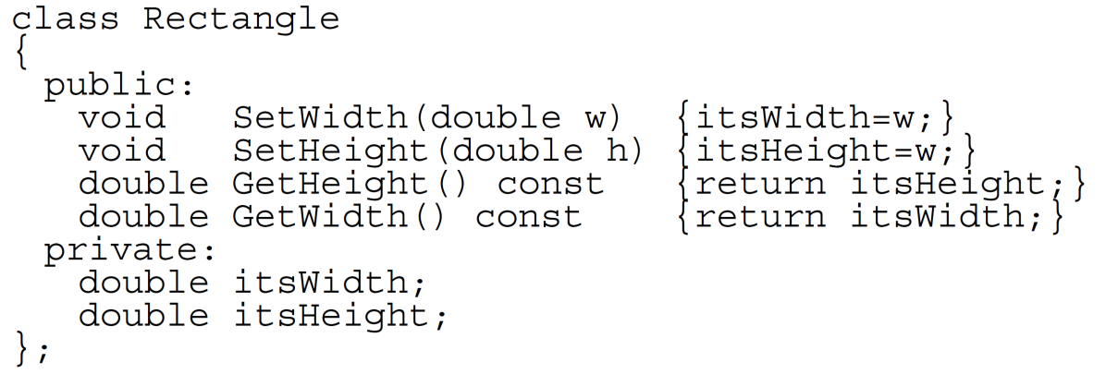
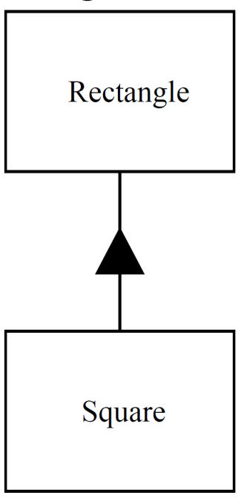
LSP - Example
What is the problem?

Slide 31
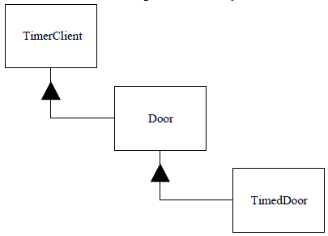
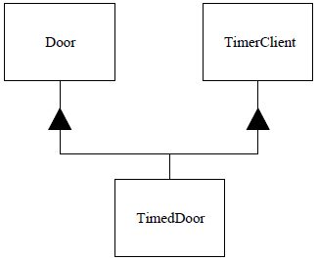
Interface Segregation Principle
Many client specific interfaces are better than one general purpose interface
Clients should not be forced to depend upon interfaces that they do not use

Slide 33
Dependency Inversion Principle
A. High-level modules should not depend on low level modules. Both should depend on abstractions.
B. Abstractions should not depend upon details. Details should depend upon abstractions

Slide 34
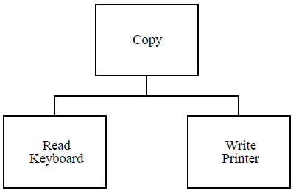
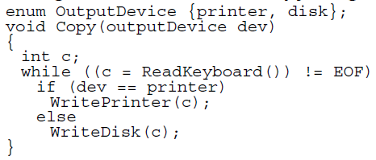
Example for bad code

Slide 35
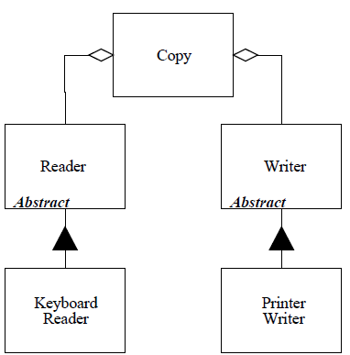
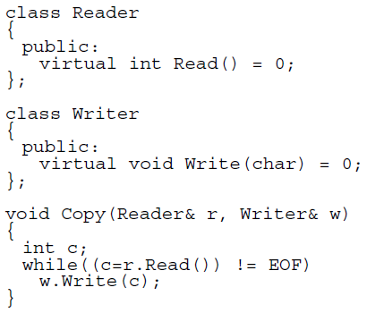
How to do it better

Slide 36
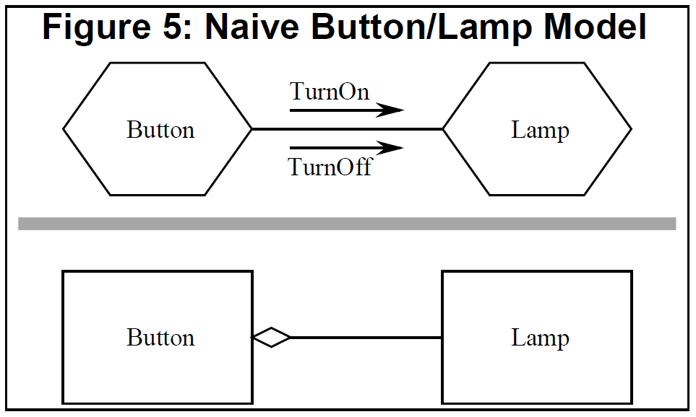
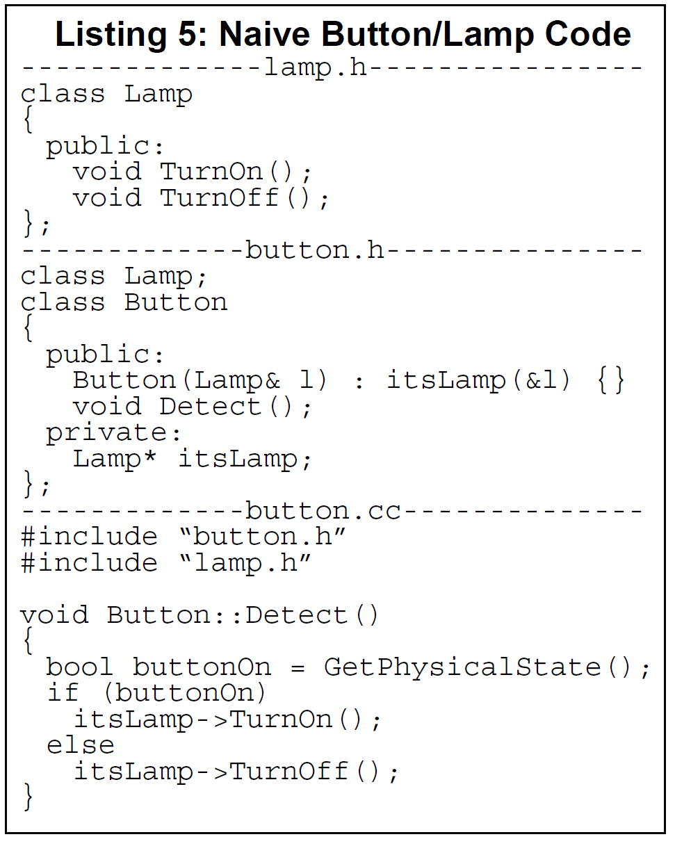
Another example – BAD CODE

Slide 37
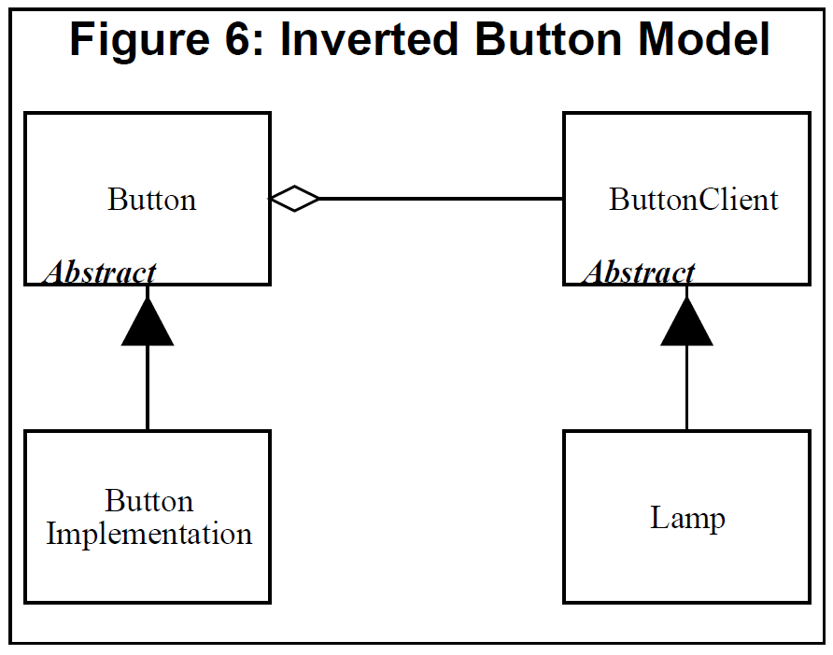
Another example – GOOD CODE

Slide 38
General statements
Use std::cout instead of printf
Do not use C arrays like: double myVal[10] The standard library offers a long list of container classes (vector, map, set, list, …) which are more powerful and more safe
As an alternative there are root classes like TClonesArray
Do not fear to refactorize (clean up) your code. SVN prevents you from braking something.
If you use pointers in your classes make sure you clean them up at the end
If you use pointers in your classes write an appropriate copy constructor and assignment operator

