Slide 1
Some Remarks on Ξ* & Ω*
Jun 09, 2016 | Albrecht Gillitzer, IKP Forschungszentrum Jülich
LVII PANDA Meeting, GSI Darmstadt, June 2016

Slide 2
Outline
Summary of Baryons 2016
Ideas for the Strange Baryon Spectroscopy Program
MC event generation issues

Slide 3
Baryons 2016
Invitation to give an overview talk on strange baryon spectroscopy
Not a PANDA talk
Scientific program:
8 plenary sessions
21 parallel sessions
topics: light, heavy and exotic baryons
parallel session on „physics of hyperons“

Slide 4
Strange Partners
Approximate SU(3) flavor symmetry
N* & Δ states have partners in the strange sector
focus on Ξ and Ω
Ξ: as many states as N* & Δ together
Ω: as many states as Δ
scrutinize our understanding of the baryon excitation pattern

Slide 5
Status of Ξ* Resonances: RPP 2014
Chin. Phys. C 38 (2014) 090001
?
Ξ(1820):
Teodoro78 favors J = 3/2, but cannot make a parity discrimination. Biagi 87c is consistent with J = 3/2 and favors negative parity for this J value.
?

Slide 6
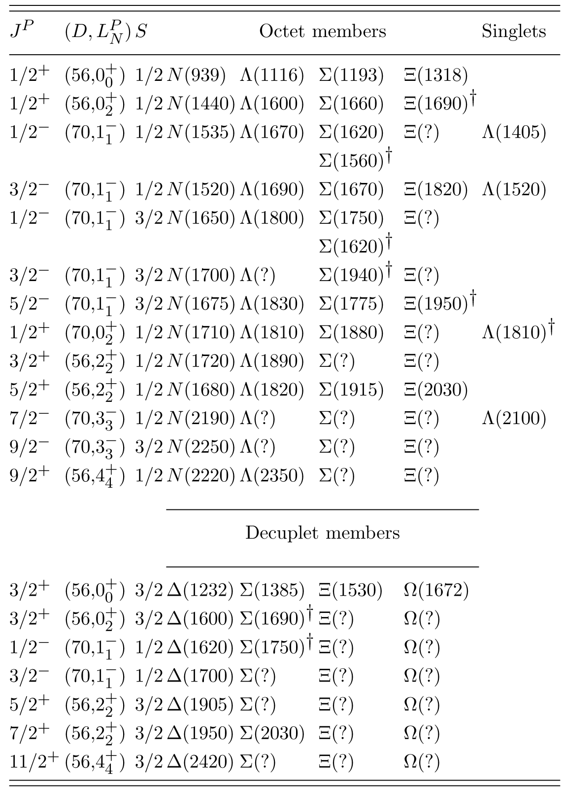
SU(6) x O(3) Classification
RPP 2014: Chin. Phys. C 38 (2014) 090001
„Assignments for …
Ξ(1820) and Ξ(2030), are merely
educated guesses.“
Ξ(1690), Ξ(1950):
T. Melde et al., PRD 77 (2008) 114002
decuplet: no Ξ*, no Ω*
“… nothing of significance on Ξ resonances has been added since our 1988 edition.”
?

Slide 7
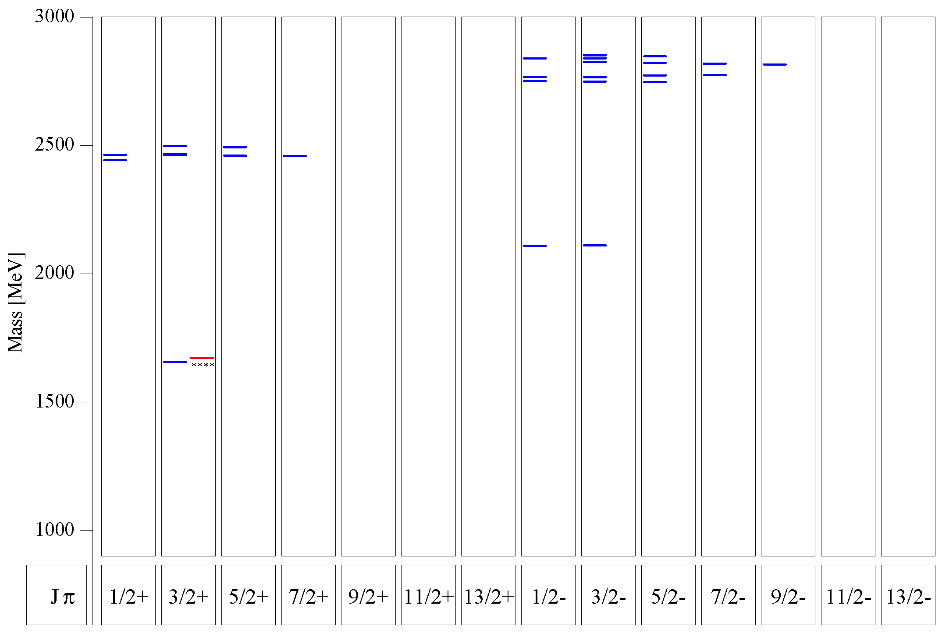
Quark Model
Ξ:
many states predicted below 3 GeV
compare 1/2⁺ and 1/2⁻ excitation
Ω:
several states predicted between 2 GeV and 3 GeV
compare 3/2⁺ and 3/2⁻ excitation
Ξ
U. Löring et al., EPJA 10 (2001) 447
Ω
s.a.: M. Pervin, W. Roberts, PRC 77 (2008) 025202

Slide 8
Experimental Prospects
Invitation to give a talk on „Strange Baryons …with reference to the programs at PANDA, GlueX, and LHCb”
pp → Ξ*X (prompt or delayed) LHCb
γp → K⁺K⁺Ξ* GlueX, CLAS12
pp → Ξ*Ξ & c.c. PANDA
e⁺e⁻ → Ξ*X (prompt or delayed) Belle II
BES III
K⁻p → K⁺Ξ^{*-} J-PARC
K_{L}p → K⁺Ξ^{*0} Hall D K_{L} beam
P. Spradlin, Wednesday
L. Guo, Tuesday
_
_
_
J. Yelton, Thursday
M. Destefanis, Thursday
M. Naruki, Tuesday
S. Taylor, Tuesday

Slide 9
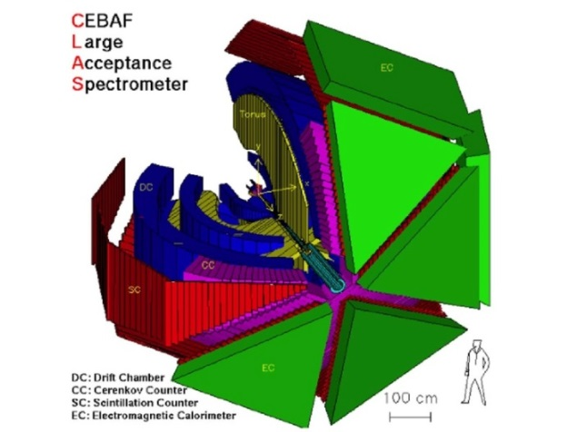
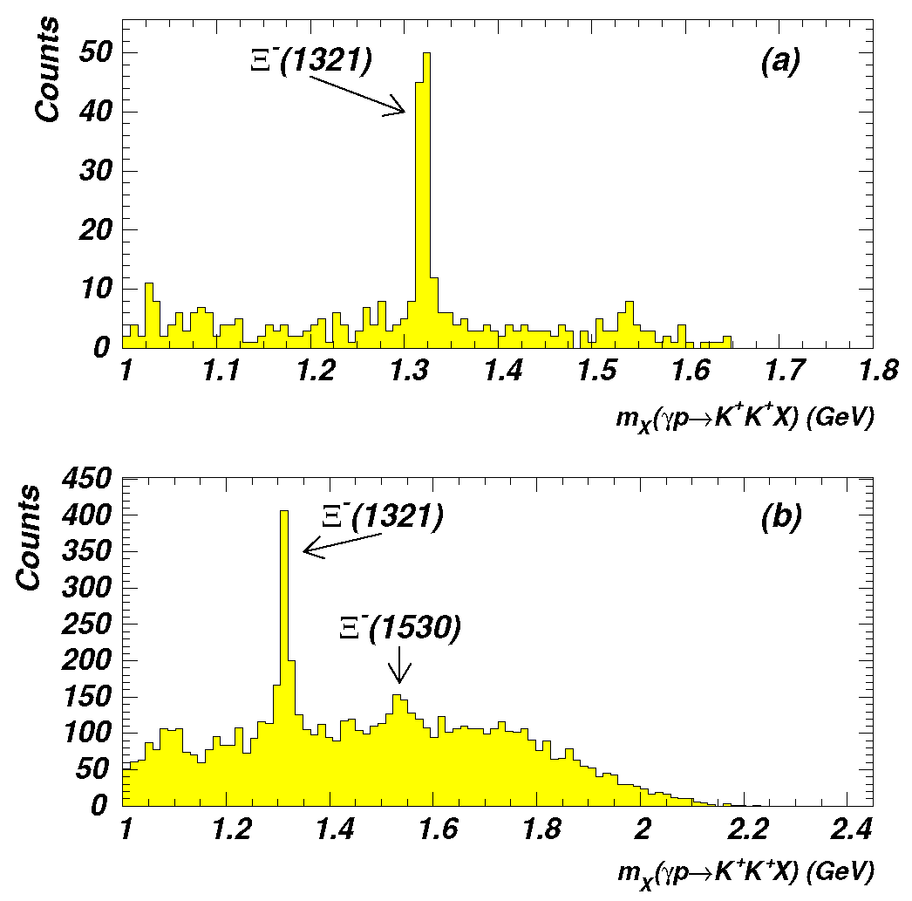
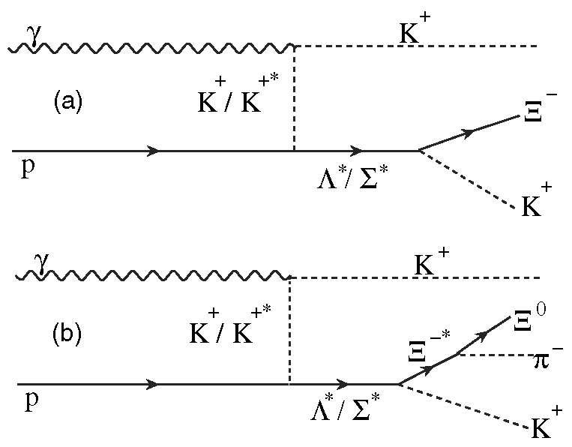
Ξ Production in γp: CLAS
Runs g6a, g6b:
first exclusive photoproduction of Ξ⁻
reaction γp → K⁺K⁺ X
g6a:
3.2 – 3.9 GeV
g6b:
3.0 – 5.2 GeV
J. Price et al., PRC 71 (2005) 058201

Slide 10
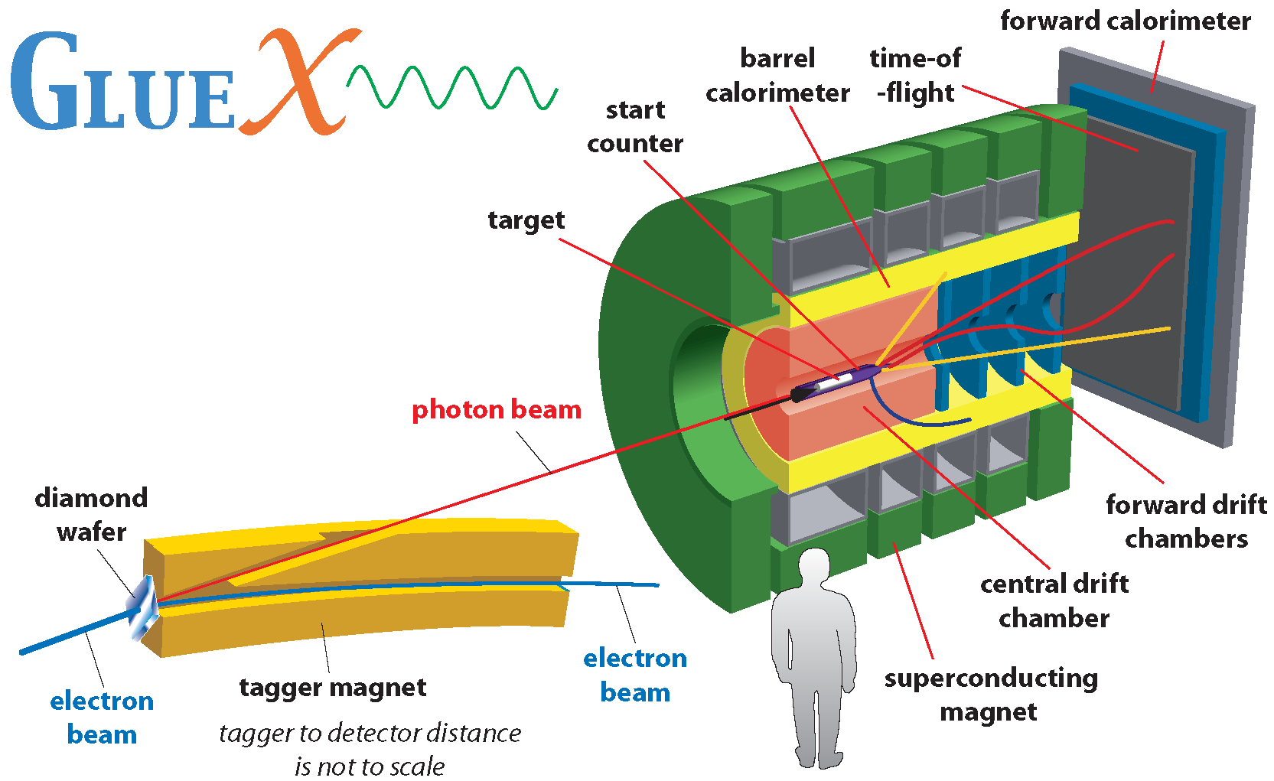
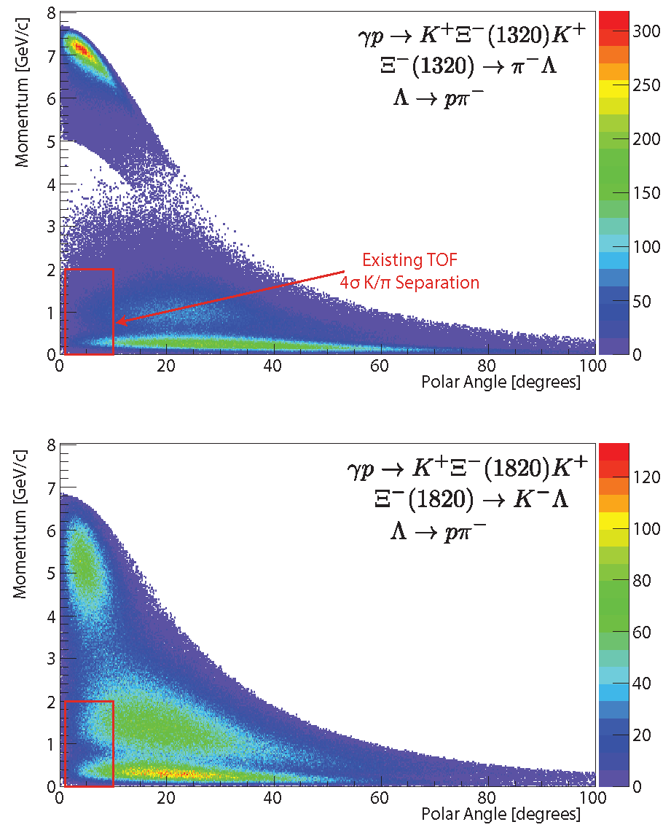
Ξ Production at GlueX
GlueX Proposal (JLAB PAC 39, 40 & 42): „Decays to Strange Final States“
Study excited Ξ states
parity measurement of the g.s. Ξ⁻
will probably need enhanced kaon identification in forward region
Components of BaBar DIRC for GlueX
A. AlekSejevs et al., arXiv:1305.1523
GlueX proposal to PAC 40

Slide 11
Talk at EMMI Workshop „Resonances in QCD“, GSI Darmstadt, October 12-14, 2015

Slide 12
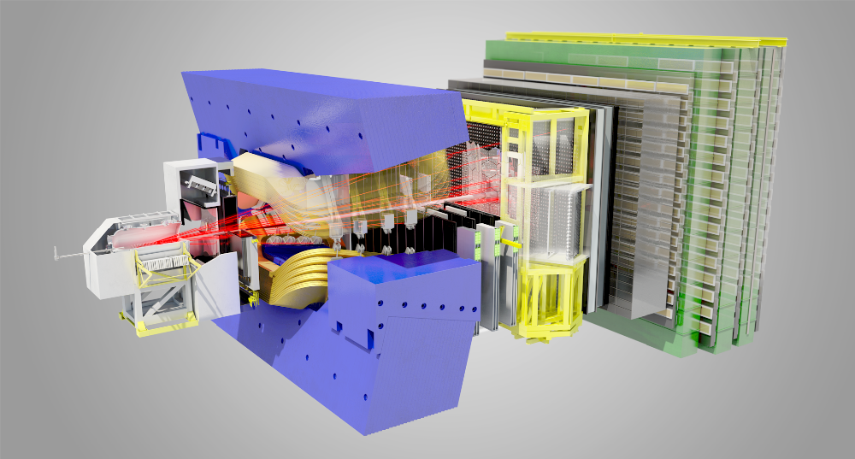
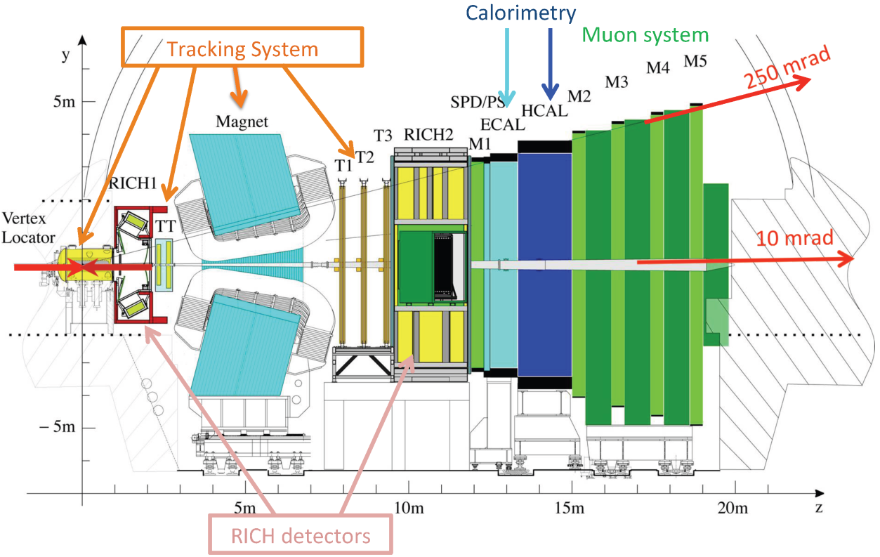
Strange Baryons at LHCb
Run | Year | √s [TeV] | ∫Ldt
I | 2011 | 7 | 1 fb⁻¹
I | 2012 | 8 | 2 fb⁻¹
II | 2015 | 13 | 320 pb⁻¹
LHCb track types
Patrick Spradlin, Wednesday
Sebastian Neubert, Thursday

Slide 13
Λ_{b} → K P_{c} → K J/ψ p
Λ_{b} → J/ψ Λ* → J/ψ K p

Slide 14
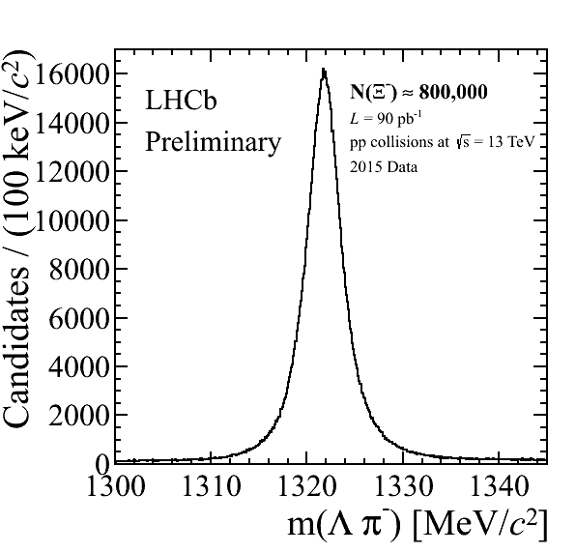
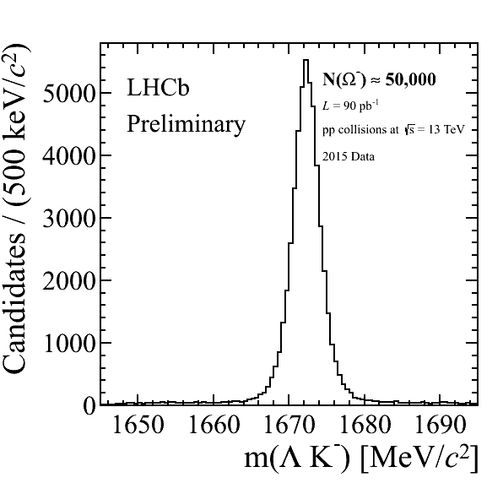
Strange Baryons at LHCb
2015 Run II data: √s = 13 TeV
first analysis to study prompt Ξ and Ω production*
* communicated by M. Pappagallo

Slide 15
Early Physics: Expected Rates for Strange Baryons
initial phase: $L≅{10}^{31}{cm}^{−2}s^{−1}$ instead of $L≅{2∙10}^{32}{cm}^{−2}s^{−1}$
nevertheless the $Ξ\overline{Ξ}$ production rate will be $R_{Ξ\overline{Ξ}}≅10/s≅{10}^{6}/d$
for $Ω\overline{Ω}$ production we expect $R_{Ω\overline{Ω}}≅0.3/s≅{3∙10}^{4}/d$
for excited states the cross section should be of the same order of magnitude as for the ground state for given $\sqrt{s}−\sqrt{s_{thr}}$
the detected rate depends on the specific decay mode (branching & reconstruction efficiency)
e.g. $\overline{p}p→{\overline{Ξ}}^{+}Ξ^{∗−}→$ ${\overline{Ξ}}^{+}Ξ^{−}π^{0}→\overline{Λ}π^{+}Λπ^{−}π^{0}→\overline{p}π^{+}π^{+}pπ^{−}π^{−}π^{0}$ assume $b=0.5∙{0.64}^{2}=0.2$ and $ε=5\%$ → $R_{det}≅$ ${10}^{4}/d$

Slide 16
Ξ* / Ω* Studies within the PANDA Physics Program
good case for initial phase with lower L
Λ & Σ spectroscopy can be done in parallel
long runs to measure the X(3872) width in energy scan planned:
parallel trigger for Ξ* and Ω*
p ≈ 7.0 GeV/c
M_{max}(Ξ*) ≈ 2.55 GeV (M_{max}(Ω*) ≈ 2.20 GeV)
later: long runs for threshold scan of D_{s}D_{s}(2317)
p ≈ 8.8 GeV/c
M_{max}(Ω*) ≈ 2.61 GeV
$$±$$
$$∓$$

Slide 17
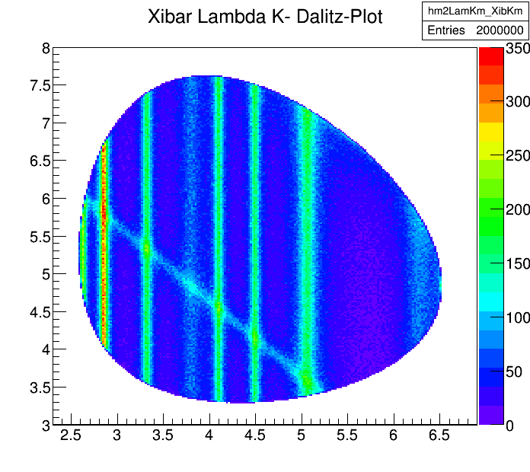
Ξ* Production at p = 7.0 GeV/c
EvtGen
${\overline{p}p→{\overline{Ξ}}^{+}Ξ^{∗−}→\overline{Ξ}}^{+}ΛK^{−}$
included all Ξ* states in PDG above $Λ\overline{K}$ threshold
typical width ~20 MeV
decay: PHSP
added ${\overline{Ξ}}^{+}ΛK^{−}$ cont.
added $K\left(3100\right)$ seen in $\overline{p}Λ$, $\overline{p}Λ nπ$ & c.c.
$$M^{2}\left({\overline{Ξ}}^{+}K^{−}\right) \left[{GeV}^{2}/c^{4}\right]$$
$$M^{2}\left(ΛK^{−}\right) \left[{GeV}^{2}/c^{4}\right]$$

Slide 18
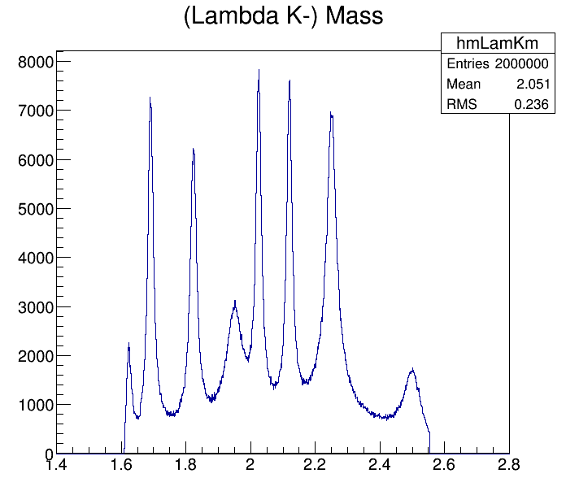
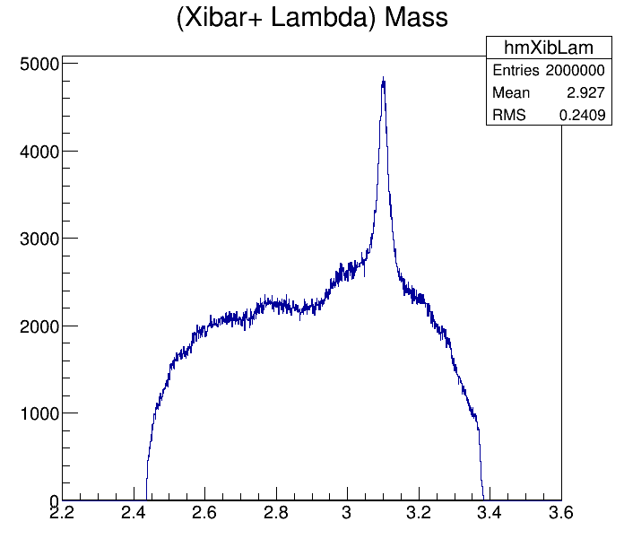
Ξ* Production at p = 7.0 GeV/c
projections on $ΛK^{−}$ and ${\overline{Ξ}}^{+}Λ$ mass
$$M\left(ΛK^{−}\right) \left[GeV/c^{2}\right]$$
$$M\left({\overline{Ξ}}^{+}Λ\right) \left[GeV/c^{2}\right]$$

Slide 19
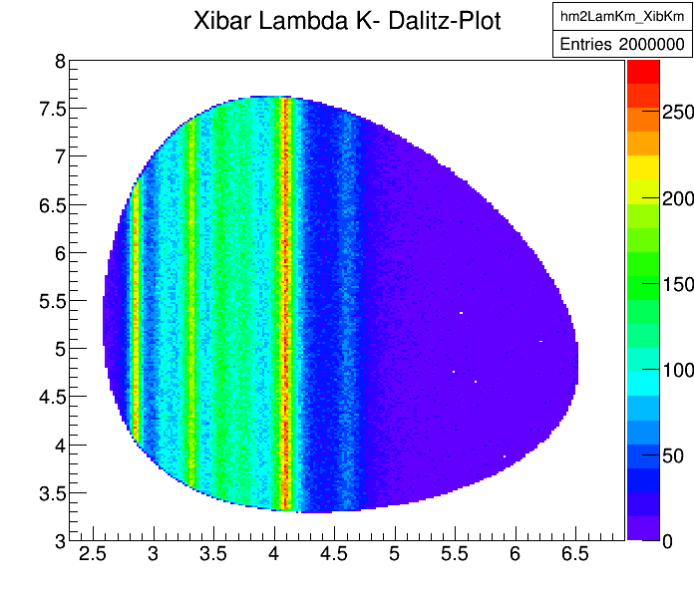
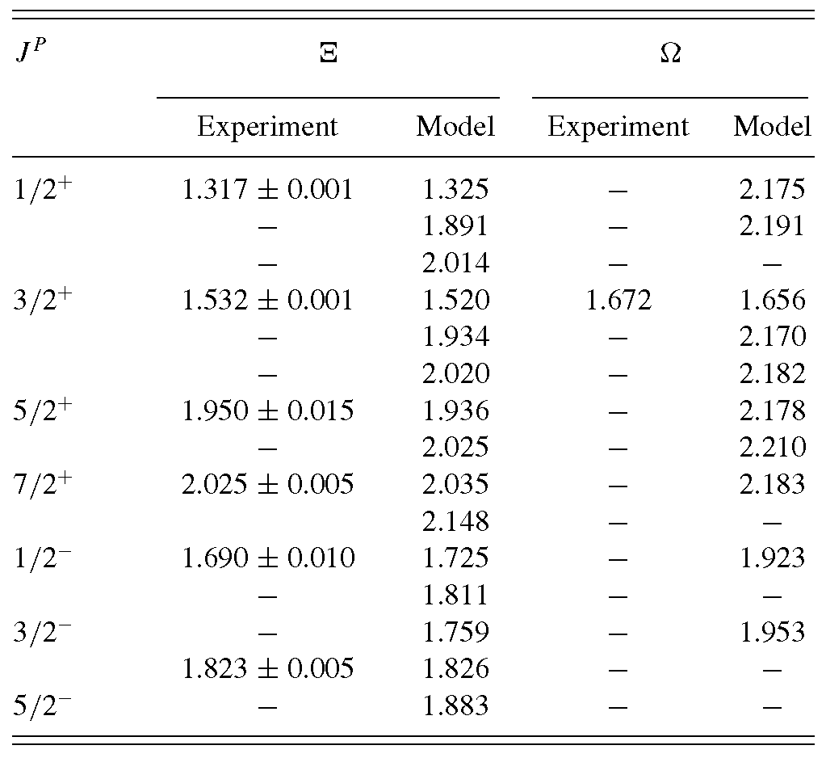
Ξ* Production at p = 7.0 GeV/c
same as before but Ξ* states taken from M. Pervin, W. Roberts, PRC 77 (2008) 025202:
$$M^{2}\left({\overline{Ξ}}^{+}K^{−}\right) \left[{GeV}^{2}/c^{4}\right]$$
$$M^{2}\left(ΛK^{−}\right) \left[{GeV}^{2}/c^{4}\right]$$

Slide 20
13 states above
$Λ\overline{K}$ threshold
M. Pervin, W. Roberts,
PRC 77 (2008) 025202

Slide 21
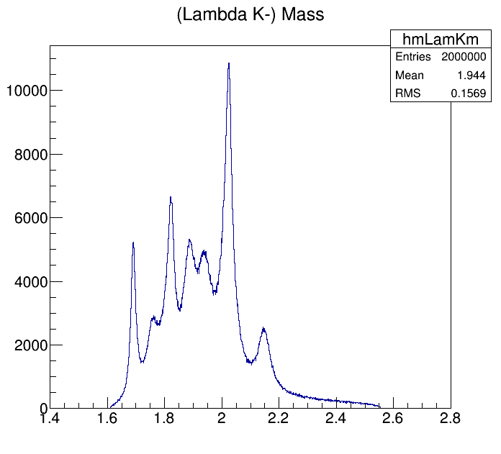
Ξ* Production at p = 7.0 GeV/c
Ξ* states taken from M. Pervin, W. Roberts, PRC 77 (2008) 025202
width taken from PDG or assumed to be 50 MeV
projection on $ΛK^{−}$ mass
partial overlap: 13 states result in 7 bumps
$$M\left(ΛK^{−}\right) \left[GeV/c^{2}\right]$$

Slide 22
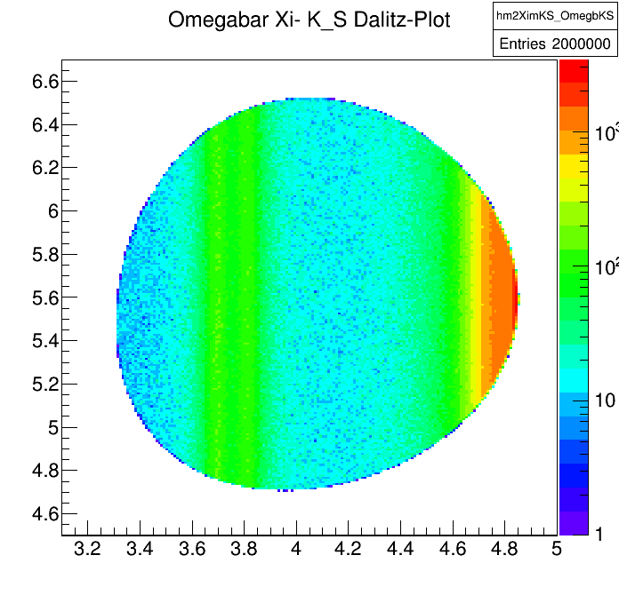
Ω* Production at p = 7.0 GeV/c
${\overline{p}p→{\overline{Ω}}^{+}Ω^{∗−}→\overline{Ω}}^{+}Ξ^{−}K_{S}$
Ω* states taken from M. Pervin, W. Roberts, PRC 77 (2008) 025202:
$$M^{2}\left({\overline{Ω}}^{+}K_{S}\right) \left[{GeV}^{2}/c^{4}\right]$$
$$M^{2}\left(Ξ^{−}K_{S}\right) \left[{GeV}^{2}/c^{4}\right]$$

Slide 23
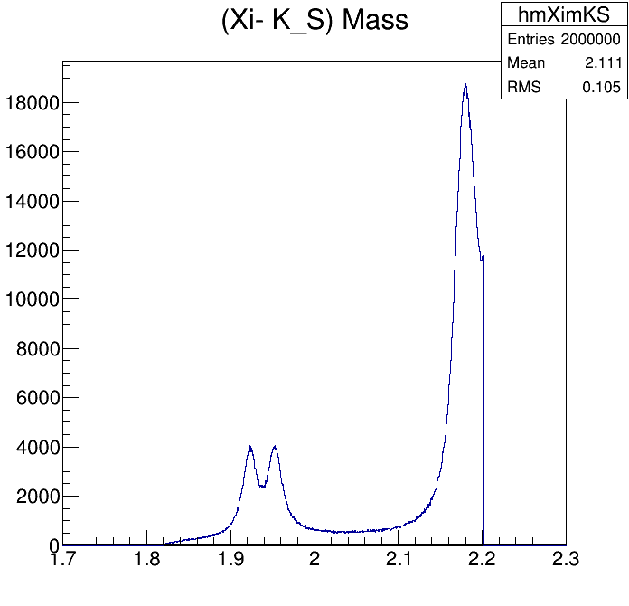
Ω* Production at p = 7.0 GeV/c
Ω* states taken from M. Pervin, W. Roberts, PRC 77 (2008) 025202
20 MeV width assumed
projection on $Ξ^{−}K_{S}$ mass
large overlap: 9 states result in only 3 bumps
$$M\left(Ξ^{−}K_{S}\right) \left[GeV/c^{2}\right]$$

Slide 24
Issues in MC Event Generation
Problem in EvtGen: in reaction $\overline{p}p→\overline{X}X^{∗}$ a flat mass distribution is generated instead of Breit-Wigner if $\overline{X}X^{∗}$ mass is larger than mass of pbarpSystem in file evt.pdl. (solved)
Would like to generate realistic angular distributions for Ξ* and Ω* decay particles depending on J^{P} value
No appropriate decay model implemented in EvtGen
Question:
include this in EvtGen?
use independent PWA code?

