Slide 1
Current status of works on the barrel EMC at IHEP
Andrey Ryazantsev
on behalf of the IHEP-Protvino group

Slide 2
Major milestones for the EMC Barrel Mechanics

Slide 3
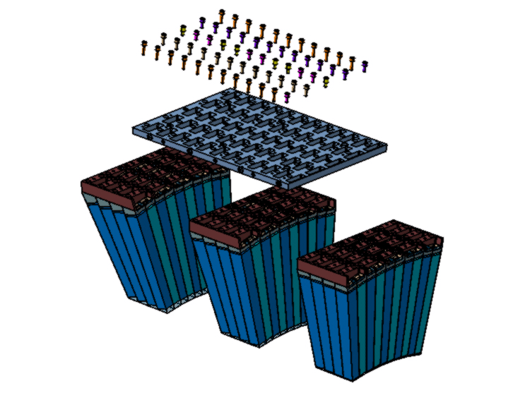
Super-module structure
Module plate

Slide 4
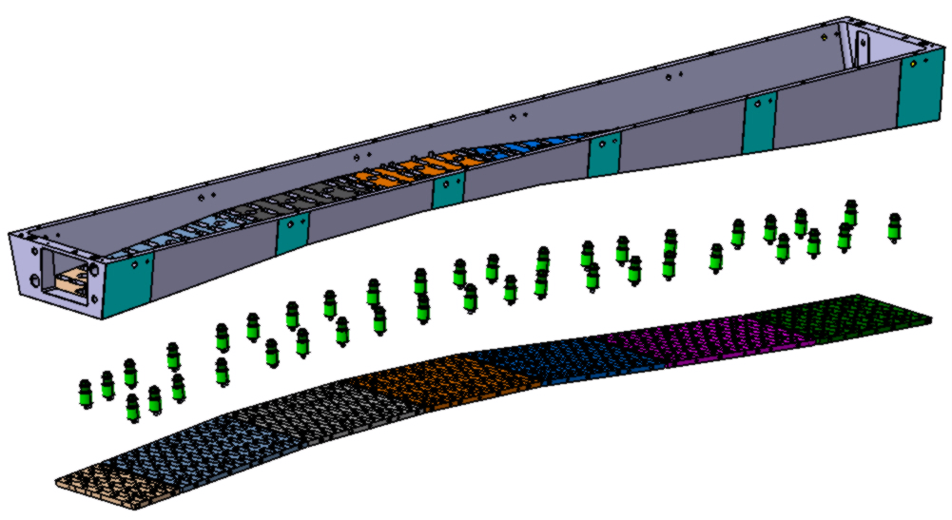
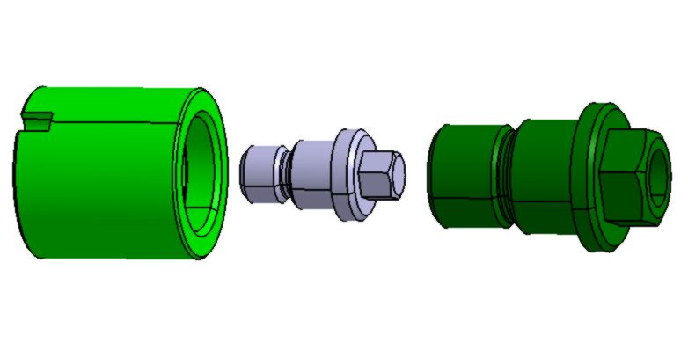
Crystals modular support structure
Support beam
(Aluminum)
Support feet, 40 pcs.
(G10 )
Module plates, 7 pcs.
(Aluminum)

Slide 5
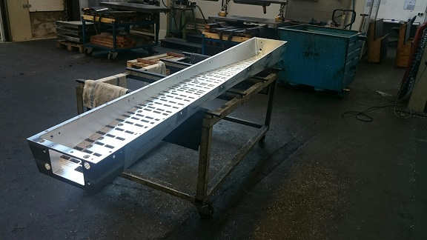
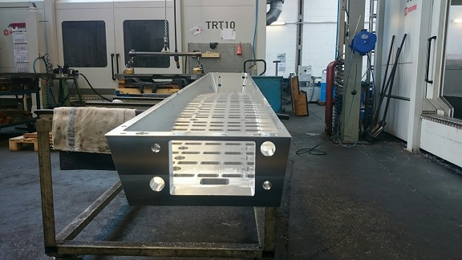
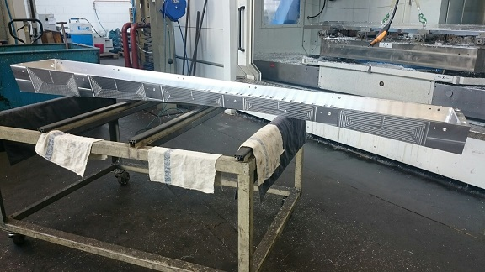
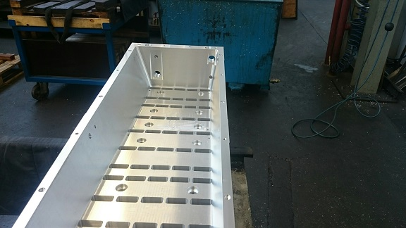
Support beam at production facility

Slide 6
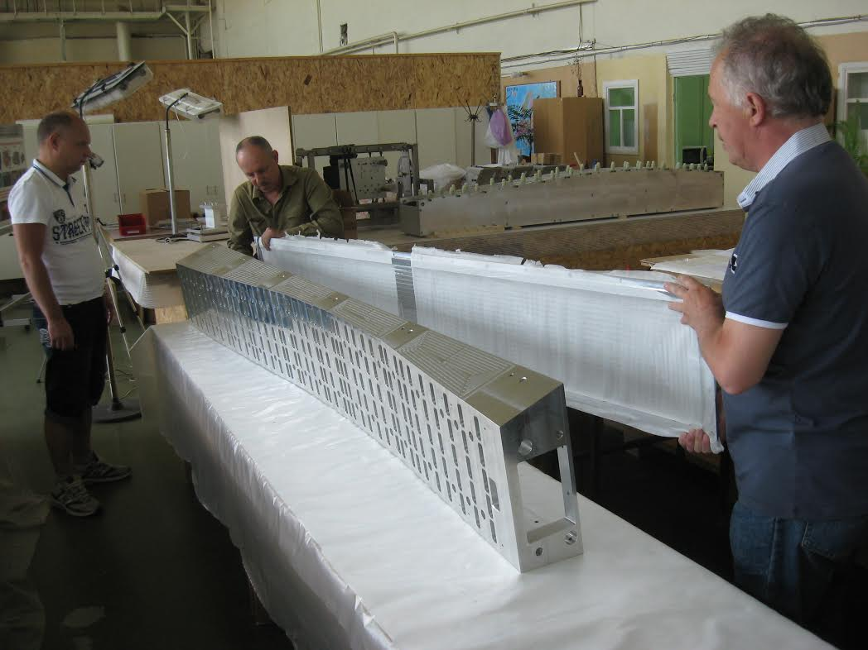
Support beam delivered at IHEP

Slide 7
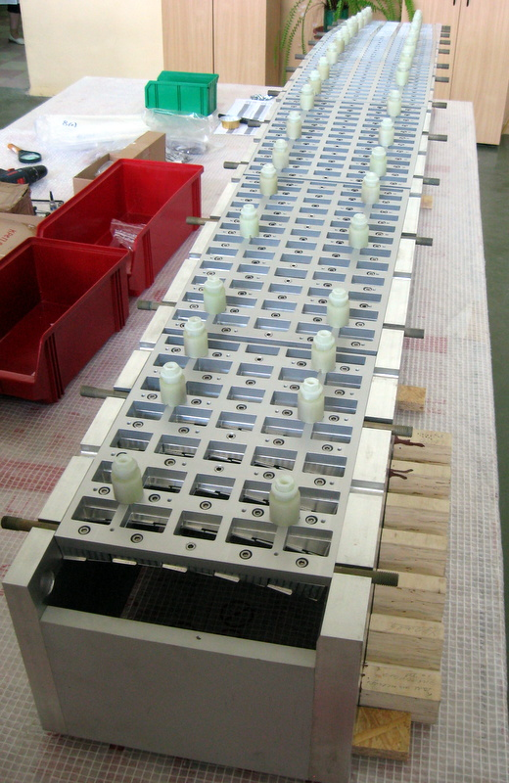
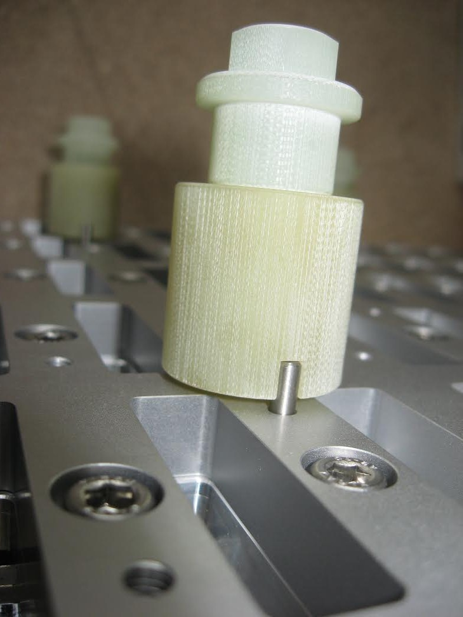
Module plates with mounted support feet

Slide 8
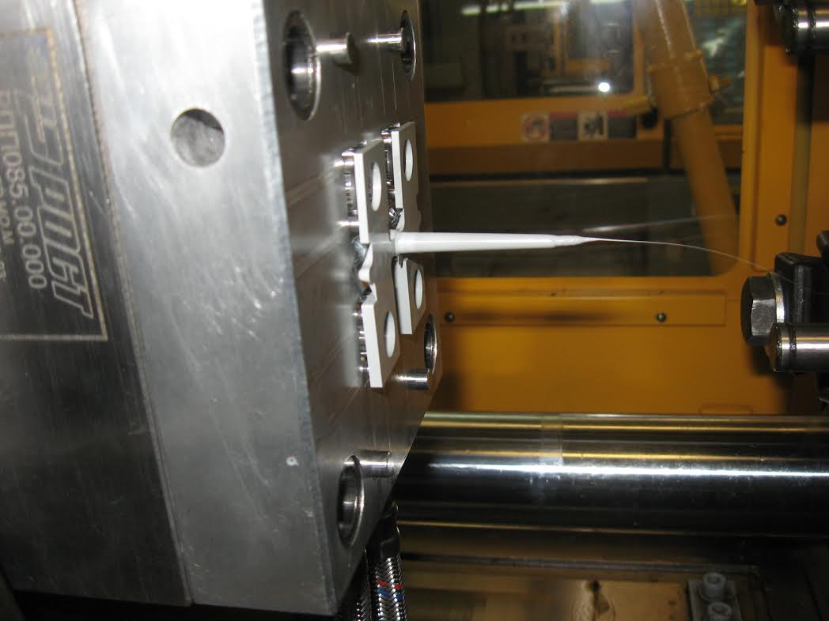
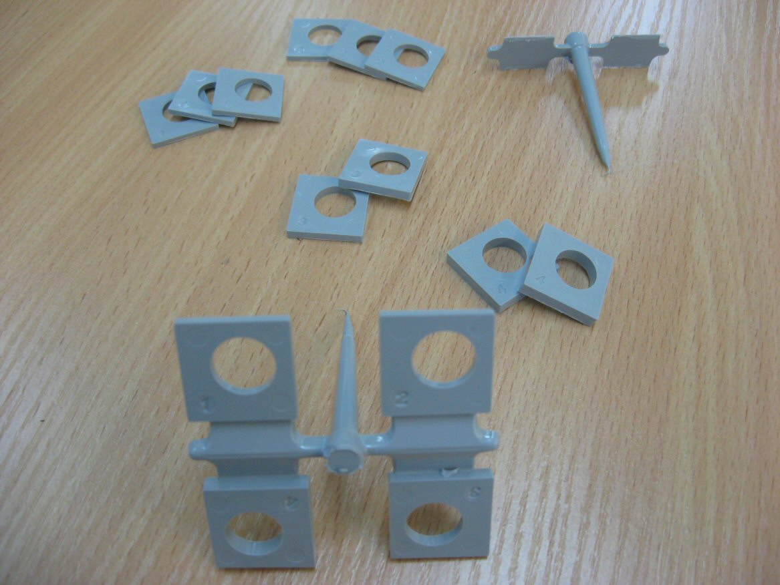
Front inserts production at IHEP

Slide 9
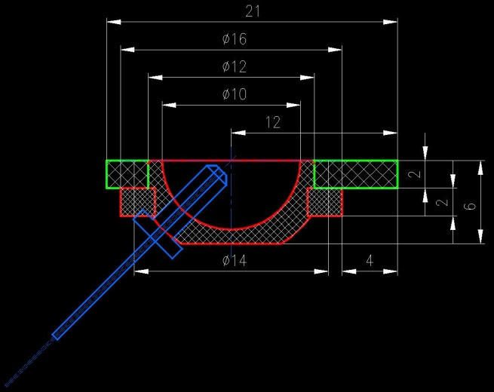
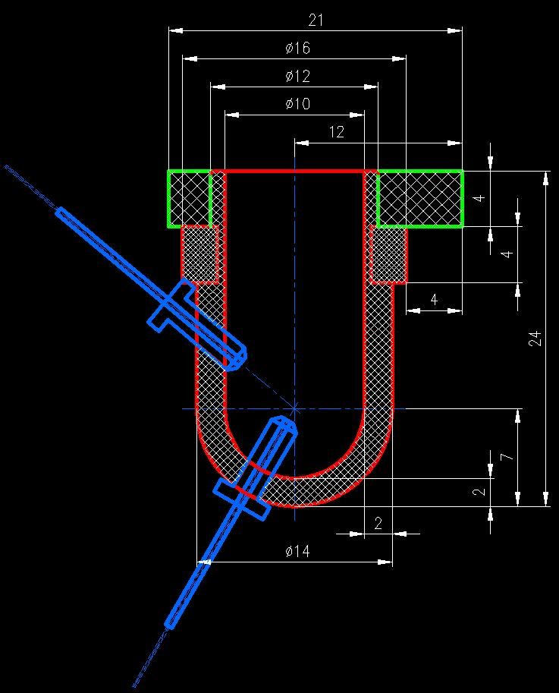
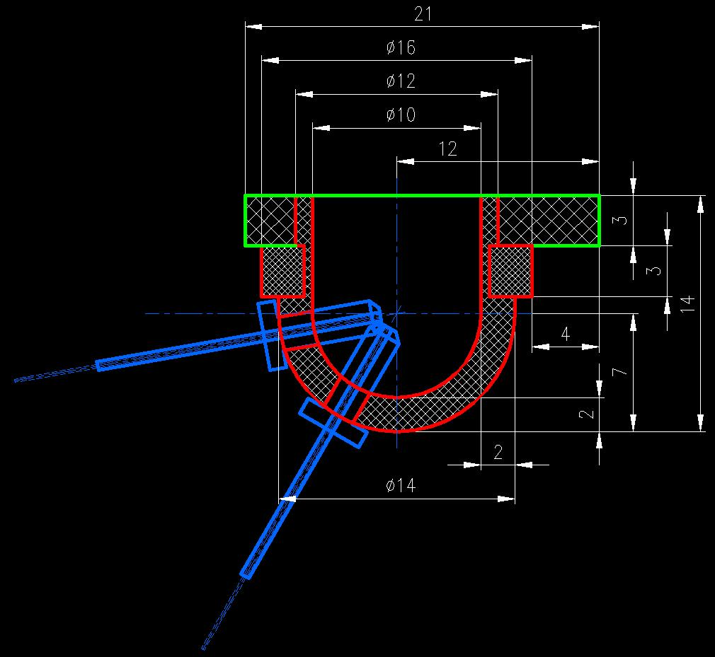
Design of front inserts and optical fibers coupling

Slide 10
Summary
Manufacturing of single carbon alveoli units of 18 different types for the whole barrel was completed. Spare units of each type were produced in amount of about 10%.
Special mold is ready for the mass production of front inserts at IHEP. Production rate is about 100 pcs./day.
Module plates and support feet as well as the support beam were produced and delivered to IHEP; pre-assembling test is in progress .
Addendum 3 and Addendum 4 to the Collaboration Contract which are necessary to solve custom formalities and perform delivery of Batch #2 of the components and devices for the pre-series slice assembling were written and sent to FAIR for the final approval and signing.
We plan to finish all the tests during couple of weeks and hope to get signed Addenda a.s.a.p.

