Slide 1

News from APD screening @

Slide 2
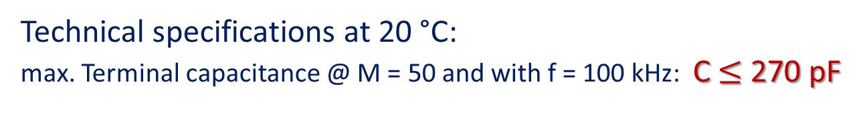
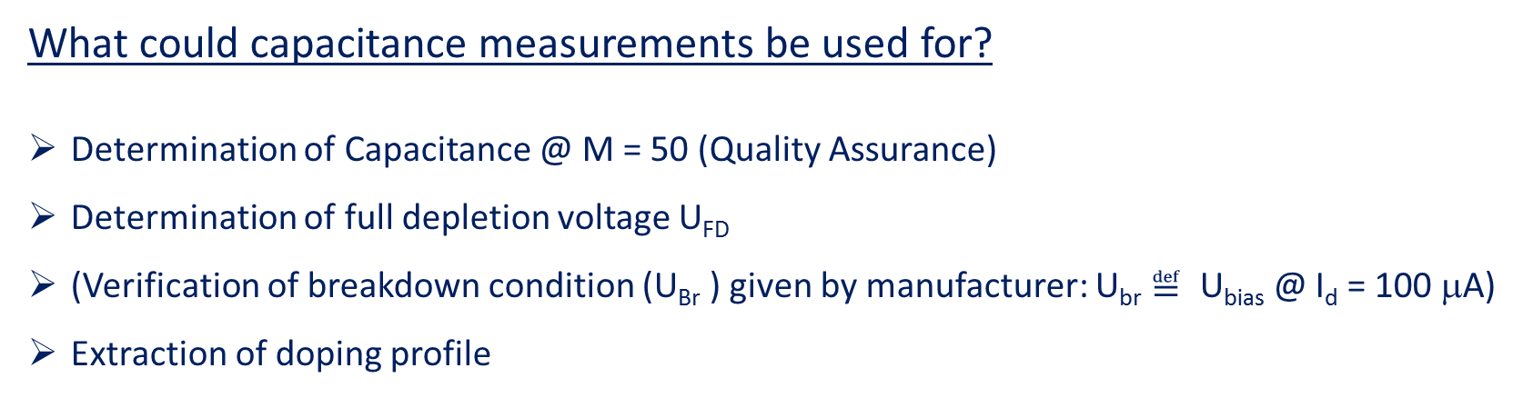
Capacitance measurements
What could capacitance measurements be used for?
Determination of Capacitance @ M = 50 (Quality Assurance)
Determination of full depletion voltage U_{FD}
(Verification of breakdown condition (U_{Br} ) given by manufacturer: U_{br} $≝$ U_{bias} @ I_{d} = 100 μA)
Extraction of doping profile
Technical specifications at 20 °C:
max. Terminal capacitance @ M = 50 and with f = 100 kHz: C $≤$ 270 pF

Slide 3
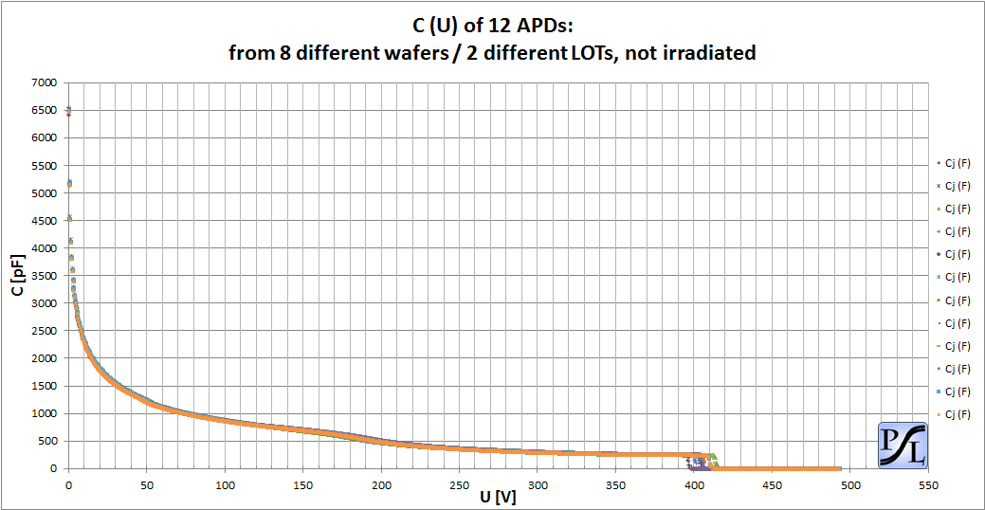
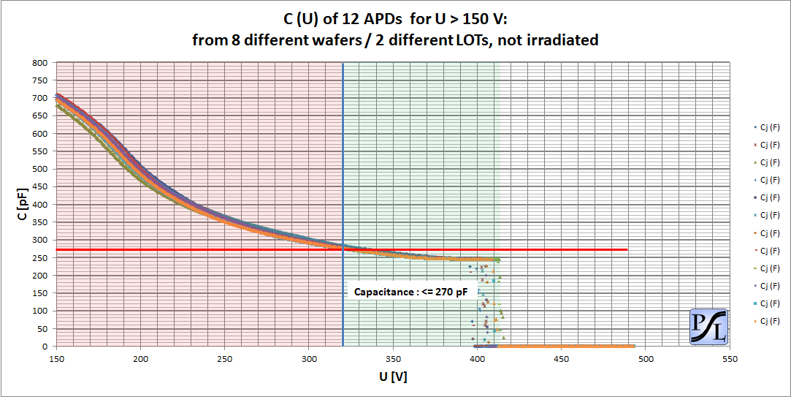
Capacitance measurements
Different U_{br} values

Slide 4
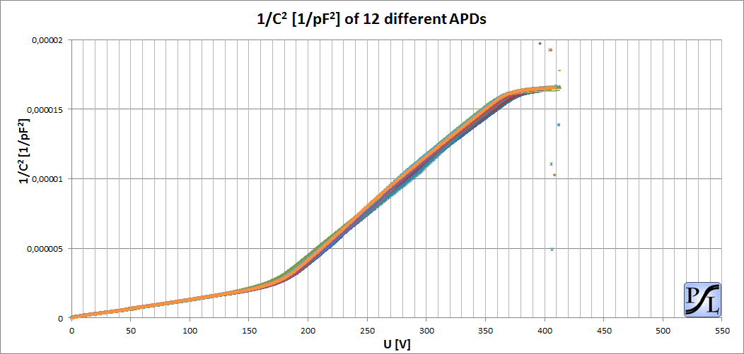
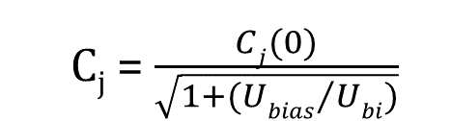
Capacitance measurements
C_{j} = $\frac{Cj(0)}{\sqrt{1+({Ubias}/{Ubi})}}$

Slide 5
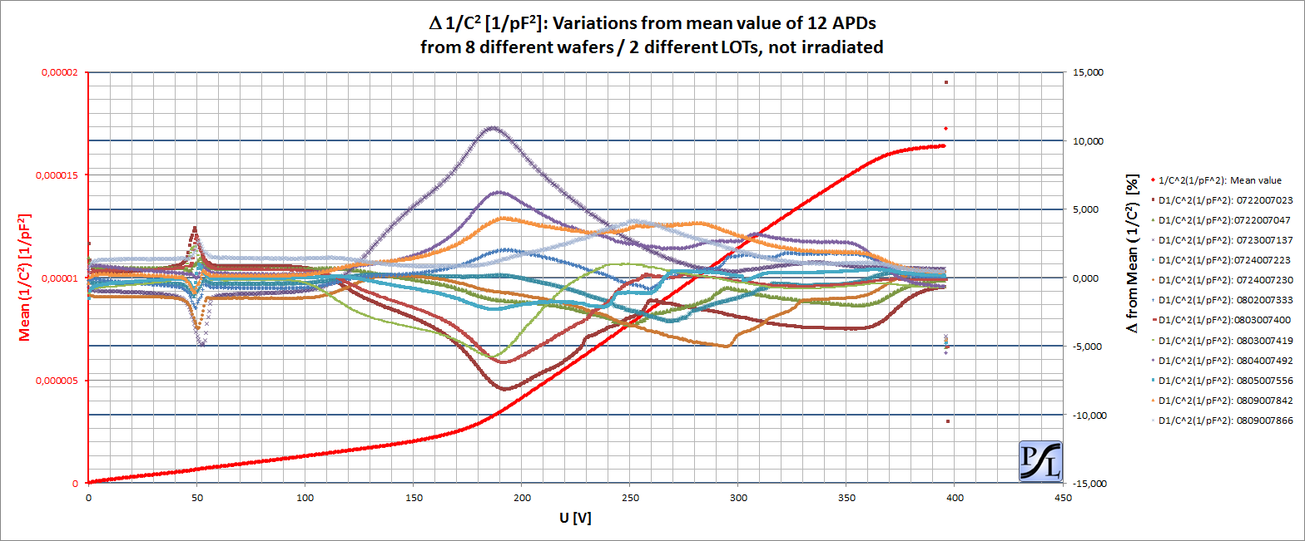
Capacitance measurements
Bias voltage area used

Slide 6
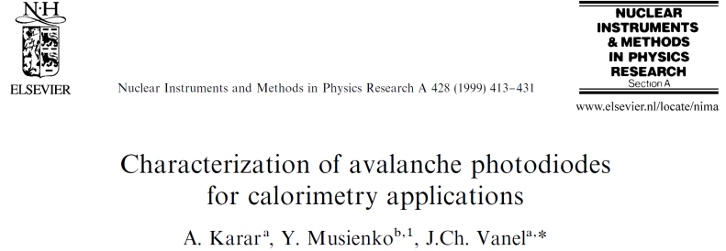
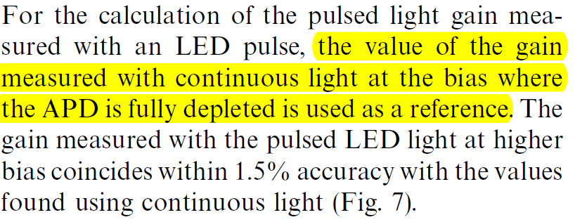
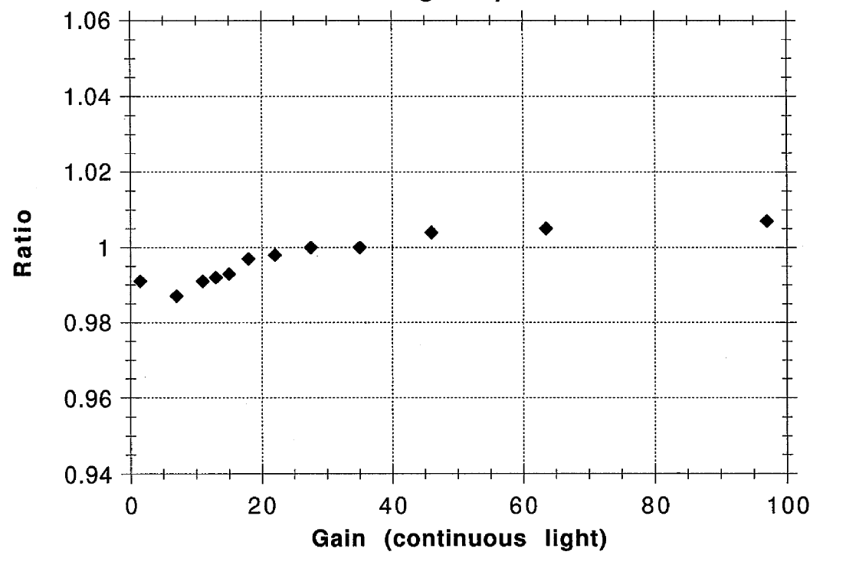
Full depletion
Two different methods of APD gain determination (without using
radioactive sources) are possible:
continous and pulsed light illumination
We know already:
A reference value for gain normalization between these two methods
is needed
Therefore:
The individual full depletion voltage of each APD should
be used as reference point for this investigation.
Figure 7

Slide 7
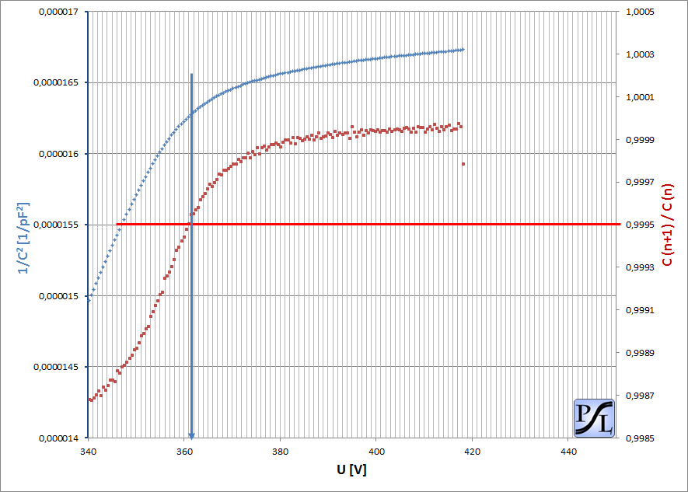

Full depletion
Determination of full depletion voltage U_{FD}
Start of full depletion plateau @
Capacitance Ratios $≥$ 0.9995
U_{FD}

Slide 8
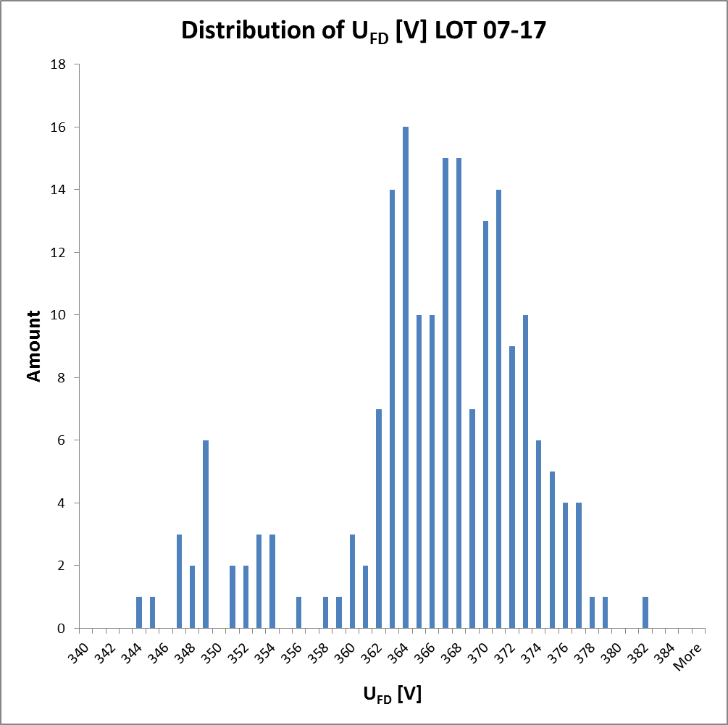
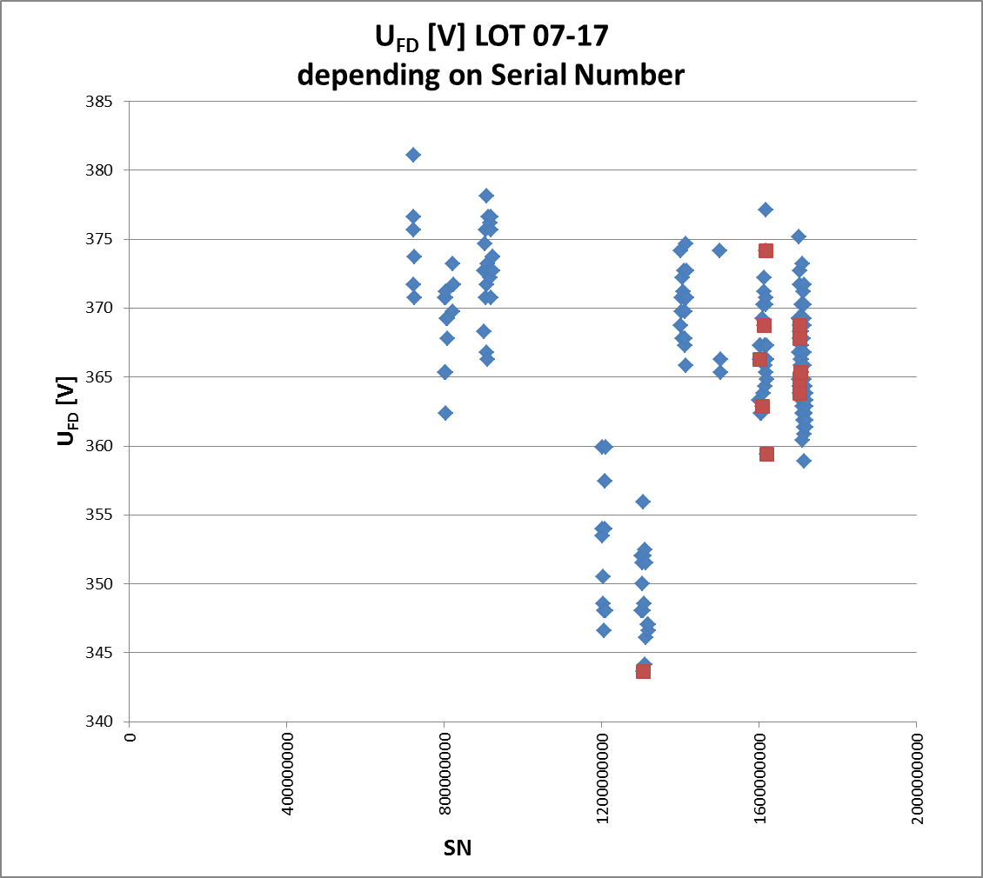
Full depletion
194 APD samples measured so far

Slide 9
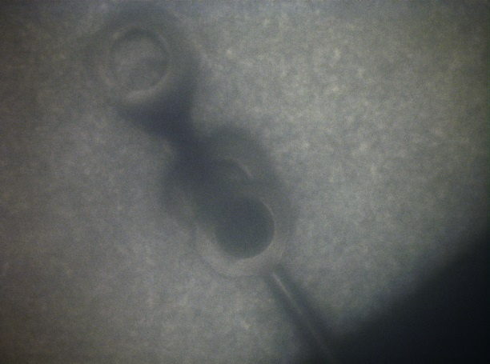
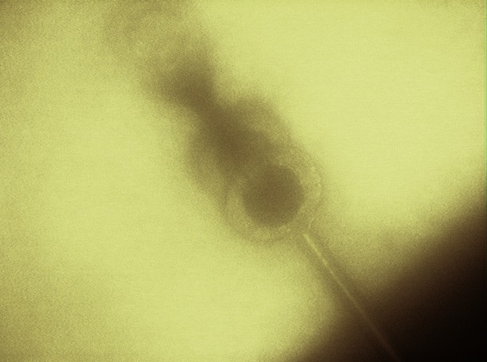
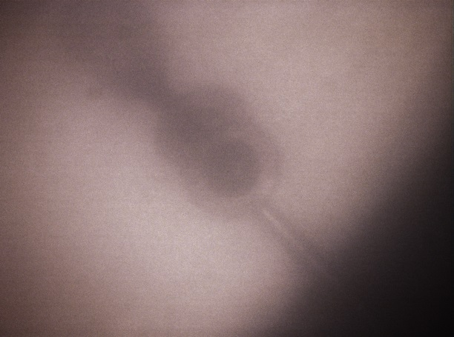
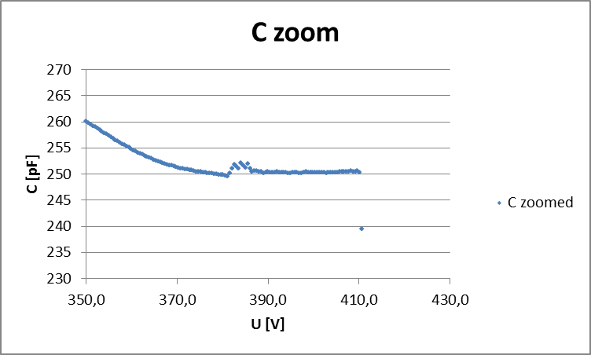
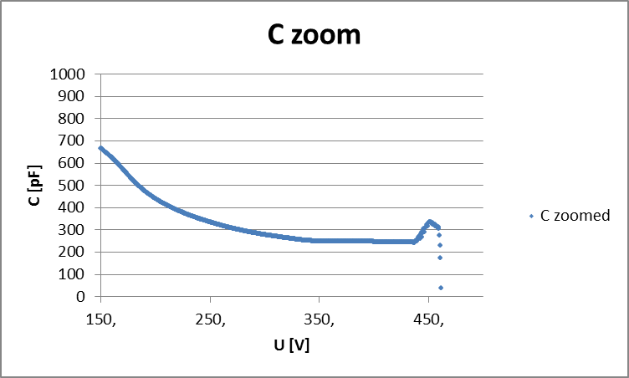
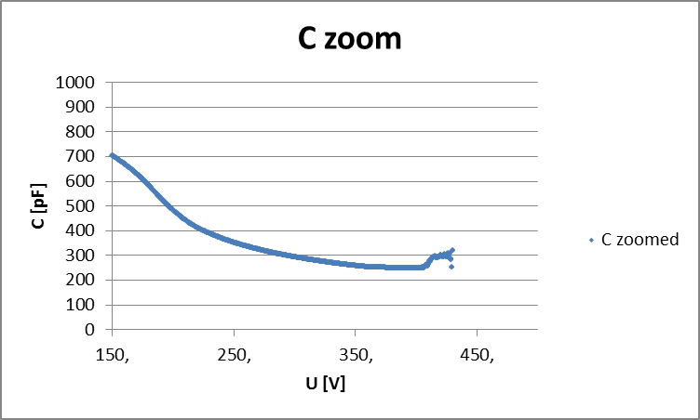
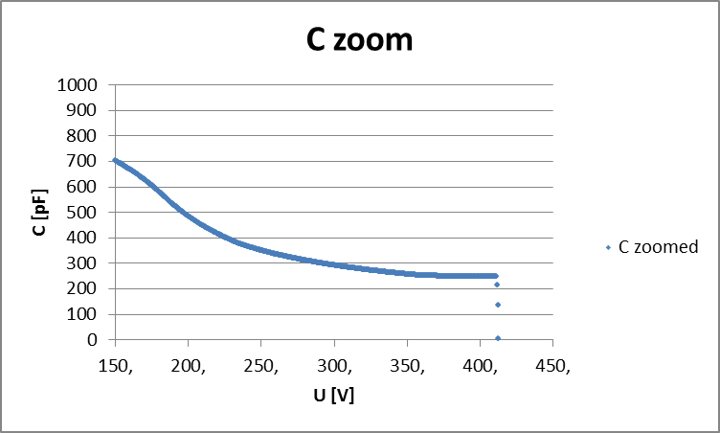
Full depletion
„Ground“ bonding:
SN 1305103897
SN 1703018749
SN 1715019518
APD outside specs,
reached us by accident,
not part of delivery
„Unusual“ behaviour
„Usual“ behaviour
All of them inside techn. specs.

Slide 10
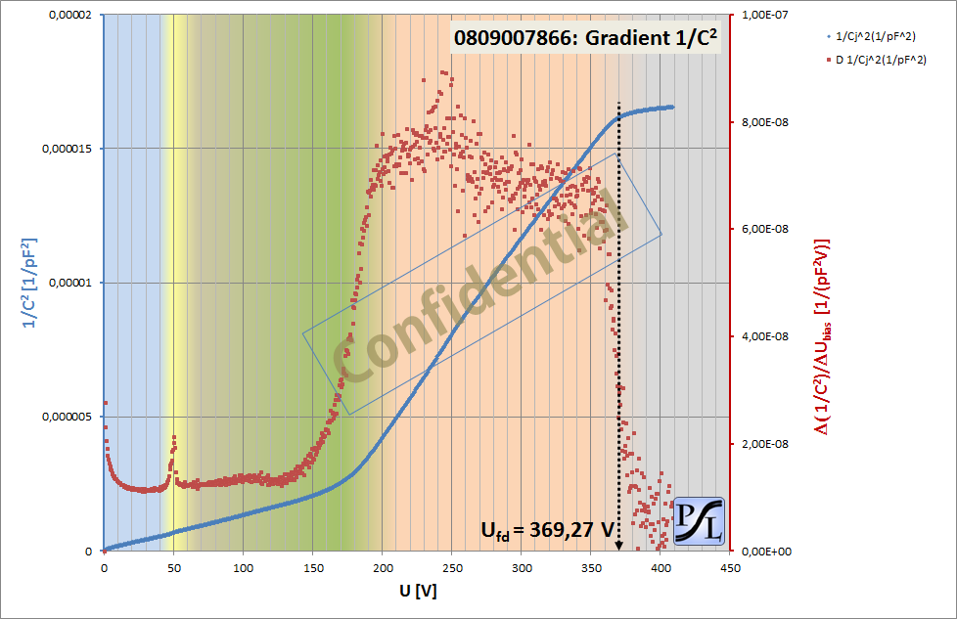
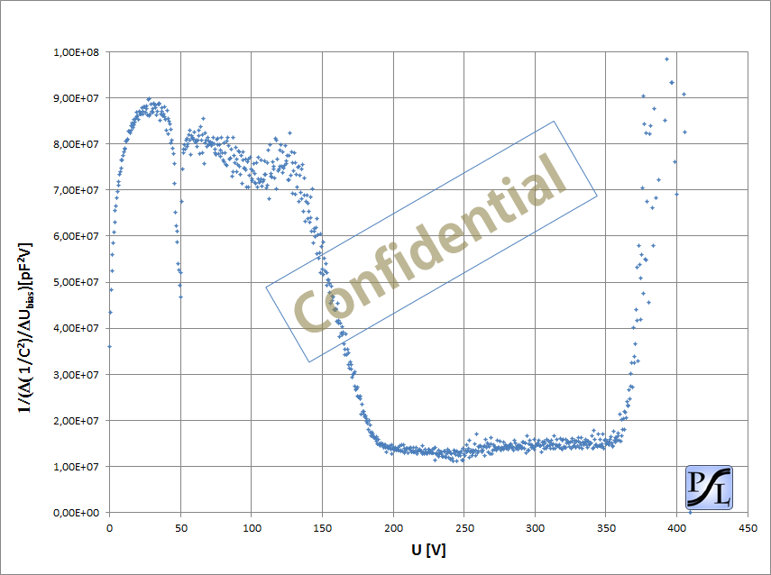

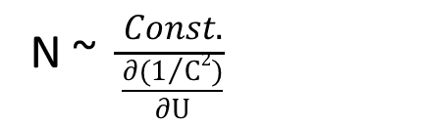
Doping profile
$$\frac{∂(1/{C2})}{∂U}$$
N ~ $\frac{Const.}{\frac{∂(1/{C2})}{∂U}}$

Slide 11
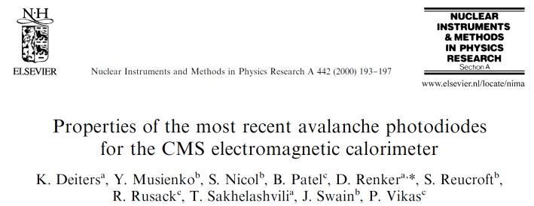
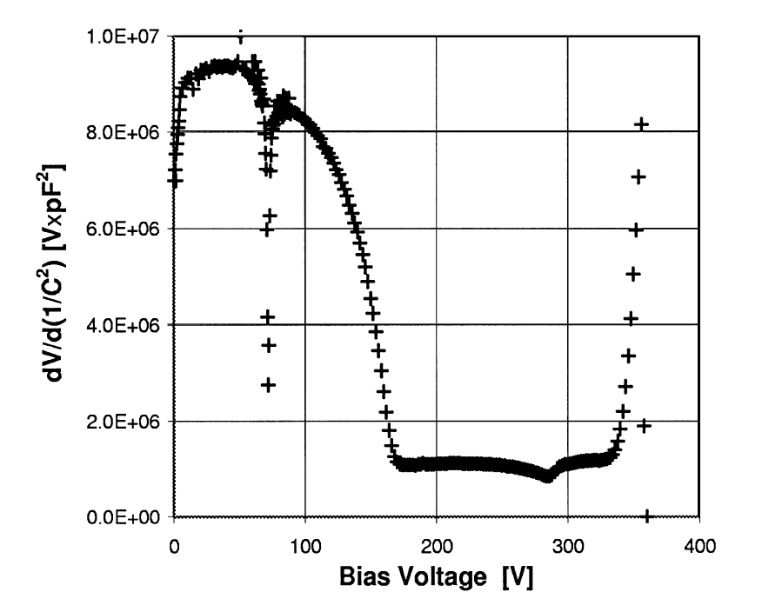
Doping profile

Slide 12
Summary:
Capacitance measurements ongoing (Lot 07-Lot 17 finished)
ALL Capacitances measured so far are inside techn. specs.
Unusual behaviour of individual APDs above Breakdown under investigation
Capacitance variances inside regime of operation in the order of ± 2 %
Full depletion voltages determined in addition: Mean value at ~370 V (using a fixed boundary condition for the capacitance ratio)
Doping profiles extracted for each APD passing the Capacitance determination cycle (~ 200 doping profiles available)
Doping profiles in very good agreement with CMS APD: nearly identical internal structure
overall screening status: further ~6000 APDs pre-validated @ T = -25 °C -> in pipe for final validation, all APDs (with available MoU) passed the first screening cycle, MoU with Mainz signed last month

