Slide 1
Status of the Cryostat Design. Cryostat Assembly Procedures
Joint Institute for Nuclear Research (Dubna)
Evgeny Koshurnikov
GSI, Darmstadt
June 7, 2016

Slide 2
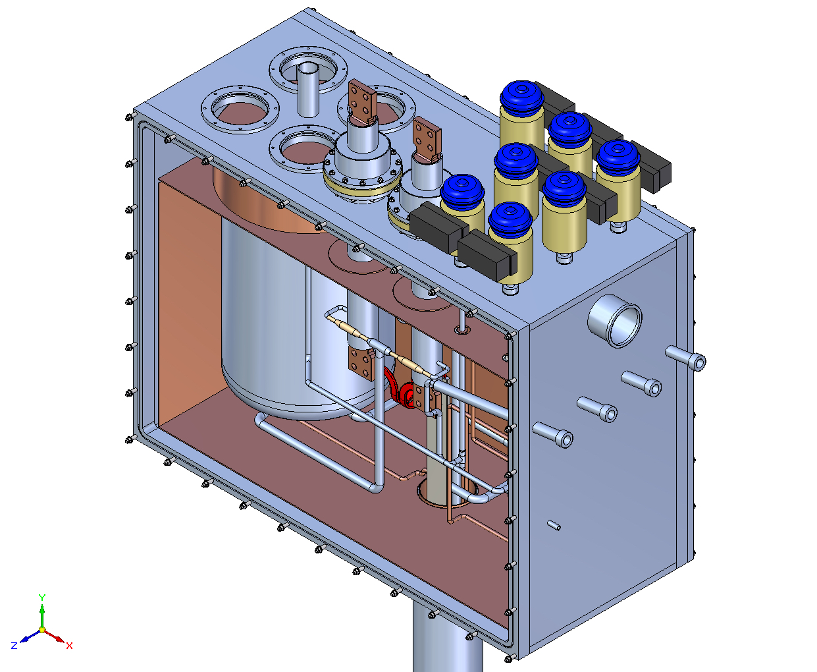
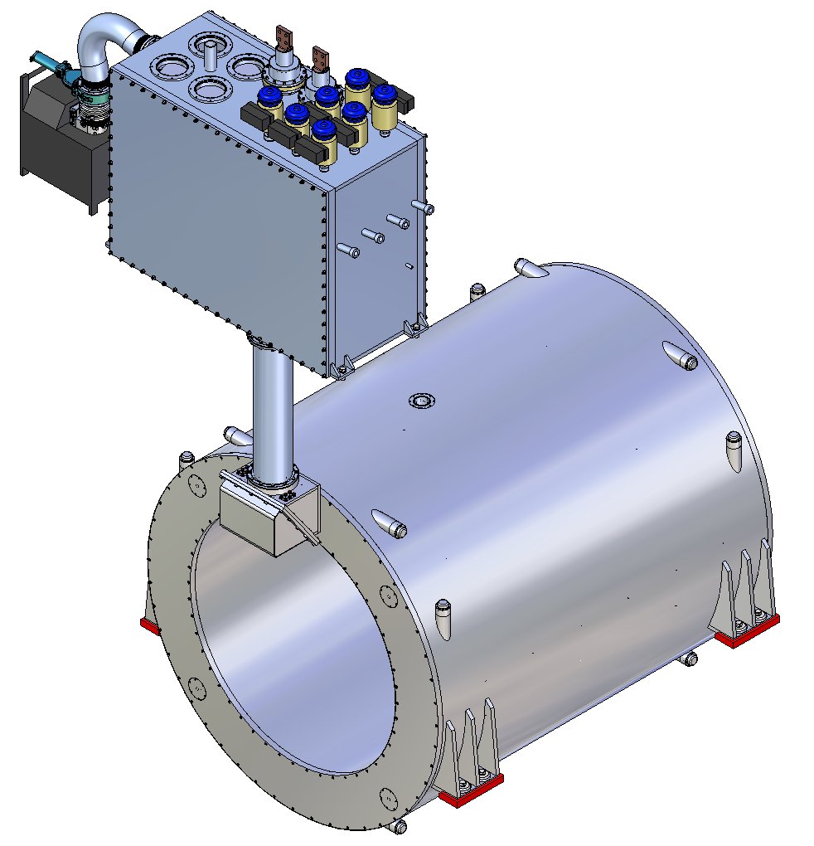
PANDA magnet Cryostat and Control Dewar

Slide 3
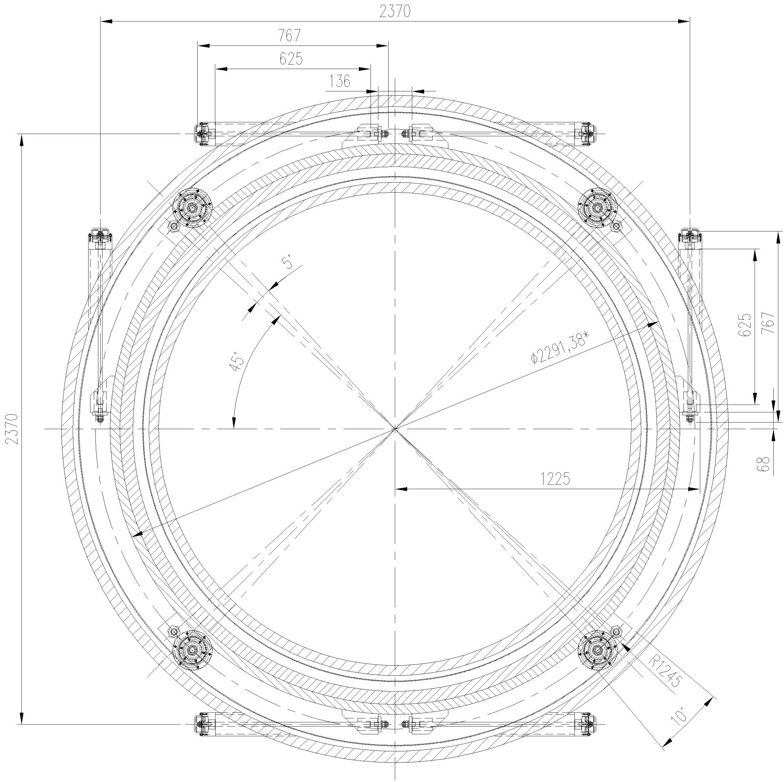
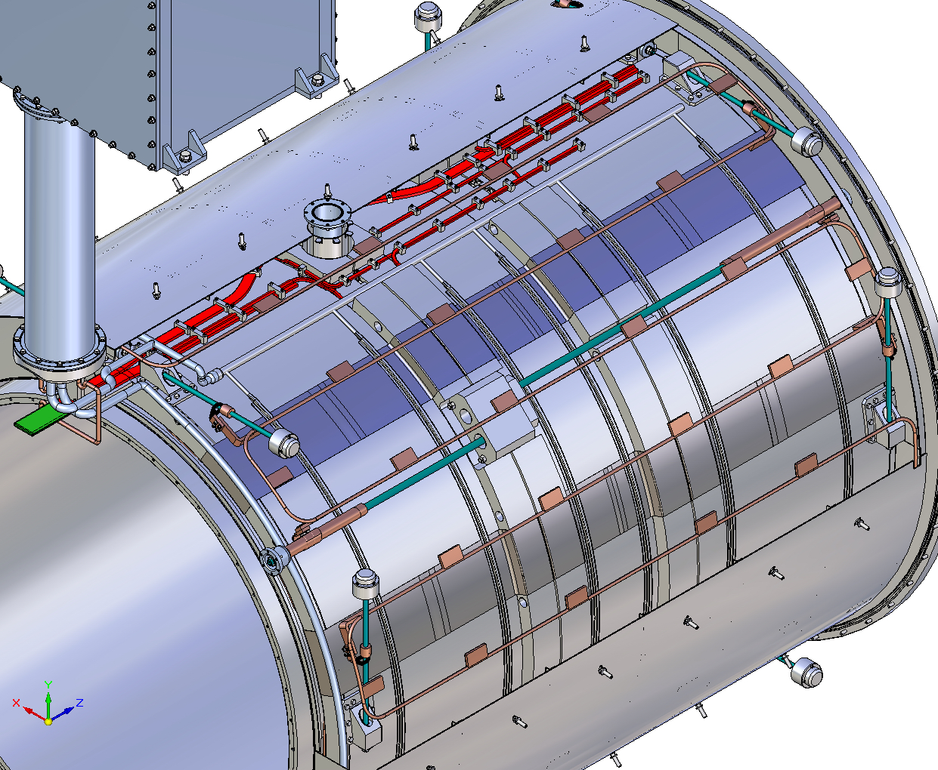
Cryostat sections
Thermal screen
A short tie of axial suspension
Cold mass
Horizontal tie of radial suspension
Vertical tie of radial suspension

Slide 4
Preparation of initial documentation for Engineering Design Stage
3D model of the iron yoke with reduced number of slots for muon panels is prepared and placed at EDMS
TOSCA model for the iron yoke with reduced number of slots is prepared and placed at EDMS
Magnetic forces and cryogenic computations have been completed.
Addition mechanical computation for final optimization of the cold mass suspension design is in progress.
Drawings of the Cryostat and control Dewar have been prepared practically but we expect some minor updating the suspension design based on the results of computation
Technical Description of the cryostat is in the process of finalization
It takes 2-3 months to complete the work

Slide 5
Procedures of the Cryostat Assembly
Assembly procedures of the Cryostat in Novosibirsk and in CERN, as well as the Assembly procedure of the cryostat with Iron Yoke in GSI have been developed as a part of design documentation
Wishing to reduce the overall manufacturing cost of the magnet we plan to use the same technological equipment everyplace
Detailed description of assembly procedures lets to determine requirements for the working space and for crane equipment at the assembly sites . Furthermore, it is necessary for planning and for optimization of logistic

Slide 6
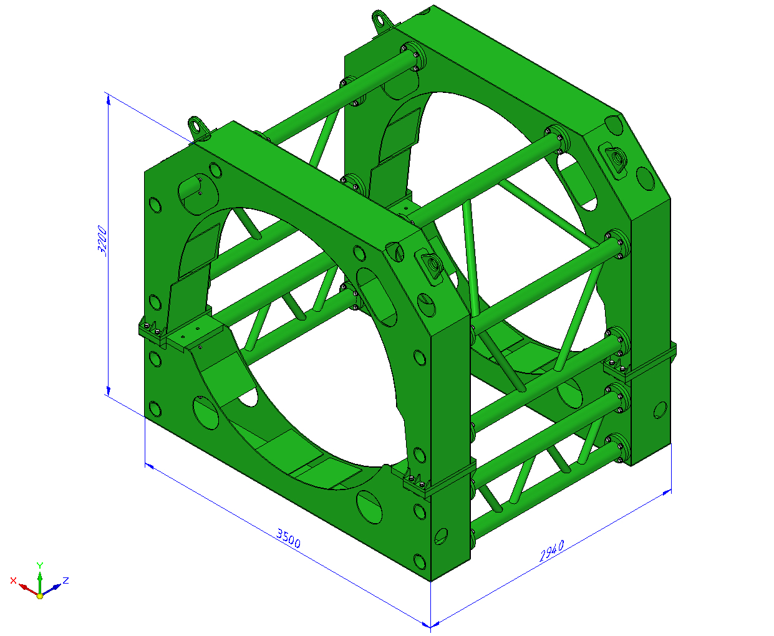
Following set of technology equipment should be prepared for assembly and tests of the cryostat:
Transport-technological device designed to adjust the shape of the cryostat outer shell during its assembly, for tests of the cryostat/solenoid, for installation of the solenoid into the Iron Yoke, as well as for the safe transportation of the cryostat/ solenoid.
At least the lower part of the device should be made of stainless steel to provide the solenoid test with magnetic field at CERN. Weight of the device is 4.8 tons.

Slide 7
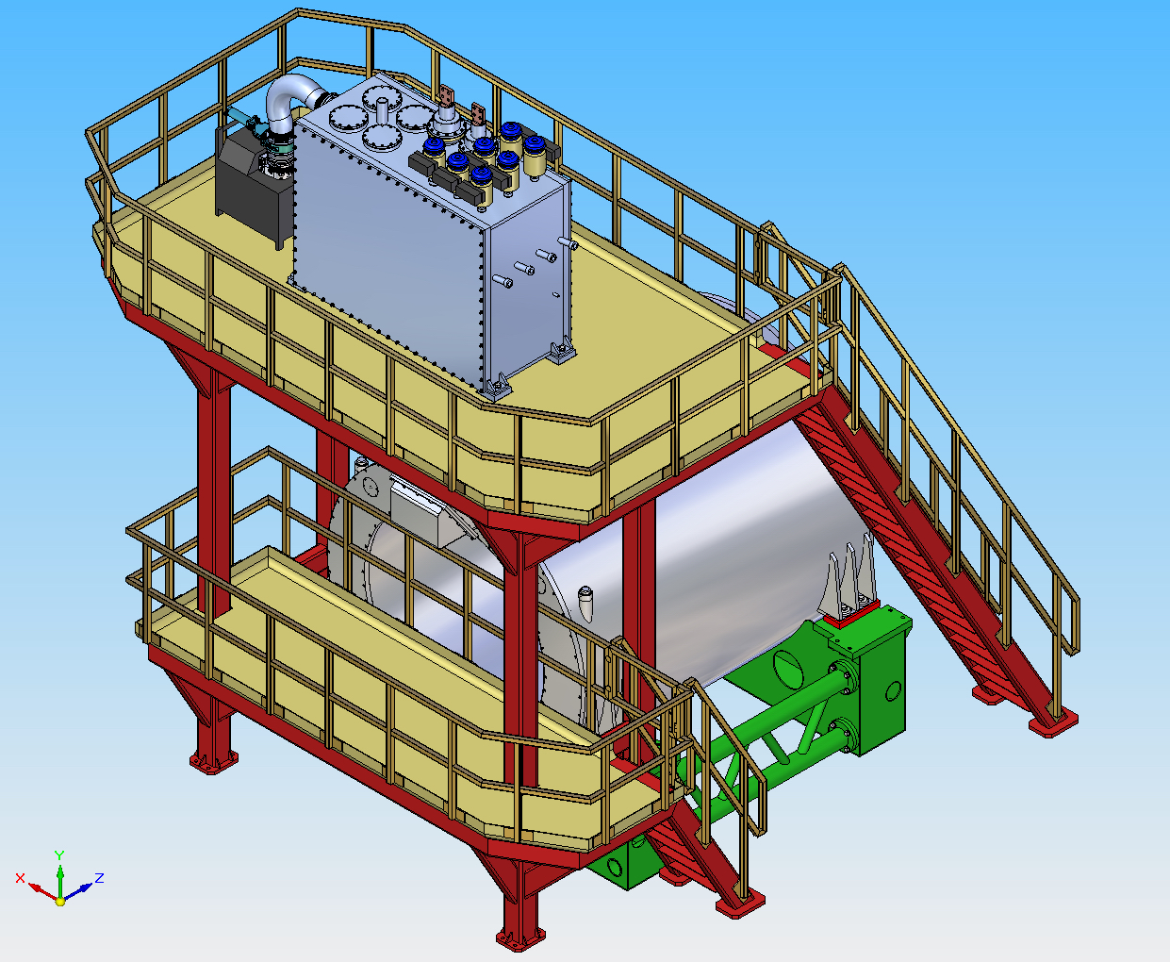
2. Technological device for cryogenic and magnetic tests of the assembled cryostat/solenoid at producer place and in CERN. It has to be manufactured of stainless steel (or aluminum alloy) to provide the solenoid test with magnetic field at CERN. It’s weight is about 6 tons.

Slide 8
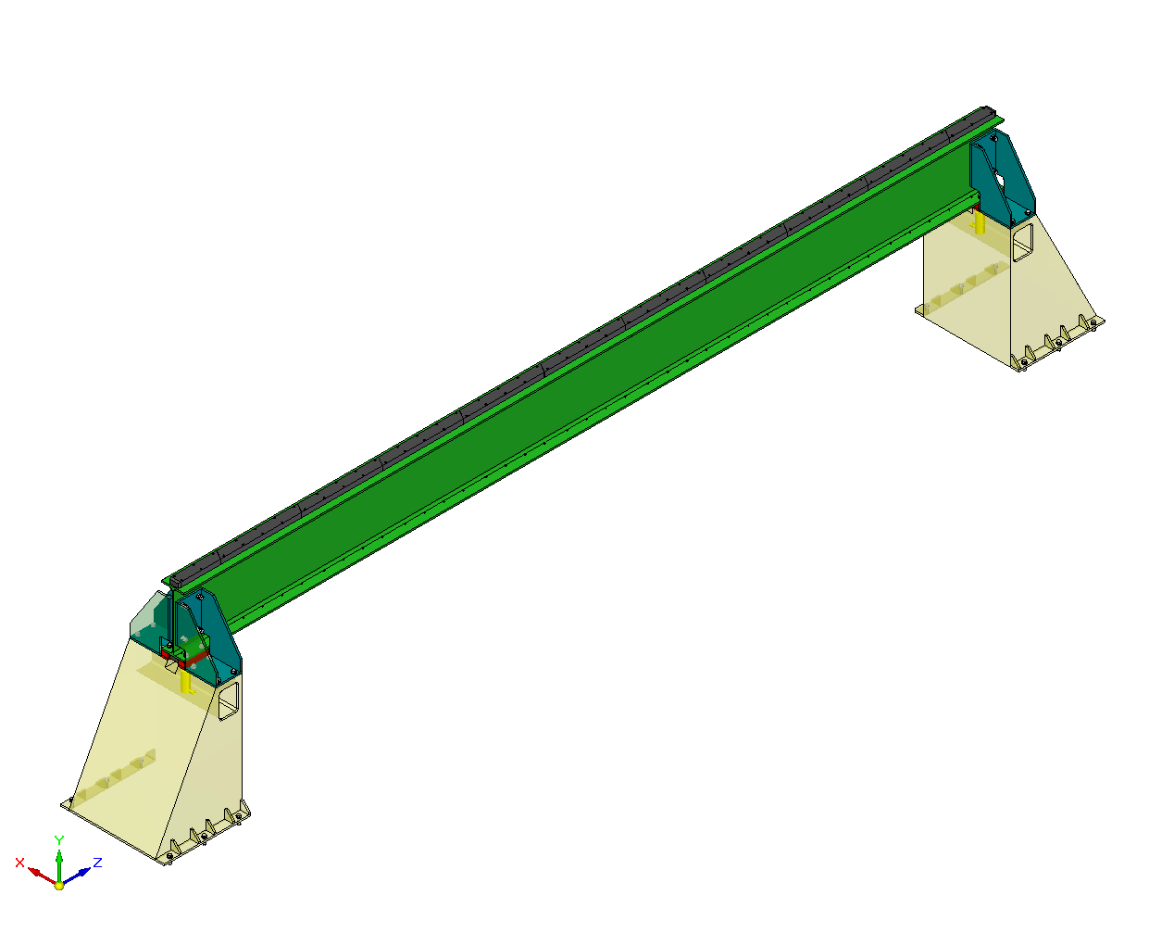
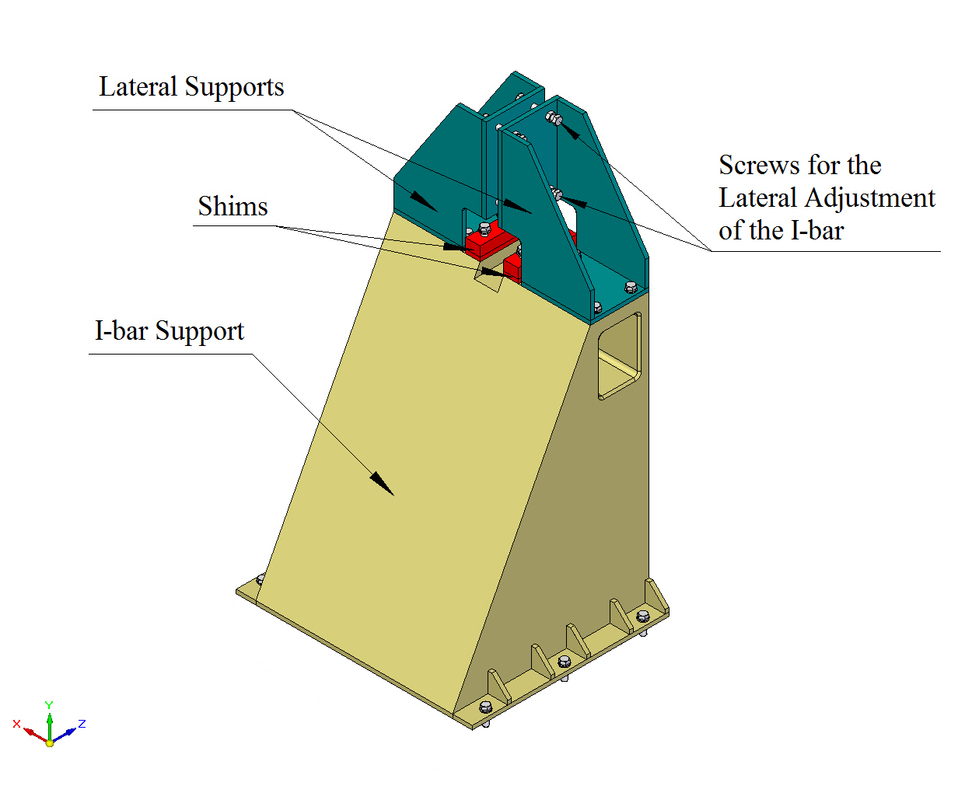
3. The mounting beam (complete with supports) for installation of the inner cryostat shell and the cold mass into the outer cryostat shell and for installation of the cryostat into the Iron Yoke. At the top and bottom shelves of a standard I-beam two steel bars are installed to move load along them on roller skates. Weight of the mounting beam is 2.3 ton.
Maximal weight load of the beam < 19 tons
Maximal sag of the mounting beam up to 11 mm

Slide 9
4. Bearing arrangement intended to adjust the shape of the inner cryostat shell during its assembly using 12 individually controlled sliders advanced in radial direction. The device is equipped with 4 roller skates (two upper and two lower) (BOERKEY model III AM-H-50CrV4-FR-E). Weight of the device is ~ 1.9 tons

Slide 10
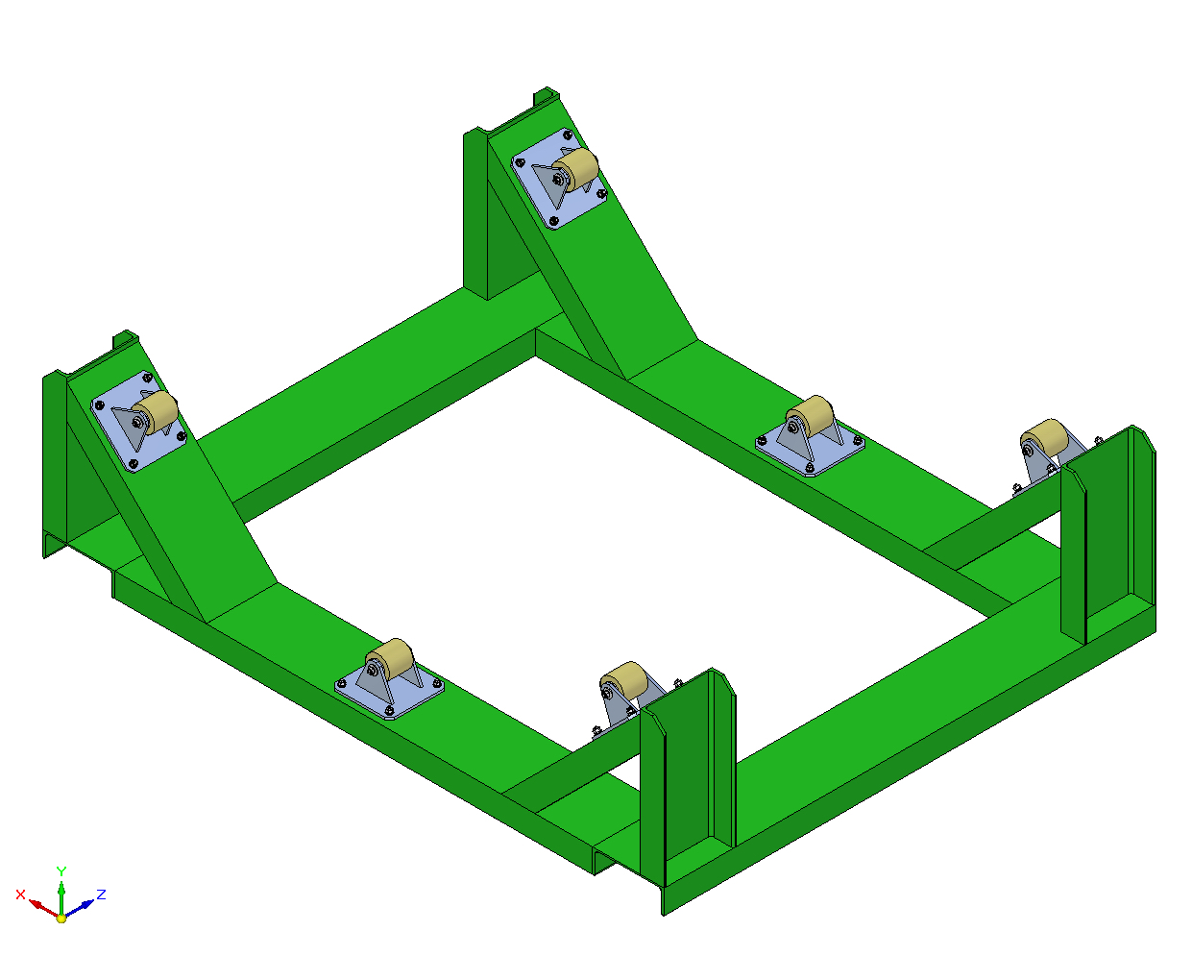
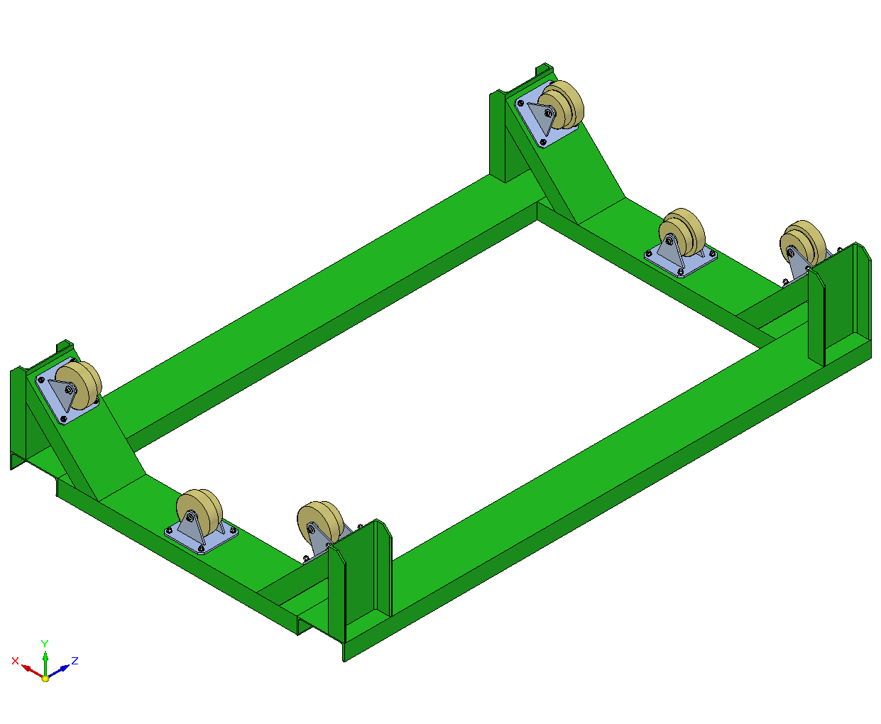
5. Multipurpose lifting Traverse 6. Supports for the inner and outer shells of the cryostat

Slide 11
Assembly and tests of the cryostat without cold mass at the producer place

Slide 12
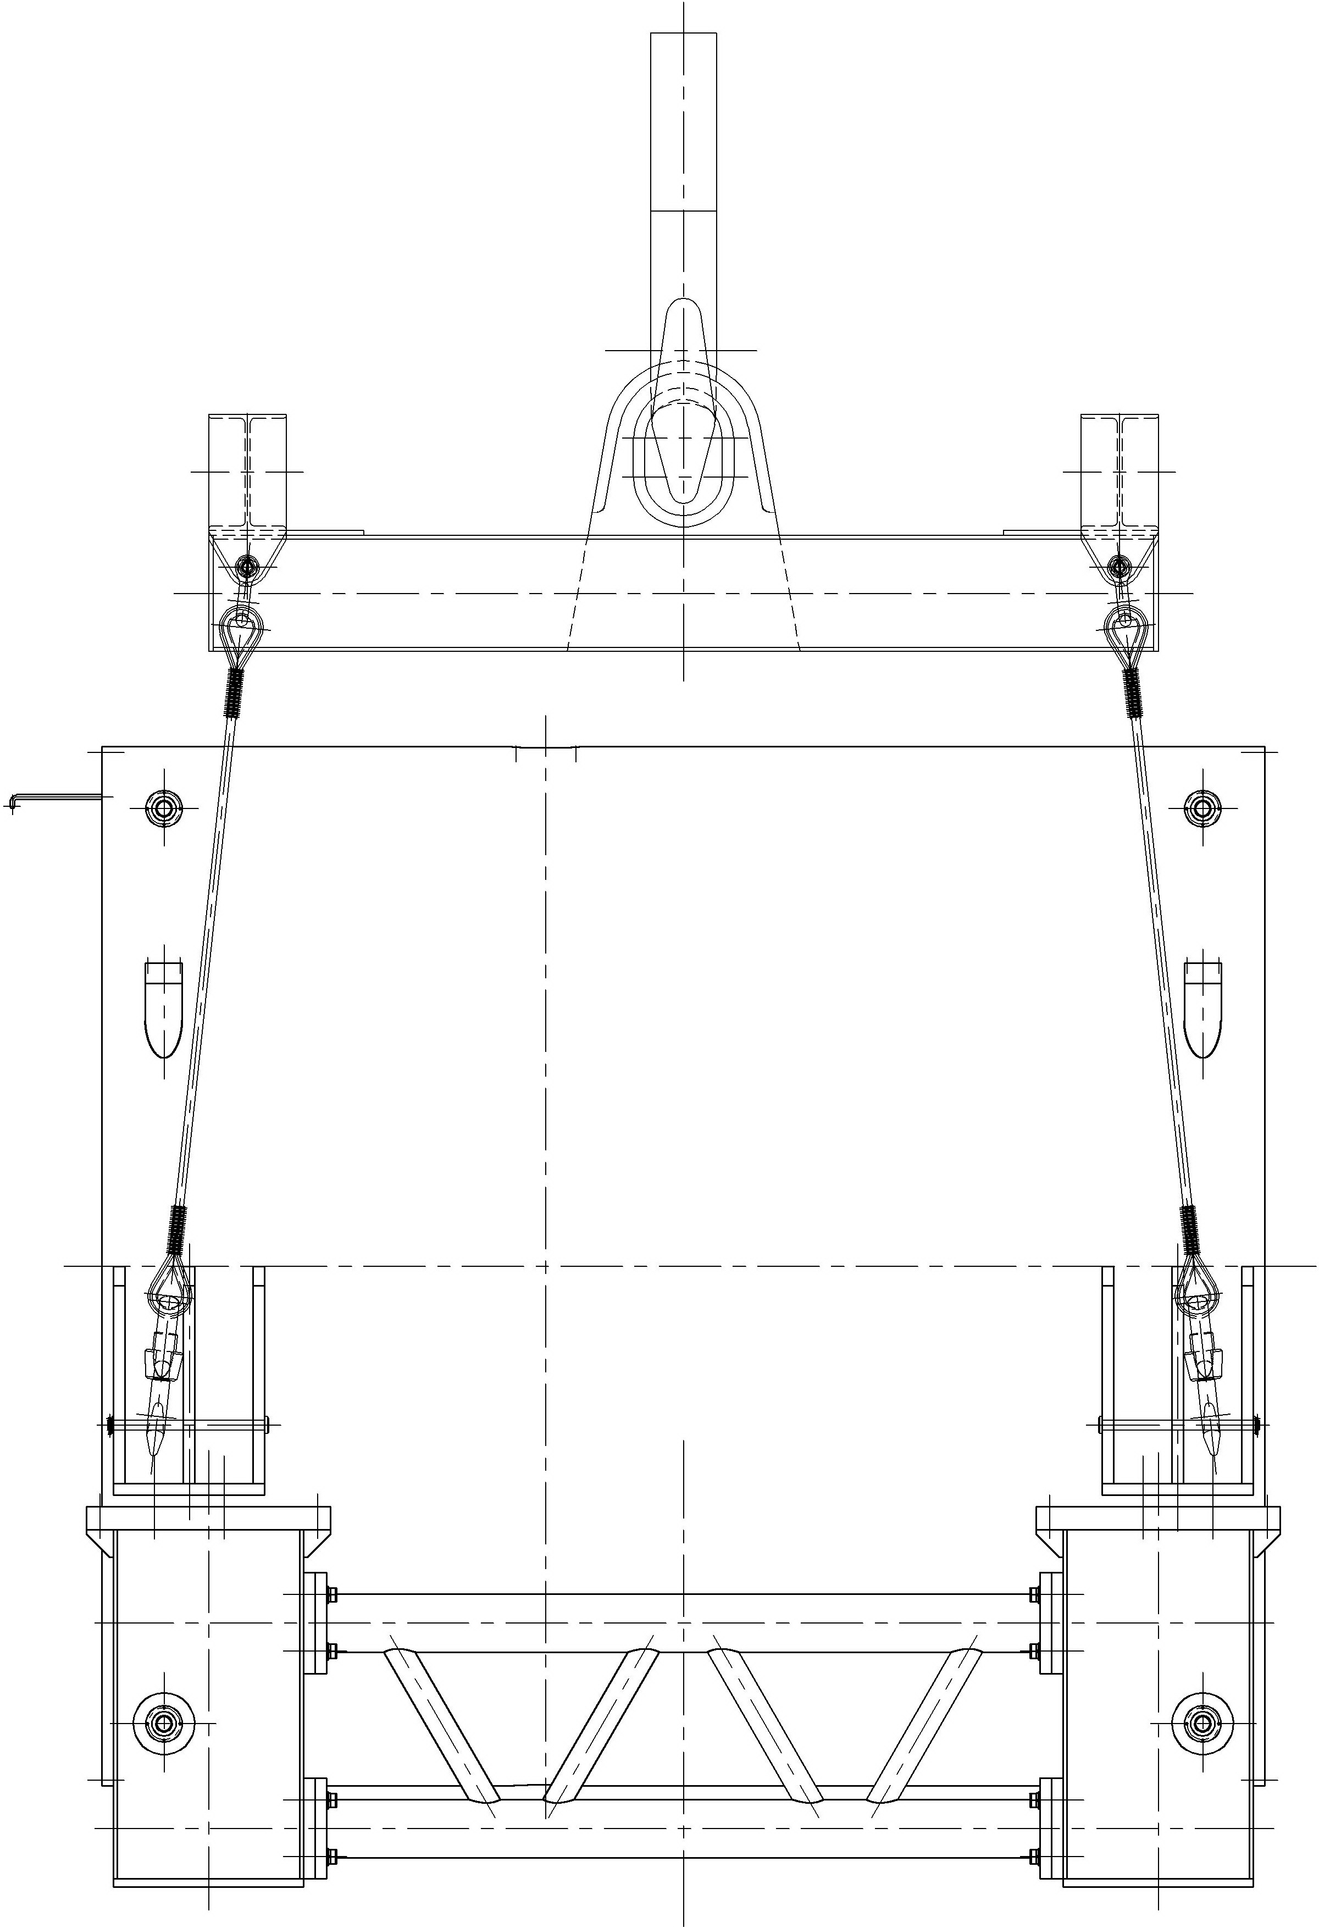
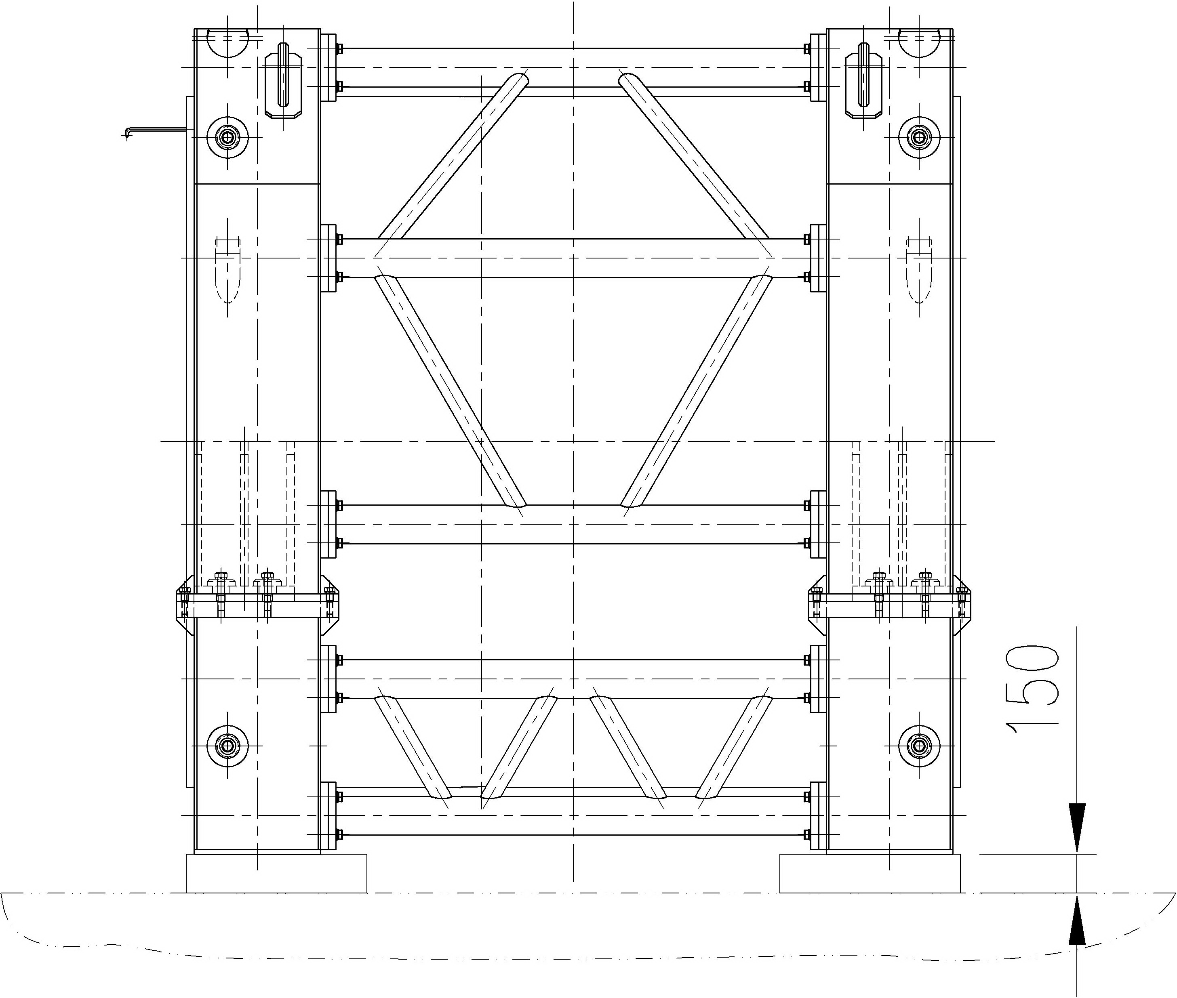
✧ Set up the outer shell of the cryostat with the installed thermal screen into the transport-technological device. ✧ With help of the transport-technological device cylindricity of the end seating surfaces of the shell should be achieved.

Slide 13
Installation of the mounting beam into the outer cryostat shell assembled with one cryostat flange

Slide 14
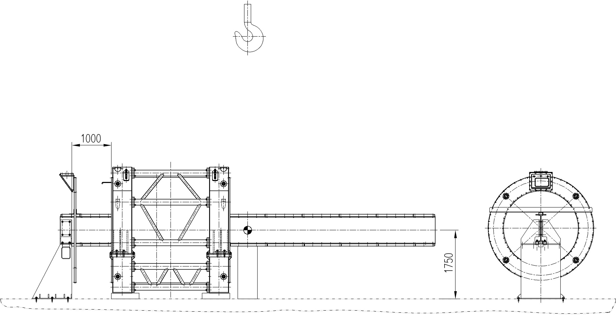
✧ Installing the mounting beam on two supports at the ends of the shell (end and intermediate ones). ✧ Fixing the end support on the foundation. ✧ Installation of the side stops on the end support of the mounting beam .

Slide 15
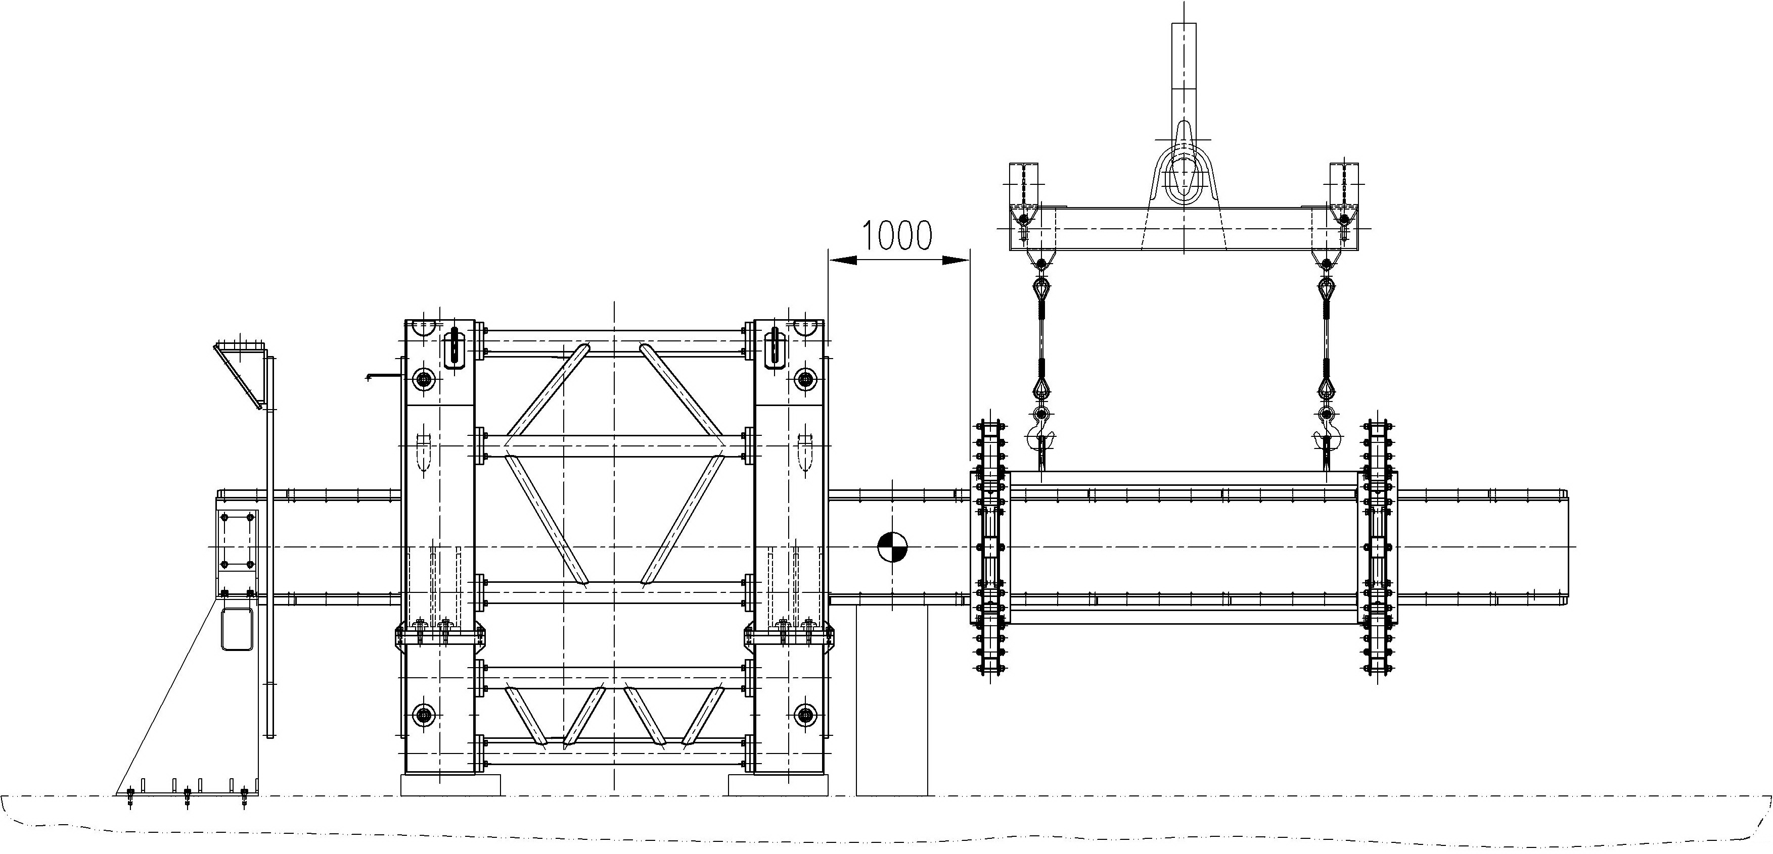
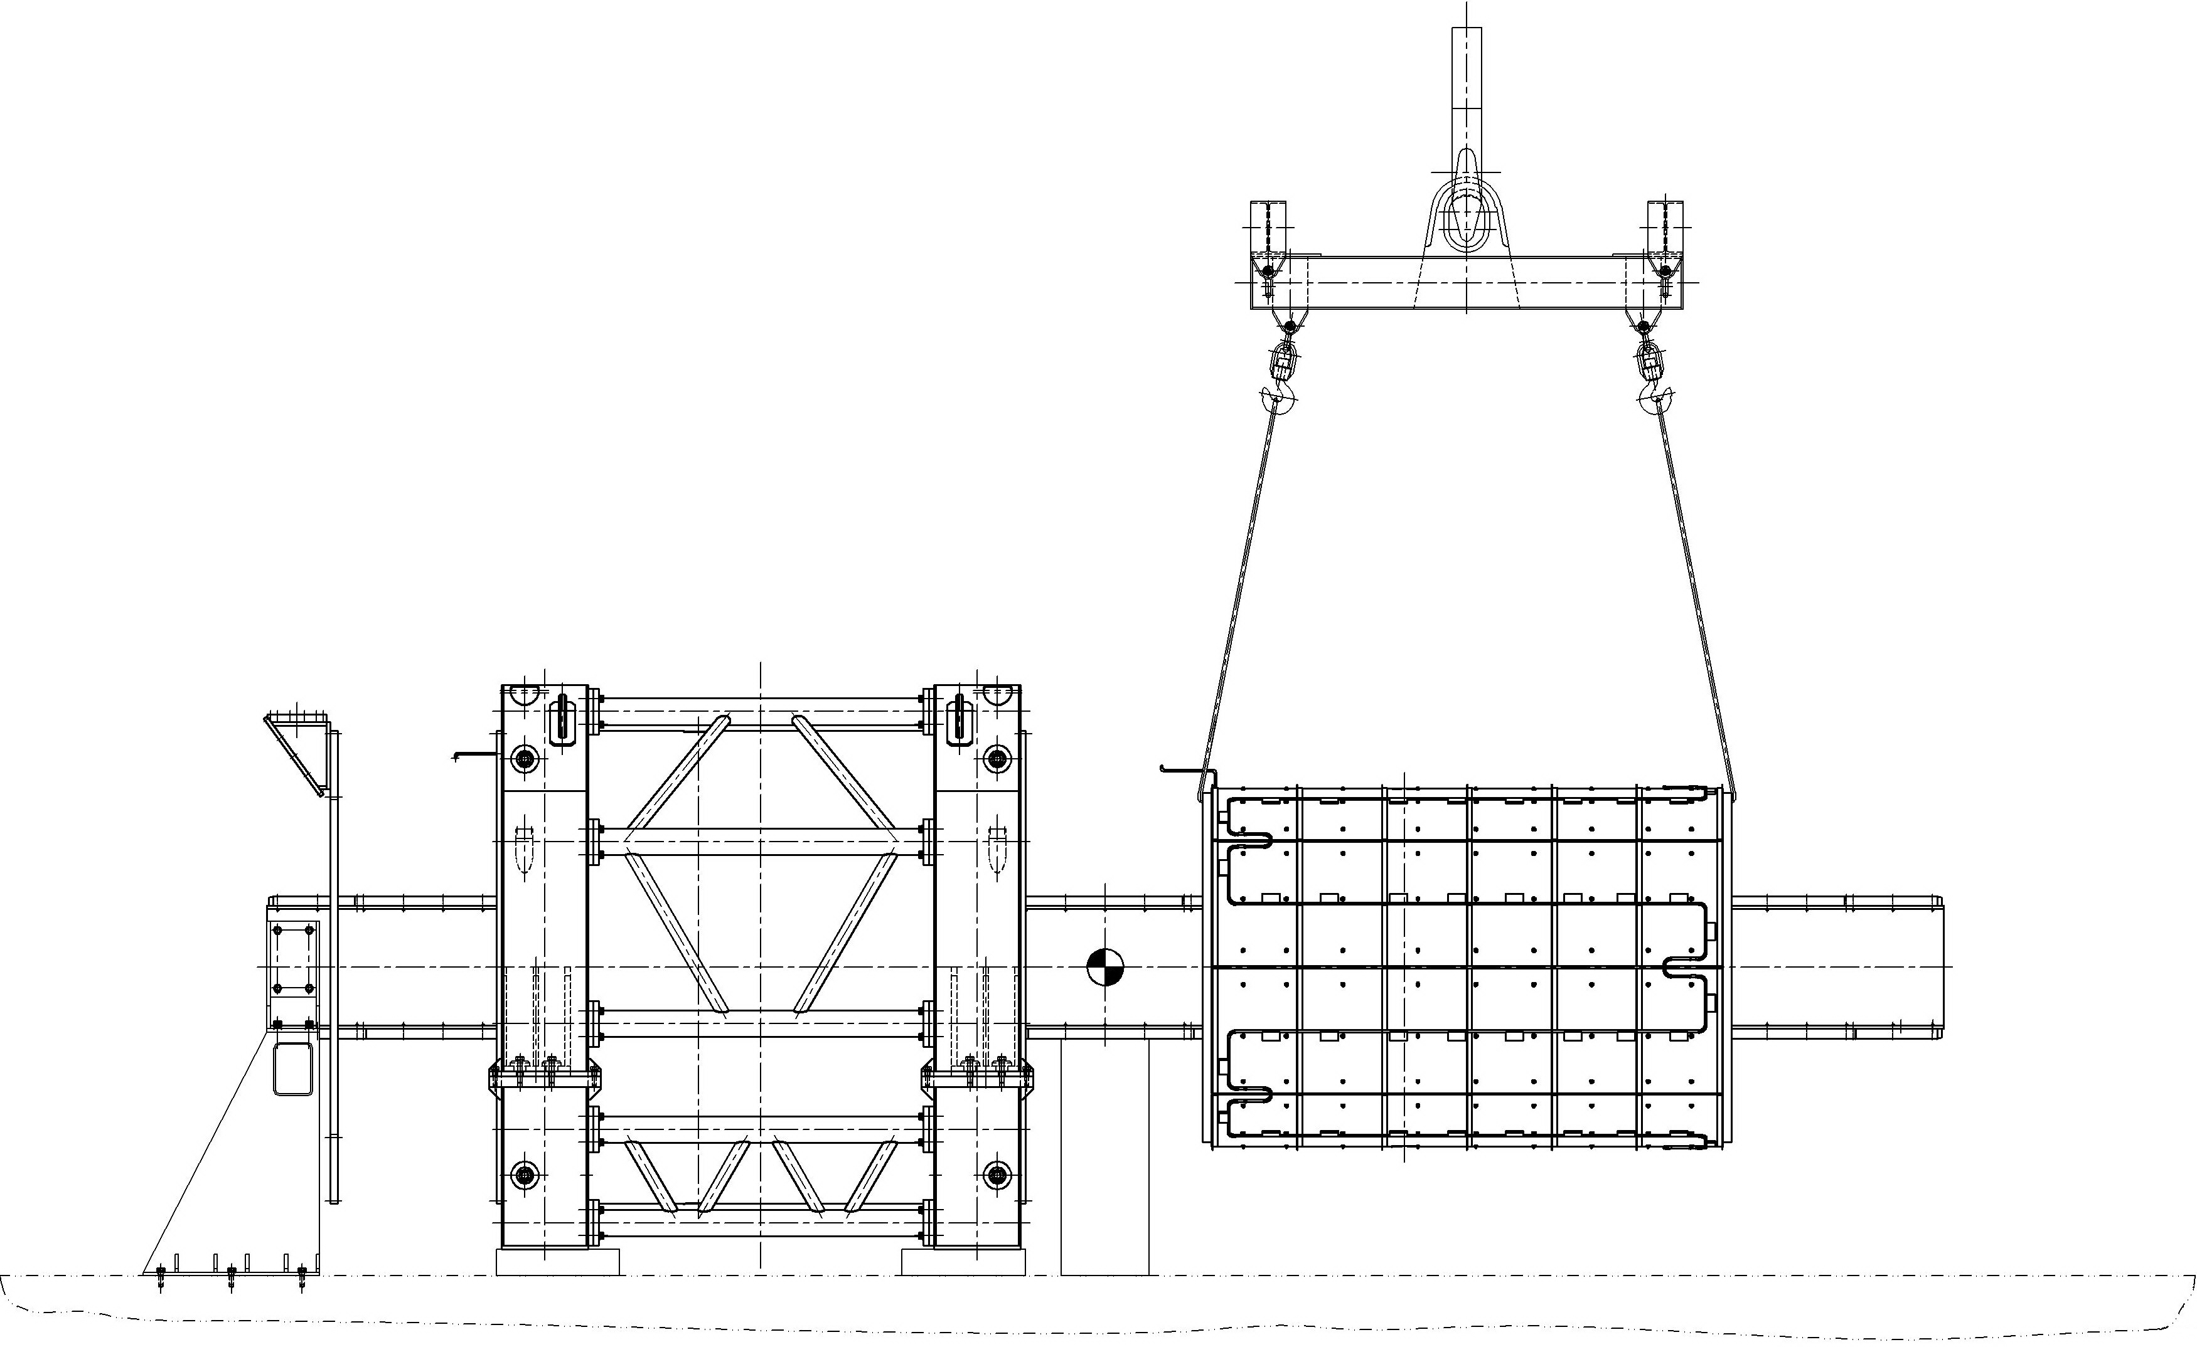
✧ Installation of the bearing arrangement on the free end of the mounting beam ✧ Installation of the inner vacuum shell with installed thermal screen on the bearing arrangement located at the free end of the mounting beam.

Slide 16
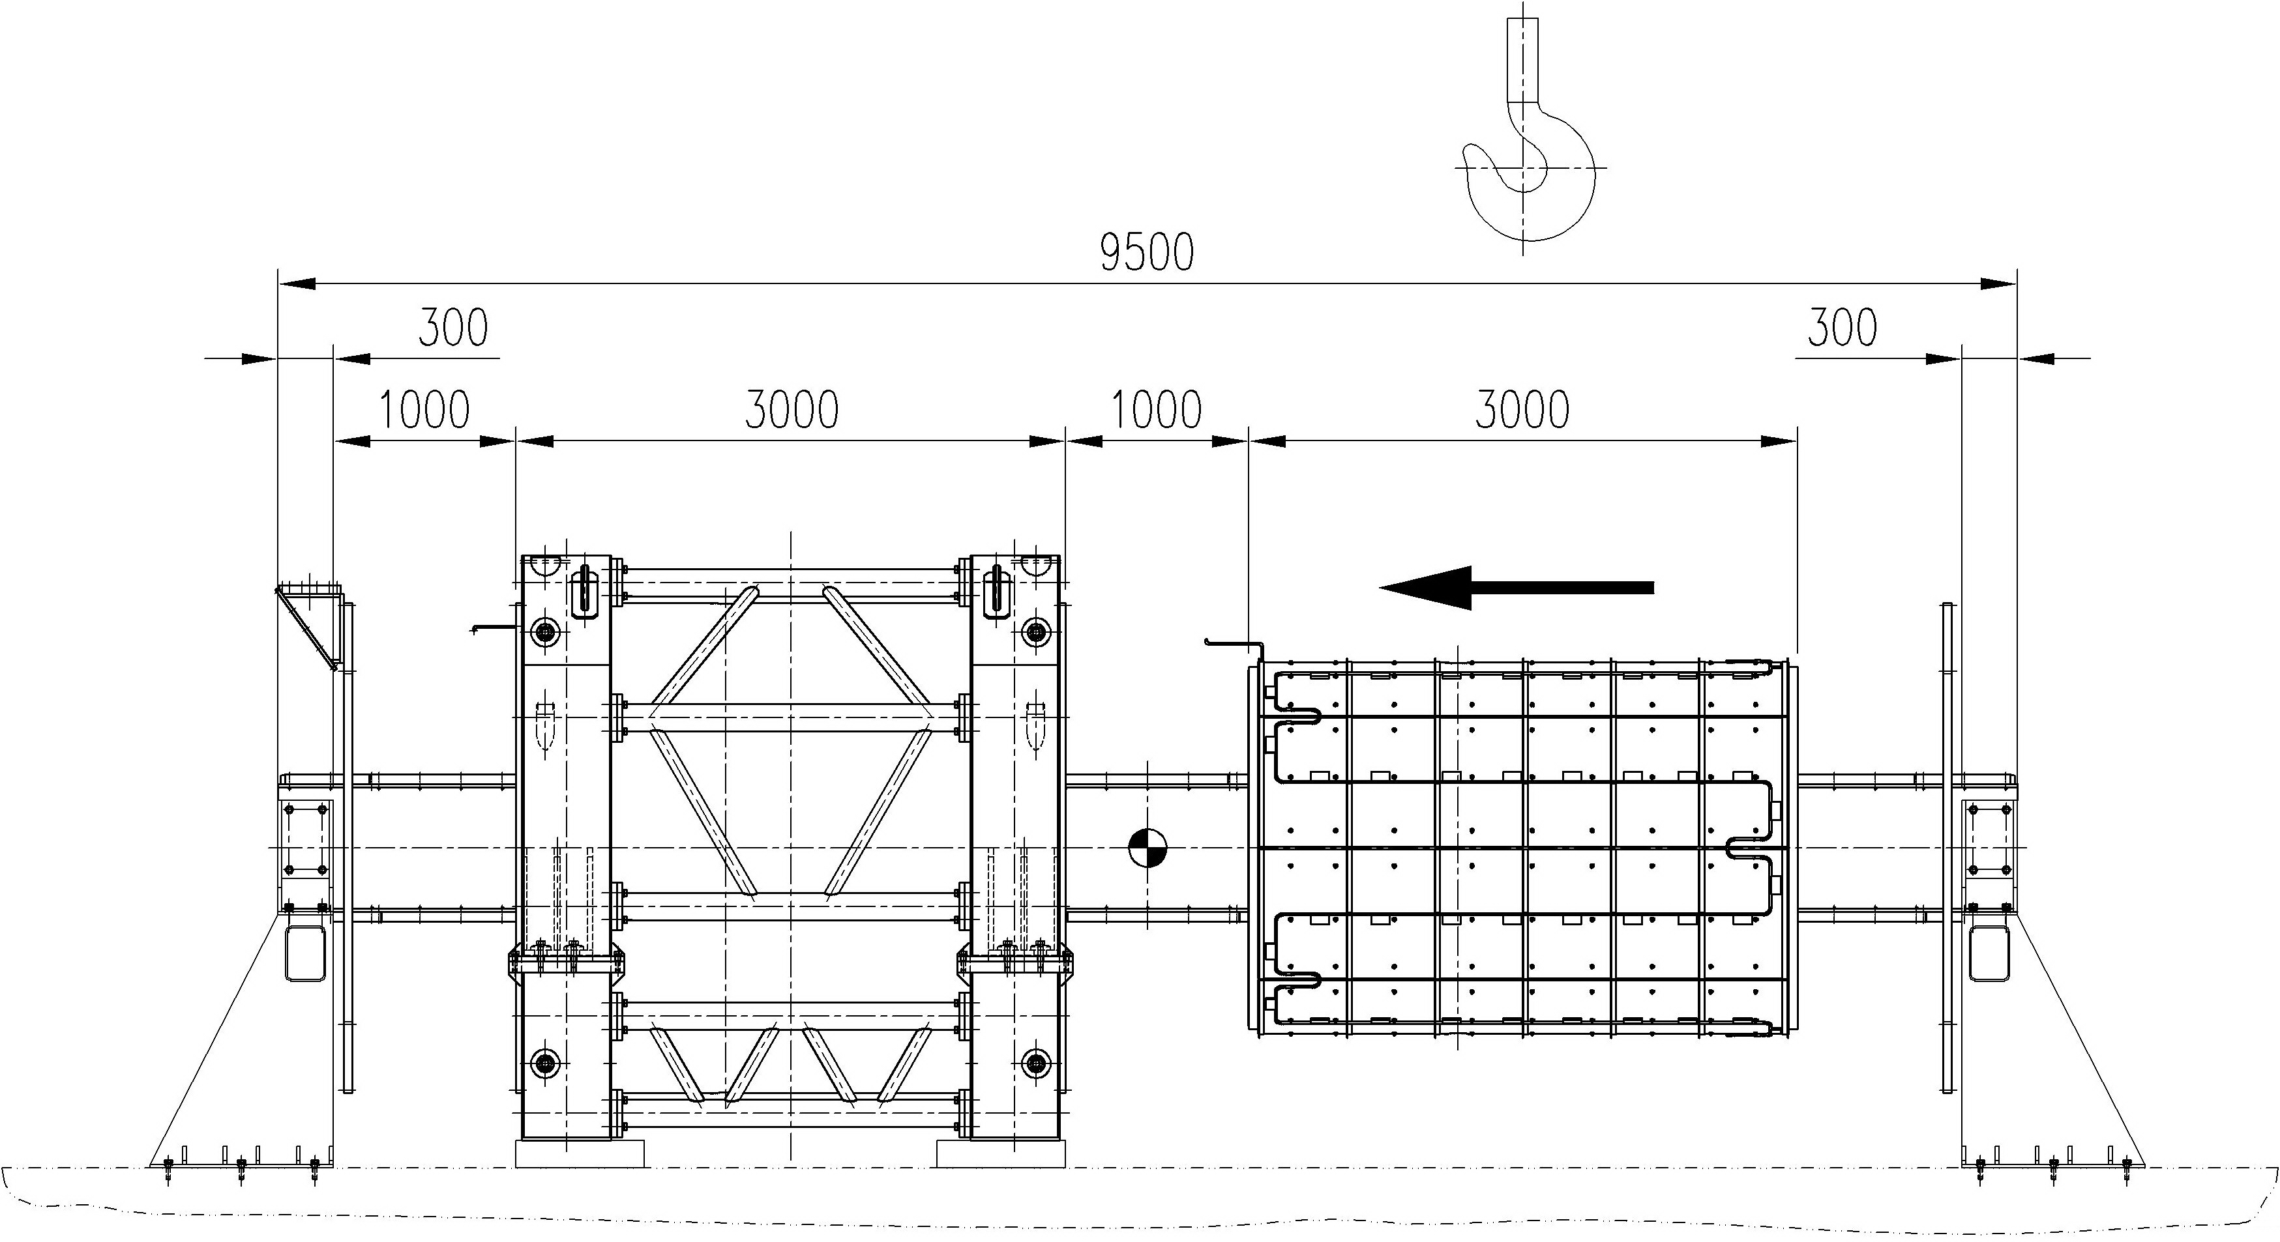
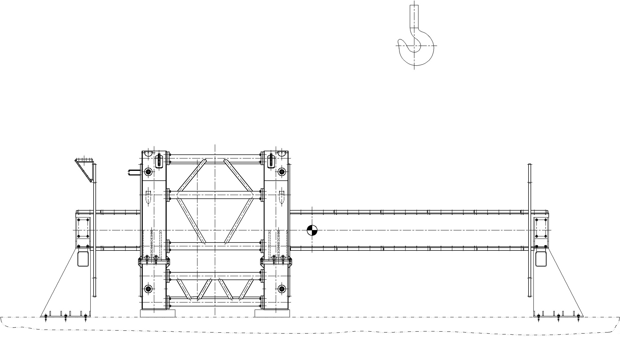
✧ Putting the second flange of the cryostat at the free end of the mounting beam. ✧ Installing end support and removing the intermediate one. ✧ Ensuring coincidence of the axes of the cryostat shells by the jacks and by adjusting bolts in the side stops of the end supports ✧ Rolling the inner shell into the cryostat ✧ Providing roundness of the end seat surfaces of the shell using the distance sliders of the bearing arrangement and fixing the shell relative to the bearing arrangement

Slide 17
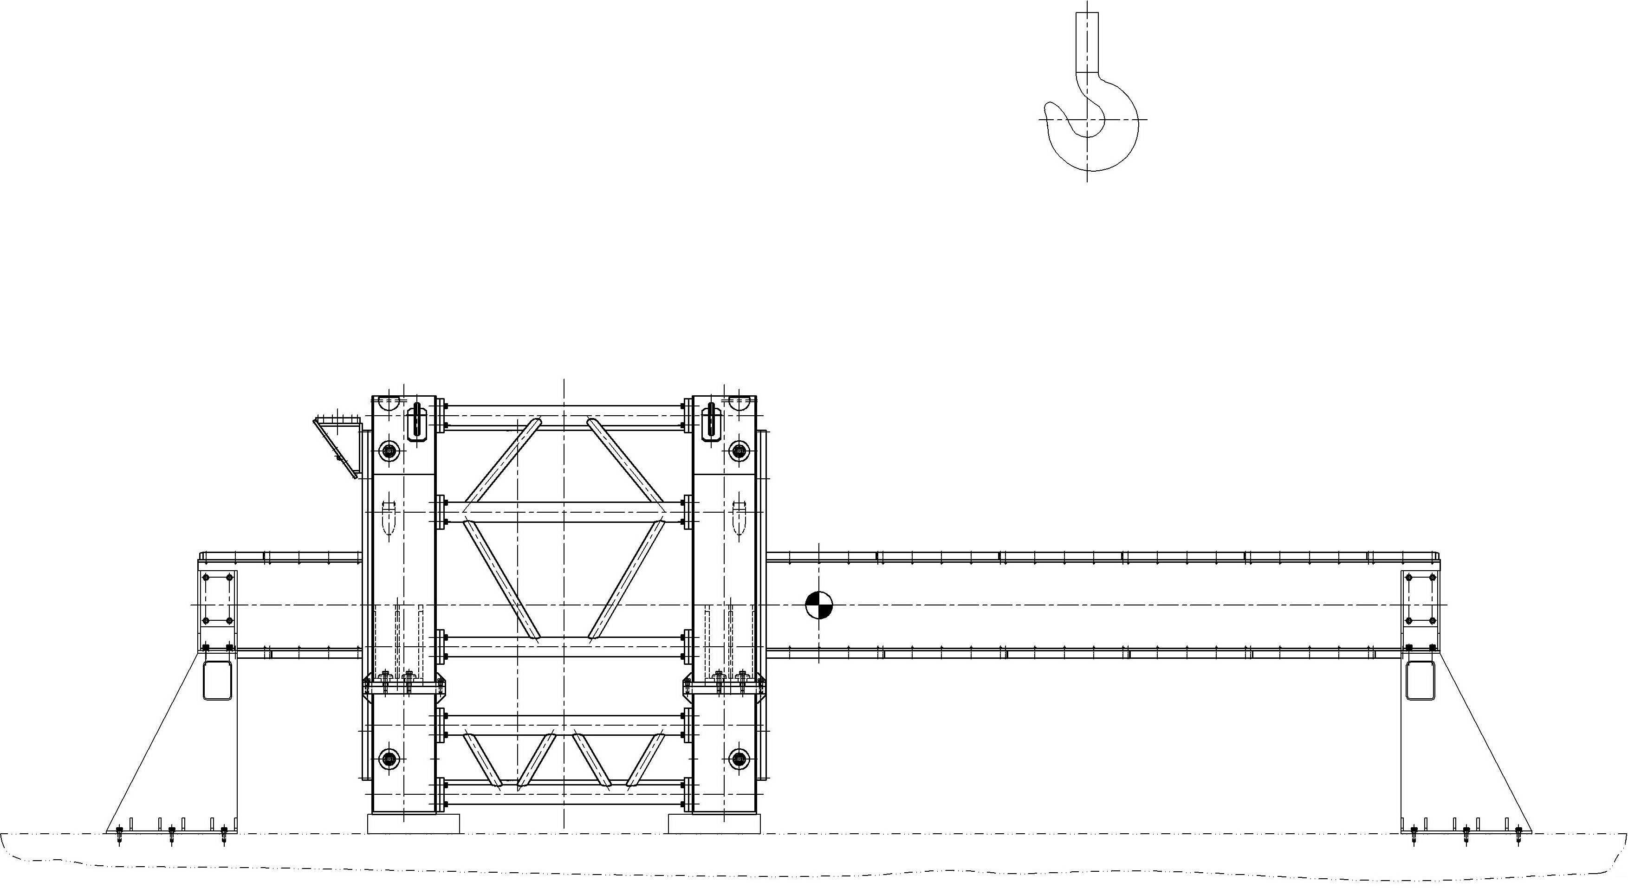
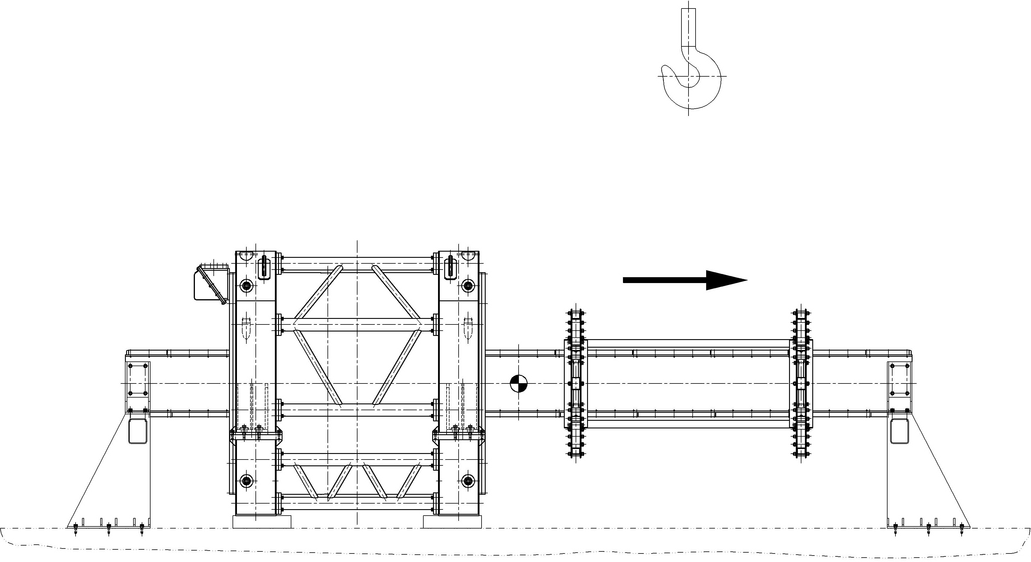
✧ Connection of cooling pipes of the screen shells and installation of the end flanges of the thermal screen. ✧ Installation of the end spacers between shells of the vacuum vessel. ✧ Installation of the cryostat flanges . ✧ Rolling out the bearing arrangement from the cryostat to the edge of the mounting beam.

Slide 18
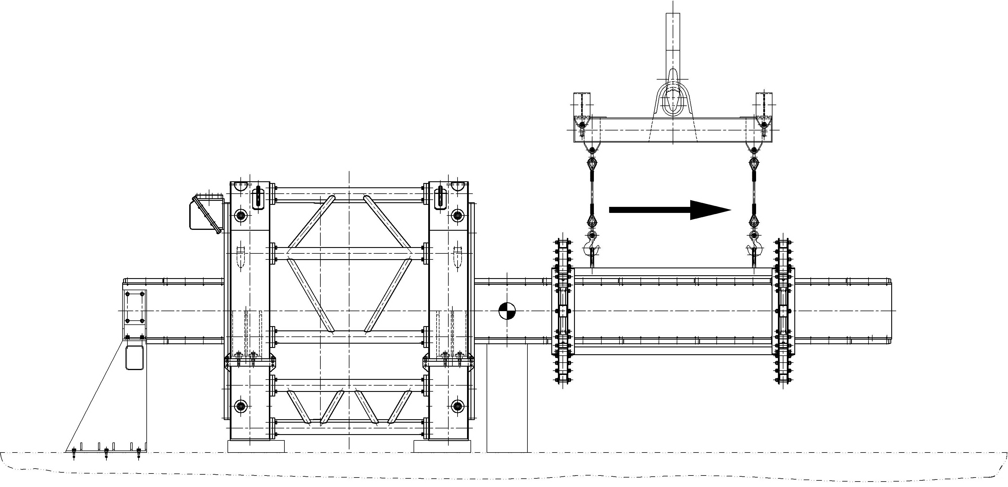
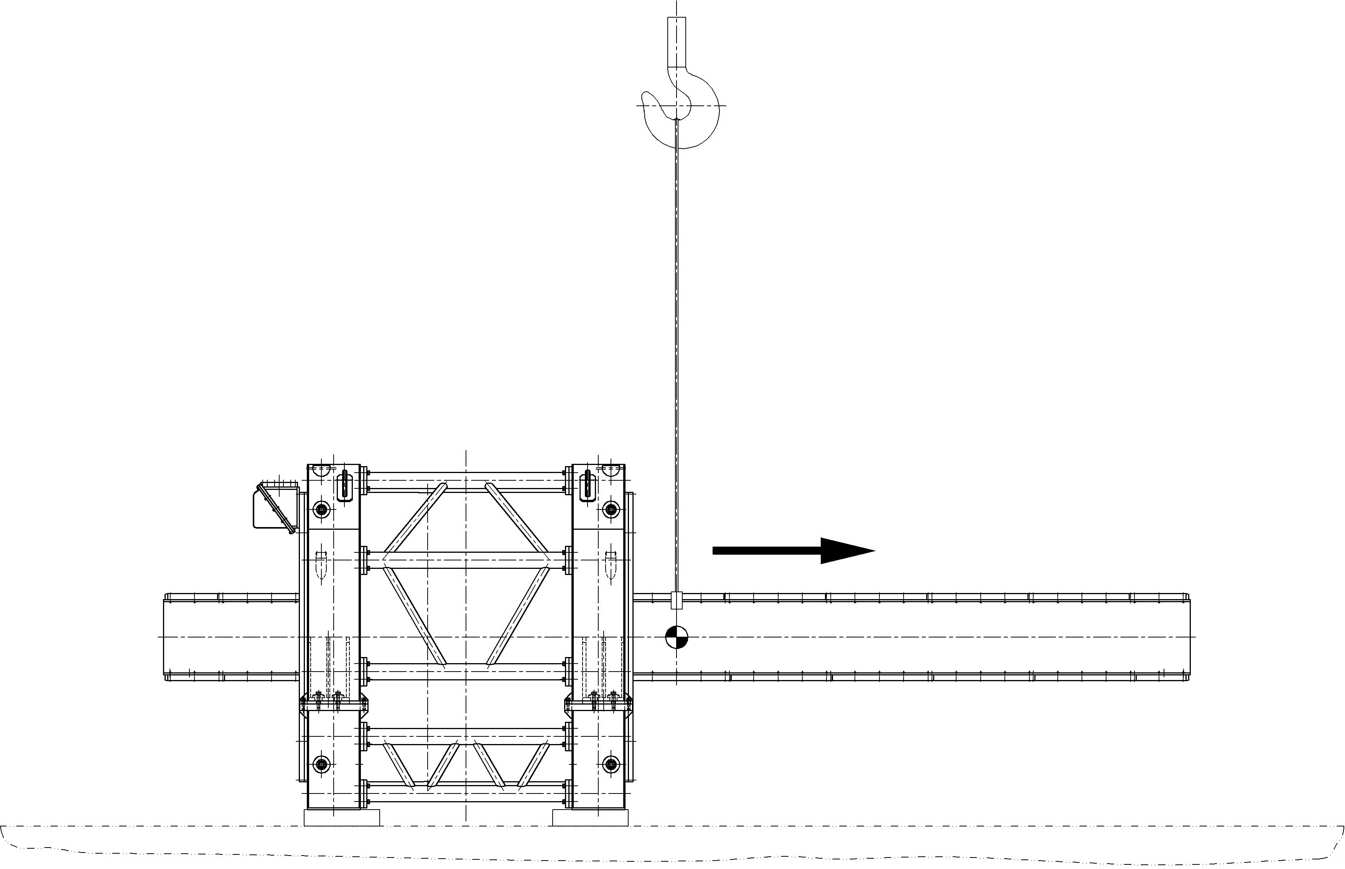
✧ Uninstallation of the bearing arrangement, ✧ Removing beam supports and mounting beam

Slide 19
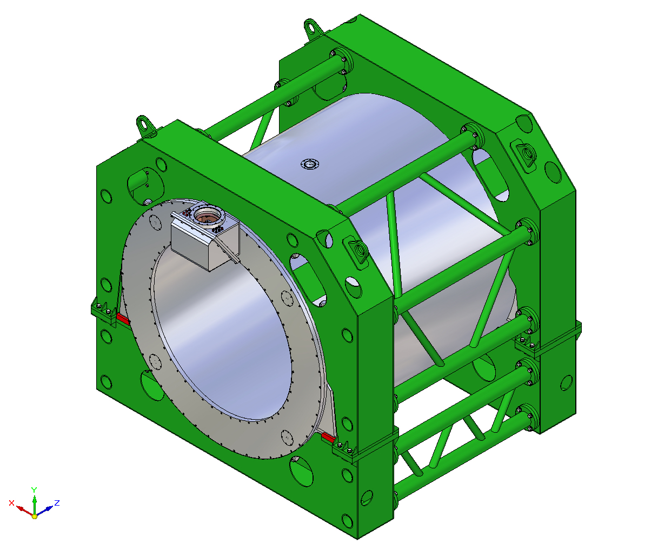
Assembled cryostat encapsulated inside the transport-technological device.

Slide 20
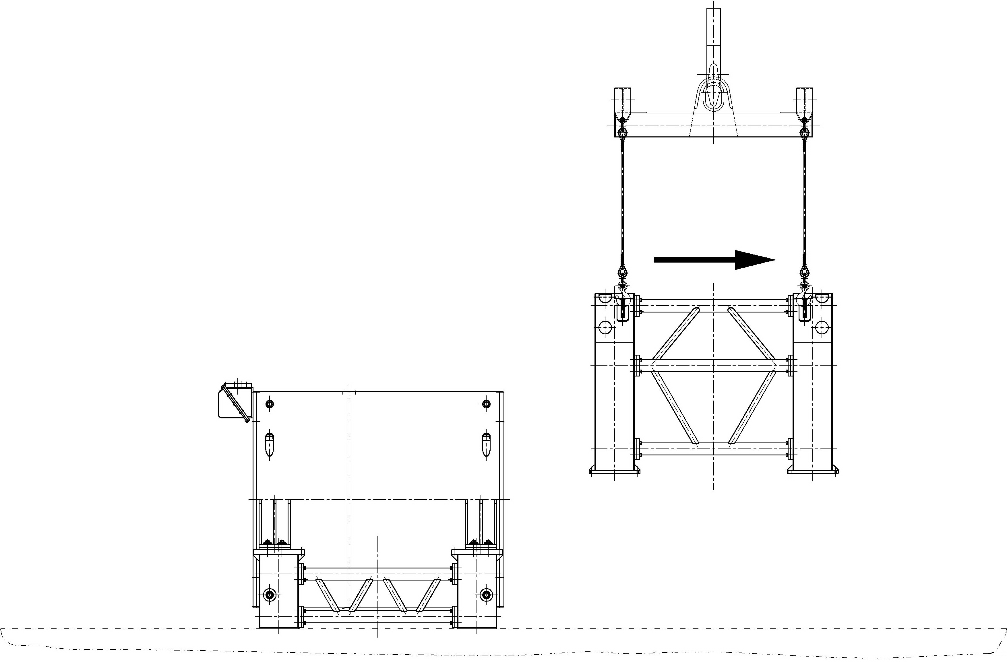
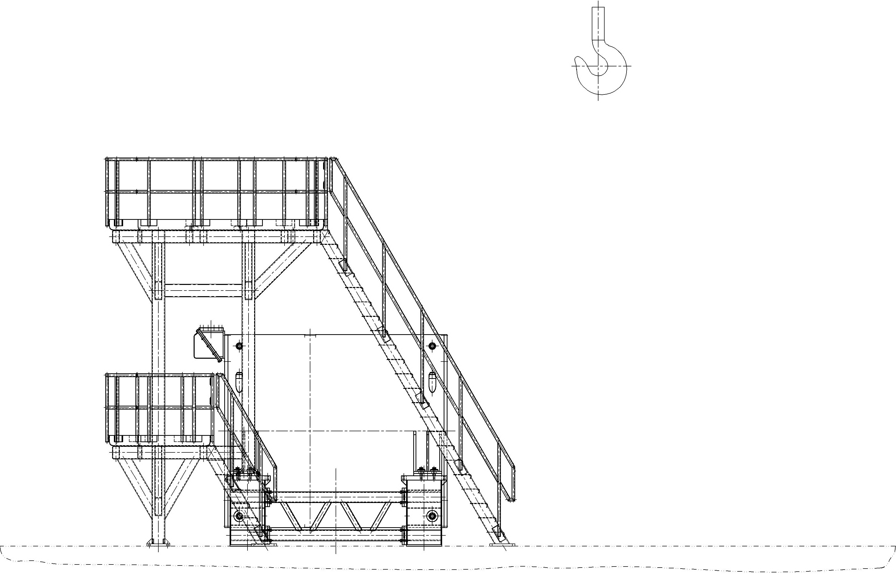
✧ Removing of the upper part of the transport-technological device. ✧ Installation of the technological device for cryogenic tests of the assembled cryostat.

Slide 21
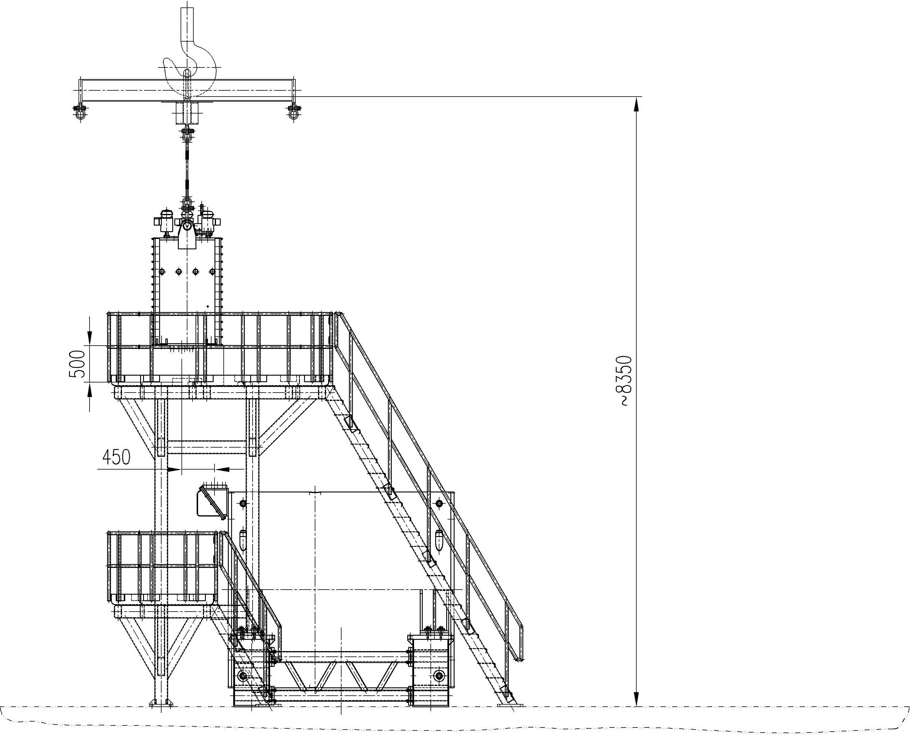
✧ Placing the Control Dewar on two supports in the intermediate position to mount Chimney. ✧ Mounting the Control Dewar in the operation position. ✧ Cryostat is ready for cryogenic tests

Slide 22
Following components shall be transported to CERN/GSI:
Cryostat/solenoid installed into the transport-technological device (weight 11.4/17 tons, length x width x height = 3090 mm x 3500 mm x 3200 mm)
Control Dewar (weight 3.3 tons, length x width x height = 960 mm x 2150 mm x 1980 mm)
Chimney ( weight 50 kg, length x diameter = 1580 mm x 335 mm)
The mounting beam (complete with supports)
Technological device for cryogenic and magnetic tests of the assembled cryostat/solenoid
Bearing arrangement
Multipurpose lifting traverse
Supports for the inner and outer shells of the cryostat
Technological equipment should be stored in the GSI during the entire period of the magnet operation

Slide 23
Assembly and tests of the cryostat with the cold mass at CERN

Slide 24
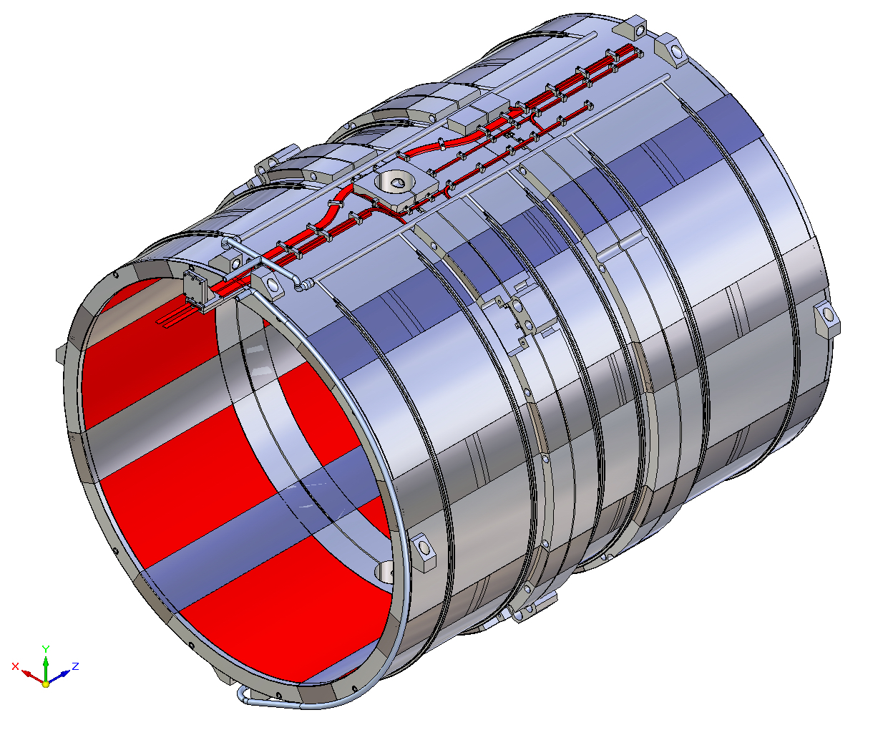
Cold Mass is to be equipped by heat exchanger pipes, bus bars, instrumentation and covered by blankets of multilayer insulation

Slide 25
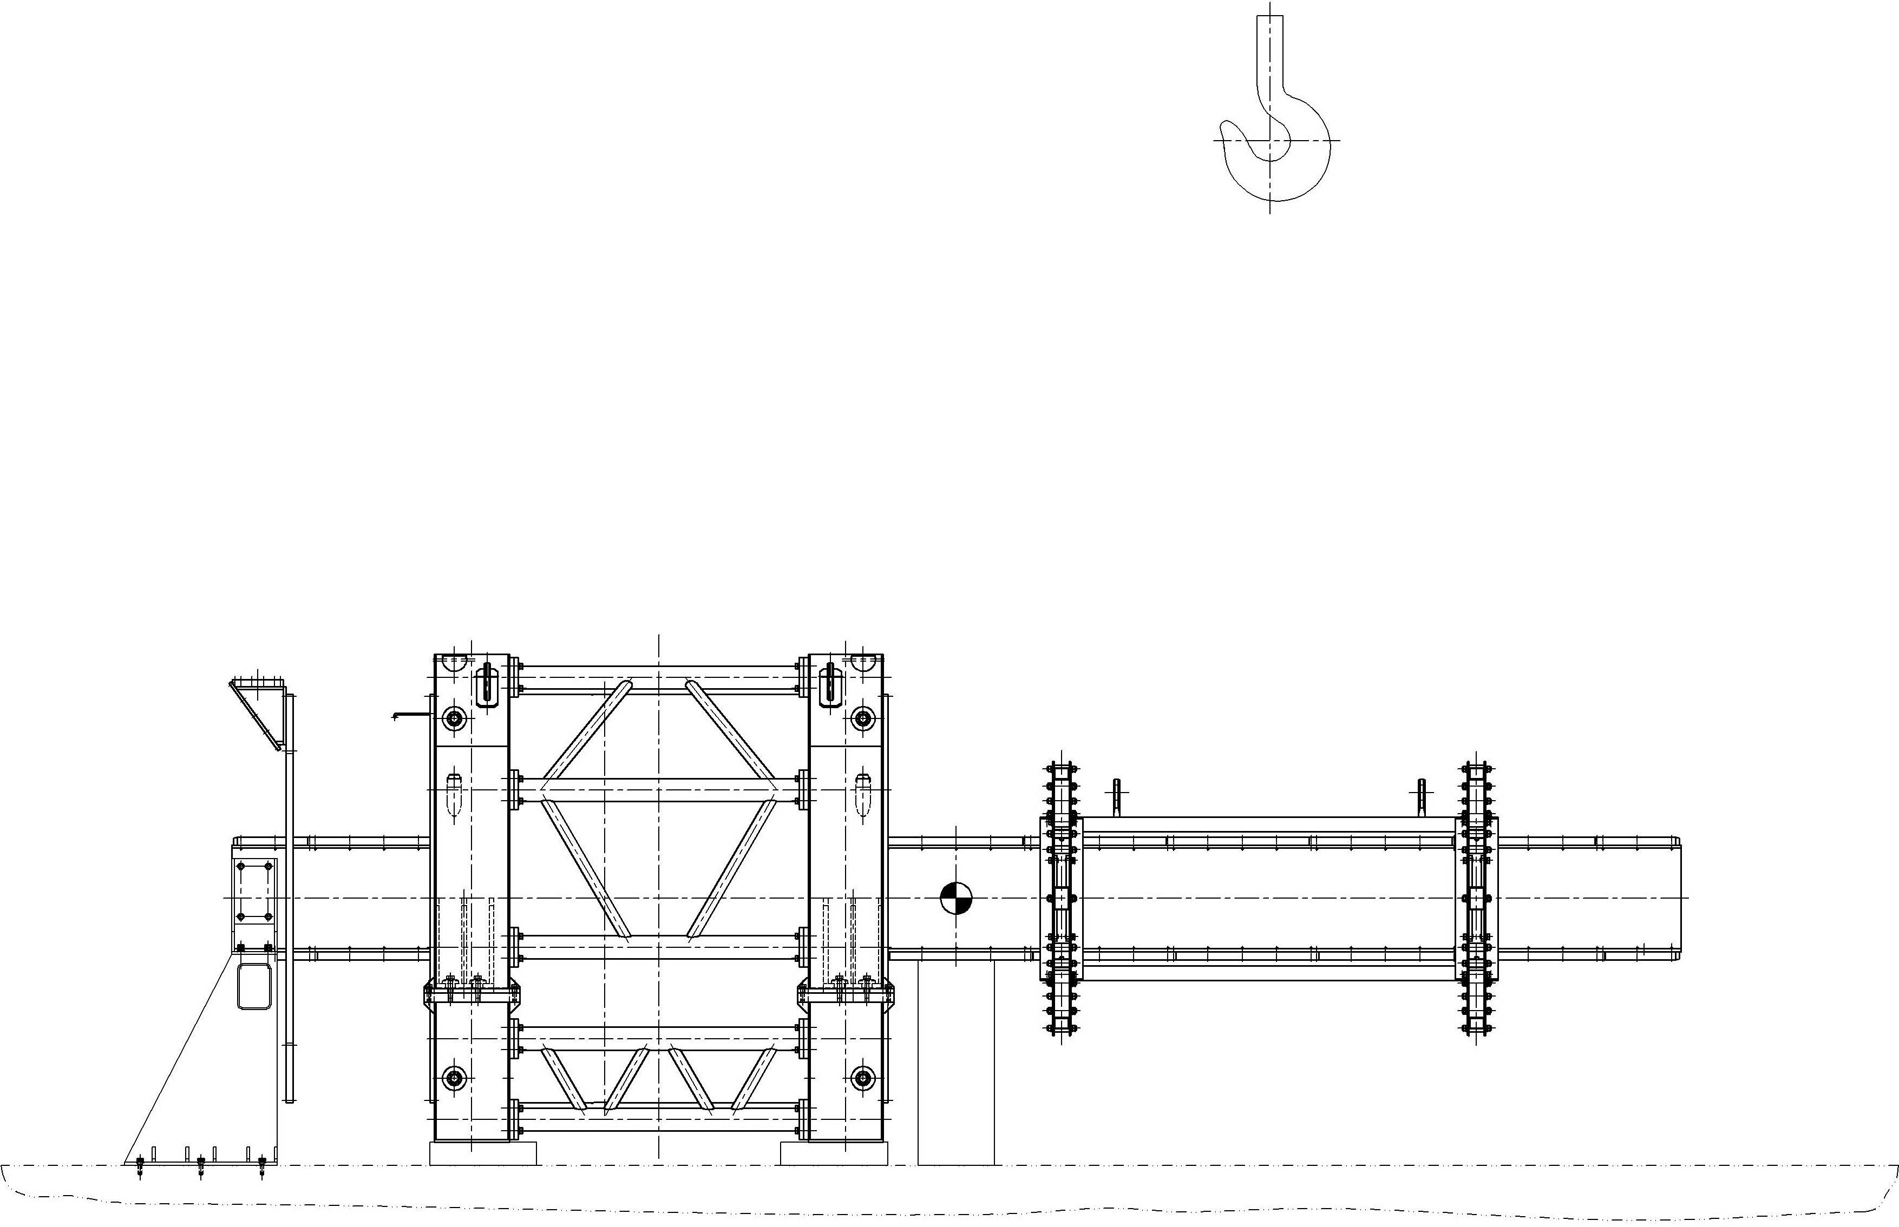
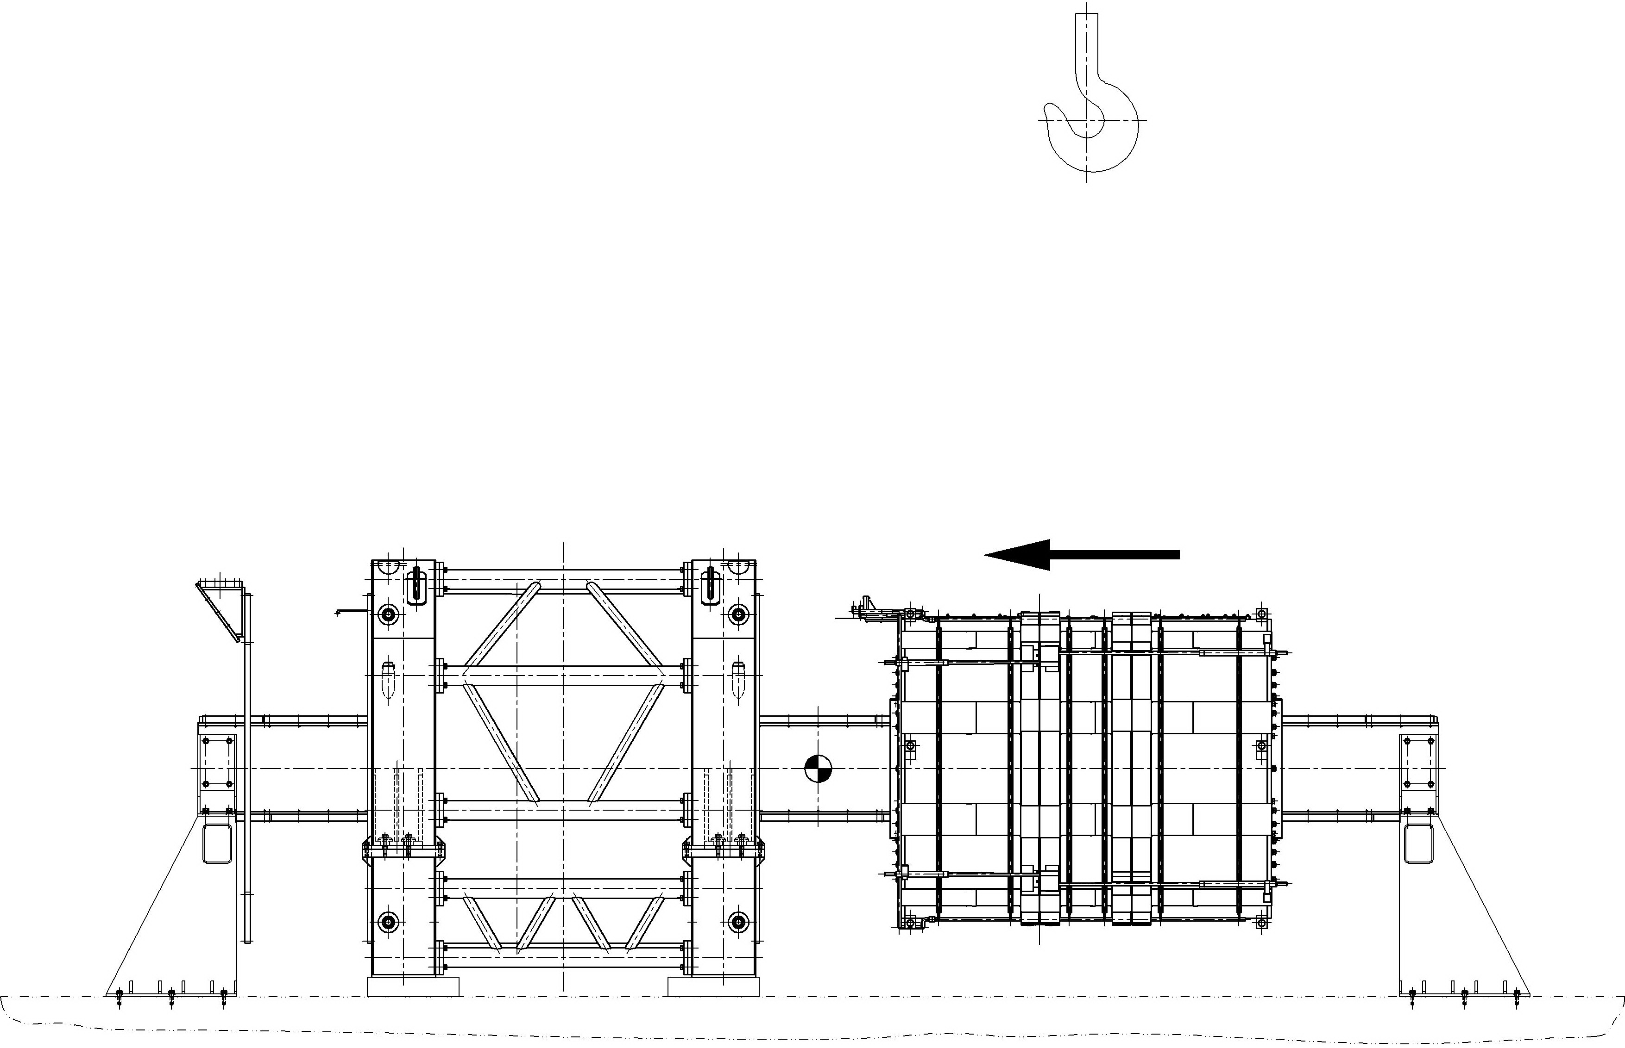
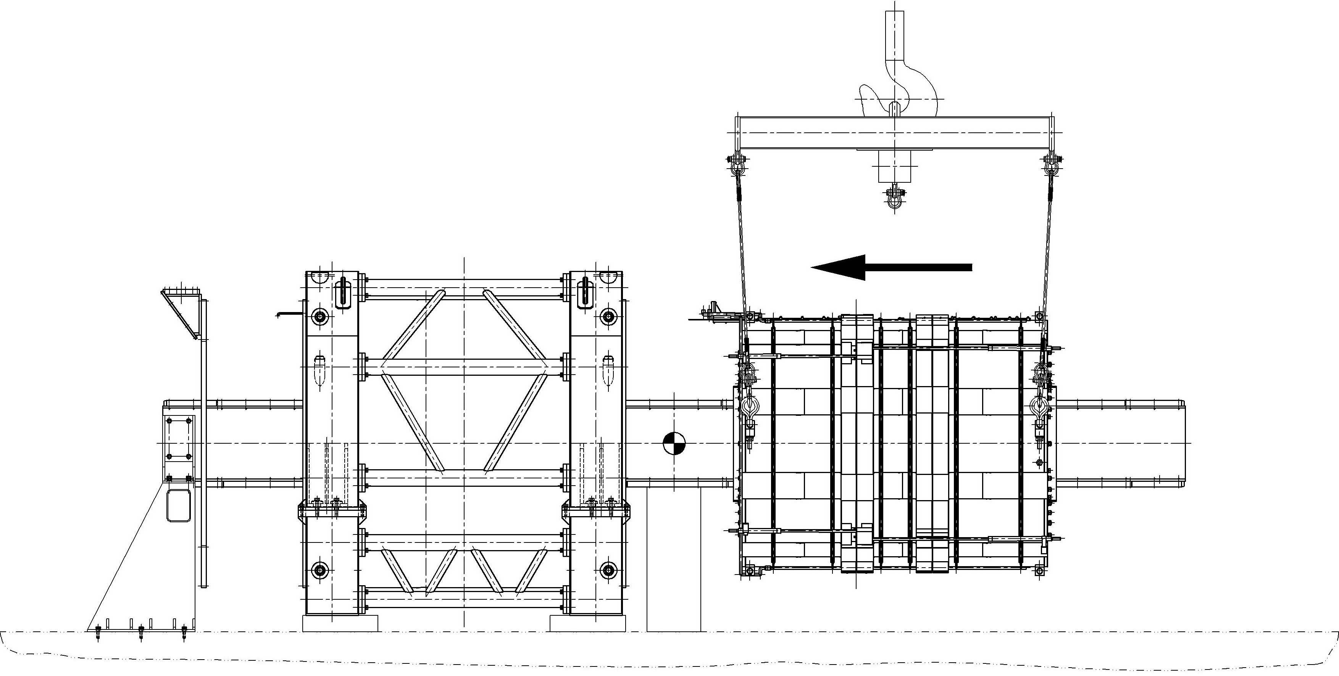
✧ Before installation of the Cold Mass the Cryostat has to be disassembled ✧ Installation procedure of the cold mass is very similar to the assembly procedure of the inner shell of the cryostat vessel
✧

Slide 26
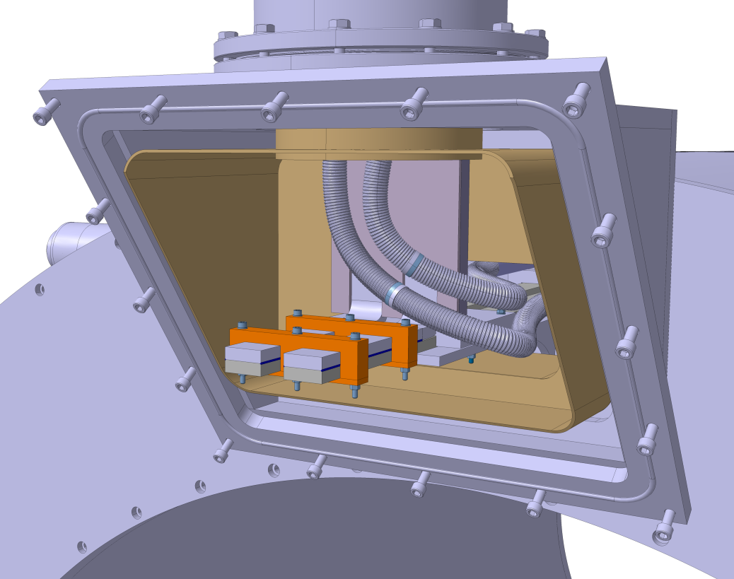
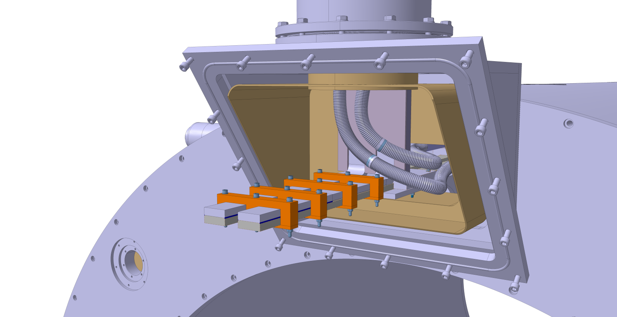
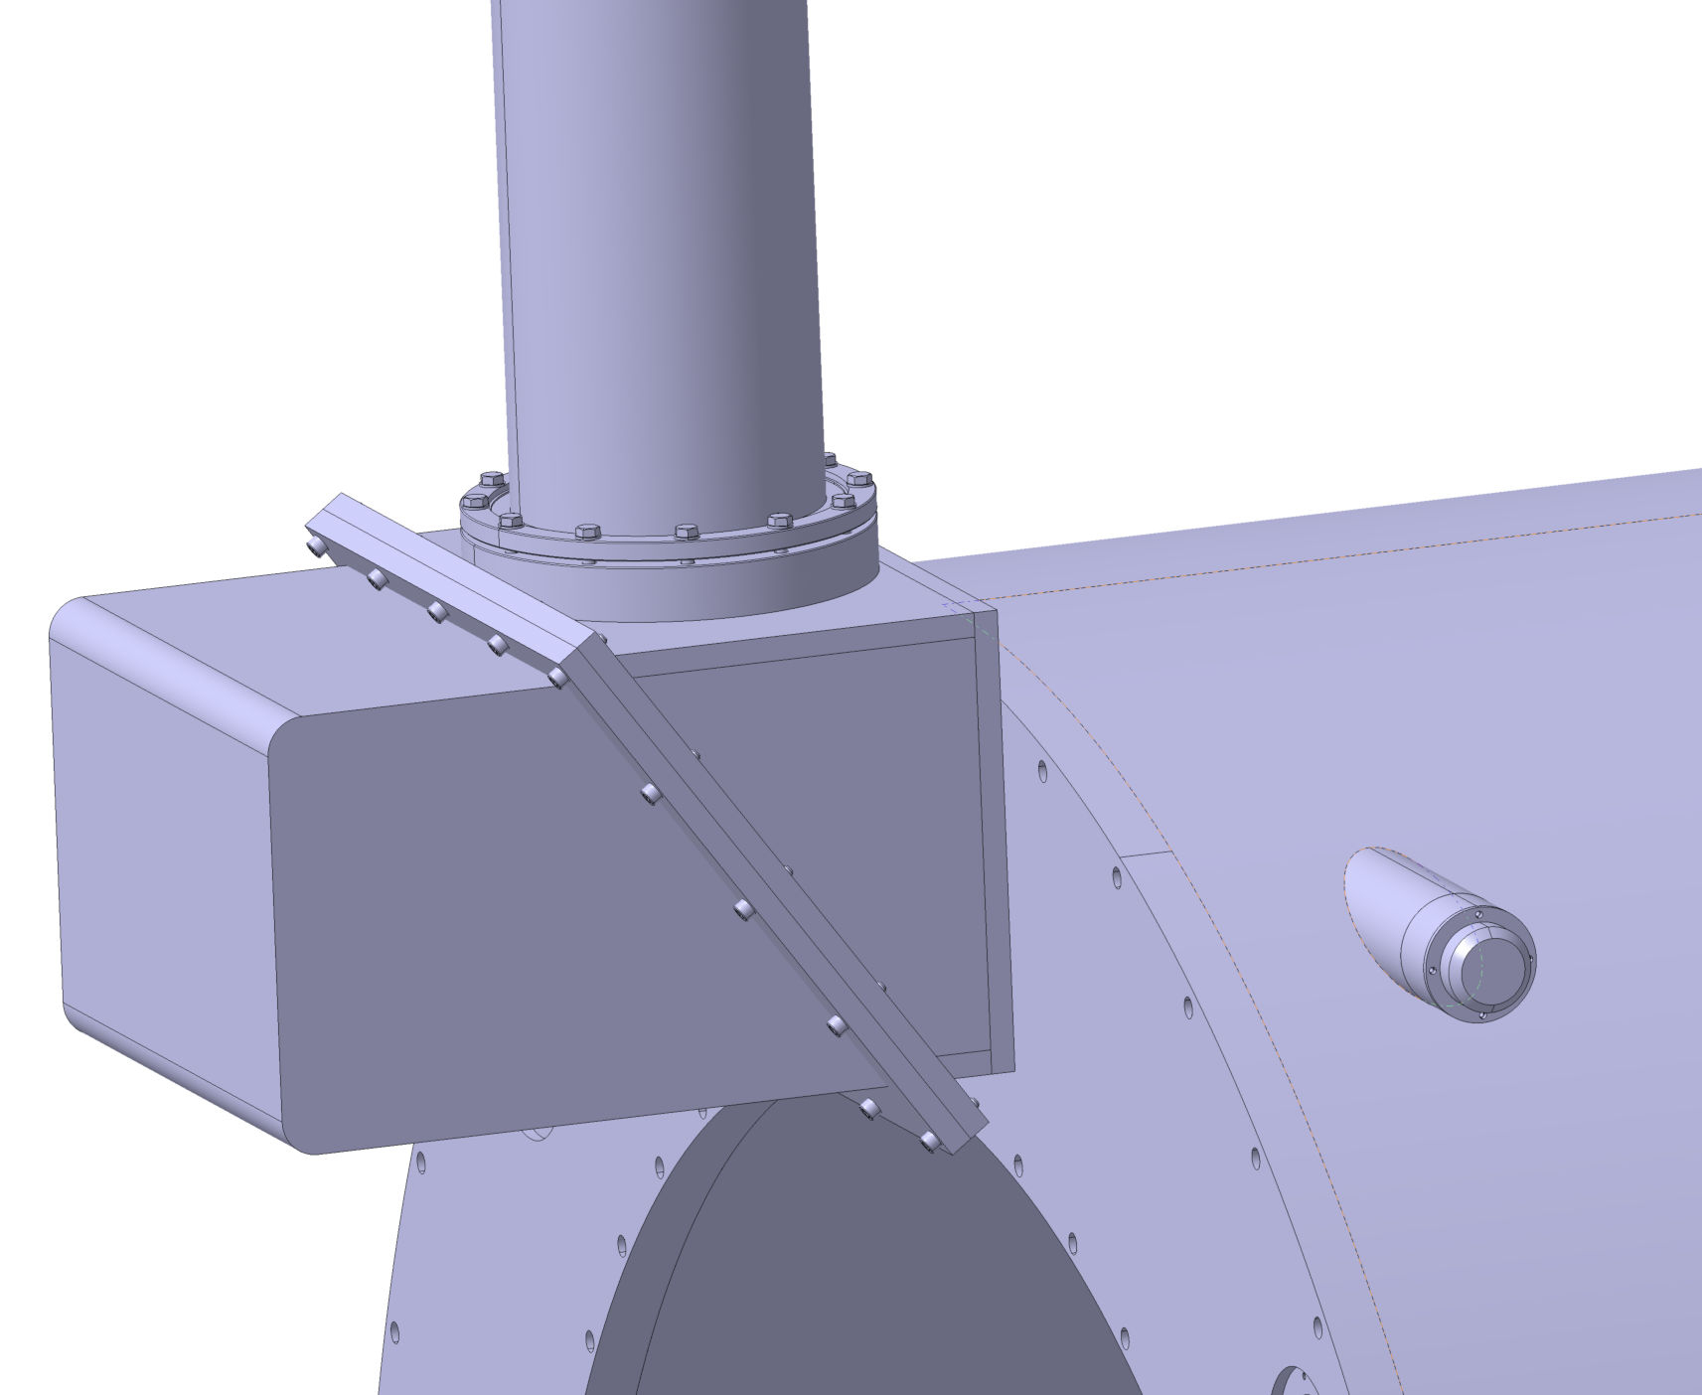
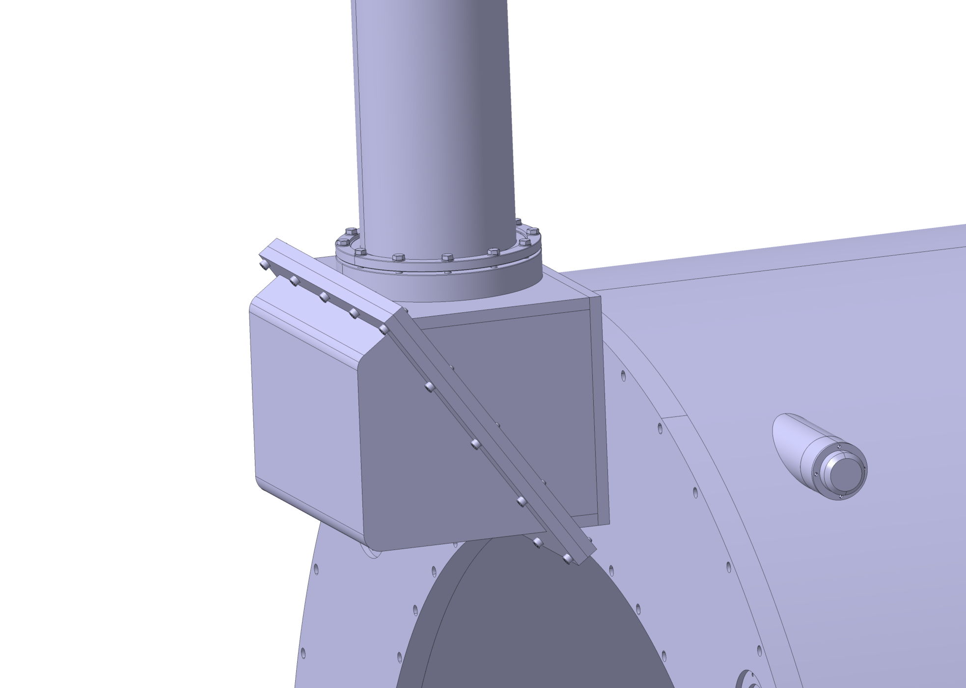
Spare lengths of bus bars are foreseen by CERN team for tests of the solenoid with magnetic field . An elongated cover will be required to accommodate these lengths in the interface box .

Slide 27
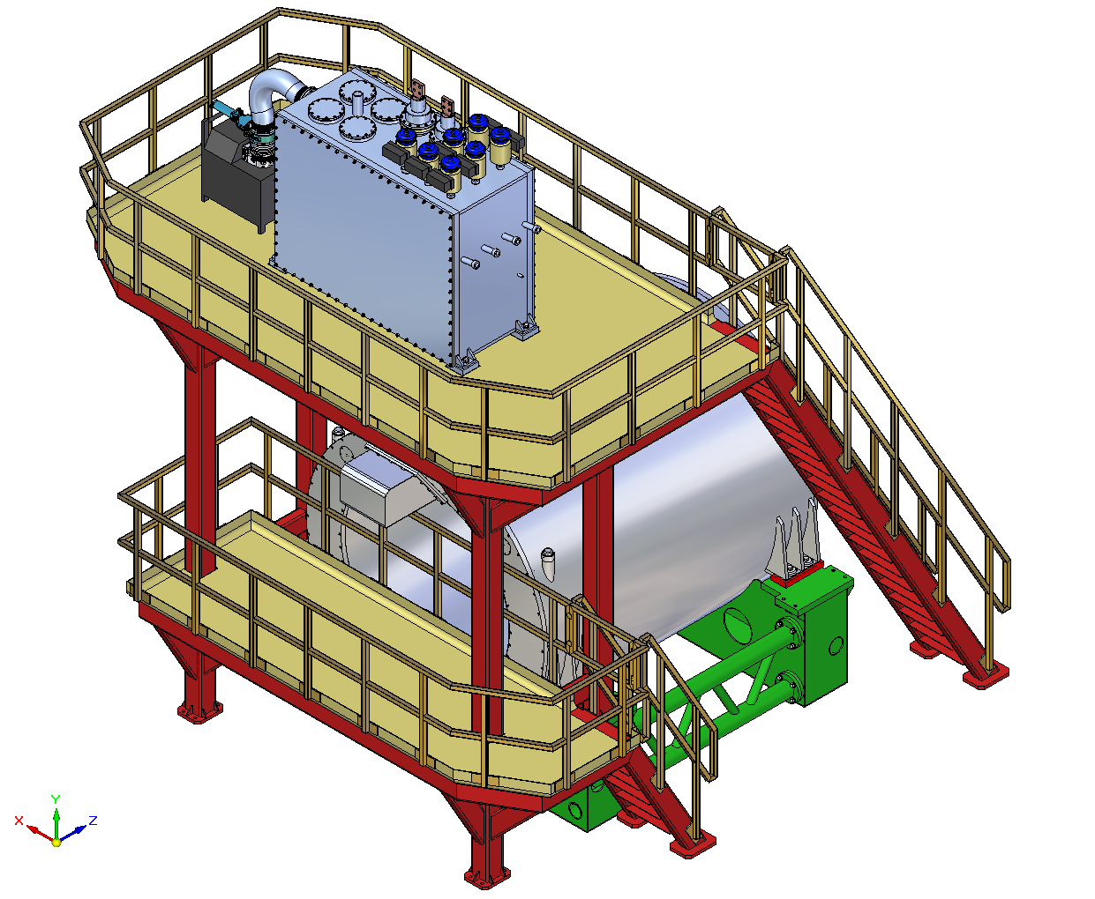
Solenoid prepared for tests at CERN

Slide 28
Cryostat Mounting into the Yoke (GSI)

Slide 29
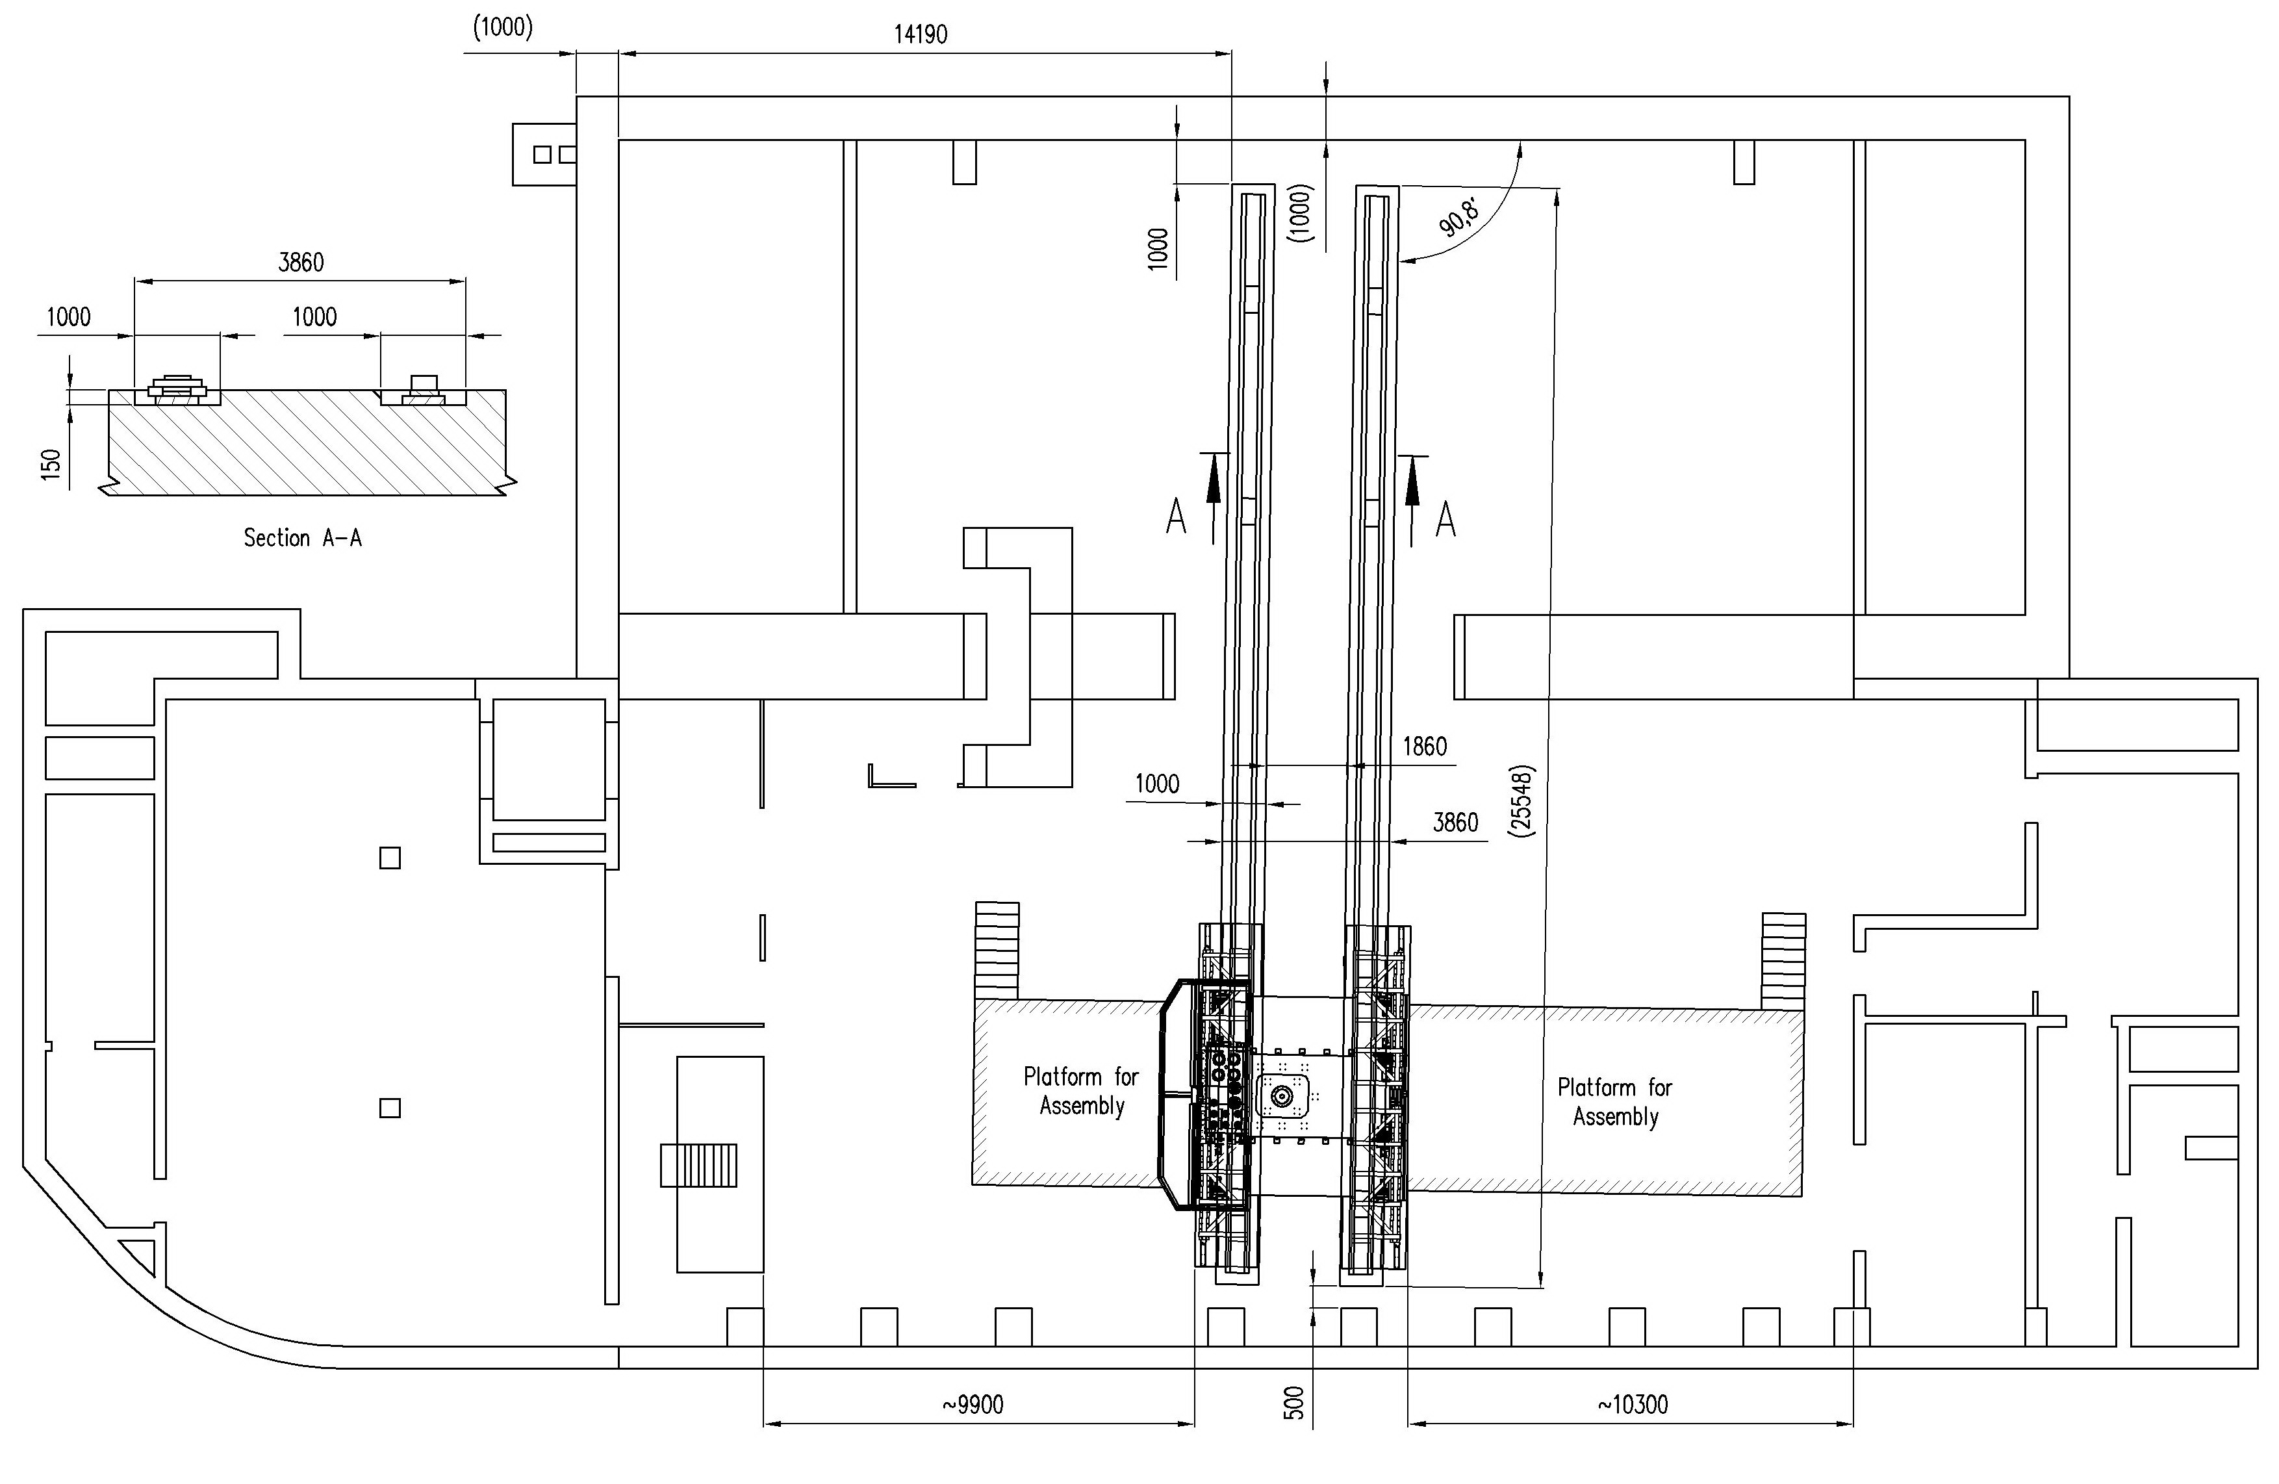
Preparation of the Assembly area for solenoid installation

Slide 30
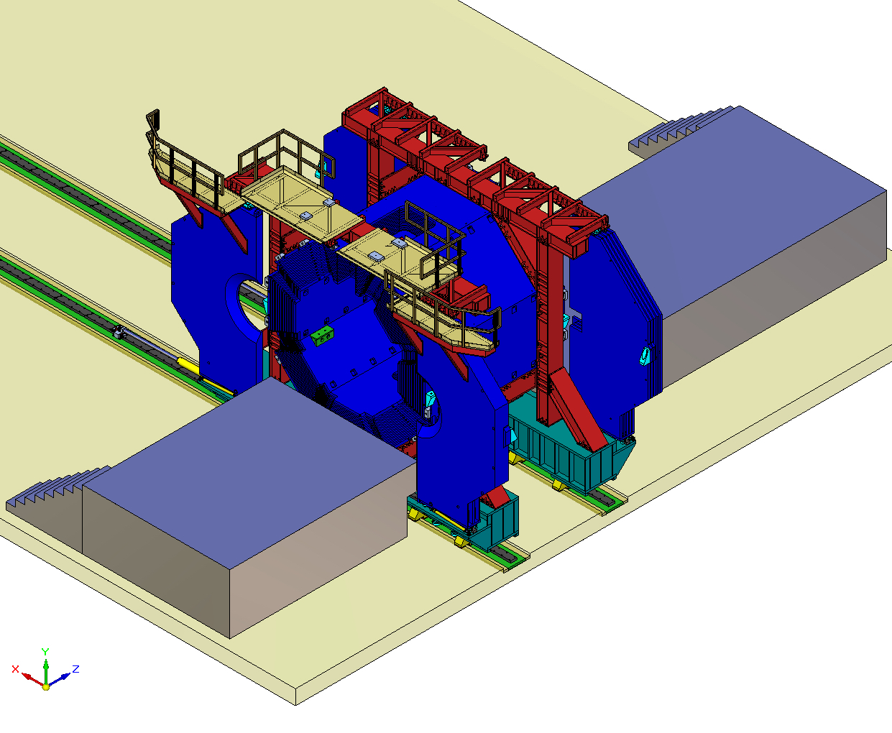
Initial preparation - the Yoke doors are opened, platforms for cryostat assembly are installed

Slide 31
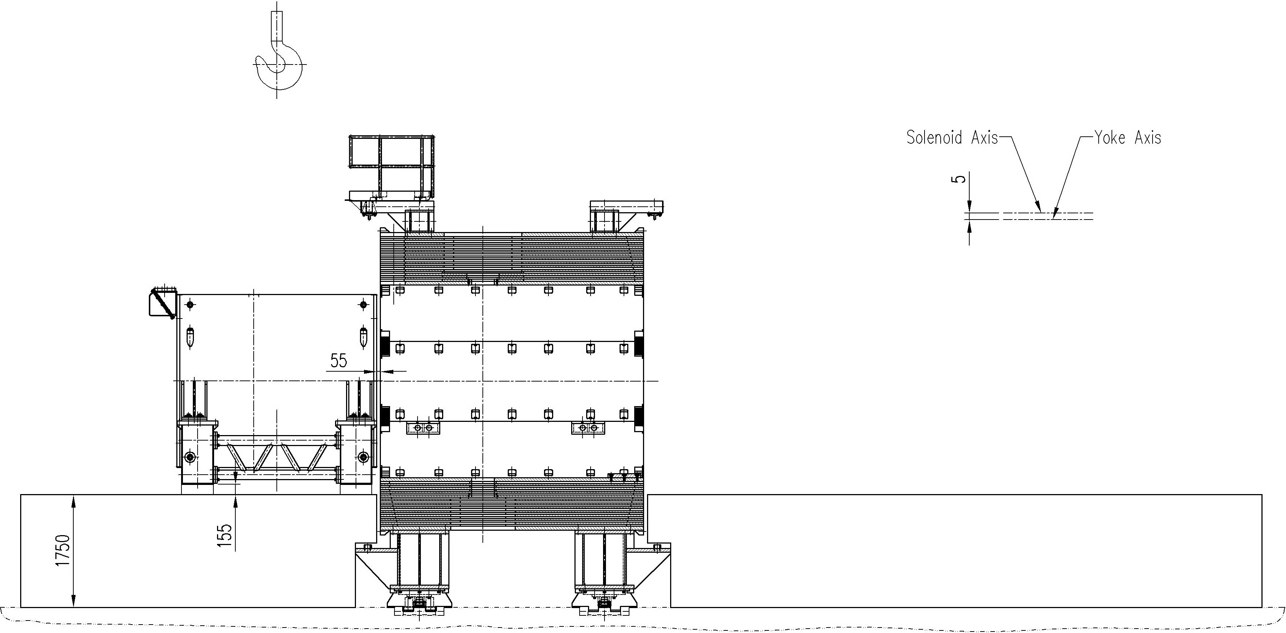
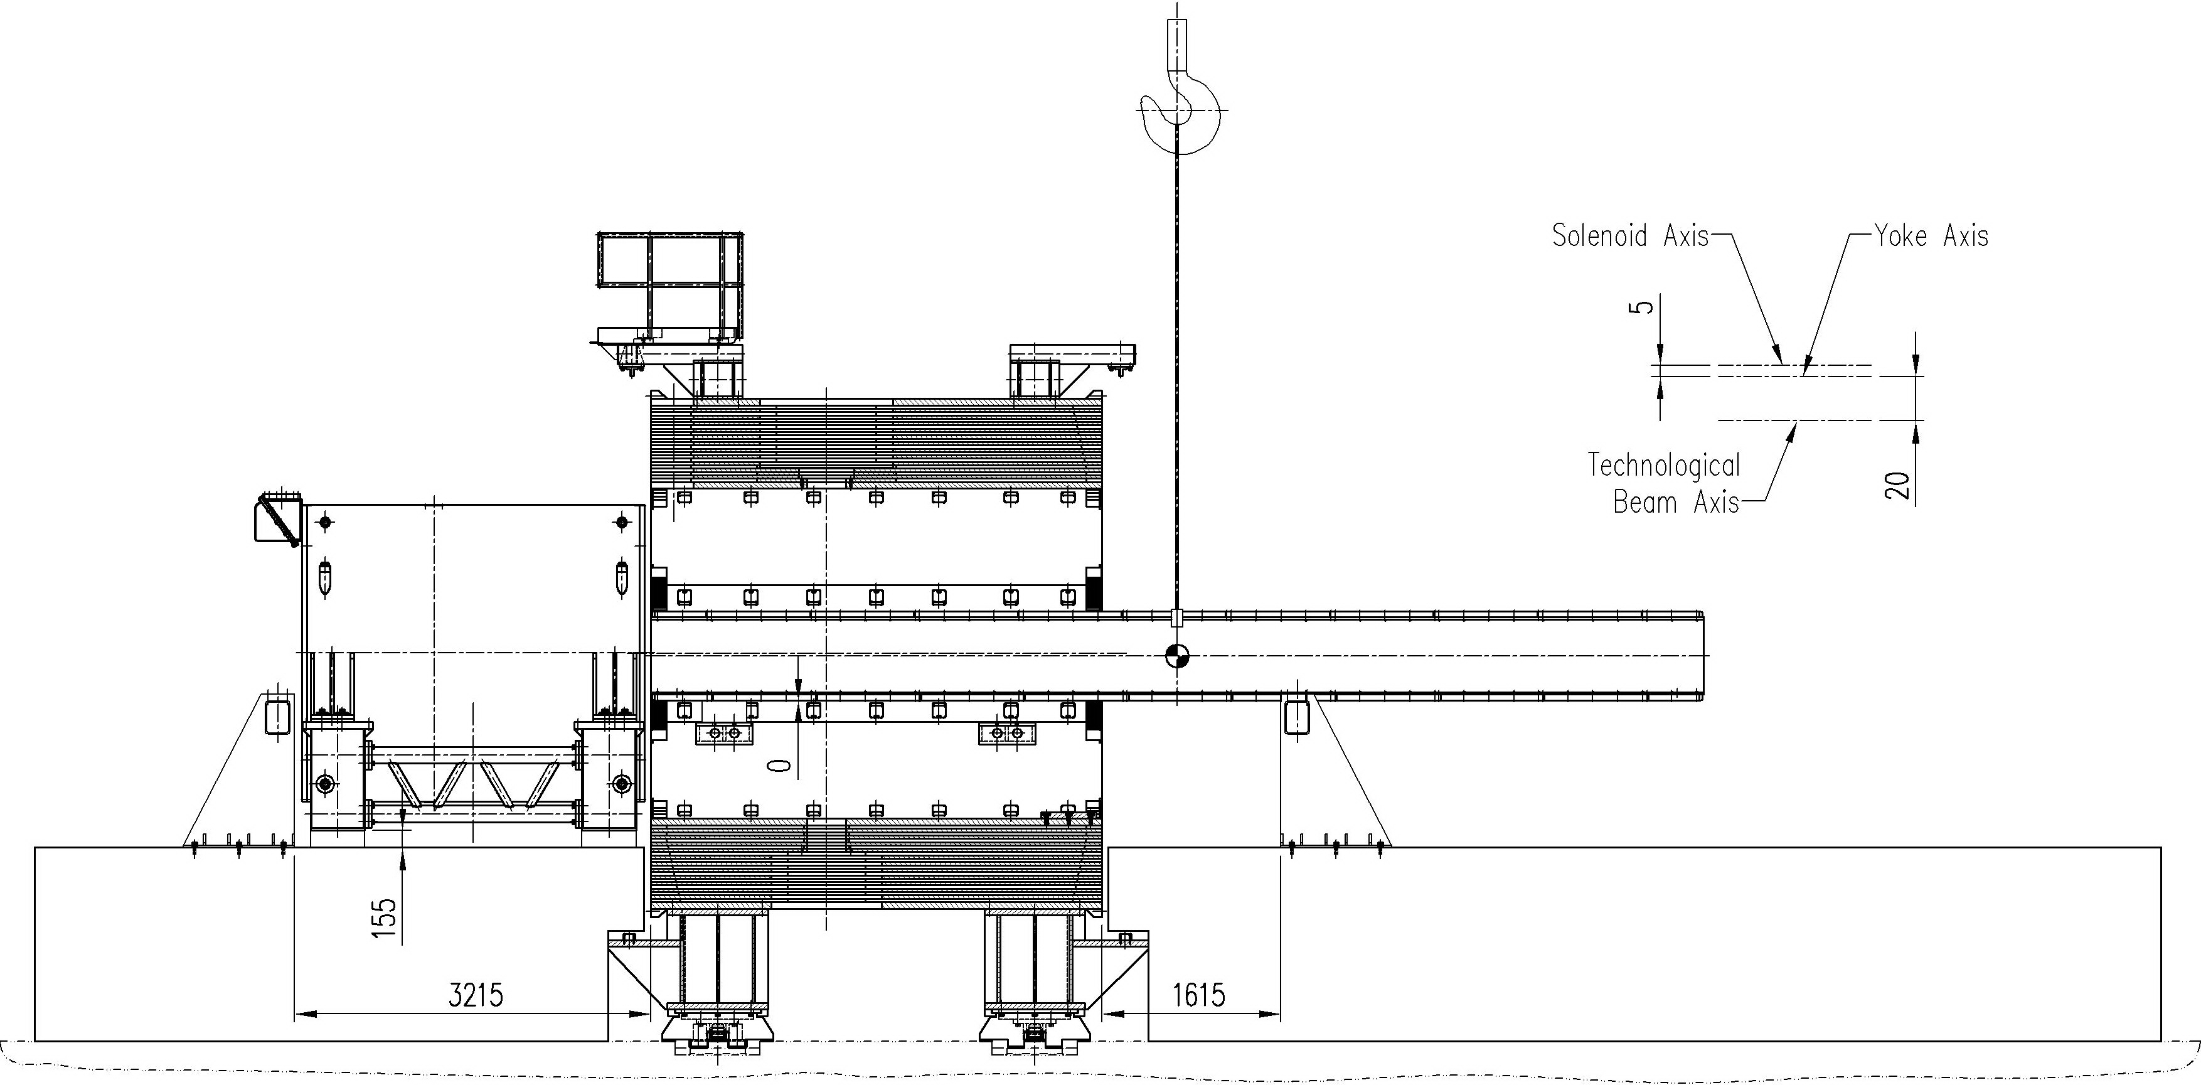
✧ placing cryostat (with preliminary mounted bearing arrangement inside) close to the butt end of the yoke barrel ✧ insertion of the mounting beam into the yoke aperture

Slide 32
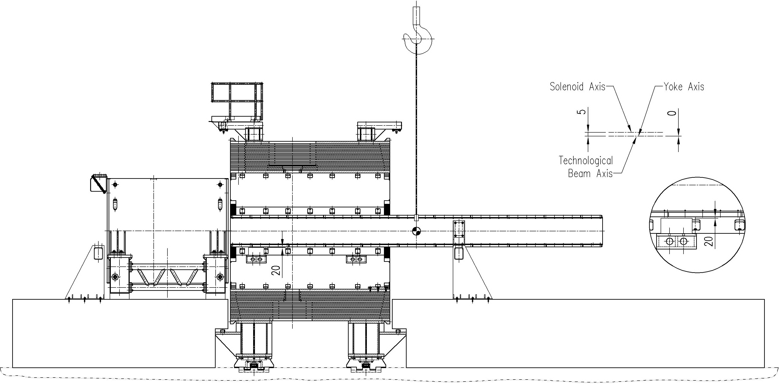
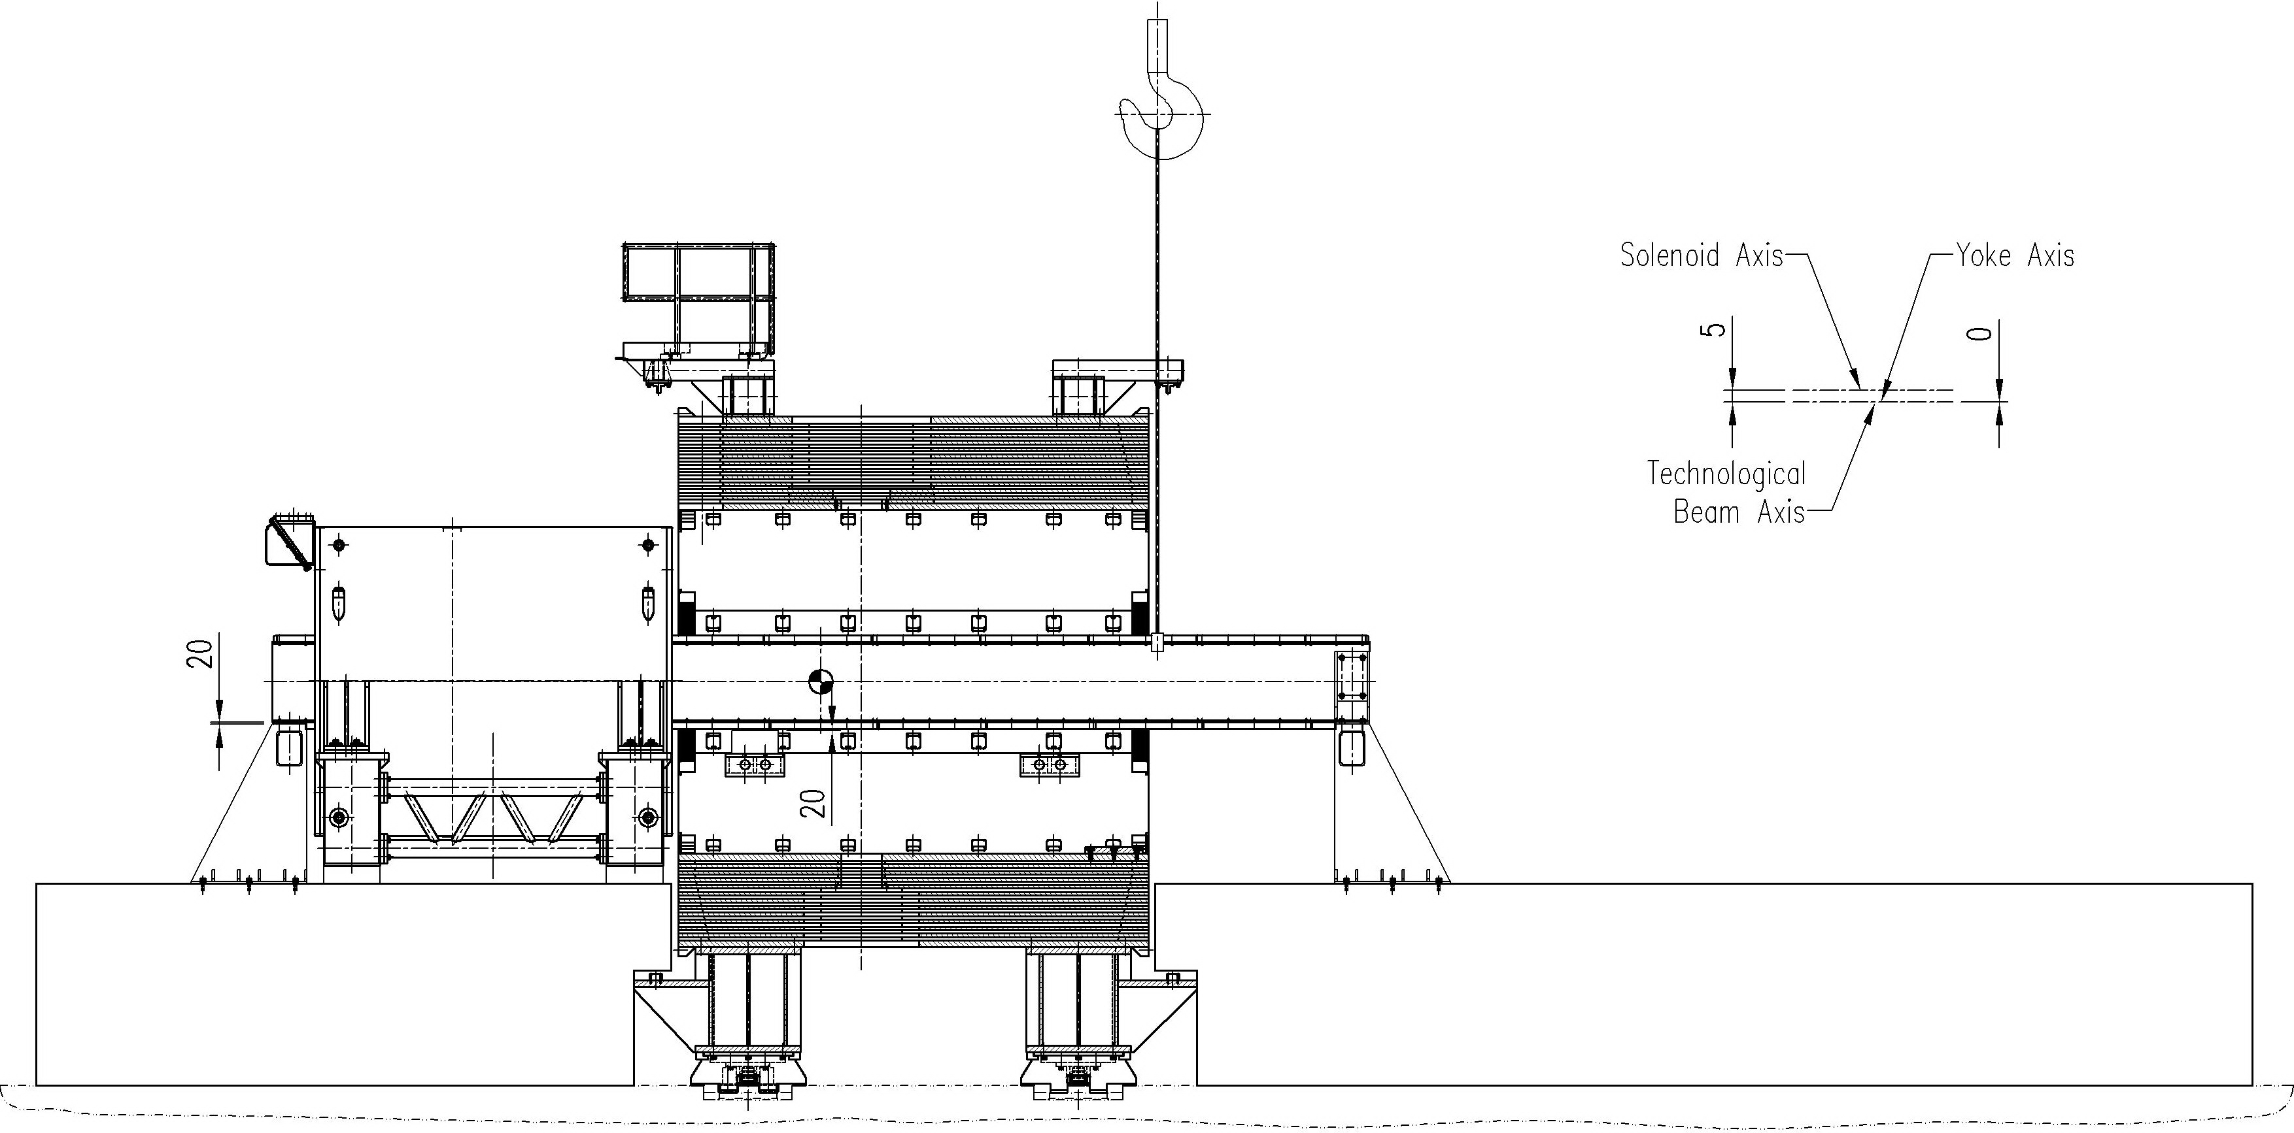
✧ Pulling the mounting beam through the cryostat using the lower roller skates of the bearing arrangement . ✧ Fixation of the beam on the end supports ✧ Mounting lateral stops of the supports

Slide 33
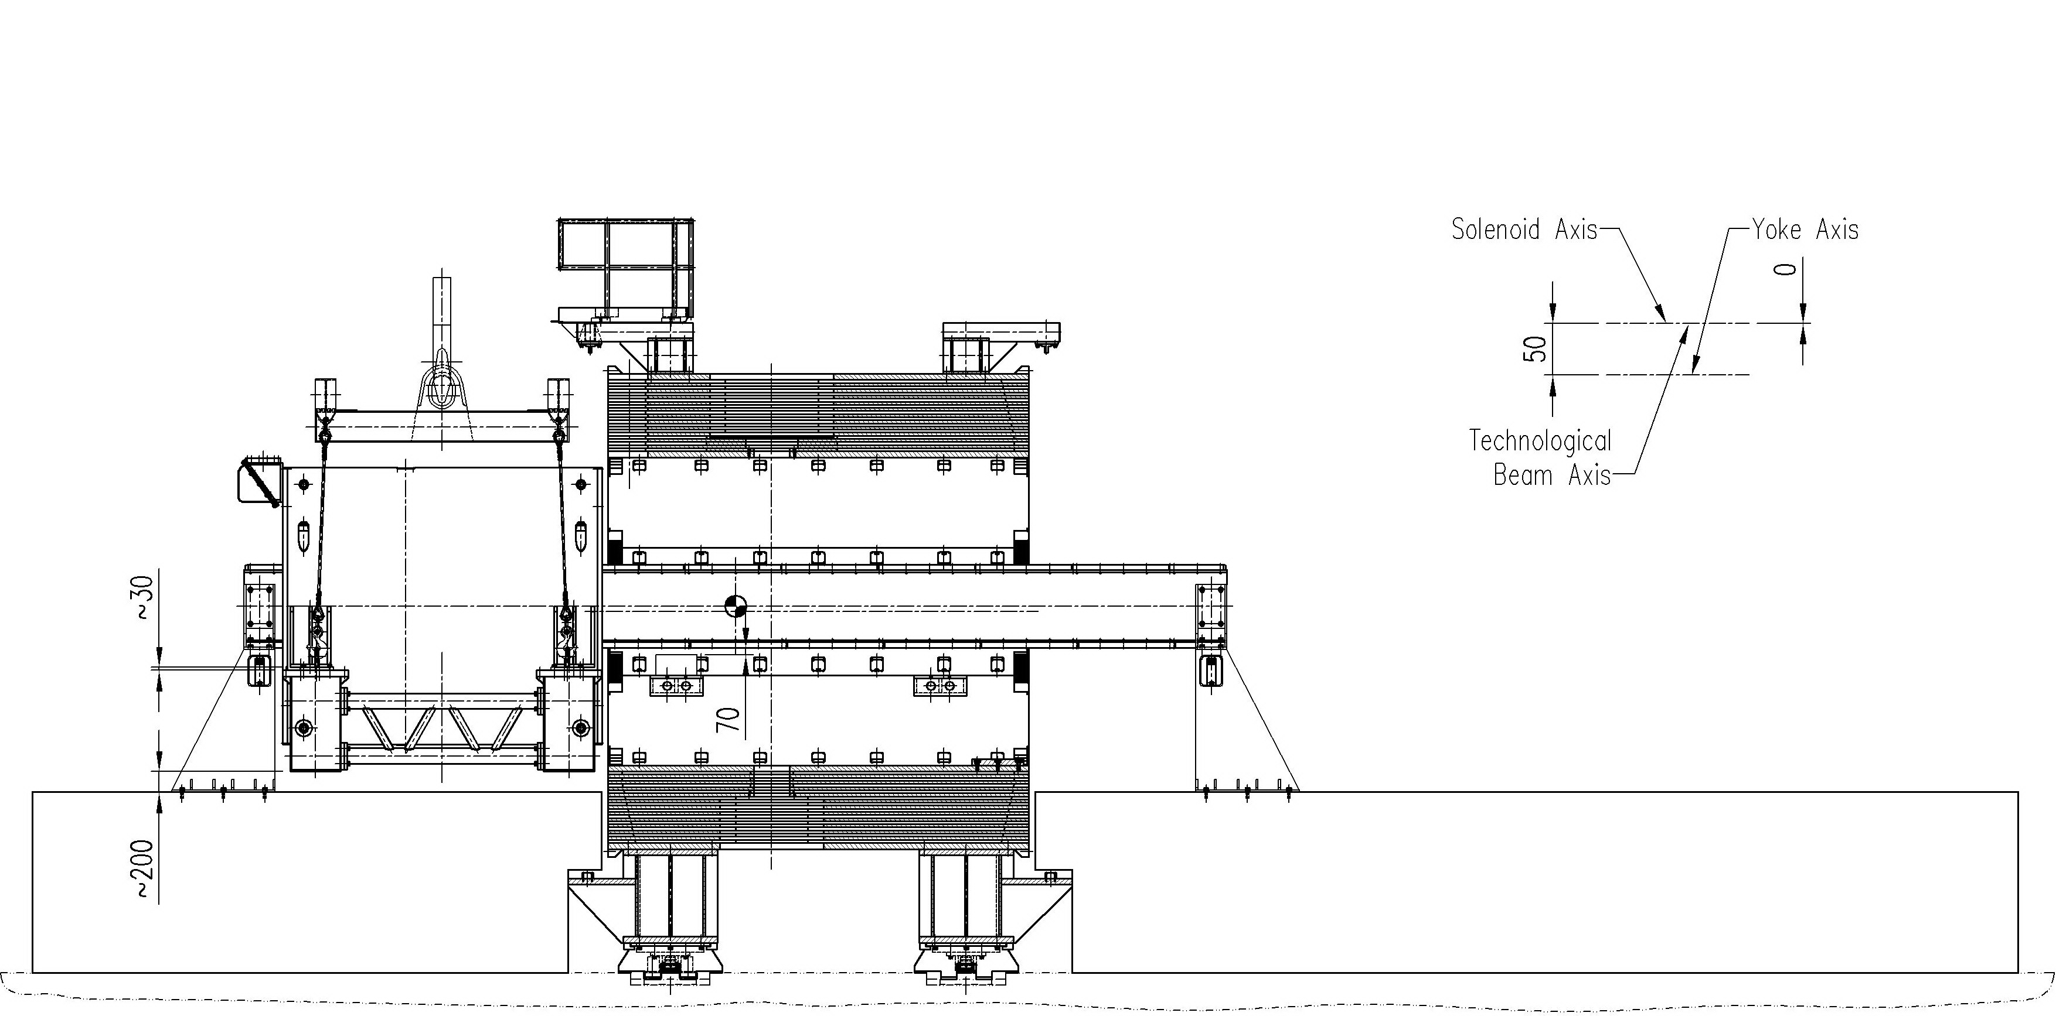
✧ Suspension of the cryostat with transport-technological device on the crane hook ✧ Removing supports below the cryostat stand ✧ Disconnecting the Сryostat from the Stand

Slide 34
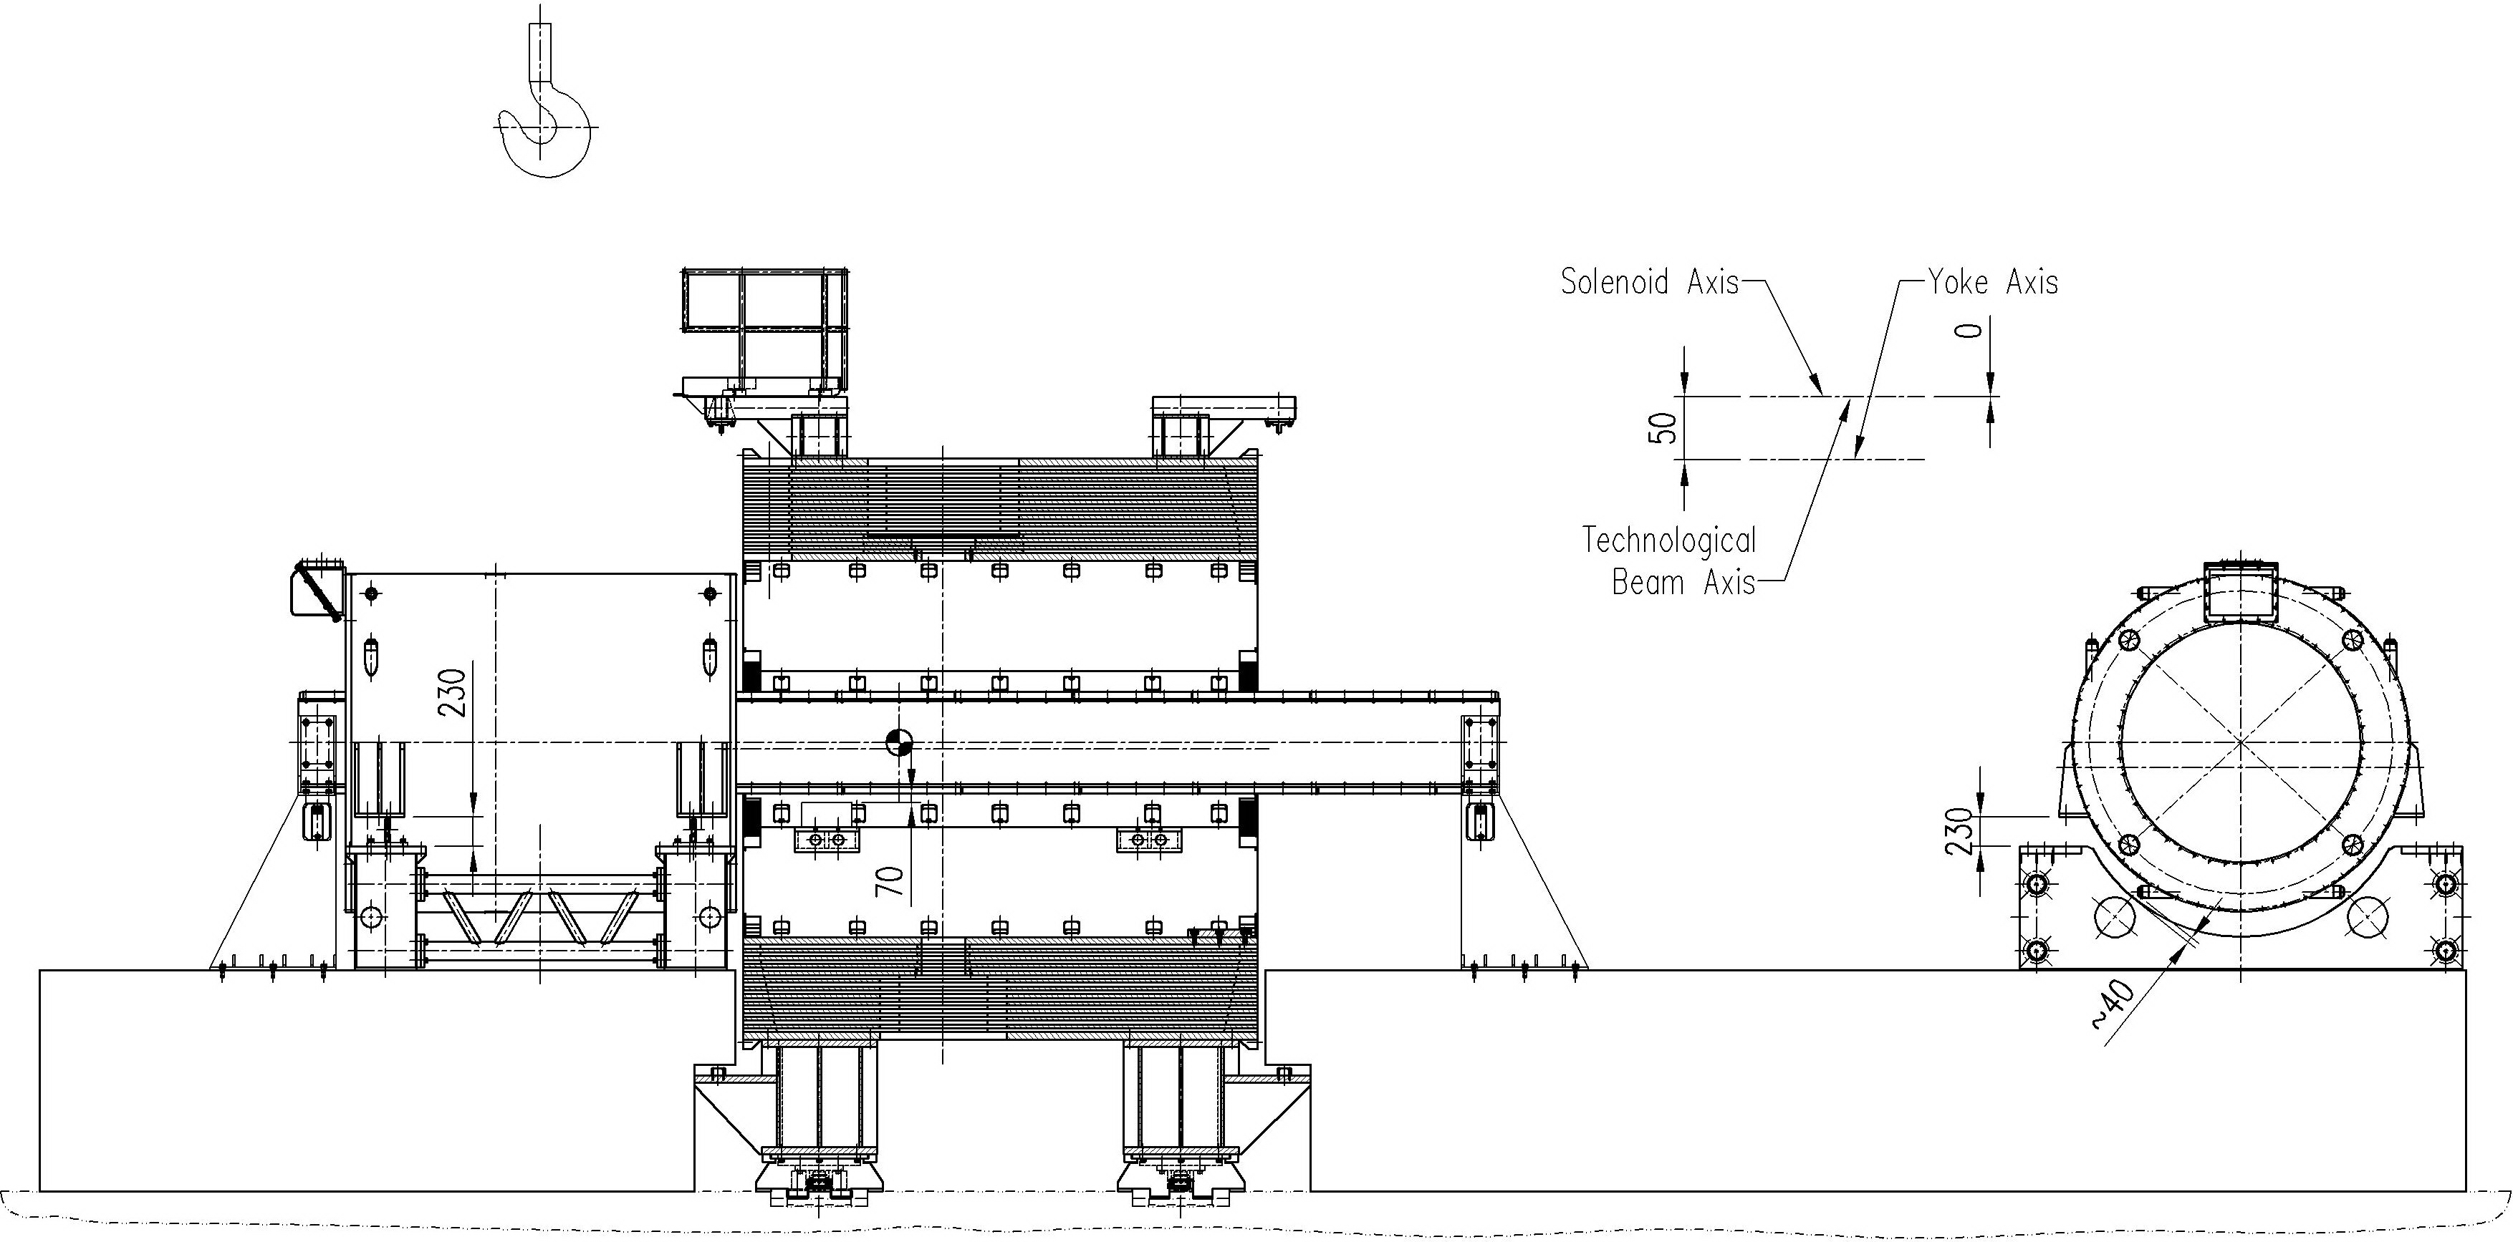
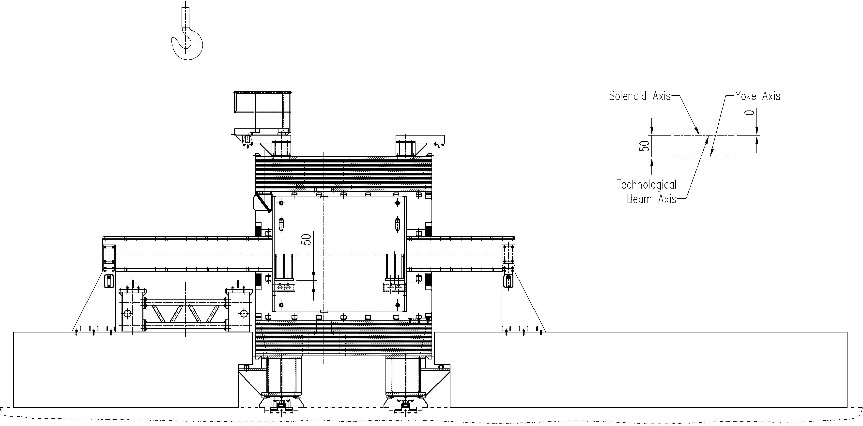
✧ Lowering the Stand to the flow (cryostat is suspended on the mounting beam) ✧ Mounting tailor made Shims for correcting the position of the Cryostat relative to the Iron Yoke ✧ Rolling up the Cryostat into the Yoke Barrel

Slide 35
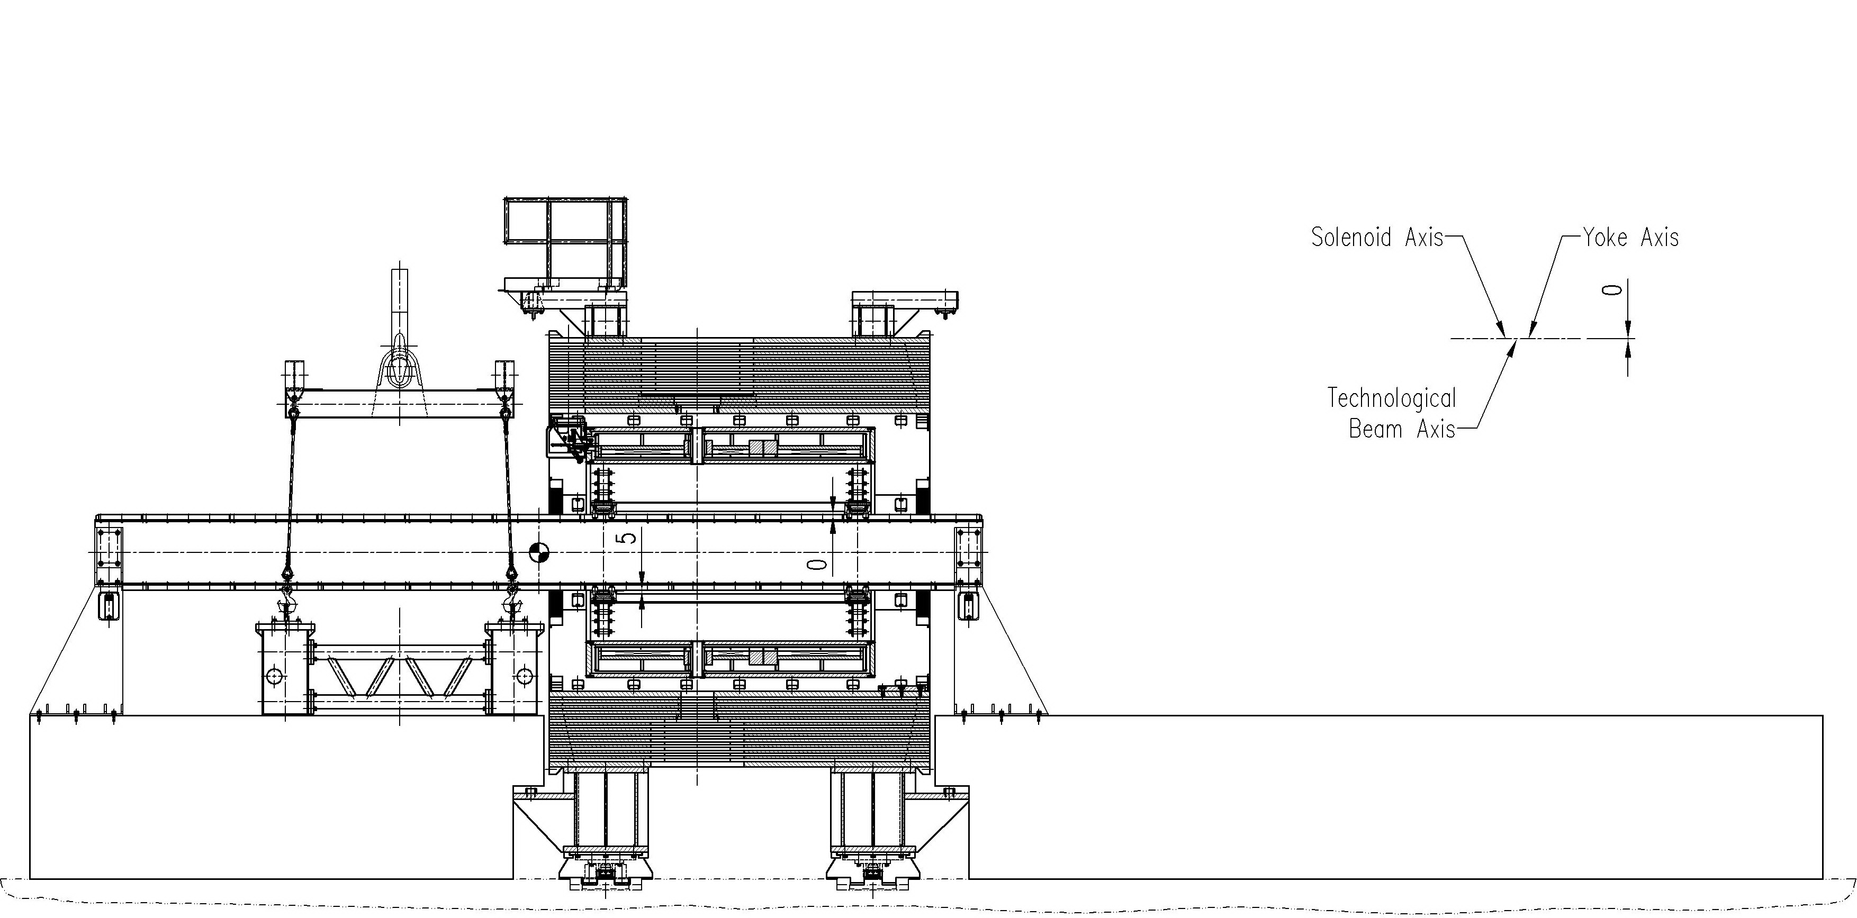
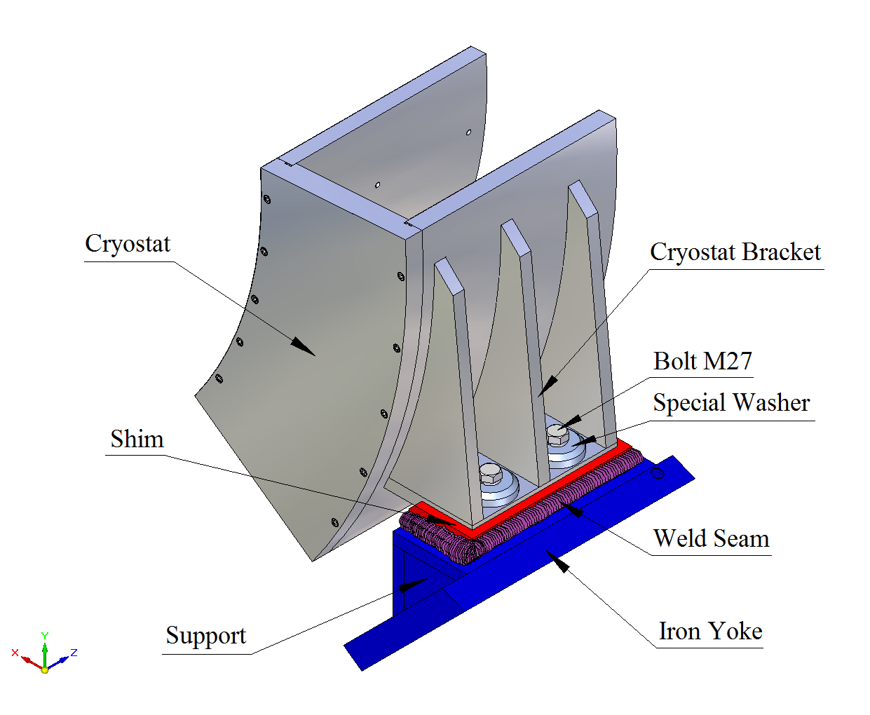
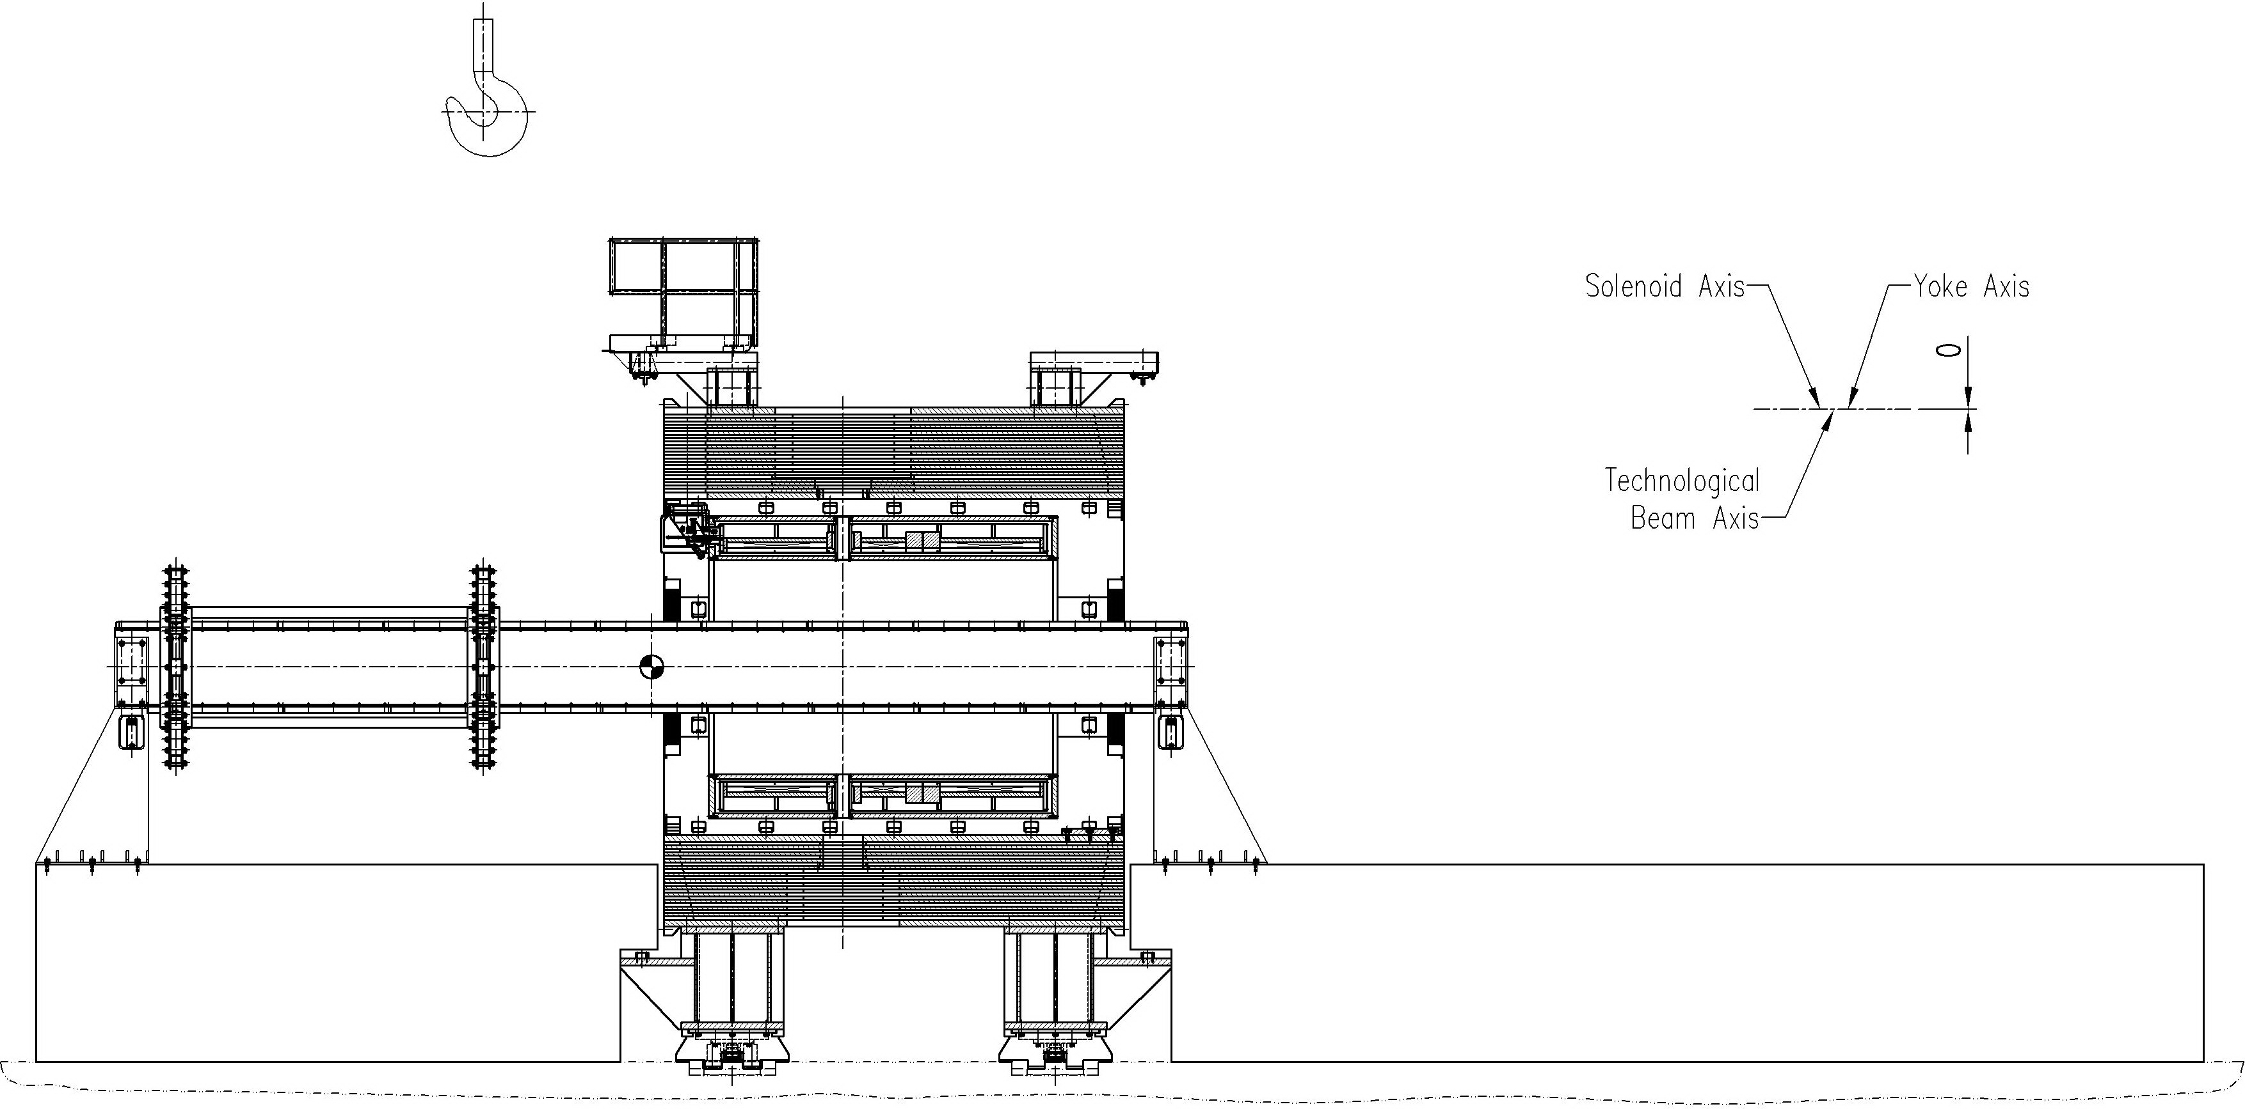
✧ Fixation of the cryostat to the supports on the yoke barrel beams. ✧ Removal the cryostat stand by crane from assembly area. ✧ Rolling out the bearing arrangement from the cryostat to the end of the beam.

Slide 36
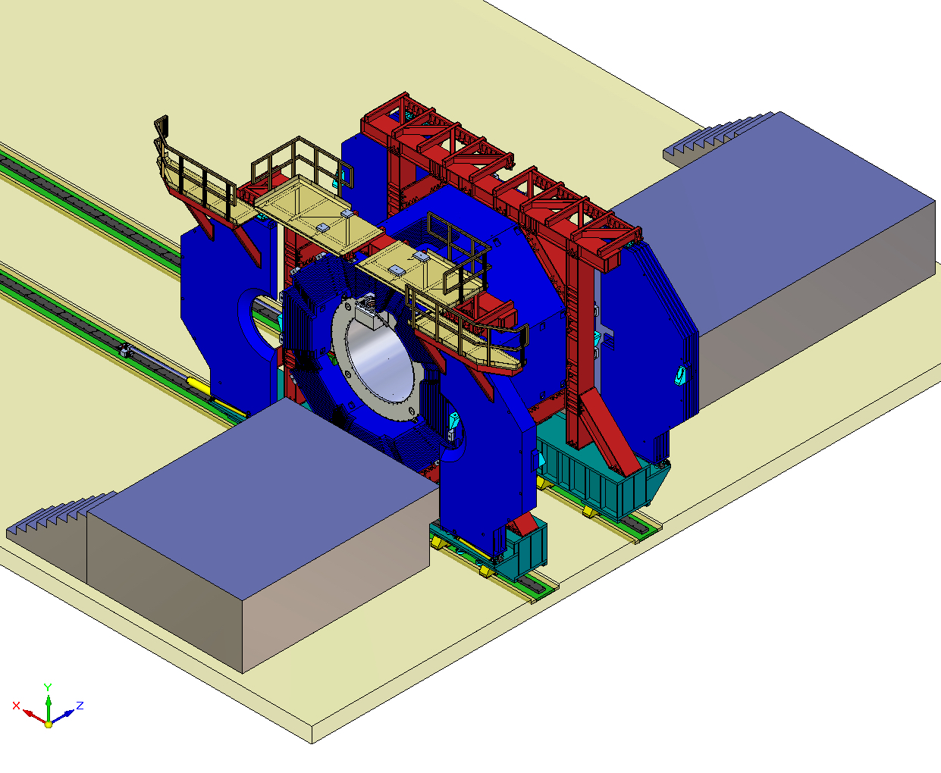
Cryostat assembled with the Iron Yoke

Slide 37
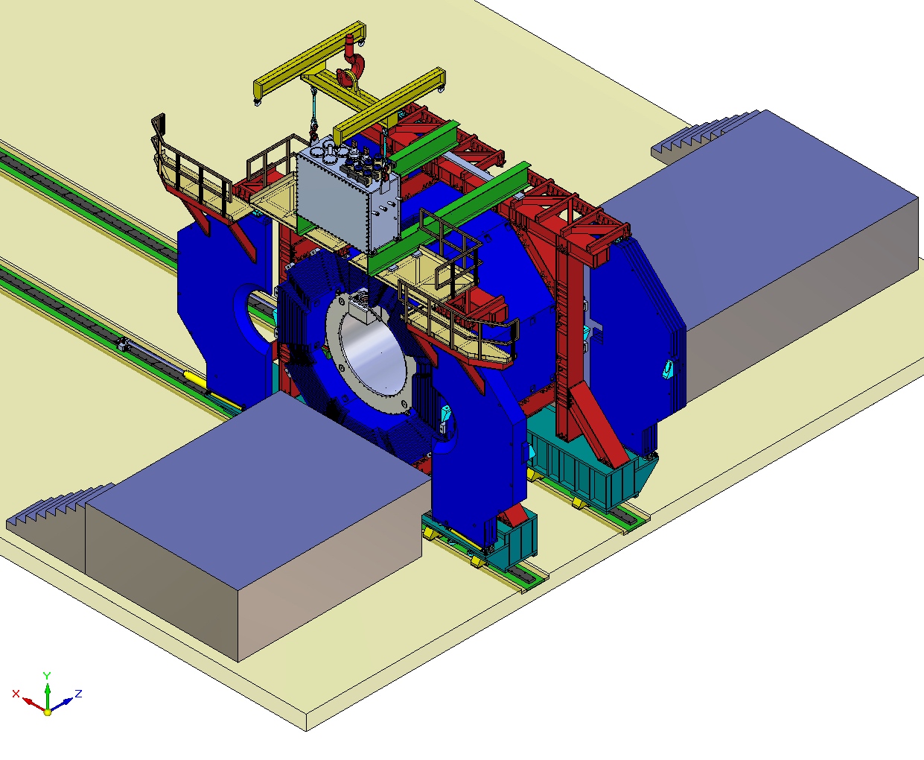
Placing the Control Dewar on two support beams in the intermediate position to mount Chimney

Slide 38
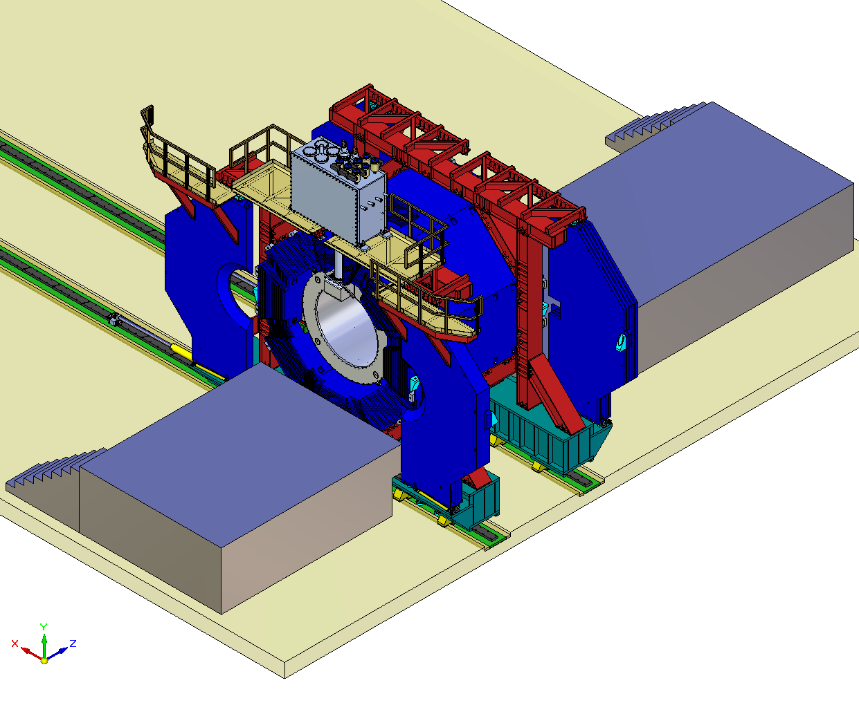
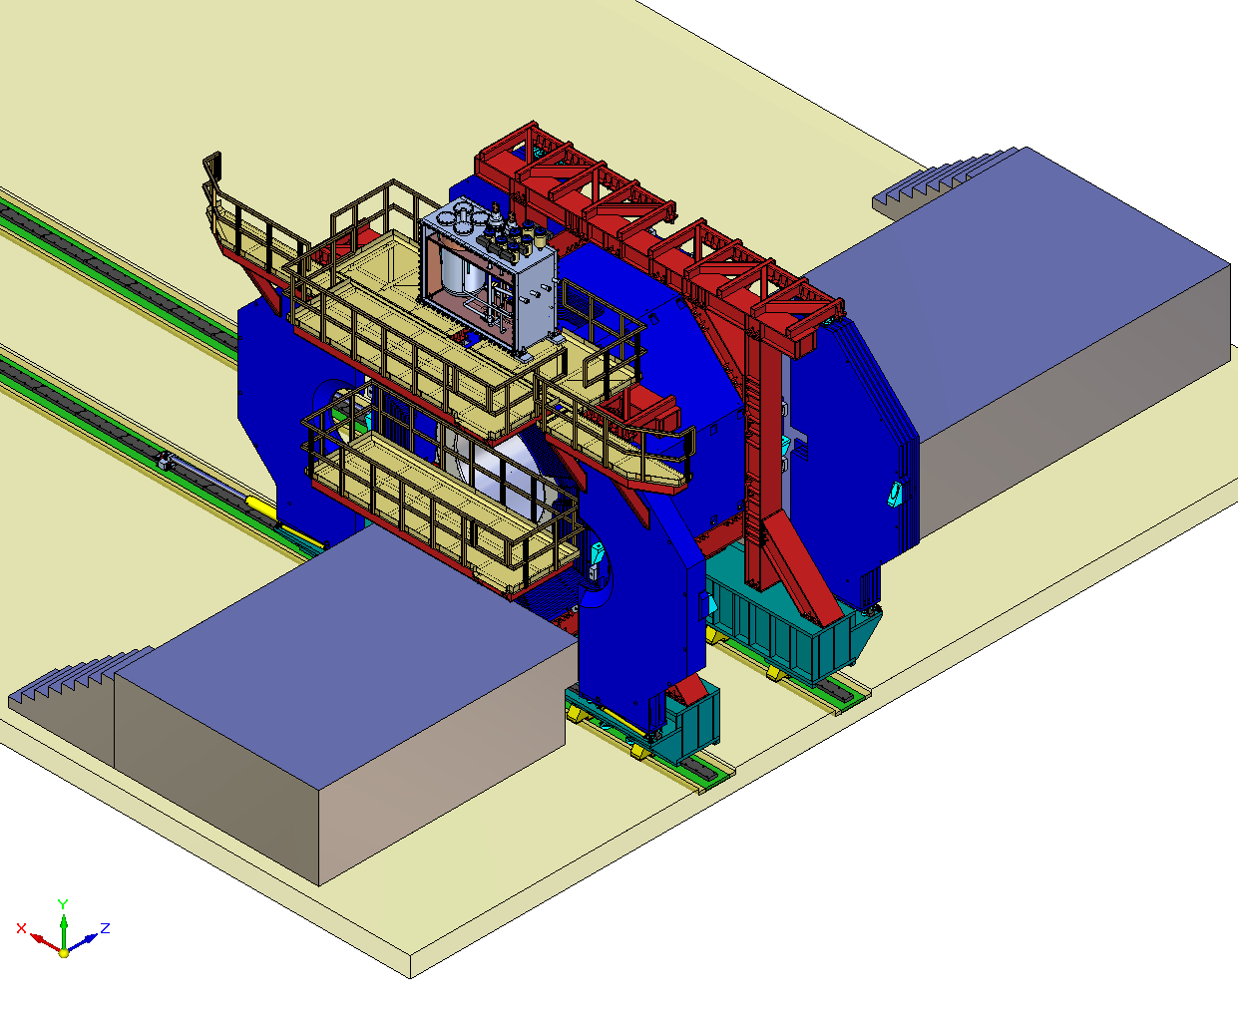
Mounting the Control Dewar in the operation position

Slide 39
Finally assembled PANDA magnet

Slide 40
Interfaces to be coordinated
Interface of the control Dewar with helium supply lines (in operation and in parking positions)
Interface of the bus bars of the power supply and control Dewar current leads (in operation and in parking positions)
Interface of the control Dewar and target equipment on the top platform
Final interface of the bus bars and helium tubing of the cold mass inside the interface box
Final interface of the ties of the cold mass suspension system and the brackets on the outer surface of the sc coil support cylinder
Positions of flights of stair to get to the top platform for control Dewar service

Slide 41
It takes to coordinate interface drawings with every system adjoined the magnet – practically this work has not been started yet

Slide 42
THANK YOU FOR YOUR ATTENTION!

