Slide 1
Event Building
at 2 MHz and 20 MHz
| Tobias Stockmanns

Slide 2
Event Building with Gaps
t
gap
If the time gap between two adjacent hits of one detector is larger than a threshold ➔ put all hits between gaps into one event

Slide 3
Question
How good does this work for different interaction rates and different detectors?
2 MHz
20 MHz
MVD
STT
GEM
SciTil

Slide 4
Some Definitions
t
time between events
time inside an event
mixed event

Slide 5
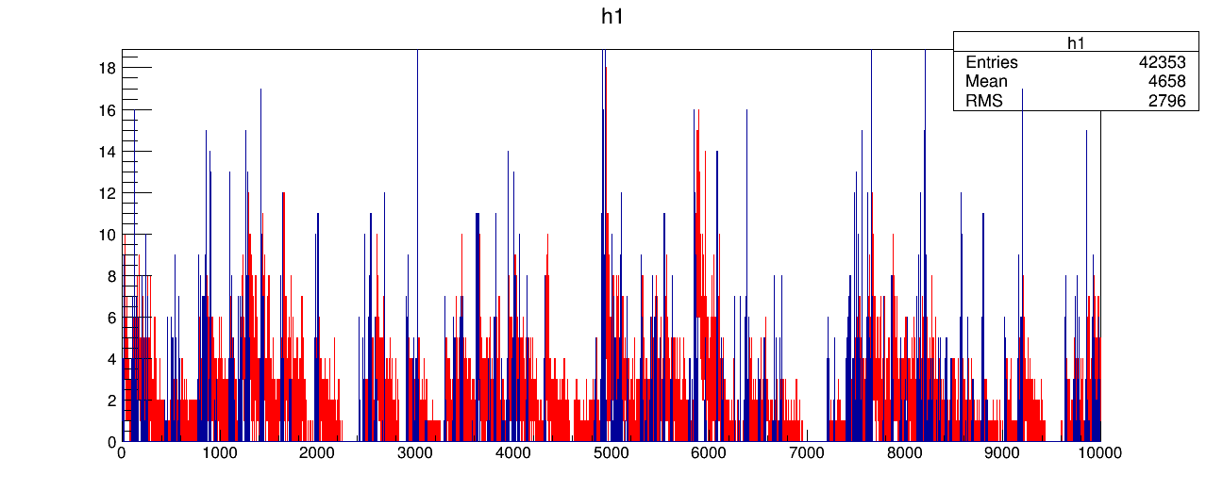
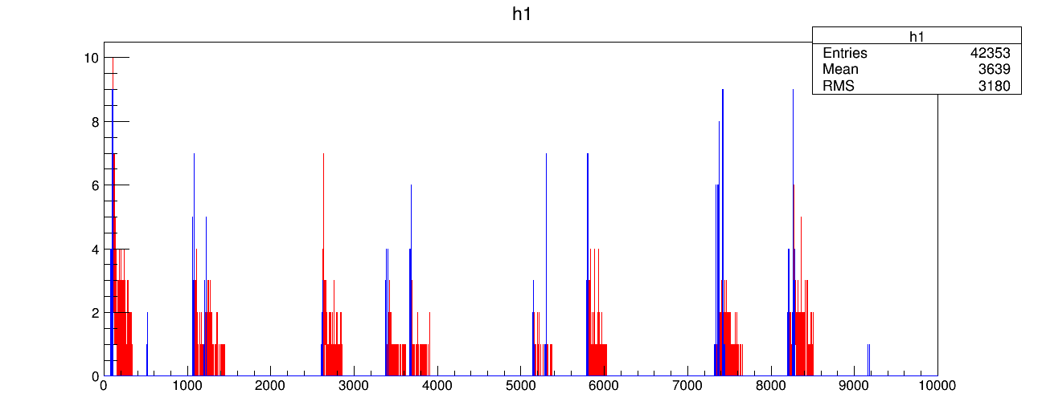
Time Series
20 MHz
MVD
STT
DPM events
t [ns]
2 MHz
t [ns]

Slide 6
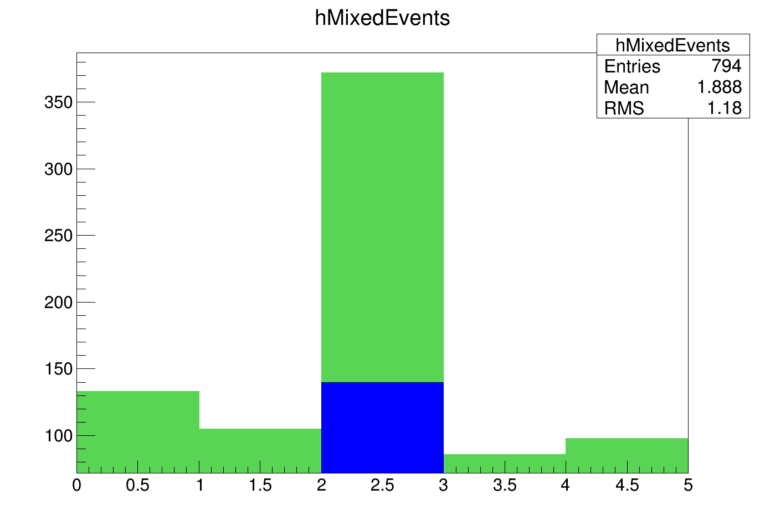
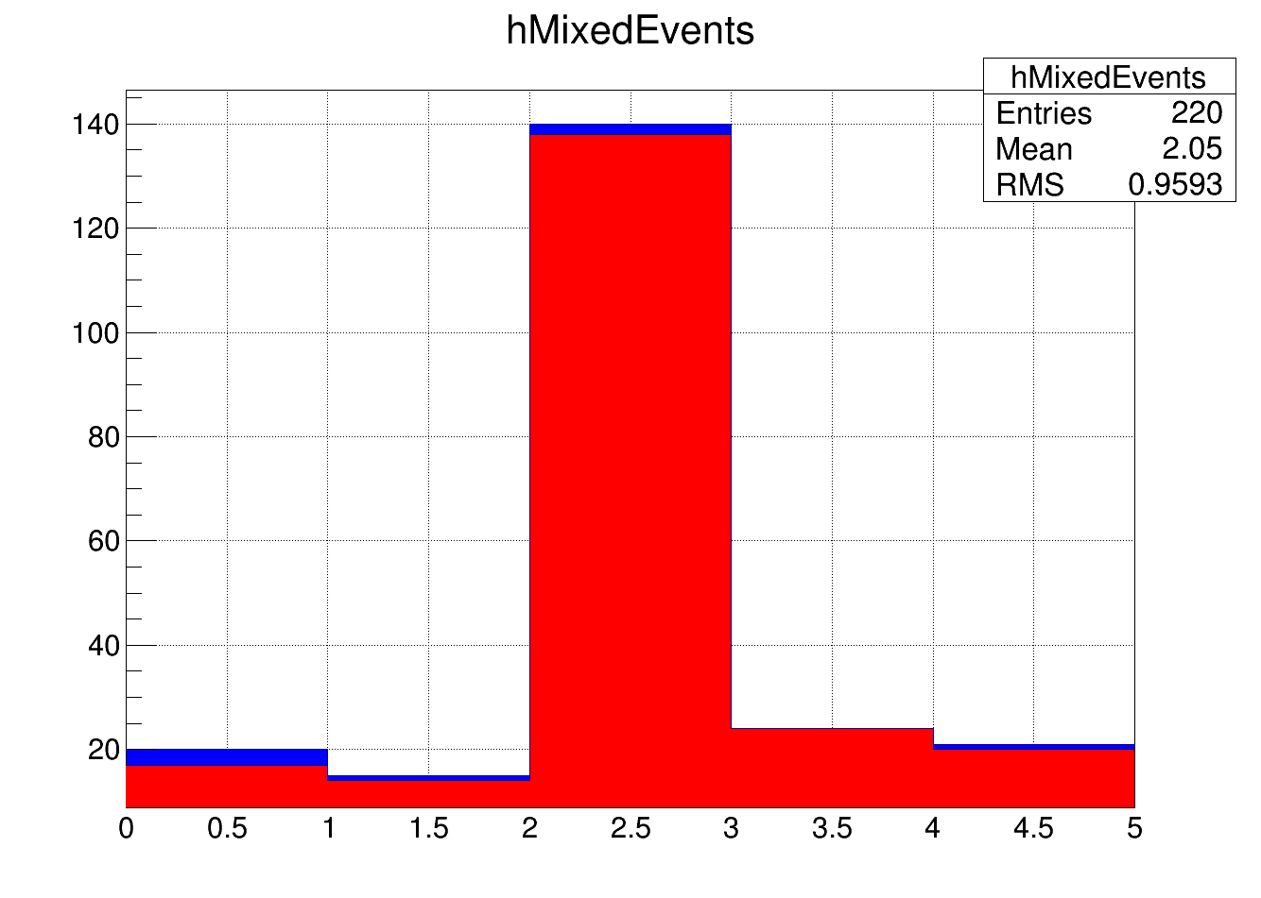
Directly mixed events
Is one event with a lower event number inside a group of hits with a higher event number?
2 MHz all / prim. only
20 MHz / 2 MHz
all
20 MHz
prim
2 MHz
MVD pixel
MVD strip
STT
GEM
SciTil
MVD pixel
MVD strip
STT
GEM
SciTil
500 DPM events

Slide 7
Mixed events
t
mixed event
No mixed event but events not separable by gap

Slide 8
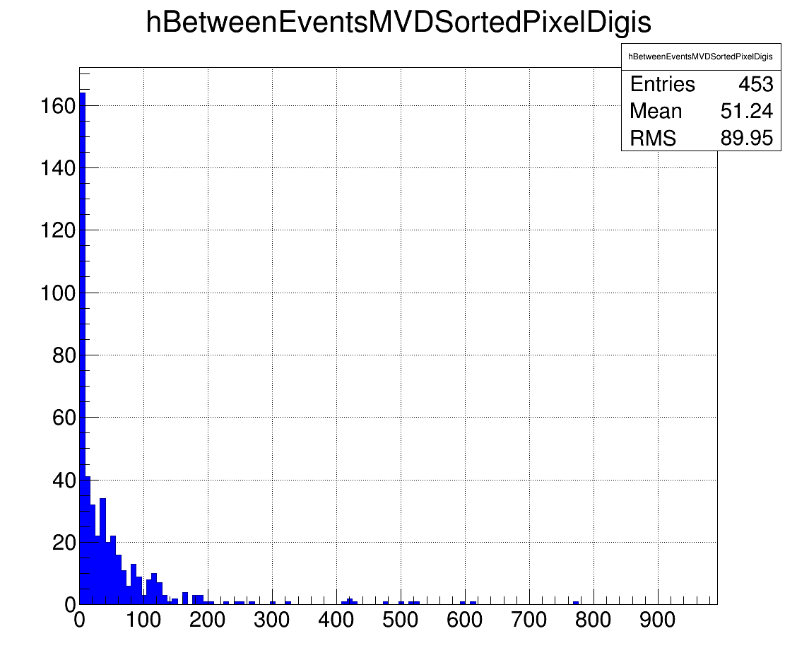
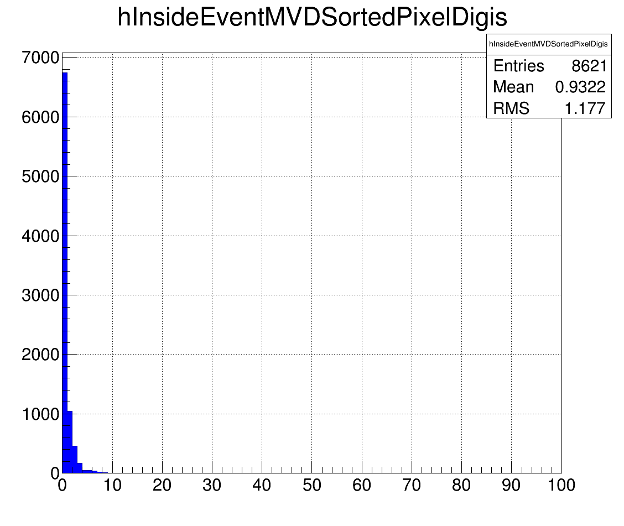
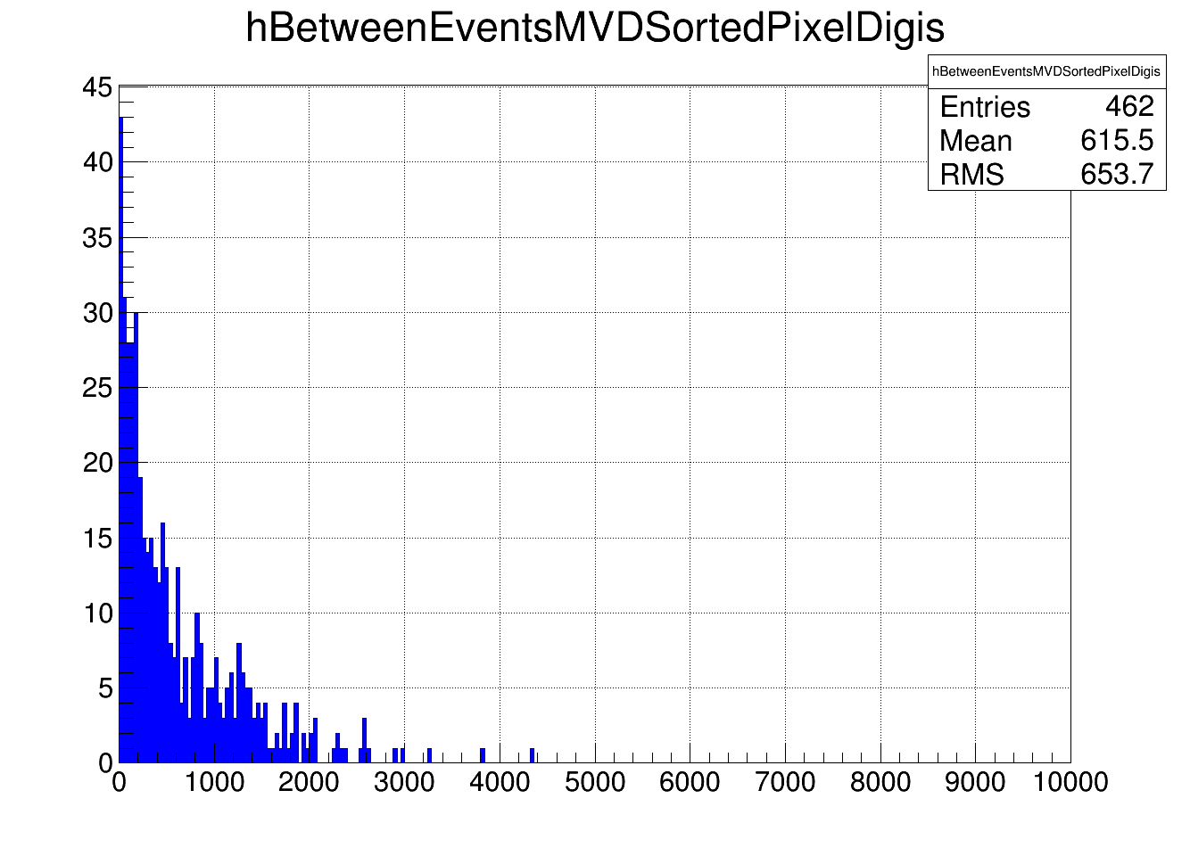
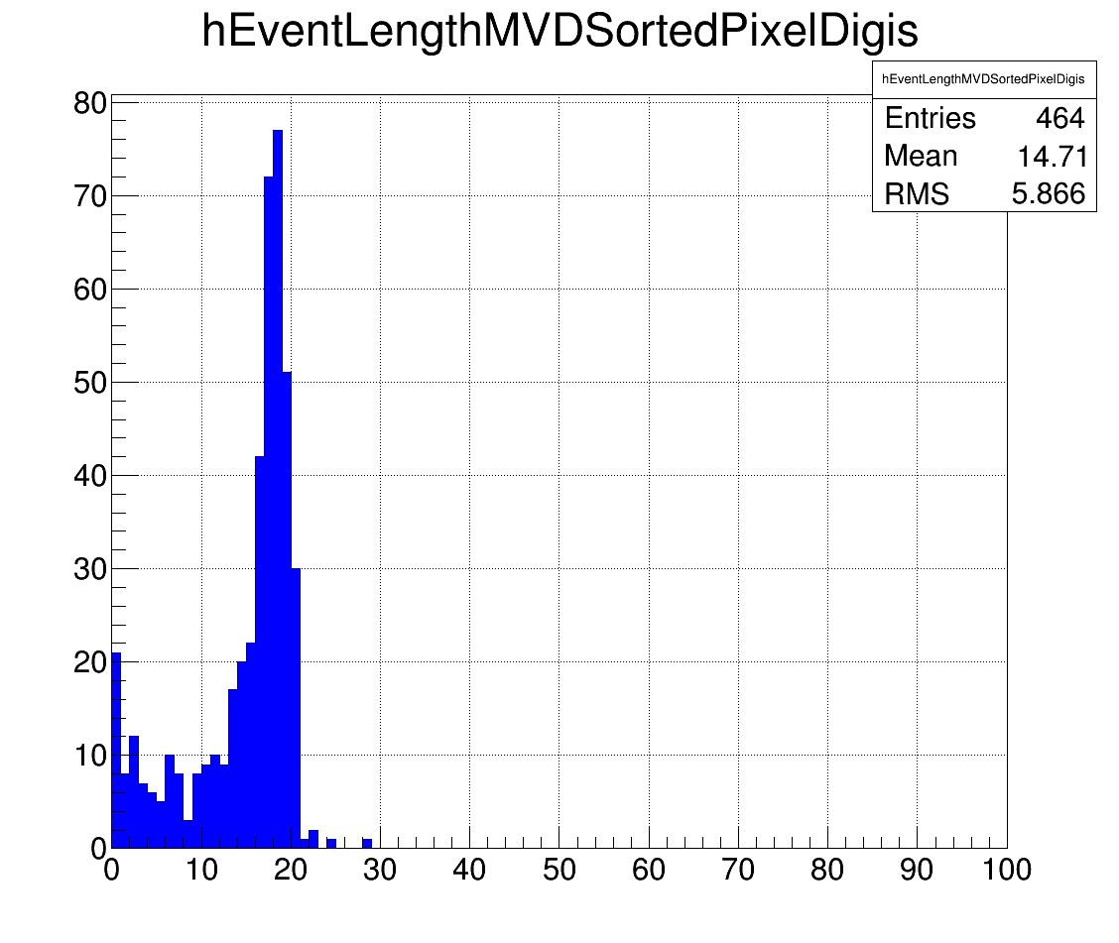
MVD Pixel
Time between two events 20 MHz
Time between two hits in one event
Length of one event
Time between two events 2 MHz
Different scale!

Slide 9
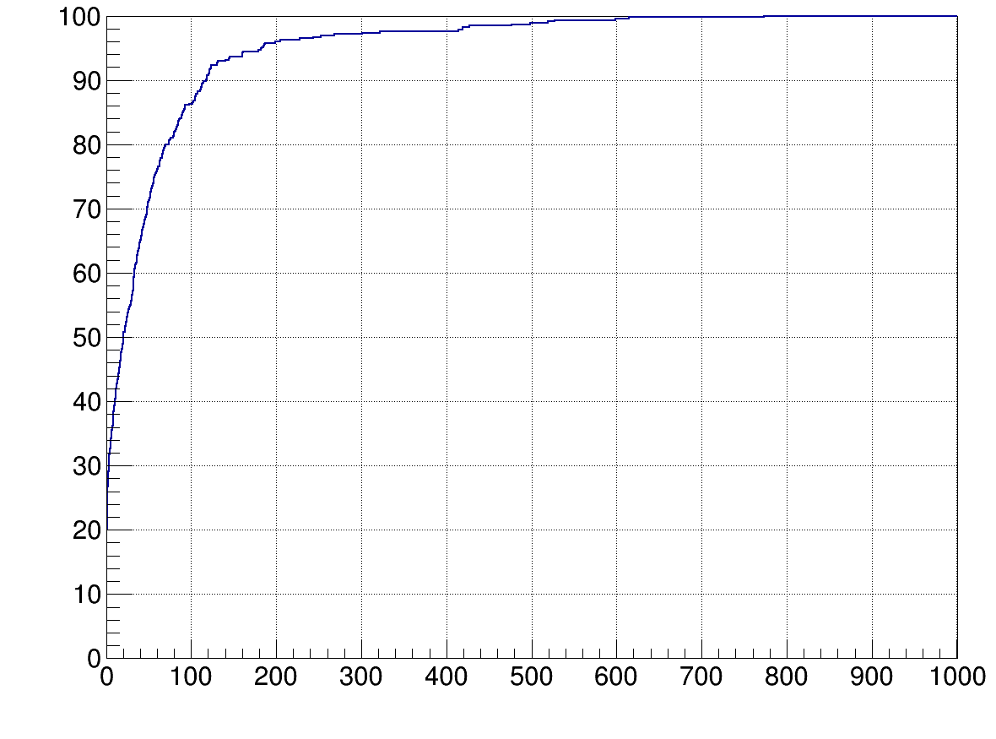
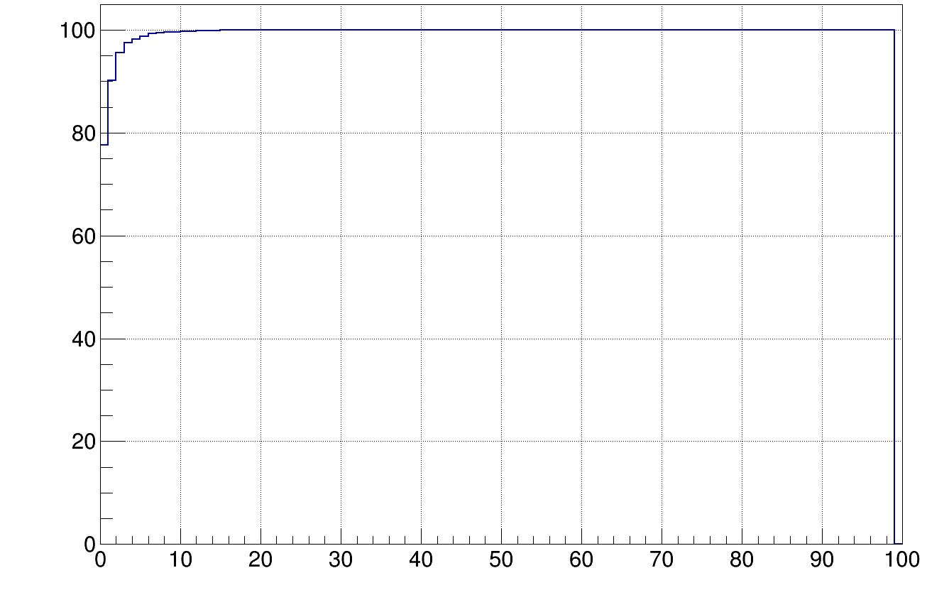
MVD Pixel
Time between two events 20 MHz
Time between two hits in one event
Integral of time between events in %
Integral in %

Slide 10
MVD Pixel
Time between two events 20 MHz
Time between two hits in one event
Integral of time between events in %
Integral in %
100 % at 20 ns

Slide 11
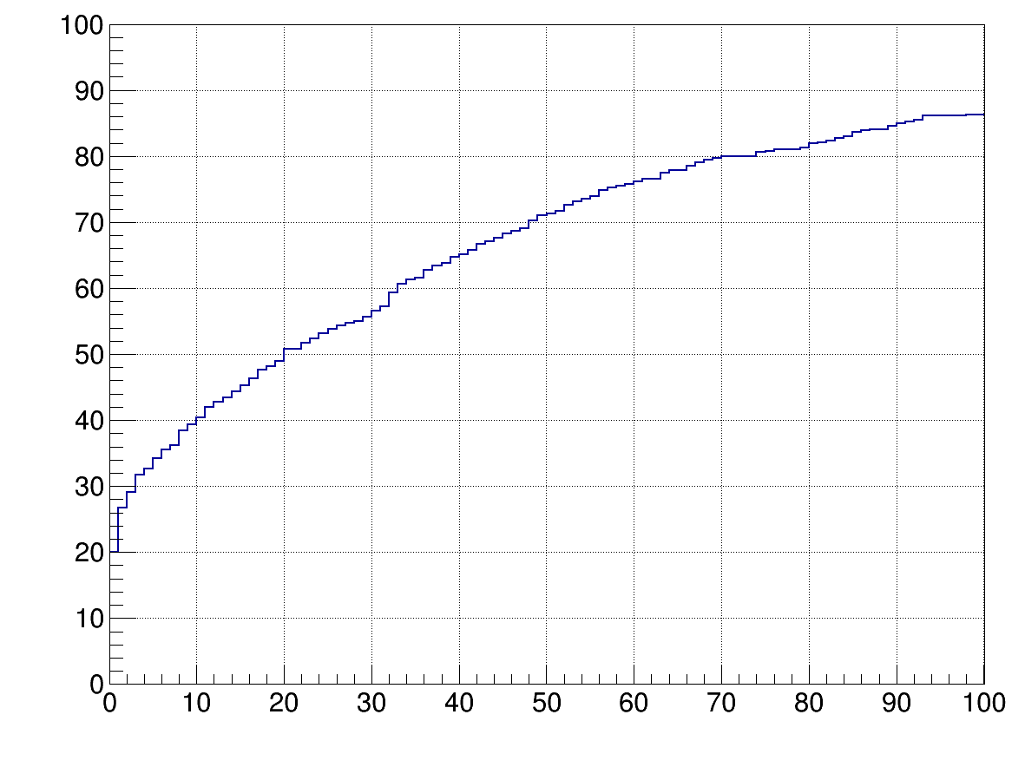
MVD Pixel
Time between two events 20 MHz
Time between two hits in one event
Integral of time between events in %
Integral in %
50 % mixed events
20 MHz
100 % at 20 ns
at 20 ns

Slide 12
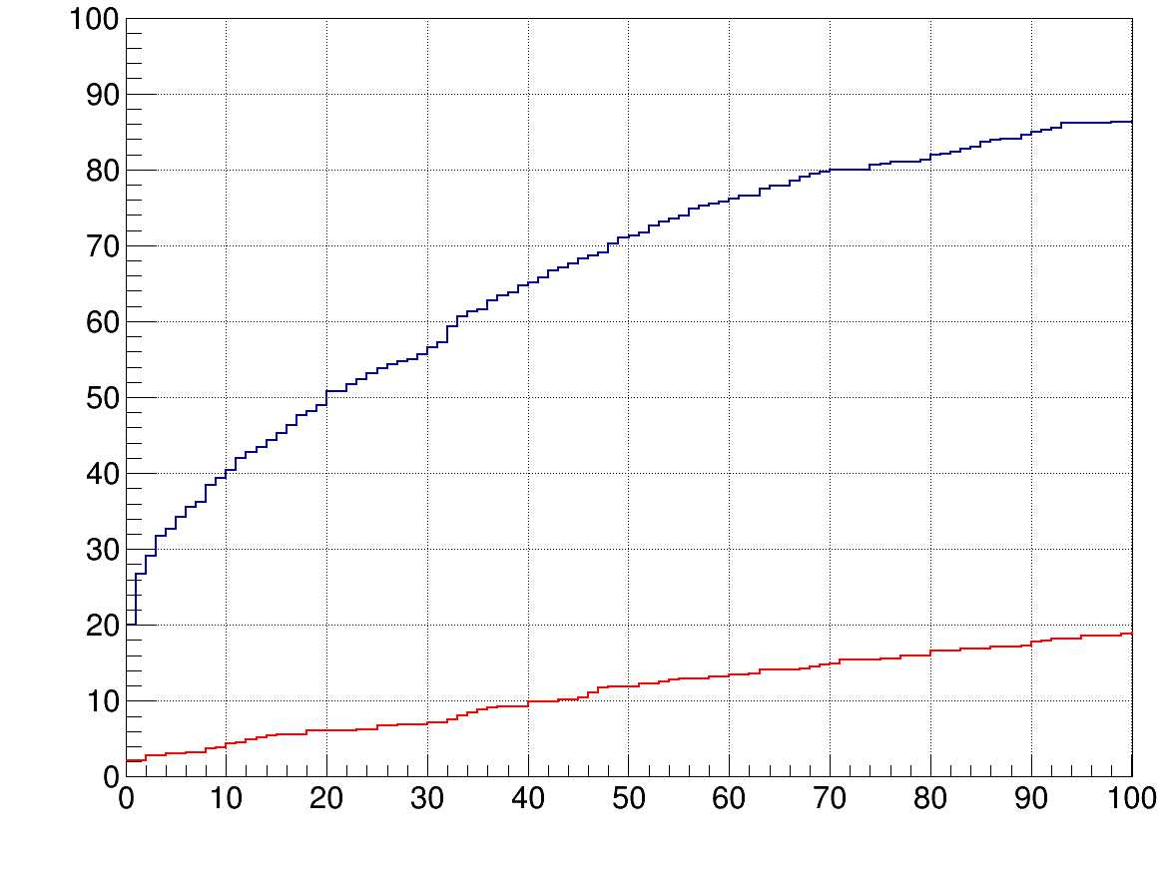
MVD Pixel
Time between two events 20 MHz
Time between two hits in one event
Integral of time between events in %
Integral in %
20 MHz
2 MHz
5 % mixed events
at 2 MHz
100 % at 20 ns
at 20 ns

Slide 13
MVD Pixel
Time between two events 20 MHz
Time between two hits in one event
Integral of time between events in %
Integral in %
20 MHz
50 %
2 MHz
5 %
100 % at 20 ns

Slide 14
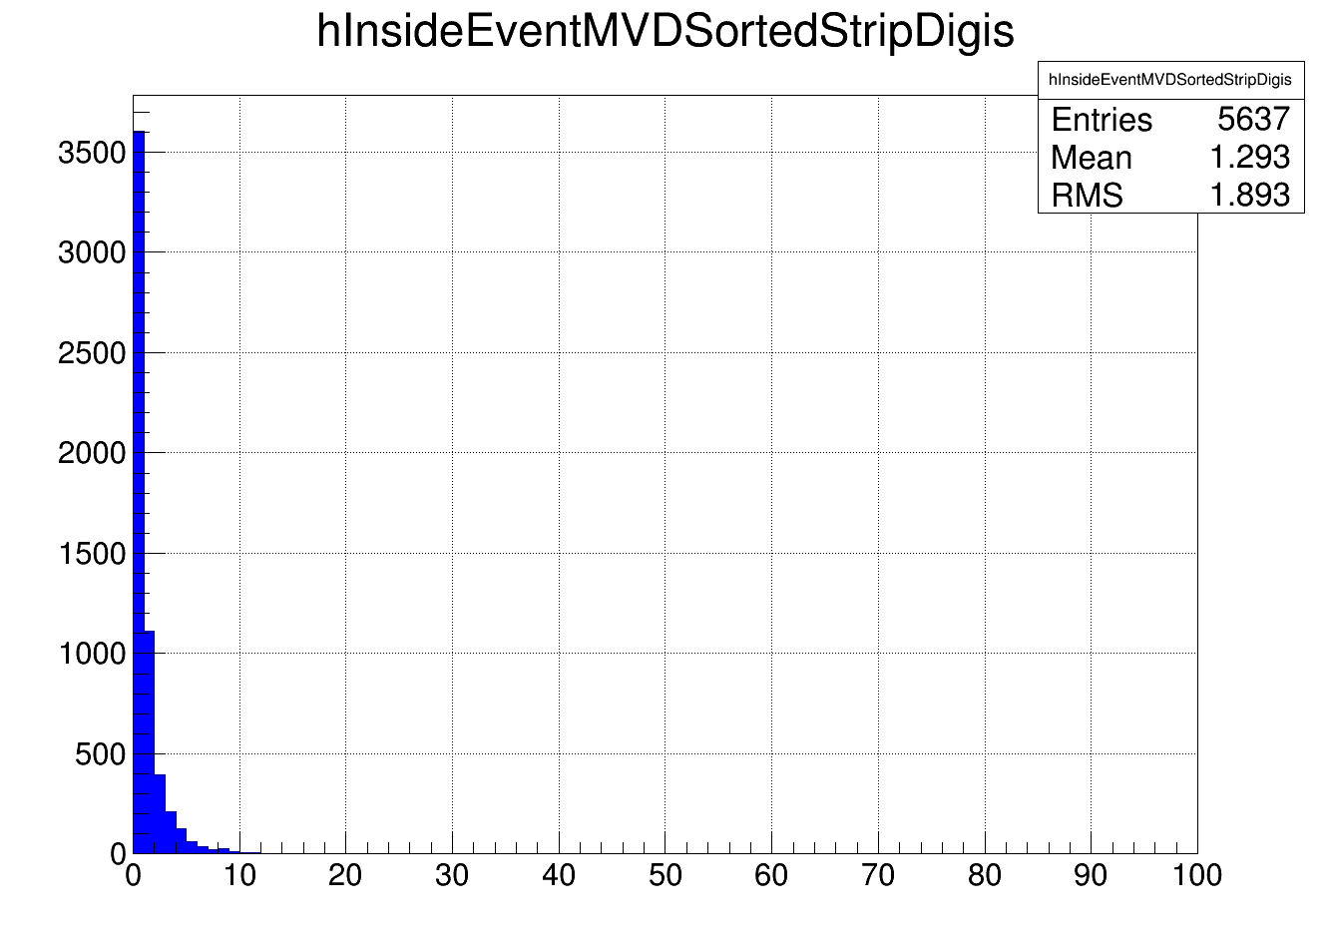
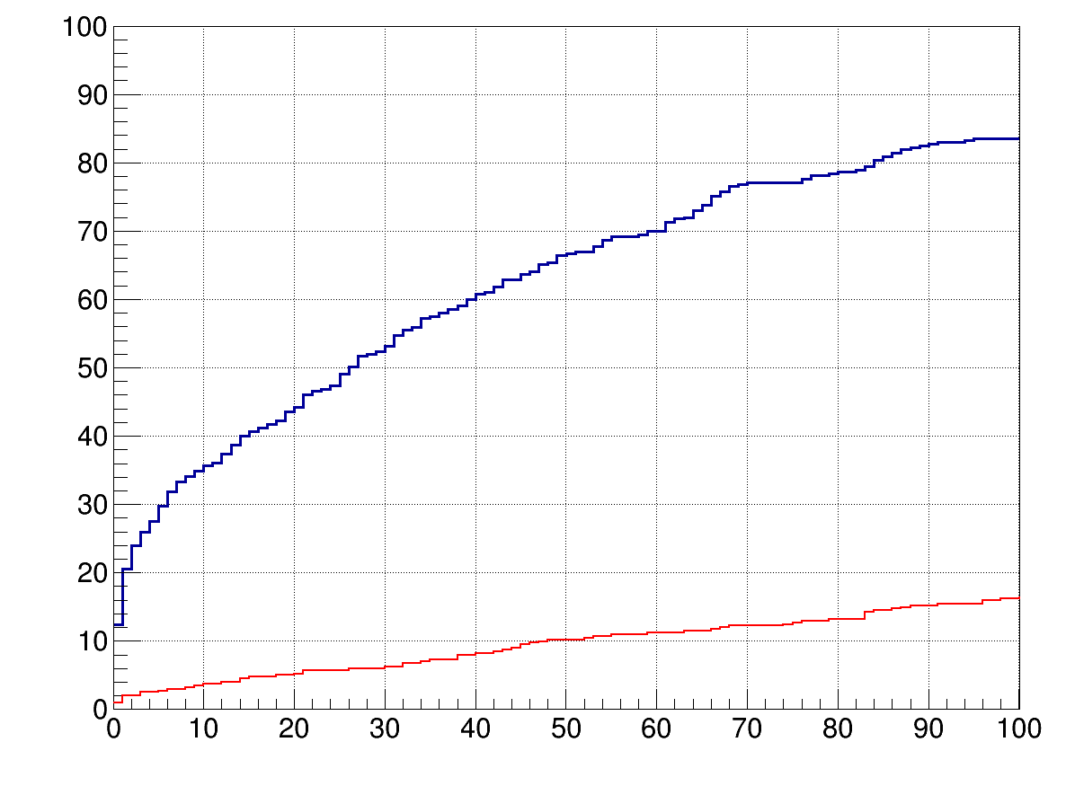
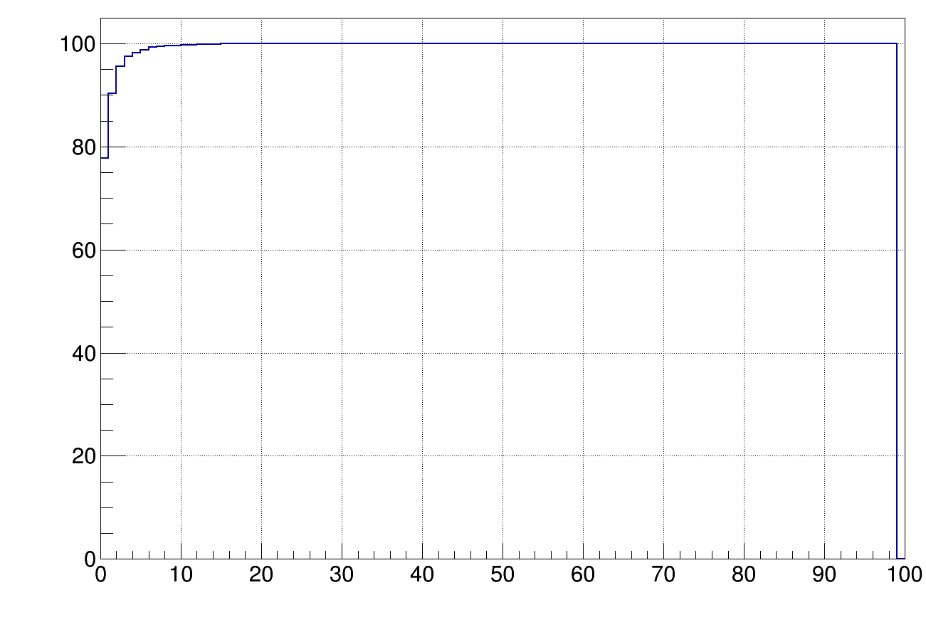
MVD Strip
Time between two events 20 MHz
Time between two hits in one event
Integral of time between events in %
Integral in %
20 MHz
45 %
2 MHz
5 %
100 % at 20 ns

Slide 15
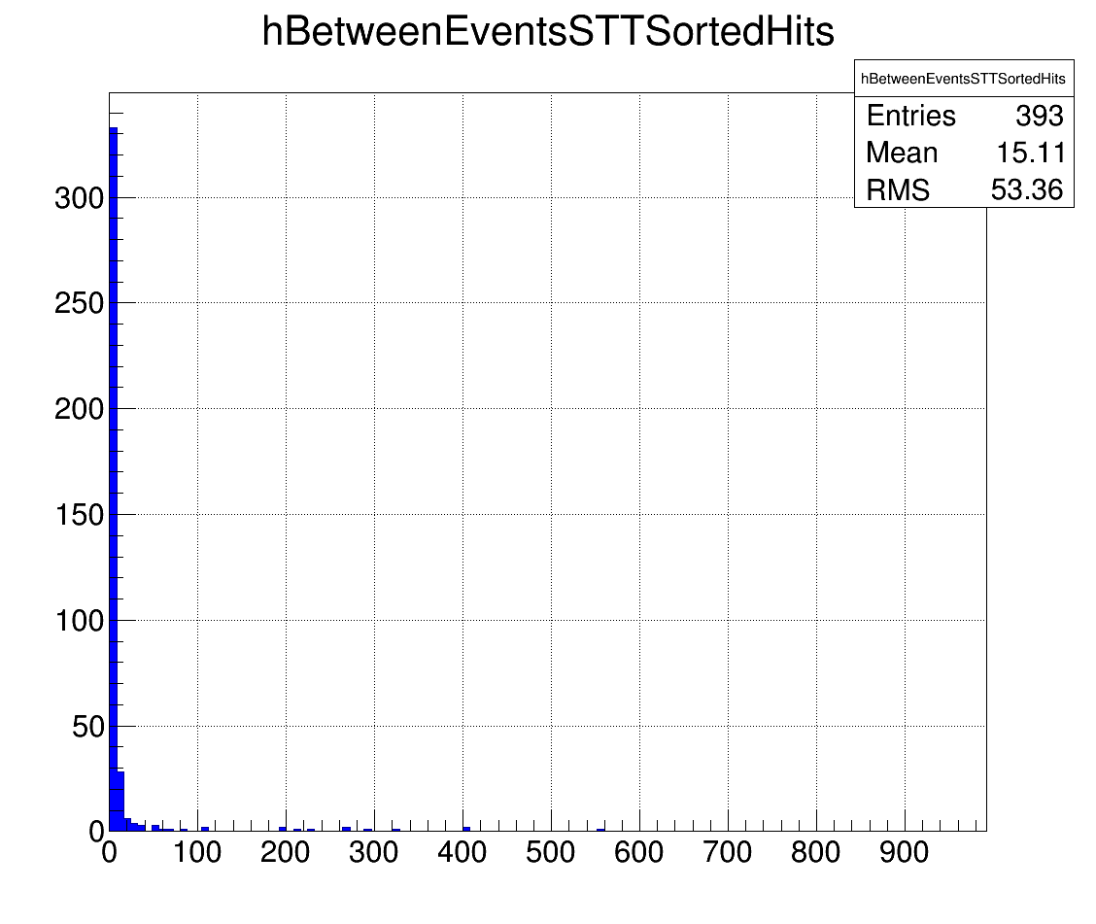
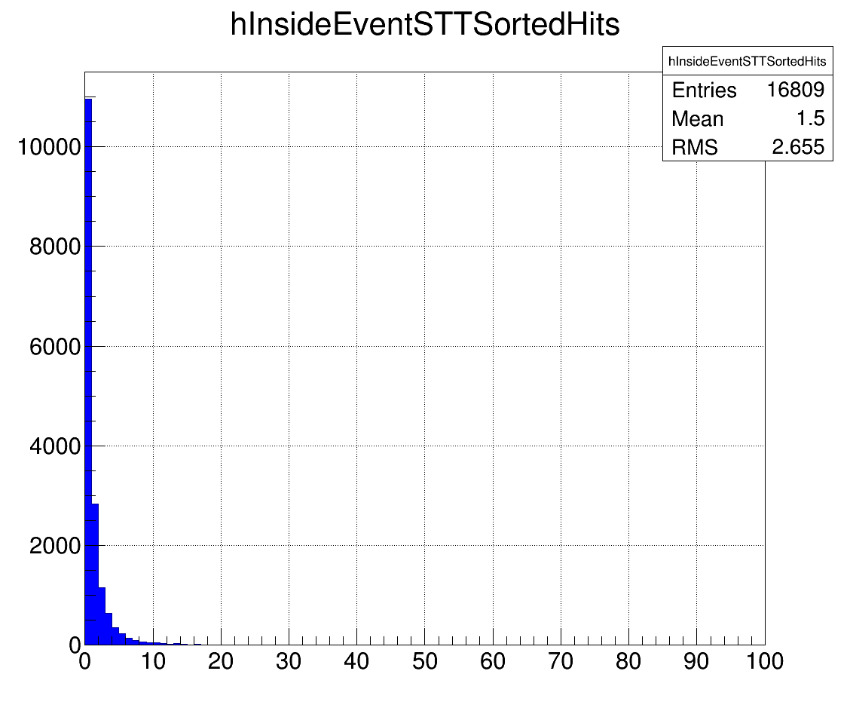
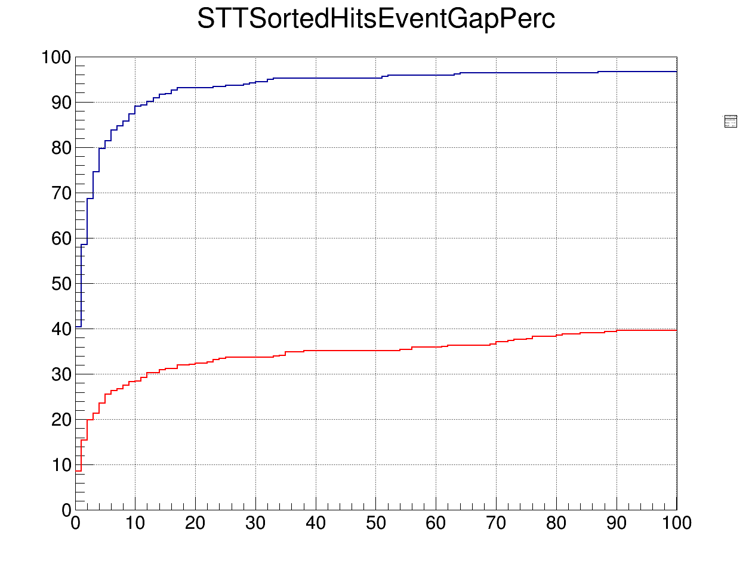
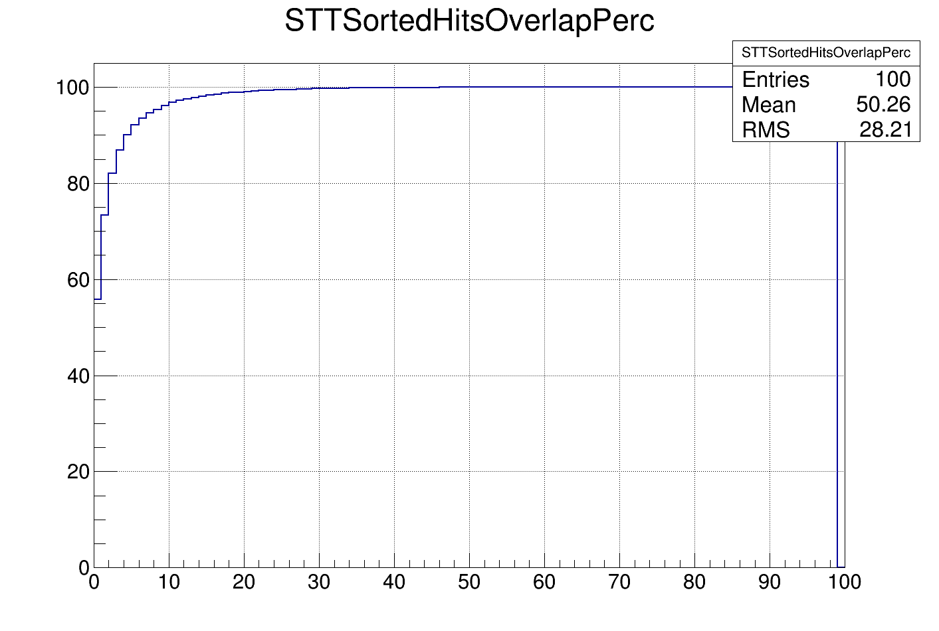
STT
Time between two events 20 MHz
Time between two hits in one event
Integral of time between events in %
Integral in %
20 MHz
95 %
2 MHz
35 %
100 % at 50 ns

Slide 16
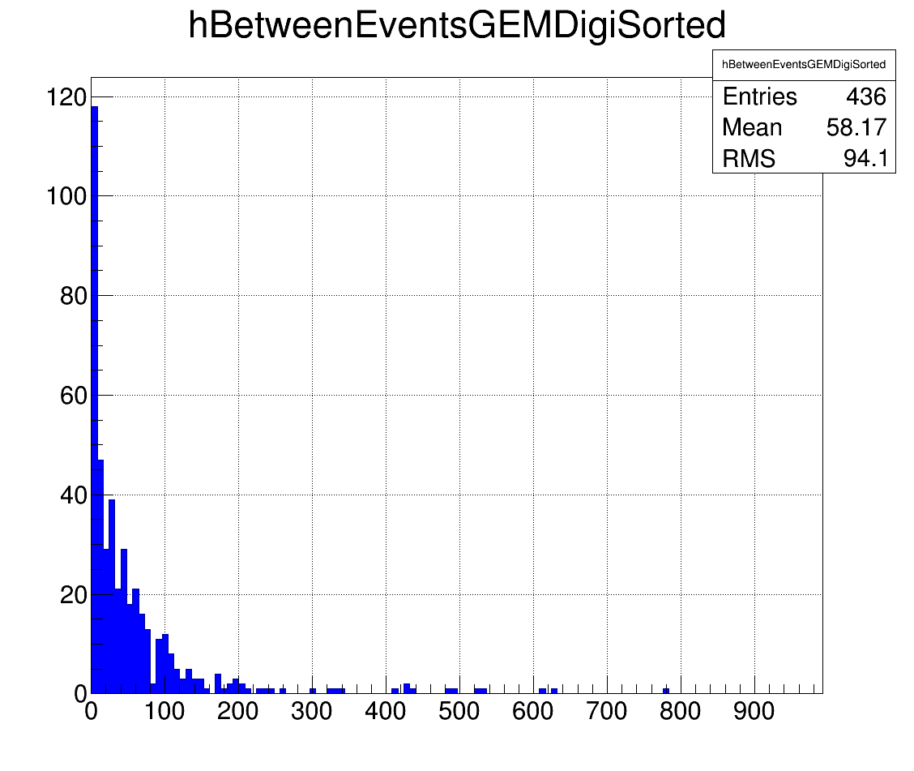
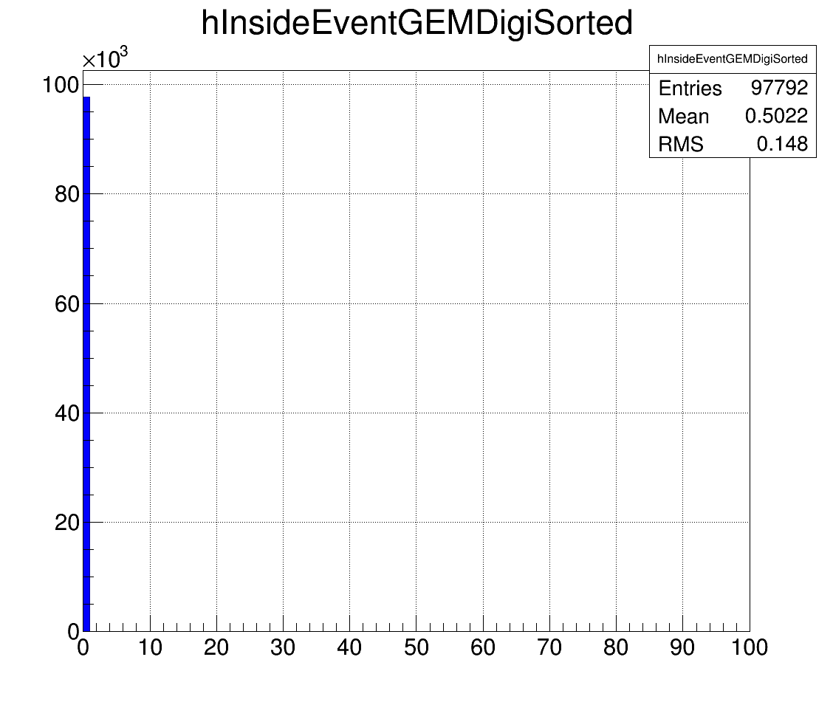
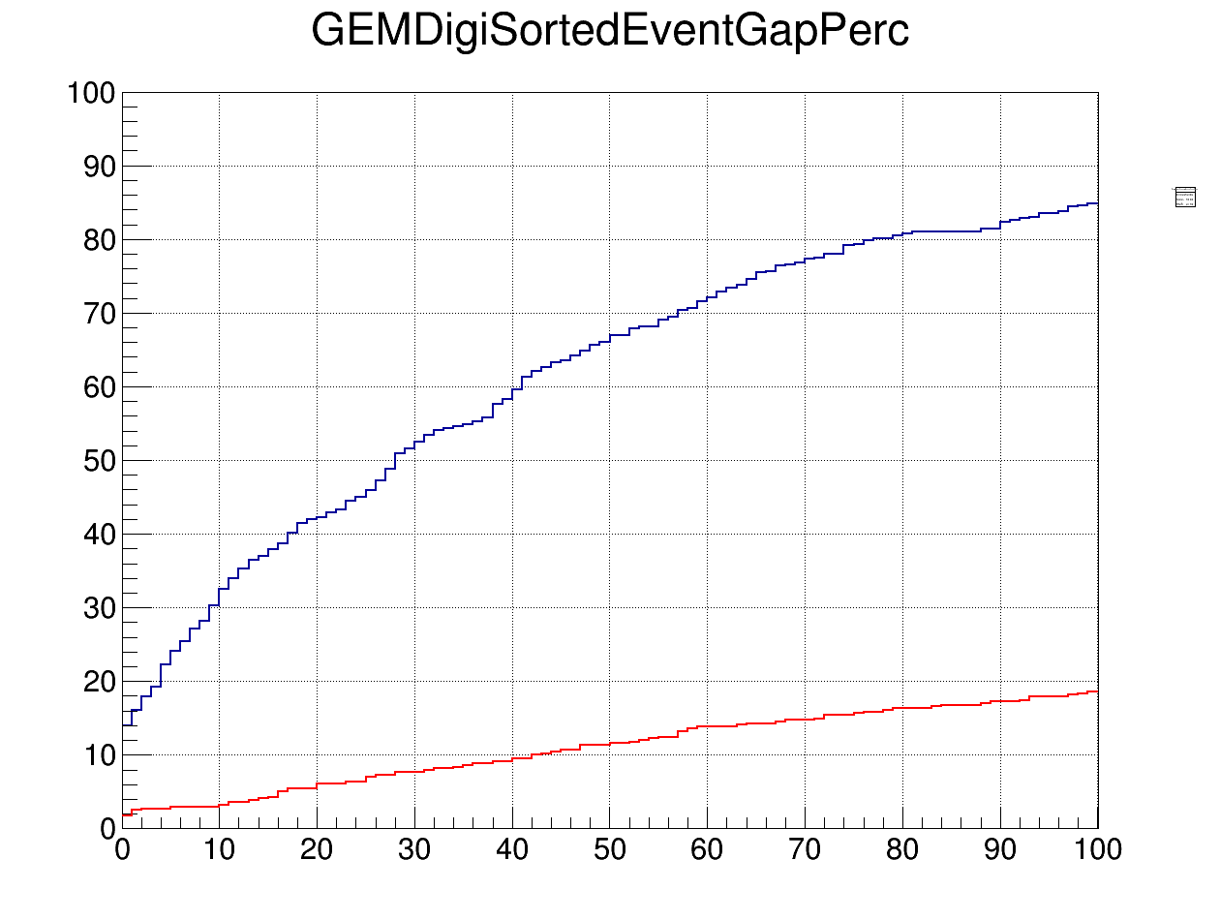
GEM
Time between two events 20 MHz
Time between two hits in one event
?
Integral of time between events in %
Integral in %
20 MHz
42 %
2 MHz
5 %
assumed 100 %
at 20 ns

Slide 17
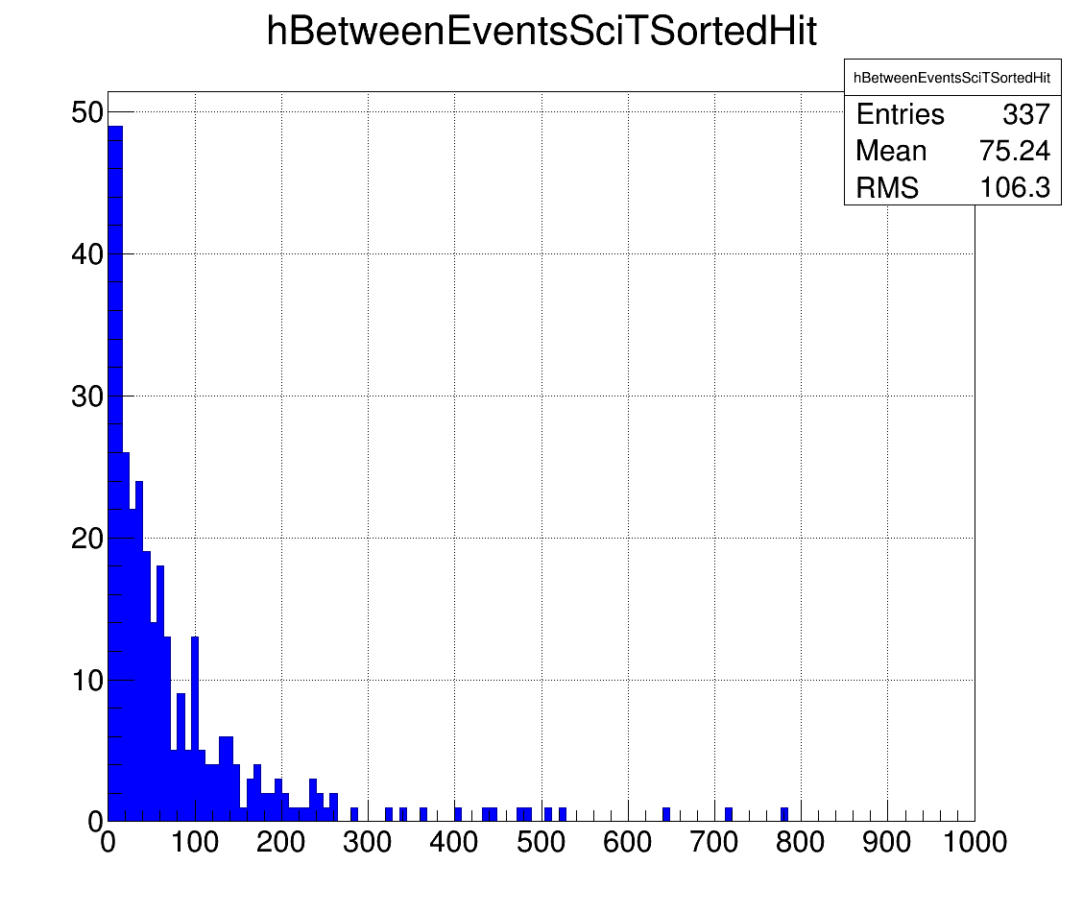
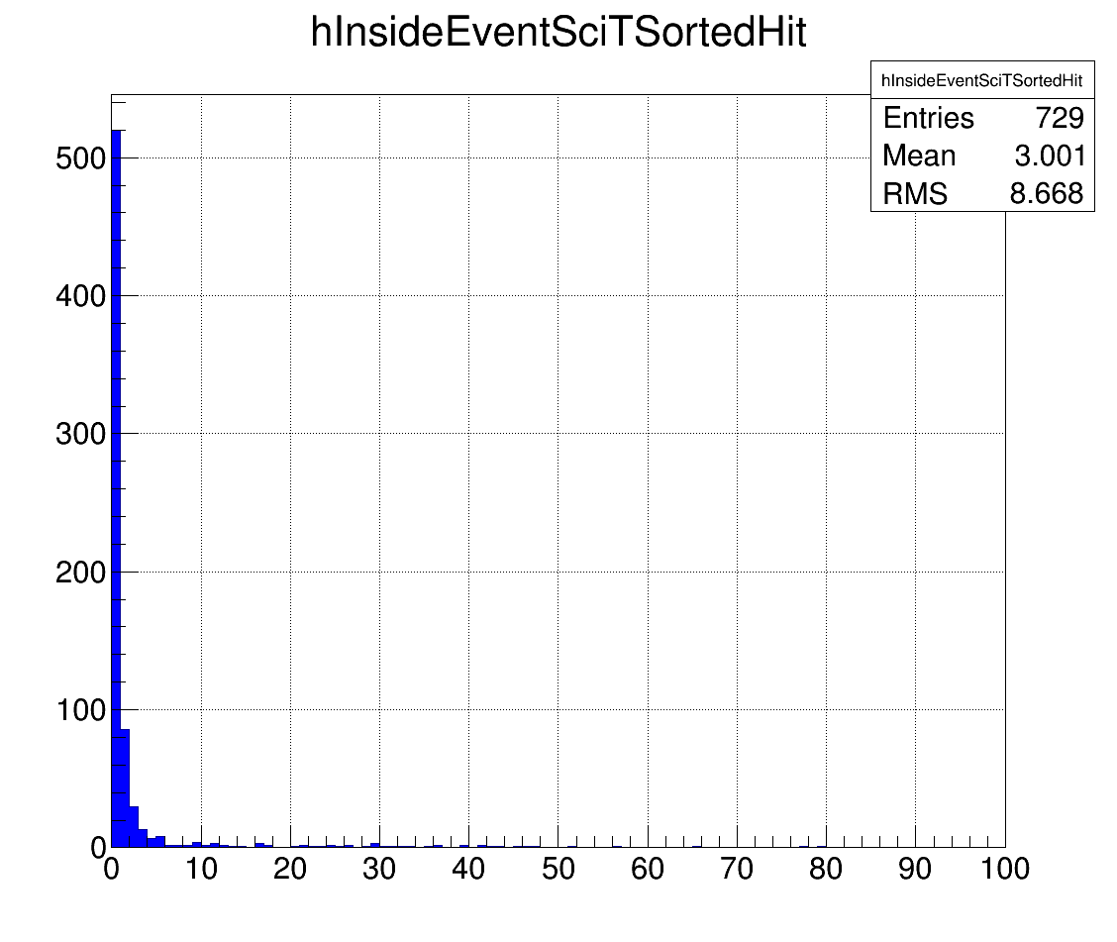
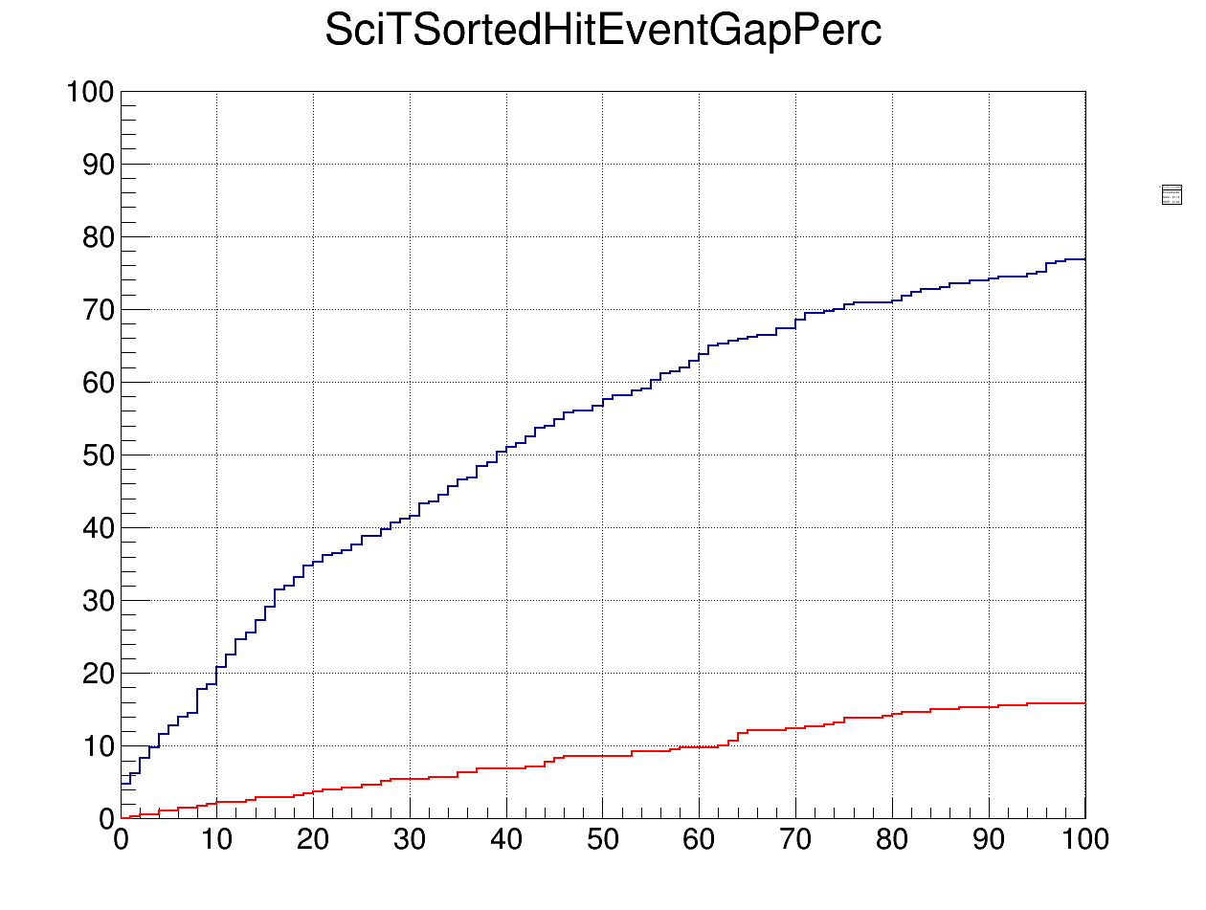
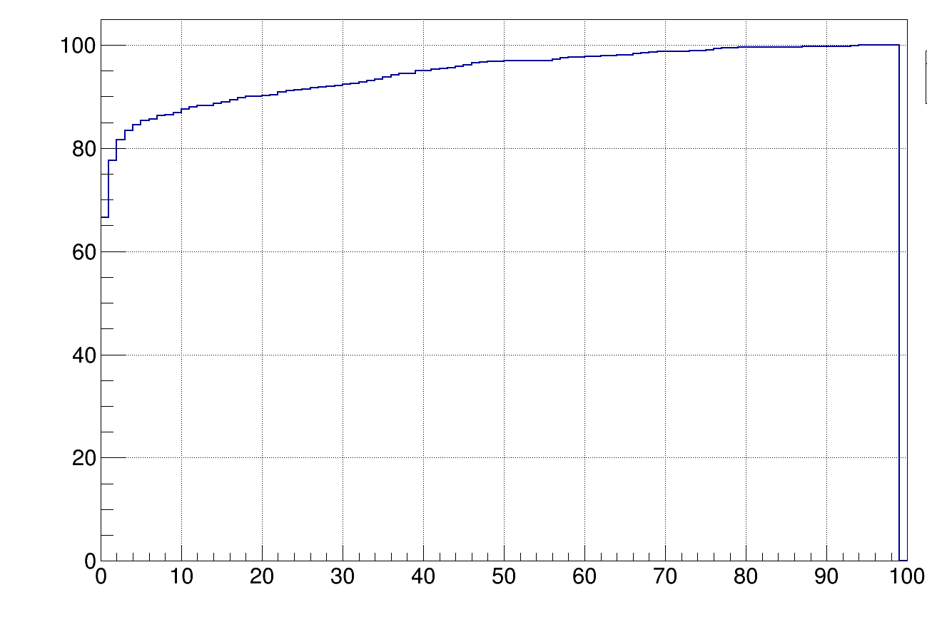
SciTil
Time between two events 20 MHz
Time between two hits in one event
Integral of time between events in %
Integral in %
20 MHz
75 %
2 MHz
15 %
100 % at 100 ns

Slide 18
Overlapping Events
 | MVD pixel | MVD strip | STT | GEM | SciTil
Gap | 20 ns | 20 ns | 50 ns | 20 ns | 100 ns
20 MHz | 50 % | 45 % | 95 % | 42 % | 75 %
2 MHz | 5 % | 5 % | 35 % | 5 % | 15 %

Slide 19
Conclusions & Remarks
Gap event builder is a very simple event builder operating at single detectors
Suitable to operate in the first stage of reconstruction
Gives almost clean events for fast detectors (MVD, GEM) at 2 MHz
SciTil and especially STT have a higher number of mixed events
Once tracking information is taken into account a much higher purity can be achieved
All results strongly depend on how realistic the subdetectors are simulated inside PandaRoot

