Slide 1
Barrel EMC assembling
(EDMS DOCUMENT NUMBER 1421085/1)
  Andrey Ryazantsev, Valery Ferapontov
  on behalf of the IHEP-Protvino group

Slide 2
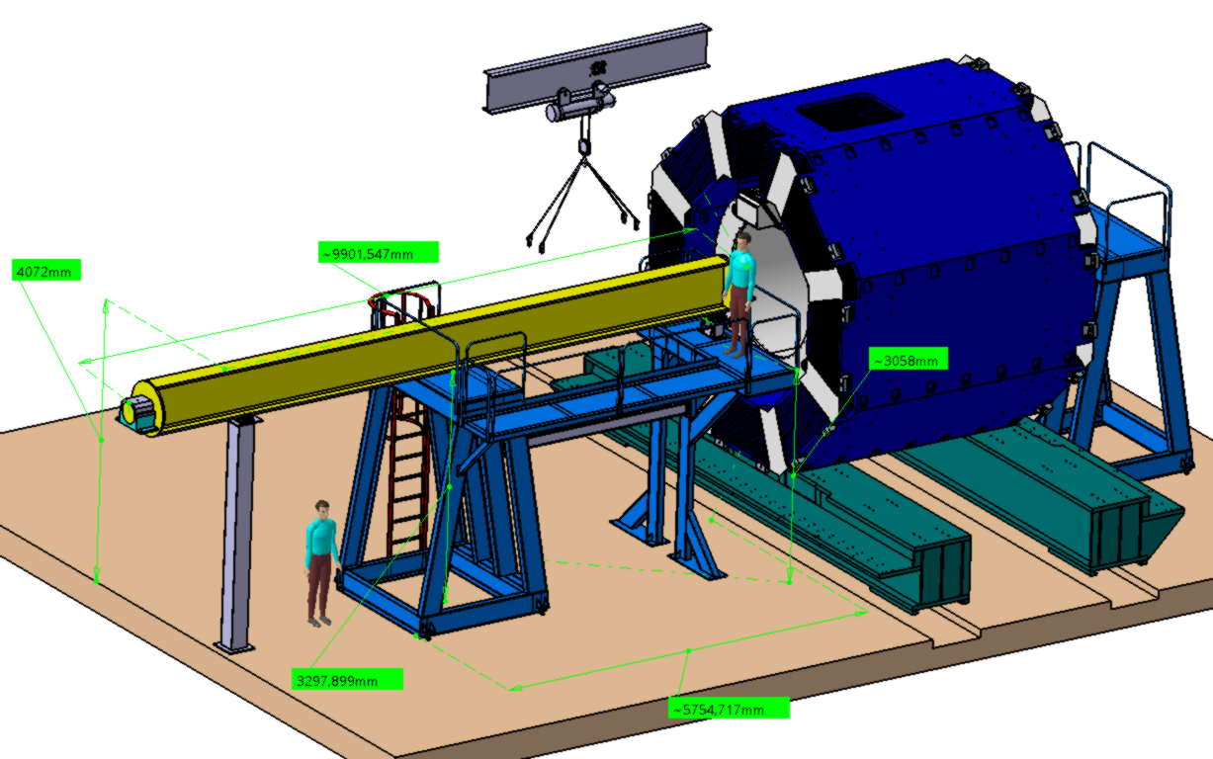
How to assemble barrel
Beam
9900x300x700
W= 3065 kg
Support #1
250x250x3280
W= 240 kg
Support #2.1
2030x2000x3260
W= 1250 kg
Support #3
4120х600x3260
W= 265 kg
Support #4
800x2635х3260
W= 735 kg
Support #2.2
2030x2000x3260
W= 1250 kg

Slide 3
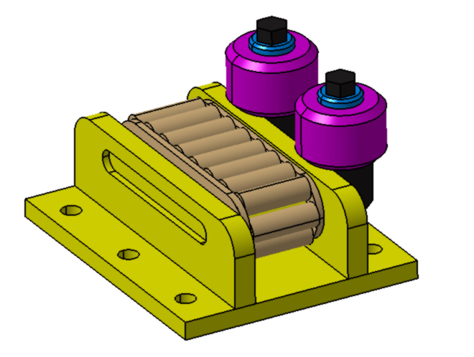
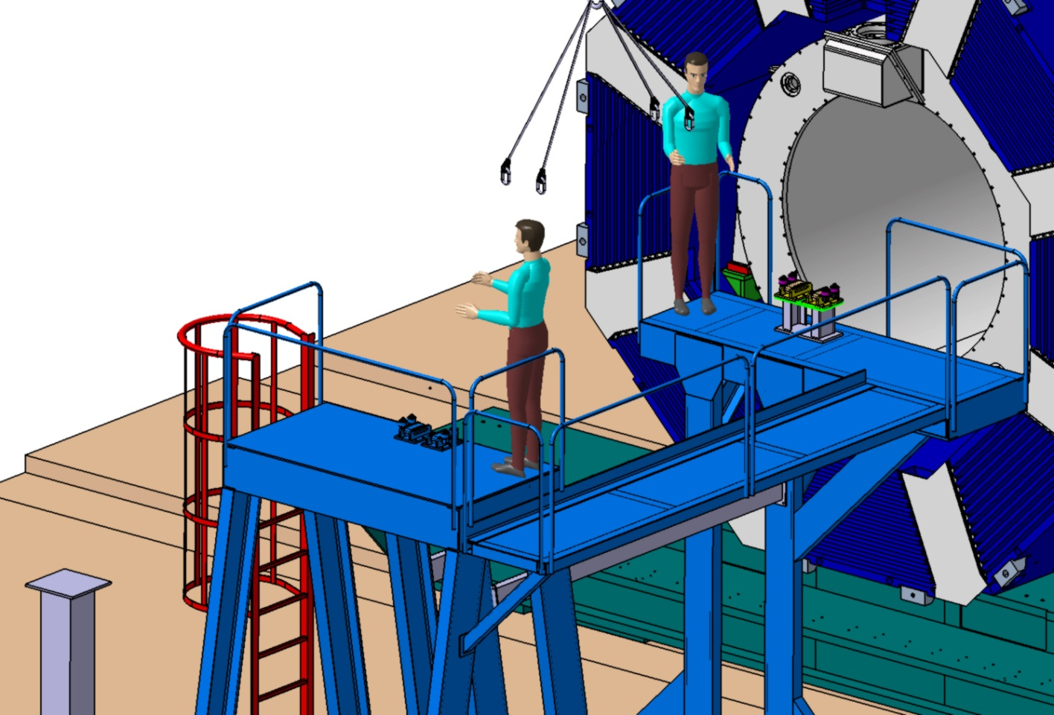
How to assemble barrel

Slide 4
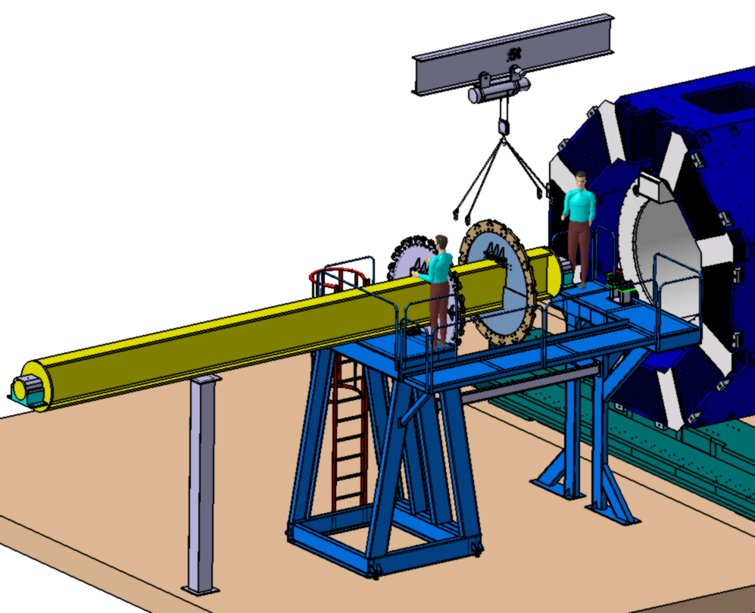
How to assemble barrel
Procedures:
Mounting of two Support Rings
with special Flanges

Slide 5
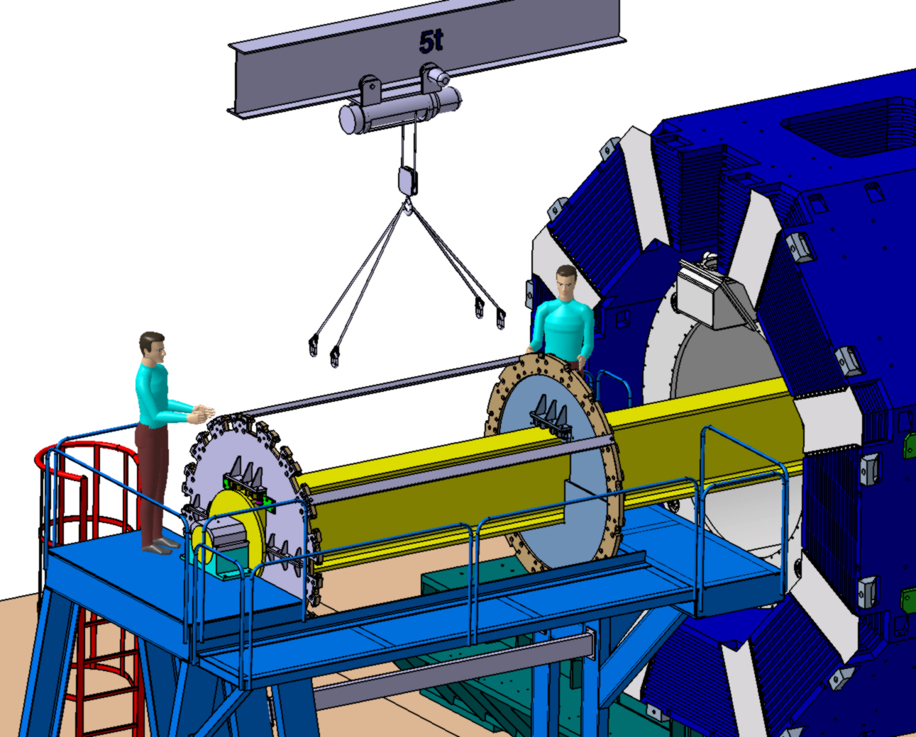
How to assemble barrel
Procedures:
Moving the Beam inside the Cryostat;
Fix Flanges with four rectangular Tubes;

Slide 6
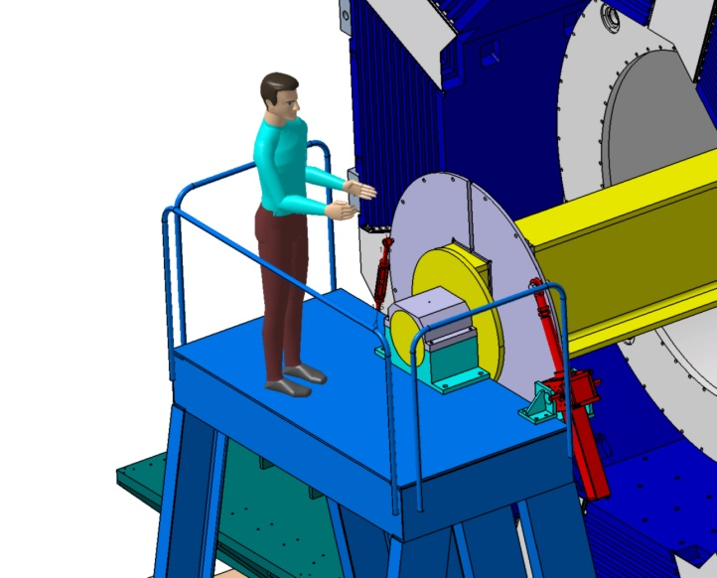
How to assemble barrel
Procedures:
Mounting of 2 mechanical Jacks (ZIMM- Austria);
Mounting of a Lanyard.

Slide 7
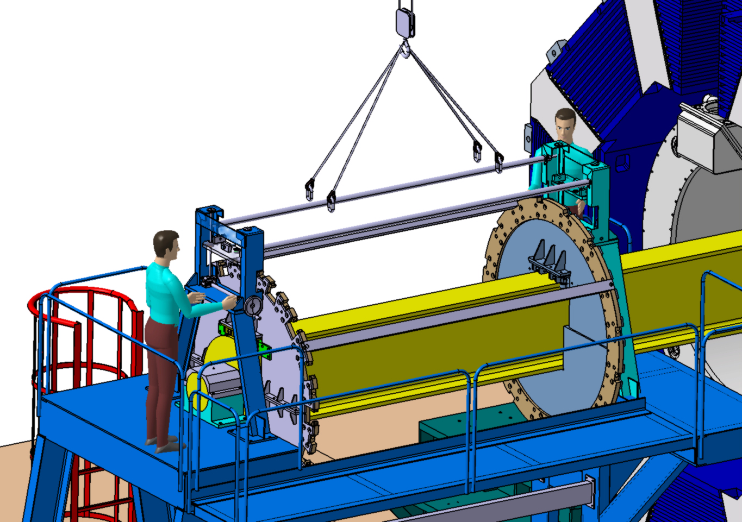
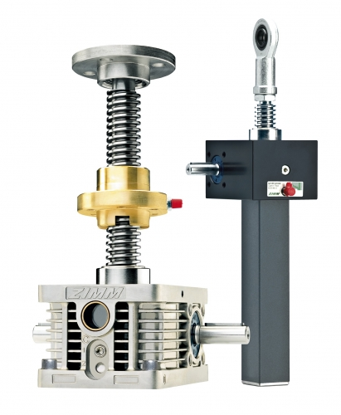
How to assemble barrel
Procedures:
Mounting of 2 lifting Devices;
Mounting of 2 Spacers.
Pick up both supporting Plates of Lifting Devices on ~ 300 mm.

Slide 8
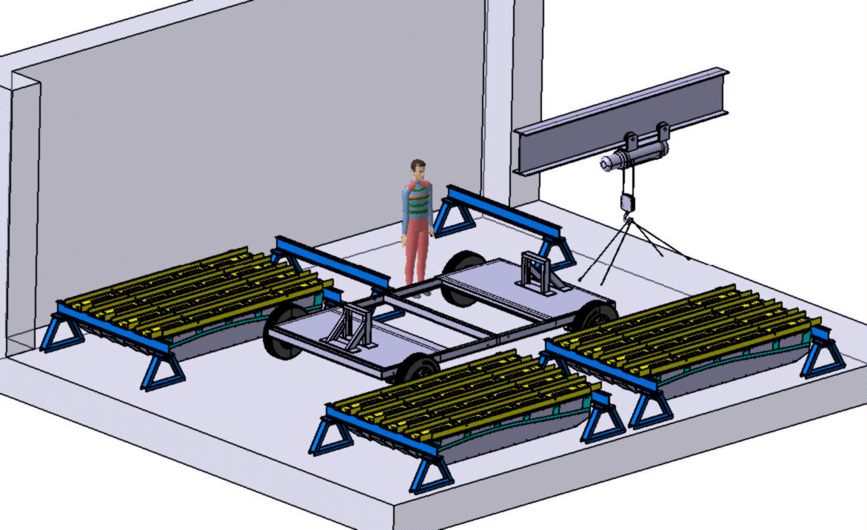
How to assemble barrel

Slide 9
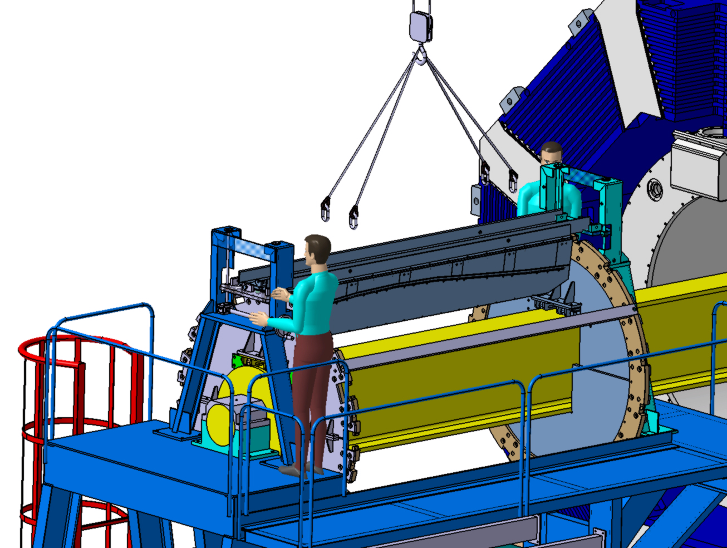
How to assemble barrel
Procedures:
Installation of 1-st Slice on the Supporting Plates;
Put down the Slice using screw Jack Actuators of the Lifting Devices.

Slide 10
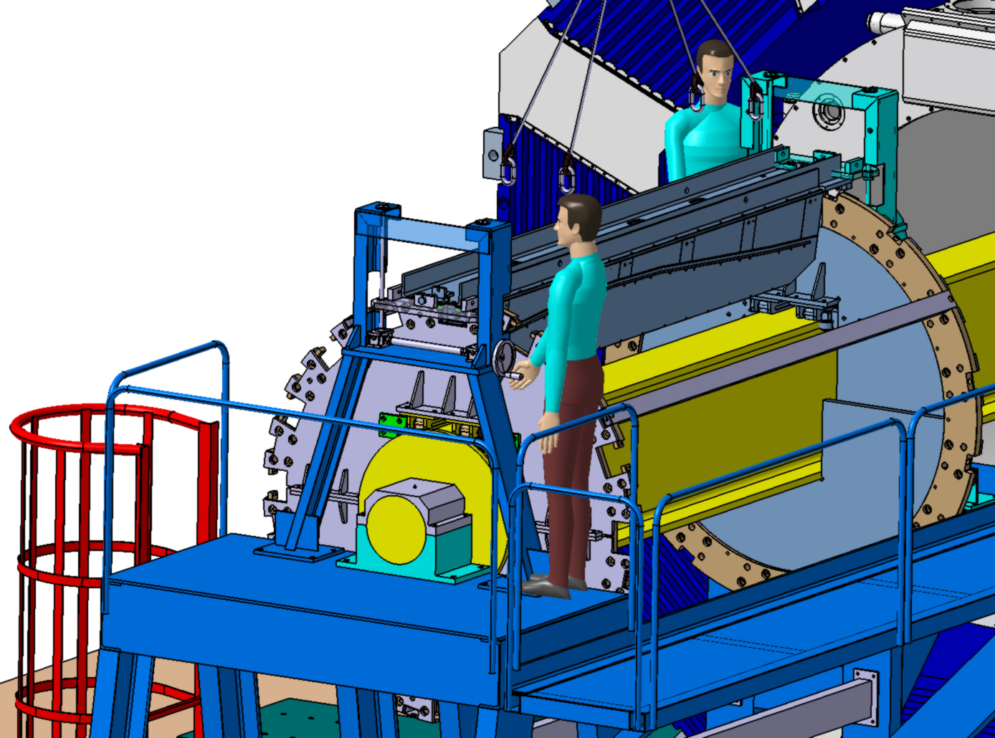
How to assemble barrel
Procedures:
Adjusting the Slice to Holes on Upstream and Downstream Rings;
Install special shims from Downstream side of Slice and fix them by means of 2 special bolts;
Join Slice to the Rings with 2 special Pins and 2 Bolts M16

Slide 11
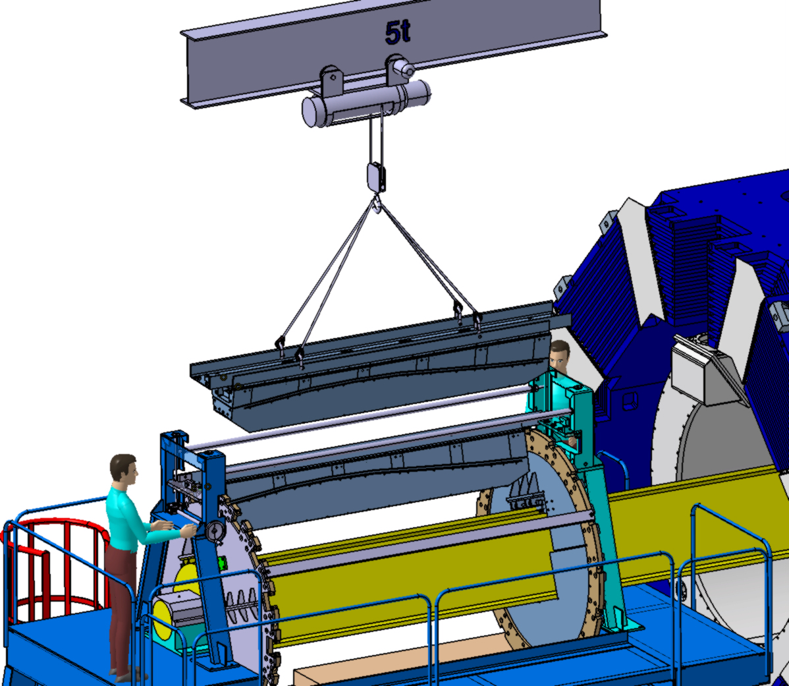
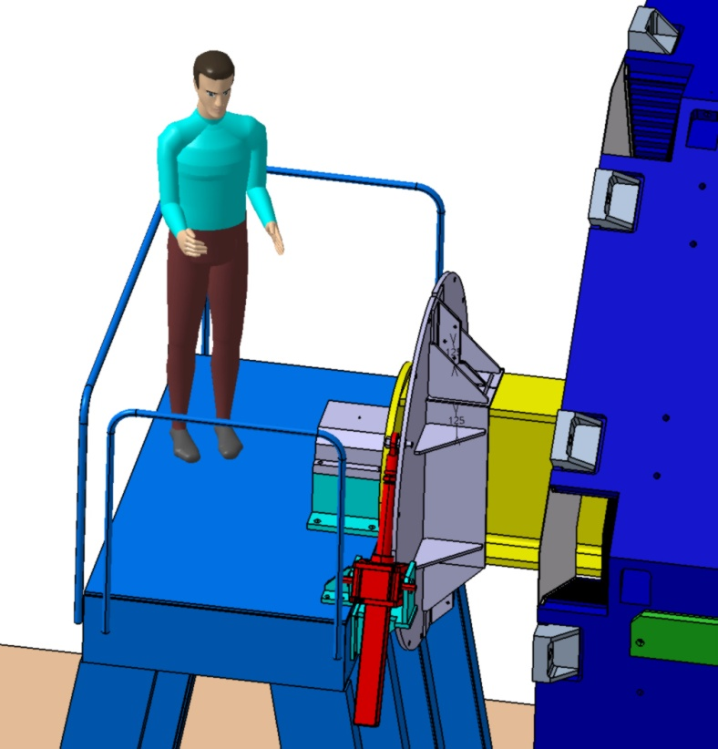
How to assemble barrel
Procedures:
Rotate Beam with Jack by 22,5 degrees;
Fix Flange from Downstream side of the Beam by means of Lanyard

Slide 12
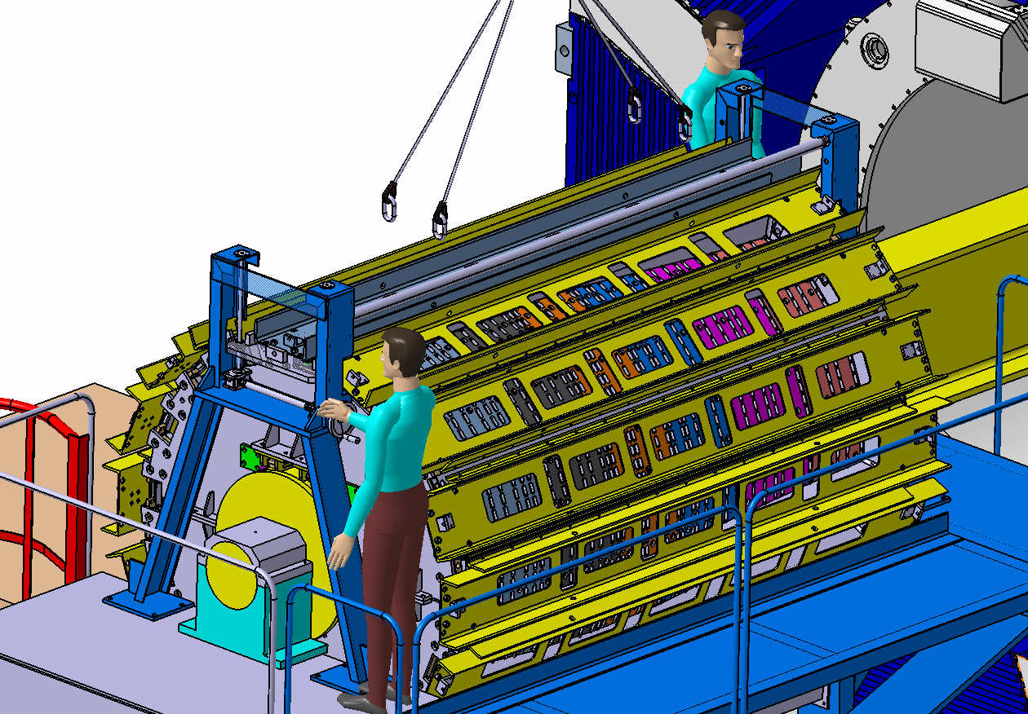
How to assemble barrel

Slide 13
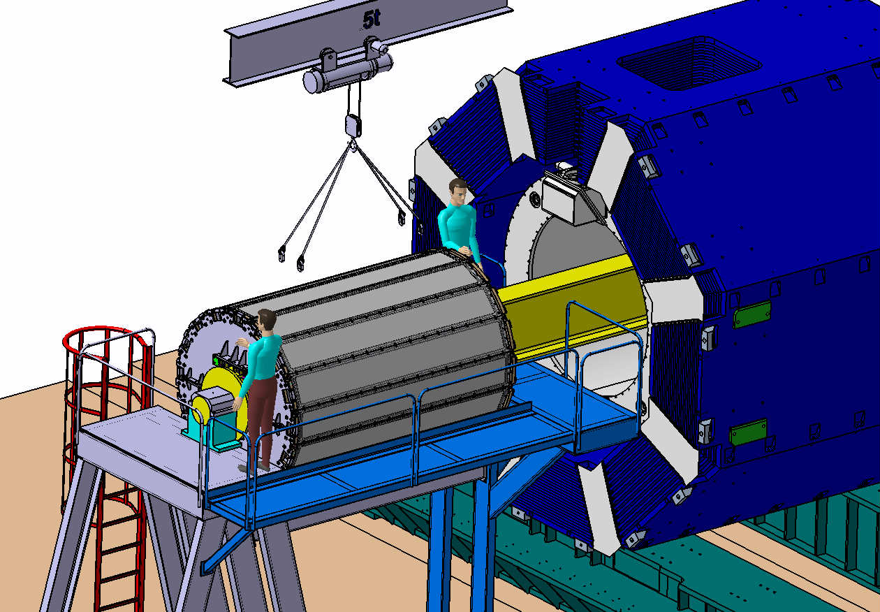
How to assemble barrel

Slide 14
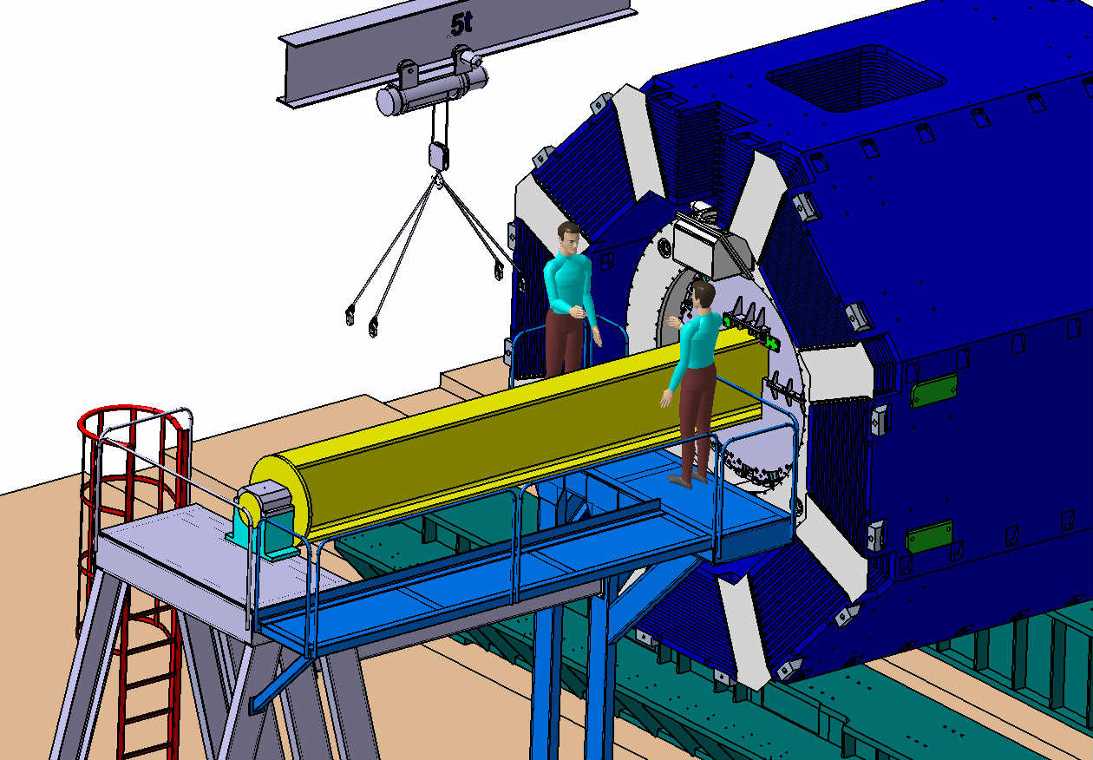
How to assemble barrel

Slide 15
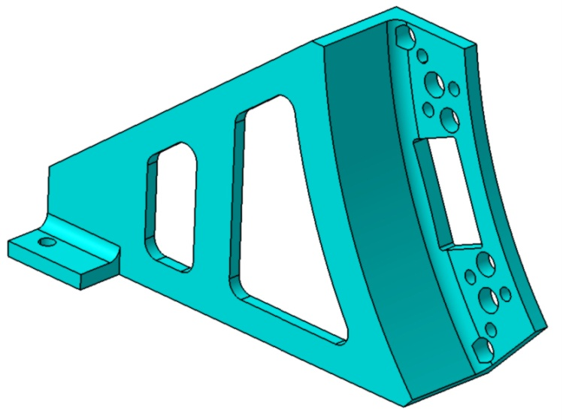
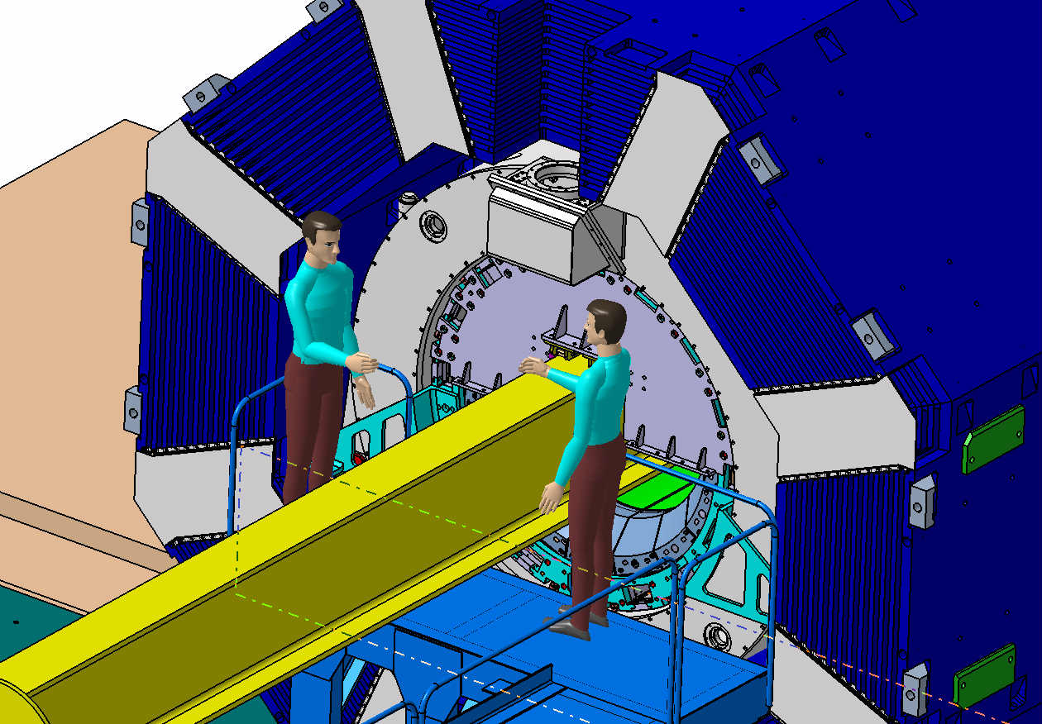
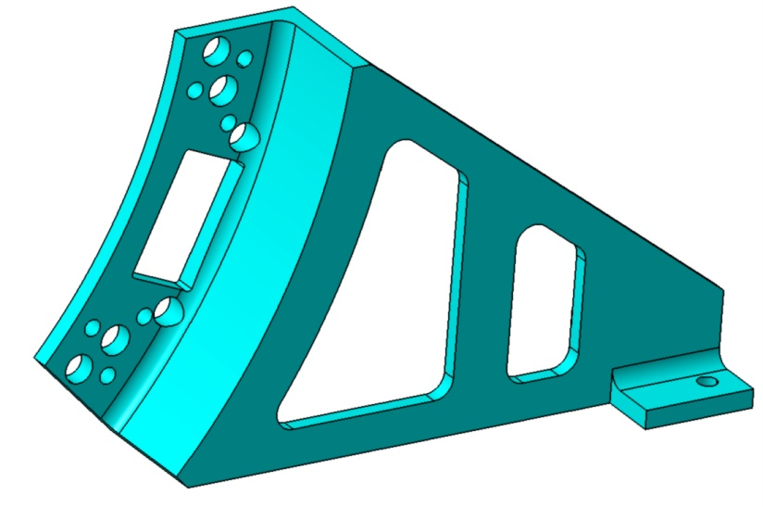
How to assemble barrel

Slide 16
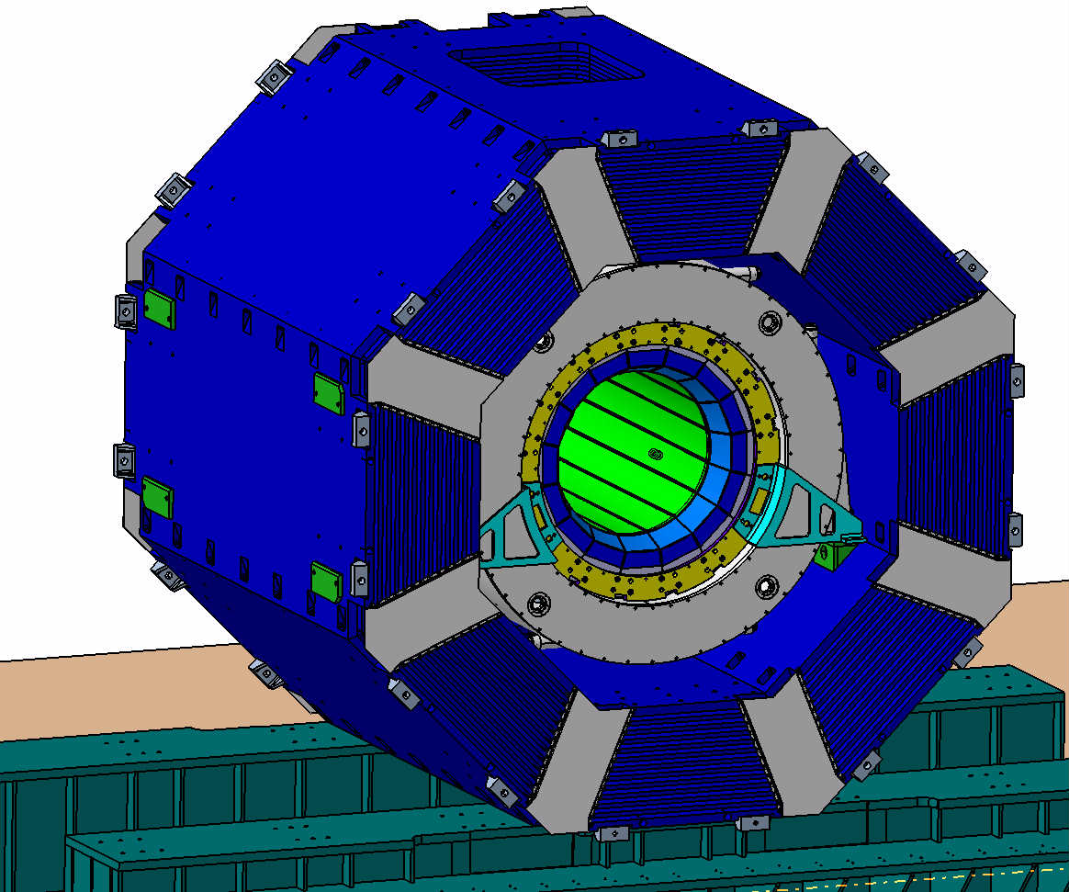
How to assemble barrel

Slide 17
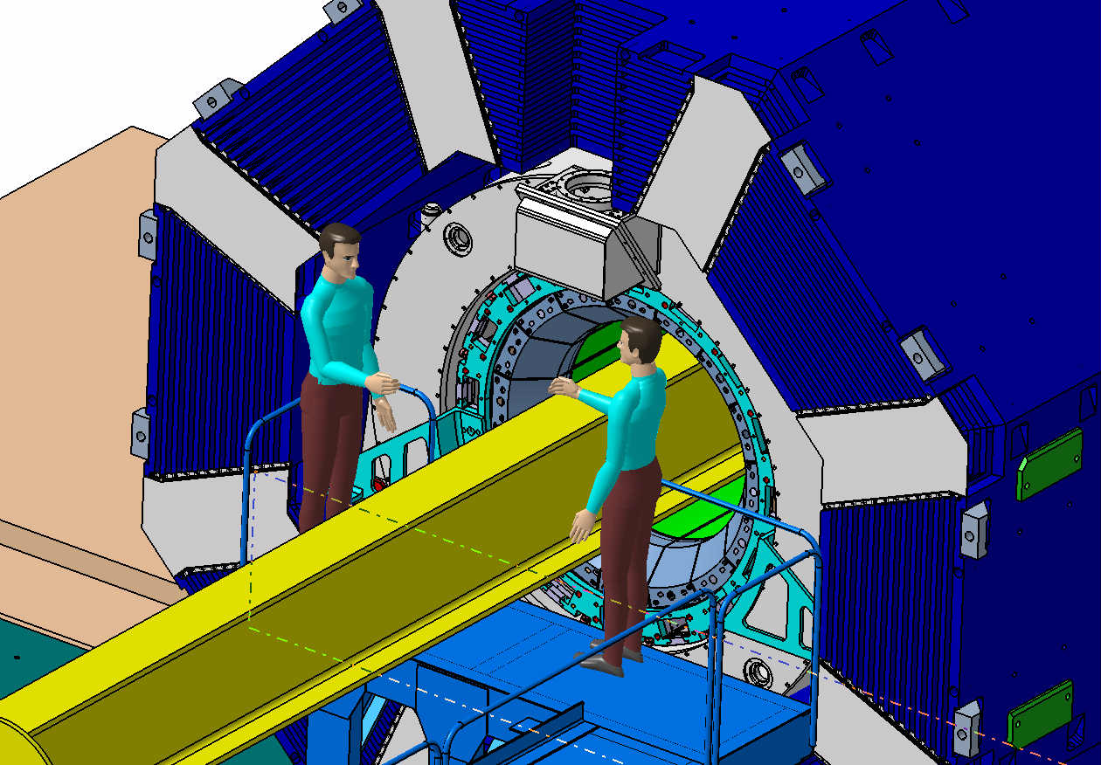
How to assemble barrel

Slide 18
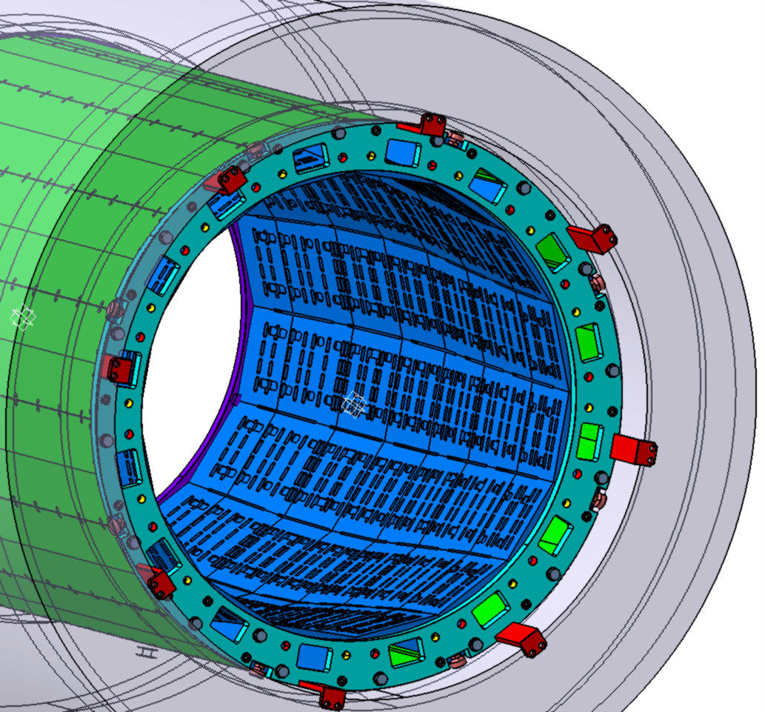
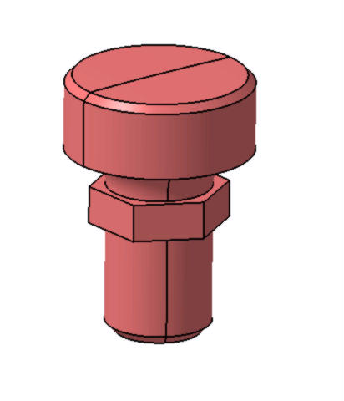
How to assemble barrel

