Slide 1


Status of work on the project # 06-1000012-8865 (VNIINM)
Team leader -V.Pantsyrny

Slide 2
INTRODUCTION
One of the main goals in development of magnets for FAIR is the reduction of AC losses in coils under pulse magnetic field. It is recognized that the main contribution in AC losses in coil comes from wire magnetization and filament hysteresis losses are the largest loss component during a magnet cycle. A wire with filaments diameter of 3.5-2.5 µm is of interest with Jc≥2700 A/mm² (5 T; 4.2 K), Cu/non Cu ratio of 1.8-1.3 and filament twist pitch as small as possible without a degradation of critical current density. This wire with small filaments should contain a resistive (Cu-0.5%Mn or Cu-5-10% Ni) inter-filament matrix to reduce inter-filament coupling current loss and OF copper outside and inside the filamentary region to provide required stabilization.

Slide 3
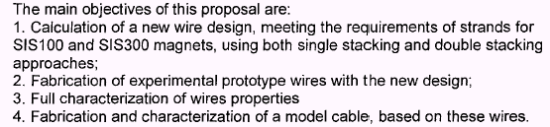
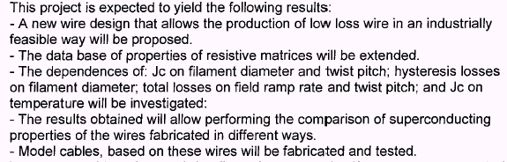

Slide 4
RESEARCH PROGRAM
Tasks Description
1. Calculation of wire design
2. Design of three-metal (NbTi/Nb/ resistive matrix), the first multifilamentary and the second multifilamentary billets.
3. Procurement of initial materials (Nb, Ti, Cu, Mn), preparation and characterization of high homogeneity Nb-(47±1%)Ti alloy and resistive Cu-0.5%Mn alloy.
4. Fabrication of semi-products from NbTi, Nb, Cu and CuMn. Investigations of mechanical properties.
5. Assembly of the first multifilamentary billet and fabrication of samples of experimental single stacked wire.
6. Investigation of critical current density dependencies on heat treatment regime and twist pitch for the samples fabricated from the first multifilamentary billet.
7. Assembly of the second multifilamentary billet and fabrication of samples of experimental double stacked wire.
8. Investigation of critical current density dependencies on heat treatment regime and twist pitch for the samples fabricated from the second mutifilamentary billet.
9. Structural investigations. Testing of mechanical properties of experimental wires.
10. Critical current measurements at 4.2-6K and investigation of critical current density and “n” parameter.
11. Magnetization measurements at quasi-stationary and alternating fields, investigation of AC losses.
12. Fabrication and testing of model cable for SIS100 and investigation of wire and cable samples for SIS100 and SIS300.
13. Overall analysis of the project results. Preparation of a final report.

Slide 5
AMENDMENTS
made during the work
The programme was corrected twice on diameters and amount of wires to be fabricated :
1. First, after discussion at the INTAS-GSI kick-off meeting in Darmstadt (the decision of 28.06.2007).
Two types of 0.825 mm wire / 250m + 250 m
One type of 0.46 mm wire / 400 m
2. Second, after discussion on cable layout (the decision of 26.09.2008).
One type of 0.5 mm wire / 400 m
One type (double stacked) of 0.825 mm wire / 250 m
One type (single or quasi single stacked) of 0.8 mm wire /250 m
Short sample of 0.825 mm wire of different lay-outs

Slide 6
Initial materials T3. Procurement of initial materials (Nb, Ti, Cu, Mn), preparation and characterization of high homogeneity Nb-(47±1%)Ti alloy and resistive Cu-0.5%Mn alloy.
Certified initial materials (niobium, titanium, copper, manganese) were prepared for fabrication of the billet’s elements
The ingot of superconducting Nb-(47±1%)Ti alloy has been melted and homogenized
The ingot of resistive Cu-0.5%Mn alloy has been melted

Slide 7
Tests of initial materials
Chemical composition of superconducting alloy (ingot # 527)
 | Ti, wt% | Ta ppm | Fe ppm | Si ppm | Cr ppm | Al ppm | Ni ppm | Cu ppm | Sn ppm | O ppm | N ppm | C ppm | P ppm
Specified | 46.0-48.5 | 2000 | 300 | 100 | 150 | 125 | 100 | 100 | - | 700 | 150 | 200 | -
Real | 47.8 | 160 | 110 | 36 | 53 | 75 | 28 | < 10 | <10 | 200 | <50 | 160 | <30

Slide 8
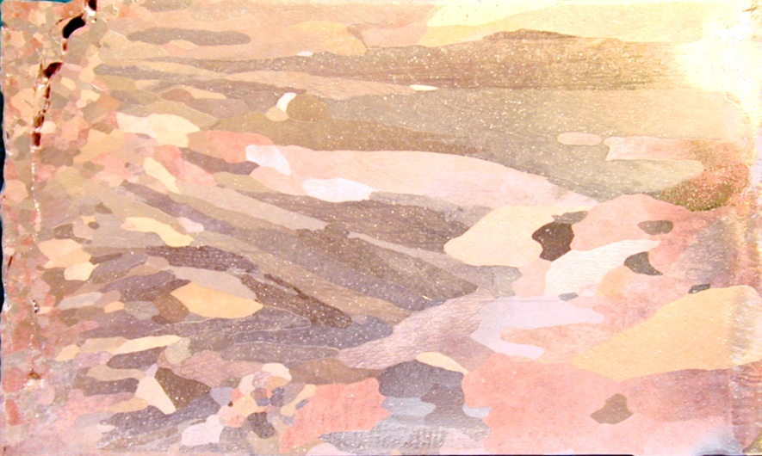
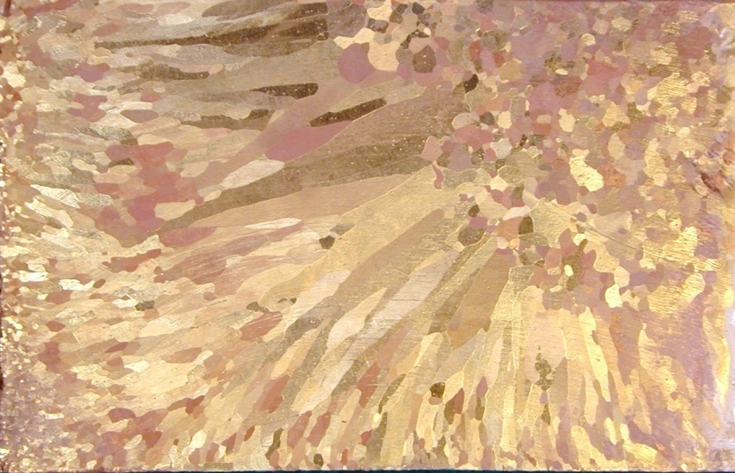
Resistive alloy. Fragments of structure (ingot 130mm in dia) Microhomogeneity (Profile of Mn content).
Top
center
periphery
Bottom
center
periphery

Slide 9
Tests of initial materials
Resistive alloy Cu-0.5%Mn
Room temperature resistivity
Cold drawn – 3.37-3.41 μΩ-cm
Annealed (500°C) – 3.41-3.42 μΩ-cm
Resistivity in liquid helium
Cold drawn – 1.62 μΩ-cm
Annealed (500°C) – 1.70 μΩ-cm

Slide 10
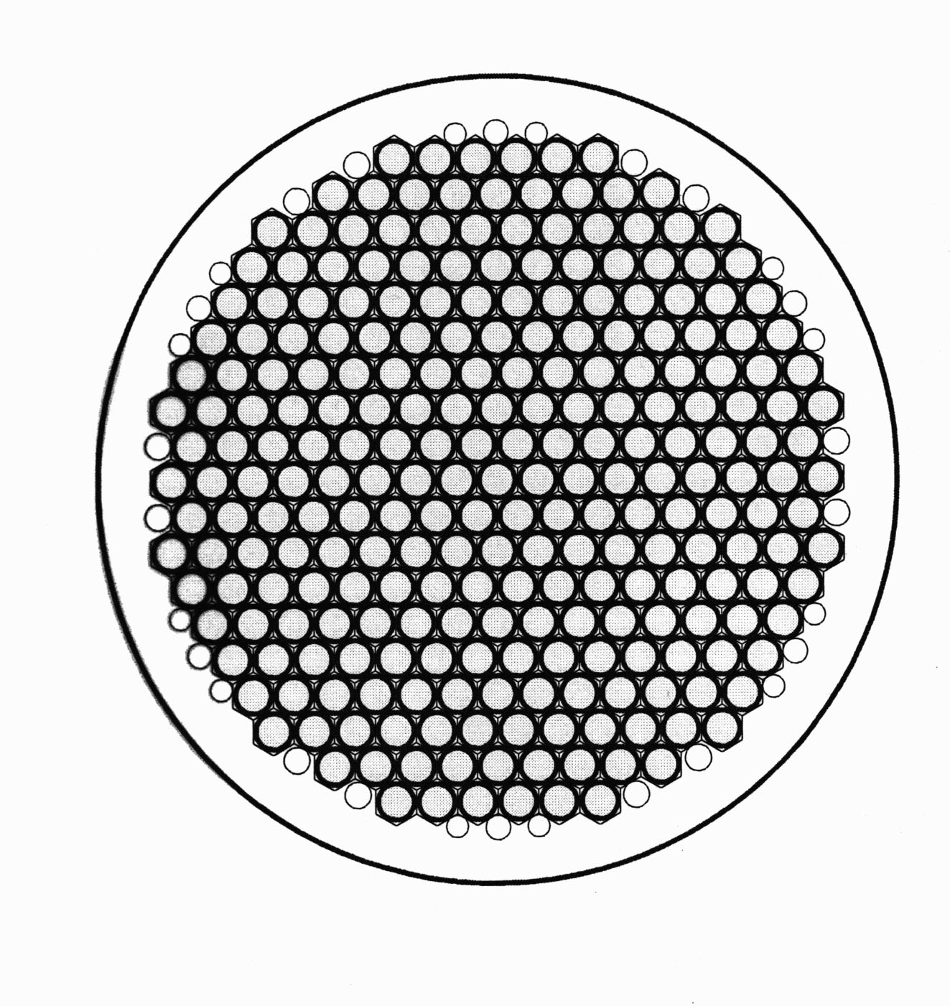
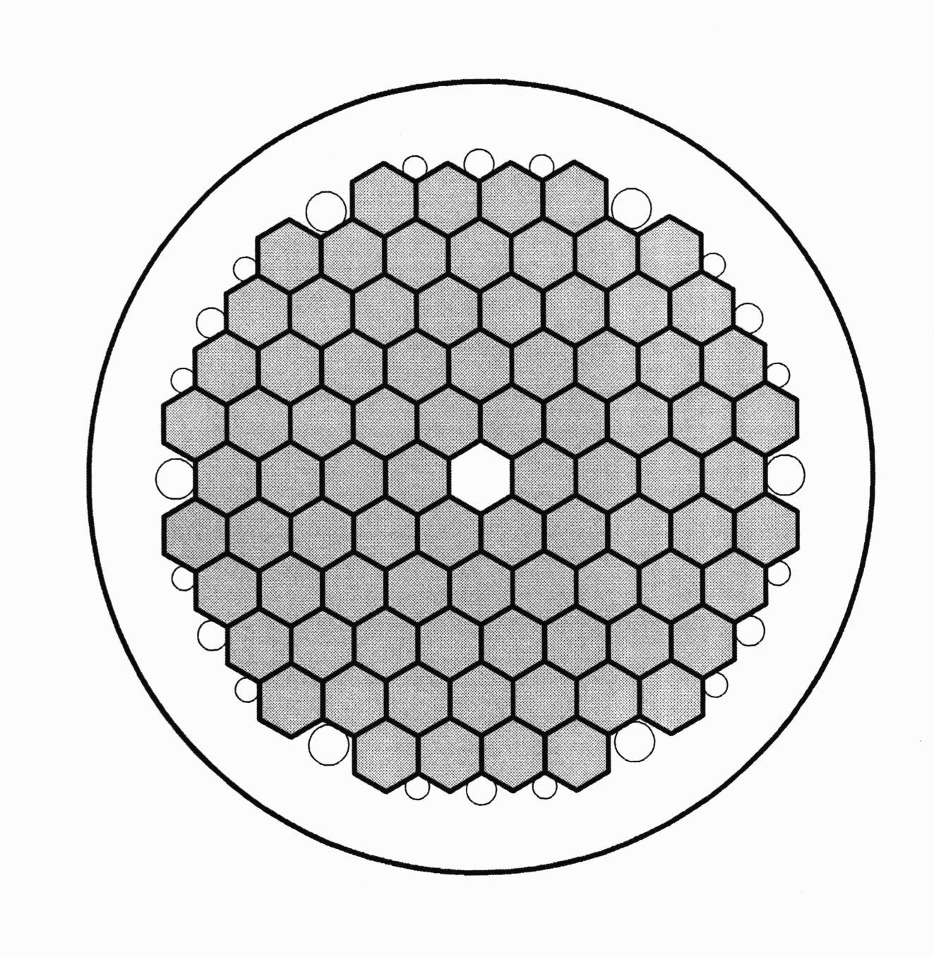
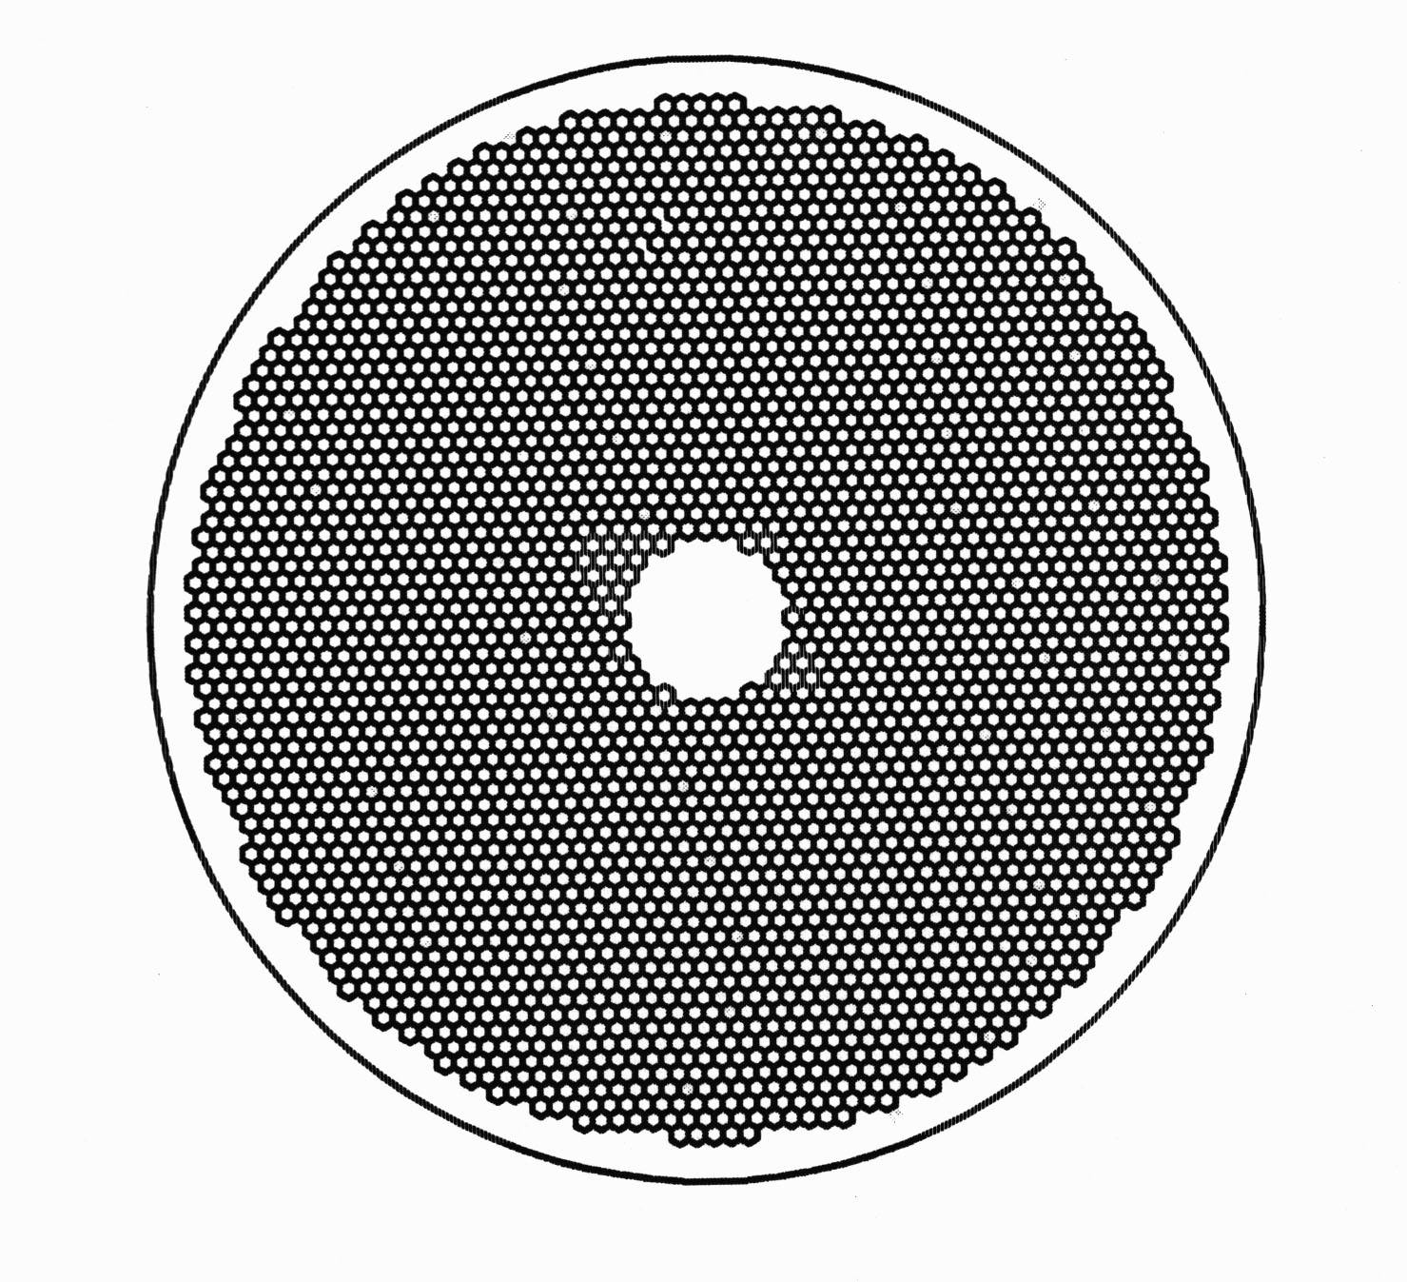
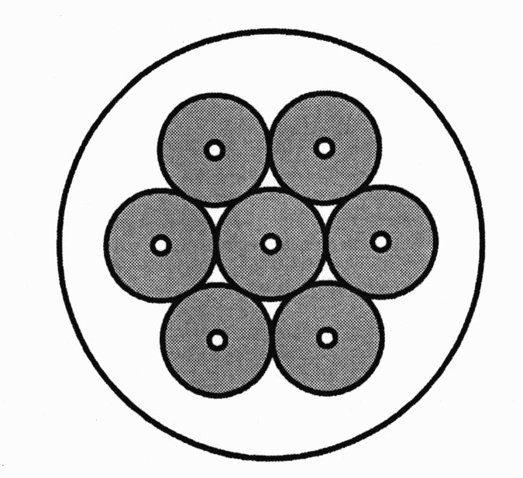
T1. Calculation of wire design.
1. SIS 300 0.825 mm wire - Ordinary hot double stacking
2. SIS 300 0.825 mm wire - I – hot single stacking + II-cold bonding (quasi single)

Slide 11
T2. Design of three-metal (NbTi/Nb/ resistive matrix), the first multifilamentary and the second multifilamentary billets.
Final design of 0.825 mm wire
Matrix/(NbTi+Nb) ratio | 1.5/1 (PF= 40%)
Filament diameter (deviation possible) | 3.5 μm
Filaments spacing (deviation possible) | 0.35 μm
Critical current (5 T, 4.2K), A | ≥500
RRR | ≥100
Design of three-metal (NbTi/Nb/ Cu-0.5%Mn billets, the first and the second multifilament billets were calculated under these parameters.

Slide 12
T4. Fabrication of semi-products from NbTi, Nb, Cu and CuMn. Investigations of mechanical properties.
1. Semi-products for fabrication of starting elements for three metal NbTi/Nb/ CuMn billets:
NbTi bars was extruded from NbTi ingot
Nb flat billet was extruded from Nb ingot
Cu-Mn tubes were extruded from Cu-0.5% Mn ingot.
2. Starting elements for three metal billet assemblies were fabricated:
NbTi cores were annealed and machined
Nb sheets were rolled and vacuum annealed
Cu-Mn cans and Cu caps were turned
3. Three metal NbTi/Nb/ CuMn billets were assembled, evacuated, sealed and extruded into rods, cold drawn up to the final sizes of each design.

Slide 13
4. Starting elements for the first multifilament billets were fabricated:
Three metal NbTi/Nb/ CuMn hexagonal rods were straightened and cut
Cu cans and caps were turned
Cu fillers were drawn, straightened and cut.
5. Starting elements for the second multifilament billets of each design were fabricated:
Cu rod, cans and caps were turned for HDS designs
Cu fillers were drawn, straightened and cut for HDS design
Cu tube were prepared and Cu caps were turned for (HSS+CB) design

Slide 14
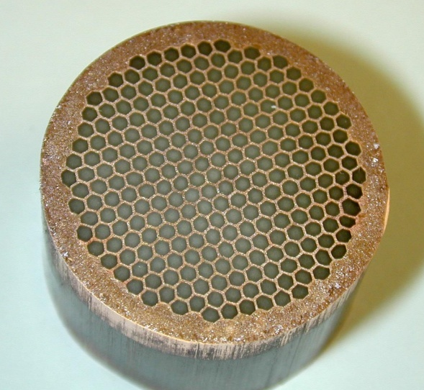
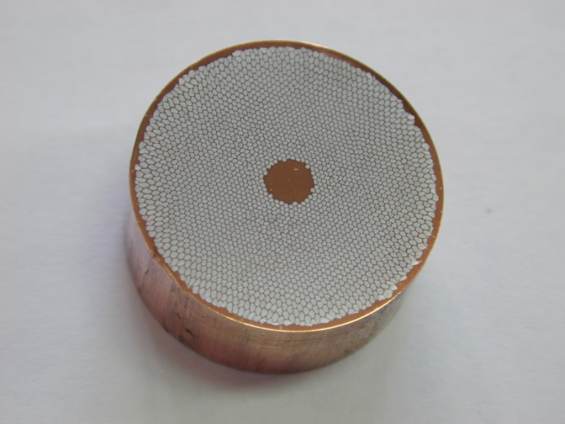
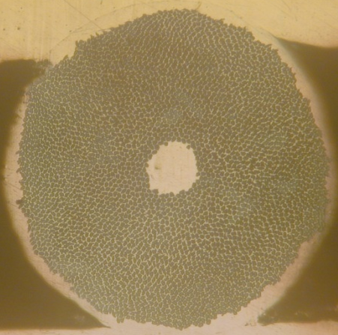
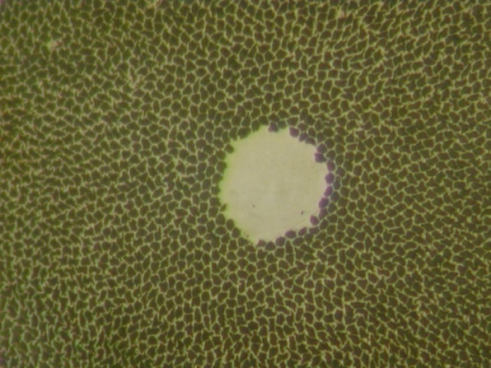
T5. Assembly of the first multifilamentary billet and fabrication of samples of experimental single stacked wire.
First stage 379 filament rod
First stage 3132 filament rod
Model single stacked
3132 filament wire:
Wire dia = 0.24 mm
Filament dia = 3.5μm
P.F. (non Cu) = 64.85%

Slide 15
T6. Investigation of critical current density dependencies on heat treatment regime and twist pitch for the samples fabricated from the first multifilamentary billet.
Single stacked 0.24 mm wire
5 HT at 385°C
Samples with different twist pitch – w/t; 7 mm; 4 mm; 2 mm
Parameter | w/t | 7mm | 4 mm | 2 mm
Ic,A (5T, 4.2K, 0.1μV/cm) | 79 | 77 | 72 | 55
Jc, A/mm² (5T, 4.2K, 0.1μV/cm) | 2804 | 2626 | 2553 | 1950
n | 37.5 | 33 | 25 | 19
Crucial diminishing of Jc at 2mm pitch !

Slide 16
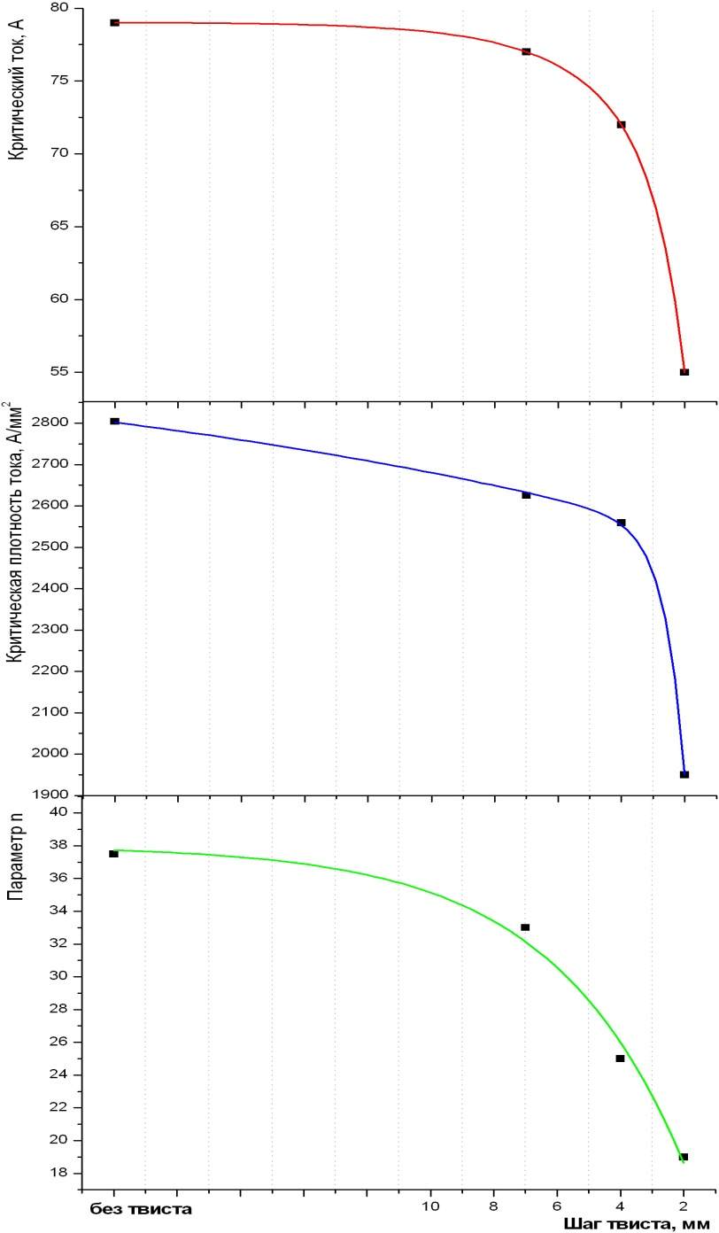
The drastic drop in critical current and “n” parameter took place at twist pitch of approximately 5 πD

Slide 17
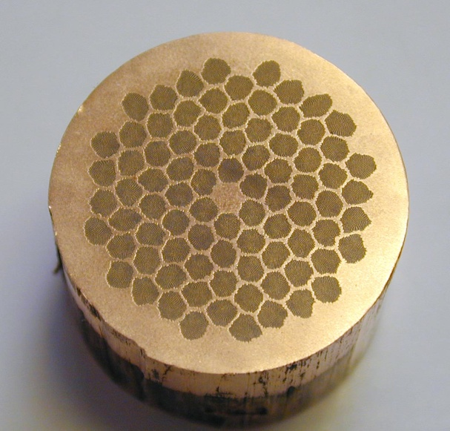
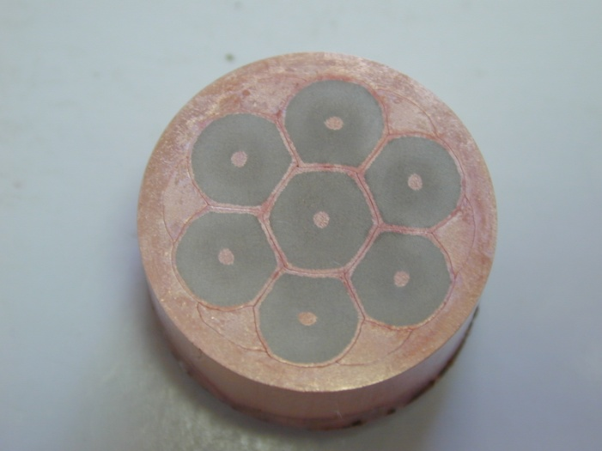
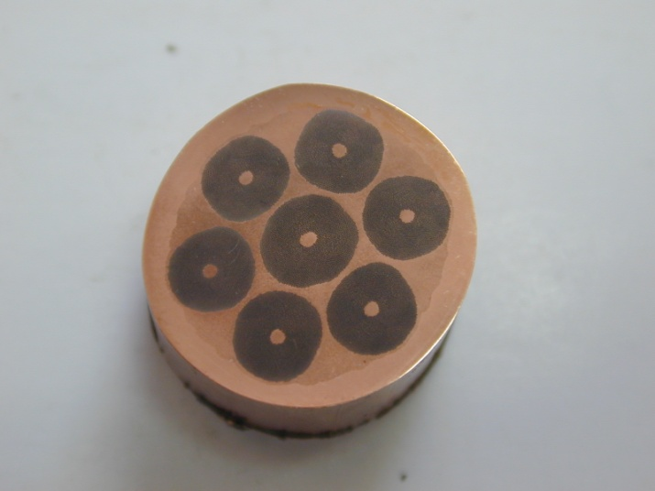
T7. Assembly of the second multifilamentary billet and fabrication of samples of experimental double stacked wire.
Good drawability!
379×84 –hot extrusion
Pure drawability!
Breakage since
1.5 mm originated
from the central cluster
3132×7 – cold bonding
3132×7 – hot extrusion

Slide 18
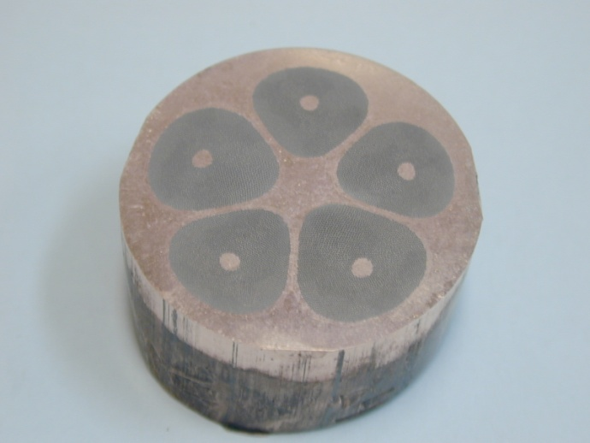
We changed the design of second stage billet to (3132×5) on the base of the same semi-products.
3132×7 – hot extrusion
3132×5 – hot extrusion
Advantage – copper in the center;
Disadvantage – 4 μm filaments instead of 3.5 μm filaments in (3132×7) layout
at wire diameter of 0.825 mm
Good drawability!

Slide 19
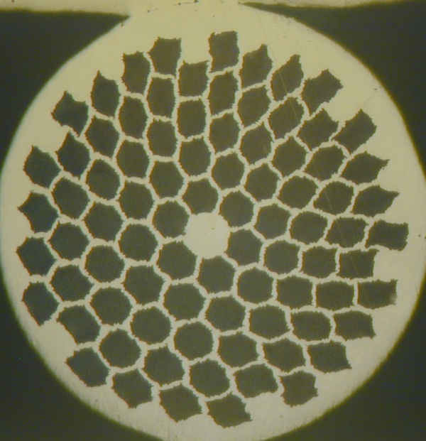
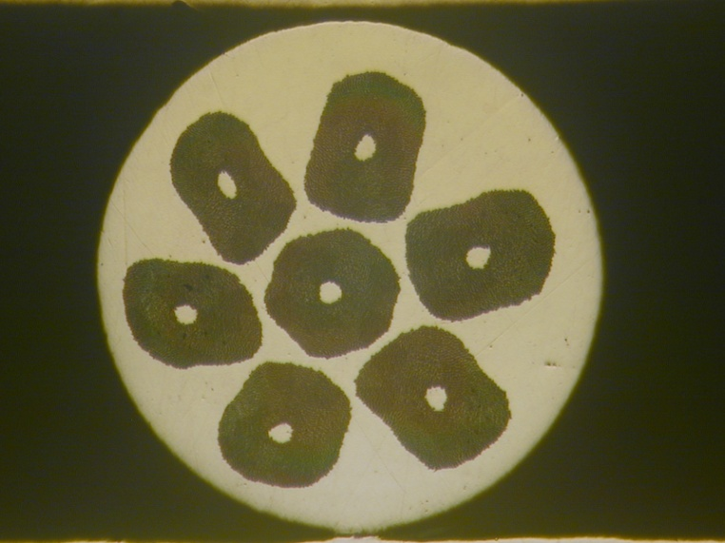
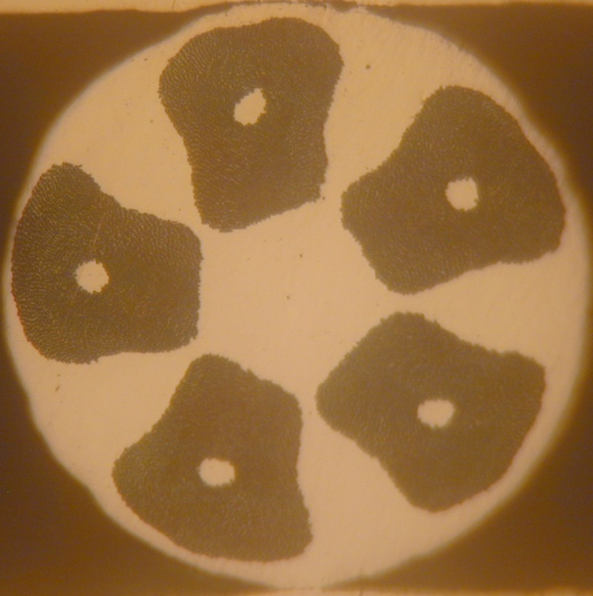
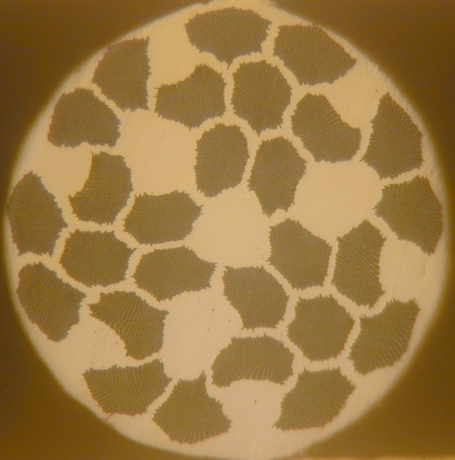
Wires fabricated
379×84 – ∅ 0.825 mm
3132×7 – ∅ 1.5 mm -stopped
3132×5 –∅ 0.825 mm; ∅ 0.79 mm
379×27 – ∅ 0. 5 mm – fabricated from
the rest semi-products

Slide 20
T8. Investigation of critical current density dependencies on heat treatment regime and twist pitch for the samples fabricated from the second mutifilamentary billet.
Jc vs HT was studied for 0.825 mm (379×84) wire
manufactured with 4 or 5 HT
3% increase of Jc was found (from 2548 to 2632 A/mm² at 5T and twist pitch =11mm)
2. Jc vs twist pitch was studied for 0.825 mm (379×84) wire
manufactured with 4 HT and twist pitch =11;8 and 6 mm
and also for 0.825 mm (3132×5) wire manufactured with 5 HT
and twist pitch =12 and 8 mm.
No dependence was found for (379×84) wire at 11-6 mm pitch range.
Jc keeps on 2550 A/mm² level (5T; 0.1 μV/cm).
Jc decrease from 2400 A/mm² at Lp=12 mm to 2100 A/mm² at Lp=8 mm was found for (3132×5) wire.

Slide 21
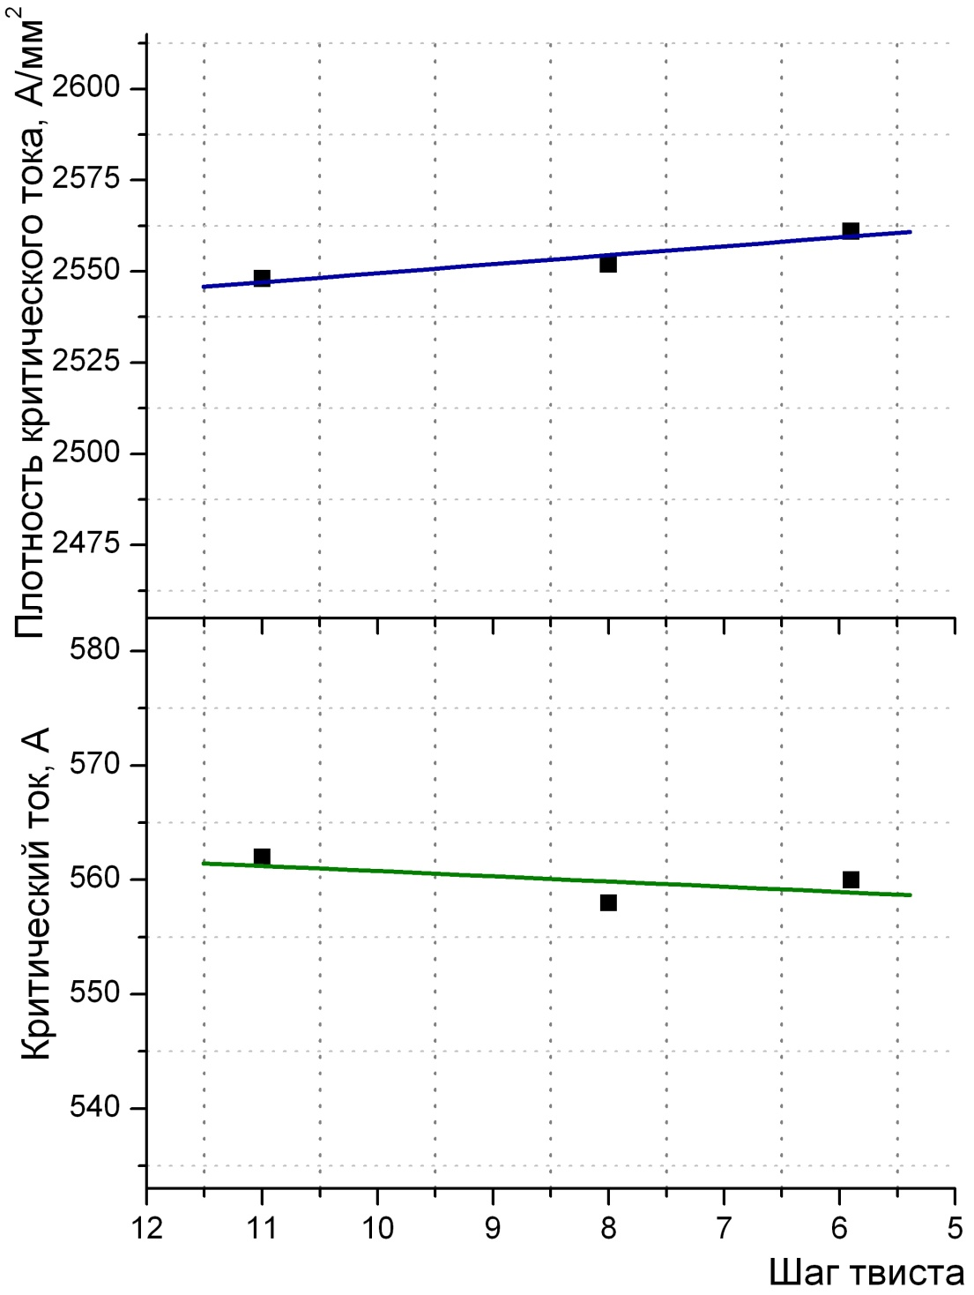
No drop in critical current and “n” parameter down to twist pitch of approximately 2 πD
Jc vs twist pitch was studied for 0.825 mm (379×84) wire

Slide 22
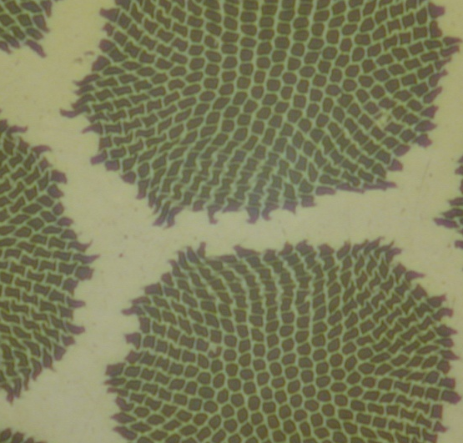
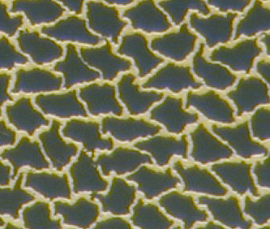
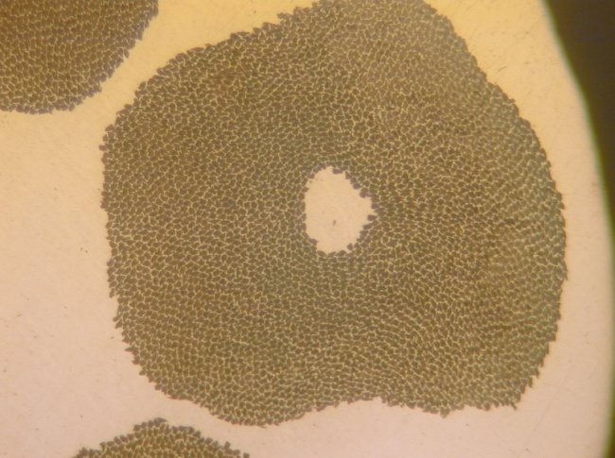
T9. Structural investigations. Testing of mechanical properties of experimental wires.
Fragments of filaments zone
0.825 mm wire
(3132×5 filaments)
Model 0.24 mm wire
(3132 filaments)
0.825 mm wire
(379×84 filaments)
Shape of filaments in the center of cluster –uniform;
on periphery - non uniform
Spacing – uniform.
Shape of filaments –
non uniform/
the consequence of hand straightening
Shape of filaments –
non uniform/
the inheritance
of the first stage assembly

Slide 23
Mechanical properties
Position | Sample | σ_{B}, MPa | σ_{0,2}, MPa | δ, % | Note
1 | ∅0.825 (379×84) 4 HT | 868 | 773 | 1,9
2 | ∅0.825 (379×84) 5HT | 883 | 823 | 1,8 | Minor increase against 4HT
3 | ∅0.825 (3132×5) cold drawn | 743 | 576 | 2,1
4 | ∅0.825 (3132×5) 5HT | 836 | 775 | 1,7 | Noticeable increase against cold drawn

Slide 24
T10. Critical current measurements at 4.2-6K and investigation of critical current density and “n” parameter.
Сritical current density at 4.2-6K was determined for the 0.79 mm (3132×5) wire.
We use Bottura equation for the
description of Jc(B,T)
with the following parameters:
Co | 355542
Bcm(0) | 14,83
Tc0 | 9,05
Alfa | 1,84
Betta | 1,9
Gamma | 2,58
Database on Jc(B,T) is available.

Slide 25
T11. Magnetization measurements at quasi-stationary and alternating fields, investigation of AC losses.
Pos. | Wire | Qh, mJ/cm³ |  |  |  | D fil. | D eff | D eff/D fil.
 |  | ±0.5 T | ±1 T | ±1.5T | ±3T
1 | 0.24/3132 PF=0.65 | 36.1 | 53.5 | 65.2 | 88.3 | 3.4 | 5.2 | 1.53
2 | 0.825/379×84 PF=0.40 | 21.2 | 30.4 | 37 | 50.6 | 2.9 | 4.68 | 1.61
3 | 0.79/379×84 PF=0.40 | 14.9 | 21.4 | 25.8 | 30.3 | 2.8 | 4.7 | 1.68
4 | 0.825/3132×5 PF=0.41 | 28.2 | 42 | 52.2 | 71.4 | 4.2 | 7.1 | 1.69
5 | 0.79/3132×5 PF=0.41 | 19.1 | 28 | 34 | 44 | 4.1 | 6.4 | 1.56
6 | 0.5/ 379×27 PF=0.397 | 14.8 | 21.6 | 26 | 29 | 3.1 | 3.8 | 1.23
7 | 0.85/ 55×162 PF=0.42 (UNK) | 48 | 66 | 79 | 106 | 5.84 | 12.4 | 2.12
8 | 0.73/4488 PF=0.392(ITER) |  |  | 48.1 | 67.4 | 6.7 | 7.6 | 1.13

Slide 26
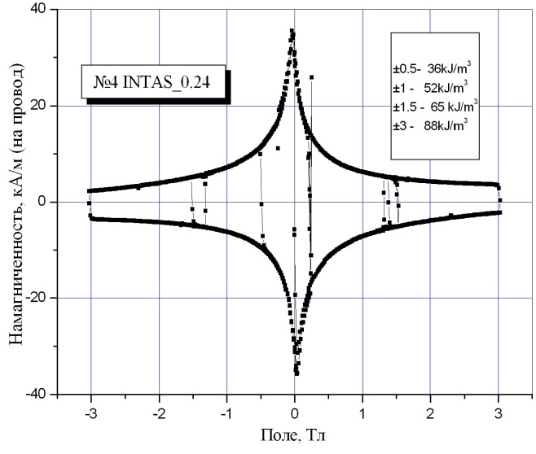
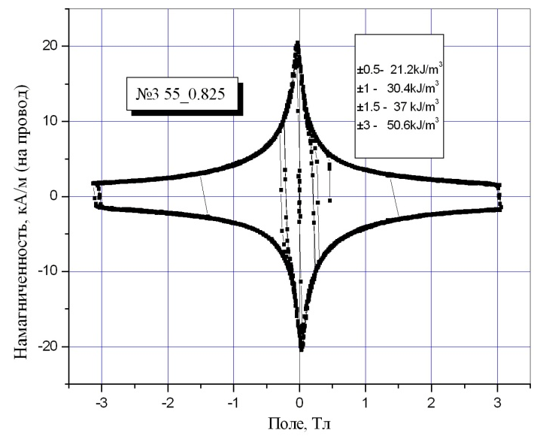
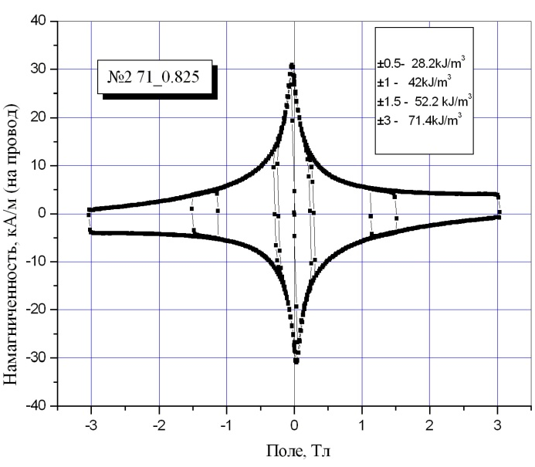
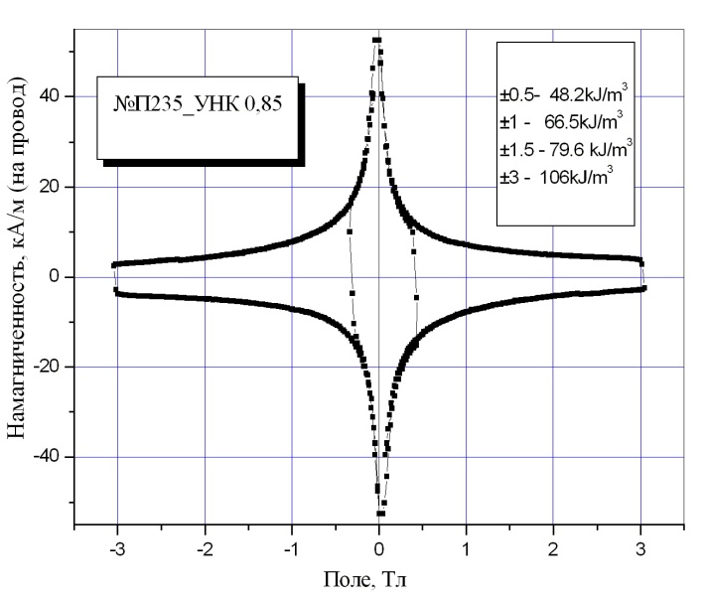
Magnetization loops
Hysteresis losses can be diminished using modern straightening machine in industry

Slide 27
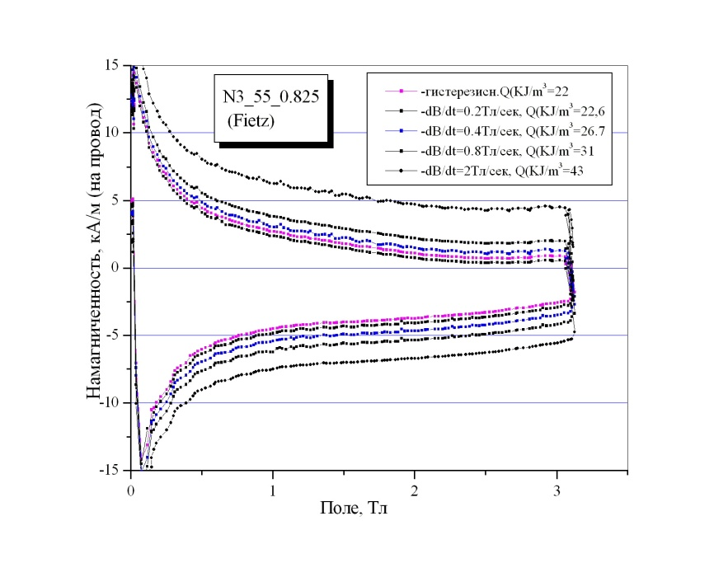
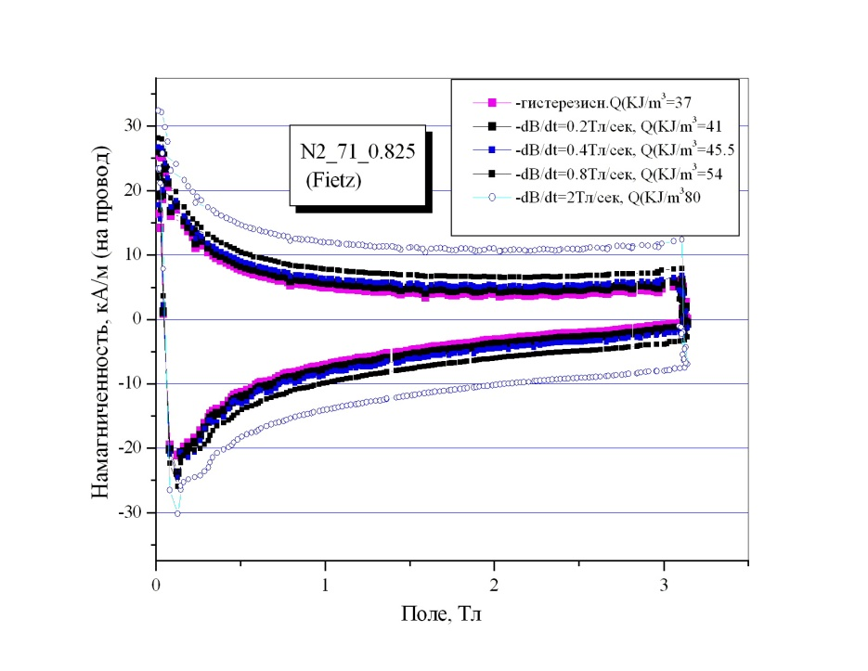
Dynamic losses
0.825 mm wire (379×84)
Lp=12
0.825 mm wire (3132×5)
Lp=12
Lp can be diminished using modern twisting machine in industry.

Slide 28
Deliveries
To JINR
0.825 mm wire (3132× 5) with twist pitch 11 mm – 260 m
0.79 mm wire (3132× 5) with twist pitch 8 mm – 244 m
0.5 mm wire (3132× 5) with twist pitch 8 mm – 191 m
0.825 mm wire sample (379× 84) with twist pitch 11 mm – 26 м
5 .0.79 mm wire sample (379× 84) with twist pitch 8 mm – 23 м
To IHEP
0.825 mm wire (379× 84) with twist pitch 11.7 mm – about 1000 м
(separate contract).

Slide 29
T12. Fabrication and testing of model cable for SIS100 and investigation of wire and cable samples for SIS100 and SIS300.
Will be reported by the JINR Team’s representative

Slide 30
What we have got from this work:
Technology
The experience in melting and characterization of Cu-0.5%Mn alloy
of high homogeneity
2. The experience in correction of extrusion regimes for the
wires with Cu-0.5%Mn matrix
3. Two double stacked lay outs allowing to fabricate wire
with a good drawability
Investigations
Data base on Jc (3-8T, 4.2K) for the wires of different lay outs
with different twist pitch
Data base on Jc (5-8T, 4.2-7K)
Data base on Qh for the wires of different lay outs

Slide 31
What we have achieved in our first wires
Critical current density up to 2630 A/mm² (0.5 mm wire 379×27 with 3.1 µm filaments).
2. Hysteresis losses of 50.6 mJ/cm³ at ±3T for 0.825/379×84 wire
with Jc (5T) = 2550 A/mm² and 2.9 µm filaments
3. Hysteresis losses of 29 mJ/cm3 at ±3T for 0.5/379×27 wire
with Jc (5T) = 2630 A/mm² and 3.1 µm filaments

Slide 32
What could be improved
on the base of experience accumulated during the work on the Project
Filament shape distortion – available with use of modern straightening machine in our new plant
2. Twist pitch diminishing - available with use of modern twisting machine in our new plant

