Slide 1
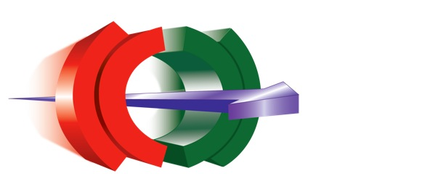
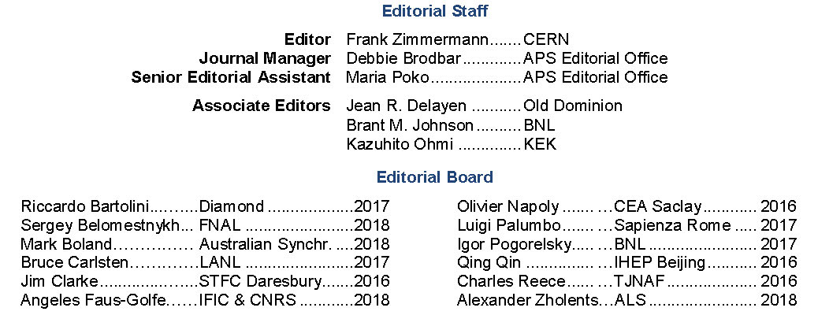
from PRST-AB to PRAB challenges for Accelerator Journals
Frank Zimmermann, CERN
http://journals.aps.org/prab/

Slide 2
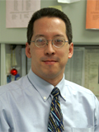
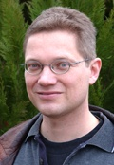
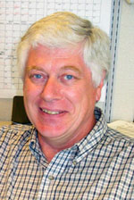
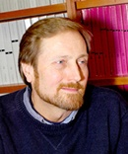
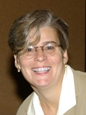
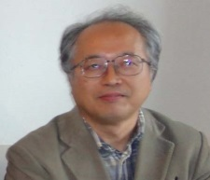
PRAB
people
Editor in Chief
Pierre Meystre
APS Editorial Director
Daniel T. Kulp
Editor
Frank Zimmermann, CERN
Associate Editors
Jean Delayen, ODU
Brant M. Johnson, Brookhaven National Laboratory
Kazuhito Ohmi, KEK
Journal Manager
Debbie Brodbar, APS Editorial Office
Assistant Editor
Maria Poko, APS Editorial Office
Editorial Board
[(2008) - Rick Baartman, Samuel Krinsky, Michael W. Poole, Ferdinand Joachim Willeke
(2009) - Oliver Boine-Frankenheim, Shinji Machida, Lia Merminga, Peter Ostroumov
(2010) - Reinhard Brinkmann, Yong Ho Chin, Jean Delayen, Jean-Marc Filhol ]
(2011) - Shane Koscielniak, Eugene Perevedentsev, Vladimir Shiltsev, Andy Wolski
(2012) - John Corlett, Luca Giannessi, Lars Gröning, Gennady Stupakov
(2013) - Marie-Emmanuelle Couprie, Georg Hoffstaetter, Richard Walker, Kaoru Yokoya
(2014) - Klaus Flöttmann, Wolfram Fischer, Andrei Seryi, Uli Wienands
(2015) - Oliver Brüning, Sarah Cousineau, William Fawley, Steve Peggs]
(2016) - Jim Clarke, Olivier Napoly, Qing Qin, Charles Reece
(2017) - Riccardo Bartolini, Bruce Carlsten, Luigi Palumbo, Igor Pogorelsky
(2018) – Mark Boland, Sergey Belomestnykh, Angeles Faus-Golfe, Alexander Zholents

Slide 3
introducing PRAB (formerly PRST-AB)
pioneering Open Access journal, launched by the APS in 1998, on the initiative of the founding editor Robert H. Siemann and his colleagues
APS journal covering all aspects of accelerators from fundamental physics to technology; articles on original work, reporting a significant scientific or technical advance, plus review articles
funding from Sponsors allows its distribution at no cost to authors or readers
two affiliated professional groups – the EPS-AG and the APS-DPB – are jointly responsible for the health and vitality of PRAB by providing advice and encouraging scholarly publication in accelerator science and technology
of roughly 3,600 manuscripts submitted since the journal inception, about two thirds have been published or accepted for publication; this fraction has remained rather stable throughout the journal history

Slide 4
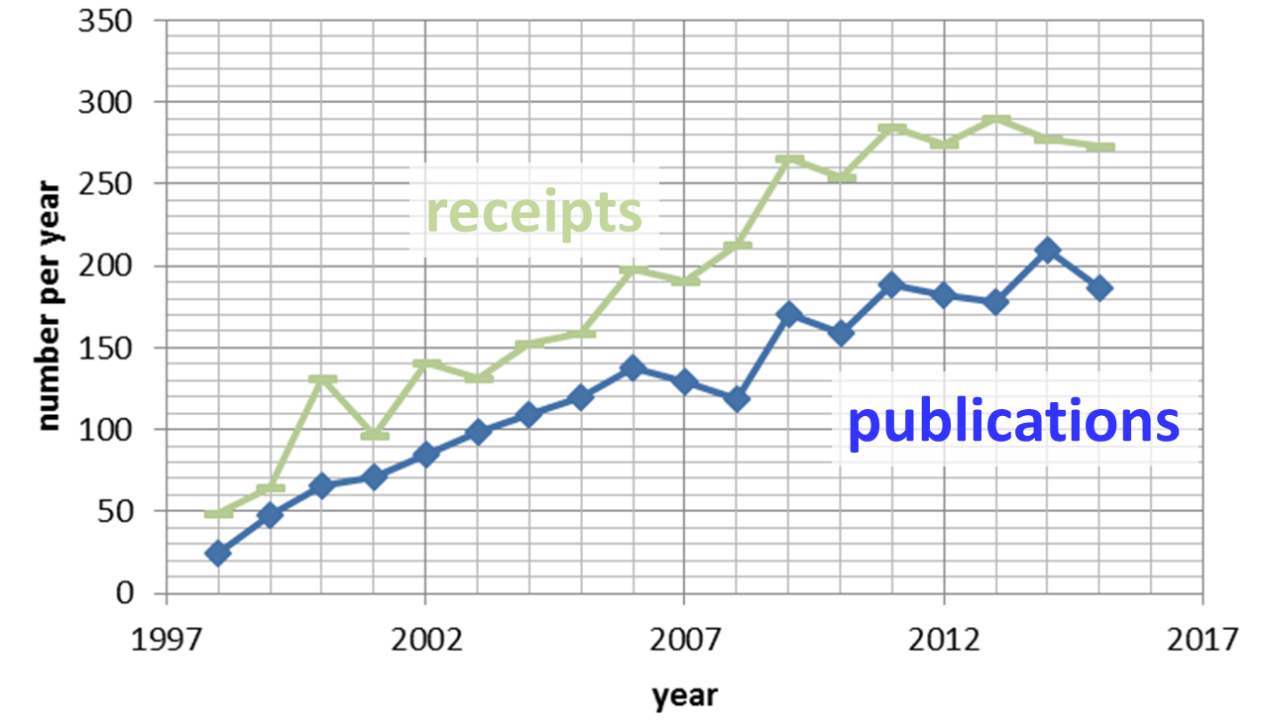
annual manuscript receipts and PRAB/PRST-AB publications
PRST-AB/PRAB has been steadily growing; in 2014, for the first time more than 200 articles were published in a year

Slide 5
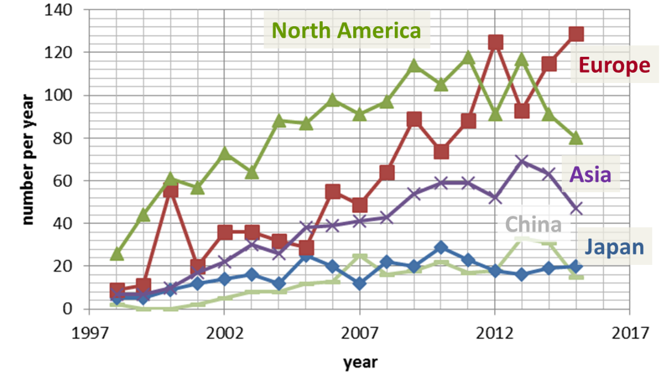
annual PRAB/PRST-AB manuscript receipts per region of submitting author
Figure 2
now ~70% of papers from outside North America

Slide 6
PRST-AB has just become PRAB
For many years, the PRST-AB Editors, the PRST-AB Editorial Board and many PRST-AB authors had expressed concerns that the “Special Topics” in the journal title created confusion and diminished the standing of the journal. From various institutes it was reported that the “Special Topics” label had lowered the perceived value of articles published in this journal, despite the fact that its acceptance criteria were (and are) essentially the same as those of the other Physical Review journals. Since 1 January 2016 the name of the journal is Physical Review Accelerators and Beams without “Special Topics” (ST).
With the arrival of two additional subject-specific journals in the Physical Review family of journal – namely Physical Review Applied and Physical Review Fluids – it had become apparent that the Special Topics name was definitely no longer needed for any of the APS journals. The removal of “Special Topics” also visually integrates PRAB into the Physical Review family of journals and better emphasizes its content.
While this name change clearly serves the best long-term interest of the accelerator community, some short-term difficulties may be encountered. The most important immediate consequence of this name change will be the lack of a meaningful Impact Factor for up to two years. It may also require some time for readers, authors, referees, librarians, and sponsors to make the proper connections between the old and new names or ISSNs.
This change in name was fully supported by the PRST-AB Editorial Board and had been intensely discussed with the APS leadership.

Slide 7
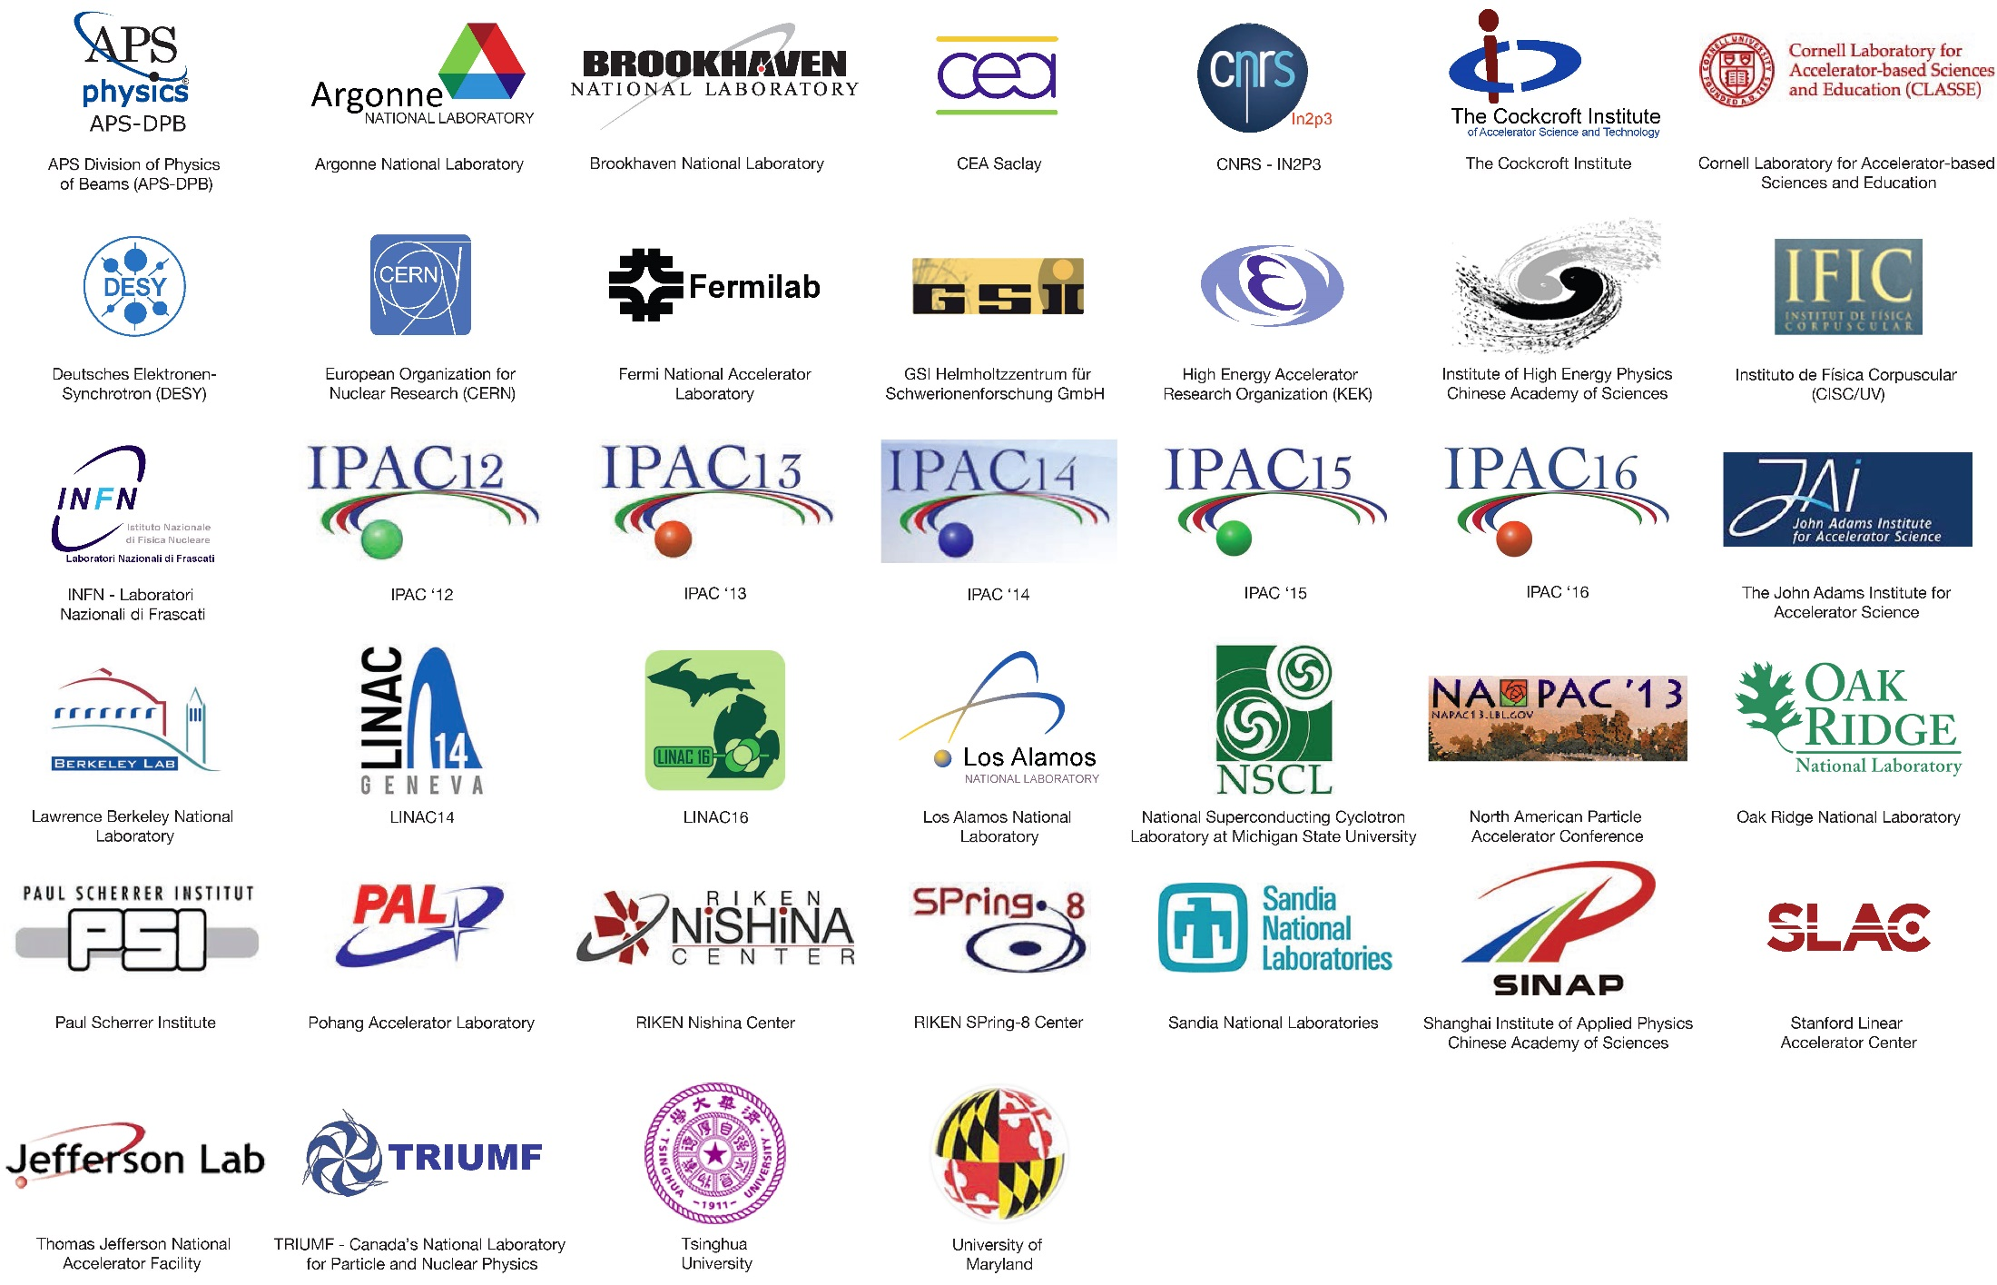
PRAB – Institutional Sponsors

Slide 8
PRAB – Industrial Sponsors (since 2015!)
At the annual Editorial Board meeting held during IPAC’16, representatives from the industrial sponsors reported that also these benefit from their sponsorship:
RadiaBeam sees additional web-site visitors coming from PRAB, resulting in additional sales, which more than compensate for the amount of the PRAB sponsorship
COSYLAB values the additional link, thanks to the PRAB sponsorship, between the sponsoring company and the accelerator community
Continually updated lists of industrial and institutional PRAB sponsors are available at
http://journals.aps.org/prab/sponsors

Slide 9
K. Kirby, APS CEO

Slide 10
K. Kirby, APS CEO

Slide 11
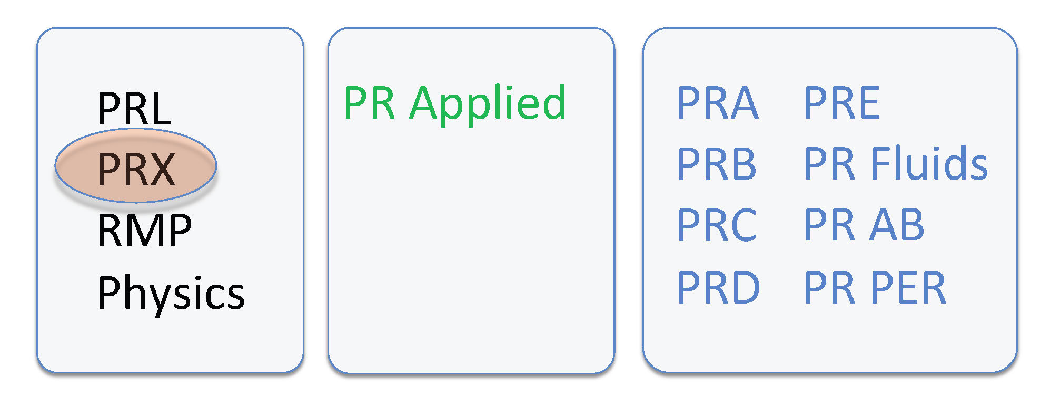
Physical Review Family of Journals
P. Meystre, APS EIC

Slide 12
P. Meystre, APS EIC

Slide 13
P. Meystre, APS EIC

Slide 14
some of the PRAB challenges
making the Open Access journal fully self-sustained financially
annual deficit ~20% covered by APS
sponsorship drives etc.
improving the academic standing of accelerator physics
cultivating journal publications in the accelerator field
raising the impact factor (will IPAC light proceedings help?)
inviting / publishing more review articles
referring process / review procedure
finding and motivating referees
avoiding referee overload
adjusting the acceptance criteria / standards
more/fewer rejections without review?
“physics at the boundaries” (e.g. material papers on ferrites, NEG, shielding concretes, or applications – medical treatments, biological studies, nuclear physics etc.)

Slide 15
h-index of institutes
PRSTB / PRAB H-index 43
Institution H-index
LBL 27
ARGONNE 21
LIVERMORE 18
UCLA 18
CERN 16
FERMILAB 16
PRINCETON 16
BNL 15
DESY 15
SLAC 15
JLAB 14
LOS ALAMOS 14
KEK 14
MSU 14
CORNELL 12
FRASCATI 12
INFN (all sections) 12
MARYLAND UNIVERSITY 12
OXFORD 11
GSI 10
OAK RIDGE 10
MAX-PLANCK 10
NOVOSIBIRSK 9
RAL 9
Indiana university 8
PSI 8
Muenchen 7
PROTVINO 7
University la Sapienza 7
DIAMOND 6
DUBNA 6
J-PARC 6
University Frankfurt 6
BESSY 5
Cockcroft 5
Old Dominion 5
MAX-lab 5
STONY BROOK 5
University TUD 5
TRIUMF 5
ELETTRA 4
LEGNARO 4
SNS 4
FZJ 3
MIT 3
SOLEIL 3
ESRF 2
IHEP 2
Computed by G. Franchetti

