Slide 1
Universities and Laboratories in China
Weibin Liu
IHEP, China

Slide 2
Overview
History of the accelerator development in China
Introduction of some accelerator facilities of China
Accelerator research in some universities of China
Summary

Slide 3
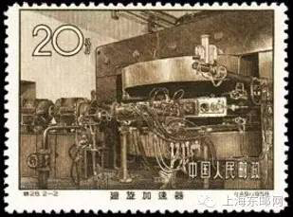
1. History of the accelerator development in China
In 1957, a 2.5MeV proton electrostatic accelerator was built in China Institute of Atomic Energy (CIAE).
In 1958, the first cyclotron in China was built in CIAE; A 400 KeV high voltage multiplier was built in Tsinghua University.
Stamp in memory of the first cyclotron in China
In 1959, a 5 MeV betatron was build in Tsinghua Univ.
In 1964, a 30 MeV electron linac was built in the Institute of Physics (the predecessor of IHEP).
In 1965, a 2.5 MeV electron cyclotron was built in Tsinghua Univ.

Slide 4
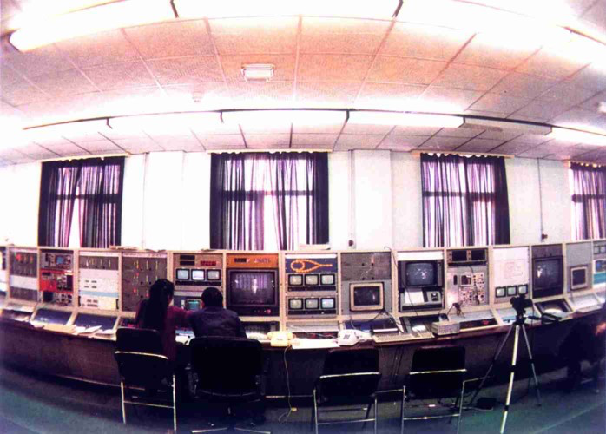
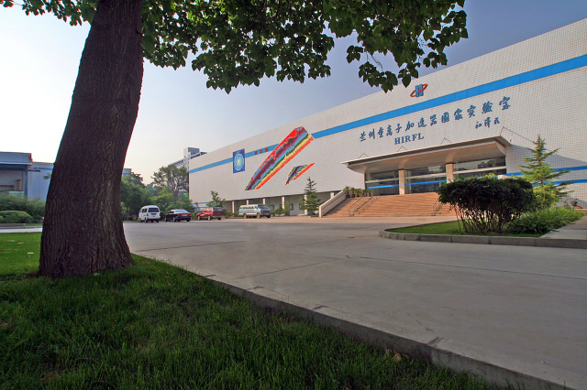
In 1982, the first proton linac (10 MeV) in China was built in IHEP.
In 1988, Beijing Electron Positron Collider (BEPC) was built in IHEP; HIRFL (Heavy Ion Research Facility in Lanzhou ) was put into operation in the Institute of Modern Physics (IMP).
Control room of BEPC
HIRFL

Slide 5
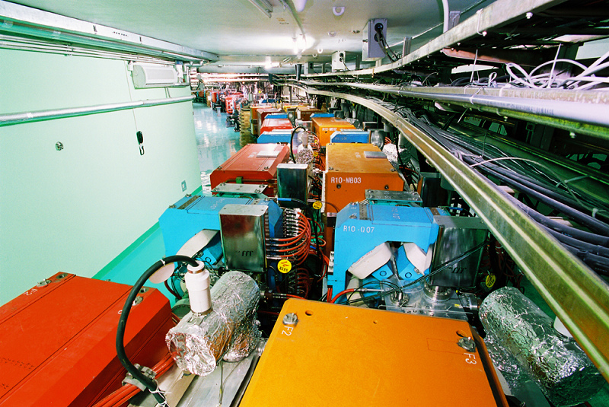
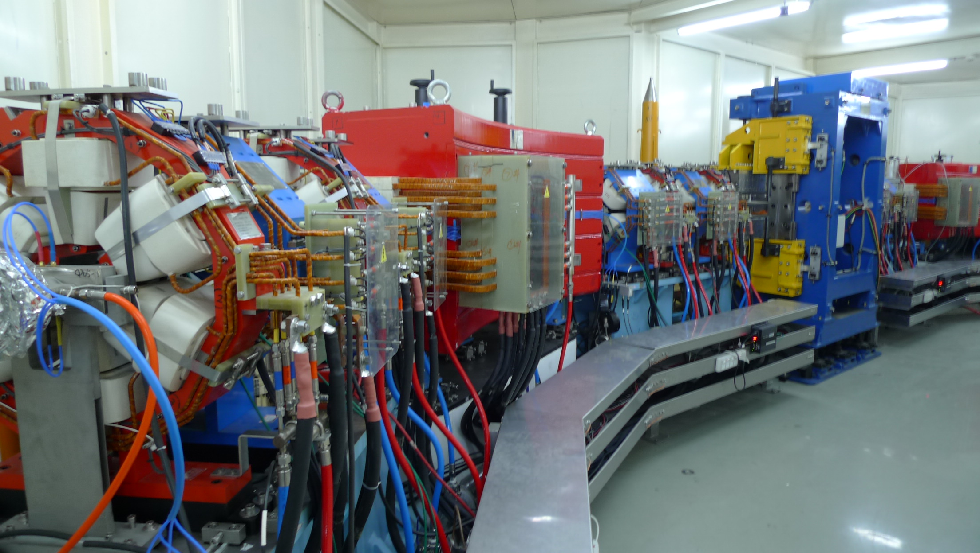
In 1989, the first dedicated synchrotron radiation facility (NSRL) in China was built in USTC in Hefei.
In 2004, Phase II Project of NSRL was completed.
In 2008, HIRFL-CSR Project passed the state inspection.
In 2009, the major upgrade of BEPC (BEPCII) passed the State Acceptance Test and was put into operation.
The storage ring of BEPCII
The storage ring of NSRL

Slide 6
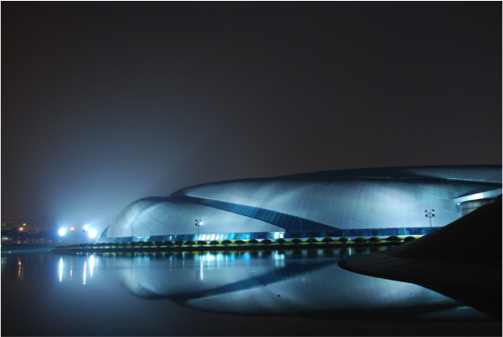
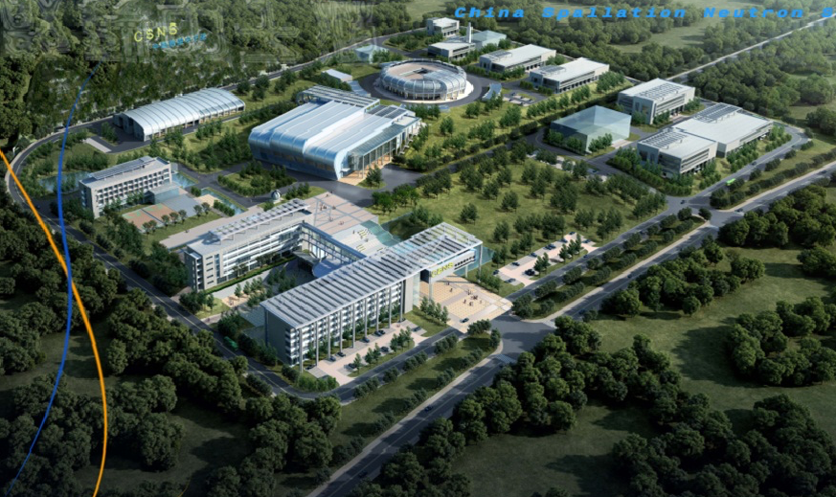
In 2010, Shanghai Synchrotron Radiation Facility (SSRF) passed the state inspection.
In 2011, China Spallation Neutron Source (CSNS) construction started in Dongguan, Guangdong province.
…...
SSRF
CSNS

Slide 7
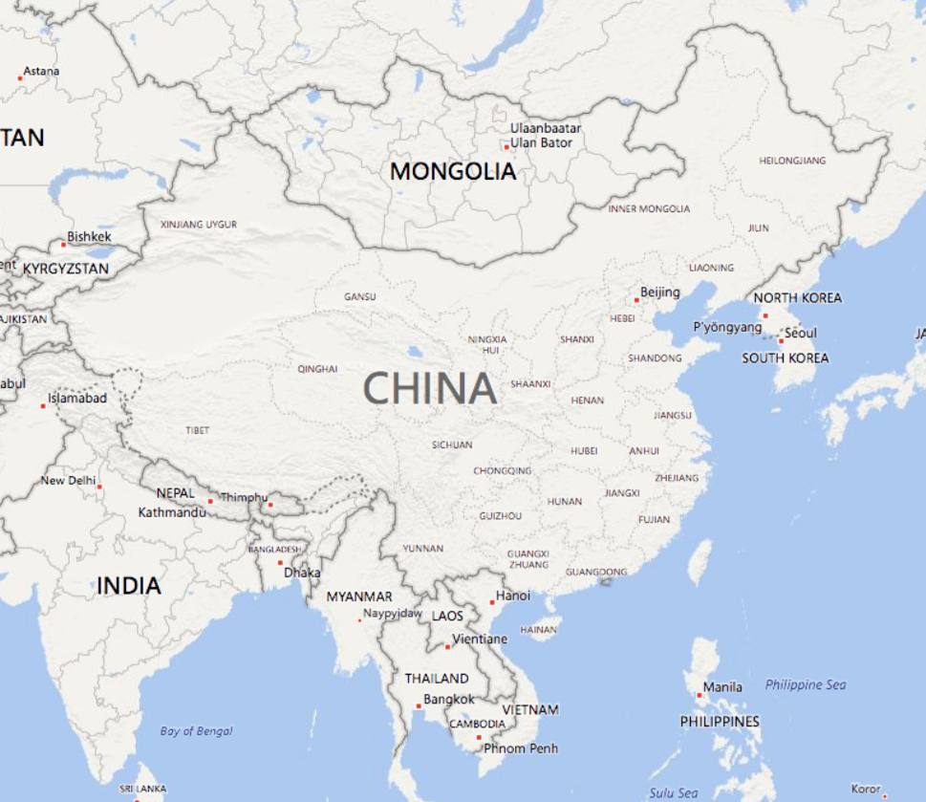
Accelerator Research in Institutes and Universities of China
HIT
IHEP (BEPC)
Tsinghua Univ.
IMP
Peking Univ.
CIAE
USTC (NSRL)
CAEP
HUST
SIAP (SSRF)
NSRRC
IHEP (CSNS)

Slide 8
2. Introduction of some accelerator facilities of China

Slide 9
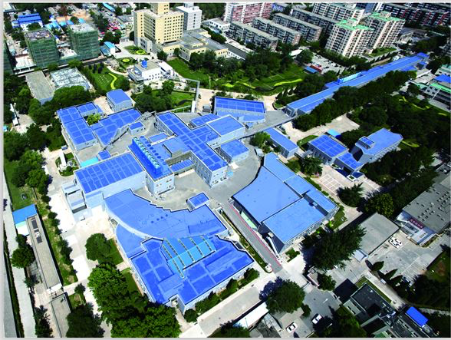
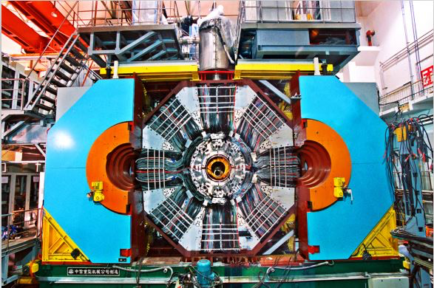
Institute of High Energy Physics
The Institute of High Energy Physics (IHEP) of the Chinese Academy of Sciences (CAS) was founded in 1973. IHEP is a comprehensive research base for particle and astroparticle physics, accelerator physics and technology, radiation technologies and applications, as well as for nuclear analytical techniques and interdisciplinary research.
IHEP manages a number of China’s major scientific facilities, including the Beijing Electron Positron Collider (BEPC), the Beijing Spectrometer (BES), the Beijing Synchrotron Radiation Facility (BSRF), the International Cosmic-Ray Observatory at Yangbajing in Tibet, the Daya Bay Reactor Neutrino Experiment, the China Spallation Neutron Source, the Hard X-ray Modulation Telescope (HXMT), and the Accelerator-driven Sub-critical System (ADS) as well as the Jiangmen Underground Neutrino Observatory (JUNO).
The main building of IHEP
A Bird’s View of BEPCII
BESIII

Slide 10
Since the first successful e+e- collisions at the Beijing Electron Positron Collider (BEPC) in October 1988, IHEP has become established as one of the world’s major High Energy Physics (HEP) laboratories. Several important physics results were obtained with BEPC by the Beijing Spectrometer (BES) collaboration, such as the precision measurement of the τ lepton mass, direct and model-independent measurement of the Ds meson decay constant, precision measurement of the resonance parameters of the J/ψ, and precision measurements of hadron cross-sections (R values) for electron-positron annihilations in the 2-5 GeV energy region.
In July 2009, the major upgrade of BEPC (BEPCII) passed the State Acceptance Test and was put into operation, with an initial luminosity 30 times greater than BEPC. In recent years, the luminosity of BEPCII has been continuously improved to an unprecedented level, allowing the BESIII Collaboration to obtain a number of very important new results, such as the discovery of charged charmonium Zc (3900) and the first observation of many new light hadrons.
On April 5th 2016, the luminosity of BEPCII reached the design goal, 1×10³³ cm⁻²s⁻¹.

Slide 11
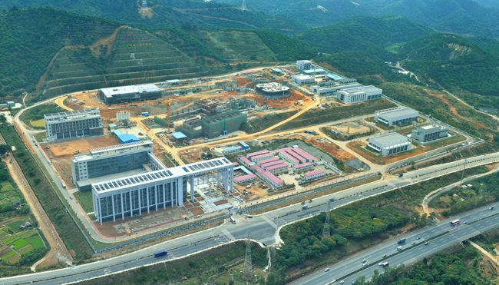
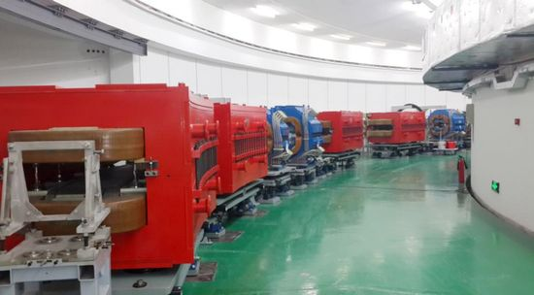
China Spallation Neutron Source (CSNS)
CSNS construction site locates in Dongguan, Guangdong province. It is about 85 km from Guangzhou and about 125 km from Hong Kong. IHEP will set up a new branch on the present green field. CSNS will be the first large scientific facility in the south China where the economy grows very rapidly. It is expected the CSNS construction and operation will have positive effects in promoting the sciences and high-tech development in the area.
(1.6 GeV, 100 kW, ~ 230 m)
Bird view of CSNS (2015)
RCS of CSNS (2016)

Slide 12
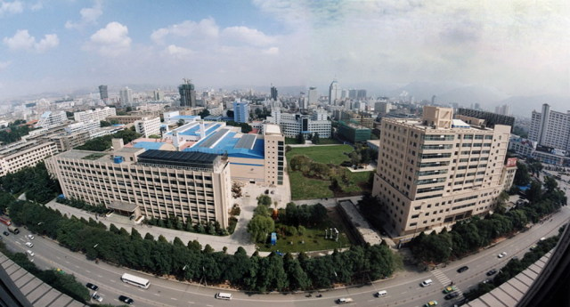
The Institute of Modern Physics
The Institute of Modern Physics (IMP) of the Chinese Academy of Sciences was founded in l957. IMP operates the Heavy Ion Research Facility in Lanzhou (HIRFL), which consists of the Sector Focusing Cyclotron, the Separated Sector Cyclotron, the Cooler Storage Ring (CSR), and a number of experimental terminals. After a half century of development, IMP has become the most important research center for heavy ion sciences in China.
Cancer therapy has been developed at IMP since 2006. In collaboration with local government agencies and hospitals，two dedicated heavy-ion treatment facilities are under construction in Lanzhou and Wuwei in Gansu Province.

Slide 13
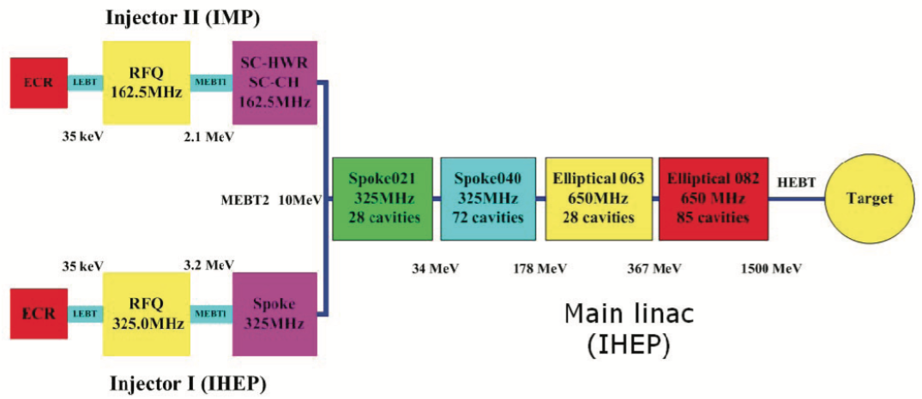
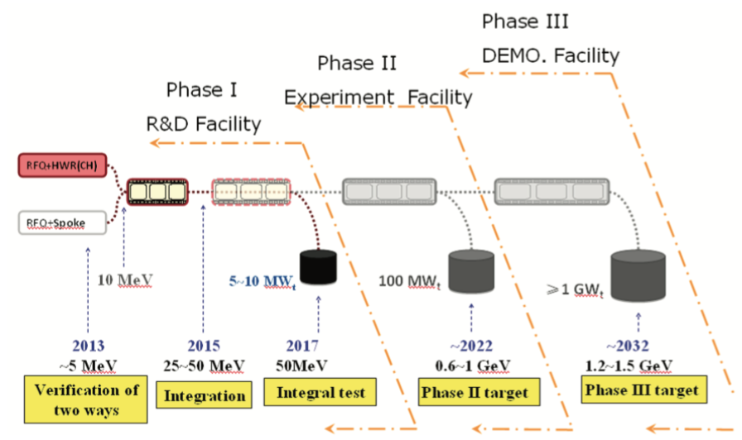
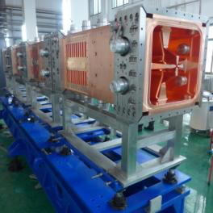
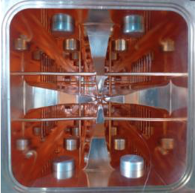
In 2010, IMP took charge of the Advanced Nuclear Fission Energy Program-ADS Transmutation System, a strategic priority research program of CAS. In collaboration with other institutes in China, the project was approved by the central government at the end of 2010. This long-term project aims to build a demonstration facility for the transmutation of nuclear waste produced in nuclear power plants.
Layout of ADS Accelerator
Road map of ADS
162.5MHz/2.1MeV 15mA RFQ for ADS (2014)

Slide 14
National Synchrotron Laboratory
National Synchrotron Laboratory (NSRL) is the first dedicated synchrotron radiation facility in China, which locates on the West Campus of the University of Science and Technology of China (USTC), in Hefei, Anhui Province.
It is one of the key issues of China’s investments on large-scale scientific research facilities. Its construction began on Nov. 20, 1984, and completed with a national review in Dec. 1991. After Phase II Project from 1999 to 2004 and Upgrading from 2012 to 2014, NSRL now owns a fully upgraded soft X-ray synchrotron radiation facility. The synchrotron is close to the 3rd generation level, and the facility is now with five ready-to-use endstations: combustion and flame, soft X-ray microscopy, catalysis and surface science, angle resolved photo-emission spectroscopy, atomic and molecular physics. It has six other beamlines now open for future endstations.

Slide 15
3. Accelerator research in some universities of China

Slide 16
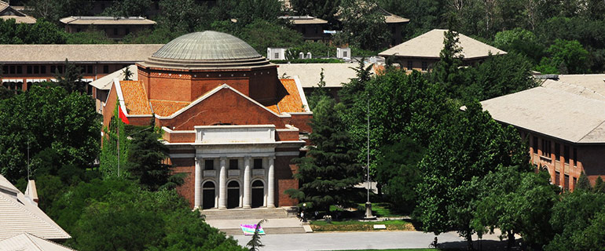
Tsinghua University
The Accelerator Lab of Tsinghua Univ. is engaged in research of low energy electron linac, accelerating structure, and beam dynamics.
The lab participated in designing and manufacturing China's first electron linac for medical applications, irradiation and dosage benchmarking. Besides the extensive research in S-band accelerator, the lab also devoted much efforts in designing and manufacturing C-band, L-band and X-band accelerators.

Slide 17
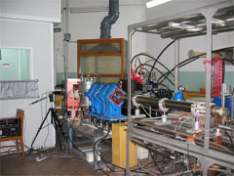
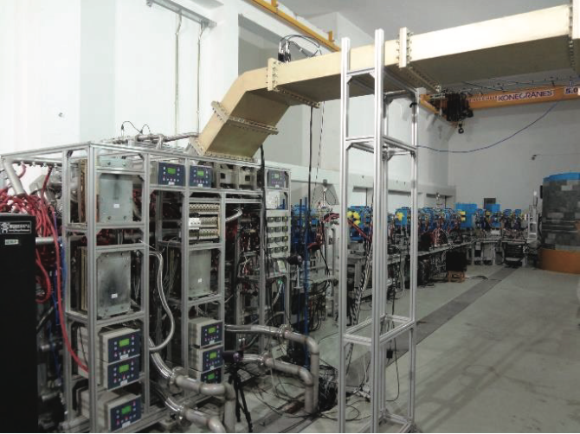
The lab's goal is to construct an advanced center for low energy electron linac research, an advanced X-ray source based on Thomson scattering and an influential cradle for cultivation of qualified researchers in accelerator physics.
Some courses on accelerator have been offered to undergraduate and graduate for many years. A great number of people graduated from Tsinghua entered many accelerator labs in China.
Cargo & vehicle inspection of NUCTECH
Tsinghua Thomson scattering X-ray source
Compact Pulsed Hadron Source (CPHS) linac facility and the target station (2013)

Slide 18
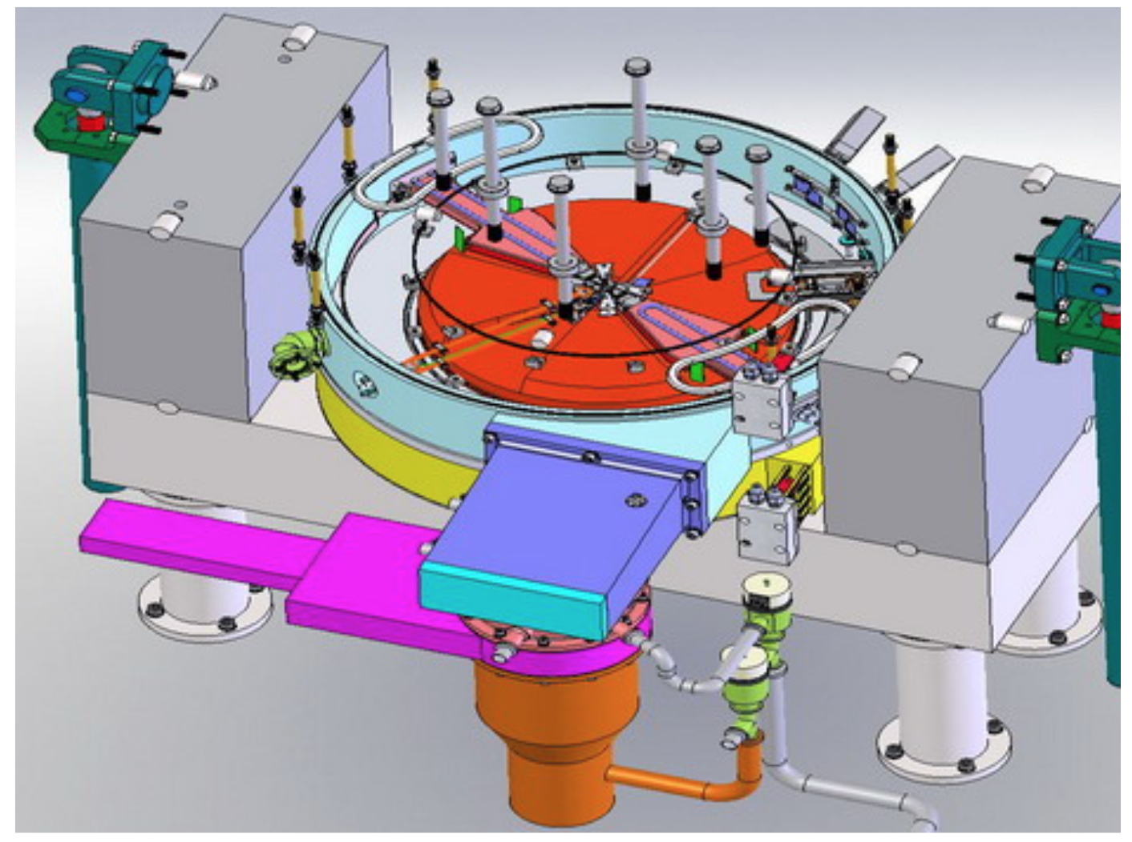
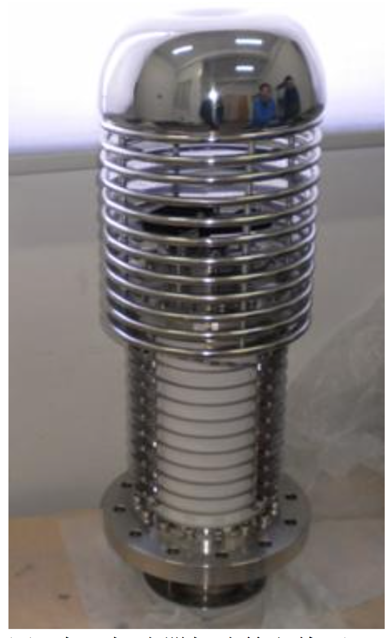
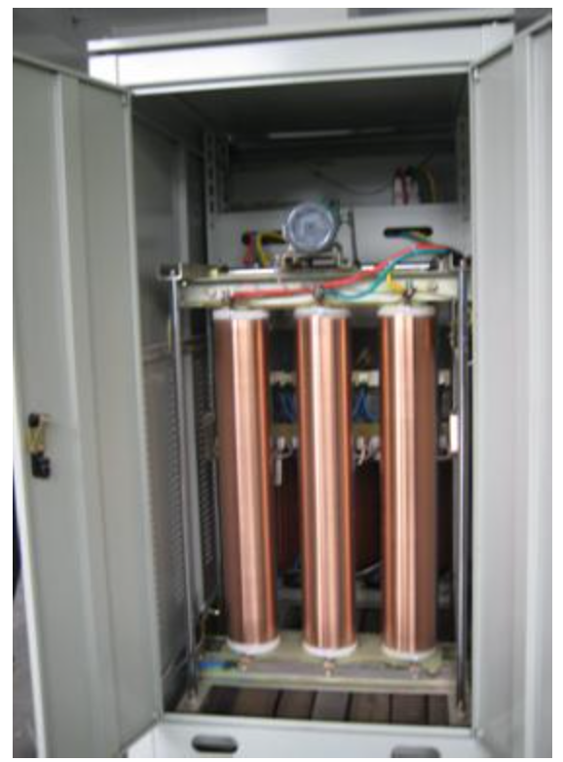
Huazhong University of Science and Technology
Huazhong University of Science and Technology (HUST) is located in Wuhan, Hubei Province. HUST established a “Electromagnetic Theory and Charged Particle Beam Application Research Center” specialized on researches of the development and application of low energy particle accelerator. The accelerators under the R&D conducted by this center are the low energy cyclotron and low energy high voltage electron accelerator.
Low energy cyclotron
Acceleration Tube
100k VA Transformer

Slide 19
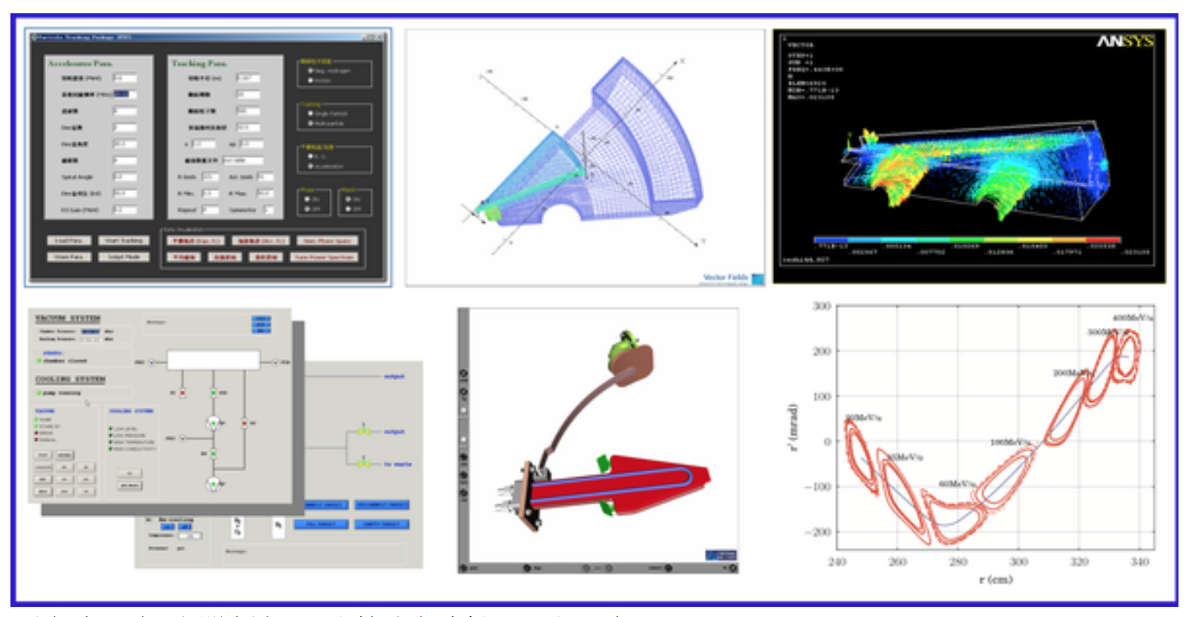
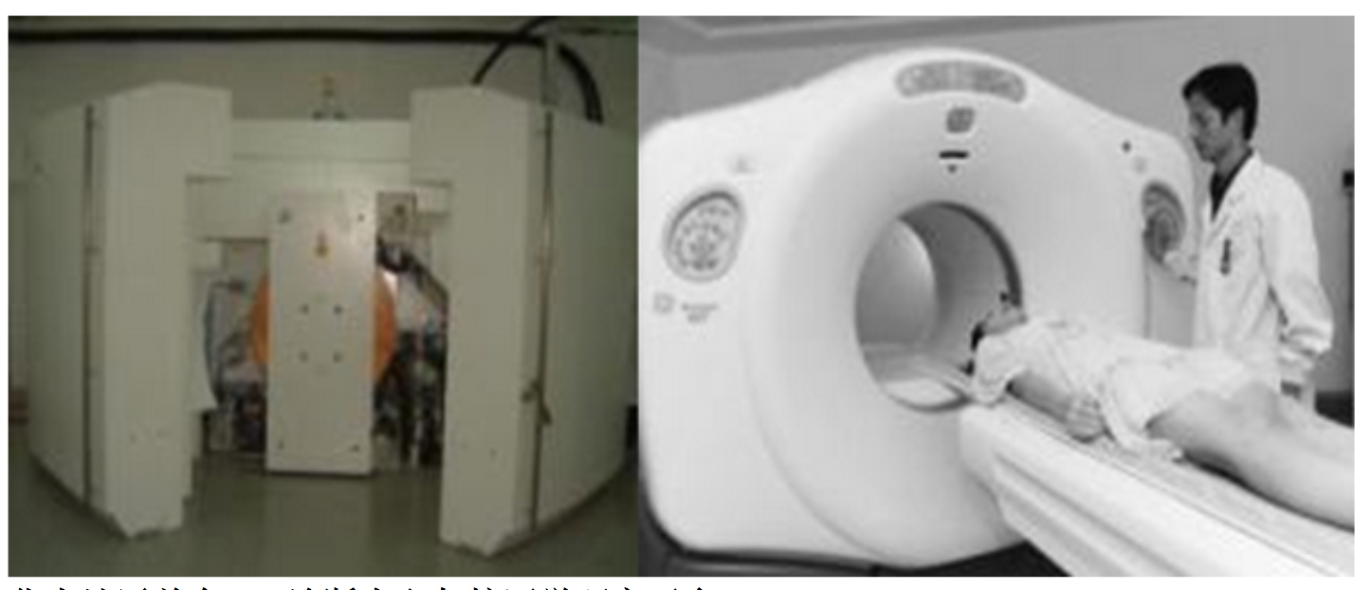
Supported by a number of national projects and cooperating with other schools in HUST and local hospital, this institute has built seven accelerator related experimental platforms.
Accelerator-design-oriented virtual prototype platform
The first PET diagnostic center and nuclear medicine platform in Central China

Slide 20
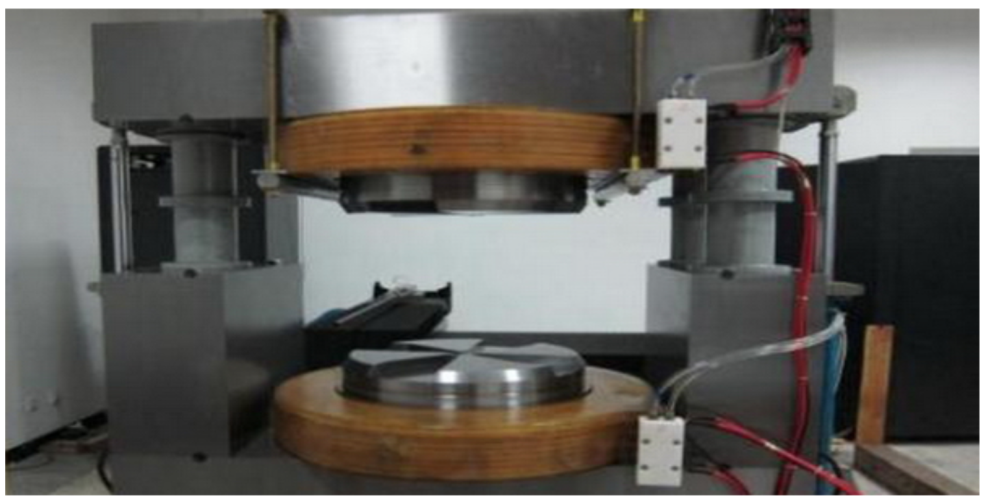
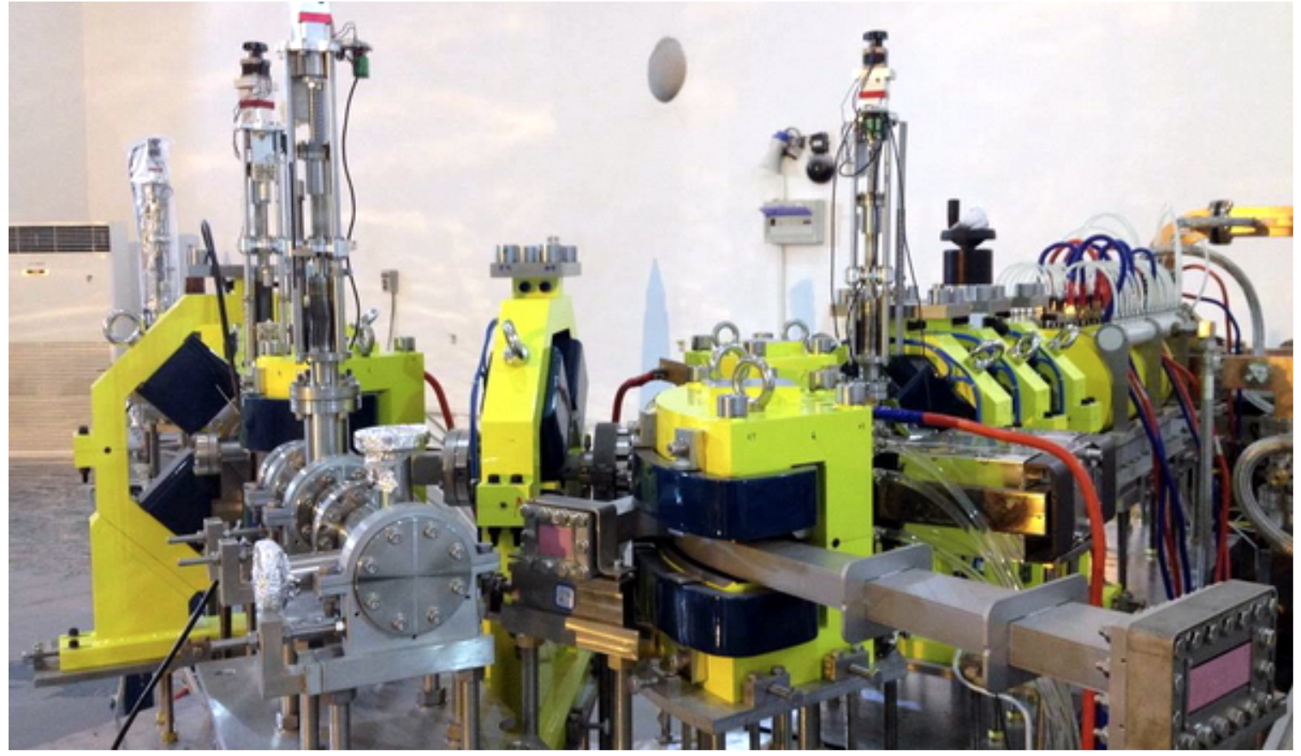
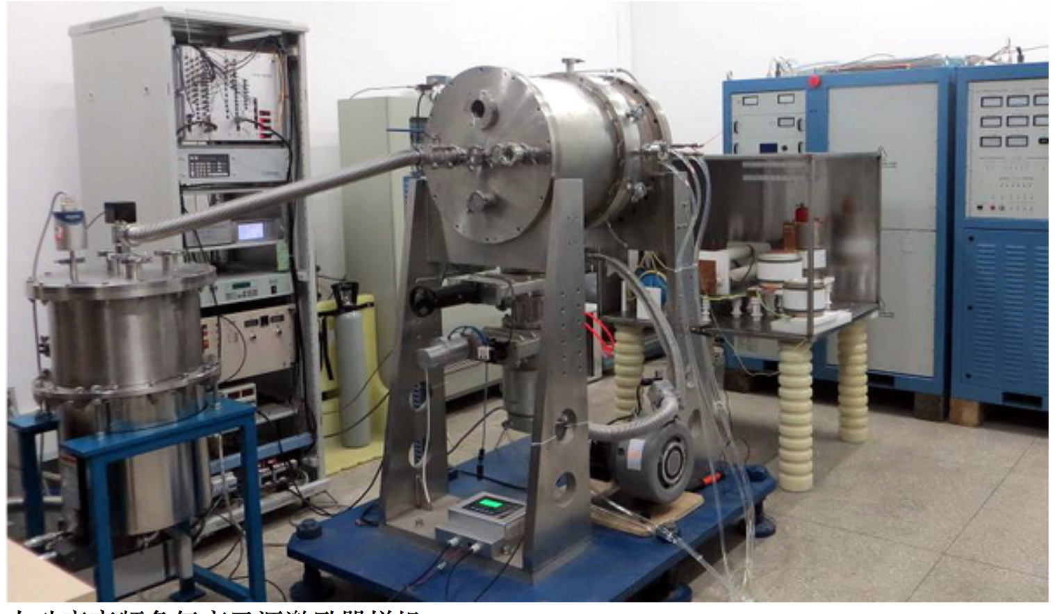
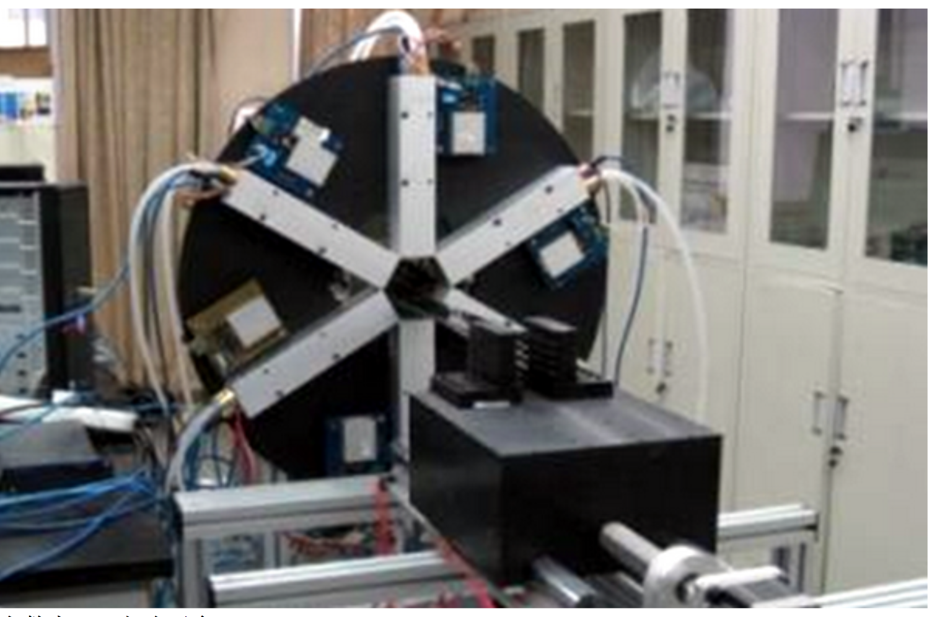
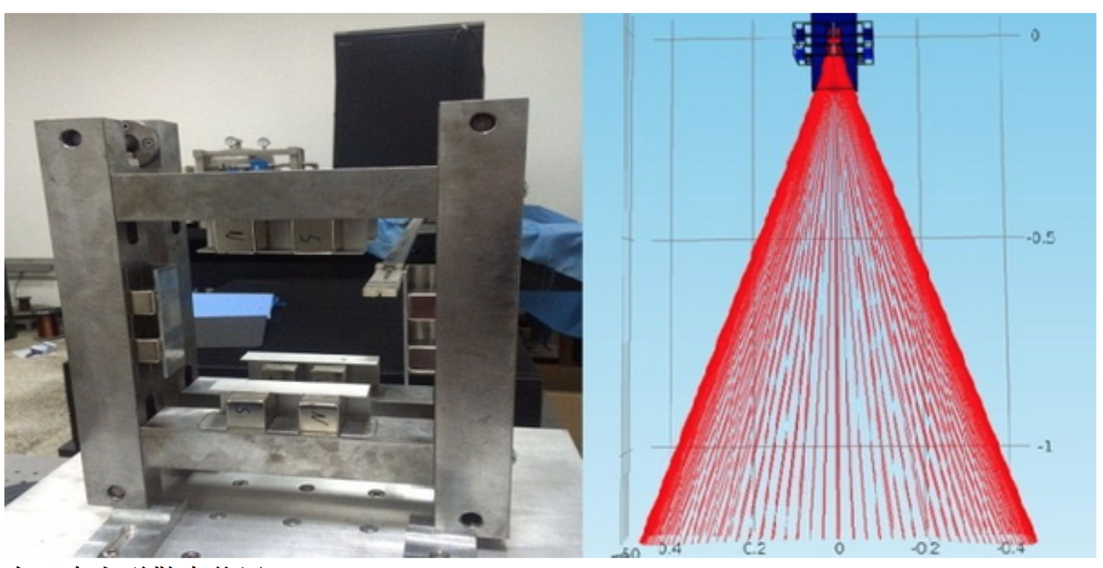
Magnet for 10MeV compact cyclotron
Compact Terahertz FEL source
prototype of H⁻ source RF exciter
Digital PET platform
permanent magnet spread system

Slide 21
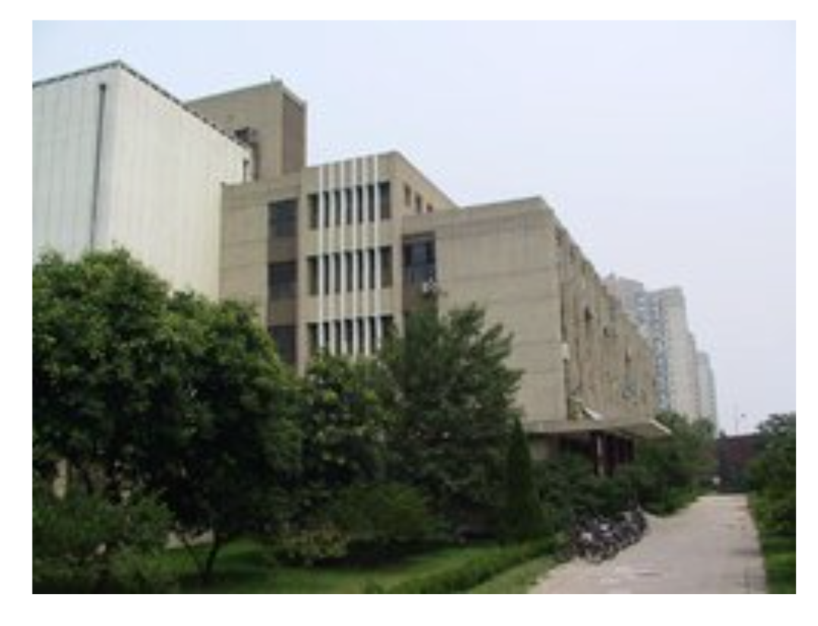
Accelerator Study in Peking University
In Peking University, accelerator research is mainly developed in the Institute of Heavy Ion Physics and State key Laboratory of Nuclear Physics and Technology.
Based on the advantages of a great number of talented staff and multi-disciplines in the Peking University, through 60’s years accumulation and development, over 5,000 talents have grown up in nuclear science and technology.
Now, accelerator study in Peking University concentrates on these areas:
FEL and RF superconducting accelerator
RFQ
Accelerator-based mass spectroscopic
Ion beam physics and Its Applications
Advanced particle accelerator technology
Neutron and fission physics
Electrostatic Accelerator Laboratory
Institute of Heavy Ion Physics

Slide 22
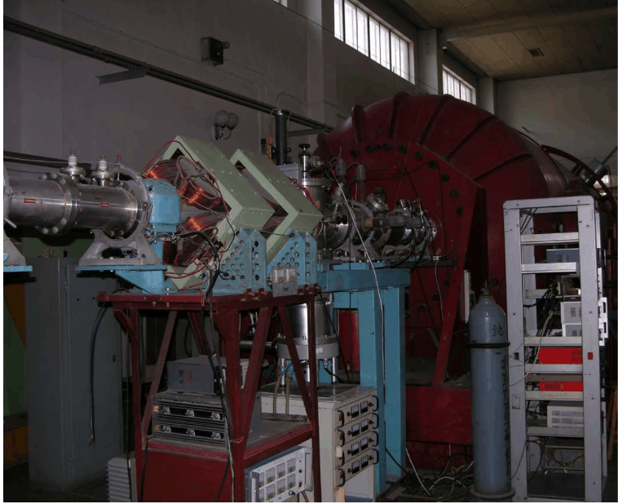
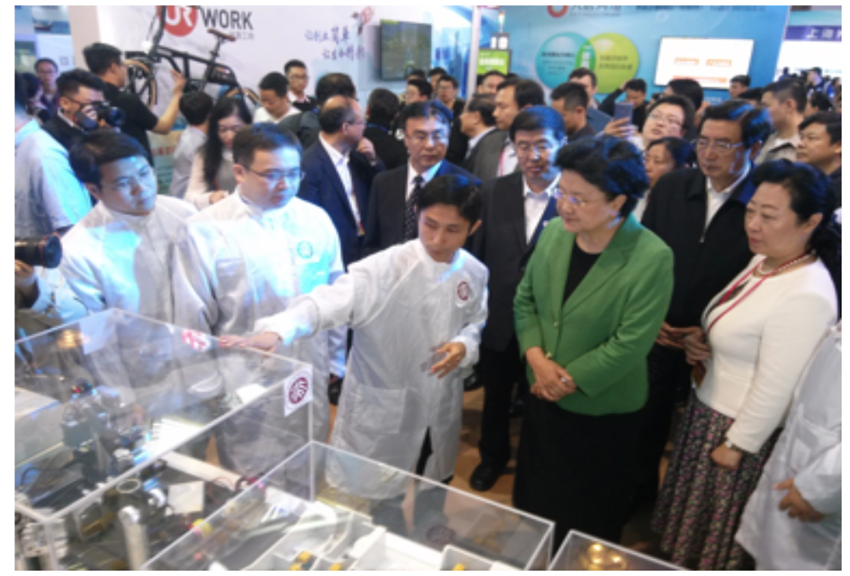
Accelerator Study in Peking University
There are over 50 staff ( > 30 obtained PhD) in the Institute of Heavy Ion Physics and there are about 80 staff in the State key Laboratory of Nuclear Physics and Technology.
Large scale accelerator research equipment in Peking University including:
2×1.7MV EN tandem accelerator, 1MV RFQ, 4.5MeV Van de Graaff Accelerator, Laser particle accelerator……

Slide 23
Shanghai Synchrotron Facility
SSRF as a advanced third generation light source is the Chinese largest synchrotron research facility to date. Since commencing operation in May 2009 the SSRF has provided bright x-ray beams to more than 10000 users from universities, institutes, hospitals and high-tech companies from around the China and the world. SSRF is also actively involved in the training and education of our next generation of scientists and engineers.
(3.5 GeV, ~4 nm, ~300 mA, 432 m)

Slide 24
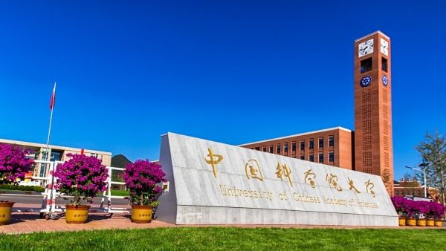
University of Chinese Academy of Sciences
University of Chinese Academy of Sciences (UCAS) is a higher education institution established with the approval of the Ministry of Education, focusing on graduate education. The predecessor of UCAS was the Graduate School of Chinese Academy of Sciences (GSCAS), which was founded in 1978 as the first graduate school in China by approval of the State Council. UCAS graduated the first doctoral student in science, first doctoral student in engineering, first female doctoral student and first student with double doctoral degrees in China. In 2014, UCAS began to recruit undergraduates.

Slide 25
In June 2012, GUCAS was renamed UCAS. It started enrolling undergraduate students for the first time, and its mission is to cultivate innovative leading talents in science and technology for the future of the nation. Now there are 664 registered undergraduate students studying in this university.
Being the largest graduate education institution, UCAS' main task has long been graduate education. Up to December 2015, the number of postgraduate students is 44,500, including 22,300 doctoral students, 22,200 master students, and 1063 international students including 749 doctoral students, ranking first in China.
A dozen professors of IHEP have taught accelerator-related courses in UCAS(GSCAS) over ten years. Every year, over 40 graduate students take part in these courses study.

Slide 26
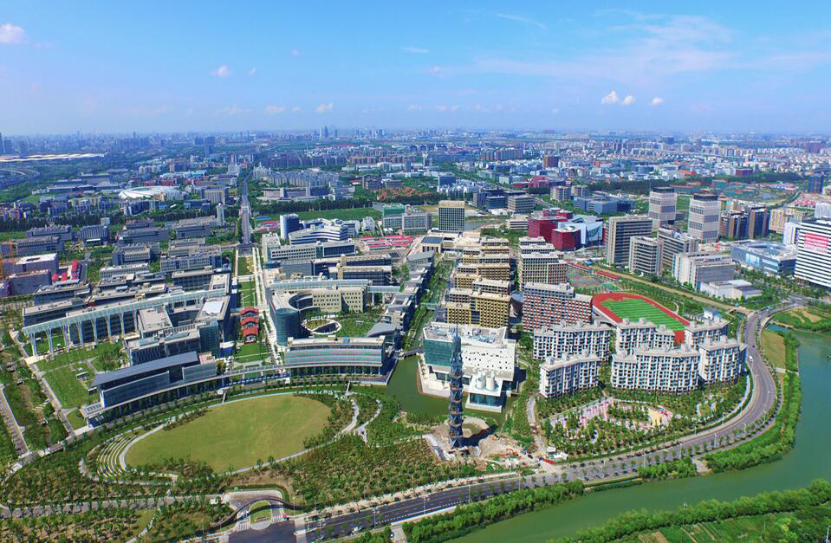
ShanghaiTech University
Officially approved to open on September 30th 2013 by China’s Ministry of Education, ShanghaiTech University is a small-scale research university of academic excellence jointly established by Shanghai Municipal Government and Chinese Academy of Sciences (CAS).
ShanghaiTech located in Shanghai Pudong Science and Technology Park of CAS in Zhangjiang InnoPark, it is in the vicinity of several national research
institutes and large scientific facilities, such as CAS Shanghai Advanced Research Institute, Shanghai Synchrotron Radiation Facility, and close to industries and venture funds within the Zhangjiang InnoPark.
The undergraduate students will reach 2,000 and graduate students will reach 4,000.

Slide 27
4. Summary
Over the past 30 years, China has achieved great success in the field of accelerator with the support of the country. Many large scale accelerator facilities were built, such as BEPC, NSRL, HIRFL, SSRF, etc. And some small scale accelerator equipment were developed, such as the first RFQ of China in Peking Univ., CPHS in Tsinghua Univ., Compact Terahertz FEL source in HUST, etc.
Now some accelerator projects are or will be started. A strategic priority research of ADS is carried out since 2010. CSNS construction started in 2011. The normal operation for users is foreseen in 2018. HEPS (High Energy Photon Source) as a advance photon source (6 GeV, <6 pm, ~200 mA, ~1.3 km) will be constructed in 2018. Pre-study of CEPC-SppC is in progress since 2013.
More and more young people are attracted to the accelerator field. Accelerator area are showing a very good prospects.

Slide 28
Thanks for your attention!

