Slide 1

Universities and Laboratories in Japan
Yasuhiro Okada
Executive Director, KEK
“Universities meet Laboratories”
November 4, 2016, LAL, France
Input from Seiya Yamaguchi, Director, Accelerator Laboratory, KEK
Reference: Susumu Kamada, 1st EuCAN WS “ Universities meet Laboratories”

Slide 2
Accelerator Facilities in Japan
Major accelerator facilities (KEK, RIKEN, J-PARC)
Joint Usage / Research Center (University-based)
Light source facilities
Medical accelerators
Various accelerators in universities, research institutes, and industry

Slide 3
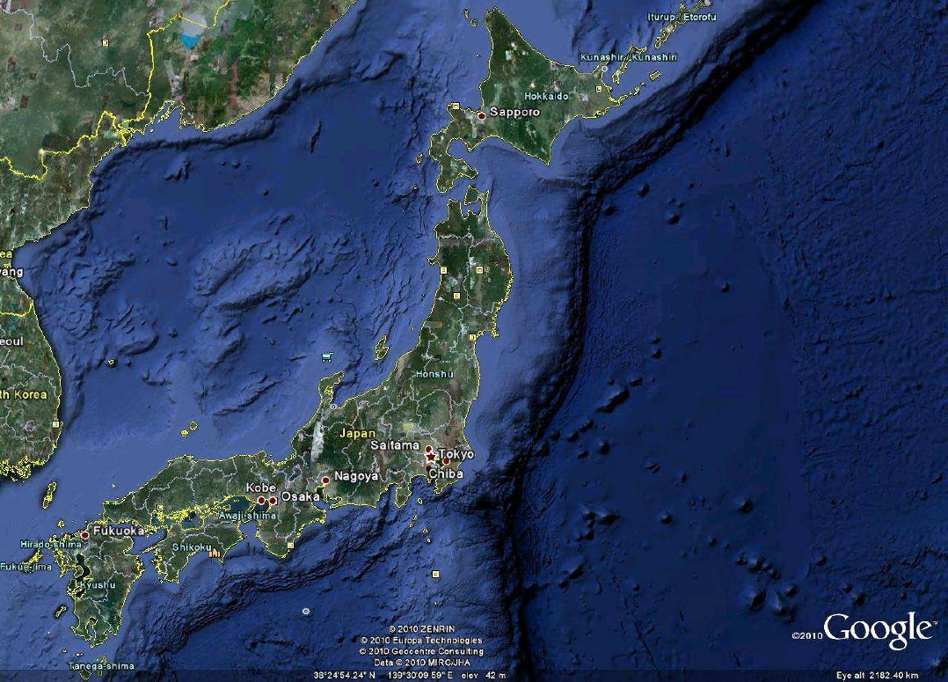
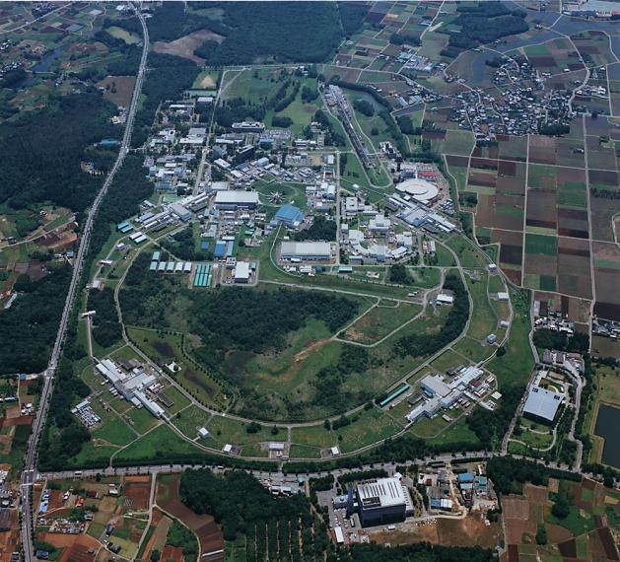
KEK and J-PARC
KEK Tsukuba campus
J-PARC
A joint project between KEK and Japan Atomic Energy Agency (JAEA)
Super KEKB
Photon Factory
ATF, STF, cERL

Slide 4
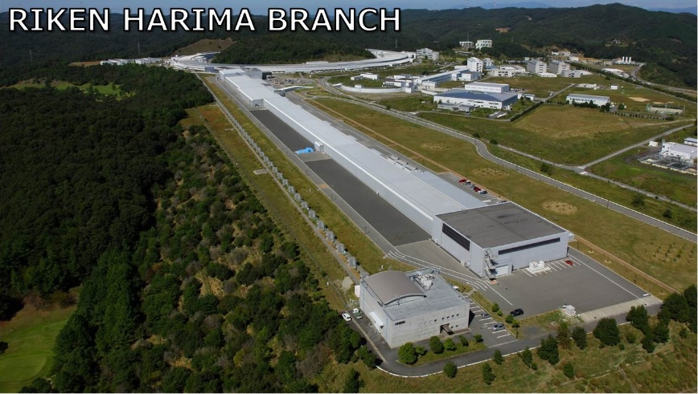
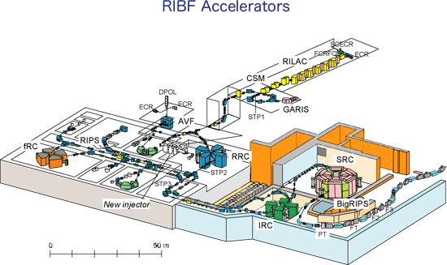
RIKEN (Wako, Harima)
RIKEN (Harima)
Spring-8, SACLA
RIKEN(Wako)
RI Beam Factory (RIBF)

Slide 5
Joint Usage/ Research Center in Universities
.
Research Center fro Nuclear
Physics (RCNP), Osaka University
Research Center for Electron
Photon Science(ELPF),
Tohoku University
Hiroshima Synchrotron
Radiation Center (HiSOR),
Hiroshima University
.
.
.
Research Reactor Institute (KURRI),
Kyoto University

Slide 6
Light Source Facilities in Japan

Slide 7
From S. Kamada, 1st EuCAN WS “ Universities meet Laboratories”

Slide 8
Number of accelerator scientists and staff
KEK: Accelerator Laboratory ~230
(Applied Research Laboratory ~80
including Cryogenics science, Mechanical engineering)
RIKEN RIBF ~25
Spring-8, SACLA ~70
J-PARC (from JAEA) ~30
Universities ~110

Slide 9
Different organization system
Accelerator scientists belong to organizations of different types. Their hiring
system, carrier paths are different.
National Research and Development Agency
RIKEN
JAEA
National Institutes for Quantum and Radiation Science and Technology (QST)
(including charged particle therapy)
Inter-University Research Institute Corporation
KEK
Institute of Molecular Science, UVSOR
University
Joint Usage/Research Center in Universities
University researchers

Slide 10
Graduate school education in accelerator science
The Graduate University for Advanced Studies (SOKENDAI)
A graduate school based on Inter-University Research Institutes
Department of Accelerator Science is associated to KEK
We have been accepting about 3 students per year including
foreign students (mostly from Asian counties)
Number of students in accelerator science
 | Active PhD students | PhD theses /year
SOKENDAI | 9 | ~4
Other Universities | 30 | ~8
Total | ~40 | ~12
The total number of SOKENDAI students at KEK is about 60

Slide 11
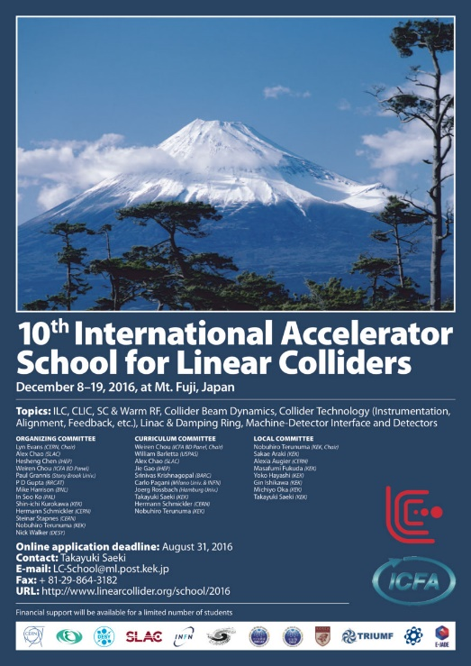
Cooperation/Collaboration between KEK and Universities
R&D for future accelerator projects
ILC R&D, cERL, etc.
Collaboration in various national funding R&D programs
KEK support program in accelerator-related science
Technical, intellectual, and financial support to research and educational
activities in universities
Support to domestic and international accelerator-related schools
Accelerator seminar
OHO series since 1984
Students, young researchers and engineers from univeisities and industriy

Slide 12
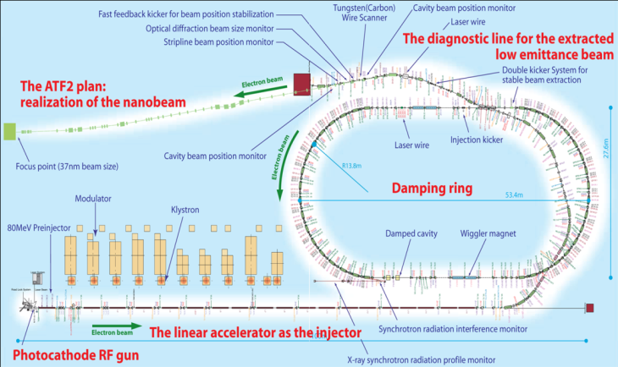
International collaboration in accelerator science
KEK hosts large international HEP experiments
~700 members in Belle II
~500 members in T2K
The ATF collaboration is a very successful international collaboration in accelerator science

Slide 13
Collaboration in the Horizon 2020 programs
E-JADE
Europe-Japan Accelerator Development Exchange Programme
Accelerator collaboration in HL-LHC, ATF, ILC, etc.
CERN, France, Spain, Germany, UK
JENNIFER
Japan and Europe Network for Neutrino and Intensity Frontier Experimental Research
Collaboration in Belle II and T2K experiments
Italy, Germany, Austria, Poland, Czech Republic, Slovenia,
Turkey, France, Spain, UK

Slide 14
Mobility of accelerator scientists
Accelerator field has less mobility than other fields, for example,
the HEP field in Japan.
KEK dominates in number of positions in accelerator scientists
Although KEK employs a similar staff system to universities
(Professor, Associate Professor, Assistant Professor, PD)
other national research laboratories have a quite different system.

