Slide 1
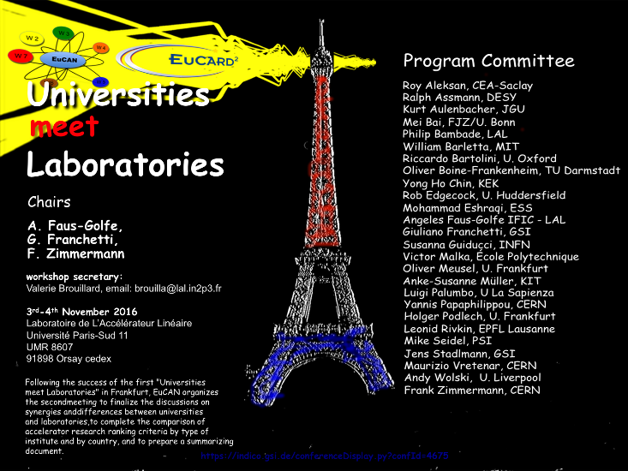
EPS-AG and EPS-AG initiatives
G. Arduini, M. Seidel
For the EPS-AG Elected Board

Slide 2
Who are we?
EPS-AG:
277 members to date
The EPS-AG is managed by an Elected Board (18 Members). Elections to the Board are held every three years, and a General Assembly takes place during each IPAC in Europe.

Slide 3
Elected Board Members (2014-17)
Board Chair | Gianluigi Arduini, CERN
Board Chair-Elect | Mike Seidel, PSI
Former Board Chair, Ex-officio | Andy Wolski, U. Liverpool, Cockcroft Institute
CERN | Paul Collier, Maurizio Vretenar, Frank Zimmermann
France | Philip Bambade, LAL Marie-Emmanuelle Couprie, SOLEIL
Germany | Ralph Assmann, DESY Oliver Boine-Frankenheim, GSI Anke-Susanne Müller, FZK/ANKA
Italy | Giovanni Bisoffi, INFN/LNL Susanna Guiducci, INFN/LNF
Spain | Angeles Faus-Golfe, IFIC Montse Pont, CELLS
Sweden | Andreas Jansson, ESS
Switzerland | Hans-Heinrich Braun, PSI
UK | Deepa Angal-Kalinin, STFC/DL/ASTeC
Board IPAC'17 SPC Chair and IPAC'17 OC Chair | Gianluigi Arduini, CERN, Elected 2008, Board Mandate 2011, 2014 IPAC'14 SPC Chair and Board Chair-elect, IPAC'17 Board and OC Chair
Board Chair-Elect and IPAC'17 SPC Chair | Mike Seidel, PSI, Elected 2011, Board Mandate 2014, 2017 IPAC'17 SPC Chair and Board Chair-elect, IPAC'20 Board and OC Chair
Former Board and IPAC'17 OC Chair, Ex-officio | Andy Wolski, U. Liverpool, Cockcroft Inst., Elected 2008, Board Mandate 2011, 2014, IPAC'11 SPC Chair and Board Chair-elect, IPAC'14 Board and OC and Board Chair, 2014-2017 Ex-officio Board Member

Slide 4
Aims of EPS-AG
The aims of the EPS Accelerator Group are:
to promote research and development of all kinds of particle accelerators and the associated technology, as well as their applications;
to encourage contacts between specialists in the field in European and non-European institutions, in particular through the organization of the International Particle Accelerator Conference (IPAC) when held in Europe;
to stimulate international co-operation and exchange of information;
to promote efficient and effective use of resources and foster high standards
http://www.eps.org/group/EPS-AG

Slide 5
IPAC
EPS-AG has organized the European Particle Accelerator Conferences (EPAC) since 1988
Strong support to the creation of an International Particle Accelerator Conference (IPAC)
Aim: provide a comprehensive world-wide overview of the field of particle accelerators, as well as presentations of progress in all technologies involved.
Since 2010 3-year cycle:
Americas
Asia (including Oceania)
Europe (including Russia, Middle-East and Africa).

Slide 6
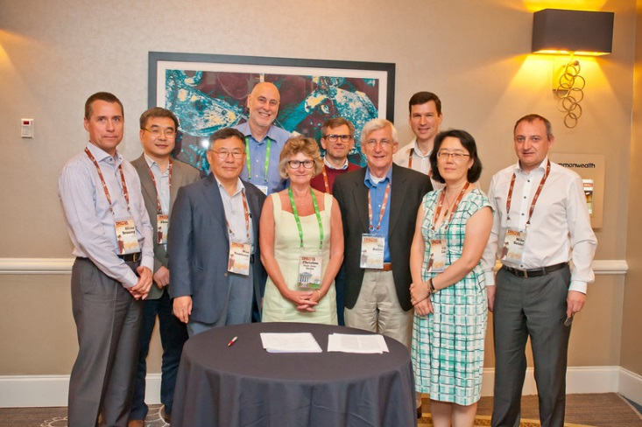
IPAC
MoU for the Coordination of IPACs in the three regions brought into effect at IPAC’15
The MoU defines a common set of rules for organizing IPACs, still leaving enough room for development.
Formalizing an effort of coordinating actions on subjects of common interest, e.g.:
Publications
Student support
Approach towards Industry

Slide 7
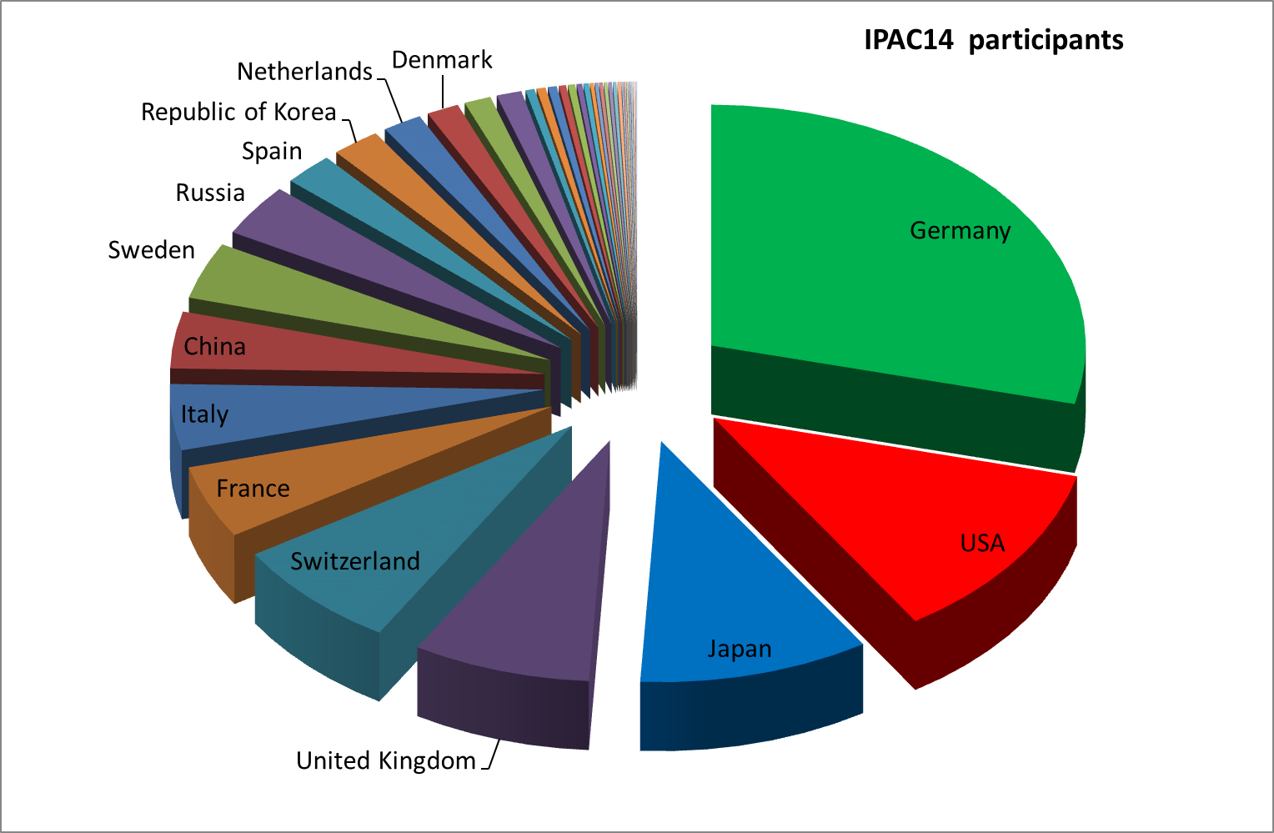
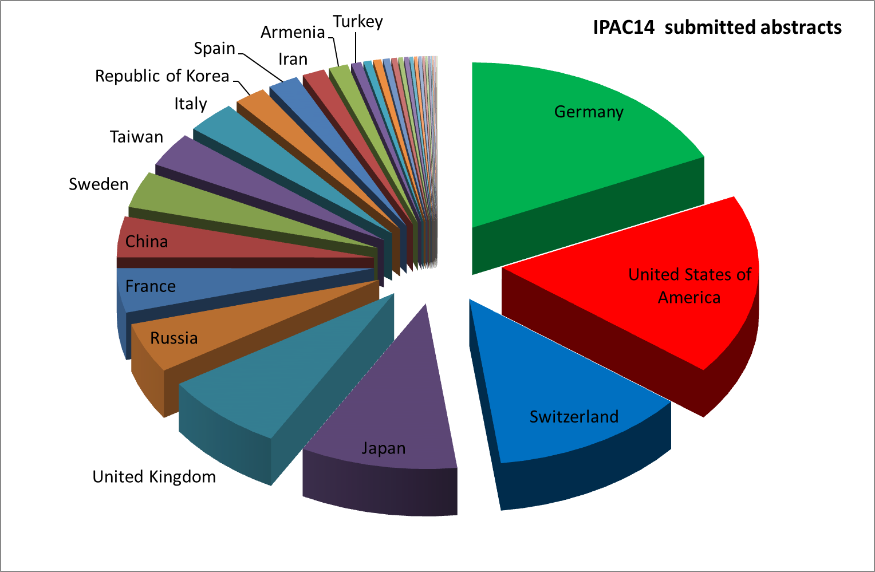
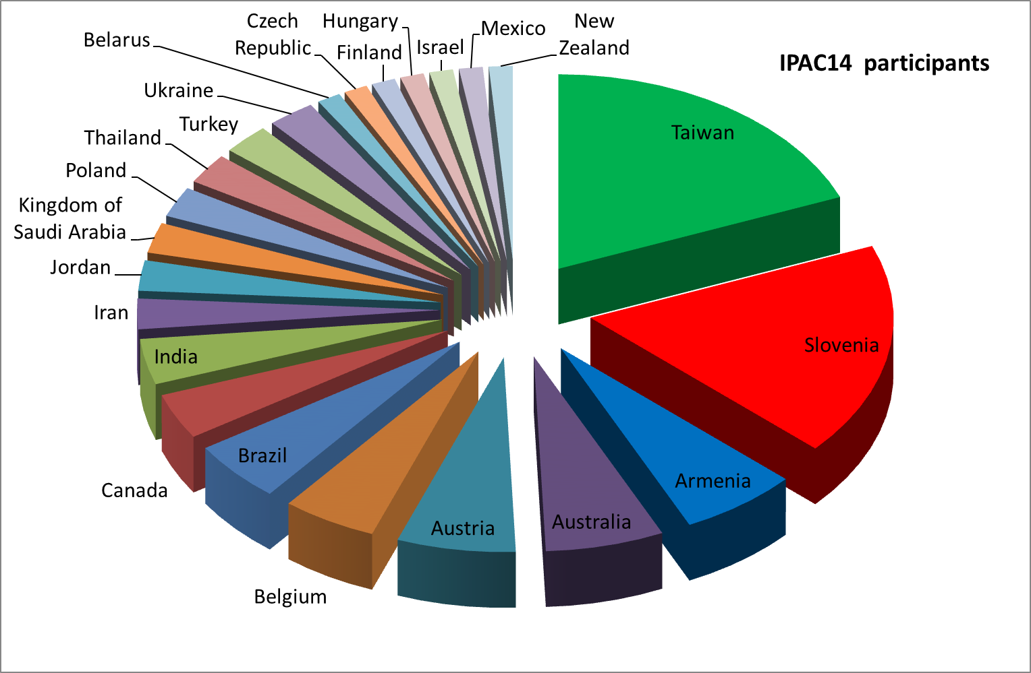
IPAC
An example:
IPAC’14 in numbers
1405 scheduled contributions by more than 200 Institutions or Companies from 33 different countries
1287 Participants from 37 different countries

Slide 8
Engagement with Students
Favour the interaction among students and Accelerator Scientists
Particularly important for small Centres/Universities/Countries entering the field
Student poster session is the highlight of the IPAC conferences (~100 participants)
EPS-AG is coordinating the collection of funds among the various European Laboratories to finance the grants for European Students
EPS-AG is heavily involved in the organization of the Student Poster Session in particular in the IPAC taking place in Europe
Notes:
Grat opportunity to exchange experience

Slide 9
Engagement with Students
Student programme:
Floor for students to present their work and establish contacts with Universities, Research Institutes and Industries for their possible professional development
Relying on the strong support of the European Laboratories:
Student grants (to European Students): IPAC’14: 92 (55), IPAC’15: 90 (30), IPAC’16: 75 (27)
Among the European Student Grant recipients: best JUAS student
How to extend/guarantee sustainability to the student programme?
Sponsorship by Industries ➔ Being pursued for IPAC’17 and in general for the IPAC series

Slide 10
Accelerator Prizes
Aimed at recognizing/highlighting the work of colleagues at different levels in their career as a model for the community and new comers:
The Rolf Wideröe Prize for outstanding work in the accelerator field with no age limit.
The Gersh Budker Prize for a recent, significant contribution to the accelerator field with no age limit.
The Frank Sacherer Prize for an individual in the early part of his or her career, having made a recent significant, original contribution to the accelerator field.
The Bruno Touschek Prize, awarded to a student registered for a PhD or diploma in accelerator physics or engineering or to a trainee accelerator physicist or engineer in the educational phase of their professional career, for the quality of work and promise for the future.

Slide 11
Publications & Dissemination Policy
Support opportunities for researchers in accelerator physics and technology to publish the results of their work as easily and effectively as possible, and in such a way that publications in the field of accelerators can be properly accounted in any assessment of research performance. Two main channels
JACoW (EPS-AG is one of the stakeholders, via the SPC)
Physical Review Accelerators and Beams (PRAB)
Collaboration with JACoW to improve the “visibility” of the Conference Proceedings
Improvement of referencing
First steps implemented for IPAC14: more space for the references in the articles
Sponsorship to PRAB from IPAC
demonstrates the support of the community for completely open access, high quality, refereed journals

Slide 12
Publications & Dissemination of Results – Actions
Support members of the accelerator science community in Europe, by raising issues in connection with the use of bibliometric data for the assessment of research performance
Letters to Institutions
Input for EPS Statements (http://c.ymcdn.com/sites/www.eps.org/resource/collection/B77D91E8-2370-43C3-9814-250C65E13549/EPS_statement_June2012.pdf )
Try to ensure that accelerator scientists, because of the culture and practices in this field of research, are not disadvantaged in any assessment exercise making use of such data.

Slide 13
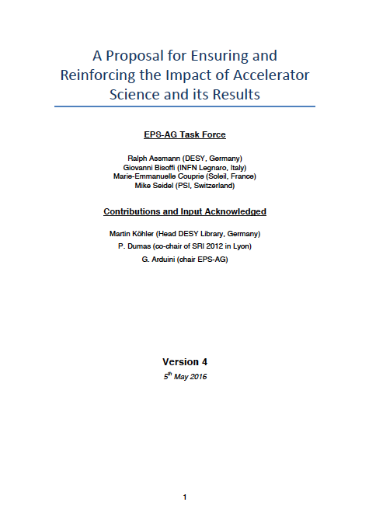
Publications & Dissemination of Results – Actions
Task force set-up during last EPS-AG Board Meeting held in Lund on 4th December 2015:
R. Assmann (convener) – DESY, Germany
G. Bisoffi – INFN Legnaro, Italy
M.-E. Couprie – SOLEIL, France
M. Seidel – PSI, Switzerland
Report in May 2016

Slide 14
Findings
IPAC one of the most successful conference series in science.
The JACoW publications are used extensively in accelerator science and are accessible openly on the internet. Success story.
Science is more and more often assessed by performance indicators derived from peer-reviewed publications. The IPAC conference proceedings, being not peer-reviewed are often not counted as publications.
Our field facing growing problems in recognition of its scientific output, in competition for funding and in career opportunities for young scientists who must compete with other fields.

Slide 15
Present Situation (IPAC)
JACOW
PRAB
Non-peer reviewed
Conference publications
Open source
Peer reviewed
Journal publications
Open source
97 %
3 %
special invitation of promising papers, free choice for authors

Slide 16
Present Situation (IPAC)
JACOW
PRAB
Non-peer reviewed
Conference publications
Open source
Peer reviewed
Journal publications
Open source
97 %
3 %
EXCELLENT SUCCESS
Rapidly available
Fast communication
Fully open source
Huge information pool
Widely used by online generation
special invitation of promising papers, free choice for authors
EXCELLENT SUCCESS
High quality journal papers
Aiming at high impact factor

Slide 17
Present Situation (IPAC)
JACOW
PRAB
Non-peer reviewed
Conference publications
Open source
Peer reviewed
Journal publications
Open source
97 %
3 %
ISSUES
No scientific QA
Some only publish here
Not counted as pubs in some organiz. at all
No training in peer review for young coll.
special invitation of promising papers, free choice for authors
ISSUES
Impact factor lower than possible due to lack of citations

Slide 18
Recommendations
The achievements of IPAC and JACoW should be preserved.
Medium/Long term:
EPS-AG formulates a statement that provides input to science funding bodies on publications and their recognition in accelerator science. Ongoing effort.
Short-term:
Start a process of turning the IPAC conference proceedings into open access indexed publications for a significant fraction of conference papers.

Slide 19
IPAC2017 (Pilot)
JACOW
PRAB
Non-peer reviewed
Conference publications
Open source
Peer reviewed
Conference preprints
Open source
Peer reviewed
Journal publications
Open source
82 %
15 %
3 %
promising papers
Author choice First come, first serve
special invitation of

Slide 20
Refereed IPAC proceedings
Lean reviewing process such that a fraction of the conference papers shall be recognized as publications (listed in Thomson, ISIS and/or SCOPUS) and counted in the performance indicators of research organizations.
Young accelerator scientists trained early on for peer-review publication → more peer-reviewed publications. Later expected to aim at higher impact journals, such increasing overall science impact of our field even more.
Consistent referencing rules for the modified IPAC proceedings will increase the impact factor of accelerator journals, such as PRAB (previously PRSTAB). These journals aim at high impact factor.
Our position in funding discussions and project applications will be strengthened, as performance indicators based on publications are an important input to decisions.

Slide 21
Step-Wise Approach
Propose defining in advance a limited number N_{max} of IPAC proceeding papers that will be accepted for refereeing.
N_{max} must be agreed on among all involved actors and should correspond to the available resources for editing and refereeing. Here, we assume that N_{max} = 200 is a realistic assumption for the first relevant IPAC, i.e. IPAC17.
Realistically achievable workload ensured, success guaranteed.
Implementing the process over several IPAC’s will offer opportunity to learn from experience, identify problems and address them at the next IPAC.
The step-wise approach will ensure that all regions participate to the process of moving towards refereed IPAC papers and bring in their particular expertise and requirements.

Slide 22
Publications at IPAC’17
Three levels of publications will be offered for IPAC’17 :
Publication of the conference proceedings at the JACoW website (all accepted paper)
Publication of the refereed IPAC proceedings papers as part of the Institute of Physics Journal of Physics: Conference Series on a first come, first served basis
Publication in a Special Edition offered by the online journal Physical Review Accelerators and Beams (PRAB) for the Eighth International Particle Accelerator Conference IPAC’17 (authors of selected papers will be encouraged by the SPC)

Slide 23
Engagement with Industry
Industrial Exhibition at IPACs
Floor for Industries to present their products and establish contacts with Laboratories/Universities:
100 exhibitor booths at IPAC14 (a record in Europe)
Session for Engagement with Industry @ IPAC
addressed to Research Institutes/Universities and Industry
to improve mutual understanding in contractual matters, joint research and development, measures to improve contract goals

Slide 24
Engagement with Industry
So far two-hour oral sessions addressing on Wednesday afternoon:
emerging markets
collaboration between accelerator laboratories and industry
technology transfer
For IPAC’17:
Try a different format with moderated panel discussions to favour interaction and exchange of ideas
Larger involvement of industrial partners in the preparation of the programme of the session and in general to the conference programme through an industrial council. In preparation:
Job Fair
Best student poster prize sponsored by Industry

Slide 25
Engagement with Industry
Future Accelerator Projects Booklet:
To provide information on future Accelerator Projects and Upgrades in occasion of the IPAC Conferences
available to ALL exhibitors associated with JACoW Accelerator Conferences.
An EPAC tradition revived for IPAC’14 thanks to the effort of Christine Petit-Jean Genaz ➔ continued at IPAC’15 and being pursued for IPAC’17 (F. Zimmermann)
Collected feedback by direct interaction with exhibitors/questionnaire
Aim at greater coordination among the IPACs in different regions in the Organization of the “Industrial Sessions”

Slide 26
Conclusions
EPS-AG has been supporting exchange of information and new ideas in the field of accelerator science through the successful conference series of European and the International Particle Accelerator conferences now running since almost 30 years
Particular engagement for:
Students and their career development (publications, ...)
Relation with Industries (knowledge transfer, market opportunities, ...)
Recent actions mostly targeted in those directions

Slide 27
We need your Help!

Slide 28
Acceptance Criteria I
The acceptance criteria for refereed IPAC proceedings must ensure that the following standards are met:
The published work must not contain clear errors or factual mistakes.
The presentation of the results must be understandable.
For example, axes of scientific graphs must be labeled, units must be given or commented on, important assumptions and inputs must be specified, ...
The paper must be in good English.
Work and related results by others must be referenced and properly acknowledged.
The paper must include references to literature that are appropriate.

Slide 29
Acceptance Criteria II
The paper must include own work, performed by the authors and not published beforehand elsewhere.
Acceptable is a paper that includes self-performed theoretical analysis, a self-performed simulation, a self-performed measurement, a new method, report on newly installed hardware at an accelerator, a study on a new project or a new working point related to accelerators.
Acceptable is a self-performed review of results, challenges or achievements.
Acceptable are evolutionary improvements ("small steps in performance parameters").
Acceptable are descriptions of non-understood results and unexpected problems that were encountered.
Acceptable are cross checks and verifications of predictions or previous results.

Slide 30
Rejection Criteria
Papers are considered not-correctable and therefore rejected in following cases:
The paper has been published in a peer-reviewed publication channel before.
The whole Ansatz is wrong.
The work is from somebody else or claiming authorship from somebody else.
Requested changes are not implemented in time.

Slide 31
Peer Reviewed IPAC’17 Proceedings (Pilot)
Interested authors will have the possibility to request that their paper is considered for publication as part of a Peer-Reviewed IPAC Proceedings at the time of the submission of the abstract.
The refereed IPAC proceeding paper will be published as part of the Institute of Physics Journal of Physics: Conference Series (http://conferenceseries.iop.org/content/home ) in addition to JACoW.
Visible in the known publication and citation databases (http://conferenceseries.iop.org/content/quick_links/Abstracted%20In ).
The IoP Proceedings Licence Terms and Conditions is available at: http://conferenceseries.iop.org/content/quick_links/IOP%20Proceedings%20Licence .

