Slide 1
The Silicon Tracking System of the CBM experiment at FAIR
Anton Lymanets^{1,2} for the CBM collaboration
DPG Frühjahrstagung
14 - 18 March 2016
Technische Universität Darmstadt
¹ GSI, Darmstadt, Germany
² Institute for Nuclear Research, National Academy of Sciences, Ukraine

Slide 2
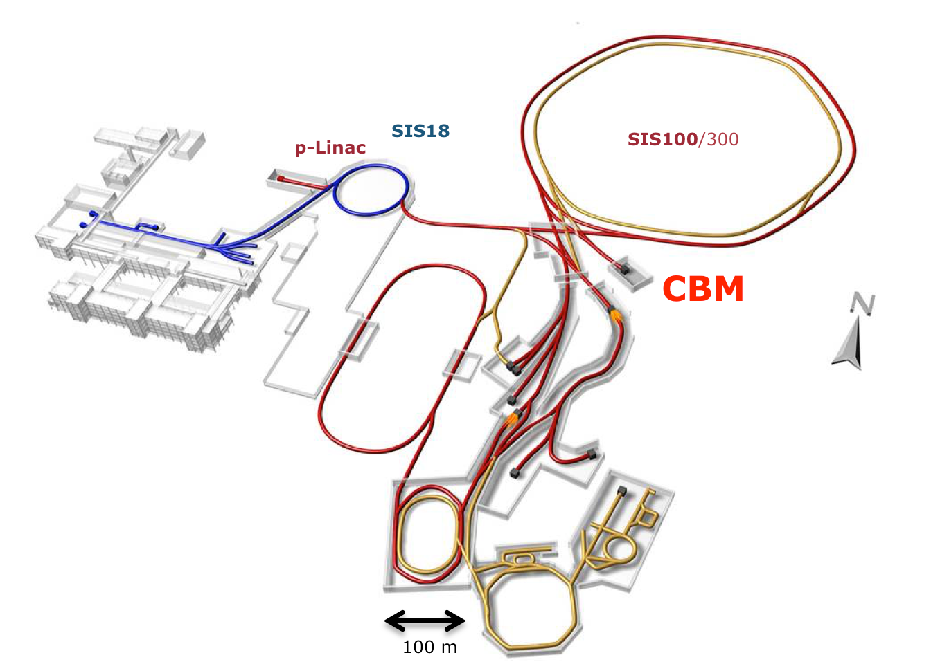
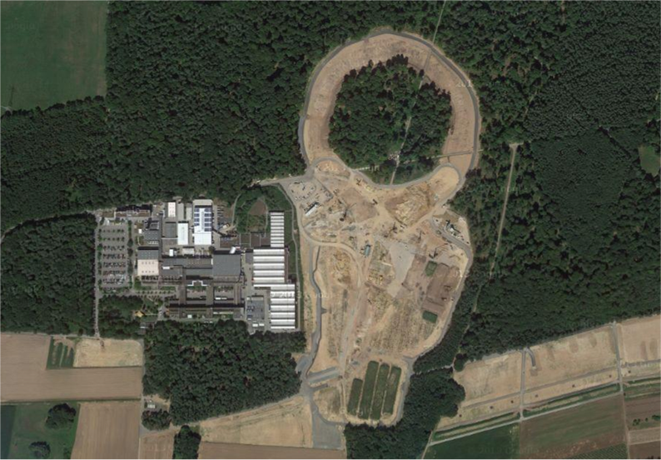
Facility for Antiproton and Ion Research
GSI
FAIR
SIS 100
under construction
existing
facility
SIS-100
protons: 30 GeV
Au: 11 GeV/nucleon

Slide 3
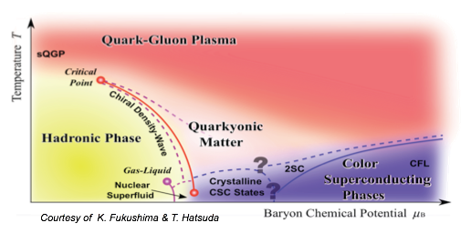
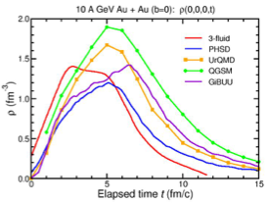
QCD phase diagram
СВМ
nuclear matter formation at high baryon density and temperature
models predict 1st oder phase transition with formation of mixed and exotic phases
existence of critical end-point
10 GeV/nucleon

Slide 4
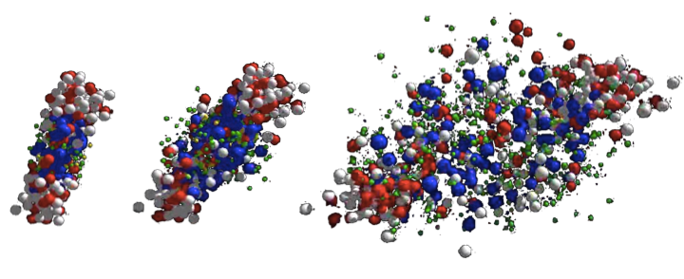
Probing the dense fireball
Au+Au collision at 10.7 GeV/nucleon as simulated in the UrQMD transport code
π, K, Λ, ...
p, Λ, Ξ⁺, Ω⁺, J/ψ
Ξ⁻, Ω⁻, φ
resonance decays
ρ → e⁺e⁻, μ⁺μ⁻
Leptonic and hadronic signals from all stages of nucleus-nucleus collisions
Rare probes: multistrange hyperons, low mass vector mesons, charmonium, strange dibaryons, hypernuclei.

Slide 5
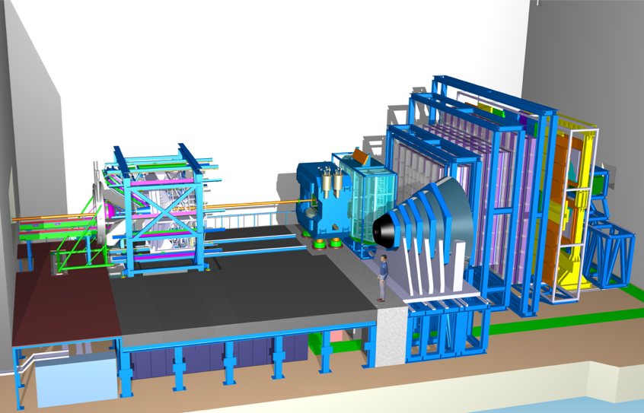
CВМ experiment
Ring
imaging
Cherenkov
detector
Time-of-flight detector
Silicon Tracking System
Dipole magnet
HADES:
p+p, p+A
A+A (low mult.)
Micro
Vertex
Detector
Transition
radiation
detector
Online event selection on a computing farm
Projectile
spectator
detector
Muon detector
Vertexing: MVD
Tracking: STS, MUCH, TRD, ToF
Particle ID: RICH, TRD, ToF
Calorimetry: ECAL, PSD

Slide 6
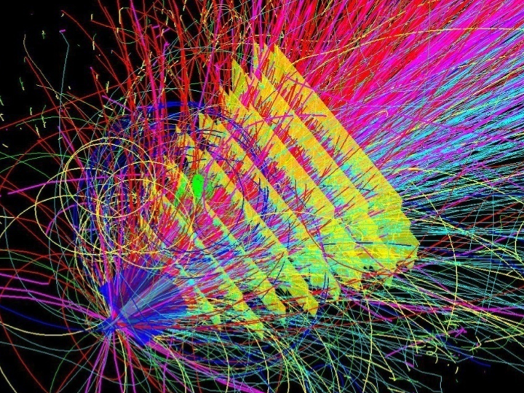
Tracking challenge
central nucleus-nucleus collision
~700 charged particles

Slide 7
Experimental requirements
10⁵ - 10⁷ Au+Au collisions per second.
secondary vertex determination (σ≈50 µm)
track reconstruction from hadron and lepton probes
fast and radiation tolerant detectors
self-triggering front-end electronics
fast data acquisition system + online event selection on a computing farm
4D track reconstruction

Slide 8
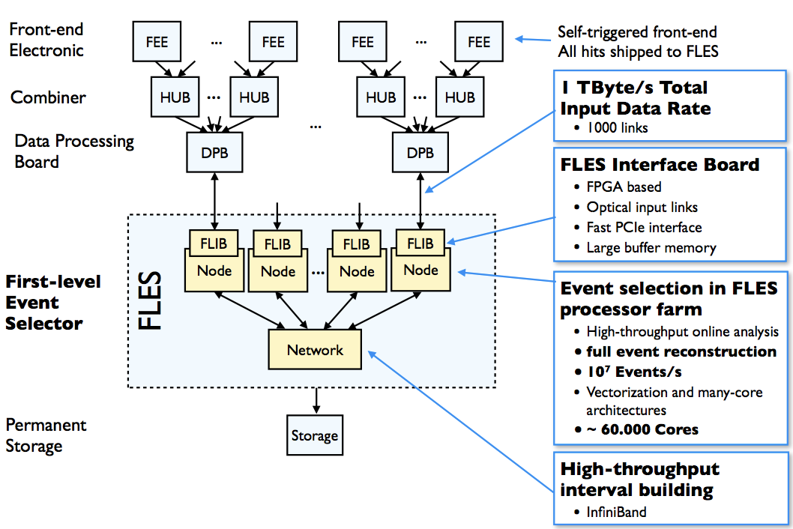
Online data flow
First-level Event Selector

Slide 9
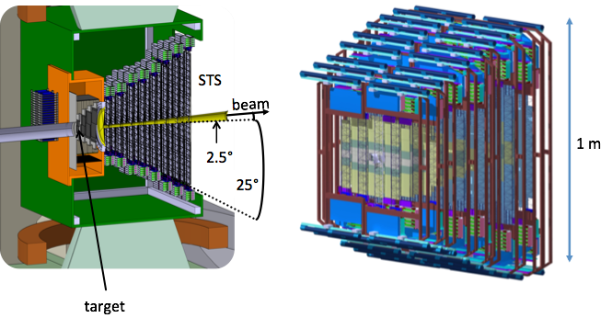
Silicon Tracking System
8 tracking stations in the magnet aperture
double-sided silicon microstrip detectors
Acceptance: 2.5˚< 𝜃 < 25˚
Active area: 4 m²

Slide 10
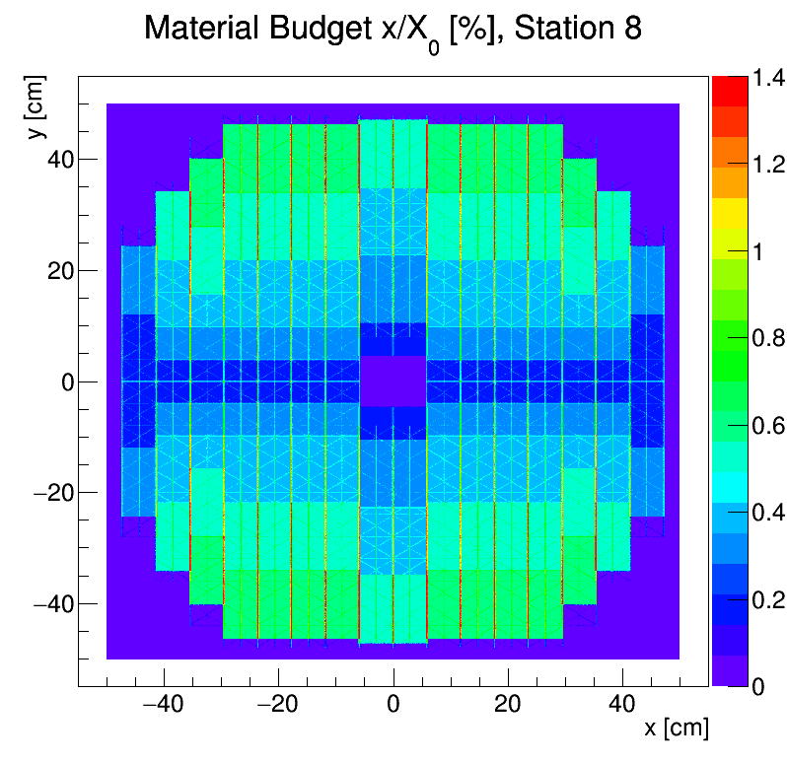
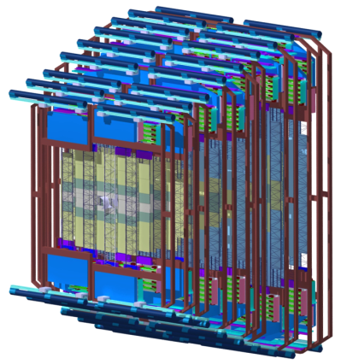
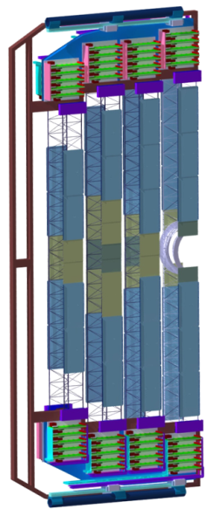
STS integration concept
X/X0, %
1 m
8 tracking stations
mechanical unit
ladder
material budget for station 8
896 detector modules including:
1220 double-sided microstrip sensors
~ 1.8M readout channels
~ 16 000 readout chips
~ 16 000 ultra-thin readout cable stacks

Slide 11
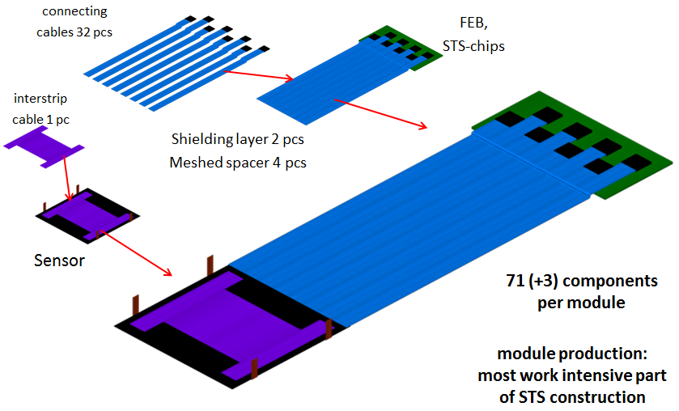
Detector module concept
896 modules required
4-5 modules per ladder
Modules comprises:
sensor
ultra-thin mirocables
front-end board

Slide 12
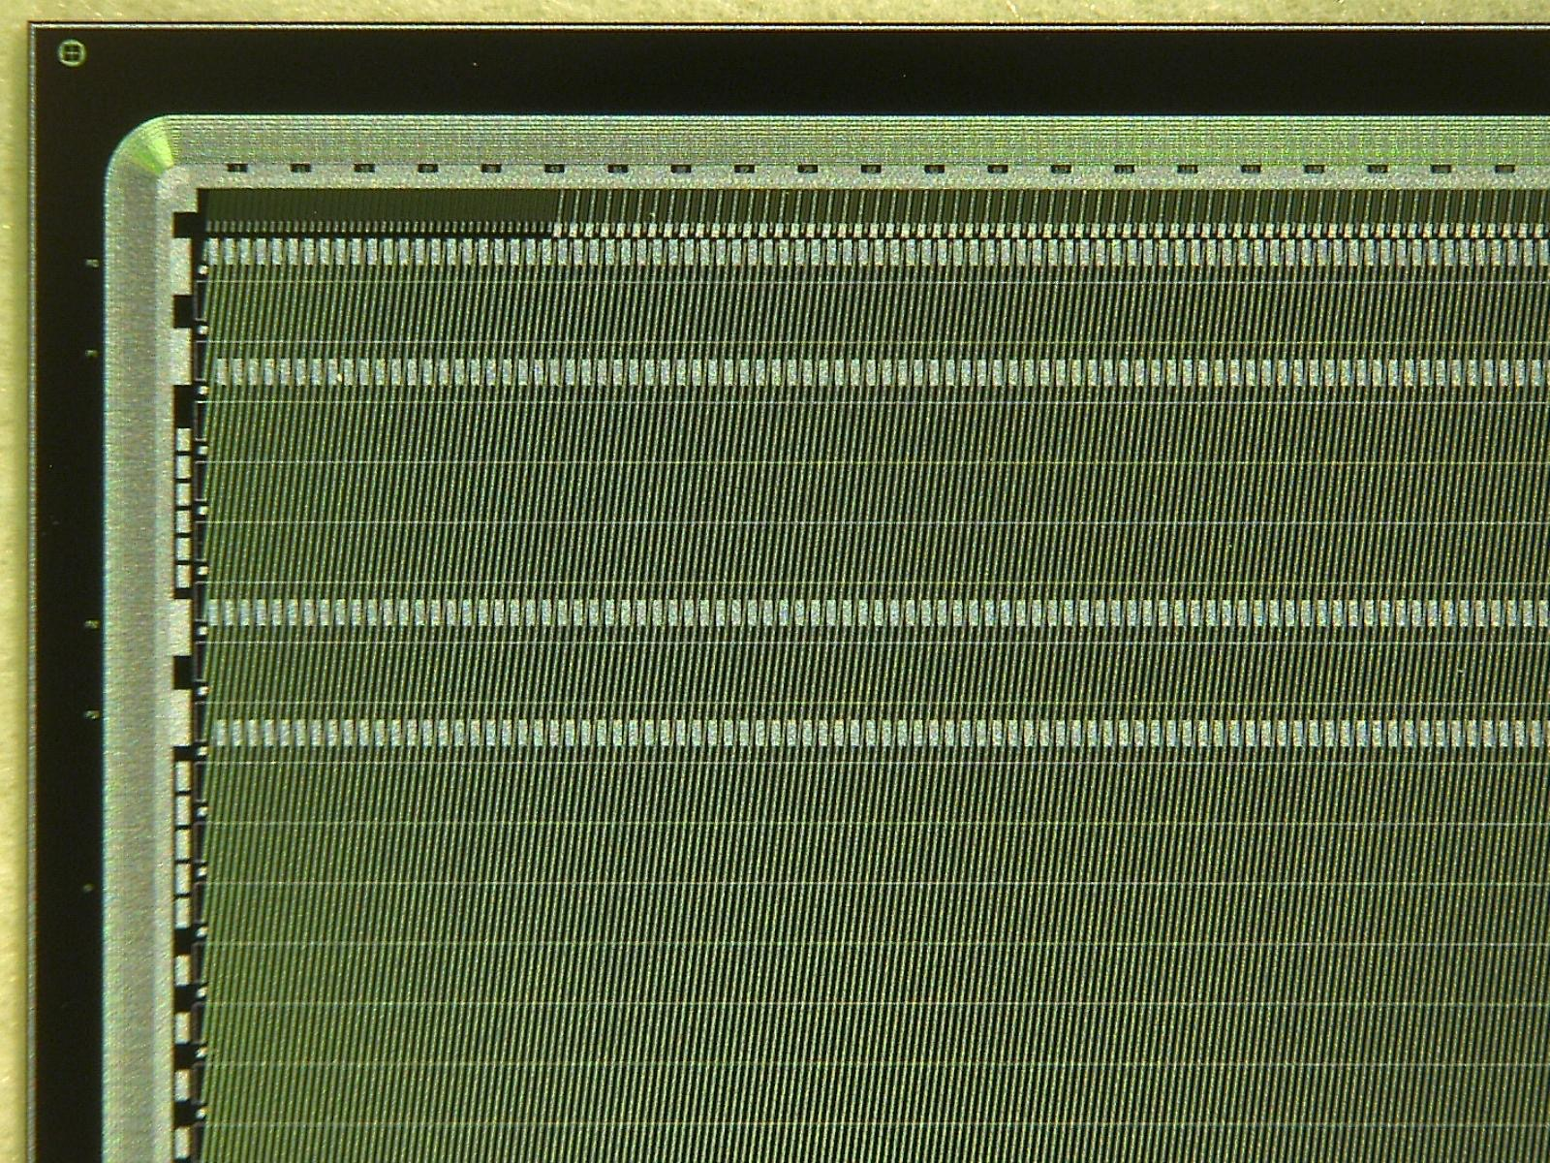
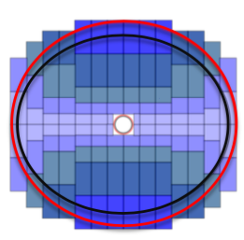
Silicon microstrip sensors
double-sided
1024 channels per side
58 µm pitch
300 µm thick
stereo angle 7.5˚(р-side)
dimensions: 6×2 cm², 6×4 cm², 6×6 cm², 6×12 cm²
2nd metallization to interconnect short corner strips
Layout STS5 and 6

Slide 13
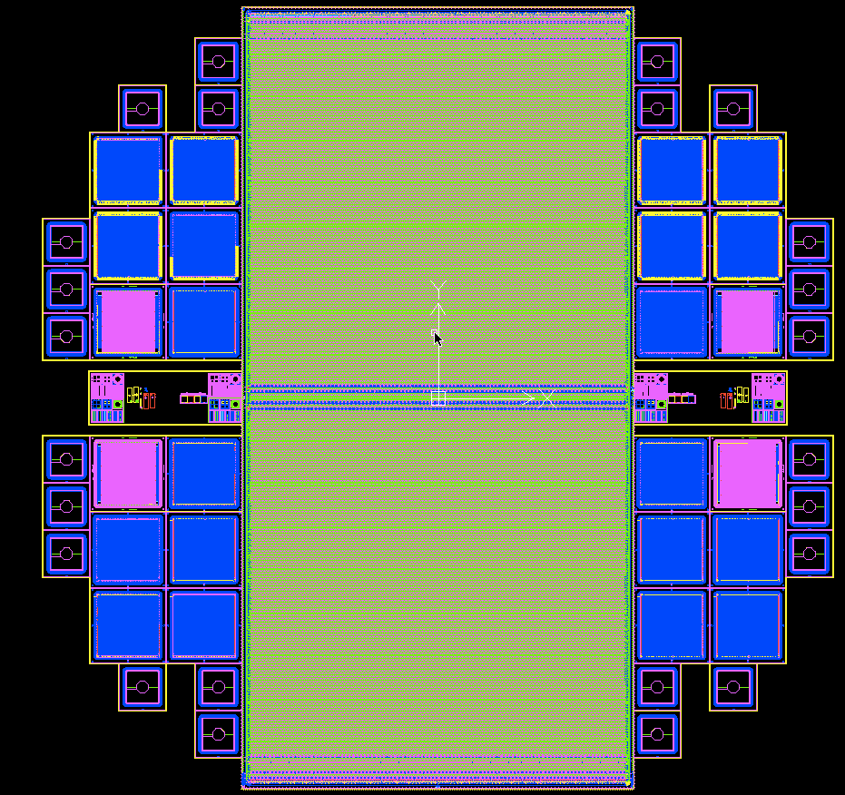
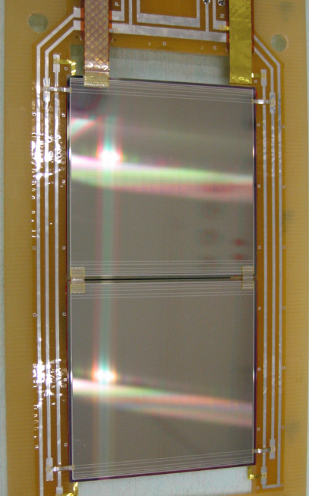
Silicon microstrip sensors
6×12 cm² sensor design with readout pads in the middle of the sensor (in production by Hamamatsu)
two daisy-chained sensors with 6×6 cm² size each

Slide 14
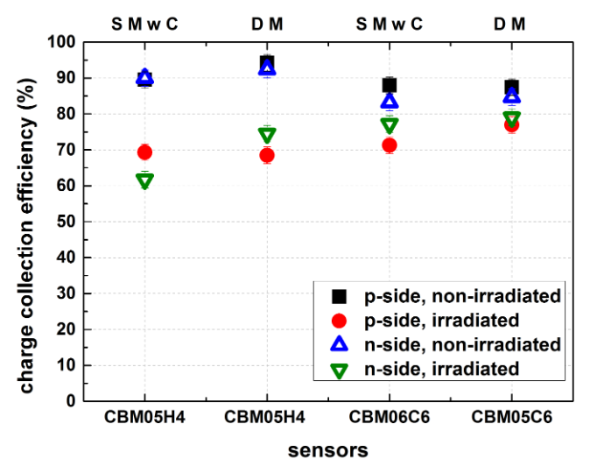
Charge collection studies
Irradiated sensors:
𝛷 = 2e14 neq/cm²
(twice maximum
fluence for CBM
lifetime)
⁹⁰Sr
Irradiated sensors show reduction in charge collection efficiency of up to 20%
CCE confirmed in a 2 GeV proton beam test at COSY

Slide 15
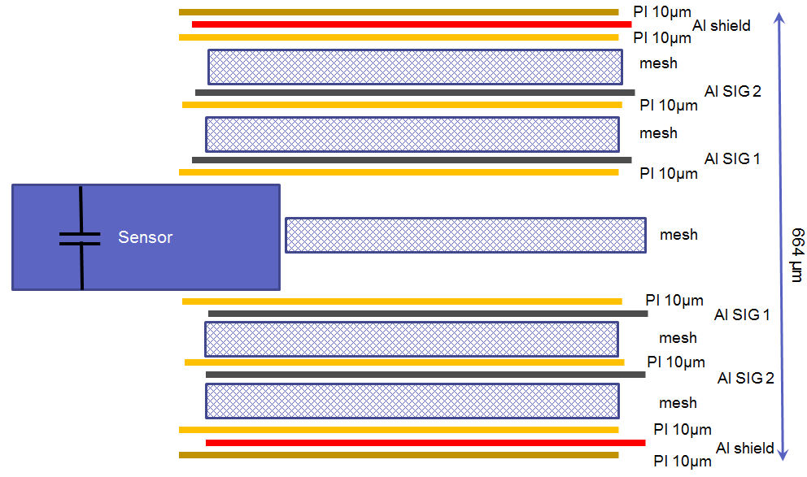
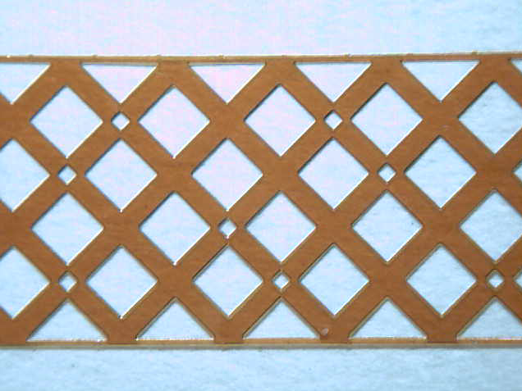
Microcables
meshed spacer
signal layer: 64 Al lines of 116 µm pitch, 10 µm thick on 14 µm polyimide, lengths up to 55 cm
Material budget per cable stack: 0.228 X0 (equivalent to 213 µm Si)

Slide 16
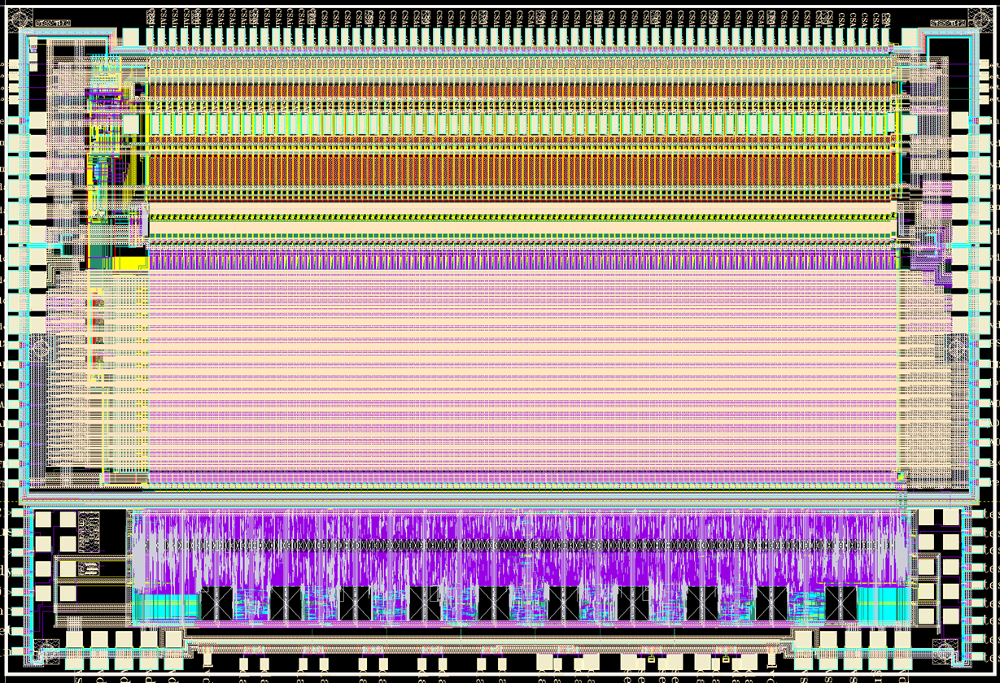
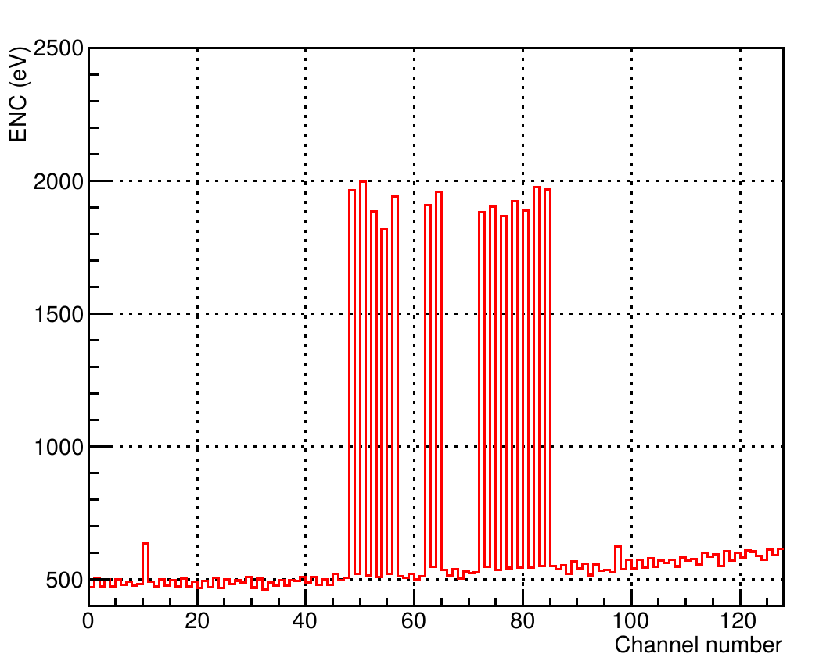
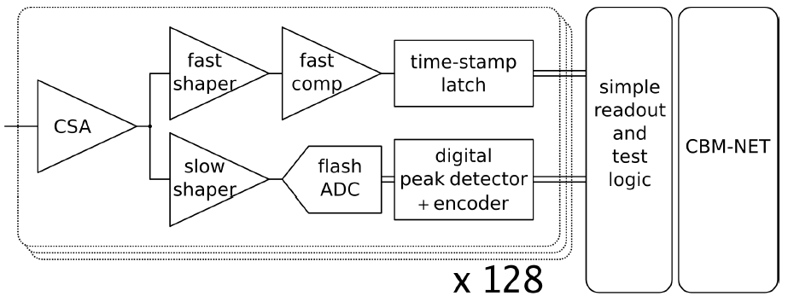
STS-XYTER ASIC
STS-XYTER ASIC
ENC vs channel number
data driven architecture
fast branch: time-stamp
slow branch: signal digitization
double-threshold discrimination: time stamp is vetoed if ADC produced no signal
CSA + PSC
SLOW SHAPER
FAST SHAPER
FAST DISCRIMINATOR
5-BIT FLASH ADC
READOUT/TEST CONTROL LOGIC
Noise performance with STS-XYTER v1 is ~1800 e⁻ (chip + two daisy-chained sensors with 62 mm strips + 30 cm cable)
Significant improvements expected after redesign
channels | 128, polarity +/-
noise | 1000 e– at 30 pF load
ADC range | 16 fC, 5 bit
clock | 160 MHz
power | < 10 mW/channel
timestamp | < 5 ns resolution
out interface | (1..5)×320 Mbit/s LVDS
t_{s} = 30 ns
r/o logic
CBM-NET
(v1.0 )
GBT (V2.0)
LSB veto
t_{s} = 80 ns

Slide 17
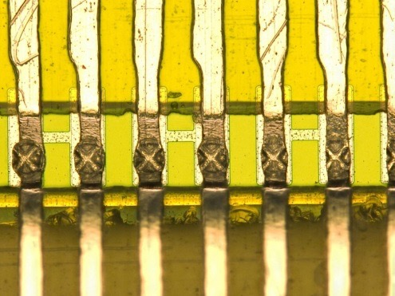
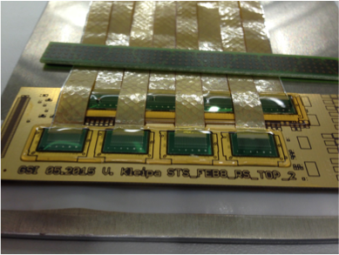
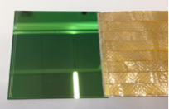
Detector module assembly
1. TAB bonding of microcables to ASICs
3. TAB bonding of microcables to sensors on both sides
2. Wire bonding ASICs to front-end boards + bond protection (glob top)

Slide 18
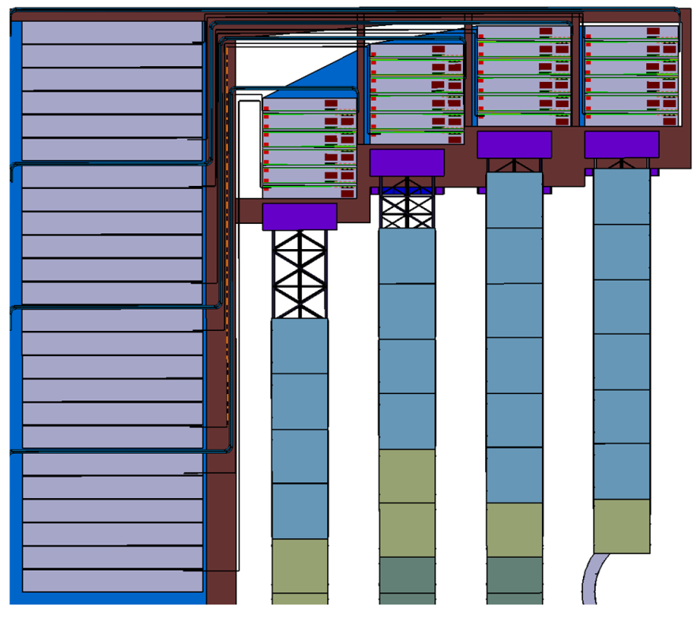
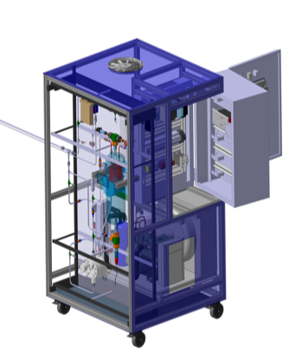
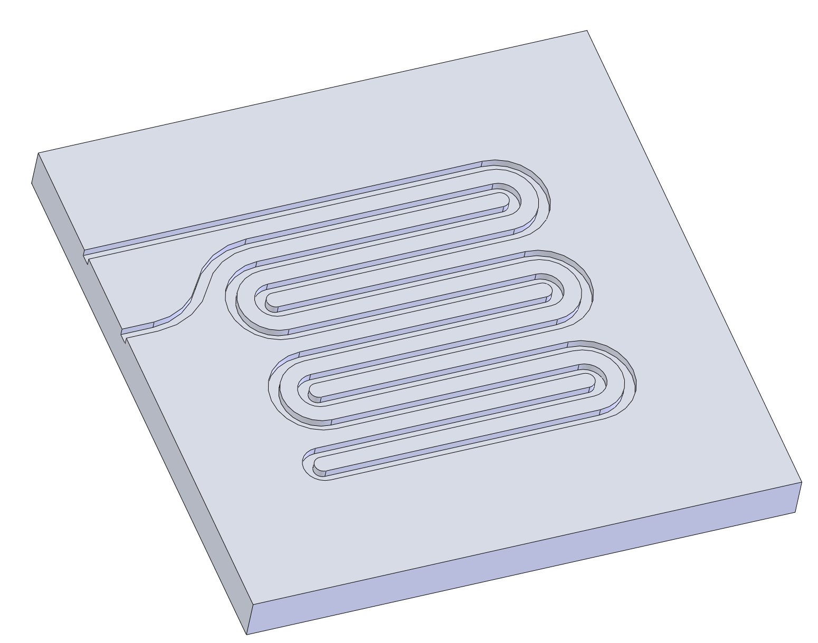
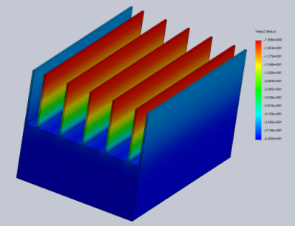
Current engineering studies
cooling
Cooling plate
cabling
Bi-phase CO₂ cooling system
STS electronics total power dissipation: 42 kW
TRACI XL: 1 kW cooling prototype
Front-end Electronics Boards
Read-out Boards, Power Boards
FEB stack 200 W
cooling plate with integrated channels

Slide 19
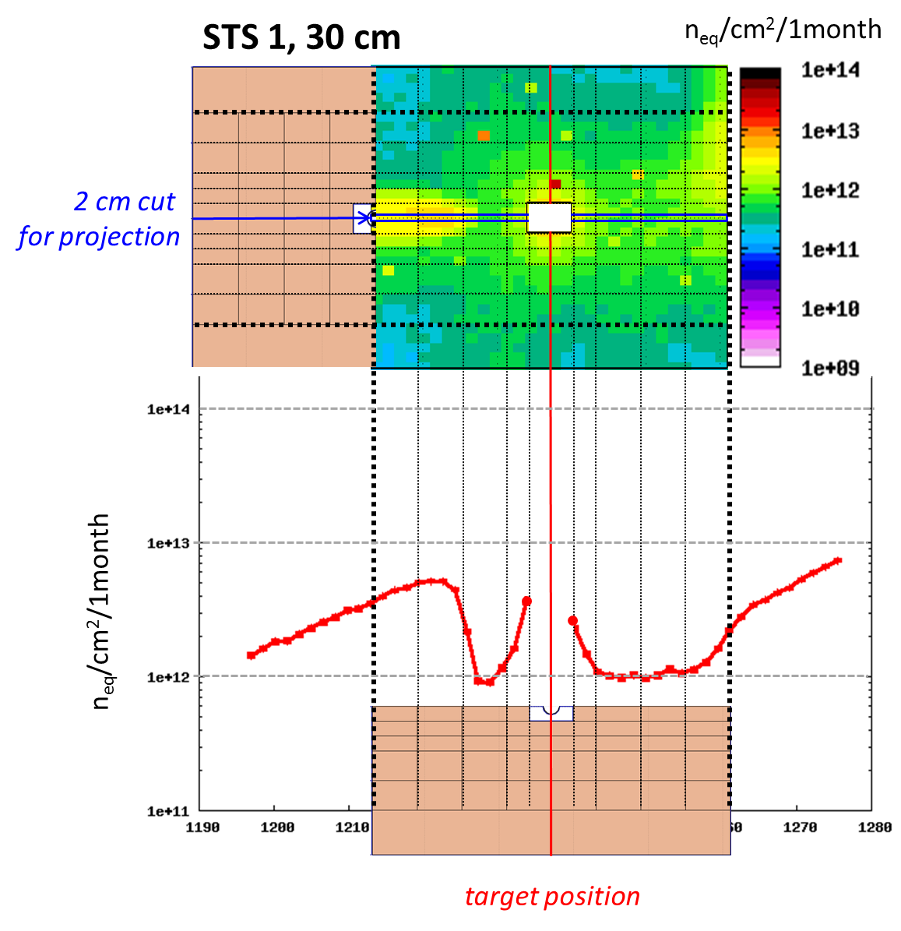
Radiation environment
neq/cm²
Radiation load per typical operation year
Non-ionzing dose: 10¹³ neq/cm² (worst case)
Ionizing dose: <100 kRad
Operation conditions:
1 month of running at 10⁹ ions/s on a 1% X0 target
neq/cm²
FLUKA calculation of non-ionizing dose for 10 AGeV Au+Au collisions at SIS100 and the CBM experiment in electron-hadron configuration.

Slide 20
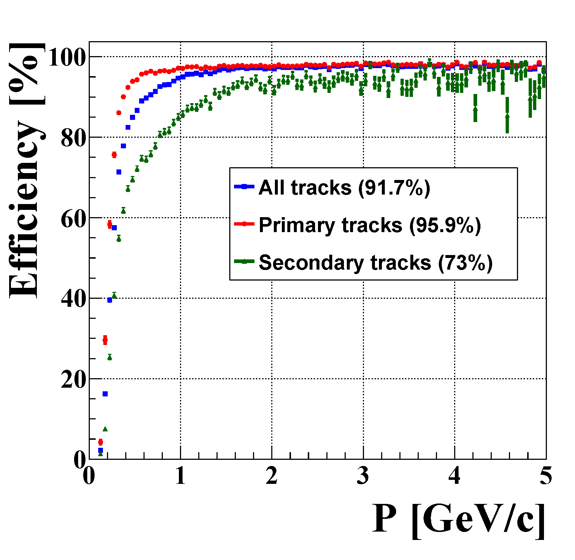
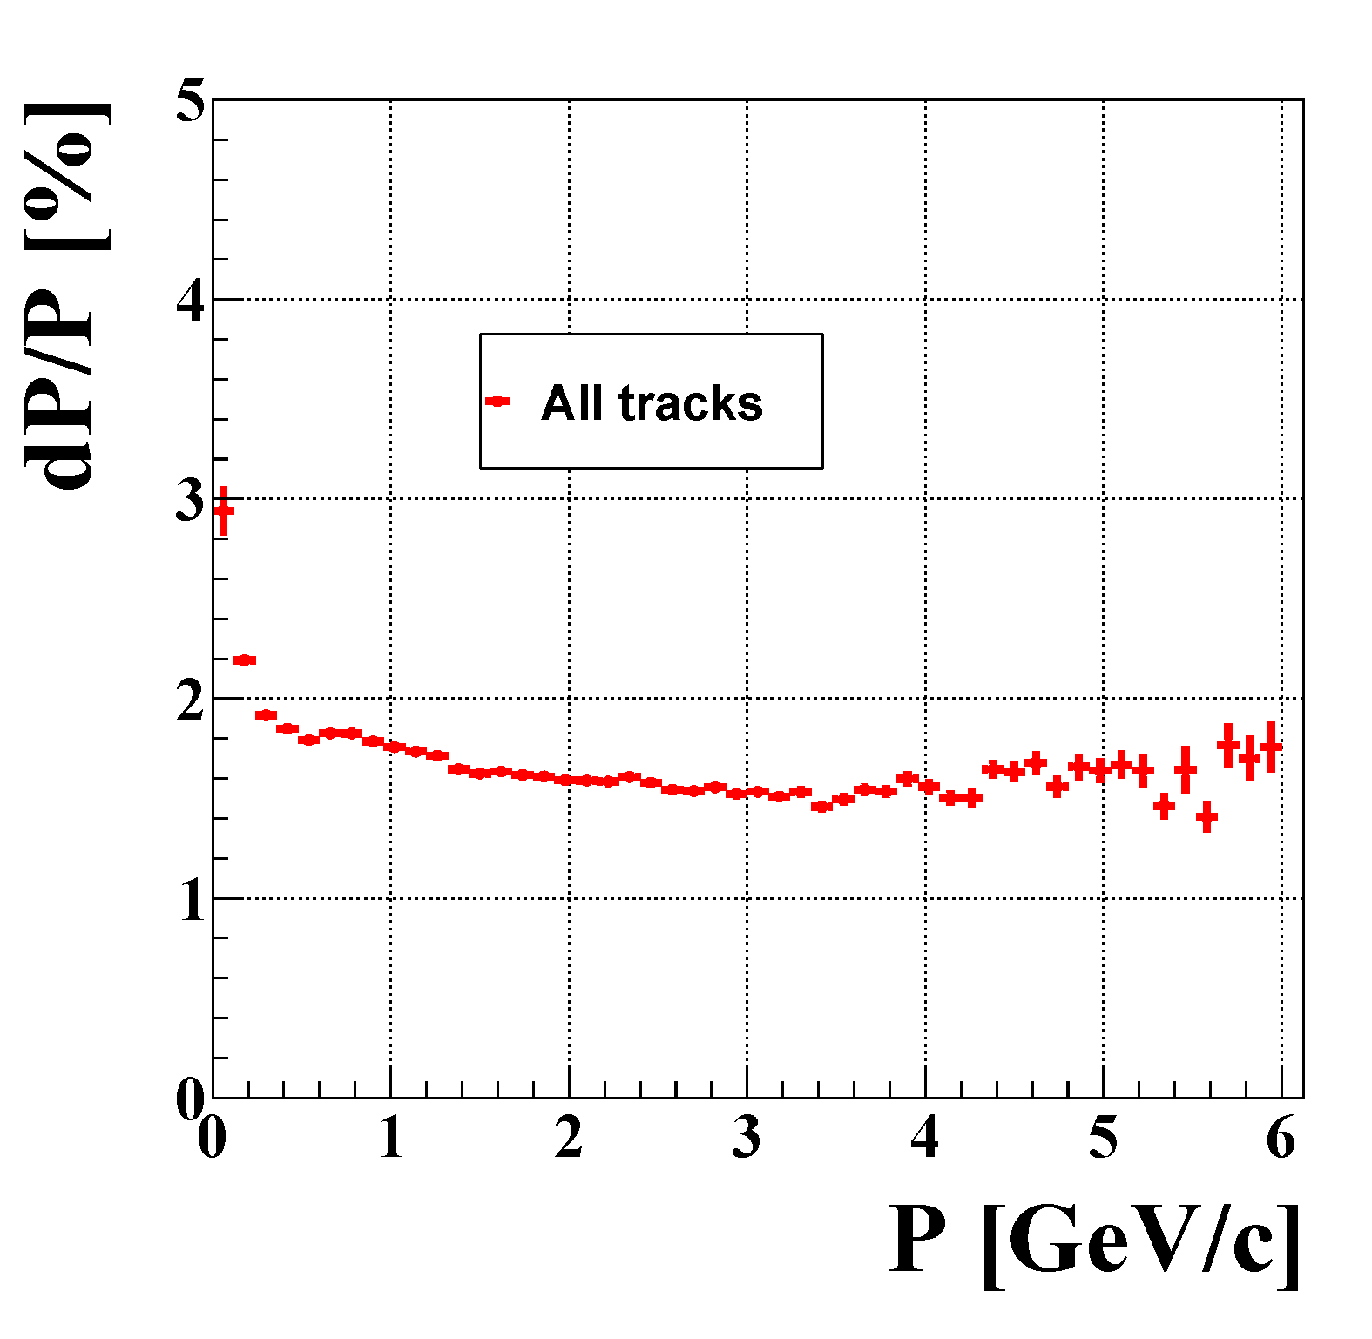
STS performance simulation
Track reconstruction efficiency
Momentum resolution
realistic detector model
CbmRoot simulation framework
Cellular Automaton track finder
Kalman Filter track fitting

Slide 21
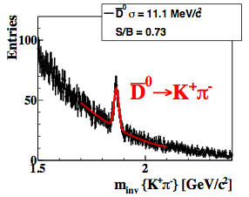
Feasibility studies at SIS-100
Tue, 17:45 HK 25.5
Tue, 16:30 HK 24.1
Operation scenario: from pA (up to 30 GeV) to AuAu (2–11 GeV/nucleon) systems
𝛆4𝜋 = 1.7%
𝛆4𝜋 = 16.5%
10¹¹ central Ni+Ni events 15 GeV/nucleon, using TOF PID
5×10⁶ central Au+Au events 10 GeV/nucleon, using TOF PID

Slide 22
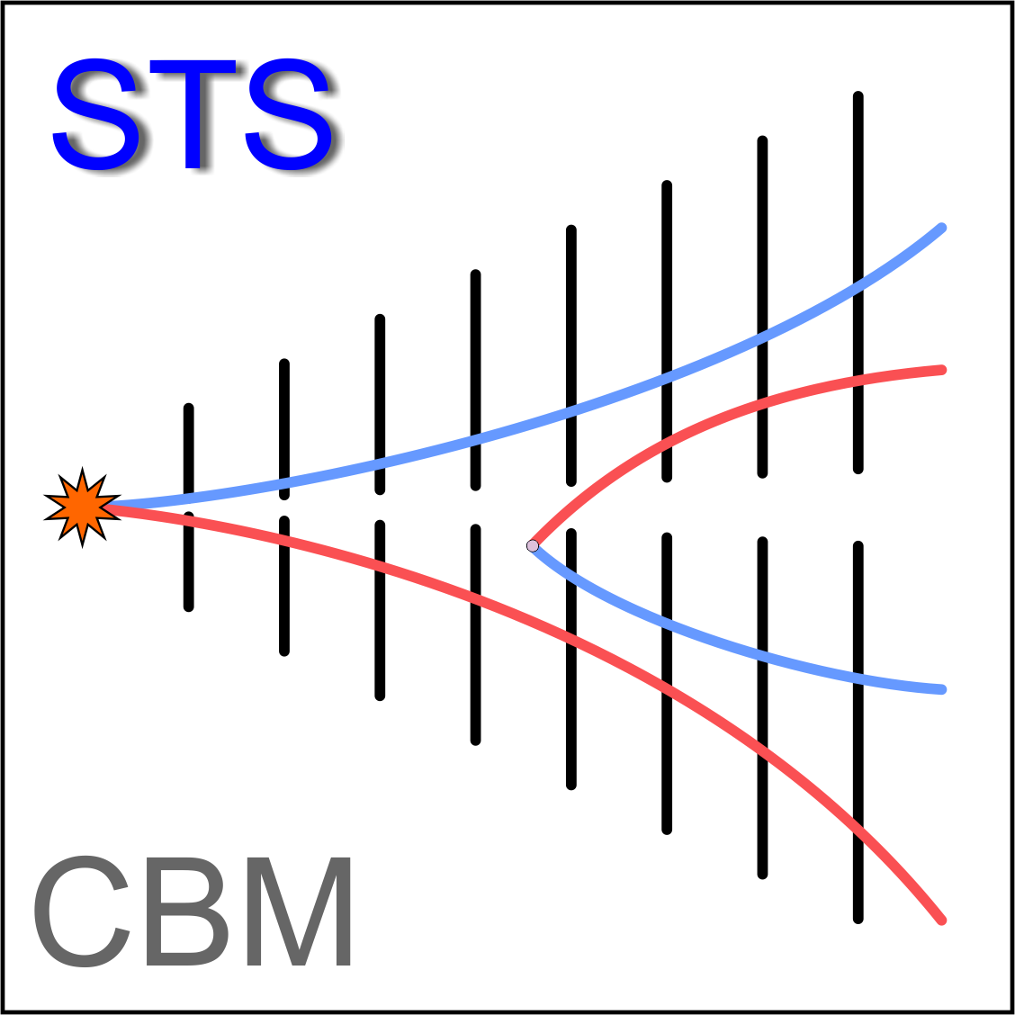
Summary
STS system concept has been presented
Progress with prototyping and engineering
Sensor prototypes delivered, radiation hardness is under investigation
Current activity is module assembly and system integration
Full-size module mockup has been produced
System engineering: mechanical structure, mounting of electronics, cabe routing. Close to completion.
Feasibility for physics measurements demonstrated
Production readiness in 2017

Slide 23
Institutions participating in STS
Germany
Darmstadt, Germany, GSI Helmholtz Center (GSI)
Karlsruhe, Germany, Karlsruhe Institute of Technology (KIT)
Tübingen, Germany, Eberhard Karls University (EKU)
Poland
Krakow, Poland, AGH University of Science and Technology (AGH)
Krakow, Poland, Jagiellonian University (JU)
Warsaw, Poland, Warsaw University of Technology (WUT)
Russia
Dubna, Russia, Joint Institute for Nuclear Research (JINR)
Moscow, Russia, Moscow State University (SINP-MSU)
Ukraine
Kharkov, Ukraine, LED Technologies of Ukraine Ltd (LTU) ^{* Partner}
Kiev, Ukraine, Kiev Institute for Nuclear Research (KINR)

Slide 24
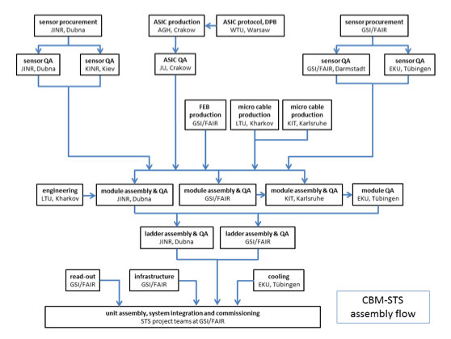
CBM STS assembly flow

Slide 25
STS related presentations at DPG 2016
Mon, 14:45 HK 8.3 Grigory Kozlov Time-based cluster and hit finding for the STS detector in the CBM experiment at FAIR
Mon, 15:00 HK 7.4 Evgeny Lavrik Optical quality assurance procedures for the sensors of CBM STS Detector
Mon, 15:15 HK 7.5 Maksym Teklishyn Quality assurance tests of the CBM Silicon Tracking System sensors with an infrared laser
Mon, 16:30 HK 14.1 Hanna Malygina The detector response simulation for the CBM Silicon Tracking System as a tool for hit error estimation
Group talk Mon, 16:30 HK 15.1 Anton Lymanets The Silicon Tracking System of the CBM Experiment at FAIR
Mon, 17:00 HK 15.2 Iaroslav Panasenko, Pavel Larionov Quality assurance of the silicon microstrip sensors for the CBM experiment
Tue, 15:00 HK 21.4 Ievgeniia Momot Radiation tolerance of microstrip sensors for the CBM Silicon Tracking System
Tue, 18:00 HK 29.7 Adrian Rodriguez Rodriguez The CBM-STS front-end electronics
Wed, 18:30 HK 45.9 Carmen Simons, Daniel Soyk, and Robert Visinka The workflow of CBM-STS silicon strip sensor module-assembly
Poster Wed, 18:30 HK 45.20 Evgeny Lavrik Bi-Phase CO2 cooling of the CBM STS detector
Poster Wed, 18:30 HK 45.63 Oleg Vasylyev, W. Niebur Mechanical integration of the detector components for the CBM Silicon Tracking System
Thu, 17:45 HK 60.6 Jörg Lehnert, David Emschermann The read-out chain of the CBM STS detector

