Slide 1
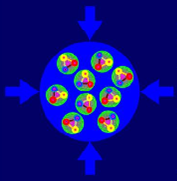
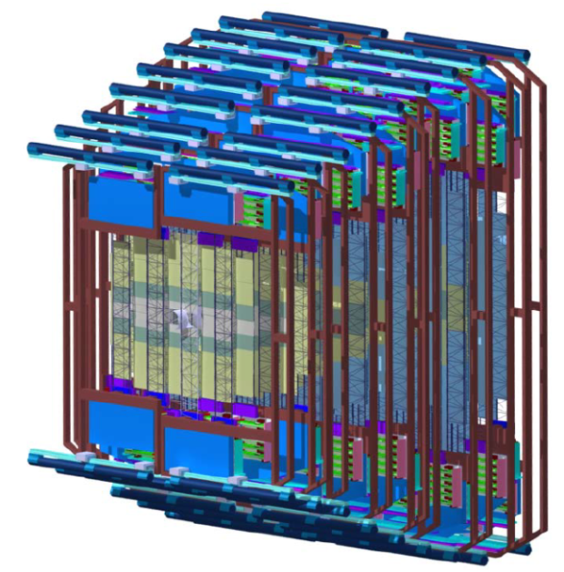
HK 60.6 The Readout Chain of the CBM STS Detector DPG Spring Meeting Fachverband “Physik der Hadronen und Kerne” Darmstadt, 17. March 2016 J. Lehnert, D. Emschermann for the CBM Collaboration
CBM
S
T
S

Slide 2
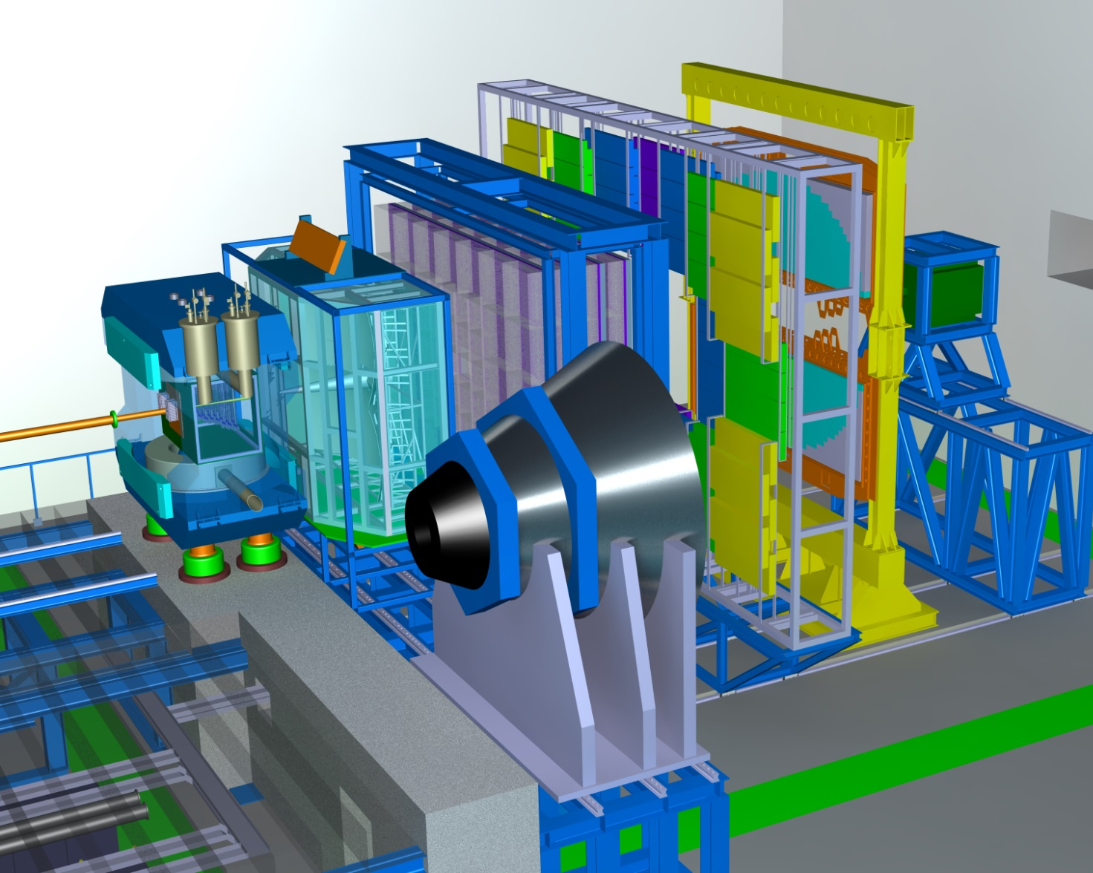
The CBM Experiment @FAIR
Dipole
Magnet
Ring Imaging
Cherenkov Detector
Transition
Radiation
Detector
Time of Flight Detector
Goal:
Exploration of the QCD phase diagram in the region of very high baryon densities
Silicon
Tracking
System
Micro
Vertex
Detector
Features
up to 10 MHz Au+Au interactions
self-triggering front-end electronics
high-speed data processing and acquisition system
4D event reconstruction and fast selection algorithms
high granularity and radiation tolerant detectors and FEE
Muon
Detector
Projectile
Spectator
Detector
Fri. 14:00 HK 66.1: D. Emschermann: “The Compressed Baryonic Matter experiment at FAIR”

Slide 3
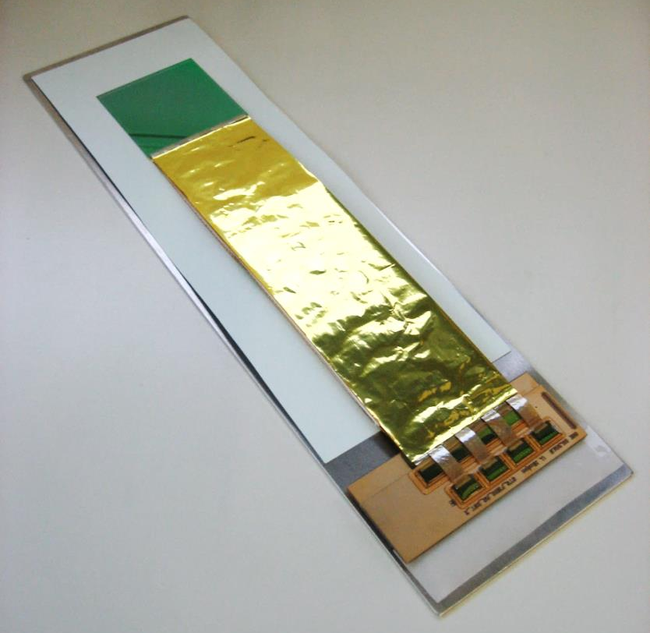
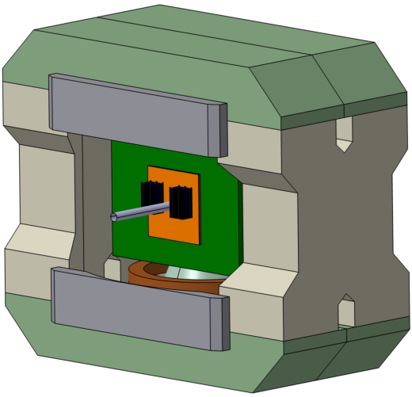
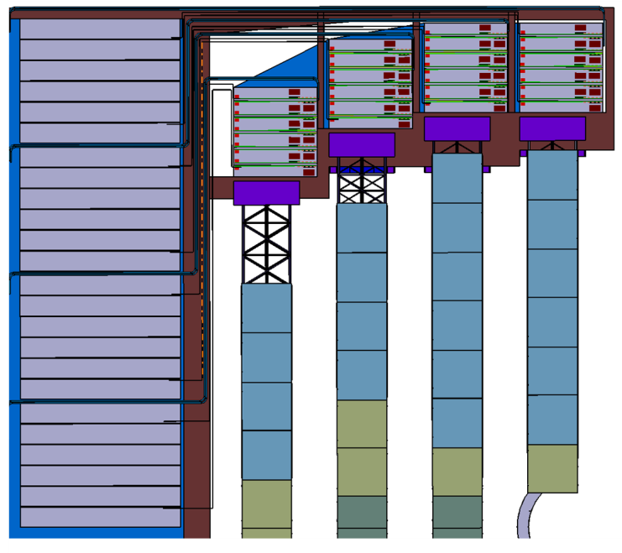
The Silicon Tracking System (STS)
Silicon micro strip detector
high-resolution momentum determination
1T dipole field
δp / p ≈ 1%
track matching into MVD and RICH/MUCH
8 tracking stations with 8-16 sensor ladders
25μm single hit spatial resolution
material budget 1% X₀ per station
radiation tolerance up to 1 × 10¹⁴ n_{eq}/cm²
Sensors
double-sided, 300 µm thick
7.5 degree stereo angle
1024 strips per side
58 µm pitch
Sensor
Cables
876
Modules
STS Box inside dipole magnet
Frontend electronics
(dummy)
Mo. 16:30 HK 15.1
A. Lymanets:
“The Silicon Tracking System of the CBM Experiment at FAIR”
Quarter Station ( every 2nd ladder)

Slide 4
Building Blocks of the Readout Chain
Control
FEE
FEE
ROB
DPB
FLES
FEE
FEB
electrical
optical
Frontend Boards (FEB) with detector specific ASIC and functionality:
STS-XYTER
provides digitized hits
5bit pulse height
14bit timestamp
Located close to sensors
Readout Boards (ROB)
data aggregation
- ASICs: several ten thousand electrical links
data readout
- optical readout interface
FE ASIC control path
clock distribution and synchronization
located inside STS box:
radiation hardness
limited space
CERN GBTX / Versatile Link
Data Processing Board (DPB) CBM DAQ layer with common hardware platform:
FPGA based
data formatting
preprocessing
timing and control interfaces
located in CBM building
First Level Event Selector (FLES)
time slice building & full event reconstruction
evaluation of physics signatures
online event selection

Slide 5
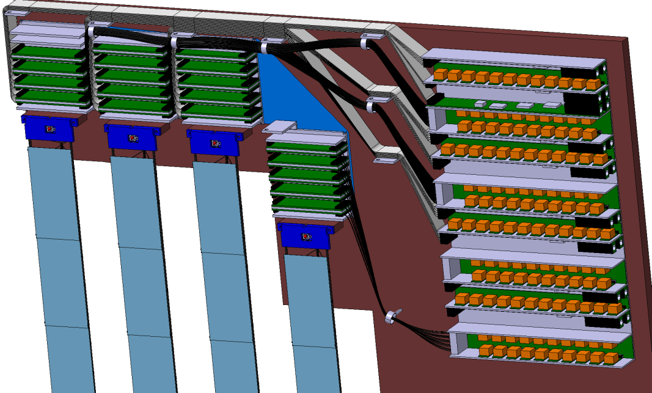
Chain Implementation
FEB
ROB
DPB
1752 FEBs
24000 electrical links ~30-80 cm
600 ROBs
2400 MM fibers
~50-80 m
78 DPBs
up to 624 SM fibers
several 100 m
CBM Building and Cave
STS Quarter Unit every second ladder
DPB
FEBs
to FLES in Green Cube
ROBs
STS
Sensors

Slide 6
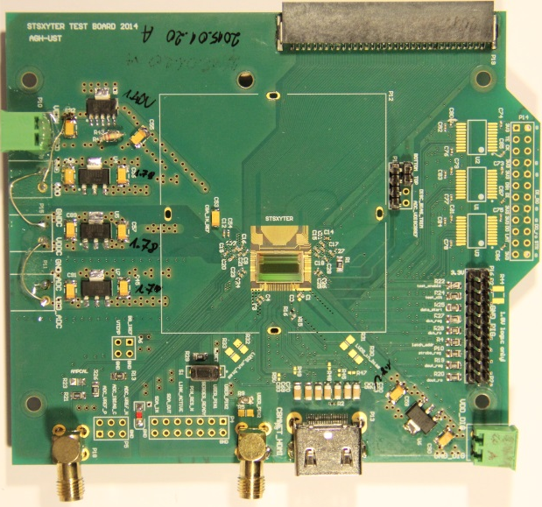
Frontend Electronics
FEB
ROB
DPB
STS-XYTER v2 frontend ASIC
new readout interface (custom protocol)
optimized noise behavior: analog frontend, powering,…
submission: April 2016
STS-XYTER v2 Prototype Boards
FEB-1: similar to board for v1 (single ASIC)
v2 ASIC testing
FEB-2: investigate new features (2 ASICs)
AC coupled E-Links
multi drop clock and control downlink
powering
connectors
FEB-8
for readout of 1 full sensor side
required for module assembly
highly integrated (space, cooling, module)
STS-XYTER v1 Prototype Board
STS-XYTER
ASIC v1
AGH Crakow
Full FEB-8 Design Study
V. Kleipa, GSI
Tue. 18:00 HK 29.7 A. Rodriguez:
“The CBM-STS front-end electronics”

Slide 7
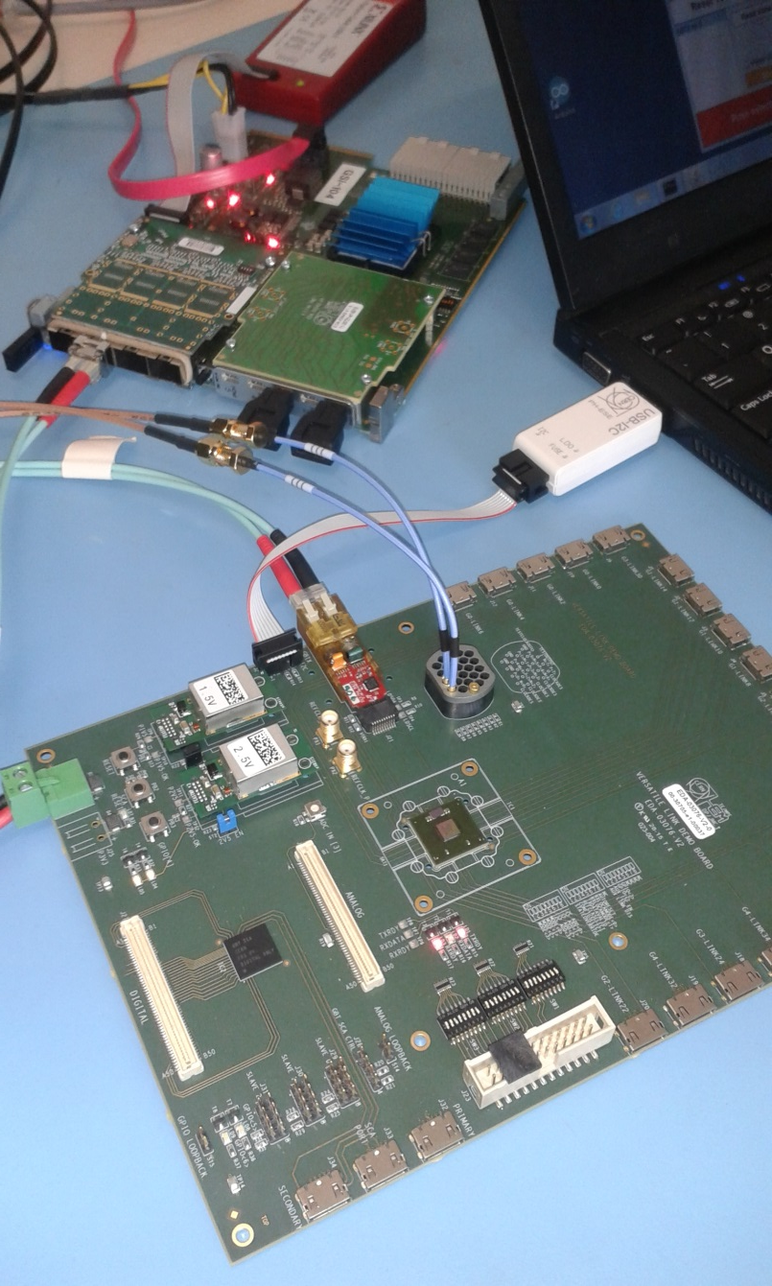
VLDB Demonstrator
FEB
ROB
DPB
Versatile Link Demonstrator Board (VLDB)
CERN development:
1 GBTx data transceiver ASIC
1 VTRx optical transceiver module
1 SCA slow control ASIC
FEE interfaces (E-Links) on HDMI connectors
First experiences with devices
device configuration and operation
performance studies
backend firmware and software development
Test readout chain
DPB prototype (AFC-K)
optical interface to VLDB/GBTx
electrical interface (E-Links)
frontend: “STS emulator” firmware (until STS-XYTER v2 available)
AFC-K (DPB)
FEAST_MP DCDC conv.
VTRx transceiver
GBTx ASIC
SCA ASIC

Slide 8
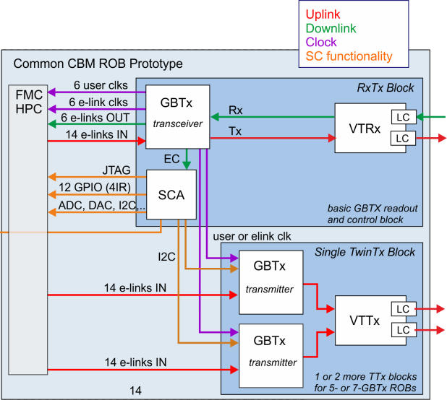
Common Prototype
FEB
ROB
DPB
Common CBM prototype Readout Board (C-ROB)
for prototyping of all GBT based readout chains in CBM
Full GBTx, SCA and Versatile Link functionality required for readout and control: STS: final ROB with different form factor, connectors, cooling features
C-ROB extension of VLDB features
3 GBTx ASICs
connect up to 40 STS-XYTER devices at 320 Mbps: hit readout, control responses
1 Optical Transceiver (VTRx) and 1 Twin Transmitter (VTTx)
3 optical uplinks : 13.44 Gbps total readout bandwidth
1 optical downlink at 3.2 Gbps for control
1 GBT SCA
I2C interface for control of slave GBTx
additional multi purpose SCA functionality
FMC connector with all frontend connectivity
GBTx E-Links
required and useful SCA functionality
flexibly connect any FEE prototype
Status: design ongoing → summer 2016
C-ROB

Slide 9
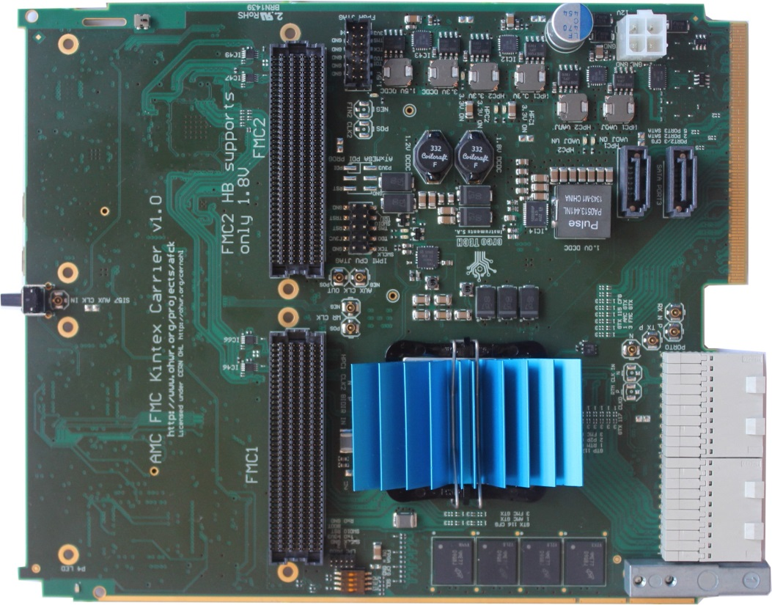
AFCK Prototype
FEB
ROB
DPB
AMC FMC Carrier Kintex (AFCK) as DPB prototype available
μTCA board
also standalone operation
Xilinx Kintex-7 325T FPGA
2 FMC (HPC) and RTM connectors
MGTs available
flexible test and development platform for next years Use with various FMC interfaces for
prototype readout chains
firmware and software development
DAQ systems for detector testing
Final DPB later for commissioning phase
Use up-to-date FPGA devices and multi channel optical Tx/Rx modules
AFCK PCB
G. Kasprowicz, Warsaw

Slide 10
DPB Firmware Blocks
FEB
ROB
DPB
Modular DPB firmware
common functionality and system & task specific blocks
for ongoing test & development activities and towards full DAQ chain
FE interfaces | Control blocks | Timing | Processing blocks | Readout interfaces
GBT-FPGA (optical GBT link) | IPbus CNTL/PHY | TFC CNTL/PHY | Stream Merger | FLES interface CNTL/PHY
 | IC/EC master |  | uSlice Builder
E-Link |  |  |  | CDAQ readout/IPbus
below STS specific blocks |  | Test
 | FEB-CTRL | STS-XYTER emulator | STS processor
 |  | Test Data gen. & checker
nXYTER CNTL |  |  | Development and Integration
Mon. 16:45 HK 14.2. D. Hutter:
“CBM First-level Event Selector Input Interface ”

Slide 11
Readout Chains for STS
FEB
ROB
DPB
Development of multiple DPB flavors with different firmware and hardware components for various readout chains:
Purpose FEB ROB DPB Flavor
STS only
ASIC protocol testing STS-XYTER emulator eDPB
GBTx testing VLDB vldbDPB
ASIC chain dry run STS-XYTER emulator VLDB vldbDPB
ASIC testing STS-XYTER FEB-1/2 eDPB
ASIC chain STS-XYTER FEB-1/2 VLDB vldbDPB
ASIC functional chain STS-XYTER FEB-1/2/8 C-ROB stsDPB
Final chain STS-XYTER FEB-8 STS-ROB-3 stsDPB
Beam-/Sensor test n-XYTER FEB E/F nDPB
tDPB
Mon. 17:00 HK 14.3. P.A. Loizeau:
“Control software for the CBM readout chain”

Slide 12
n-XYTER Readout Chain
Readout chain with predecessor ASIC n-XYTER
fully featured AFCK based readout chain for beam tests until STS-XYTER based readout chain available
legacy lab setups and sensor tests with high ADC resolution (12bit vs. 5bit)
chain consisting of: nXYTER FEB-E/F – nDPB - FLIB
readout with IPbus via SATA-to-SFP connection or optical fibers for STS modules (FLIM readout)
readout chains up to AFCK floating on sensor bias potential
Target: larger system for beam tests end of 2016
6 silicon strip sensors ( D’sUT and reference) + 2 hodoscopes
16 AFCK: nDPB and
tDPB for timing and synchronization

Slide 13
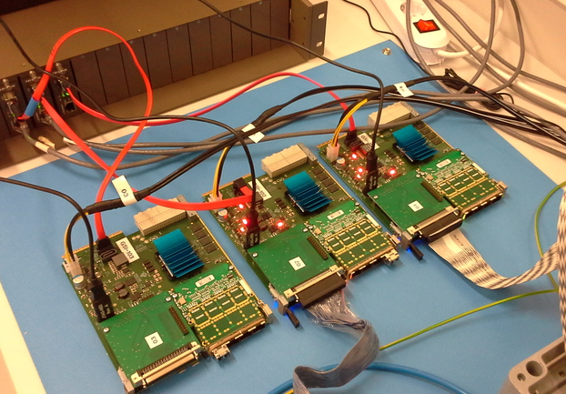
n-XYTER Readout Chain: Status
AFCK with
SCSI and quad SFP FMCs
SATA-to-SFP interface
Prototype chain for hodoscope readout:
2 hodoscopes
2 n-XYTER FEB-E
2 nDPB
IPbus readout
Hodoscopes with MAPMT
(later: silicon strip sensors)
FEB-E with n-XYTER
courtesy D. Emschermann

Slide 14
Summary and Outlook
Frontend Board, Readout Board and Data Processing Board as major components of CBM Silicon Tracking System readout chain:
STS specific FEB with 8 STS-XYTER ASICS and challenging boundary conditions → prototypes for testing of STS-XYTER v2; full prototype late this year
CERN GBTx/Versatile Link based ROB with many functional synergies within CBM → common prototype C-ROB being designed
Common DPB hardware (AFCK) as basis for various development and prototype readout chains. Modular approach → many building blocks (firmware cores, hardware: FMC addons) for various DPB flavors and chains ready or under development
Dedicated chain with n-XYTER ASIC and DPB based readout for upcoming test beam times: commissioning

Slide 15
Acknowledgements
GSI Darmstadt: D. Emschermann, V. Kleipa, P. Koczon, J. Lehnert, P.-A. Loizeau, W.F.J. Müller, A. Rodriguez, C.J. Schmidt, J. Yang (USTC/GSI)
WUT Warsaw: W. Zabołotny, G. Kasprowicz, A. Byszuk et al.
AGH Krakow: R. Szczygieł, K. Kasiński, R. Klescek, P. Otfinowski et al.
FIAS Frankfurt: J. de Cuveland, D. Hutter et al.
KIT Karlsruhe: L. Meder et al.
Univ. Heidelberg: D. Gottschalk et al.
IRI Frankfurt: A. Oancea, S. Manz et al.
… a common effort shared by many …

