Slide 1
Strangeness with CBM
Volker Friese
International Conference on Matter under High Densities
21. – 23. June 2016
Sikkim Manipal Institute of Technology, Rangpo

Slide 2
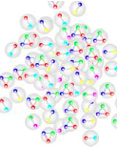
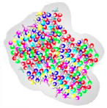
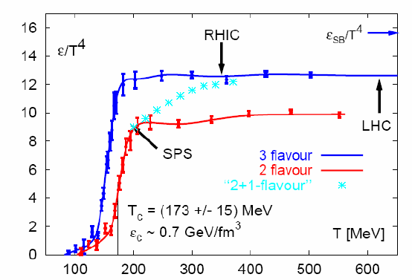
What is all about
confined matter: hadrons
deconfined matter: quarks and gluons
Lattice QCD: phase transition at critical energy density ε_{c} / critical temperature T_{c}

Slide 3
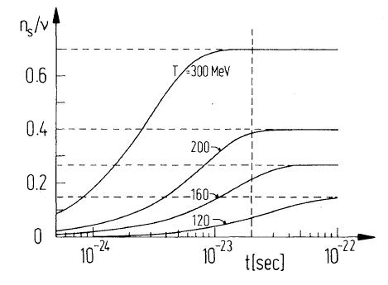
Why strangeness is interesting
No strangeness in entrance channel (nucleons): strangeness is produced in the reaction
Hadronic production (e. g. p+p -> KΛp): m_{K} ≈ 500 MeV >> T_{H}
Partonic production (e.g. g + g -> s sbar): m_{s} ≈ 100 MeV <= T_{H}
Relaxation of s-Quarks in a QGP within few fm/c ≈ lifetime of the fireball
Expectation: More strangeness production in A+A relative to p+p, if QGP was formed
„Strangeness enhancement“
Koch, Müller, Rafelski, Phys. Rep. 142 (1986) 167

Slide 4
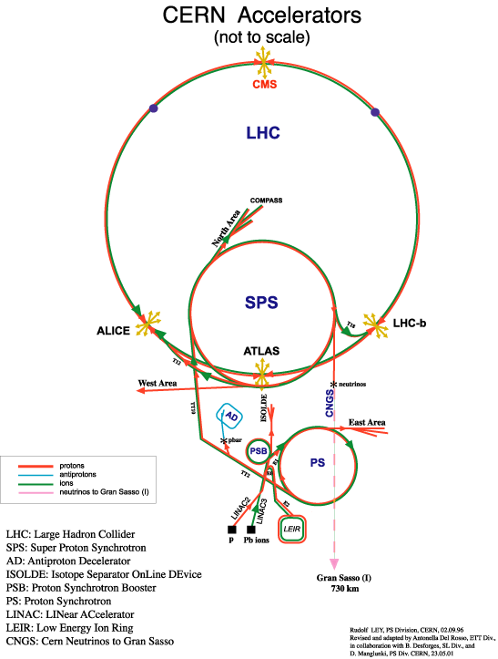
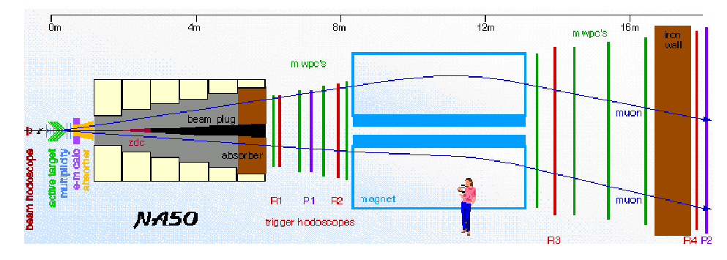
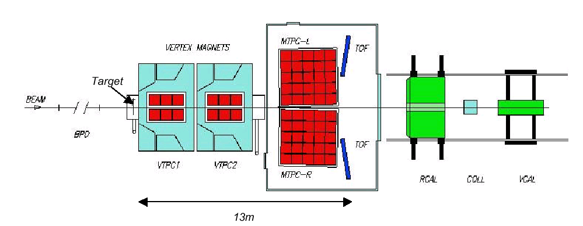
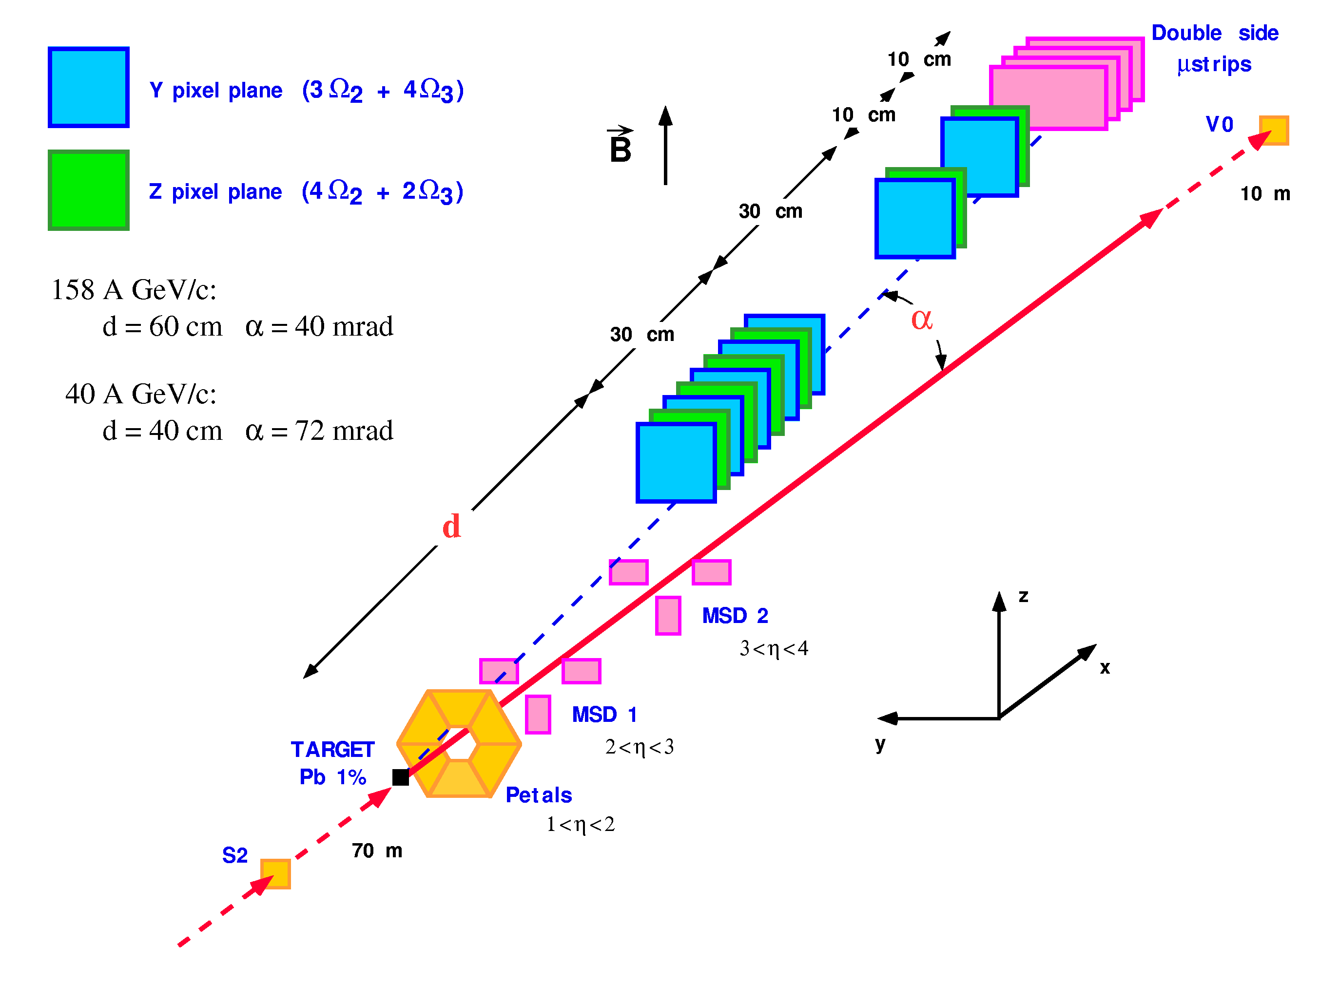
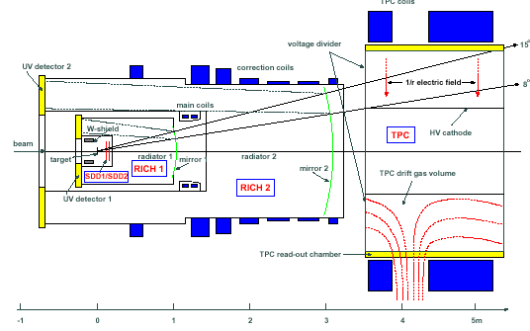
Experiments...(SPS)
NA49
NA45
WA97

Slide 5
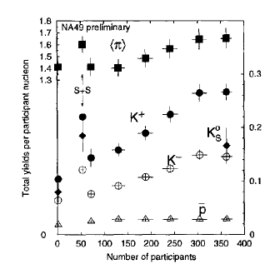
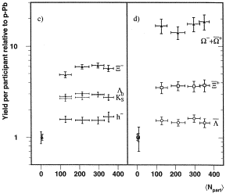
...and results
NA49, Nucl. Phys. A 661 (1999) 45
WA97, Phys. Lett. B 499 (1999) 401
strangeness enhancement relative to p+p observed (factor 15 for Ω!)
Hierarchy with number of strange valence quarks : E(K,Λ) < E(Ξ) < E(Ω)

Slide 6
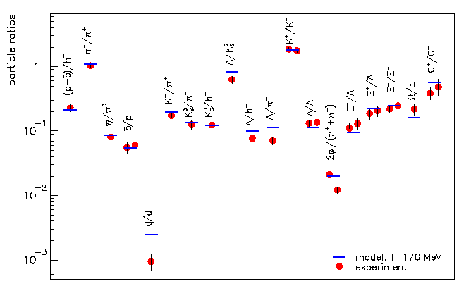
But: the statistical model
Particle multiplicities (multiplicity ratios) are well described by a hadron gas in chemical equilibrium.
Including strange particles:
Ξ, Ω
Fit parameters: T_{chem}, μ_{b}, (V)
J. Stachel, Nucl. Phys. A 654 (1999) 119 c
Why equilibrium? Hadronic relaxation processes are not efficient enough..
T_{chem} ≈ 170 MeV ≈ T_{c}: coincidence?
What is the relation to strangeness enhancement?

Slide 7
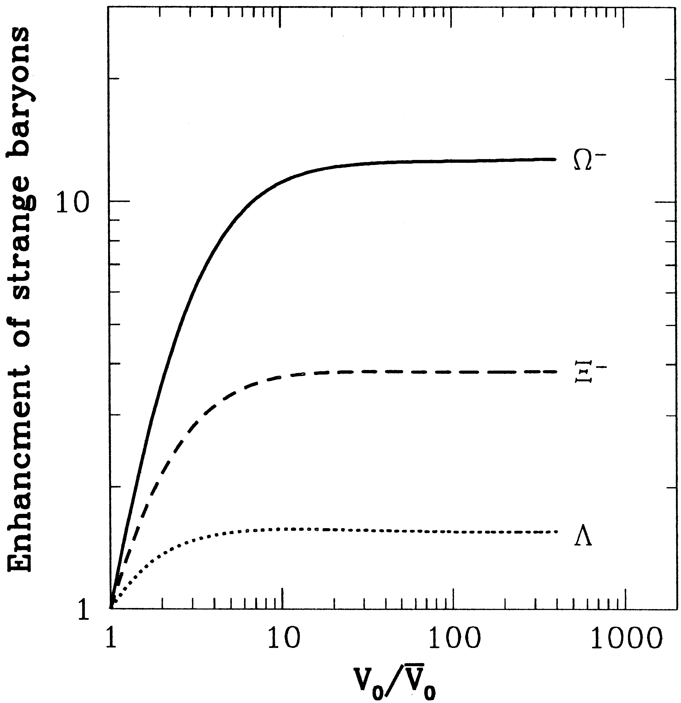
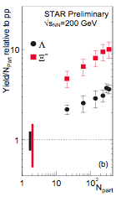
Strangeness enhancement and statistical model
Small systems: exact conservation of strangeness (needs canonical formulation)
Large systems: approximation by conservation of strangeness on average: grand-canonical formulation
Strangeness enhancement -> „canonical suppression“
Strangeness enhancement as a volume effect!
S. Hamieh, K. Redlich und A. Tounsi, Phys. Lett. B 486 (2000) 61

Slide 8
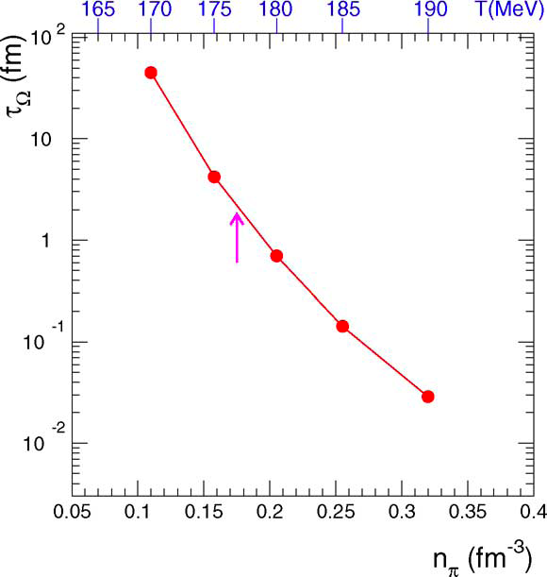
Why chemical equilibrium?
Braun-Munzinger, Stachel, Wetterich 2004: Equlibration of strangeness through collisions with more than two particles in the entrance channel (strangeness exchange reactions, e. g.
2π + 3K -> Ω);
Extreme dependence of rates from temperature and/or density: effective only at T≈T_{c}
Strangeness content is determined at phase boundary.
Equilibration of strangeness (in particular of multi-strange baryons) is indirect proof of phase transition.
P. Braun-Munzinger, J. Stachel und C. Wetterich, Phys. Lett. B 596 (2004) 61

Slide 9
Searching for the onset of deconfinement
Following the argumentation „equilibration of multi-strange baryons -> QGP“, one would search for the onset of deconfinement by measuring strange baryon abundances at lower energies.
  Down to which collision energies does the hadron gas model hold?
Model fits describe data at lower SPS and at AGS
  But with a limited amount of particle species
  Data on multi-strange baryons are scare

Slide 10
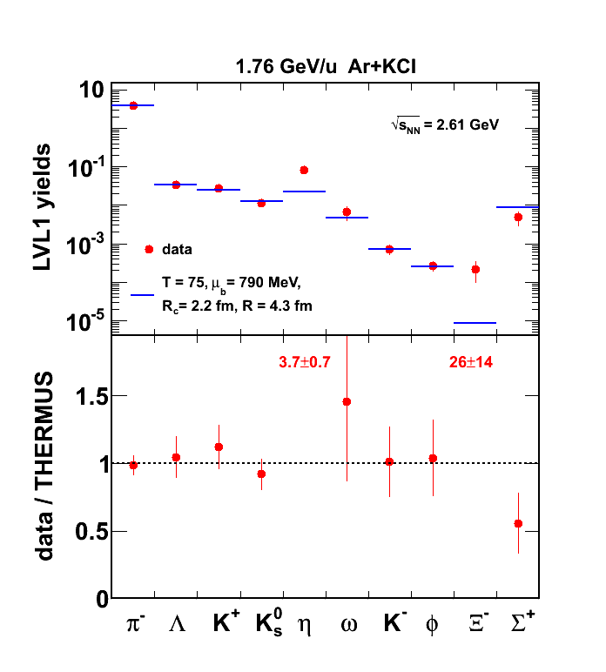
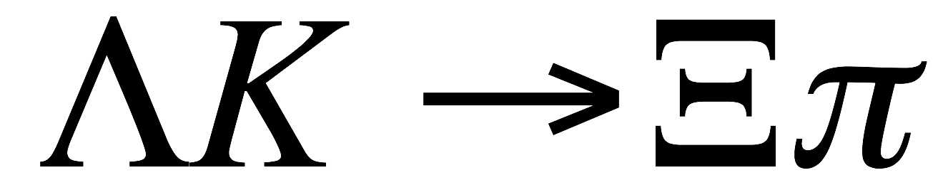
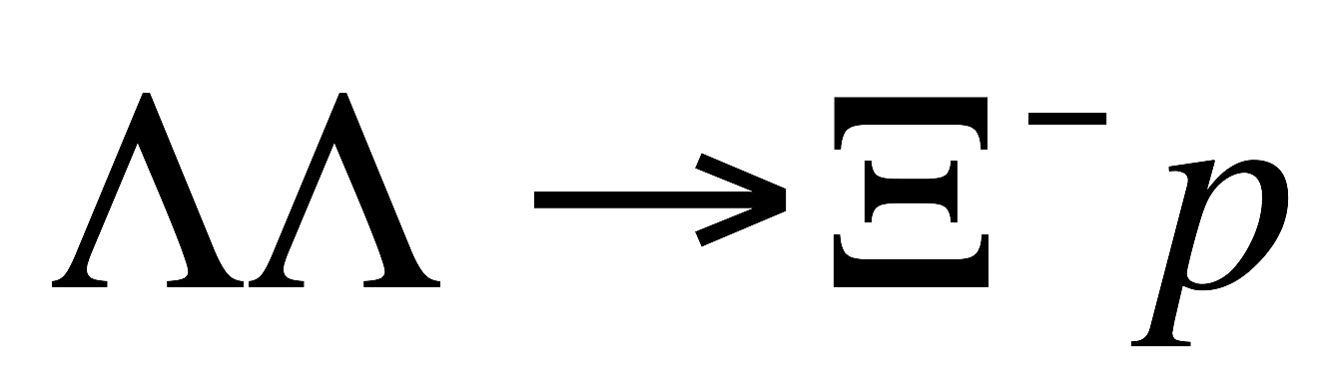

Breakdown of strangeness thermalisation?
HADES
HADES result for Xi⁻ at SIS-18 (1.76A GeV): Xi⁻ yield is off by an order of magnitude from the statistical model.
N.b.: This is deep sub-threshold. Production through multi-step processes
R. Holzmann, CBM Physics Workshop, April 2010

Slide 11
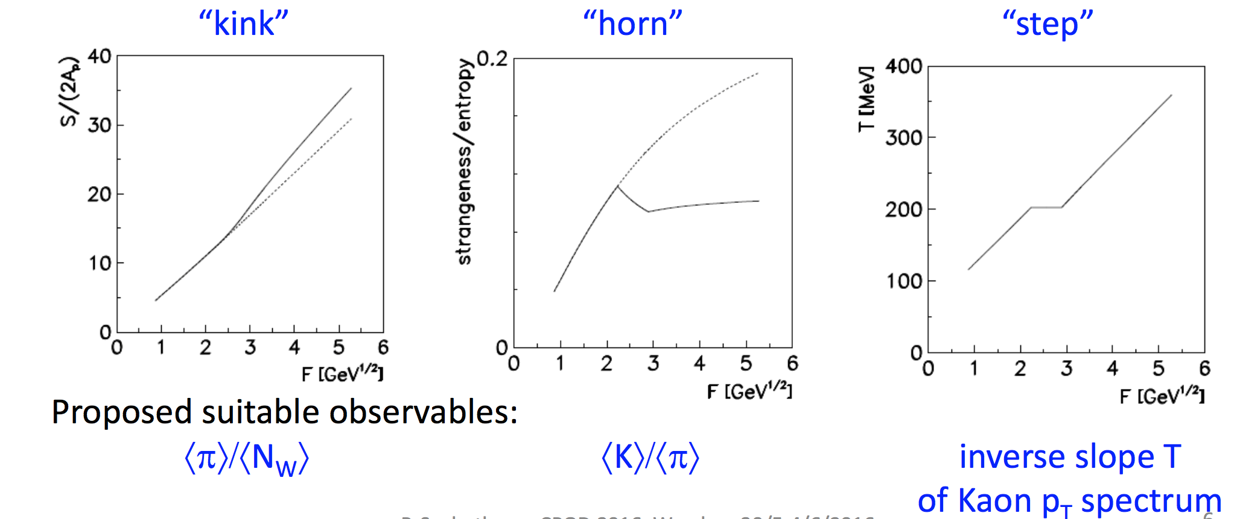
The search for the onset
“Statistical Model of the Early Stage”:
“Early stage” (hadronic / partonic) im thermal equilibrium
First-order phase transition at ε_{c}/T_{c}
Mixed phase around ε_{c}

Slide 12
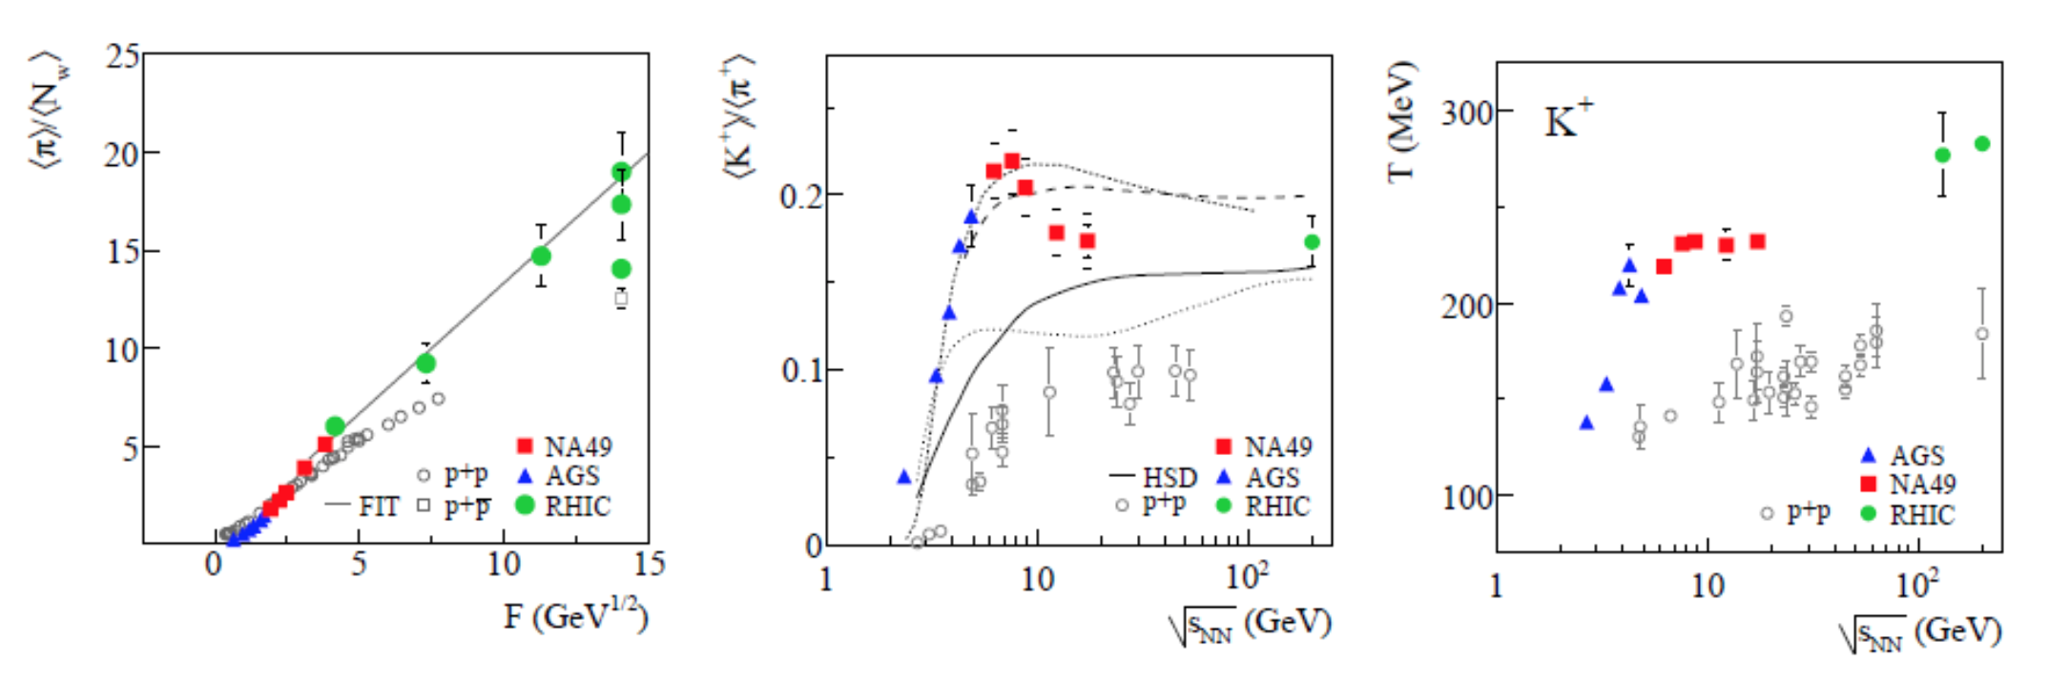
Results at SPS (NA49)
Evidence for the onset of deconfinement at 30A GeV ?

Slide 13
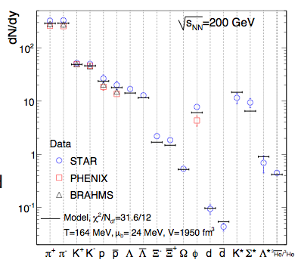
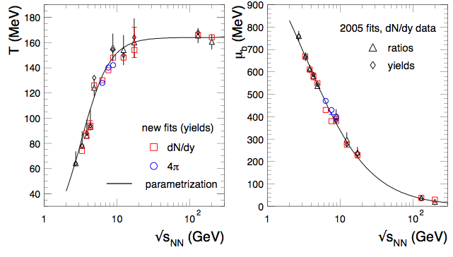
What about the statistical model?
Fits for many collision energies: SIS, AGS, SPS, RHIC
T, μ_{b} monotonic functions of √s_{NN}
T saturates at √s_{NN} ≈ 10 GeV; T_{limit} ≈ 160 MeV

Slide 14
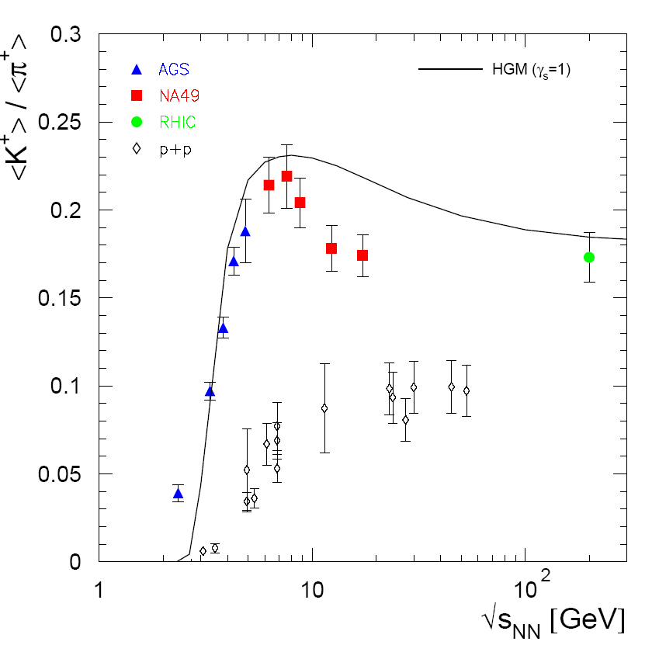
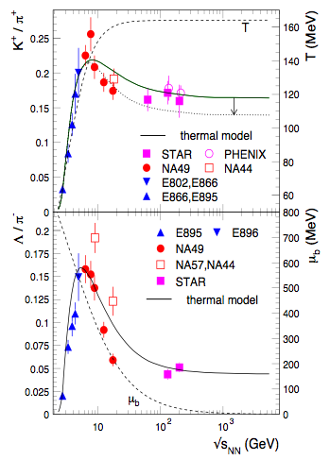
The „horn“ in the statistical model
2006
2009
A. Andronic, P. Braun-Munzinger und J. Stachel, Nucl. Phys. A 772 (2006) 167
Broad maximum at ≈ 30A GeV (interplay of T and μ_{b})
No satisfactory description of the K/pi energy dependence
Improvement when including high-mass resonances
A. Andronic, P. Braun-Munzinger und J. Stachel, Phys. Lett. B 673 (2009) 142

Slide 15
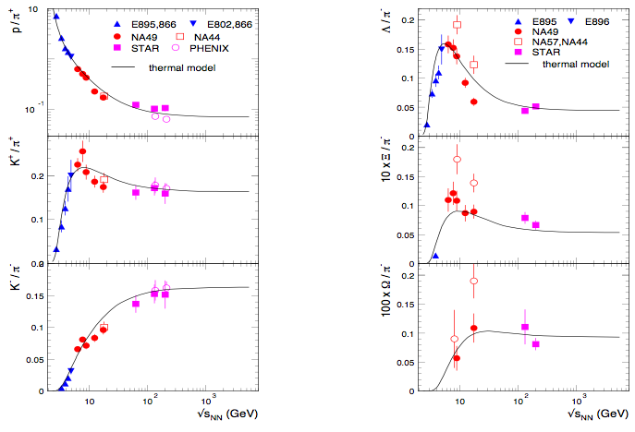
The need for data on multi-strange baryons
A long-lasting debate: pure hadronic description or signal of drastic change in matter properties?
Data on multi-strange baryons will be decisive!

Slide 16
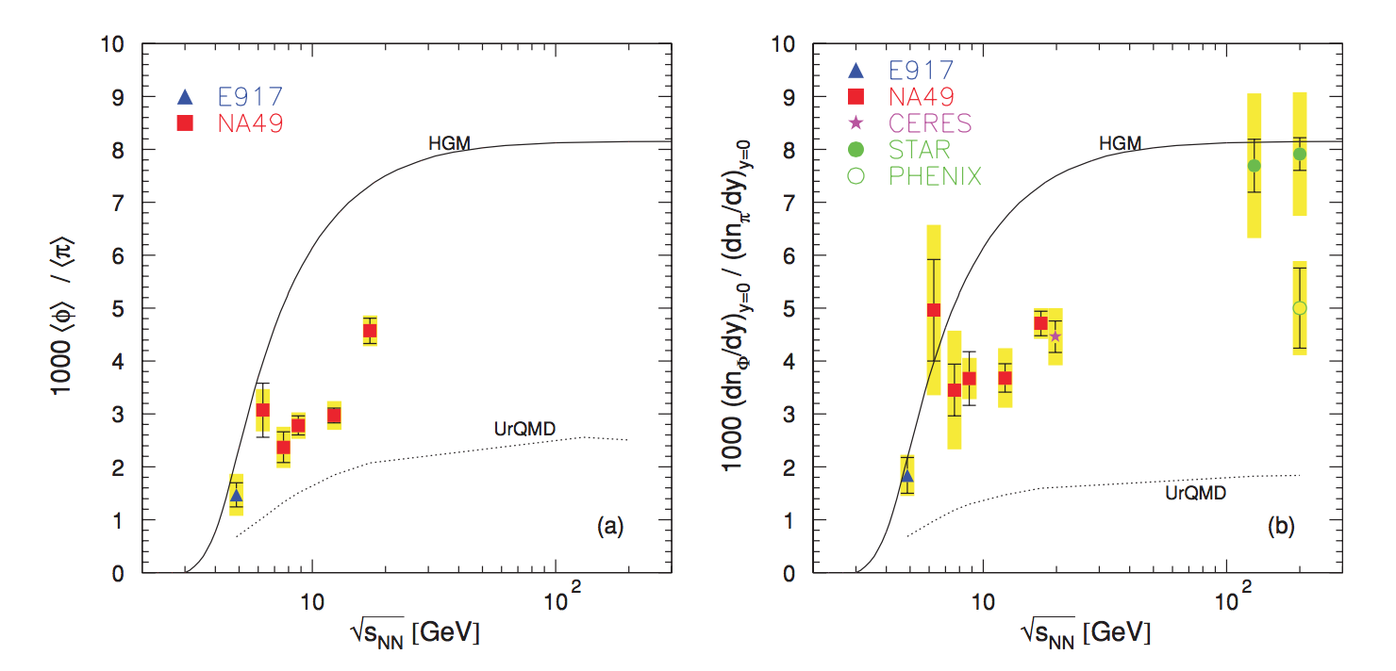
Not to forget: the phi meson
s-sbar: strangeness-neutral in a hadronic picture; double-strange in a partonic view
No satisfactory description of the excitation function neither by statistical model nor by microscopic transport
HADES (sub-threshold): good description by statistical model

Slide 17
What about strange anti-baryons?
At large net-baryon density, the production of anti-baryons is heavily suppressed. This is not the case in a deconfined phase.
pHSD model: microscopic transport; assumes QGP in fireball regions where a critical energy is exceeded
For comparison: HSD (pure hadronic)
At top SPS energy: small effect on Xi, huge effect on anti-Xi.

Slide 18
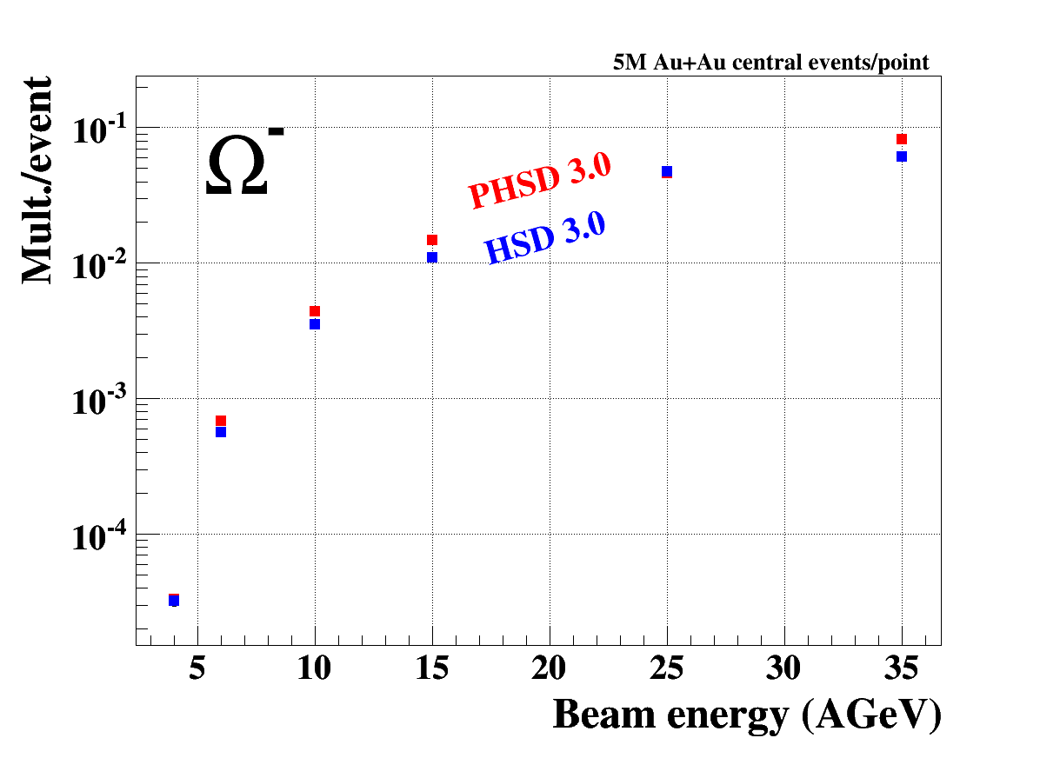
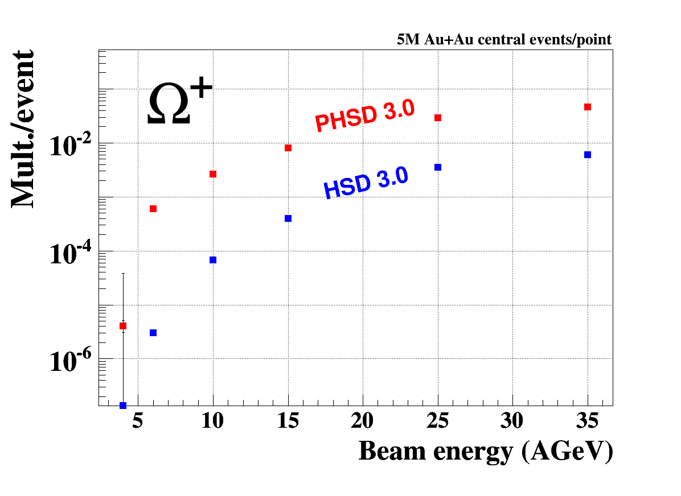
Strange anti-baryons at CBM energies
”Enhancement” of strange-anti-baryons is expected to be much stronger at lower energies!

Slide 19
Summary
Strangeness below top-SPS energy is far from being understood.
Many open questions:
  Does thermalisation hold at lower energies?
  Can the „horn“ be fully understood in terms of the statistical model?
  What are the production mechanisms near or below threshold?
A systematic measurement of multi-strange hadrons is most promising to answer those questions
  CBM, BM@N, MPD, NA61, STAR
Multi-strange anti-baryons are probably even more sensitive
  CBM is probably the only experiment able to address these

