Slide 1
Production of Multi-Strange Hyperons at FAIR Energies.
Hushnud
Department of Physics, A.M.U, Aligarh
CBM Meet at Sikkim Manipal University, 21-23 June 2016

Slide 2
Outline
Introduction
Strangeness production mechanism
Details of Input
Results
Summary

Slide 3
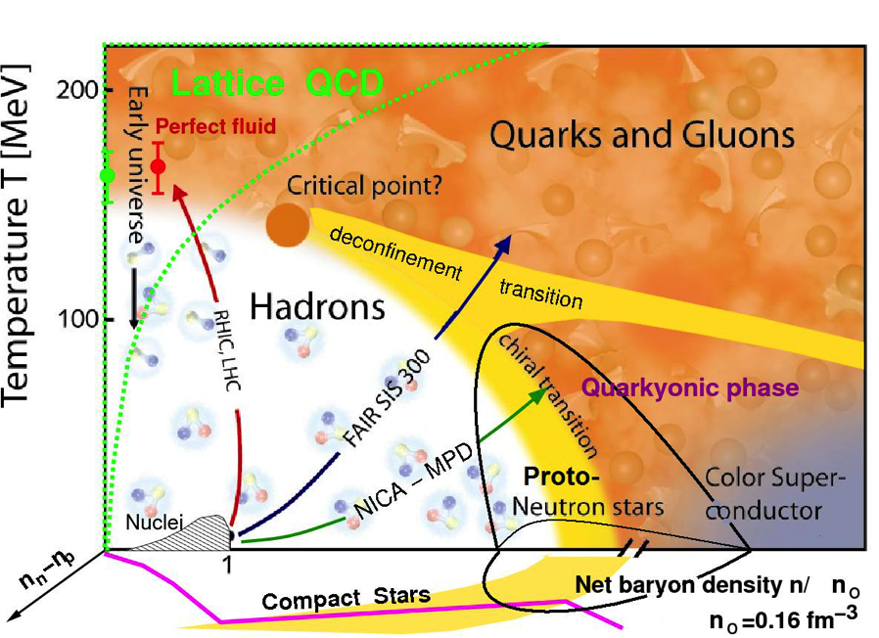
The Phase Diagram Of Strongly Interacting Matter matter

Slide 4
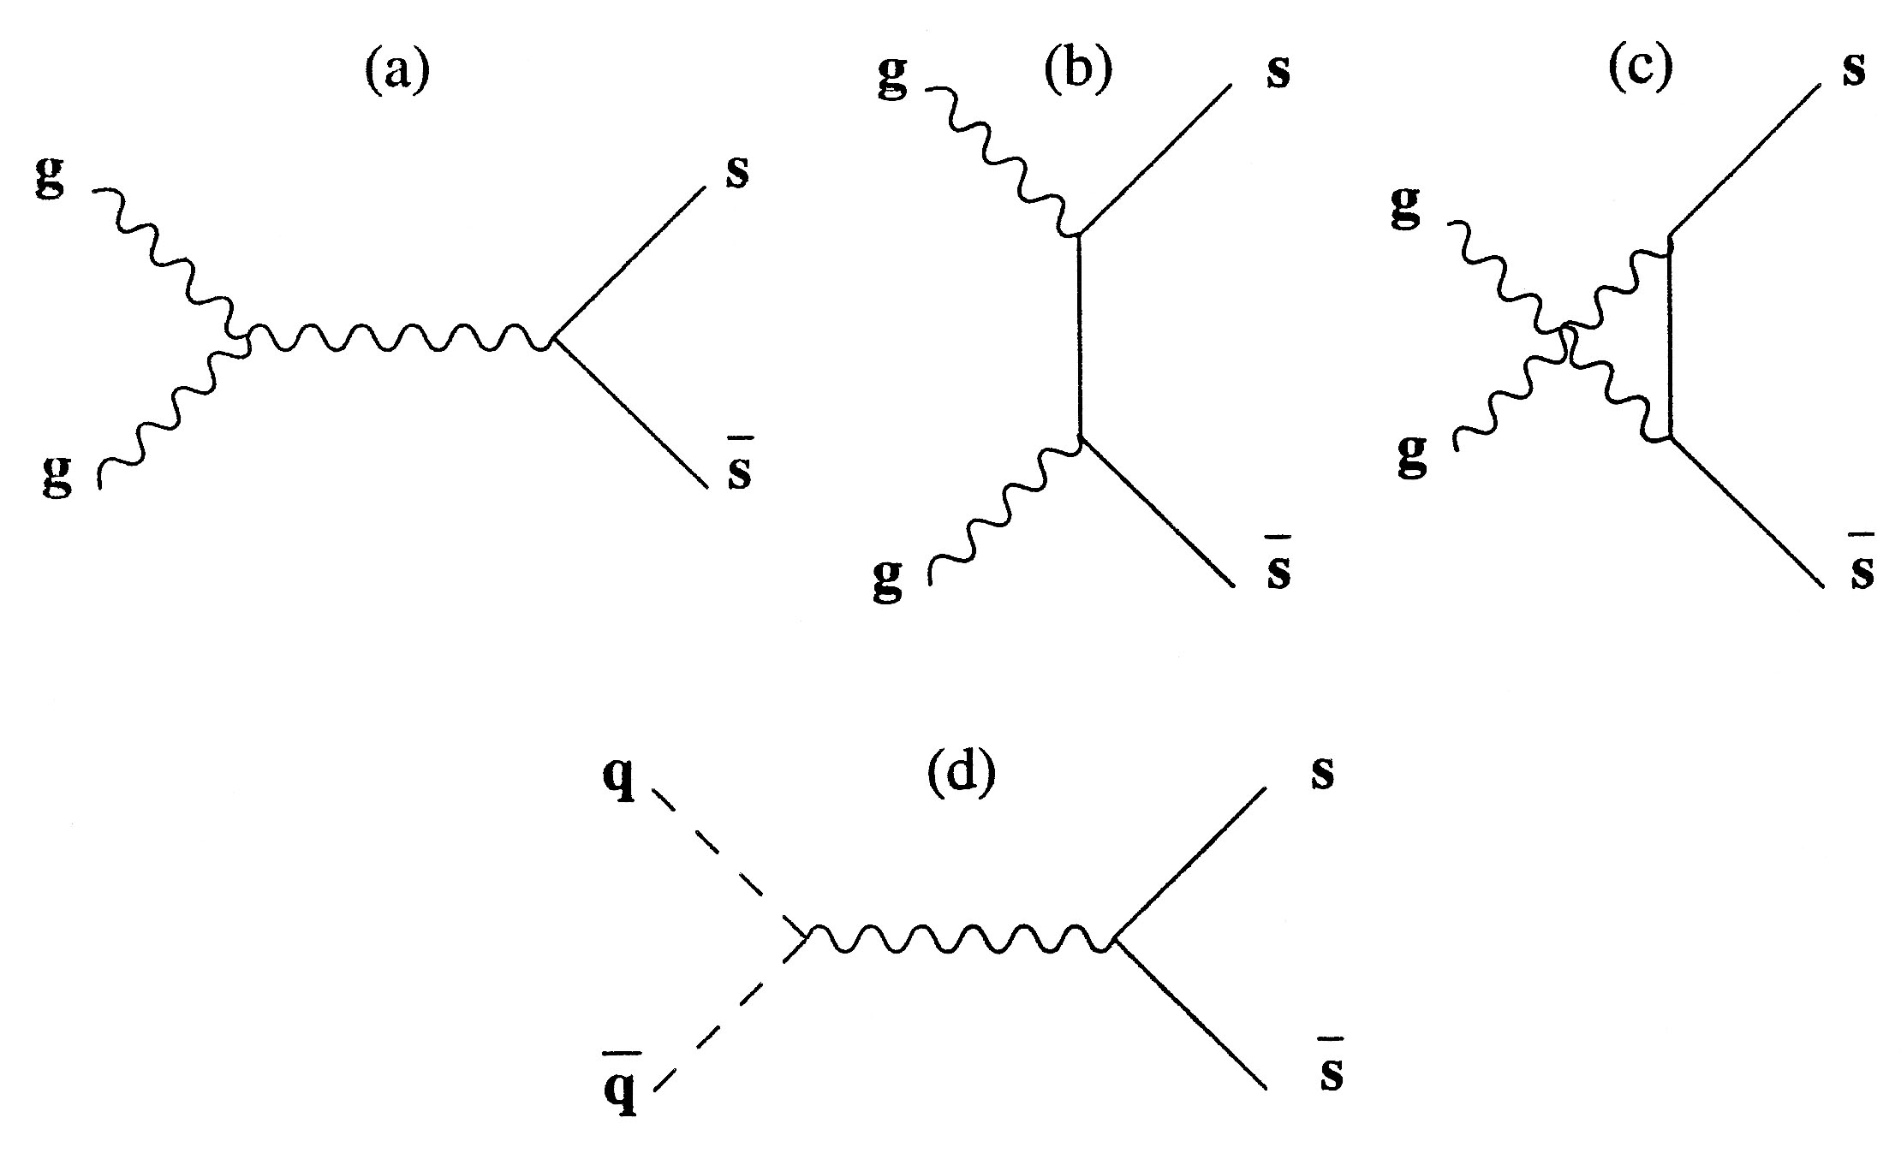
Strangeness enhancement is one of the QGP signature
Strangeness has to be produced (no s-Quarks in nucleons)
Thresholds are high in hadronic reactions,
e.g..: N + N → N + Λ+ K (E_{thres} ≈ 700 MeV)
Fast equilibration in a QGP via partonic processes,
e.g. gluon-fusion
more production of s-bars in dense baryonic matter → enhanced production of strange particle (having more than one strange quarks)
⇒ Enhancement of strange particle production in A+A relative
to p+p expected (in particular multi-strange particles)

Slide 5
Production of multi-strange baryons has the potential to probe
the density and the EOS of the medium.
300 Ξ⁻ in Au+Au collisions at 6 AGeV and no Ω⁻ up to beam 30 AGeV .
CBM experiment, capability of handling high interaction rate → detect particles with very low cross-section.
Performed a model based
study of the production of
strange particle with
varying strangeness at FAIR
energy.

Slide 6
Input Parameters
Energy range = 5-90 AGeV
Central Au+Au collision
No of Events = 1 Million
Rapidity cut = -0.5 < y < 0.5
Model Used
Transport Model: UrQMD and AMPT (both default and string melting mode)
Input parameters for AMPT model
Lund string parameters; a = 2.2 and b = 0.5 /GeV²
parton screening mass = 1.8 (1/fm) ~ cross section 10 mb
strong coupling constant α_{s} = 0.47

Slide 7
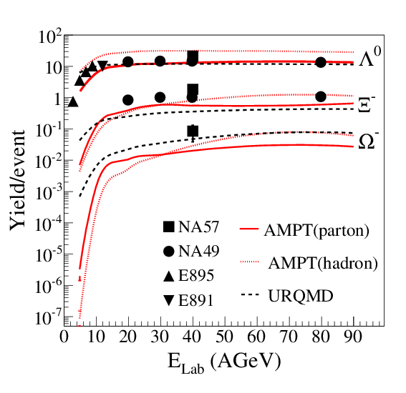
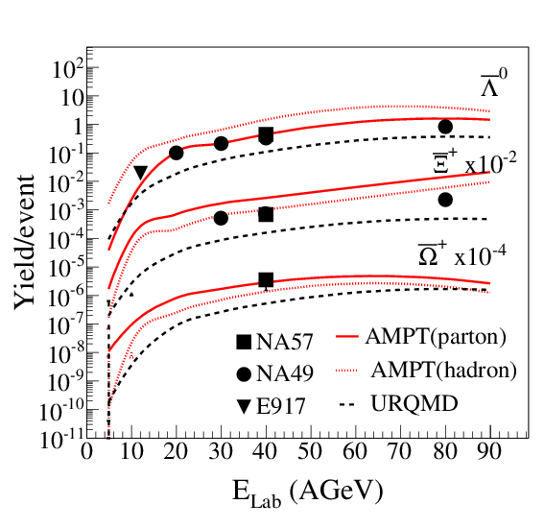
Energy Dependence: Yields
UrQMD model reproduces reasonably well the average yields of Λ⁰ hyperons.
The anti-hyperon yields are underestimated by a factor of about 5.
AMPT (hadronic ) overestimate Λ⁰ hyperons and underestimate the multi-strange hyperons.
Over estimate anti- Λ⁰ and reproduce other data point.
AMPT (parton) underestimate the hyperons but overestimate the anti – Ξ⁺ hyperons and matches well with anti-Ω+.

Slide 8
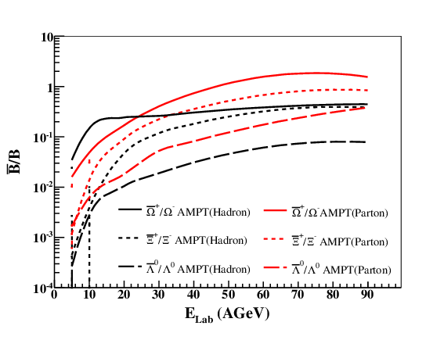
Energy Dependence: Ratio
Increase of the particle ratios up to 20 AGeV is significantly steeper for the partonic than hadronic mode.
Anti-Ω ⁺/Ω ⁺ > anti-– Ξ⁺ / Ξ⁻ > anti-Λ⁰/Λ⁰ by factor of 10.
At low energies, production of multi-strange antihyperons strongly depends on multiple collisions of partons or hadrons which are enhanced at high densities.

Slide 9
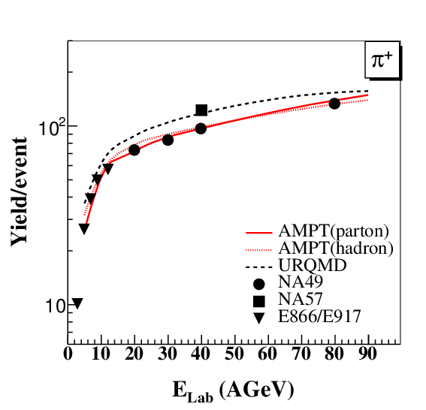
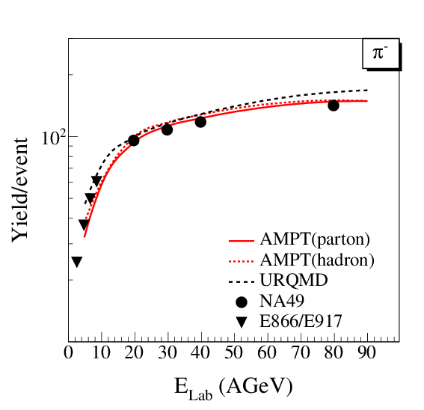
Energy Dependence: Yields
All the models reproduce the experimental data points within 20 - 30% difference but AMPT partonic approach leads to relatively better agreement

Slide 10
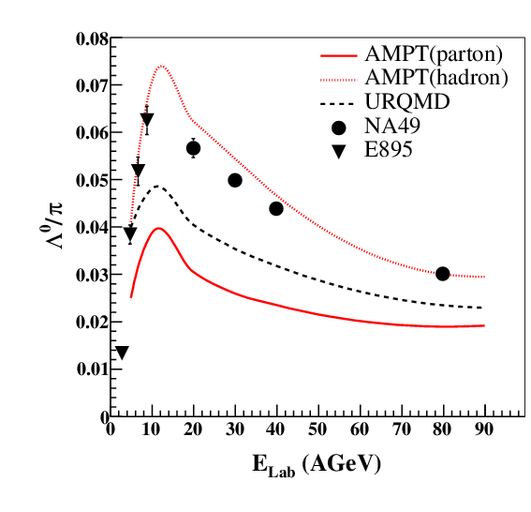
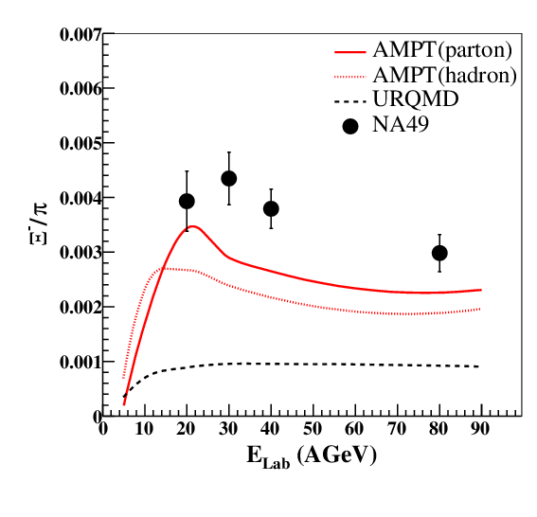
Energy Dependence: Ratio

Slide 11
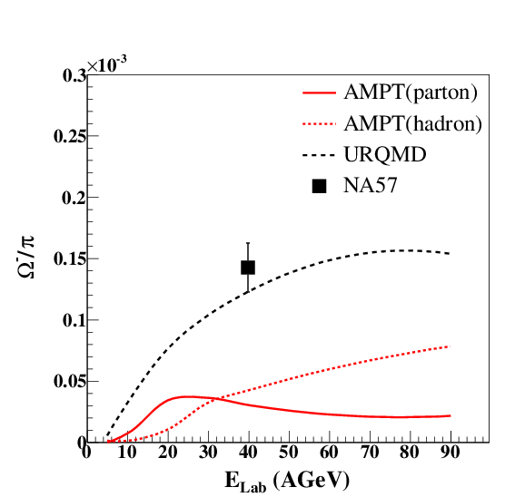
Energy Dependence: Ratio
All the ratios show a peak like structure around 11 AGeV (SIS100).
UrQMD shows increase followed by saturation.
Below 20 AGeV , the AMPT partonic mode predicts enhanced hyperon than hadronic mode; multi-strange particles are a sensitive probe of QCD matter at large baryon densities.

Slide 12
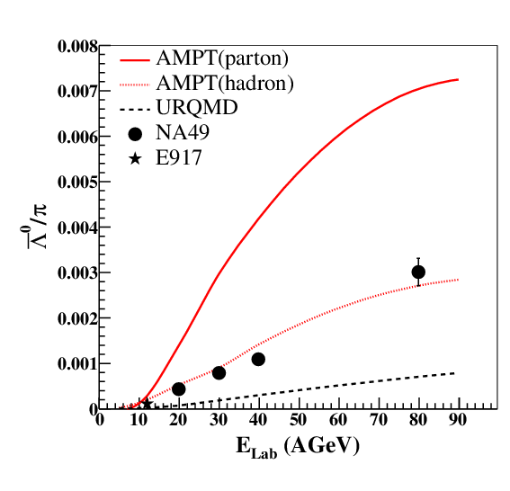
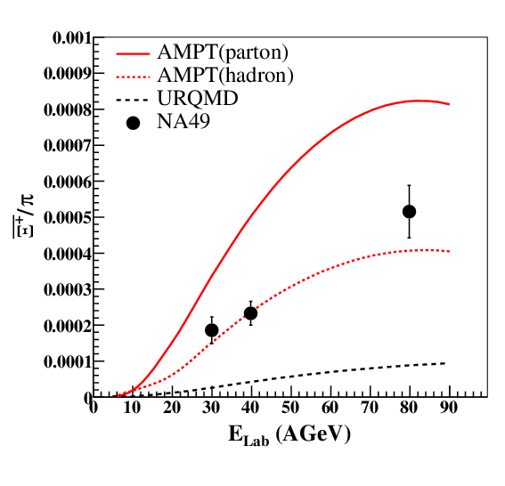
Energy Dependence: Ratio

Slide 13
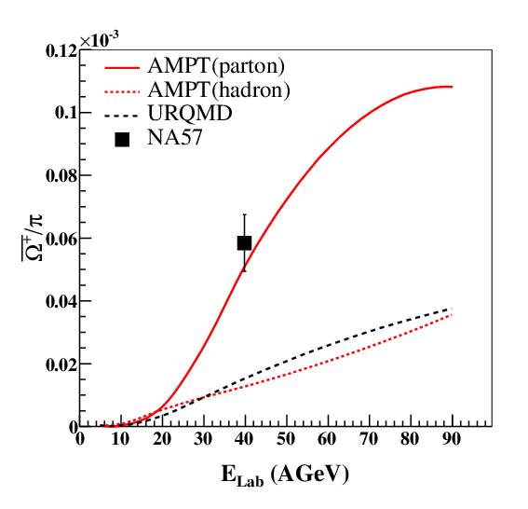
Energy Dependence: Ratio
No peak like structure for antihyperons to pion ratio.

Slide 14
Summary
Production of antihyperons are more enhanced in the partonic mode as compared to the enhancement of hyperons, the trend is quite opposite in AMPT (hadronic) mode.
AMPT code indicates more production of multi-strange hyperons in the partonic mode in comparison to hadronic scenario at beam energies up to 20 AGeV.
Multi-strange hyperons are promising observables to study of degrees of freedom of QCD matter in neutron star core densities.
CBM detector set-up is ideal for measurement of multi-strange hyperons; is designed and fabricated at FAIR.

Slide 15
Acknowledgment
Dr. Subhasis Chattopadhyay (VECC)
Prof. Peter Senger (GSI)
Shabir Ahmad (KU)

Slide 16
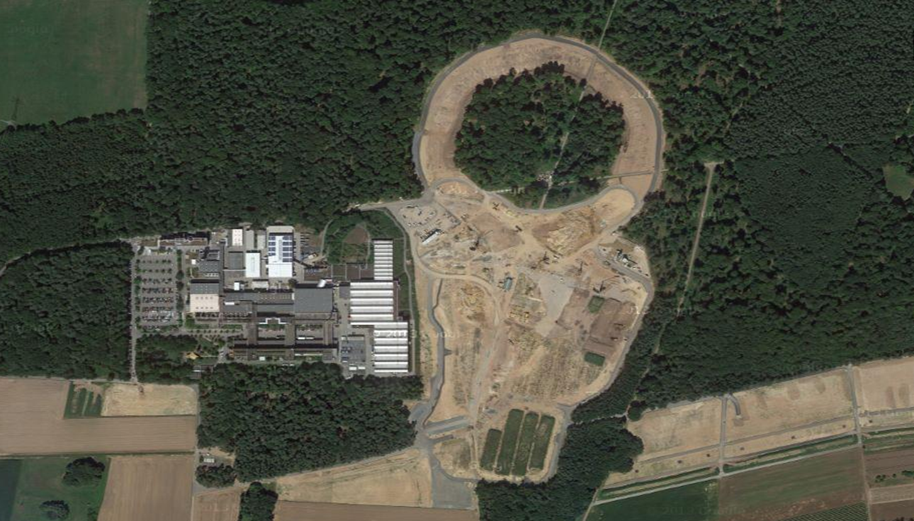
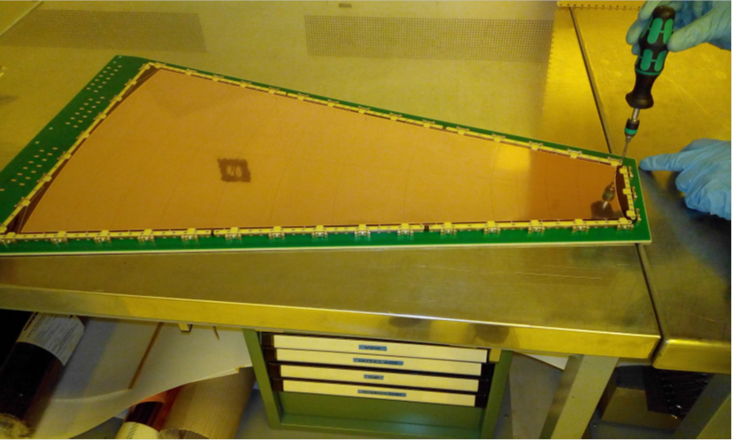
Thank You

