Slide 1
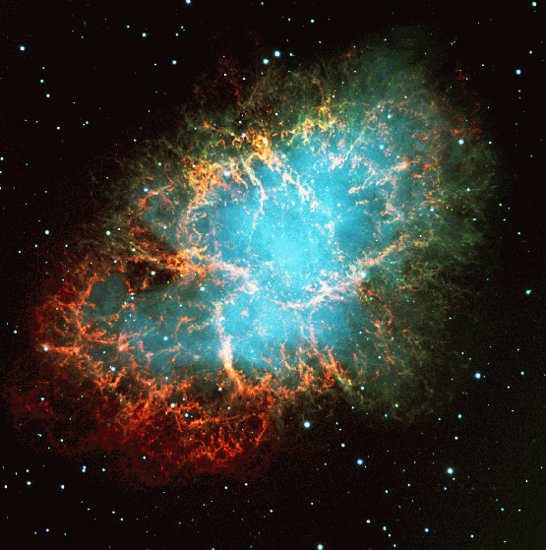
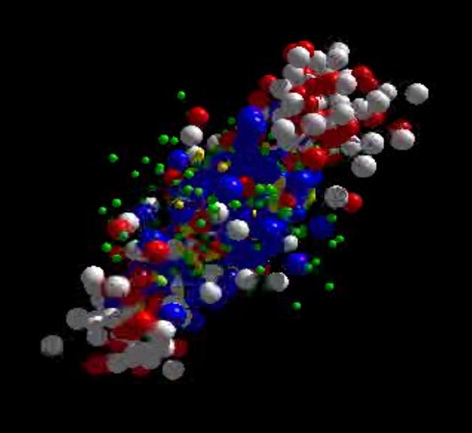
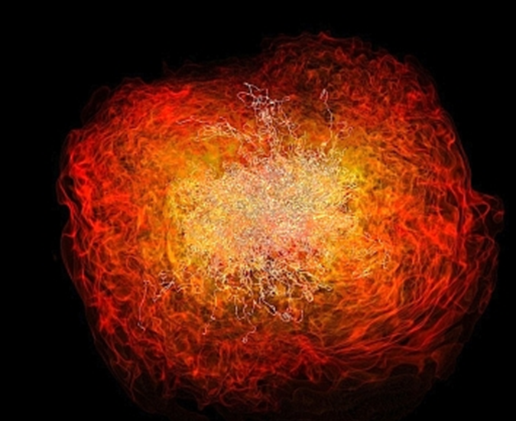
QCD matter physics at FAIR
The CBM experiment
Peter Senger GSI and Univ. Frankfurt
The CBM physics case
Status experiment preparation
Outline:
International Conference on Matter under High Densities,
21 – 23 June 2016, Sikkim Manipal Institute of Technology, Rangpo, Sikkim, India

Slide 2
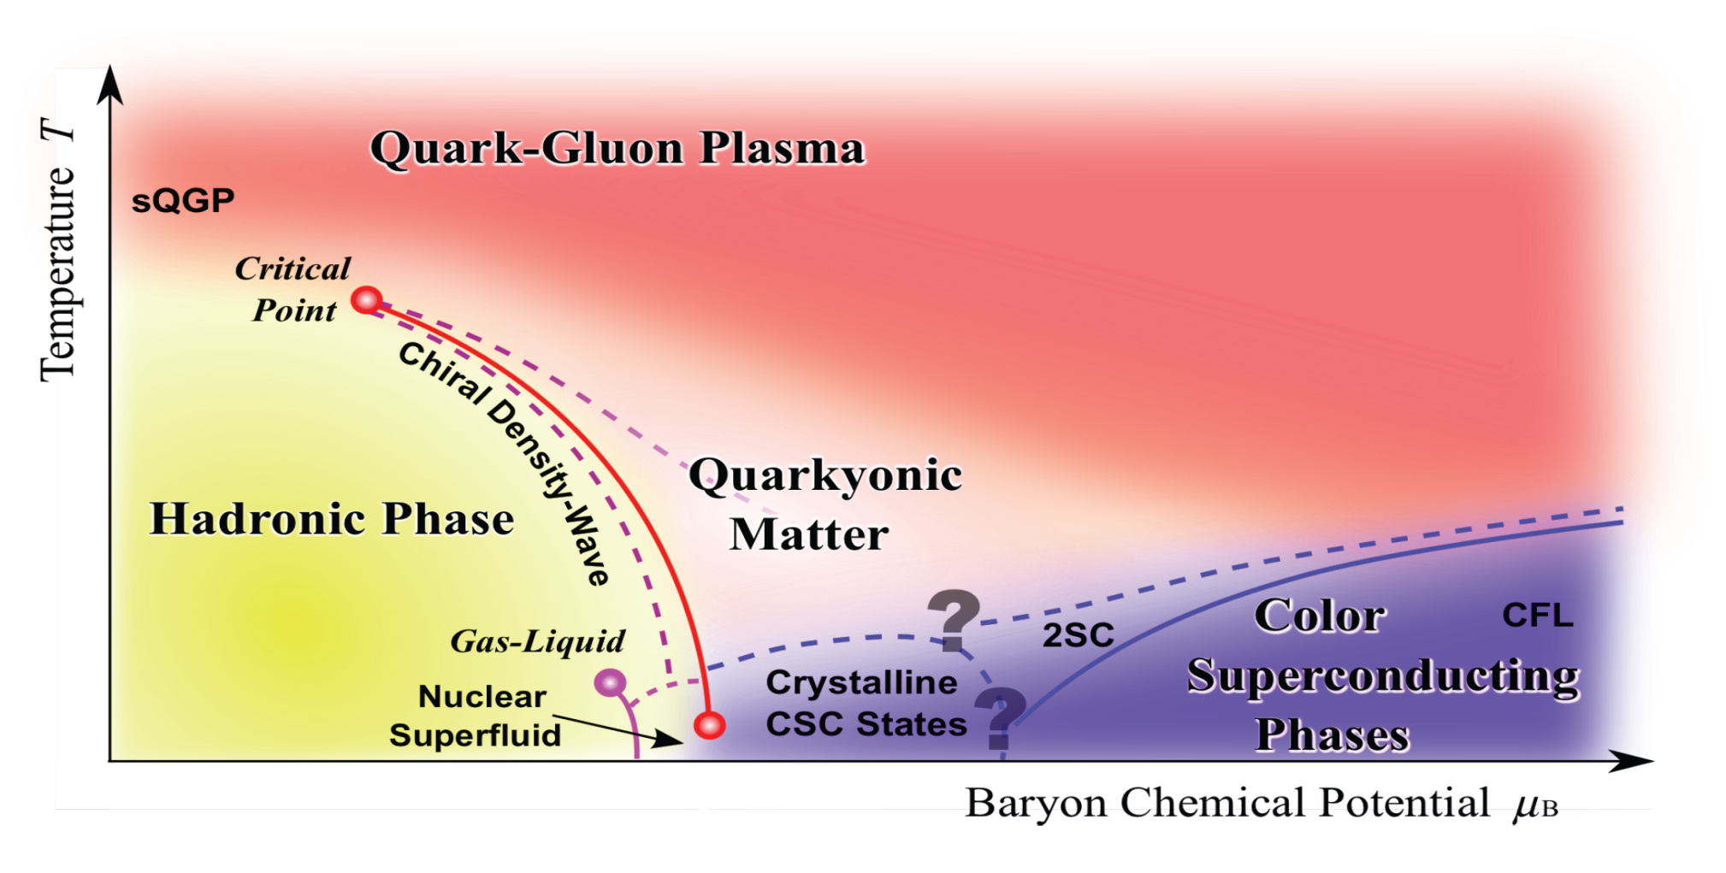
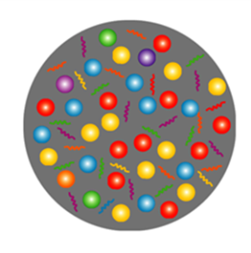
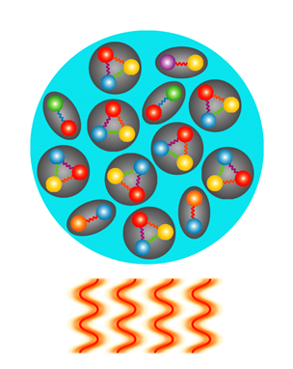
Exploring the QCD phase diagram
Courtesy of K. Fukushima & T. Hatsuda
At very high temperature:
➢ N of baryons ≈ N of antibaryons
Situation similar to early universe
➢ L-QCD finds crossover transition between
hadronic matter and Quark-Gluon Plasma
➢ Experiments: ALICE, ATLAS, CMS at LHC
STAR, PHENIX at RHIC

Slide 3
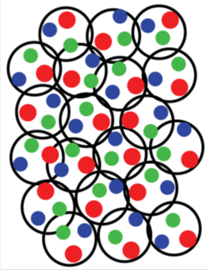
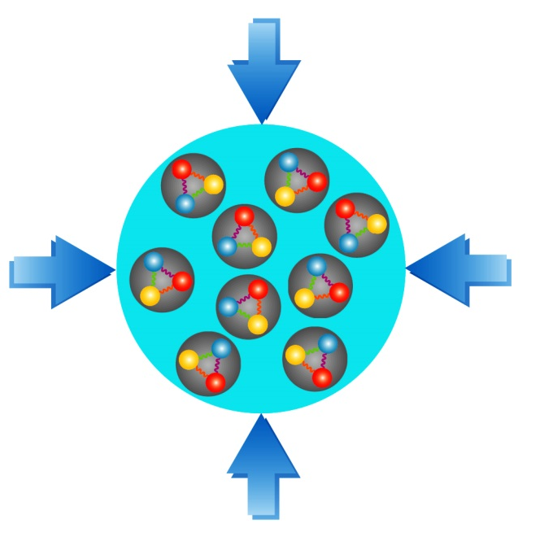
Exploring the QCD phase diagram
Courtesy of K. Fukushima & T. Hatsuda
At high baryon density:
➢ N of baryons >> N of antibaryons
Densities like in neutron star cores
➢ L-QCD not (yet) applicable
Models predict first order phase transition
with mixed or exotic phases
Experiments: BES at RHIC, NA61 at CERN SPS,
CBM at FAIR, NICA at JINR, J-PARC

Slide 4


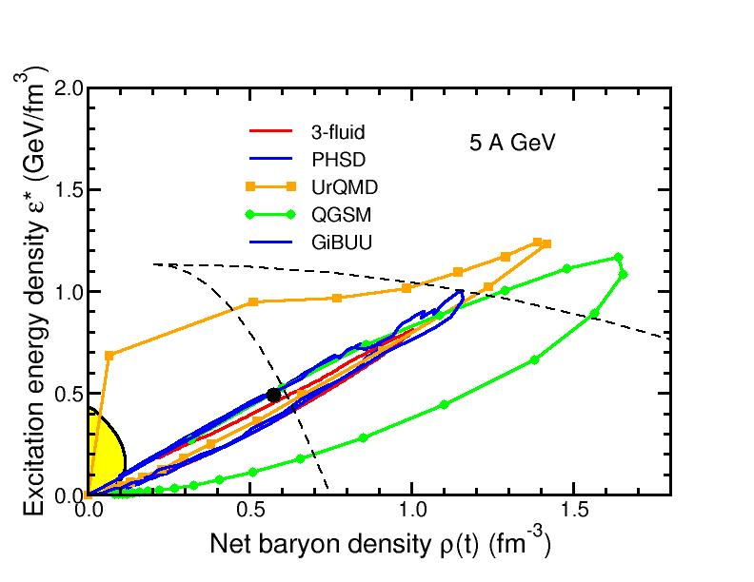
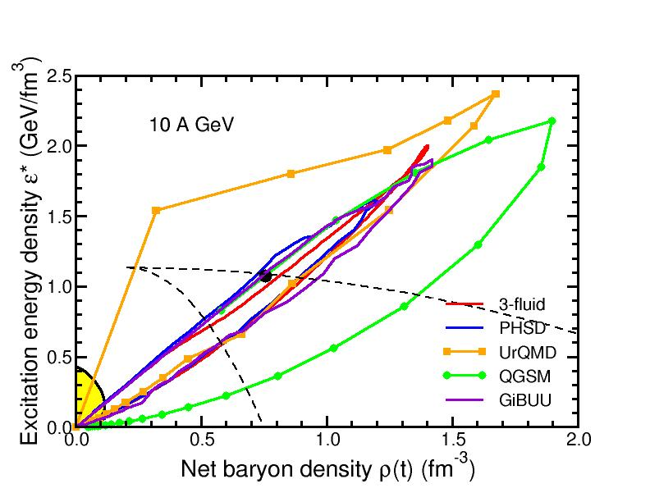
Baryon densities in central Au+Au collisions
I.C. Arsene et al., Phys. Rev. C 75, 24902 (2007)
5 A GeV
10 A GeV
8 ρ₀
5 ρ₀
phase
coexistence
phase
coexistence

Slide 5
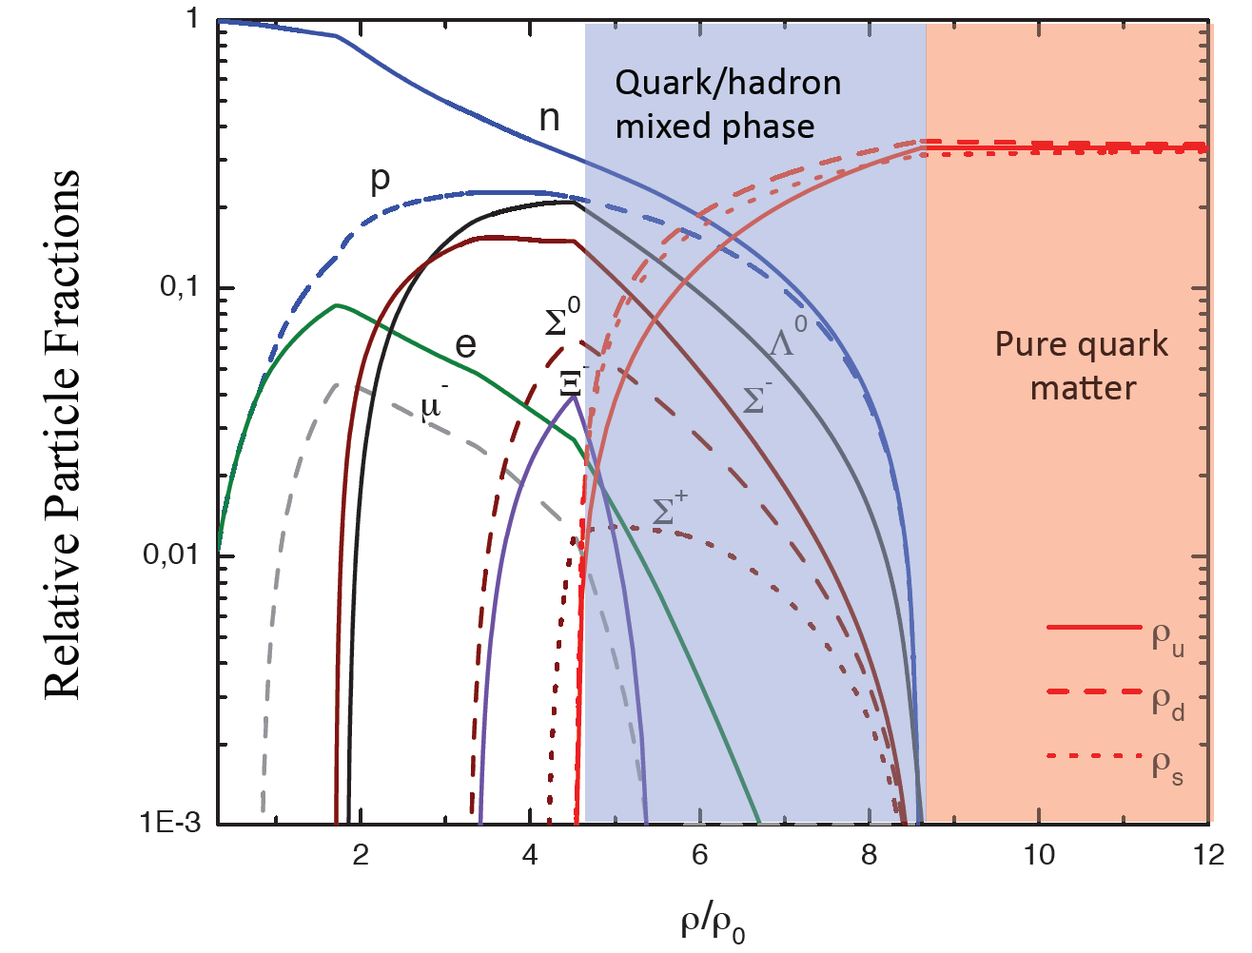
Quark matter in massive neutron stars?
M. Orsaria, H. Rodrigues, F. Weber, G.A. Contrera, arXiv:1308.1657
Phys. Rev. C 89, 015806, 2014

Slide 6
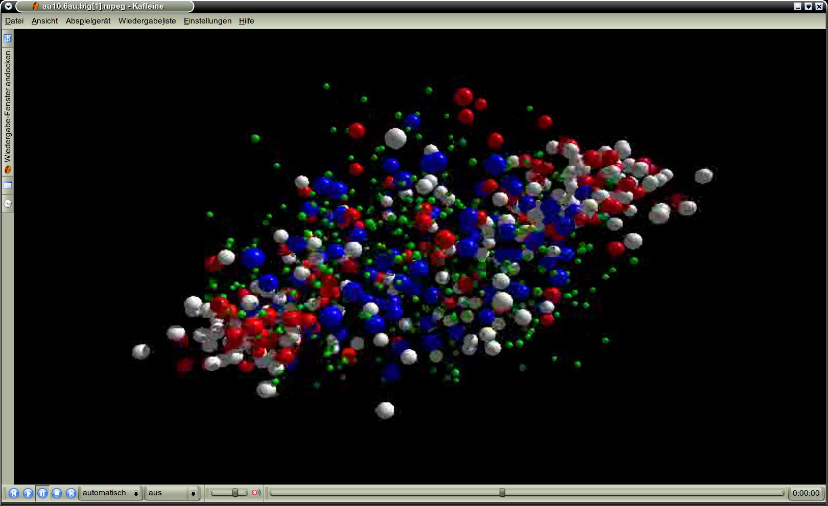
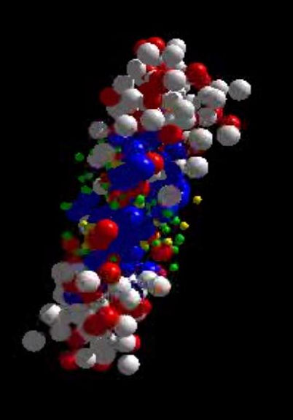
Messengers from the dense fireball:
CBM at FAIR
UrQMD transport calculation Au+Au 10.7 A GeV
Ξ⁻, Ω⁻, φ
π, K, Λ, ...
p, Λ, Ξ⁺, Ω⁺
ρ → e⁺e⁻, μ⁺μ⁻
resonance decays
ρ → e⁺e⁻, μ⁺μ⁻
ρ → e⁺e⁻, μ⁺μ⁻

Slide 7
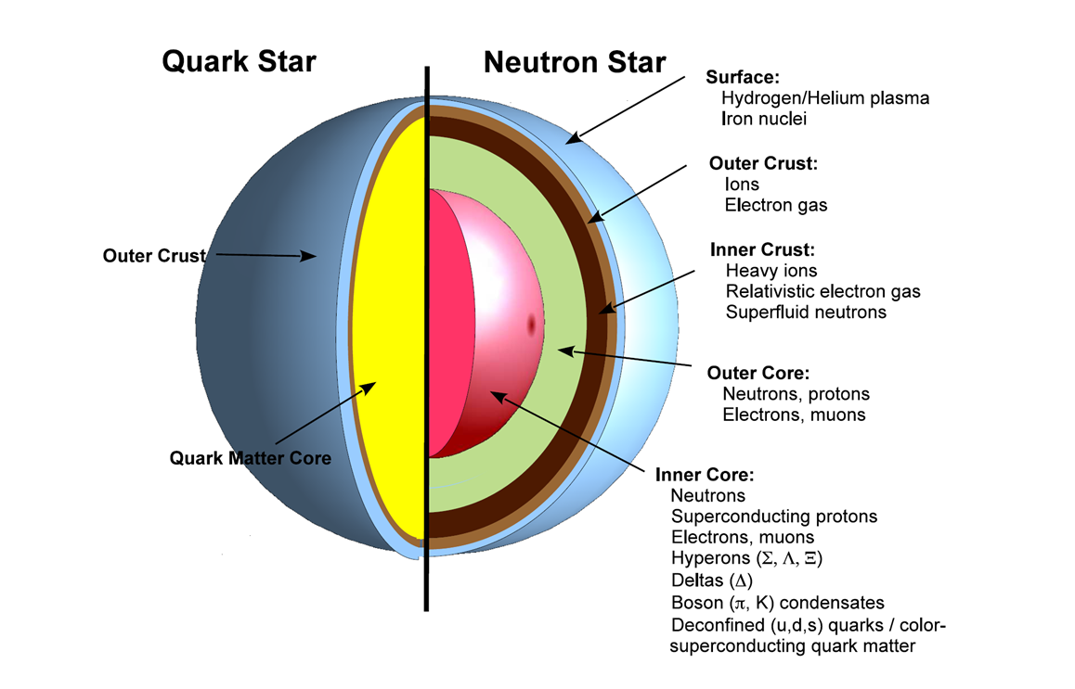
The physics case of CBM
➢ The equation-of-state of QCD matter
at neutron star core densities

Slide 8

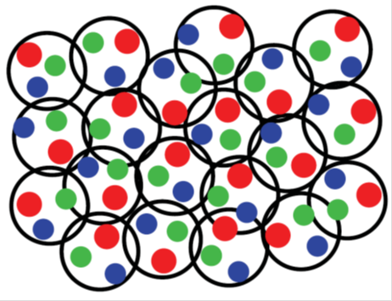
The physics case of CBM
➢ The equation-of-state of QCD matter
at neutron star core densities
Phase transitions from hadronic matter
to quarkyonic or partonic matter at high ρ_{B},
phase coexistence, critical point

Slide 9
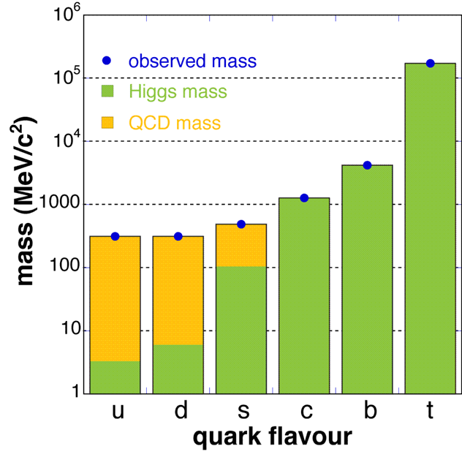
The physics case of CBM
➢ The equation-of-state of QCD matter
at neutron star core densities
Phase transitions from hadronic matter
to quarkyonic or partonic matter at high ρ_{B},
phase coexistence, critical point
Chiral symmetry restoration
in dense baryonic matter

Slide 10

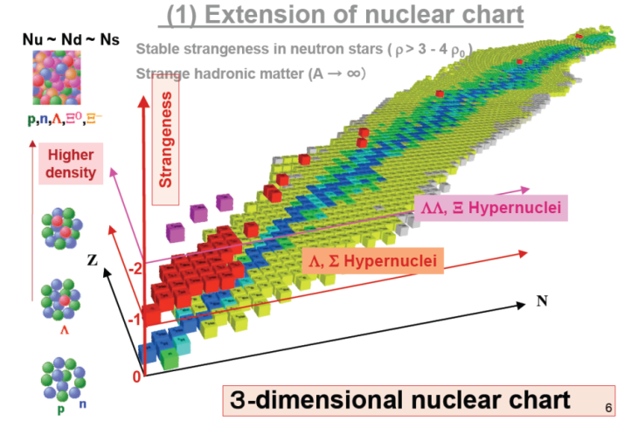
The physics case of CBM
➢ The equation-of-state of QCD matter
at neutron star core densities
Phase transitions from hadronic matter
to quarkyonic or partonic matter at high ρ_{B},
phase coexistence, critical point
Chiral symmetry restoration
in dense baryonic matter
Extension of the nuclear chart
into the strange domain

Slide 11

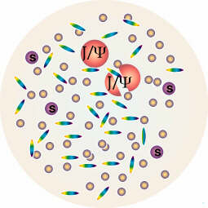
The physics case of CBM
➢ The equation-of-state of QCD matter
at neutron star core densities
Phase transitions from hadronic matter
to quarkyonic or partonic matter at high ρ_{B},
phase coexistence, critical point
Chiral symmetry restoration
in dense baryonic matter
Extension of the nuclear chart
into the strange domain
Charm production at threshold energies
in cold and hot matter

Slide 12
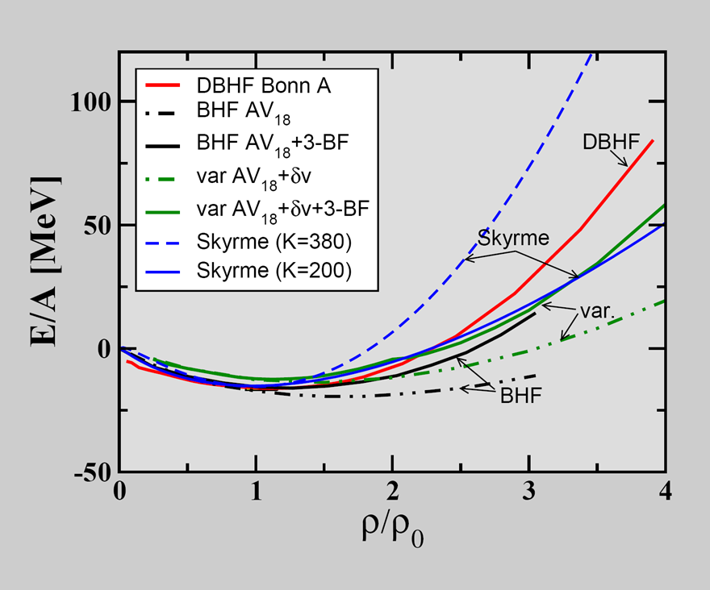
CBM physics case I
The QCD matter equation-of-state at neutron star core densities
Equation of state:
P = δE/δV⏐_{T=const}
V = A/ρ
δV/ δρ = - A/ρ²
P = ρ² δ(E/A)/δρ⏐_{T=const}
Equation of state of symmetric nuclear matter
T=0: E/A = 1/ρ ∫ U (ρ)dρ
Effective NN-potential:
U(ρ)=αρ+βρ^{γ}
E/A(ρ_{ο}) = -16 MeV
δ(E/A)(ρ_{ο})/δρ = 0
Compressibility:
κ = 9ρ² δ² (E/A)/ δρ²
C. Fuchs, Prog. Part. Nucl. Phys. 56 (2006) 1

Slide 13
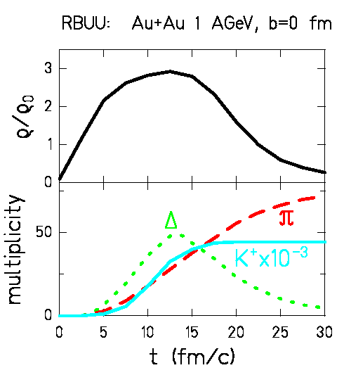
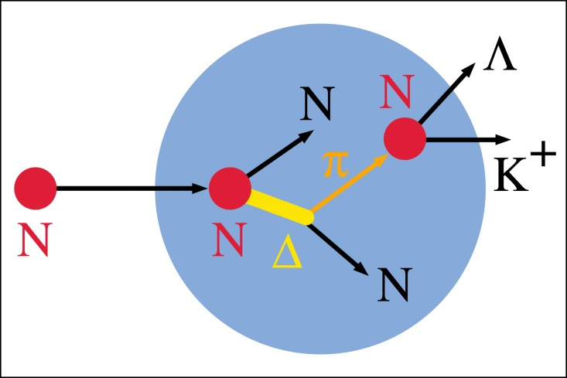
The equation-of-state of (symmetric) nuclear matter
Observable: Kaon production in Au+Au collisions at 1 AGeV
pp → K⁺Λp (E_{thres}= 1.6 GeV)
Kaon production via multiple collisions
Idea: K⁺ yield ∝ baryon density ρ ∝ compressibility κ

Slide 14
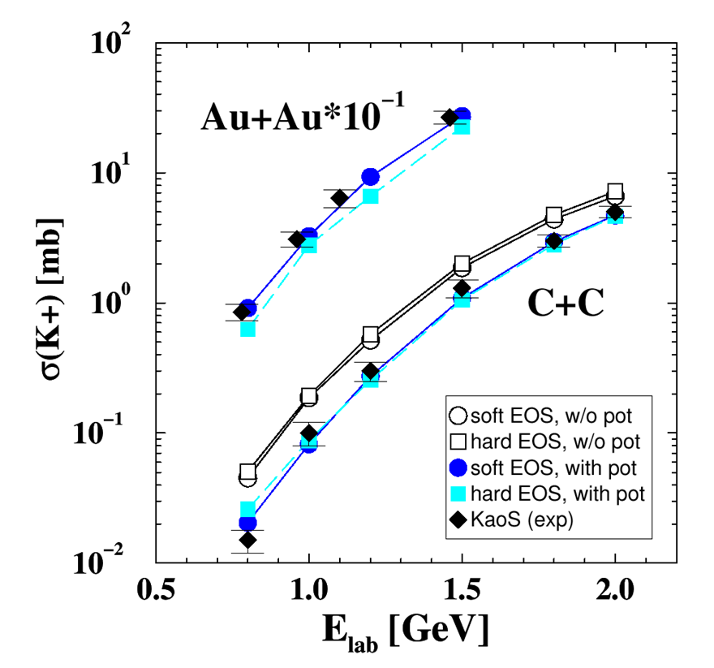
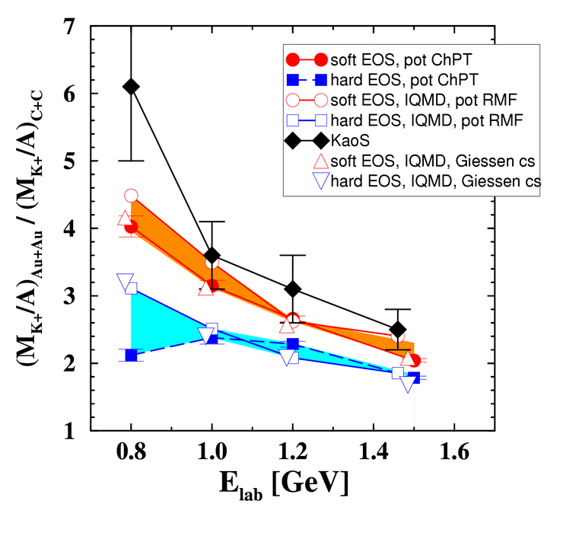
The equation-of-state of (symmetric) nuclear matter
Experiment: Excitation function of K⁺ production in Au+Au and C+C collisions
C. Sturm et al., (KaoS Collaboration), Phys. Rev. Lett. 86 (2001) 39
Model calculation: Ch. Fuchs et al., Phys. Rev. Lett. 86 (2001) 1974
soft equation-of-state: κ ≤ 200 MeV

Slide 15
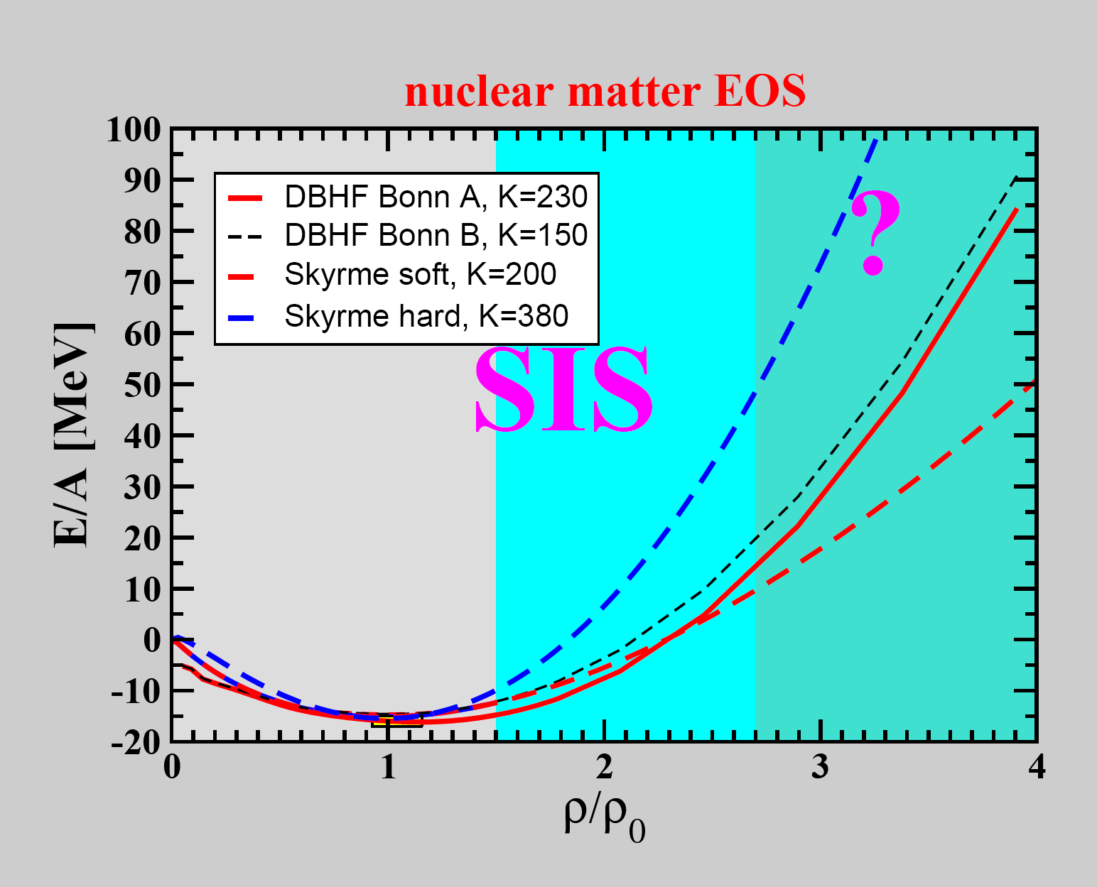
?
(sub)threshold
production
of K⁺ mesons

Slide 16
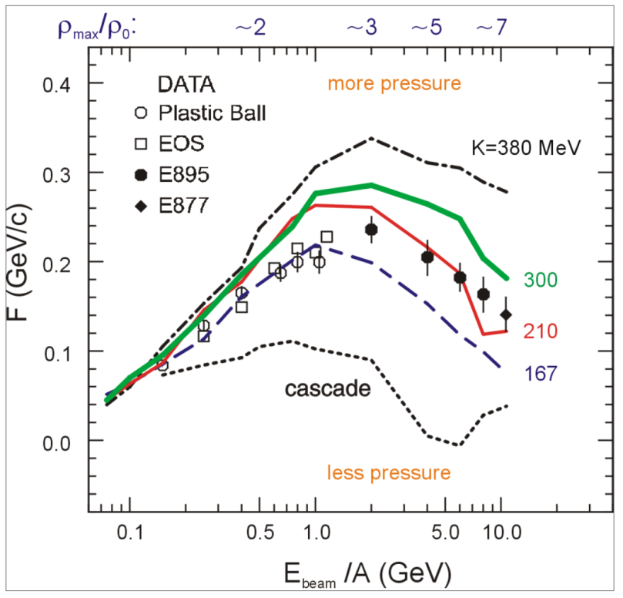
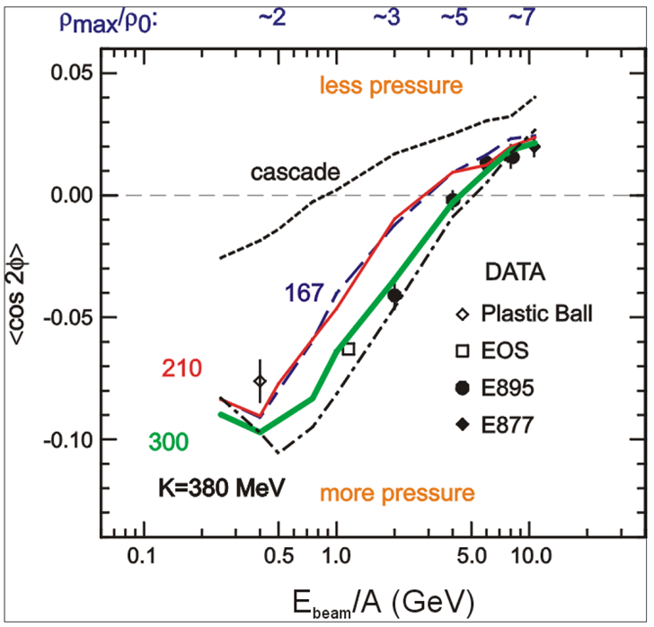
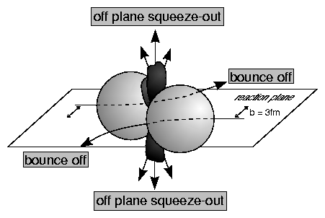
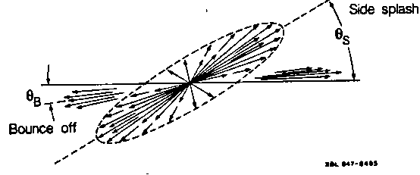
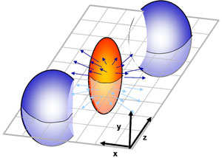
The equation-of-state of (symmetric) nuclear matter
Experiments at AGS: collective flow of protons in Au+Au collisions
Azimuthal angle distribution: dN/dφ = C (1 + v₁ cos(φ) + v₂ cos(2φ) + ...)
F = d(p_{x}/A)/d(y/y_{cm})
P. Danielewicz, R. Lacey, W.G. Lynch, Science 298 (2002) 1592

Slide 17
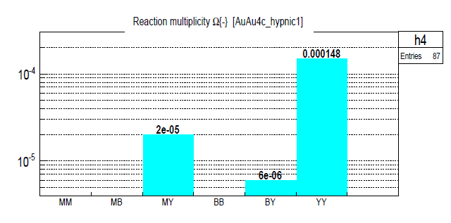
CBM physics case and observables
The QCD matter equation-of-state at neutron star core densities
➢ collective flow of identified particles (π,K,p,Λ,Ξ,Ω,...)
driven by the pressure gradient in the early fireball
➢ particle production at (sub)threshold energies via
multi-step processes (multi-strange hyperons, charm)
Direct multi-strange hyperon production:
pp → Ξ⁻ K⁺K⁺p (E_{thr} = 3.7 GeV)
pp → Ω⁻ K⁺K⁺K⁰p (E_{thr} = 7.0 GeV)
pp → Λ⁰Λ⁰ pp (E_{thr} = 7.1 GeV)
pp → Ξ⁺ Ξ⁻ pp (E_{thr} = 9.0 GeV)
pp → Ω⁺ Ω⁻ pp (E_{thr} = 12.7 GeV
Ω⁻ production in 4 A GeV Au+Au
Hyperon production via multiple collisions
pp → K⁺Λ⁰p, pp → K⁺K⁻pp,
pΛ⁰→ K⁺ Ξ⁻ p, πΛ⁰→ K⁺ Ξ⁻ π,
Λ⁰Λ⁰→ Ξ⁻ p, Λ⁰K⁻ → Ξ⁻ π⁰
3 . Λ⁰ Ξ⁻ → Ω⁻ n, Ξ⁻K⁻ → Ω⁻ π⁻
Antihyperons
1. Λ⁰ K⁺ → Ξ⁺π⁰ ,
2. Ξ⁺ K⁺ → Ω⁺ π⁺.
HYPQGSM calculations , K. Gudima et al.

Slide 18
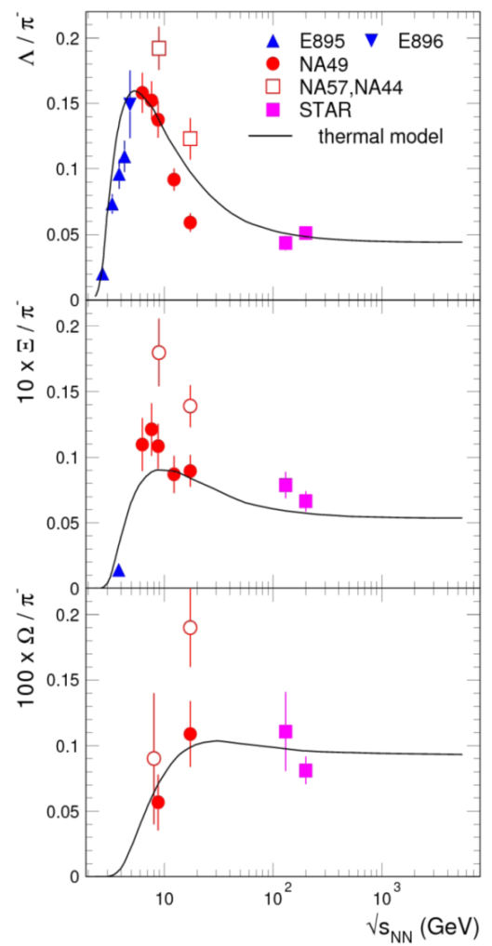
CBM physics case and observables
The QCD matter equation-of-state at neutron star core densities
➢ collective flow of identified particles (π,K,p,Λ,Ξ,Ω,...)
driven by the pressure gradient in the early fireball
➢ particle production at (sub)threshold energies via
multi-step processes (multi-strange hyperons, charm)
Direct multi-strange hyperon production:
pp → Ξ⁻ K⁺K⁺p (E_{thr} = 3.7 GeV)
pp → Ω⁻ K⁺K⁺K⁰p (E_{thr} = 7.0 GeV)
pp → Λ⁰Λ⁰ pp (E_{thr} = 7.1 GeV)
pp → Ξ⁺ Ξ⁻ pp (E_{thr} = 9.0 GeV)
pp → Ω⁺ Ω⁻ pp (E_{thr} = 12.7 GeV
Pb+Pb, Au+Au
central collisions
Very few data
at FAIR energies
Hyperon production via multiple collisions
pp → K⁺Λ⁰p, pp → K⁺K⁻pp,
pΛ⁰→ K⁺ Ξ⁻ p, πΛ⁰→ K⁺ Ξ⁻ π,
Λ⁰Λ⁰→ Ξ⁻ p, Λ⁰K⁻ → Ξ⁻ π⁰
3 . Λ⁰ Ξ⁻ → Ω⁻ n, Ξ⁻K⁻ → Ω⁻ π⁻
Antihyperons
1. Λ⁰ K⁺ → Ξ⁺π⁰ ,
2. Ξ⁺ K⁺ → Ω⁺ π⁺.
FAIR

Slide 19
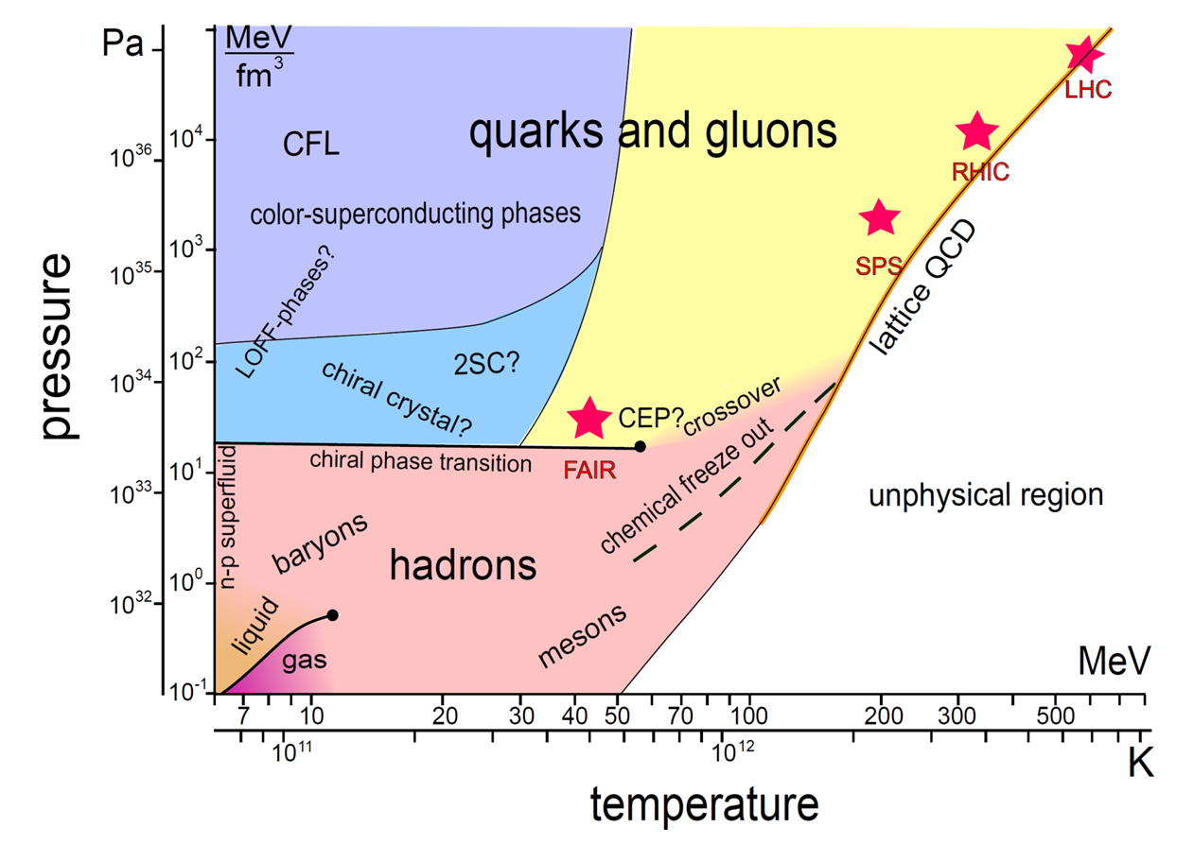
CBM physics case II
Phase transitions from hadronic matter to quarkyonic
or partonic matter at high ρ_{B}, phase coexistence, critical point
J. Wambach, K. Heckmann, M. Buballa, Act. Phys. Pol. B, Vol. 5 (2012)

Slide 20
Chemical freeze-out and
the QCD phase boundary
Thermal model fits to measured hadron abundances suggest
that all hadrons are in chemical equilibrium (including multi-strange hyperons)
A. Andronic, P. Braun-Munzinger, K. Redlich, J. Stachel, Jour. Phys. G38 (2011)

Slide 21
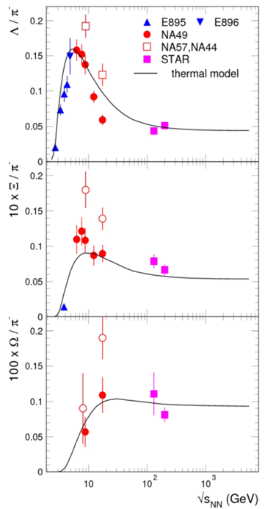
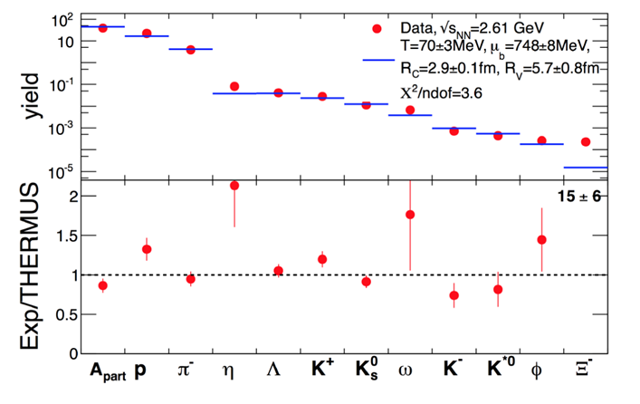
CBM physics case and observables
Phase transitions from hadronic matter to quarkyonic
or partonic matter at high ρ_{B}, phase coexistence, critical point
excitation function of strangeness: Ξ⁻(dss),Ξ⁺(dss),Ω⁻(sss),Ω⁺(sss)
→ chemical equilibration at the phase boundary
Very few data
at FAIR energies
Particle yields and thermal model fits
HADES: Ar + KCl 1.76 A GeV
G. Agakishiev et al., arXiv:1512.07070

Slide 22
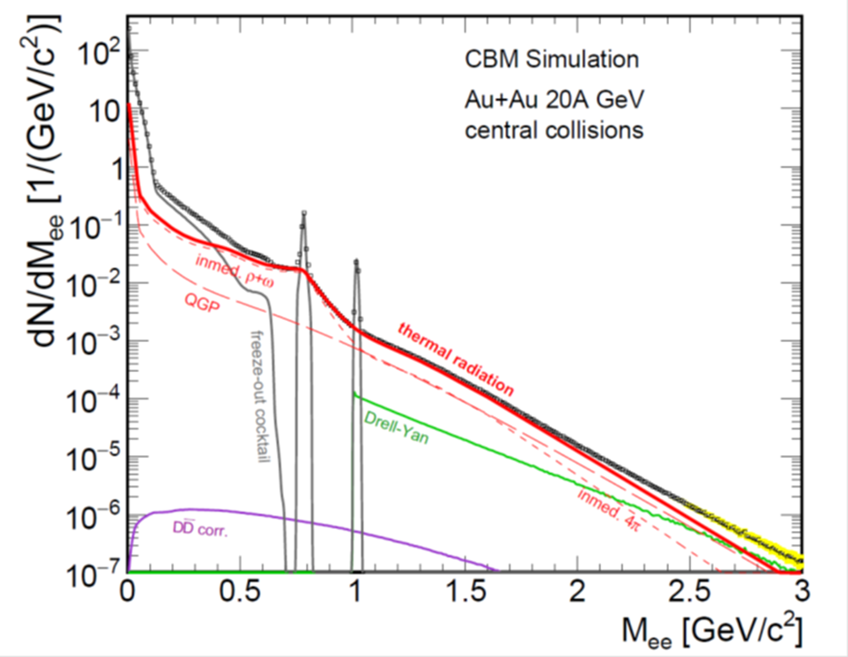
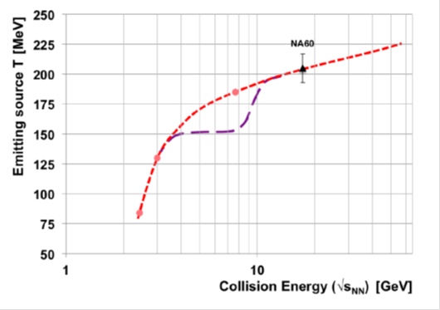
CBM physics case and observables
Phase transitions from hadronic matter to quarkyonic
or partonic matter at high ρ_{B}, phase coexistence, critical point
excitation function of strangeness: Ξ⁻(dss),Ξ⁺(dss),Ω⁻(sss),Ω⁺(sss)
→ chemical equilibration at the phase boundary
excitation function (invariant mass) of lepton pairs:
Thermal radiation from QGP, caloric curve
Invariant mass distribution of lepton pairs
Slope of dilepton invariant mass spectrum
1 GeV/c² < M_{inv} < 2.5 GeV/c²
No data
at FAIR energies

Slide 23
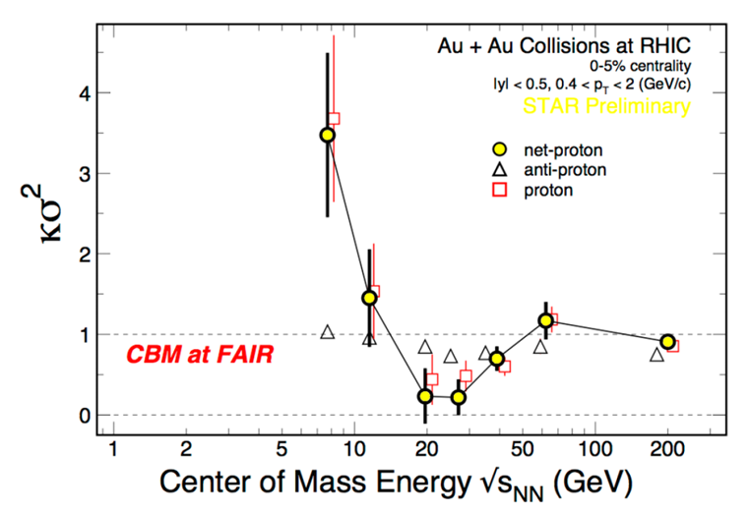
CBM physics case and observables
Phase transitions from hadronic matter to quarkyonic
or partonic matter at high ρ_{B}, phase coexistence, critical point
excitation function of strangeness: Ξ⁻(dss),Ξ⁺(dss),Ω⁻(sss),Ω⁺(sss)
→ chemical equilibration at the phase boundary
excitation function (invariant mass) of lepton pairs:
Thermal radiation from QGP, caloric curve
event-by-event fluctuations of conserved quantities (B,S,Q):
”critical opalescence”
➢ anisotropic azimuthal angle distributions: “spinodal decomposition”
No data
at FAIR
energies
4th moment of net-proton multiplicity distribution:
critical fluctuations
Spinodal decomposition
of the mixed phase

Slide 24
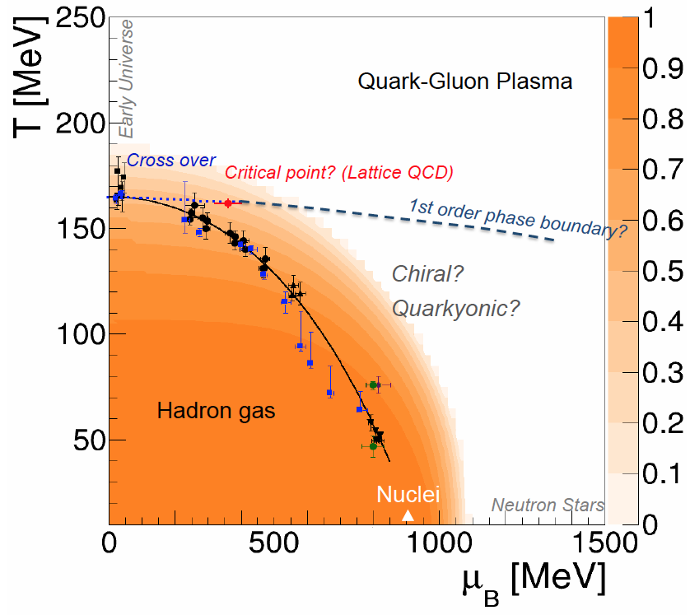

CBM physics case III
Onset of chiral symmetry restoration at high ρ_{B}
Chiral condensate: orange region
Origin of quark masses

Slide 25
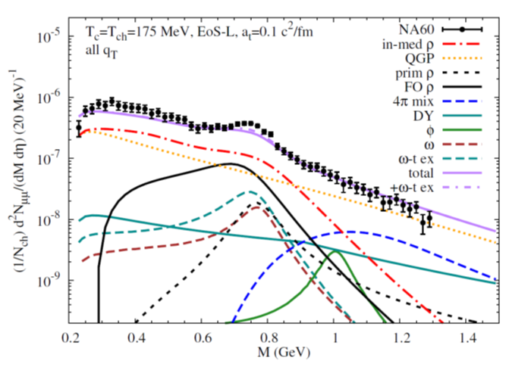
CBM physics case and observables
Onset of chiral symmetry restoration at high ρ_{B}
➢ in-medium modifications of hadrons: ρ,ω,φ →e⁺e⁻(μ⁺μ⁻)
➢ dileptons at intermediate invariant masses: 4 π → ρ-a₁ chiral mixing
Dilepton excess
In+In 158 A GeV
Experiment: R. Arnaldi et al. [NA60 Coll.], Phys. Rev. Lett. 96, (2006) 162302,
Theory: R. Rapp, J. Wambach and H. van Hees, in Relativistic Heavy-Ion Physics, edited by R. Stock,
Landolt Börnstein (Springer), New Series I/23A (2010), arXiv:0901.3289 hep-ph

Slide 26

CBM physics case and observables
Onset of chiral symmetry restoration at high ρ_{B}
➢ in-medium modifications of hadrons: ρ,ω,φ →e⁺e⁻(μ⁺μ⁻)
➢ dileptons at intermediate invariant masses: 4 π → ρ-a₁ chiral mixing
No data
at FAIR energies

Slide 27
Summary Dileptons
courtesy Tetyana Galatyuk

Slide 28

CBM physics case IV
Extensions of the nuclear chart to the strange domain

Slide 29

CBM physics case and observables
N-Λ, Λ-Λ interaction, strange matter?
➢ (double-) lambda hypernuclei
➢ meta-stable objects (e.g. strange dibaryons)
Double lambda hypernuclei production
in central Au+Au collisions at 10 A GeV:
 | Multiplicity | Yield in 1 week
⁵_{ΛΛ}H | 5 ⋅ 10⁻⁶ | 3000
⁶_{ΛΛ}He | 1 ⋅ 10⁻⁷ | 60
Assumption for yield calculation:
Reaction Rate 1 MHz
BR 10% (2 sequential weak decays)
Efficiency 1%
SIS100
A. Andronic et al., Phys. Lett. B697 (2011) 203

Slide 30
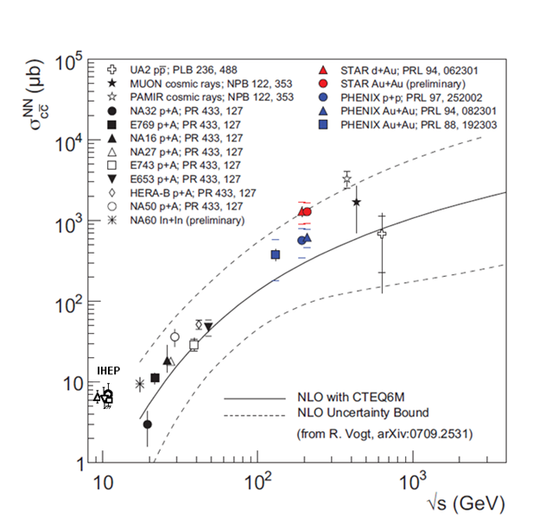
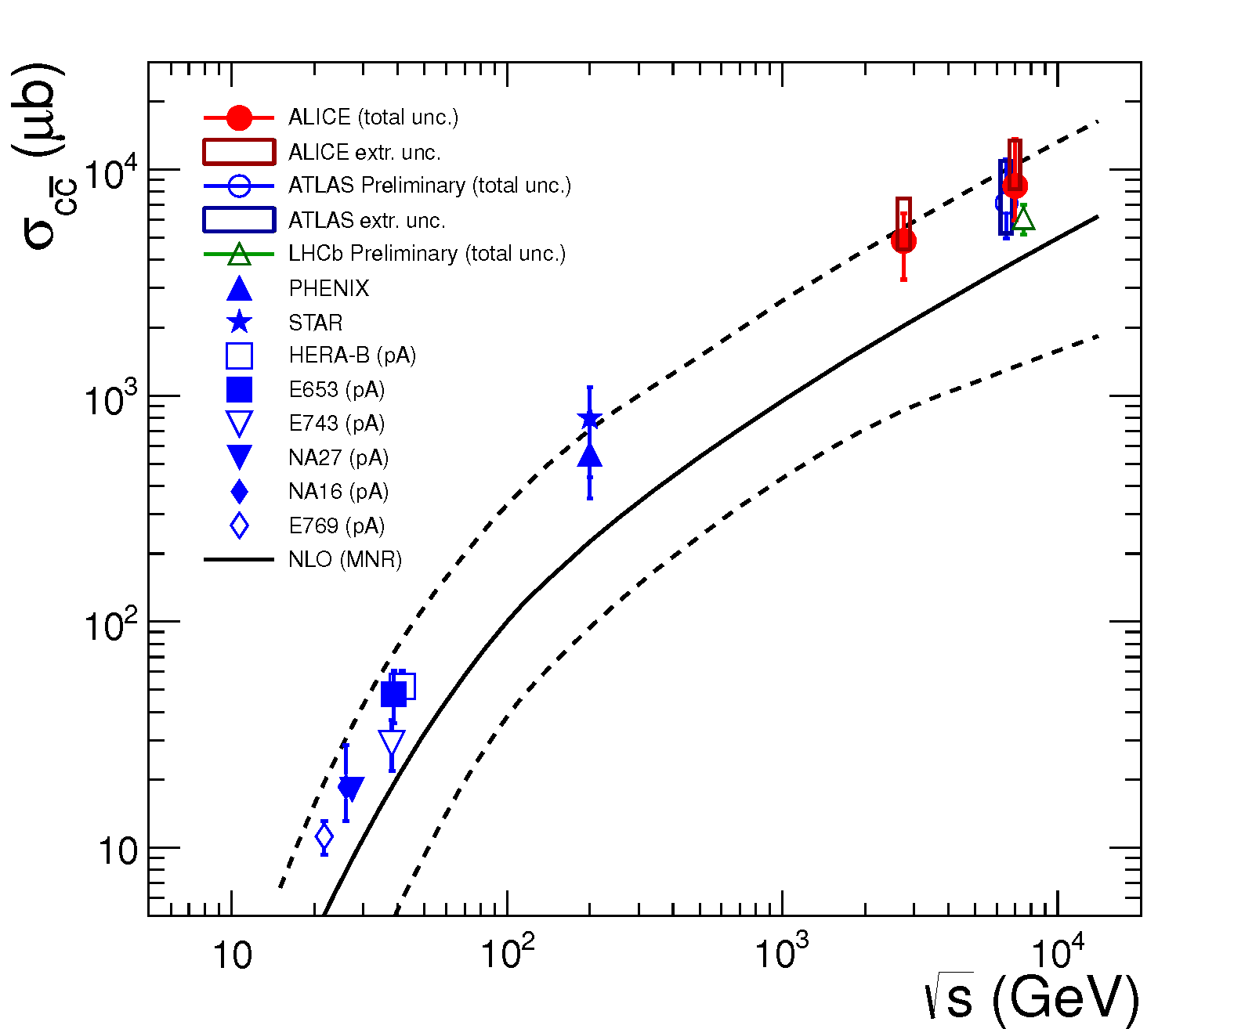
CBM physics case V
Charm production at threshold energies in cold and dense matter
ALICE JHEP 1207 (2012) 191, arXiv:1205.4007
A. Frawley, T. Ulrich, R. Vogt, Phys.Rept.462:125-175,2008

Slide 31
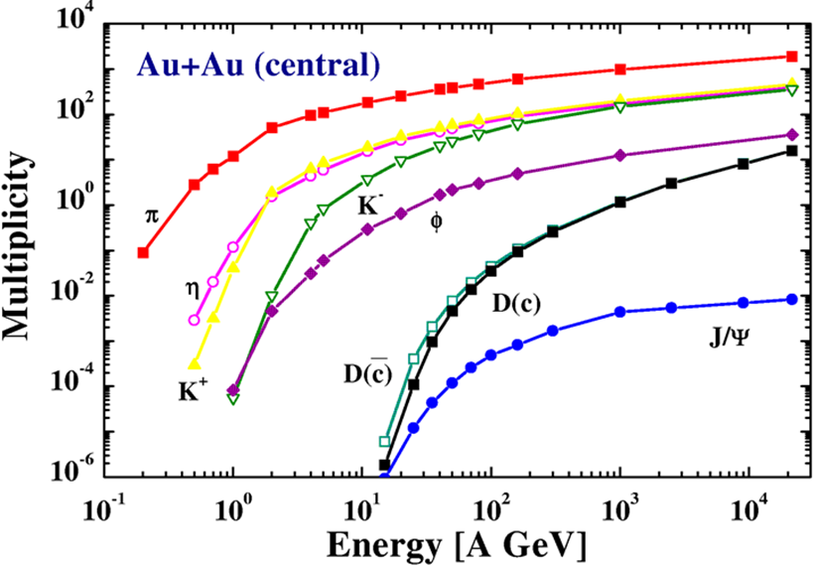
CBM physics case and observables
Charm production at threshold energies in cold and dense matter
➢ excitation function of charm production in p+A and A+A (J/ψ, D⁰, D±)
HSD calculation
Central coll. Au+Au 10 A GeV :
M_{J/ψ} = 1.7⋅10⁻⁷
UrQMD calculation including
subthreshold charm production via
N* → Λ_{c} + D and N* → N +J/ψ
Central Au+Au collisions 10 A GeV:
M_{J/ψ} = 5⋅10⁻⁶
W. Cassing, E. Bratkovskaya, A. Sibirtsev,
Nucl. Phys. A 691 (2001) 753
J. Steinheimer, A. Botvina, M. Bleicher, arXiv:1605.03439v1

Slide 32
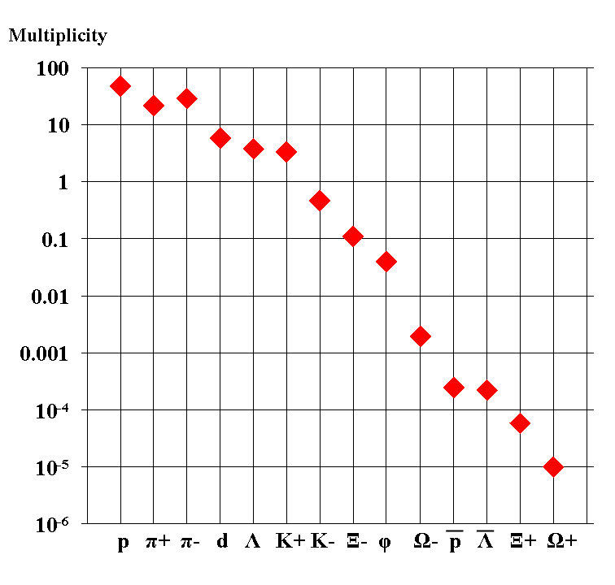
Experimental challenges
Particle yields in central Au+Au 4 A GeV
Statistical model, A. Andronic, priv. com.
AGS
extremely high
interaction rates
required !
e⁺e⁻
μ⁺μ⁻

Slide 33
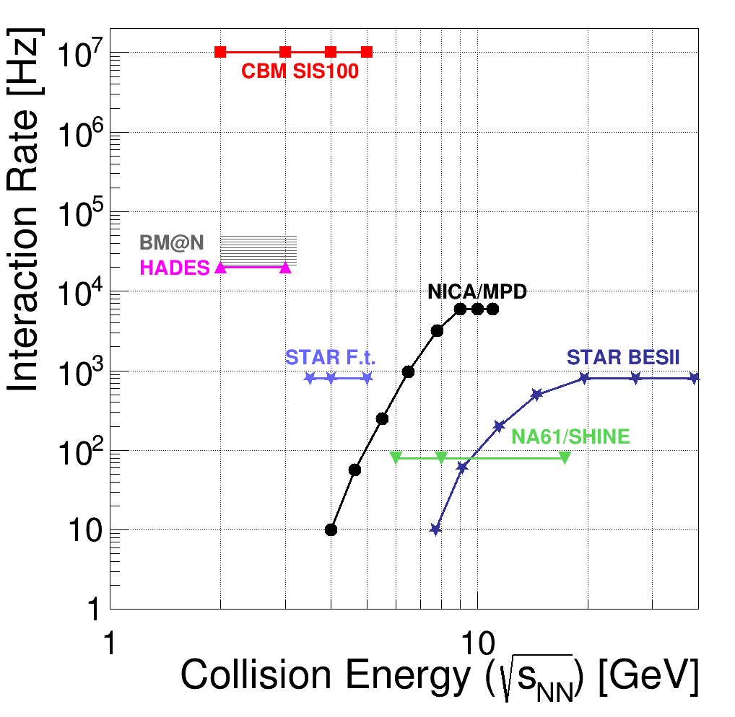
Experiments exploring dense QCD matter
high
net-baryon densities

Slide 34
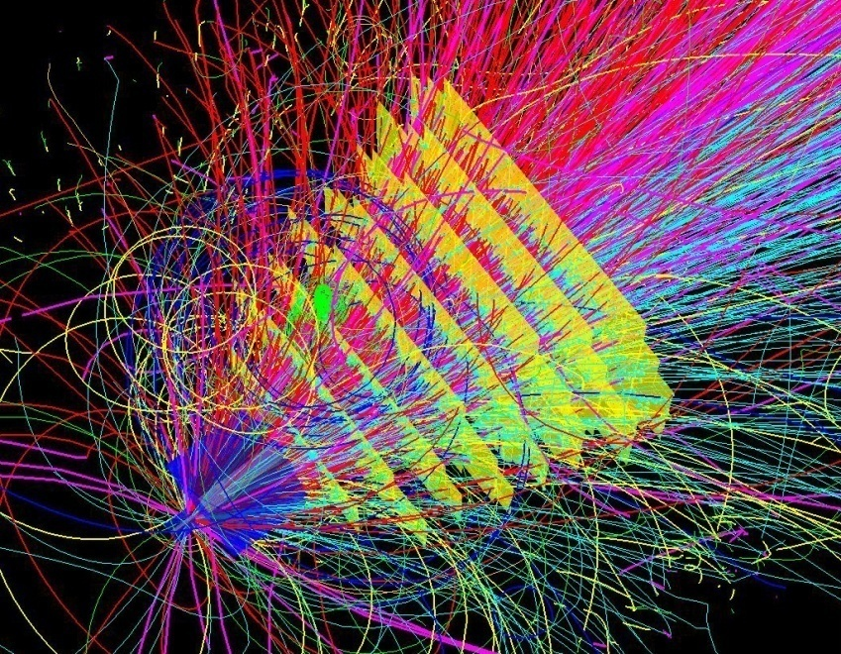
Experimental requirements
10⁵ - 10⁷ Au+Au reactions/sec
determination of displaced vertices (σ ≈ 50 μm)
identification of leptons and hadrons
fast and radiation hard detectors and FEE
free-streaming readout electronics
high speed data acquisition and high performance
computer farm for online event selection
4-D event reconstruction
Notes:
34
34
34

Slide 35
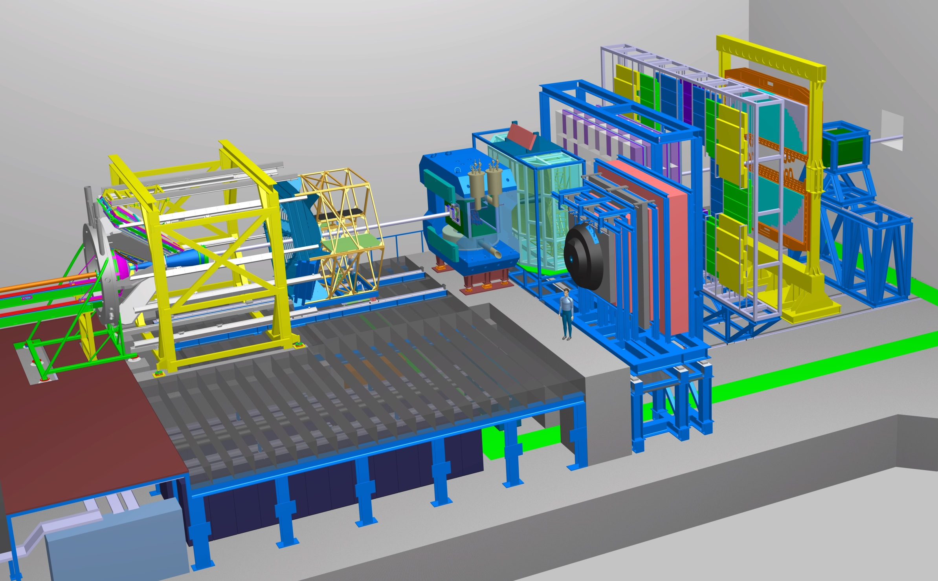
Experimental requirements
Transition
Radiation
Detector
Time of Flight
Detector
Ring
Imaging
Cherenkov
Dipol
Magnet
Silicon
Tracking
System
HADES
p+p, p+A
A+A (low mult.)
Micro
Vertex
Detector
Muon
Detector
Projectile
Spectator
Detector
DAQ/FLES HPC cluster

Slide 36
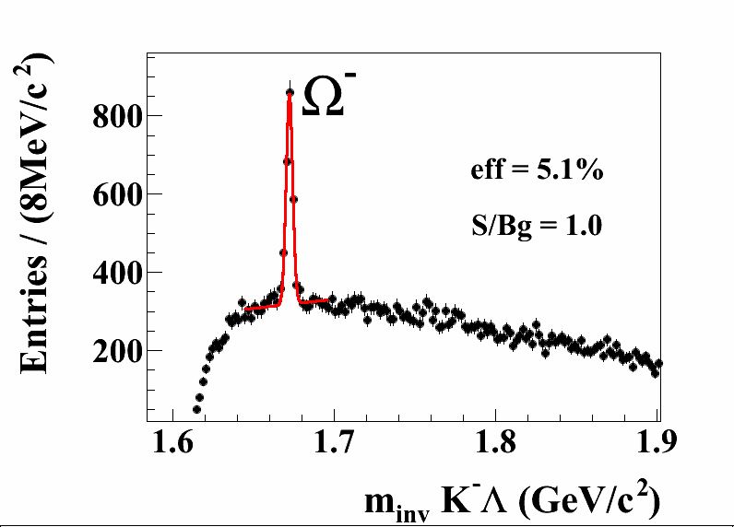
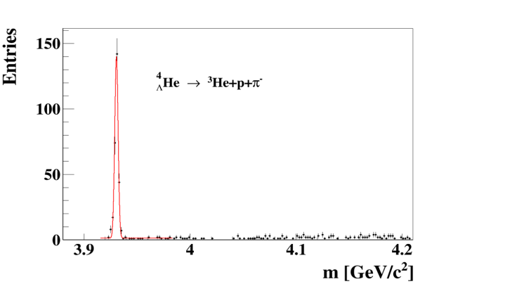

Hadron measurements
Time of Flight
Detector
Dipol
Magnet
Silicon
Tracking
System
DAQ/FLES HPC cluster
Projectile
Spectator
Detector
Hyperons and
hypernuclei
in central
Au+Au collisions at 10A GeV
→ΛK⁻

Slide 37
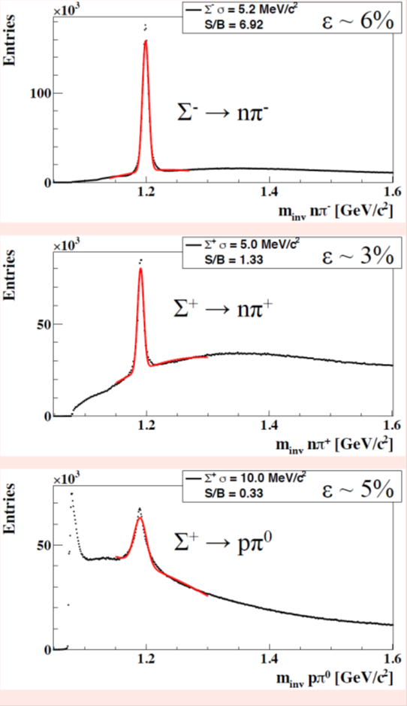
Hadron measurements
Time of Flight
Detector
Dipol
Magnet
Silicon
Tracking
System
Micro
Vertex
Detector
DAQ/FLES HPC cluster
Projectile
Spectator
Detector
Hyperons with neutral daughter in central
Au+Au collisions at 10A GeV

Slide 38
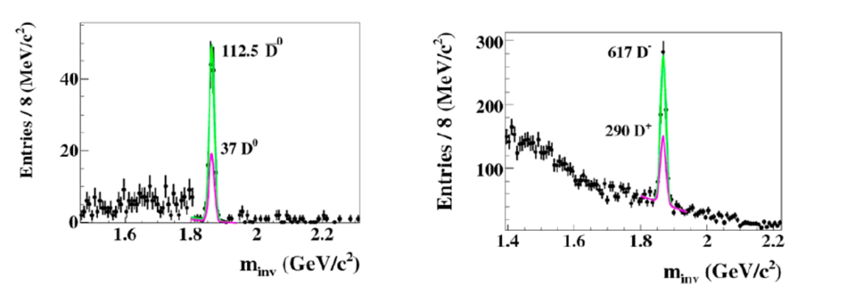

Open charm measurements
Time of Flight
Detector
Dipol
Magnet
Silicon
Tracking
System
Micro
Vertex
Detector
DAQ/FLES HPC cluster
Projectile
Spectator
Detector
Open Charm in p+A
30 GeV and Ni+Ni
15A GeV

Slide 39
Di-electron measurements
Transition
Radiation
Detector
Time of Flight
Detector
Ring
Imaging
Cherenkov
Dipol
Magnet
Silicon
Tracking
System
Micro
Vertex
Detector
e⁺e⁻
Projectile
Spectator
Detector
DAQ/FLES HPC cluster
Dileptons in central
Au+Au collisions at 8A GeV

Slide 40


Di-muon measurements
Transition
Radiation
Detector
Time of Flight
Detector
Dipol
Magnet
Silicon
Tracking
System
Muon
Detector
DAQ/FLES HPC cluster
Projectile
Spectator
Detector
Di-muons in central
Au+Au collisions at
8A GeV and
10A GeV (J/ψ)
µ⁺µ⁻
η
ω
φ
J/ψ→µ⁺µ⁻
ρ

Slide 41

Online particle identification in CBM:
The KF Particle Finder
successfully used online in the STAR experiment

Slide 42







CBM Technical Design Reports
# | Project | TDR Status
1 | Magnet | approved
2 | STS | approved
3 | RICH | approved
4 | TOF | approved
5 | MuCh | approved
6 | HADES ECAL | approved
7 | PSD | approved
8 | MVD | submission 2016
9 | DAQ/FLES | submission 2017
10 | TRD | submission 2016
11 | ECAL | submission 2016

Slide 43
CBM mile stones
CBM components | TDR approved | Start production | Ready for installation | Ready for beam
Micro Vertex Detector (MVD) | 01.04.17 | 30.04.18 | 31.12.19 | 30.06.20
Silicon Tracking System (STS) | 05.07.13 | 31.03.17 | 31.03.20 | 31.12.20
Ring Imaging Cherenkov Detector (RICH) | 07.01.14 | 31.12.16 | 31.12.19 | 31.12.20
Muon Detector (MUCH) | 28.02.15 | 31.12.16 | 31.12.19 | 31.12.20
Transition Radiation Detector (TRD) | 01.04.17 | 31.12.17 | 31.12.20 | 31.12.21
Time of Flight System (TOF) | 30.04.15 | 31.06.16 | 31.12.19 | 31.12.20
Electromagnetic Calorimeter (ECAL) | 31.12.16 | 30.06.18 | 31.12.19 | 31.12.20
Projectile Spectator Detector (PSD) | 28.02.15 | 31.12.15 | 31.12.18 | 31.12.19
Dipol Magnet | 01.10.13 | 30.06.17 | 31.12.19 | 30.06.20
Online Systems (DAQ and FLES) | 31.12.17 | 30.06.18 | 30.06.19 | 31.12.19
CBM detectors will be in place
to take the first beams from SIS100

Slide 44

The CBM cave

Slide 45


The CBM Collaboration: 60 institutions, 530 members
Croatia:
Split Univ.
China:
CCNU Wuhan
Tsinghua Univ.
USTC Hefei
CTGU Yichang
Czech Republic:
CAS, Rez
Techn. Univ.Prague
France:
IPHC Strasbourg
Hungary:
KFKI Budapest
Budapest Univ.
Germany:
Darmstadt TU
FAIR
Frankfurt Univ. IKF
Frankfurt Univ. FIAS Frankfurt Univ. ICS
GSI Darmstadt
Giessen Univ.
Heidelberg Univ. P.I.
Heidelberg Univ. ZITI
HZ Dresden-Rossendorf
KIT Karlsruhe
Münster Univ.
Tübingen Univ.
Wuppertal Univ.
ZIB Berlin
Russia:
IHEP Protvino
INR Troitzk
ITEP Moscow
Kurchatov Inst., Moscow
LHEP, JINR Dubna
LIT, JINR Dubna
MEPHI Moscow
Obninsk Univ.
PNPI Gatchina
SINP MSU, Moscow
St. Petersburg P. Univ.
Ioffe Phys.-Tech. Inst. St. Pb.
Ukraine:
T. Shevchenko Univ. Kiev
Kiev Inst. Nucl. Research
India:
Aligarh Muslim Univ.
Bose Inst. Kolkata
Panjab Univ.
Rajasthan Univ.
Univ. of Jammu
Univ. of Kashmir
Univ. of Calcutta
B.H. Univ. Varanasi
VECC Kolkata
IOP Bhubaneswar
IIT Kharagpur
IIT Indore
Gauhati Univ.
Korea:
Pusan Nat. Univ.
Poland:
AGH Krakow
Jag. Univ. Krakow
Silesia Univ. Katowice
Warsaw Univ.
Warsaw TU
Romania:
NIPNE Bucharest
Univ. Bucharest
26th CBM Collaboration meeting in Prague, CZ
14 -18 Sept. 2015

Slide 46

Summary
CBM scientific program at SIS100:
Exploration of the QCD phase diagram in the region of neutron
star core densities → discovery potential.
First measurements with CBM:
High-precision multi-differential measurements of hadrons incl.
multistrange hyperons, hypernuclei and dileptons for different
beam energies and collision systems → terra incognita.
Status of experiment preparation:
Prototype detector performances fulfill CBM requirements.
7 TDRs approved, 4 TDRs in preparation.
Funding:
Substantial part of the CBM start version is financed (+ EoI).
FAIR Phase 0:
HADES with CBM RICH photon detector,
use CBM detectors at STAR/BNL, BM@N/JINR, NA61/SPS.
mCBM@SIS18 including DAQ and FLES for full system test

Slide 48
Backup

Slide 49


Particle Identification
Detectors used: STS, TOF, TRD
TOF
+
TRD
TOF

Slide 50

Particle acceptance
central Au+Au collisions at 4 A GeV

Slide 51

Particle acceptance
central Au+Au collisions at 10 A GeV

Slide 52


Di-muon acceptance
in central Au+Au collisions
at 4 A GeV
at 8 A GeV

Slide 53
Particle yields based on HSD calculations
10% most central Au+Au collisions at 6 and 10 A GeV
Particle (mass MeV/c²) | Multi- plicity 6 A GeV | Multi- plicity 10 A GeV | decay mode | BR | ε (%) | yield (s⁻¹) 6 A GeV | yield (s⁻¹) 10 A GeV | yield in 10 weeks 6 A GeV | yield in 10 weeks 10 A GeV | IR MHz
K⁺ (494) | 12.5 | 20 | - | - | 31 | 3.9·10⁵ | 6.2·10⁵ | 2.4·10¹² | 3.7·10¹² | 1
K⁻ (494) | 1.4 | 3 | - | - | 27 | 3.8·10⁴ | 8.1·10⁴ | 2.3·10¹¹ | 4.8·10¹¹ | 1
ρ (770) | 5 | 9 | L⁺L⁻ | 4.7·10⁻⁵ | 4.6 | 1.1 | 2.0 | 6.5·10⁶ | 1.2·10⁷ | 1
ω (782) | 3.3 | 6 | L⁺L⁻ | 7.1·10⁻⁵ | 5.2 | 1.2 | 2.2 | 7.4·10⁶ | 1.3·10⁷ | 1
φ (1020) | 0.07 | 0.12 | L⁺L⁻ | 3·10⁻⁴ | 6.0 | 1.3·10⁻¹ | 2.2·10⁻¹ | 7.6·10⁵ | 1.3·10⁶ | 1
Λ (1115) | 10.4 | 17.4 | pπ⁻ | 0.64 | 18 | 1.2·10⁵ | 2.0·10⁵ | 7.2·10¹¹ | 1.2·10¹² | 1
͞Λ (1115) | 4.6·10⁻⁴ | 0.034 | ͞pπ⁺ | 0.64 | 11 | 1.1 | 81.3 | 6.6·10⁶ | 2.2·10⁸ | 10
Ξ⁻ (1321) | 0.054 | 0.222 | Λπ⁻ | 1 | 6 | 3.2·10³ | 1.3·10⁴ | 1.9·10¹⁰ | 7.8·10¹⁰ | 10
Ξ⁺ (1321) | 3.0·10⁻⁵ | 5.4·10⁻⁴ | Λπ⁺ | 1 | 3.3 | 9.9·10⁻¹ | 17.8 | 5.9·10⁶ | 1.1·10⁸ | 10
Ω⁻ (1672) | 5.8·10⁻⁴ | 5.6·10⁻³ | ΛK⁻ | 0.68 | 5 | 17 | 164 | 1.0·10⁸ | 9.6·10⁸ | 10
Ω⁺ (1672) | - | 7·10⁻⁵ | ΛK⁺ | 0.68 | 3 | - | 0.86 | - | 5.2·10⁶ | 10
J/ψ (3097) | ⁻ | 1.74·10⁻⁷ | L⁺L⁻ | 0.06 | 5 | - | 5.2·10⁻⁴ | - | 3100 | 10
³ _{Λ}H (2993) | 4.2·10⁻² | 3.8·10⁻² | ³Heπ⁻ | 0.25 | 19.2 | 2·10³ | 1.8·10³ | 1.2·10¹⁰ | 1.1·10¹⁰ | 10
⁴_{Λ}He (3930) | 2.4·10⁻³ | 1.9·10⁻³ | ³Hepπ⁻ | 0.32 | 14.7 | 110 | 87 | 6.6·10⁸ | 5.2·10⁸ | 10
p + A collisions at 20 and 30 GeV
Particle (mass MeV/c²) | Multi- plicity 20 GeV | Multi- plicity 30 GeV | decay mode | BR | ε (%) | yield (s⁻¹) 20 GeV | yield (s⁻¹) 30 GeV | yield in 10 weeks 20 GeV | yield in 10 weeks 30 GeV | IR MHz
D± (1869) | 3.4·10⁻⁷ | 1.3·10⁻⁶ | K⁺π⁻π⁻ | 0.09 | 13 | 4.0·10⁻² | 1.5·10⁻¹ | 2.4·10⁵ | 9.2·10⁵ | 10
D⁰ (1865) | 5.1·10⁻⁷ | 2.0·10⁻⁶ | K⁺π⁻π⁻π⁺ | 0.08 | 2 | 8.2·10⁻³ | 3.2·10⁻² | 4.9·10⁴ | 1.9·10⁵ | 10
J/ψ (3097) | 7.5·10⁻⁸ | 2.9·10⁻⁶ | L⁺L⁻ | 0.06 | 5 | 2.3·10⁻³ | 8.7·10⁻² | 1.4·10⁴ | 5.2·10⁵ | 10

Slide 54
Status CBM collaboration contracts (Russia)
Project | Partner in Russia | Task | Costs (€ 2005 ) | Fraction of total costs | Council Decision | Status
SC dipole magnet | JINR BINP | Design and Construction | 3.758 Mio | 100% | 9.07.2014 | In preparation
STS | JINR Dubna | Construction of detector ladders for first 4 stations | 2.115 Mio | 23% | 10.12.2013 | signed
PSD | INR Troitzk | Design and Construction | 0.778 Mio | 81% | 30.06.2015 | signed
RICH | PNPI Gatchina | Construction of mechanical structures, gas system | 1.45 Mio | 28% | 9.07.2014 | Ready for signature
MUCH | PNPI Gatchina | Construction of absorbers, mechanical structures, gas system | 3.022 Mio | 39% | 30.06.2015 | In preparation
MUCH | JINR Dubna | Straw tube chambers | 0.49 Mio | 6% | 30.06.2015 | In preparation
TOF | ITEP | Inner zone | 0.468 Mio | 7 % | ---- | In discussion
54

Slide 55
Status CBM in-kind contracts
Project | Partner Institution | Task | Costs k€ 2005 | Council decision | Status In-Kind contract
STS | AGH, Crakow, Poland | Design and Construction of STS-XYTER chip | 572 | 30.06.2015 | Ready to be signed
STS | JU, Crakow, Poland | Sensors, test procedures for STS-XYTER chip and FEE | 707 | June 2016 | In preparation
STS | AGH, Crakow, Poland | STS-XYTER Front-End Board | 261 | June 2016 | In preparation
HADES | JU, Crakow, Poland | HADES ECAL Mechanical frame | 200 | 30.06.2015 | signed
STS | WUT, Warsaw, Poland | Development of Data Processing Boards (DPBs) | 260 | 30.06.2015 | In preparation
TOF | IFIN-HH, Bukarest, Romania | RPC chambers and FEE | 748 | 30.06.2015 | In preparation
MUCH | VECC, Kolkata + 12 Indian Institutes | GEM chambers and FEE | 3022 | 10.12.2015 | In preparation
55

Slide 56
Status CBM purchase
Nr. | contracts | Value M€ | partner | Status
1 | Purchase RICH MAPMT HAMAMATSU | 1.65 | GSI | Ordered
2 | STS module assembly contract | 1.1 | KIT Karlsruhe | Signed
3 | Purchase iron for beam dump | 0.25 | KIT Karlsruhe | Signed
4 | Purchase ASIC GBTx | 1.245 | CERN | Ordered
Agreement with China
Nr. | contracts | Value M€ | Partner | Status
1 | MRPC Time-of flight detector | 4.0 | CCNU Wuhan | Signed
2 | TOF read-out electronics | 0.8 | CCNU Wuhan | Signed

Slide 57
Nuclear matter at high baryon density
exchange of
few mesons
nucleons only
exchange of
many mesons
structural change of hadrons
Baryons overlap
Quark Fermi sea
∼ 2 ρ₀
∼ 5 ρ₀
courtesy Toru Kojo (CCNU)

