Slide 1
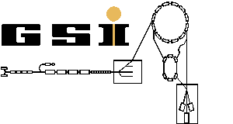
Computing in CBM
Volker Friese
GSI Darmstadt
International Conference on Matter under High Densities
21 – 23 June 2016
Sikkim Manipal Institute of Technology, Rangpo

Slide 2
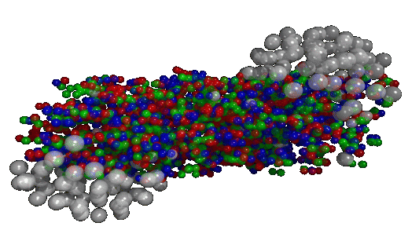
Complex Tasks
The Hope:
Learn from the multitude of emitted particles (final state) about the state of the matter immediately after the collision (early state)
The Task:
Detect the final-state particles as completely as possible and characterise them w.r.t. momentum and identity (π, K. p, …)

Slide 3
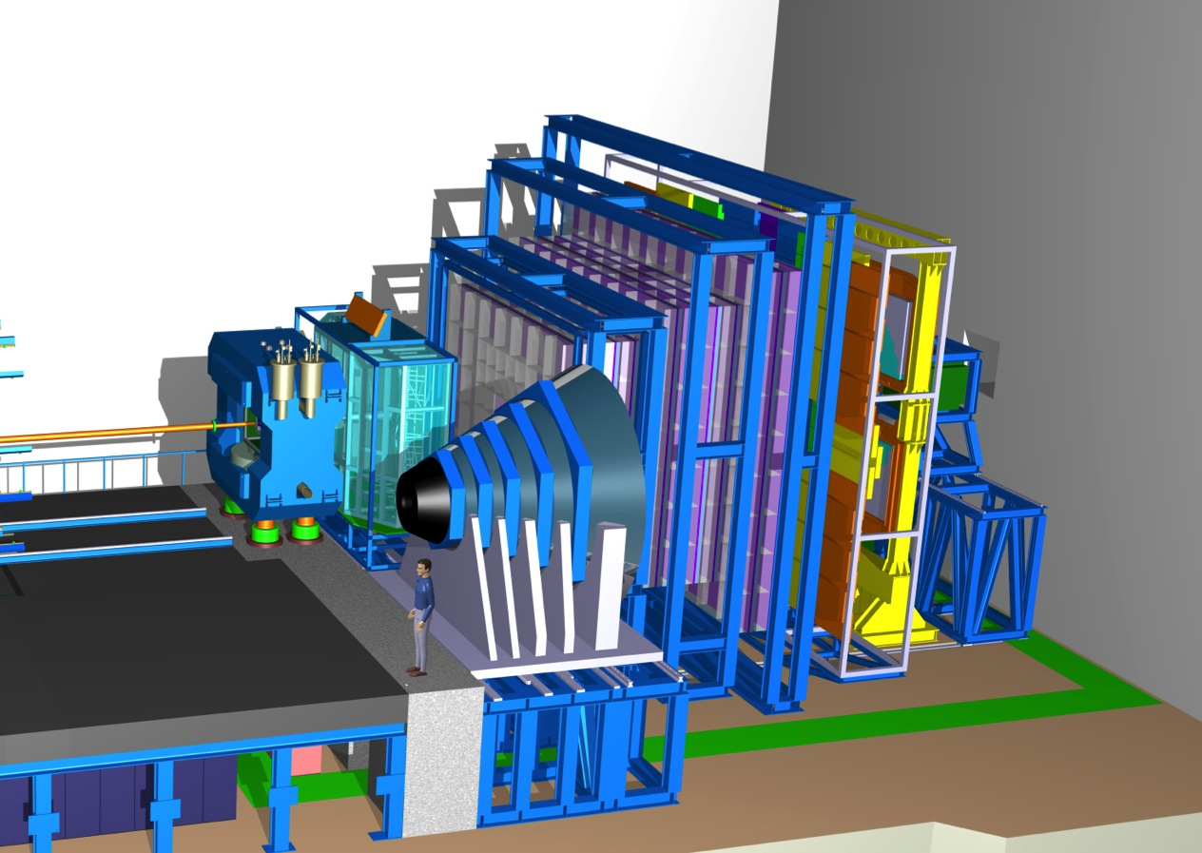
Complex Devices
TRD
TOF
RICH
Dipole magnet +
Silicon Tracking System
PSD
Muon System

Slide 4
Tasks for reconstruction

Slide 5
„Reconstruction“
Particles
Detector
Raw Data
001101011010101000110001011100100110
Hi, I am channel 31846002. If you have a DAQ map, you will know that this is strip 348 of module l4u03 of the fourth layer of the main tracker. I just saw a charge of 11 ADC units. My clock reads 723948532 ns.
Reconstruction delivers a list of particles (trajectories) with momenta (and ID), which is the input for the higher-level physics analysis.

Slide 6
Reconstruction Tasks
are typically pattern recognition issues
act both local…
  cluster / hit finding
  local track finding
… or global
  connect track information from different detector systems
Algorithms are usually developed by experts and executed in a central production.
Results are provided to the physics users in some suitable event format.
  user normally does not see raw data

Slide 7
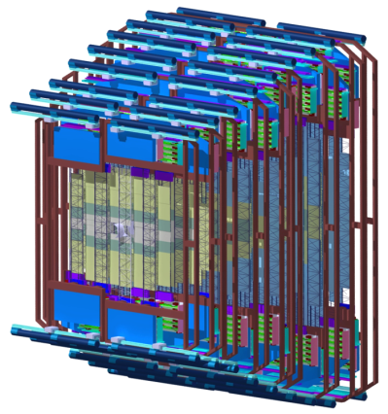
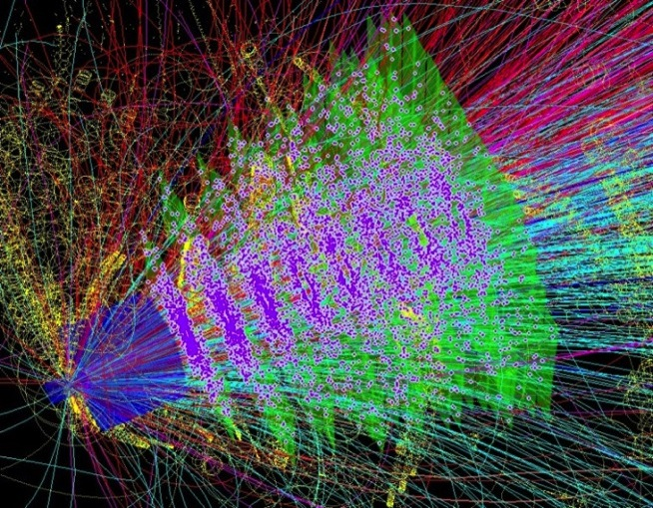
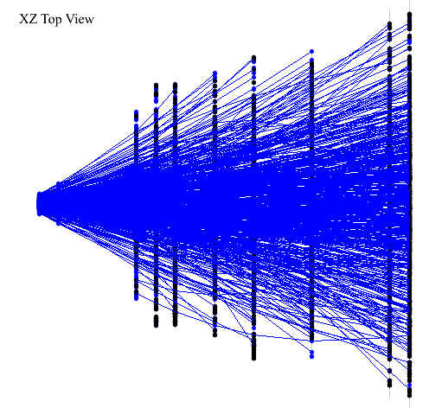
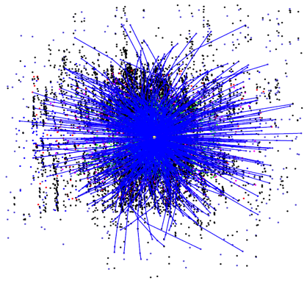
Example: Track Finding in the Main Tracker
Silicon Tracking System
Event Display
Reconstructed Tracks
Track finding: define a set of measurements (hits) which belong to one and the same trajectory (particle)
Difficulty: Large number of hits; fake hits exceed true hits by factors.

Slide 8
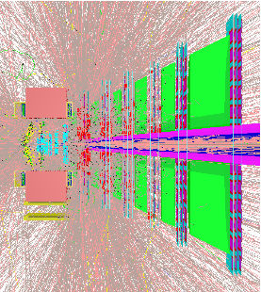
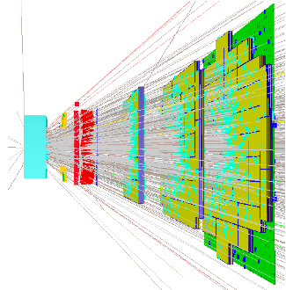
Similar: Track Finding in the MUCH and TRD
Reconstructed Tracks
Muon System: Outside magnetic field (straight tracks), but absorber layers complicate tracking
TRD: Outside magnetic field (straight tracks); coordinate resolution worse than STS

Slide 9
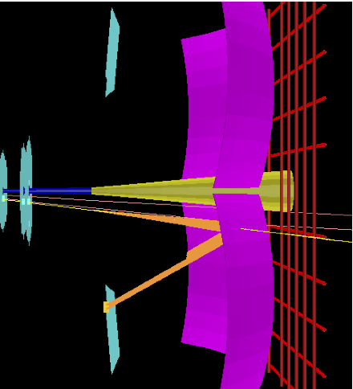
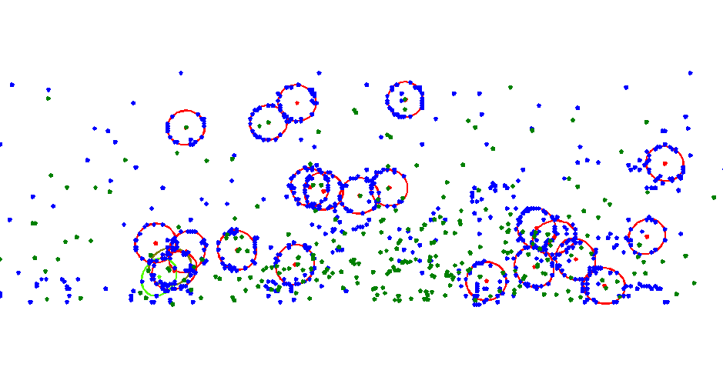
Another Example: Ring Finding in the RICH
Event Display
Problems:
High hit / ring density
Overlapping rings
Ring distortions
Cherenkov light emitted by electrons in the radiator is mirrored and focused into rings onto the photodetector plane.

Slide 10
Event Reconstruction: A First Upshot
The pattern recognition problems in event reconstruction from raw data are common to HEP experiments.
A bunch of methods were applied in previous or current experiments.
There is, however, nothing “off the shelf”; methods and algorithms have to be adapted / tuned / developed for each experiment.
Reconstruction in heavy-ion experiments is more demanding than in particle physics because of the large track multiplicity -> high complexity of the event topology.
There are solutions developed for CBM which fulfil our demands in terms of efficiency and precision.

Slide 11
High Rates and the Data Challenge

Slide 12
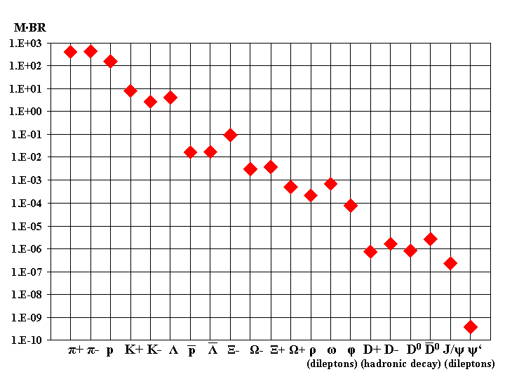
The Shopping List
Model predictions of particle multiplicities (Au+Au, 25A GeV)
The bulk
The needles in the haystack
Measurement of very rare probes: requires extreme interaction rates
Which rate is possible in heavy-ion reactions?

Slide 13
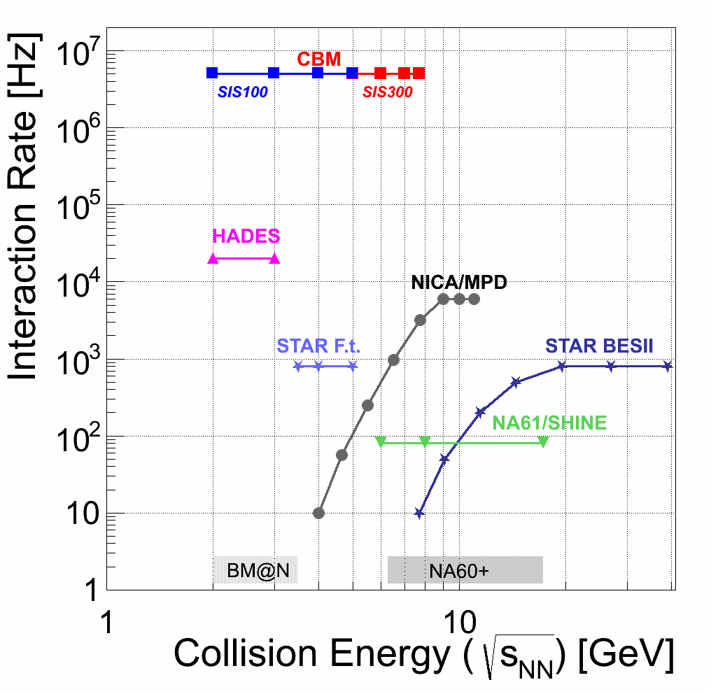
The Rate Landscape
Can one do a MHz heavy-ion experiment?

Slide 14
Limiting Factors
At an interaction rate of 10 MHz (Au+Au), the average time between subsequent events is 100 ns.
  but there are many with much less time spacing.
Detectors have to be fast
  possible (i.e., solid-state detectors instead of gas drift chambers)
Read-out electronics has to be fast
  not trivial, but possible
The limiting factor is the data rate to be shipped from the detectors to the permanent storage.

Slide 15
The Data Rate Problem
At an interaction rate of 10 MHz (Au+Au), the raw data rate from the detector is about 1 TB/s.
What can we store?
  to tape: several GB/s
  to disk: 100 GB/s no problem (e.g., GSI Lustre FS)
What do we want to store?
  at 1 GB/s archival rate, the amount of data after 2 months of beam time is 5 PB.
The storage bandwidth is rather limited by the cost of storage media than by technological constraints.
For a given rare observable, 99% of the raw data are physically uninteresting.
  we would like to trigger on such observables.

Slide 16
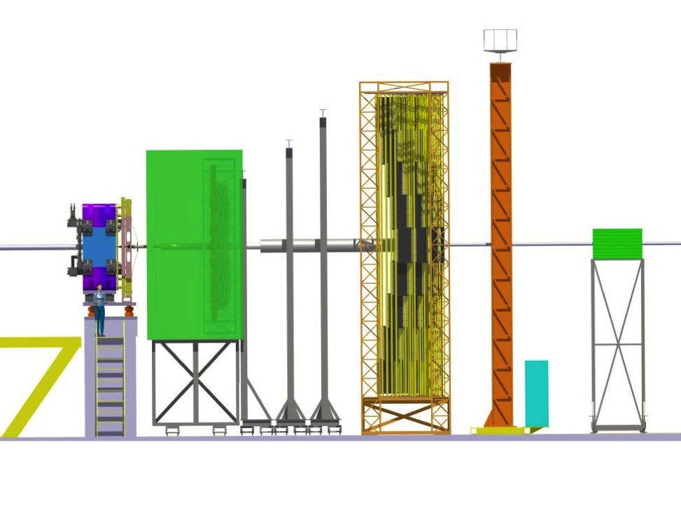
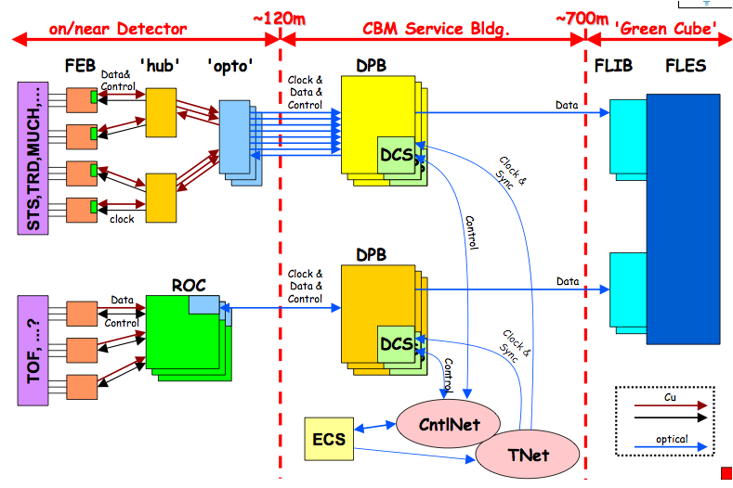
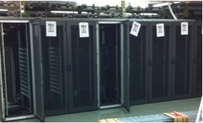
The Online Task
Online Data Processing
CBM FEE
~ GB/s
1 TB/s
at max. interaction rate
Mass Storage

Slide 17
Trigger:
tells the readout electronics when to read out the detector
tells the electronics whether to send the collected data further or discard then

Slide 18
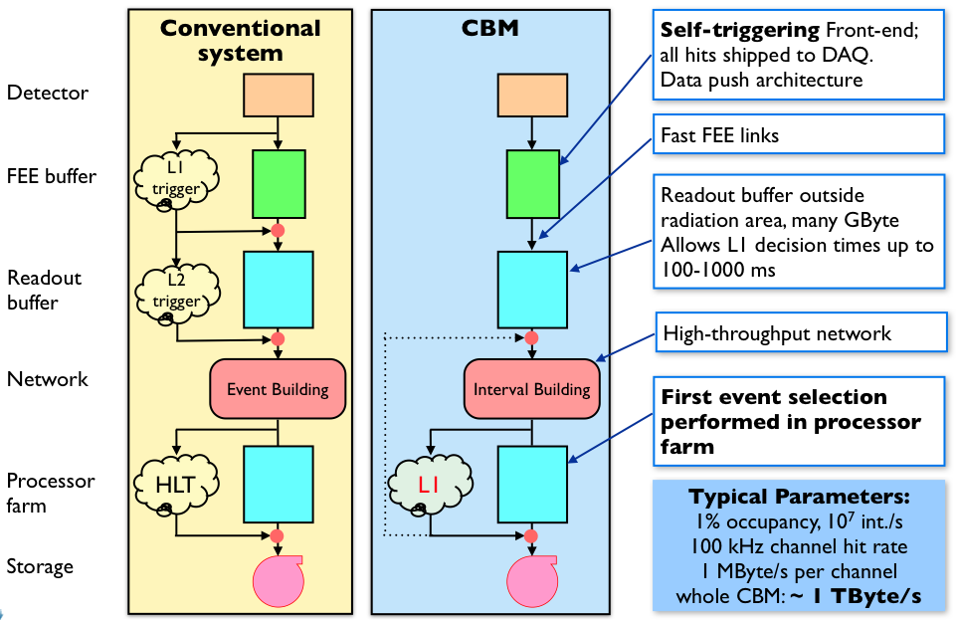
A Trigger Example (Schematic)
tell all electronics to send data
Data Acquisition
System
data
trigger particle
detector
target
interaction detector
beam
beam detector
produced particle
data are buffered on-chip until decision whether to use them or not
low-level decision is evaluated in hardware logic or on FPGAs
start electronics
reset electronics

Slide 19
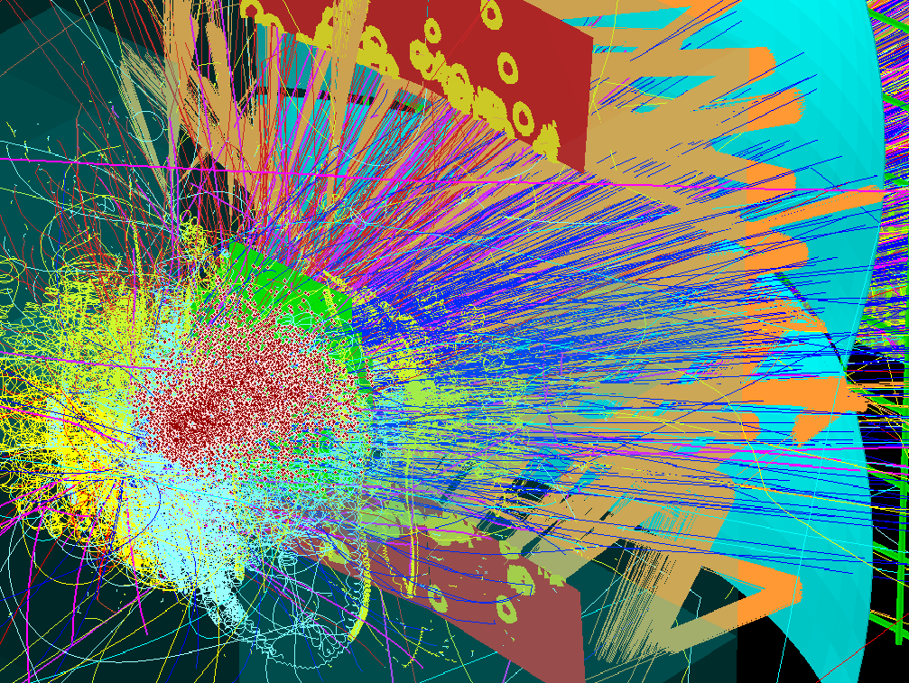
Why a Triggered Readout Does Not Work for CBM
The trigger signatures (e.g. Ω⁺ cascade decay) are complex and involve several detector systems at a time (e.g., STS + TOF)
  not possible to implement in hardware
1 MHz or above does not allow for high trigger latency
  FEE buffer is difficult and expensive, in particular if radiation hard
  not possible to wait for trigger decision in software

Slide 20
Free Streaming Read-out and Data Aqcuisition
Continuous readout by FEE
FEE sends data message on each signal above threshold
(“self-triggered”)
Hit message come with a time stamp
DAQ aggregates messages based on their time stamp into “time slices”
Time slices are delivered to the online computing farm (FLES)
Decision on data selection is done in the FLES (in software)

Slide 21


Triggered and Free-Running Readout
Trigger: snapshots of the detector
Trigger-less: a movie of the detector
N.b.: Too large to be stored! Will be cut into pieces in the photo lab (= FLES).

Slide 22
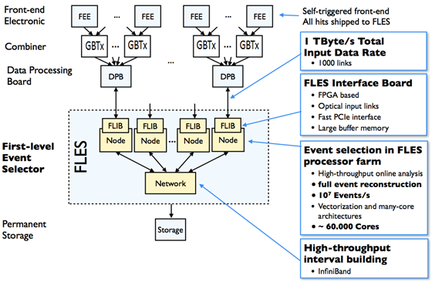
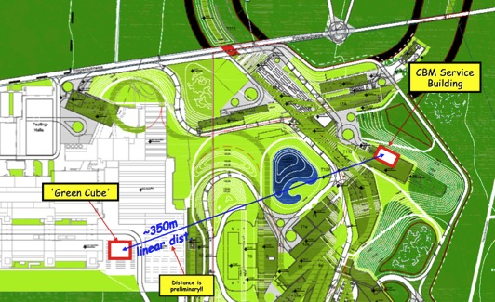
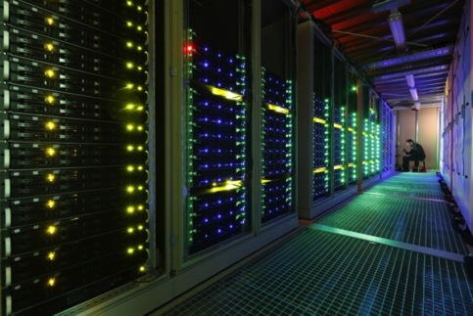
DAQ and First-Level Event Selector
FLES prototype: Loewe CSC Frankfurt

Slide 23
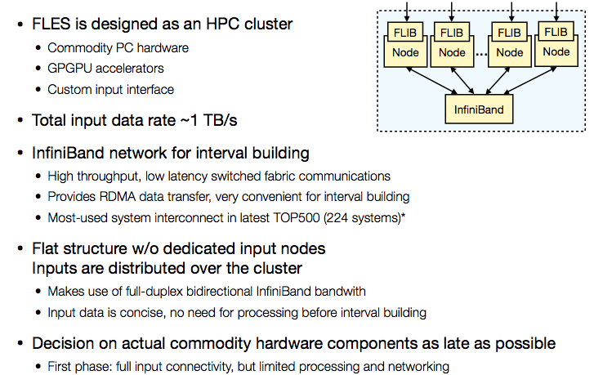
FLES Architecture

Slide 24
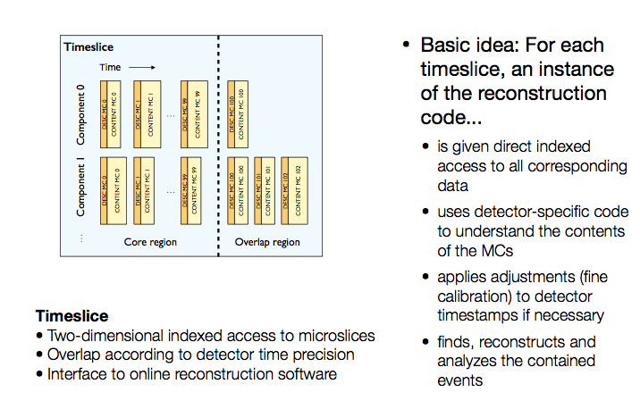
Time Slice: Interface to Online Reconstruction

Slide 25
Consequences for Online Computing
CBM tries to achieve high interaction rate capability with a novel readout paradigm.
Data will be continuously read out; the full data volume will be shipped to CPU.
Online data selection will happen on the online compute farm (O(10⁵) cores), where data reconstruction will be performed in real-time.
The quality criteria for reconstruction algorithms are not only efficiency and precision, but also, and mostly, execution speed.
To achieve the required performance, the computing parallelism offered my modern computer architectures must be exploited.
High-performance online software is a necessary pre-requisite for the successful operation of CBM.

Slide 26
Where to parallelize?
FLES is designed as HPC cluster
  commodity hardware
  GPGPU accelerators
Chunks of data („time slice“) distributed to independently operating computing nodes.
Obvious data parallelism on event / time-slice level
But: each computing node will have a large number of cores
Need in addition parallelism within event / time slice

Slide 27
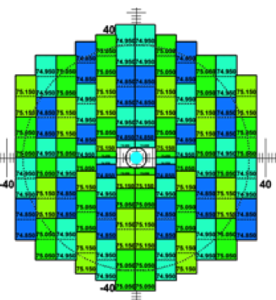
Parallelisation within event
Task Level Parallelism
MVD
hit finding
STS
cluster finding
RICH
ring finding
TRD
hit finding
TOF
hit finding
ECAL
cluster finding
STS
hit finding
STS
track finding
track fitting
> 1000 sensors
TRD
track finding
track fitting
Global Tracking
Vertexing, PID
Data Level Parallelism

Slide 28
Ways to parallelize: multi-threading
“Trivial” event-level parallelism: reconstruction with independent processes.
Exploit many-core systems with multi-threading: 1 thread per logical core, 1000 events per core. Gives good scalability.
CA Track Finder

Slide 29
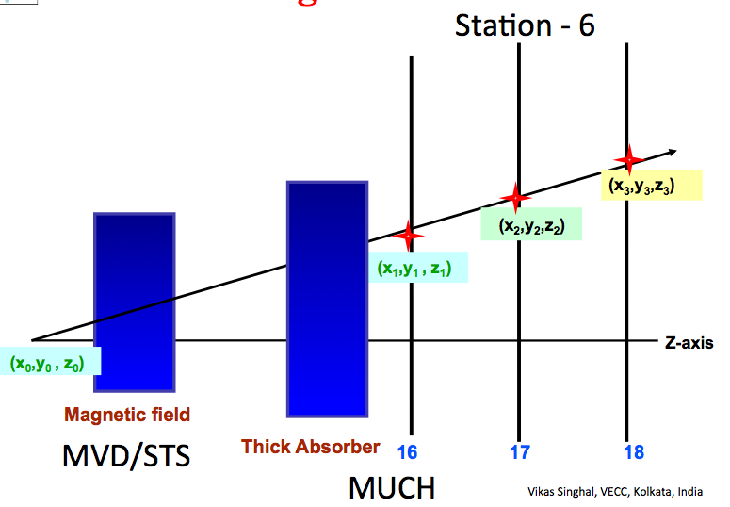
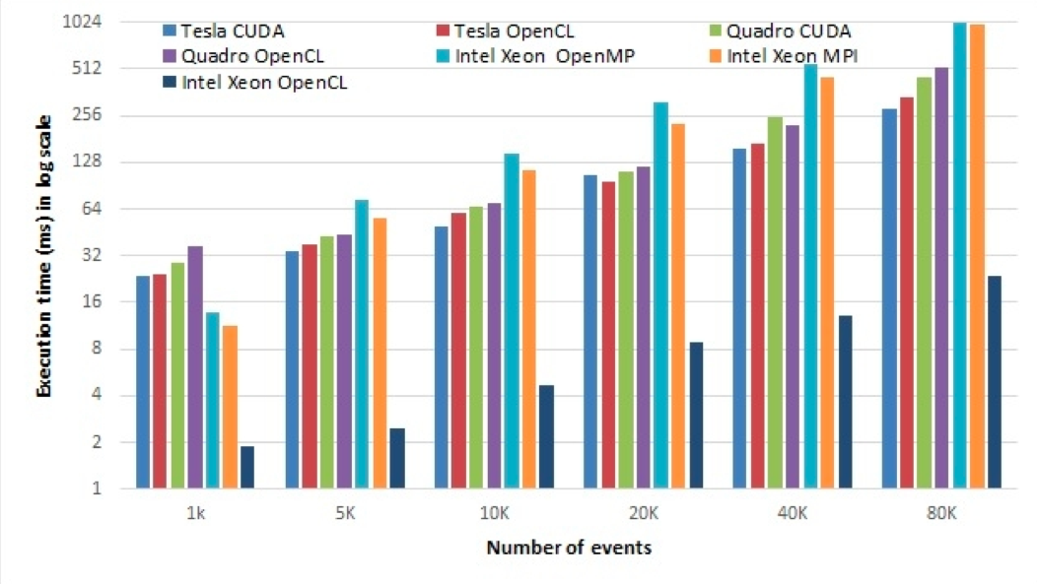
Muon trigger studies
Investigation on several CPU / GPU architectures. Strong differences between different computing paradigms on same architecture.

Slide 30
Offline Computing
Assuming we manage to solve the online computing issues, we will have some 5 PB per year on permanent storage.
How to efficiently get physics results out of them?

Slide 31
Computing Tasks
Simulations
Transport / Detector Geometry
Detector Response
Digitisation
Online Systems
Data transport
Event building
Data distribution and management
Reconstruction
From raw data to tracks and particles
Services
Experiment Control System
Databases
Analysis
From tracks to physics observables

Slide 32
Distributed Computing
10 years ago, LHC experiments were confronted with a similar problem. The amount of data was too large to be handled on a single site.
The answer was GRID computing: data and data processing are distributed on many sites worldwide.
To be considered are three factors:
  Computing power
  Storage capacity
  Data transfer between sites
Experience shows that the limiting factors are
  Network bandwidth
  Site administration

Slide 33
New Paradigms for CBM / FAIR
Today, the entire LHC grid compute power could easily be concentrated in one large computing centre.
The CBM Online Compute Cluster (~10⁵ cores) is commodity hardware; it can be used for offline computing between runtimes ( ¾ of the year ).
Since reconstruction must be fast (performable in real-time!), there is no need to store reconstructed data. Analysis can always start from raw data.
Strategy tends towards a small number of large centres connected by high-speed links - details still to be worked out.

Slide 34
Thanks for the attention!

