Slide 1
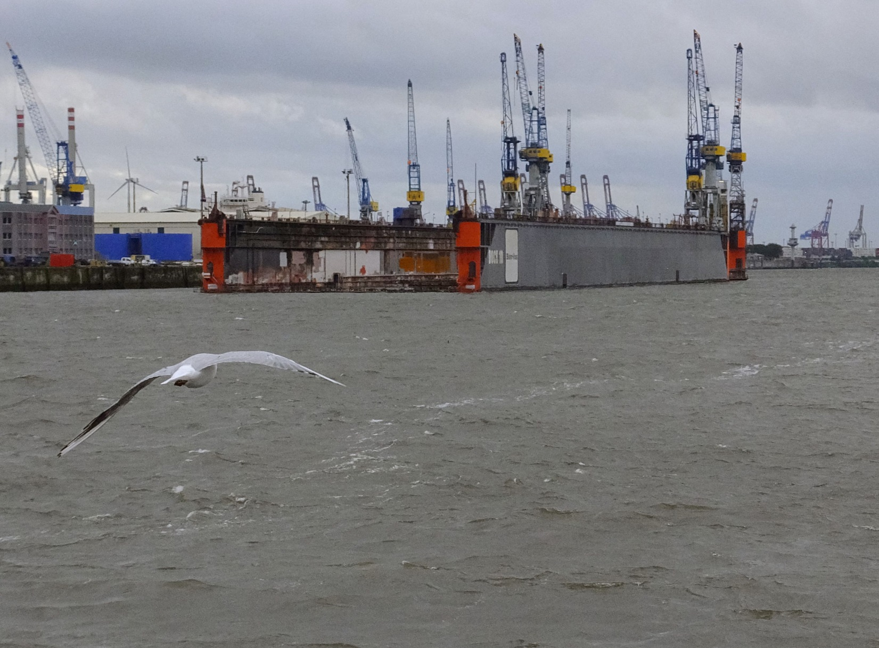
HEST Status Report
C. Kleffner, SBES
contributions from LOBI LEOB CSTI CSCO CSVS ENMA PBSP SBDE...

Slide 2
topics
overview
upgrades 2011 .. 2015
future upgrades

Slide 3
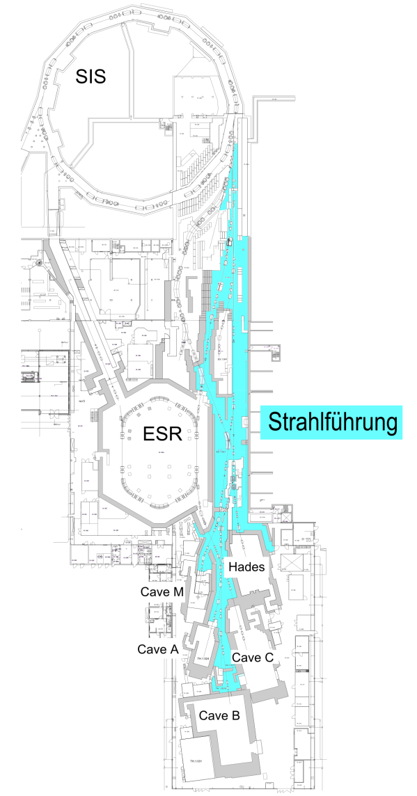
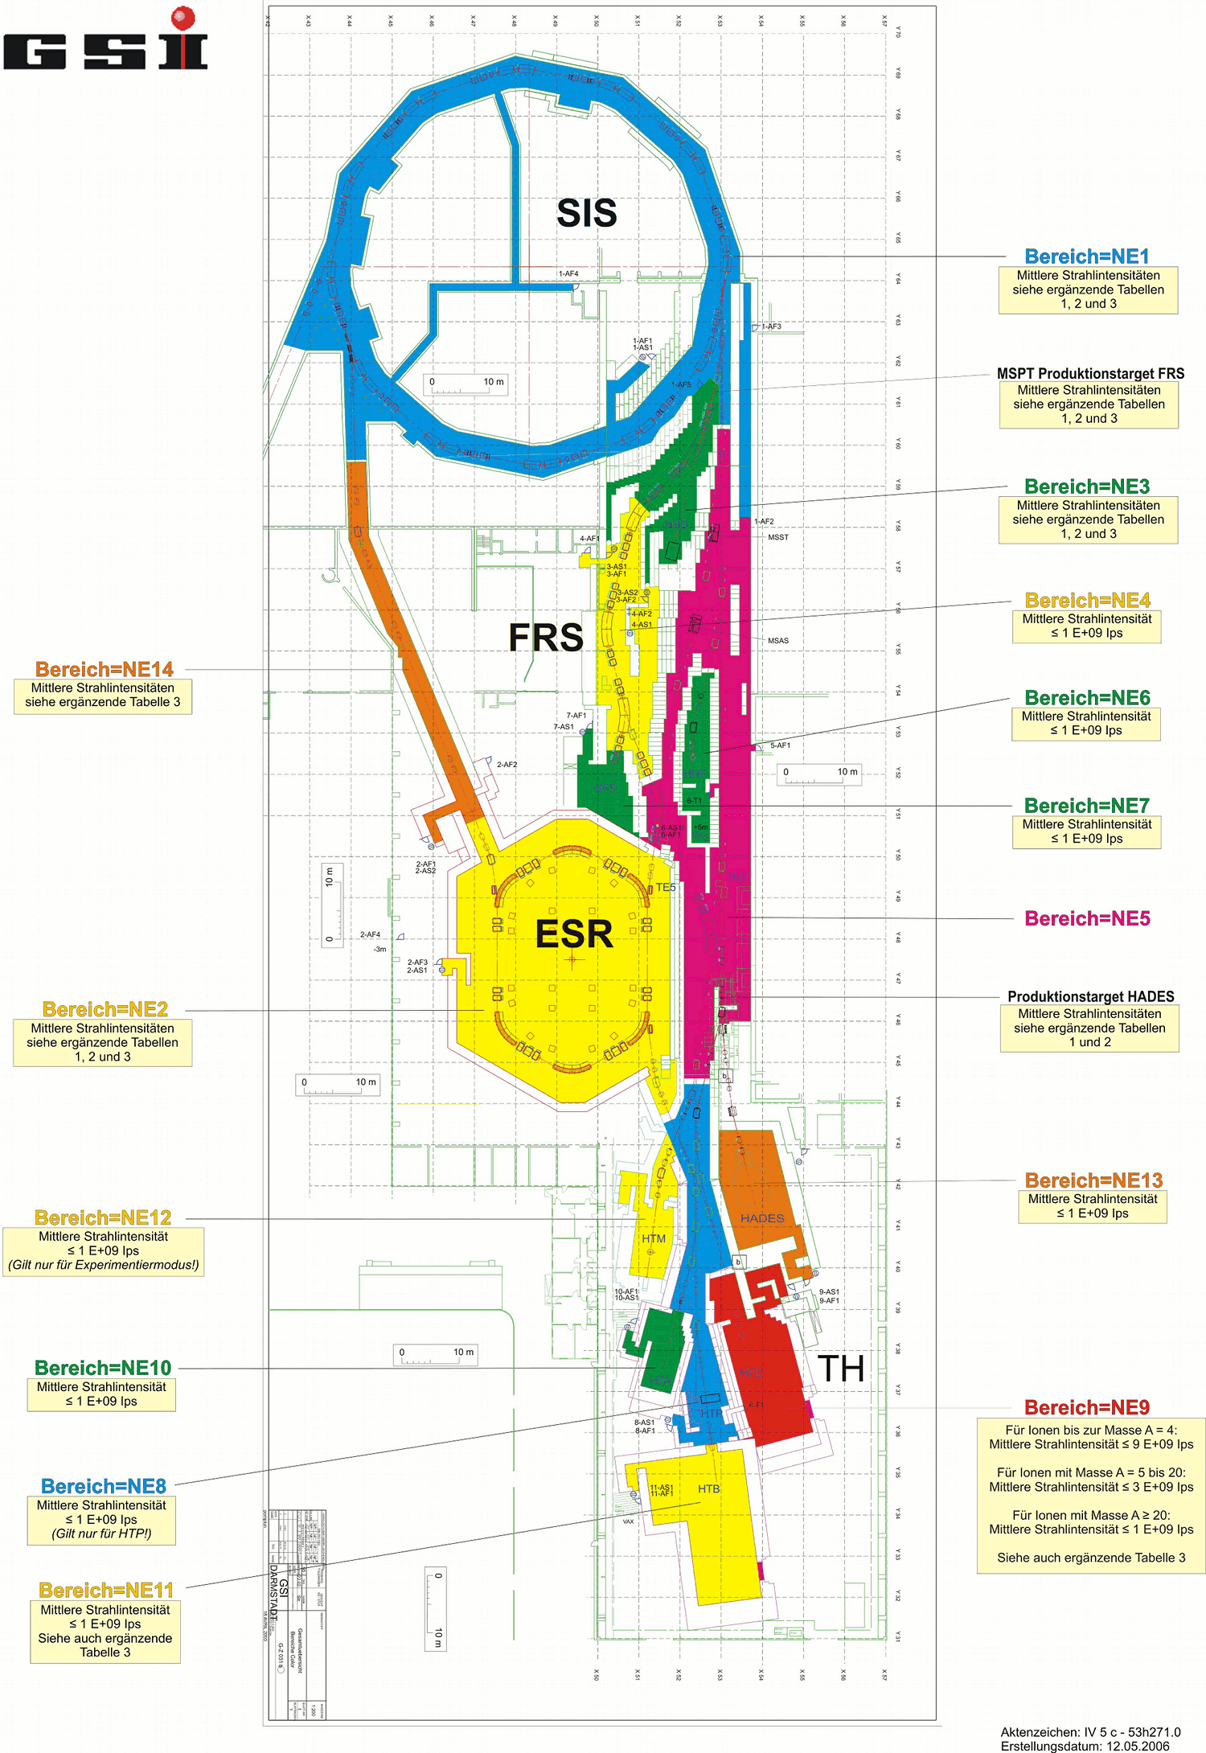
HEST overview
radiation protection, security:
NE3 area
NE5 area
NE8 area
FRS, Hitrap not part of HEST
technical
beamline between gate valve‘s
exp. handover
gate valve‘s ± X
HEST transport line

Slide 4
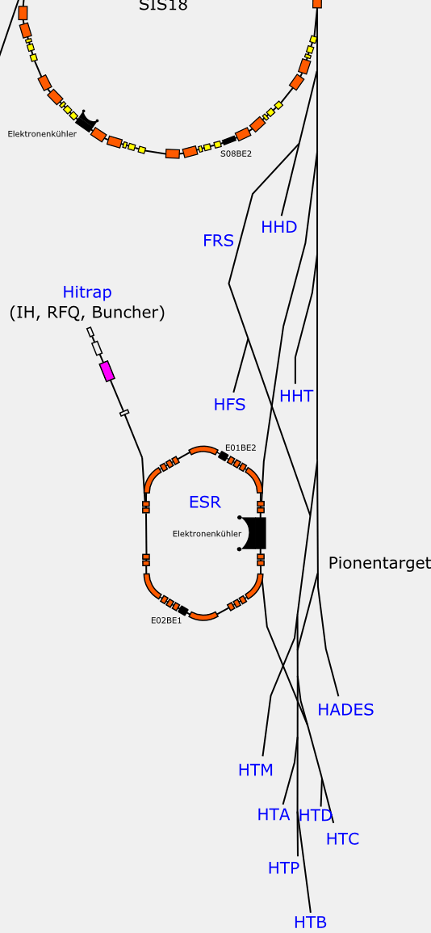
particles and caves
take it all!
→ protons ... uranium, RIPs, pions
HHD ions from SIS - beam dump
HFS RIPs from FRS
HHT ions from SIS
HTM ions from SIS
ESR ions/RIPs from SIS, FRS
HTA ions from SIS or ESR
HTA ions from SIS or ESR
HTB ions/RIPs from SIS, FRS or ESR
HTB π⁻ π⁺ from π-target
HTC,D ions/RIPs from SIS, FRS or ESR
HTC,D π⁻ π⁺ from π-target
HTP ions from SIS, ESR
HADES ions from SIS
HADES π⁻ π⁺ from π-target
Cryring comming july 2016!
courtesy: A. Bloch Späth

Slide 5
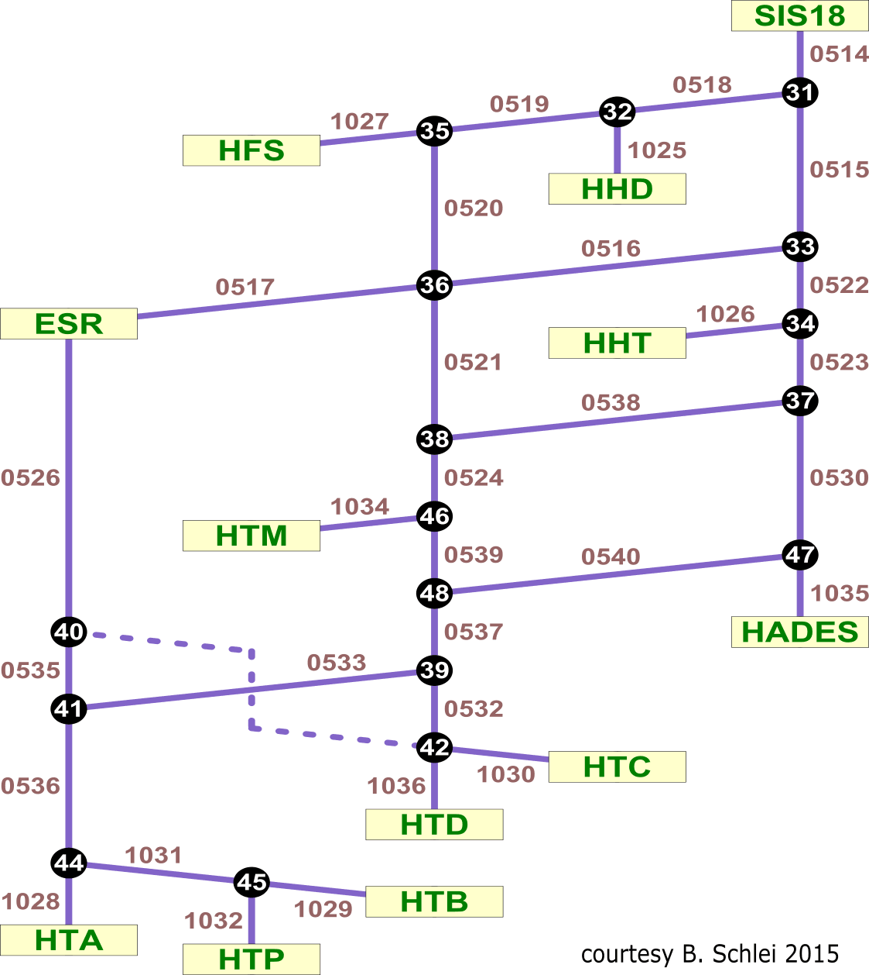
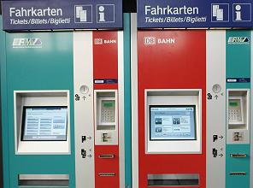
route network
branch points
switchable dipoles i.e. (31) == TS1MU1
segments
part of the beam line defined between branch points
→ thus all possible beam lines are assembled from segments
parallel operation
fast switching (shot to shot) between virtual accelerators VAcc‘s
fast and slow SIS extraction

Slide 6
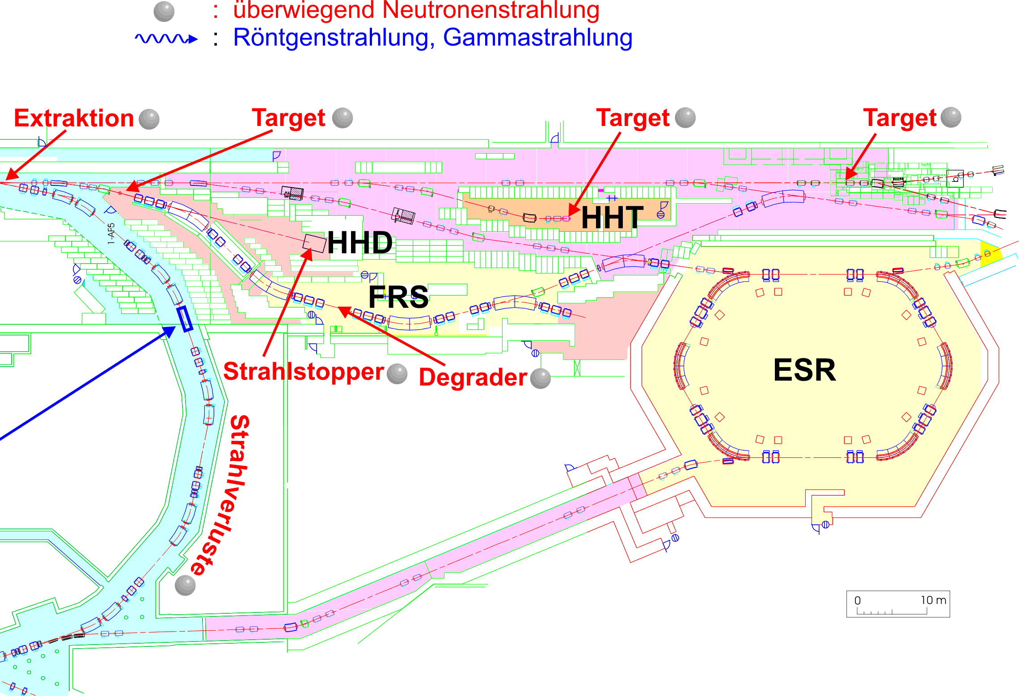
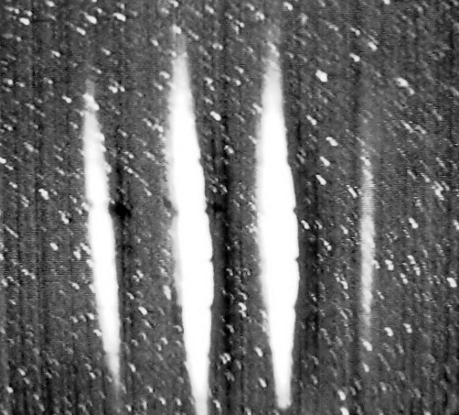
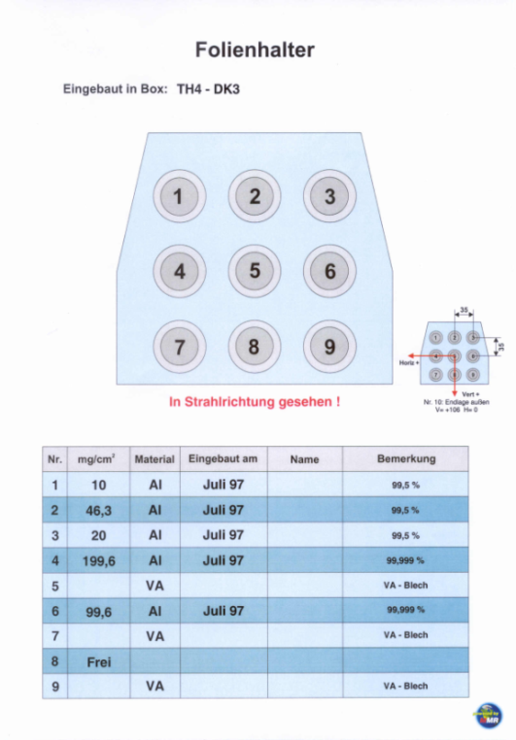
secondary particles / manipulation
FRS: target and seperator
stripper targets
pion target
example
stripped uranium beam
use of strippers and slits for charge (B/rho) changes
production of RIPs is also possible in the HEST beam transport line

Slide 7
beam parameters
rigidity
up to 18 Tm HHT, Hades, HTD, ESR 10 Tm
minimum > 1 Tm maximum rigidity – dipole constraints quadrupoles: depends on focussing strength and: power supply feedback loop stability
Bρ changes: stripper / targets
fast (HHT, ESR), slow SIS extraction
particle numbers up to 6 × 10⁹ particles/sec for Hades N/p beam

Slide 8
upgrades since 2011
HTA beamline
HTT beamline
π-target
solder joints quadrupoles
safeguarding against failure

Slide 9
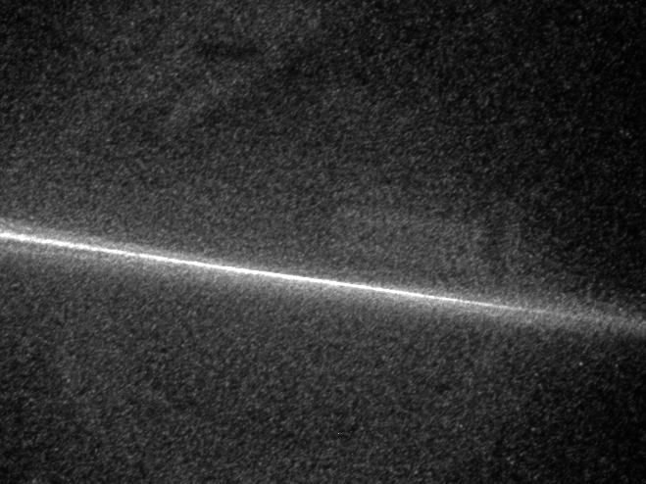
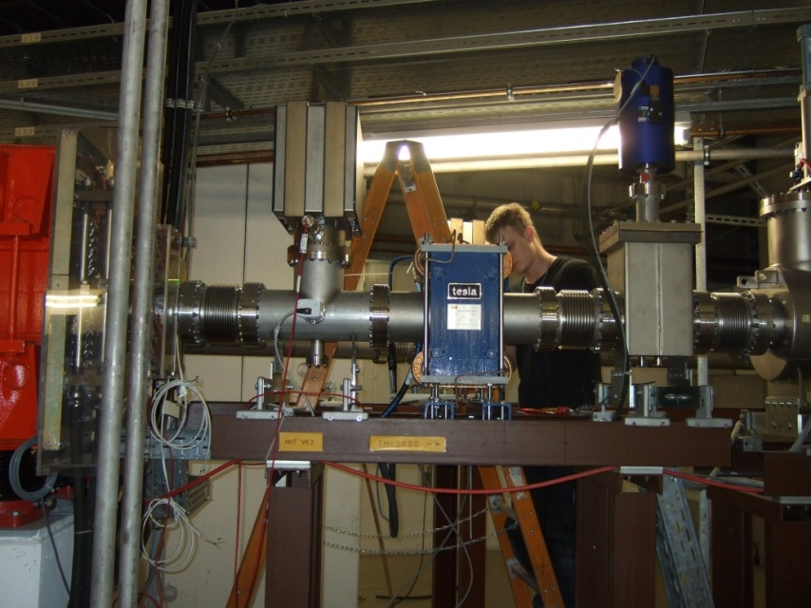
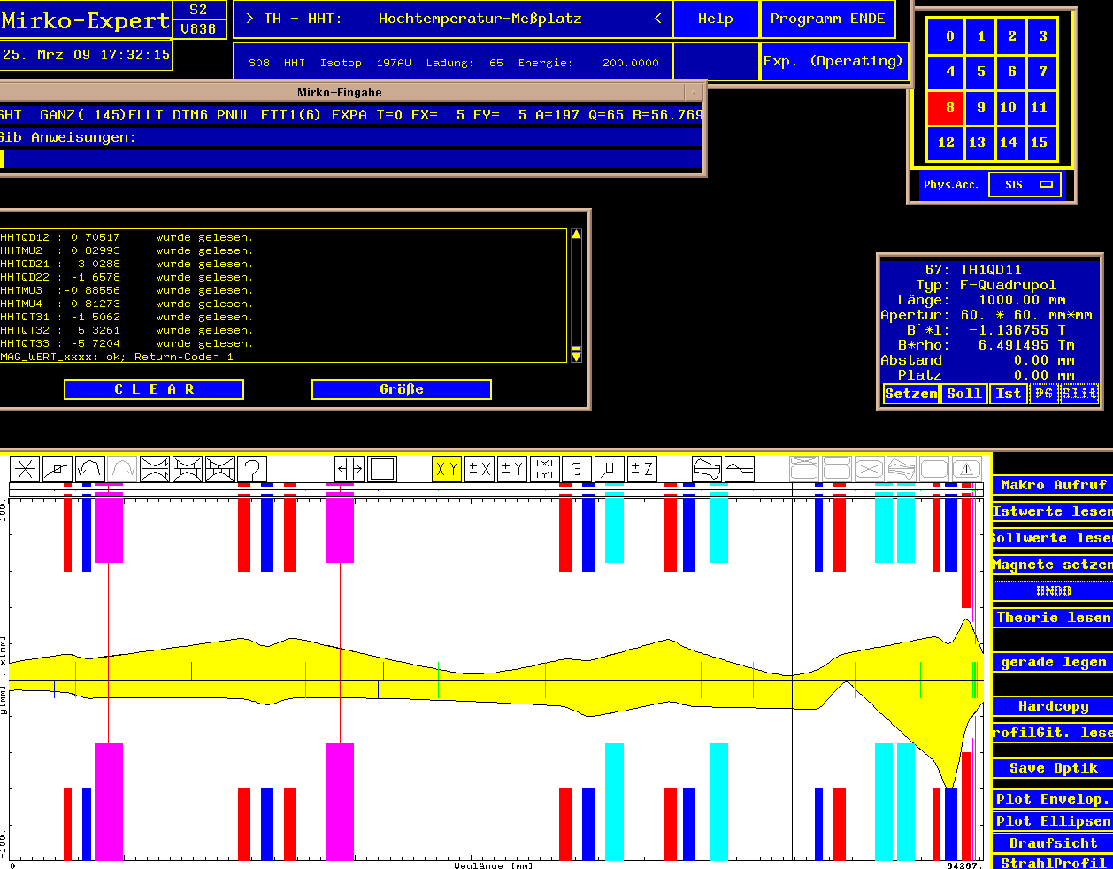
example: plasmaphysik - HHT
2013 / 2014
3 scinillating screens with CUPID
2 additional steeres
∅ < 1 mm
A. Tauschwitz

Slide 10
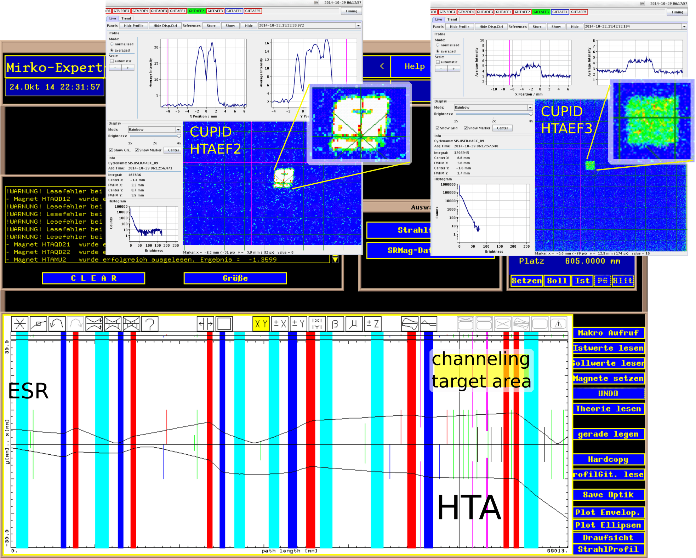
example: channeling ESR - HTA
2013/2014
1 additionel steerer (ESR cave)
revised / aligned scinillating screens with CUPID
new beam line settings for slow extraced beams (channeling)
Oct 2014
U⁸⁹⁺
190 Mev/u
slow extraction charge change

Slide 11
example: ESR – fast extraction tests

Slide 12
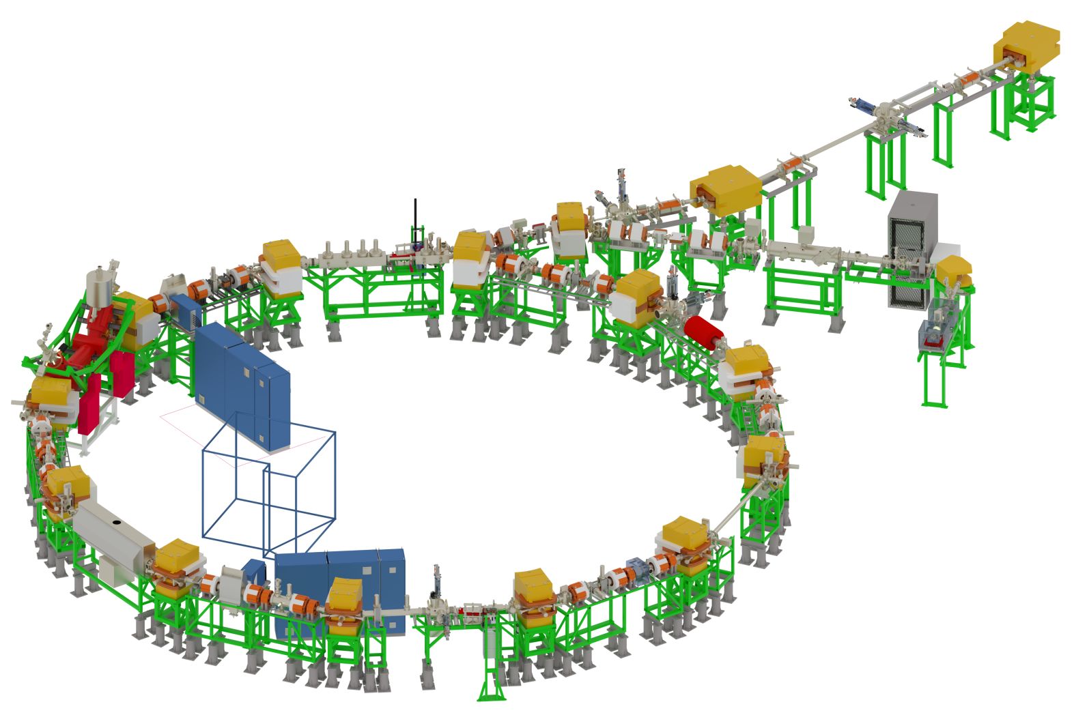
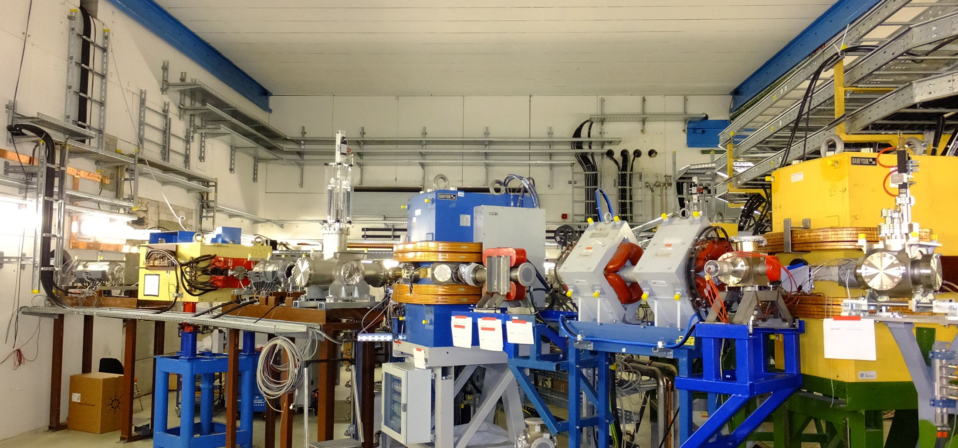
beam transfer jul 2016: ESR - Cryring
HTY injection line in Cave B 2016

Slide 13
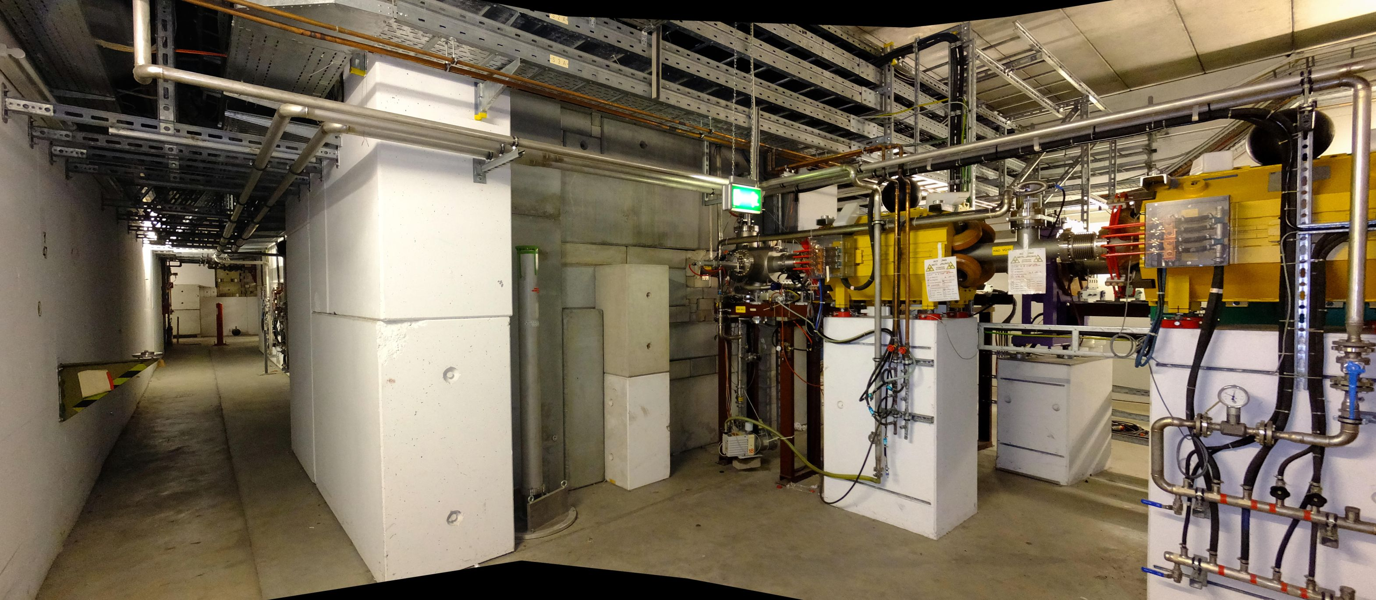
Hades – transerline to π-target

Slide 14
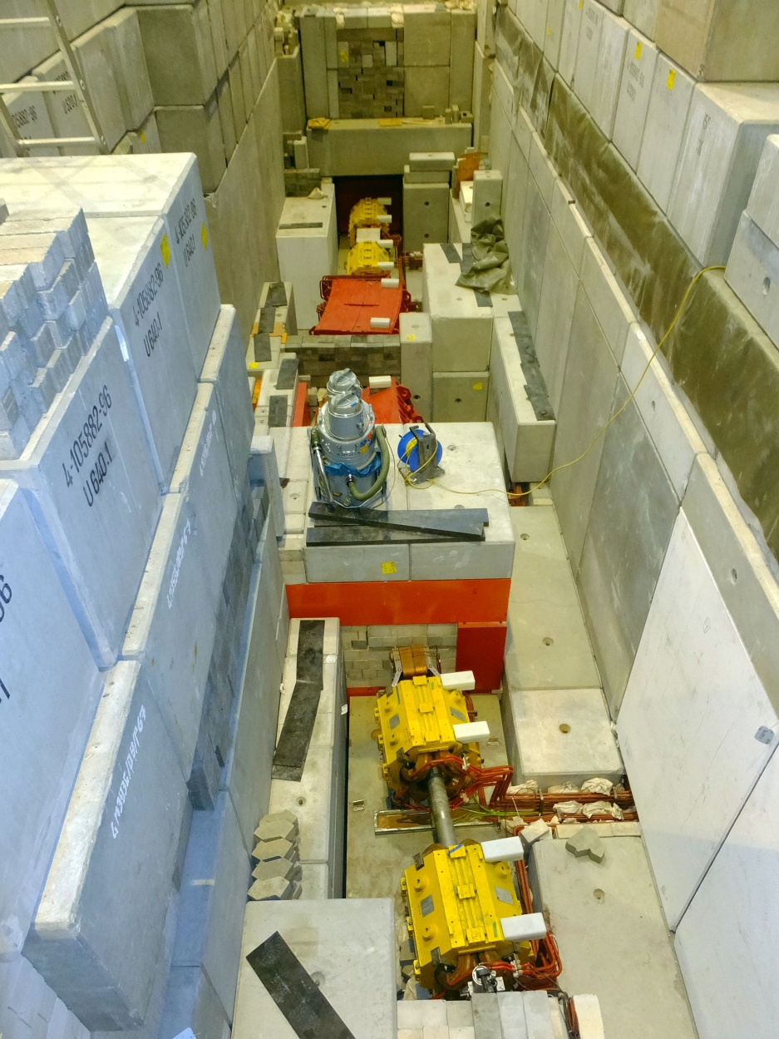
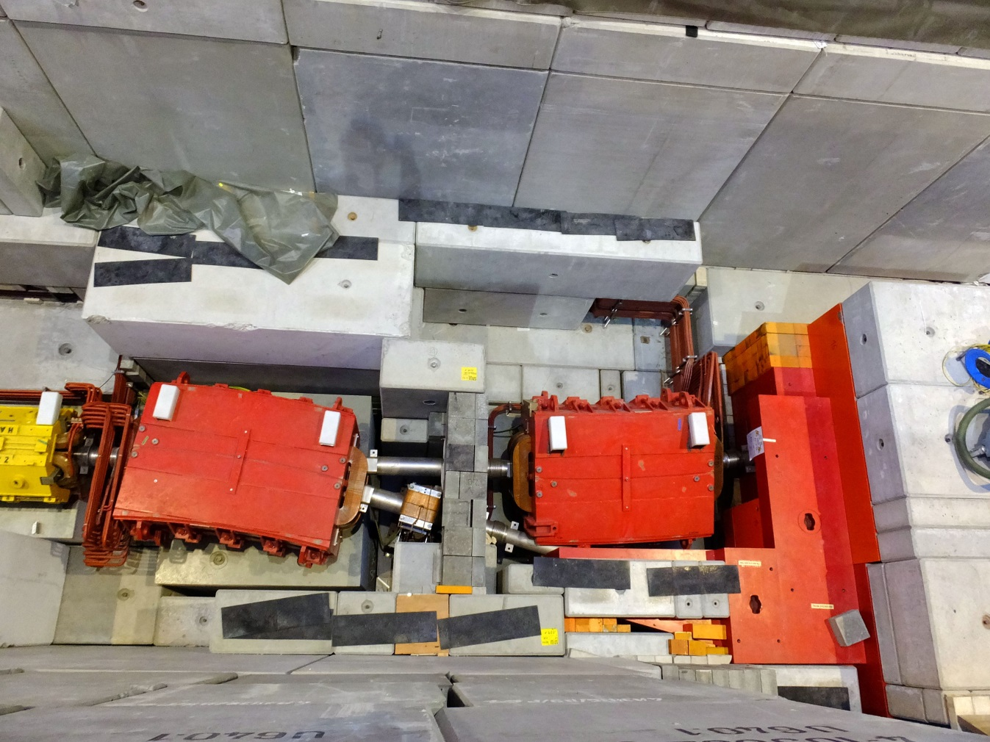
Hades – chicane

Slide 15
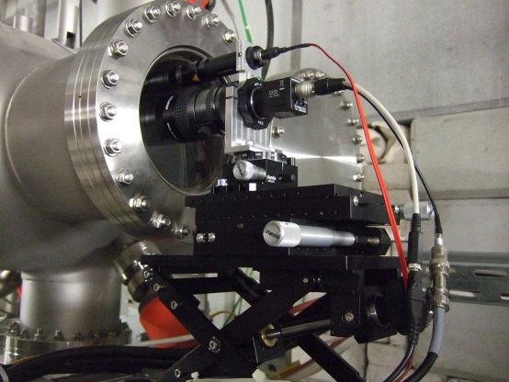
pion target - beam

Slide 16
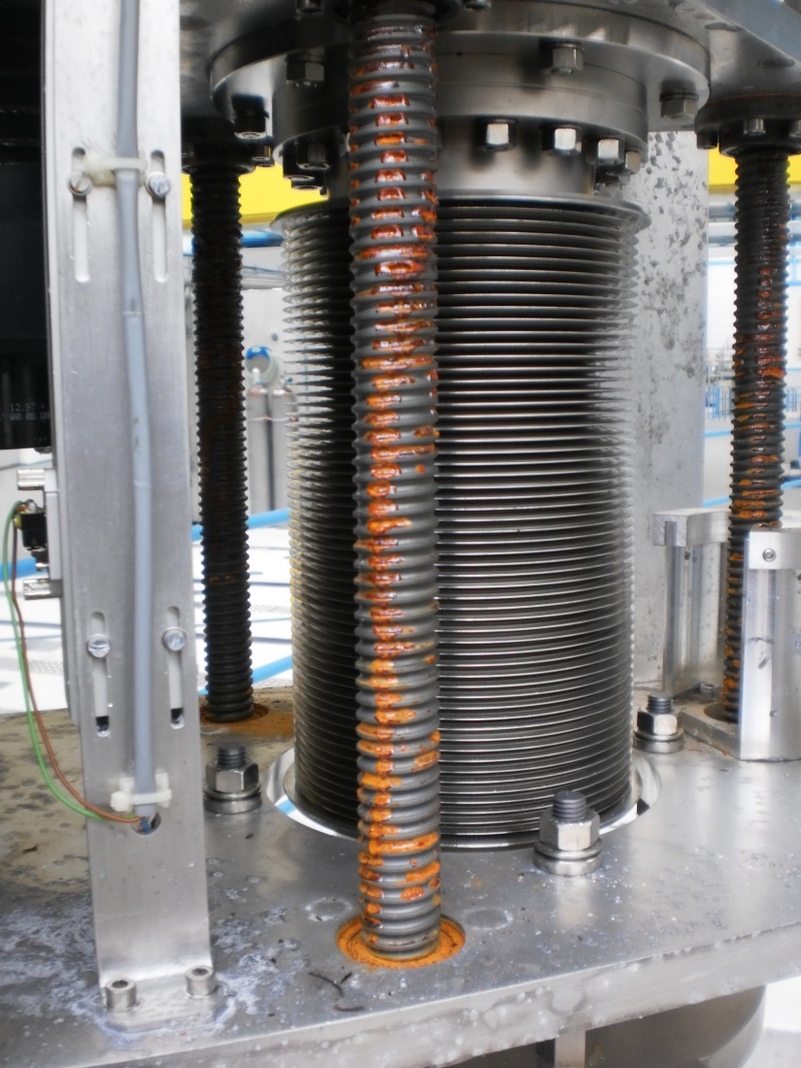
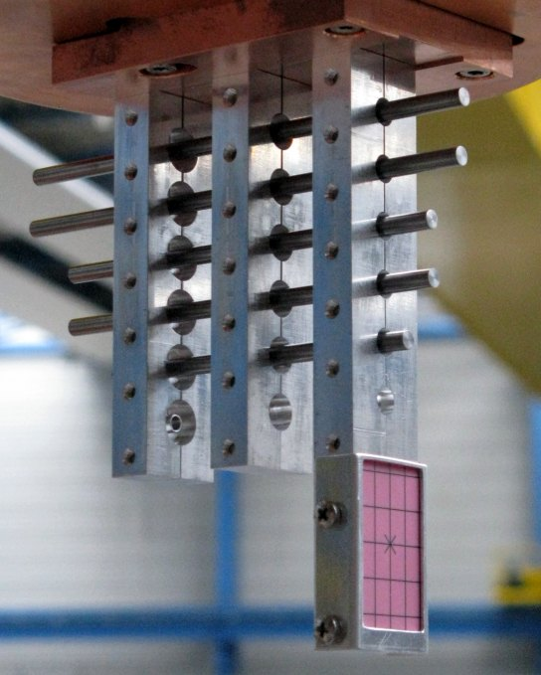
pion target (2011)
HADES collaboration wants to exchange Be targets again for the beamtimes as of 2018
smaller diameter to avoid pion losses

Slide 17
future upgrades
Hades beamline
Mini CBM
control system
upgrade
beam diagnostic
vacuum system
power supplies

Slide 18
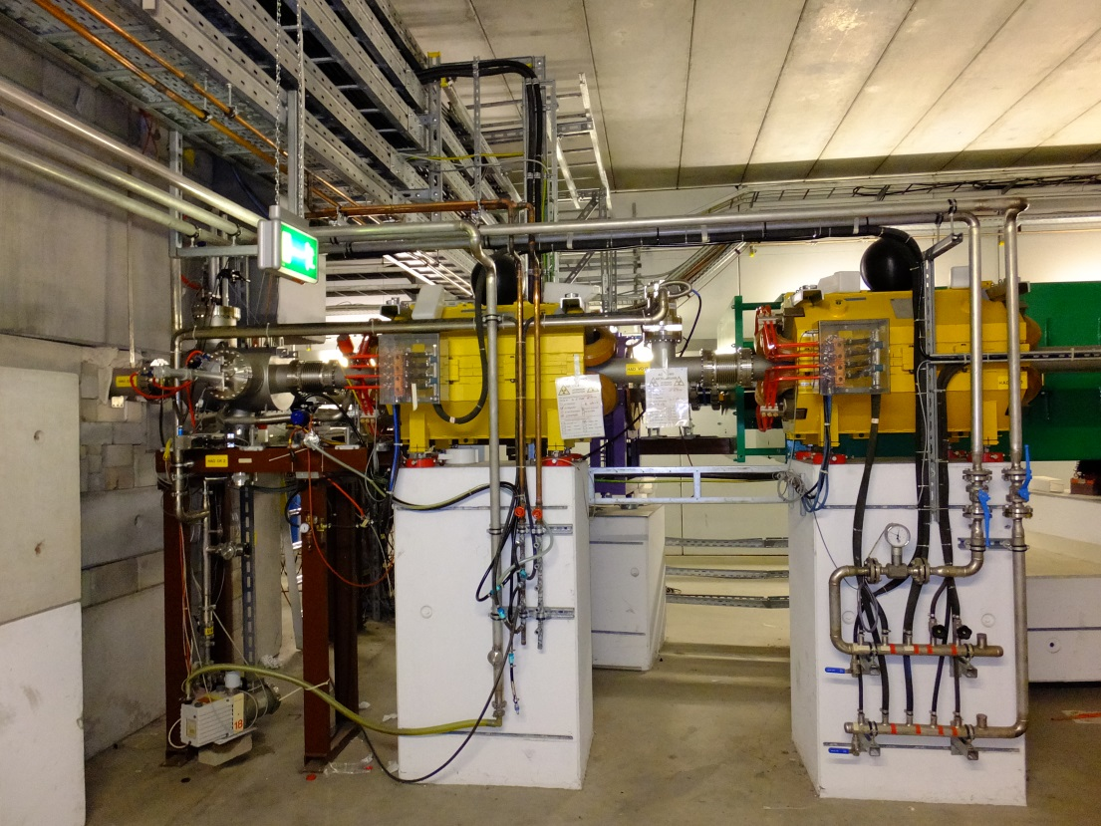
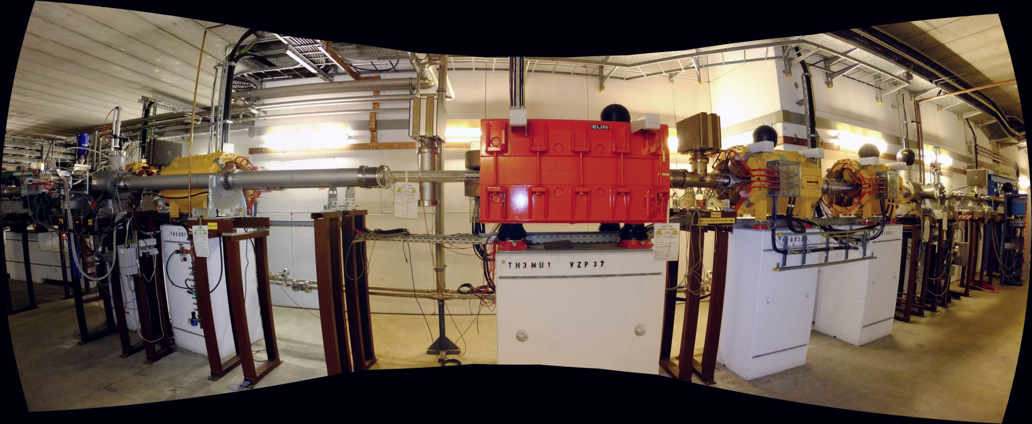
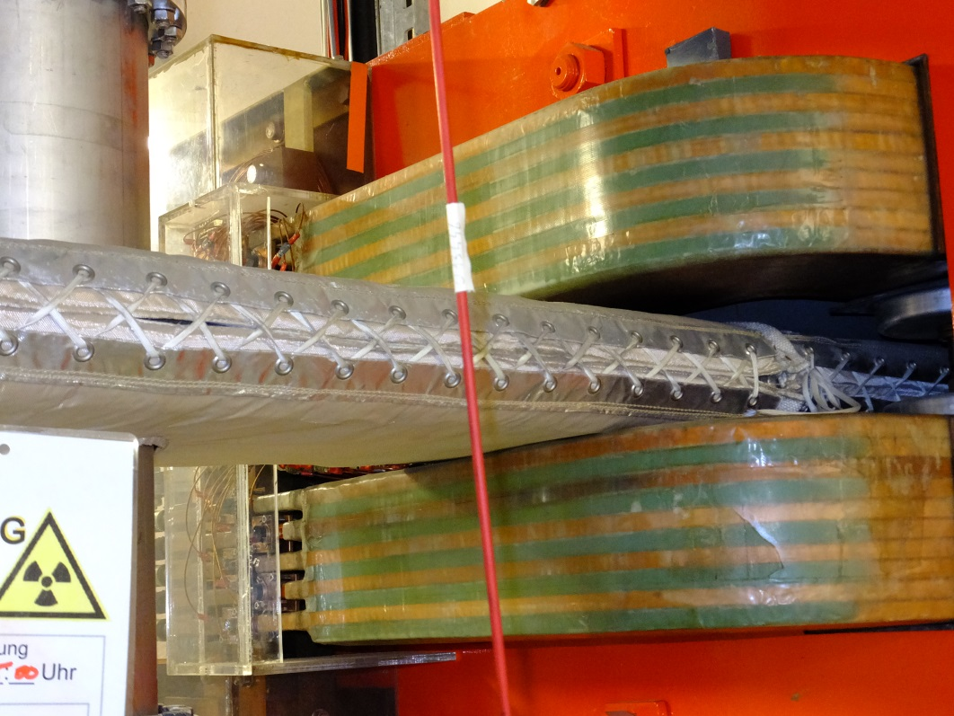
HADES – beam line actions (shutdown)
exchange vacuum chambers
alternative optic
new diagnostic elements
beryllium targets

Slide 19
HADES – beam line actions (cont.)

Slide 20
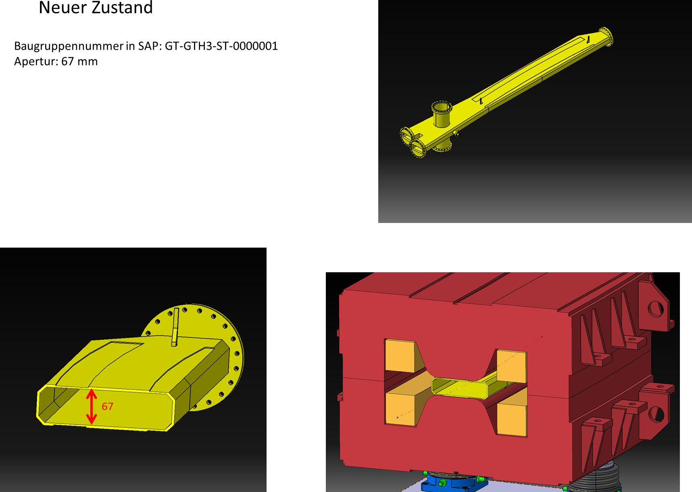
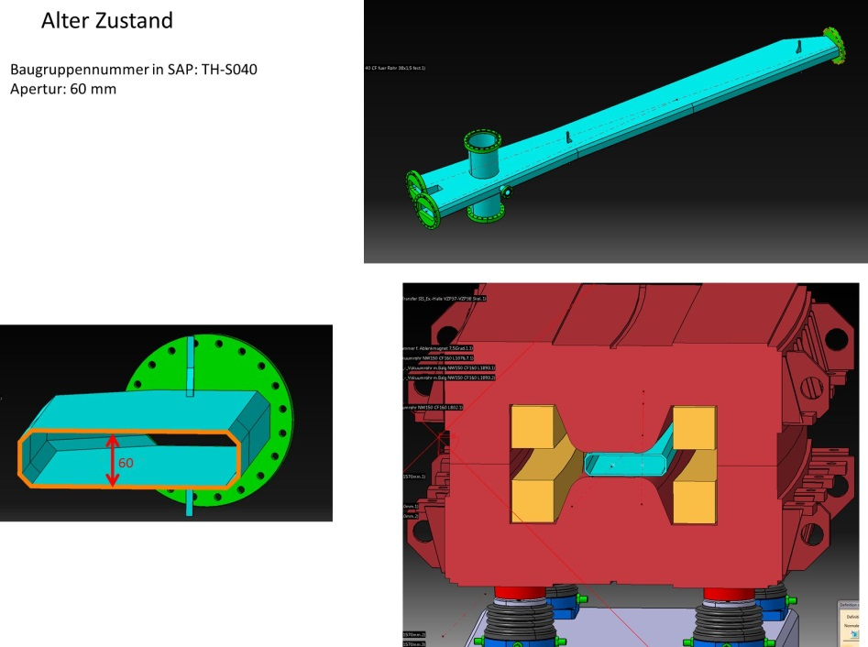
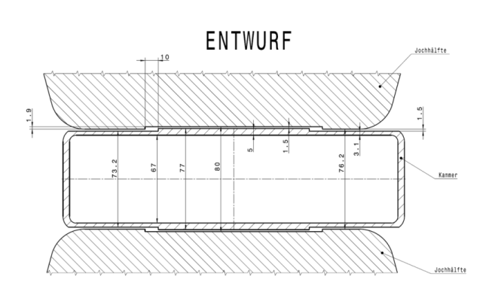
HADES – beam line actions (cont.)

Slide 21
HADES – beam line actions (cont.)
increase aperture: 110 → 125 mm

Slide 22
HADES – beam line actions (cont.)
beam diagnostic
screens CUPID
one screen with thin cromolux
additional shielding?
simple tomography should be possible
seetram
wishlist
CCCD

Slide 23
HADES – beam line actions (cont.)
beam diagnostic
screens CUPID
one screen with thin cromolux
additional shielding?
simple tomography should be possible
seetram only
wishlist
CCCD (Photo)

Slide 24
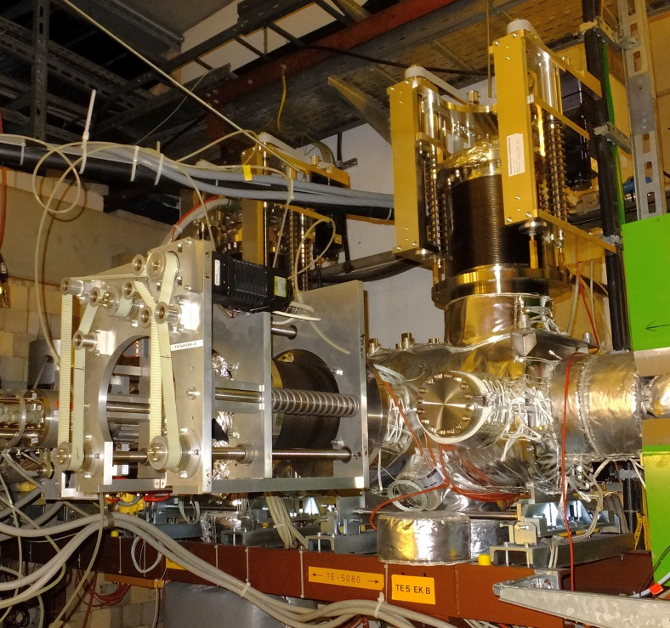
FRS – ESR
new diagnostic in injection beamline?
additional optic calculations?

Slide 25
HTD – Mini CBM
exchange of the HTDMU1 dipole
rigdity 10 Tm → 13 Tm
use of the existing HTD beamline for CBM detector tests

Slide 26
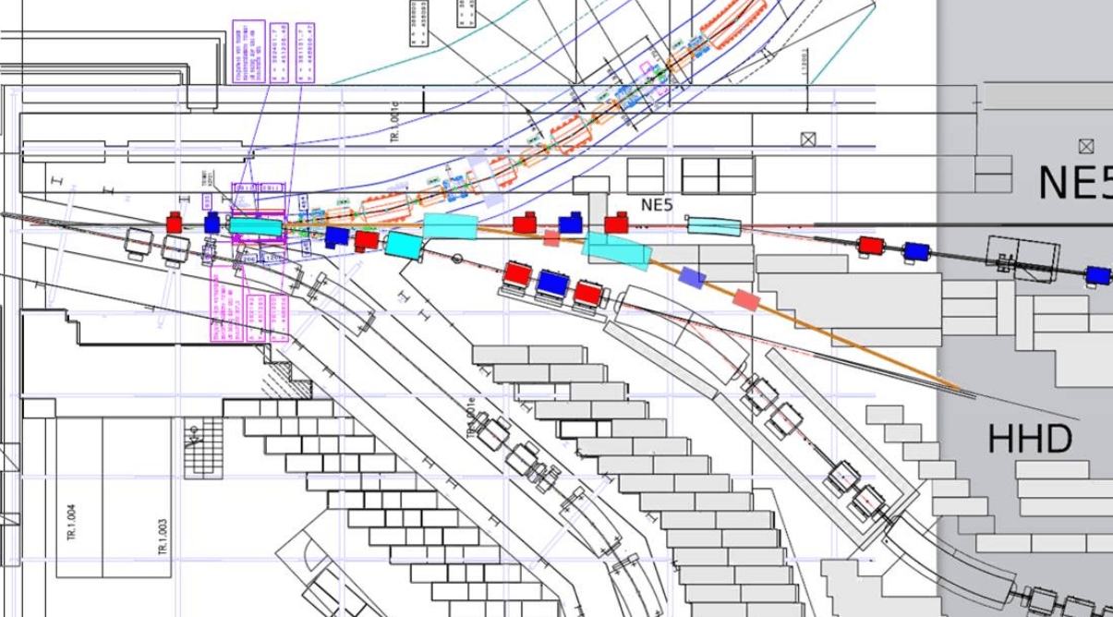
new beamline for SIS18 dump

Slide 27
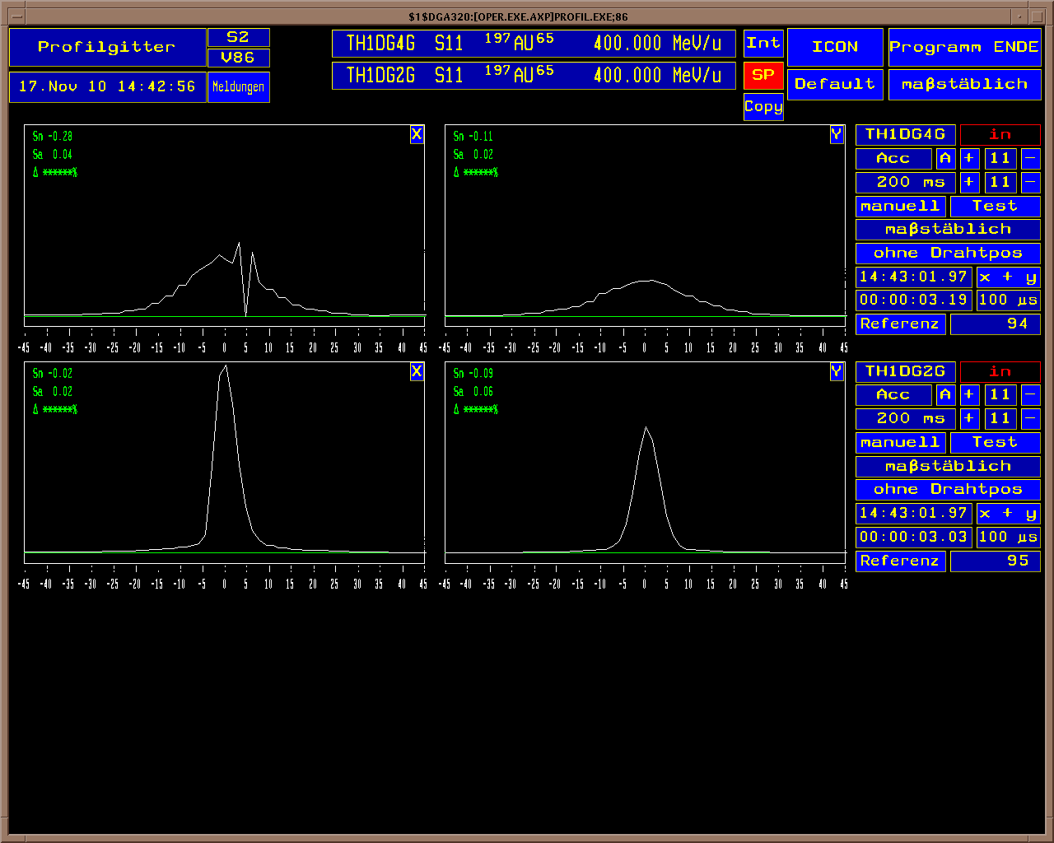
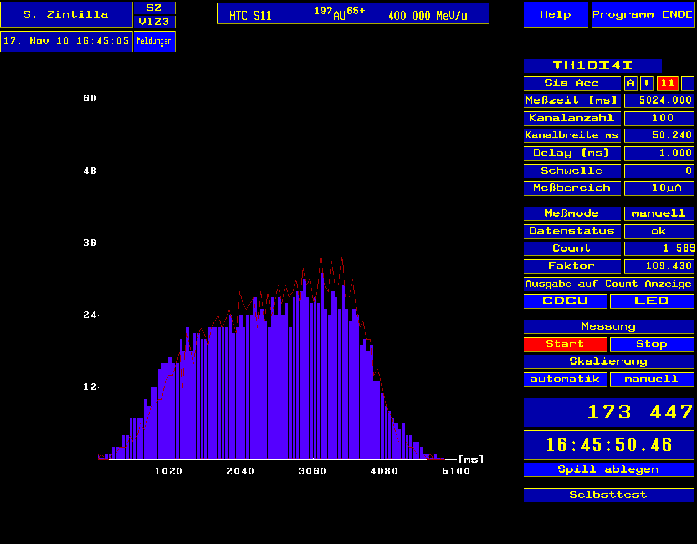
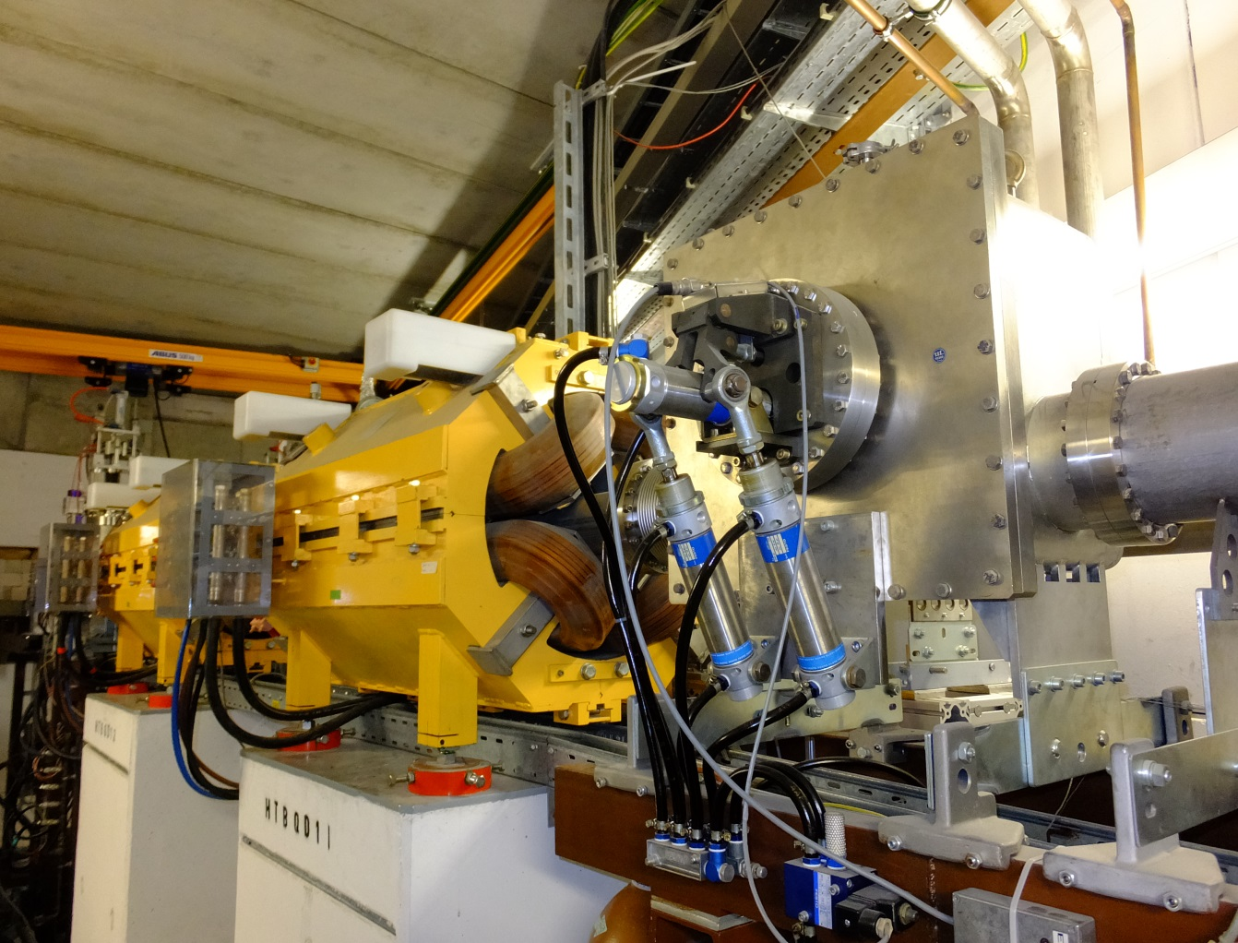
beam diagnostic
MWPC
viewing screens
particle counters
current measurement
beam stopper
→ transmission
→ beam position
→ beam profile
→ beam stability
→ interlock
wide range of particles
wide range of particle densities
fast / slow extracted beams

Slide 28
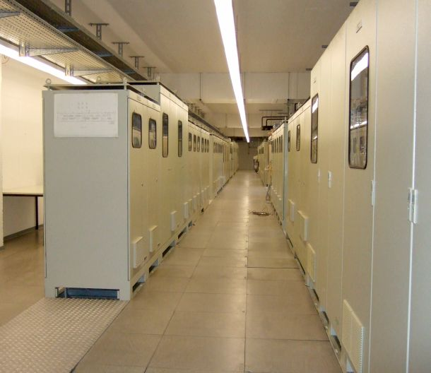
magnet power supplies

Slide 29
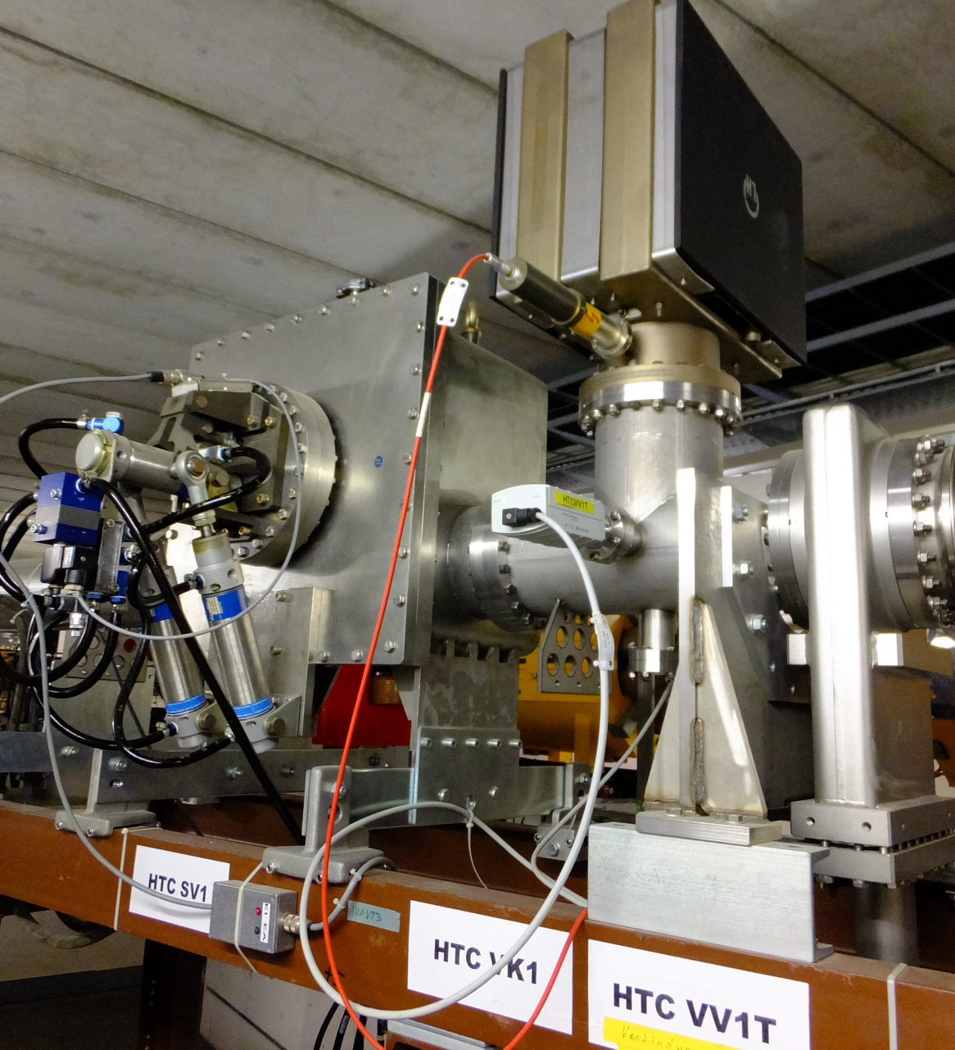
vacuum systems

Slide 30
?

Slide 31
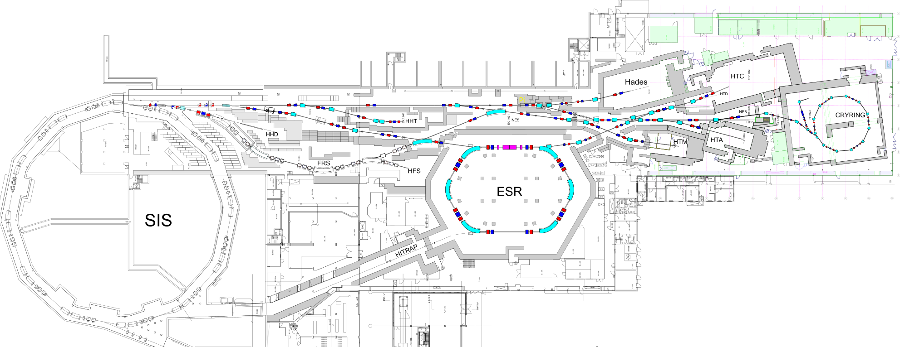
fin

