Slide 1
HEBT charge state stripper
S. Ratschow, GSI @ HIC4FAIR follow up meeting
Darmstadt, 26.2.2016

Slide 2
outline
need for another stripper
    T1S1 stripper for bare ions
    partial stripping for SPARC needs thinner stripper foils
parts of a stripping station
    dispersion (T1S1 stripper as example)
    collimators (T1S1 stripper as example)
    stripper foil (fast retractable for parallel operation)
proposal for an additional stripper in T1S3
    preparation of smaller beam size at collimators
    needed investments (in terms of equipment, not cost)

Slide 3
motivation for another stripper
CBM experiment
  highest ion energies → bare ions
  → stripping behind SIS18 (included in current design)
SPARC experiment
  H-, He-, Li- and Be-like heavy ions
  different stripper materials (C to Nd) and thicknesses (hundreds of microns) for optimum charge state yield
  → stripping behind SIS18 (not included in current design!)
foils for SPARC stripper thinner than for CBM stripper
parallel operation of FAIR
  stripper foils must be moved in and out fast
  fast operation not compatible with more than one stripper foil per drive

Slide 4
stripper in T1S1
production of bare ions
  e.g. U92+ from U73+
  e.g. Au79+ for CBM
limited space for all installations
  dipole arrangement had to be modified to make room for collimators
  no space around stripping foil drive
the position of the stripper allows stripped ions directly from SIS18
modules 0-3 of FAIR

Slide 5
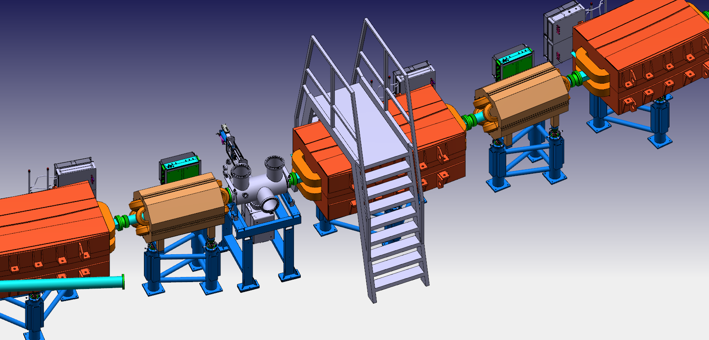
stripper foil position

Slide 6
stripper in T1S1
stripper foil collimators(horizontal)
collimators do not limit acceptance
stripper produces e.g. bare uranium U92+ with a 195mg/(cm)² Nb foil.
the stripper foil will be moved in an out cycle by cycle

Slide 7
stripper in T1S1 how it works
U91+ separation
expected: 12.5%
U90+ separation
expected: 0.5%
the blue beam is in both cases U92+

Slide 8
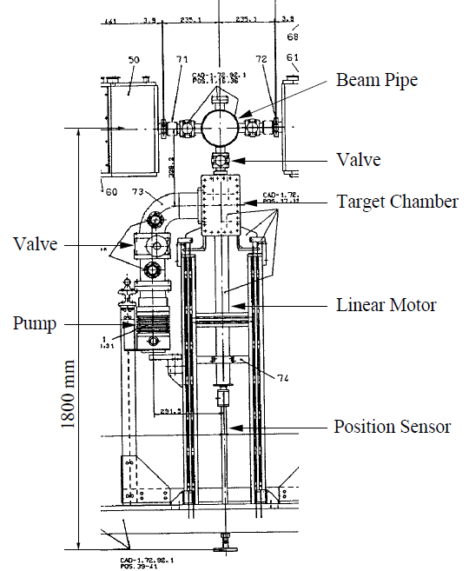
stripping foil drive
at the EDDA experiment at COSY, Jülich a fiber target was moved into and out of the beam with a linear motor within about 100ms
the linear motor has performed estimated 5M in- and out- cycles from 1994 until 2008 without problems
we could use a similar device to move our stripper foil
the speed of operation will not limit the parallel operation of FAIR
this drive is not compatible with multiple foils
GSI internal report by F. Hinterberger: „Design of the Ion Optics and Beam Preparation
for the Target Stations BIOMAT and SPARC in the HEAP-Cave and the Connection to the Transfer Lines SIS18-HEAP
and SIS100-HEAP of the FAIR Beam Transport Systems”, 2008, as prepared for the SPARC-Collaboration

Slide 9
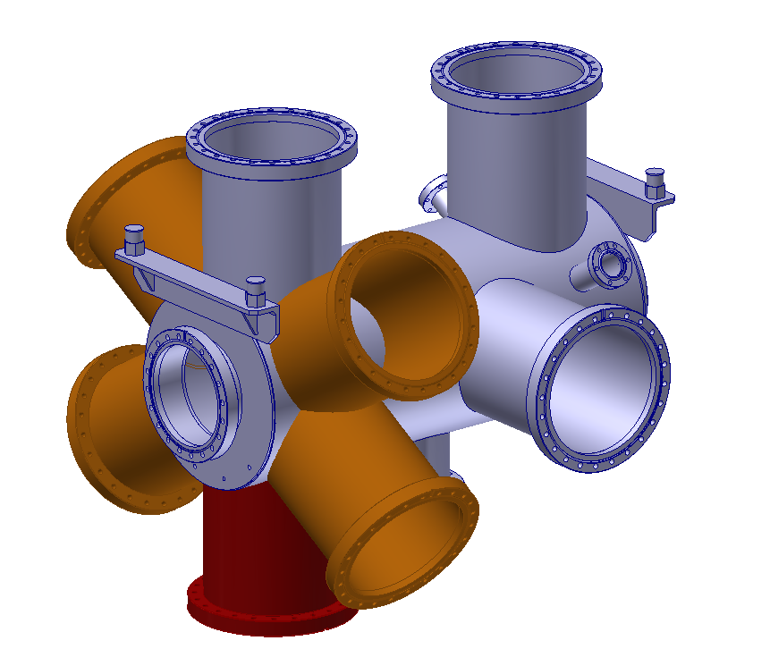
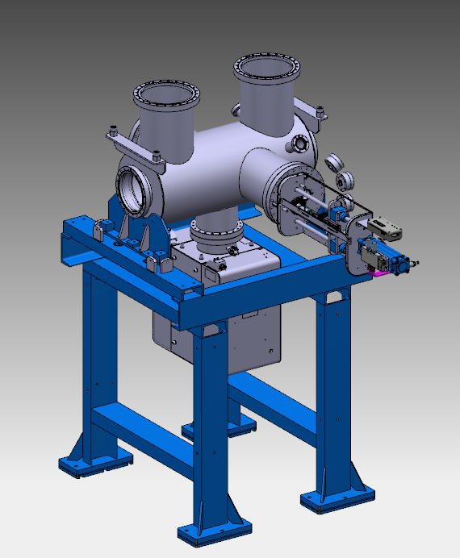
Hedgehog-Chamber
Idea of a hedgehog-chamber:
  Try to foresee installation space (flanges) for several stripper drives
  Number of manufactured and installed stripper drives could be upgraded on demand (and on budget availability)
Realization:
  Define technology (linear servo drive, pressurized air, ...)
  Estimate required installation space for one drive
  Try to accomodate several drives on the chamber
by courtesy of Lars Bozyk

Slide 10
additional stripper in T1S3
T1S3 is the best and only possible position
  next to beam dump → radiation shielding will be (hopefully) no problem.
  T1S4MV01 and *02 bend the beam by 15° (52.5° at T1S1 stripper)
  calculated horizontal to vertical emittance ratio is 3/1
modules 0-3 of FAIR

Slide 11
T1S3 and T1S4 standard optics
potential positions for
stripper foil collimators(vertical)
vertical transfer symmetric
  quadrupoles 1-9, 2-8, 3-7 and 4-6 powered in series
subsequent bend symmetric
  quadrupoles not powered in series
  one horizontally focusing quadrupole to correct horizontal dispersion and its derivative
enough space around T1S4MV01 and T1S4MV02 for stripper(s) and collimators

Slide 12
separation of U91+ relative to U92+
separation of U91+ /U92+ smallest of all ions
  when U91+ /U92+ are separated → all ions are separated
maximum scaled vertical emittance 17mm*mrad
  → shown emittance 20mm*mrad already contains a (small) margin
partial beams nowhere fully separated
without adaptions a stripper at this position will not work

Slide 13
T1S3 and T1S4 modified optics
stripper foil collimators(vertical)
dispersion given → reduction of transverse beam size
  the vertical transfer no longer symmetric
    quadrupoles must be powered separately, 4 additional power supplies
  subsequent bend no longer symmetric
    quadrupoles must be moved in order to match dispersion and derivative of disperson
this optics is only a first try and must be optimised further!

Slide 14
separation of U91+ relative to U92+
optimum position for last collimator
collimators for larger charge offsets
with modified optics: partial beams are fully separated
when last collimator catches 20mm*mrad partial beam → remaining acceptance for beam on axis 33mm*mrad
  recall: maximum scaled emittance 17mm*mrad
conclusion: a stripper in T1S3 is possible

Slide 15
investments
this is a conceptual proposal which needs further planning
necessary investments are:
  a linear drive for every additional stripper foil
  four additional power supplies for the quadrupoles in T1S3
  three collimator pairs (above and below the beam line)
  last collimator pair should be made (slowly) movable
  dedicated chambers for collimators and stripper foil drive(s)

Slide 16
thank you for your kind attention
any questions?
  please, go ahead!

Slide 17
emergency transparency section

Slide 18
What is shown on MIRKO-Plots?
(former TPP2
from the time when
AP- and PP-Cave where separate)

Slide 19
Beams to be transported
Normally the acceptance 150(horizontal)*50 (vertical) (mm*mrad)² of SIS18 is filled at 11.4MeV/u by multi-turn-injection from UNILAC
The emittance is scaled through the accelerator chain (including stripper) according to the 1/(Bρ)-law.
Magnetic rigidity and particle energy are linked by the formula
In the worst case (lowest nominal extraction rigidity, lowest charge state) the maximum emittance is
from SIS18 50mm(horizontal)*17mm(vertical)
from SIS100 25mm(horizontal)* 8mm(vertical)

Slide 20
beam line from SIS100 to the AP-cave
SIS100 vertical transfer large dispersive bend target focusing
almost no dispersion free section
almost no space for additional installations
four quadrupoles for matching of parameters
target focusing done with usual beam line quadrupoles

