Slide 1
Interface model for SIS18 and UNILAC
Sabrina Appel, Primary Beams Division, Beam Physics Department, GSI, Darmstadt

Slide 2
Optimization of a complex system
Define main optimization parameters; Separation into subsystems; Modeling
Injection
SIS18
Performance goal:
max. N/s
Extraction
UNILAC
Experiment or SIS100
Modeling:
  One attempts to find simplest model & fastest algorithms which contain the necessary physics
Optimization of the ion production chain:
  Maximum intensity per second (N/s)
  Reference beams: p, A¹⁸⁺, U²⁸⁺, U⁷³⁺
  Simple scaling laws
  Numerical optimization

Slide 3
Optimization of a complex system
Understanding of limitations; Define interface parameters and conditions
UNILAC
Injection
Extraction
Experiment or SIS100
UNILAC
SIS18
Perf. goal:
max. N/s
Intensity limitations (for N/s)
Light ions: Space charge
Multi-turn injection
Intermediate charge states: Dynamic vacuum
SC
N
DV
N,η
(Liouville)

Slide 4
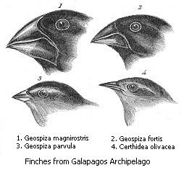
Numerical Optimization
Pareto front:
Find set of a optimal solutions instead of a single solution
The optimization problem is multi-objective
The criteria can be contradicting:
Improving one criterion means worsening others
Traditional:
Gradient-based methods or parameter scans
New methods:
Genetic algorithms, particle swarms, …
Scan
Darwin Finches
J. Gould,
Voyage of the Beagle
Gradient

Slide 5
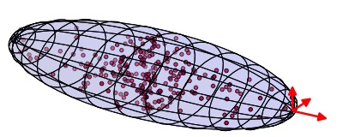
Intensity limitations: Space charge (SC)
Concept:
Space charge is the inter-particle Coulomb force.
In the beam frame SC force be evaluated with the Poisson’s equation.
x
y
z
Space charge effects:
SC limited or/and determine beam parameters and accelerator components (CERN LHC injector chain + FAIR)
SC tune shift from 2D Poisson solver
Particle In Cell algorithms
1-3D self-consistent tracking codes allow detailed investigation
Gauss
KV
Analytical model
Analytic solution of the Poisson equation for a 2D Gaussian (tune spread and particle amplitude)
Q_{y}
Simple scaling law
Q_{x}
Q_{x}
(Max. tune shift)
Notes:
detailed investigation

Slide 6
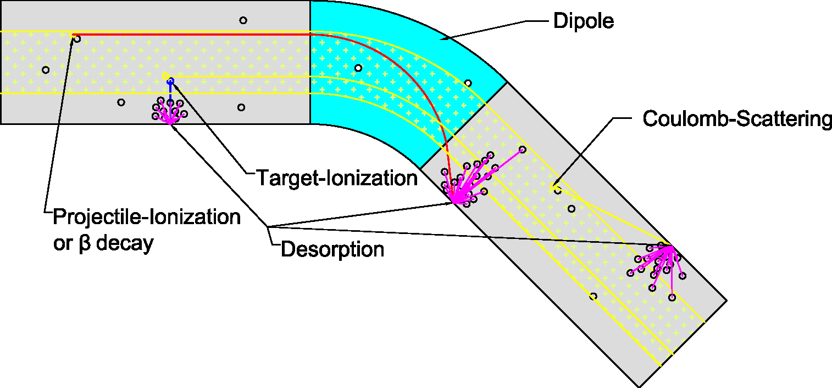
Intensity limitations: Dynamic vacuum (DV)
Intermediate charge state:
Large cross sections for electron stripping/capture
Pressure run away initiated by ion loss
Beam lifetime reduction
Initial pressure bump due to injection loss
P. Spiller, Review, Nov 2013
STRAHLsim: Accurately predict of the dynamic vacuum evolution (local model)
Global model for SIS18 ”transmission”
No Simple scaling law but fast numerical algorithms

Slide 7
Multi-turn injection into SIS
Liouville’s theorem: Injected beams only in free space
Loss should be as low as possible
Many beamletts as possible into machine acceptance
Acceptance
x’
Optimization goal
Septum
x
Analytically description, but the model is underrepresented
Parents
Genetic algorithm
Better OPT results
Dependence of interface parameter
Selection
Reproduction
Offspring
Notes:
dependence

Slide 8
Interface: UNILAC and SIS18
Multi-turn injection
SC
UNILAC
N
N,η
DV
Dependence of interface parameter
allows to define a frame, in which the required beam parameter can be matched at best for a high performance

